Slide 1
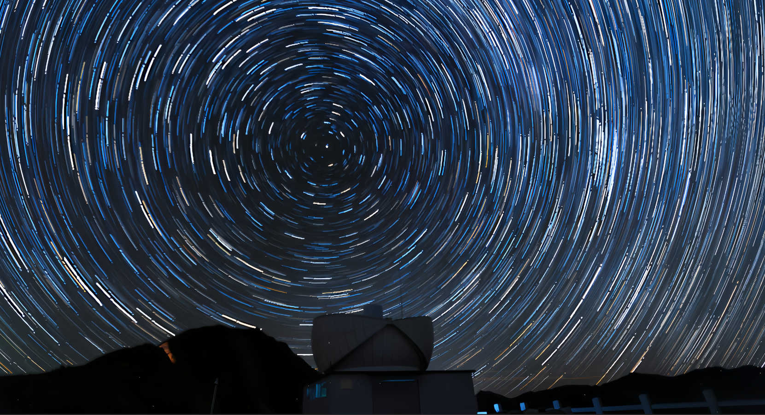


The 7th China-Chile Bilateral Conference for Astronomy
Autonomous Operation and Embodied Intelligence of
the Sun Yat-sen University 80 cm Infrared Telescope
Reporter: Zhongnan Dong
Supervisor: Bin Ma (SYSU) & Yi Hu (NAOC)
Notes:
Good afternoon, everyone.
"My name is Dong Zhongnan. I am a PhD student at Sun Yat-sen University, jointly supervised by Dr. Ma and Dr. Hu at NAOC."[National Astronomical [ˌæstrəˈnɑːmɪkl] Observatories of China].
Today, I will be presenting the Autonomous ɔ:ˈtɑ:nəməs 注意mous不是mers 不要卷舌Operation and Embodied Intelligence of the SYSU 80-centimeter ˈsentɪmiːtər Infrared Telescope."

Slide 2
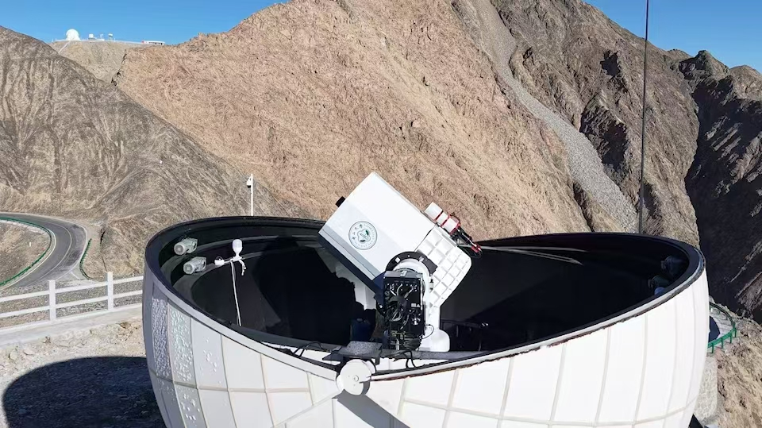

Introduction
Autonomous Operation of SYSU 80cm Infrared Telescope
Embodied Intelligence & Environment Sensing
Summary
Notes:
"My presentation will cover the following four parts."

Slide 3
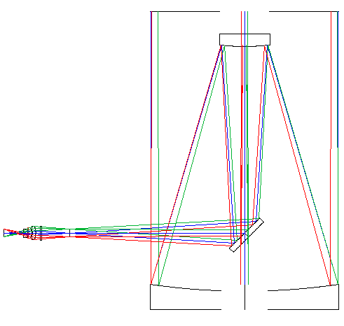
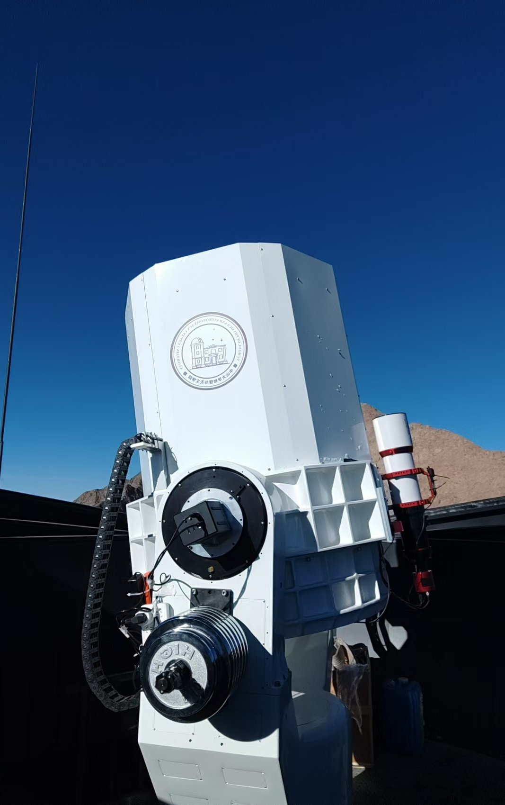
1. Introduction | SYSU 80cm Infrared Telescope
System Overview
    · Alt-azimuth, Two Nasmyth foci, f/8
    · J band (InGaAs, 10’x8’): (Vega System)
        ►16.9 mag @ 20s, 18.7 mag @ 680s
· K band (HgCdTe, 3×5’x4’):
  ►15.1 mag @ 20s, 16.8 mag @ 1440s
· Time-domain observations in J and K bands at depths comparable to the Two Micron All-Sky Survey (2MASS)
Why Autonomous Operation?
    · Minute-scale Targets of Opportunity (ToO) Response
    · Reduce cost
    · Harsh environment (Preparing for Dome A)
Commissioned: 2024.10
Site: Lenghu, the Qinghai-Tibet Plateau
Notes:
"The telescope is installed at the Lenghu site on the Qinghai-Tibet Plateau [tɪˈbɛt plæˈtoʊ](提-贝特 普拉-透). It entered the commissioning [kəˈmɪʃnɪŋ] phase in October 2024."
"This is an alt-azimuth [ˌælt ˈæzɪməθ] 奥-塔-讷-么斯telescope with two Nasmyth foci [ˈnæzmɪθ ˈfoʊsaɪ] 佛塞, designed for J and K bands.
"Our goal is time-domain observations in J and K bands, reaching depths comparable to 2MASS."
"Why is Autonomous Operation necessary? We have three reasons."
"the First is Science consider."
"For ToO follow-up, speed is critical. We receive alerts in seconds, but manual response often takes hundreds of seconds. A fully autonomous system completes the entire process—from alert to pointing—in just a few seconds."
"Second, costs."
"the Future operation of telescopes require a more efficient, low-cost approach.
"Third, the Environment."
"The harsh environment on the plateau is difficult for long-term staff. Moreover, this system serves as a testbed for our future telescope in Antarctica [ænˈtɑːrktɪkə]."
"Therefore, high-level autonomous is nessecceray."

Slide 4
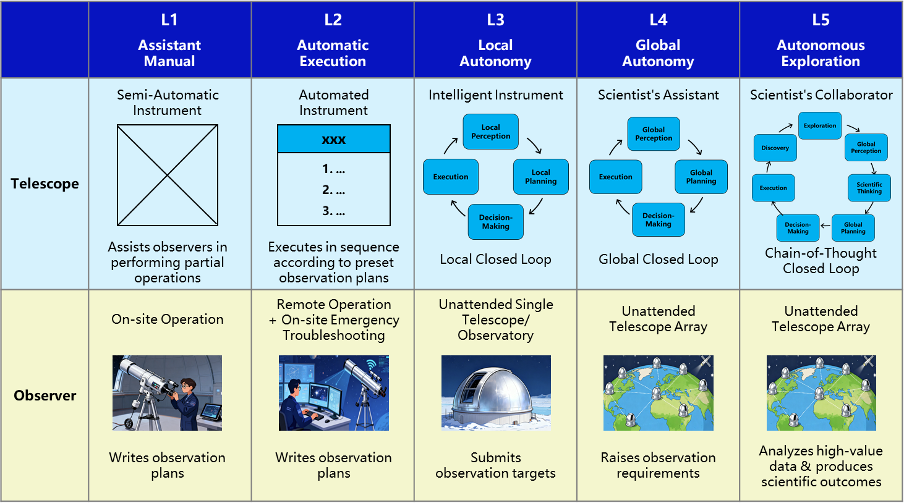
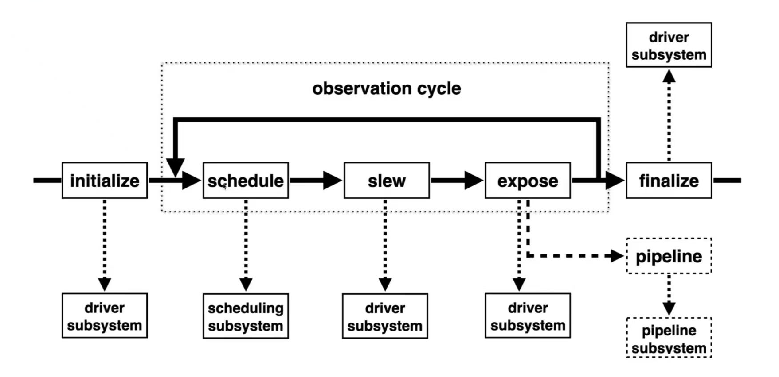
1. Introduction | Our Goal in Autonomous Operation
Embodied
Intelligence
Perception
Decision
Execution
Hu et al. 2026
Majority Telescopes Today: Level 2 Our Goal: Level 3+
Notes:
We defined 5 levels of automation. Higher levels mean less human work.
"Currently, most telescopes operate at Level 2. it‘s need Remote operation，and still requires an astronomer on duty to on-site emergency trouble-shooting."
"Higher levels need Embodied Intelligence.
'Embodied' is Perception—sensing the environment of telescope.
'Intelligence' is Action—autonomous decision and execution. This creates a closed loop system."
"Our goal is to advance to a truly unattended single observatory."
"Looking ahead, higher levels will enable coordinated 协同arrays. Ultimately, at Level 5没有s, the telescope will analyzes high-value data and produces scientific outcomes."

Slide 5
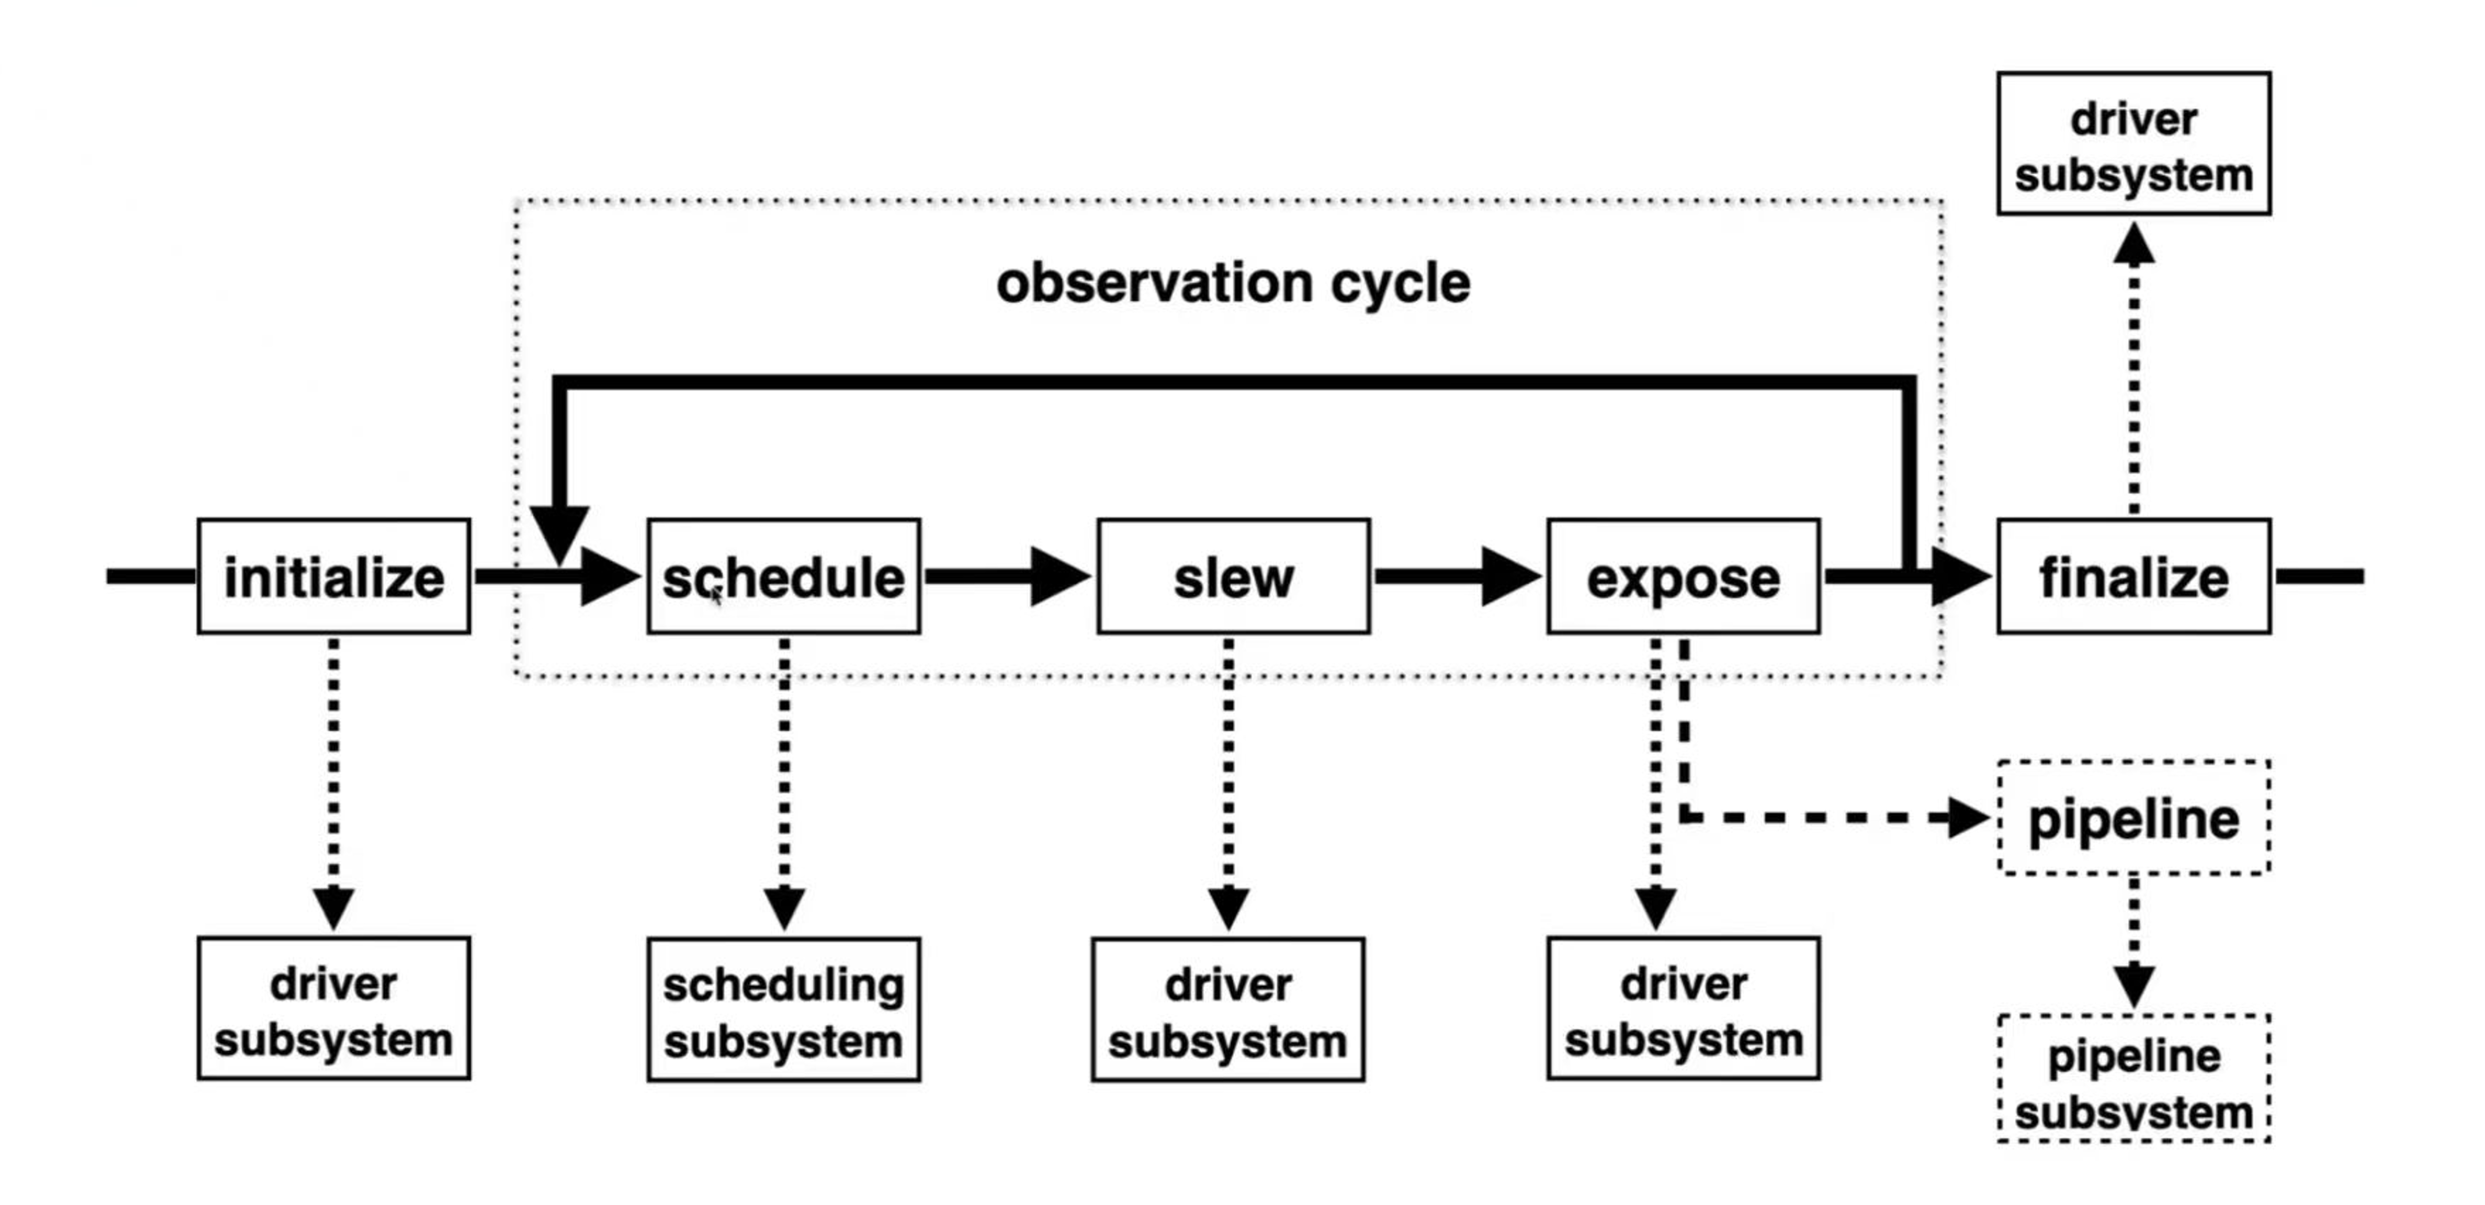
2. Autonomous Operation | Framework
Based on TAOS (Telescope Array Operating System)
· Unified Command Interface: Standardized commands for all telescopes
· High Extensibility: Easy integration of new devices via modular drivers
Integration
Commands
Drivers
Notes:
"Our control system is based on the TAOS framework."
"It features a Unified Command Interface, which uses standardized 斯丹-得儿-呆zd
commands for the entire array."
"This design ensures High Extensibility.[ɪkˌstensəˈbɪləti] 一k-斯Ten-瑟-必-乐-替"
"We developed the drivers and integrated them into a complete observation cycle [ˈsaɪkl]."

Slide 6












2. Autonomous Operation | Scheduling System
Science targets
· ToO follow-up
  ►Strategy: Rapid response and high-cadence follow-up (if visible)
  ►Space-Ground Synergy:
  Collaboration with EP and SVOM
    Real-time Alert: Time, RA/Dec, Positional Error, SNR
    Real-time Status Feedback: Weather, Telescope Operational Status
· Other Transients & Variables
  ►Strategy: Input catalog provided by PI (Target-specific exposure strategies)
6
Notes:
Let’s start with the Scheduling System.
To understand it, let's first look at the Science Targets
One of our key goals is ToO follow-up. Our strategy is simple: Rapid response and High-cadence monitoring，if it’s visible."
"We operate in Space-Ground Synergy [ˈsɪnərdʒi] with the EP and SVOM missions.""Both are X-ray satellites dedicated to detecting high-energy transients."
The system receives alerts in real-time. It also feeds back weather and telescope Operational status."
For other transients and variables, we work with partner PIs. Each target requires a cspecific exposure strategies.
We have established collaborations with dozens of institutes.

Slide 7
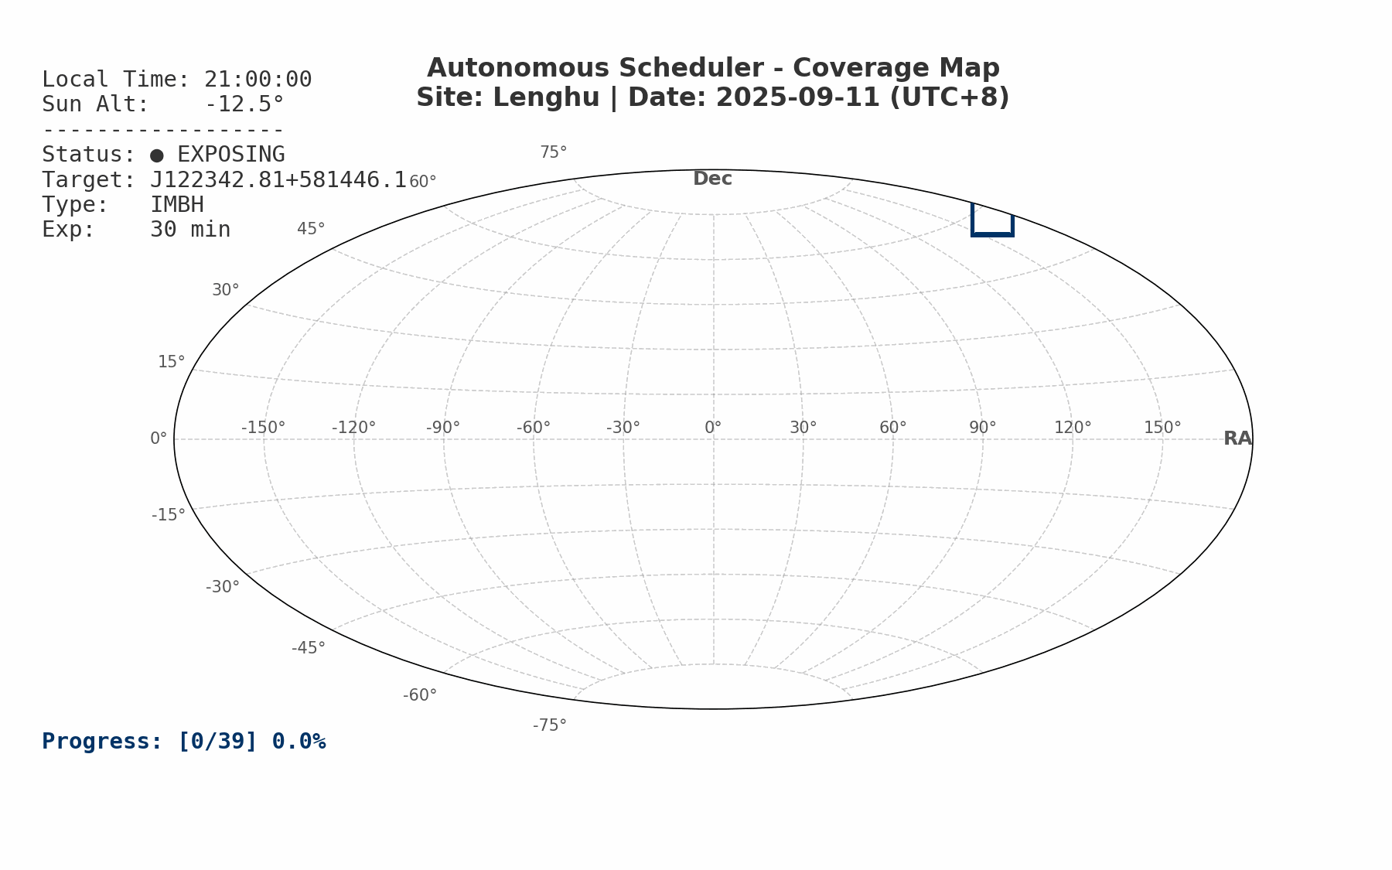
2. Autonomous Operation | Scheduling System
Scheduling Result: One-night Demo
Optimization
· Minimum Overall Airmass
· Minimum Slew Distance
  ►Not a priority (Ultra-fast slew: < 15s to point anywhere).
Constraints
· Zenith blind spot
· Target Altitude > 30°
Evolution of Scheduler:
· Phase 1: Pre-calculated full-night scheduling
· Phase 2: Fully dynamic ToO scheduling
6
Notes:
"Therefore, our top priority is Minimum Overall Airmass."
"Slew Distance is not a priority, because our telescope is ultra-fast sle—it takes under 15 seconds to point anywhere."
"Of course, we also enforce 执行constraints。 like the Zenith Blind Spot and Target Altitude limit."
"The Scheduler operates in two phases."
"Phase 1 is Pre-calculated Full-night Scheduling, as shown in the demo on the left."
"Phase 2 is Fully Dynamic ToO Scheduling. This allows the software to autonomously adjust the strategy in real-time."

Slide 8
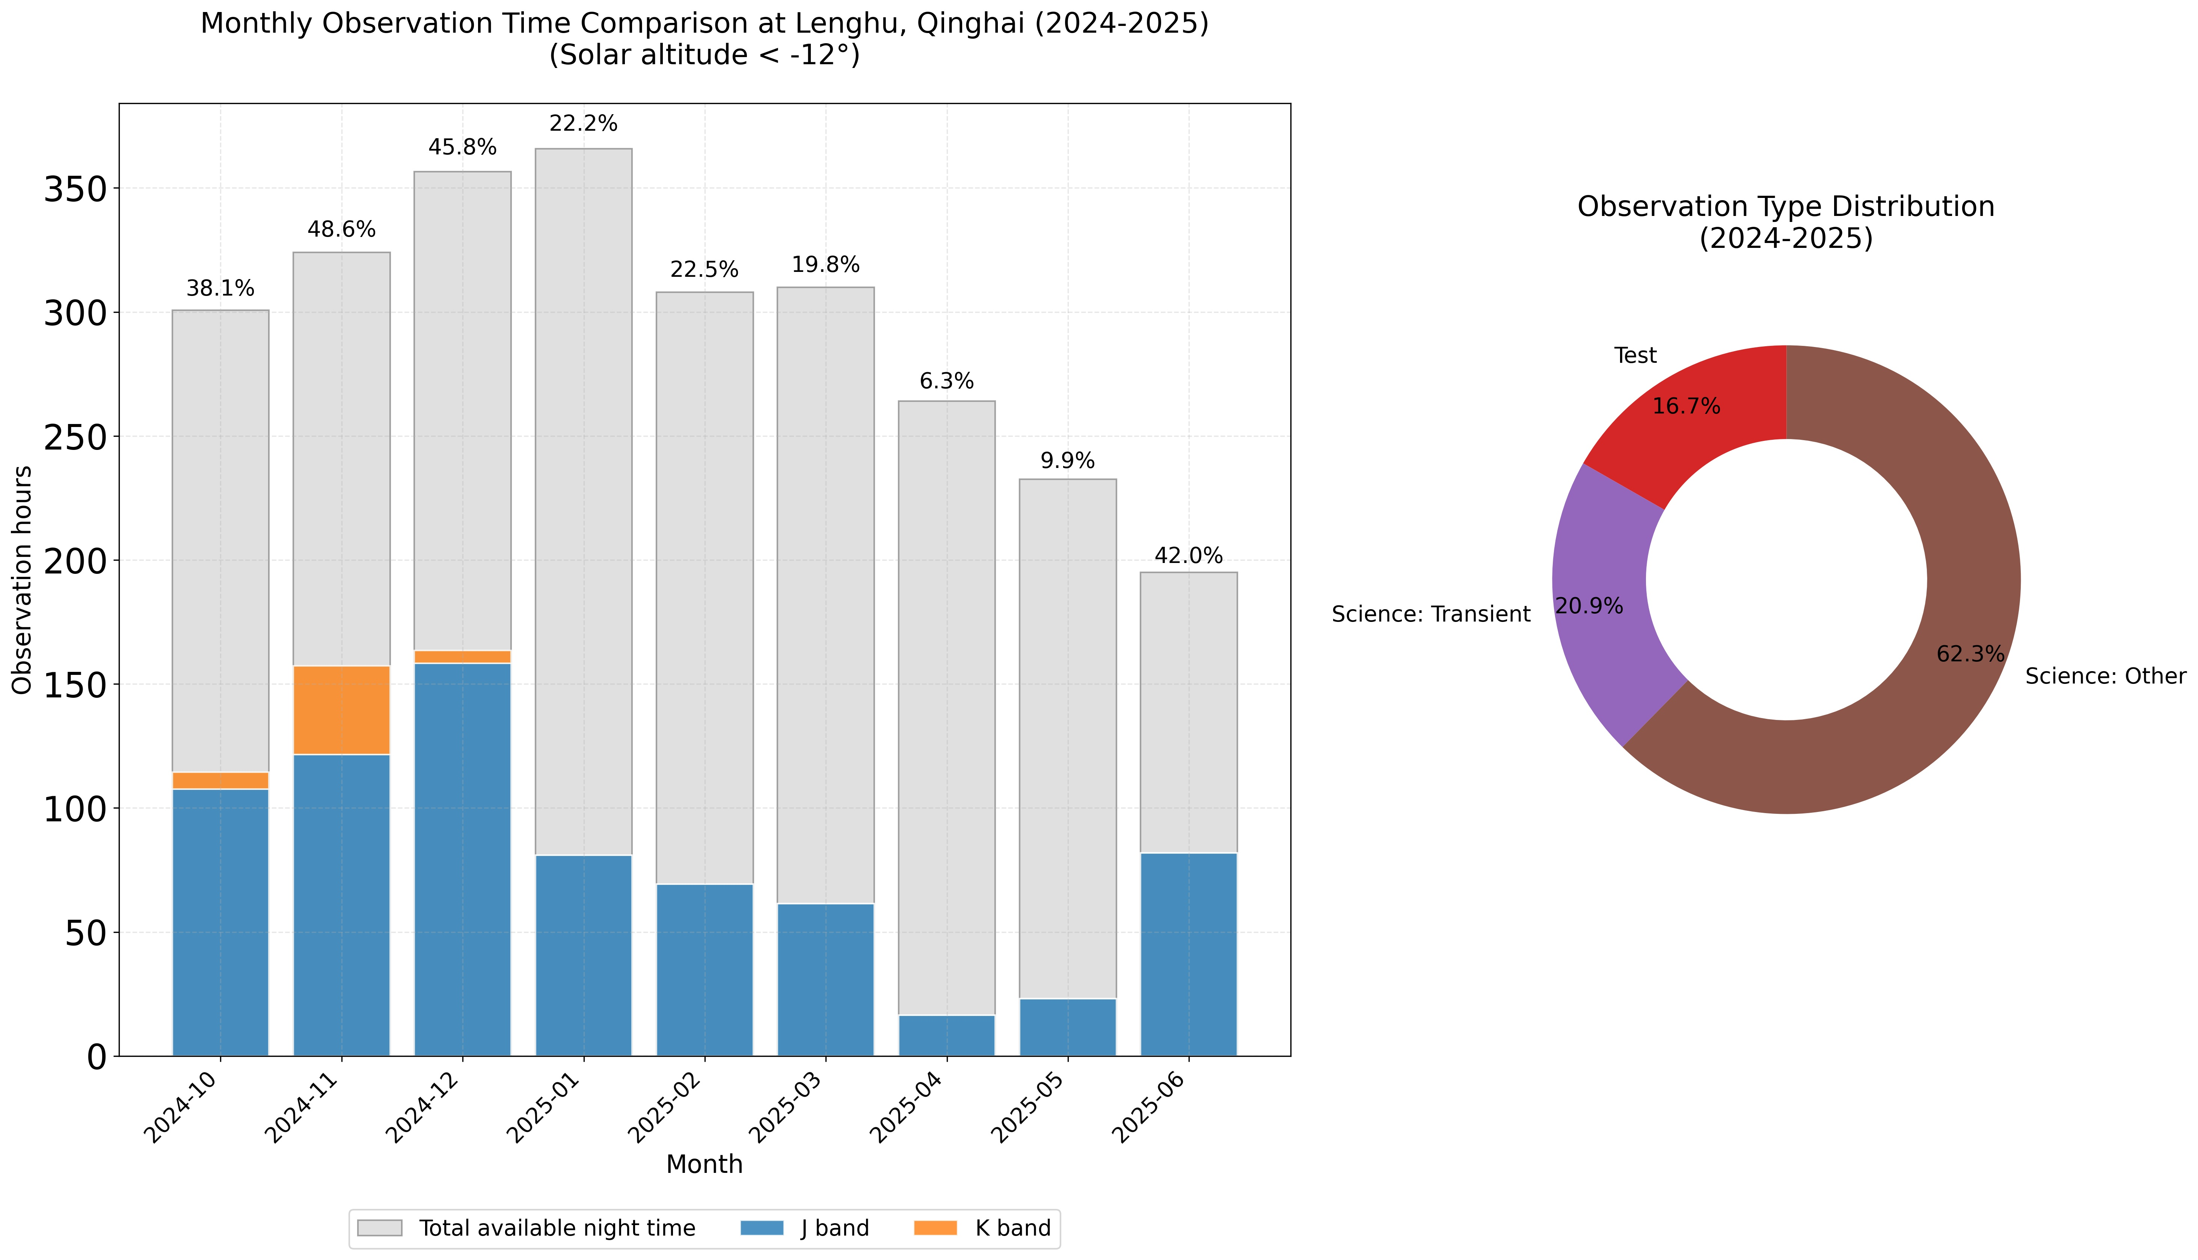
2. Autonomous Operation | Commissioning Status
Current Status: Level 2 Automation
· Scheduling:
  ►Pre-calculated (Done) / Real-time (Ongoing)
· Drivers:
  ►Telescope (Done) / Camera (Ongoing)
· Integration:
  ►Preset (Done) / Real-time (Ongoing)
Current Science Targets
· Transients:
  ►e.g., GRB afterglows, SNe, TDEs, Comets
· Virables:
  ►e.g., QSOs, AGNs, Brown dwarfs, RRLs
2024.10 - present
1,373 hours observations
Tests
Transients
Virables
3 publication in journal
12 GCN circulars
Notes:
"To date, we have achieved Level 2 Automation. This covers Scheduling, Drivers, and System Integration."
"Currently, Preset Automation is fully implemented ɪmplɪmentɪd, while Real-time Automation is in development."
"Since October 2024, we have accumulated more than One thousand hours of data."
"This effort has already produced 3 journal publications and 12 GCN circulars."

Slide 9
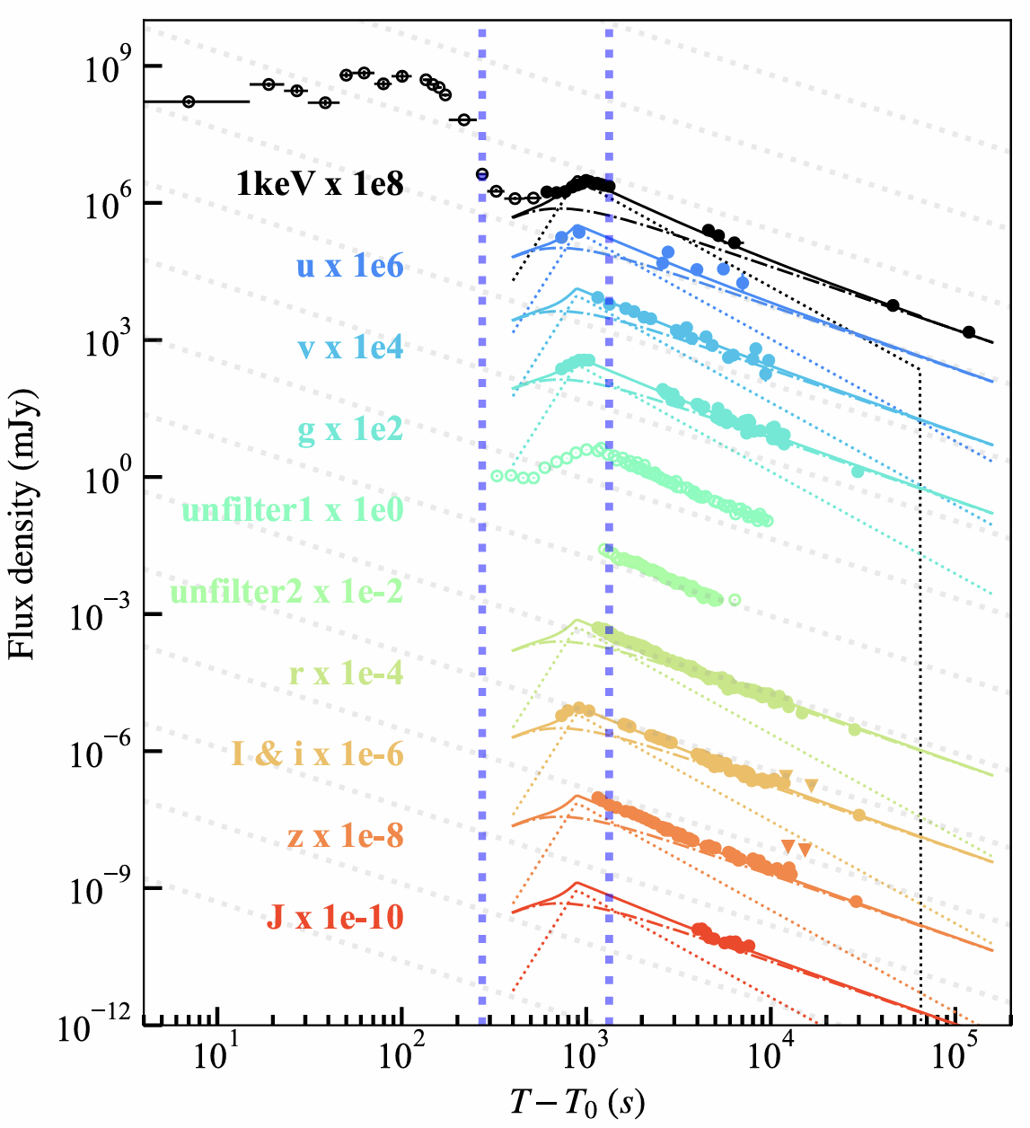
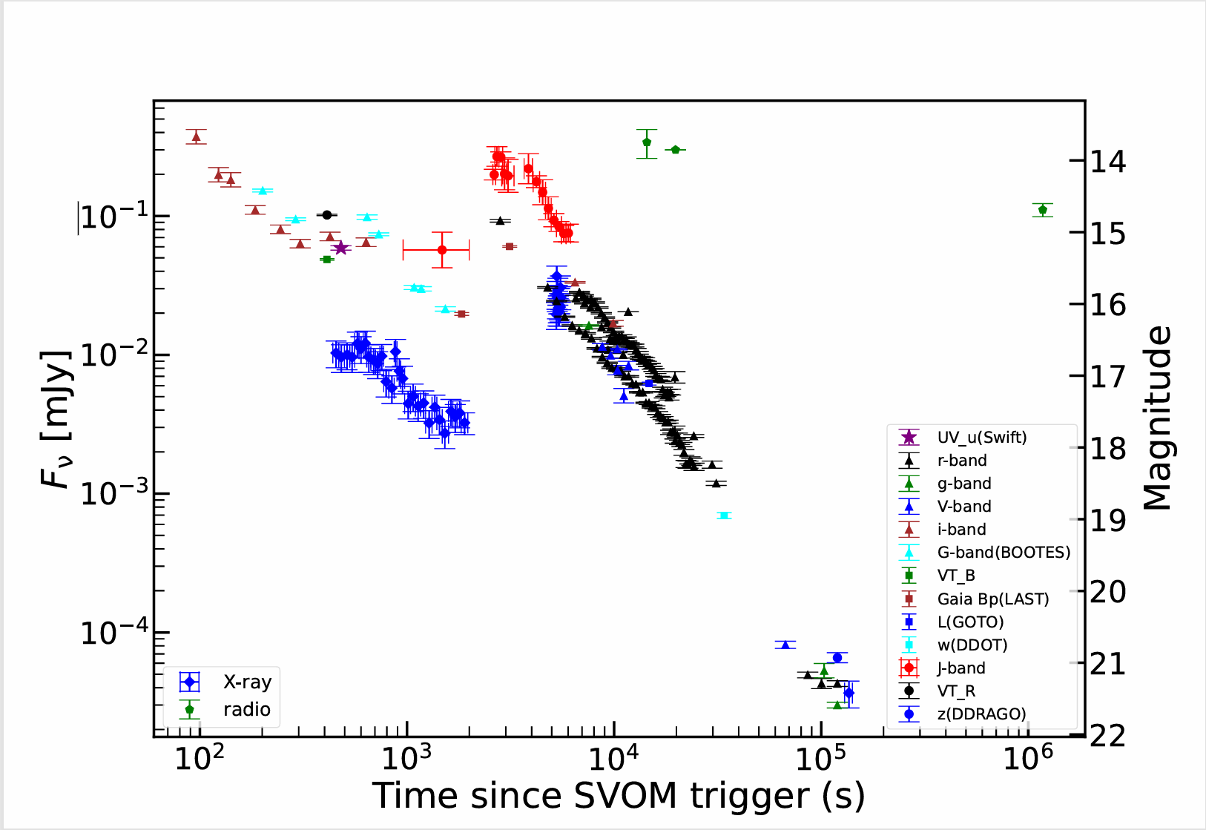
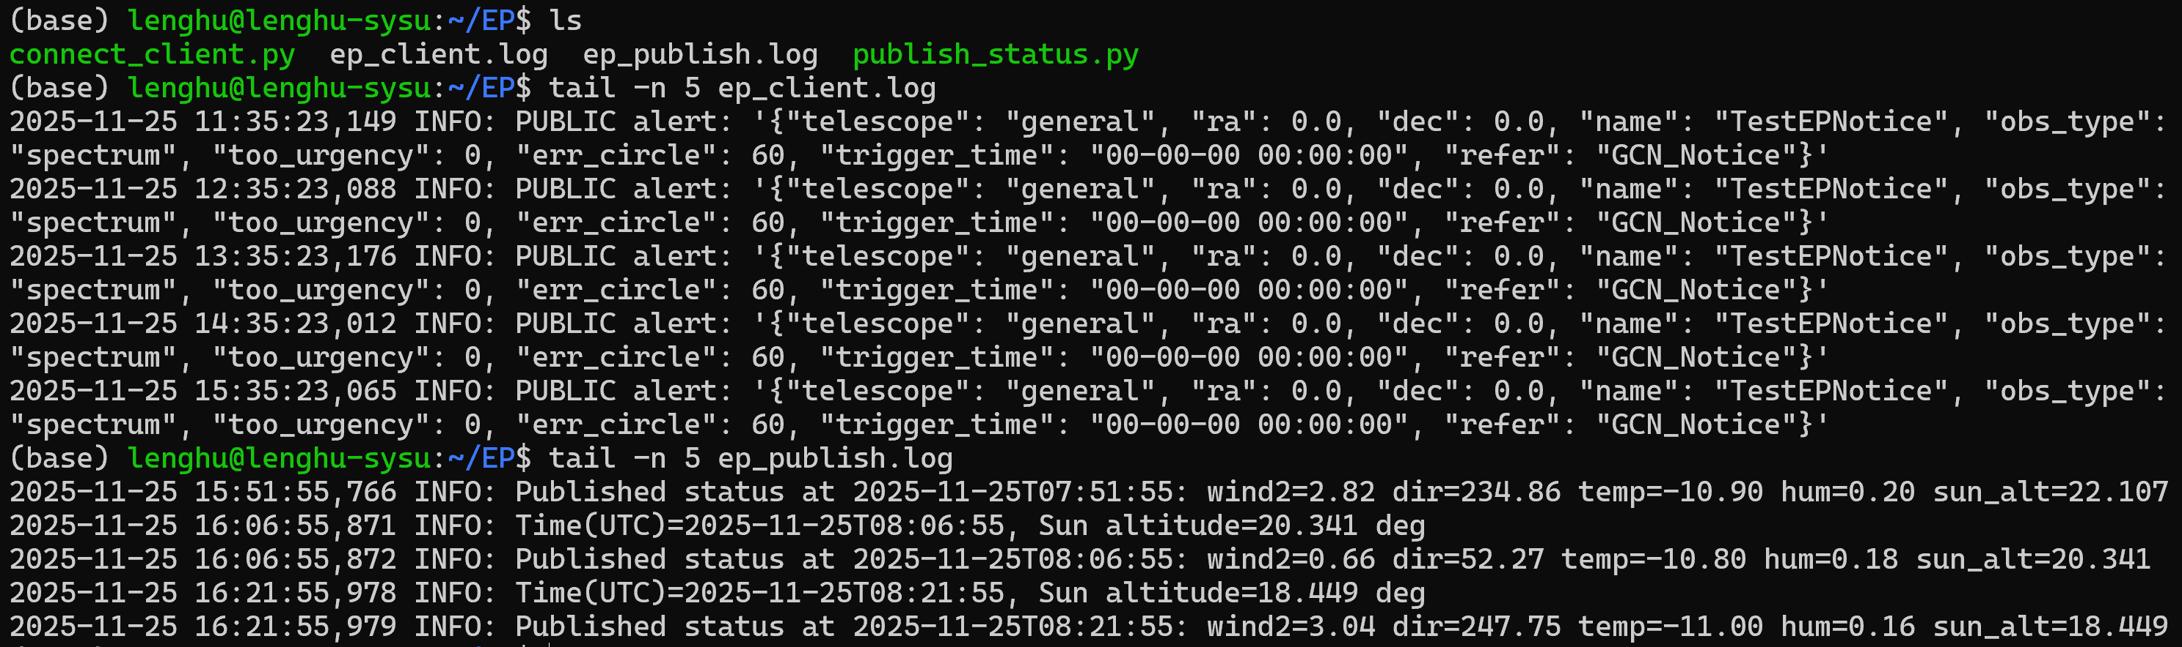
2. Autonomous Operation | J band Scientific Cases
GRB250404A afterglow
GRB251013C afterglow
Yin et al. 2025
By: Duole Cao, Chun Chen
Notes:
"For instance, please look at the figure on the left."
"Our observations contributed kənˈtrɪbjuːtɪd to the multi-wavelength analysis əˈnæləsɪs by Yin et al. [et æl]."
"Specifically, our J-band data is highlighted in the red box."
"The figure on the right demonstrates our rapid response to a ToO."
" we successfully captured the bump of the GRB."
"Thanks to our high-cadence monitoring, only our data captured the precise prəˈsaɪs timing and amplitudeˈæm.plə.tuːd"

Slide 10
3. Embodied Intelligence & Environment Sensing
Towards Level 3+ Automation
What it is?
· Local Closed-loop:
  ►Fully automated scheduling and observation
· Unattended Operation:
  ►Single observatory running without on-site staff
· Minimal Human Intervention:
  ►Requires submission of target list only
How it works?
· Powered by Embodied Intelligence
  ►Environmental Perception → Go/No-Go?
  ►Hardware Status Feedback → Abort?
  ►Data Quality Assessment → Reschedule?
Manual
Judgment & Intervention
Autonomous
Sensing & Decision
Notes:
"Moving forward, our goal is to advance Towards Level 3+ Automation."
"The fundamental difference from the current Level 2 is the shift from 'Manual Judgment' to 'Autonomous Sensing and Decision-making'."
"This requires a Local Closed-loop system, enabling fully automated scheduling and observation."
"This achieves Unattended Operation, meaning the observatory runs entirely without on-site staff."
"It also minimizes 迷-你-迈-zi-zi human interventionˌɪntərˈvenʃ(ə)n —we simply submit a target list, and the system does the rest."
"This Autonomous is powered by Embodied Intelligence."
"For example:"
"Environmental Perception determines the 'Go or No-Go' decision."
"Hardware Status Feedback decides whether to Abort operations due to errors."
"And Data Quality Assessment determines if we need to Reschedule the target."

Slide 11
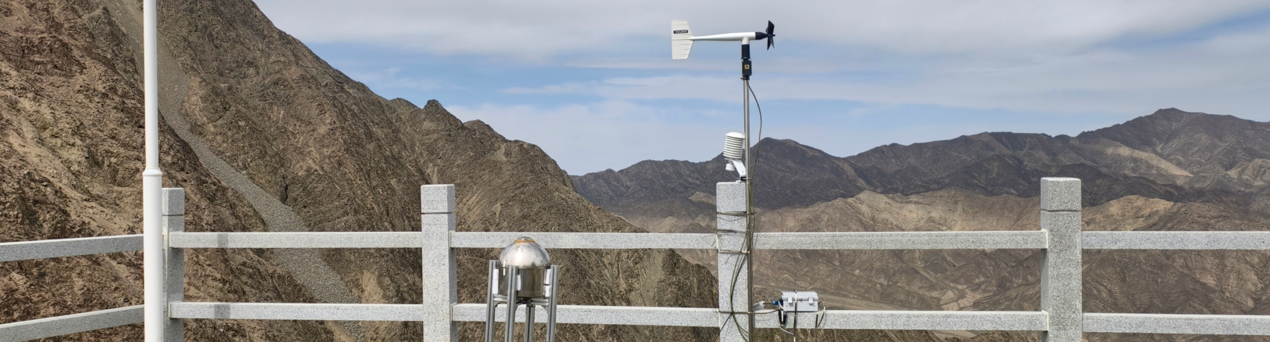
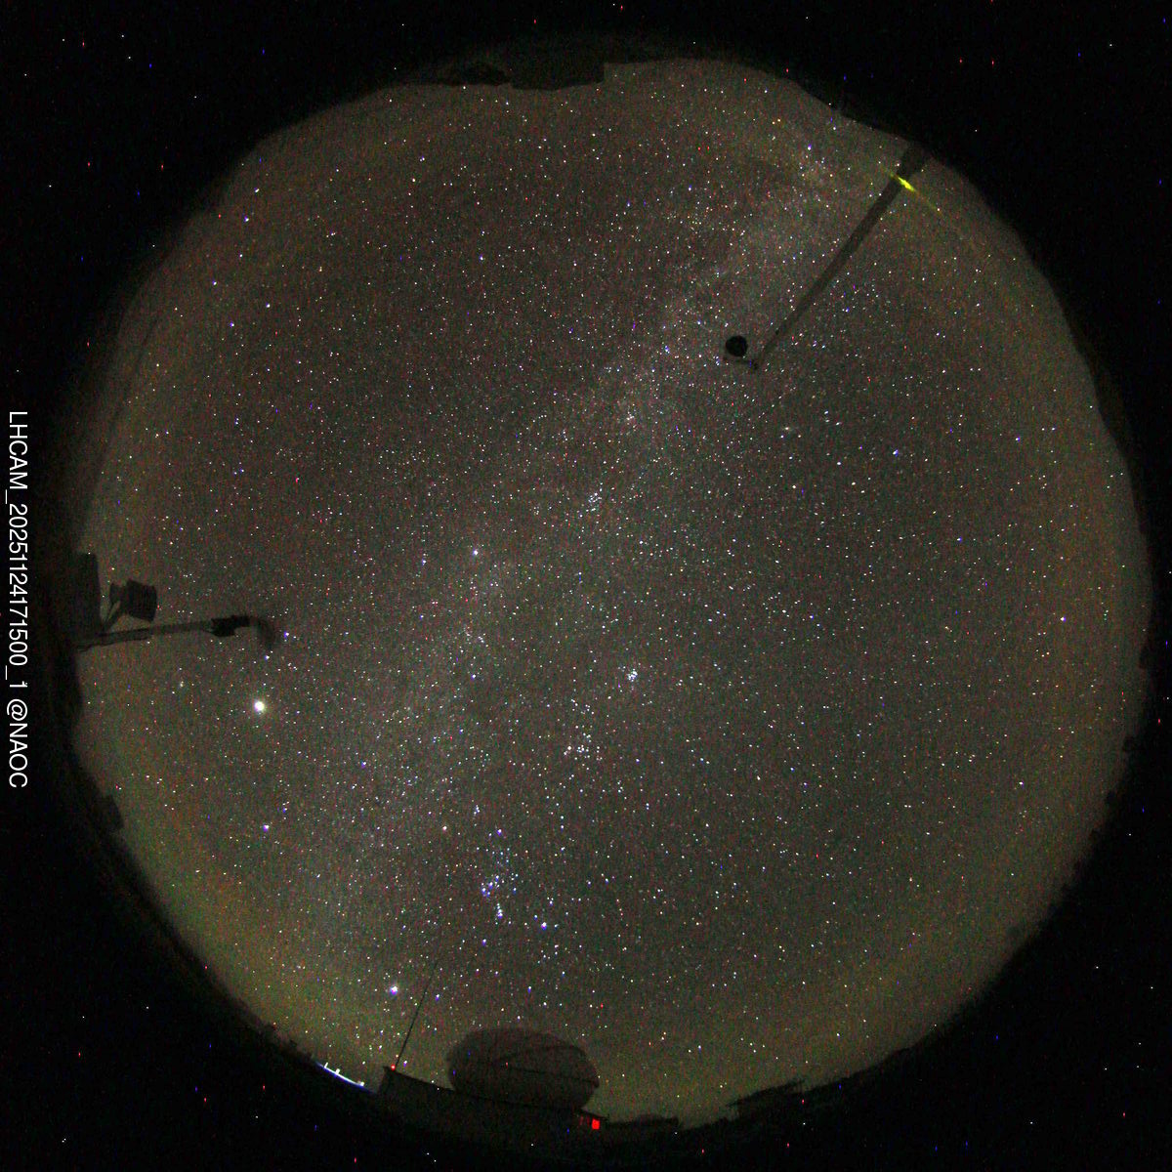
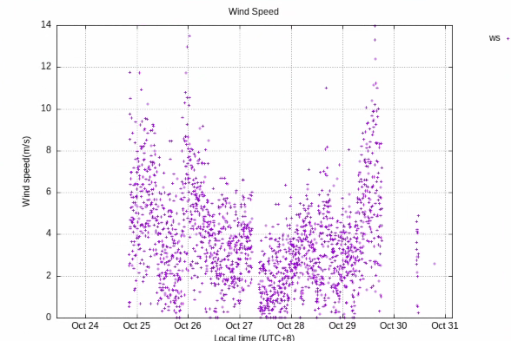
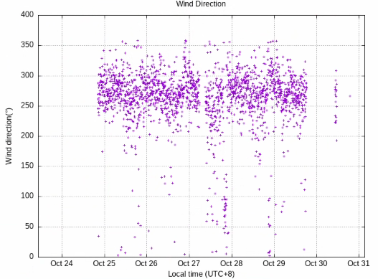
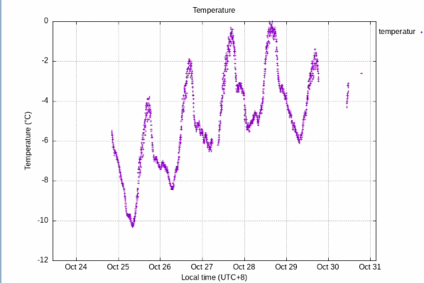
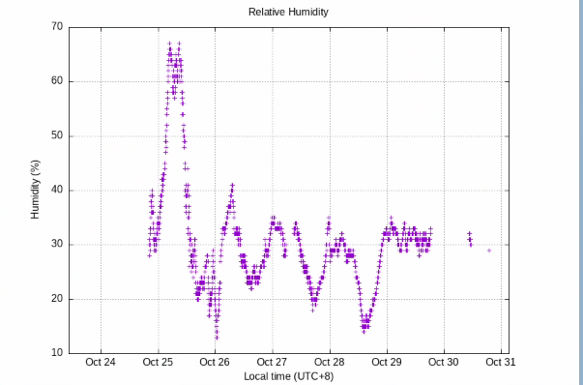
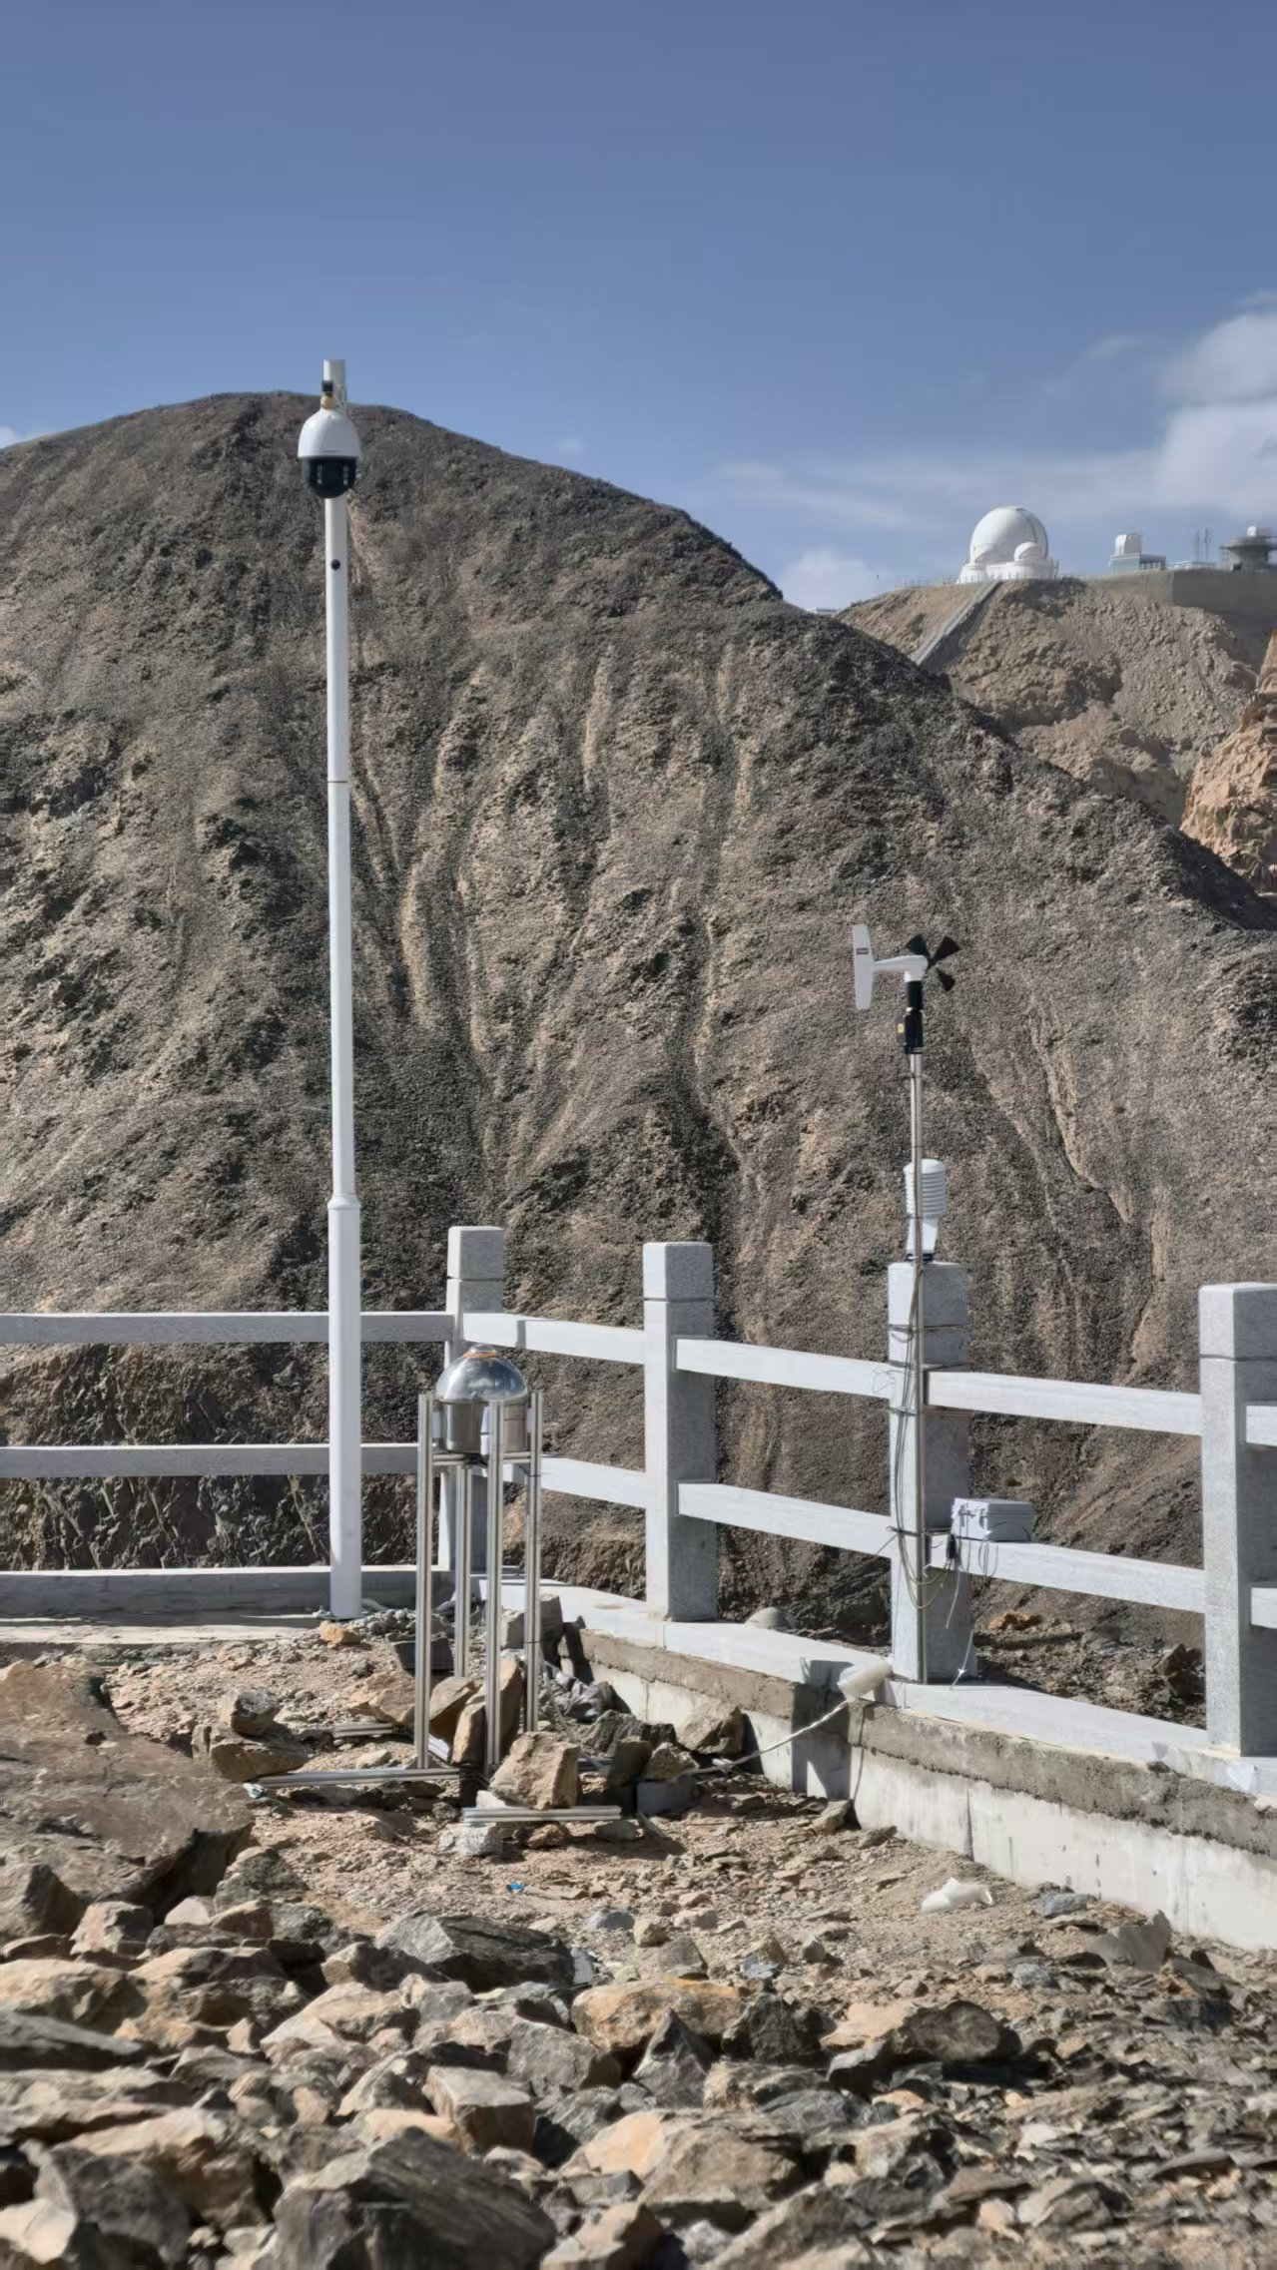
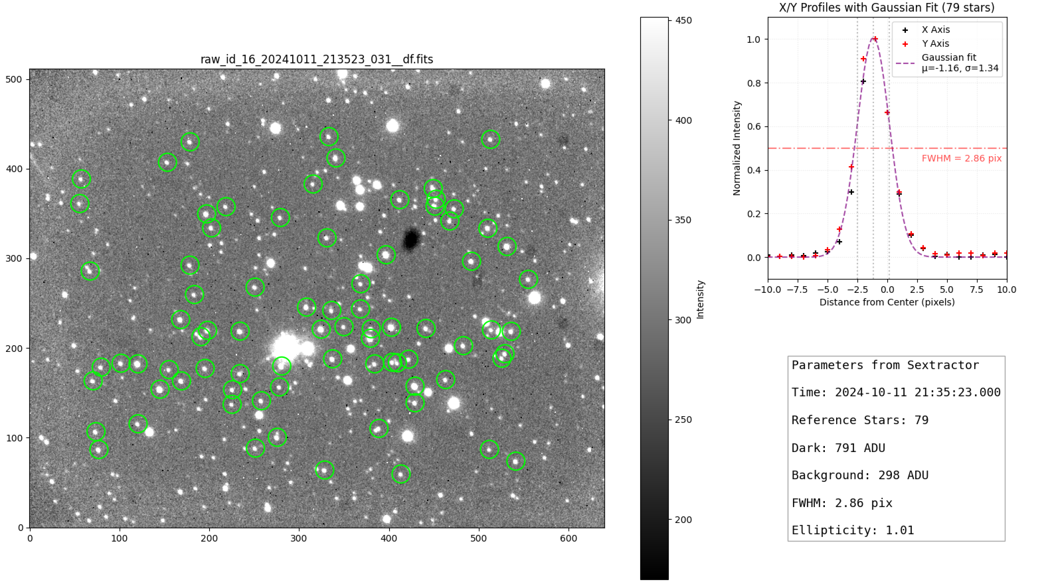
3. Embodied Intelligence & Environment Sensing
Environmental Perception
Human Judgment → Pre-defined Constraint/Priority
Atmospheric Extinction
High wind
Wind speed
Wind direction
High humidity
Temperature
Relative humidity
Yang et al., in prep.
Notes:
"To achieve Environmental Perception, we have deployed an All-sky Camera and an Automatic Weather Station."
"We feed this real-time data directly into the scheduler. This allows us to shift from 'Human Judgment' to 'Pre-defined Constraints kənˈstreɪnts 康-死转en斯and Priorities'."
"For example, the system will automatically suspend observations if wind speed or humidity [hjuːˈmɪdəti] 休 - 迷-得-踢 exceeds safety thresholds."
"Moving forward, we will use real-time atmospheric ˌætməsˈferɪk extinction derived from 获取 the All-sky Camera to dynamically adjust scheduling weights, rather than relying on Airmass ALONE. Detailed work regarding this system is currently in preparation by Yang et al.

Slide 12

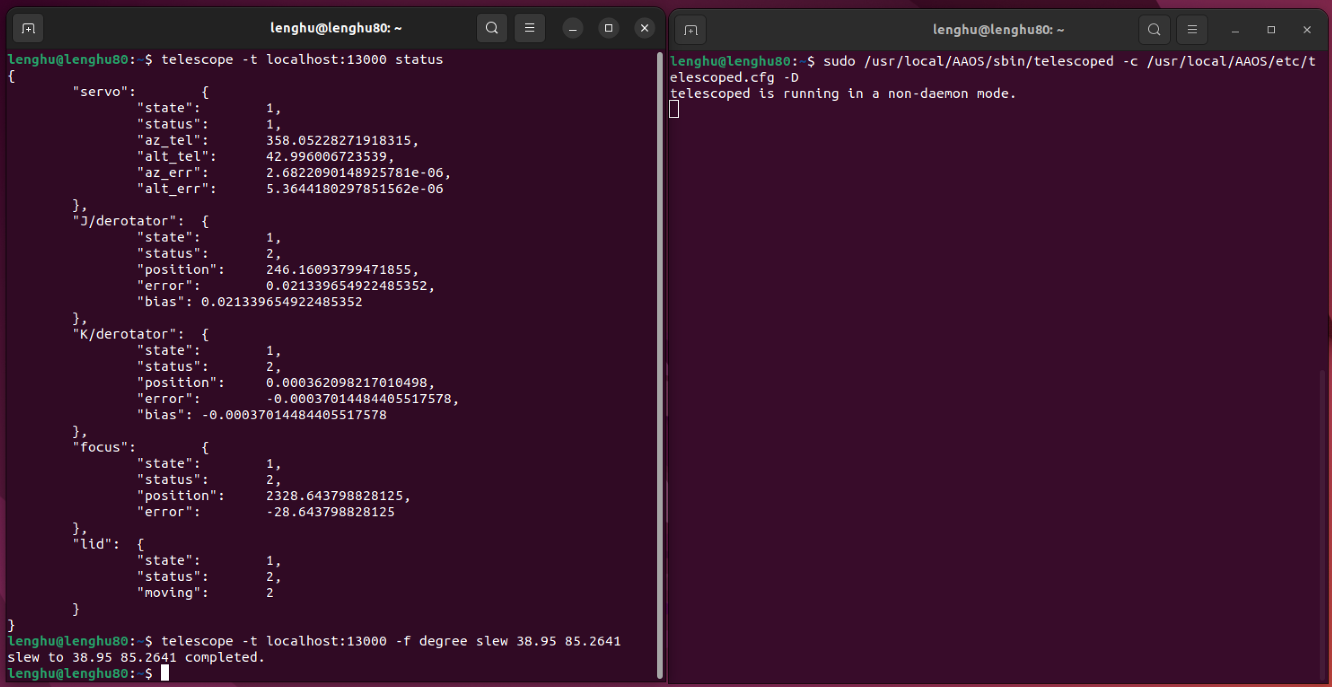
3. Embodied Intelligence & Environment Sensing
Hardware Status Feedback
· Telescope Status Monitoring: Server, Pointing, Derotation, Focus, Lid, Dome
  · Camera Status Monitoring: Exposure, Readout
Data Quality Assessment
· Image Storage and Retrieval
· Image Quality Monitoring
Check: Hardware Self-diagnosis
Check: Data Quality Validation
Image Quality
Notes:
At the same time, we are working on real-time Hardware Feedback and Data Quality Assessment."
"all physical states are converted into parameters for automation."
"This includes telescope and camera status, as well as image Quality like FWHM and ellipticity. ɪˌlɪpˈtɪsəti] (一-立p-替-色-替"

Slide 13
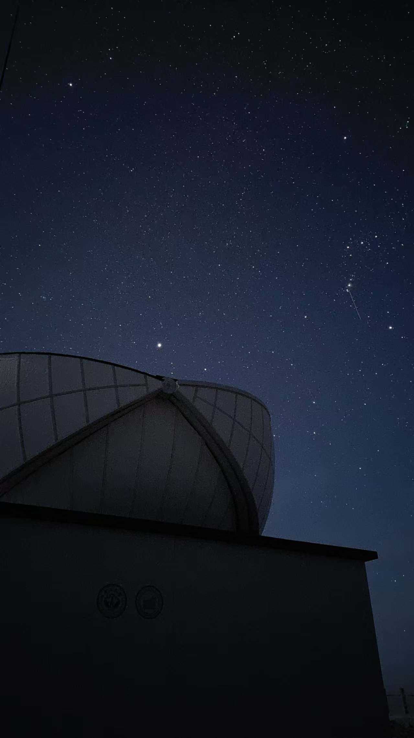
Summary
The 7th China-Chile Bilateral Conference for Astronomy
SYSU 80cm Infrared Telescope @ Lenghu
    · J band (FoV: 10’x8’): 16.9 (18.7) Vega mag @ 20s (680s)
· K band (FoV: 3×5’x4’): 15.1 (16.8) Vega mag @ 20s(1440s)
    · A total of 1,373 hours of observations has been obtained
    Autonomous Operation
    · Based on the TAOS framework
        ►Scheduling, Drivers, and System Integration
    · From L2 (preset observations) to L3+ (local closed-loop)
    Embodied Intelligence
    ►Environmental Perception
    ►Hardware Status Feedback
    ►Data Quality Assessment
Thank you!
Notes:
That concludes my presentation. Thank you for your attention. Any questions？

