Slide 1
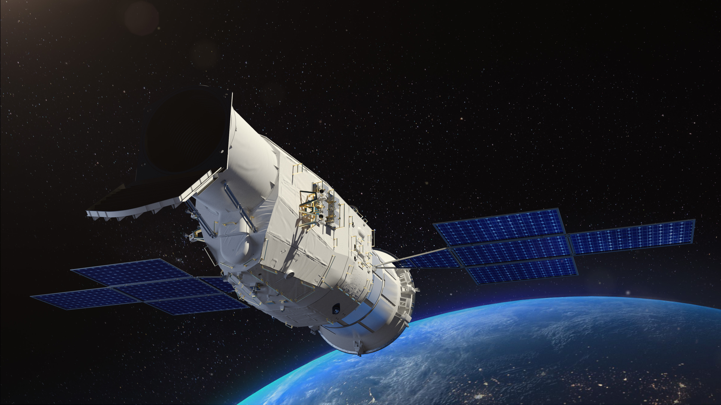
Tests of Chinese Space Station Telescope Survey Camera Focal Plane Detectors
Reporter: Zun Luo, NAOC, CAS
Supervisor: Hu Zhan
HongKong, 2026. 01

Slide 2
Content
Chinese Space Station Telescope Survey Camera (CSST SC)
CSST SC Focal Plane Detectors
Detector Test System
Basic Performamce Indicators
Characterization of Detector Effects
Summary

Slide 3
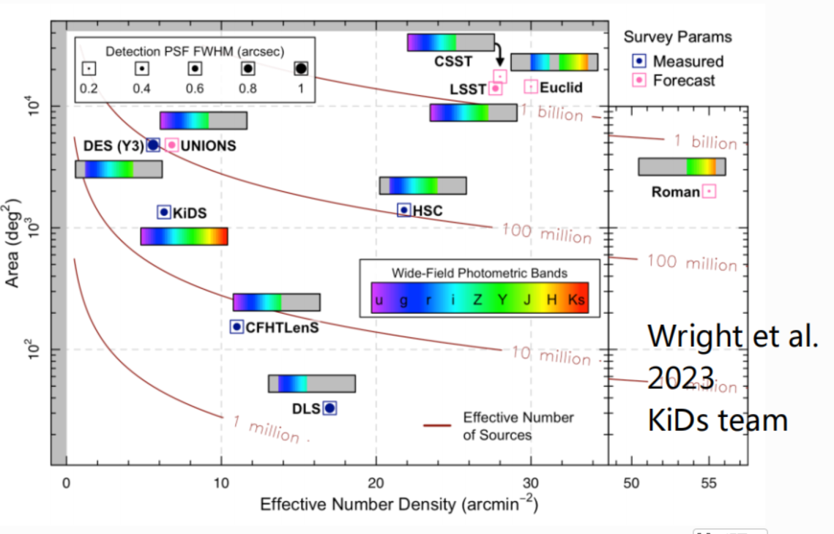
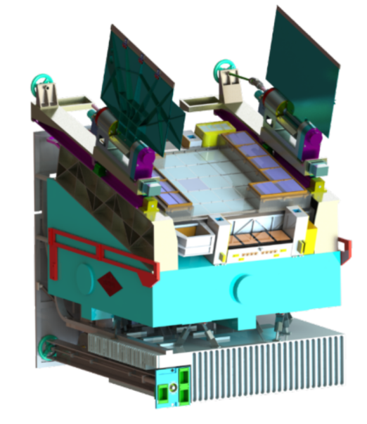

Chinese Space Station Telescope Survey Camera (CSST SC)
Chinese first 2m aperture space telescope. $1.1×1.1\deg^{2}$ large field of view.
Survey Camera (SC): 17500deg² wide field & 400deg² deep field, 255-1000nm
Wide Field Imaging：7 bands，$R_{EE80}$~0.15’’，$m_{lim}≥25.5$^{m} (Point Source, 5$σ$ AB mag)
Wide Field Slitless Spectroscopy：3 bands，$R≥200$，$m_{lim}≥23$^{m}
Deep field ：1^{m} deeper than wide field
CSST SC
CSST SC can obtain more than one billion galaxy images and one hundred million galaxy spectra, enabling scientific objects including: (1) Precision constraints on cosmology, gravitation and structure formation theories. (2) Reconstructing 3D structure and evolution history of the Milky Way. (3) Reveal formation and evolution of stars, galaxies and black holes.

Slide 4
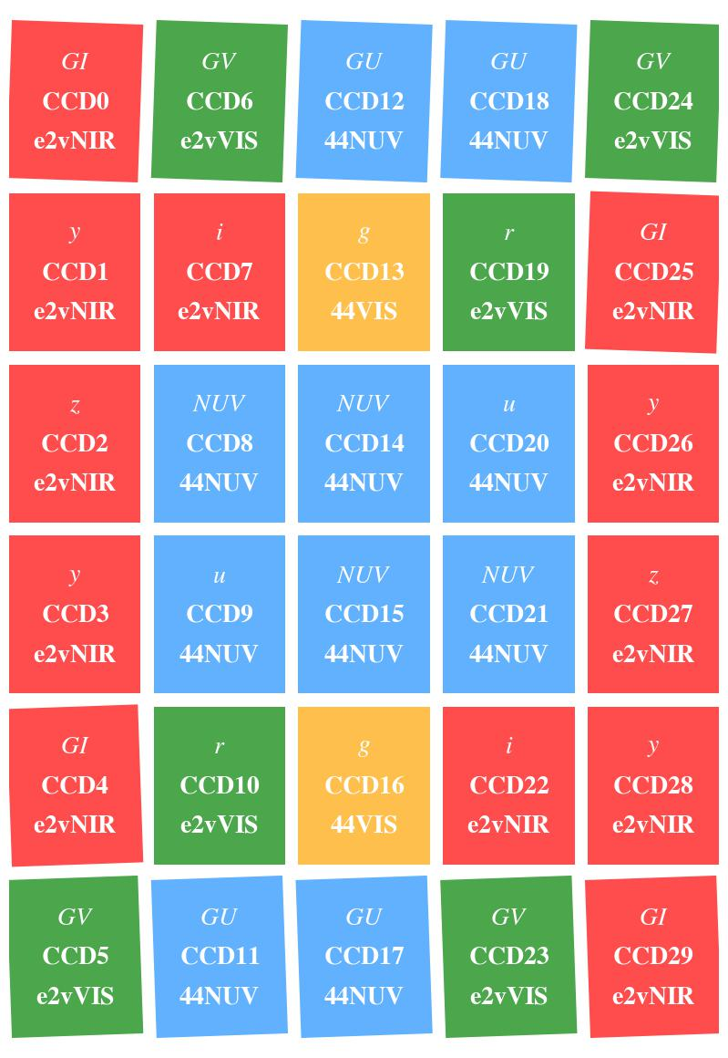
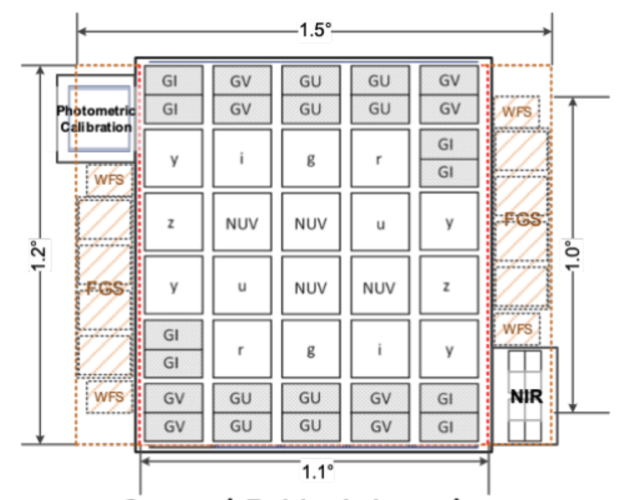
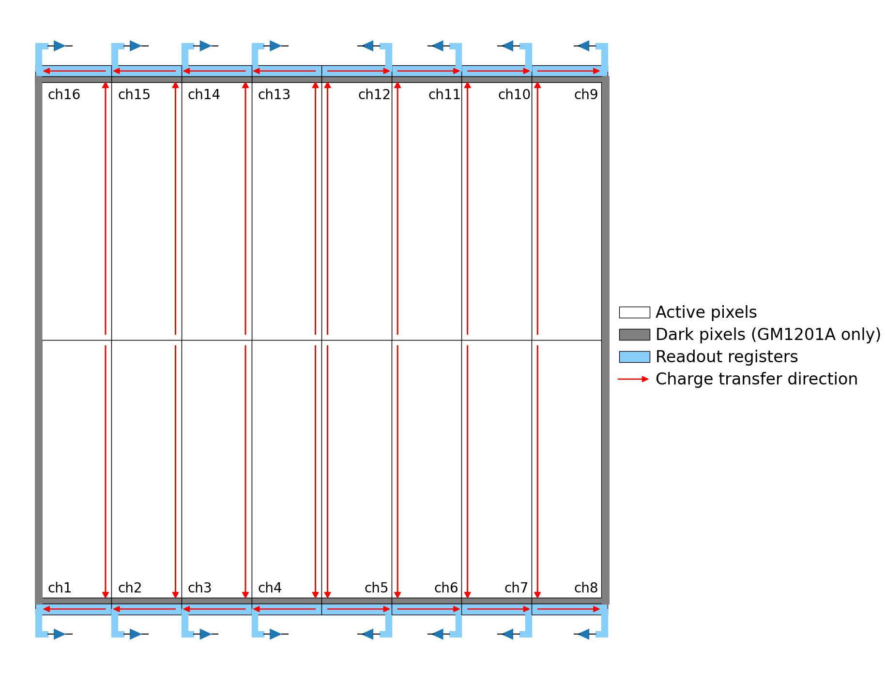
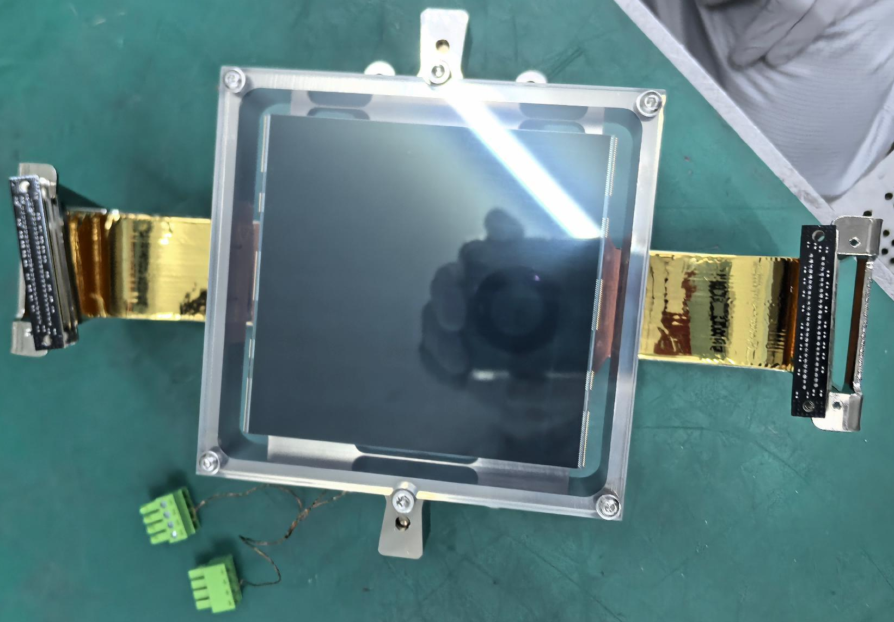
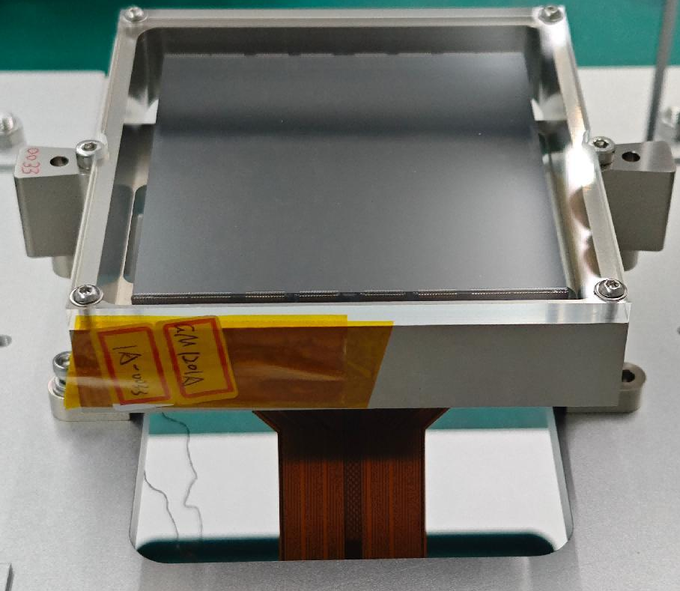

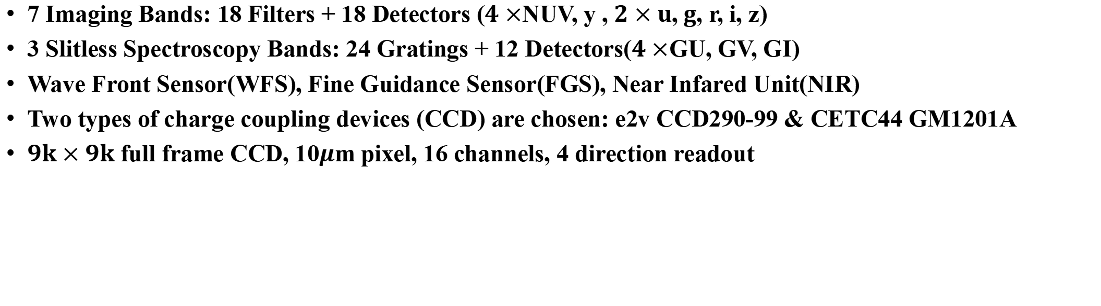
CSST SC Focal Plane Detectors
7 Imaging Bands: 18 Filters + 18 Detectors ($4×$NUV, y , $2×u$,$g$, r, i, z)
3 Slitless Spectroscopy Bands: 24 Gratings + 12 Detectors($4×$GU, GV, GI)
Wave Front Sensor(WFS), Fine Guidance Sensor(FGS), Near Infared Unit(NIR)
Two types of charge coupling devices (CCD) are chosen: e2v CCD290-99 & CETC44 GM1201A
$9k×9k$ full frame CCD, 10$μ$m pixel, 16 channels, 4 direction readout
CCD290-99
Stantard Silicon VIS(e2vVIS)
Deep Depletion NIR(e2vNIR)
GM1201A Standard Silicon
VIS Coating (44VIS)
NUV Coating (44NUV)
Each Channel:
$1152×4616$ active pixels
27 prescan

Slide 5
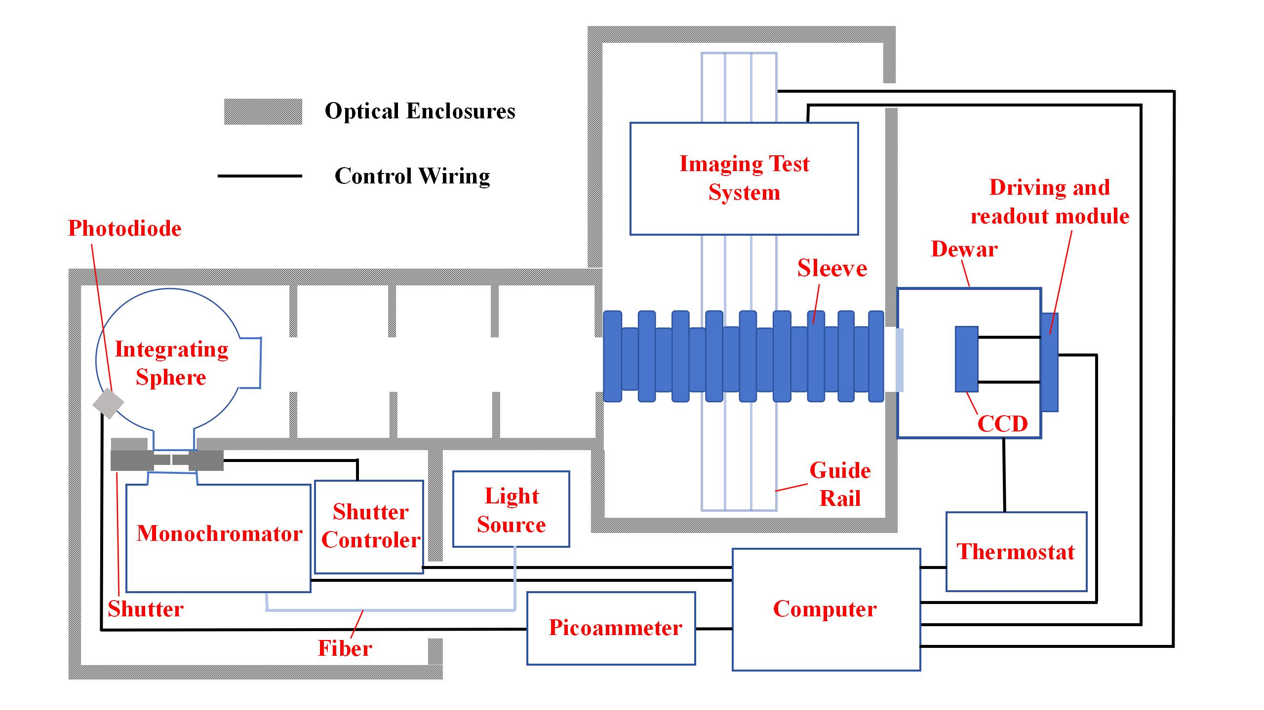
Detector Test System
Our group is responsible for SC focal plane development and performance testing.
A detector test system has been built since 2013. All CCD tests are completed.
Flat-field Tests: flat, dark, bias frames...
Imaging Tests: imaging on CCD of certain targets with optical systems：Crosstalk, residual image ...

Slide 6
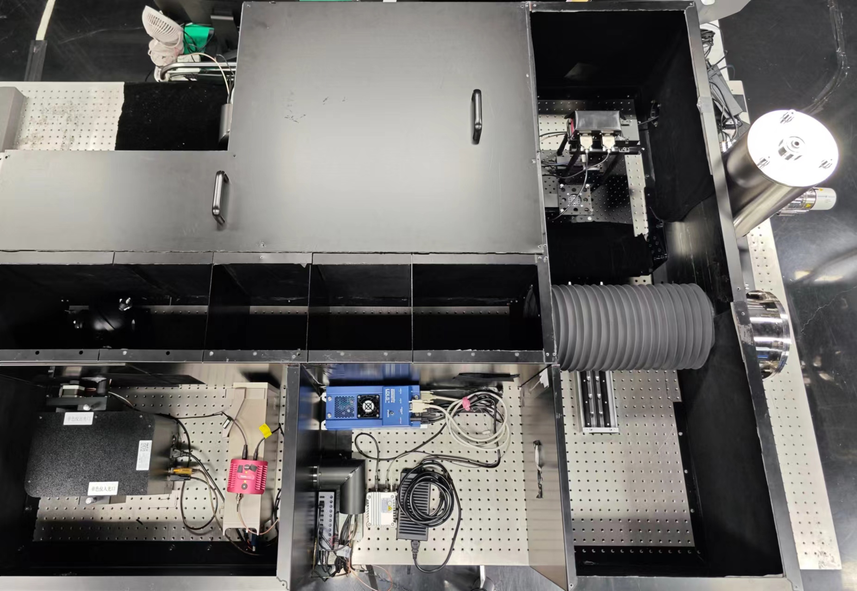
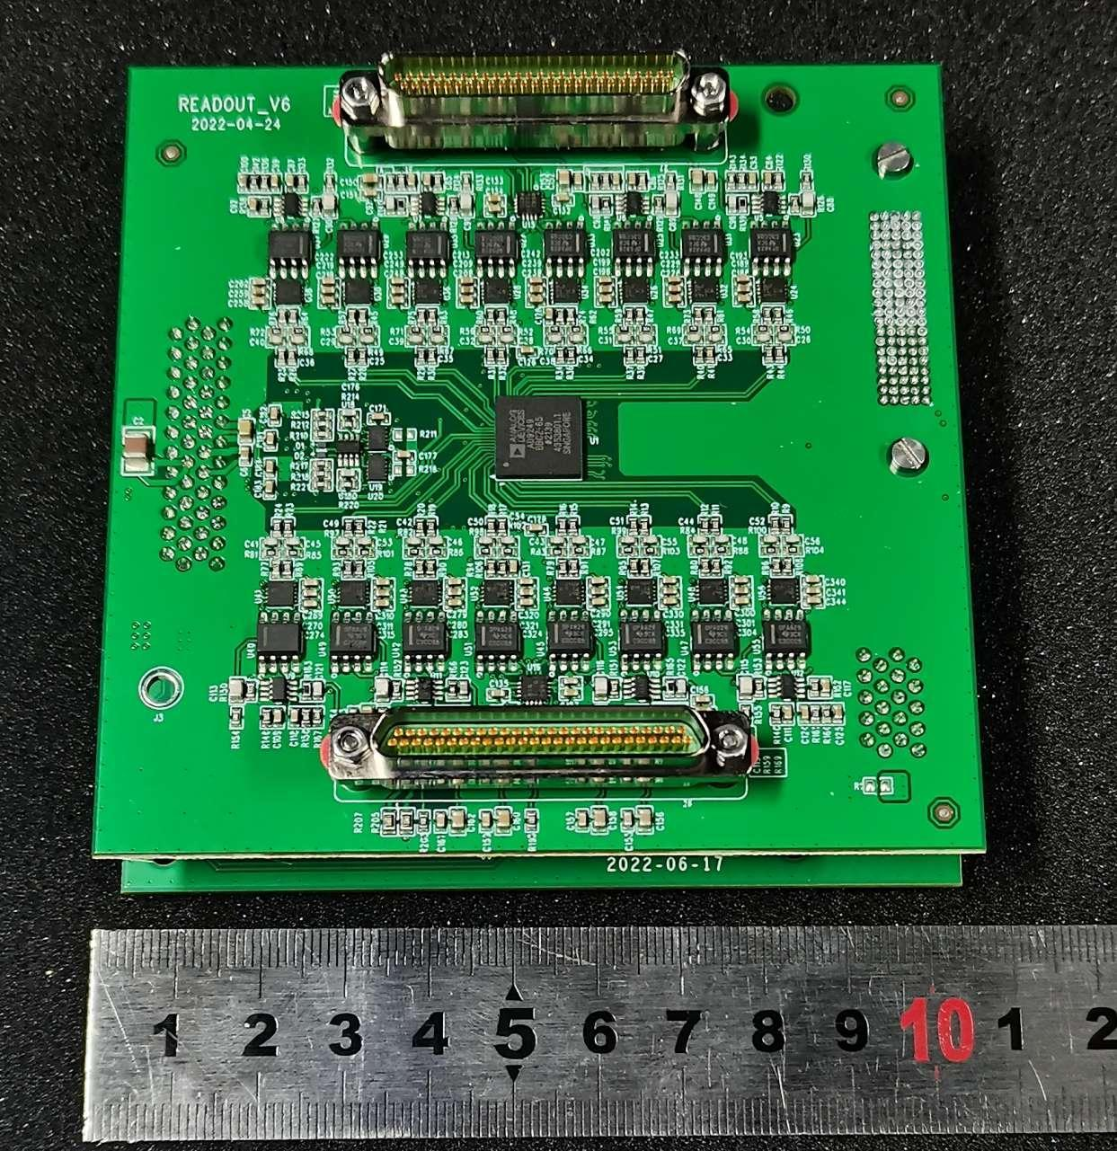
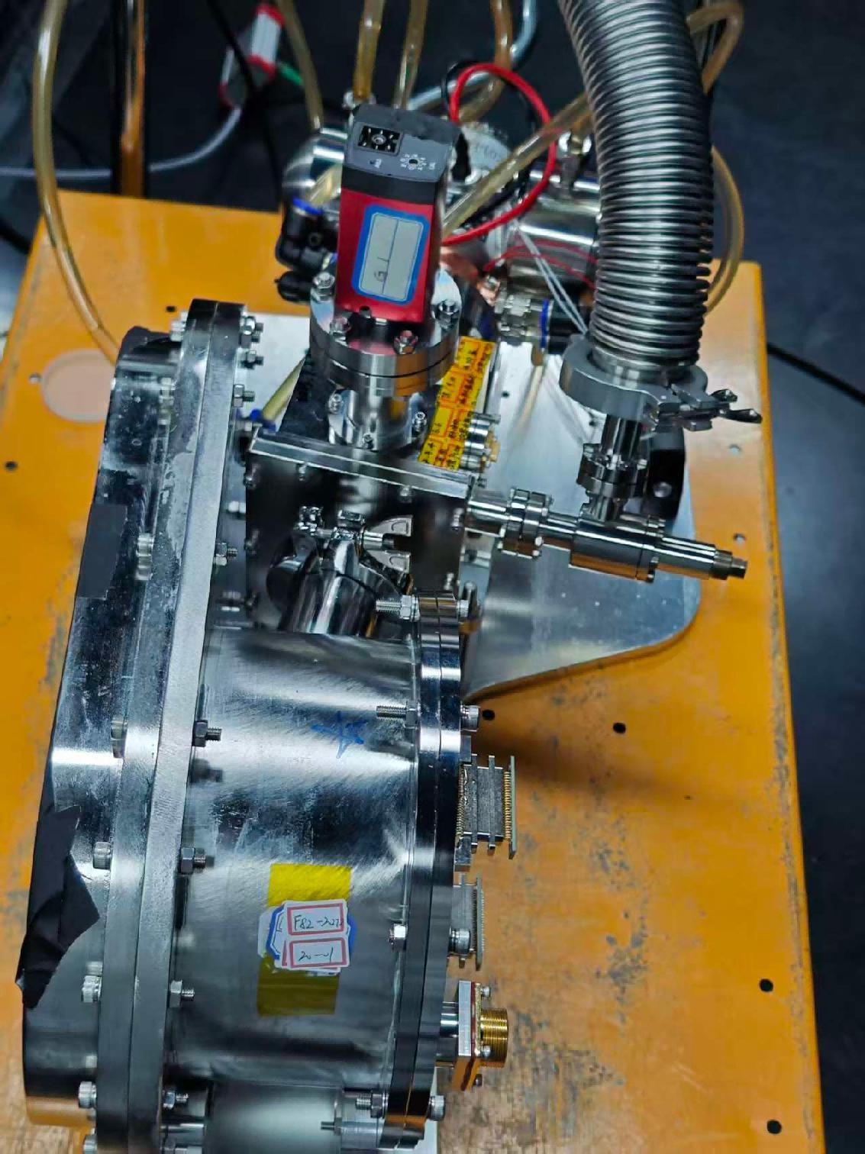
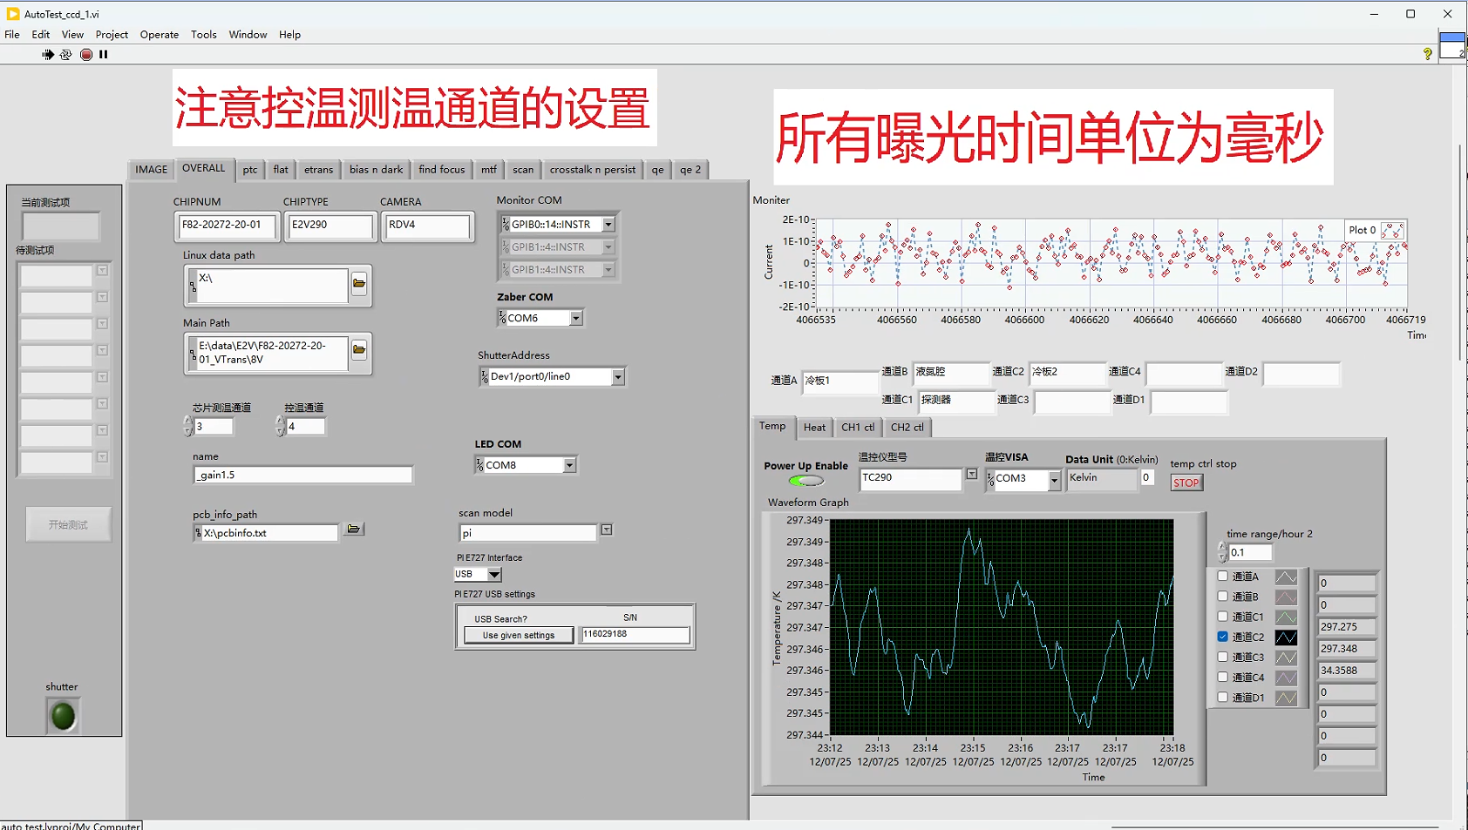
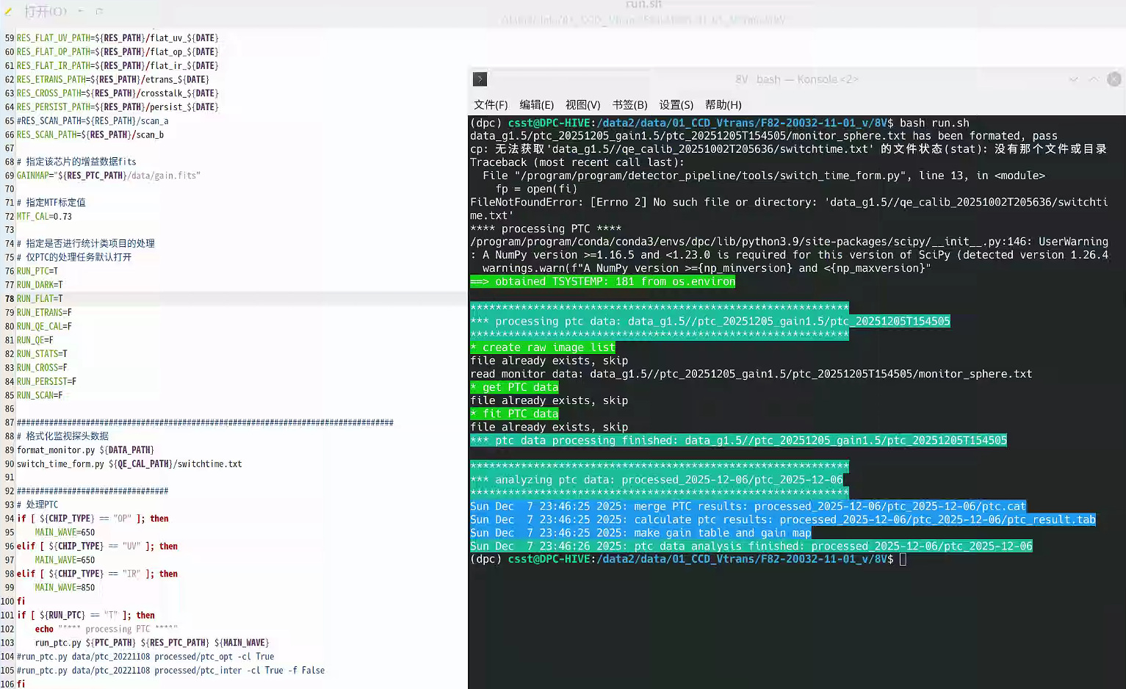
Detector Test System
Optical System
Drive&Readout Circuit
Dewar & Cryostat
Automatic Test Software
Batch Data Processing Pipeline

Slide 7
Basic Performance Indicators
QE
Gain
Incident Photon
Photoelectronic Effect
Photo-electrons
Electron
Collection
Collected
Electron
Charge Transfer
Readout
Electron
Readout
Circuit
Output
Signal
Serial/Parallel CTE
Shot Noise
PRNU
DC
RI
RN
Crosstalk
Response NL
Flat-field series：gain, response non-linearity (NL), fullwell, charge transfer efficiency (CTE)
Flat-fields at varies wavelengths：quantum efficiency(QE), pixel response non-uniformity (PRNU)
Dark&bias frames：dark current (DC), readout noise (RN)
Spot images：crosstalk, residual image (RI)

Slide 8
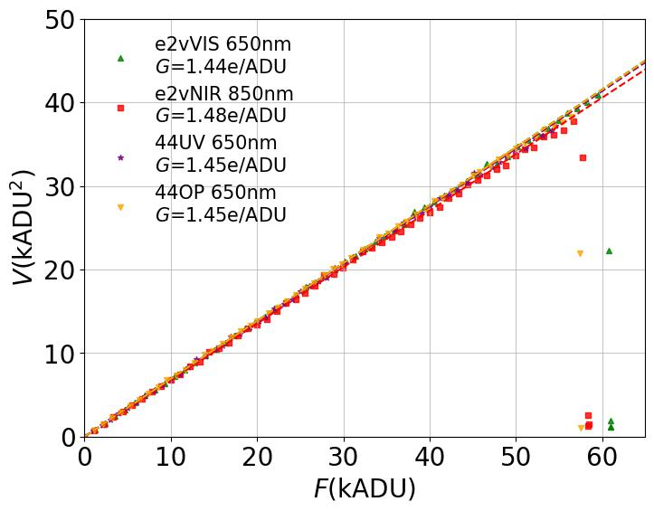
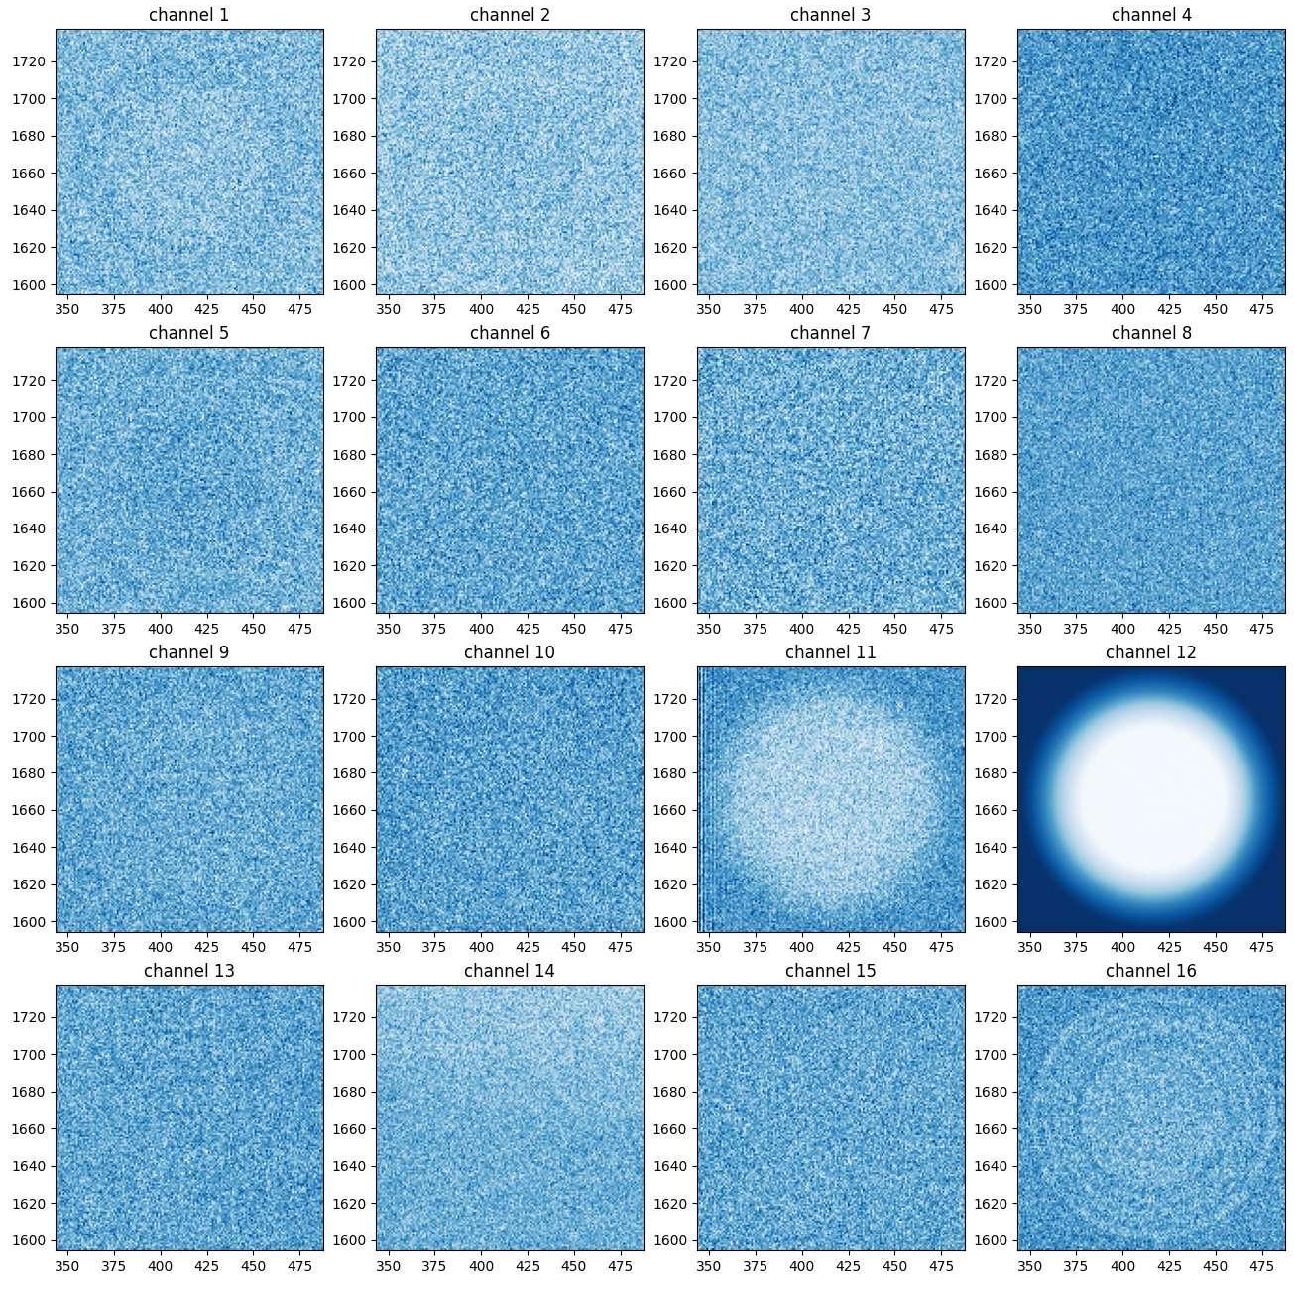
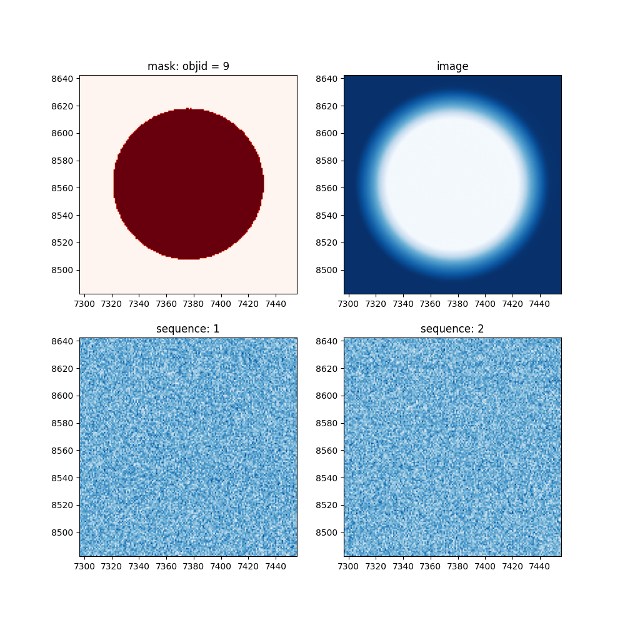
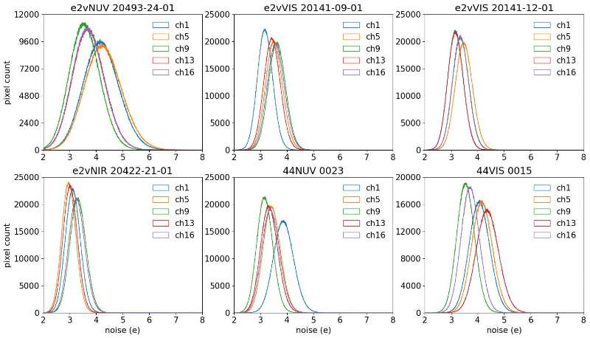
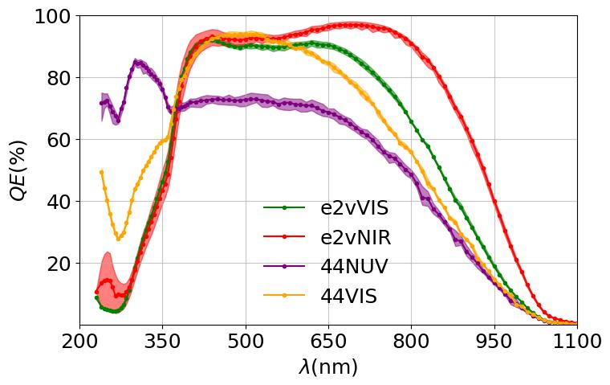
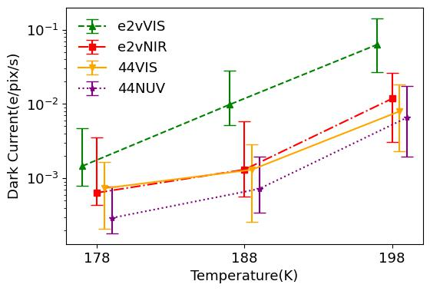
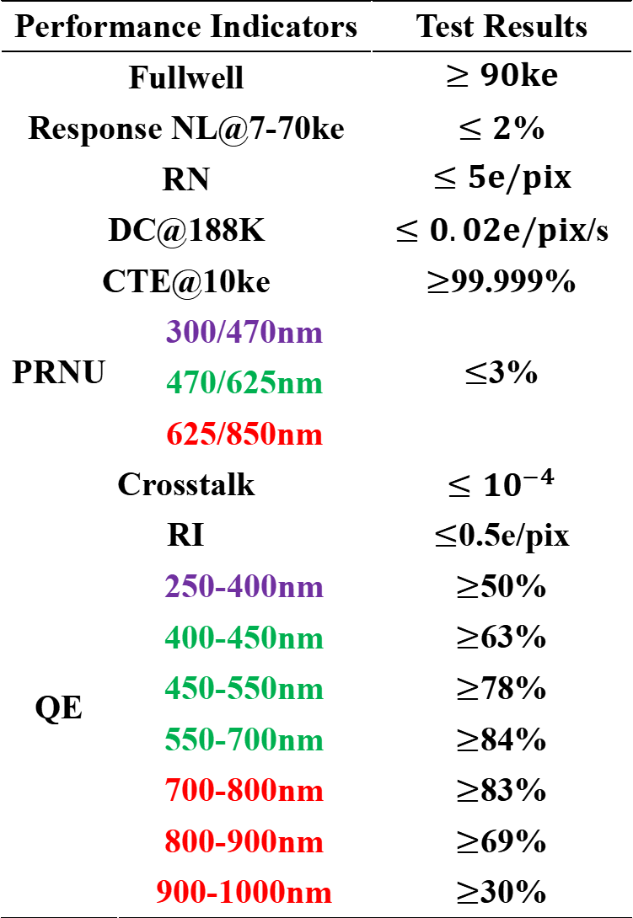
Basic Performance Indicators
Performance Indicators |  | Test Results
Fullwell |  | $$≥90ke$$
Response NL@7-70ke |  | $≤2$%
RN |  | $$≤5e/pix$$
DC@188K |  | $≤0.02e/pix$/s
CTE@10ke |  | $≥$99.999%
PRNU | 300/470nm | $≤$3%
 | 470/625nm
 | 625/850nm
Crosstalk |  | $$≤{10}^{−4}$$
RI |  | $≤$0.5e/pix
QE | 250-400nm | $≥$50%
 | 400-450nm | $≥$63%
 | 450-550nm | $≥$78%
 | 550-700nm | $≥$84%
 | 700-800nm | $≥$83%
 | 800-900nm | $≥$69%
 | 900-1000nm | $≥$30%
Crosstalk
RI
Gain (PTC)
RN
QE
Dark Current

Slide 9


Characterization of Detetor Effects
Quantum Yield
Gain
Incident Photon
Photoelectronic Effect
Photo-electrons
Electron
Collection
Collected
Electron
Charge Transfer
Readout
Electron
Readout
Circuit
Output
Signal
PRNU
BF effect
Wavelength Dependence of PRNU：
PRNU is caused by non-uniform distribution of dopants/vacancies/traps.
Blue Photons: Absorbed at the surface, electrons meet less interections.
Red Photons：Aborbed near the potential well, meet more interections.
Quantum Yield：Single ultraviolet photon may generate multiple electrons, causing bias in signal-to-noise ratio estimation.
Bright-fatter (BF) effect：Collected electrons repel newly generated electrons, this leads to image degradation of the bright sources.
Back Surface Coating
$$γ→αe$$
$$γ→αe$$
Substrate
Buried
Channel
p channel
e⁻
e⁻
e⁻
SiO₂
Metal Gates

Slide 10
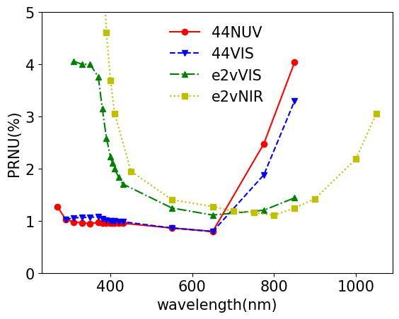
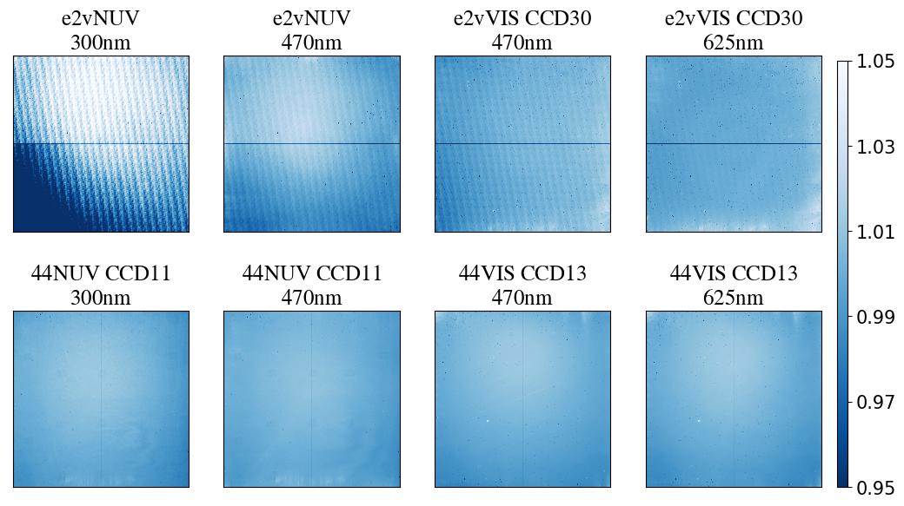
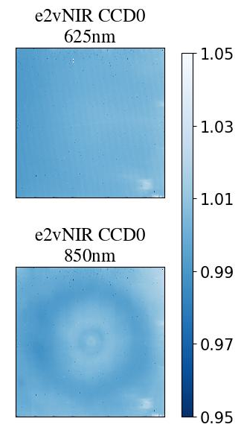
Wavelength dependence of PRNU
CCD290-99：Laser annealing, results in periodic NU of back surface potential well, causing “Brick wall pattern” in NUV. This structure fades away with increasing wavelength.
GM1201A: Atomic layer deposition (ALD) process, no brick wall pattern.
NIR photons: large absorption length in silicon, may cause large-scale PRNU patterns from multiple photon reflection.

Slide 11
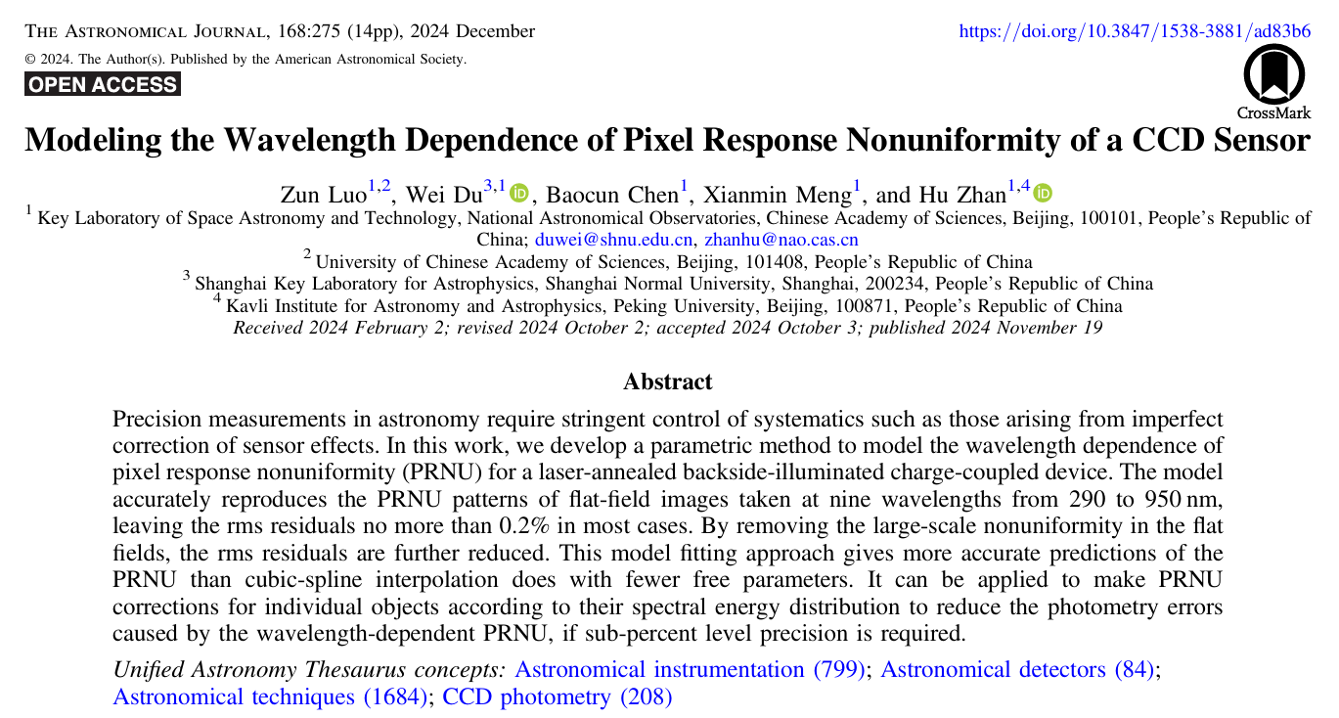
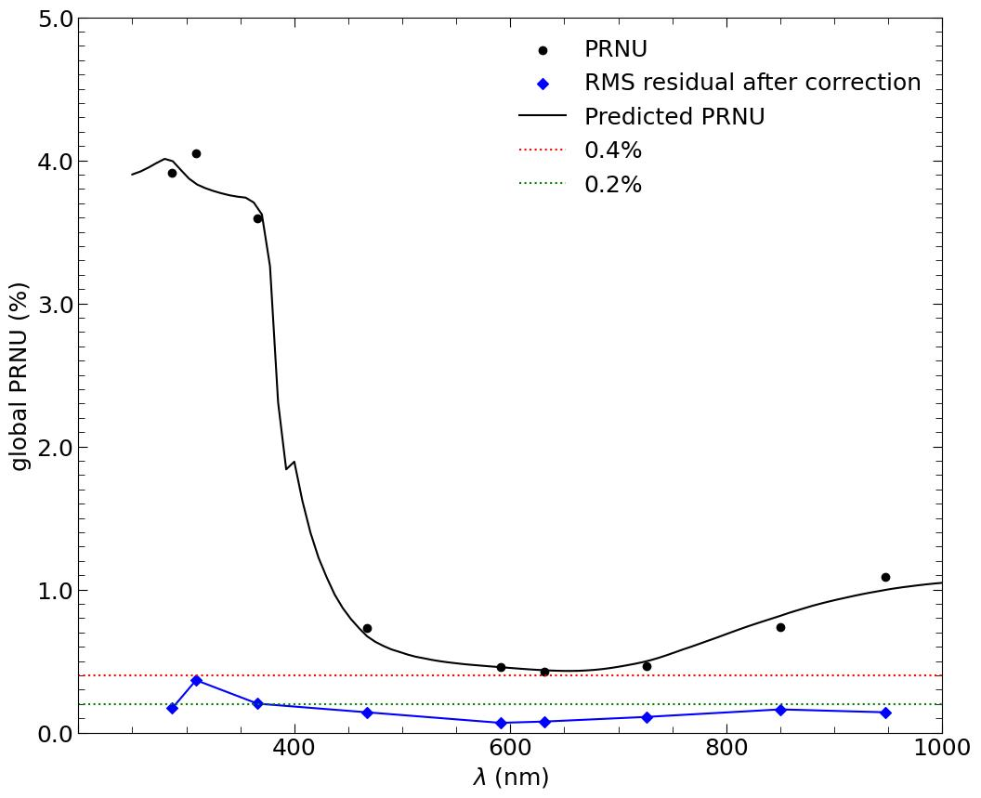
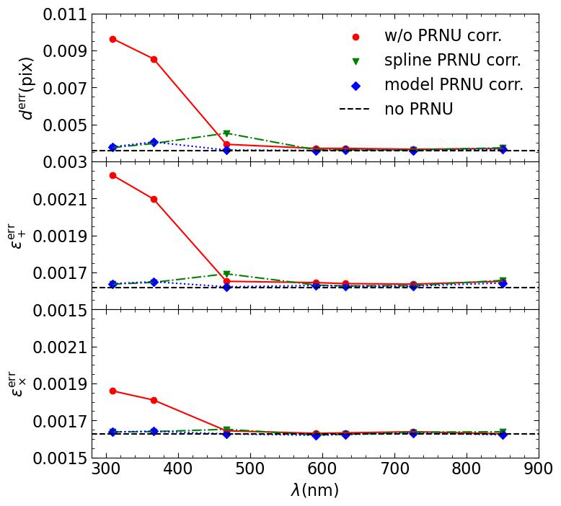
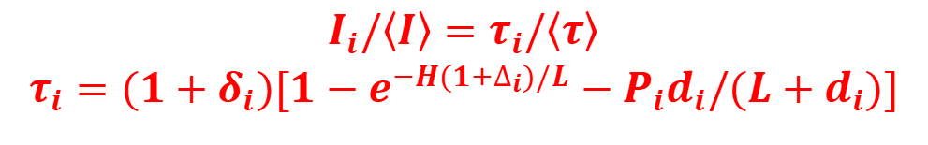
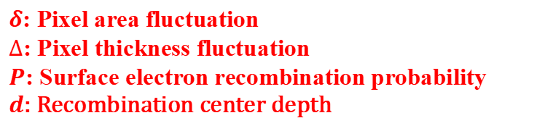
Wavelength dependence of PRNU
Luo et al.(2024) applies a four-parameter semi-physical model to fit and correct the NUV PRNU. The photmetric and astrometric errors are significantly suppressed with our model correction.
$I_{i}/〈I〉=τ_{i}/〈τ〉$
$τ_{i}=(1+δ_{i})[1−e^{−H(1+∆_{i})/L}−P_{i}d_{i}/(L+d_{i})]$
$δ$: Pixel area fluctuation
$∆$: Pixel thickness fluctuation
$P$: Surface electron recombination probability
$d$: Recombination center depth
Our model can effectively reconstruct the wavelength dependent PRNU.
Our model can effectively correct PSF position and ellipticity errors.

Slide 12
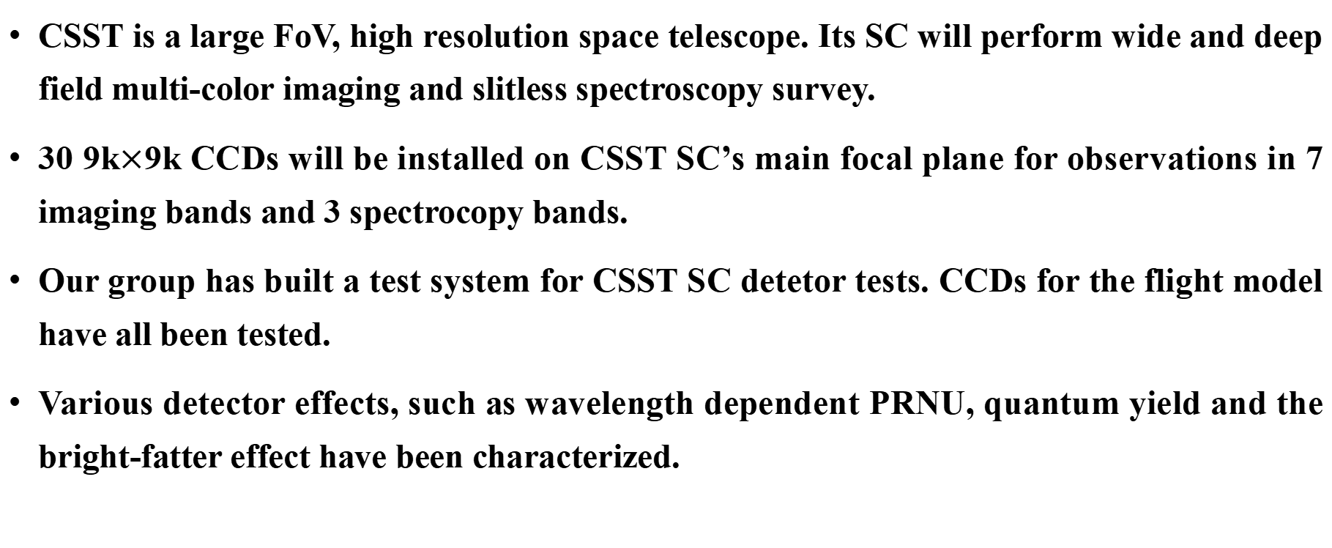
Summary
CSST is a large FoV, high resolution space telescope. Its SC will perform wide and deep field multi-color imaging and slitless spectroscopy survey.
30 9k$×$9k CCDs will be installed on CSST SC’s main focal plane for observations in 7 imaging bands and 3 spectrocopy bands.
Our group has built a test system for CSST SC detetor tests. CCDs for the flight model have all been tested.
Various detector effects, such as wavelength dependent PRNU, quantum yield and the bright-fatter effect have been characterized.

Slide 13
Thank You !
Zun Luo, NAOC, CAS
Email: luozun@nao.cas.cn

Slide 14
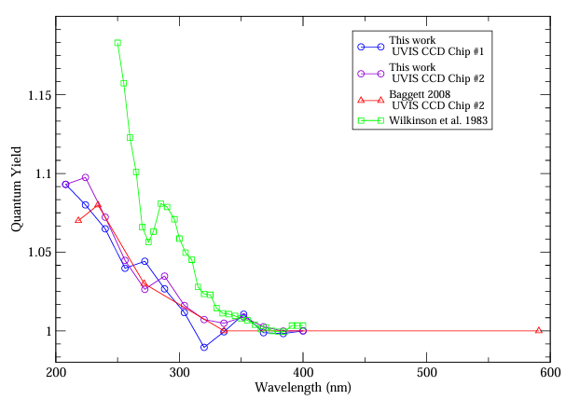
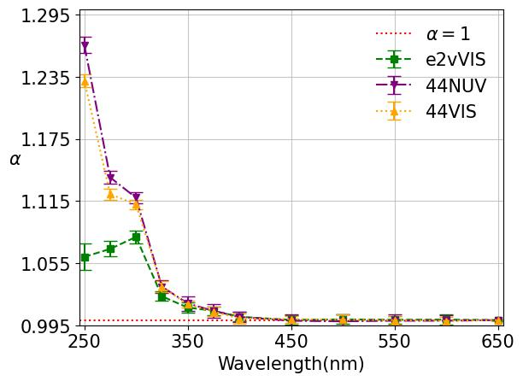
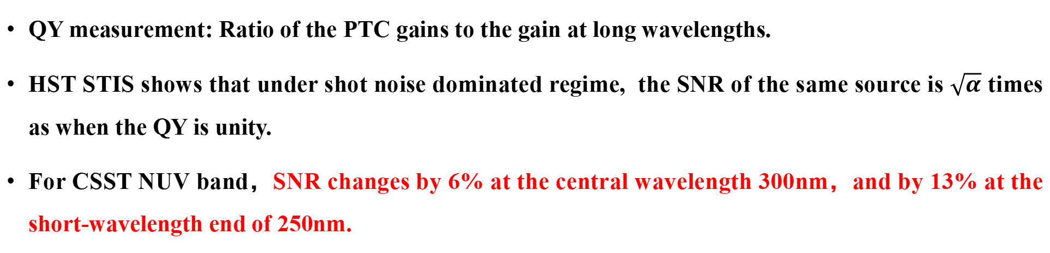
Quantum Yield (QY)
QY measurement: Ratio of the PTC gains to the gain at long wavelengths.
HST STIS shows that under shot noise dominated regime, the SNR of the same source is $\sqrt{α}$ times as when the QY is unity.
For CSST NUV band，SNR changes by 6% at the central wavelength 300nm，and by 13% at the short-wavelength end of 250nm.
Borders(2010) HST WFC3 UVIS CCD test result

Slide 15
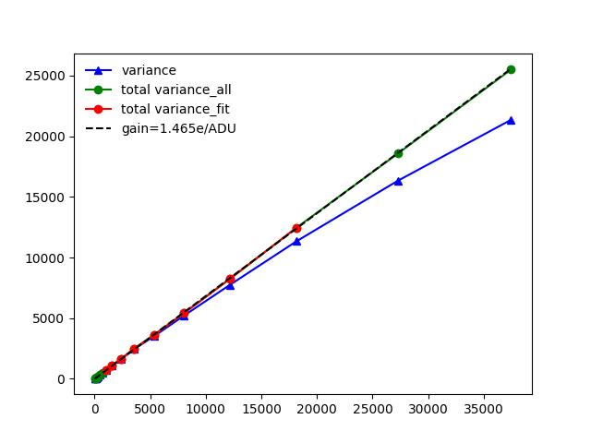
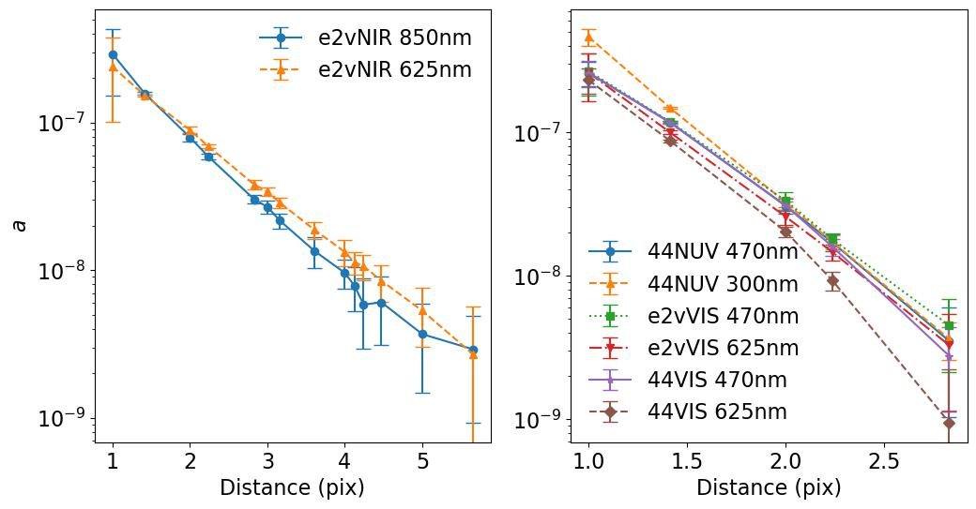
Bright-fatter (BF) effect
Repulsive interaction introduces correlations between pixels. Interaction coefficients are fitted by the correlations of the flat-fields, and can then be applied to image simulations.
Deep-depleted detectors are thicker, thus has stronger BF effect. Measured coefficients are of the same order of magnitude as comparable LSST devices. LSST tests shows that from 20ke to 90ke (peak value)，the PSF size will be increasd by 1%.
BF affects galaxy shape measurements, and should be treated carefully in weak lensing.
Variance (ADU)
PTC linearity can be effectively restored after correlation correction.
Signal (ADU)

Slide 16
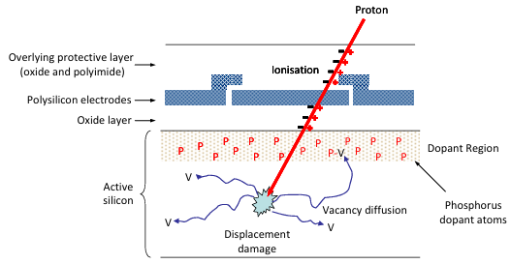
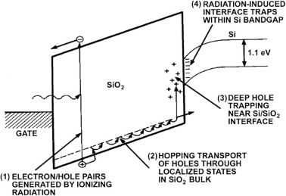
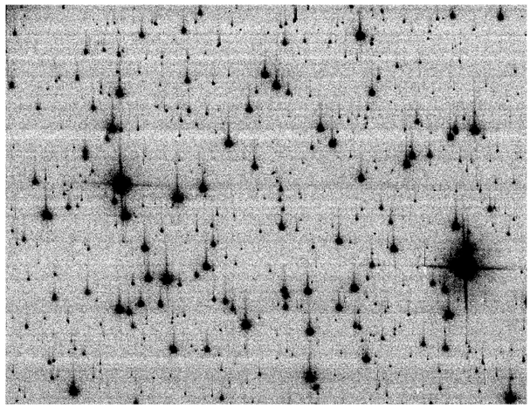
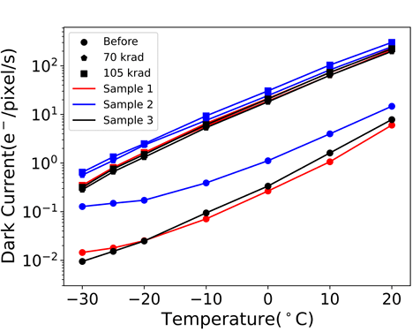
辐照试验
太空环境中，CCD探测器受到宇宙线辐照影响产生损伤，性能会发生变化。主要的辐照损伤包括分为带电粒子辐照产生的硅层内晶格空位和间隙原子（位移损伤），以及高能光子辐照产生的二氧化硅-硅界面态（总剂量效应）
位移损伤会导致电荷转移效率的降低
总剂量效应会导致暗电流和残像水平的增大
位移损伤(Hall 2012)
总剂量效应 (Sajid 2018)
Anderson (2010)
Chen (2024)

Slide 17
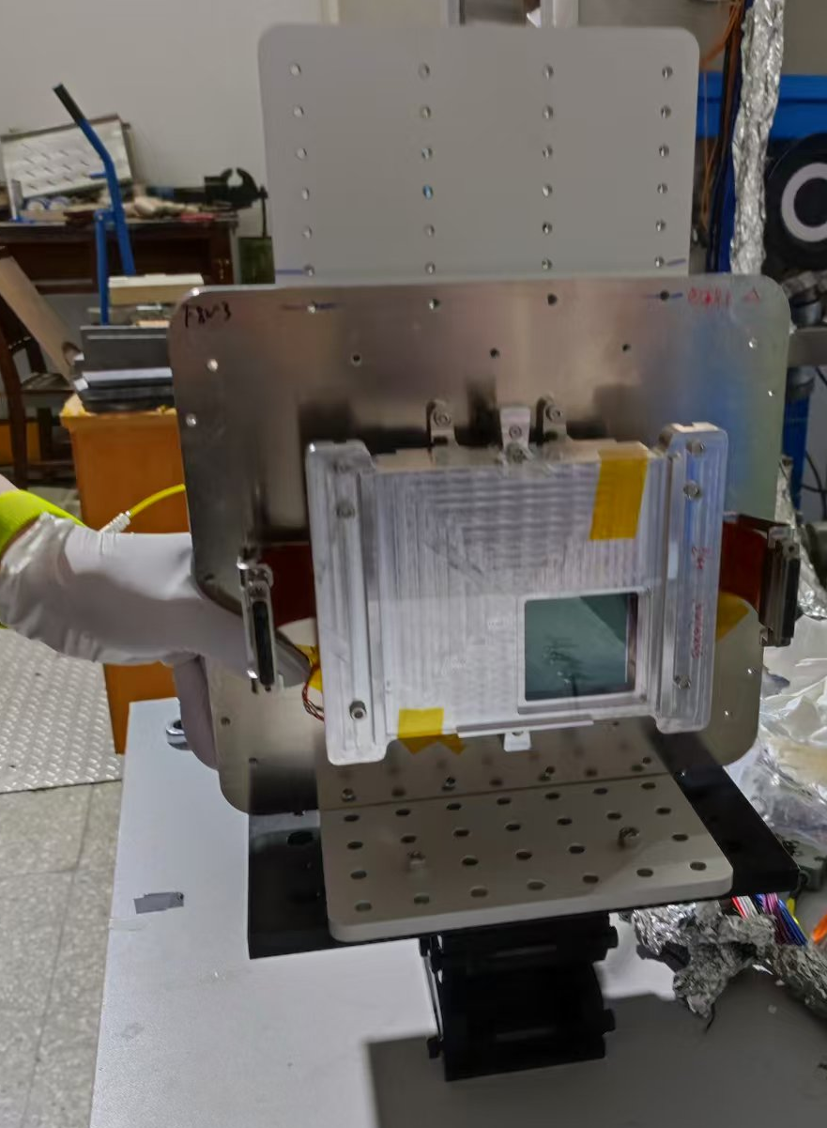
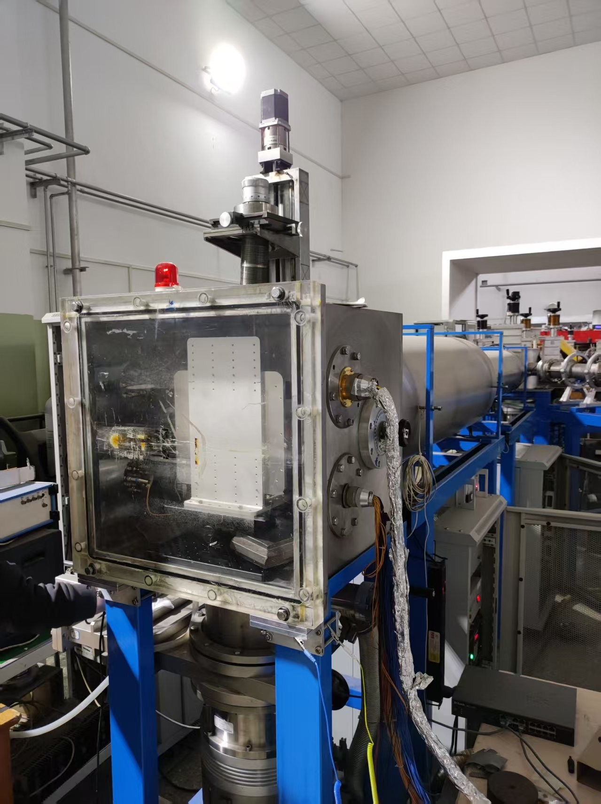
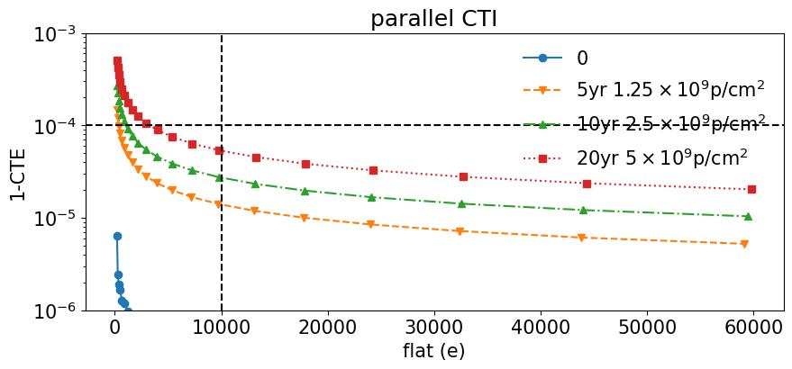
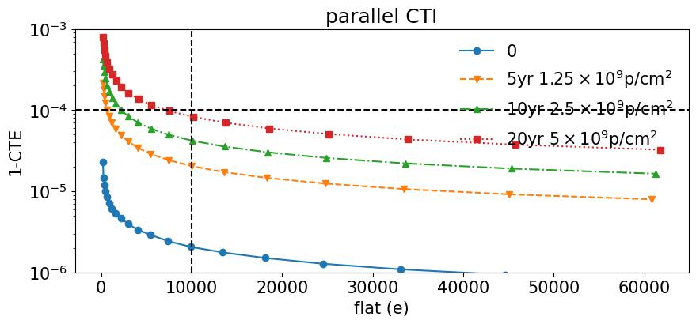
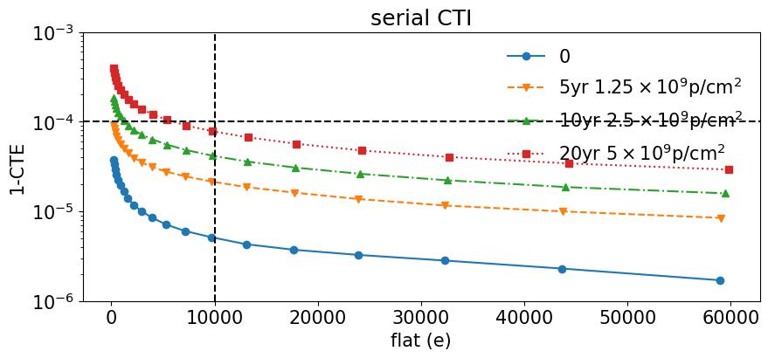
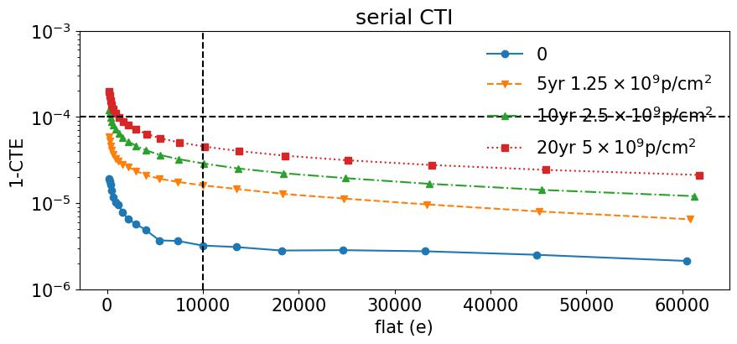

辐照试验
使用10MeV质子辐照模拟在轨位移损伤情况，$1.25×{10}^{9}p/cm2$、$2.5×{10}^{9}p/cm2$、 $5×{10}^{9}p/cm2$三个辐照剂量，分别对应在轨运行5年、10年、20年情况
e2v标准硅器件
e2v深耗尽器件
位移损伤试验工装
串列加速器

Slide 18
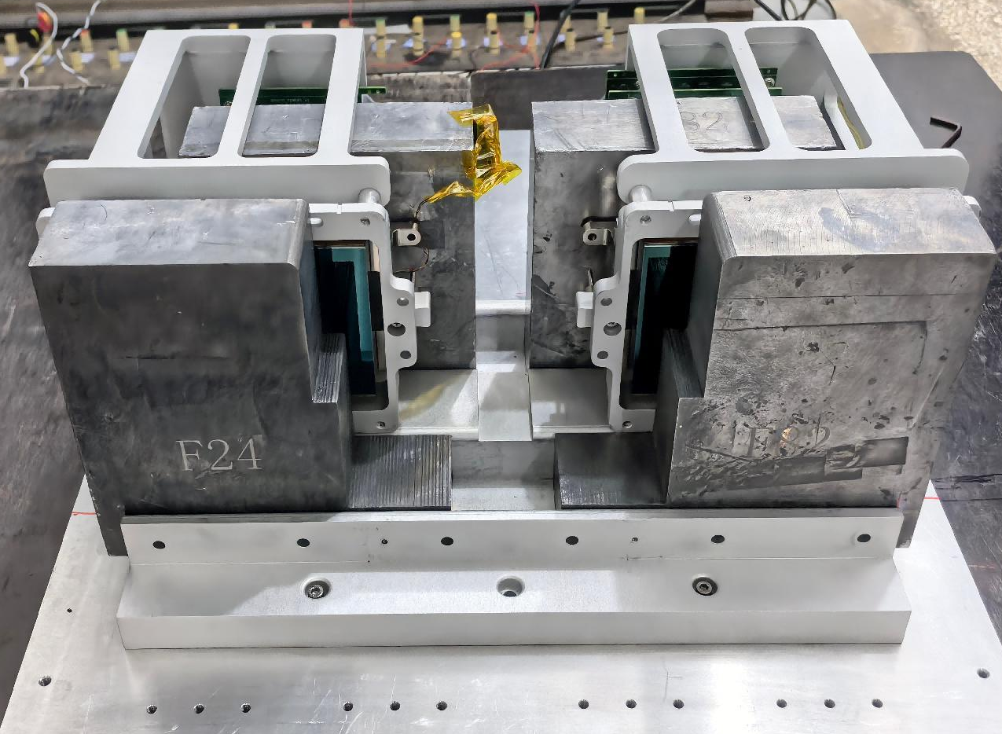


辐照试验
使用伽马射线进行辐照试验模拟总剂量效应情况，2krad、5krad两个剂量，分别对应在轨10年和25年情况。
总剂量效应试验工装
Co60伽马射线源
188K暗电流-辐照剂量关系

