Slide 1


7th China-Chile Bilateral Conference for Astronomy(CCBC2026), Hongkong University
Research on Sub Aperture Accuracy Design and Manufacturing Method of Reflector Panel for Large Aperture Submillimeter Wave Telescope
Zhengxiang Shen*, Zhe Yuan, Nuoxian Jia, Peng Chen, Saiya Wang, Runfu Peng, Yong Bi, Chenggang Shu, and Zhanshan Wang
Institute of Precision Optical Engineering Technology, Tongji University
2026-01-05

Slide 2
2
01 Submillimeter Wave Telescopes Overview
02 Sub-Aperture Accuracy and Errors Analysis
03 Sub-Aperture Design and Manufacturing
04 Conclusion and Outlook

Slide 3
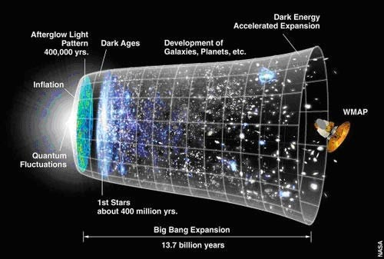
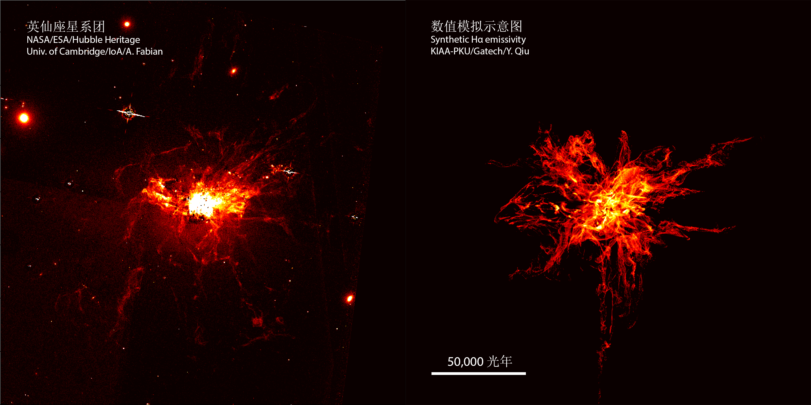
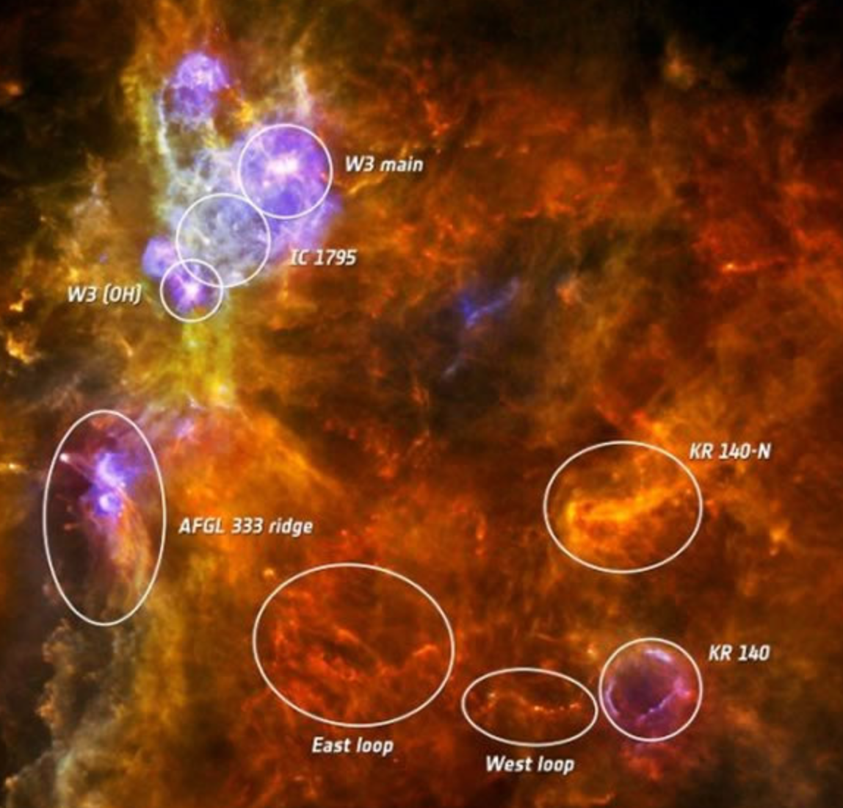



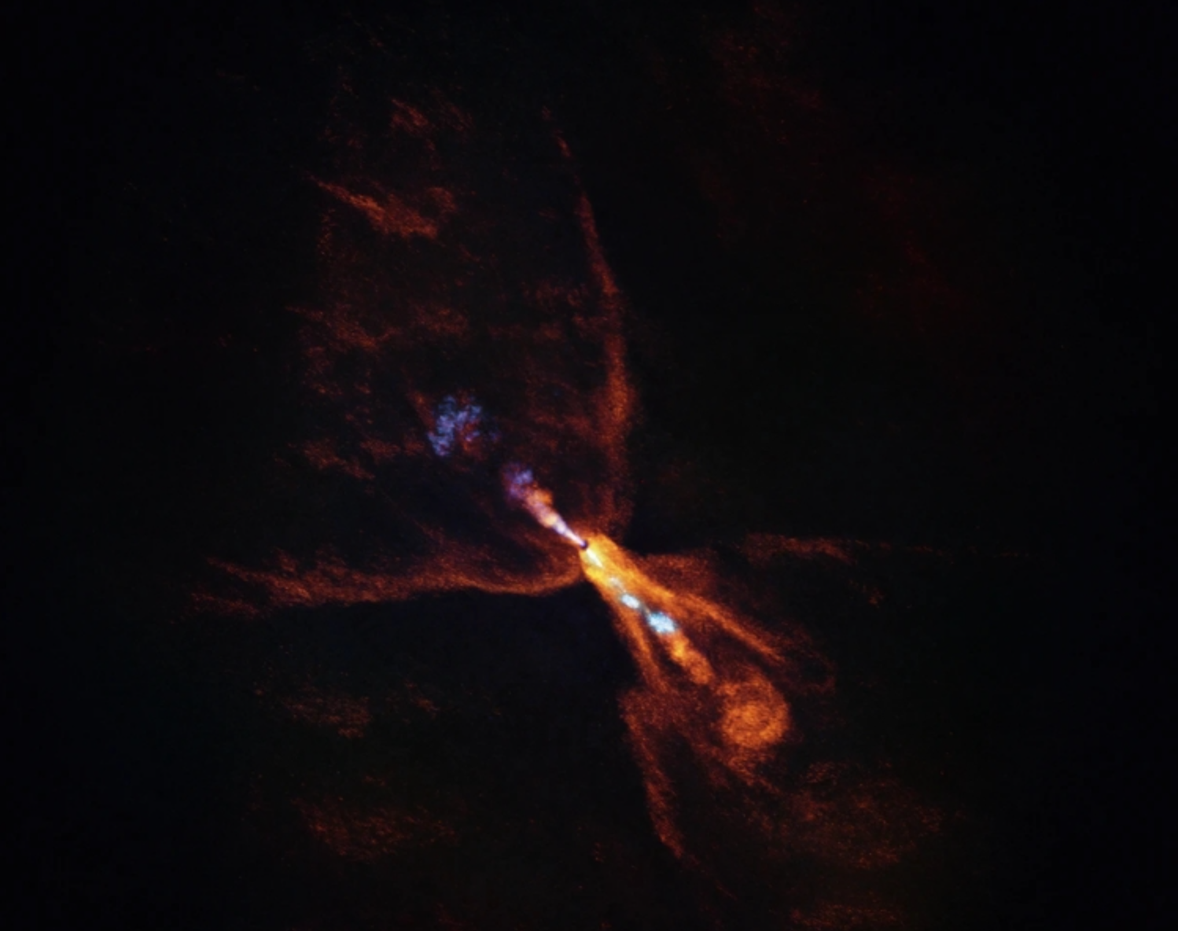
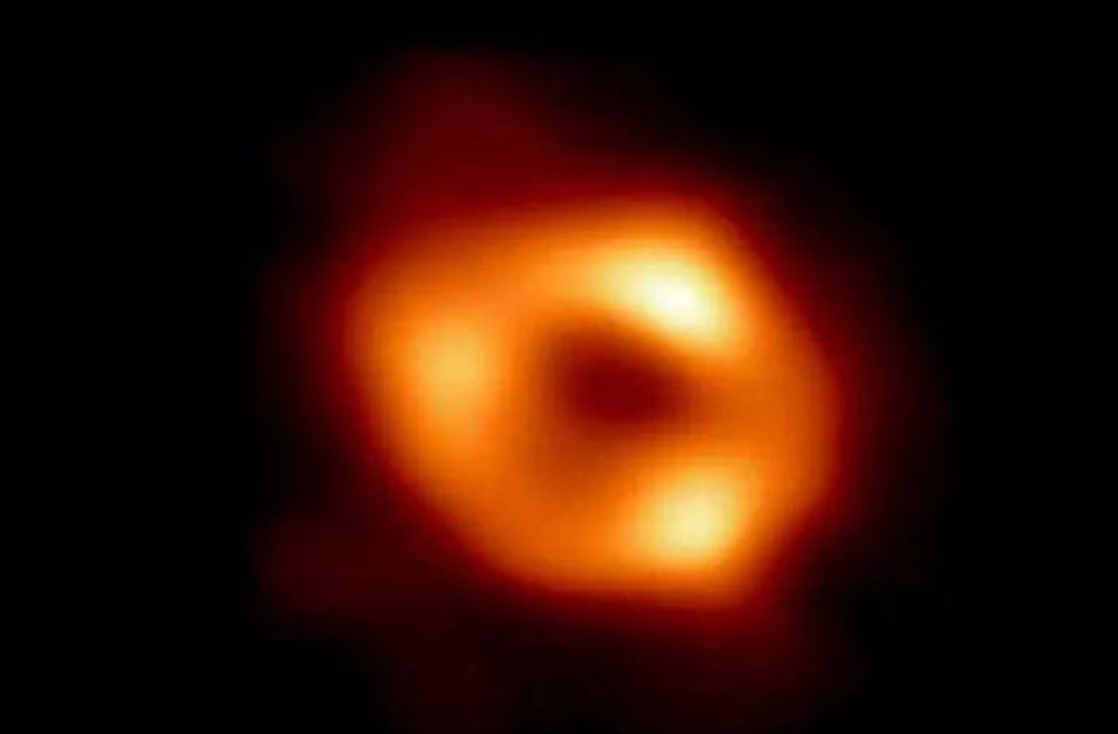

Introduction
Submillimeter-wave observations
3
3
Submillimeter waves are an important observational band in astronomy, with wavelengths ranging from 0.1 mm to 1 mm, corresponding to electromagnetic radiation with frequencies of 300–3000 GHz. The submillimeter (terahertz) band, as the only remaining “electromagnetic” observational window, is of great significance for frontier research in astronomy, including studies of galaxy evolution, star formation, and the interstellar medium.
Cosmic Microwave Background Radiation
Cold and dense interstellar gas
Distribution of Molecular Clouds
Deep Space Observation
Dust radiation redshift in the early universe
Interstellar Cold Dust Cloud
The Formation of Young Stars
Observation of Black Holes
The submillimeter wavelength band represents an exceptionally important observational window in contemporary astronomy, particularly for studying the cold, dark universe.
Notes:
Submillimeter waves correspond to electromagnetic radiation between 0.1 and 1 millimeter, forming a crucial observational band between microwaves and infrared. This wavelength range exhibits exceptional sensitivity to cold gas, cold dust, and celestial objects obscured by dust. Consequently, it plays an irreplaceable role in studying frontier topics such as the early universe, galaxy evolution, star formation, and black holes, serving as a key window for exploring the 'cold dark universe'.
亚毫米波对应 0.1 到 1 毫米的电磁辐射，是介于微波和红外之间的重要观测波段。它对低温气体、冷尘埃以及被尘埃遮挡的天体极为敏感，因此在研究早期宇宙、星系演化、恒星形成以及黑洞等前沿问题中发挥着不可替代的作用，是探索‘冷暗宇宙’的关键窗口。

Slide 4
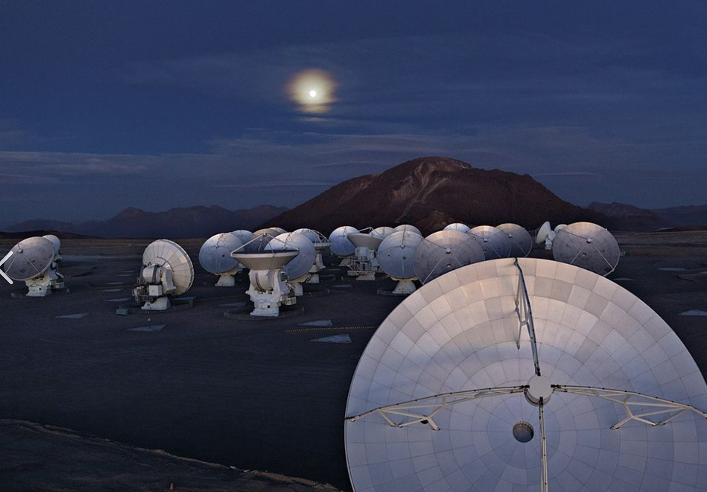
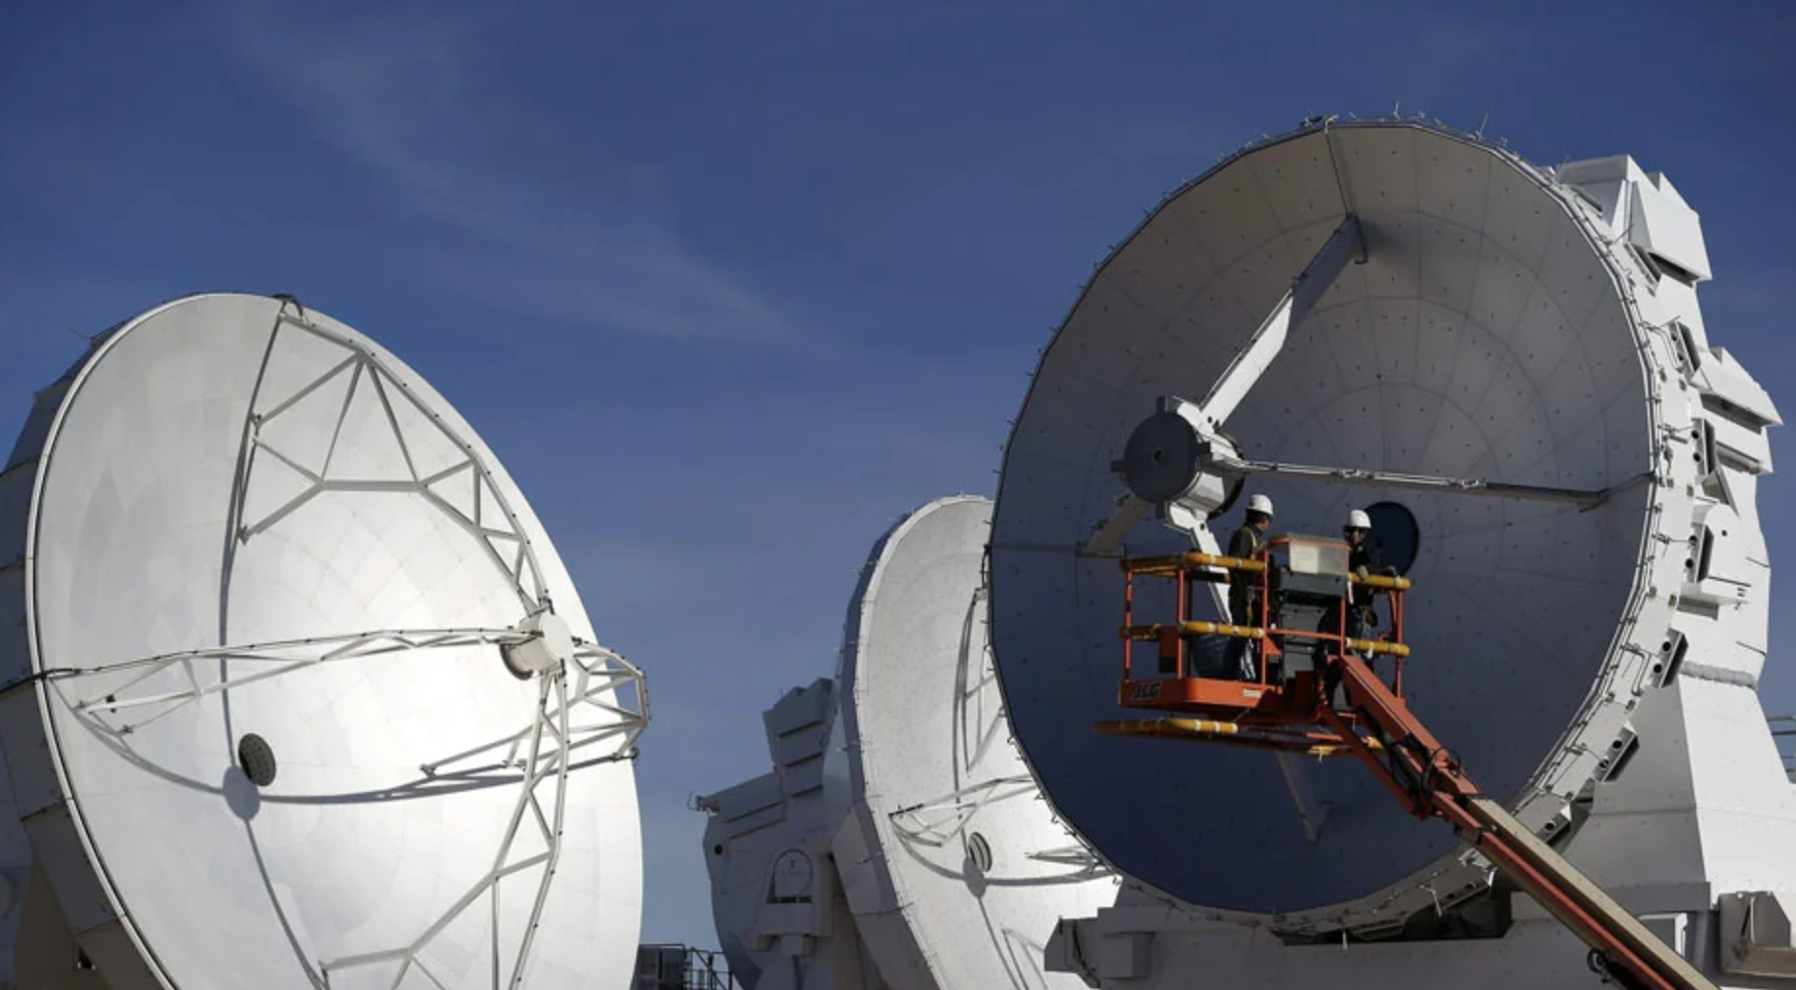
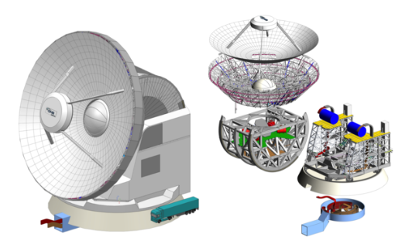
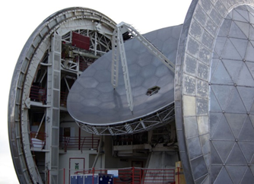
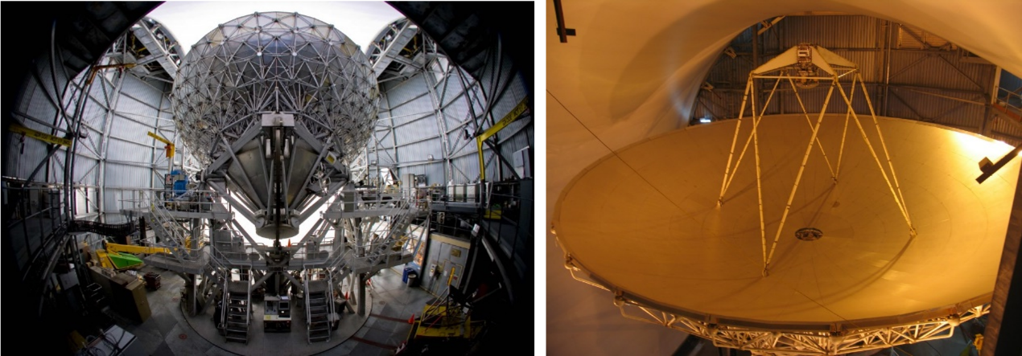
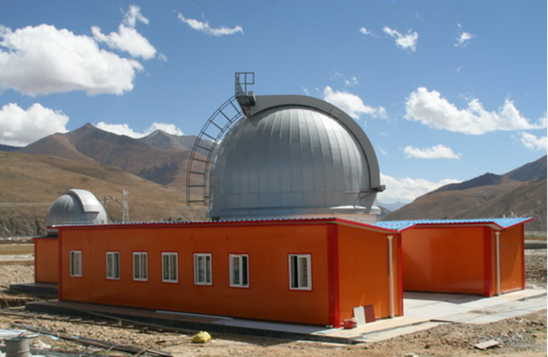
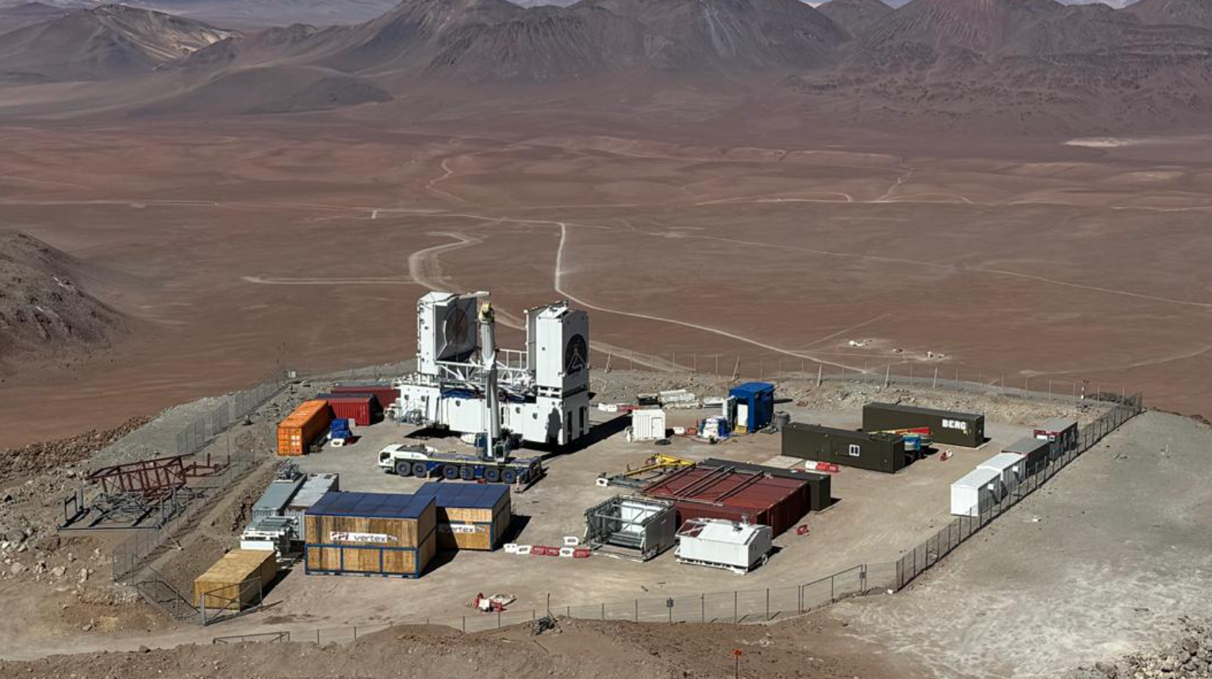
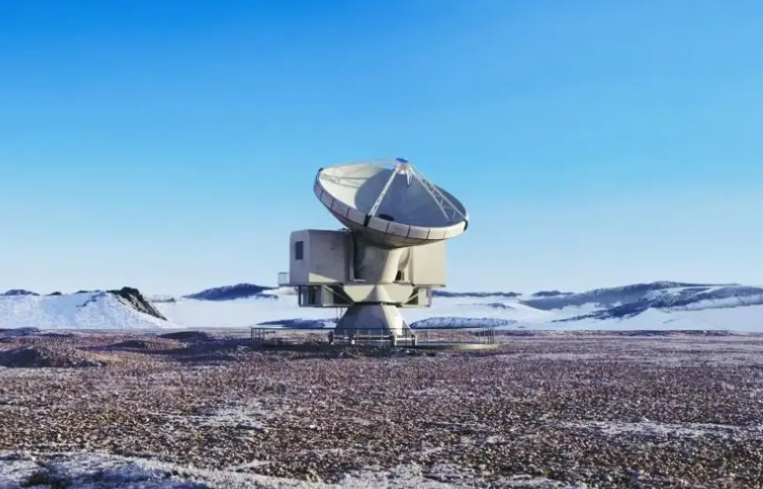
Background
Submillimeter Telescopes
4
High-altitude environments are essential for precise submillimeter telescopes, which contribute to stellar evolution, galaxy discovery, and black hole imaging.
Atacama Large Millimeter/submillimeter Array (ALMA)
Sub-Millimeter Array（SMA）
Atacama Large Aperture Submillimeter Telescope (AtLAST)
Leighton Chajnantor Telescope(LCT)
James Clerk Maxwell Telescope
China-German Cosmic Submillimeter Observatory for Molecular Astrophysics
The Fred Young Submillimeter Telescope (FYST）
15-meter Millimeter-wave Telescope(XSMT)
The demand for large-aperture submillimeter telescopes is urgent, as developing key technologies for them is a major national priority.
Notes:
Currently, several major submillimeter telescopes have been constructed and are operational worldwide, such as ALMA, SMA, and JCMT. These instruments have played a pivotal role in research on star formation, galaxy evolution, and black holes. Simultaneously, driven by evolving scientific demands, the international community is planning and constructing next-generation submillimeter telescopes with larger apertures and enhanced performance, such as AtLAST and LCT. This underscores that submillimeter astronomy is not only critically important today but also faces strong and urgent development needs in the future.
目前，全球已经建成并运行了多台重要的亚毫米波望远镜，例如 ALMA、SMA 和 JCMT，它们在恒星形成、星系演化和黑洞研究中发挥了关键作用。同时，随着科学需求的不断提升，国际上正在规划和建设新一代更大口径、更高性能的亚毫米波望远镜，如 AtLAST 和 LCT。这表明亚毫米波天文不仅已经非常重要，而且在未来仍具有强烈和紧迫的发展

Slide 5
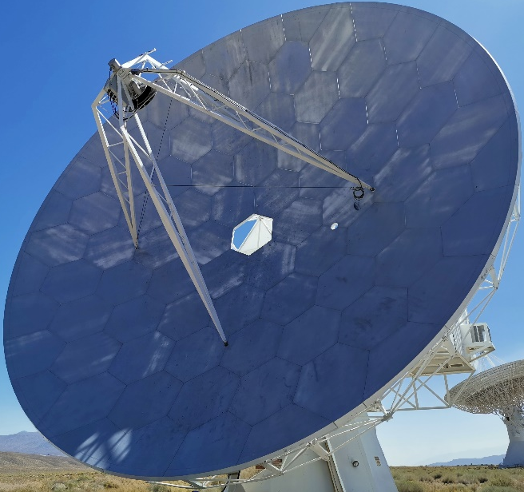
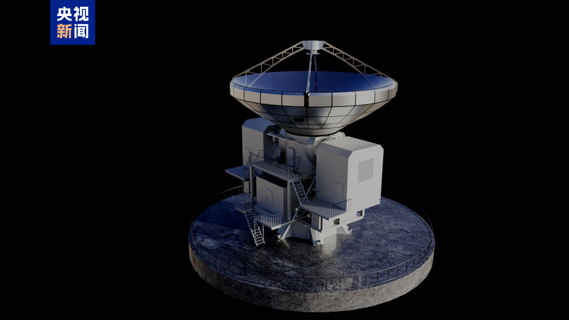
Background
Two submillimeter wave telescopes: LCT & XSMT
5
The Leighton Chajnantor Telescope (LCT) is Sub-millimeter-wave Telescope with the 10.4-meter primary reflector.
The 15-meter Millimeter-wave Telescope (XSMT), located in Qinhai, China, specializes in submillimeter-wave astronomical observations, focusing on the study of interstellar medium, star formation, and the evolution of distant galaxies.
Primary Reflector Aperture:Diameter: 10.4 m
Panel Manufacturing Precision Targets:
Single Panel Surface Profile RMS: ≤ 10–15 μm
Surface Profile RMS Requirement: ≤ 25 μm
Primary Reflector Aperture: Diameter: 15 m
Design Frequency: ≥ 300 GHz (Wavelength ≈ 1 mm)
Surface Profile RMS Requirement: ≤ 20–30 μm
Notes:
Following the introduction to the development background of submillimeter telescopes, we now turn to a significant project currently under construction—the 15-meter submillimeter telescope XSMT.
Located in Sichuan, China, XSMT is a single-dish telescope designed for submillimeter-wave observations, primarily targeting research into interstellar media, star formation, and galaxy evolution. From an engineering perspective, its primary reflector has a diameter of 15 meters and is designed to operate at frequencies above 300 GHz, imposing extremely high precision requirements on the reflector surface.
At the system level, the RMS surface profile of the entire primary reflector must be controlled within 20 to 30 micrometers. At the manufacturing level, the RMS surface profile of each individual reflector panel must achieve an even tighter tolerance of 10 to 15 micrometers. Therefore, achieving and ensuring such precision for the reflector surface is a key challenge in the XSMT construction process and one of the core focuses of this work.
在前面介绍了亚毫米波望远镜的发展背景之后，这里我们具体来看一个正在建设的重要项目——15 米毫米波望远镜 XSMT。
XSMT 位于中国四川，是一台面向亚毫米波观测的单天线望远镜，主要用于星际介质、恒星形成以及星系演化等研究。从工程角度看，它的主反射面口径是 15 米，设计工作频率在 300 GHz 以上，这对反射面的精度提出了非常高的要求。
在系统层面，整个主反射面的面形 RMS 需要控制在 20 到 30 微米以内；进一步到制造层面，单块反射面面板的面形 RMS 甚至要达到 10 到 15 微米。因此，如何实现并保证反射面达到这样的精度，是 XSMT 建设过程中需要重点解决的问题，也是本工作关注的核心内容之一

Slide 6
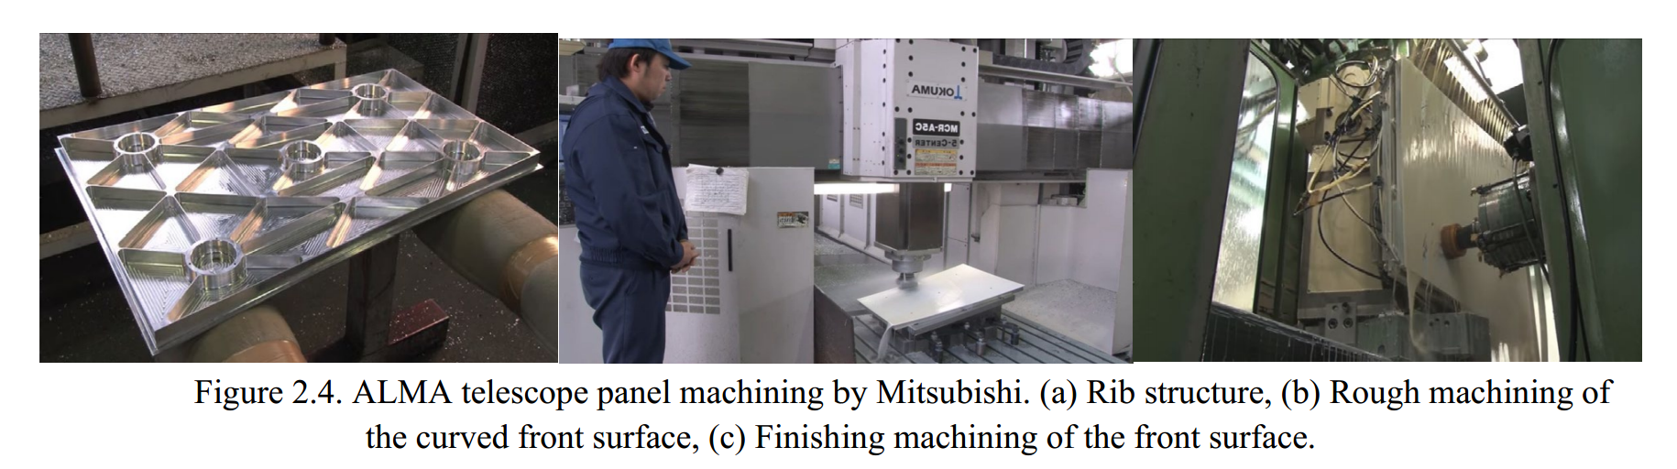
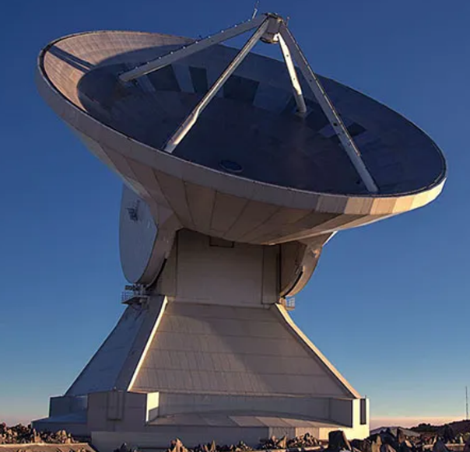
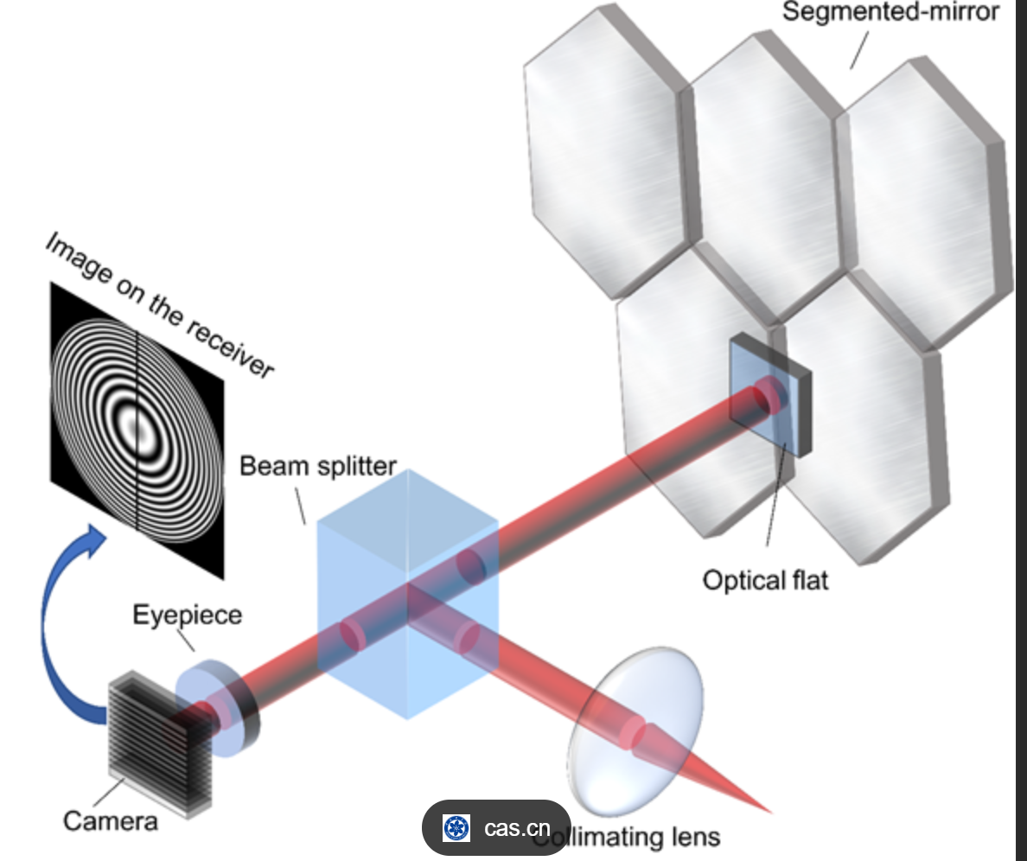
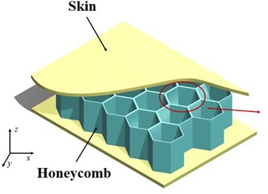
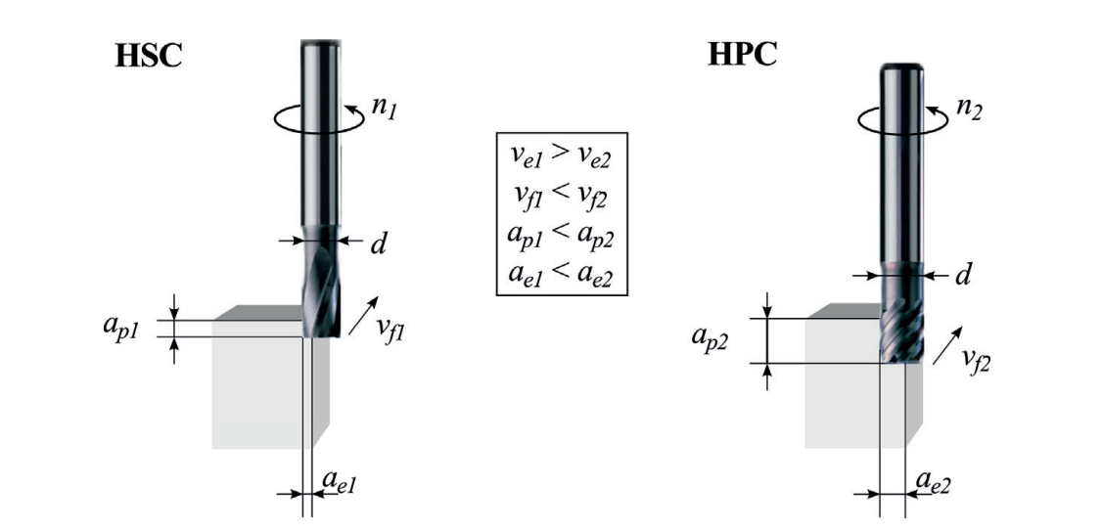
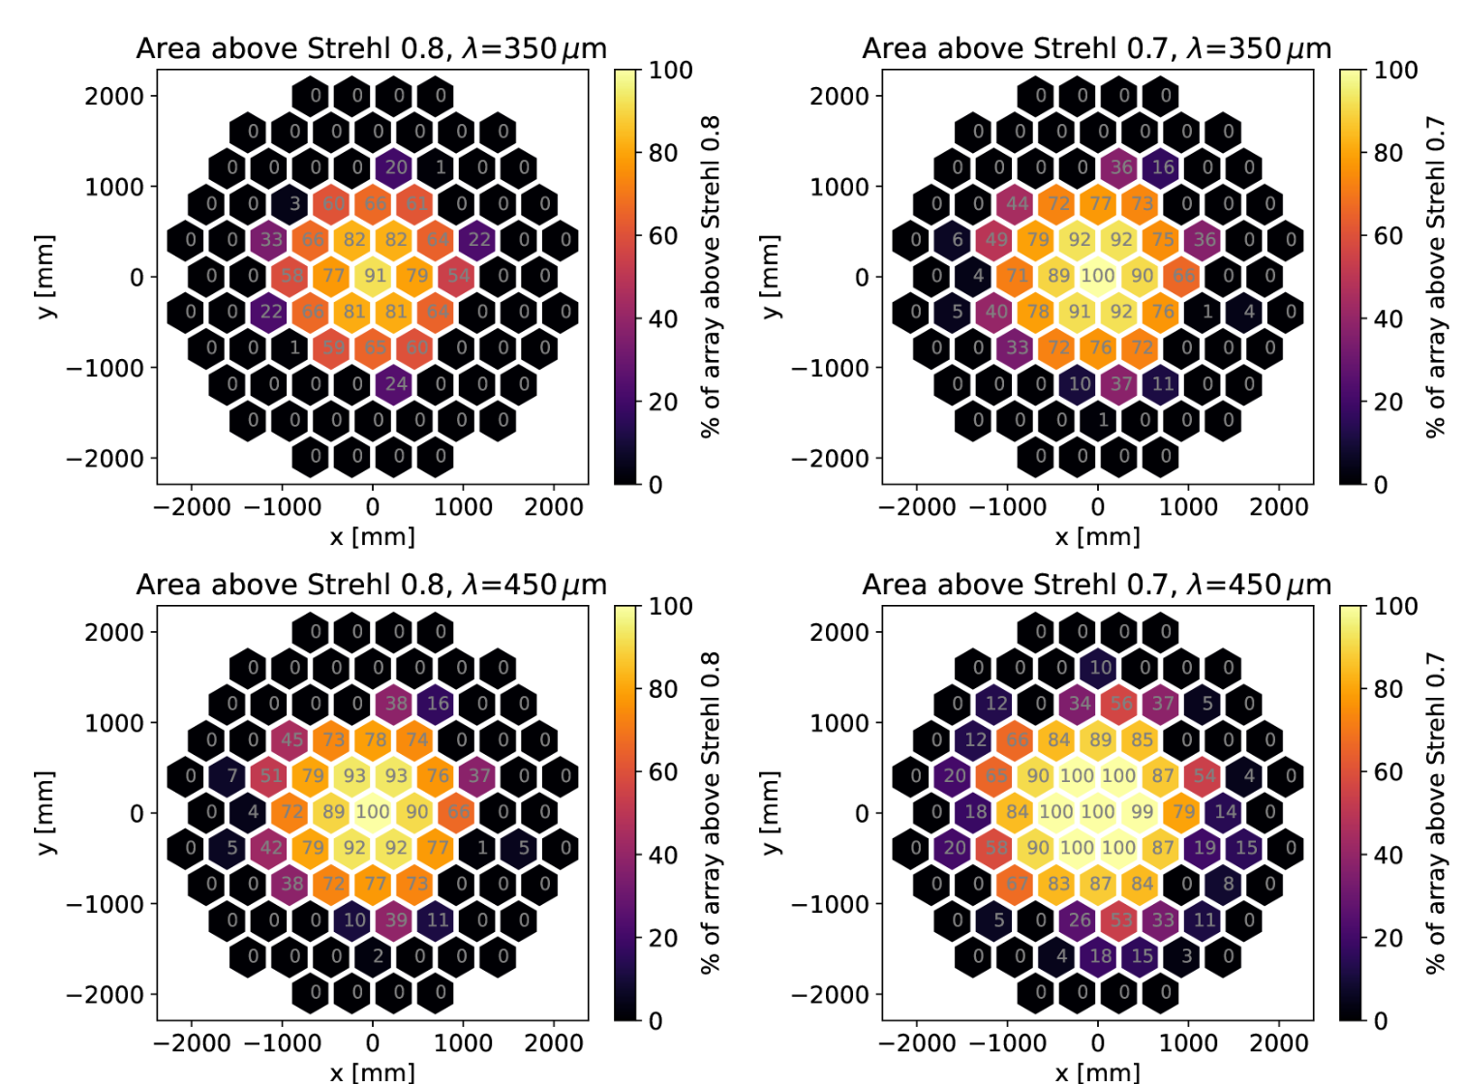
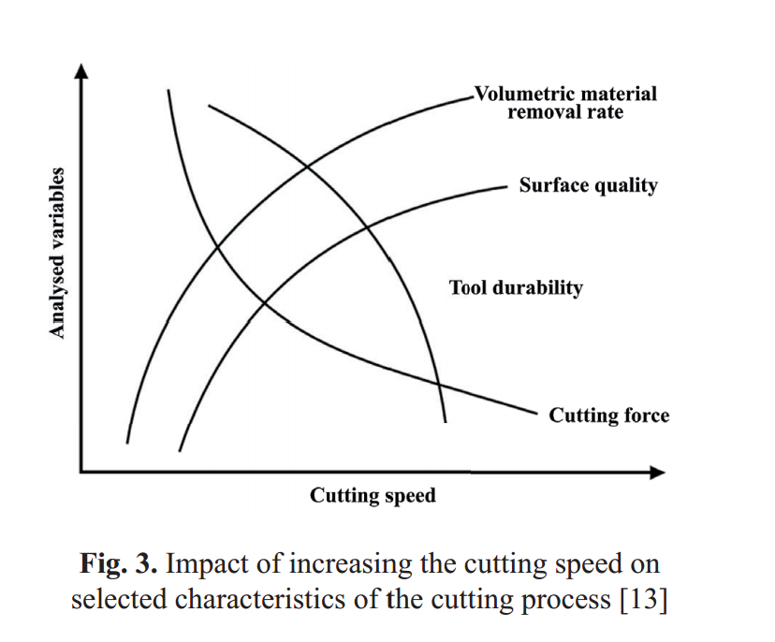
Objective
Precision of Reflecting Panels for Submillimeter Telescopes
6
High-precision manufacturing of large-diameter, high-aspect-ratio panels at the micrometer scale
The main mirror assembled from panels exhibits multi-degree-of-freedom assembly errors.
Overall Accuracy of Reflective Panel
How to Manufacture
How to process
How to splice and allignment
Honeycomb Sandwich Panel
Honeycomb sandwich panels for submillimeter telescopes require polishing to meet surface accuracy.
VS
Solid aluminum alloy panel
Errors from splicing panels of different sizes affect accuracy; precise alignment minimizes this impact.
我国对于大口径亚毫米波望远镜的建设需求非常迫切，发展大型亚毫米波射电望远镜关键技术是国家重大需求，不仅具有重要的天文科学意义，也具有重大的国家战略意义。
The surface accuracy of the reflector panel is crucial for submillimeter telescope performance, and improving overall precision is key to their construction.
Notes:
For submillimeter-wave telescopes, the overall precision of the reflective panels is a critical factor affecting system performance. On one hand, the panels themselves require micrometer-level manufacturing precision despite their large dimensions. On the other hand, assembling multiple panels introduces multi-degree-of-freedom alignment errors during the process. Therefore, the overall precision is essentially the combined result of manufacturing and assembly errors.
Addressing this challenge, my research focuses on three main aspects: first, the manufacturing methods for the reflector panels; second, enhancing surface precision through machining and polishing processes; and finally, investigating how assembly errors during panel joining affect overall precision.
对于亚毫米波望远镜来说，反射面板的整体精度是影响系统性能的关键因素。一方面，面板本身需要在大尺寸条件下实现微米级的制造精度；另一方面，多块面板在装配过程中还会引入多自由度的拼接误差。因此，整体精度实际上是制造误差和装配误差共同作用的结果。
围绕这一问题，我主要从三个方面展开研究：首先是反射面板的制造方式，其次是通过加工和抛光工艺进一步提高面板的表面精度，最后是研究面板拼接过程中装配误差对整体精度的影响。

Slide 7
7
01 Submillimeter Wave Telescopes Overview
02 Sub-Aperture Accuracy and Errors Analysis
03 Sub-Aperture Design and Manufacturing
04 Conclusion and Outlook

Slide 8
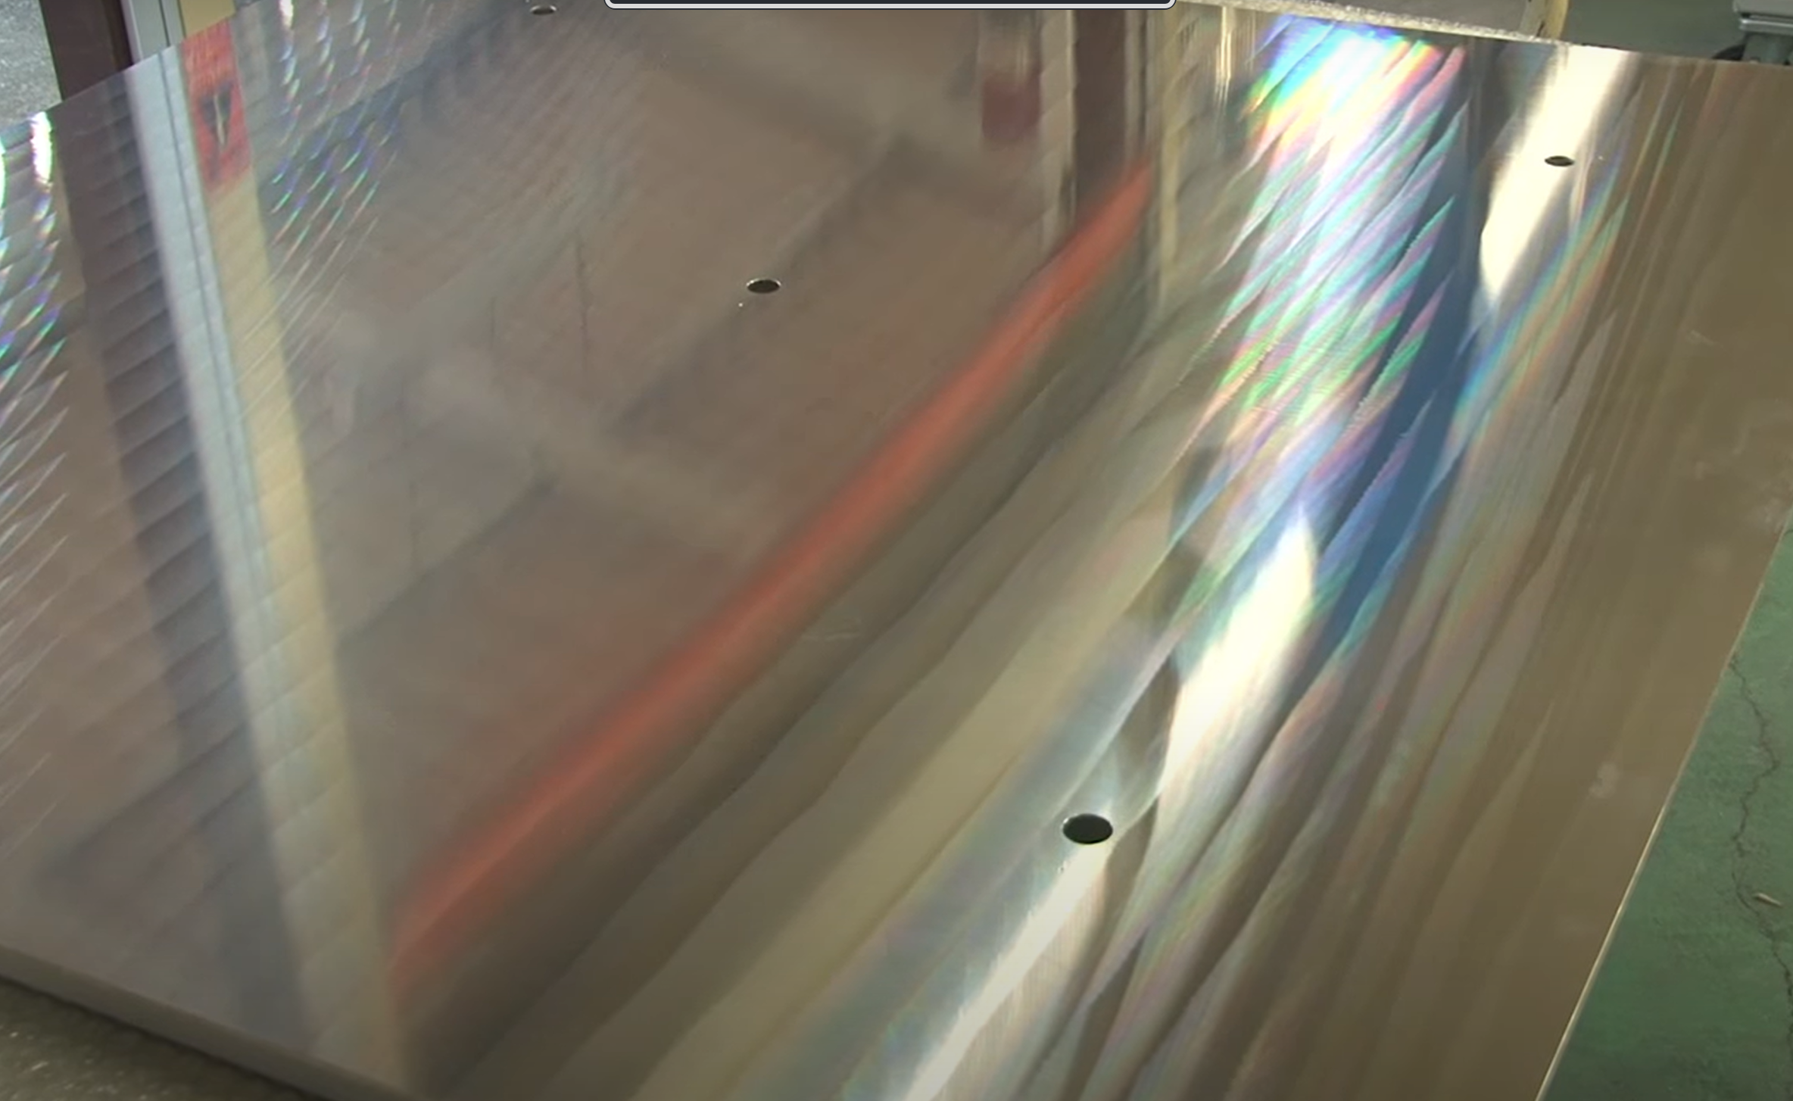
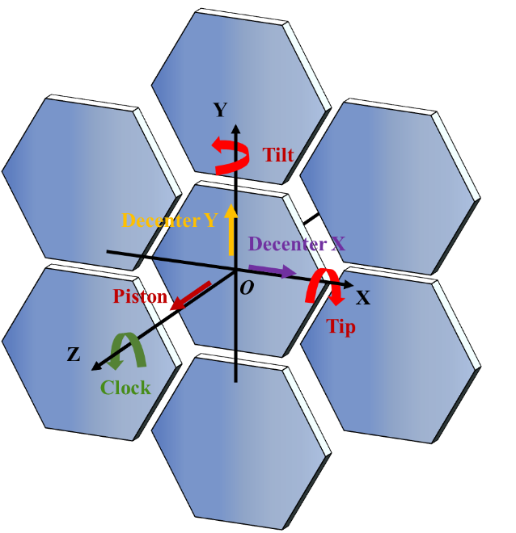
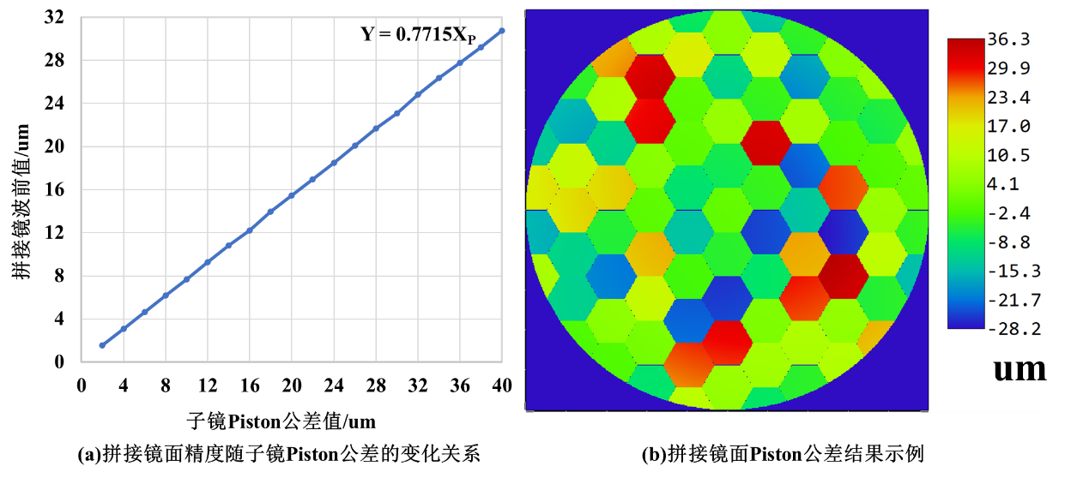
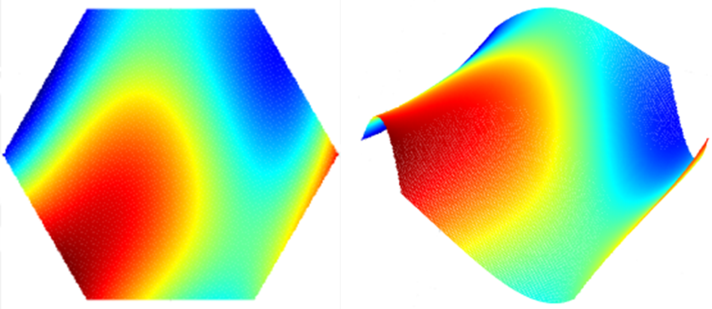
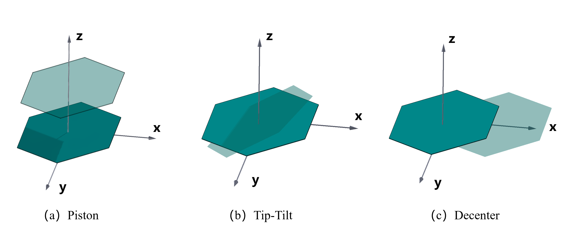
2 Error Analysis
The Sub-Aperture Error
8
Manufacturing error
Alignment error
Errors caused by panel manufacture.
six degrees of freedom of misalignment errors.
Sub-aperture error consist of two components：Manufacturing error & Aalignment error
Notes:
We first analyze the theoretical impact of sub-aperture errors on the accuracy of submillimeter telescopes. Sub-aperture errors consist of two major components: intrinsic manufacturing errors of individual sub-apertures and assembly-induced errors arising during the segmentation and alignment process. Together, these two types of errors determine the overall surface accuracy of the telescope. Manufacturing errors refer to the micrometer-level surface deviations inherent to individual panels produced during fabrication, which are constrained by machining techniques and panel size. Assembly errors include deviations in six degrees of freedom, with typical terms being piston, tilt, panel decenter, and torsional errors. For hexagonal segment assembly and metrology, piston error, tip–tilt error, and decenter error are the primary concerns.
我们首先分析子孔径误差对亚毫米望远镜的精度理论影响。子孔径误差包括子孔径自身存在的制造误差，和拼接过程中产生的子孔径拼接误差。两者共同决定了望远镜的整体面形精度。制造误差是亚毫米波望远镜面板制造时产生的面板自身的微米级偏差，受限于加工技术和面板尺寸。拼接误差包括六个自由度上的偏差，典型的有活塞、倾斜误差、面板偏心误差以及扭转自由度。在六边形拼接检测时，Piston误差、Tip-Tilt误差以及偏心Decenter误差为重点。

Slide 9
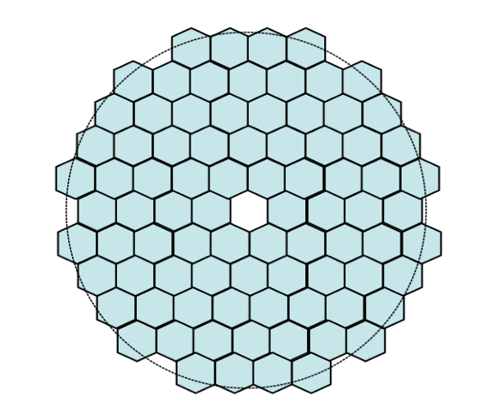
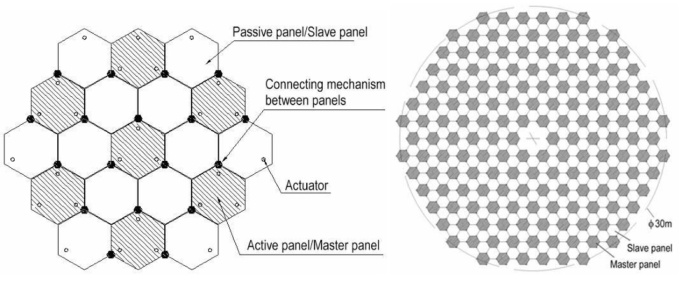
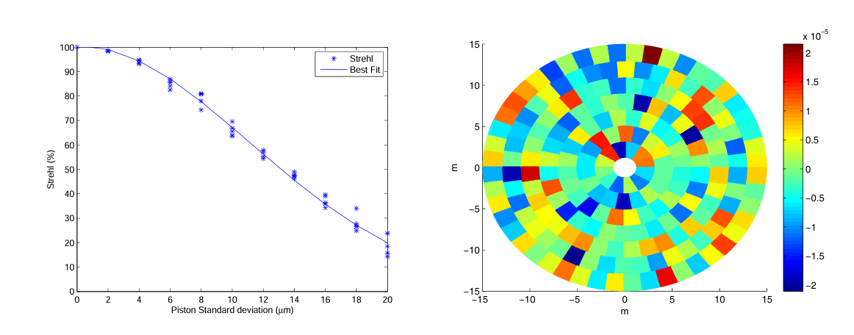
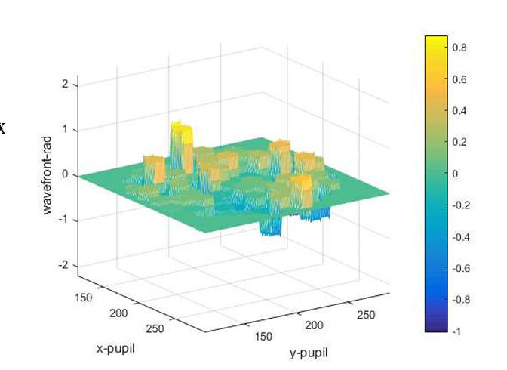
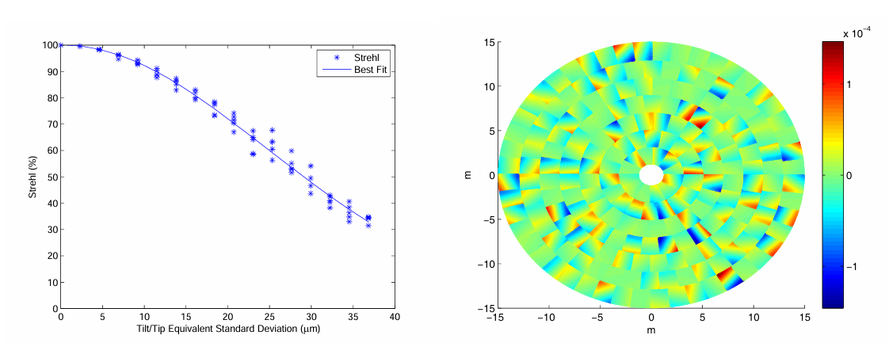
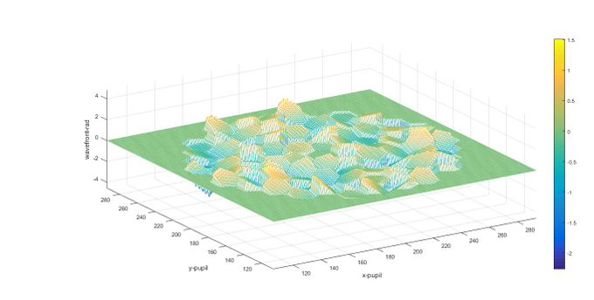
2 Error Analysis
Current State of Research
9
12-meter Large aperture Optical/infrared Telescope（LOT）
30-m THz radio telescope
co-phasing errors to Strehl ratio
Ruze’s coefficient associated to the mean value of rms surface error
(1) Shi-Dong Shen et al 2021 Res. Astron. Astrophys. 21 245
(2) De-Hua Yang et al 2011 Res. Astron. Astrophys. 11 725
Notes:
For any large segmented-mirror telescope, error analysis and numerical simulation constitute essential prerequisites for error budgeting, feasibility assessment, and telescope construction. The Nanjing Institute of Astronomical Optics and Technology (NIAOT), Chinese Academy of Sciences, investigated the relationship between co-phasing errors of hexagonal segments and the Strehl ratio for the 12-meter Large Optical Telescope (LOT), and derived error requirements for achieving the diffraction-limited co-phasing condition. In the design of a 30-meter terahertz telescope, the relationship between the Ruze efficiency factor and various sub-aperture errors was emphasized, and the differential impact of sector-shaped panel assembly errors was demonstrated.
对于任意一架大型拼接镜面望远镜而言，误差分析和模拟仿真是误差分配、可行性评估和望远镜建设的前提必要条件。中国科学院南京天文光学技术研究所分析了12米大口径光学红外望远镜LOT六边形子镜拼接面共相误差与斯特列尔比的关系，提出了系统达到共相衍射极限要求时的各误差要求。同时在30m太赫兹望远镜的设计中， Ruze系数和各子孔径误差的关系是分析的重点，最终展示了扇形子面板拼接误差的不同影响。

Slide 10
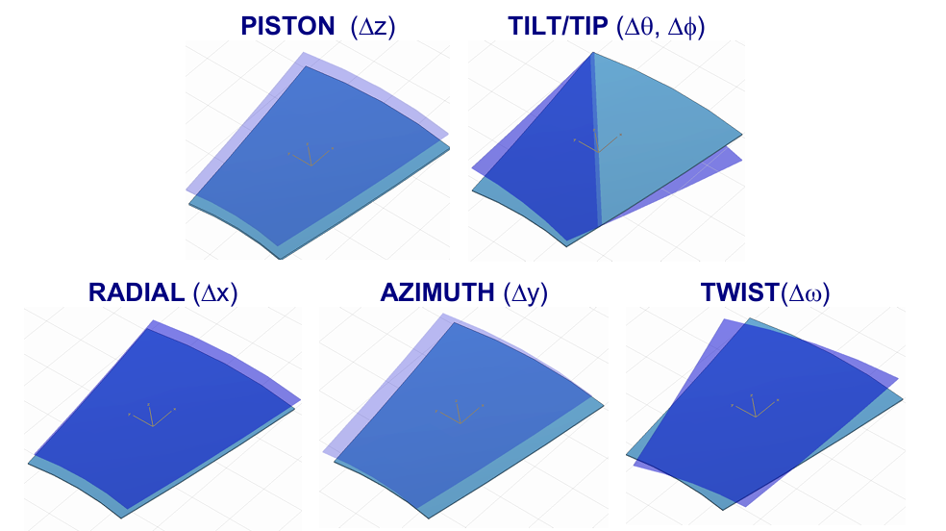
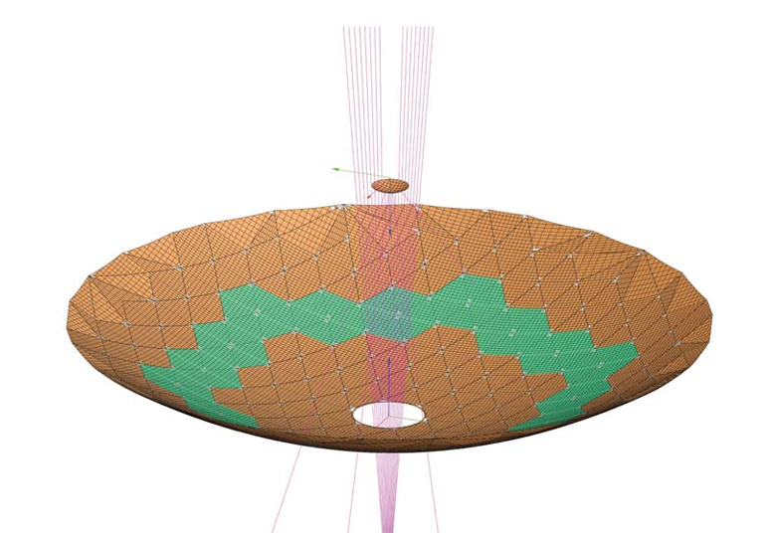
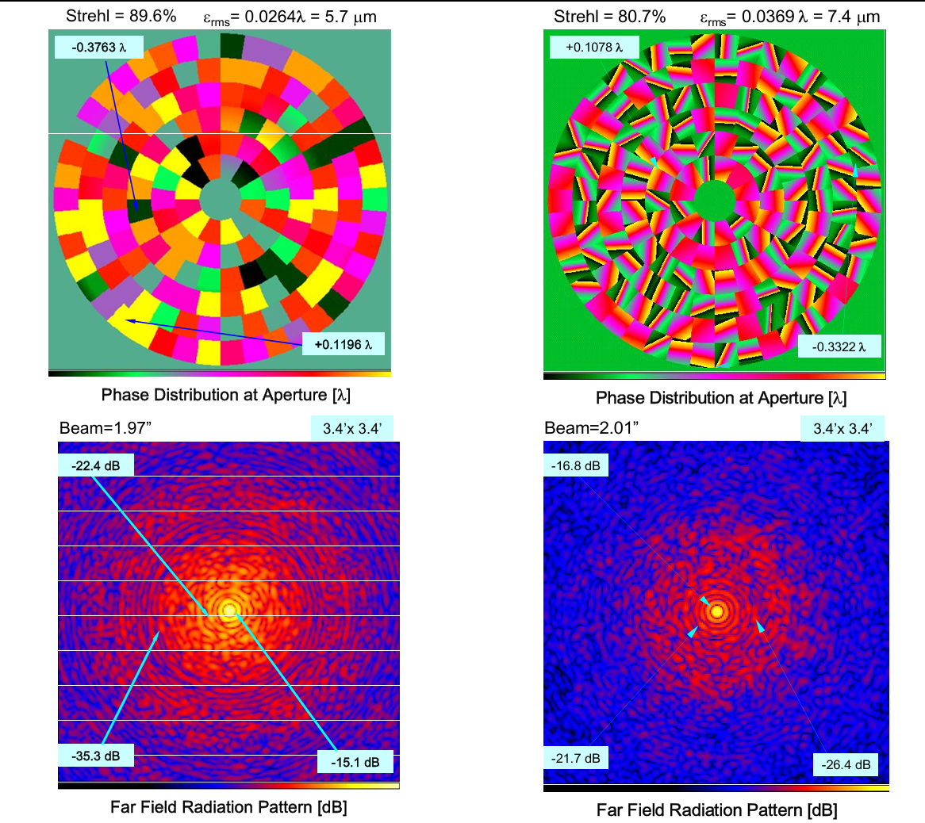
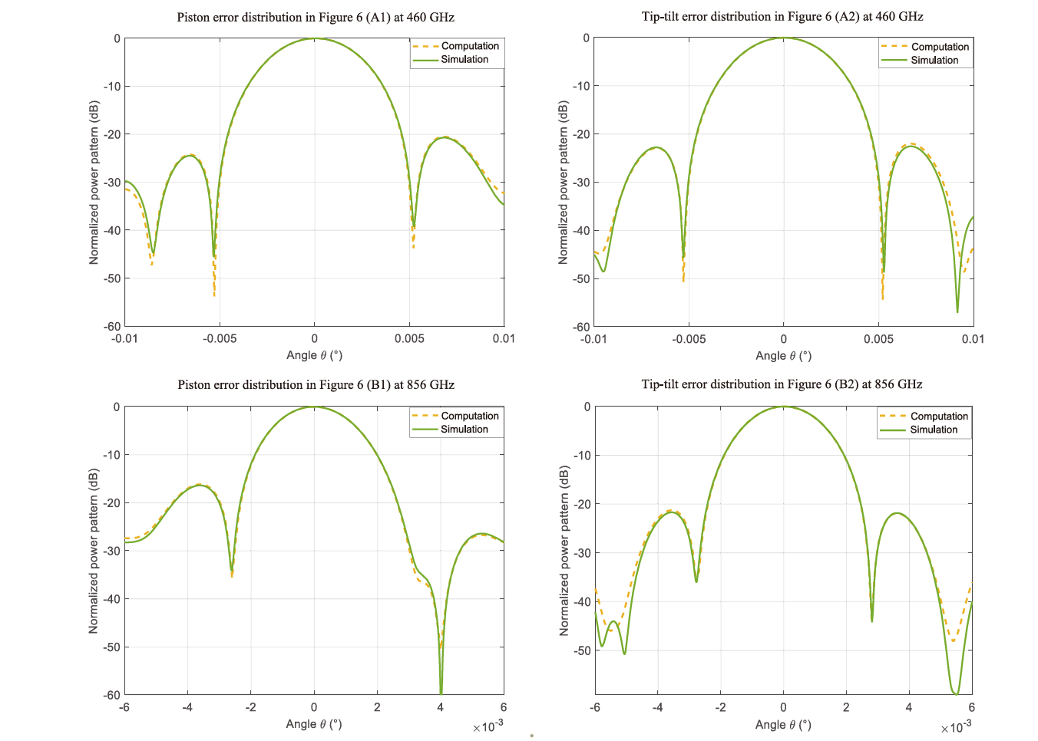
2 Error Analysis
The Sub-Aperture Error
10
Cornell Caltech Atacama Sub-millimeter Telescope (CCAT)
Leighton Chajnantor Telescope (LCT) relocation and reassembling
far field radiation pattern (Uniform illumination at 200 µm).
radiation patterns for different frequencies and panel error distributions
(1) Cortés-Medellín, Germán. "Active surface segmentation analysis of CCAT."
Ground-based and Airborne Telescopes. Vol. 6267. SPIE, 2006.
(2) Jia You et al 2024 PASP 136 064502
Notes:
In the Cornell Caltech Atacama Submillimeter Telescope (CCAT) analysis conducted at the Arecibo Observatory, sub-aperture errors were directly related to telescope efficiency, and their influence on the far-field radiation pattern was investigated. Southeast University analyzed the radiation patterns of the Leighton Telescope (LCT) after relocation and reinstallation, considering different panel assembly errors of the primary mirror across multiple operating frequency bands. Overall, existing studies in the submillimeter regime have focused predominantly on radiation pattern analysis for hexagonal segmented apertures, while quantitative investigations of the relationship between sub-aperture assembly errors and imaging Strehl ratio remain relatively limited. Consequently, the relative sensitivity of different assembly error terms is not yet intuitive.
美国阿雷西博天文台在Cornell Caltech Atacama Sub-millimeter Telescope (CCAT)分析中将子孔径误差和望远镜效率建立联系，分析了望远镜远场辐射方向图。东南大学在莱顿望远镜LCT的移址复位工作中，分析了复位后主镜不同面板拼接误差，不同工作频率段下望远镜的辐射方向图。总体来看，在亚毫米波段，关于六边形面板子孔径仿真较多地分析了其辐射方向图，对于六边形子孔径拼接误差和望远镜成像斯特列尔比之间的分析仍相对不足，各拼接误差的敏感程度并不直观。

Slide 11
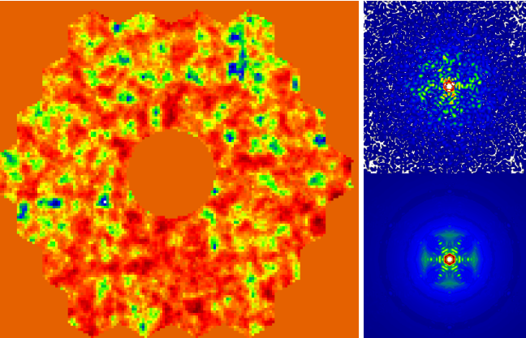
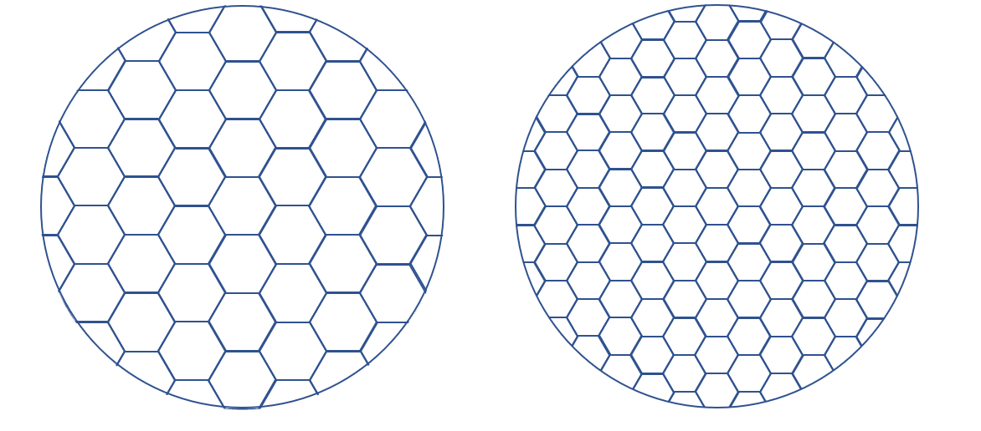
2 Error Analysis
Simulation Methods based on PAOLA software
11
We developed a Monte Carlo simulation framework to analyse sub-aperture errors that follow Gaussian statistics and to derive the corresponding sensitivity coefficients for different error types.
Panel Error Distributions
Simulation Software
VS
Error analysis：
A. Manufacturing errors & Aalignment errors
B. Different panel sizes
PAOLA IDL TOOLBOX
A simulation method based on physical optics and the physical theory of diffraction
Notes:
Building upon these previous works, we adopt a simulation approach based on physical optics and diffraction theory to establish sensitivity models for different types of sub-aperture error terms. The PAOLA software package, developed in IDL, is adapted for modeling, and a Monte Carlo simulation program is implemented to analyze sub-aperture errors following Gaussian distributions. Four types of errors—manufacturing error, decenter error, piston error, and tip–tilt error—are randomly sampled according to Gaussian statistics to evaluate the corresponding error tolerances. In addition, the influence of panel size on surface accuracy is analyzed, providing guidance for sub-aperture segmentation strategies.
我们使用了一种基于物理光学和衍射物理理论的模拟方法，提出了不同类型子孔径误差项的敏感度模型。PAOLA被改编用来建模，它是一个基于IDL的软件包，在此基础上，我们编写了一段蒙特卡洛程序来对遵循高斯分布的子孔径误差进行仿真分析。我们将子孔径Manufacturing、偏心、Piston、Tip–Tilt误差四种误差按高斯分布随机取样，模拟得到不同误差容忍度。同时分析了不同面板尺寸下面板精度，提供子孔径分块尺寸策略。

Slide 12
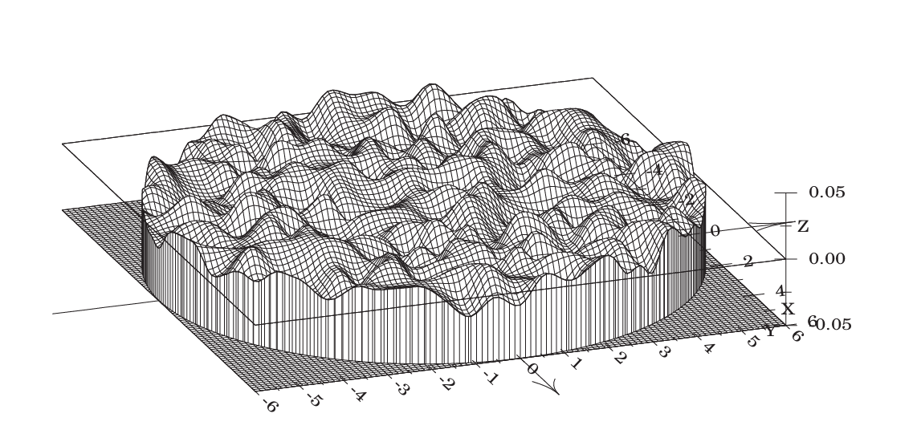
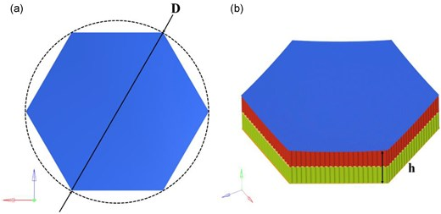



2 Error Analysis
For a segmented primary mirror composed of hexagonal sub-apertures
12
$$S=e^{−{\left(\frac{4πε_{RMS}}{λ}\right)}^{2}}$$
where
$$ε_{RMS}=γ_{i}σ_{RMS}$$
the Strehl ratio vs. the RMS surface error
$$S=\frac{1}{N}+\frac{\left(N−1\right)}{N}exp\left(−{\left(4π\frac{σ_{piston}}{λ}\right)}^{2}\right)$$
𝑁 is the total number of sub-apertures
SR vs. piston error
𝛾_{𝑖} is the sensitivity coefficient that quantifies the contribution of different sub-aperture errors
$$S=1−{\left(κ×4π\frac{σ_{Tip−Tilt}}{λ}\right)}^{2}+\frac{1}{4}\left(1+κ\right){\left(κ×4π\frac{σ_{Tip−Tilt}}{λ}\right)}^{4}$$
SR vs. tilt error
$$S=e^{−{\left(\frac{4π}{λ}\right)}^{2}}×\left[{\left(γ_{MF}σ_{MF}\right)}^{2}+{\left(γ_{Piston}σ_{Piston}\right)}^{2}+{\left(γ_{Tip−Tilt}σ_{Tip−Tilt}\right)}^{2}+{\left(γ_{Decenter}σ_{Decenter}\right)}^{2}+⋯\right]$$
Impact of Manufacturing Error on the Strehl Ratio
Impact of Misalignment Error on the Strehl Ratio
Impact of Different Panel Sizes on the Strehl Ratio
Notes:
The Strehl ratio is one of the standard metrics for evaluating the imaging quality of optical systems and has been increasingly adopted in the conceptual design of next-generation submillimeter telescopes. A Strehl ratio greater than 0.8 is generally regarded as the diffraction-limited criterion, and this threshold is adopted as the evaluation standard in this study. The sub-aperture accuracy of submillimeter telescopes is analyzed from three aspects:(A) the effect of manufacturing errors on the Strehl ratio;(B) the effect of assembly errors on the Strehl ratio;(C) the effect of panel size on the Strehl ratio.
斯特列尔比作为评估光学系统成像质量的标准之一，在新一代的亚毫米波望远镜设计概念中应用的越来越广。斯特列尔比大于0.8一般被认为衍射极限，我们将斯特列尔比大于0.8作为评估标准。从以下三个部分对亚毫米波望远镜子孔径精度进行仿真分析：A.制造误差对斯特列尔比的影响；B.拼接误差对斯特列尔比的影响；C.不同面板尺寸对斯特列尔比的影响。

Slide 13
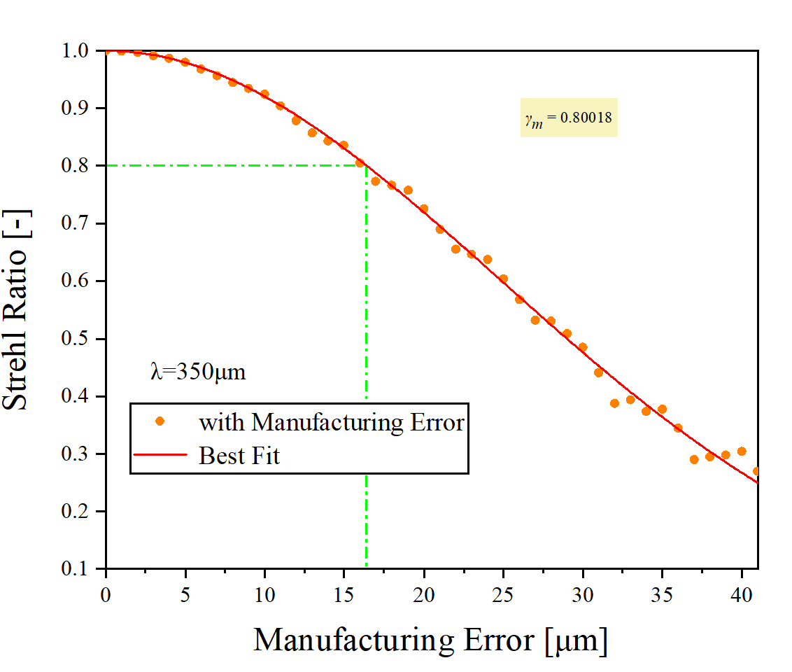
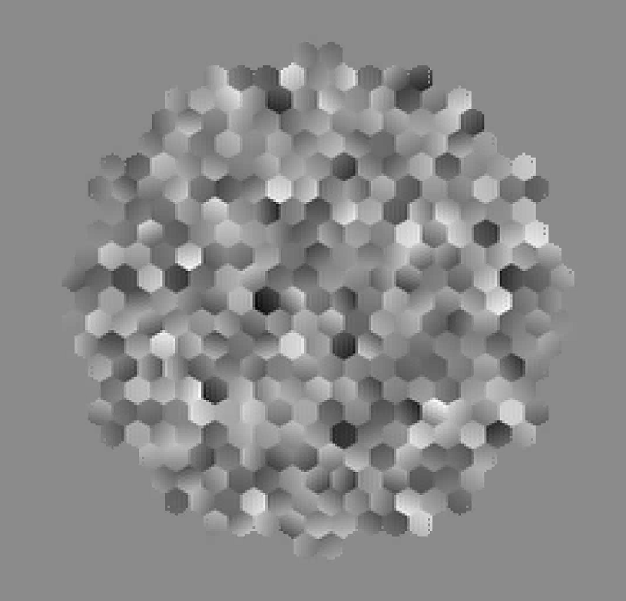
2 Error Analysis
We set Strehl ratio (SR)＞0.8 as the evaluation standard
13
Impact of Manufacturing Error
When considering the influence of manufacturing surface errors alone, the manufacturing error in the primary mirror model is represented using Zernike polynomials
Fig 1. at a wavelength of 350µm Strehl ratio of the primary mirror with Manufacturing error standard deviation.
Manufacturing Error sensitivity = 0.80018
When the RMS value of the Manufacturing error is less than 16 μm,
the Strehl ratio of the primary mirror remains above 0.8
Notes:
When considering the influence of manufacturing surface errors alone, the manufacturing error in the primary mirror model is represented using Zernike polynomials. Low-spatial-frequency manufacturing errors are modeled using second- to fourth-order aberrations according to the Noll index definition, corresponding to Zernike terms 4 through 15. Zernike aberrations are assigned to each sub-aperture following a Gaussian distribution, with the root-sum-square of all higher-order aberrations equal to the specified RMS value. The figure illustrates the variation of the Strehl ratio as a function of the standard deviation of manufacturing errors. A fitted sensitivity coefficient of 0.80018 is obtained from the simulation results. The results indicate that when the manufacturing error RMS is less than 16 μm, the primary mirror Strehl ratio remains above 0.8.
当子孔径制造面型误差单独影响时，主镜模型中制造误差通过Zernike多项式表示，取Noll定义的二至四阶像差作为低频制造误差源，即Zernike多项式第4至15项。各子孔径误差以高斯分布分配泽尼克像差，且各高阶像差的方和根等于设置RMS值。图中展示了斯特列尔比随制造误差的标准差的变化关系，仿真结果拟合得到制造误差的敏感系数为0.80018。结果为当制造误差RMS值小于16μm时，主镜斯特列尔比大于0.8。

Slide 14
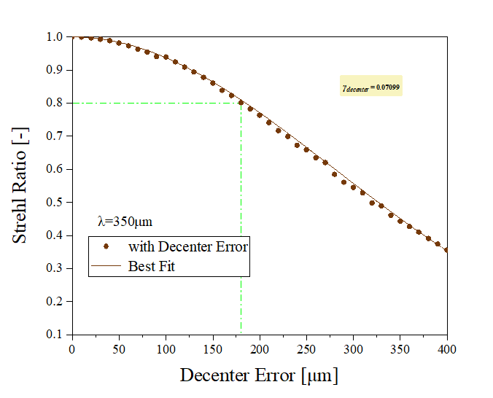
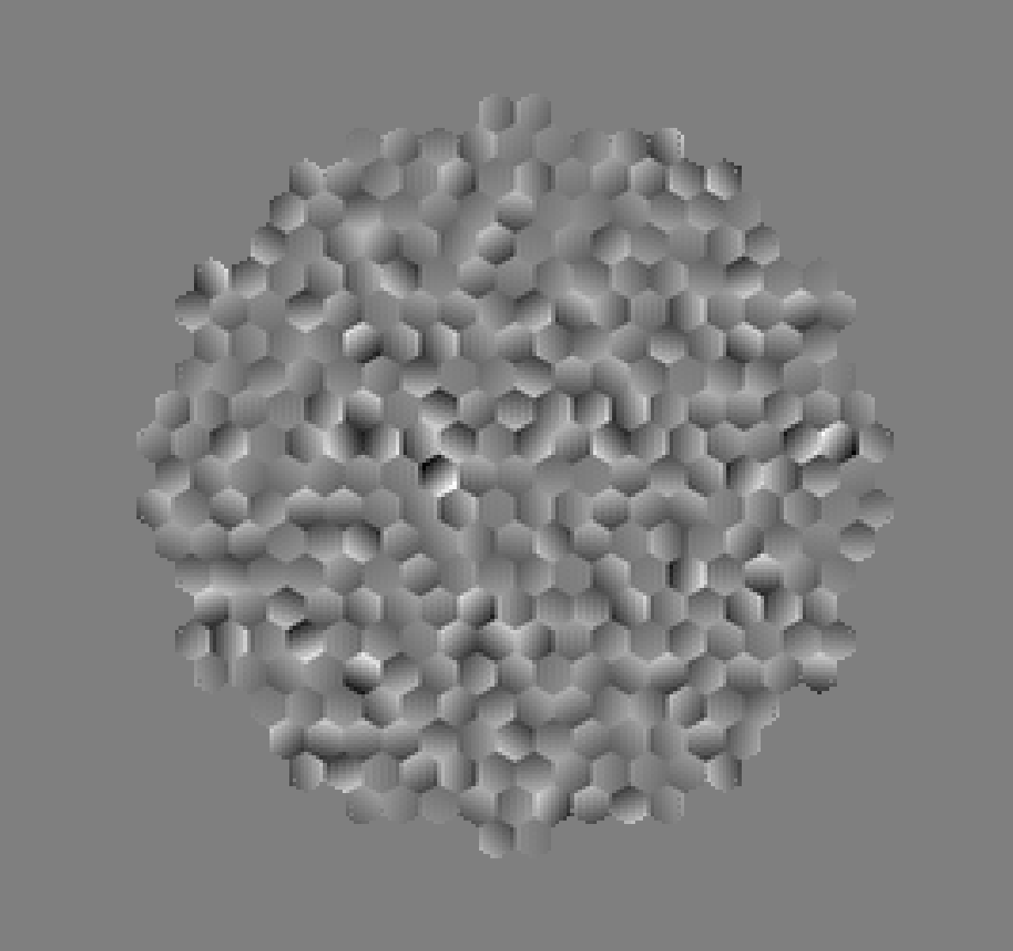
2 Error Analysis
Impact of Decenter Error
14
The decenter error refers to the in-plane displacement of a sub-aperture relative to its nominal center.
Fig 2. at a wavelength of 350µm Strehl ratio of the primary mirror with Decenter error standard deviation.
Decenter Error sensitivity = 0.07099
When the RMS value of the Decenter error is less than 180 µm—approximately half
of the operating wavelength—the Strehl ratio of the primary mirror remains above 0.8.
Notes:
The decenter error refers to the in-plane displacement of a sub-aperture relative to its nominal center. The standard deviation of the decenter error is varied from 0 to 400 μm with a step size of 10 μm. At larger error scales, an approximate fitted sensitivity coefficient of 0.07099 is obtained. When the decenter error standard deviation is less than 180 μm, which is approximately half of the operating wavelength, the primary mirror Strehl ratio remains greater than 0.8.
Decenter误差指子孔径沿子孔径镜面面内的偏离子孔径中心的移动。取Decenter误差标准差从0至400µm，间隔10µm。在较大的误差尺度下，得到近似拟合项系数为0.07099。当Decenter误差标准差小于180微米时，约等于工作波长的一半，主镜斯特列尔比大于0.8。

Slide 15
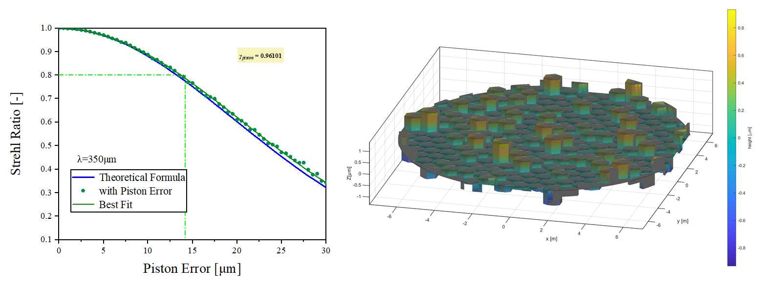
2 Error Analysis
Impact of Piston Error
15
Piston error is one of the most critical error terms in segmented mirror assembly
Fig 3. at a wavelength of 350µm Strehl ratio of the primary mirror with Piston error standard deviation.
Piston Error sensitivity = 0.96101
When the RMS value of the Piston error is less than 13 μm,
the Strehl ratio of the primary mirror remains above 0.8
Notes:
Piston error is one of the most critical error terms in segmented mirror assembly and manifests as displacement along the surface normal direction of the sub-apertures. The theoretical relationship between piston error and Strehl ratio for hexagonal segment assembly is presented. Simulations are conducted over a piston error range of 0–30 μm to evaluate its impact on the primary mirror Strehl ratio. The resulting sensitivity coefficient for piston error is 0.96101. The results show that when the piston error RMS is less than 13 μm, the Strehl ratio of the primary mirror exceeds 0.8.
活塞误差是在子孔径拼接成整镜过程中最重要的误差之一，表现在子孔径法线方向上的偏移。图中列出六边形子孔径拼接过程中，活塞误差和斯特列尔比的理论关系曲线。同时我们仿真了0-30μm的范围内，活塞误差对主镜斯特列尔比的影响，结果表明当Piston误差RMS值小于13μm时，主镜斯特列尔比大于0.8。

Slide 16
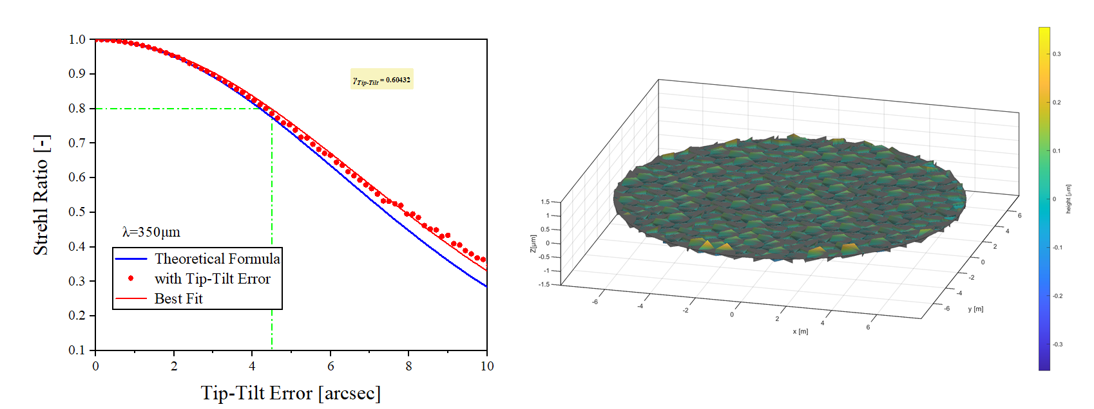
2 Error Analysis
Impact of Tip-Tilt Error
16
Tip–tilt error represents the angular deviation of a panel relative to the ideal parabolic surface and includes tilt components along both the x and y directions.
Fig 4. at a wavelength of 350µm Strehl ratio of the primary mirror with Tip-Tilt error standard deviation.
Tip-Tilt Error sensitivity = 0.60432
When the RMS value of the Tip–Tilt error is less than 4.35 arcsec,
the Strehl ratio of the primary mirror remains above 0.8.
Notes:
Finally, the effect of tip–tilt error is analyzed. Tip–tilt error represents the angular deviation of a panel relative to the ideal parabolic surface and includes tilt components along both the x and y directions. After normalization of the tilt angles, a sensitivity coefficient of 0.60432 is obtained. When the tip–tilt error RMS is less than 4.35 arcseconds, the primary mirror Strehl ratio remains above 0.8. As shown in the figure, when the error magnitude becomes large, theoretical formulas may overestimate the influence of tip–tilt errors on the Strehl ratio.
最后是倾斜误差的影响，它表现为面板相对于理想抛物面的倾斜角度，包括各个子孔径在x，y两方向的倾斜量。对倾斜误差角度量进行归一化后，得到倾斜误差敏感系数为0.60432。当Tip-Tilt误差RMS值小于4.35 arcsec时，主镜斯特列尔比大于0.8。从图中可以看到当误差较大时，理论公式可能夸大倾斜塞误差对斯特列尔比的影响。

Slide 17
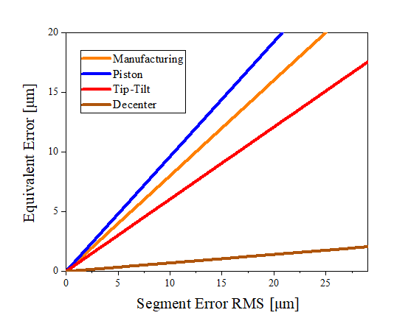
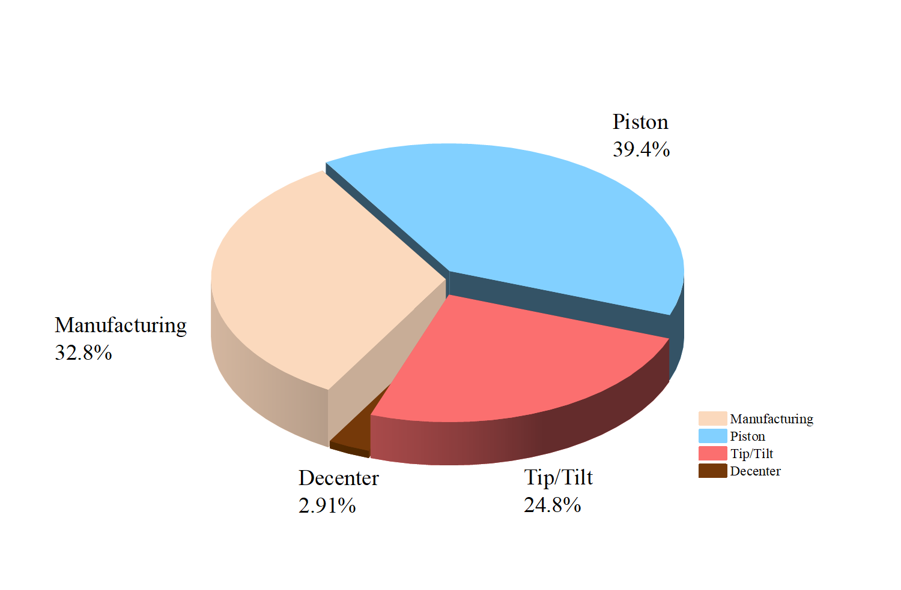
2 Error Analysis
Impact of the different sub-aperture errors
17
The Sub-Aperture Errors | Error to SR sensitivity | Proportion%
Manufacturing | 0.80018 | 32.84%
Piston | 0.96101 | 39.44%
Tip-Tilt | 0.60432 | 24.81%
Decenter | 0.07099 | 2.91%
Fig 5. Equivalent primary mirror surface errors induced by different hexagonal sub-aperture errors.
A comparison of different hexagonal sub-aperture errors corresponding sensitivity coefficients
Notes:
A comparative analysis of the sensitivity of different error terms for hexagonal sub-apertures is conducted based on the above simulations. Among all error sources, piston error has the most significant impact on primary mirror accuracy. Manufacturing error is also critical and has a greater influence than tip–tilt error, while decenter error has a substantially smaller effect on overall surface accuracy. Its sensitivity coefficient is approximately one order of magnitude lower than those of the other three error types.
综合以上仿真对六边形子孔径的不同误差影响敏感度进行对比。其中，活塞误差对主镜精度影响最大，其次，制造误差的影响也比较关键，大于倾斜Tip-Tilt误差的影响而偏心误差对整体面形精度的影响显然小于其他三种误差，敏感系数比另外三种误差少一个量级。

Slide 18
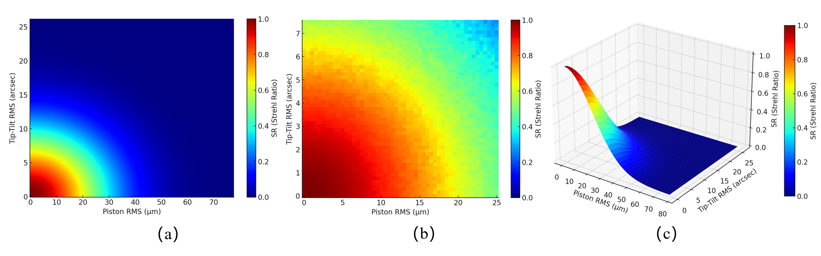
2 Error Analysis
Impact of the different sub-aperture errors
18
Combined Effects of Multiple Error Sources on the Strehl Ratio
(a) Two-dimensional(2D) distribution of the Strehl ratio as a function of Piston RMS (µm) and Tip–Tilt RMS (arcsec). (b) 2D map of the multiplicative Strehl ratio under independent piston and tip–tilt errors. (c) Three-dimensional(3D) surface of the Strehl ratio as a function of Piston RMS (µm) and Tip–Tilt RMS (arcsec).
Notes:
A comparative analysis of the sensitivity of different error terms for hexagonal sub-apertures is conducted based on the above simulations. Among all error sources, piston error has the most significant impact on primary mirror accuracy. Manufacturing error is also critical and has a greater influence than tip–tilt error, while decenter error has a substantially smaller effect on overall surface accuracy. Its sensitivity coefficient is approximately one order of magnitude lower than those of the other three error types.
综合以上仿真对六边形子孔径的不同误差影响敏感度进行对比。其中，活塞误差对主镜精度影响最大，其次，制造误差的影响也比较关键，大于倾斜Tip-Tilt误差的影响而偏心误差对整体面形精度的影响显然小于其他三种误差，敏感系数比另外三种误差少一个量级。

Slide 19

2 Error Analysis
Impact of Panel with Different Sizes
19
Panel Size (diagonal, m) | Number of panels | Error to SR sensitivity
2.5 | 55 | 0.84743
2 | 85 | 0.824
1.6 | 121 | 0.82221
1.4 | 163 | 0.80805
1.2 | 211 | 0.80845
1.1 | 265 | 0.8085
1 | 325 | 0.80565
0.9 | 391 | 0.80864
0.8 | 463 | 0.81869
Variation of the Strehl-ratio sensitivity coefficient with sub-aperture size for the primary mirror under the influence of manufacturing errors
When fabricating hexagonal sub-aperture panels, an optimal diagonal size range
is between 0.9 m and 1.4 m
Notes:
By varying panel size, primary mirror models with different numbers of sub-apertures are constructed. Nine primary mirror configurations are generated with sub-aperture sizes ranging from 0.8 m to 2.5 m, corresponding to segment counts from 463 to 55. The table summarizes the Strehl ratio sensitivity coefficients obtained from simulations for different panel sizes. The figure illustrates the variation of the manufacturing-error-induced Strehl ratio sensitivity coefficient as a function of sub-aperture size. When the diagonal size of hexagonal sub-apertures lies between 1.0 m and 1.5 m, the sensitivity of the Strehl ratio to manufacturing errors is minimized, indicating that this panel size range is preferable for panel fabrication.
通过改变面板尺寸建立不同子孔径数量的主镜模型，我们具体创建了子孔径从0.8m-2.5m变化的共9种主镜模型，其对应子孔径块数从55块至463块。表中展示了对不同尺寸子孔径主镜的分别仿真后得到的SR敏感程度系数结果。图中展示了不同尺寸子孔径的主镜在Manufacturing误差影响下SR敏感系数变化曲线。当六边形子孔径对角线尺寸在1m至1.5m时，制造误差对主镜斯特列尔比的敏感系数较小，因此制作面板时选择这一面板尺寸区间较优。

Slide 20
20
01 Submillimeter Wave Telescopes Overview
02 Sub-Aperture Accuracy and Errors Analysis
03 Sub-Aperture Design and Manufacturing
04 Conclusion and Outlook

Slide 21




3 Manufacturing
Panel Structure Design Approach
21
Design Objectives
Meet the stringent requirements for reflector surface precision in the submillimeter wave band
Achieve high rigidity and low deformation in large-aperture (15 m) structures
Balance lightweight design, manufacturability, and maintainability
Parameters | aluminum alloy | Aluminum-coated carbon fiber
density | Medium (2.7 g/cm³) | Low (1.6 g/cm³)
Coefficient of Thermal Expansion | 23.6×10⁻⁶/℃ | Carbon fiber: -0.5×10⁻⁶/°CAluminum layer: 23.6×10⁻⁶/°C
Low-temperature deformation | Maximum 279.17 μm | Maximum 1099.6 μm
Processability | High ductility (δ=43%) facilitates precision forming | Complex manufacturing process Requires addressing interlayer adhesion issues
Structural configuration:
Honeycomb sandwich panel + Multiple panels joined together
Material Selection:
Aluminum Alloy (High Specific Stiffness, Excellent Thermal Stability, Mature Processing Techniques)
Notes:
First, in terms of design objectives, it must simultaneously meet the stringent surface precision requirements of the submillimeter wave band and the demands for stiffness and deformation control under a 15-meter aperture structure, while also balancing lightweight construction and manufacturability.
Structurally, a honeycomb sandwich panel configuration was adopted, with multiple panels assembled to form the overall reflecting surface. This design effectively reduces weight while maintaining rigidity, making it particularly suitable for large-aperture systems. Aluminum alloy was primarily selected for its high specific stiffness, excellent thermal stability, and mature manufacturing processes.
A comparative analysis was conducted between aluminum alloy and aluminum-coated carbon fiber options. While carbon fiber offers lower density, it exhibits greater thermal deformation at low temperatures and involves complex manufacturing processes. After comprehensive evaluation of structural performance and engineering feasibility, the aluminum alloy honeycomb sandwich panel solution was ultimately selected.
这一页主要介绍的是反射面板的结构设计思路。首先从设计目标上来说，需要同时满足亚毫米波波段对表面精度的严格要求，以及 15 米口径结构下对刚度和变形控制的要求，同时还要兼顾轻量化和可制造性。
在结构形式上，这里采用了蜂窝夹层面板，并通过多块面板拼接来构成整体反射面。这种结构在保证刚度的同时可以有效减轻重量，也更适合大口径系统的实现。在材料选择方面，主要采用铝合金材料，因为其比刚度高、热稳定性好，而且加工工艺成熟。
同时也对比分析了铝合金和铝涂层碳纤维两种方案。虽然碳纤维密度更低，但在低温条件下的热变形较大，而且制造工艺复杂。综合考虑结构性能和工程可行性，最终选用了铝合金蜂窝夹层面板方案

Slide 22



3 Manufacturing
Panel Mechanical Properties Evaluation
22
The panel RMS results are all less than 10 μm.
Panel unit (D/t = 7:1) achieves optimal surface accuracy, ensuring excellent optical performance at various tilt angles.
Thermal coupling analysis : RMS= 8.92 μm
The elevation angle stiffness model is defined as: A = A₁ cos θ + A₂ sin θ
我国对于大口径亚毫米波望远镜的建设需求非常迫切，发展大型亚毫米波射电望远镜关键技术是国家重大需求，不仅具有重要的天文科学意义，也具有重大的国家战略意义。
The optimal diameter-to-thickness ratio of the panel was determined through thermal coupling analysis.
Notes:
Analysis of various panel sizes and D/t ratios under multiple elevation angles reveals that the RMS of all panels remains below 10 micrometers under all operating conditions, meeting the precision requirements for single-panel components in submillimeter-wave telescopes.
Further comparison reveals that a D/t ratio of 7:1 yields optimal surface accuracy across different tilt angles while providing the best overall stability. This parameter thus achieves a favorable balance between stiffness and weight reduction. Additionally, thermal-mechanical coupling analysis indicates an RMS of approximately 8.92 micrometers under thermal loading, demonstrating the structure's excellent stability under thermal environmental variations.这一页主要给出了反射面板的力学性能评估结果。通过对不同面板尺寸和不同 D/t 比在多种仰角条件下的分析可以看到，所有工况下面板的 RMS 都小于 10 微米，满足亚毫米波望远镜对单块面板精度的要求。
进一步对比发现，当 D/t 比取 7:1 时，面板在不同倾角下的表面精度表现最优，而且整体稳定性也最好。因此该参数在刚度和轻量化之间达到了一个较好的平衡。此外，还进行了热-力耦合分析，在热载荷作用下面板 RMS 约为 8.92 微米，说明该结构在热环境变化下同样具有良好的稳定性。

Slide 23

















3 Manufacturing
Simulation of hexagonal and sector panels
23
Adjusting edge panels is challenging, significantly affecting primary reflector precision.
A comparison of hexagonal and sector panels' structural performance under gravity conditions is needed.
我国对于大口径亚毫米波望远镜的建设需求非常迫切，发展大型亚毫米波射电望远镜关键技术是国家重大需求，不仅具有重要的天文科学意义，也具有重大的国家战略意义。
Hexagonal panels achieve a superior balance between stiffness, deformation control, stress distribution, and dynamic performance.
Notes:
This page primarily analyzes the structural performance of the edge panels on the main reflector surface. Compared to the central region, edge panels exhibit more complex geometries and stress conditions. Their deformation and stress states exert a more significant influence on the overall surface accuracy of the main reflector. Therefore, a comparative analysis of the structural performance under gravitational forces is conducted for two edge panel configurations: hexagonal and sector-shaped.
Simulation results reveal that hexagonal edge panels indeed exhibit a higher tendency for localized stress concentration in geometrically irregular cutout regions, stemming from the irregular edge geometry. However, it is crucial to emphasize that this stress concentration remains a localized effect without propagating across the entire panel. Overall deformation predominantly follows smooth, low-order modes. From an engineering installation perspective, the hexagonal panel exhibits higher overall symmetry. During height and tilt adjustments, it demonstrates more consistent responses across all directions, facilitating easier convergence of the overall surface profile. Although some irregularities exist in the edge regions, the edge panels constitute a relatively small proportion of the entire main reflector surface. Consequently, the impact of these localized stress concentrations on the overall surface profile accuracy is limited.
Considering structural performance, surface accuracy control, and engineering adjustability comprehensively, hexagonal panels still deliver superior overall performance in edge regions. Consequently, they were selected as the final edge panel solution.
这一页主要分析的是主反射面边缘面板的结构性能。相比中间区域，边缘面板在几何形状和受力条件上更加复杂，其变形和应力状态对整体主反射面的面形精度影响更为显著，因此这里对六边形和扇形两种边缘面板形式在重力作用下的结构性能进行了对比分析。
从仿真结果可以看到，六边形边缘面板在几何不规则的切割区域，确实更容易出现局部应力集中的现象，这是由边缘几何不规则性引起的。但需要强调的是，这种应力集中主要是局部效应，并没有在整个面板范围内扩散，整体变形仍以平滑的低阶模态为主。同时，从工程装调的角度来看，六边形面板整体对称性更高，在高度和倾角调节过程中各方向的响应更加一致，更容易实现整体面形的收敛。尽管边缘区域存在一定的不规则性，但边缘面板在整个主反射面中所占比例相对较小，因此这些局部应力集中对整体面形精度的影响是有限的。
综合考虑结构性能、面形精度控制以及工程调节可行性，六边形面板在边缘区域仍然能够实现更优的综合性能，因此被选为最终的边缘面板方案

Slide 24
3 Manufacturing
Overall Production Process Flow
24
Preliminary Design and Process Preparation
Mold Making
Preform processing
Vacuum Negative Pressure Forming
CNC Machining of Molds
Surface Finishing and Polishing of Molds
Dimension and Surface Accuracy Inspection of Molds
Aluminum Alloy Sheet Stretching
Preliminary Surface Preforming
Reduce spring back and stress concentration during formal forming
Material Laying and Positioning
Vacuum Suction Negative Pressure Forming
Face Shape and Size Inspection
Trim and finish
Photogrammetry & Coordinate Measuring Machine Inspection
Surface Curvature Inspection
CNC Trimming and Hole Drilling
Chamfering and Deburring
Edge Dimensional Accuracy Control
我国对于大口径亚毫米波望远镜的建设需求非常迫切，发展大型亚毫米波射电望远镜关键技术是国家重大需求，不仅具有重要的天文科学意义，也具有重大的国家战略意义。

Slide 25



3 Manufacturing
Prototype Manufacturing Results
25
The adjustable mold positioning is achieved using
a hexagonal aluminum alloy groove and a locating pin.
Vacuum negative pressure is applied to ensure stable positioning.
Reflective Panel Sample
Photogrammetry is used for surface shape measurement.
我国对于大口径亚毫米波望远镜的建设需求非常迫切，发展大型亚毫米波射电望远镜关键技术是国家重大需求，不仅具有重要的天文科学意义，也具有重大的国家战略意义。
Notes:
The preceding sections primarily covered the structural design and simulation analysis of the reflective panel. This page presents the actual manufacturing process and measurement results of the prototype. During prototype fabrication, an adjustable mold solution was employed. Precise mold positioning was achieved using hexagonal aluminum alloy slots and locating pins, ensuring consistent panel positioning throughout the forming process. Simultaneously, vacuum negative pressure was introduced during machining to guarantee stable panel-to-mold contact and minimize unpredictable deformation during processing.
This is the final reflective panel prototype. After forming, photogrammetry was employed to measure the surface geometry of the panel.前面主要介绍了反射面板的结构设计和仿真分析，这一页展示的是样件的实际制造过程和测量结果。在样件制造过程中，采用了可调模具方案，通过六边形铝合金槽和定位销实现模具的精确定位，从而保证面板在成形过程中的位置一致性。同时，在加工过程中引入真空负压，以确保面板与模具的稳定贴合，减少加工过程中的不确定变形。
这是最终得到的反射面板样件。成形完成后，采用摄影测量方法对面板表面形状进行测量。（老师 这里摄影测量结果是40微米左右 和最终需要的10微米相比 缺少精度提升 我就没放数值）

Slide 26
26
01 Submillimeter Wave Telescopes Overview
02 Sub-Aperture Accuracy and Errors Analysis
03 Sub-Aperture Design and Manufacturing
04 Conclusion and Outlook

Slide 27
4 Conclusion
27
Error Analysis and Sensitivity
Manufacturing errors (Piston, Tip-Tilt, Decenter) were analyzed, and tolerance requirements for sub-aperture stitching were established. The system’s Strehl ratio stays above 0.8 with Piston errors < 13μm, Tip-Tilt errors < 4.35 arcseconds, and Decenter errors < 180 μm.
2. Sub-Aperture Optimization
The optimal sub-aperture size is 0.9m to 1.4m, with a diameter-to-thickness ratio of 7:1 for best performance.
Manufacturing Method
A lightweight aluminum honeycomb sandwich panel was used, achieving a surface accuracy with RMS error < 10μm through CNC milling and polishing.
The proposed design and manufacturing methods provide a viable solution for the XSMT reflector panels, serving as a reference for future high-precision telescopes.
Notes:
Conclusion
Error Analysis and Sensitivity Model This study quantitatively analyzed the impact of manufacturing errors such as Piston, Tip-Tilt, and Decenter on imaging performance, and established an error sensitivity model with corresponding tolerance requirements for sub-aperture stitching.
When the RMS value of Piston error is less than 13μm, Tip-Tilt error is less than 4.35 arcseconds, and Decenter error is less than 180μm, the Strehl ratio of the system remains above 0.8, ensuring good imaging quality.
Sub-Aperture Size Optimization The study examined the effect of different sub-aperture sizes on the accuracy of the main reflector and determined the optimal diagonal size range for sub-apertures to be 1.0m to 1.5m. It also concluded that the optimal diameter-to-thickness ratio is 7:1.
Reflector Panel Manufacturing Method A composite structure with aluminum honeycomb sandwich panels was proposed for the reflector panel, using CNC milling, vacuum hot pressing, grinding, and polishing techniques.
The surface accuracy was achieved with an RMS surface error of less than 10μm.
Feasibility of the Technical Approach The proposed design and manufacturing methods provide a feasible technical solution for the 15-meter Submillimeter Telescope (XSMT) reflector panel manufacturing, offering valuable reference for the design of higher-precision panels for future telescopes.
误差分析与灵敏度模型本研究定量分析了活塞误差、倾斜误差和偏心误差等制造误差对成像性能的影响，建立了误差灵敏度模型，并给出了子孔径拼接的对应公差要求。
当活塞误差均方根值小于13μm、倾斜误差小于4.35角秒、偏心误差小于180μm时，系统斯特雷尔比值可维持在0.8以上，确保成像质量优良。
子孔径尺寸优化研究分析了不同子孔径尺寸对主反射镜精度的影响，确定子孔径最佳对角尺寸范围为1.0m至1.5m，并得出最佳直径与厚度比值为7:1。反射镜面板制造工艺采用铝蜂窝夹层板复合结构制造反射镜面板，通过数控铣削、真空热压、磨削及抛光工艺实现表面精度。 反射面板采用铝蜂窝夹芯板复合结构，通过数控铣削、真空热压、研磨及抛光工艺制造。表面精度达到均方根表面误差小于10μm。技术方案可行性该设计与制造方法为15米亚毫米波望远镜（XSMT）反射面板制造提供了可行技术方案，为未来更高精度望远镜面板设计具有重要参考价值。

Slide 28
Outlook
28
Optimization of Manufacturing Processes
Future efforts should focus on enhancing manufacturing processes to further improve sub-aperture stitching accuracy and reduce errors that impact imaging performance.
2. Exploring Advanced Techniques
The adoption of advanced methods like additive manufacturing could improve panel precision, reduce production time, and increase overall efficiency.
Supporting Future Telescope Development
Continued advancements in these areas will support the development of even higher-precision submillimeter telescopes, enabling deeper space exploration.

Slide 29
29
Thanks for your attention！

