Slide 1

Gravitationally Lensed View of DSFG-1 in PLCK G165.7+67.0: Strong Dust Emission and Spatially Resolved Stellar Population Analysis with JWST and SMA
7th China - Chile Bilateral Astronomy Conference (CCBC2026)
Zhiyu Yan 严知宇
yanzhiyu24@mails.ucas.ac.cn
NAOC/CASSACA
Collaborators: Daizhong Liu (PMO), Y.Sophia Dai, Yixiao Liu (NAOC/CASSACA), Ke Wang (PKU-KIAA), Fengwei Xu (MPIA)
2026.01.05 HKU

Slide 2
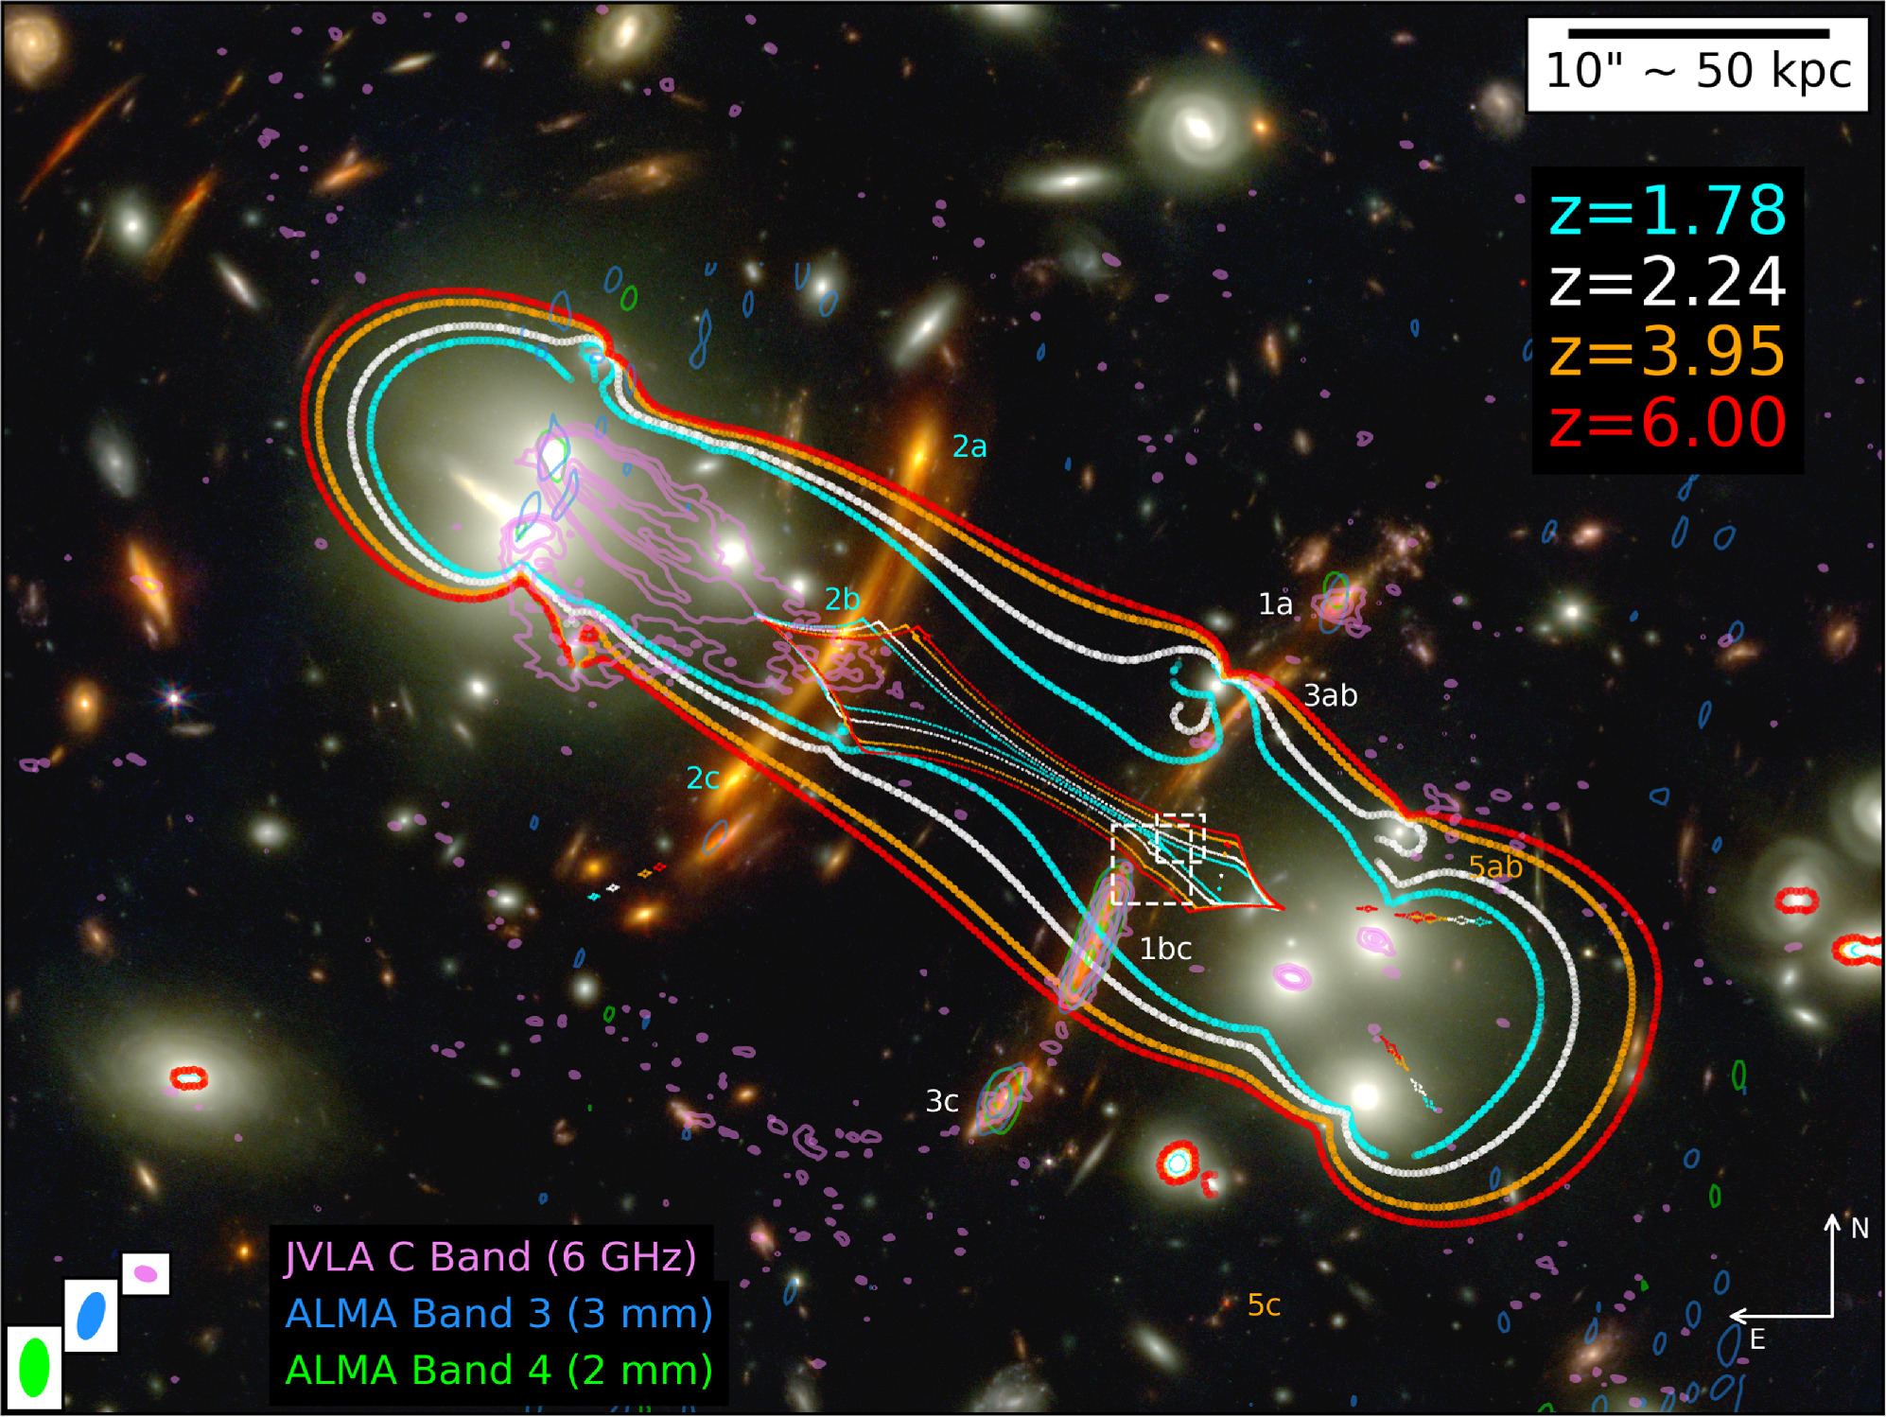
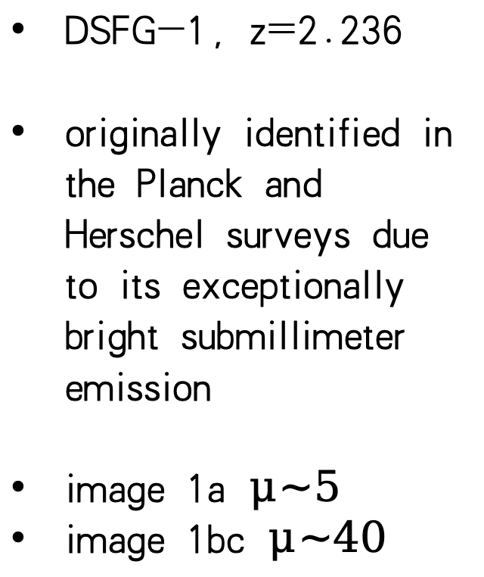
1、Overview of PLCK G165.7+67.0
DSFG-1，z=2.236
originally identified in the Planck and Herschel surveys due to its exceptionally bright submillimeter emission
image 1a $μ\sim 5$
image 1bc $μ\sim 40$
1a
1bc
Patrick et al. (2025)

Slide 3
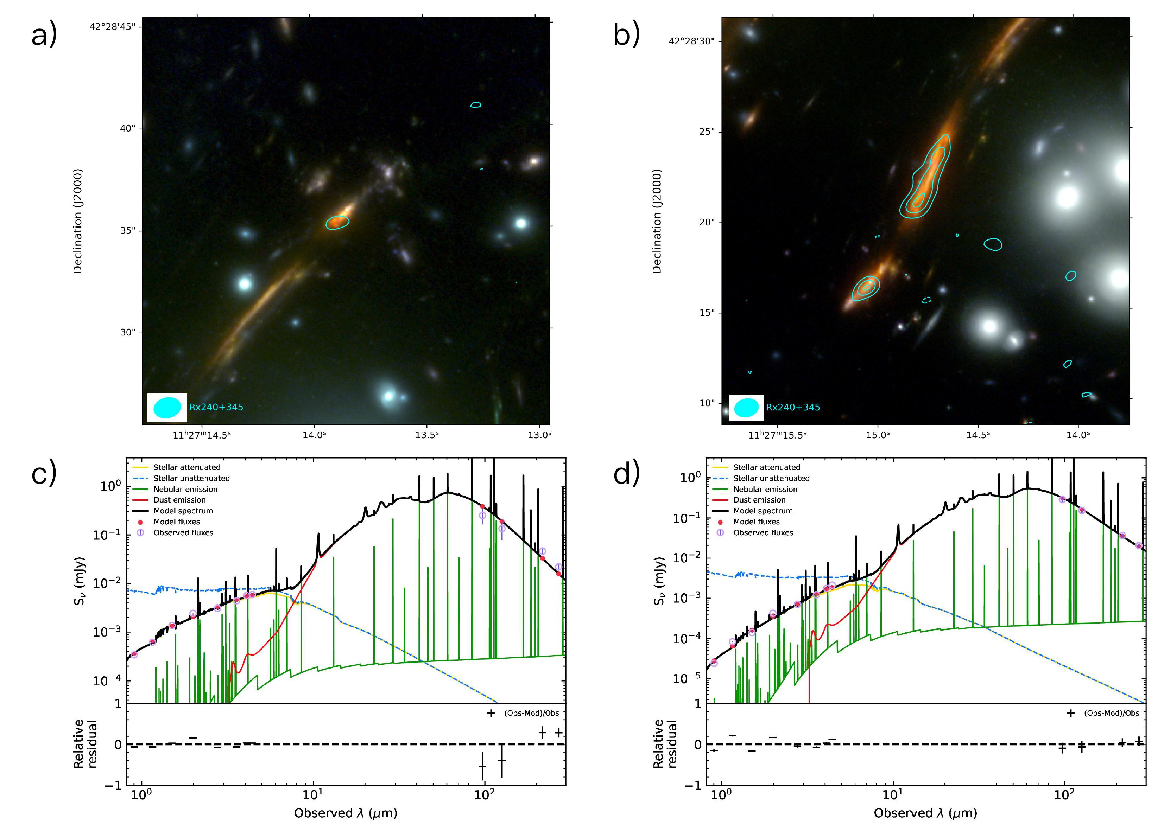
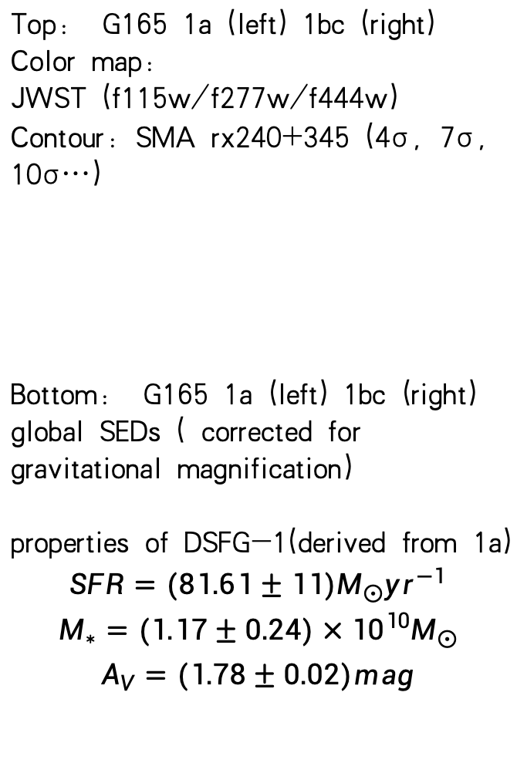
2、Global properties
image 1a
image 1bc
Top: G165 1a (left) 1bc (right)
Color map:
JWST (f115w/f277w/f444w)
Contour: SMA rx240+345 (4σ, 7σ, 10σ…)
Bottom: G165 1a (left) 1bc (right) global SEDs ( corrected for gravitational magnification)
properties of DSFG-1(derived from 1a)
$$SFR=(81.61±11)M_{⨀}{yr}^{−1}$$
$$M_{∗}=(1.17±0.24)×{10}^{10}M_{⨀}$$
$$A_{V}=(1.78±0.02)mag$$

Slide 4
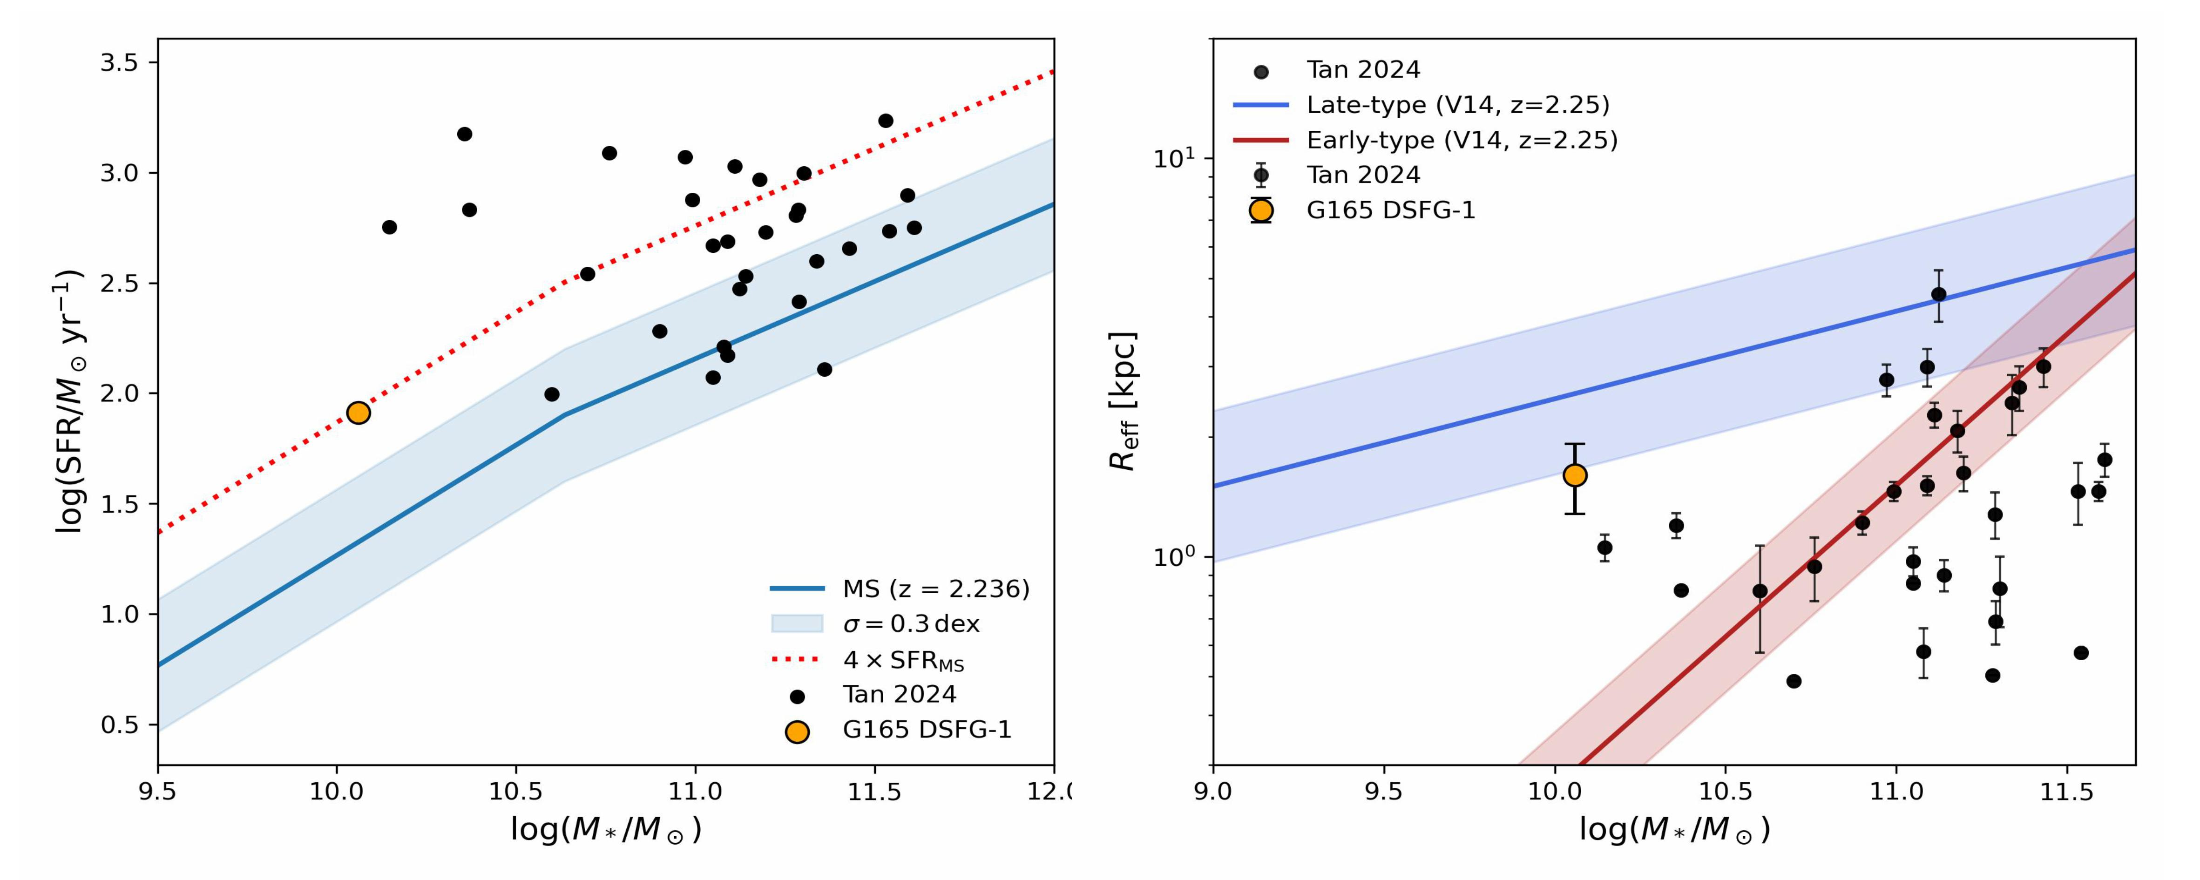
2、Global properties
Pinpointing the Galaxy in the Cosmic Evolution Picture

Slide 5
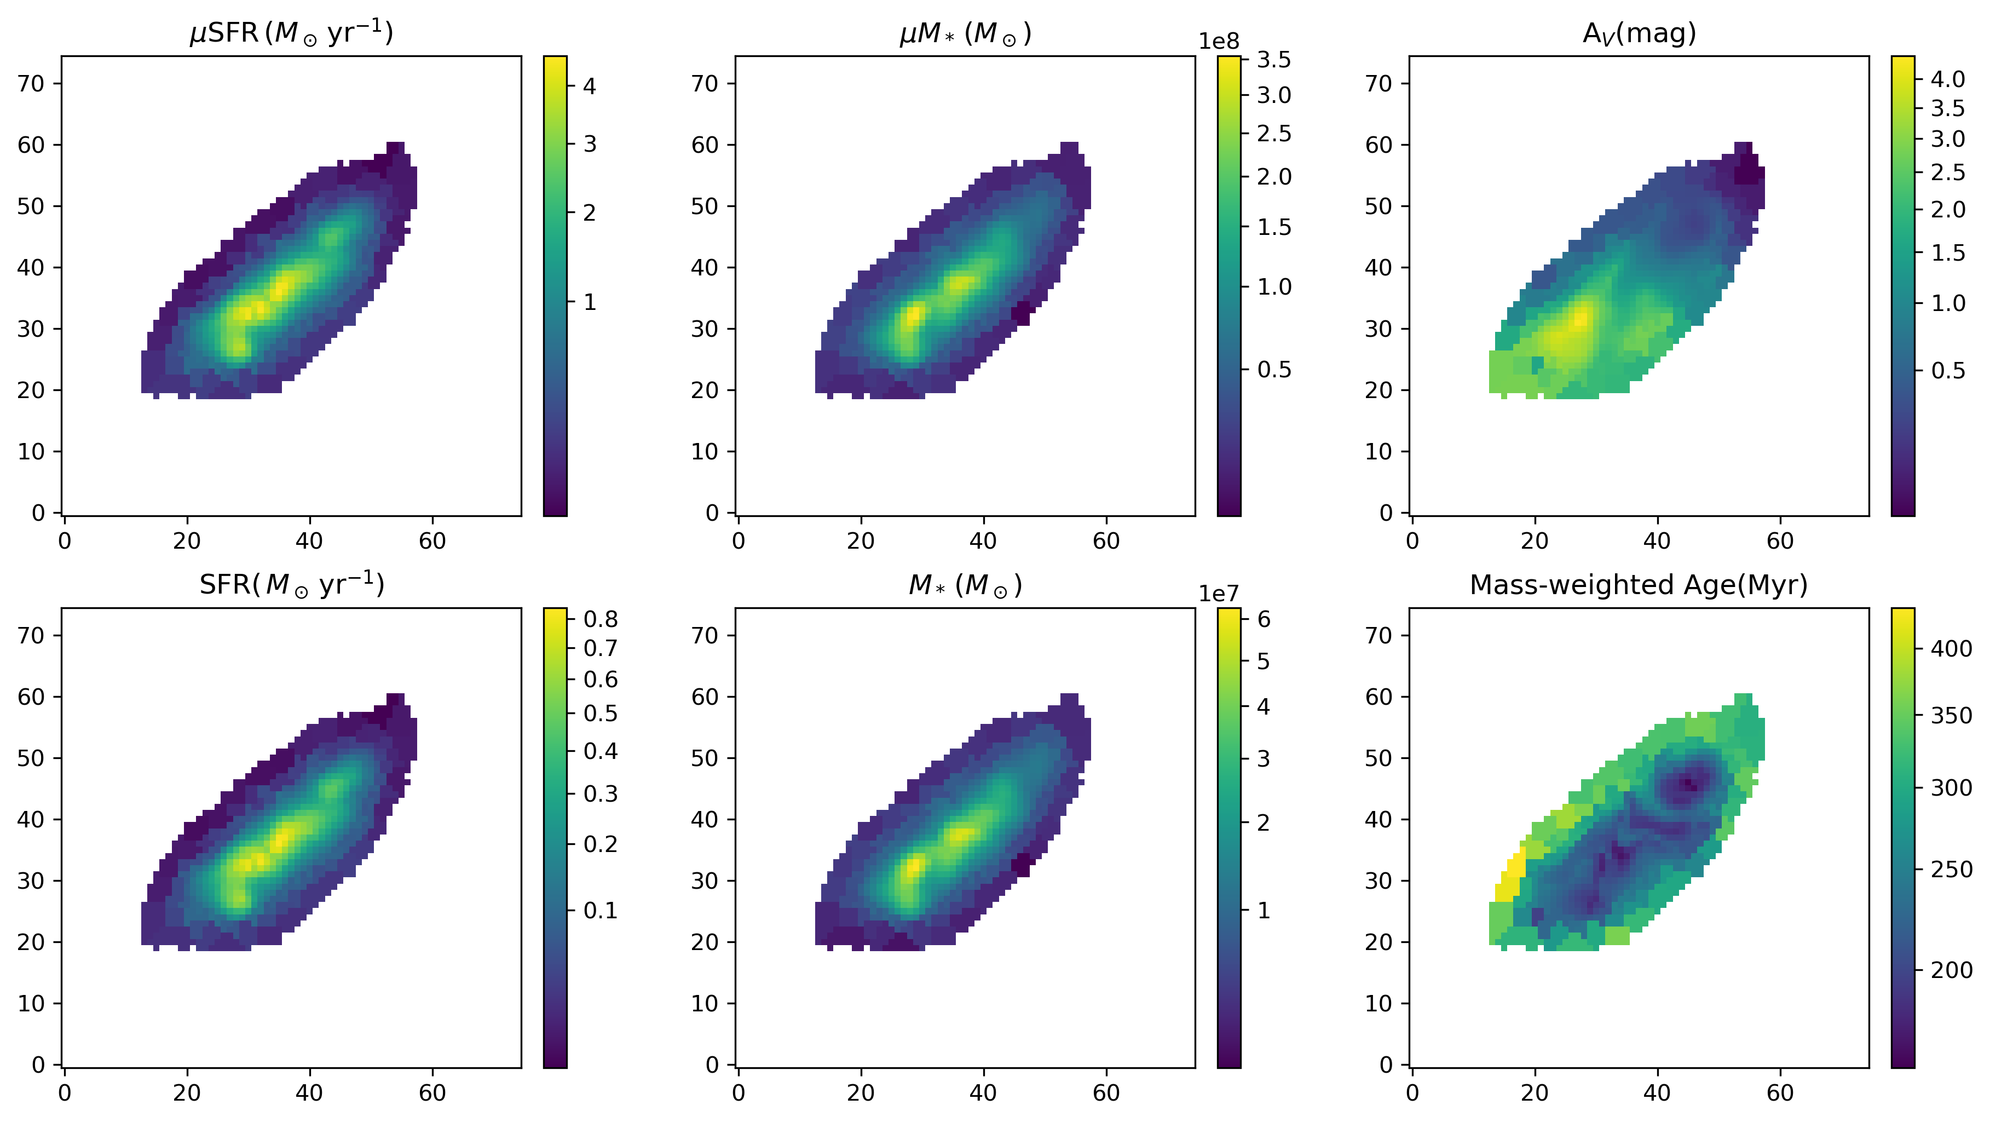
3、Resolved properties: Image Plane

Slide 6
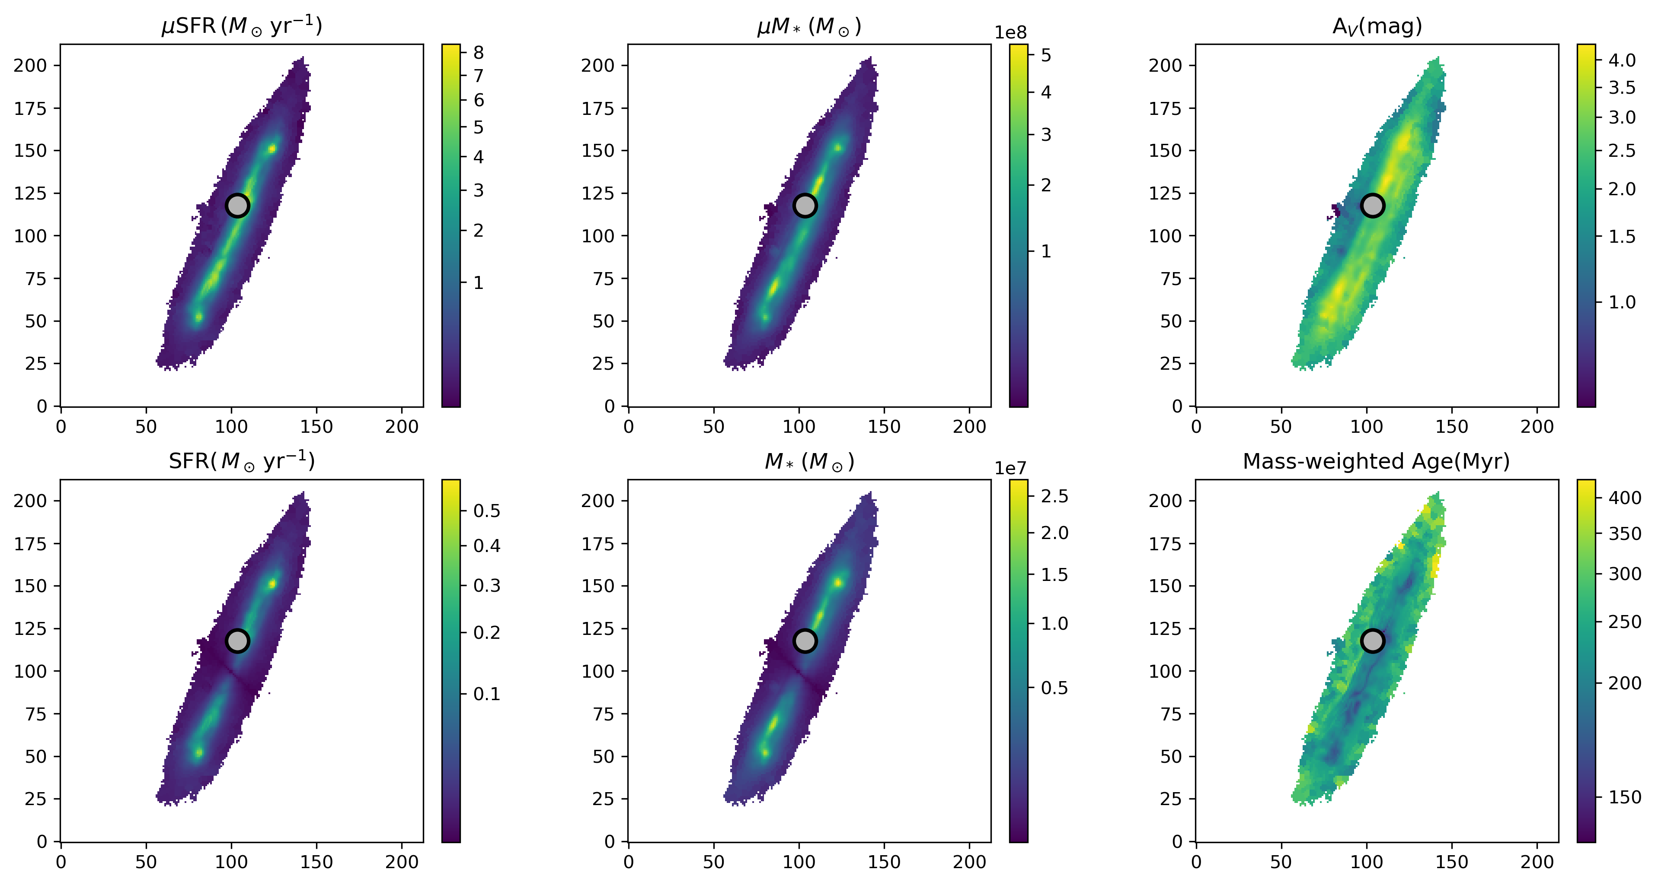
3、Resolved properties: Image Plane

Slide 7
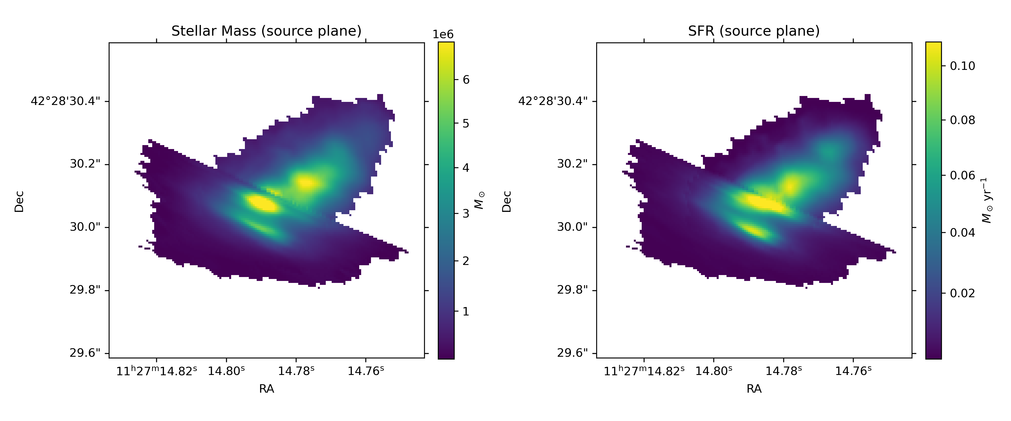
3、Resolved properties: Source-Plane

Slide 8
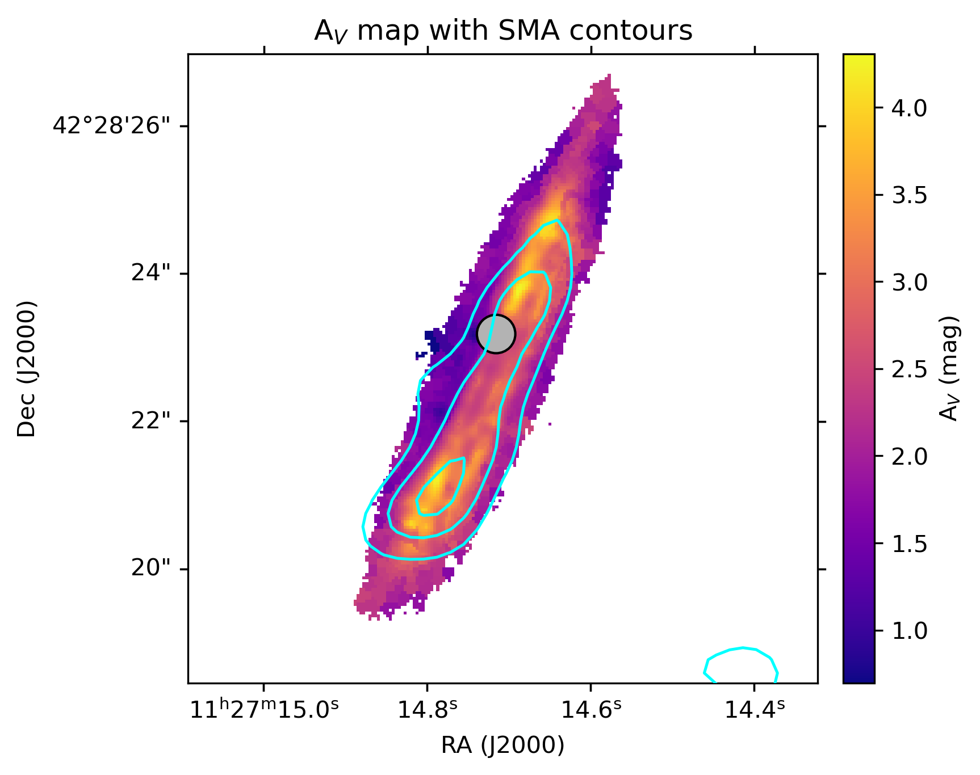
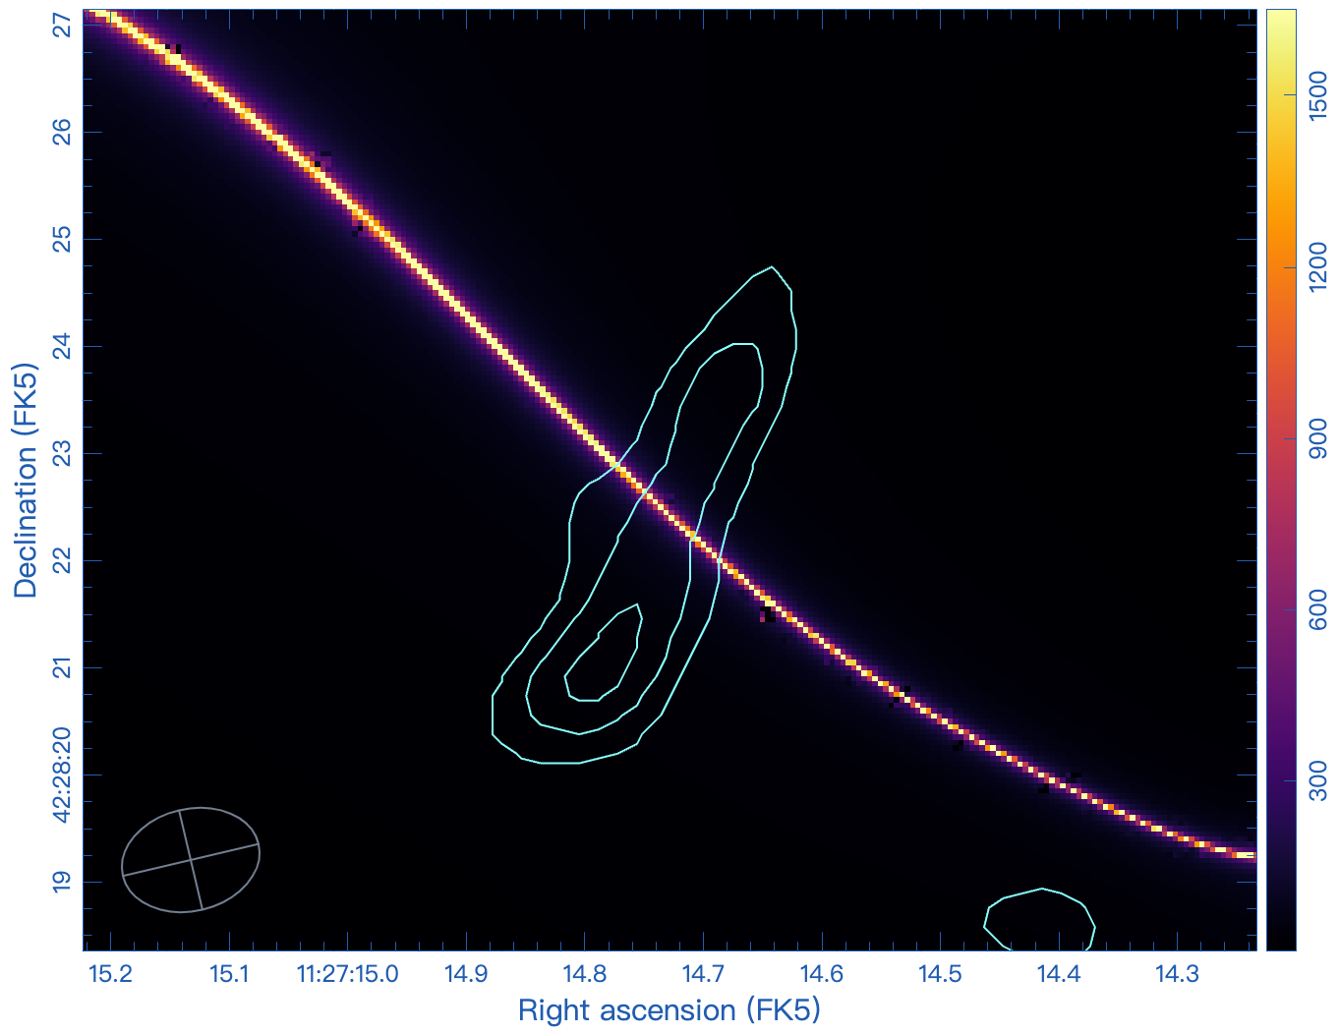
4、Discussion: Asymmetric Dust emission
critial line with SMA contours

Slide 9
5、Summary
We present a joint JWST+ALMA+SMA study of the strongly lensed dusty star-forming galaxy DSFG-1 in PLCK G165.7+67.0.
DSFG-1 is a starburst galaxy lying 4 times above the main sequence, and unlike the compact SFGs at similar z closer to ETGs, it has an extended morphology more similar to LTGs.
The presence of multiple stellar mass concentrations in the reconstructed source-plane stellar mass map suggests a dynamically complex system, consistent with an interacting or merging scenario.
The SMA data further show an asymmetric dust continuum distribution, whose origin remains unclear and will require deeper submillimeter observations to resolve.

Slide 10
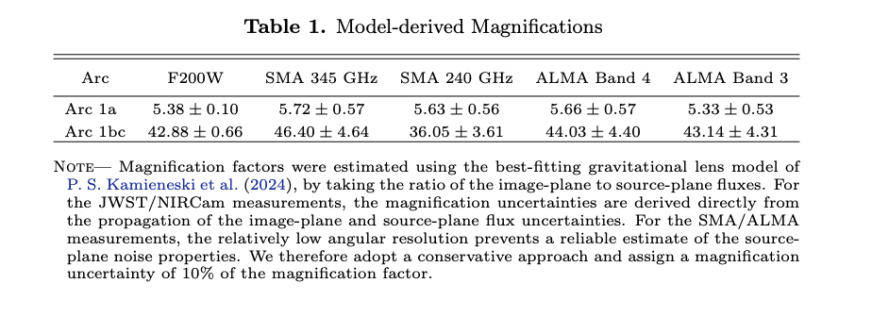
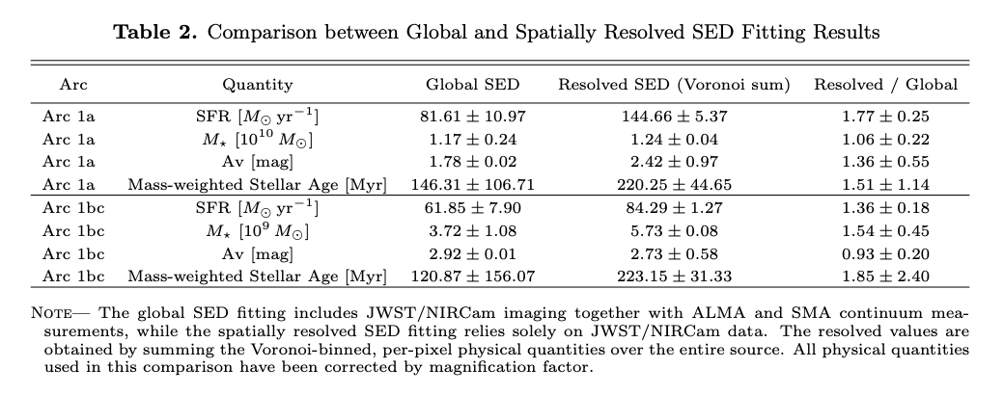
6、Appendix

Slide 11
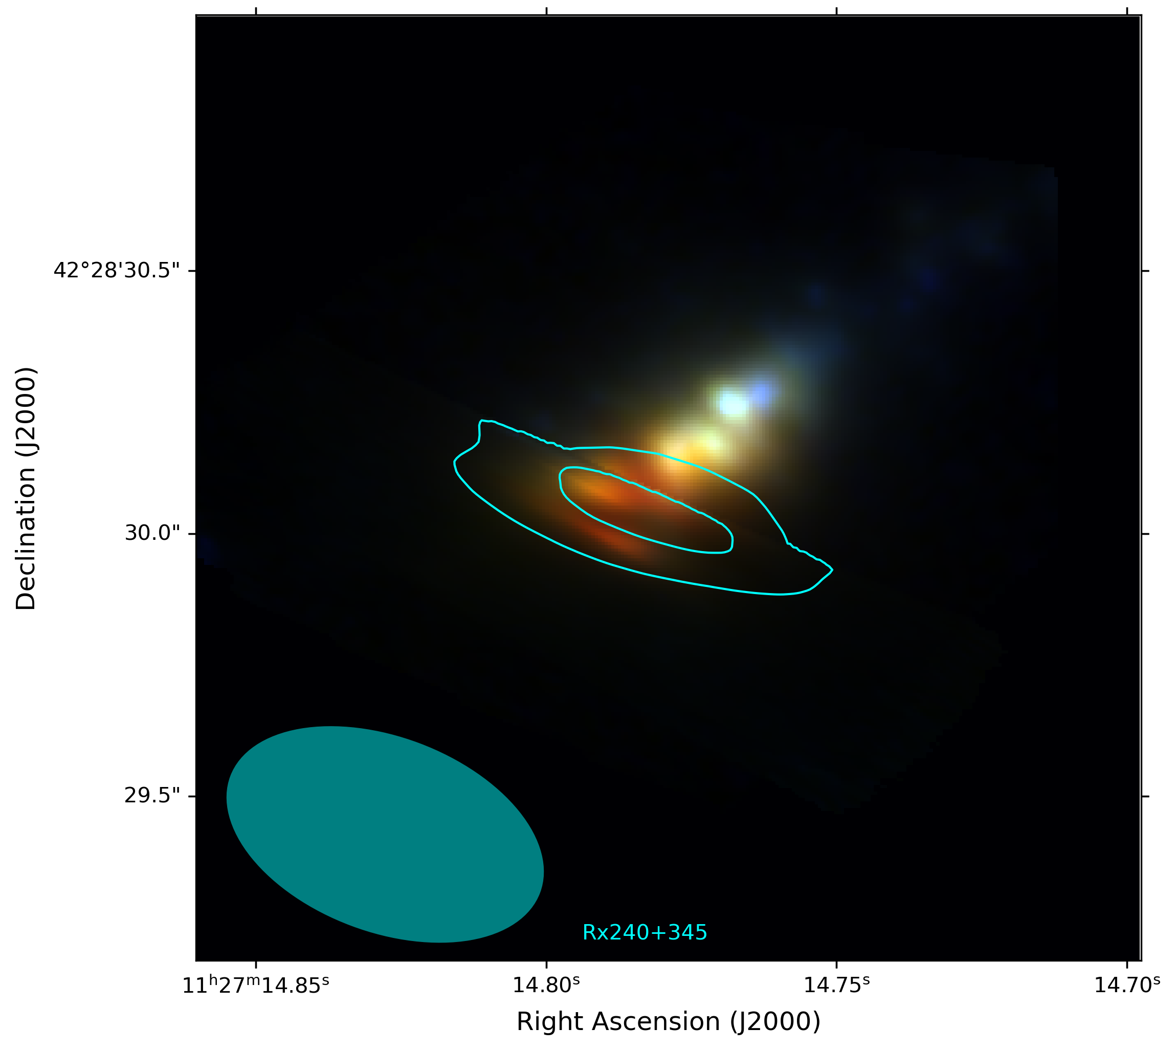
6、Appendix
Source-plane JWST image with SMA contour
G165 source-plane JWST map (f115w/f277w/f444w) with SMA rx240+345 contour (Start from 4sigma, step of 3 sigma)
cyan shows the approximate beam

Slide 12

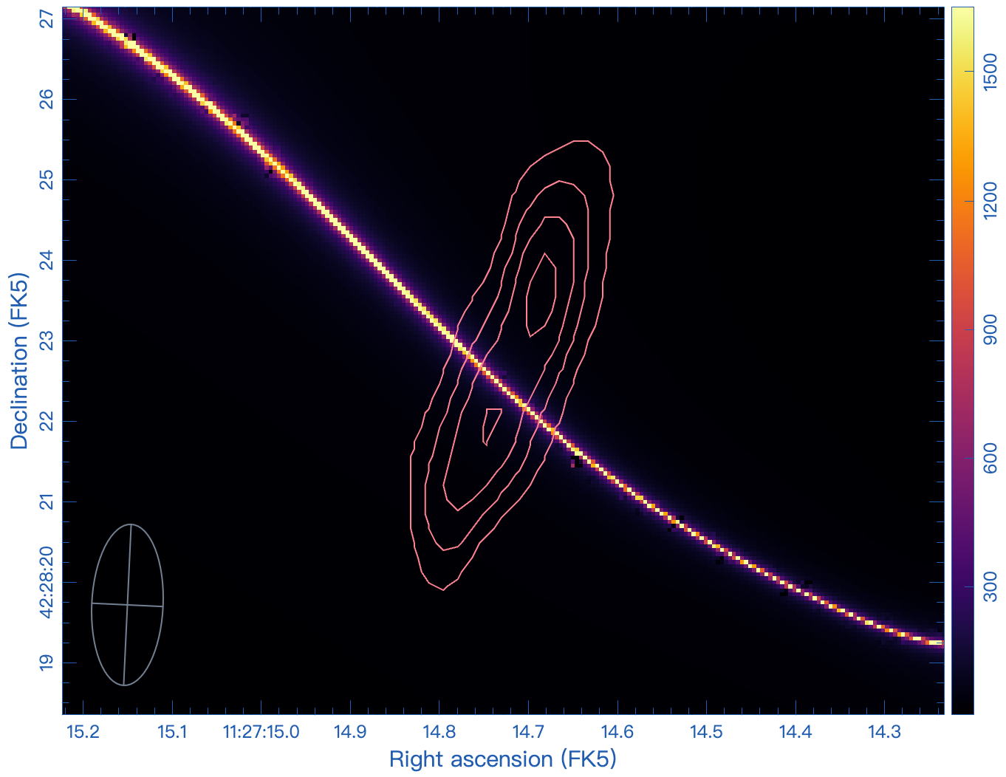
6、Appendix
critial line with ALMA 2mm contours
critial line with ALMA 3mm contours

