Slide 1

Antarctic Infrared Binocular Telescope:
Observations in the 1.4 µm water-vapor-absorption band
Reporter: Pu Lin (Sun Yat-sen University) Supervisor: Bin Ma
Collaborator: Haonan Yang, Jinji Li, Haoran Zhang, Michael C. B. Ashley, Zhongnan Dong,
Lu Feng, Wei Huang, Yi Hu, Zhaohui Shang, Yun Shi, Shijie Sun, Xu Yang, Yong Zhang
2026-01-09 @ Hong Kong

Slide 2
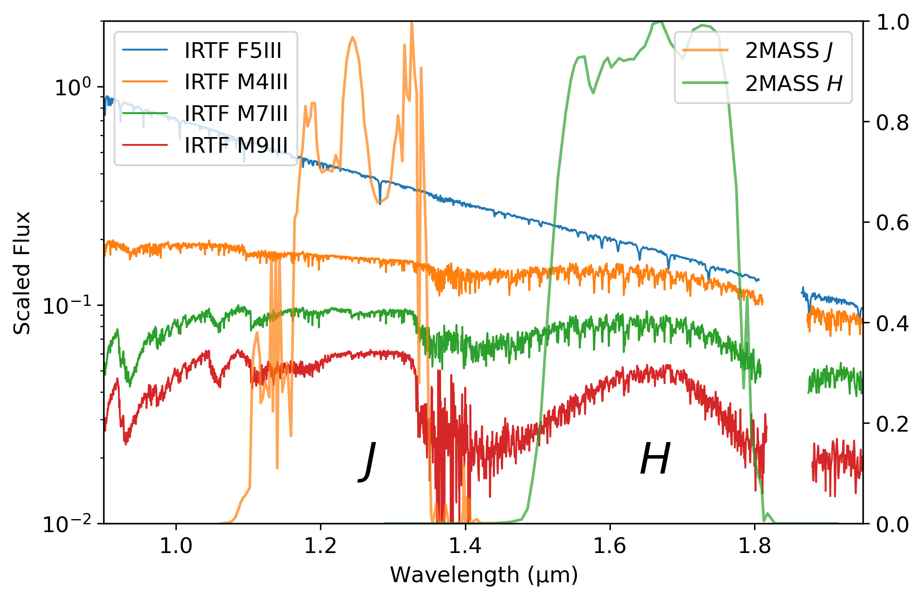

Why 1.4 μm?
Early-type star (blue):
straight scaled spectra
featureless (relatively)
3 Late-type stars:
water-vapor-absorption features
stronger for later-type
Observations in 1.4 μm:
study water-vapor in late-type stars
Gap between $J$ and $H$ filters:
strongly hindered by atmosphere of Earth itself (in the ground)

Slide 3
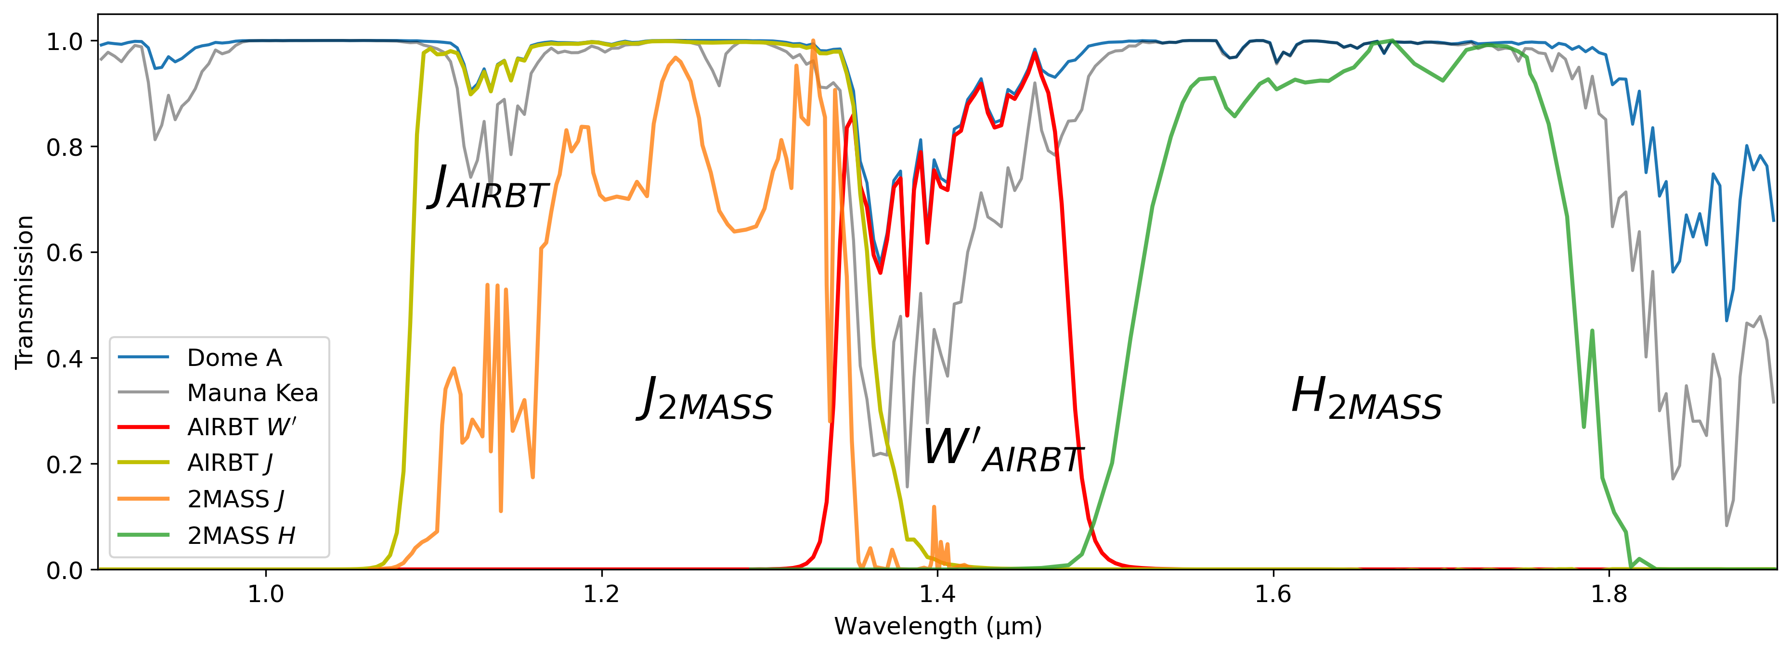
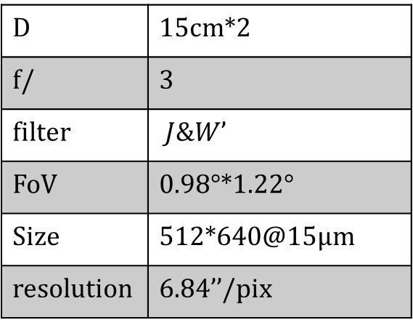

Observation
Dome A: dry condition, higher atmosphere transmission at 1.4 μm ($≳$70%)
New designed $W’$ filter: 1.34-1.48 μm
Antarctic Infrared Binocular Telescope (AIRBT):
two 15-cm optical tubes, $J$&$W’$ filter
search for and study ultracool stars
detect water-vapor-absorption feature
D | 15cm*2
f/ | 3
filter | $J$&$W’$
FoV | 0.98°*1.22°
Size | 512*640@15μm
resolution | 6.84’’/pix

Slide 4
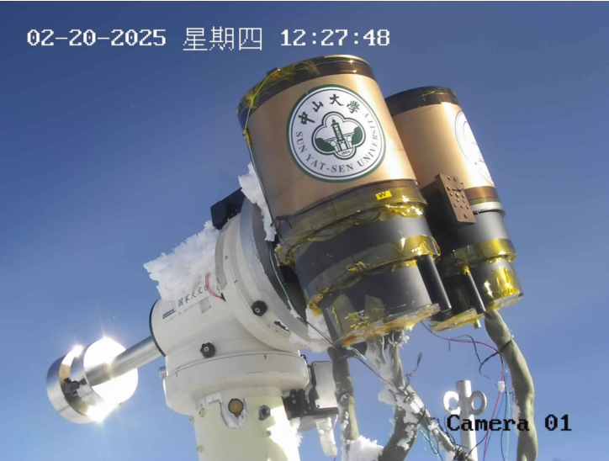
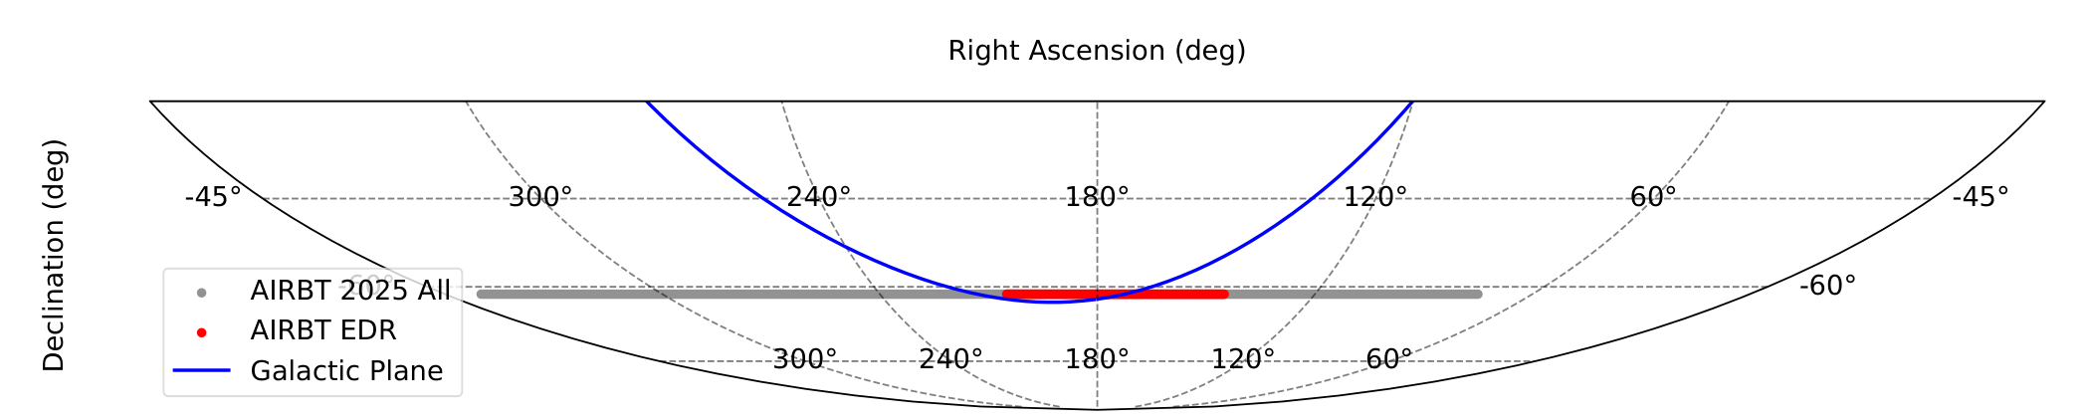

Observation
Antarctic Infrared Binocular Telescope (AIRBT):
2023.01, CHINARE 39, installed at Dome A
2025.01, CHINARE 41, operational in $J$ and $W’$ bands
Observation strategy: fixed direction
(equatorial mount issue)
RA= ${70}^{°}\sim {355}^{°}$, DEC=$−{61.7}^{°}\sim −{61.0}^{°}$ (gray)

Slide 5

Data Processing
Early Data Release: 3 days of data
RA= ${145}^{°}\sim {205}^{°}$, DEC=$−{61.7}^{°}\sim −{61.0}^{°}$ (red)
20deg² in the Galactic plane
Purpose:
evaluate performance
explore potential
Aperture photometry; Astrometry
Photometric calibration reference: 2MASS

Slide 6
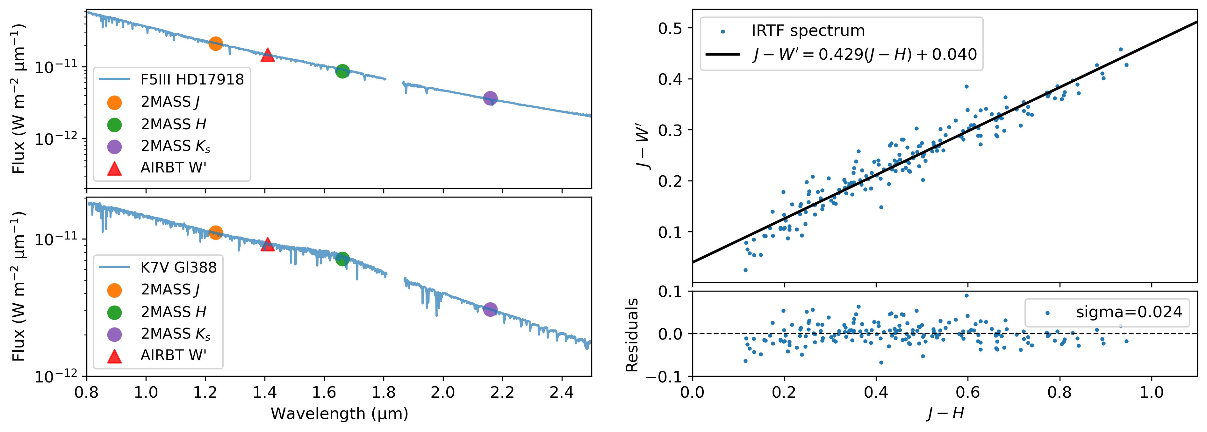

Data Processing
Photometric calibration: transform from 2MASS $J\&H$ bands
Early-type stars: straight and featureless between $J$&$H$ bands
Linear fit: integration of IRTF spectrum ($≤$K7)
Uncertainty: 0.024mag
Future: calibration with standard stars

Slide 7
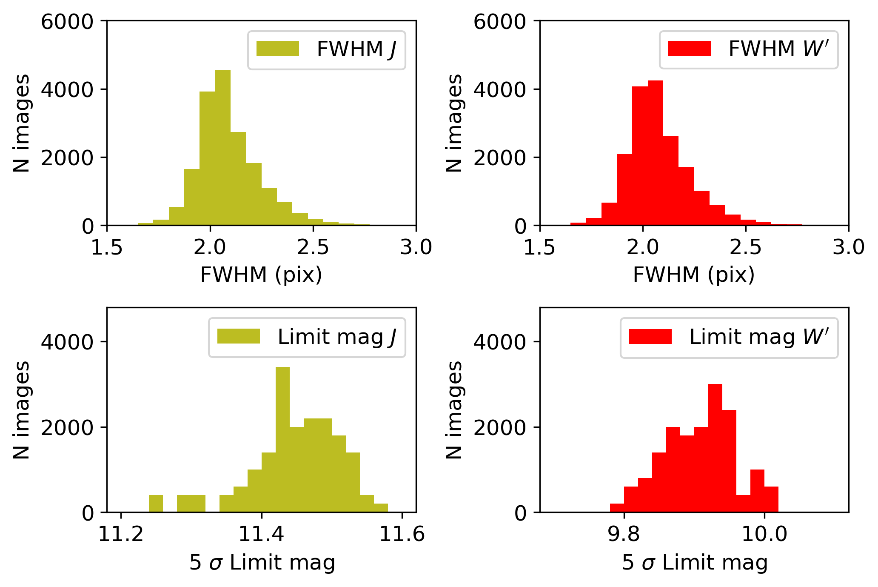

Data Processing
Photometric result
5σ limitmag@2s (median):
$J=11.5mag$, $W′=9.9mag$
image coadd:
8 min exposure / day (fixed direction)
$J=13.9mag$, $W′=12.2mag$

Slide 8
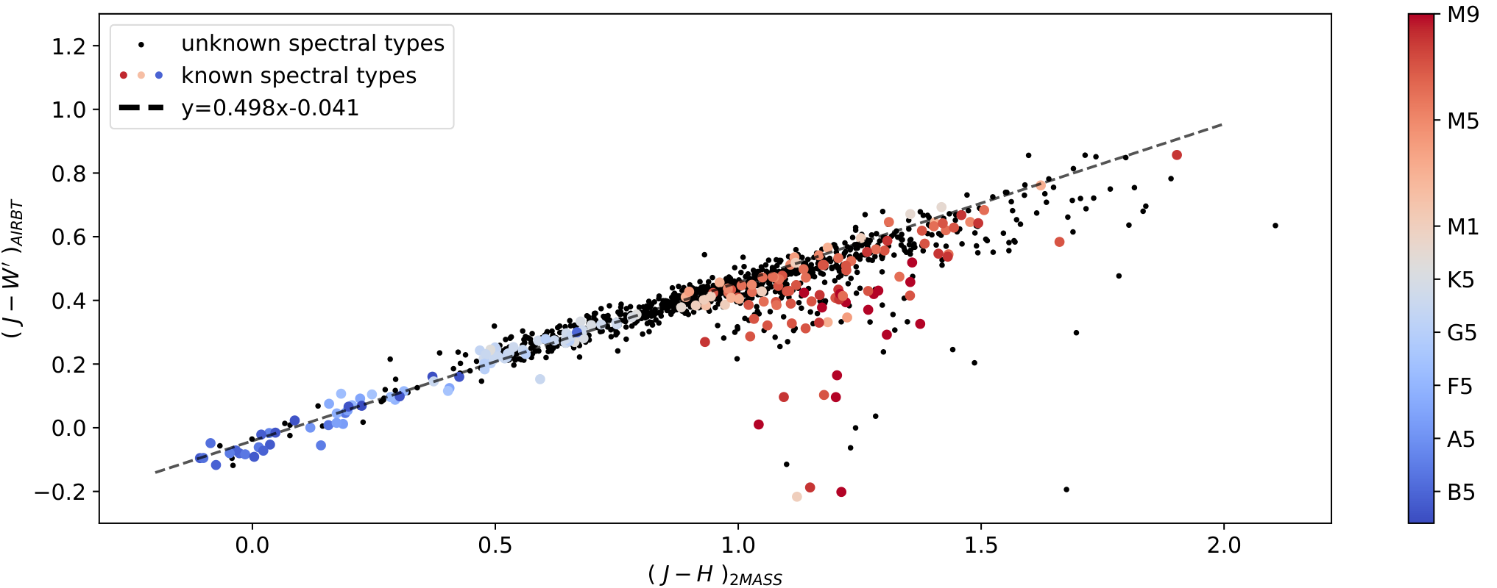
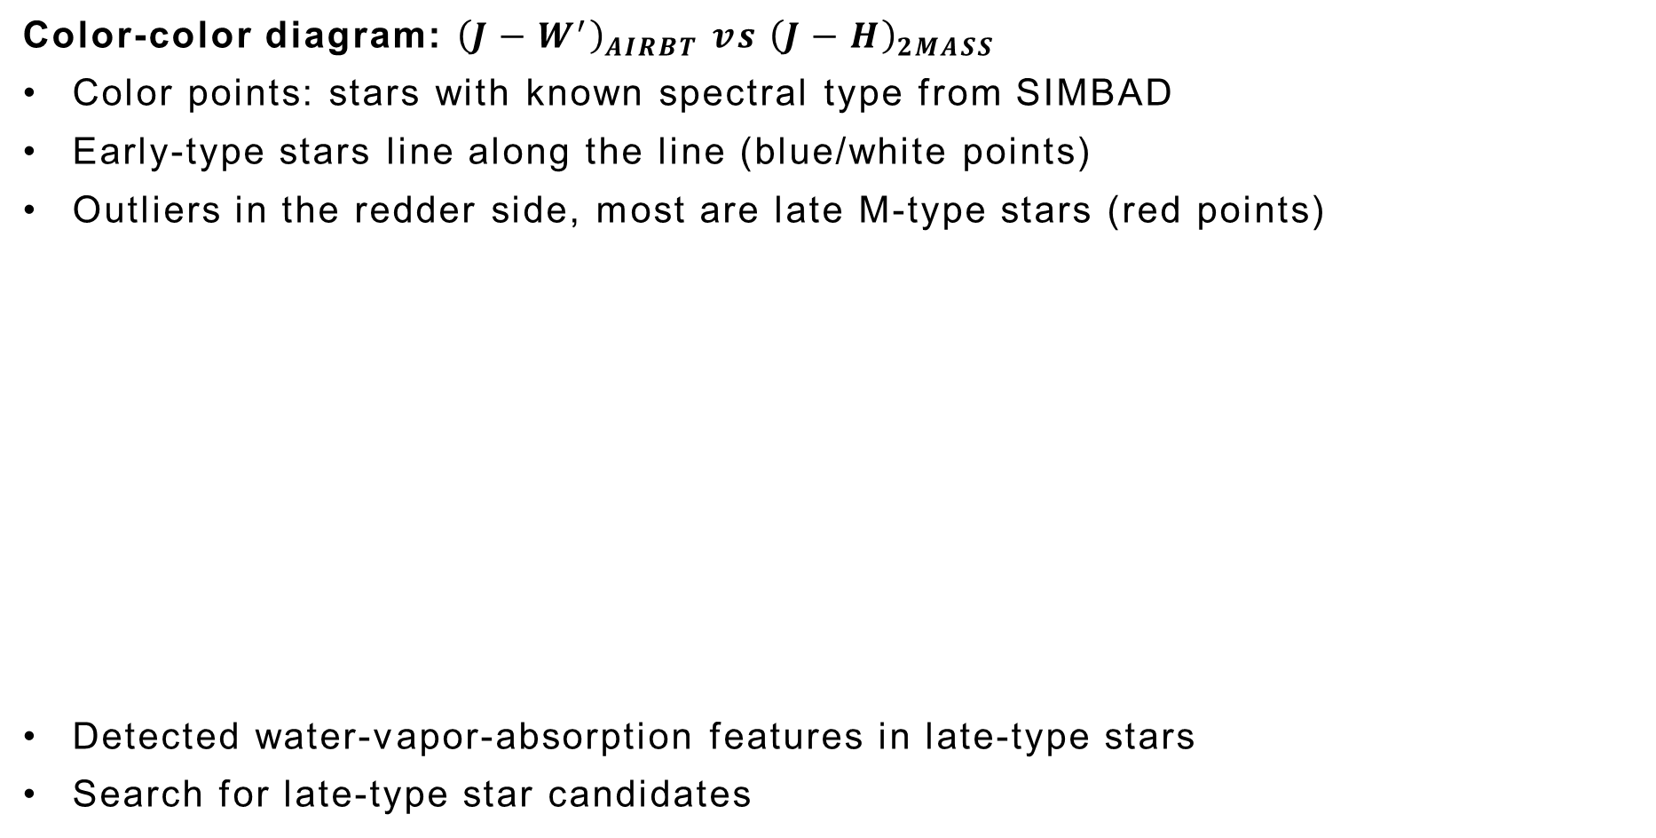
Scientific Results
Color-color diagram: ${\left(J−W^{′}\right)}_{AIRBT} vs {\left(J−H\right)}_{2MASS}$
Color points: stars with known spectral type from SIMBAD
Early-type stars line along the line (blue/white points)
Outliers in the redder side, most are late M-type stars (red points)
Detected water-vapor-absorption features in late-type stars
Search for late-type star candidates

Slide 9
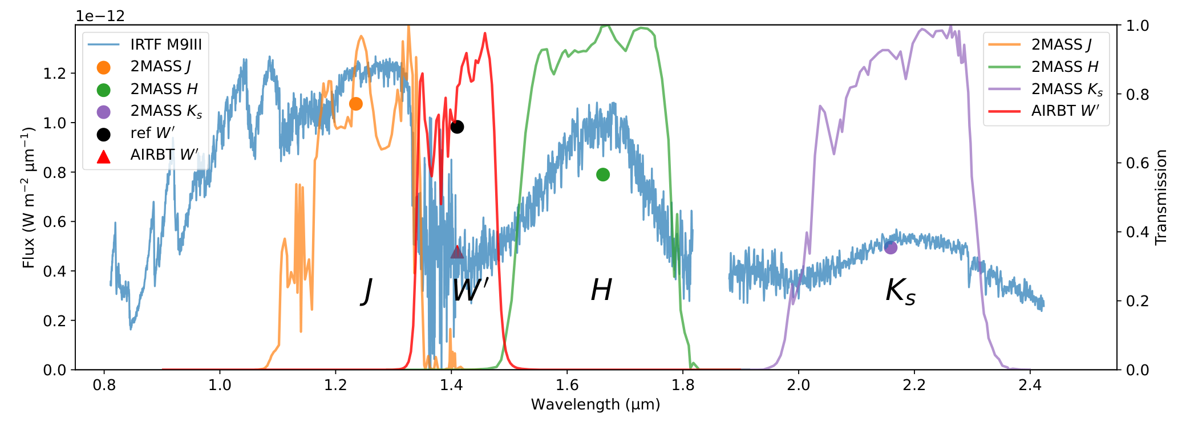
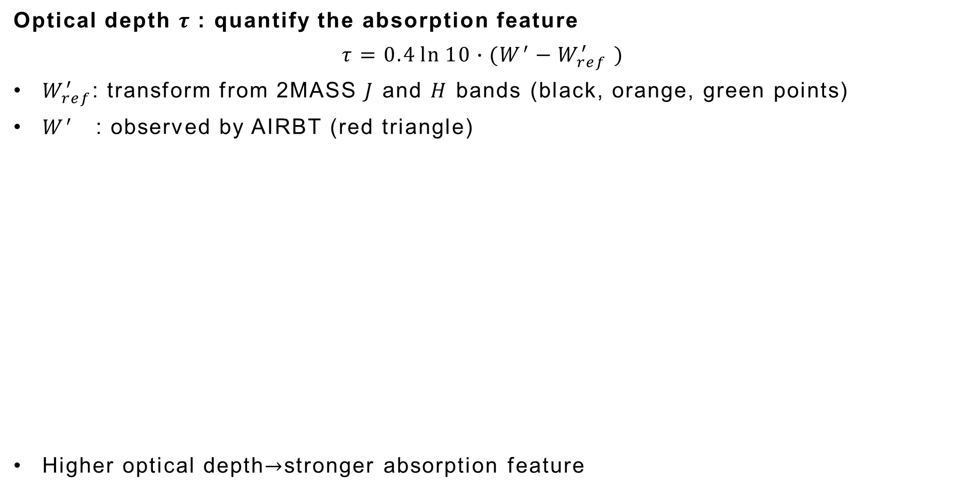
Scientific Results
Optical depth $τ$: quantify the absorption feature
$$τ=0.4\ln{10}∙(W^{′}−W_{ref}^{′} )$$
$W_{ref}^{′}$: transform from 2MASS $J$ and $H$ bands (black, orange, green points)
$W^{′}$ : observed by AIRBT (red triangle)
Higher optical depth$→$stronger absorption feature

Slide 10
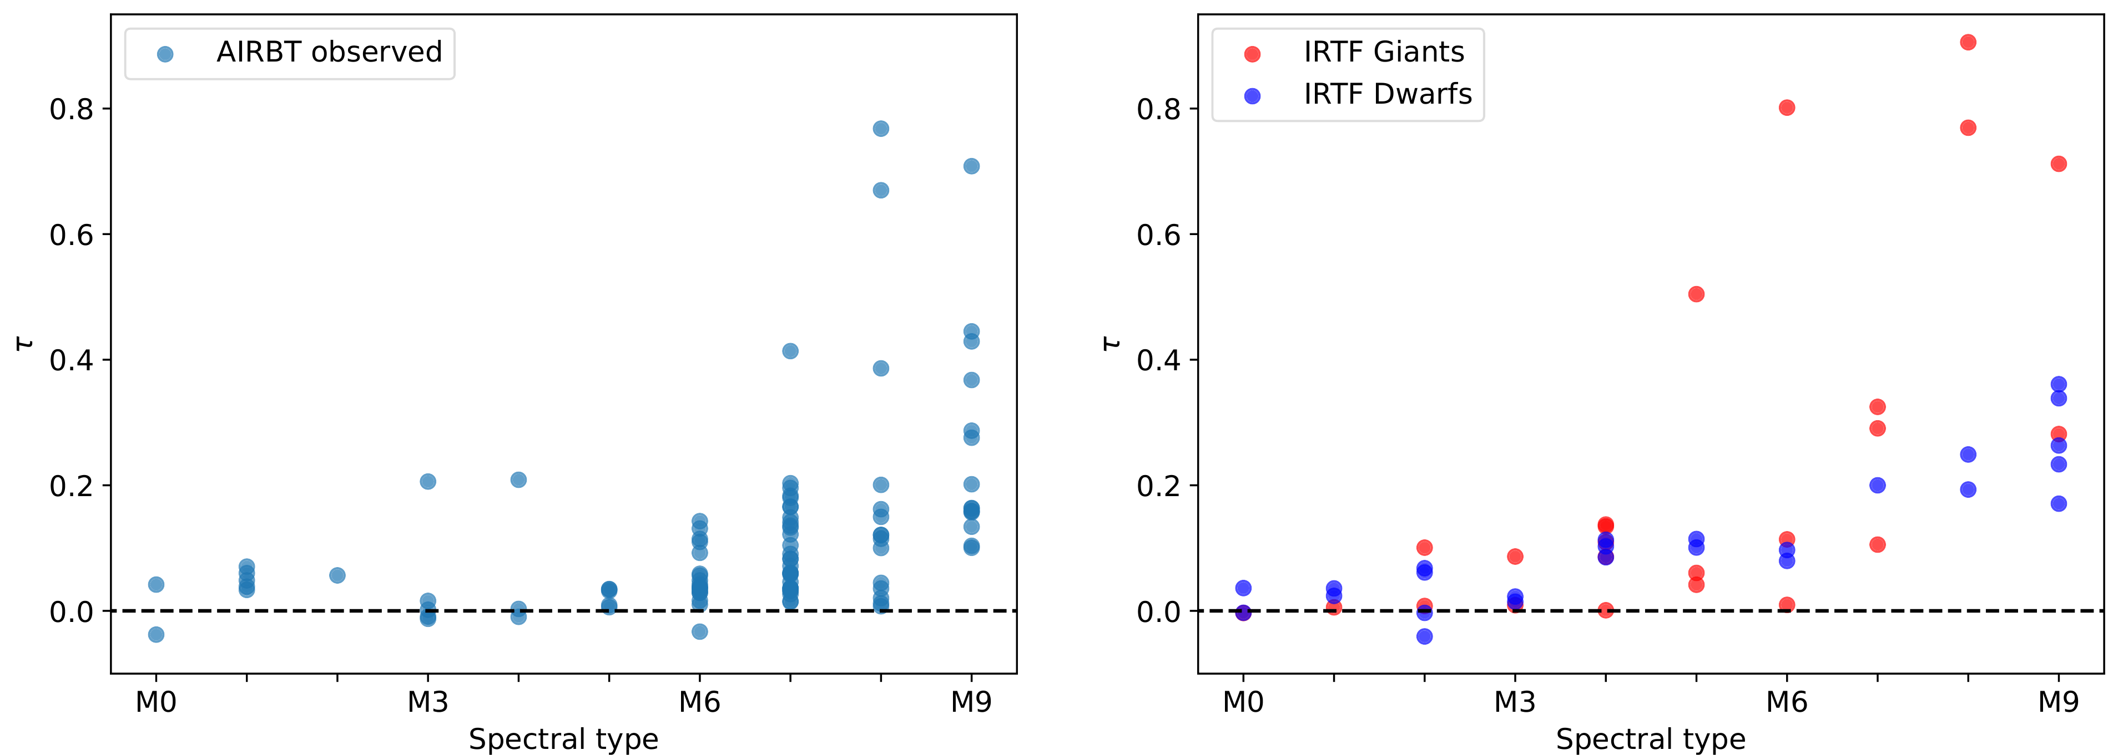

Scientific Results
AIRBT observed / IRTF spectrum: optical depth vs spectral type
Before M6: $τ\sim 0$
After M6: later the spectral type $→$ higher the optical depth
Estimate subtypes for late-type star candidates
Dispersion: brightness variation $↔$ spectral type changes

Slide 11
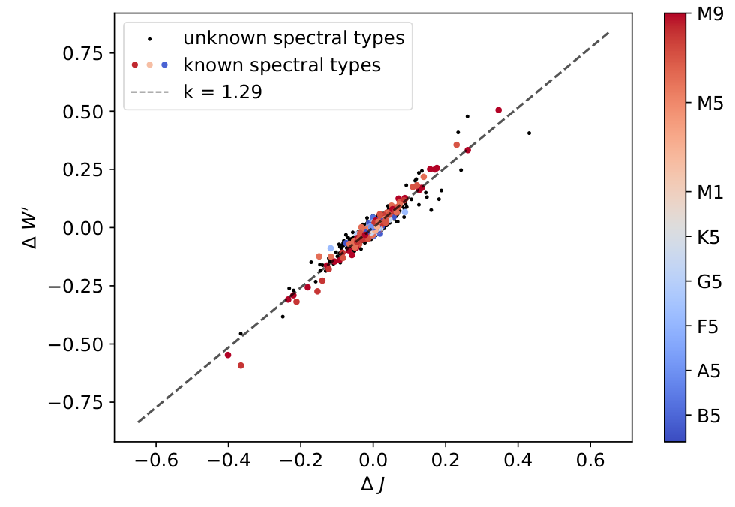
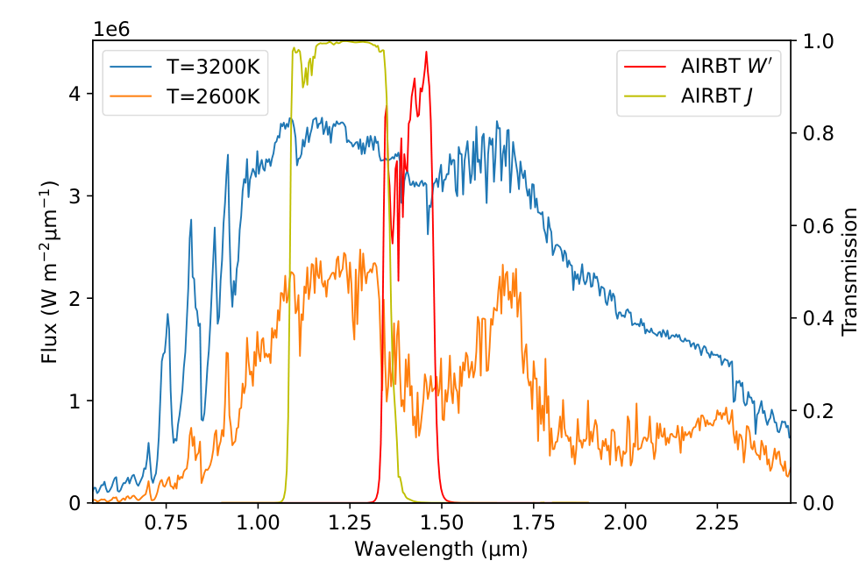

Scientific Results
Over 3 nights: $ΔW^{′}\sim 1.29ΔJ$
Continuum spectrum without absorption (Planck; Stefan-Boltzmann): $ΔW^{′}≤ΔJ$
Excess $ΔW^{′}$: variations of water-vapor
PHOENIX model: $ΔW^{′}>ΔJ$
Detect the variations of water-vapor correlated with brightness

Slide 12
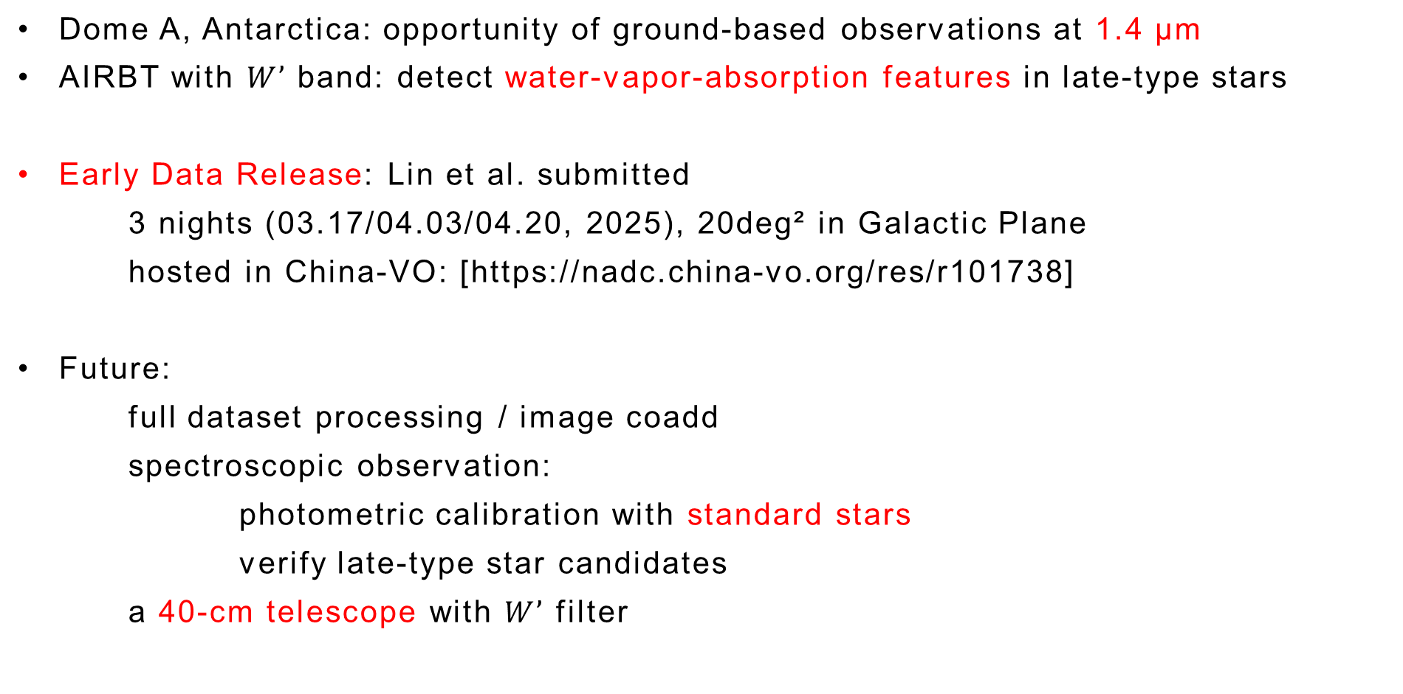
Summary
Dome A, Antarctica: opportunity of ground-based observations at 1.4 μm
AIRBT with $W’$ band: detect water-vapor-absorption features in late-type stars
Early Data Release: Lin et al. submitted
3 nights (03.17/04.03/04.20, 2025), 20deg² in Galactic Plane
hosted in China-VO: [https://nadc.china-vo.org/res/r101738]
Future:
full dataset processing / image coadd
spectroscopic observation:
photometric calibration with standard stars
verify late-type star candidates
a 40-cm telescope with $W’$ filter
Thanks!
mabin3@mail.sysu.edu.cn
linp@mail2.sysu.edu.cn

