Slide 1
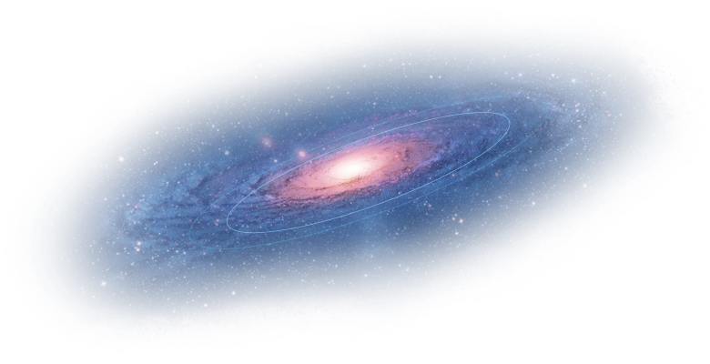
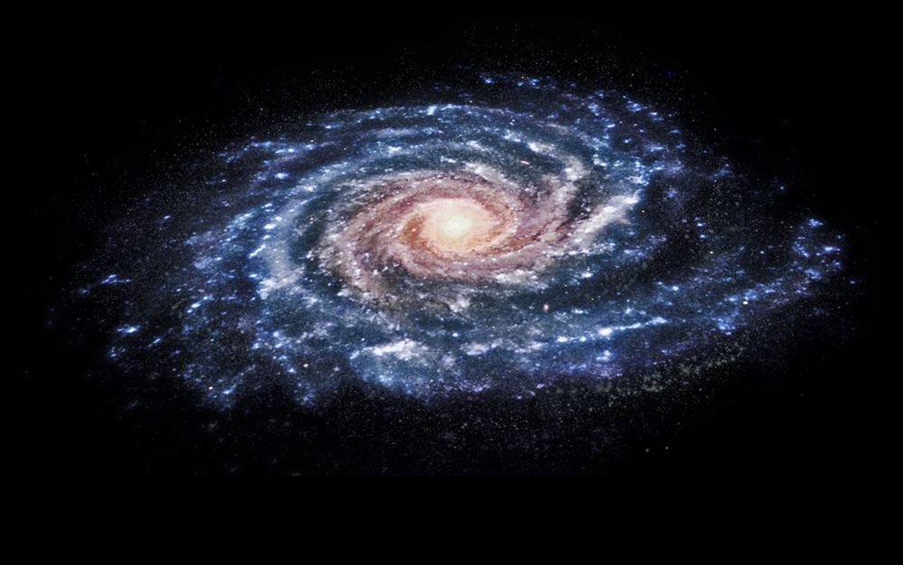
The Halo Outskirts With VAriable STars (HOWVAST) survey: detecting Milky Way mass tracers beyond 100 kpc
Ricardo R. Muñoz
Associate Professor, Departamento de Astronomía
Universidad de Chile
Gustavo Medina (University of Toronto), Jeffrey Carlin (Vera C. Rubin Obs.), Kathy Vivas (CTIO), Clara Martínez-Vázquez (NSF NOIRLab)
January 8th, 2026, CCBC2026
Notes:
notes

Slide 2
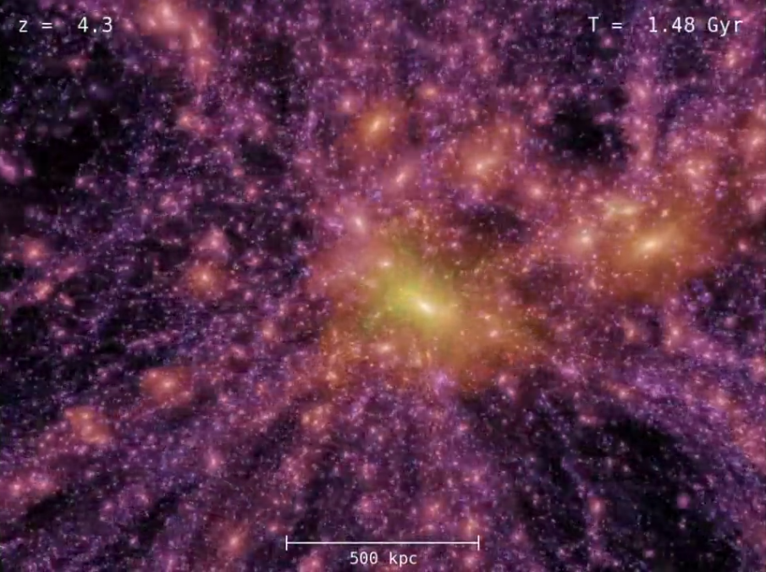
Why we care about the outer halo
In the ΛCDM framework, the extended halo of Milky Way retains key information to place our Galaxy in a cosmological context
The outer halo contains a significant number of satellites (globular clusters, dwarf galaxies), stellar streams, and stars
Halo stars can be used as tracers of the structure, accretion history, and mass of the Milky Way out to large radii
The outer halo (> 100 kpc) is vastly unexplored, mostly due to the
scarcity of tracers and technical limitations (e.g., to derive distances)
Aquarius simulation
Notes:
notes

Slide 3
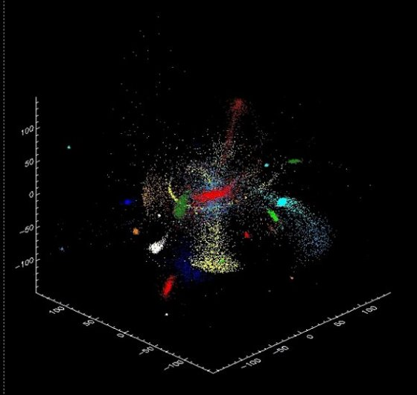
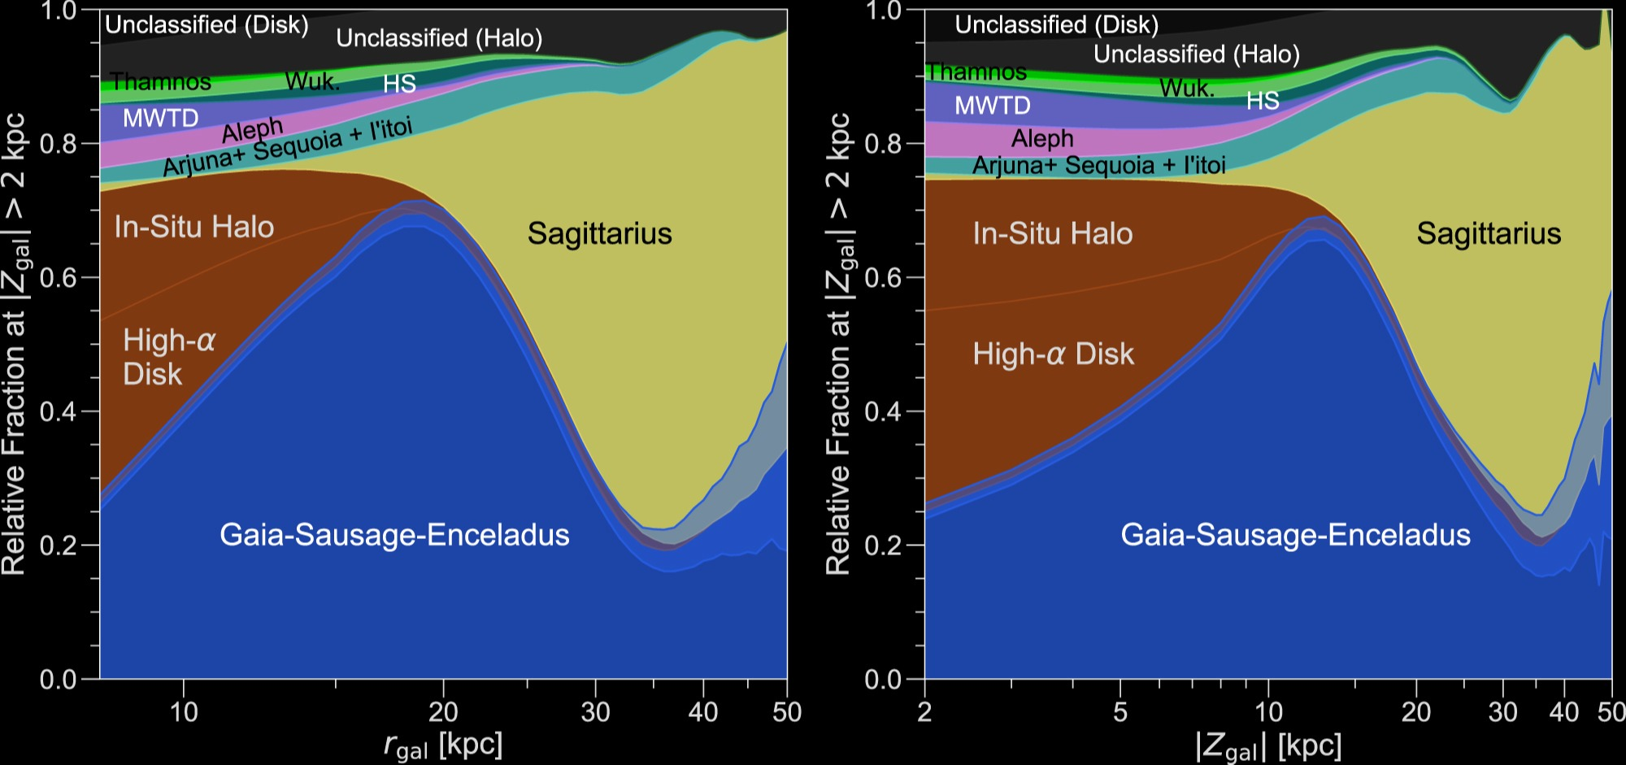
Building up the Milky Way halo
The Milky Way is thought to have accreted and tidally destroyed hundreds of low-mass systems in the past ~12 Gyr.
Naidu et al. 2020
Bullock & Johnston 2005

Slide 4
Building up the Milky Way halo
The Milky Way is thought to have accreted and tidally destroyed hundreds of low-mass systems in the past ~12 Gyr.
In-situ stars: formed initially in the halo or kicked out of the disk
Accreted stars: From accreted galaxies/globular clusters
Naidu et al. 2020

Slide 5
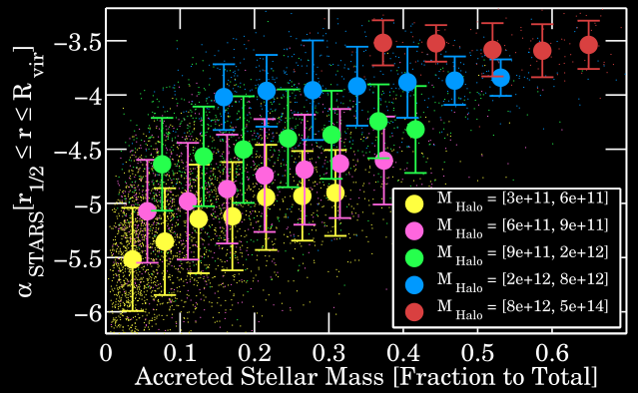
Building up the Milky Way halo
Pillepich et al. 2014, used Illustris simulations to study the imprint of the stellar accretion history of a galaxy on the outer halo slope.
Outer halo slope

Slide 6
The role of RR Lyrae stars in the study of the outer halo

Slide 7
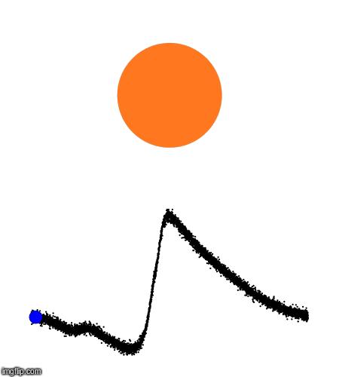
RR Lyrae as tracers in the halo
Diagnostic tools of Galactic archaeology
- PL relation: Precise distance indicators
- Population II, low mass stars
- Relatively common, easily identifiable
C: Zdenek Prudil
log (Temperature)
Notes:
PL relation that is tight in the NIR
The properties of RRL make them excellent probes of the formation and evolution of stellar populations
The mere presence of these stars requires an age greater than 10 gyr approx.

Slide 8
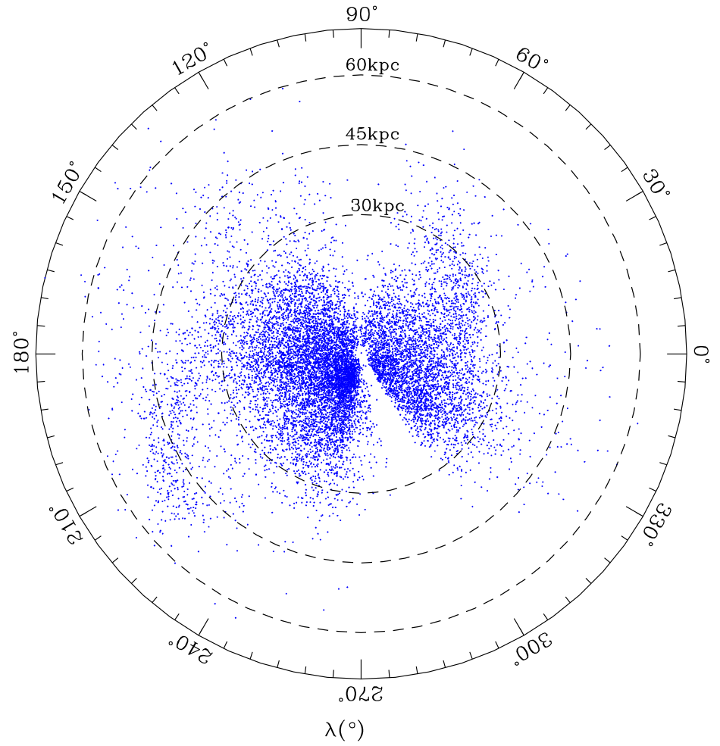
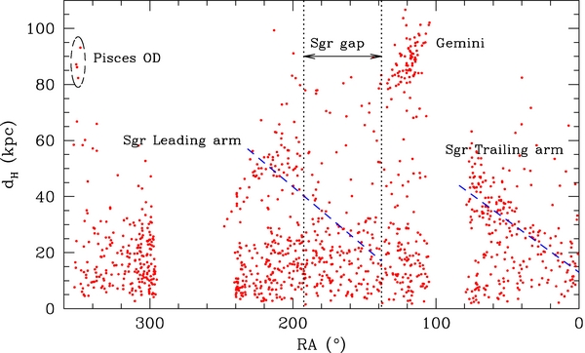
The search for distant RR Lyrae stars
With the Catalina survey, ~14,000 RRab RRLs found in "the largest volume of the Milky Way ever surveyed with RRLs (∼20,000 sq deg)" (out to ~100 kpc)
Drake et al. (2013a)
Drake et al. (2013b)

Slide 9
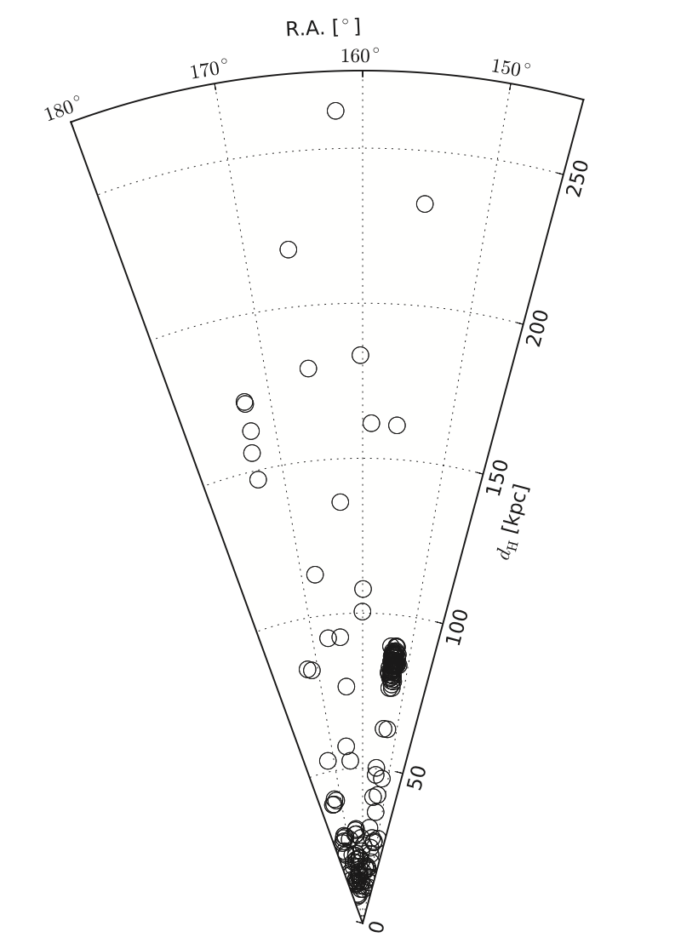
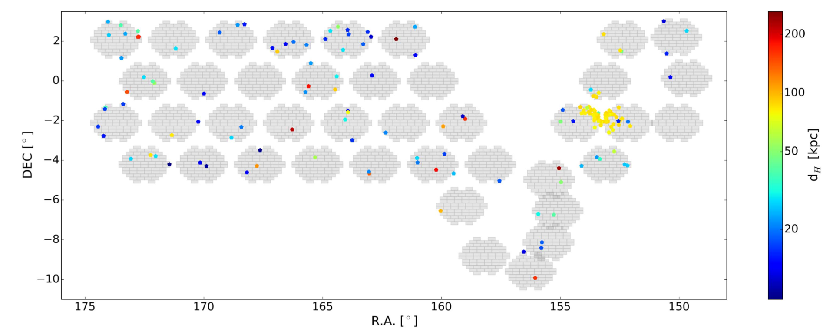
The search for distant RR Lyrae stars (HiTS)
Identification of ~173 RR stars using the HiTS survey over an area of ~120 deg²
Distances out to ~250 kpc
Medina, Munoz et al. (2018)

Slide 10
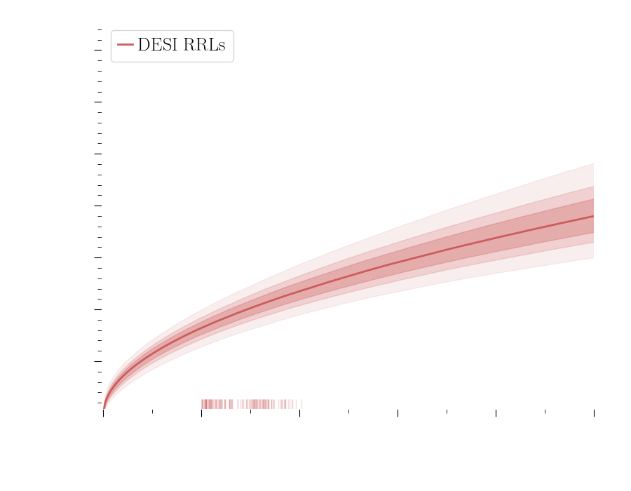
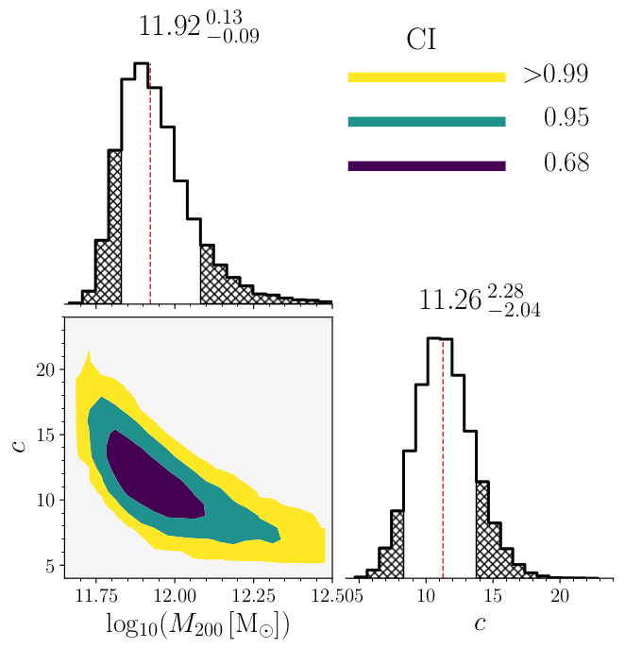
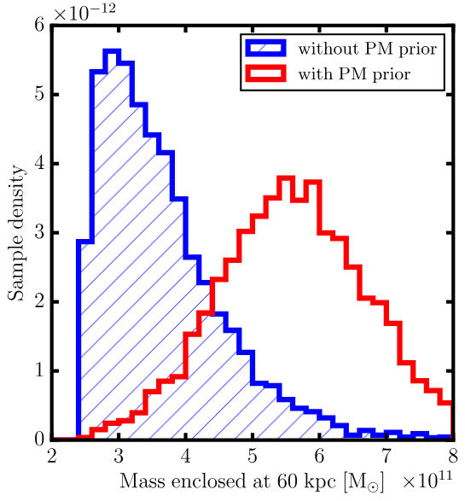
The mass of the Milky Way
Measuring the MW mass requires distant tracers, presents large scatter at large radii, and depends largely on the availability of spectra (and/or proper motions)
Using DESI data (< 120 kpc)
Using LAMOST data (< 80 kpc)
Using streams (< 60 kpc)
Medina et al. in prep.
Prudil et al. (2022)
Hendel et al. (2018)

Slide 11
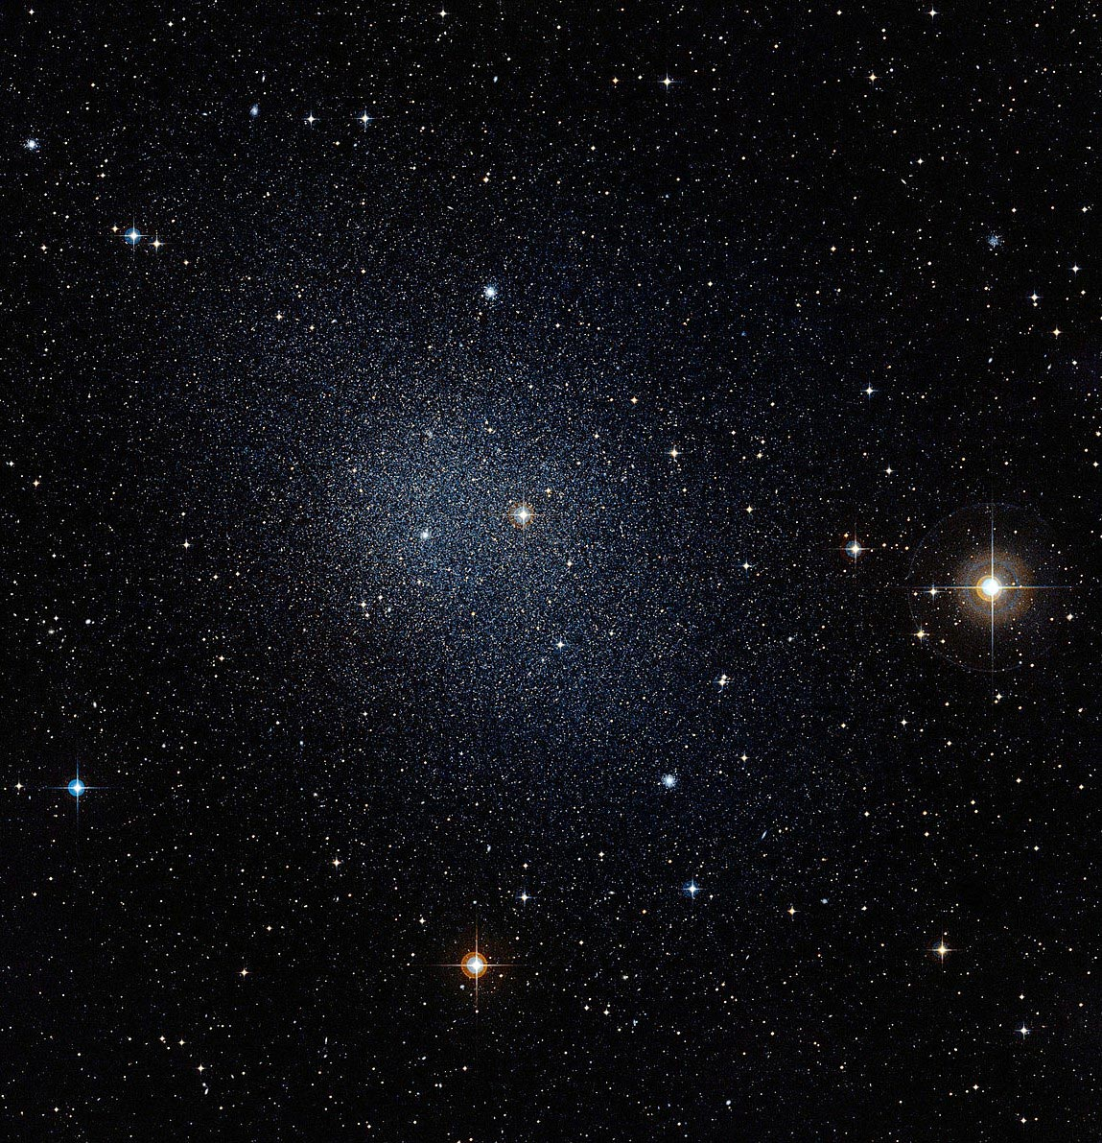
The discovery of dwarf galaxies
Typical Milky Way dSph galaxy

Slide 12
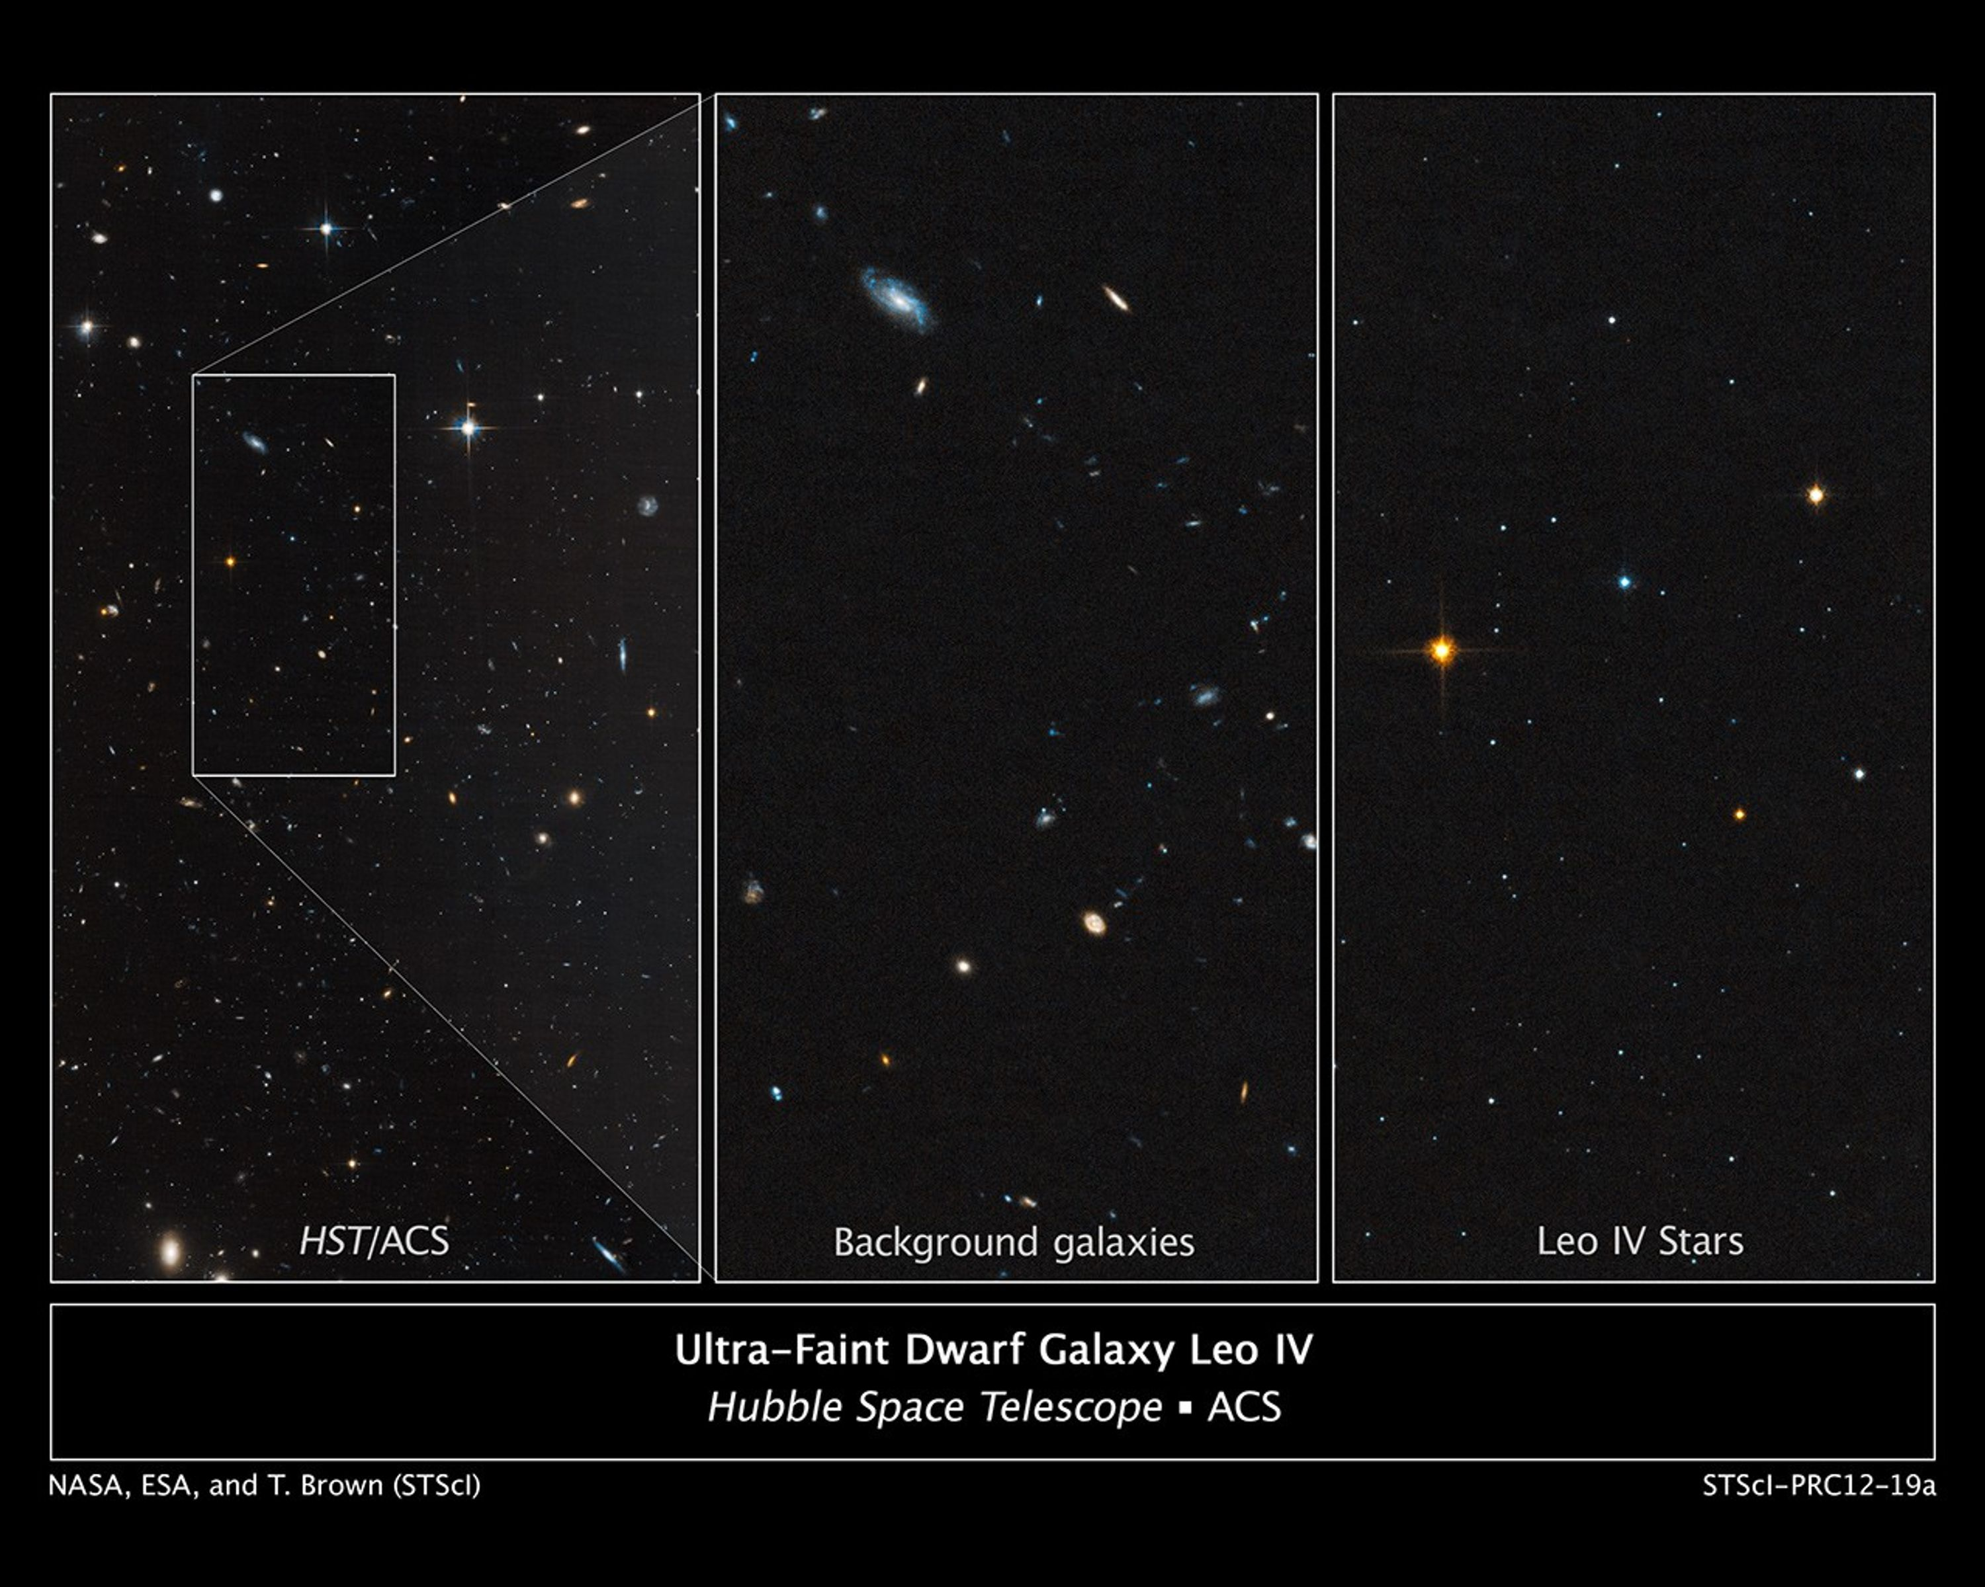
The discovery of dwarf galaxies
Ultra-Faint dwarf galaxy

Slide 13
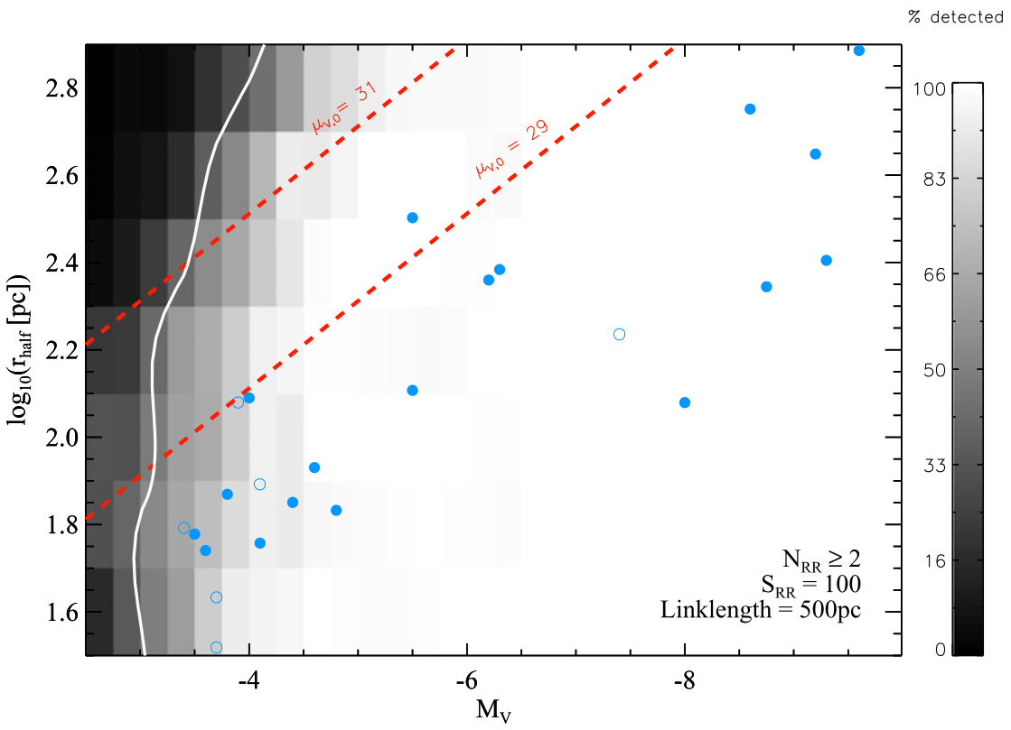
The discovery of dwarf galaxies
The role of (distant) RR Lyrae stars?
Even small groups of distant RR Lyrae stars > 50 kpc can trace undiscovered systems (e.g., Sesar et al. 2014, Baker & Willman 2015)
Baker & Willman (2015)

Slide 14
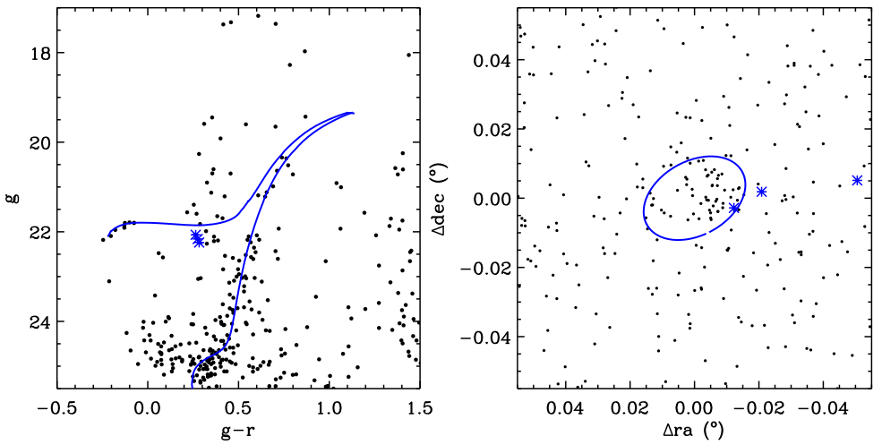
The discovery of dwarf galaxies
The role of (distant) RR Lyrae stars?
Even small groups of distant RR Lyrae stars > 50 kpc can trace undiscovered systems (e.g., Sesar et al. 2014, Baker & Willman 2015)
Leo V
(Medina, Munoz et al. 2017) -- 173 kpc
Baker & Willman (2015)

Slide 15
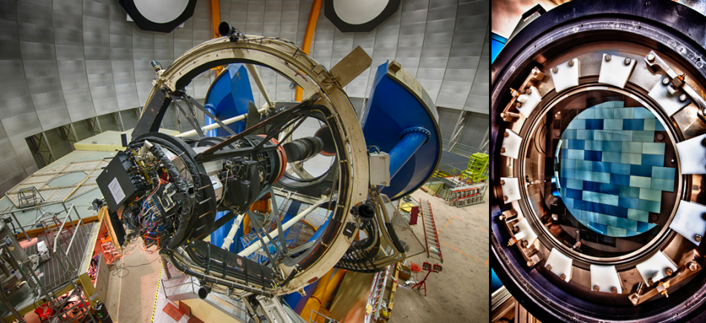
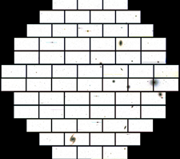
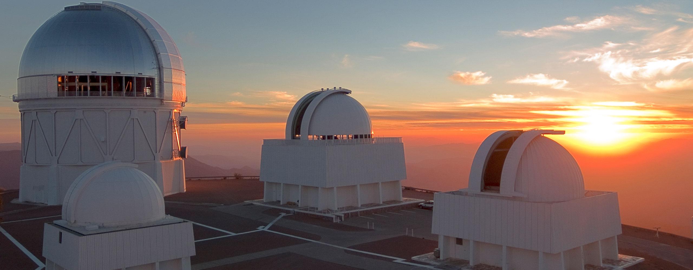
The HOWVAST survey
The Halo Outskirts with Variable Stars (HOWVAST) survey uses the Dark Energy Camera (DECam)
C: NOIRLab
Medina, Muñoz et al. (2024)

Slide 16
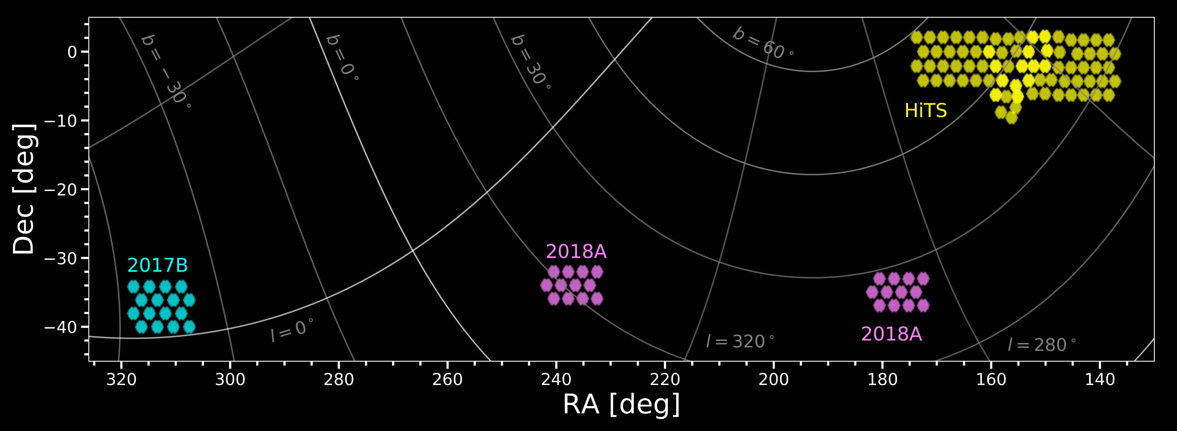
The HOWVAST survey
The Halo Outskirts with Variable Stars (HOWVAST) survey uses the Dark Energy Camera (DECam)
Medina, Muñoz et al. (2024)

Slide 17
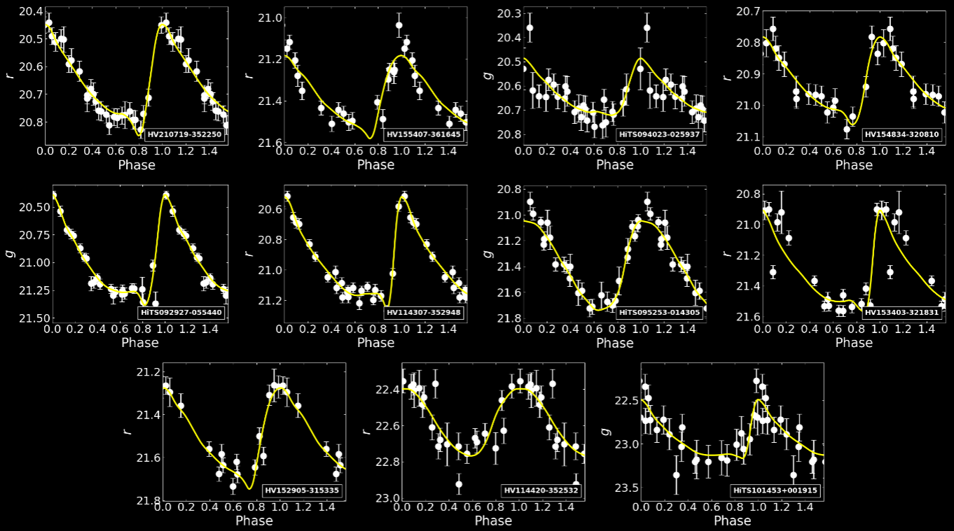
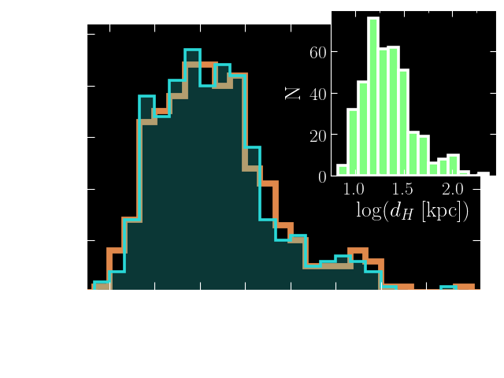
HOWVAST results
A total of ~ 600 RR Lyrae stars out to 270 kpc
Medina, Muñoz et al. (2024)

Slide 18
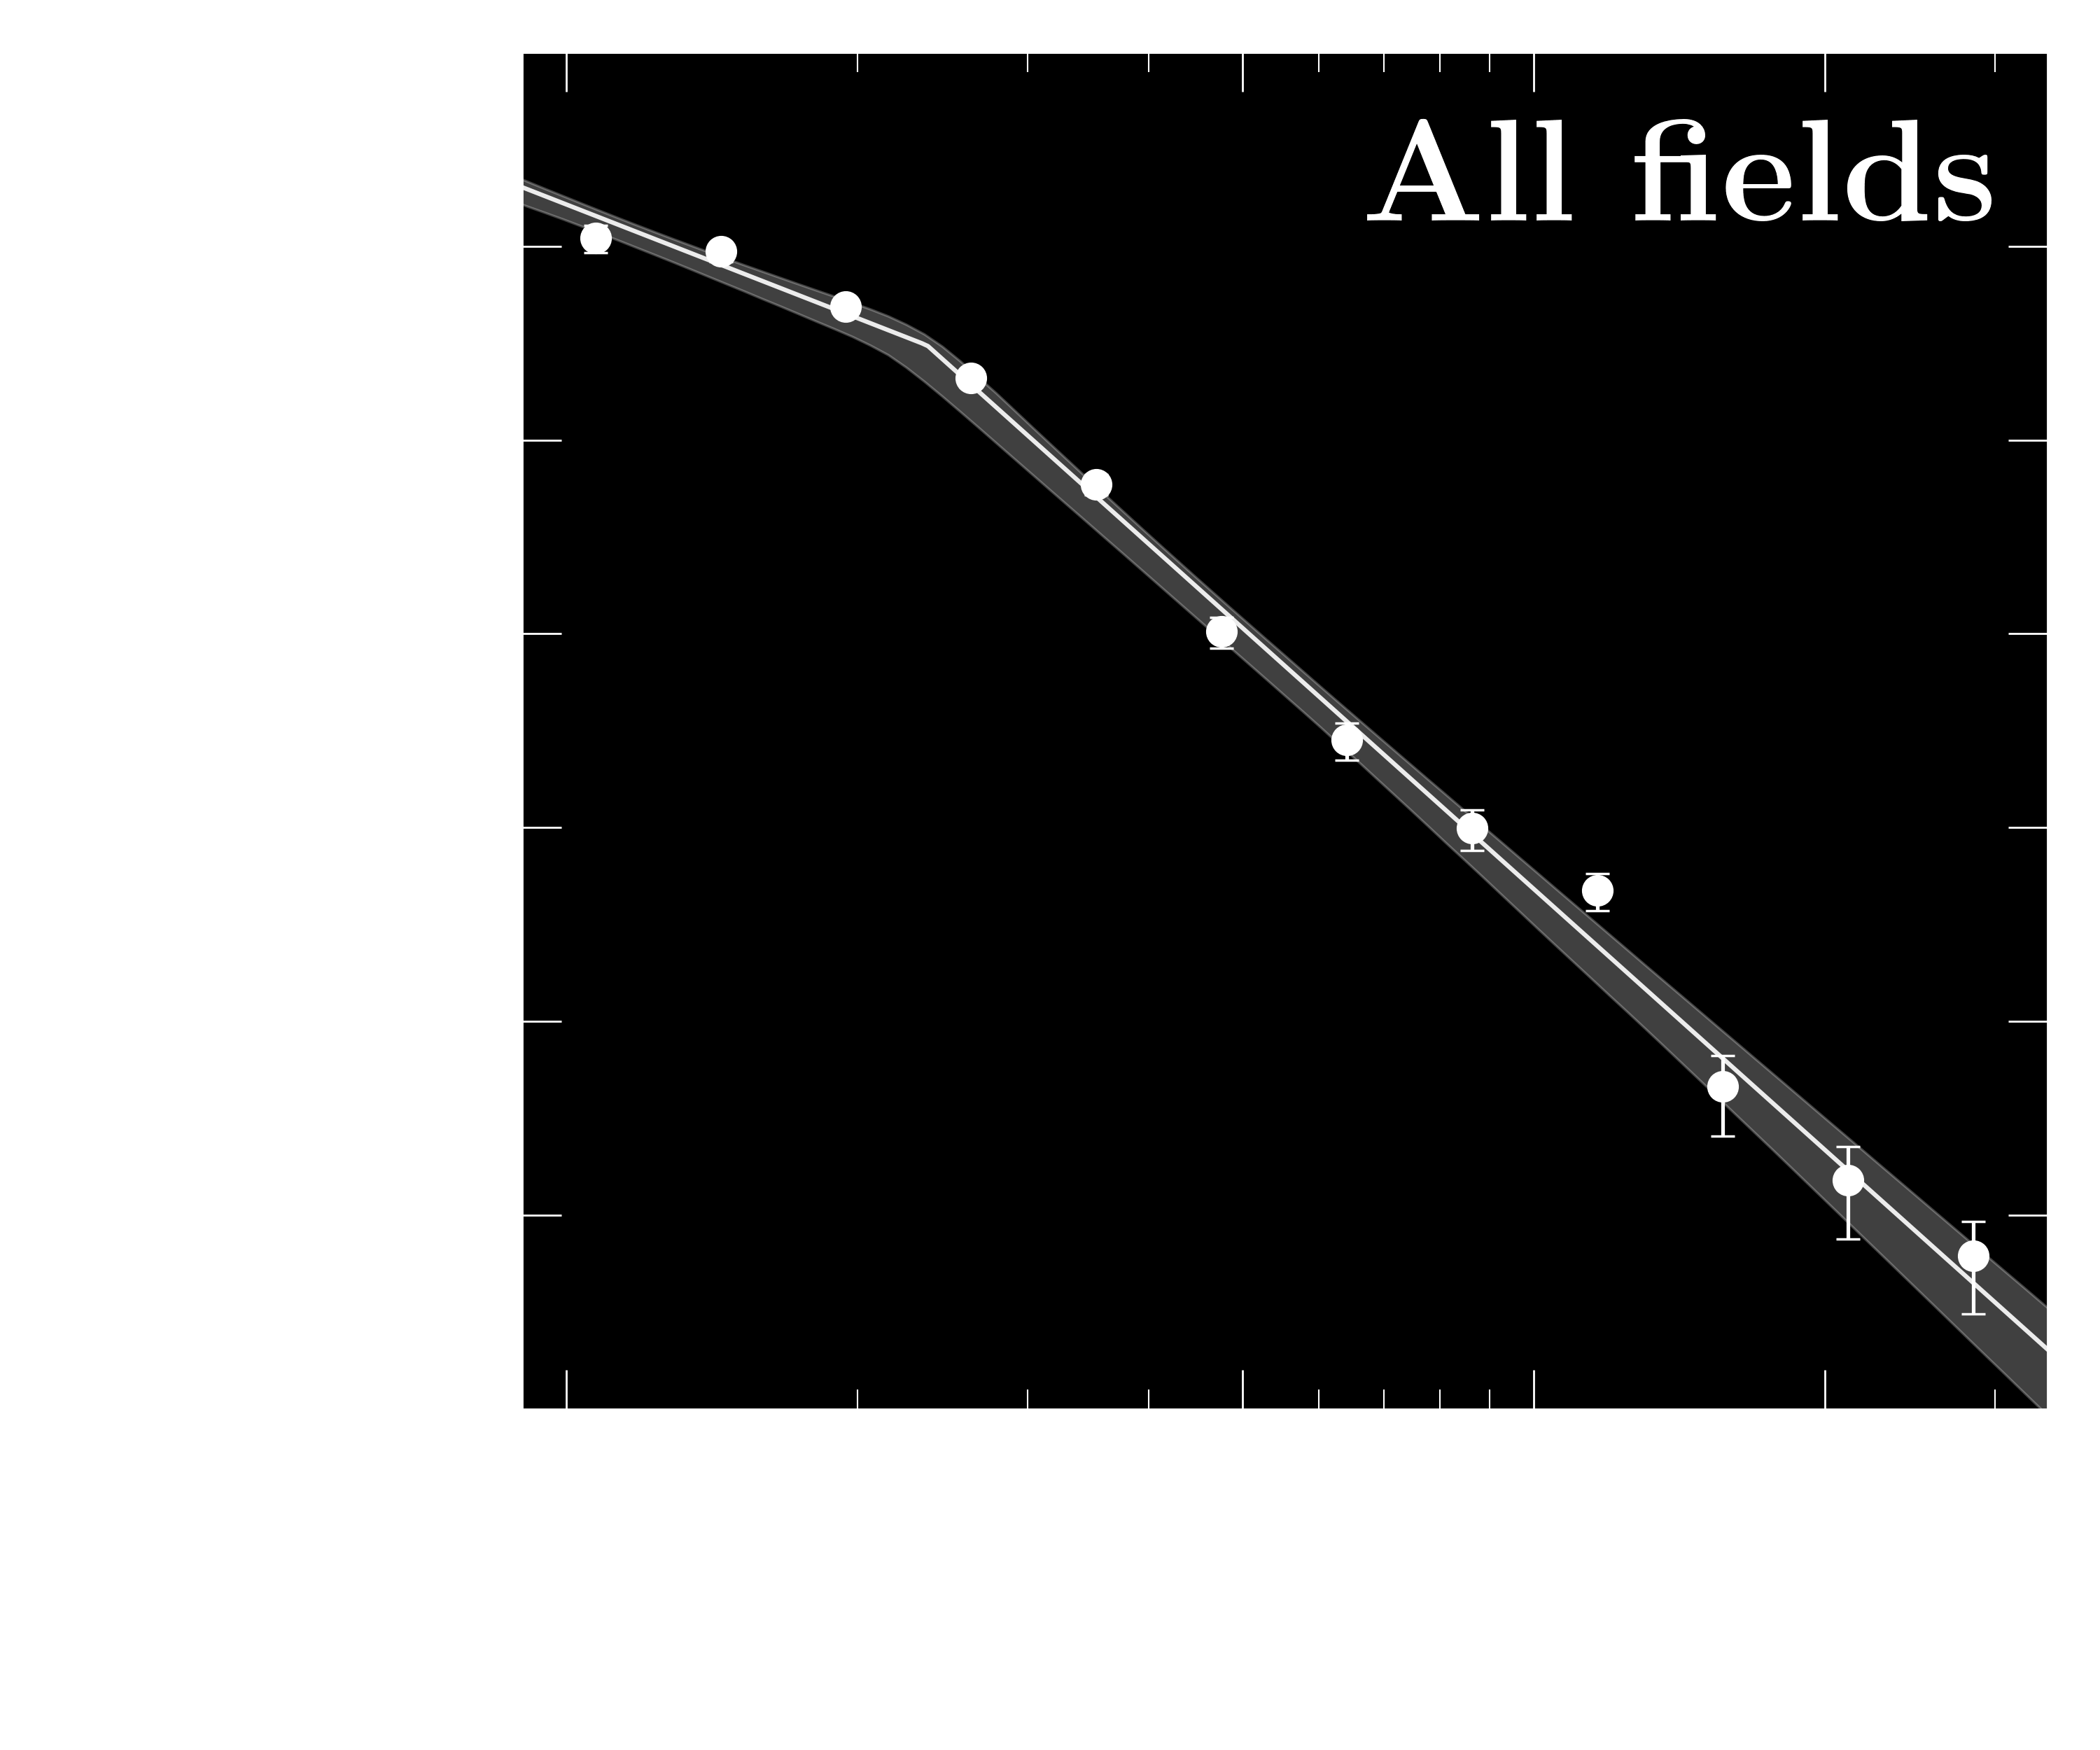
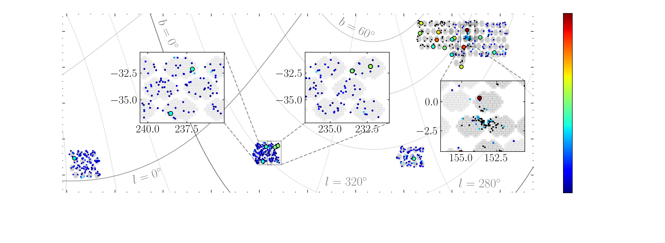
HOWVAST results: spatial distribution
The radial distribution follows a broken power law with a break at 22 kpc
> 600 RRLs identified in ~350 sq.deg.
25 field RRLs beyond 100 kpc (~1 per 10 sq. deg)
n = ⎼ 4.47
Medina, Muñoz et al. (2024)

Slide 19
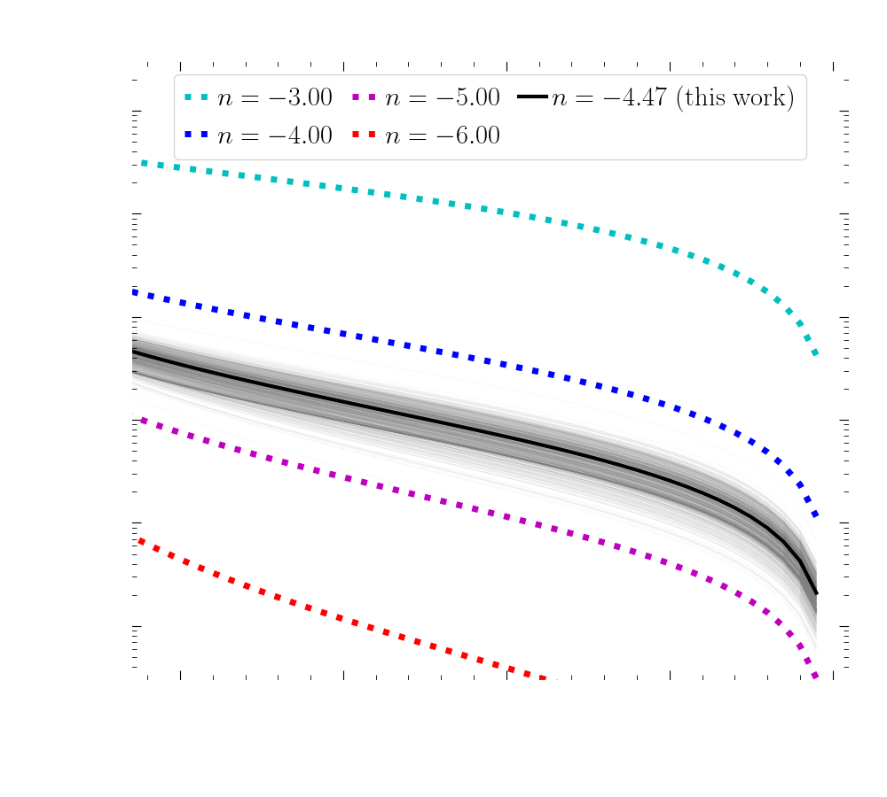
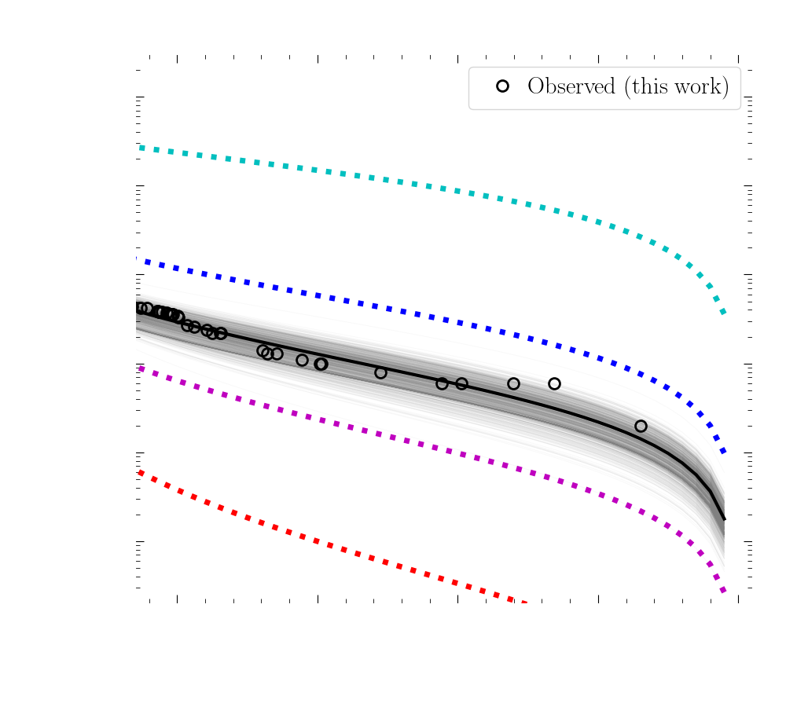
HOWVAST results: spatial distribution
Outer halo slopes
> 3,000 RRLs expected beyond 100 kpc!
Medina, Muñoz et al. (2024)

Slide 20
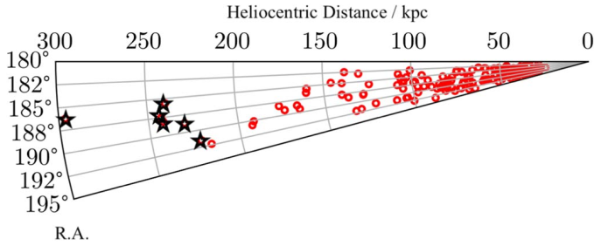
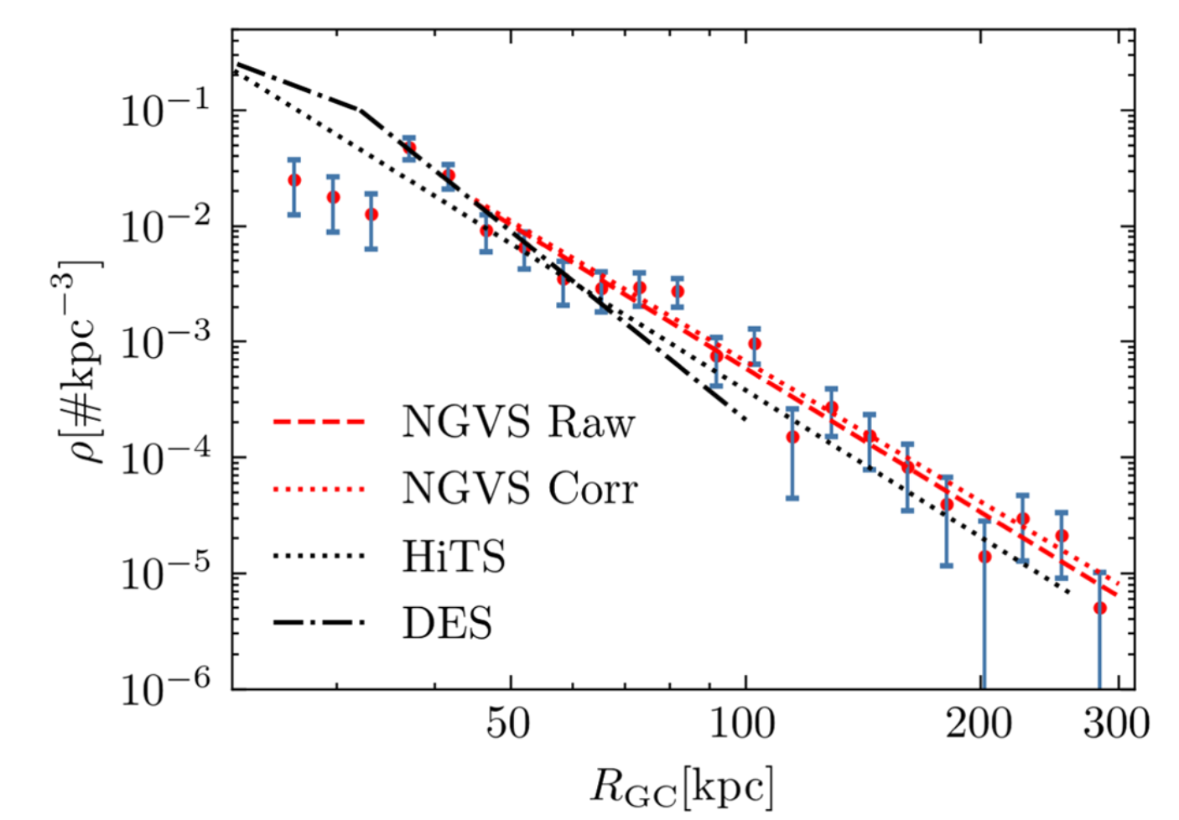
The search for distant RR Lyrae stars
Detection of ~180 RRLs in ~100 sq. deg. using ugiz CFHT/MegaCam photometry from the Next Generation Virgo Cluster Survey (NGVS) using template fitting
Distances out to ~300 kpc (mean g > 23 mag)
Sample used to study the halo number density profile with n = ⎼ 4.09+/⎼0.1
Feng et al. (2024)

Slide 21
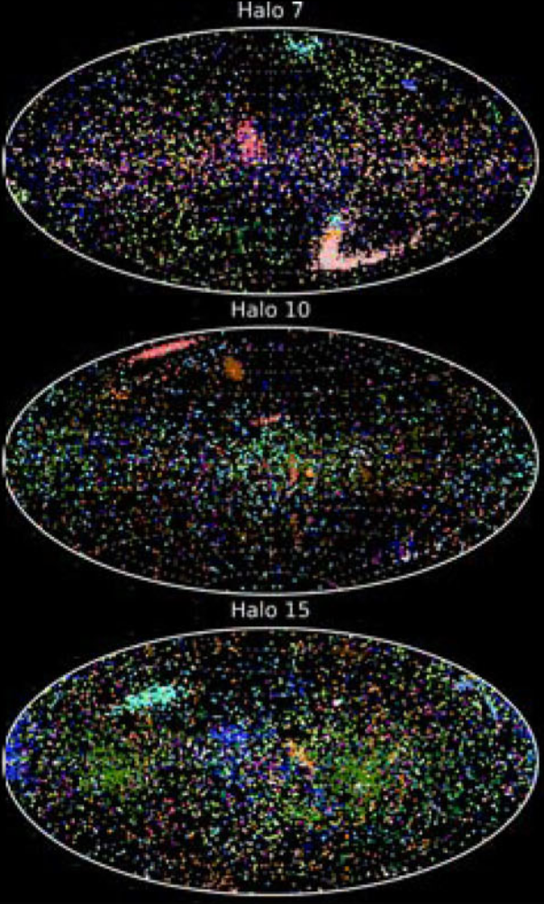
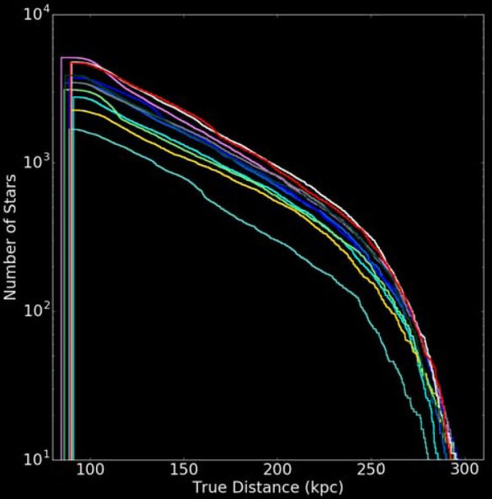

Distant RR Lyrae in the LSST era
Between 2,000 and 10,000 RR Lyrae beyond
100 kpc are predicted by models and observations
Several Galactic archaeology-related science cases, such as:
- halo shape and inclination,
- study of overdensities,
- anisotropies and wakes,
- distant systems,
- and many more
Sanderson et al. (2017)
10⁴
10³
10²
10¹
N
100 150 200 250 300
True distance [kpc]

Slide 22
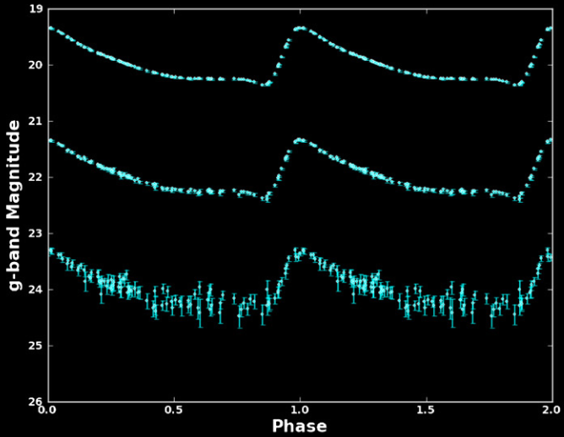
Distant RR Lyrae in the LSST era
- The Vera C. Rubin Observatory's LSST will recover a highly complete sample of the thousands of outer halo RRLs expected out to ∼ 400 kpc.
- The community is getting ready for the challenge.
Synergy with other surveys (dedicated and large-scale)
Oluseyi et al. (2012)
Developing brokers to help with the classification (e.g., ALeRCE, Antares, Fink)
Period-luminosity relations (Marconi et al. 2023), light-curve templates (e.g., Oluseyi et al. 2012, Braga et al. 2024), physical properties (e.g., Bhardwaj et al. 2023)

Slide 23
Summary
Samples of distant halo RRLs are important to:
1) Measure the slope of the halo radial density profile
2) Search for faint outer halo systems and streams
3) Help estimate the mass of the Milky Way at large distances
With our HOWVAST survey, we detected 30 RRLs beyond 100 kpc, and out to 270 kpc. Models predict at least ~3,000 RRLs > 100 kpc over the entire sky. Our results support a MW halo on the massive side of current determinations and a relatively active recent accretion history of the outer halo.
Detecting RRLs at large distances remains a challenging task that requires large amounts of telescope time. However, the advent of the LSST will open a new era in the exploration of the outer halo

Slide 24
Thank you!

