Slide 1
Statistical Studies of Exoplanets with LAMOST and Future Prospects with ESST
Ji-Wei XIE (謝基偉）
Nanjing University （南京大學）
2026-01-08，HongKong （香港）
Notes:
Good afternoon everyone! It's a real pleasure to give the talk today to share our recent work on exoplanet statistics.

Slide 2
Outline
Research Background
  Importance and Important Progresses of Planetary Statistics
Exoplanet Statistical Research Based on LAMOST
  2.1 Progress from LAMOST+Kepler Synergy
  2.2 Progress from LAMOST+Gaia+Kepler/TESS Synergy
  (the “PAST”Series)
Prospects and Summary
Notes:
Here’s my outline. In the first part, I just want to emphasize a common sense： planetary statistics is very important.

Slide 3
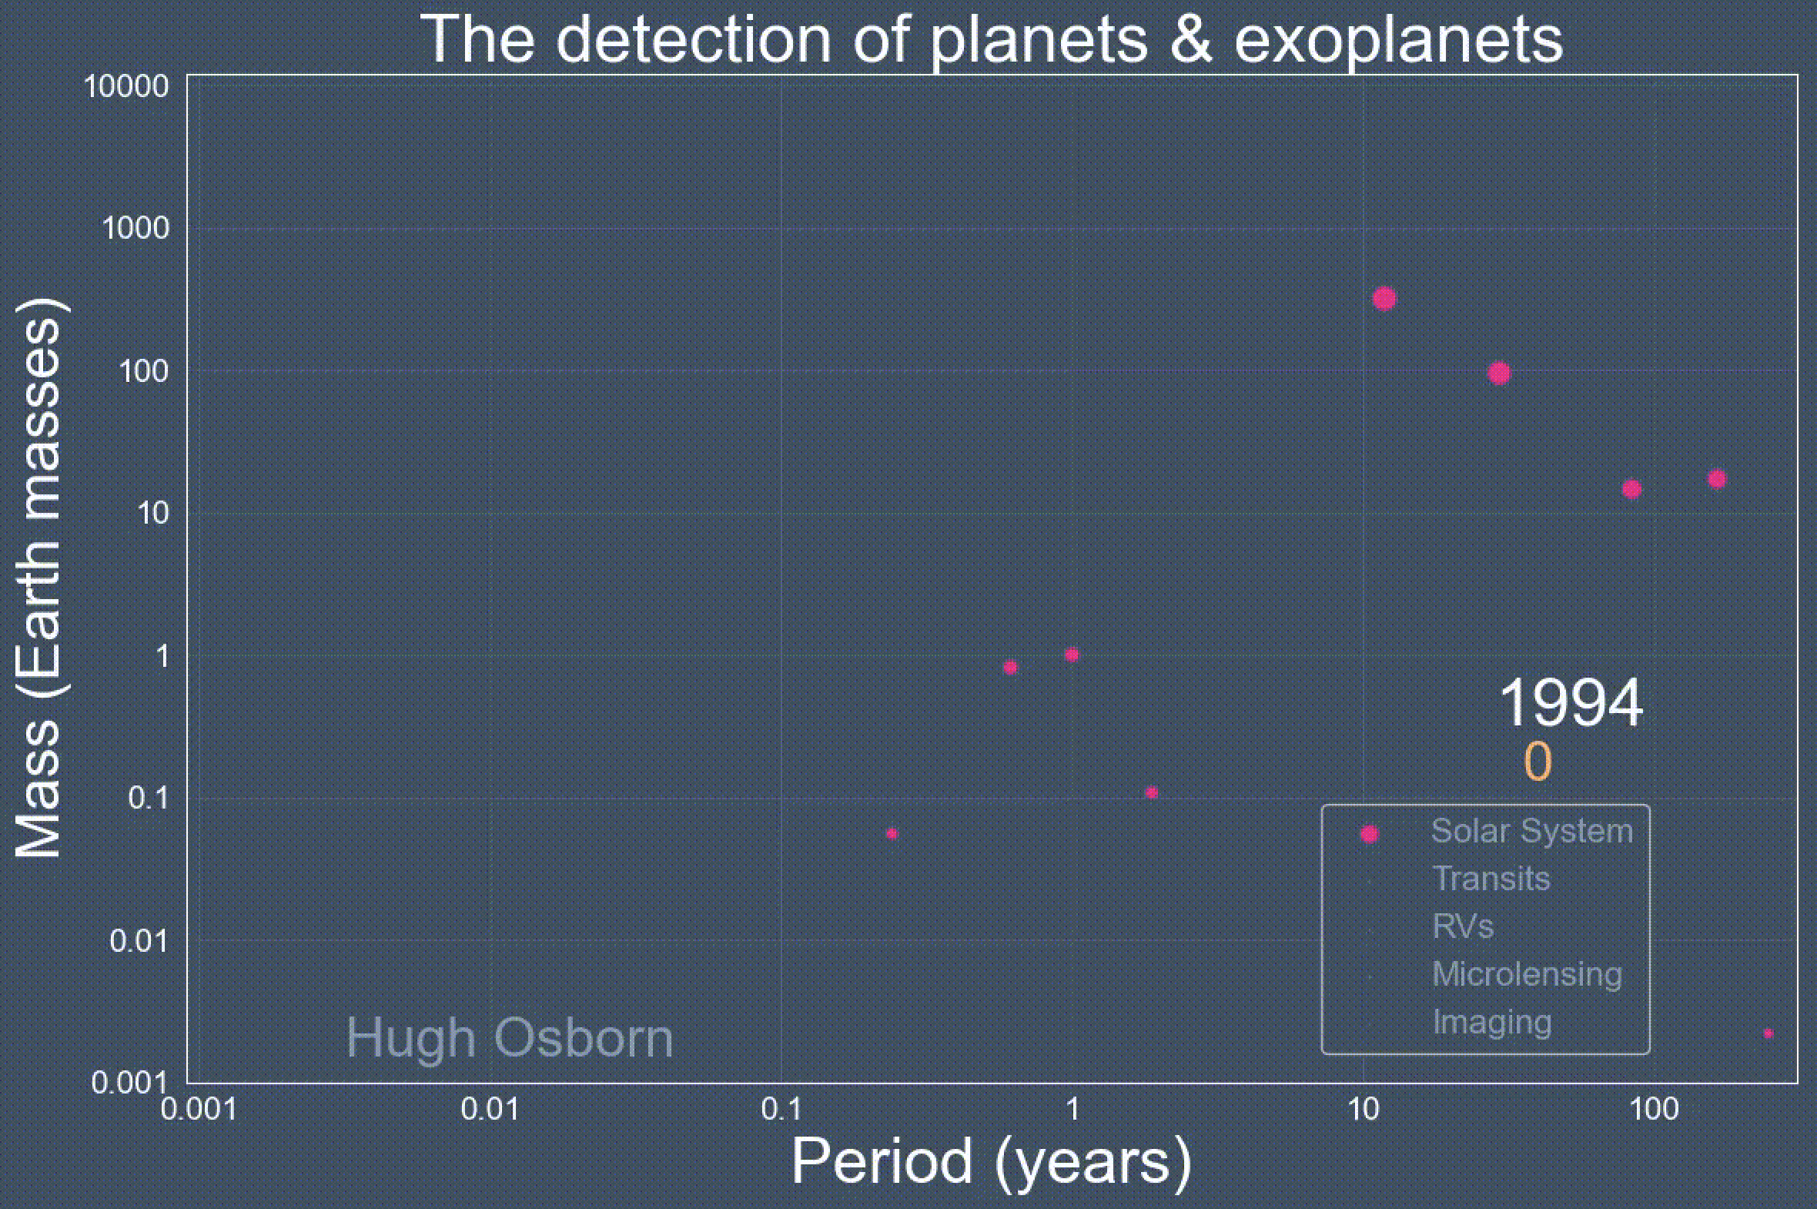
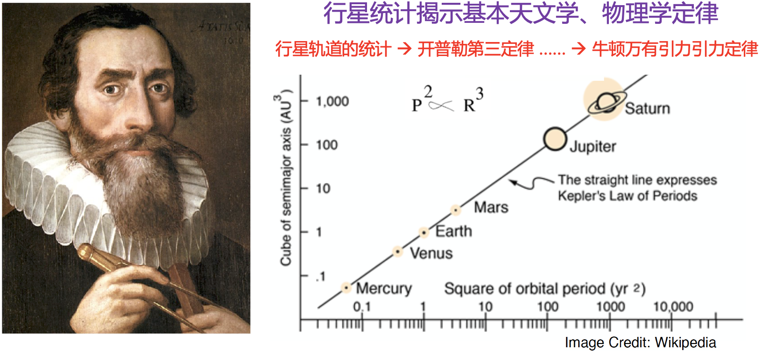
Important Progresses of Planetary Statistics
Era of the Solar System Planets (Pre-1995)
Before 1995
Notes:
The importance has been well demonstrated 400 years ago by Kepler using only 6 planets in our solar systems. The Kepler law revealed by the statistics of these 6 planets is the foundation of our physics and astronomy today.

Slide 4
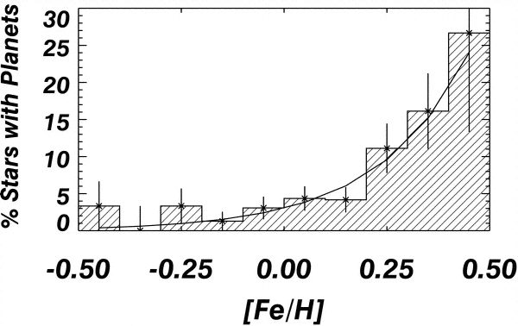
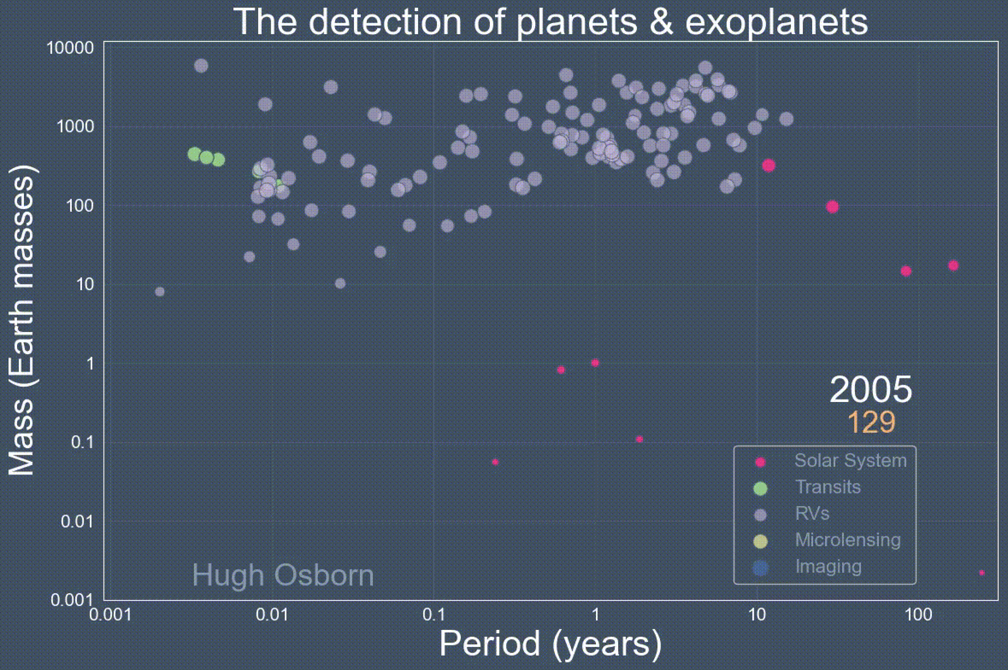
Important Progresses of Planetary Statistics
Era of Exoplanets (1995-)
giant planets - stellar metallicity correlation
observational foundation for the theory of planet formation (Core Accretion)
Jupiter-like Planets
mainly by ground-based RV
First Half:1995-2010
Fischer & Valenti 2005
Also see
Gonzalex 1998
Santos+2001
Santos+2004
Notes:
Since 1995, important progresses of Planetary Statistics have been made beyond the solar system. For example, the well known giant planets - stellar metallicity correlation was established in the first half of exoplanet era, which is the observational basis for the current standard model of planet formation.

Slide 5
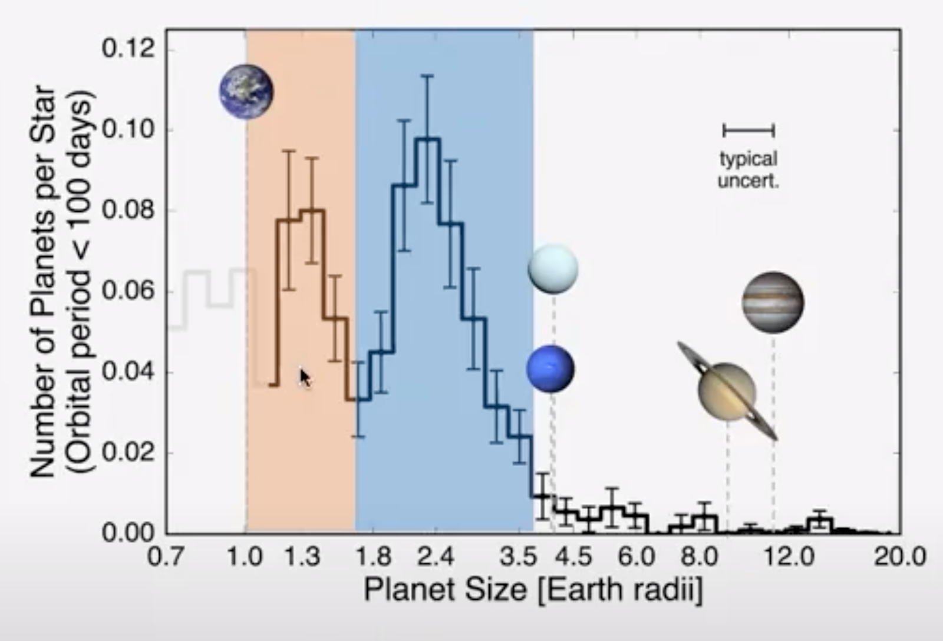
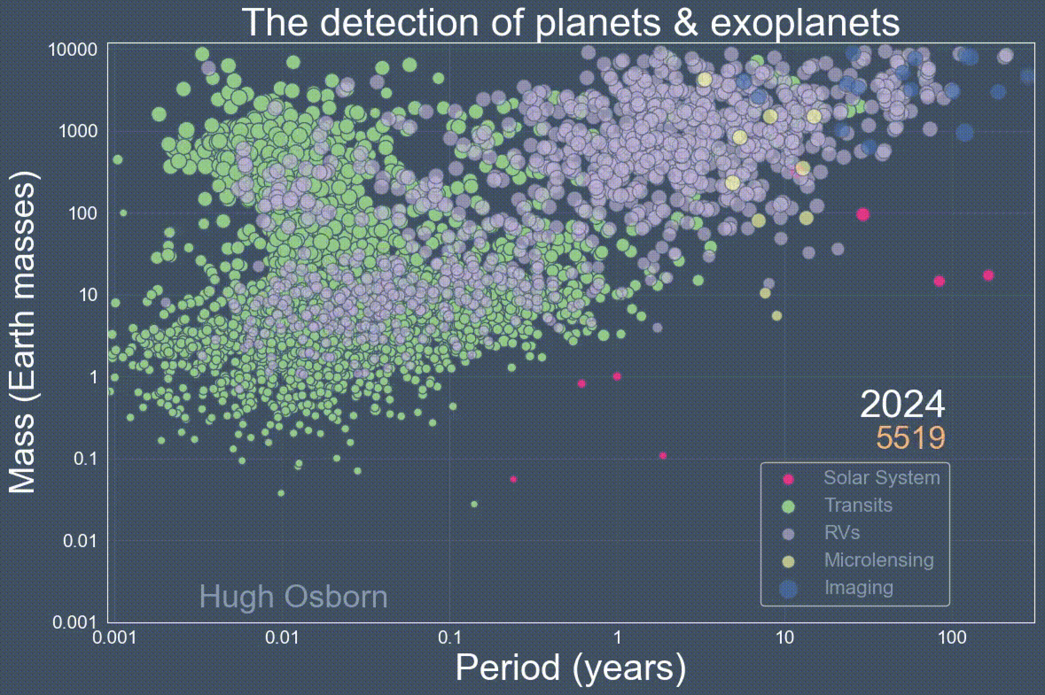
Important Progresses of Planetary Statistics
Era of Exoplanets (1995-)
the Planet Radius Valley
Super Earths/Sub-Neptunes
mainly by space-based Transit
Revealing the formation and evolution of different planet populations
Second Half: 2010-2025
Fulton et al. 2017
Also see
Owen & Wu 2013
Van Eylen et al. 2018
Notes:
Another example is the well know radius valley established in the second half of exoplanet era, which tells us a lot about the diversity in how small planets form and evolve.

Slide 6
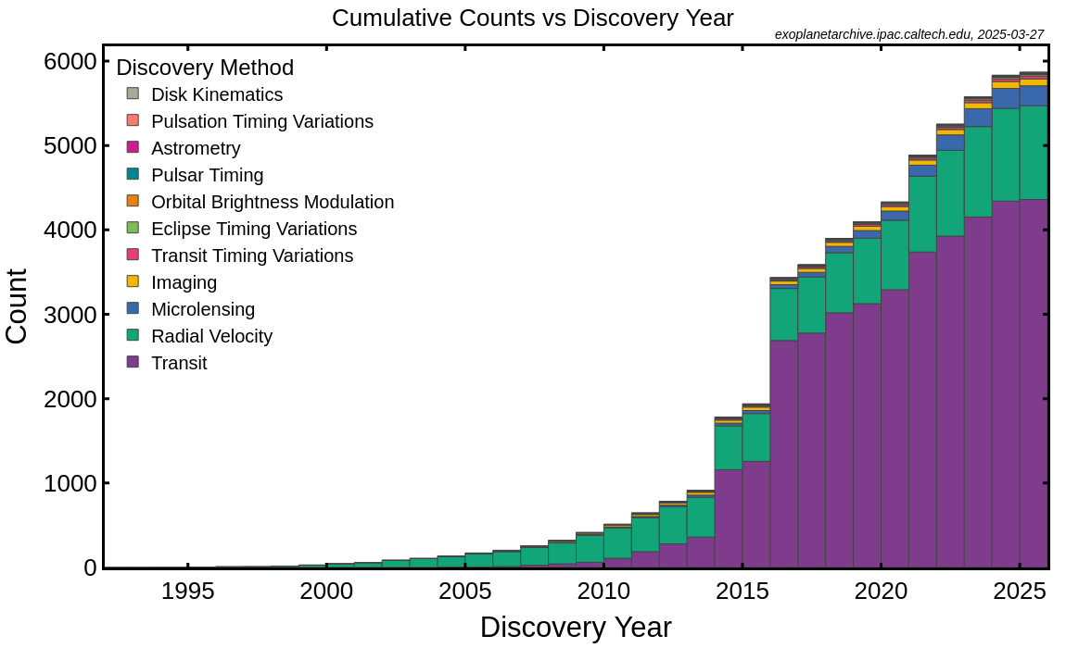
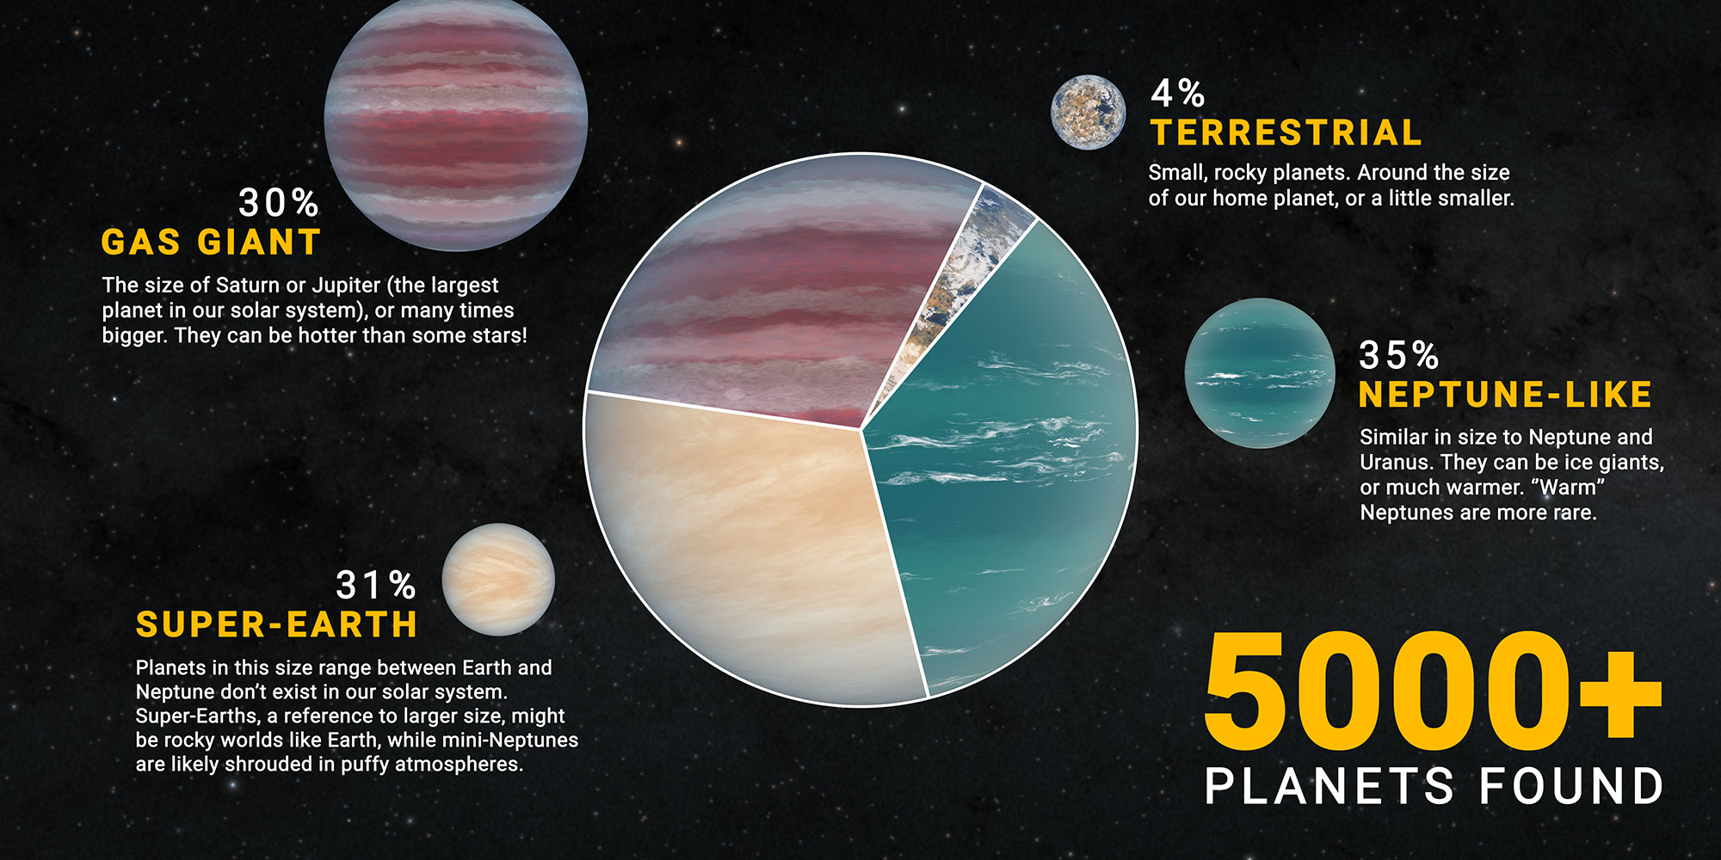


Exoplanets: the Era of Planet Census
By finding thousands of planets, exoplanet field has been revolutionized and entered a new era of exoplanet census.
Notes:
So, in a word, Planetary statistical studies are important, and we are in the good time by finding thousands of exoplanets.

Slide 7
Outline
Research Background
  Importance and Important Progresses of Planetary Statistics
Exoplanet Statistical Research Based on LAMOST
  2.1 Progress from LAMOST+Kepler Synergy
  2.2 Progress from LAMOST+Gaia+Kepler/TESS Synergy (“PAST”Series)
Prospects and Summary
Notes:
Then, in the second part, I will introduce our Exoplanet Statistical Research Based on LAMOST.

Slide 8

LAMOST
Large sky Area Multi-Object Fiber Spectroscopy Telescope
Features: Large field of view (20 square degrees), Multi-object (4000 fibers).
over 20 million spectra, nearly 3 times the sum of other international survey telescopes).
2012-2017: first phase of scientific observations.
2018-2023: second phase of scientific observations.
2024- : third phase of scientific observations.
Notes:
The Full name of LAMOST is Large sky Area Multi-Object Fiber Spectroscopy Telescope. The key features are the large field of view and the 4,000 fibers. LAMOST provides us with a large sample of stars with well-measured parameters, which is crucial for exoplanet statistics.

Slide 9
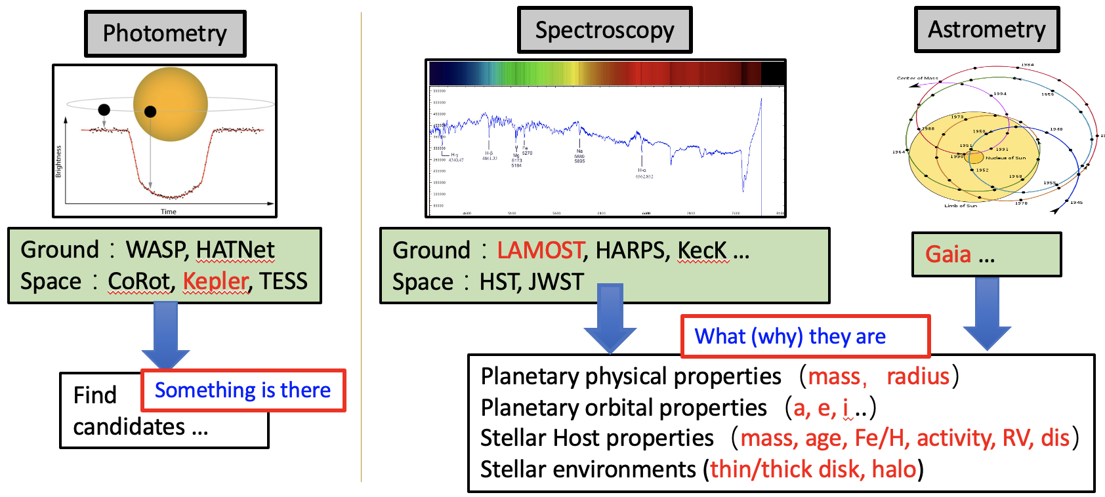
Why LAMOST ?
Exoplanet census needs star census
Know thy star, know thy planet
To accurately characterize planets (2) To reveal the star-planet relations
Notes:
Why LAMOST is important for exoplanet statistical studies.
Because, planet census needs not only to know lots of planets but also to know lots of stars.
As the saying goes “Know thy star, know thy planet.”
Planet survey like Kepler is a photometry survey, which alone provides limited information.
By combining with stellar spectroscopy survey, like Lamost, and Astrometry survey like gaia, we can accurately characterize the properties of planets and study their relations to stars, which can provide more constraints to planet formation and evolution.

Slide 10
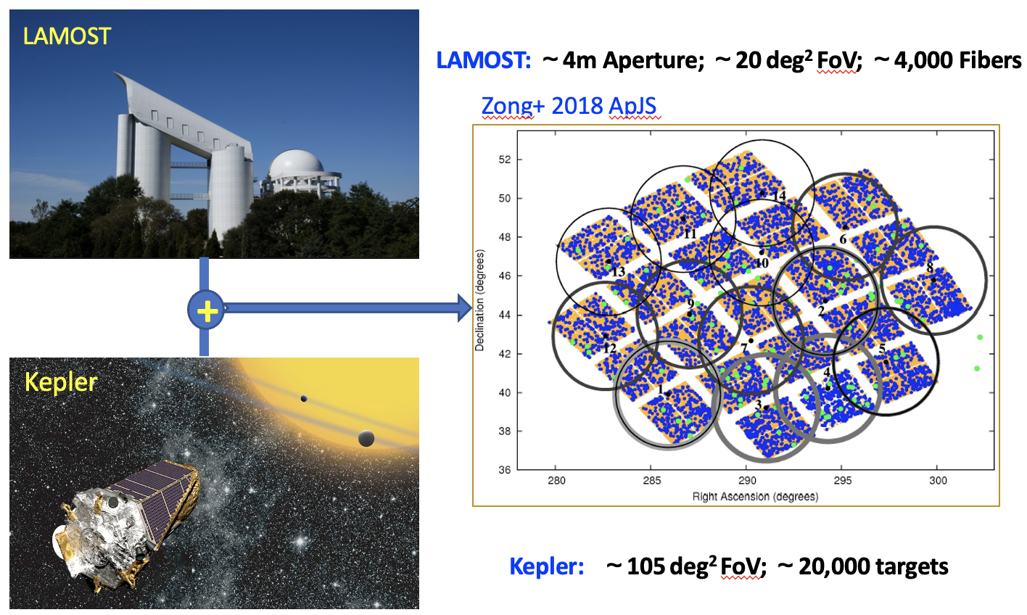
LAMOST-Kepler Synergy
De Cat, Fu, Yang et al., 2015
Notes:
We started with the LAMOST-Kepler synergy.

Slide 11
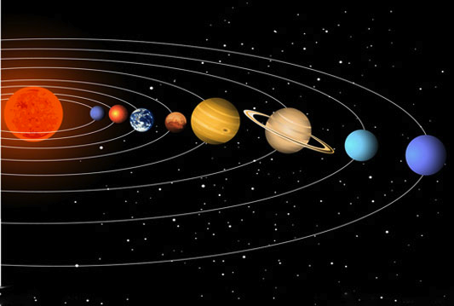
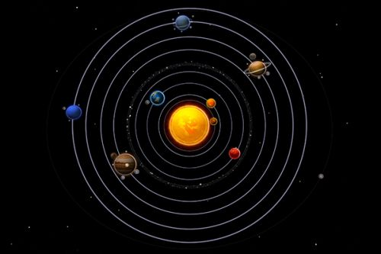
Revealing the orbital patterns of exoplanets
Two basic observational facts of the Solar System.
(1) Nearly Coplanar
(2) Nearly Circular
Scientific Question: Is this nearly "perfect" orbital configuration of the Solar System unique?
What about the orbits of exoplanets?
Notes:
Using this LAMOST-Kepler sample, we first carried out two studies. One focused on exoplanet orbits. We know our Solar System's eight planets orbit in nearly the same plane, with very small inclinations, and their orbits are almost circular, with low eccentricities. So, is our Solar System's neat architecture special? Now that we've found thousands of exoplanets, we can ask: what do *their* orbits look like? Answering this helps us understand our Solar System's place in the universe.

Slide 12
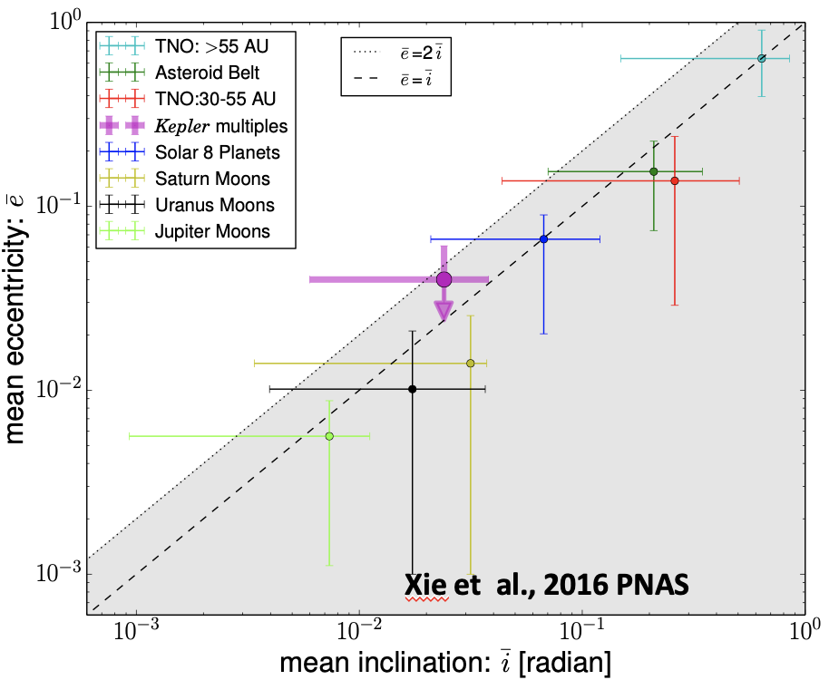
Revealing the orbital patterns of exoplanets
A common pattern
inside and outside the Solar System
The Solar system is not special in this regard.
Xie* & Dong* et al. 2018 PNAS
Notes:
Using the LAMOST-Kepler data, we measured the distributions of orbital eccentricities and inclinations for exoplanets. We found that most small planets actually have very circular orbits, similar to our Solar System. Interestingly, we also found a common linear trend linking the average eccentricity and inclination in Kepler multi-planet systems and in our own Solar System. This suggests that flat, circular orbital architectures like our Solar system is not so special.

Slide 13
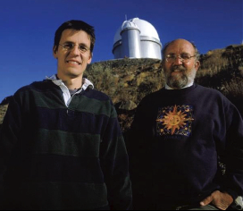

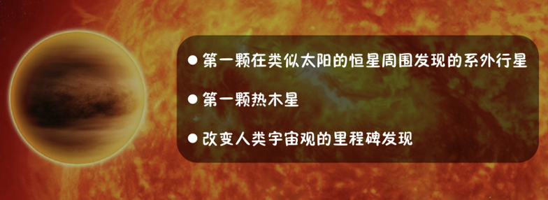


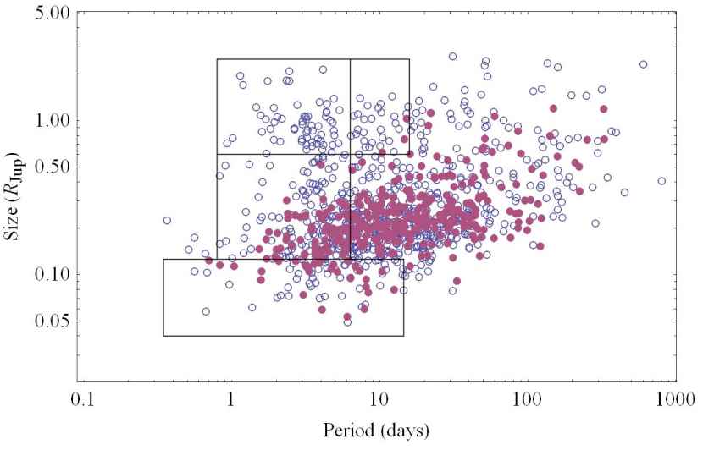
Discovering a new planet population
研究背景:
热木星倾向于出生富贵的独生子女家庭
Hot Jupiters prefer in
(metal-) “rich” “single-child”
family
Fischer & Valenti 2005
Also see
Gonzalex 1998
Santos+2001
Santos+2004
Steffen+2012
See also Huang+2016
Notes:
The other study was about hot Jupiters. As more were found, two key features emerged from previous statistics: first, the strong correlation with high host star metallicity—they prefer metal-rich stars. Second, hot Jupiters are often "only children," rarely having other planetary neighbors close by. In short, hot Jupiters tend to be born in "rich, single-child families."

Slide 14
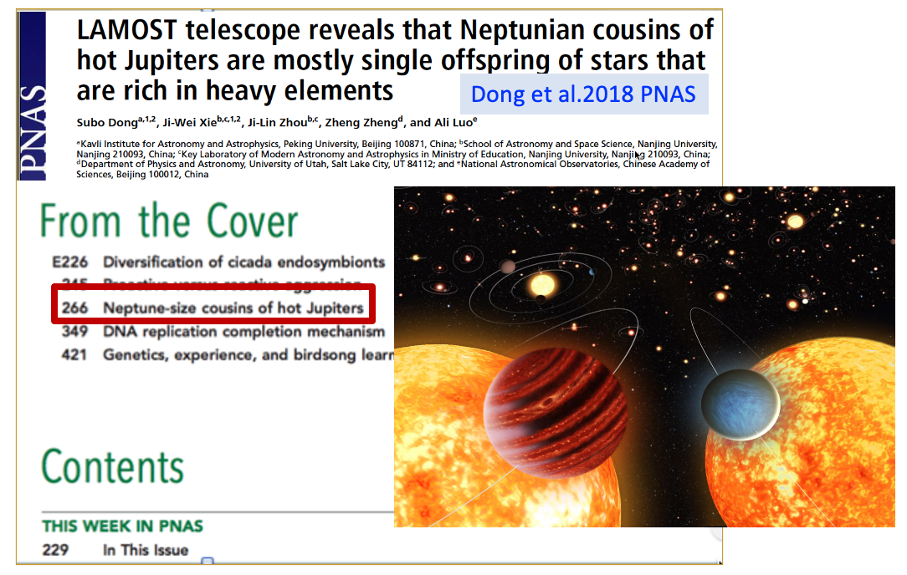
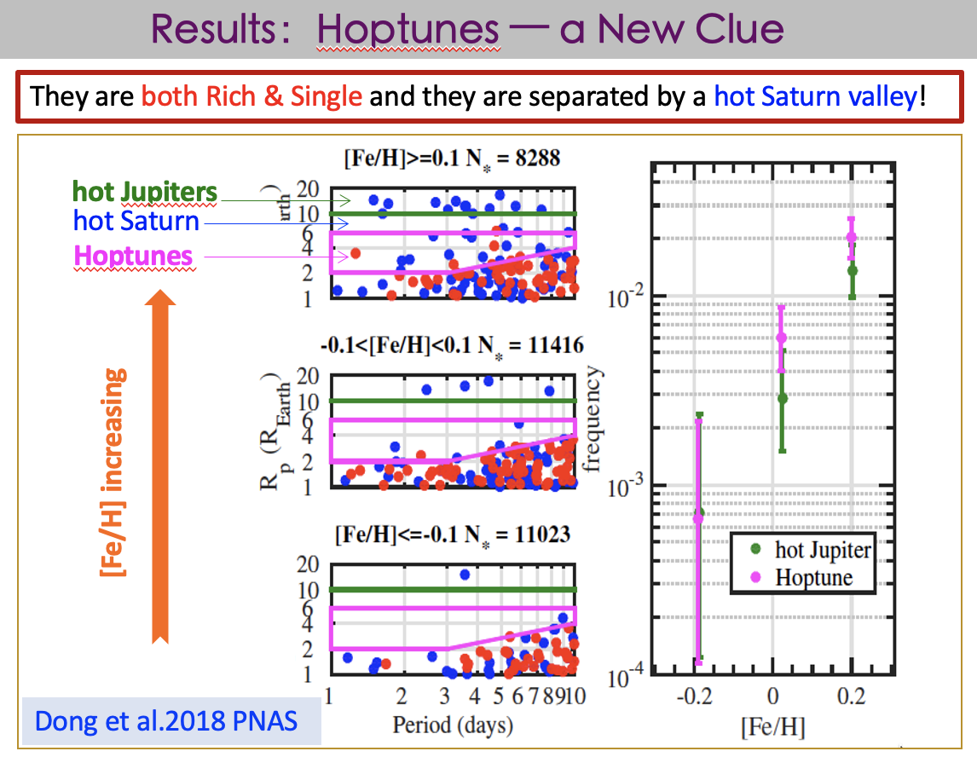
Discovering a new planet population
Dong* & Xie* et al. 2018 PNAS
Notes:
Using the LAMOST-Kepler sample, especially the metallicities from LAMOST, we discovered a population similar to hot Jupiters but smaller—about Neptune-sized. We call them "hoptunes." They share the same two key features: a preference for metal-rich stars and being relatively lonely. You can see in the plot on the right that as metallicity increases, the occurrence of both hot Jupiters (green) and hot Neptunes (pink) rises together.

Slide 15

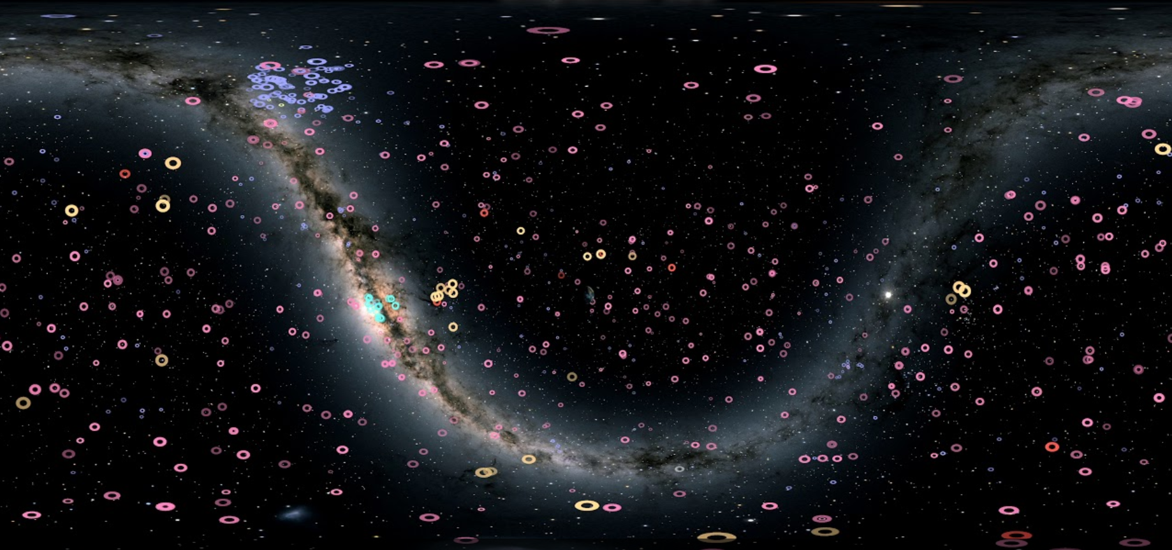
LAMOST – Kepler– Gaia Synergy
光谱Spectroscopy
测光 Photometry
天测Astrometry
Teff,
logg,
RV,
Fe/H
…
Kepler
TESS
Distance,
Proper
Motion
…
Gaia
LAMOST
Exoplanet in the Galactic Context
Planet Census
In the Milky Way
银河系的大背景下
行星普查
Planetary Properties as functions of Galactic Environments (e.g., Thin/Thick disks)
Planetary Properties as functions of Time (Kinematic age, Isochrone age, Rotation age)
Notes:
The value of LAMOST increased even more with the release of Gaia data. By combining these three fundamental datasets of Astronomy—spectroscopy from LAMOST, photometry from Kepler, and astrometry from Gaia—we can study exoplanets in a broader context of our Galaxy. And we can do many more interesting statistical studies.

Slide 16










NJU Exoplanet Census Team
Ji-Wei XIE
谢基伟
Di-Chang CHEN
陈迪昌
Jia-Yi YANG
杨佳祎
Pei-Wei TU
涂培玮
Di WU
武迪
PAST
PET
POET
DEB
CASH
Rui-Sheng ZHANG
张睿晟
Planets Across Space and Time (PAST)
“穿越”系列
Chao-Feng JIANG
姜朝峰
Meng-Fei SUN
孙梦菲
Exoplanet
census
Planetary Edge Trends （PET）
“宠物”系列
Planetary Orbital Eccentricity Trends (POET)
“诗人”系列
Ke-Ting Xin
辛科霆
Dong-Shen An
安东升
Demographics of Exoplanets in Binaries (DEB)
“新秀”系列
Chemical Abundance Shapes History(CASH)
“现金”系列
Notes:
Facing such a great opportunity, our team at Nanjing University has already laid out plans. We have conduct exoplanet statistical studies in different series. In this talk, I only have time to mention the PAST series.

Slide 17
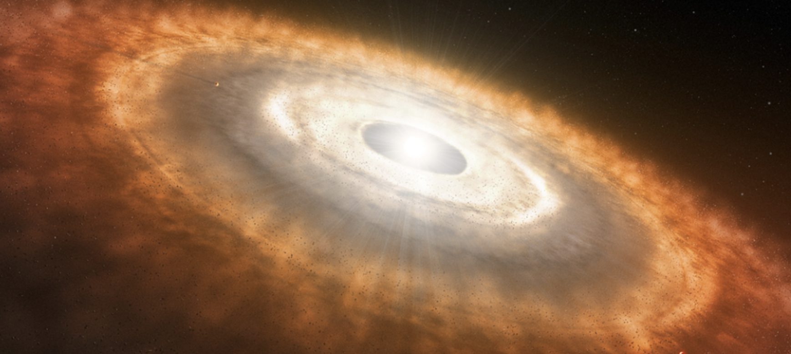

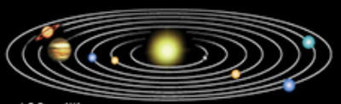
NJU Exoplanet Census Team: "PAST" Group
Di-Chang Joined the faculty of
SYSU this summer
Jia-Yi YANG
杨佳祎
Di WU
武迪
Di-Chang CHEN
陈迪昌
Pei-Wei TU
涂培玮
“穿越”系列
Planets Across Space and Time (PAST)
To Reveal the Observational Evidences of Planetary Evolution
0.01 Gyr
0.1 Gyr
1 Gyr
Notes:
PAST, stands for "Planets Across Space and Time." I give it the Chinese name "穿越" (Chuanyue), to express that we really want to go back to the PAST, to find direct observational evidence for how planetary systems formed and evolve.

Slide 18
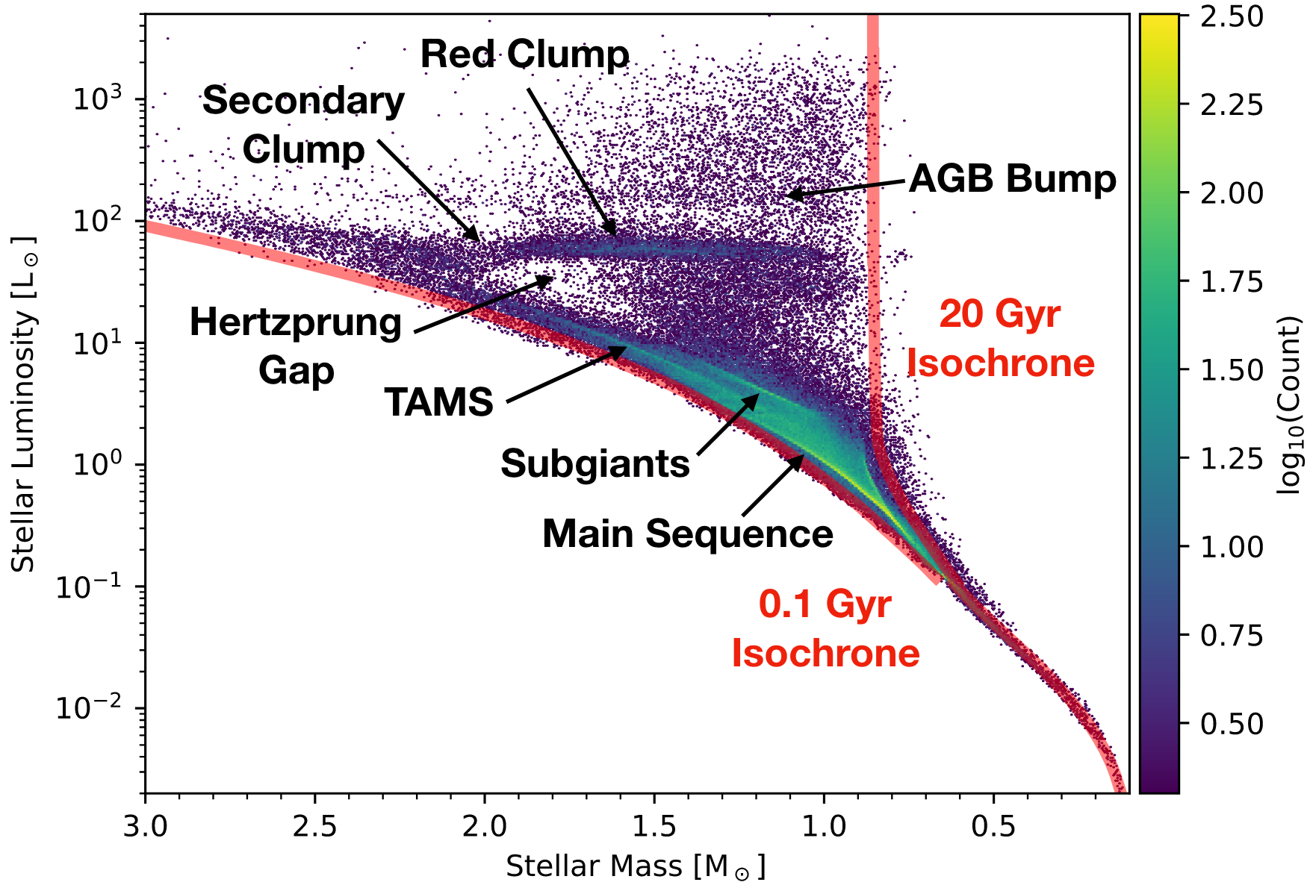
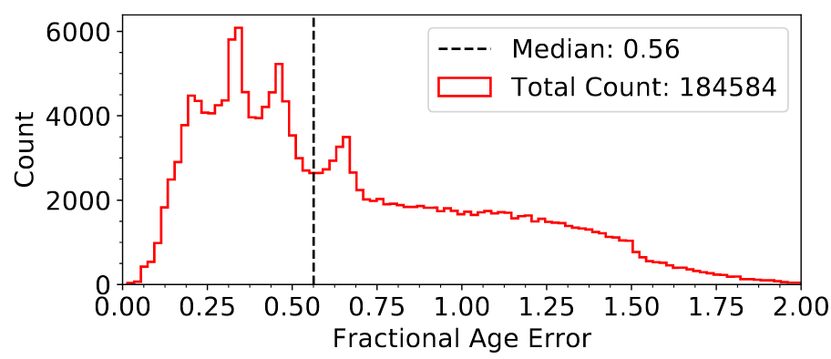
Challenges of the Research
Age is crucial, but estimating age, especially the age of exoplanet host stars (main sequency), is not an easy task.
median error 56%
Berger et al. 2020
Notes:
Now, the key is to derive the age of star. However, estimating age is not an easy task. The age estimates provided by commonly used stellar evolution models often have large errors for main-sequence stars, which are the majority of planet host stars. For instance, the median age error for most exoplanet host stars reaches 56%.

Slide 19
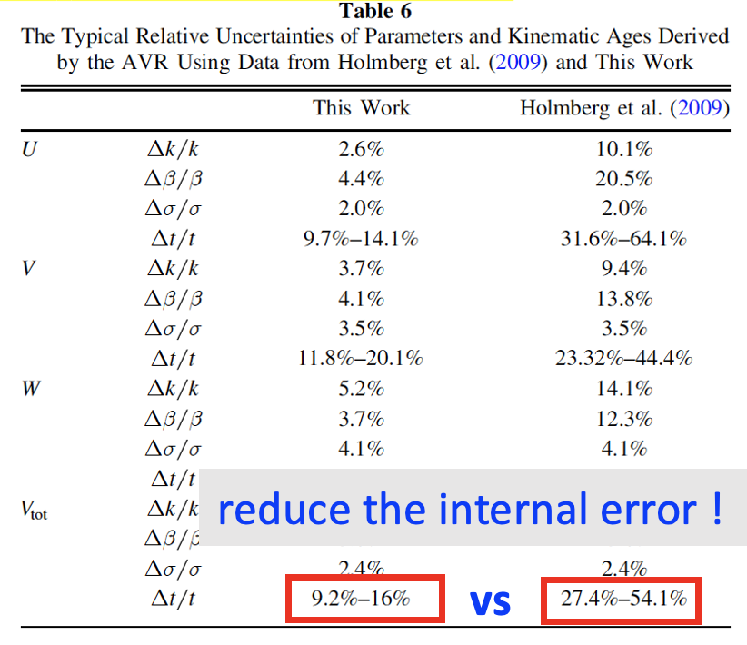
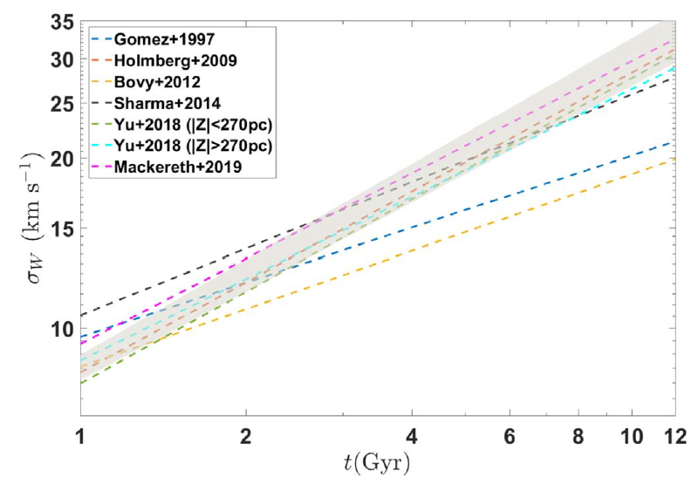
PAST Approach: Kinematic Age
A Well Calibrated Age-Velocity Relation based on LAMOST and Gaia
Reducing the age error from approximately 50% to 15%
Chen et al. 2021 ApJ
Notes:
To overcome this difficulty, we took a different approach and used stellar motion to estimate stellar ages. Using large samples from LAMOST and Gaia, we recalibrated the relationship between velocity dispersion and age, reducing the error to about 15%. This gave us a much better foundation to study how planets change over billions of years.

Slide 20
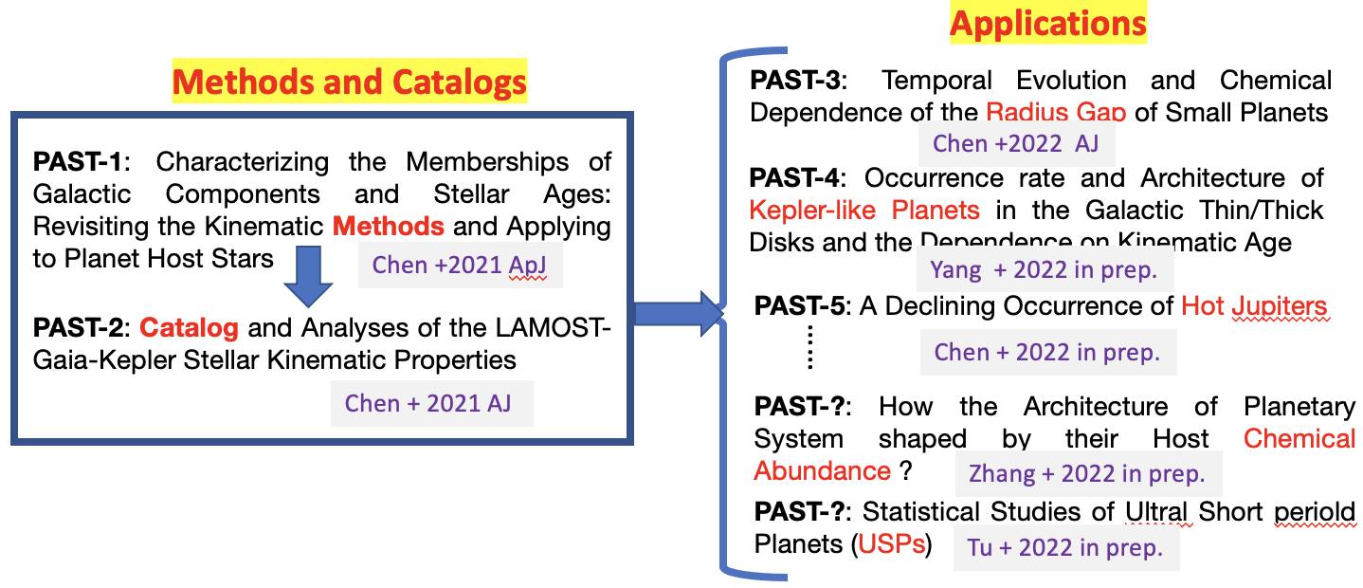
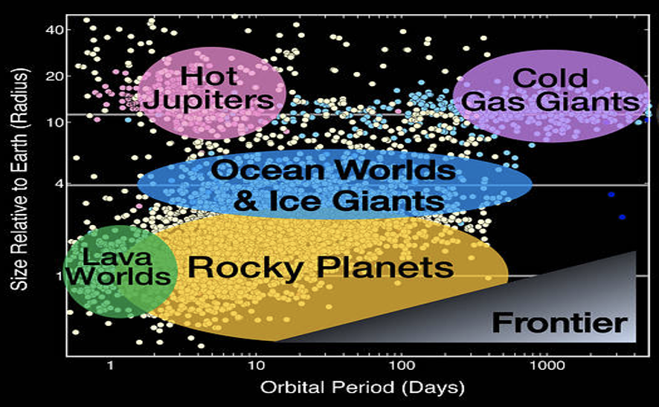



Plan of the PAST
PAST-3 & 4: Applications to Super-Earths & Sub-neptunes; (Chen+2022 AJ, Yang+2023 AJ)
PAST-5 & 7: Applications to Hot Jupiters; (Chen+2023 PNAS, Chen+2025 Nature Astronomy)
PAST-6: Application to USP planets (Tu+2025 Nature Astronomy)
Notes:
The plan of PAST is, first we revise the method and build the catalog.
Because different populations of planets may have different formation and evolution paths, different people will apply to different populations of planets.

Slide 21
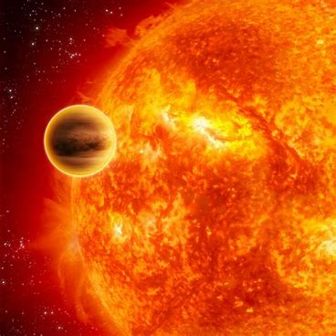
Hot Jupiters
Notes:
For Hot Jupiters.

Slide 22
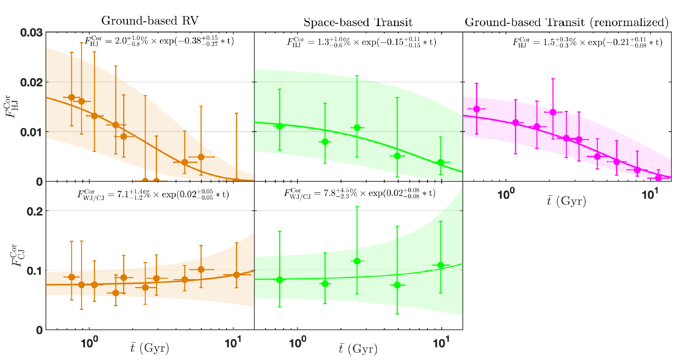
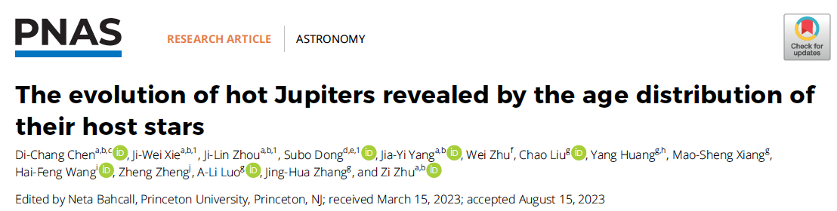
Evolution of Hot Jupiters
Hot Jupiters
Hot Jupiter (not cold Jupiters):
Occurrence decreases with age
Cold Jupiters
PAST-5: Chen , Xie* & Zhou* et al. 2023 PNAS
Notes:
We found the occurrence rate of hot Jupiters drops significantly with age,in contrast, the occurrence rate of cold Jupiters stays pretty constant with age.

Slide 23
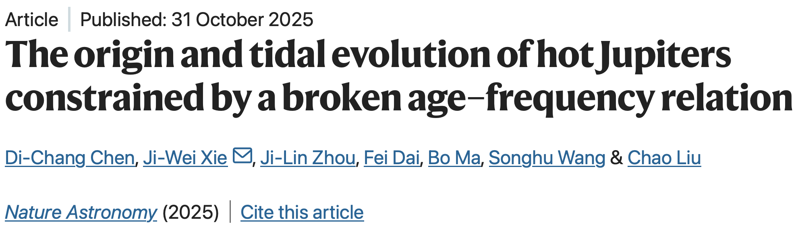
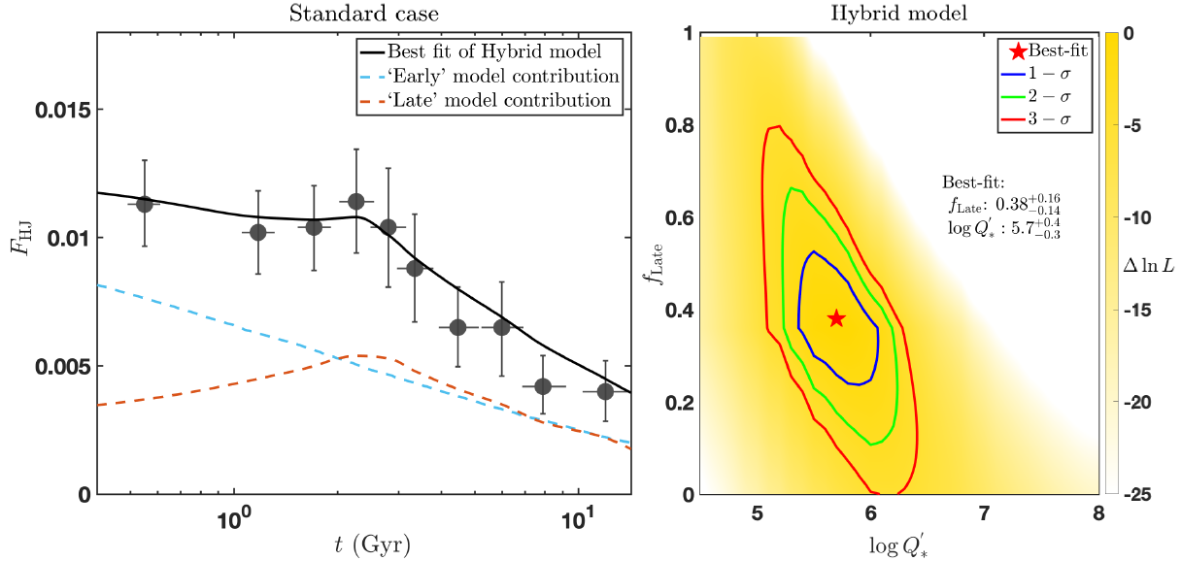

New Progress
PAST-7: Chen, Xie*, Zhou et al. 2025 Nature Astronomy
Quick model: ~ 60%
Timescale within < 0.1 Gyr
In-situ formation, disk migrarion
planet scattering/Kozai-Lidov
Slow model: ~40%
Timescale from ~0.1-10 Gyr
Secular chaos in multiple systems
Stellar tidal factor: $log Q_{∗}^{’} = {5.7}_{−0.3}^{+0.4}$
Notes:
More recently, using a larger sample, we found the decreasing trend for hot Jupiter is not straight but prefer a broken relation.
And using such a broken age-frequency relation, we can constrain the relative contributions of different HJ formation models and the stellar tidal factor at the same time.

Slide 24
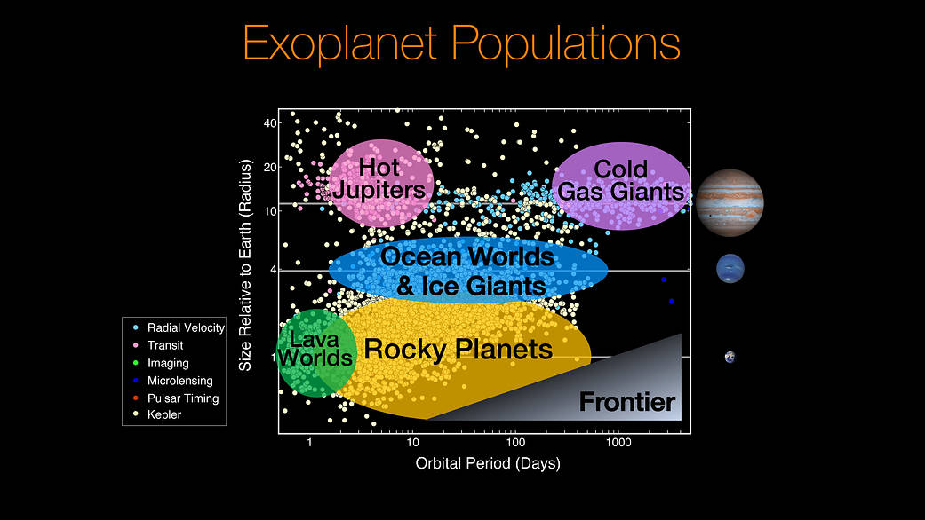
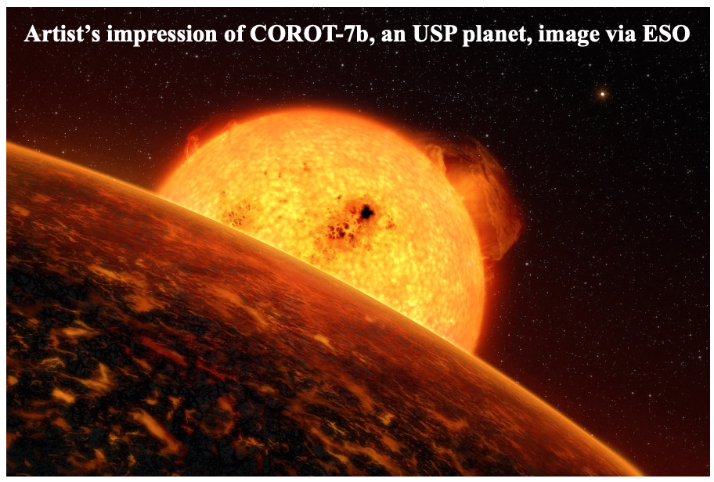
Ultra Short Period (USP) planets
Notes:
Finally, let's look at Ultra-Short-Period Planets, or USPs. These are a special group with orbital periods of less than 24 hours. They're so close to their stars that their surfaces can be hotter than 2000K—they are real Lava worlds and their origins are mysterious.

Slide 25
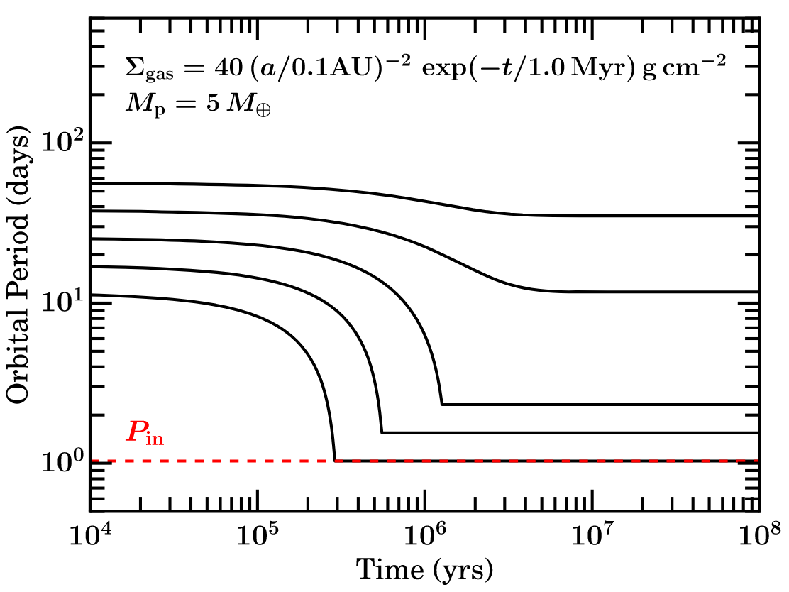

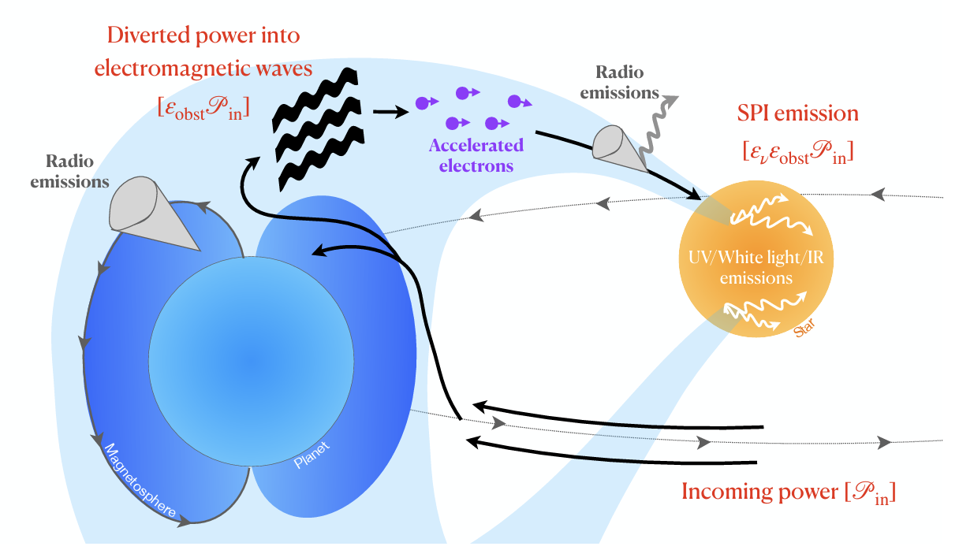
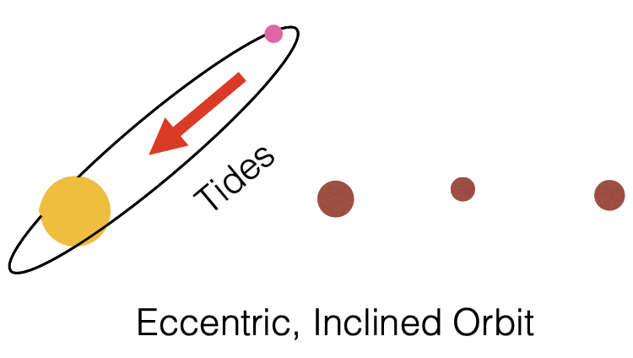

USP planets' origins remain enigmatic
Arrival time at the USP’s orbit
$≪$ ~ 1 Gyr
Myrs to Gyrs, depend on initial conditions
disk migration
stellar tides
Schlaufman et al. 2010, Lee & Chiang 2017
Becker et al. 2021, Lee & Chiang 2017
planetary eccentricity tides
Petrovich et al 2019, Pu & Lai 2019
magnetic effects
Strugarek et al. 2017, 2025
Colle et al. 2025 Lee & Owen 2025
planetary obliquity tides
Millholland & Spalding 2020
See also Eve J. Lee and Douglas Lin’s talk on April 23
Notes:
Several models have been proposed, but which model is correct/or dominated is in debate. One way to constrain these models is to study the age dependence of USP planets because different models operate on different timescales and produce different architectures.

Slide 26

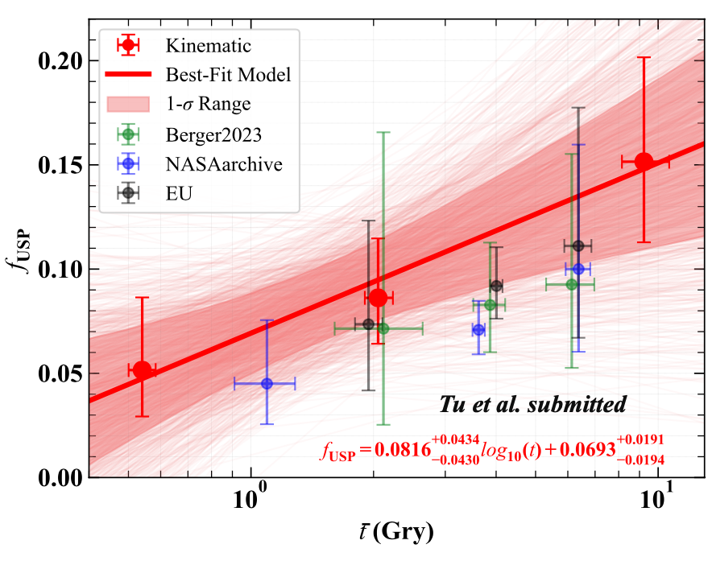
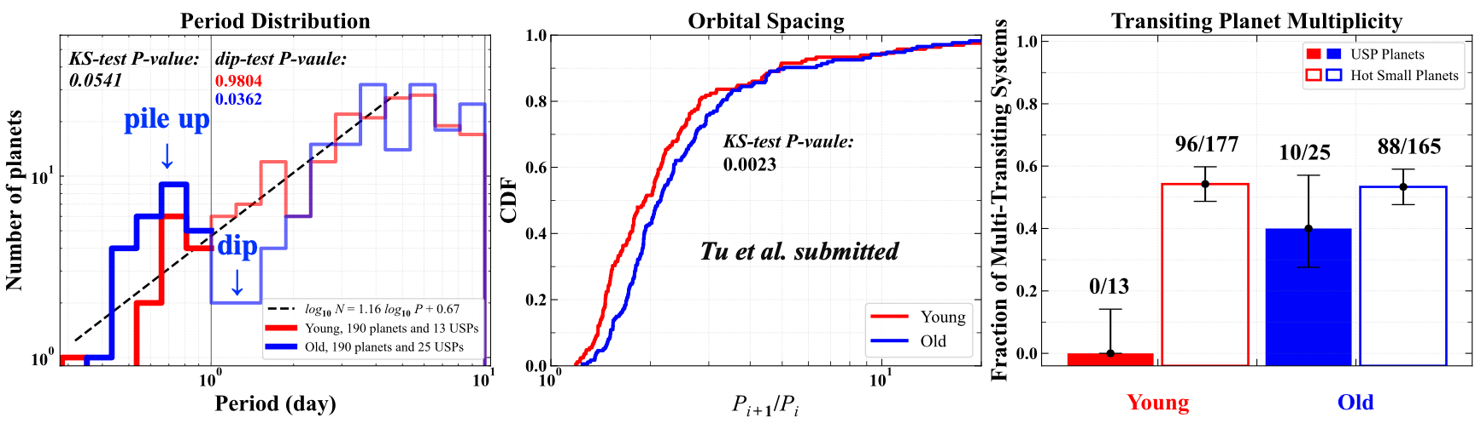
Evolution of USP Occurrence Rate and Architecture
PAST-6: Tu, Xie*, et al. 2025 Nature Astronomy
USP migration formation spans billions of years, formation rate increases over time.
Early-formed (≲ 1 Gyr) USPs have larger orbital inclinations => violent formation process.
Late-formed (≳ 1 Gyr) USPs have smaller orbital inclinations => quiet formation process.
Notes:
Our sixth PAST paper, focused on USPs. Using data from LAMOST, combined with Gaia and Kepler, we figured out their age distribution and how their occurrence rate and orbital architecture changes over time, which put important constraint to their formation and migration.

Slide 27
Outline
Research Background
  Importance and Important Progresses of Planetary Statistics
Exoplanet Statistical Research Based on LAMOST
  2.1 Progress from LAMOST+Kepler Synergy
  2.2 Progress from LAMOST+Gaia+Kepler/TESS Synergy (“PAST”Series)
Prospects and Summary
Notes:
For future outlook

Slide 28
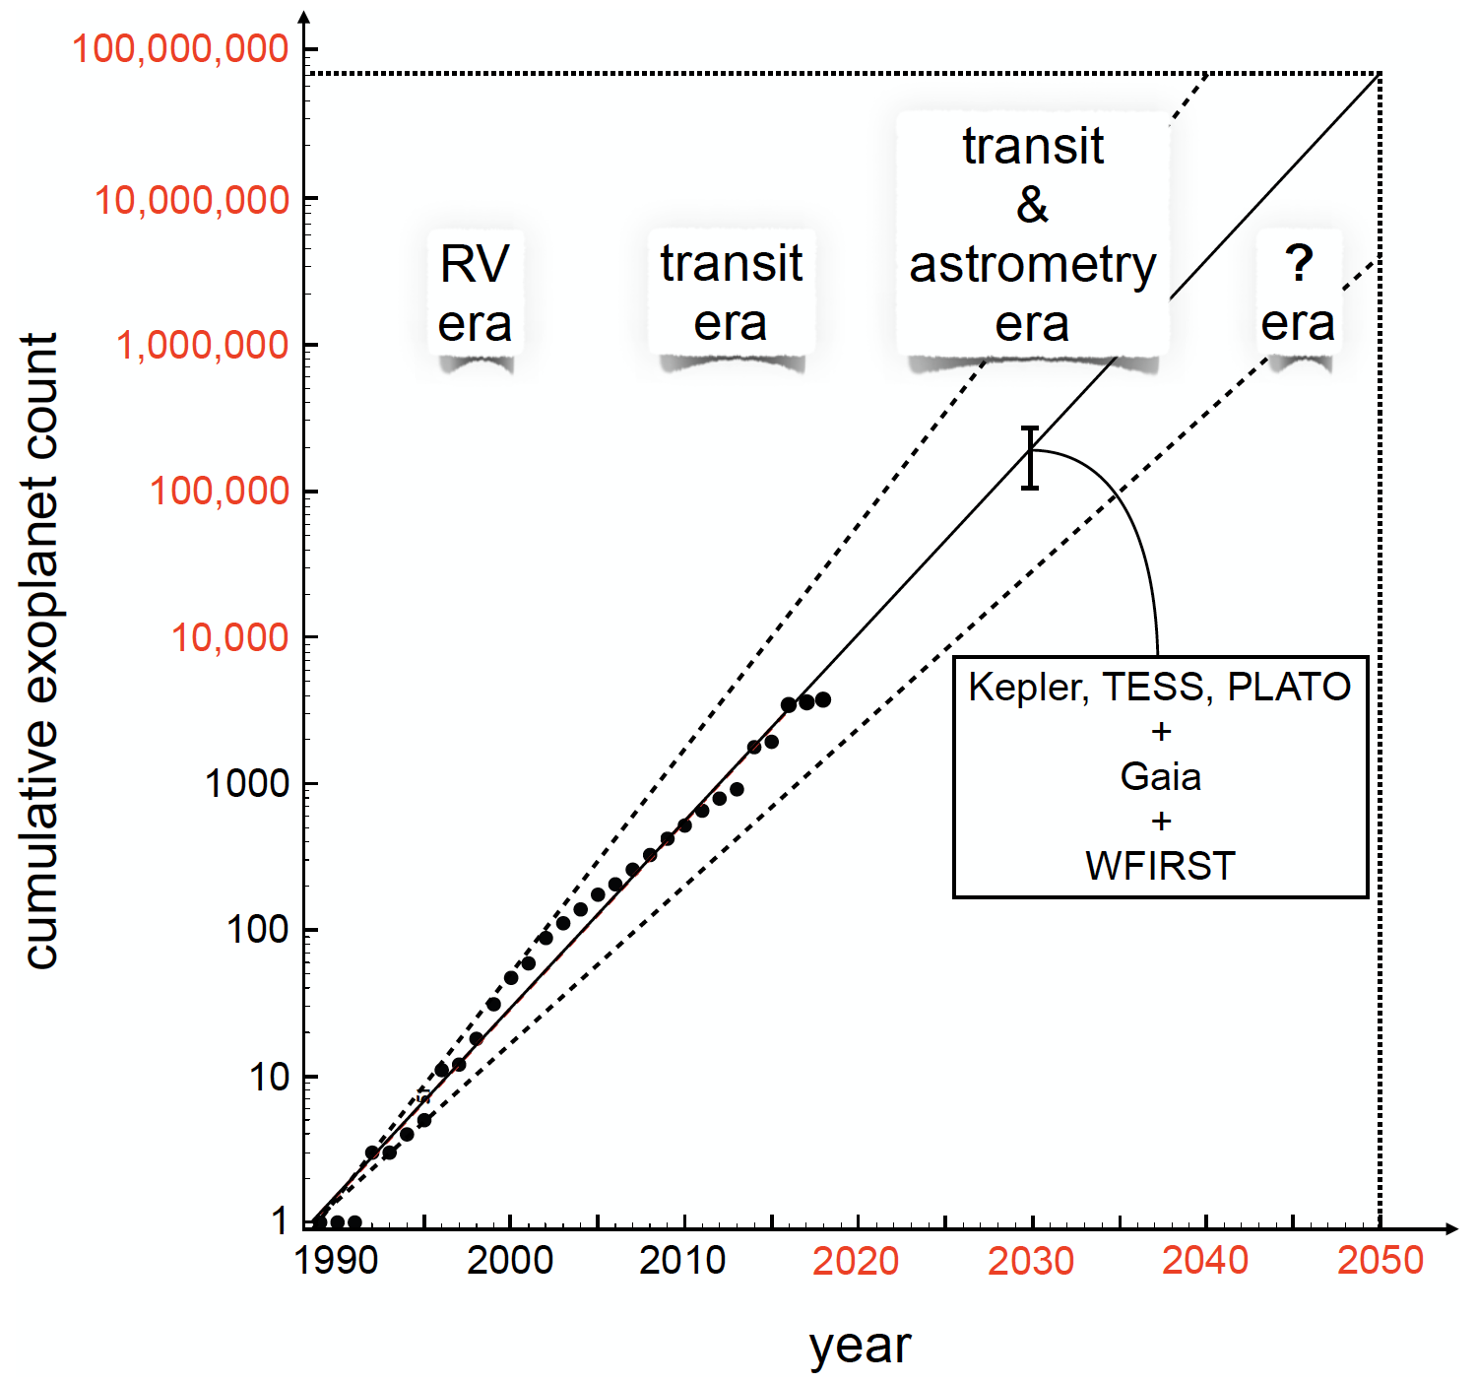
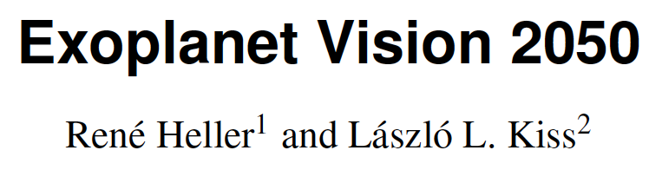
Bright Future of Exoplanet Statistics
太阳系外行星系统
Exoplanets
Notes:
First, the future of exoplanet statistics is bright. Based on current and planned missions, we expect over 100,000 discoveries by 2030—more than an order of magnitude increase from today. This will allow us to explore a much wider range of planetary properties.

Slide 29
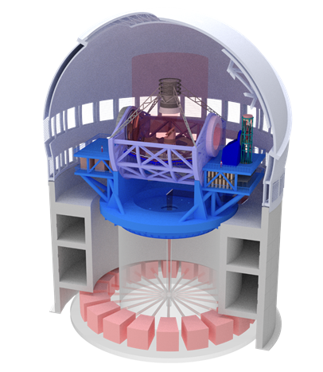
Bright Future of Exoplanet Statistics
The "Successor" to the LAMOST Telescope — "ESST"
Extremely large Spectroscopic
Survey Telescope （ESST）
Large sky Area Multi-Object Fiber Spectroscopy Telescope （LAMOST）
12 Meters， 30, 000 fibers (plan in 2030)
4 Meters，4000 fibers (since 2011)
Notes:
And furthermore, "ESST”, the "Successor" to the LAMOST Telescope —will boost the power of collecting stellar spectra by an order of magnitude, thereby dramatically advancing our capacity to conduct large-scale exoplanet census studies.

Slide 30
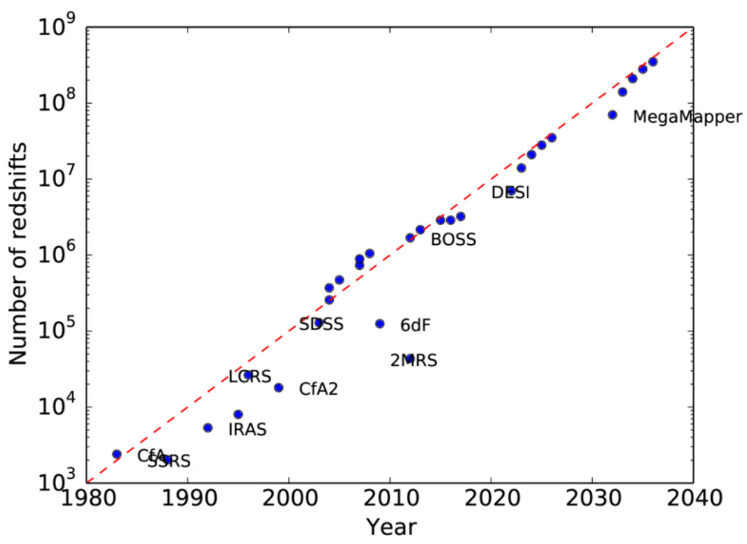
Exoplanets vs. Galaxies
太阳系外行星系统
银河系外恒星系统
Exoplanets
Galaxies
VS
Notes:
This is similar to what have already happened in the field of galaxy. Over the past decades, large spectroscopic galaxy surveys revolutionized our understanding of the universe. Comparing these trends, we can expect a similar boom in the exoplanet field, profoundly advancing our knowledge of how planetary systems, including our own, form and evolve.

Slide 31
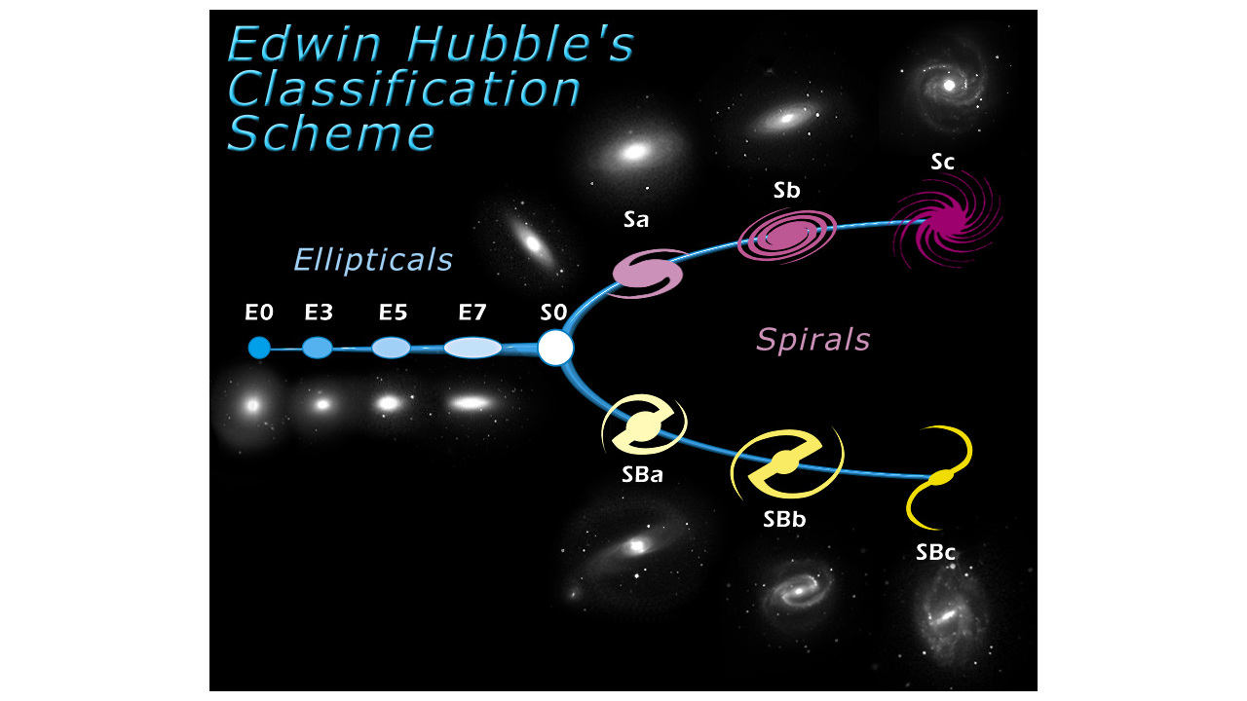
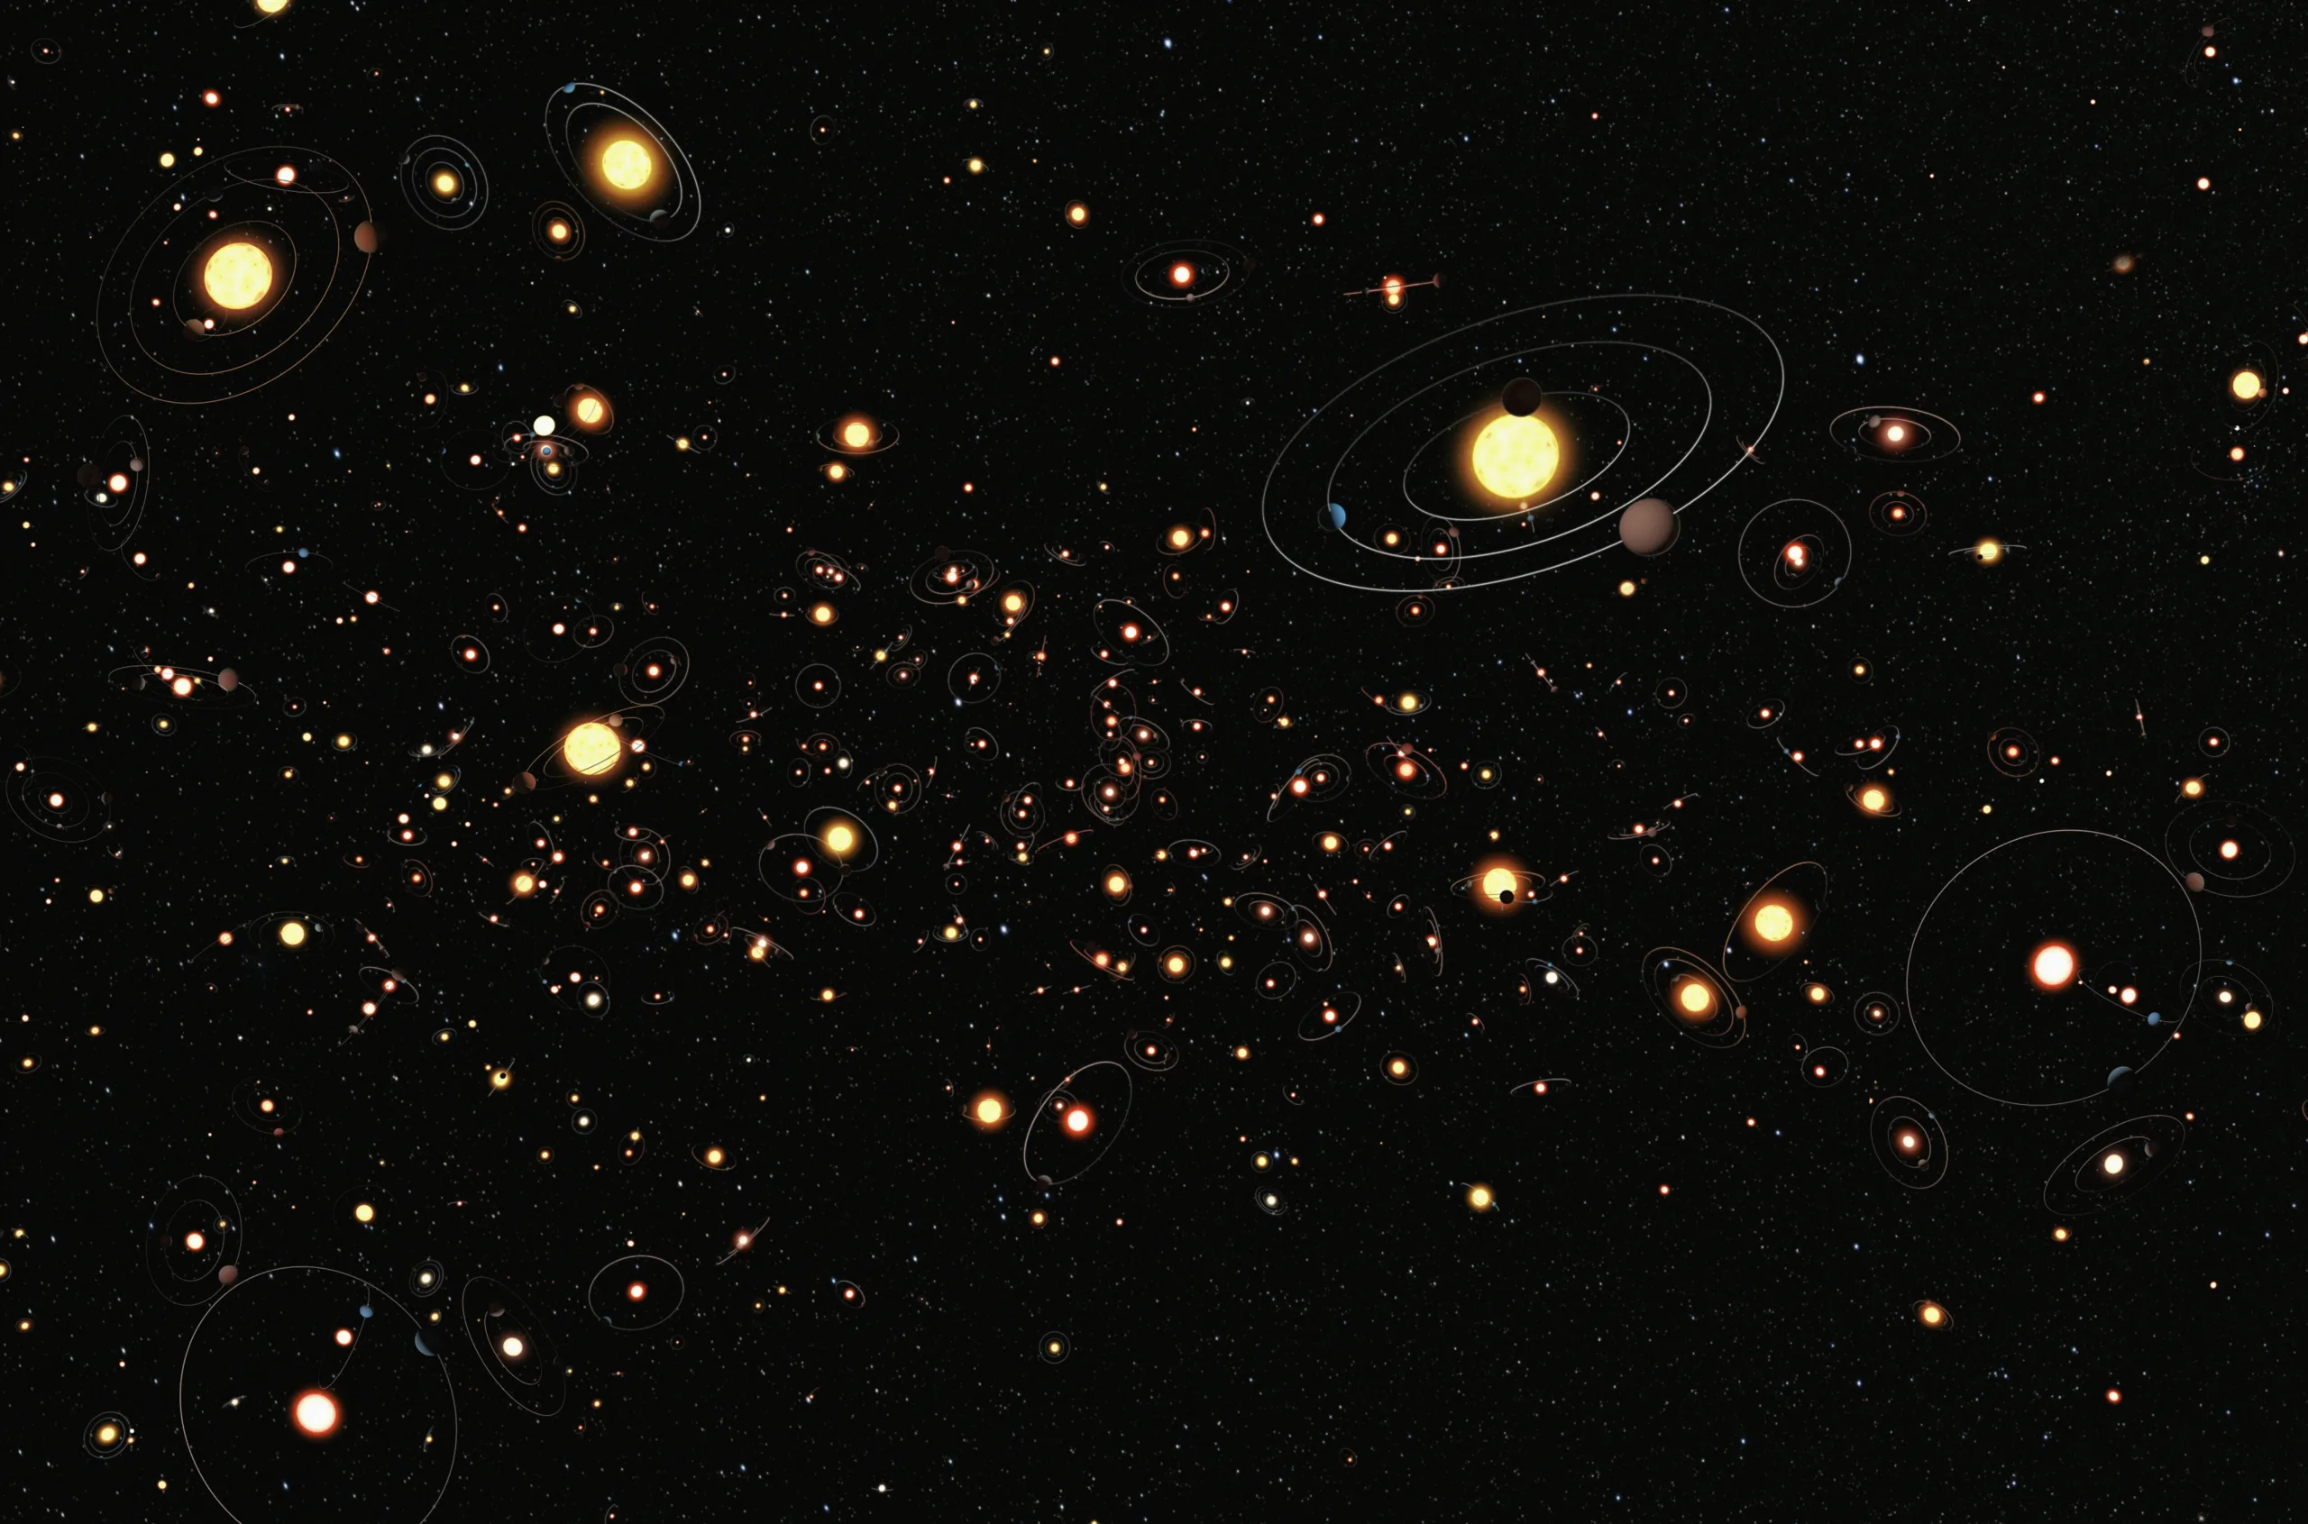

Lessons from the extragalactic astronomy
太阳系外行星系统
银河系外恒星系统
Exoplanets
Galaxies
See the future of the exoplanet field from the past of the galaxy field
VS
How to classify exoplanets ?
hubblesite.org
Notes:
From a statistics viewpoint, a major achievement in the early stage of extragalactic astronomy is the Hubble classification scheme for galaxies. Will we find a similar classification for exoplanets? As the number of known planets grows, we will find our way to classify planets.

Slide 32
Summary
The Future for Exoplanet Census is bright
Star survey（e.g., LAMOST）is essential for planet census
Time (or Age) is an important dimension to explore
(PAST is important for Future)
系外行星普查统计前途光明
大型恒星巡天（如LAMOST）是非常必要的
时间（年龄）维度方面的探索是关键
Notes:
Finaly, I want to summary my talk with three sentences.
1. The future of exoplanet census statistics is very promising.
2. Large stellar surveys like LAMOST are essential.
Exploring the time dimension—stellar age—is crucial, because PAST is important for Future
Thank you!

