Slide 1
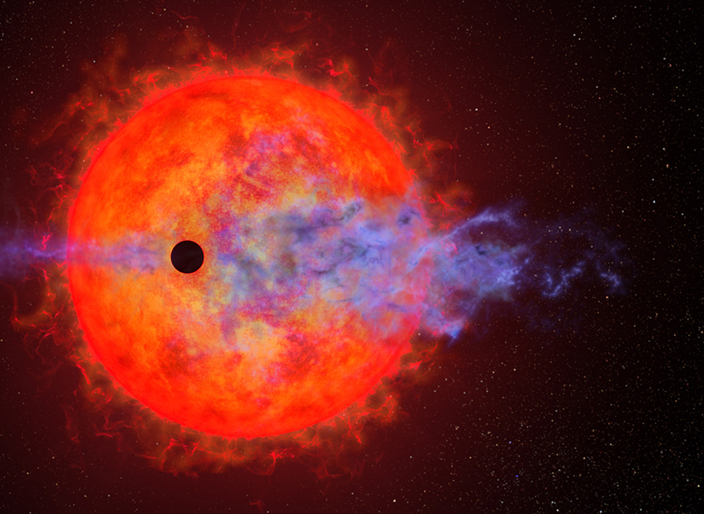
Are AU Mic b and c on Mutually Inclined Orbits?
Zitao Lin (林子滔)
Department of Astronomy, Tsinghua University
Sharon Wang, Zhen Guo, Krzysztof Zieliński, the CHEOPS team, and the PFS team
© NASA, ESA, Joseph Olmsted (STScI)

Slide 2




Stellar Obliquity
$$ψ$$

Slide 3
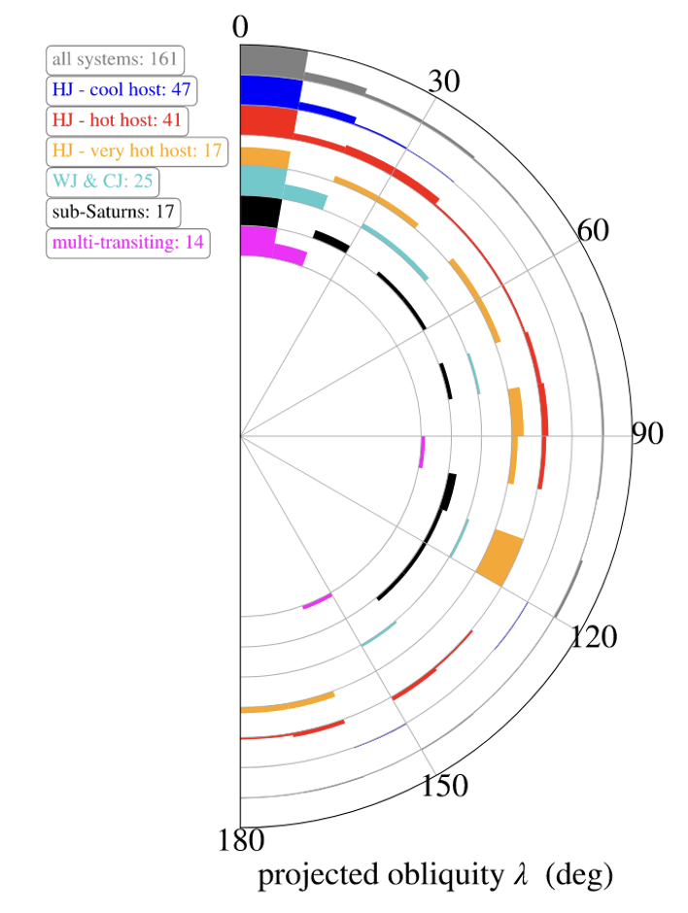
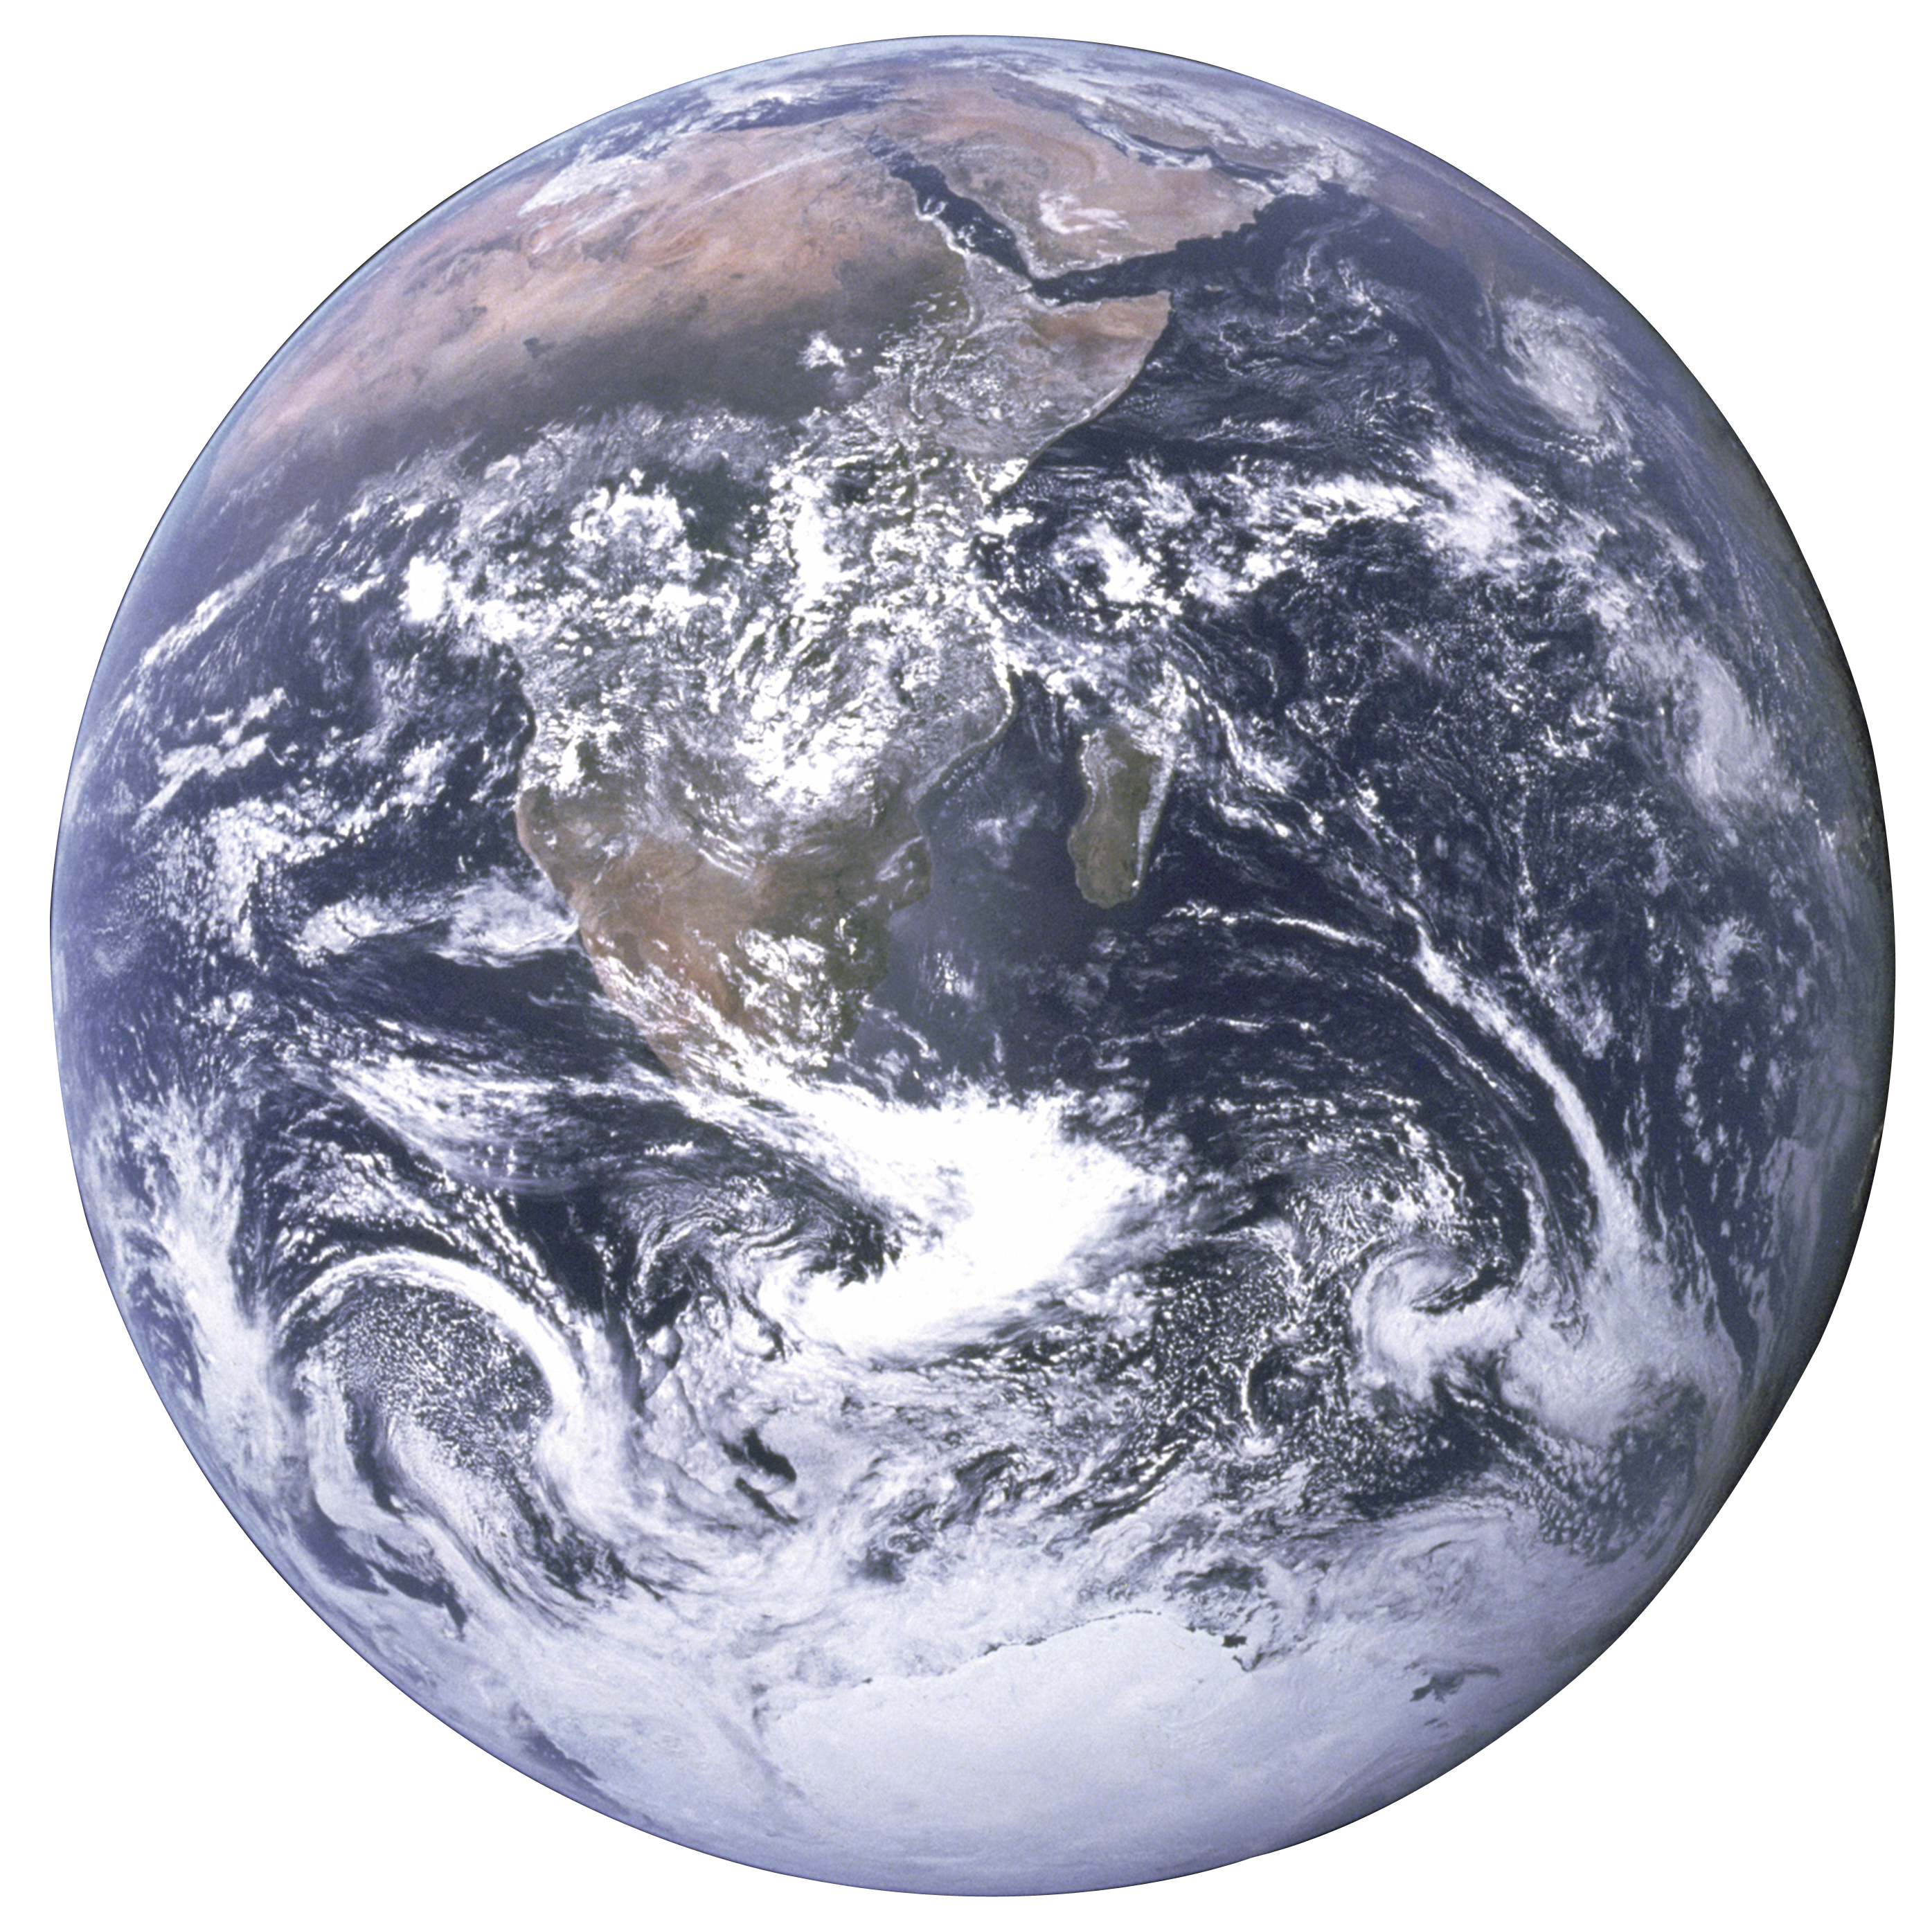
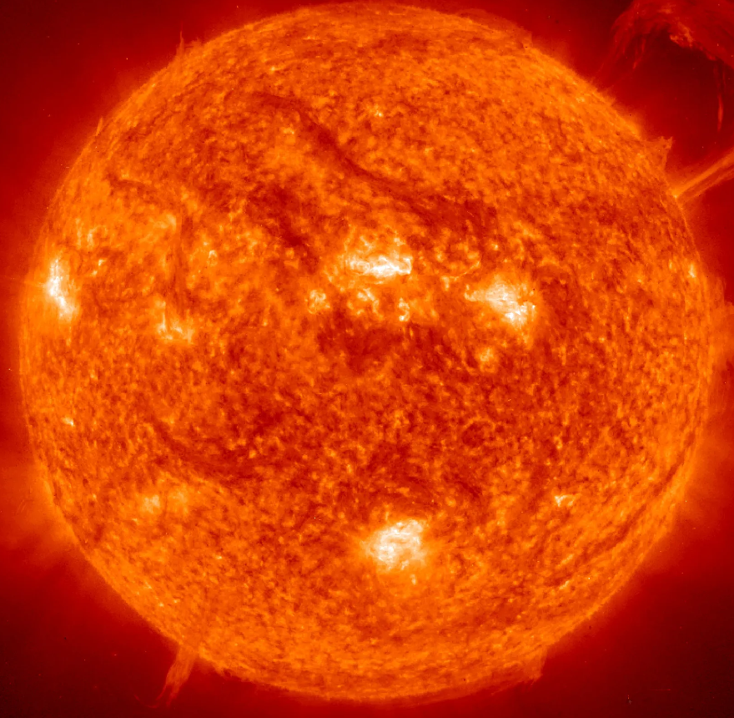

Stellar Obliquity
Exoplanetary Systems
Solar System
$$\sim 7°$$
(Albrecht et al. 2022)

Slide 4
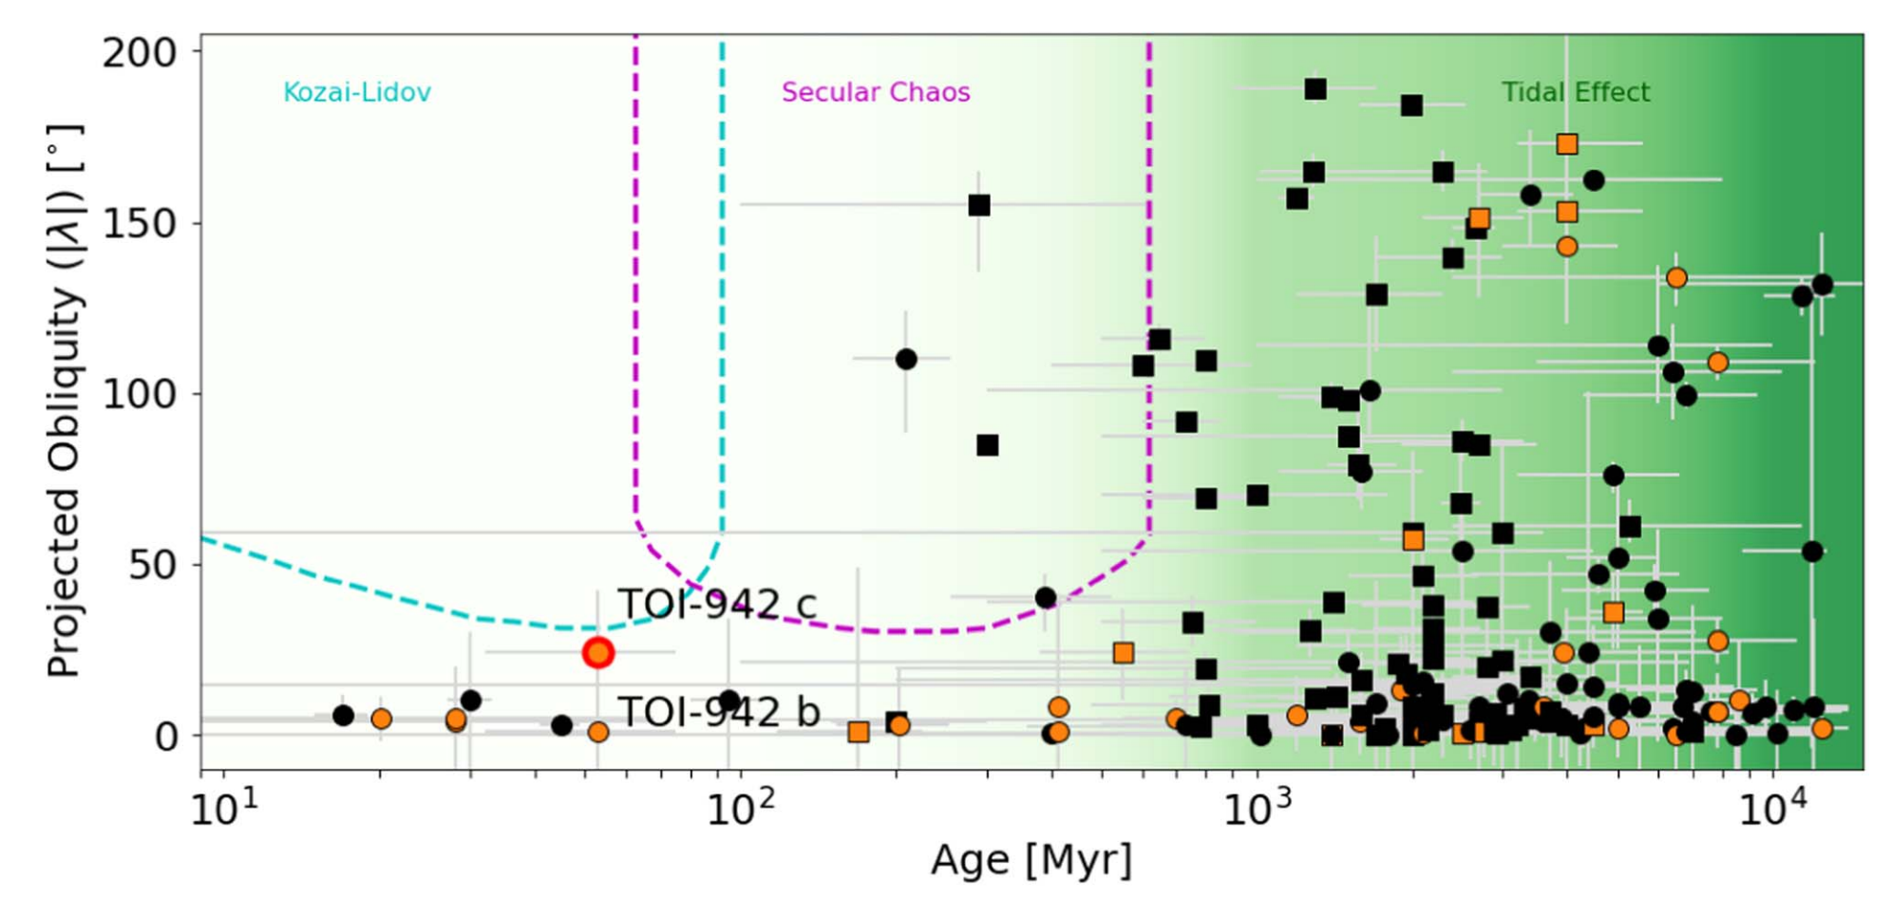
All Young Planets are Aligned?
(Teng et al. 2024)

Slide 5
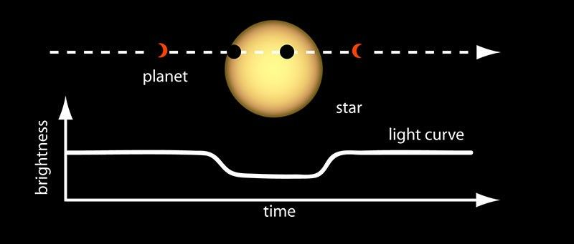
Measuring Obliquities of Transiting Planets
© NASA Ames

Slide 6
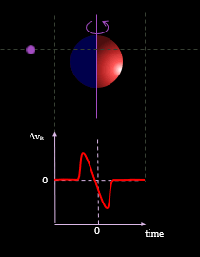
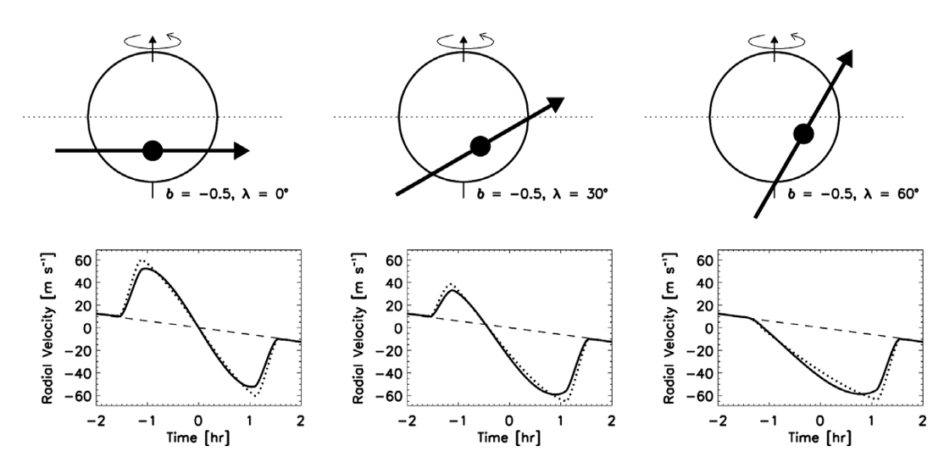
Rossiter–McLaughlin (RM) Effect
(Winn 2011)
(Wikipedia)

Slide 7
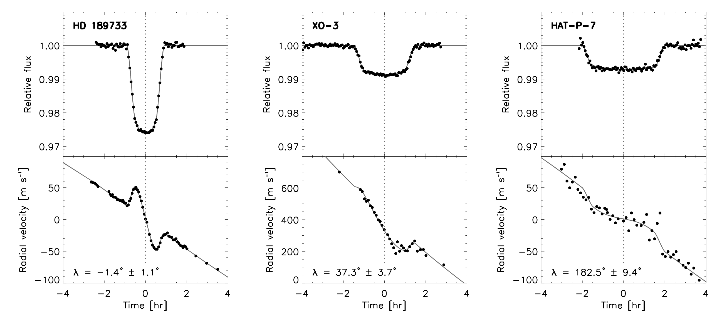
Rossiter–McLaughlin (RM) Effect
(Winn 2011)
(Wikipedia)

Slide 8
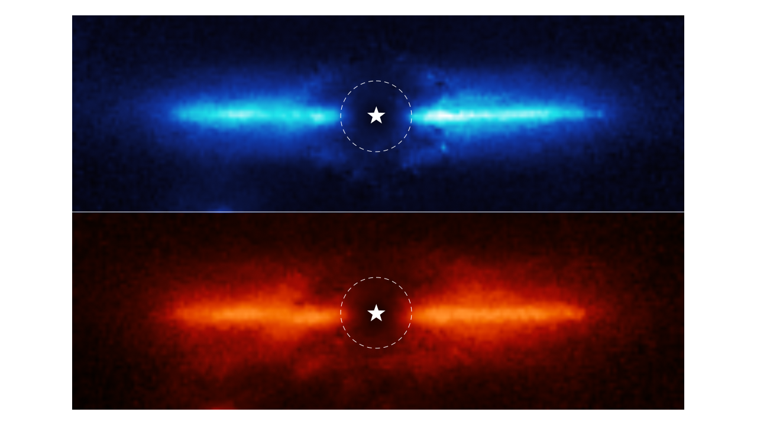

AU Mic
~ 20 Myr
~ 9.7 pc
$T_{eff}$ ~ 3600 K
Debris disk (aligned)
JWST Image
© NASA, ESA, CSA, and K. Lawson, A. Pagan

Slide 9




AU Mic
~ 20 Myr
b
c
~ 9.7 pc
$T_{eff}$ ~ 3600 K
Debris disk (aligned)
$$\sim 4 R_{⨁}$$
$$\sim 2.5 R_{⨁}$$
2 transiting planets
$$P=8.46 day$$
$$P=18.86 day$$

Slide 10
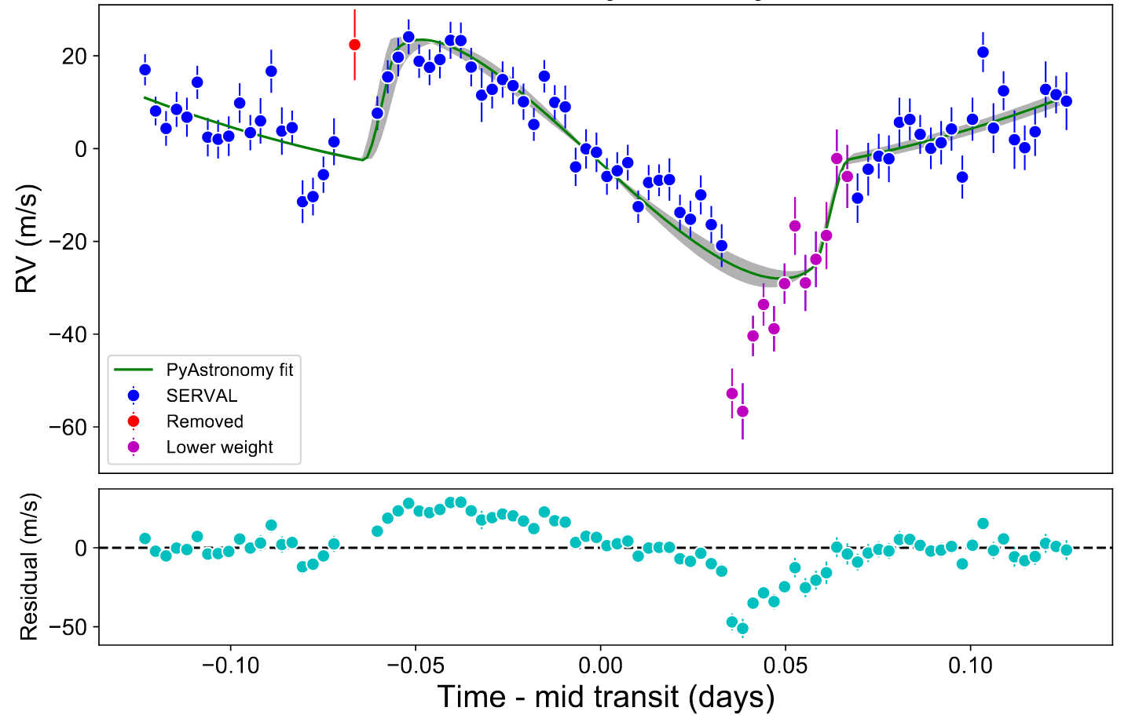
AU Mic
~ 20 Myr
~ 9.7 pc
$T_{eff}$ ~ 3600 K
Debris disk (aligned)
2 transiting planets
b: aligned
(Palle et al. 2020)

Slide 11
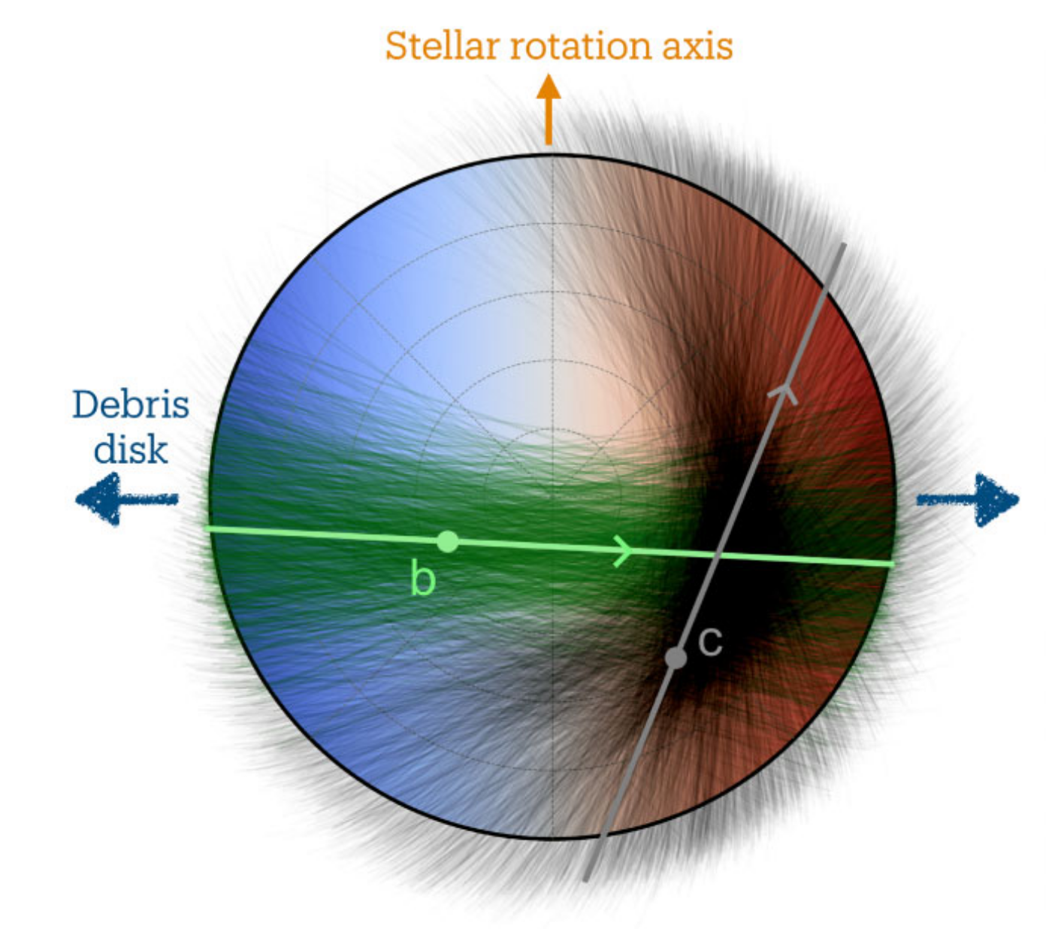

AU Mic
$$λ_{c}=67.8°_{−49.0°}^{+31.7°}$$
~ 20 Myr
~ 9.7 pc
$T_{eff}$ ~ 3600 K
Debris disk (aligned)
2 transiting planets
b: aligned
c: misaligned?
ESPRESSO data
(Yu et al. 2025)

Slide 12
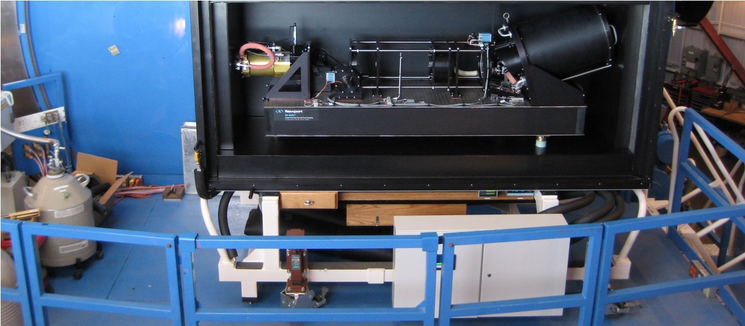
RM Observation
Instrument: Planet Finder Spectrograph (PFS) on Magellan

Slide 13
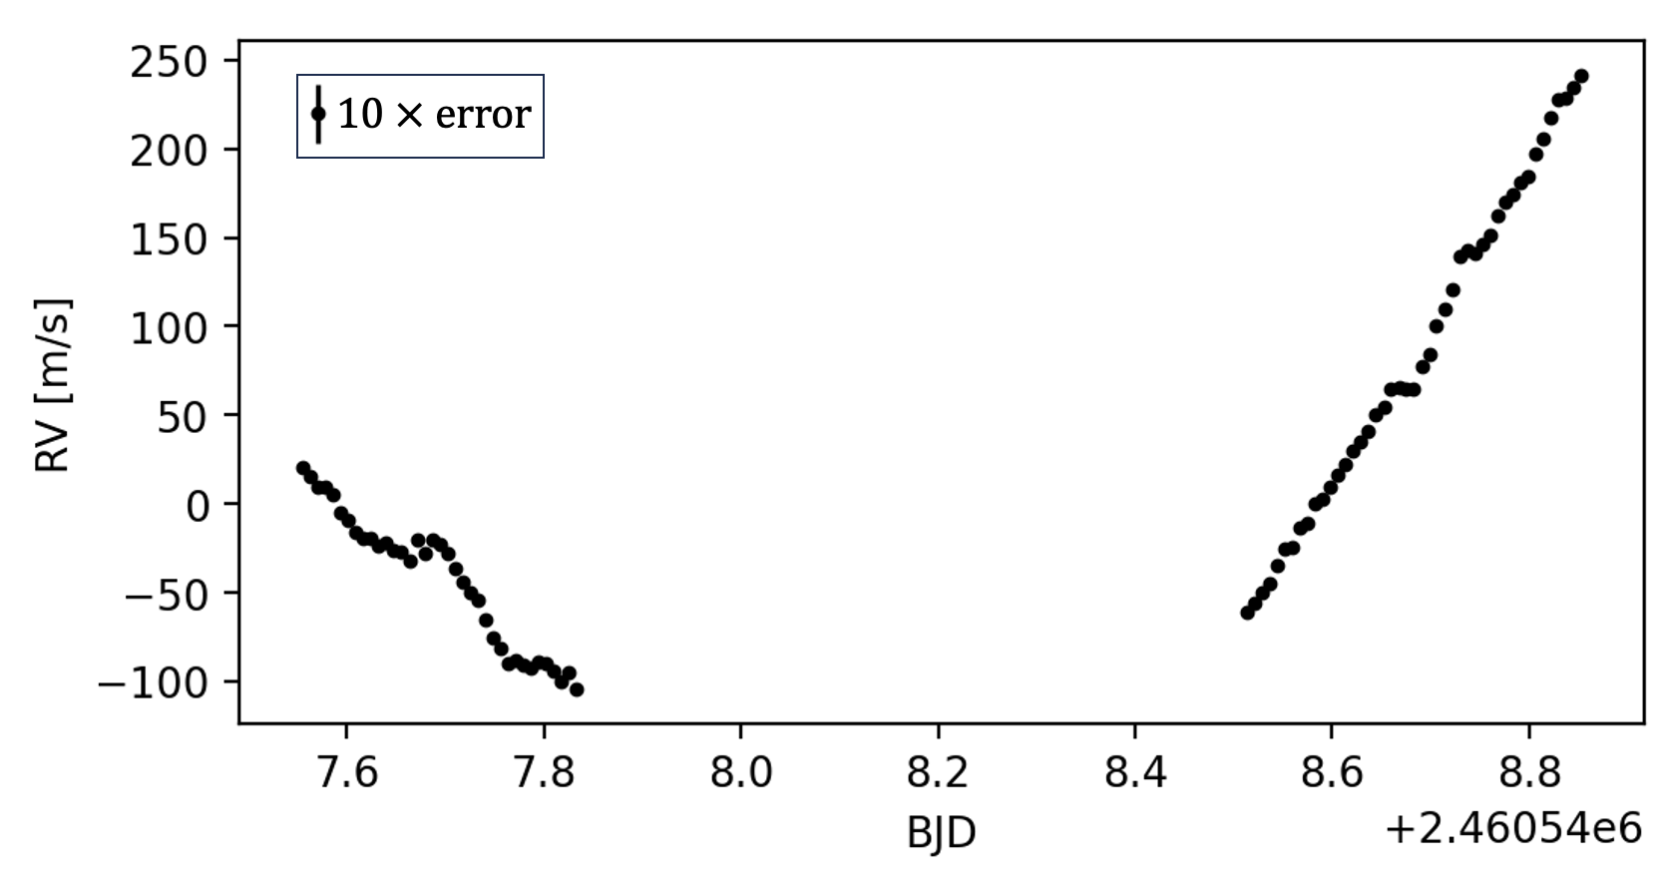
RM Observation
Magellan Planet Finder Spectrograph (PFS)
2 transits in
2 consecutive nights

Slide 14
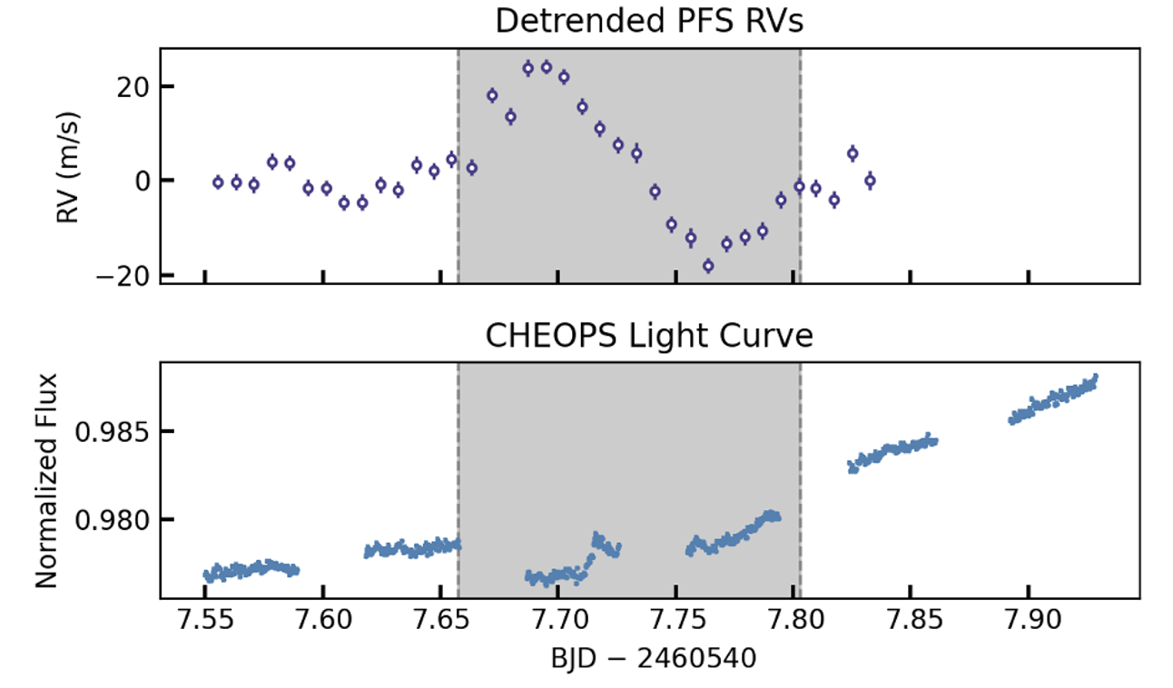
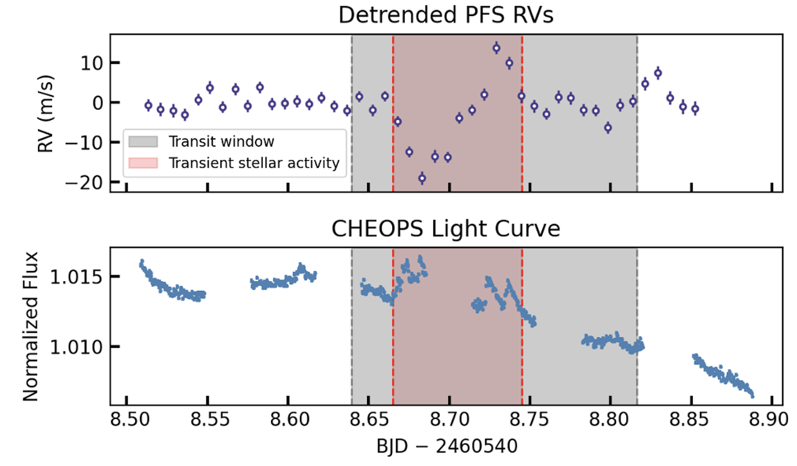
RM Observation
An unexpected stellar activity occurred in the transit of planet c and obscured expected RM signal.
First night
Second night

Slide 15
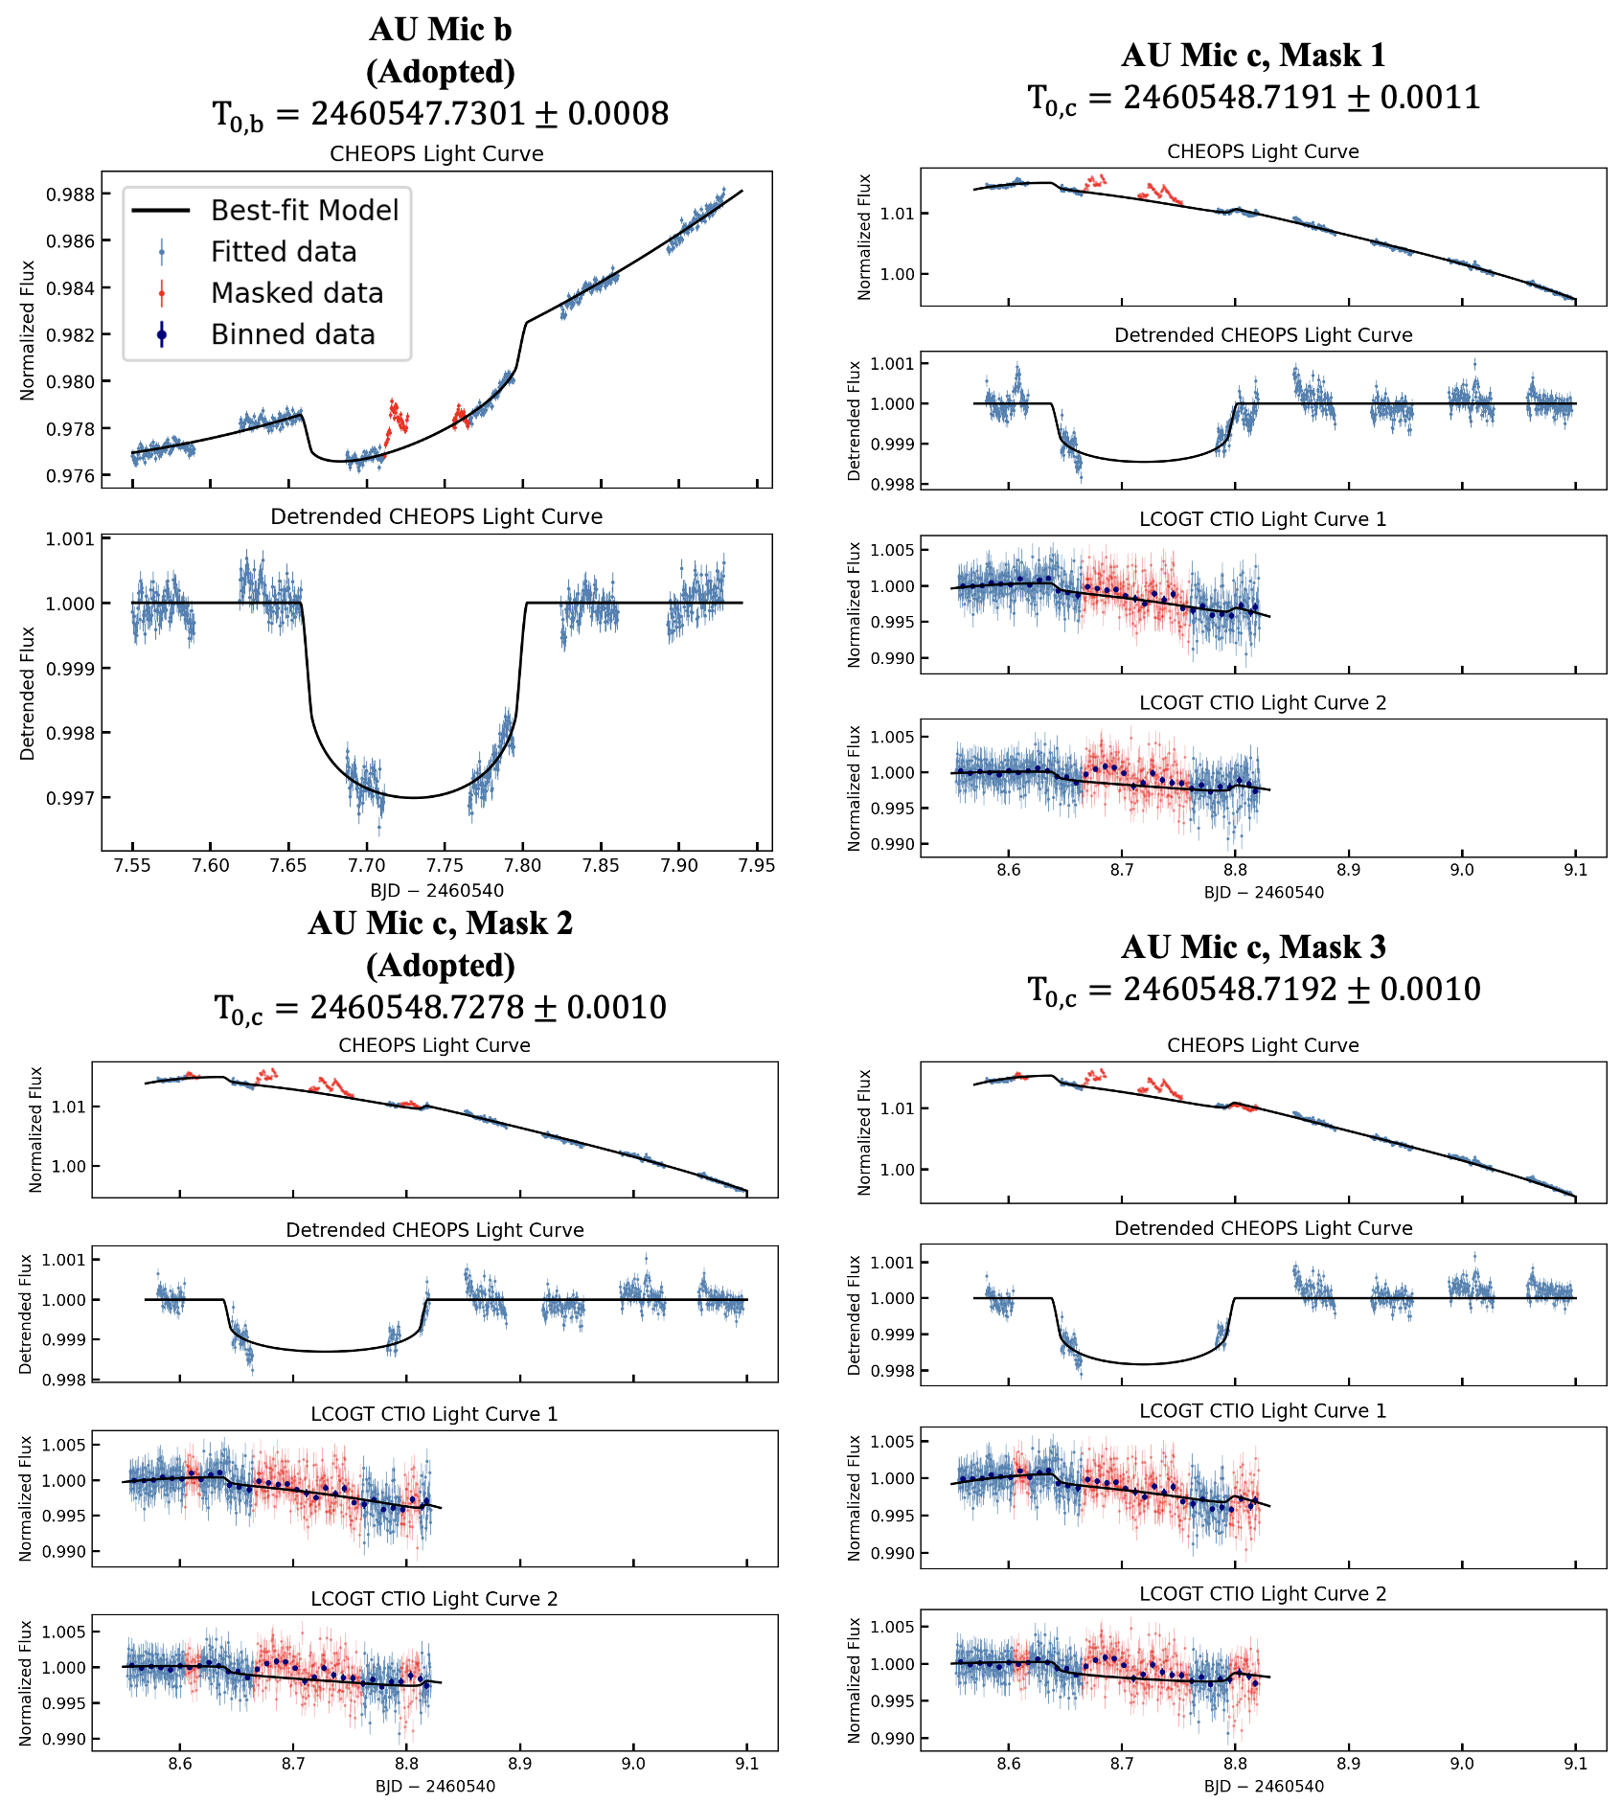
Transits Fitting on Photometry Data
First night
Second night

Slide 16
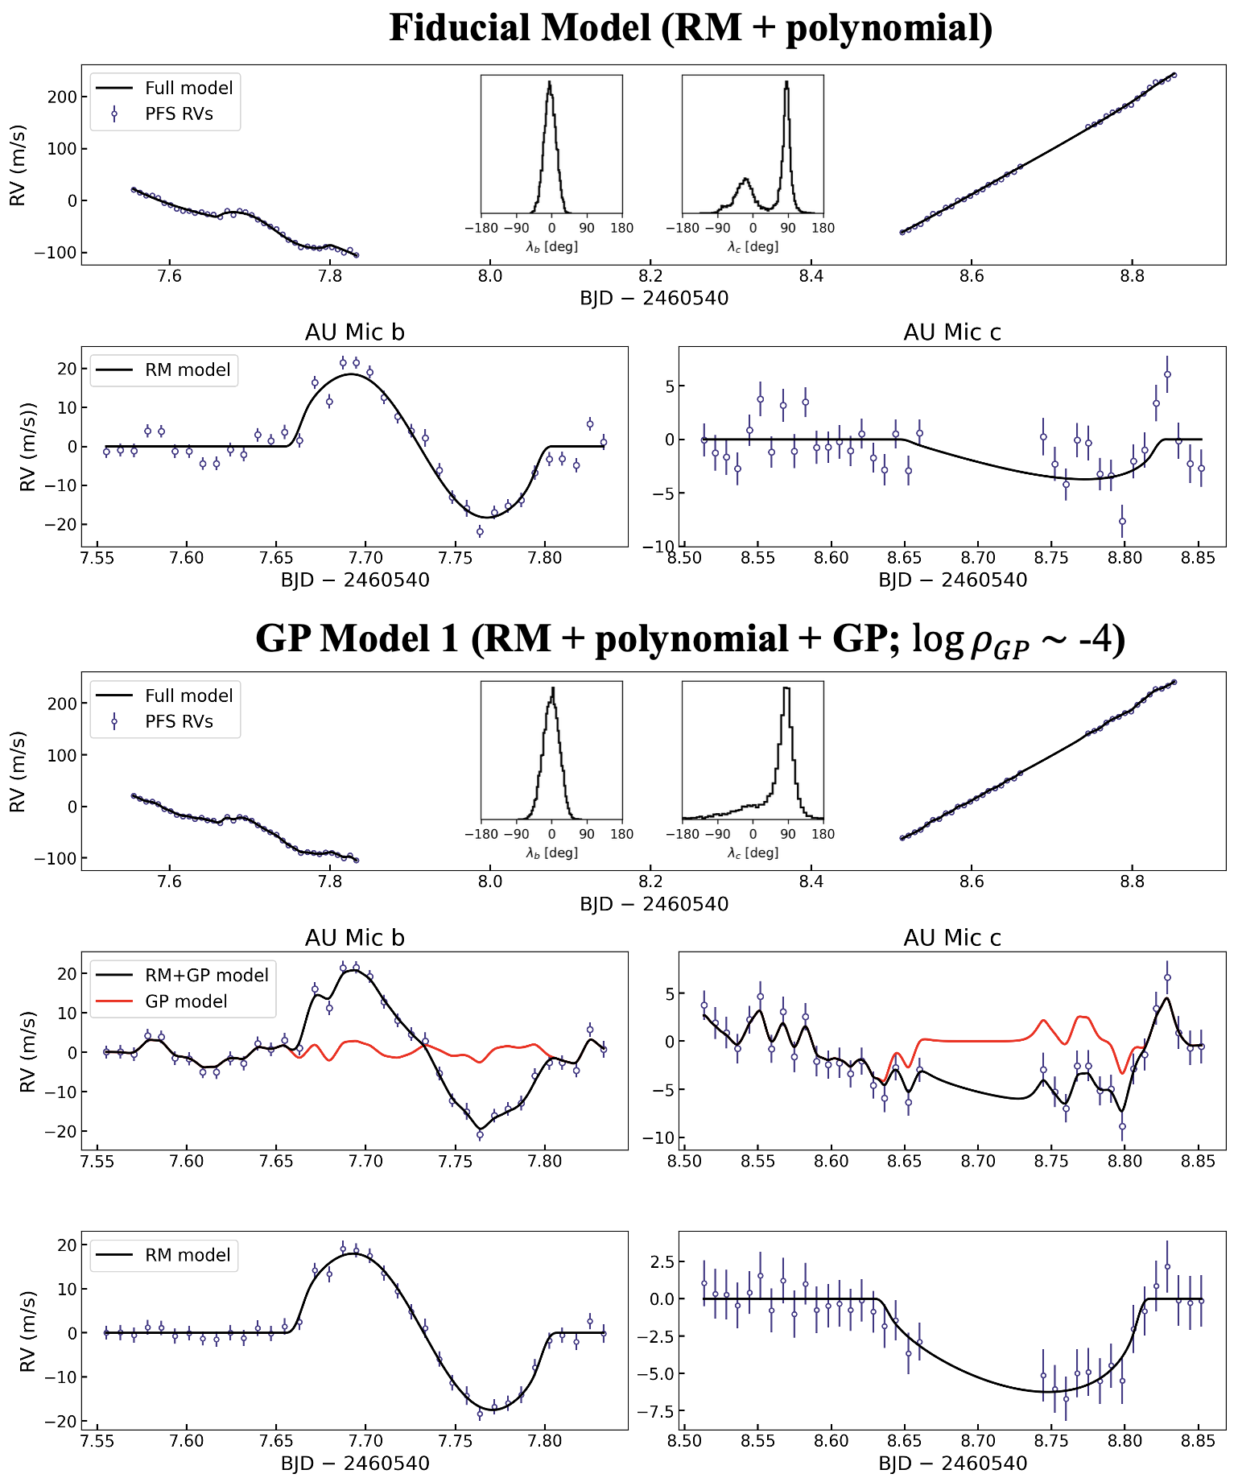

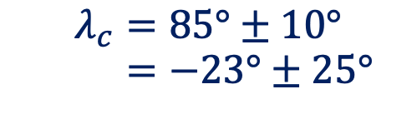
Fiducial RM Fitting
$$λ_{c}=85°±10°$$
$$=−23°±25°$$
$$λ_{b}=−2°±15°$$

Slide 17


RM Fitting with GP
$$λ_{c}=78°_{−65°}^{+21°}$$
$$λ_{b}=−1°±20°$$

Slide 18
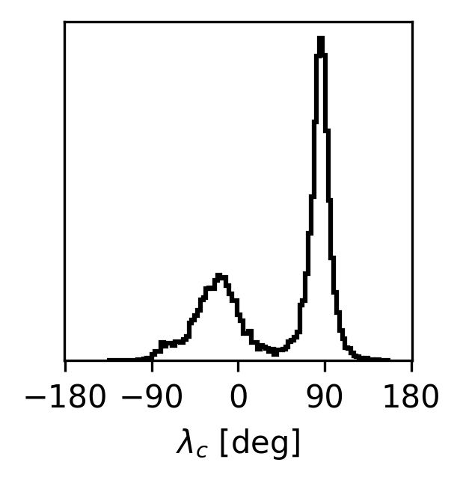
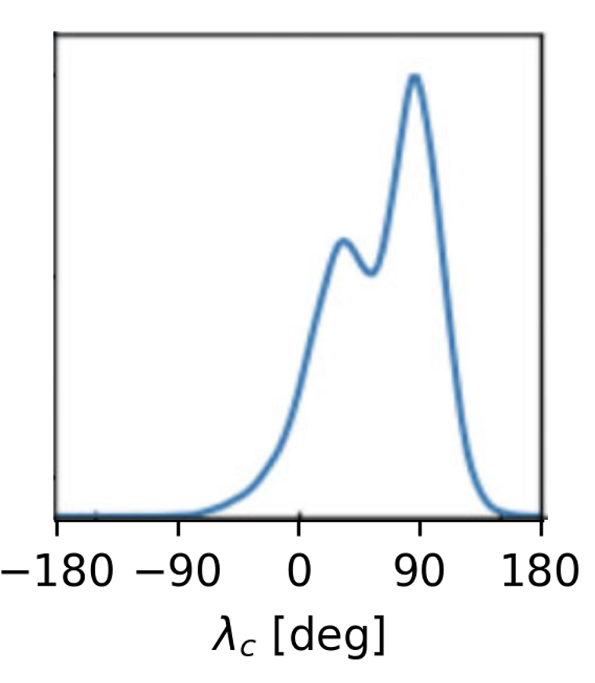
Similar Posterior from Independent Measurements
Our results (Magellan PFS)
VLT ESPRESSO results
(Yu et al. 2025)

Slide 19
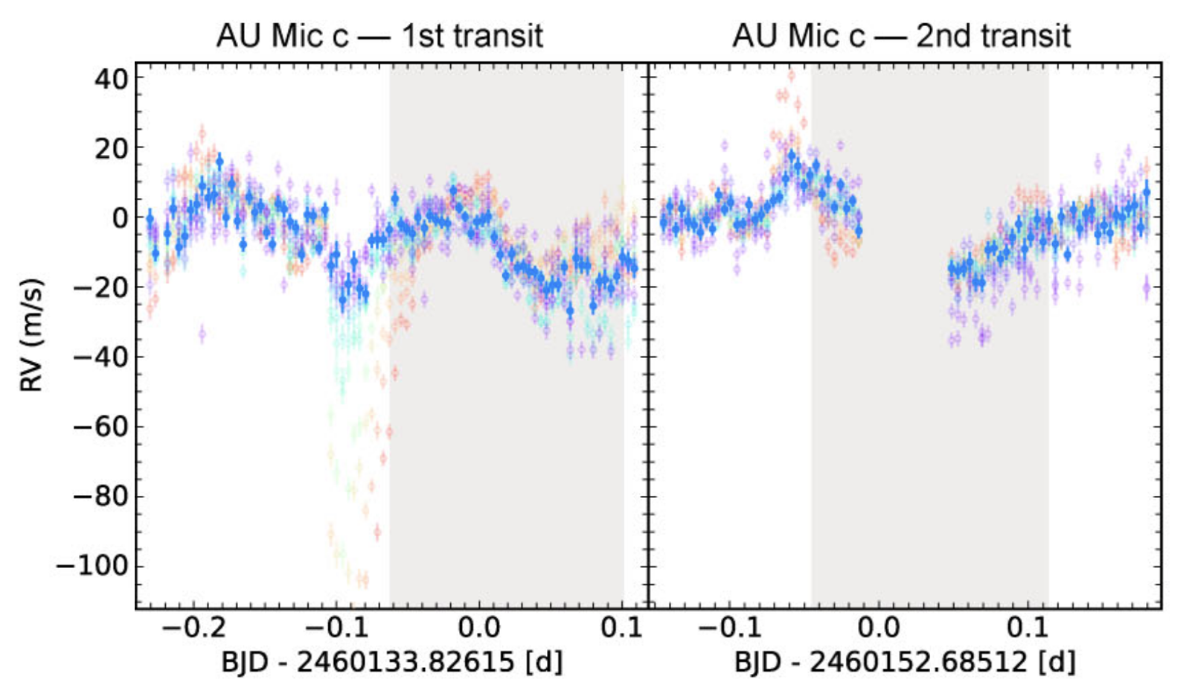
VLT ESPRESSO RVs
(Yu et al. 2025)

Slide 20
Take-Home Message
We conducted RM observations on a ~20-Myr planetary system AU Mic using Magellan PFS. Results favor a polar orbit of AU Mic c, but cannot rule out an aligned orbit.
Stellar activities are major challenge for studies of young systems like AU Mic.

Slide 21
Back-up Slides

Slide 22
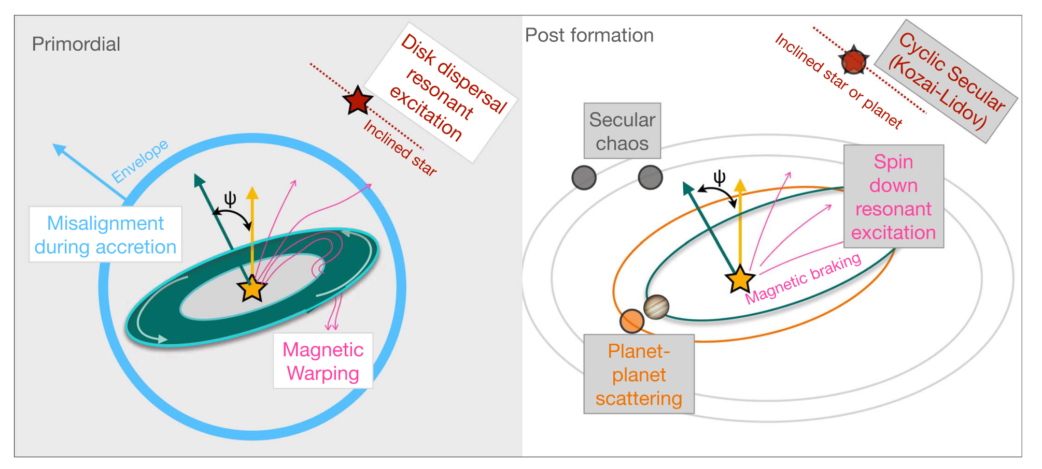
(Albrecht et al. 2022)

Slide 23
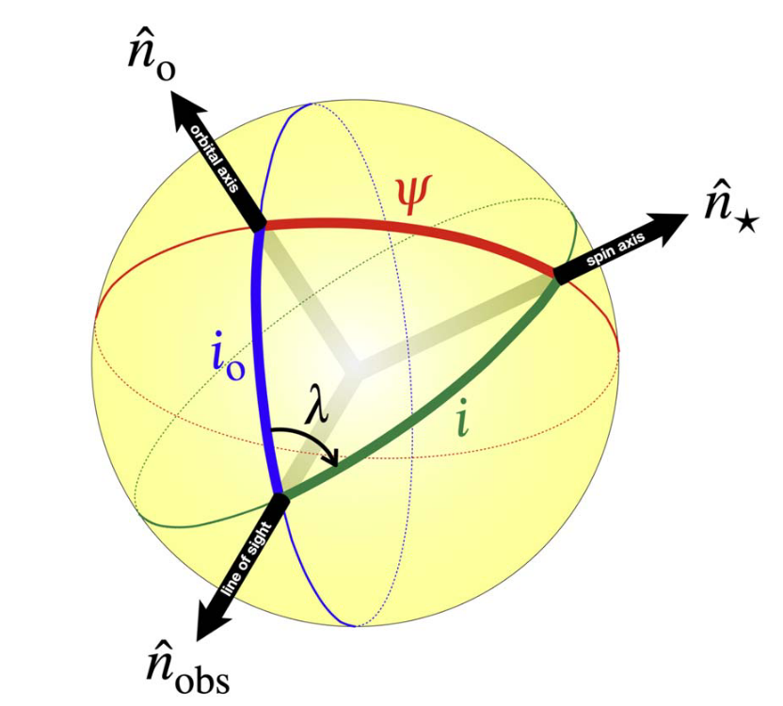
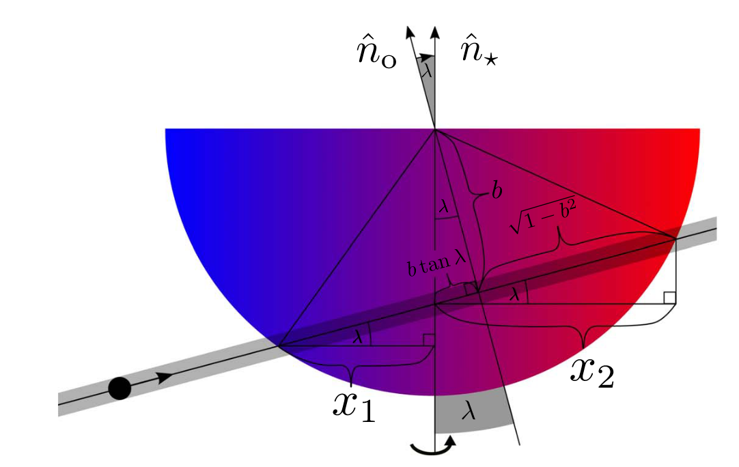
(Albrecht et al. 2022)

Slide 24
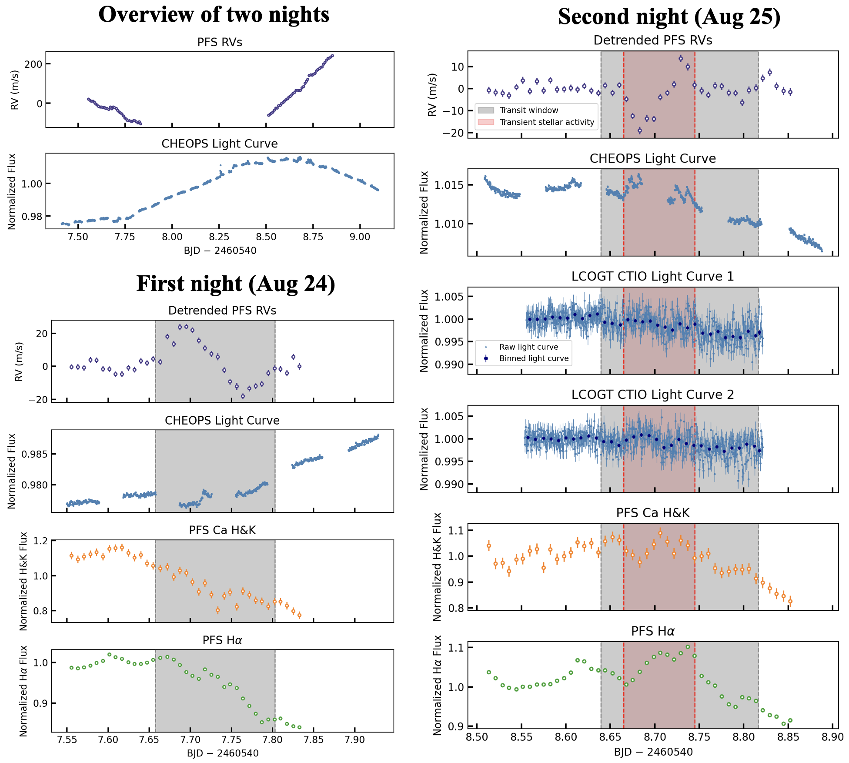

Slide 25
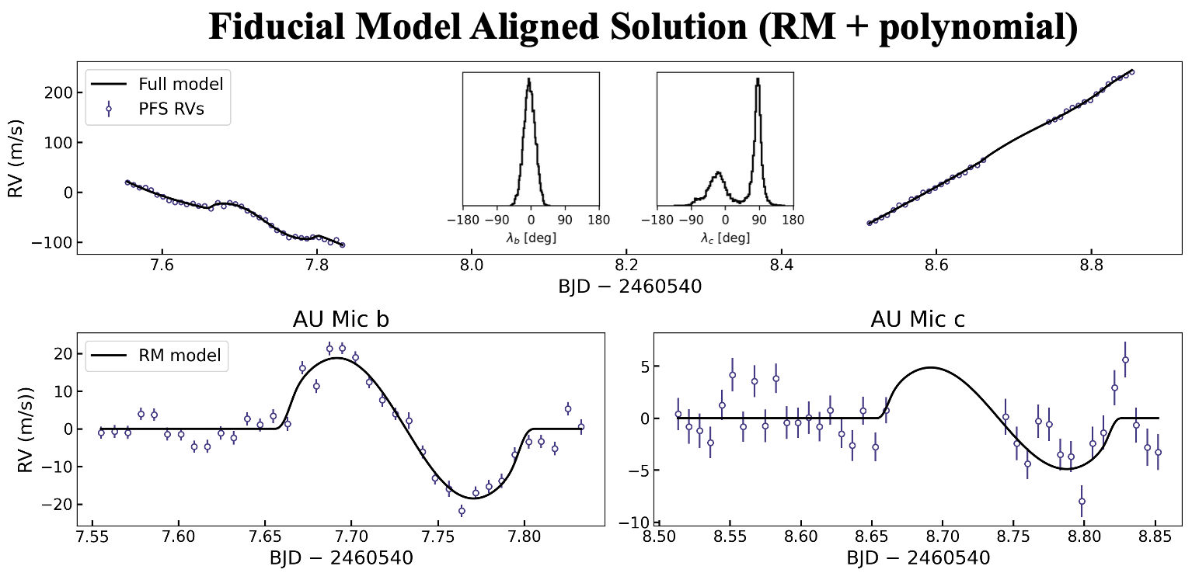

Slide 26
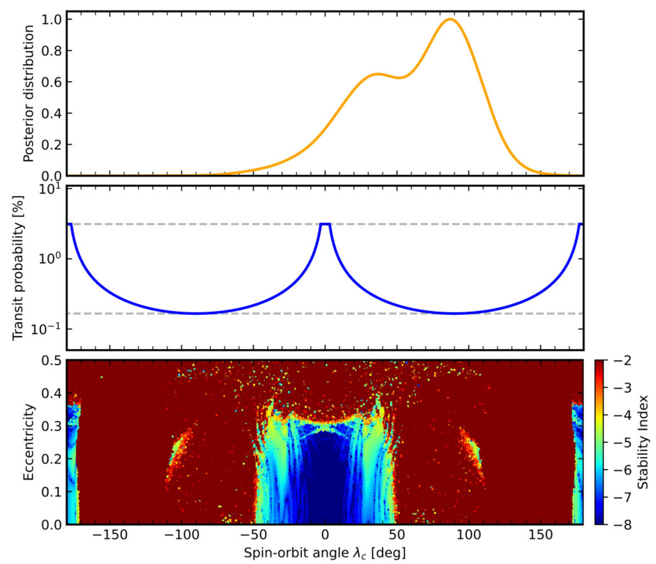
(Yu et al. 2025)

Slide 27

Problems of Misalignment of c
Transit probability?

Slide 28
