Slide 1
The Hyperluminous, Dust-obscured Quasar W2246-0526: ALMA High-Resolution [CII] Imaging
Mai Liao (Rubin/LSST-Chile postdoc, UDP/Chile)
Roberto Assef (UDP/Chile), Chao-Wei Tsai (NAOC/China)
Hot DOG fans group: Peter Eisenhardt (NASA/JPL), Daniel Stern (NASA/JPL), Andrey Vayner (NASA/JPL), Andrew W. Blain (UOL/UK), Tanio Dıaz-Santos (FORTH), Hyunsung D. Jun (CIOT/ US), Roman Fernandez Aranda (UOC/Greece), Jingwen Wu (NAOC/China), Guodong Li (KIAA/China), Devika Shobhana (UDP/Chile), Dejene Zewdie (NWU/South Africa)
China-Chile Bilateral Astronomy Conference; Hongkong; 2026

Slide 2
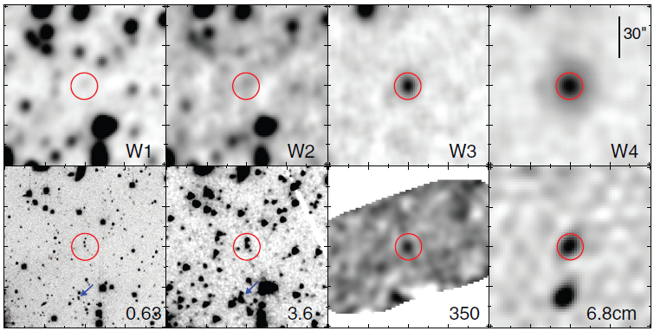
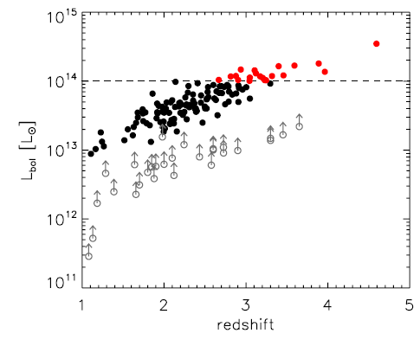
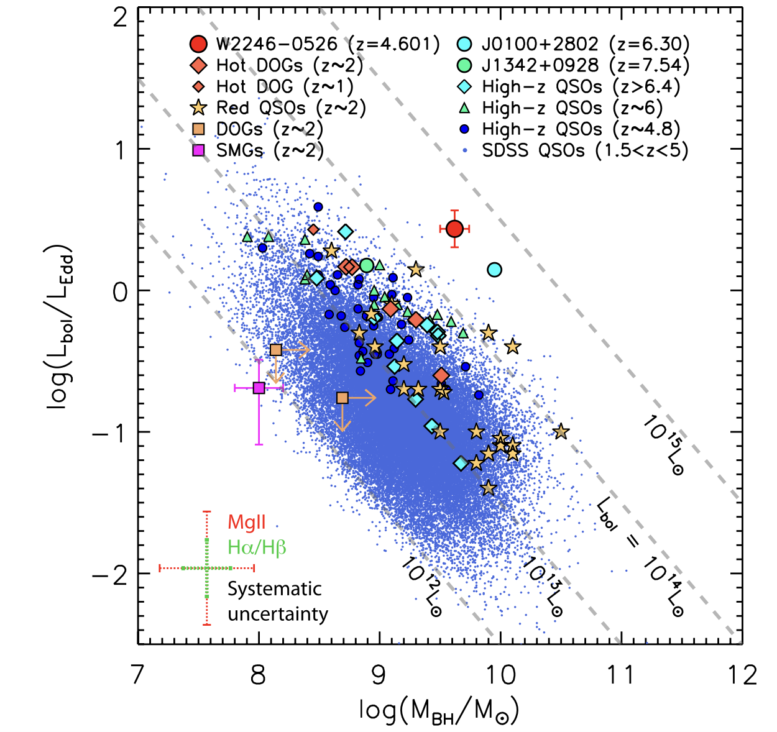
W2246-0526 the most luminous Hot dust obscured galaxy (Hot DOG) ever the most powerful, obscured quasars in the Universe
WISE Survey
Hot DOGs
z = 4.602
Lbol: 3.6 x 10¹⁴ Lsun
Mbh (Mg II): 10^{9.6} Msun
R_{edd} = 2.8

Slide 3
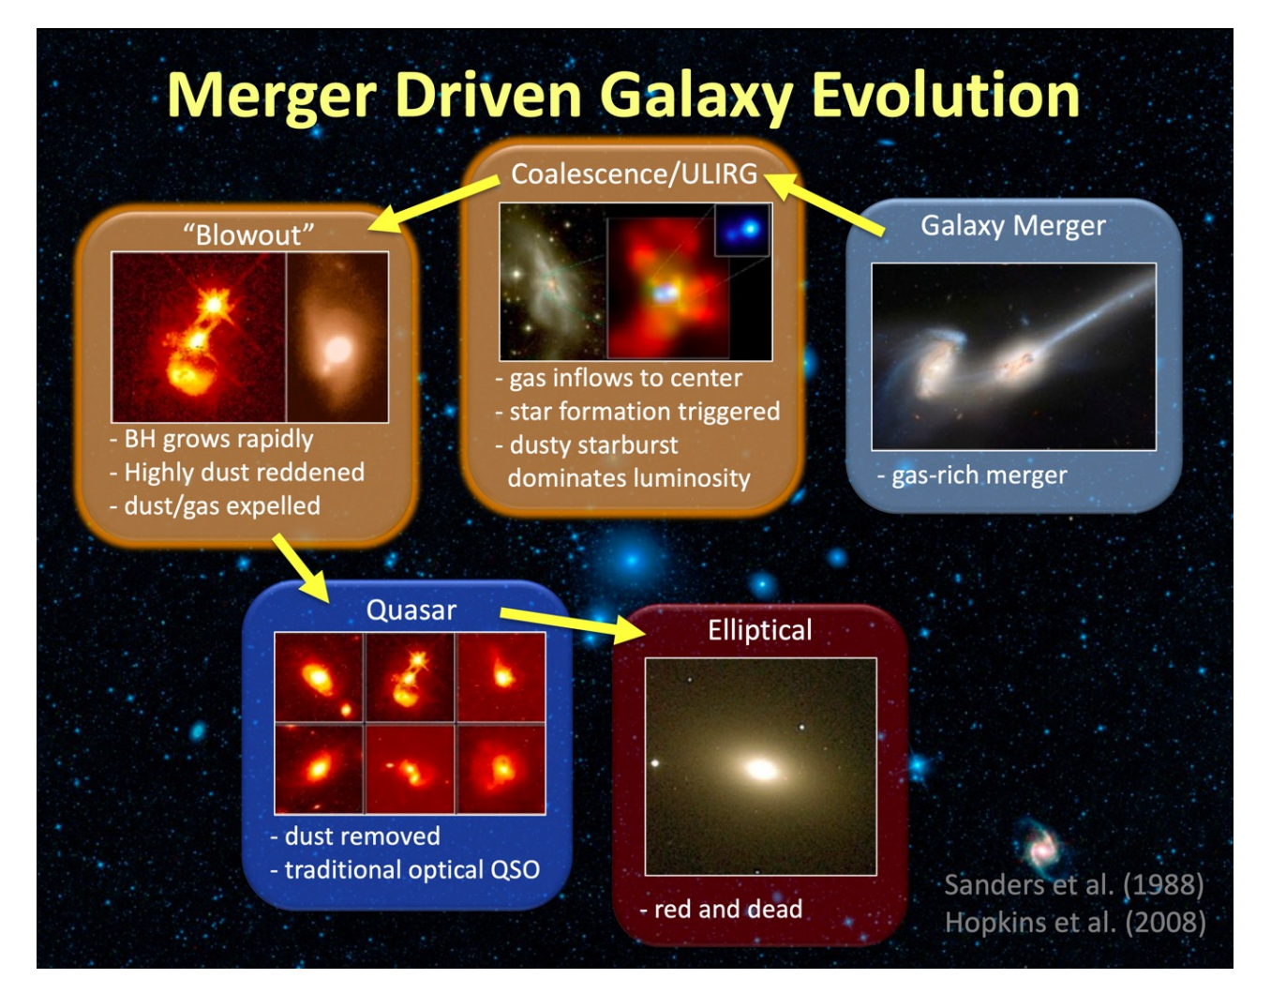
Why Hot DOGs are so important?
AGN blowing-out phase
Obscured AGN to unobscured AGN
Strong AGN feedback (outflows)
Heat/clear out the surrounding medium and potentially shut down star-formation of the host galaxies
Probing a key stage of SMBH-galaxies co-evolution

Slide 4
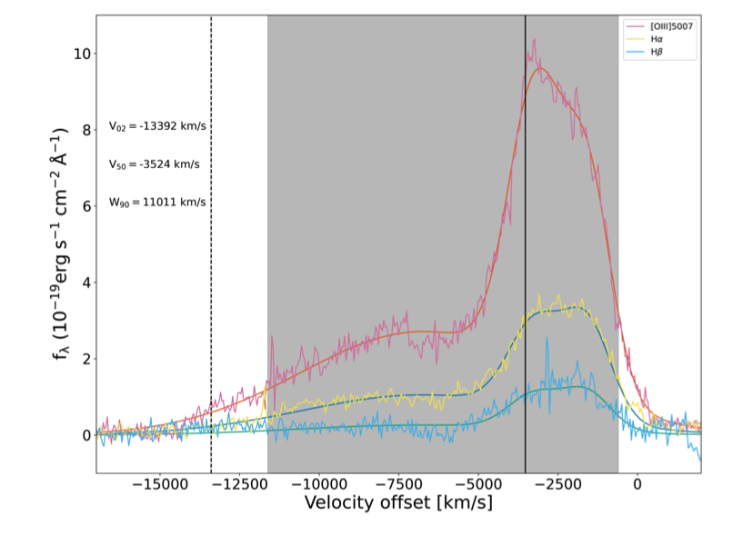
W2246-0526: powerful [OIII] blueshifted outflows (JWST/NIRspec)
Mass outflowing rate:
2000 M⨀/yr
Kinematic energy:
5% Lbol
[O III] outflows are confined in 0.18”/1.2kpc central beam, but likely power shocked heated gas in Ha (extending to a few tens kpc)
Vayner et al. (2025, ApJ, 989, 230)

Slide 5
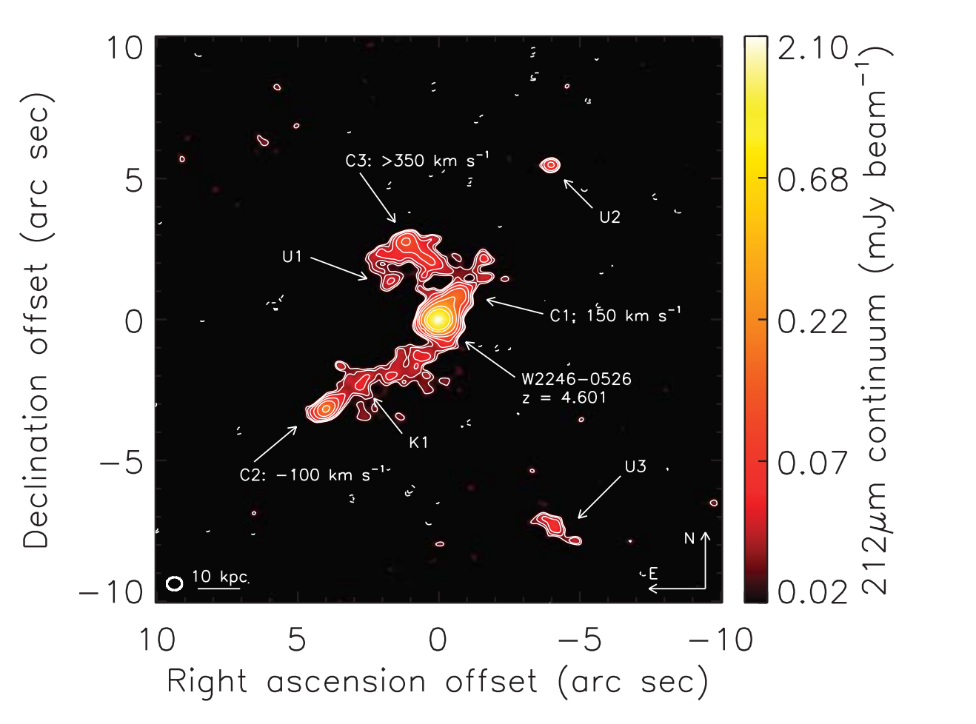
W2246-0526: multiple merger system observed by dust continuum at 212 um at ALMA 0.5”/3.3kpc beam
Diaz-Santos et al.(2018, Science)
Notes:
Hot DOG中恒星形成率通常在什么范围

Slide 6
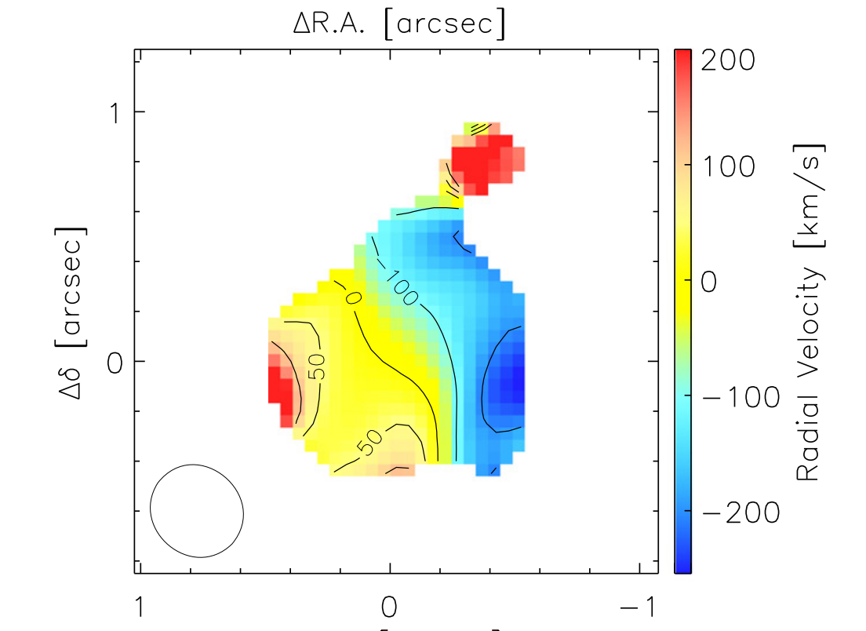
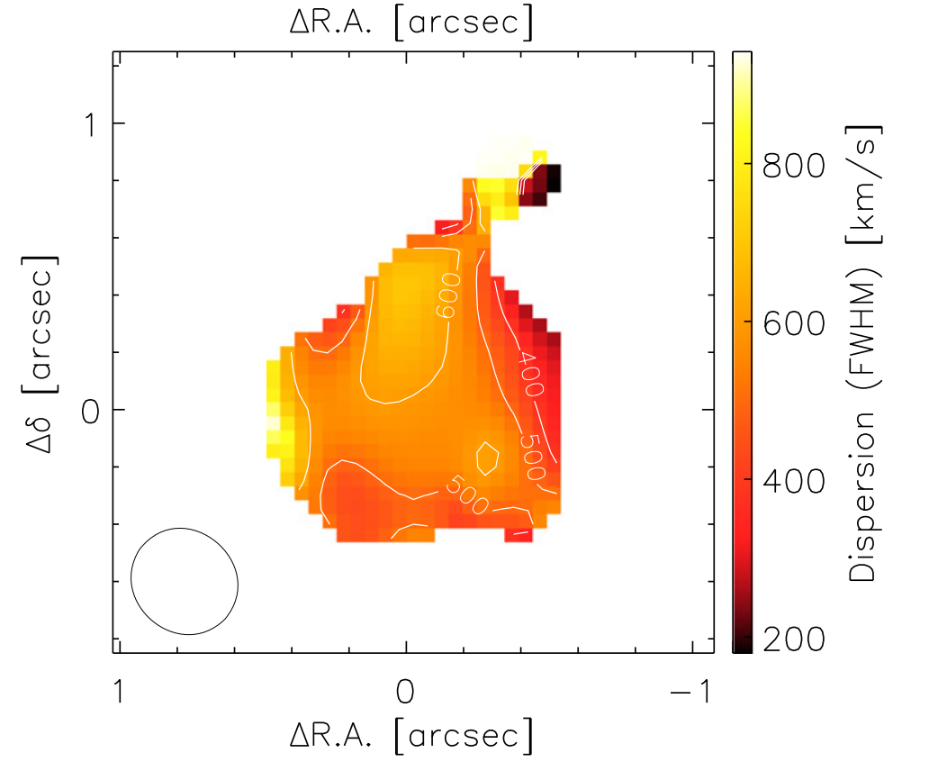
Highly turbulent ISM in low-resolution [CII] observations (0.35”/2.3kpc beam) suggesting AGN outflows in W2246-0526
Velocity field: M1
Velocity dispersion field: M2 field
Diaz-Santos+2016 (ApJL)

Slide 7
ALMA high-resolution [CII]: resolving the AGN nuclear outflows
0.1” / 650 pc beam (natural-weighting cube)
0.069” / 450 pc beam (uniform-weighting cube)
[CII] emission map

Slide 8
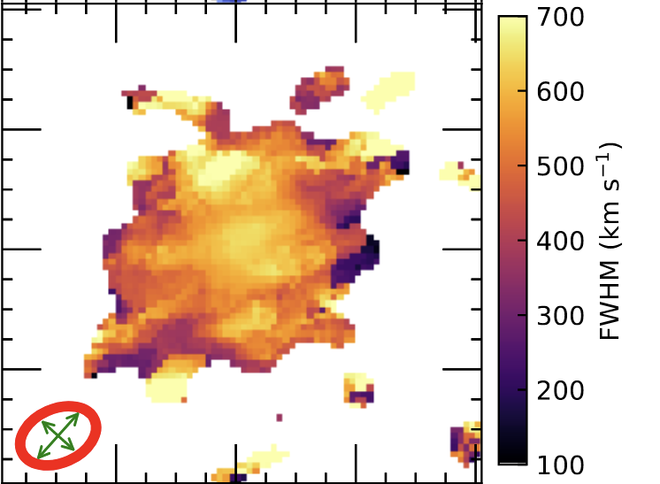
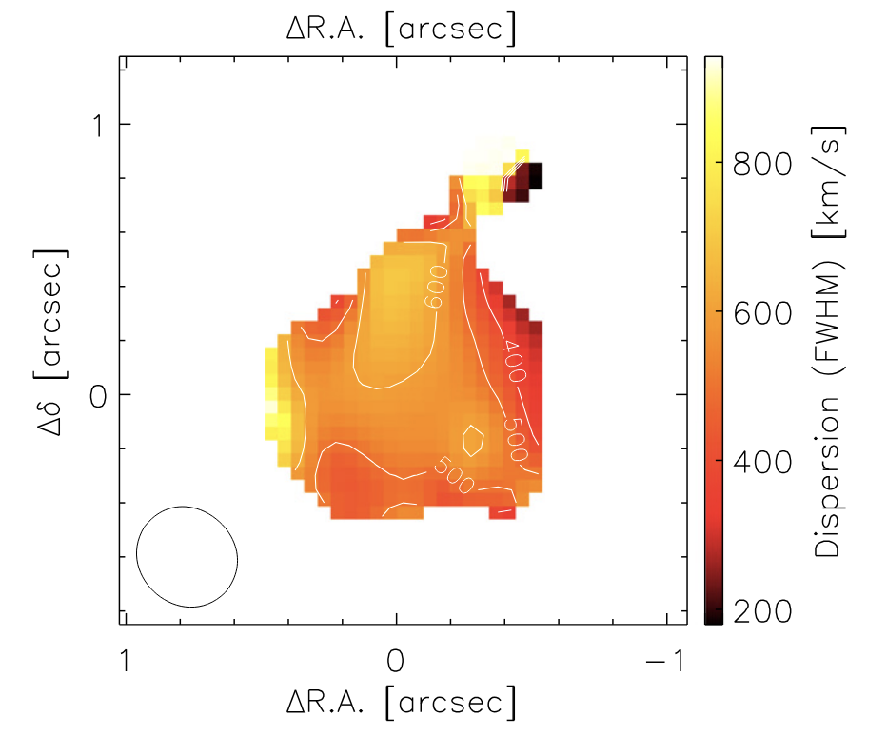
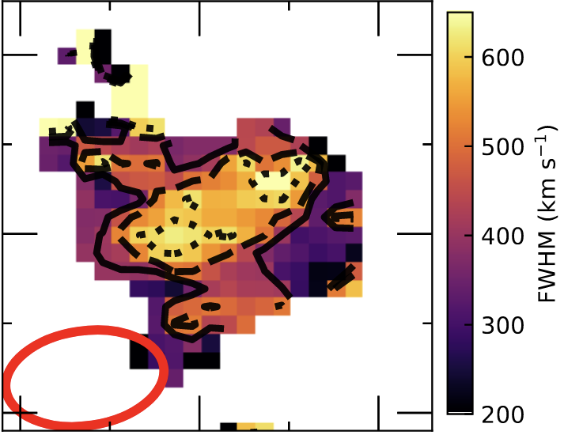
ALMA high-resolution [CII]: high turbulent ISM
[CII] emission: velocity dispersion map

Slide 9
The structures on the velocity field are dominated by AGN outflows (the high-velocity gas)
Blue contours: [-660,-420] km/s
green contours: [240,720] km/s
Decomposing [C II] outflows with ring and pixel by pixel spectrum fitting
Natural

Slide 10
High-resolution (0.07”/450pc beam) [CII] kinematics for W2246-0526
Nuclear AGN cold outflows properties
Liao, RJA, Tsai et al. 2026 (ready for submission)
Dynamically measure central SMBH mass
Liao, RJA, Tsai et al. 2025 (under review, arXiv:2504.13409v1)

Slide 11
Isolated nuclear [CII] outflows in W2246-0526
Asymmetric
Liao, RJA, Tsai et al. 2026
(to be submitted)

Slide 12
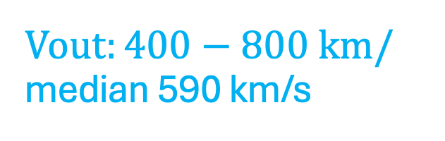
$Vout:400−800 km/$ median 590 km/s
Isolated nuclear [CII] outflows in W2246-0526
Not fast
Liao, RJA, Tsai et al. 2026
(to be submitted)

Slide 13
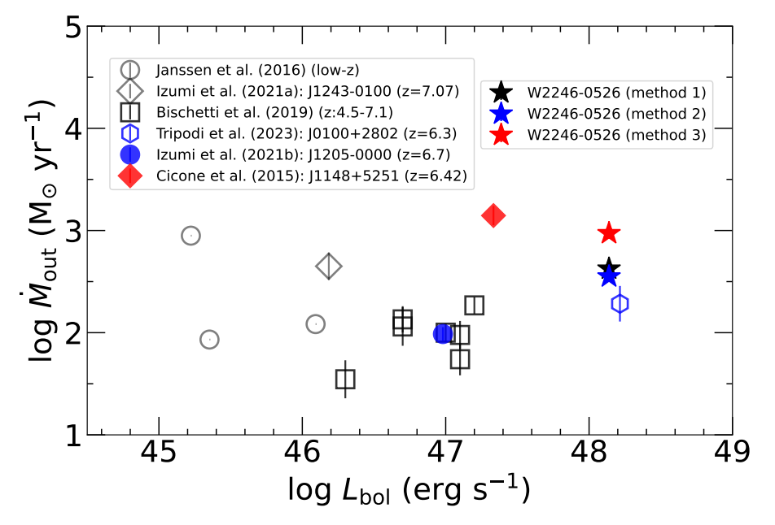
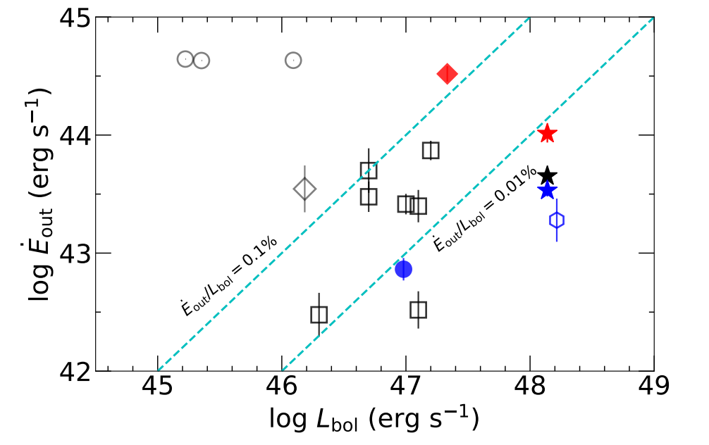
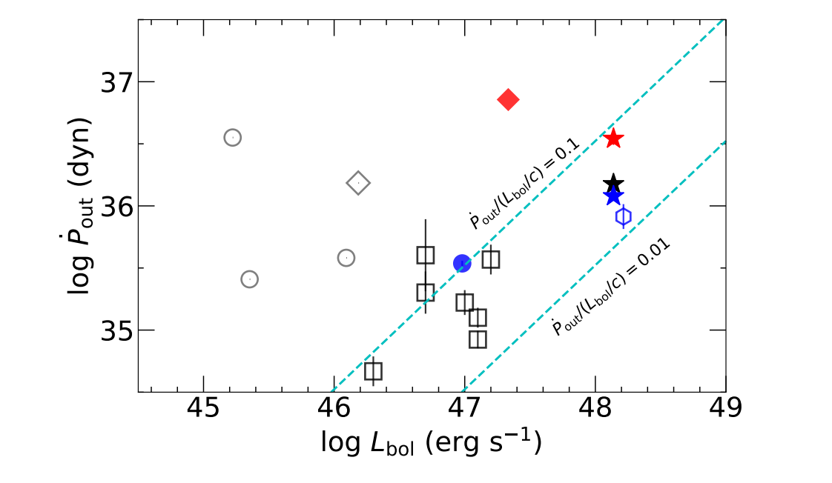

Nuclear [C II] Outflows in
W2246-0526
Kinematic energy: $\sim 0.01\%$ of $L_{Bol}$
some of the most powerful outflows known to date
Liao, RJA, Tsai et al. 2026
(to be submitted)

Slide 14
Implications for the asymmetric, powerful but not fast nuclear [CII] outflows in W2246-0526
Scenario: nuclear [CII] outflows are interacting with dense ISM
  outflows are trapped and slowed down
  Transfer their energy to the ISM
  Power galaxy-scale high turbulence kinematics
Combining the deep low-resolution (0.35”/2.3kpc beam) [C II] data to map the whole [CII] outflows structures from the inner to outer region

Slide 15

Dynamical SMBH mass measurement by resolving the black hole sphere of influence (SoI) at redshift of 4.6
Dispersion total model:
SMBH mass+Host mass (Sersic profile)
M_{BH}: 6.16 $±$ 0.29 $× {10}^{9}$Msun
Additional centrally concentrated host components (stars or gas) in center to dominate over the BH gravity, are very unlikely!!!
Liao, RJA, Tsai et al. 2025 (arXiv:2504.13409v1)

Slide 16
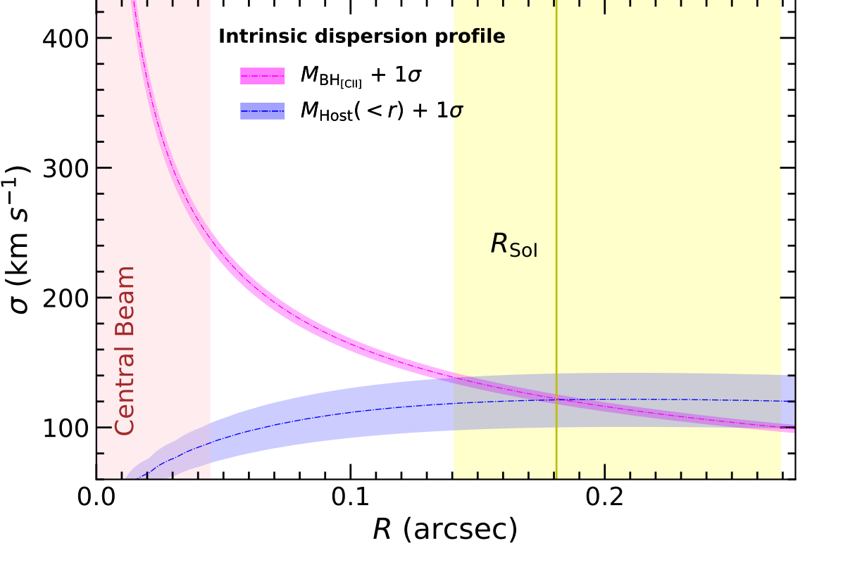

Dynamical SMBH mass measurement by resolving the black hole sphere of influence at redshift of 4.6
SoI diameter:
${2.37}_{−0.52}^{+1.18}$ kpc (${0.362}_{−0.08}^{+0.18}”$ )
Liao, RJA, Tsai et al. 2025 (arXiv:2504.13409v1)

Slide 17
Implications for black hole part
W2246-0526: first successful dynamical SMBH mass measurement at z > 2 by using ALMA high-resolution [CII] emission line through resolving SoI
The obscured quasars may be :
key to allow [C II] survivability in the inner regions through the heavy obscuration to avoid over ionization
the primary targets for increasing dynamical SMBH mass estimates in the early Universe

Slide 18

Summary
By using the ALMA high-resolution [C II] imaging, we disentangle the effect of AGN feedback that yielded the high turbulence ISM system in W2246-0526, and find
The spatial resolved AGN [C II] outflows:
are asymmetric and in slow velocity (vout:400-800 km/s)
have some of the most powerful outflows known to date
(2) The outflow-free host dispersion profile requires the presence of an SMBH with a mass of 6 $× {10}^{9}$Msun

Slide 19
ALMA high-resolution [CII] observations for Hot DOGs
Plans
1) The most luminous, Hot DOG W2246 at z = 4.6:
Powerful, asymmetric outflows; dynamically measure black hole mass
Other three EL Hot DOGs (W0220, W0134, W0410, under progress)
High-resolution: 0.05”-0.02” at ALMA Band 8 (PI: Mai Liao)
Goals: increase the number of dynamical SMBH mass in the early Universe
study their nuclear [C II] outflows and AGN feedback, and help to understand how unique is W2246-0526
3) EL Hot DOG W0831: merger activity (under progress)
multiple-peaked [CII] spectrum, multiple narrow components on channel maps

Slide 20
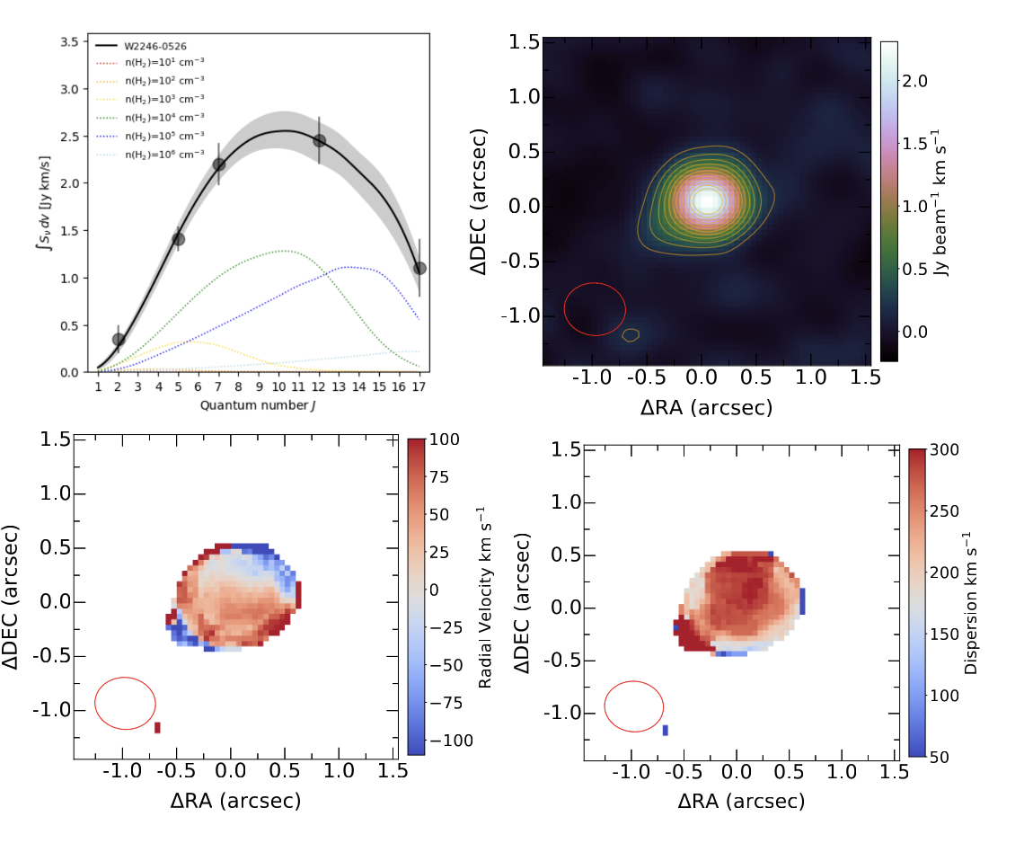
Painting the comprehensive picture for the AGN outflows in W2246-0526—shocked heated host
CO SED and M0, M1, M2 maps for CO (12-11) at 0.5”/3.3 kpc
1) JWST/NIRSpec: powerful [O III] outflows likely the primary driver of the radiative shocks on the ISM and CGM
2) High-resolution [CII] observations: nuclear powerful, asymmetric [CII] outflows
ISM-quasar feedback interaction, powering the turbulent motion, injecting energy into the ISM
3) CO SED (2–1, 5–4, 7–6, 12–11, 17–16), peaking at CO (12-11) , the temperature ratio between the CO molecular gas kinematics and the dust, is ∼ 3.9
consistent with shocking heating
High-resolution CO(12-11) (0.07”, PI: Mai Liao)
mapping CO (12–11) outflow in the nuclear region, tracing the strongest AGN feedback from molecular outflows

Slide 21
Thanks for your attention!

Slide 22
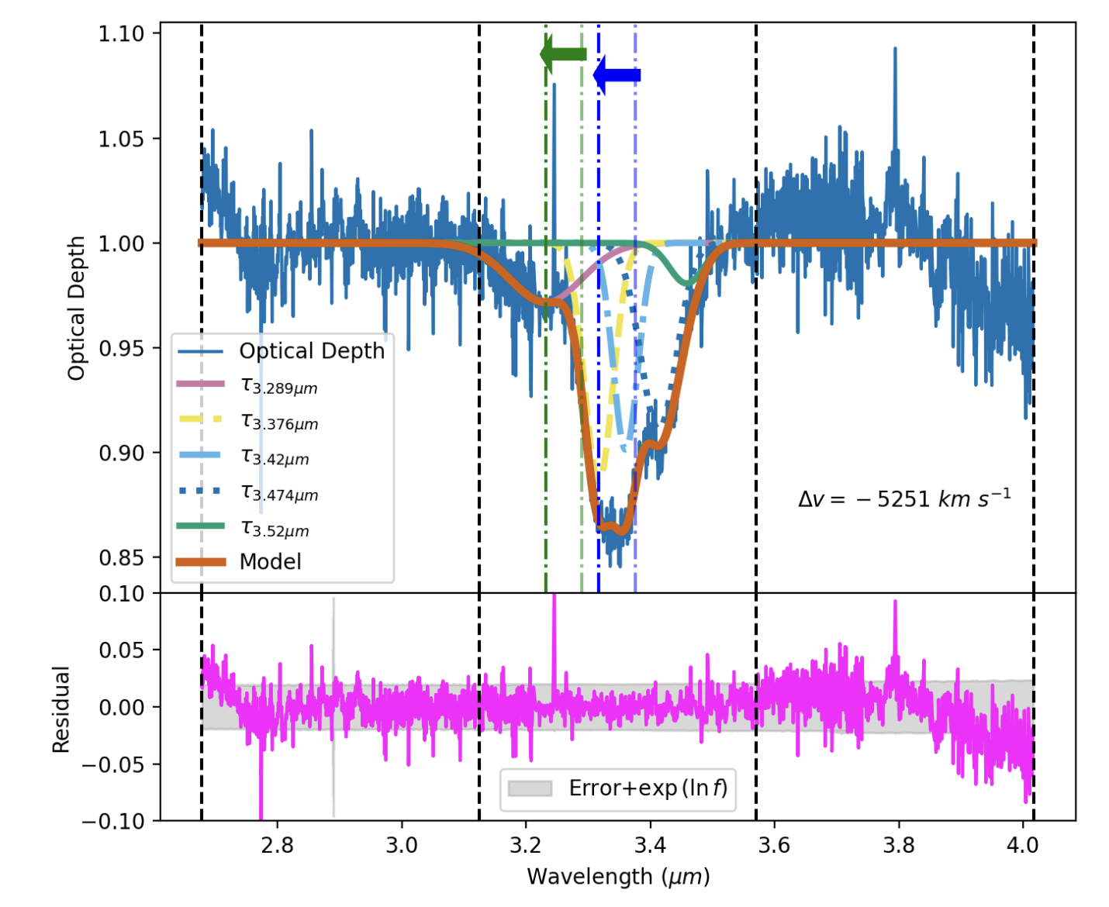
W2246-0526: powerful dusty outflows (JWST/MIRI)
Vayner et al. (submitted, arXiv:2510.09870)

Slide 23
SMBH-galaxy co-evolution: black holes are over-massive for Hot DOGs
1) Hosts would grow faster than the SMBHs?
AGN feedback must be insufficient to stop star-formation
2) Outliers?
Stellar mass of W2246-0526:
Largely unconstrained
A range between JWST estimates(young stellar population dominates) and previous SED fitting estimates (old stellar population dominates )
W2246-0526 ([CII] black hole mass) and other Hot DOGs (Mg II based Black hole mass)
Liao, RJA, Tsai et al. 2025 (arXiv:2504.13409v1)

Slide 24
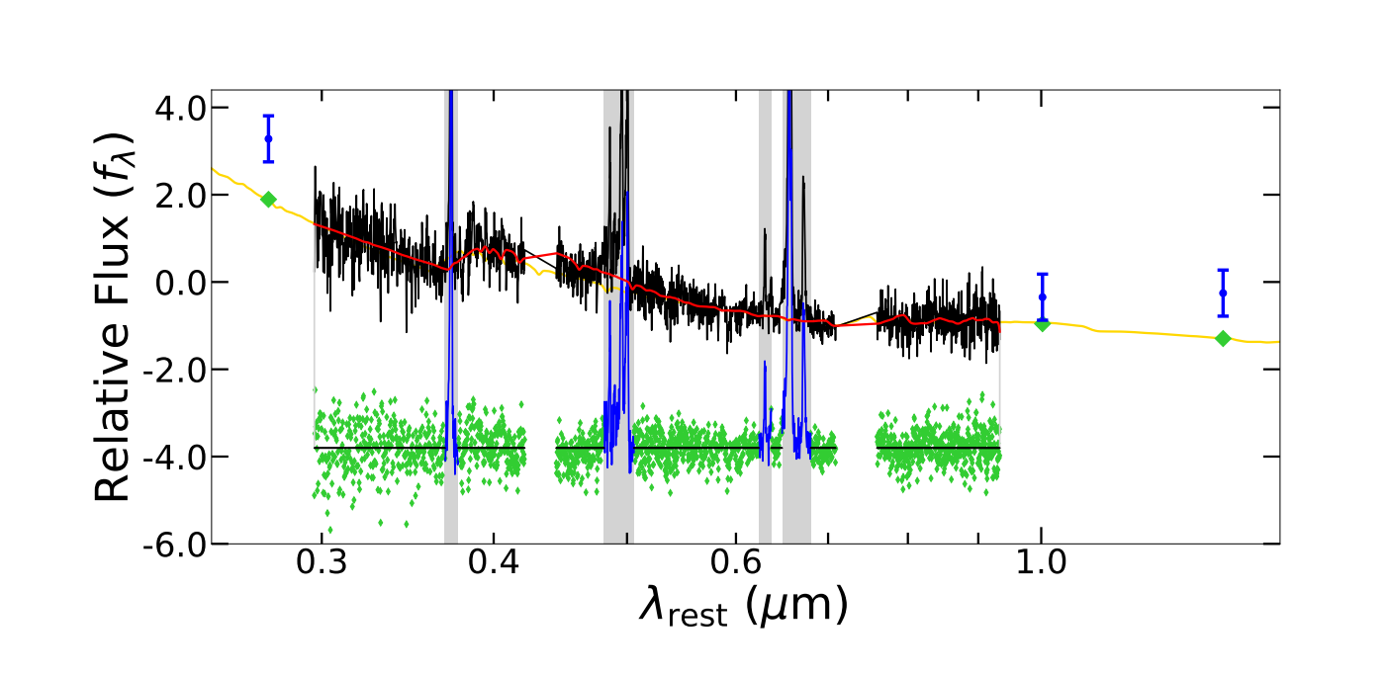
JWST SED fitting

Slide 25
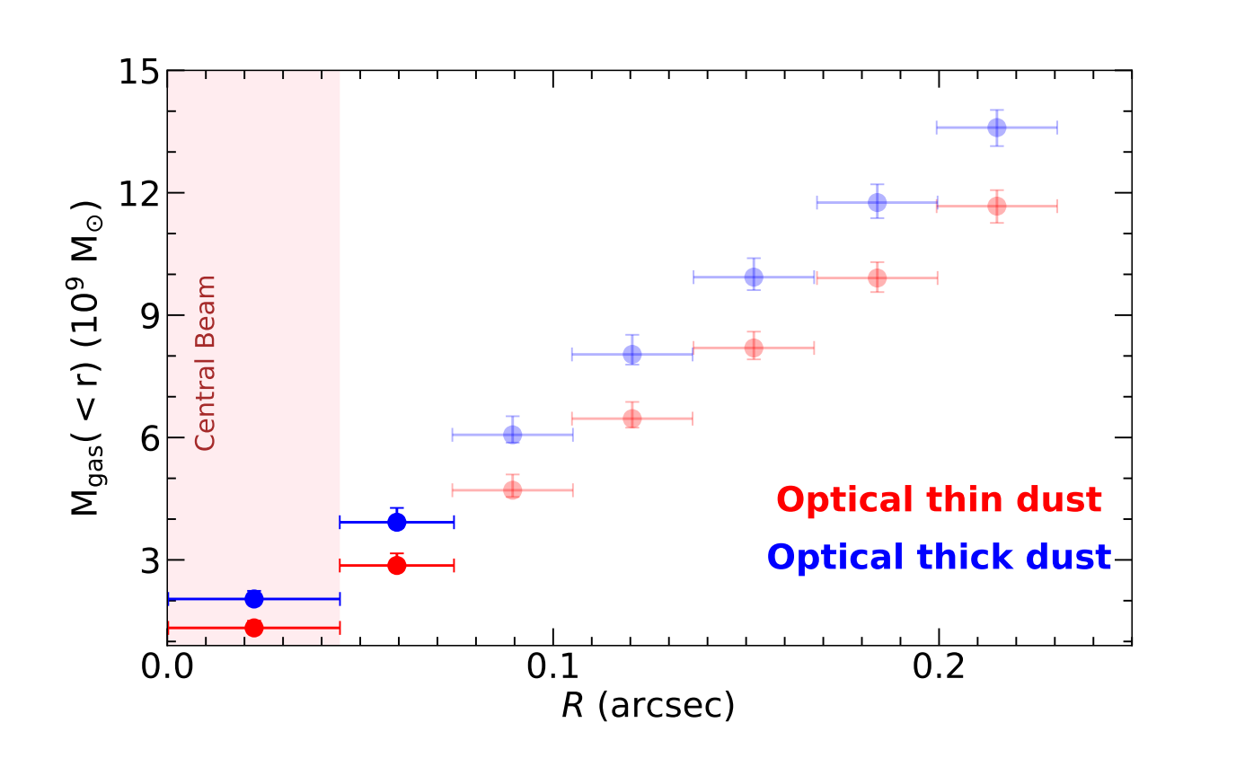
Dust-based gas mass

Slide 26
Measuring SMBH mass is challenging
The most direct and robust way (dynamical):
Observing BH gravitational effects on matter within black hole sphere of influence
Needing high spatial resolution to resolve SoI for high-redshift AGN, with high SNR tracers
Indirect way:
Reverberation mapping (RM): deriving the BLR radius by measuring time lag between variations in continuum flux and variations in broad-line luminosity
RM requires decades, to map the time lag due to cosmological time dilation for high-redshift AGN
Single-epoch spectrum method:
Based on RM to derive R-L relation in local Universe
The local single-epoch method may not fit for high-redshift AGN, testing its reliability in the early Universe is highly demanded

