Slide 1
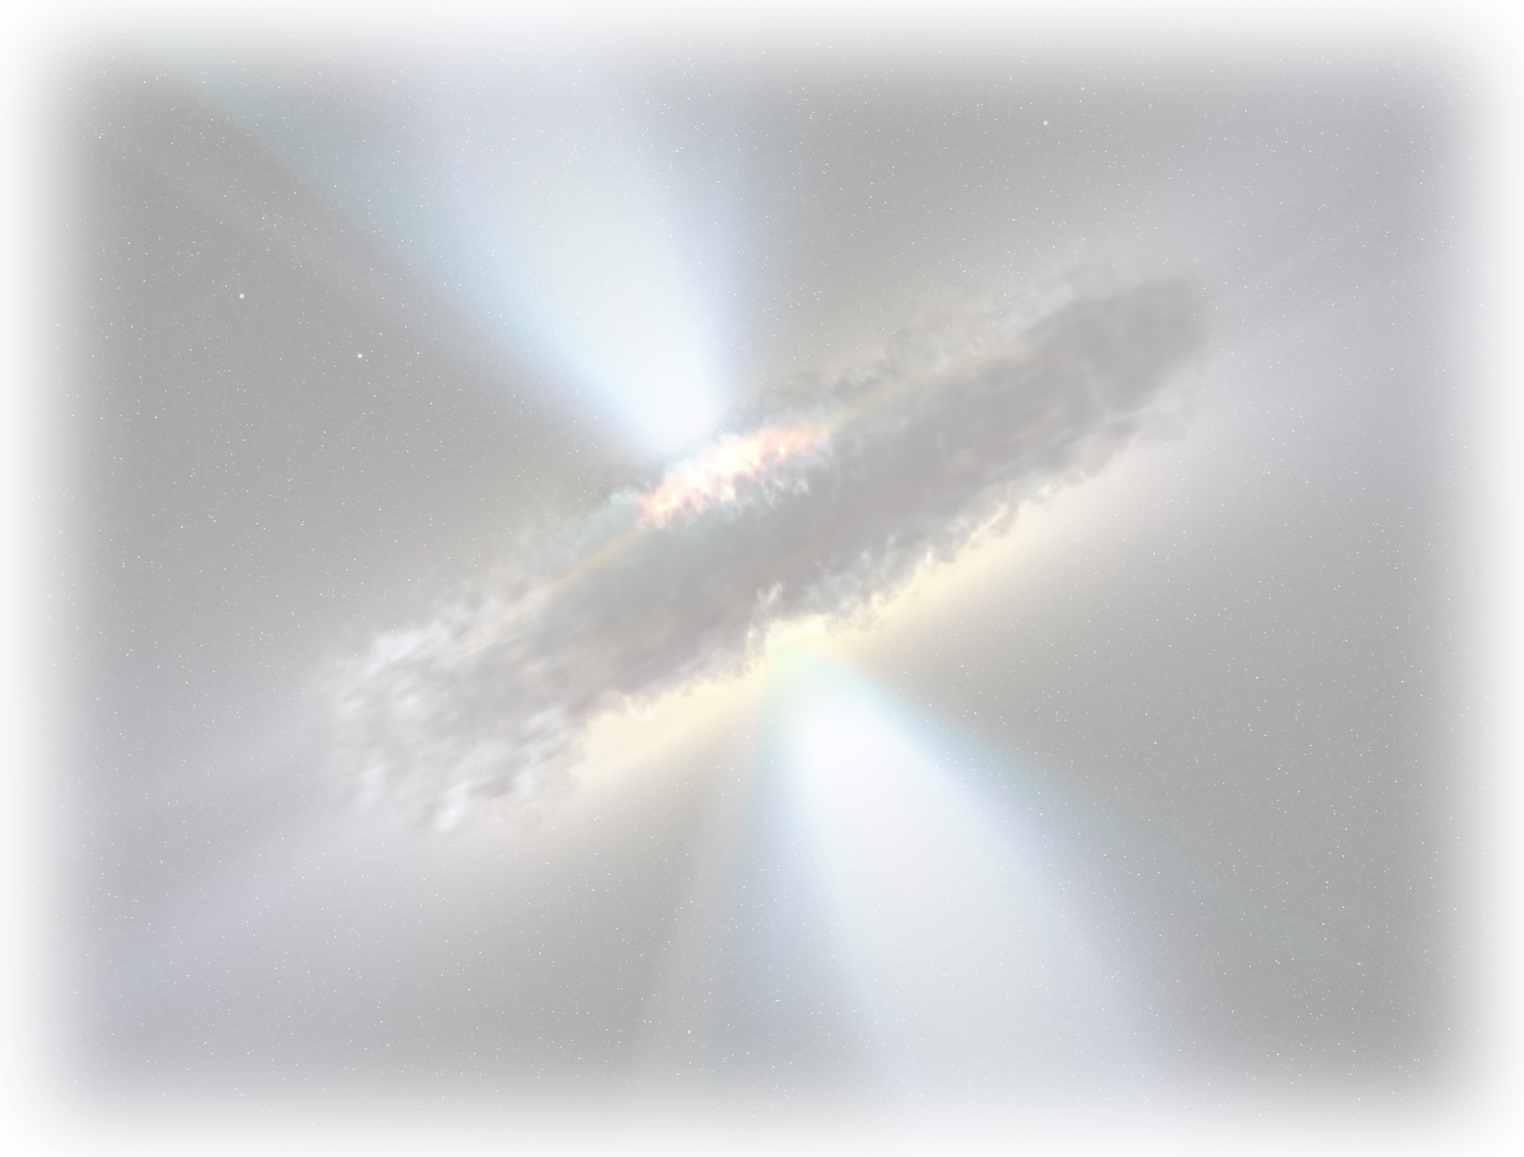
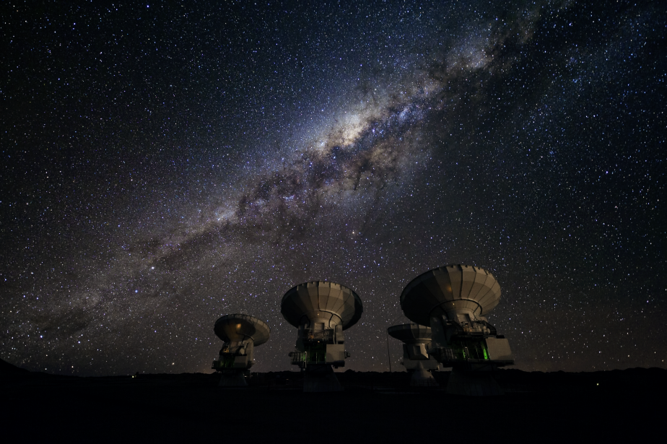
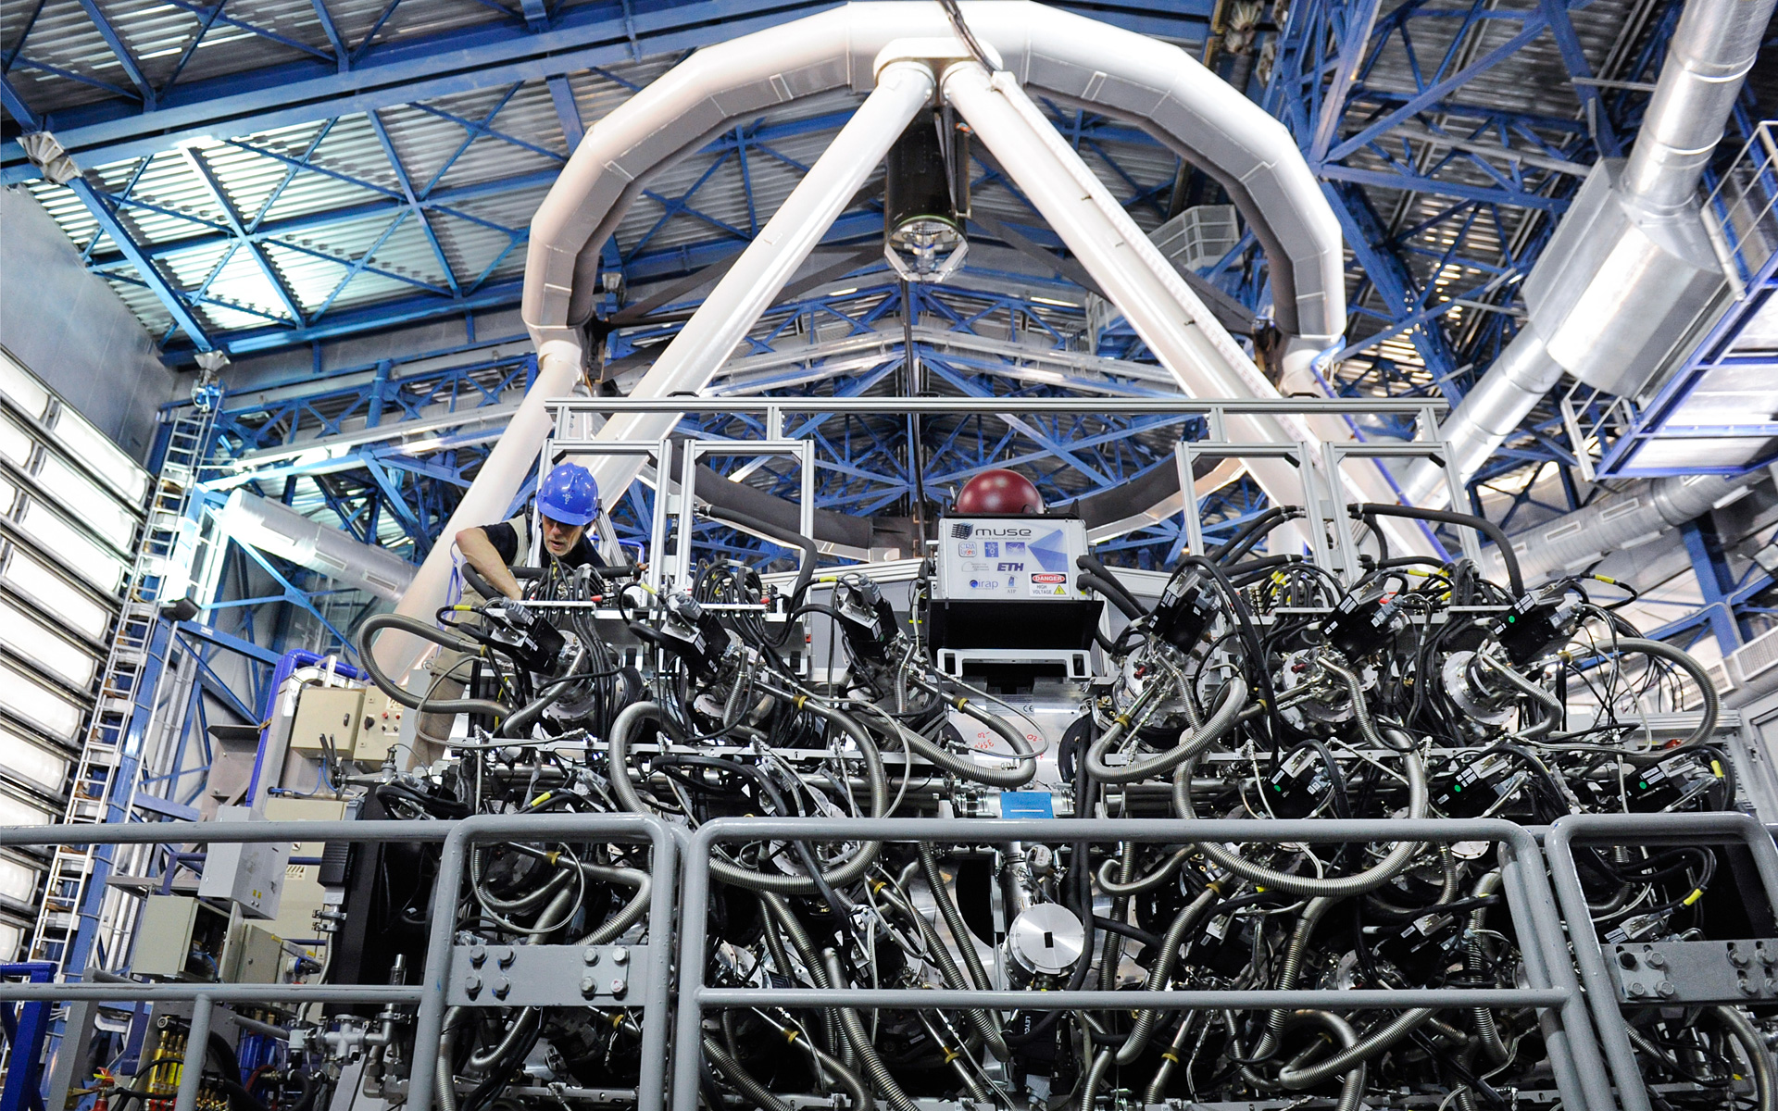
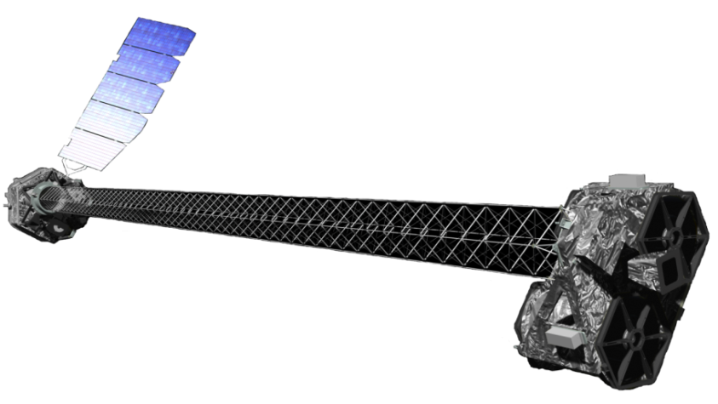


Feeding and Finding Close-Separation Dual AGN: Insights from Multiwavelength SEDs and ALMA Observations
Ezequiel Treister
Institute of Advanced Studies
Universidad de Tarapacá
Postdocs: Fondecyt: Ignacio del Moral-Castro (PUC)
Graduate Students: PhD: Macarena Droguett, Msc: Jenny Ramos
Former Visiting Fullbright PhD: Makoto Johnstone (UVa)
Former: Clemente Riesco, Marco Troncoso, Dusán Tubín, Valentina Zagal, Fernando Peñaloza (students), Carolina Finlez, Federica Ricci, Giacomo Venturi, Patricia Bessiere, George Privon (postdocs)
Main Collaborators: Franz Bauer (UTA), Mike Koss (Eureka), Meg Urry, Priya Natarajan (Yale), Tonima Ananna (Wayne St.), Loreto Barcos-Muñoz, George Privon (NRAO), Aaron Evans (UVa/NRAO), Claudio Ricci (UDP), Dave Sanders (IfA, Hawaii), Ran Wang, Luis Ho (PKU), Sophia Dai (NAOC), Francisco Muller-Sanchez (U. of Memphis), and others
Notes:
--------------------------------------------------------------------------------
SLIDE 1: Title Slide
TIME: 0:00-0:30 (30 sec)
--------------------------------------------------------------------------------
[As audience settles]
"Thank you for the introduction. I'm excited to be here at CCBC for the first
time, and especially excited about spending the next month at NAOC after this
meeting.
Today I'll share recent results on finding and feeding close-separation dual
AGN—work that relies heavily on ALMA and addresses fundamental questions about
how supermassive black holes grow during galaxy mergers.
This is truly collaborative work—you can see the team here, including colleagues
at PKU and NAOC with whom we've been working for several years."

Slide 2
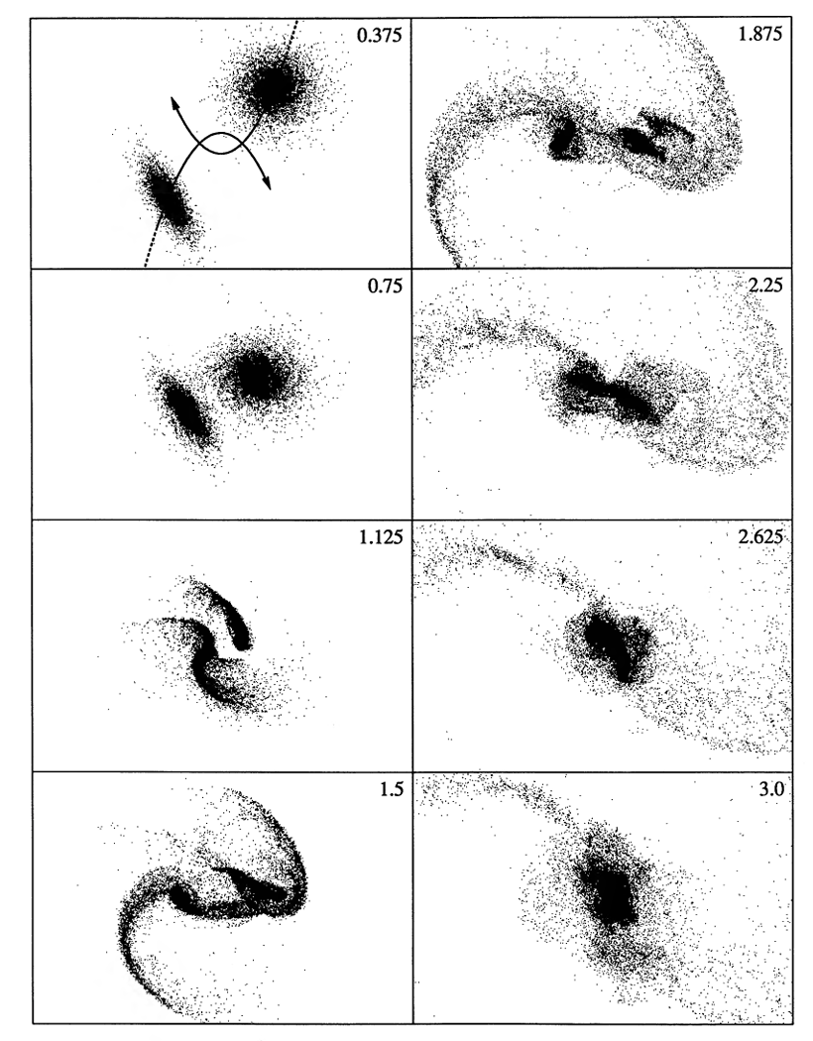
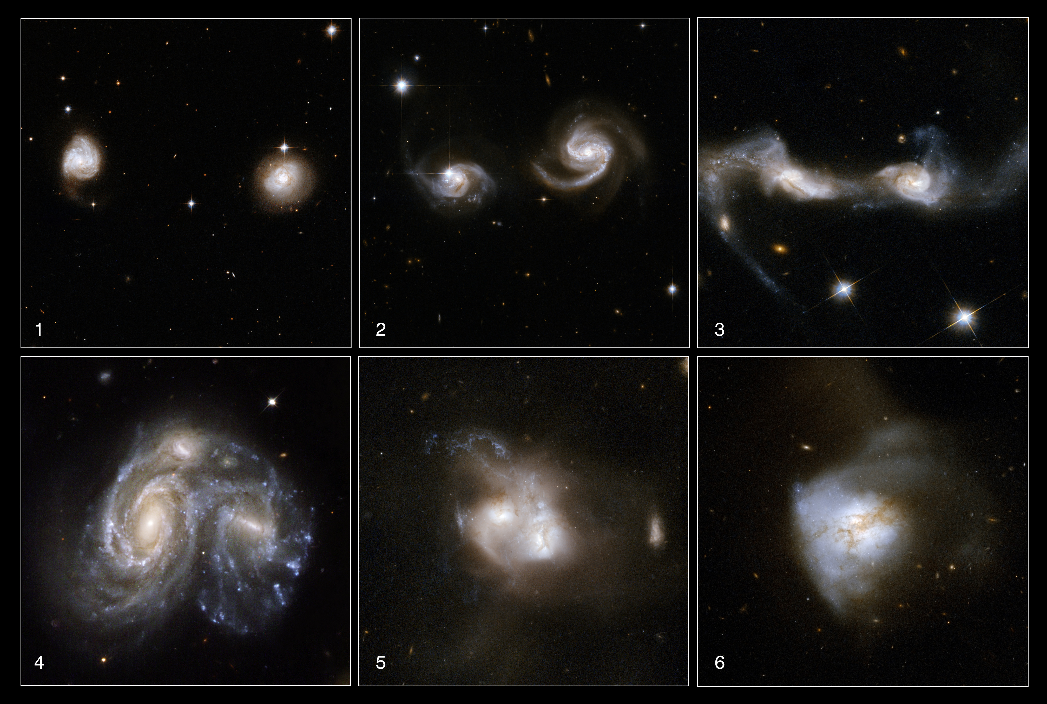
Major Galaxy Mergers as Drivers of Supermassive Black Hole Growth
Major galaxy mergers drive gas inflows fueling both star formation and SMBH accretion
Credit: NASA, ESA, the Hubble Heritage Team and
A. Evans, K. Noll, and J. Westphal
Barnes (1992)
Notes:
--------------------------------------------------------------------------------
SLIDE 2: Major Galaxy Mergers as Drivers of SMBH Growth
TIME: 0:30-1:30 (1 min)
--------------------------------------------------------------------------------
"Let me start with the big picture. We know major galaxy mergers drive gas
inflows that fuel both star formation and black hole accretion.
On the left, the classic Barnes 1992 simulations showing the merger sequence.
On the right, beautiful Hubble images of real systems at different stages.
The key physics: gravitational torques during the interaction efficiently remove
angular momentum from the gas, driving it toward the nuclear regions where the
SMBHs reside."

Slide 3
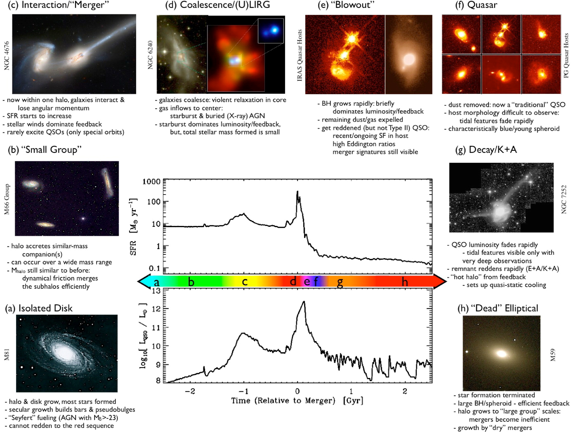
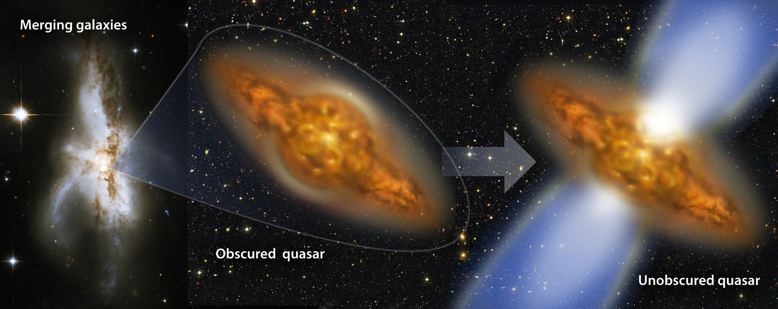
Δt=96±23 Myrs
Treister et al. 2010
Numerical simulations indicate that the dual AGN phase, at <10 kpc separations, is where most SMBH growth and the highest SFR rates are expected. Phase lasts ≲100-200 Myrs
Very difficult to find due to heavy obscuration and high-resolution requirements.
Only a few confirmed systems in the local Universe so far.
Hopkins et al. (2008), based on Sanders et al. (1988)
Notes:
3
--------------------------------------------------------------------------------
SLIDE 3: Hopkins Timeline + Dual AGN Phase
TIME: 1:30-3:00 (1.5 min)
--------------------------------------------------------------------------------
"This cartoon from Hopkins, building on the Sanders evolutionary sequence, shows
what we expect to happen.
The critical point: numerical simulations predict that the dual AGN phase—when
the two nuclei are separated by less than 10 kpc—is where most of the SMBH
growth occurs. This phase lasts only about 100-200 million years.
From our own work, the heavily obscured phase lasts roughly 100 Myr before the
system blows out the dust and becomes a visible quasar.
But here's the challenge: this phase is extremely difficult to observe. Heavy
obscuration hides the AGN, and the small separations require high angular
resolution. That's why we have only a handful of confirmed systems despite
decades of searching."

Slide 4
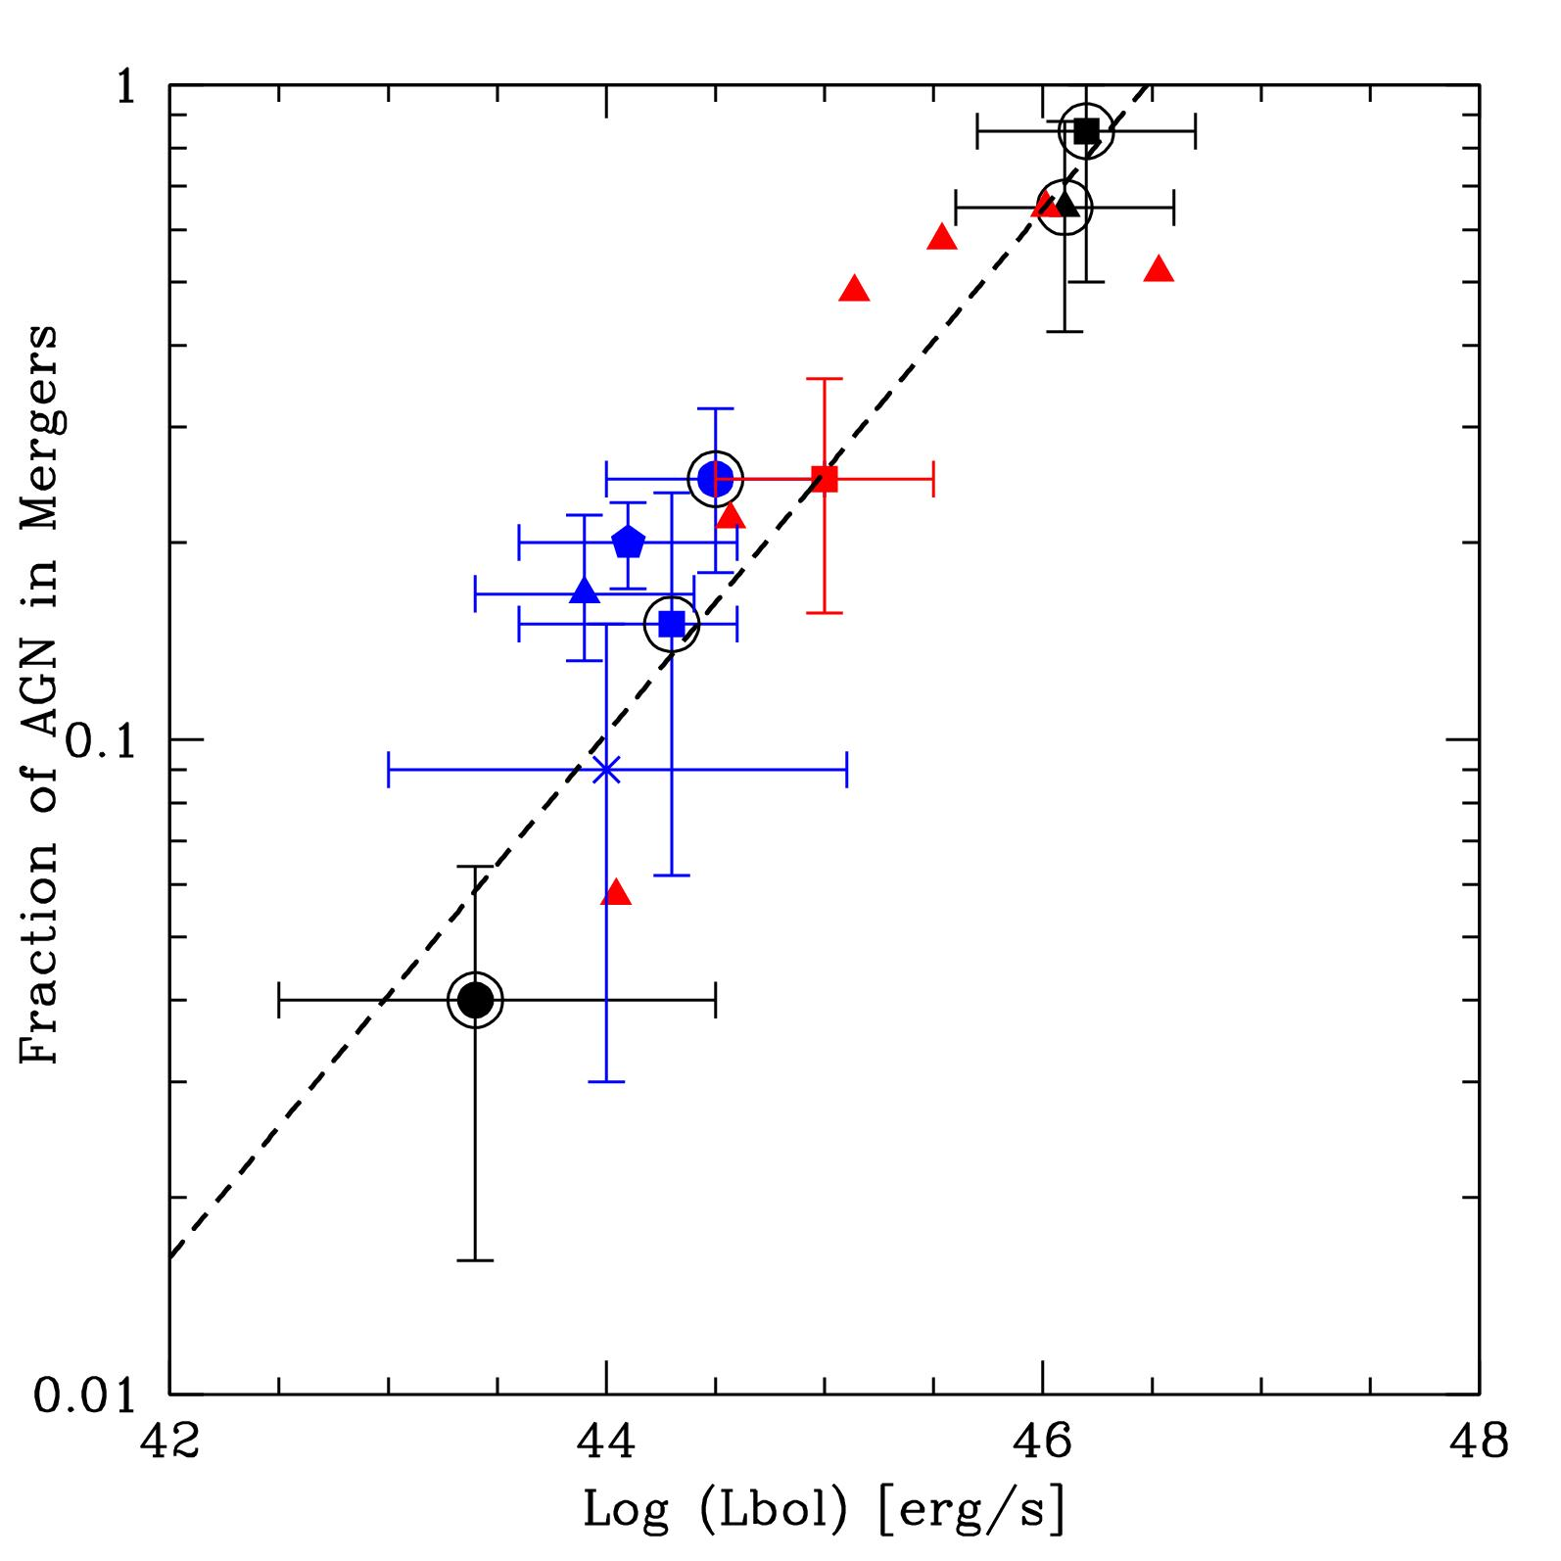
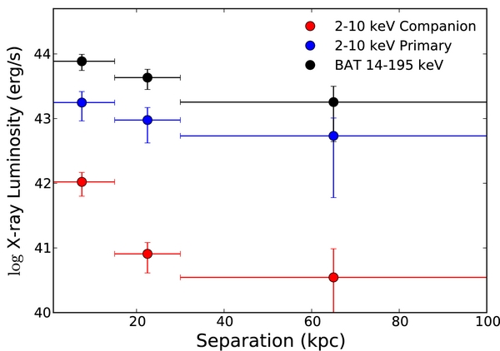
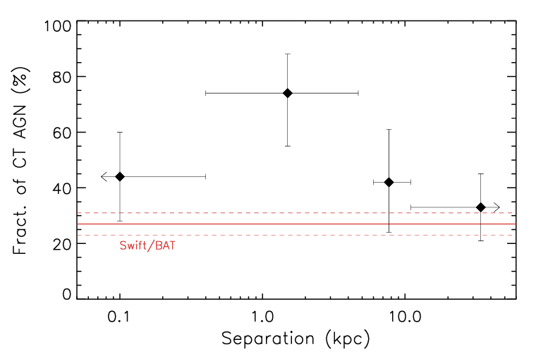
SMBH Growth-Galaxy Mergers Observational Connection
Major galaxy mergers trigger the most luminous AGN (most rapid SMBH accretion)
Higher luminosities towards smaller nuclear separations
Treister et al. 2012
Koss et al. (2012)
Most of the SMBH growth in late merger stages is heavily obscured (Compton thick; N_{H}>10²⁴ cm⁻²)
Ricci et al. (2021)
Notes:
4
--------------------------------------------------------------------------------
SLIDE 4: SMBH Growth-Galaxy Mergers Observational Connection
TIME: 3:00-4:15 (1.25 min)
--------------------------------------------------------------------------------
"What do the observations tell us?
Three key results here. Left panel from our 2012 work: the most luminous AGN
are preferentially found in mergers—the merger fraction increases dramatically
above 10^46 erg/s.
Middle panel from Koss: X-ray luminosity increases as nuclear separation
decreases. The closer the nuclei, the more luminous the AGN.
And critically, from Claudio Ricci's work on the right: the fraction of
Compton-thick AGN—those with column densities above 10^24—rises dramatically
at separations below 10 kpc, reaching 80% at the smallest separations.
This tells us most of the growth is hidden behind extreme columns of gas and
dust."

Slide 5
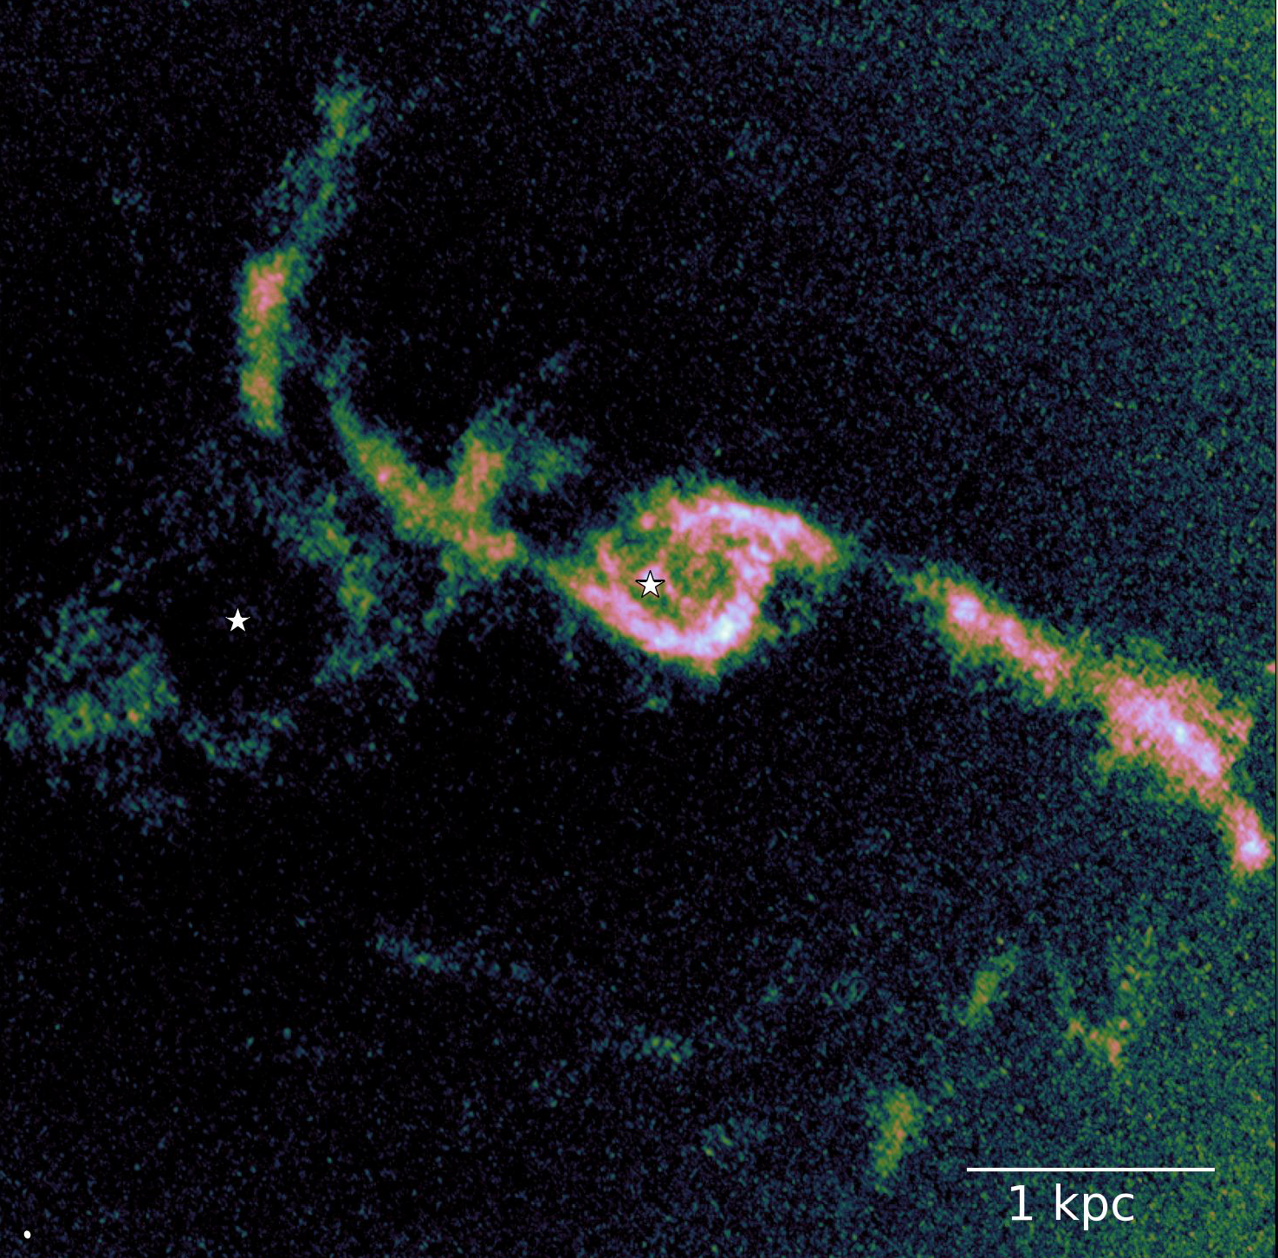
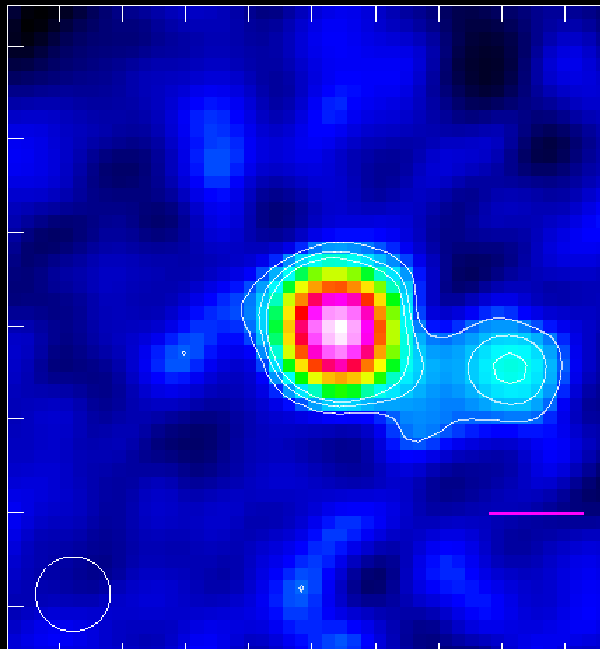
Three Fundamental Questions
How do AGN activity and star formation evolve through the merger sequence?
What fuels SMBH growth in these systems? Is there sufficient molecular gas?
How can we systematically find the most heavily obscured dual AGN at the smallest nuclear separations?
Notes:
5
--------------------------------------------------------------------------------
SLIDE 5: Three Fundamental Questions
TIME: 4:15-5:00 (45 sec)
--------------------------------------------------------------------------------
"So this sets up three fundamental questions I'll address today:
First, how do AGN activity and star formation evolve through the merger sequence?
Second, what actually fuels the black hole growth? Is there sufficient molecular
gas, and how does it get to the nucleus?
And third—perhaps most practically—how can we systematically find these heavily
obscured dual AGN at the smallest separations where they're hardest to detect?
Let me take these one by one."

Slide 6
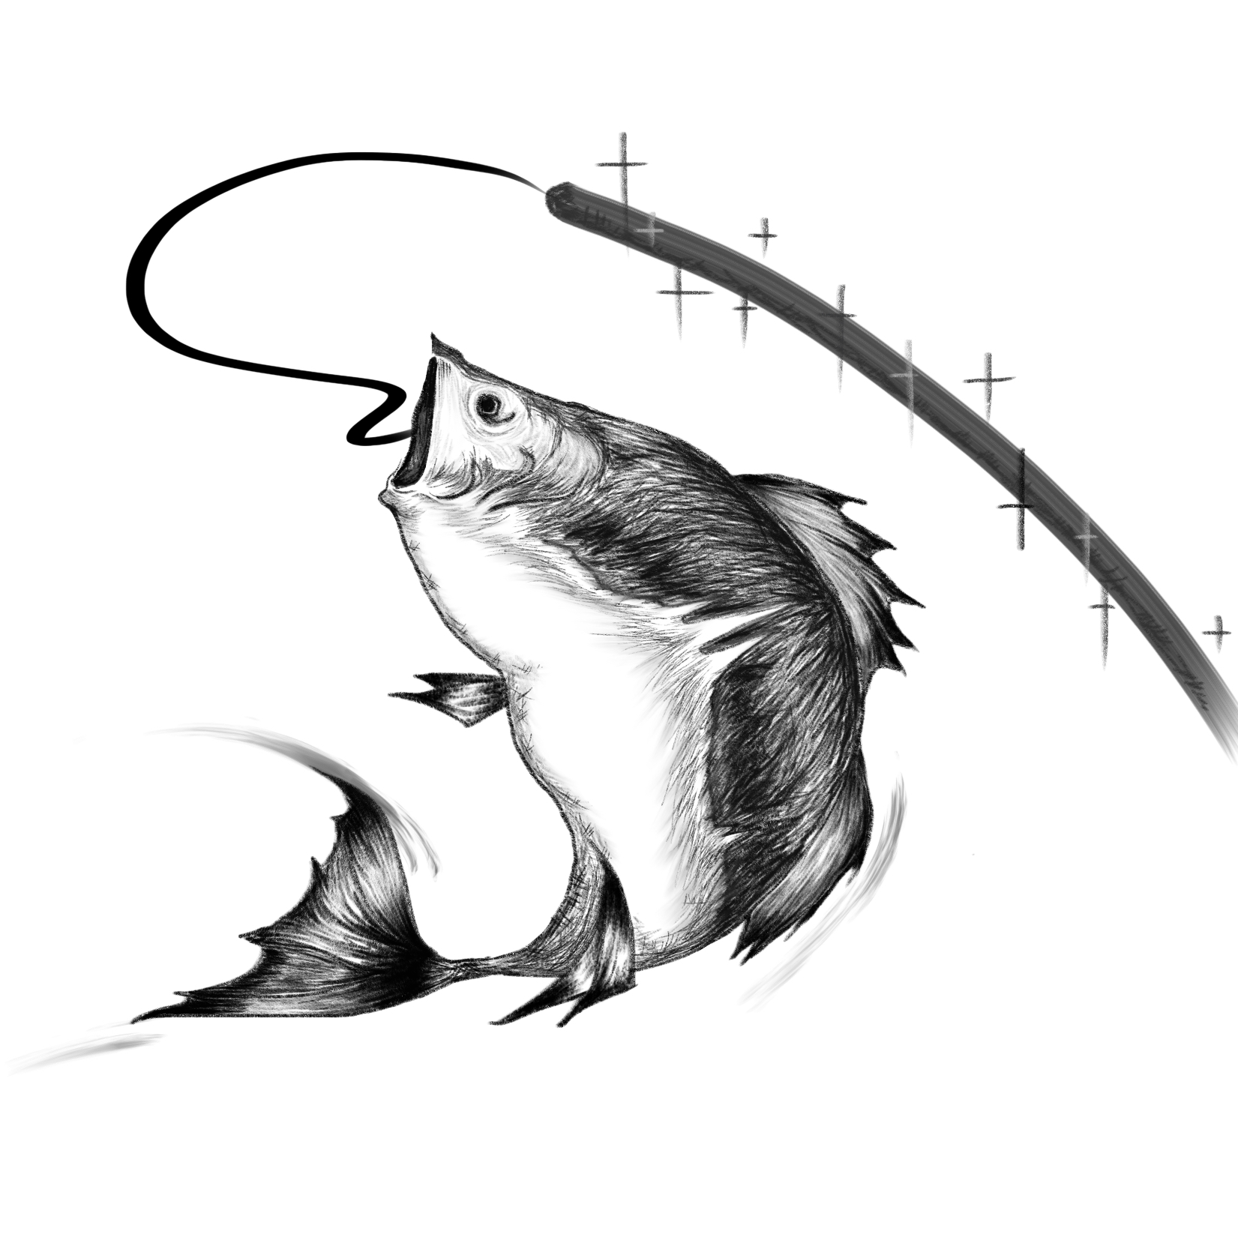
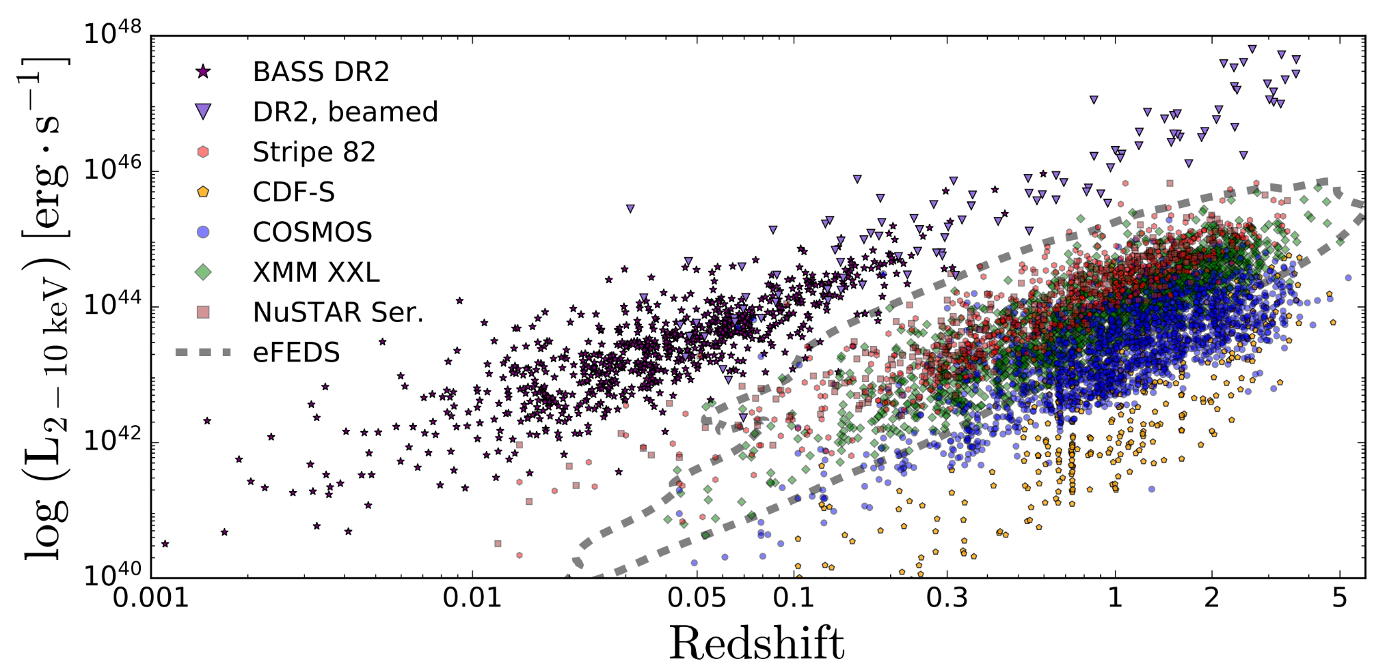
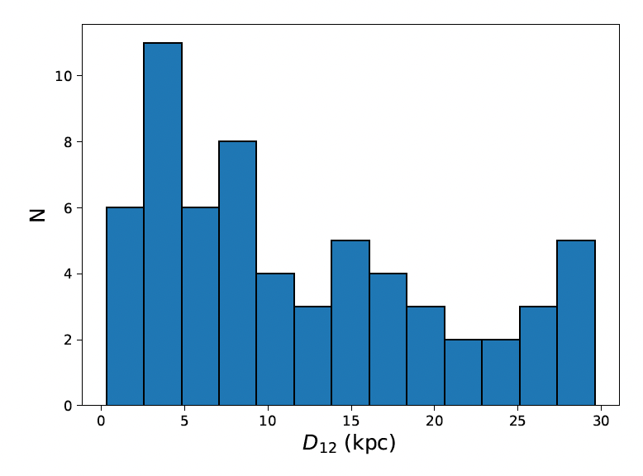
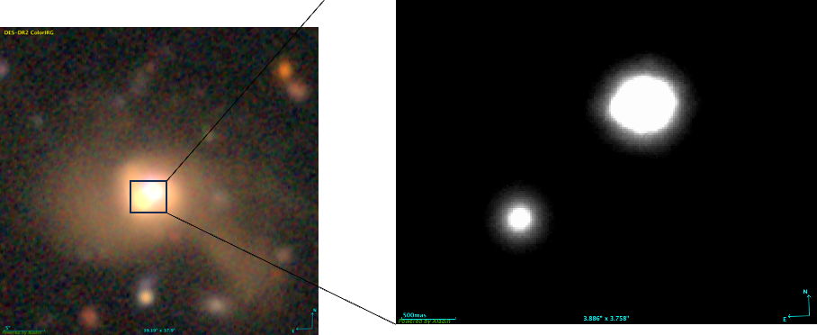
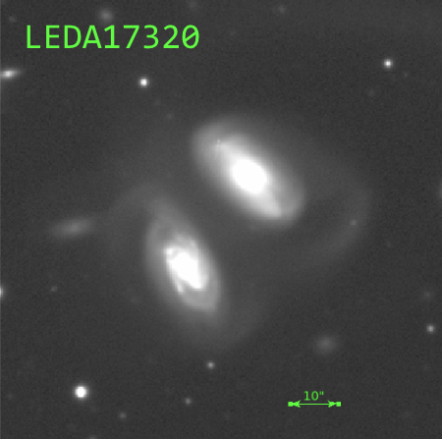
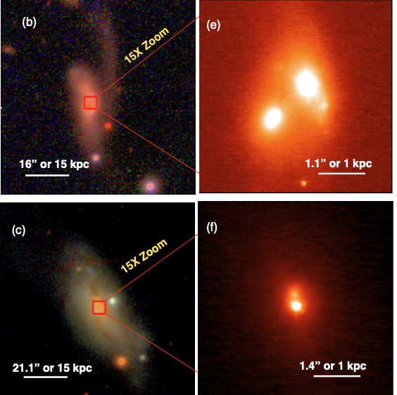
Swift-BAT Spectroscopic Survey (BASS)
https://www.bass-survey.com/
~1000 all-sky AGN selected in hard X-rays (14-195 keV). DR2 (Koss et al., 2022)
Hard X-rays (14-195 keV) less affected by obscuration → unbiased AGN census
Extensive multi-wavelength follow-up
~20% of sources in major mergers
Goal: map physical drivers along the merger timeline
Selected 71 AGN in major mergers with high-res imaging
Separations of 0.3-30 kpc
8 single nuclei AGN
8 dual AGNs
55 single AGN in double nuclei systems.
Troncoso ,Treister et al. (2025)
Notes:
6
--------------------------------------------------------------------------------
SLIDE 6: Swift-BAT Spectroscopic Survey (BASS)
TIME: 5:00-6:15 (1.25 min)
--------------------------------------------------------------------------------
"To address the first question, we use the Swift-BAT AGN Spectroscopic Survey—
BASS.
About 1000 AGN selected in hard X-rays from 14-195 keV. This is crucial because
hard X-rays penetrate obscuration much better than optical selection, giving us
a relatively unbiased census.
About 20% of these sources are in major mergers—that's our parent sample.
From this, Marco Troncoso—who recently defended his Master's thesis and is now
starting his PhD at MPE—selected 71 AGN in major mergers with high-resolution
imaging from HST and Keck.
The separations span from 300 pc to 30 kpc. We have 8 confirmed dual AGN, 8
single-nucleus systems, and 55 cases where we see two nuclei but only one
confirmed AGN."

Slide 7
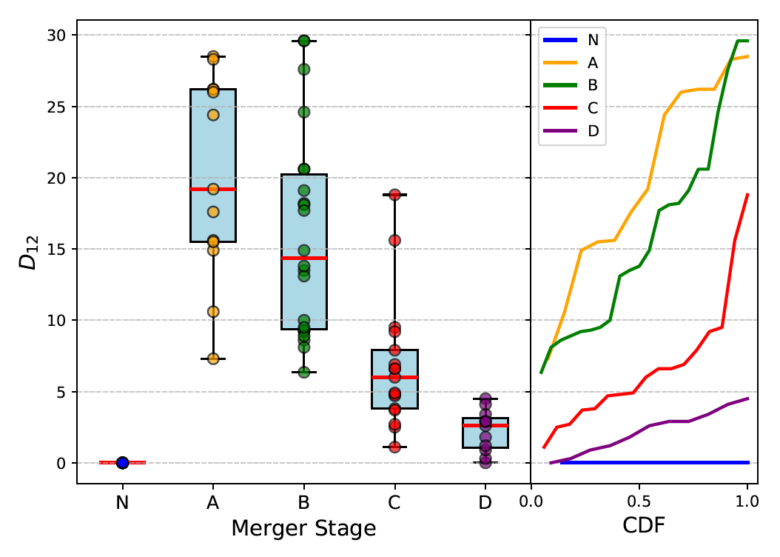
BASS AGN in Major Galaxy Mergers
Visual Morphological Classifications
Nuclear Separation and Merger Stage Strongly Correlated (as expected)
Troncoso ,Treister et al. (2025)
Notes:
7
--------------------------------------------------------------------------------
SLIDE 7: Nuclear Separation and Merger Stage
TIME: 6:15-7:00 (45 sec)
--------------------------------------------------------------------------------
"First result from Marco's work: morphological merger stage correlates strongly
with nuclear separation, as expected.
We classified systems from stage A through D using visual morphology. Stage D
systems—the most advanced mergers—cluster at the smallest separations below
5 kpc.
This validates that we can use either metric as a proxy for merger progress."

Slide 8
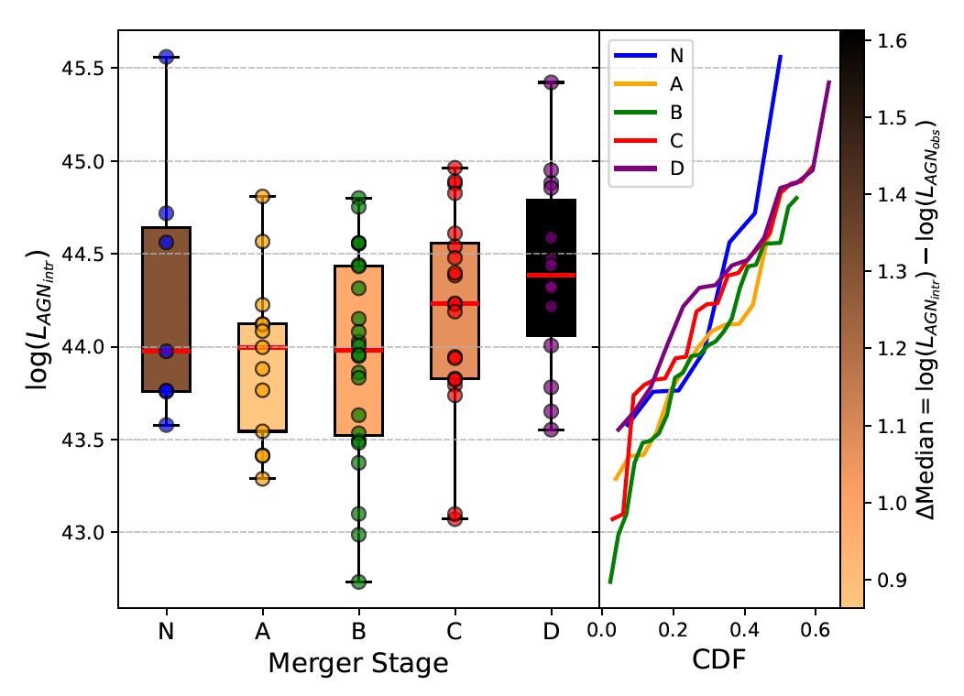
BASS AGN in Major Galaxy Mergers
Visual Morphological Classifications
Slight increase in AGN luminosity and obscuration with merger stage
Troncoso ,Treister et al. (2025)
Notes:
8
--------------------------------------------------------------------------------
SLIDE 8: AGN Luminosity and Obscuration vs. Stage
TIME: 7:00-8:00 (1 min)
--------------------------------------------------------------------------------
"Now the key result: AGN luminosity and obscuration both increase with merger
stage.
Left panel shows intrinsic AGN luminosity. Right panel shows the difference
between intrinsic and observed luminosity—a proxy for obscuration.
Late-stage mergers show 2.4 times higher AGN luminosity and 2.8 times higher
obscuration compared to early stages. Star formation rates are 5 times higher.
This confirms the evolutionary picture: as mergers progress, more gas reaches
the nucleus, fueling both AGN and star formation, while also increasing the
obscuration."

Slide 9
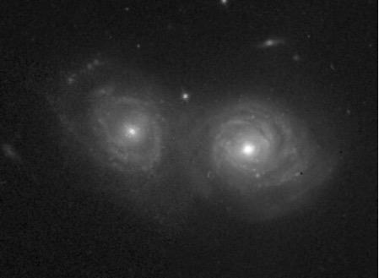
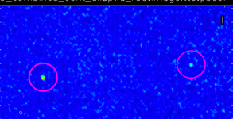
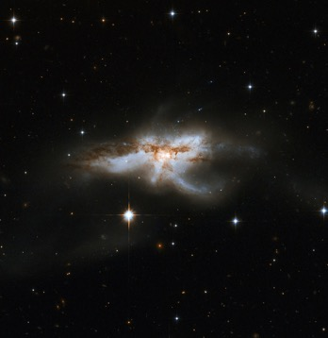
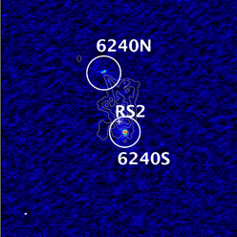
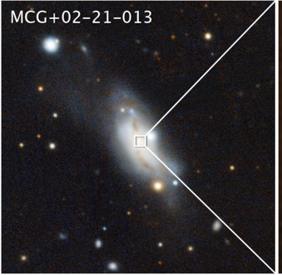
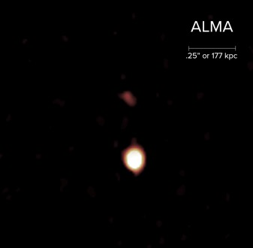
Known Dual AGN Selected from X-rays
Mrk 739
Mrk 463
Tubín+2021
Treister+2018
z=0.02985 (1”~600pc )
Nuc. Sep. ~5.8” (3.4 kpc)
z=0.0504 (1”~1kpc )
Nuc. Sep. ~3.8” (3.8 kpc)
NGC 6240
UGC 4211
ALMA
.25” (177 pc)
Zoom
20X
Koss+2023
60”
Treister+2020
z=0.034 (1”~700pc ) Nuc sep. ~0.3” (230 pc)
z=0.0243 (1”~490pc )
Nuc. sep. ~1.5” (735 pc)
Notes:
--------------------------------------------------------------------------------
SLIDE 9: Known Dual AGN Selected from X-rays
TIME: 8:00-9:00 (1 min)
--------------------------------------------------------------------------------
"Now let me turn to the molecular gas question. To study what fuels these
systems, we focus on the handful of confirmed dual AGN.
Here are four benchmark systems spanning separations from 230 pc in UGC 4211—
the closest confirmed dual AGN—up to about 4 kpc in Mrk 463 and Mrk 739.
All were confirmed through X-ray observations, mostly Chandra, which provides
the arcsecond resolution needed to separate the nuclei."

Slide 10
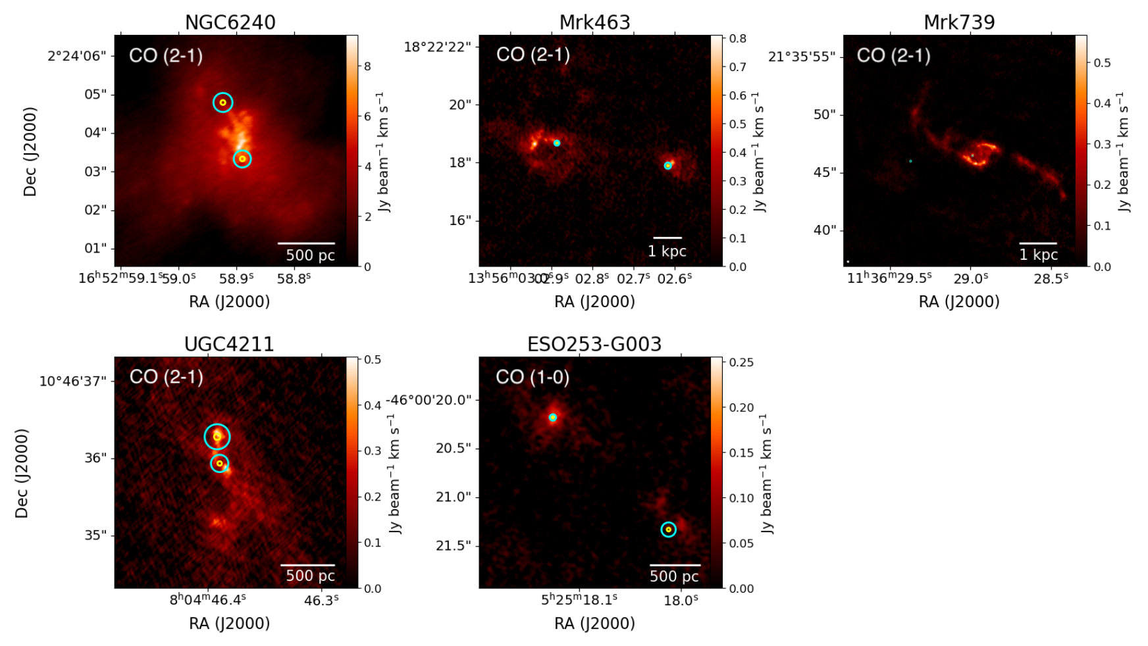
Molecular gas in known dual AGN
ALMA Cycle 8-10 high-resolution observations of CO in nearby dual AGN
Sep ~1kpc
Sep ~4kpc
Sep ~4kpc
Sep ~0.2kpc
Sep ~1.5kpc
Johnstone,Treister et al. (2025)
Notes:
--------------------------------------------------------------------------------
SLIDE 10: Molecular Gas in Known Dual AGN - CO Maps
TIME: 9:00-10:00 (1 min)
--------------------------------------------------------------------------------
"We obtained ALMA Cycle 8-10 observations of CO in these systems. This is work
led by Makoto Johnstone, who was a Fulbright visiting PhD student with us and
is now finishing at UVa.
These maps show the molecular gas distribution traced by CO 2-1 or CO 1-0.
What's immediately striking: large concentrated reservoirs of molecular gas in
all systems. The cyan circles mark the AGN positions—you can see gas is clearly
available to feed both black holes in most cases.
This result was just featured in an NRAO and ALMA press release last month."

Slide 11
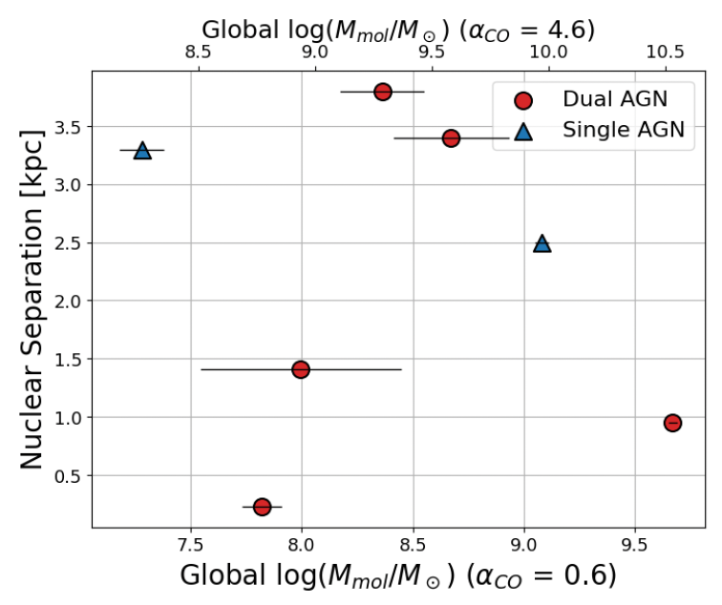
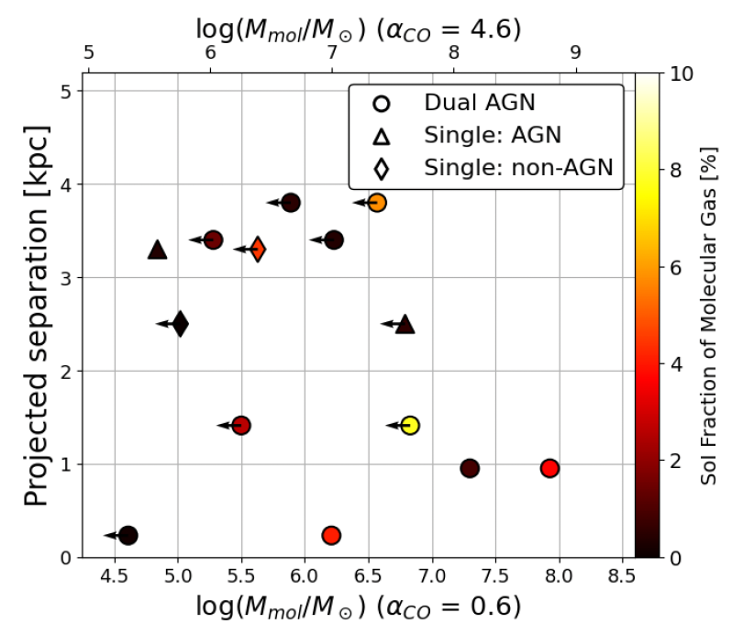
Molecular gas in known dual AGN
The global molecular gas mass of the host galaxy is relatively constant across nuclear separation.
The SMBH Sphere of Influence (SoI; region where SMBH gravity dominates) contains higher fractions of the molecular gas at smaller nuclear separations.
→The gas distribution becomes more centrally concentrated as the merger progresses.
The non-rotating molecular gas mass is weakly anti-correlated with the Eddington ratio, but it does not correlate with the AGN bolometric luminosity.
Johnstone,Treister et al. (2025)
Notes:
--------------------------------------------------------------------------------
SLIDE 11: Molecular Gas Results - Concentration
TIME: 10:00-11:00 (1 min)
--------------------------------------------------------------------------------
"Here's the quantitative result.
Left panel: global molecular gas mass versus nuclear separation. The total gas
content is roughly constant—mergers aren't running out of fuel.
Right panel is the key: the fraction of gas within the black hole's sphere of
influence—where its gravity dominates—increases dramatically at smaller
separations.
The gas distribution becomes more centrally concentrated as the merger
progresses. Mergers are very efficient at delivering gas to the doorstep of
the black holes."

Slide 12
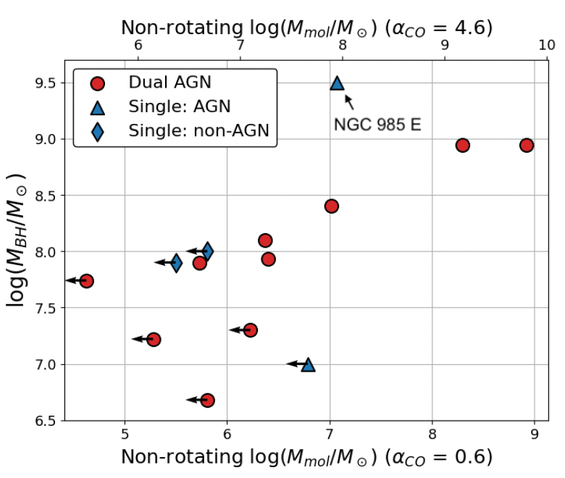
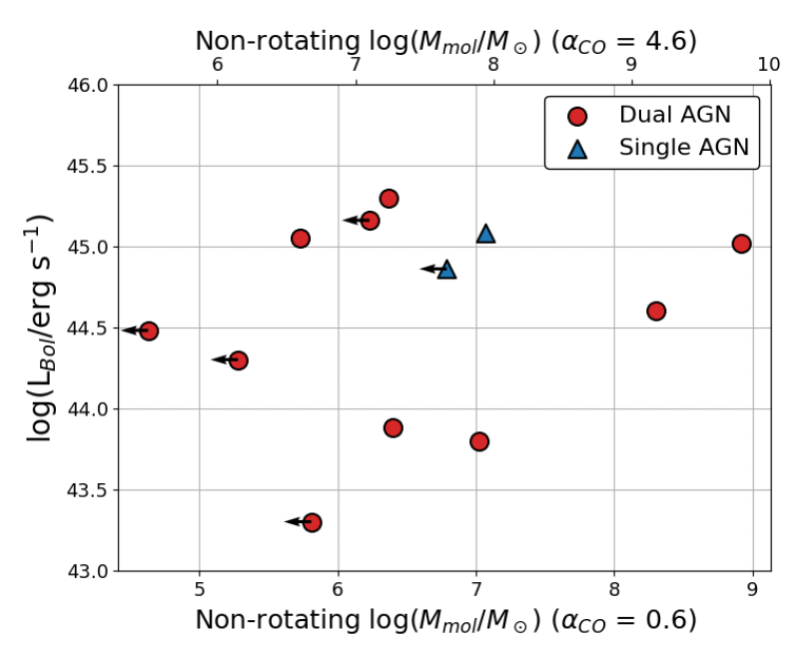
Molecular gas in known dual AGN
The molecular gas properties of single and dual AGN systems are relatively consistent with each other.
Same gas supply → different AGN activity = variability
Johnstone,Treister et al. (2025)
Notes:
--------------------------------------------------------------------------------
SLIDE 12: Same Gas Supply → Variability
TIME: 11:00-12:00 (1 min)
--------------------------------------------------------------------------------
"But here's the puzzle—and the main punchline from the press release.
Left panel: black hole mass versus non-rotating molecular gas mass. Right panel:
bolometric luminosity versus non-rotating gas.
Single AGN and dual AGN have essentially the same gas properties. Similar gas
supply, but different AGN activity.
The press release called this 'picky eaters'—even with plenty of food nearby,
most SMBHs are nibbling rather than gorging.
The implication: AGN variability, not gas availability, determines whether we
see dual AGN. The AGN activity is highly episodic, which explains why catching
both black holes 'on' simultaneously is so rare."

Slide 13
mm Continuum/X-rays Correlation
Very significant correlation between sub-mm continuum emission and X-ray luminosity
Origin of the coronal emission unclear, but likely self-absorbed Synchrotron radiation from a very compact (few R_{g}) nuclear region, peaking at ~100 GHz.
Both are directly connected to the SMBH accretion rate
Sub-mm continuum is not affected by obscuration (unbiased!)
ALMA provides unmatched spatial resolution and sensitivity.
Behar et al. (2015, 2018), Kawamuro et al. (2022), Ricci et al. (2023)
Notes:
--------------------------------------------------------------------------------
SLIDE 13: mm Continuum/X-rays Correlation
TIME: 12:00-13:15 (1.25 min)
--------------------------------------------------------------------------------
"Now to the third question: how do we find heavily obscured dual AGN?
The answer comes from this remarkable correlation between millimeter continuum
emission and X-ray luminosity, established by Behar, Kawamuro, and Claudio Ricci.
The mm emission likely comes from self-absorbed synchrotron radiation from a
very compact region—just a few gravitational radii from the black hole—peaking
around 100 GHz.
Both tracers connect directly to the accretion rate. But crucially, the mm
continuum is not affected by obscuration. Even Compton-thick columns are
transparent at these wavelengths.
ALMA gives us both the sensitivity and the sub-arcsecond resolution we need."

Slide 14
mm Continuum/X-rays Correlation
Known dual AGN (colored points) fall within ±3σ of the single AGN correlation
Both nuclei contribute but follow the same underlying mm/X-ray physics
Key validation: This correlation can identify dual AGN systems
Droguett et al., ApJL submitted
Notes:
--------------------------------------------------------------------------------
SLIDE 14: Dual AGN on the mm/X-ray Correlation
TIME: 13:15-14:15 (1 min)
--------------------------------------------------------------------------------
"This is new work from Macarena Droguett, my PhD student, just submitted to
ApJ Letters.
The question: do dual AGN follow the same correlation as single AGN?
The answer is yes. The colored points are known dual AGN—Mrk 463, NGC 6240,
UGC 4211, Arp 220. They all fall within 3-sigma of the single AGN correlation.
This validates that we can use the mm/X-ray correlation to identify AGN
activity in both nuclei of a merger."

Slide 15
mm Continuum/X-rays Correlation
Position relative to correlations + SFR constraints separate AGN vs SF contributions.
(U)LIRGs between the two relations show significant AGN contribution
Strategy: Use mm/X-ray correlation to find heavily obscured dual AGN candidates in ALMA survey
Droguett et al., ApJL submitted
Notes:
--------------------------------------------------------------------------------
SLIDE 15: mm/X-ray Correlation - Strategy
TIME: 14:15-15:00 (45 sec)
--------------------------------------------------------------------------------
"The strategy emerges from this plot.
The solid line is the AGN correlation. The separate line at lower mm luminosity
is what you'd expect from pure star formation.
By knowing the position relative to both correlations, plus independent SFR
constraints, we can separate AGN from star formation contributions.
Systems between the two relations—like these ULIRGs—show significant AGN
contribution that may be missed by X-rays alone.
This gives us a method to find heavily obscured dual AGN candidates in ALMA
surveys."

Slide 16
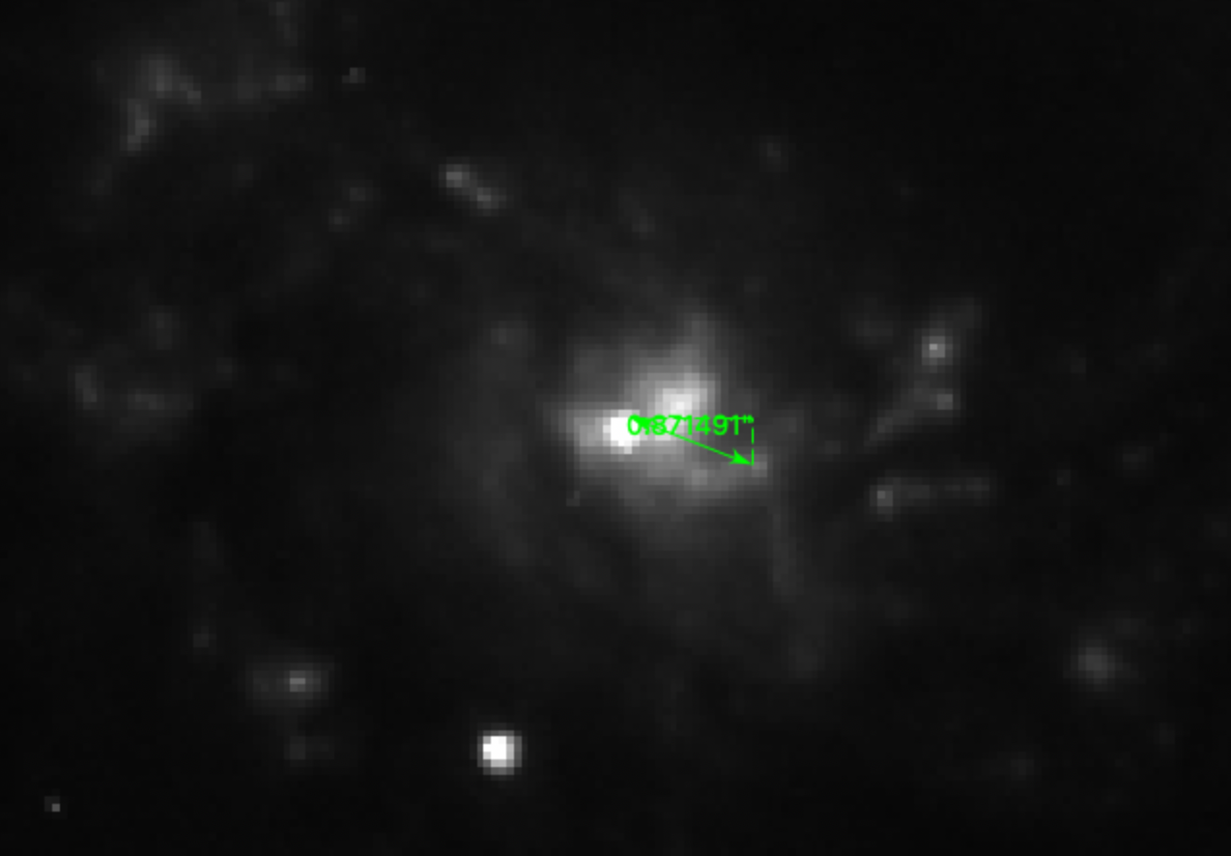
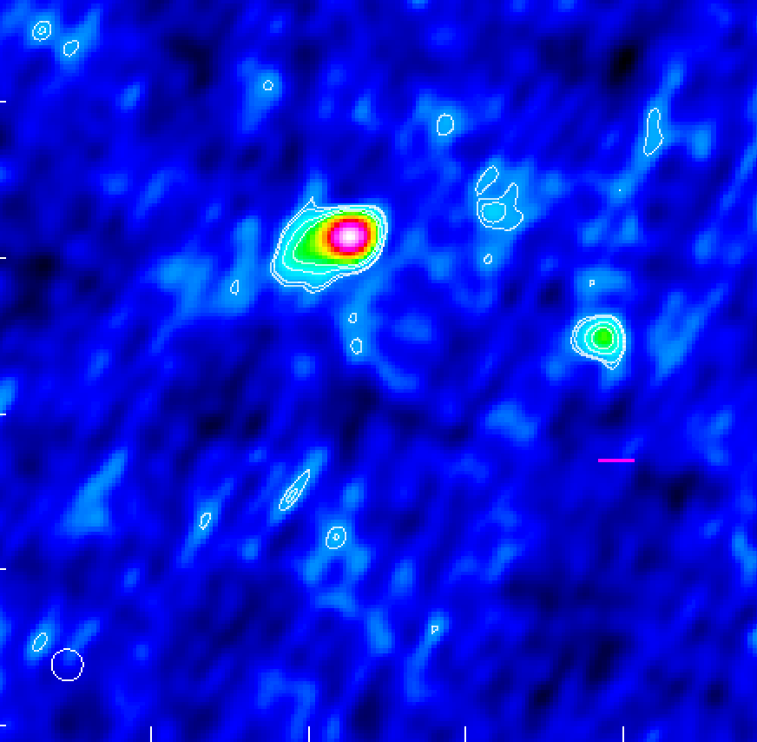
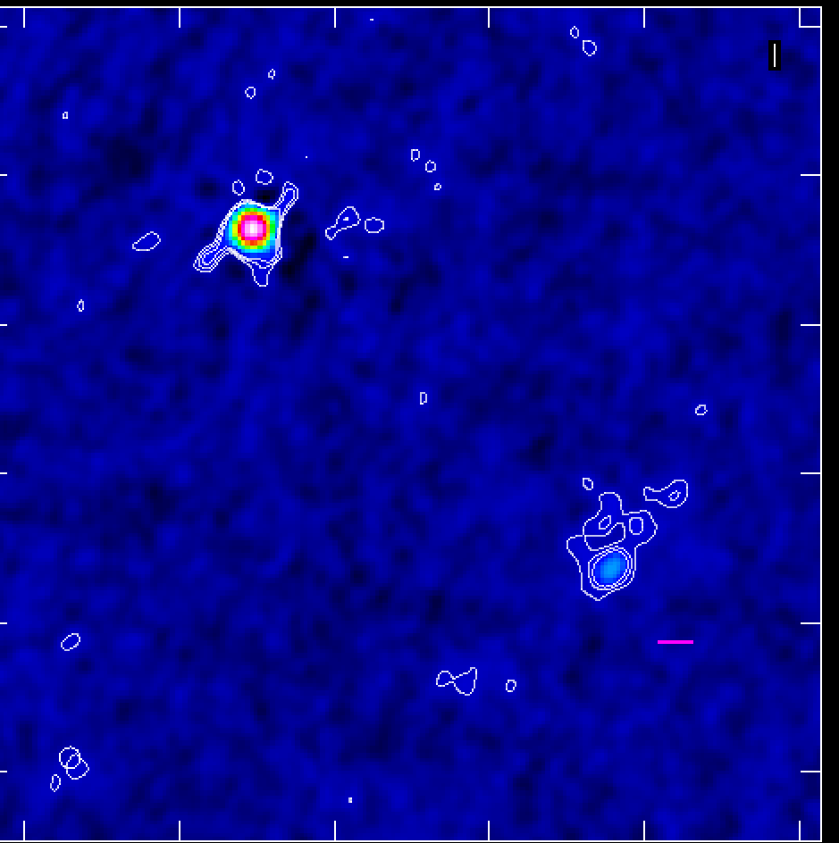
ALMA Cycles 9-11 Continuum Observations
Samples visually-selected post-mergers confirmed by HST and Keck AO with X-ray detections.
35 hours of ALMA high-resolution band 3 (~100 GHz) observations for nuclear separations from 50pc to <1kpc
~60 hours of ALMA band 6 ACA (~5” resolution) for ~5-30 kpc separations
Main goal: search for hidden dual AGN in ALMA sub-mm continuum
Also, observations of ¹²CO(1-0) or ¹²CO(2-1)
z=0.046 (200 Mpc), ~1 kpc/”
dist=0.87”, 870 pc
z=0.042 (190 Mpc), 0.9 kpc/”
dist=1.66”, 1.5 kpc
z=0.026 (120 Mpc), 0.6kpc/”
dist=0.2”, 120 pc
Notes:
--------------------------------------------------------------------------------
SLIDE 16: ALMA Cycles 9-11 Continuum Observations
TIME: 15:00-16:15 (1.25 min)
--------------------------------------------------------------------------------
"We're now executing this strategy with a major ALMA program spanning Cycles 9
through 11.
35 hours of high-resolution Band 3 observations—that's 100 GHz—targeting
nuclear separations from 50 pc to 1 kpc.
Plus 60 hours with the ACA at coarser resolution for wider separations out to
30 kpc.
The sample is visually-selected post-mergers confirmed with HST and Keck
adaptive optics, all with X-ray detections.
Here are three examples showing the optical morphology, X-ray detection, and
our ALMA continuum detections of dual nuclear sources."

Slide 17
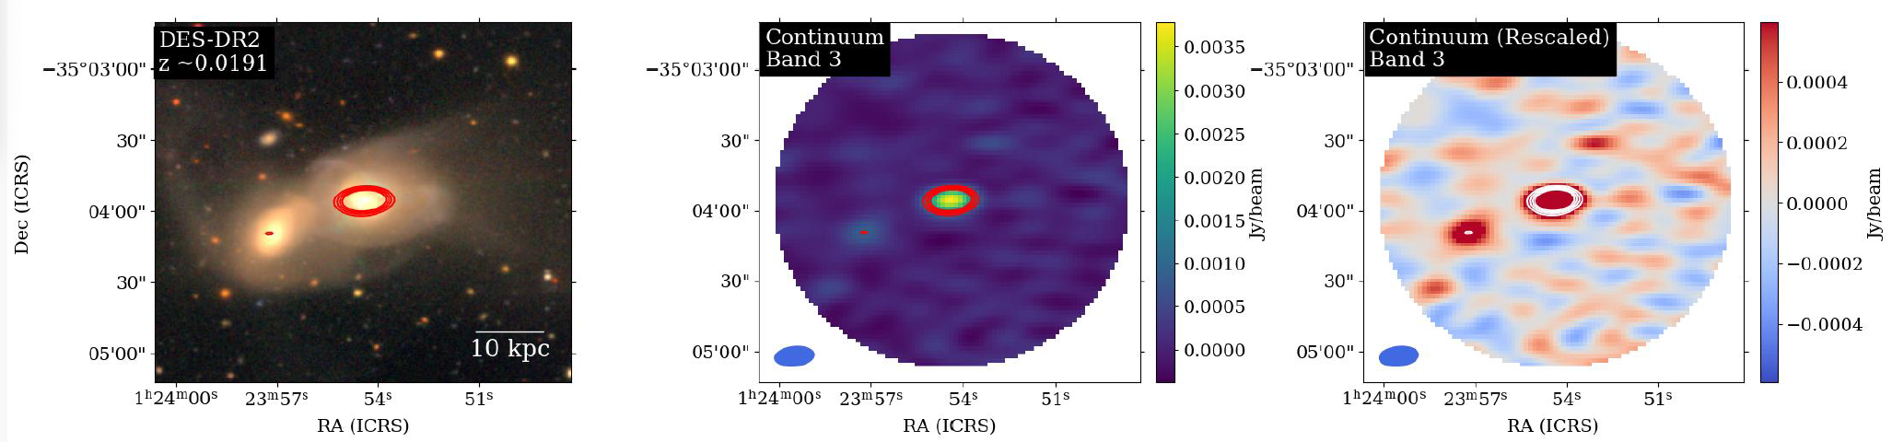
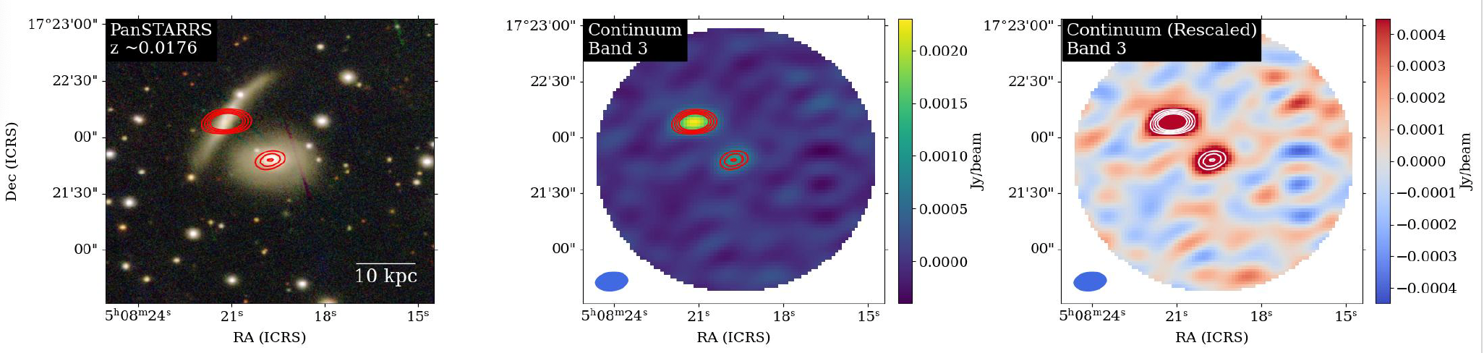
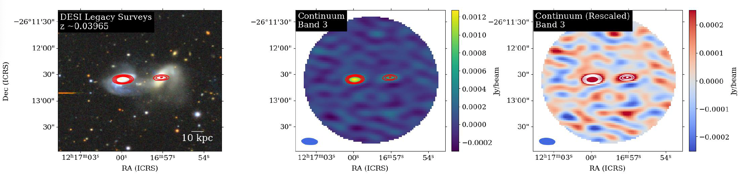
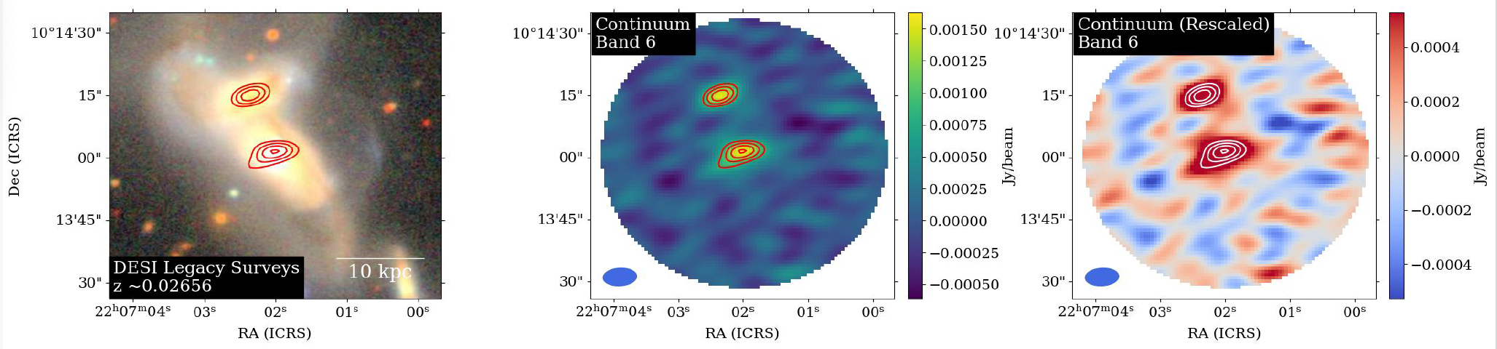
Pair AGN candidates at ~10-30 kpc separations
Several (new) confirmed pair AGN at >10 kpc nuclear separations identified thanks to ongoing ALMA continuum survey.
Only ALMA cycle 10 dual AGN shown here. Analysis of fully observed cycle 11 data is ongoing.
Notes:
--------------------------------------------------------------------------------
SLIDE 17: Pair AGN Candidates at 10-30 kpc
TIME: 16:15-17:15 (1 min)
--------------------------------------------------------------------------------
"Results are coming in.
These are newly confirmed pair AGN at separations greater than 10 kpc,
identified through our ALMA continuum survey.
What you're seeing: optical image, raw ALMA continuum, and residual after
subtracting the primary source—revealing the companion.
This is just Cycle 10 data. Analysis of the fully observed Cycle 11 data is
ongoing, and we expect more discoveries."

Slide 18
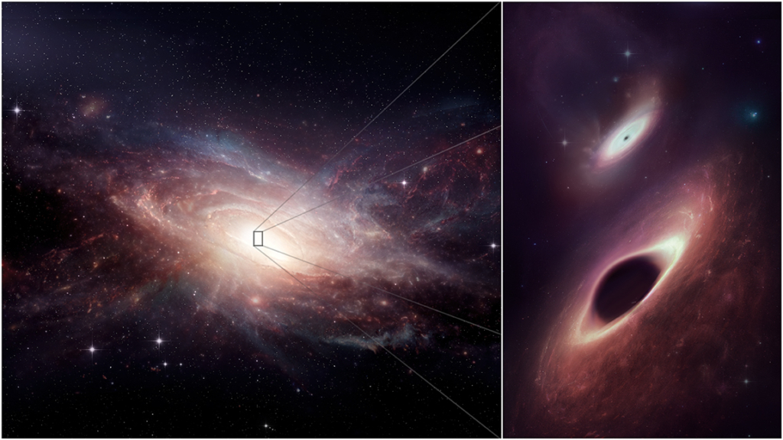
Summary
Dual AGN at kpc-scales represent a critical phase of merger-driven SMBH growth
ALMA provides an unprecedented tool to find and characterize them
📊 Q1: How do AGN and star formation evolve through mergers?
Merger morphological stage, driver of evolution
Late-stage mergers show 5× higher SFR, 2.4× higher AGN luminosity, 2.8× higher obscuration
Merging AGN host galaxies do not necessarily found on the star-forming main sequence
⛽Q2: What fuels SMBH growth in these systems?
Molecular gas becomes more centrally concentrated at smaller separations
Similar gas content in single vs dual AGN → variability drives dual AGN occurrence
🔍 Q3: How can we find heavily obscured dual AGN near coalescence?
mm-X-ray correlation successfully identifies obscured AGN, unaffected by Compton-thick obscuration
Dual AGN follow the same correlation as single AGN
ALMA continuum observations reveal new dual AGN candidates at 0.1-1 kpc separations
These are the parent population of LISA gravitational wave sources.
Future: ngVLA/SKA will reach ~pc scales.
Notes:
--------------------------------------------------------------------------------
SLIDE 18: Summary
TIME: 17:15-18:30 (1.25 min)
--------------------------------------------------------------------------------
"Let me summarize.
Dual AGN at kpc scales represent a critical phase of merger-driven SMBH growth,
and ALMA provides unprecedented tools to find and characterize them.
On question one: morphological stage drives evolution. Late-stage mergers show
5 times higher star formation, 2.4 times higher AGN luminosity, and 2.8 times
higher obscuration.
On question two: molecular gas becomes more centrally concentrated at smaller
separations. But the similar gas content in single versus dual AGN tells us
variability—not gas availability—drives dual AGN occurrence. The 'picky eaters'
result.
On question three: the mm/X-ray correlation successfully identifies obscured
AGN, unaffected by Compton-thick absorption. Our ALMA continuum observations
are revealing new dual AGN candidates at 0.1-1 kpc separations.
These systems are the parent population of LISA gravitational wave sources.
Looking ahead, ngVLA and SKA will push to parsec scales."

Slide 19
The Future
Ongoing Projects
ALMA Cycles 9-11 continuum survey (~95 hrs) — dual AGN candidates
High-resolution CO observations of merger systems
Multiwavelength SED analysis (BASS merger sample)
VLT/MUSE IFU spectroscopy of dual AGN hosts
Collaboration Opportunities
FAST + ALMA: HI 21cm + CO for complete gas census across merger stages
LRDs: obscured AGN at high redshift (?)
Simulations: dual AGN feeding & variability
X-ray follow-up of mm-selected candidates
AXIS proposed mission
SKA pathfinders / ngVLA science cases
Please contact me or email me at etreister@academicos.uta.cl if interested in collaborating on any of these topics.
I will be at NAOC Beijing from January 11th to February 7th
Notes:
--------------------------------------------------------------------------------
SLIDE 19: The Future / Collaboration Opportunities
TIME: 18:30-20:00 (1.5 min)
--------------------------------------------------------------------------------
"Finally, looking forward.
On the left, our ongoing projects—the ALMA continuum survey, high-resolution
CO observations, the BASS merger analysis, and VLT/MUSE spectroscopy.
On the right, collaboration opportunities I'm excited to explore.
[MENTION ORALLY - not on slide:] I should note we've been collaborating with
Ran Wang and Luis Ho at PKU, and Sophia Dai here at NAOC for several years—so
there's already a foundation to build on.
The FAST + ALMA synergy is particularly interesting for this audience. FAST's
HI 21cm observations trace the atomic gas reservoirs—the outer fuel supply in
early merger stages. Combined with ALMA's CO observations of molecular gas in
the nuclear regions, we could trace the complete gas flow from 100 kpc scales
down to the feeding zones. This directly tests the 'picky eaters' picture: is
the bottleneck in delivering atomic gas, converting it to molecular, or the
final accretion step?
Also interested in pushing to higher redshift with JWST observations of
obscured AGN—possibly including the Little Red Dots we're working on—and of
course simulations to understand the feeding and variability we observe.
I'll be at NAOC until February 7th. Please find me during the conference or
email me if you're interested in any of these directions.
Thank you."

Slide 20
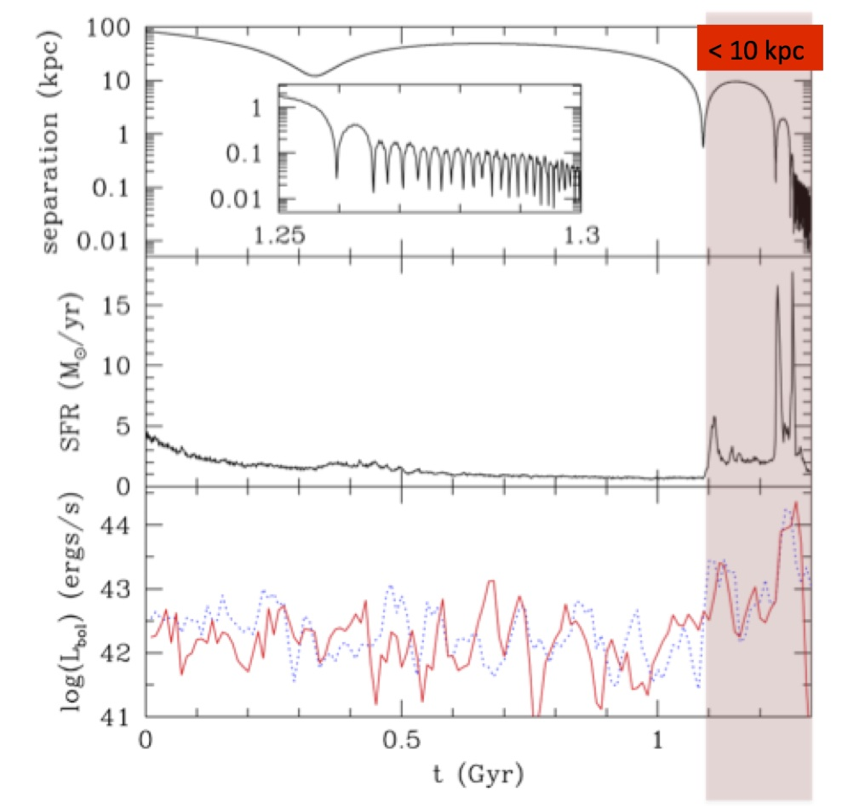
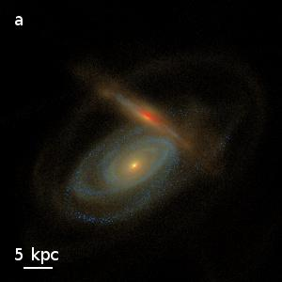
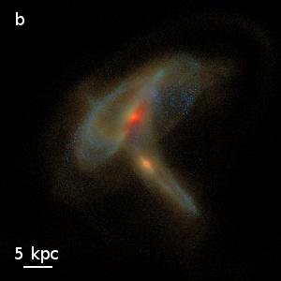
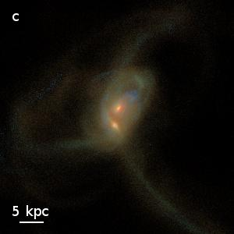
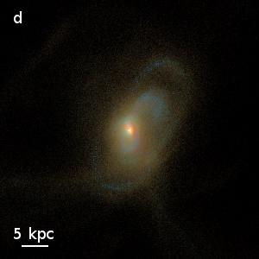

The Dual AGN Phase
Blecha et al. (2018)
Van Wassenhove et al. (2012)
Numerical simulations indicate that the dual AGN phase, at <10 kpc separations, is where most SMBH growth and the highest SFR rates are expected.
Phase lasts ≲100-200 Myrs
Very difficult to find due to heavy obscuration and high-resolution requirements.
Only a few confirmed systems in the local Universe so far.
Notes:
20
Zoom in on the dual AGN phase - separations less than 10 kiloparsecs. Van Wassenhove's simulations show this is where SMBH separation decreases rapidly. Blecha's work shows this phase has the highest SFR and AGN luminosity - lasting only 100-200 million years. But these systems are extremely difficult to find due to heavy obscuration and resolution requirements. Only a handful confirmed in the local universe.

Slide 21
BASS AGN in Major Galaxy Mergers
Sample
Near-IR AO Imaging
22 nearby (z<0.1) late-stage mergers candidates observed with the instrument GSAOI at Gemini South. 4 of them are late-stage mergers, 10 have higher separations and 8 do not show two nuclei.
BASS Extended Sample
To extend our range of separations, we added 32 nearby (z<0.1) mergers with projected separations between 4-28 kpc.
Koss+2018 Sample (HST+Keck)
In 2018, Koss et al. found from a random sample of nearby (z<0.1) AGNs 17/96 late-stage mergers with separations below 10 kpc.
71 sources
Separations of 0.3-30 kpc
8 single nuclei AGN
8 dual AGNs
55 single AGN in double nuclei systems.
Troncoso ,Treister et al. (2025)
Notes:
21
We studied 71 BASS AGN in mergers. This includes Koss 2018's random sample of 17 late-stage mergers below 10 kpc, plus we added 32 systems at larger separations and used Gemini near-IR adaptive optics for another 22 candidates. Final sample: 8 single nucleus AGN, 8 dual AGN, and 55 single AGN in double nucleus systems - separations from 300 parsecs to 30 kiloparsecs.

Slide 22
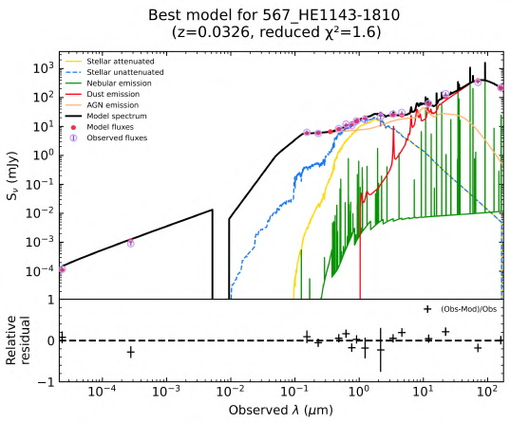
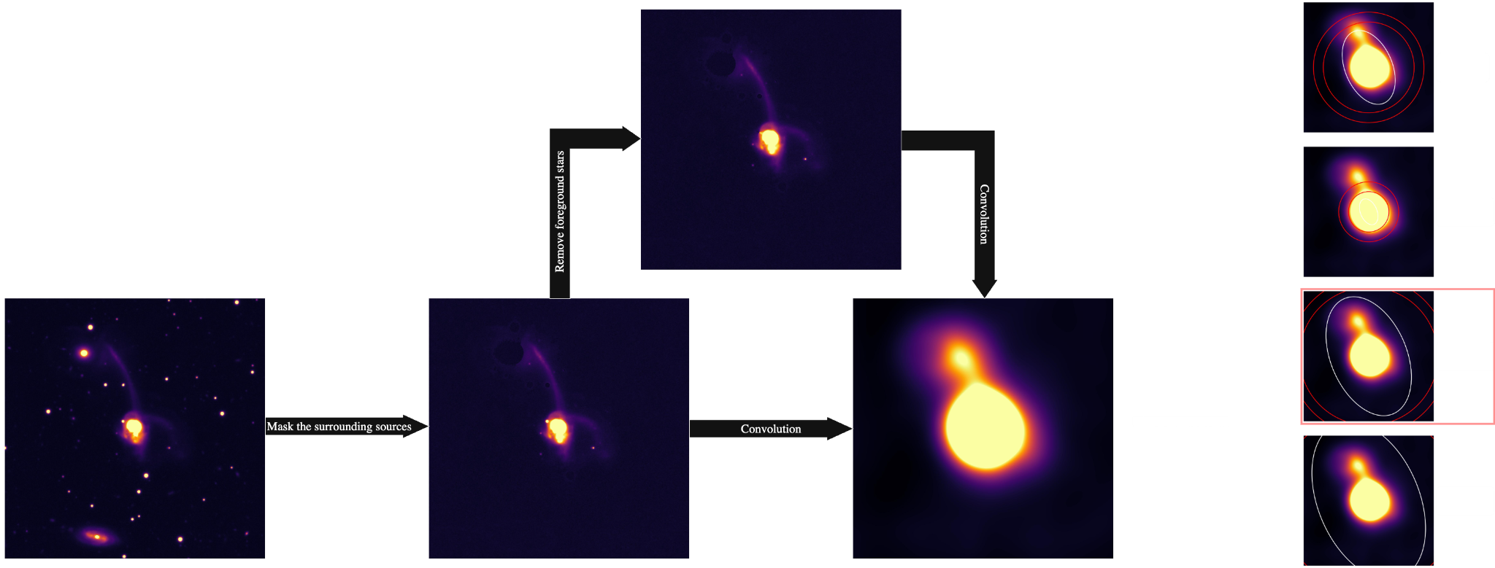
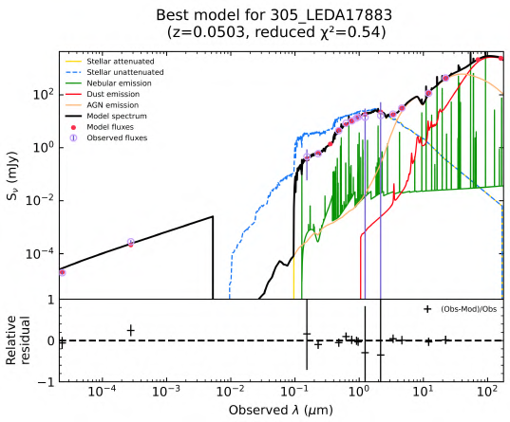
BASS AGN in Major Galaxy Mergers
Multiwavelength SED Fitting
Custom photometry pipeline: PSF-matched, star-masked, 12″ resolution
CIGALE (delayed + burst SFH, Calzetti-like dust, SKIRTOR torus, X-ray module)
Dual-AGN treated with two torus components to avoid IR degeneracy
Troncoso ,Treister et al. (2025)
Notes:
22
We built a custom photometry pipeline - PSF-matched, star-masked, 12 arcsecond resolution. Used CIGALE with delayed plus burst star formation histories. For dual AGN, we used two torus components to avoid infrared degeneracy between the two nuclei. This gives us AGN luminosity, star formation rates, and obscuration for each system.

Slide 23
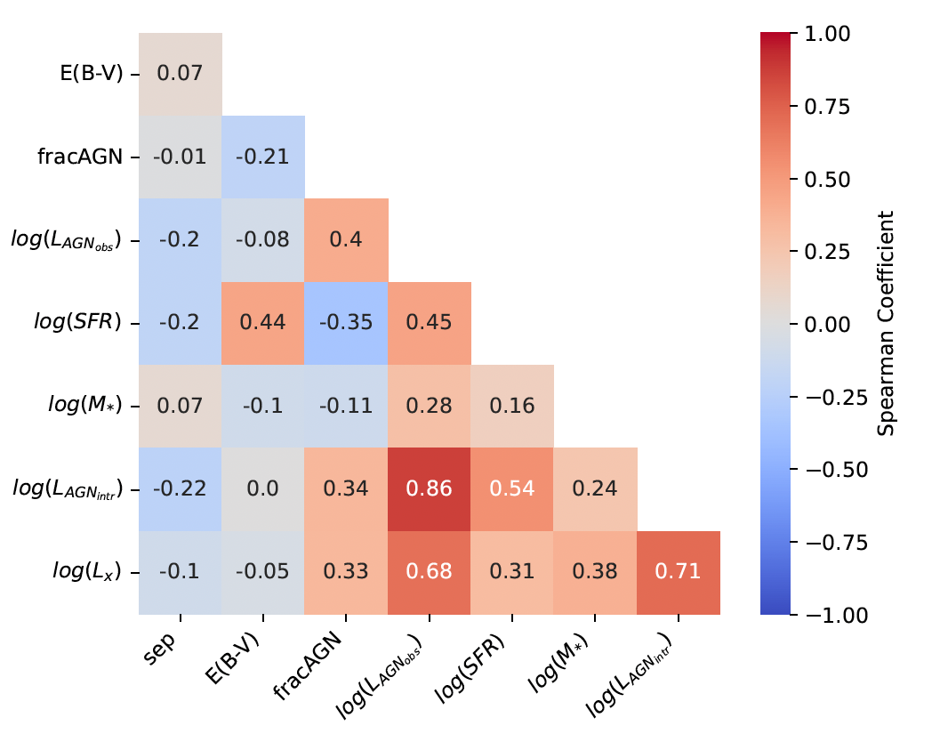
BASS AGN in Major Galaxy Mergers
Correlations between Physical Parameters
No obvious correlation between stellar mass and SFR.
Sources not on the star formation main sequence
Slight anti-correlation between fracAGN and SFR.
Mild correlation between the AGN luminosity and SFR
No obvious correlation with nuclear separation
Troncoso ,Treister et al. (2025)
Notes:
23
Here's what we found. No correlation between stellar mass and SFR - these sources are OFF the star-forming main sequence. Slight anti-correlation between AGN fraction and SFR. Mild correlation between AGN luminosity and SFR. But critically - no obvious correlation with nuclear separation. This suggests separation alone doesn't tell the story.
fracAGN = fraction of total (bolometric) luminosity from the AGN (vs. star formation)

Slide 24
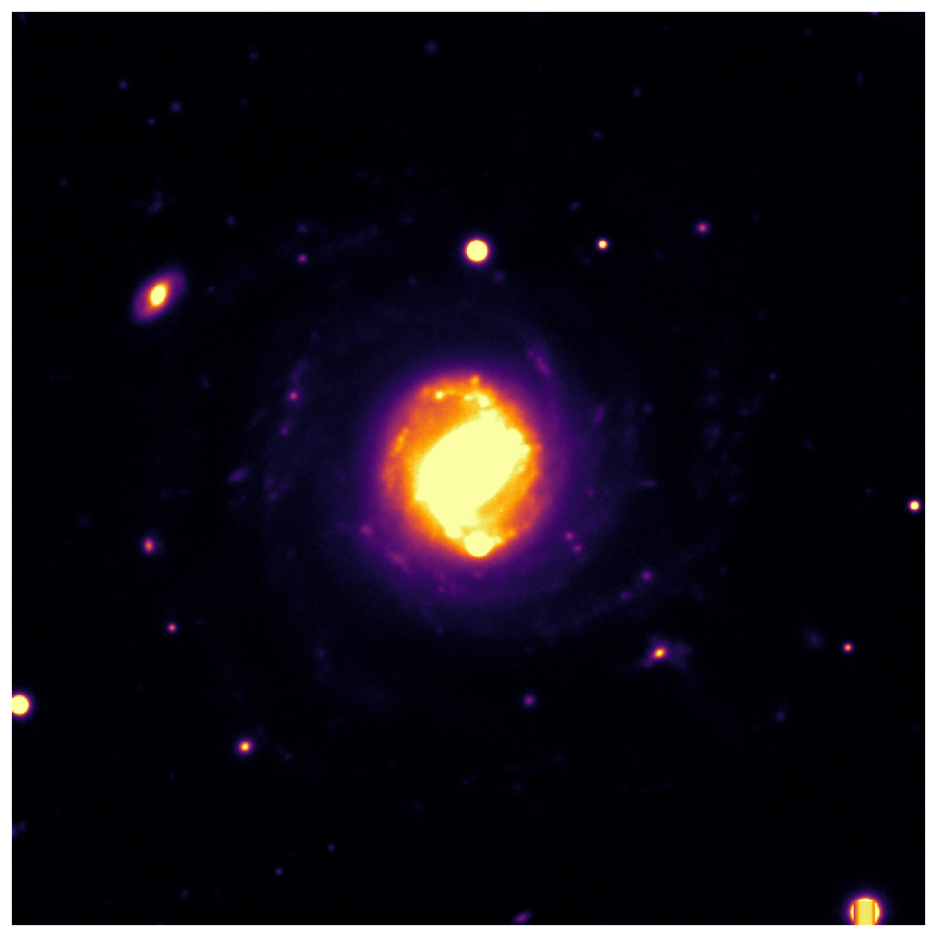




BASS AGN in Major Galaxy Mergers
Visual Morphological Classifications
To trace the merger stage, we visually classify our sources using the criteria of Stierwalt et al. (2013)
N
A
B
Isolated/Pre-merger
First passage
Separated Pair
C
D
Ongoing Merger mid-stage
Late-stage coalescence
Troncoso ,Treister et al. (2025)
Notes:
24
So instead of using separation, we classified merger stage visually using Stierwalt's criteria. N - isolated, pre-merger. A - first passage with tidal features. B - separated pair. C - ongoing merger, mid-stage with strong distortions. D - late-stage coalescence, single distorted remnant. This morphological approach proved much more informative.

Slide 25

Comparison Single AGN in Mergers
Comparison sample of single AGN in mergers at similar separations and distances.
Sep ~2.5kpc
Sep ~3.3kpc
Johnstone,Treister et al. (ApJ in press)
Notes:
For comparison, we also observed two single AGN in mergers at similar separations - Mrk 975 and NGC 985. This lets us compare: are dual AGN special in their gas content, or are they similar to single AGN at the same stage?

Slide 26


Molecular gas in known dual AGN
More massive SMBHs have higher surface densities of non-rotating (i.e. available for BH accretion) molecular gas within their SoIs.
The non-rotating molecular gas mass is weakly anti-correlated with the Eddington ratio but does not correlate with AGN bolometric luminosity.
Johnstone,Treister et al. (2025)
Notes:
Looking at non-rotating gas - available for black hole accretion - more massive black holes have higher surface densities within their spheres of influence. But here's the surprise: this doesn't strongly correlate with AGN bolometric luminosity or Eddington ratio. Gas availability isn't the limiting factor.
Eddington ratio = accretion rate relative to maximum possible for a given black hole mass

Slide 27


Mrk 463
Two separate components with some gas in between
Gradients present, evidence of potential influx
z=0.0504 (1”~1kpc )
Nuc. Sep. ~3.8” (3.8 kpc)
Treister+2018
~-600km/s outflow
Mrk463E
Mrk463W
Biconical outflow:
v_{term}~350 km/s
~3.3kpc
M_{out}~500M_{o}/yr
ALMA CO(2-1) Moment 8
Mrk463W
AGN-ionized emission line region ~10kpc away
ALMA CO(2-1) Moment 1

Slide 28



Mrk 739
Mrk 739
Foreground galaxy (West) dominated by star formation. Low luminosity, obscured AGN
Background (East), ionizing tidal tail from higher luminosity unobscured AGN
Tubín et al. (2021)

Slide 29



Mrk 739E Nuclear Star Forming Ring
Stellar populations ~2-3 Gyrs old
Not consistent with the expected merger timescale
Tubín et al. in prep.

Slide 30


Molecular Gas in Mrk 739
Mrk 739
ALMA CO(2-1) Moment 8
Mrk739W
Mrk739E
Tubín+2021
Tubín+in prep.
z=0.02985 (1”~600pc )
Nuc. Sep. ~5.8” (3.4 kpc)
Two distinct, separate components
No obvious interactions between them
Consistent with two rotating disks
ALMA CO(2-1) Moment 1
Mrk739W
Mrk739E
Tubín+in prep.

Slide 31

NGC 6240
z=0.0243 (1”~490pc )
Nuc. sep. ~1.5” (735 pc)
~40M_{o}/yr in Hα
62 M_{o}/yr in [OIII]
ALMA CO(2-1) Moment 1
ALMA CO(2-1) Moment 0
Muller-Sanchez et al., 2018
NGC 6240
Most gas found between the nuclei, connecting them.
Significant, >500 km/s, outflow (~4000 M_{o}/yr) containing 10% of molecular mass.
60”
Treister+2020

Slide 32


UGC4211
ALMA CO(2-1) Moment 0
Lack of CO in the southern nucleus
Velocity gradient centered on northern nucleus
Significant molecular gas in between the nuclei
UGC4211N
UGC4211S
ALMA CO(2-1) Moment 1
UGC 4211
ALMA
.25” (177 pc)
Zoom
20X
Koss+2023
z=0.034 (1”~700pc ) Nuc sep. ~0.3” (230 pc)

Slide 33

Significant and complete samples of dual AGN
Currently, very few incomplete and biased samples of confirmed dual AGN at separations of 1-10 kpc.
Identifying these systems is difficult due to obscuration and the required spatial resolutions.
Significant and more complete samples of dual AGN can be obtained in the next few years by combining morphological information from large imaging surveys, identification of dual systems with ALMA, and confirmation of their AGN nature.
Koss, ET, et al. (2023)
Notes:
Which brings us to question three. Currently we have very few dual AGN at 1-10 kpc separations - incomplete, biased samples. Hard to find due to obscuration and resolution requirements. But we can obtain more complete samples by combining morphological info from imaging surveys, identifying dual systems with ALMA, and confirming their AGN nature. Let me show you how.

Slide 34

Magnetic Coronal Emission in Radio Quiet AGN
Combining radio and mm/sub-mm observations, we can identify these different components in (nearby) AGN.
Origin of the coronal emission unclear but likely self-absorbed Synchrotron radiation from a very compact (few R_{g}) nuclear region, peaking at ~100 GHz.
Inoue & Doi 2018
Notes:
The key is that radio-quiet AGN show coronal emission in the millimeter - self-absorbed synchrotron radiation from a very compact, few-Schwarzschild-radii region, peaking around 100 GHz. By combining radio and millimeter observations, we can identify this AGN signature separately from jets, star formation, and dust.

Slide 35
Dual AGN candidates at ~1 kpc separations
z=0.042 (190 Mpc),
0.9 kpc/”
dist=1.66”, 1.5 kpc
z=0.046 (200 Mpc), ~1 kpc/”
dist=0.87”, 870 pc
z=0.026 (120 Mpc), 0.6kpc/”
dist=0.2”, 120 pc
Notes:
And we're finding them. Three examples of new dual AGN candidates at approximately 1 kiloparsec separations. Top: 1.5 kpc separation. Middle: 870 parsecs. Bottom: just 120 parsecs - among the closest dual AGN candidates ever found. ALMA continuum clearly resolves both nuclei. These are exactly the systems that were hidden before.

Slide 36


The Future: SKA and ngVLA
ngVLA and SKA will allow us to reach sub-pc scales up to much higher redshifts.
From Burke-Spolaor et al. (2018)
Notes:
Looking ahead: ngVLA and SKA will let us reach sub-parsec scales up to much higher redshifts. We'll resolve orbital motion directly, measuring binary periods over years. This will complete the census of SMBH pairs from kiloparsecs all the way down to parsec-scale binaries approaching coalescence.

Slide 37

Results
When the IR luminosity is dominated by the AGN, the SFR decreases.
AGN could play a role in quenching star formation.
28

Slide 38

Results
Higher AGN luminosities are associated with higher SFRs in merging systems.
BASS sample do not exhibit a significant correlation.
Dual AGNs show a clear correlation.
30

Slide 39

Results
26

Slide 40
Results
Four distinct groups:
  Quiescent
26

Slide 41
Results
Four distinct groups:
  Quiescent
  Below MS (green valley)
26

Slide 42
Results
Four distinct groups:
  Quiescent
  Below MS (green valley)
  On the MS
26

Slide 43
Results
Four distinct groups:
  Quiescent
  Below MS (green valley)
  On the MS
  Above MS (starburst)
26

