Slide 1
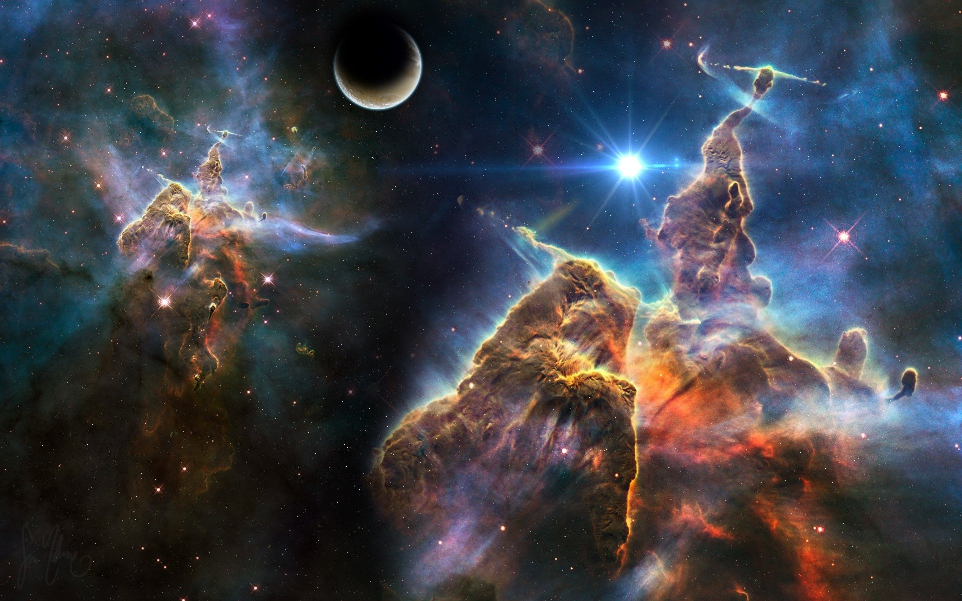
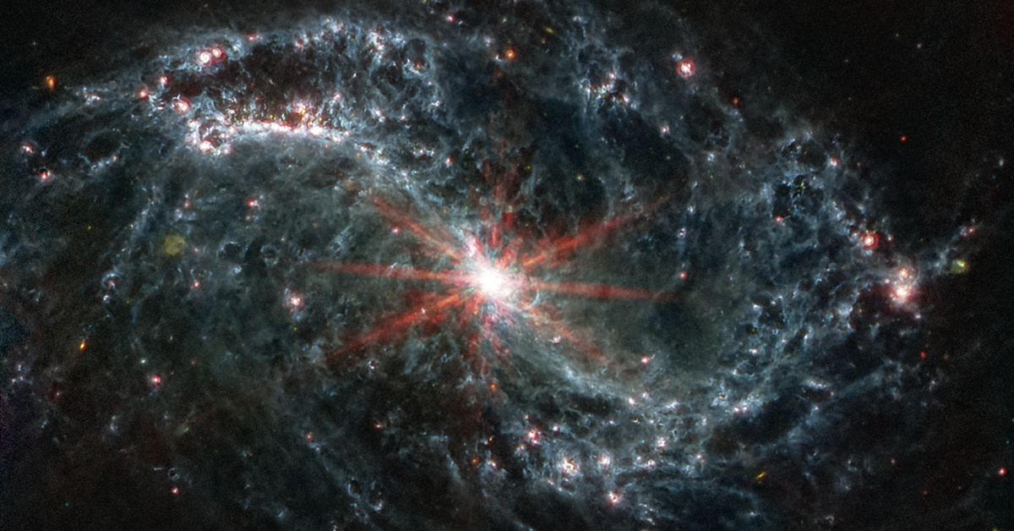
What determines star formation in the Galaxy
Jingwen Wu (NAOC/UCAS)
Collaborators： Sihan Jiao, Zhi-Yu Zhang, Chao-Wei Tsai, Neal Evans, Di Li,
Baobab Liu, Junzhi Wang, Yan Sun, Yong Shi, Qizhou Zhang, Xing Lu
CCBC 2026
U. Hong Kong
Notes:
This is my first time to introduce this work at simulation community, maybe also the galaxy community. I really hope it can bring help to the filed outside star formation. These are my collaborators, I would say, they include quite a bit cuurently the best players in the field of star formation.

Slide 2
Three big problems in Star Formation:
Notes:
People keep asking, what are big questions left for star formation
Cris Mackee: 1. IMF 2. The rate of star formation 3. Massive Star formation 4.. Cluster formation 5. The first stars

Slide 3
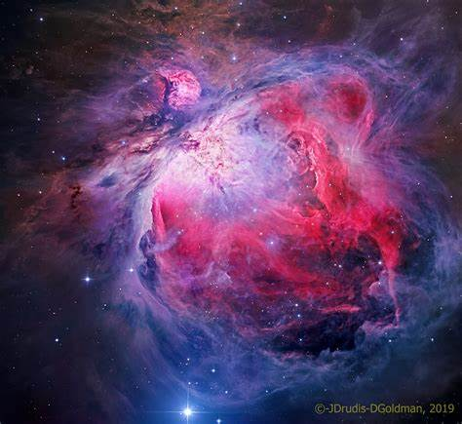
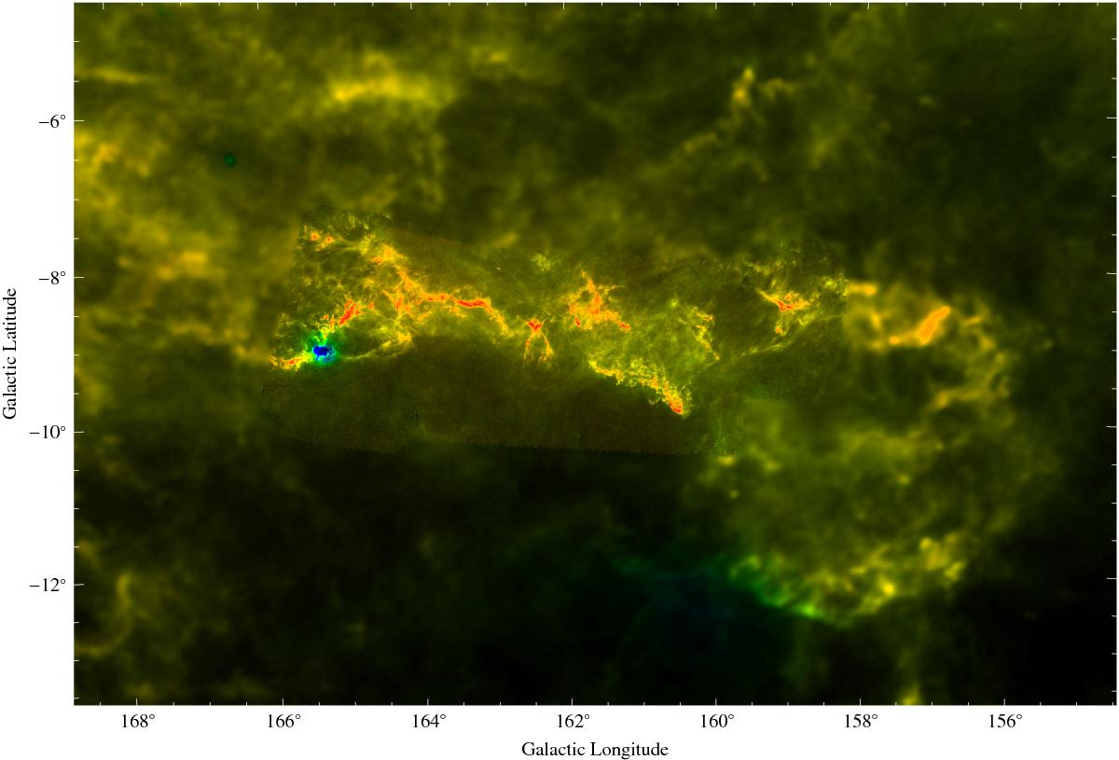
A fundamental question:
What determines the rate and efficiency of star formation in molecular clouds ?
Orion
California
Central Molecular Zone
Notes:
What do you think are big questions in star formation? I think the most direct and important question is why star formation are different in different clouds. What control this ?

Slide 4
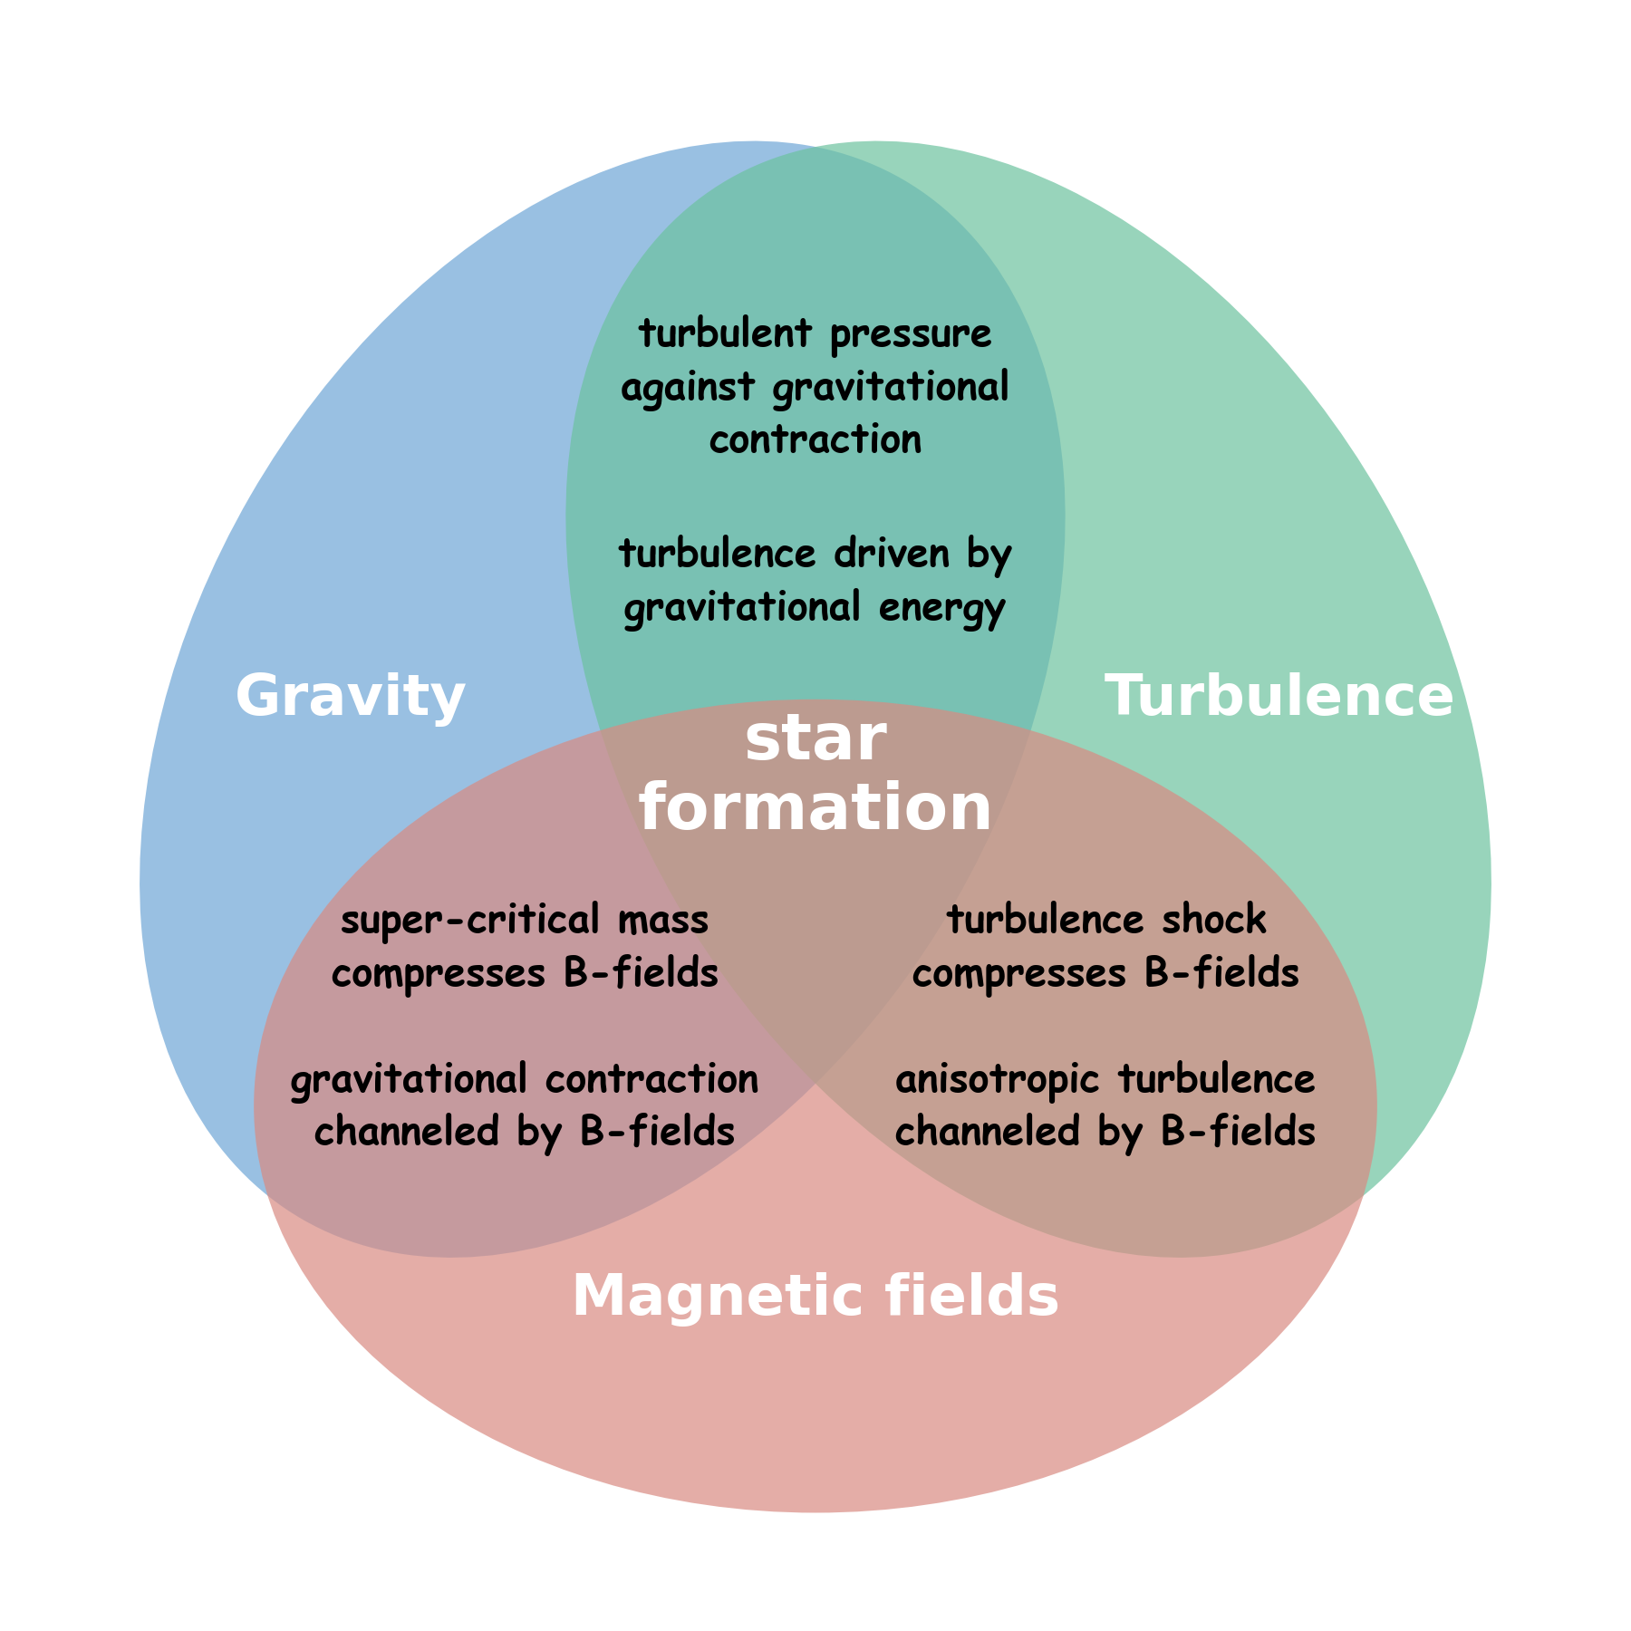
Star Formation is a complex process
Chemical
network
Environment
In observations, any observed quantities are subject to the combination effects of Gravity, Turbulence and Magnetic field.
From theories, there is not a
comprehensive theoretical
framework for star formation
yet, due to the complexity.
Li 2017
Notes:
Why this is difficult to find the answer,
在不同尺度交叉重叠，共同演化. In every pixel, what you measured is a combination of all these factors.

Slide 5
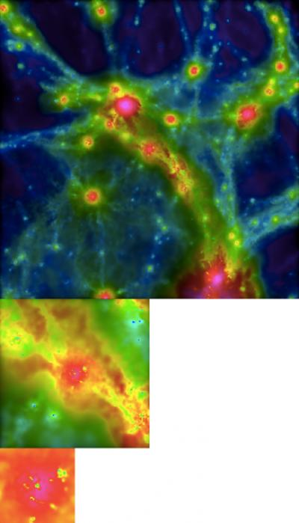
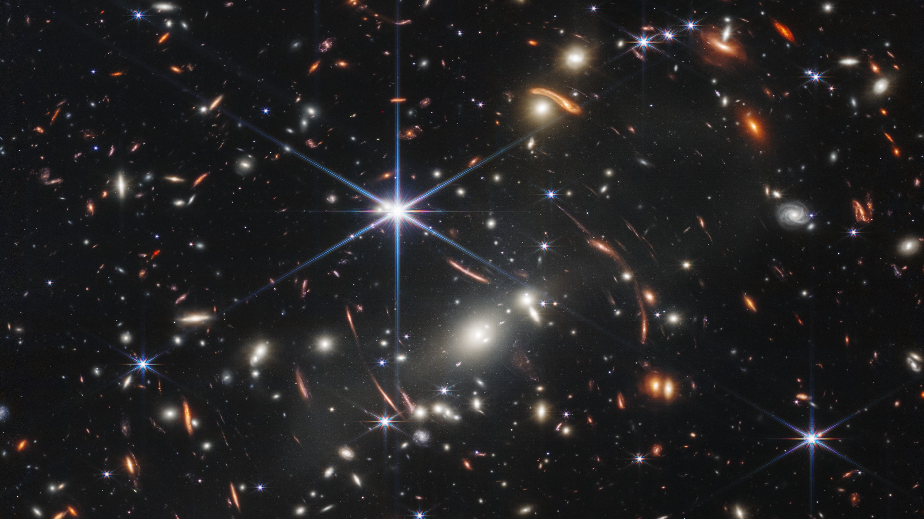
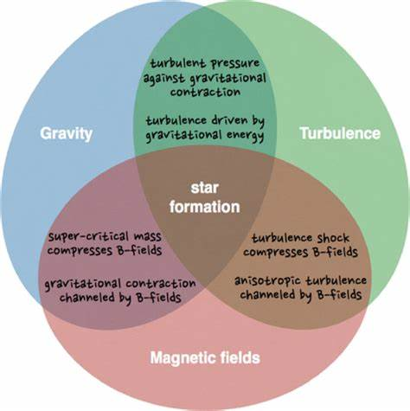
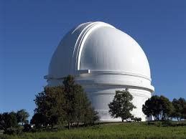
Kennicutt-Schmidt law
Physics!
Observation，Theory
Notes:
However, we need to understand what happen in the distant galaxies, the star formation in early universe. Establish such a connection correctly is challenging

Slide 6


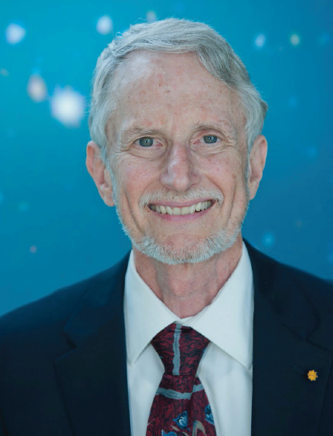
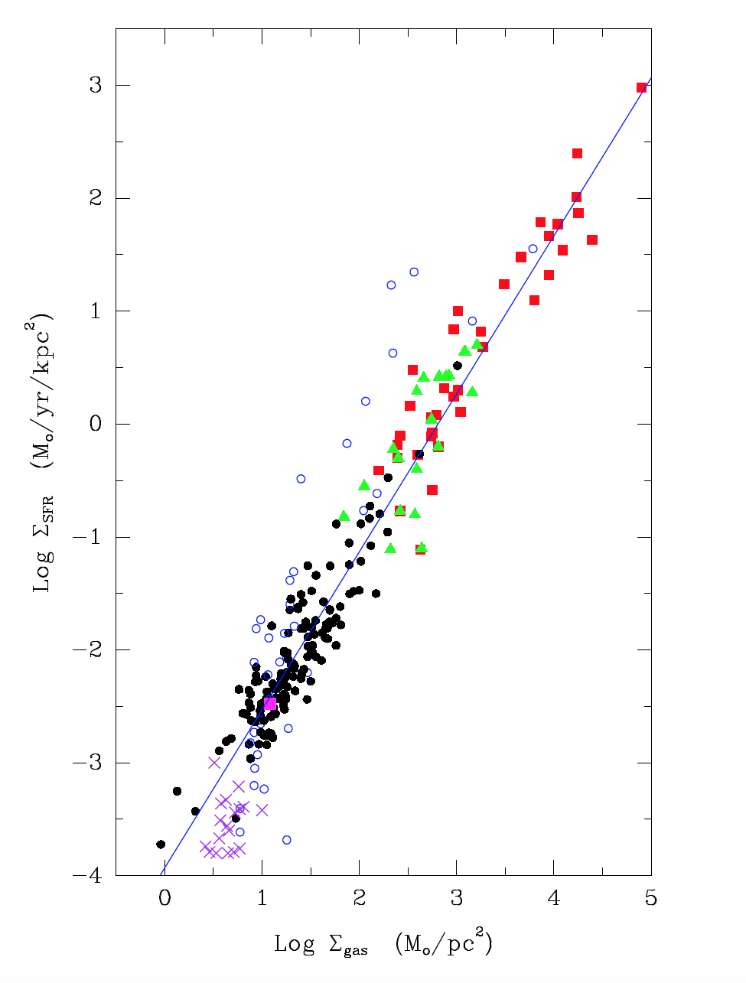
Kennicutt-Schmidt law
An empirical correlation between gas content and
star formation rate, averaged over time and spatial scales
Marrten
Schmidt
Rob
Kennicutt
Neal
Evans
∑_{SFR} = A ∑_{gas}^{N} N~1.4
Kennicutt 1998, ARAA Citation ~6000
Kennicutt et al. 1998, Citation ~5000
Kennicutt & Evans 2012, ARAA, citation ~2500
Bigiel et al. 2008
HI+CO
Kennicutt & Evans 2012, ARAA
Notes:
It is quite practical, but not physical
经验关系+基本猜测：与气体含量相关？求诸经验关系，在空间和时间上取平均效果;
As a simplified and compromised approach, people try to directly link observatable parameters and physical values, that is empirical coorelations. Gas – SFR: positive, N~1.4
Very high citations, widely used in deriving SFR in galaxy observations and in simulations
But people do have worry on it: The physical origin of 1.4 wan not clear, atom gas/molecular gas (~1 over large scales and higher density),
Different samples leads to different slopes, from 1-3

Slide 7
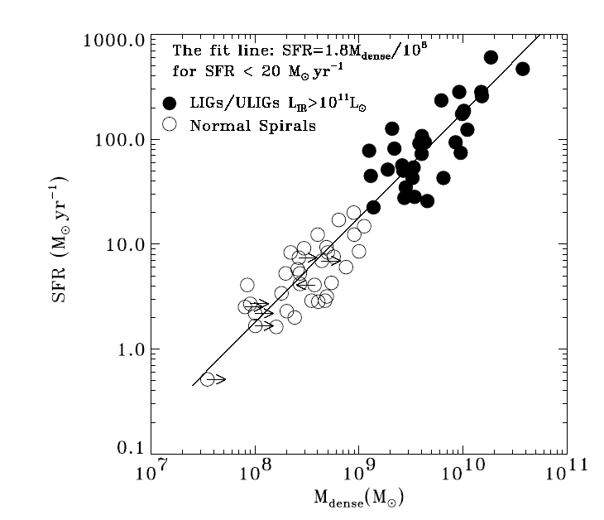
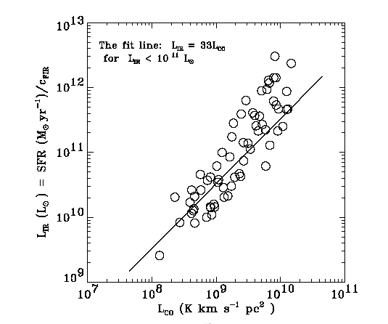
Dense gas version K-S law: looking for star forming gas
L_{IR}, Star formation rate
Gao, Yu
L_{CO,} Amount of total gas
L_{HCN}
(Gao & solomon 2004 a,b)
Linear correlation between L_{IR} and L_{HCN 1-0}
(Wu, Evans et al. 2005)
Notes:
Only part of gas in total gas lead to star formation: which part? Star forming gas

Slide 8
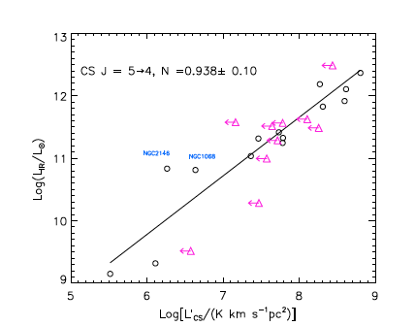
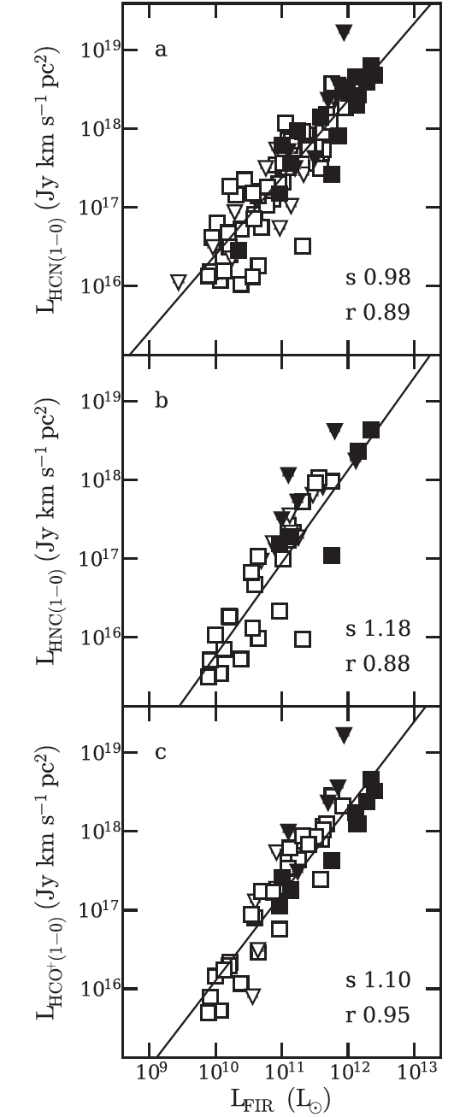
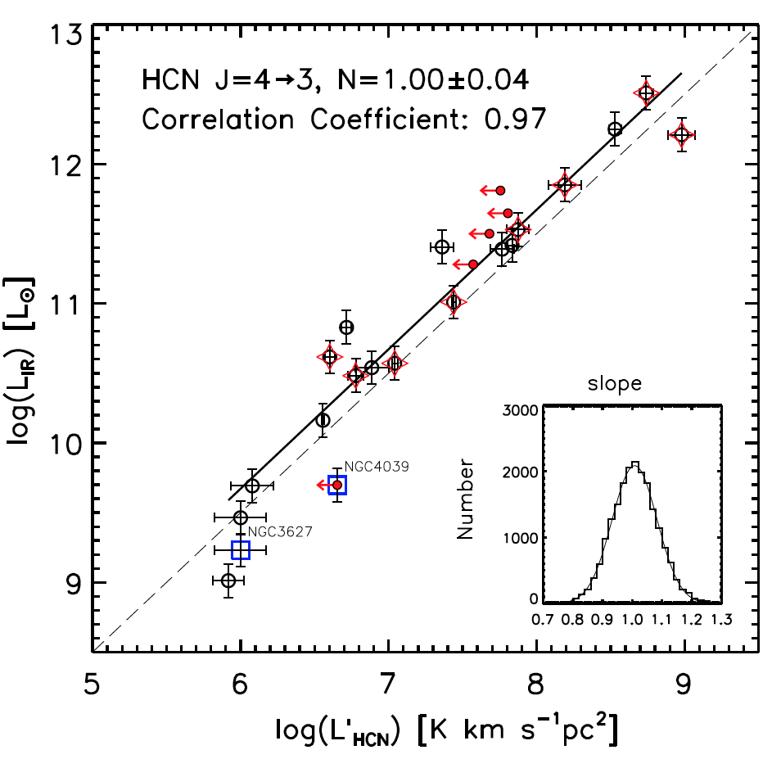
More tests in dense gas: Linear correlations with SFR
Wang et al. 2011
Zhang et al. 2014
（Tan et al. 2018)
Baan et al. 2008
Li et al. 2021

Slide 9
“Dense” gas leads to star formation:
Lada 2010
Evans 2014
Av > 8 is an empirical threshold of dense gas found in nearby star-forming clouds
Notes:
In the Milky Way, dense gas was also found to be critical for star formation, valid for dust-extinction derived dense gas mass vs. SFR (YSO)

Slide 10
Dense gas = Star forming gas ?
1. Can we measure M_{dense} accurately ?
2. If we can measure M_{dense} , is dense gas the star forming gas?
1. From L_{line} to M_{dense}
2. There are notable exceptions!
The Galactic central molecular zone (CMZ) has a huge amount of dense gas, but the star formation efficiency is lower by an order of magnitude.
Optical depth/Radiative transfer
Abundance /Chemistry
Excitations
Sub-thermal-emission
HCN 1-0
is mostly from diffused
regions.
Star formation normally occurs in dense regions, but dense regions not necessarily host active star formation.
(Evans 2020)
Notes:
Is dense gas the answer to the star forming gas ?
我们要找到真正的恒星形成气体，也必须要解决这两个问题 so bot questions are not likely to be yes

Slide 11
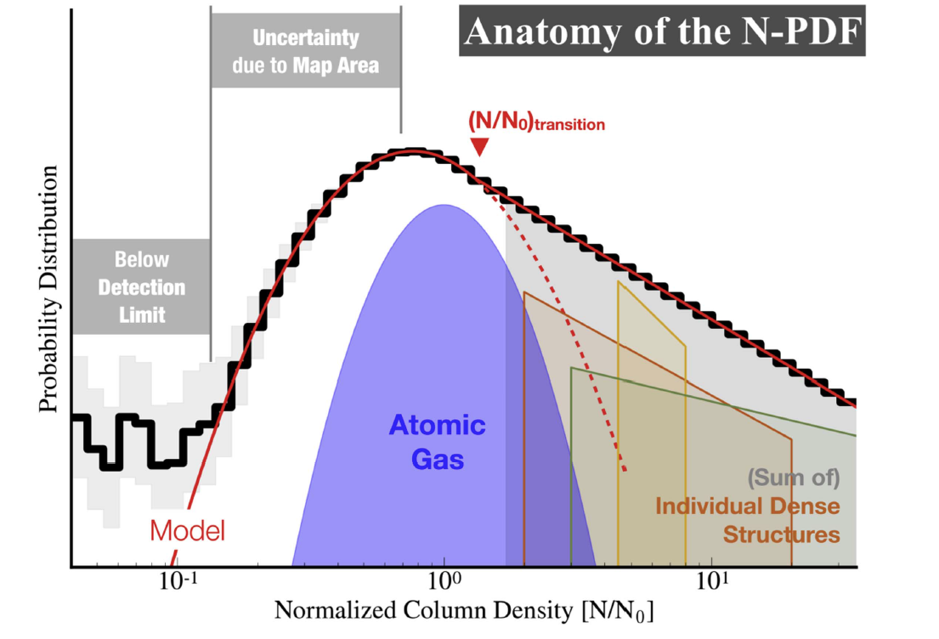
Column density probability distribution function（N-PDF）
Switch to density space
Volume density
Probability distribution function (nPDF)
Vazquez-Semadeni 1994
Lognormal:
Turbulent, unbounded gas
Random process
Power-Law:
Gravitationally dominated (bound) gas
2D –approximation
N-PDF
Klessen 2000
Federrath et al. 2010
Burkhart et al. 2017
（Chen et al. 2018)
Separate Gravity/Turbulence in density space instead of spatial space
with nPDF and N-PDF
Notes:
Then nhow can we do that: What we can observed are always integrated quantities along the light of sight, combining all the contributions together, but some physics can be reflected by the density distribution. It has been discovered that
The original concept is density probability function, N-PDF is a 2D version of that, but the effect is similar. Although you can not separate them from the physical space, you my be able to separate them in density space

Slide 12
The first test in Ophiuchus
Use dust emission (optically thin) to generate N-PDF
The separation N_{threshold} between Gravity/Turbulence corresponds to Av~8 !
Gravitationally bound gas = star forming gas ?
Notes:
发现的契机

Slide 13
Gravitationally bound gas = star forming gas ? Extend to other nearby clouds:
N_{threshold} in most nearby clouds agrees with Av=8 cut: (Av-8 physical explanation)
Some with variations: Turbulence contribution ? Need a unfixed threshold.
A tight , linear correlation between bound gas mass M_{sgb} and SFR.
Notes:
到了这一步，仍然nothing surprise，和原来的结果一致，只不过更tight一些，但是物理图像变得更为清晰：引力束缚气体很节能就是我们一直在找的恒星形成气体

Slide 14
Gravitationally bound gas = star forming gas ? Extend to massive clouds:
The N_{threshold} vary a lot in massive clumps (More than a factor of 10)..
A linear correlation between bound gas mass M_{sgb} and SFR for distant, massive clouds.
We see linear M_{sgb}-SFR correlations both in low mass/nearby clouds and distant, massive clouds.
Two SFR systems： YSO counting method (for nearby clouds)
Bolometric luminosity methods (for massive clouds)
may account for the offset of the two linear correlations.
If they reflect the same intrinsic correlation,
The SFRs converting factor is: SFR（YSO）= 7.8 SFR（L_{bol})

Slide 15
Combine low-mass, nearby sample and distant, massive sample
CMZ
CMZ
A nicely tight, linear
Bound gas mass
Vs.
Star formation rate
correlation
(Jiao, Wu, Zhang et al. 2025)
Bound gas mass
After excluding turbulence contribution, bound gas mass present a perfectly tight, linear correlation with SFRs, valid over 4 orders of magnitude.
CMZ also agrees with this correlation: Only a small fraction of dense gas in CMZ is bound due to very high turbulence.

Slide 16
Bound gas threshold vs. a fixed Av=8 threshold
The classical Av=8 ”dense gas” threshold:
A non-linear，scattered correlation
After separating gravitational bound
gas and turbulent gas:
A very tight, linear correlation.
Turbulence is critical in identifying star forming gas, especially in massive clumps

Slide 17
Star formation efficiency （the SFR per amount of bound/dense gas）
Bound gas
v.s.
Dense gas
Gravitationally bound gas has a consistent star formation efficiency in the Milky Way.
Once bound, gas will be converted into stars at a constant rate of about 0.4%/Myr, despite their environments . → Simulations

Slide 18
Now we can look back these classical puzzles
Why there is a Av=8 threshold
Happen to be close to the separation
column density between bound gas and
turbulent gas for low-mass clouds.
It doesn’t work well for massive clouds.
Why CMZ has a very low SFE
Due to the very turbulent environment,
N_{threshold} is very high (~40X of Orion B),
only a small fraction is bound that can
form stars.
Evans 2014

Slide 19
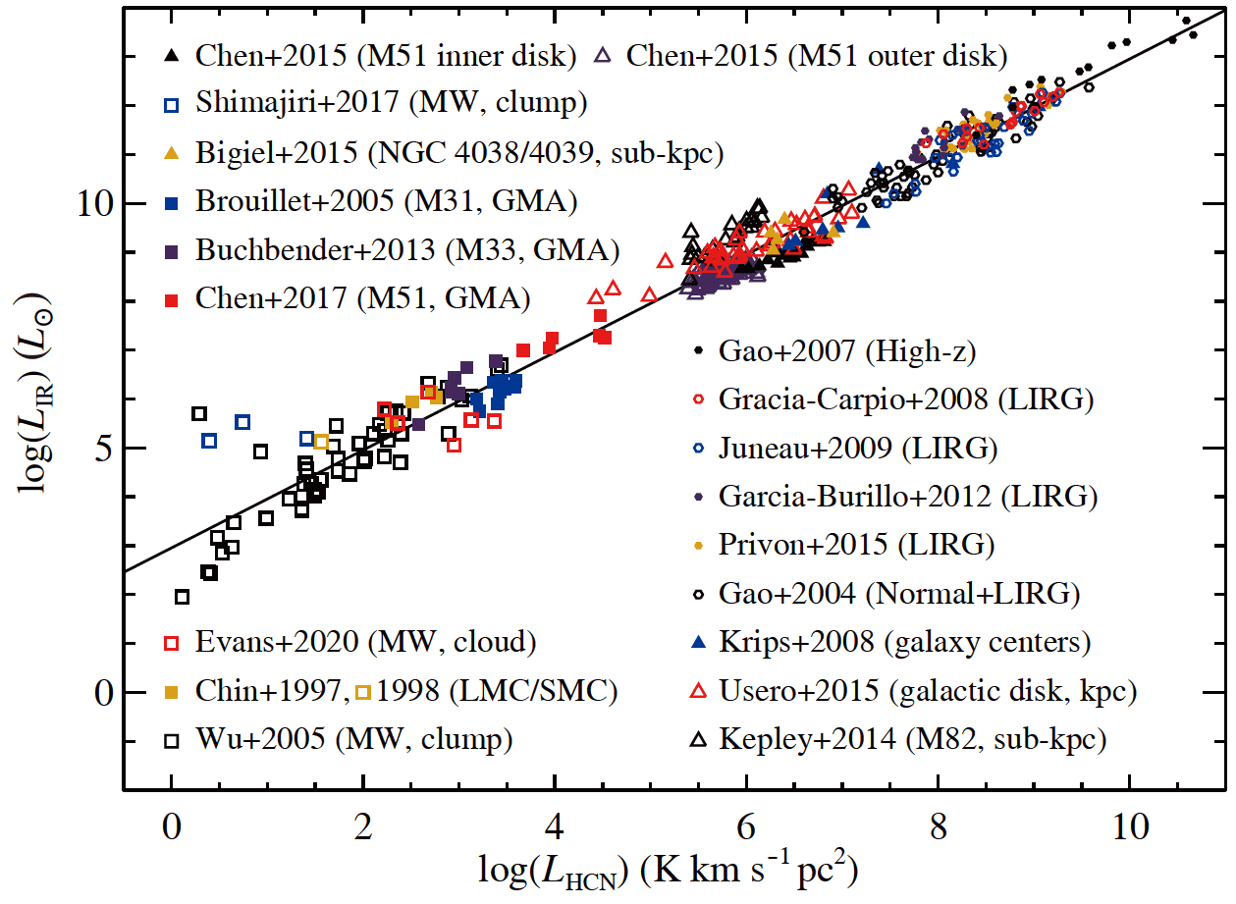
A new version of Kennicutt-Schmidt law
----with clear physical explanation
2025 NSFC Original
Exploration funding
Gao et al. 2021
Gao-Soloman correlation
Jiao, Wu, Zhang et al. 2025
Kennicutt & Evans 2012, ARAA
K-S law 1.0: total gas version
Kennicutt 1997，1998，
Kennicutt & Evans 2012
K-S law 2.0: dens gas version
Gao & Solomn 2004a,b,
Wu+ 2005, Gao + 2021
K-S Law 3.0: bound gas version
Jiao, Wu,+2025
Notes:
把经验公式赋予了物理意义，可以定量的测量star forming gas有多少，提供了独立测量恒星形成率的一个工具

Slide 20
Conclusions/ Take home messages
A tight, linear correlation between the gravitationally bound gas and star formation rate is found, valid over 4 orders of magnitude in Galactic clouds, including CMZ.
Gravitationally bound gas mass determines star formation in the Galaxy; Once bound, gas presents a consistent efficiency (~ 0.4%/Myr) to form stars.
This finding provides an independent method to measure SFRs, and a more practical, reliable approach to generate SFR in simulations (gas know when gravity wins in simulations).
We can establish a new, bound-gas version of Kennicutt-Schmidt law, with clear physical meaning.
Notes:
目前的结果已经很漂亮了，但是仅仅是开始。

