Slide 1


7th China-Chile Bilateral Conference for Astronomy , Hong Kong, HKU
Searching for the Exoplanet source of carbon fullerenes
SeyedAbdolreza Sadjadi (薩布笛)
Laboratory for Space Research, Faculty of Science, the University of Hong Kong
December 08st, 2025

Slide 2
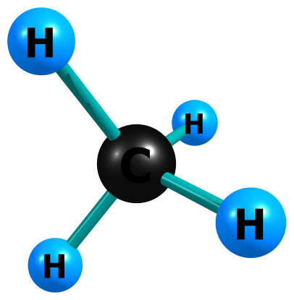
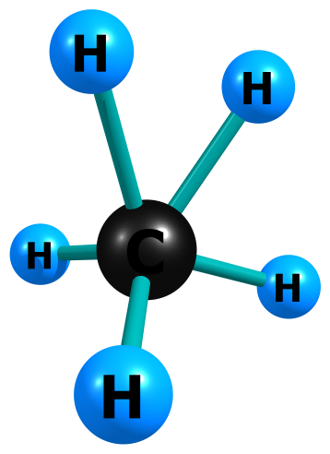
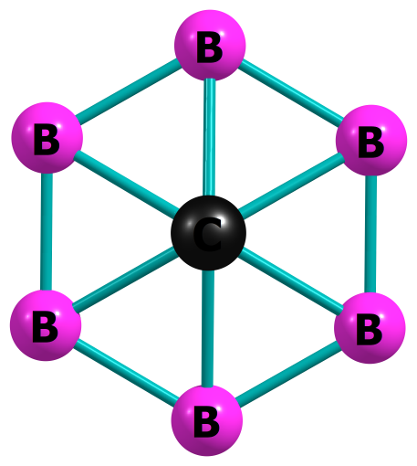
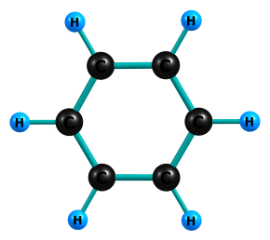
19th century
Predictable and Rigid Atom
Valency is 4
1952
Tal’rose et al
USSR
CH5(+) Methanium ,
Valency is 5
2000
Exner & Schleyer
Planar Hexa Coordinate Carbon (PHC)
B6C(2-)
Valency is 6
21st Century Unpredictable and Soft Atom
7th China-Chile Bilateral Conference for Astronomy , Hong Kong, HKU
Our Obsession About Carbon

Slide 3
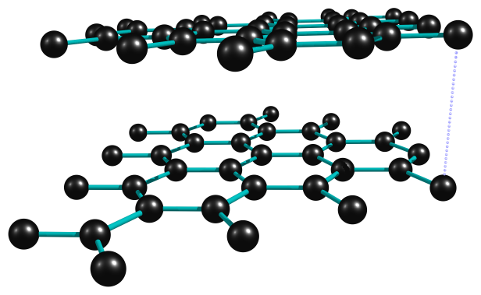
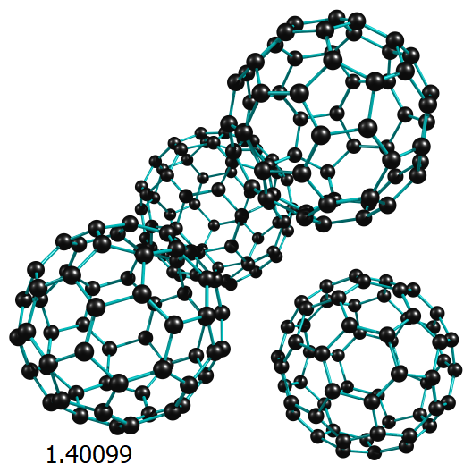
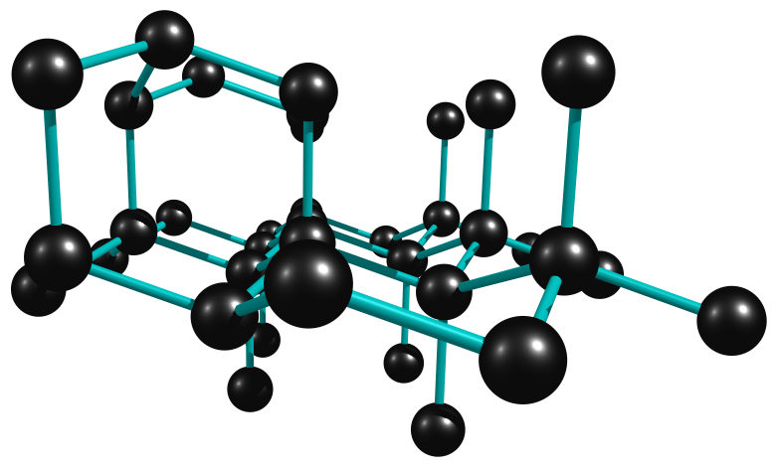
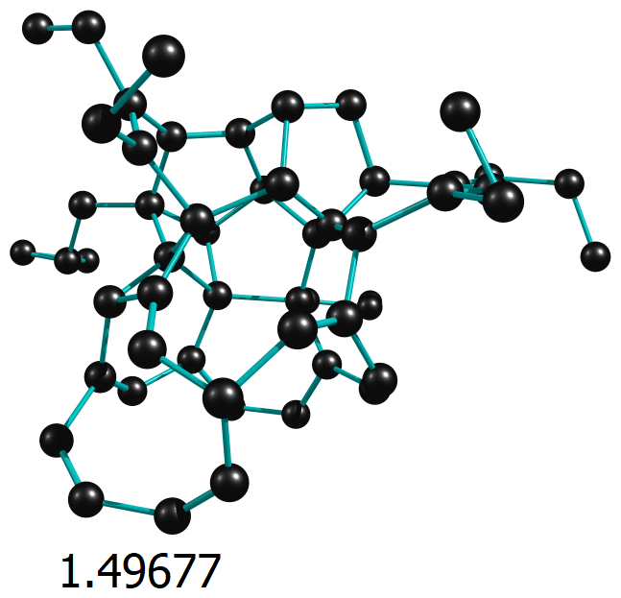
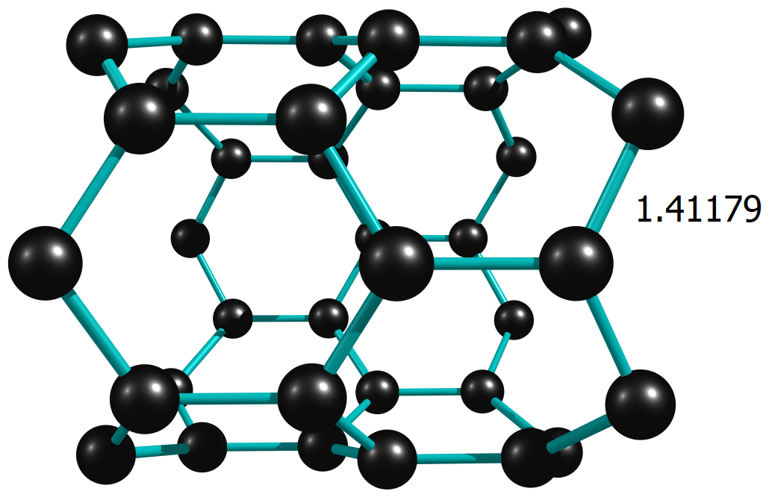
7th China-Chile Bilateral Conference for Astronomy , Hong Kong, HKU
Mother Nature Is Sculpting Carbon Allotropes
3.35550Å
1.54449
1.42260
Graphite
Neutron Diffraction
The most thermodynamically stable form of carbon
Diamond
X-Ray
C60 Fullerene
Solid State
500 Allotropes
Science Direct
Amorphous
Theory
Single Wall Nanotube
Theory

Slide 4
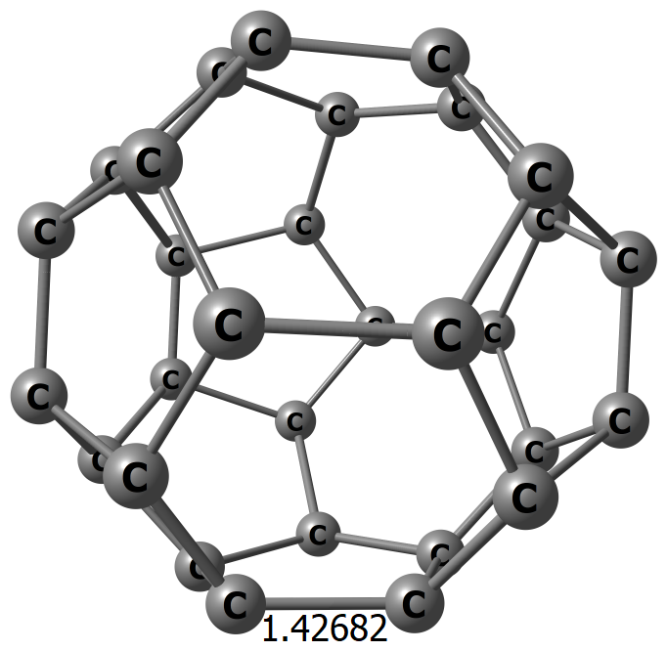
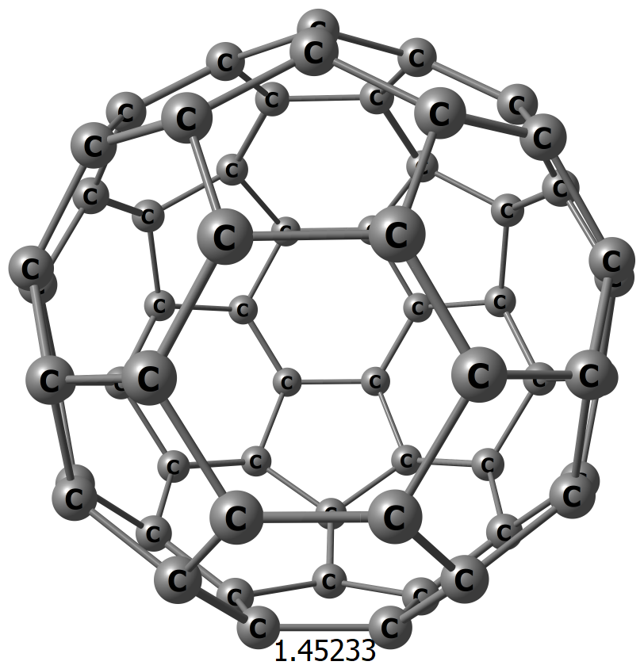
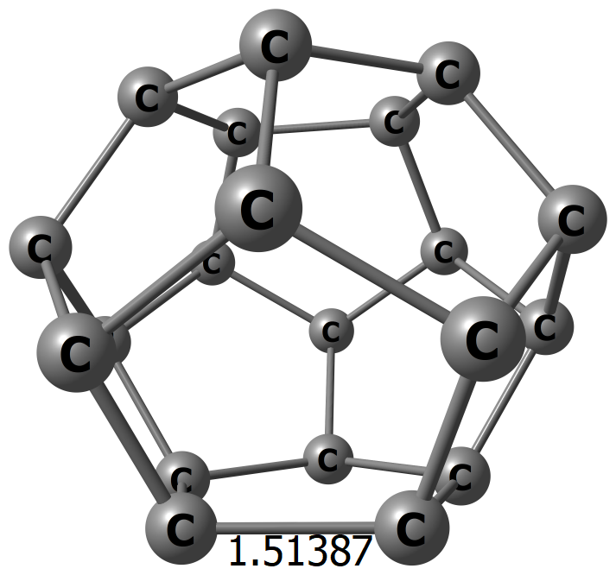
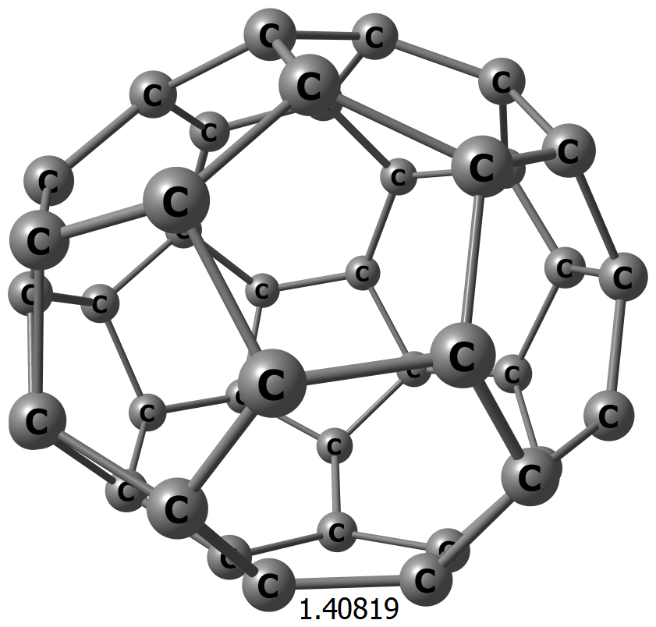
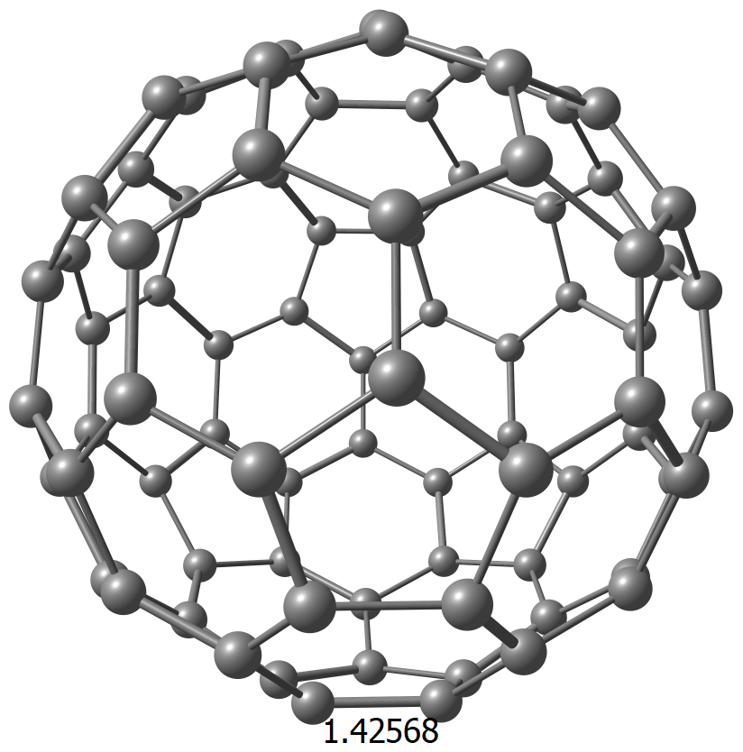
7th China-Chile Bilateral Conference for Astronomy , Hong Kong, HKU
Fullerenes Classical Family Photo
C20
Year: 2000
C30
C40
C60
Molecules composed solely of an even number of carbon atoms, which form a cage-like fused-ring polycyclic system with twelve five-membered rings and the rest six-membered rings.
Large Positive Heat of Formation
C₂₀: 2358.2 ± 8.0 kJ mol⁻¹
C₆₀: 2520.0 ±20.7 kJ mol⁻¹
300 g water from 0 to 100 per producing 720 g of C60 or 240 g of C20
C80

Slide 5
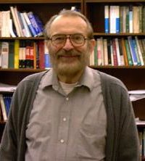
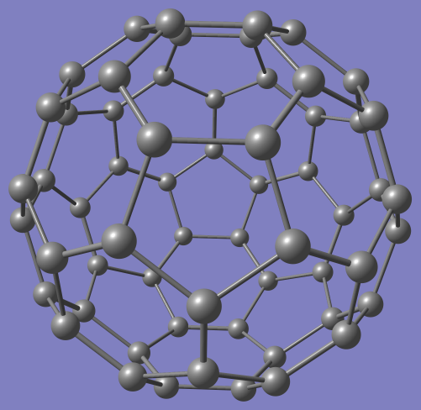
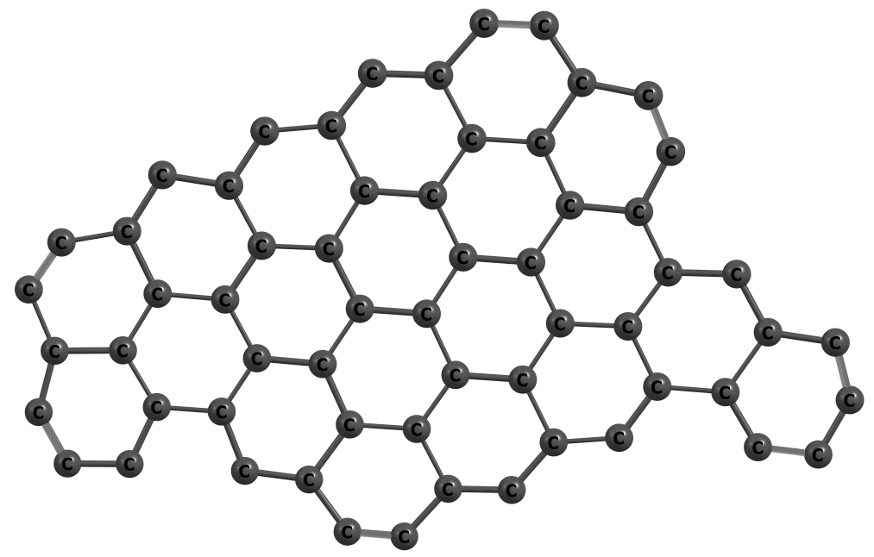
7th China-Chile Bilateral Conference for Astronomy , Hong Kong, HKU
A Trapped Molecule
Prof. Dr. Dr. Paul Von Rague Schleyer
1930–2014
1,200 papers.
authored or coauthored 12 books.
1-Why should exist?
An illusory consequence of the lack of
Decomposition route with small activation barriers leading to lower energy “sheet like” products.
Chemist who launched the study of caged hydrocarbons.¹
Source:
1- Schaefer, H. Paul von Ragué Schleyer (1930–2014). Nature 517, 22 (2015). https://doi.org/10.1038/517022a
2- Chen & Schleyer et al 2012, Phys. Chem. Chem. Phys, Volume 14, Page 14886-14891

Slide 6
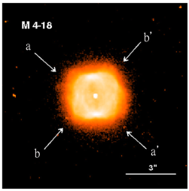
7th China-Chile Bilateral Conference for Astronomy , Hong Kong, HKU
Terrestrial and Extraterrestrial Source of Fullerene
Terrestrial natural sources
Of Fullerenes are Rare
A tiny fraction of some minerals called Shungite can be found in Russia
Source:
1-Hsia et al 2025 ApJ, Under Review

Slide 7
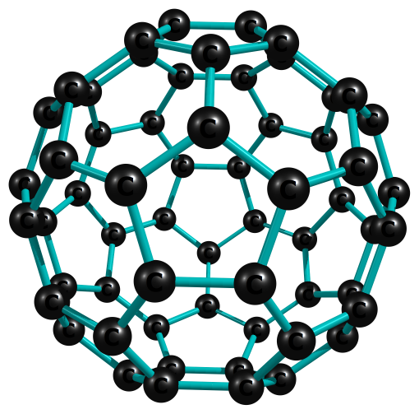

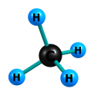
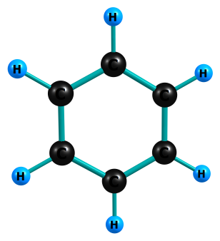
7th China-Chile Bilateral Conference for Astronomy , Hong Kong, HKU
Sittler’s Model of Atmospheric Formation of Fullerenes
Sittler’s model for Ionosphere of Titan : Conversion of Methan to Fullerenes under UV radiation
It is based on Howard combustion synthesis of Fullerenes (C₆₀ & C₇₀)
O2 (Oxygen)
C6H6 (Benzene)
Soot (Black Carbo), 12 % C₆₀ and C₇₀
Compound
CH₄
Methane
Element
C₆₀
Fullerene
Many chemical reactions do not proceed under the radiation
Source:
1-Sittler et al, Icarus, 344, 113246, (2020)

Slide 8


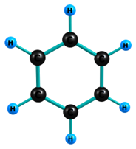
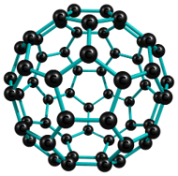


7th China-Chile Bilateral Conference for Astronomy , Hong Kong, HKU
A Possible Synthesis Route : My Cookbook
CH₄+ O2
3C2H2 (Acetylene)
C6H6
Heat, 1500$℃$
2-3 eV per molecule, High Energy Cosmic-Ray (Zhou 2010)
Howard recipe : Mix it with O₂, 76 torr
C6H6 + O2
Heat: 120 $℃$
C60
Source:
1-Zhou et al, ApJ, 718, 1243-1251, (2010)

Slide 9
7th China-Chile Bilateral Conference for Astronomy , Hong Kong, HKU
Overview of Sittler’s Model
Chemically driven exchange of elemental form of carbon between atmosphere and the crust of a planet ( Fullerenes Rain)
So far no fullerenes has been detected in planets/moon atmospheres within the solar system
We estimate that temperature above 1500$℃$ is required in addition to UV
We estimate that temperature above 1500℃ is required in addition to UV
Are fullerenes stable under high energy radiation condition?

Slide 10
7th China-Chile Bilateral Conference for Astronomy , Hong Kong, HKU
Ionization Tolerance Limit (ITL)
Classical Concept: Coulomb Explosion
Far larger than normal +2 or +3 Charge
C₆₀ Fullerene Highly Positively Charged Timeline
1994
Sheier & Mark
1996
2005
Cioslowski et al
Diaz et al
C₆₀(14+)
Theoretical
2010
Handbook of Nanophysics Clusters and Fullerenes
2021
2003
Bhardwaj et al
C₆₀(12+) 0.5 µs
Experiment Gas Phase
Sadjadi & Parker
C₆₀(26+)
We found 12 new species
Theoretical
C₆₀(10+)
Theoretical
C₆₀(7+)
Experimental Gas Phase
How many Charges can C₆₀ hold at most?

Slide 11
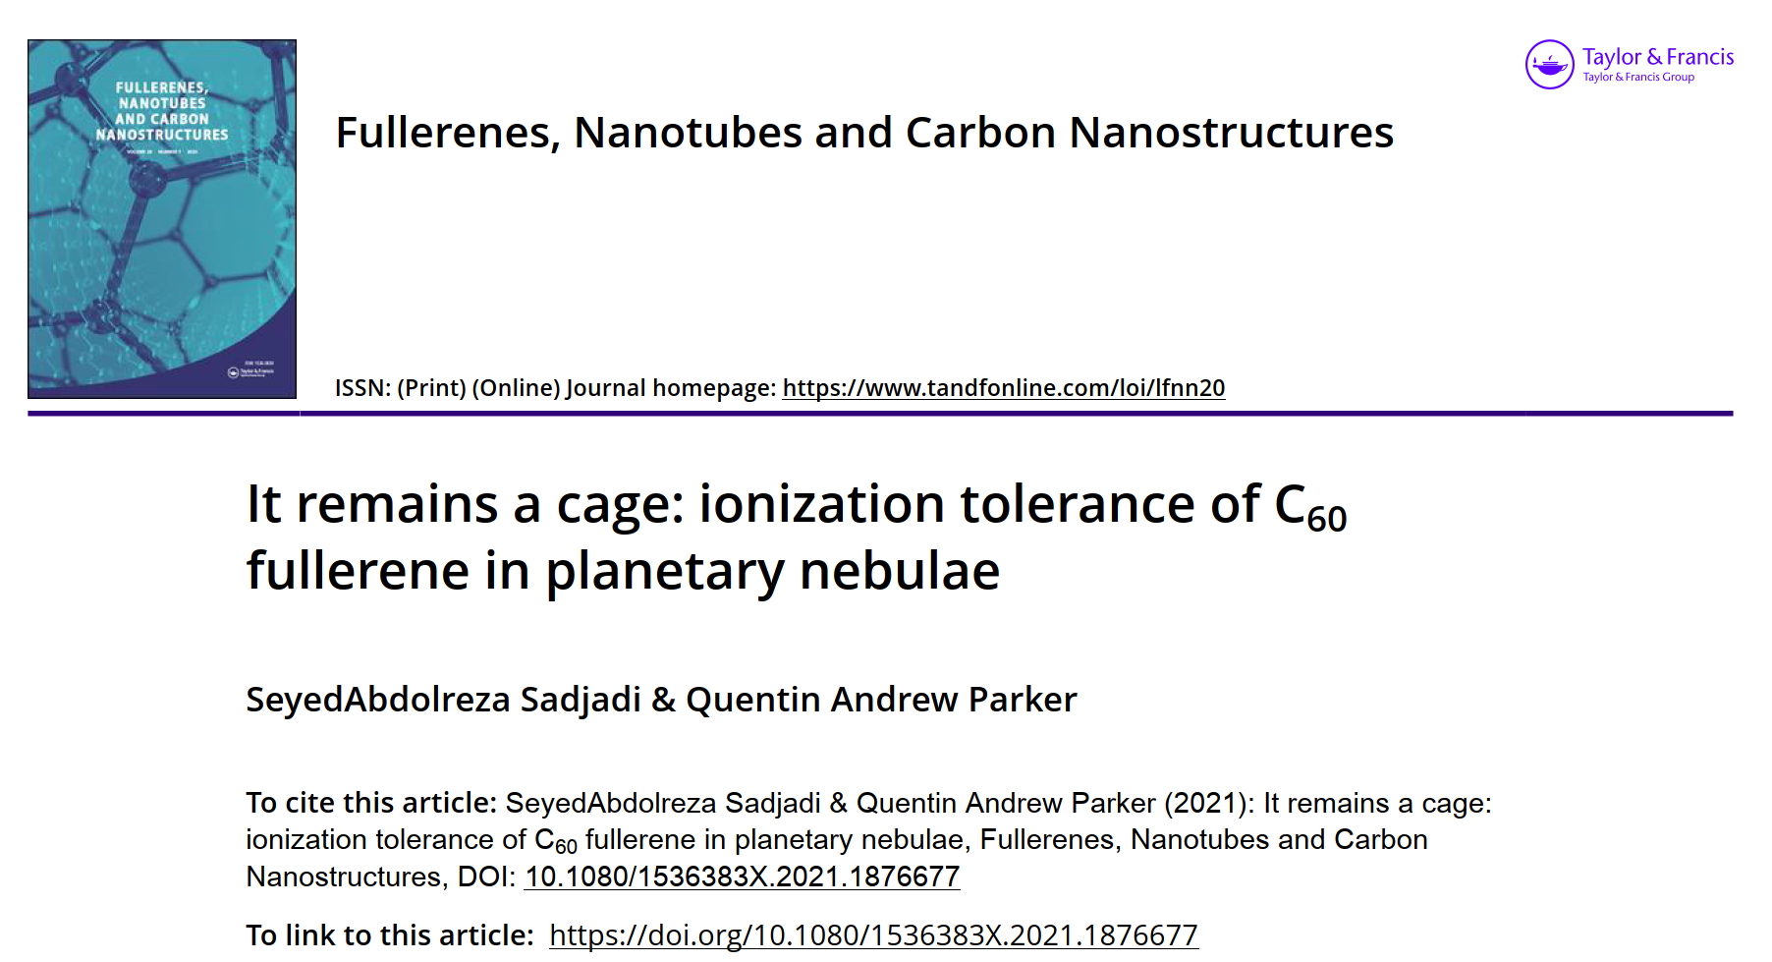
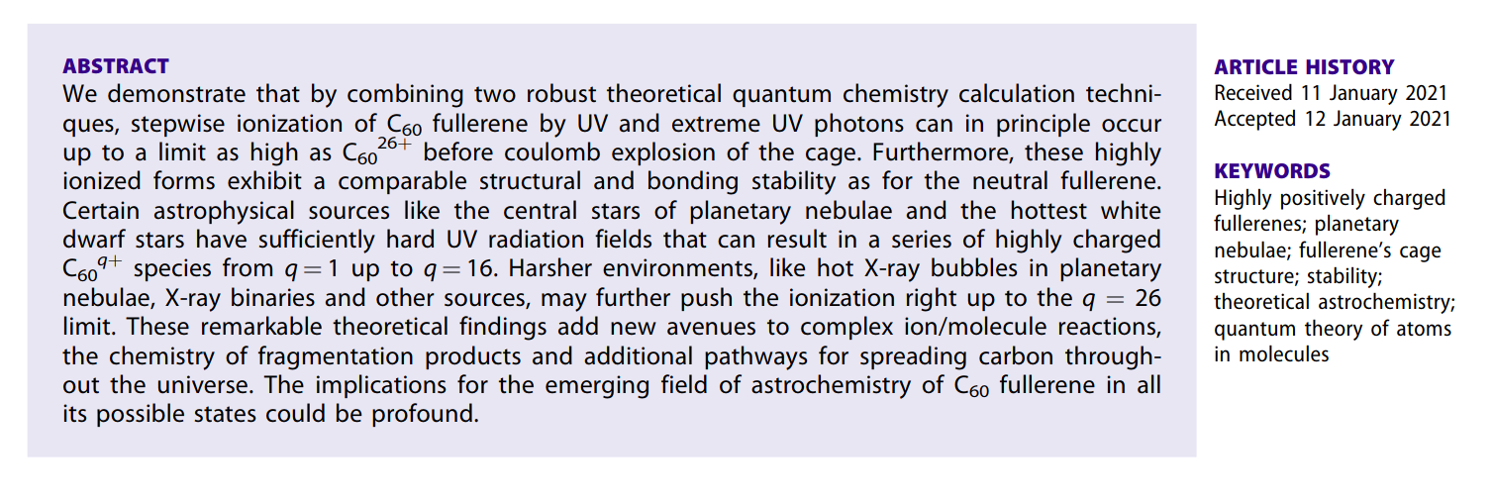
7th China-Chile Bilateral Conference for Astronomy , Hong Kong, HKU
It Remains the Cage

Slide 12
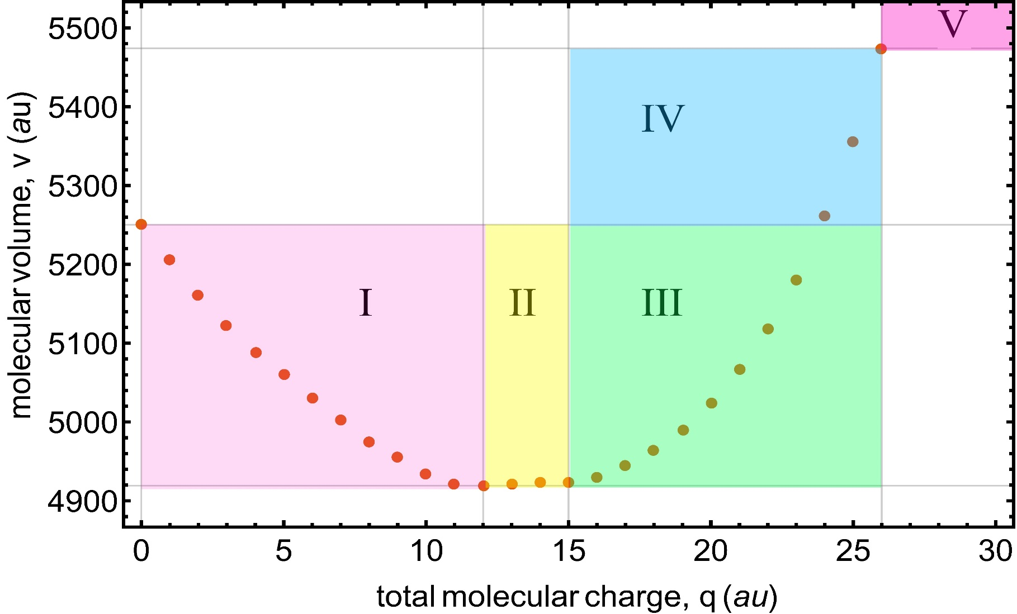
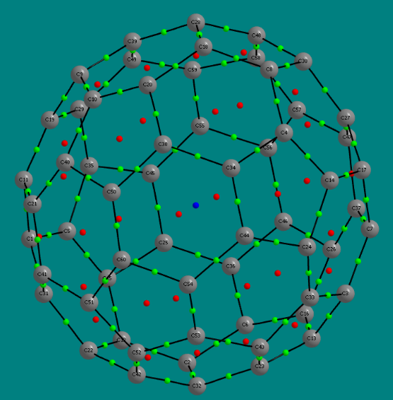
7th China-Chile Bilateral Conference for Astronomy , Hong Kong, HKU
Path to the Formation of C₆₀^{q+} Cages
Through the Mechanism of stepwise single photon ionization of C₆₀
It remains a Cage up to +26 Charge
All Bonding, Rings and Cage Persist in all charged cations up to +26
QTAIM Critical Role in this Study
82.44 eV (Extreme UV)
7.80 eV (Vacuum UV)
5 different volume change zones
Each zone has its characteristic
Spectroscopic features.
Zone V, (+27) Fragmentation zone
Molecular graph, C₆₀(26+)
Aliphatic Cage
Source:
1- Sadjadi & Parker 2021, FNCN, Volume 29, Pages 620-625

Slide 13
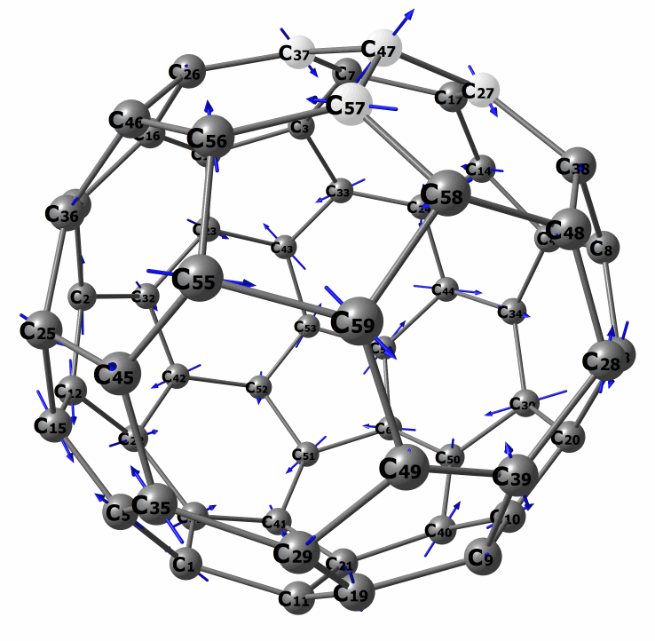
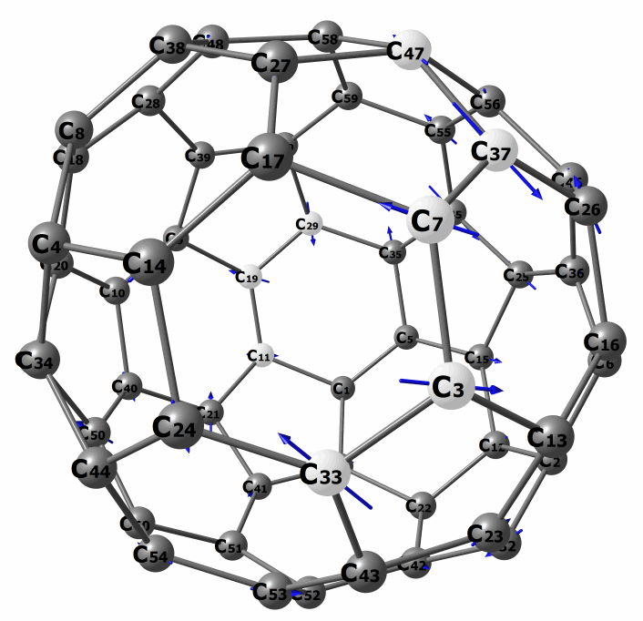
7th China-Chile Bilateral Conference for Astronomy , Hong Kong, HKU
Vibrational Motions of C₆₀ ²⁶⁺
11.19 µm
No H atoms involved , in plane ring deformation
16.40 µm
Out of plane ring deformation
Source:
1- Sadjadi et. al, 2022, ApJ, 934:75

Slide 14
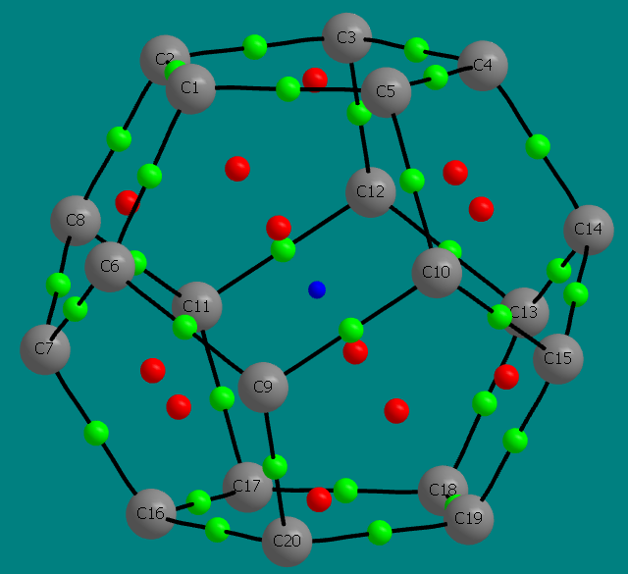
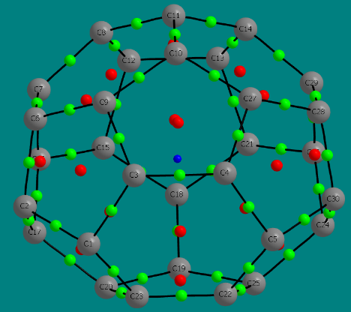
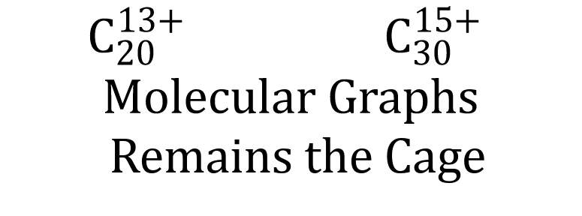
7th China-Chile Bilateral Conference for Astronomy , Hong Kong, HKU
ITL for Smallest Fullerene: C₂₀ and C₃₀
Ionisation Tolerance Limit
Incredibly high ITL
Half of C₆₀
$$C_{20}^{13+} C_{30}^{15+}$$
$$Molecular Graphs$$
Remains the Cage
Source:
1- Sadjadi and Parker in Road map on Carbon molecular nanostructure in space, Ed by Hensen, Hernadez, Campbell, Eur.Phys.J.D, 97, 94 (2025)

Slide 15
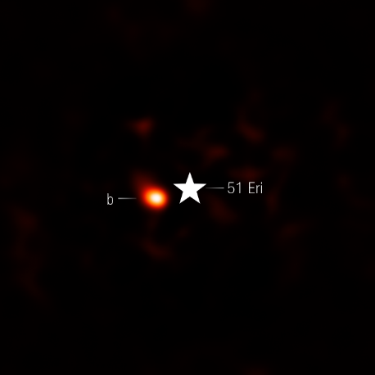
7th China-Chile Bilateral Conference for Astronomy , Hong Kong, HKU
Current Exoplanets Candidates
51 Eri B
V: 5.22 mag
CH₄, H₂O detected
GJ 229 c
V: 8.13 mag
CH₄ detected ?
Star (1.56 solar mass), 7190.90 K
All archived obervations are in NIR
T(eq) = 700 K
Large atmospheric mass contains
CH4, O2 or H2O
Hot Star as the source of heat and high energy radiations
Source:
1- Eri 51 B NIR camera image with Webb data from proposal: 1194 (M. E. Ressler). Image processing: Alyssa Pagan (STScI).

Slide 16
7th China-Chile Bilateral Conference for Astronomy , Hong Kong, HKU
Suggested Spectroscopic Method of Detection :UV/VIS
Catalogue of IR spectra of All C60(q+) (n=0-26) have also been published
Source:
1- Sadjadi et. al, 2022, ApJ, 934:75

Slide 17
7th China-Chile Bilateral Conference for Astronomy , Hong Kong, HKU
UV/VIS Spectra of the Smallest Fullerene

Slide 18
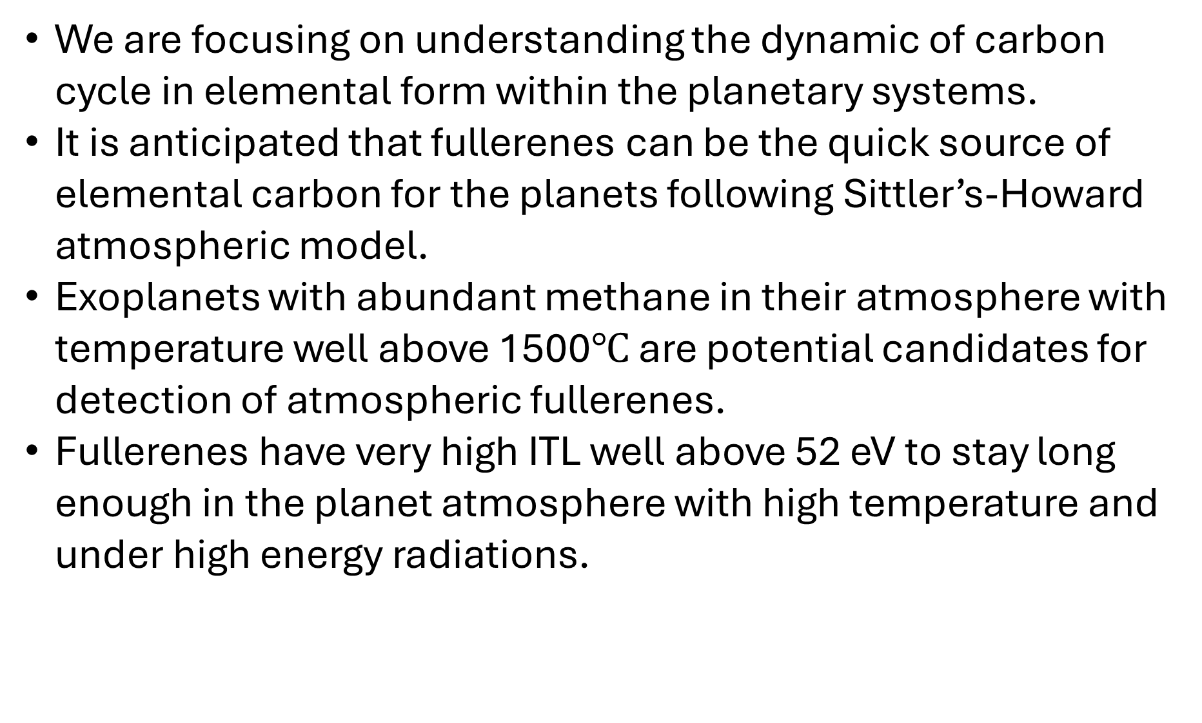
7th China-Chile Bilateral Conference for Astronomy , Hong Kong, HKU
Conclusions
We are focusing on understanding the dynamic of carbon cycle in elemental form within the planetary systems.
It is anticipated that fullerenes can be the quick source of elemental carbon for the planets following Sittler’s-Howard atmospheric model.
Exoplanets with abundant methane in their atmosphere with temperature well above 1500$℃$ are potential candidates for detection of atmospheric fullerenes.
Fullerenes have very high ITL well above 52 eV to stay long enough in the planet atmosphere with high temperature and under high energy radiations.

Slide 19
7th China-Chile Bilateral Conference for Astronomy , Hong Kong, HKU
Special Thanks to My Senior Astrophysicist and Astrochemist Collaborators:
Prof. Quentin Parker, Dr. Chih Hao Hsia, Prof. Yong Zhang
& Prof. Bernard Foing
Thanks to COST-NanoSpace
And
Thanks to you All

