Slide 1
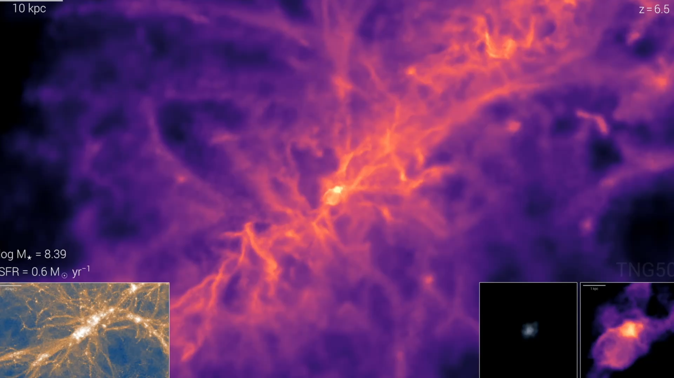



tage ≲ 1 Gyr
The Dynamic, Multi-Phase Nature of Early (≲1 Gyr) Galaxies: Insights from ALMA and JWST
Rodrigo Herrera-Camus
Universidad de Concepción, Chile
Partner Group

Slide 2
What are the key physical processes driving galaxy formation and evolution?

Slide 3
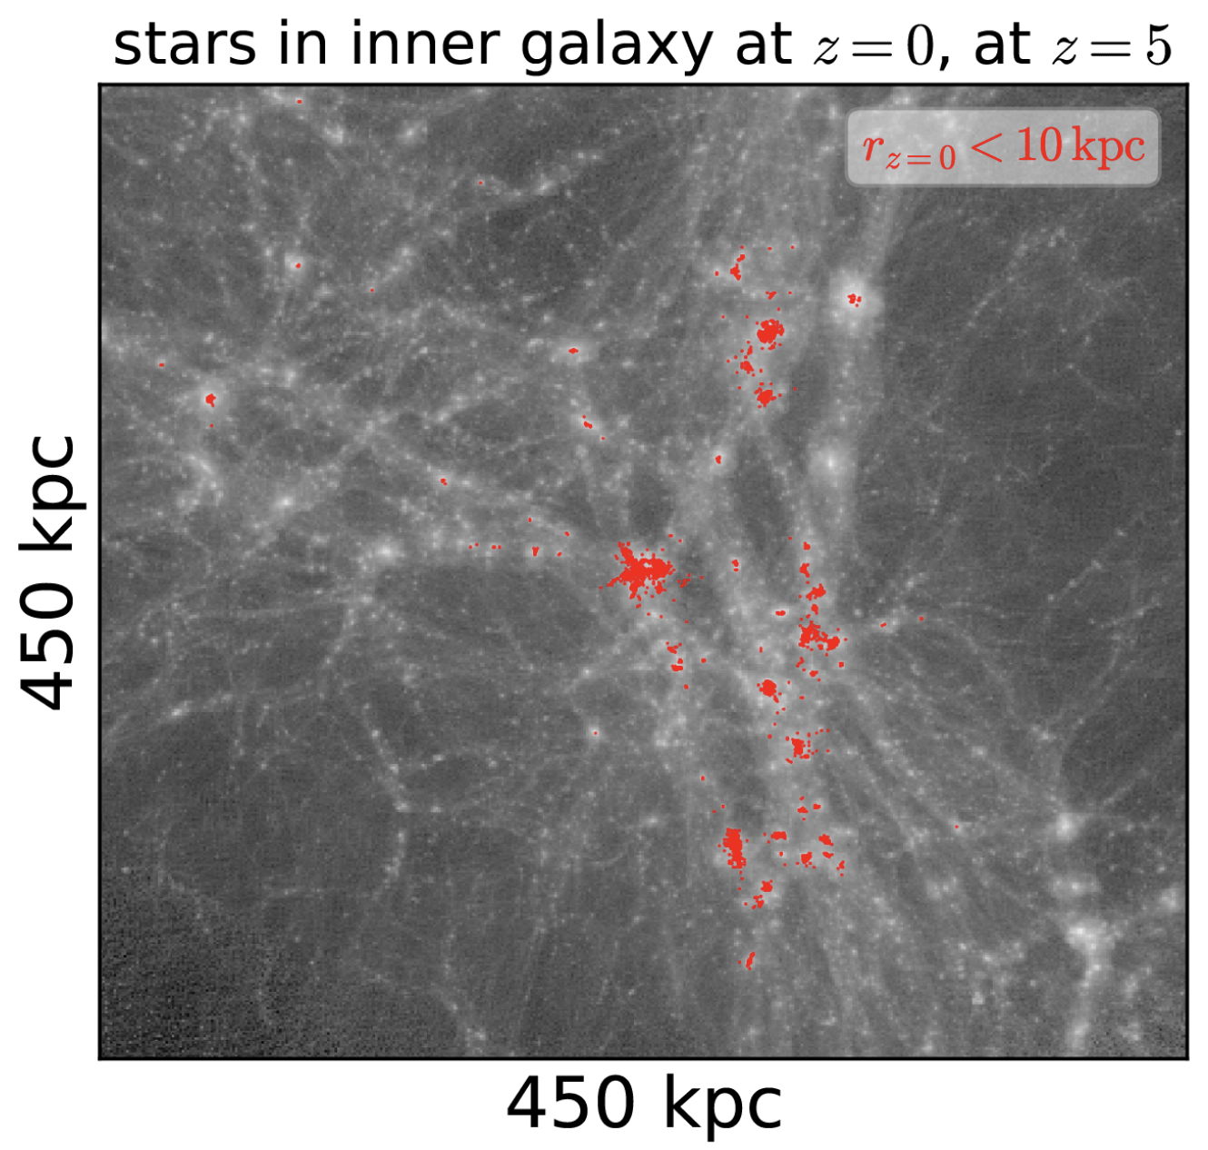
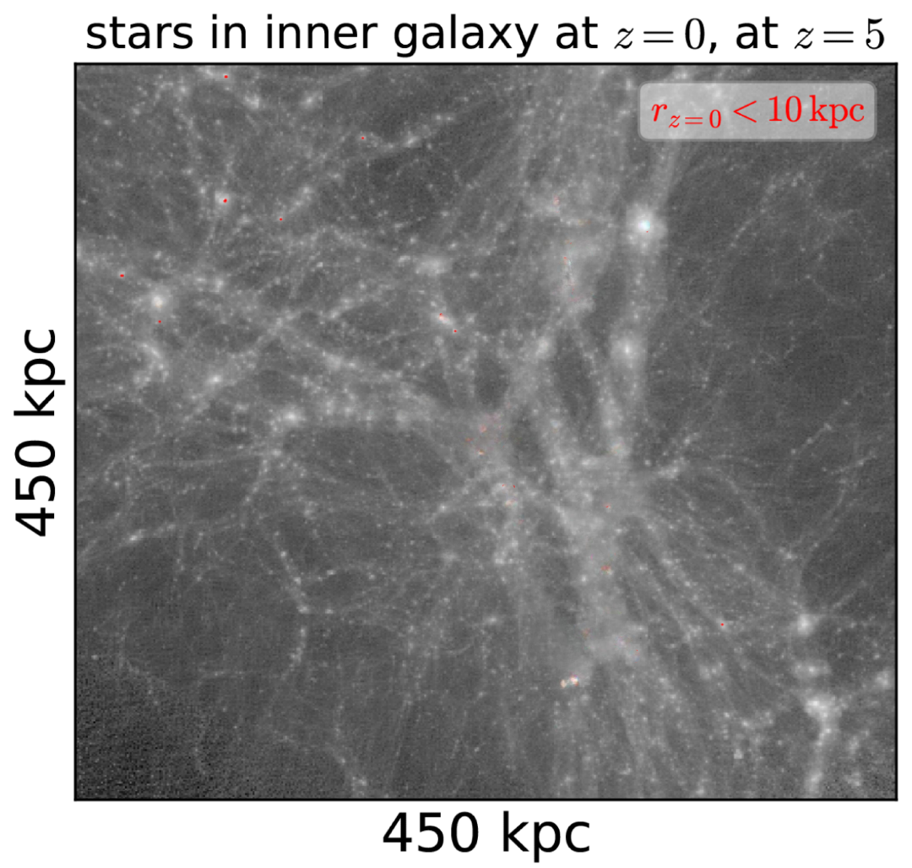
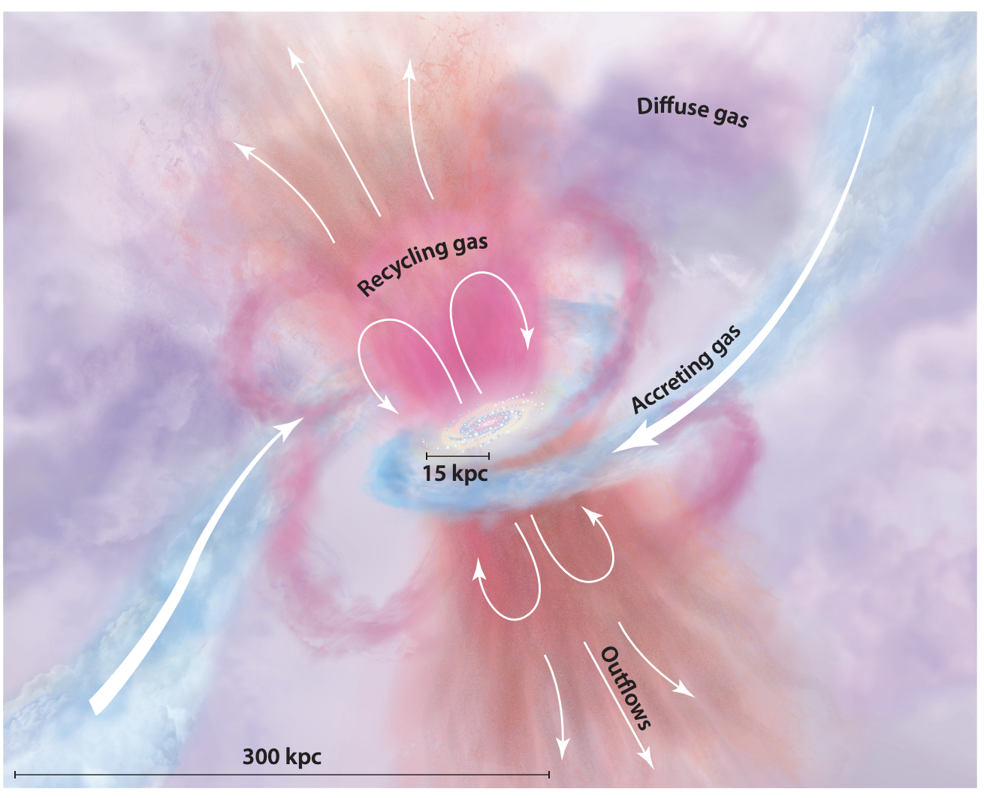

Baryon cycle
OUTFLOWS
RECYCLING
GAS
ACCRETING
GAS
El-Badry et al. 2018
Tumlinson, Peeples & Werk 2017

Slide 4
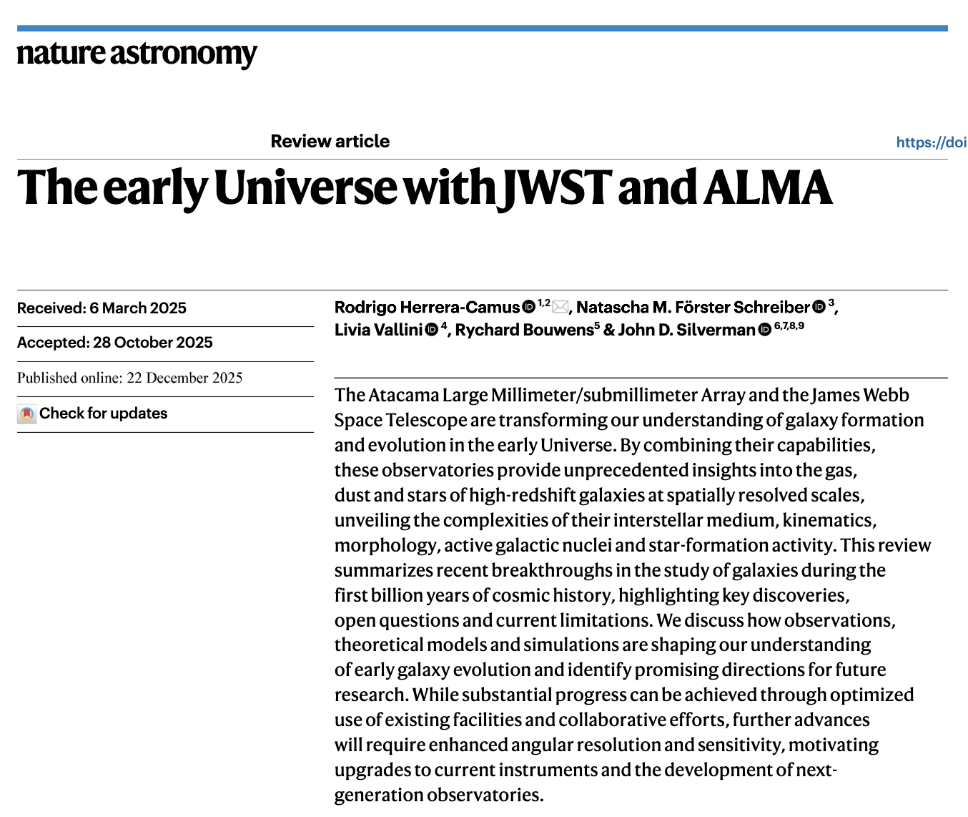
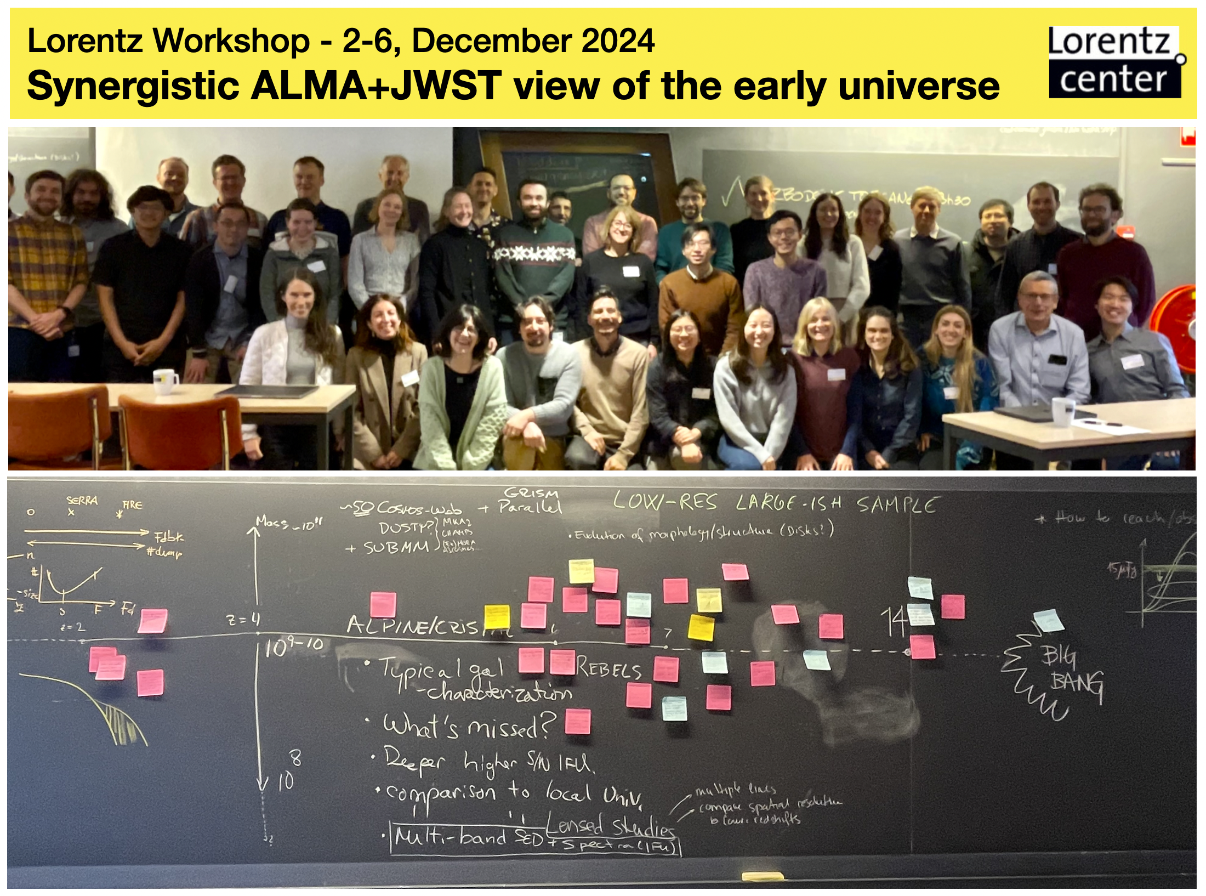

Slide 5
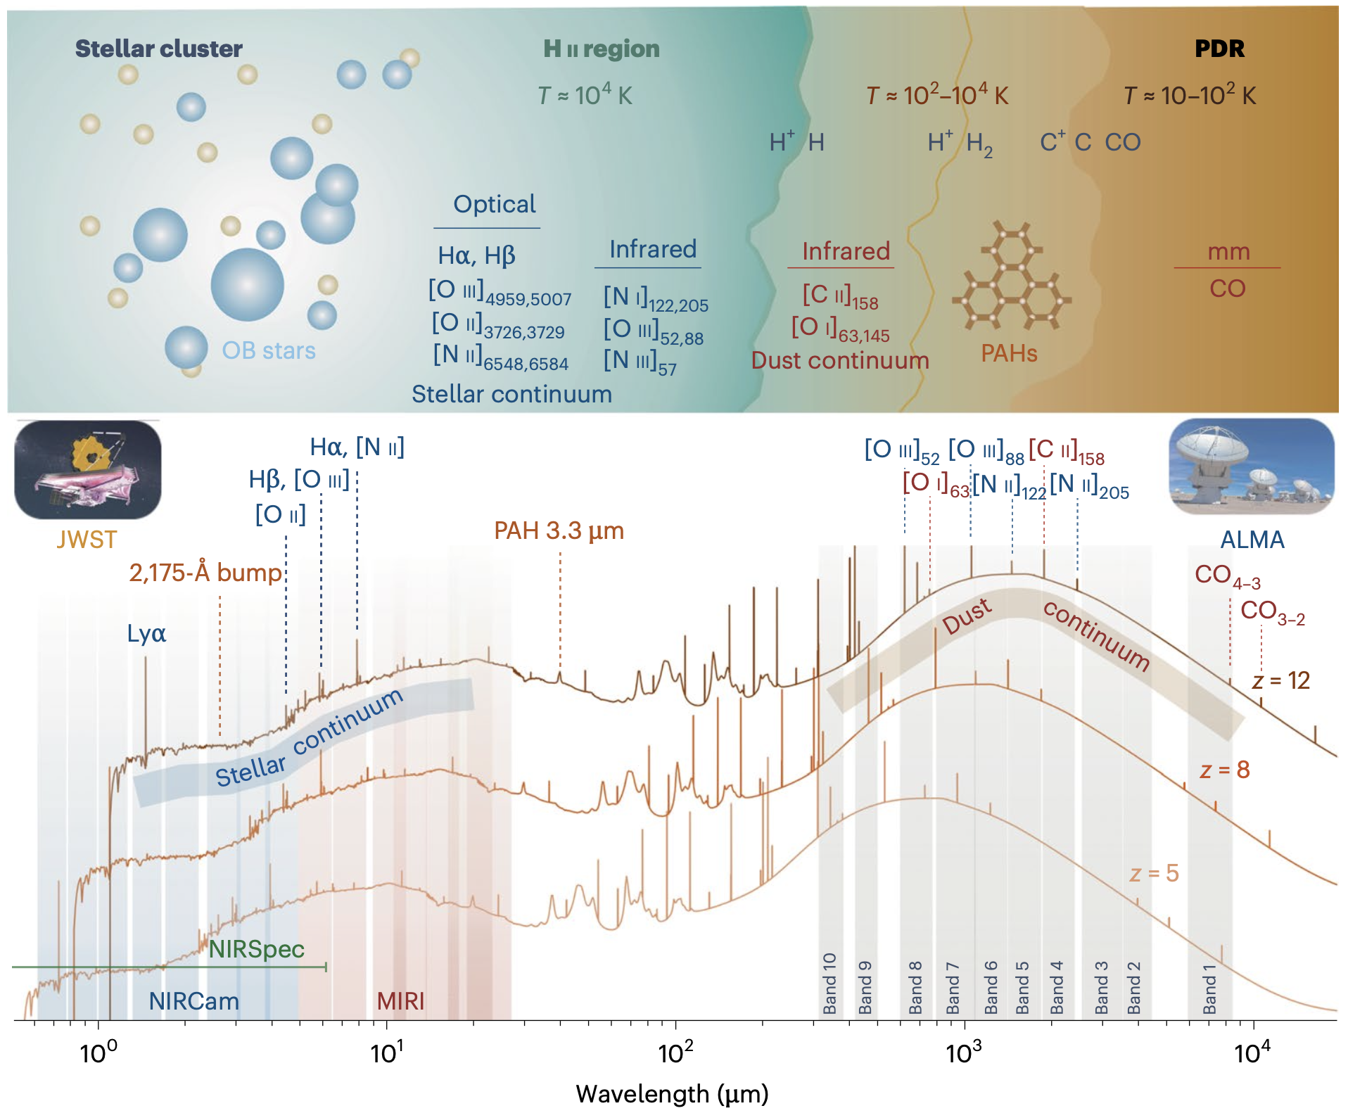
Herrera-Camus+25a
Nat. Astro. Review

Slide 6
Herrera-Camus+25a
Nat. Astro. Review

Slide 7
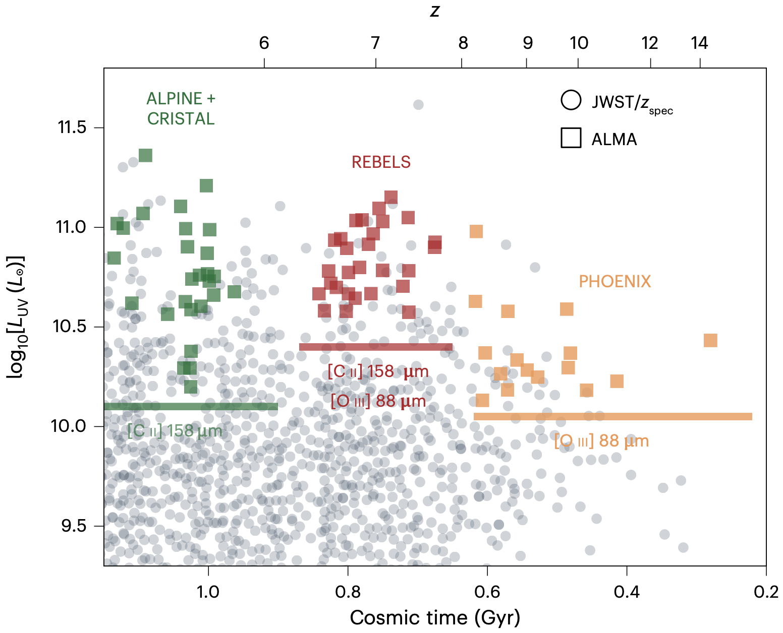
The first ~1 Gyr of the Universe…
Herrera-Camus+25a
Nat. Astro. Review

Slide 8
Key discoveries (ISM):
Surprisingly metal enriched (≈0.1-0.2Z⦿) systems only 300 Myr after Big-Bang
Unexpectedly high N/O ratios
Substantial dust reservoirs: PAHs at z≈5 and 2175 Å bump at z≈7
Electron densities significantly higher than at z≈0
Bright, z≳10 galaxies: very low dust attenuation (outflows)
Herrera-Camus+25a
Nat. Astro. Review

Slide 9
Key discoveries (ISM):
Surprisingly metal enriched (≈0.1-0.2Z⦿) systems only 300 Myr after Big-Bang
Unexpectedly high N/O ratios
Substantial dust reservoirs: PAHs at z≈5 and 2175 Å bump at z≈7
Electron densities significantly higher than at z≈0
Bright, z≳10 galaxies: very low dust attenuation (outflows)
Herrera-Camus+25a
Nat. Astro. Review

Slide 10
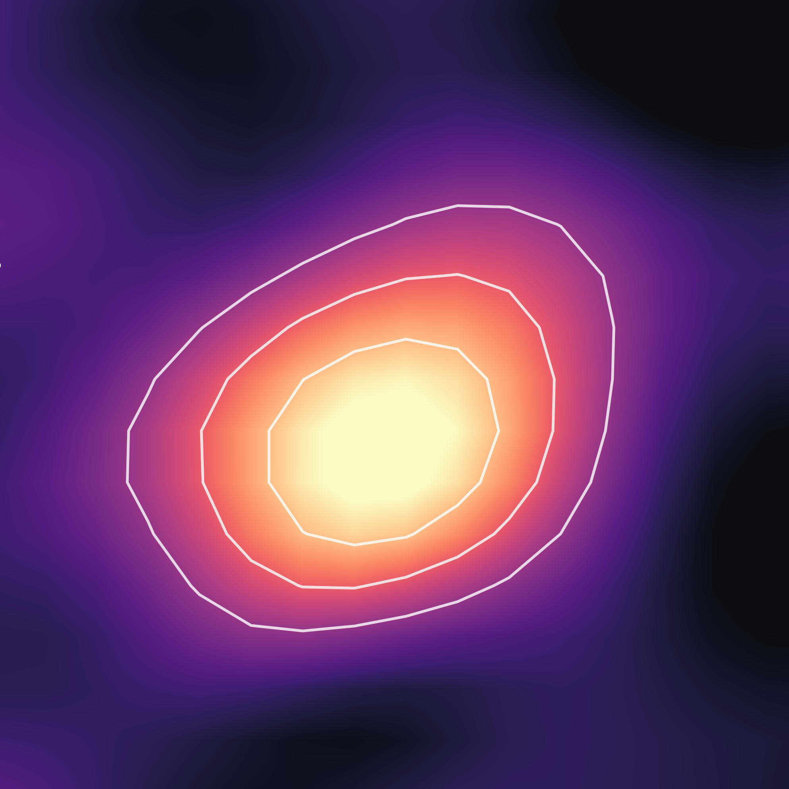
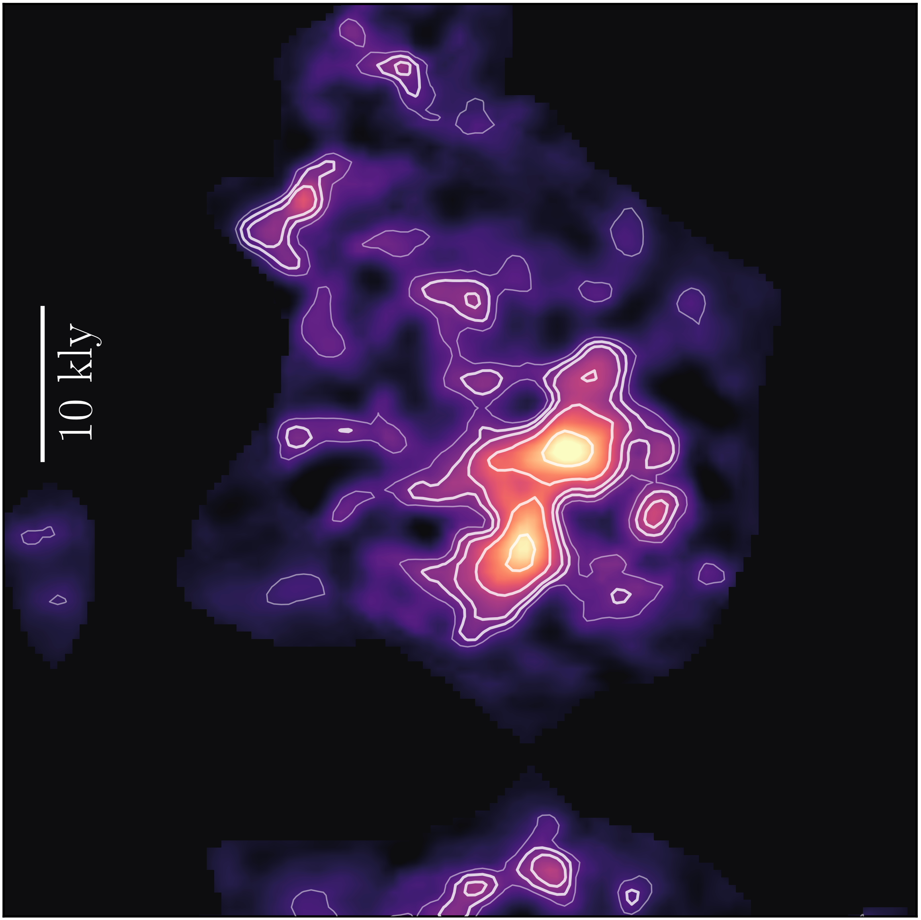
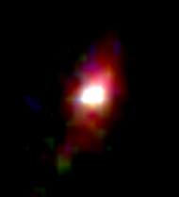

Stars
Cold Gas
Stars
Cold Gas
3 kpc
10,000
light-years
James Webb Space Telescope
ALMA
James Webb Space Telescope
ALMA +
[CII] 158 µm
Le Fèvre et al. 2020
Bethermin et al. 2020
Faisst et al. 2020

Slide 11

Stars
Cold Gas
Stars
Cold Gas
Cold Gas
3 kpc
10,000
light-years
James Webb Space Telescope
ALMA
James Webb Space Telescope
ALMA +
[CII] 158 µm
Survey paper:
Herrera-Camus et al. 2025b

Slide 12
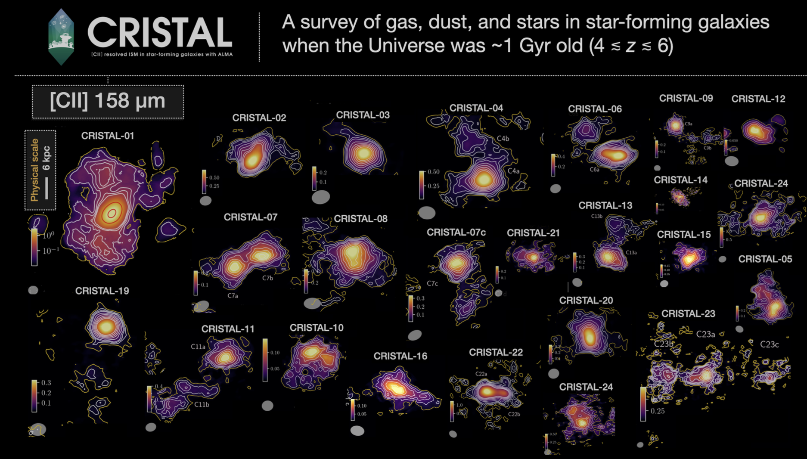
Herrera-Camus et al. 2025
Based on the successful ALPINE ALMA LP (Le Fevre et al. 2020)
Herrera-Camus et al. 2025b

Slide 13
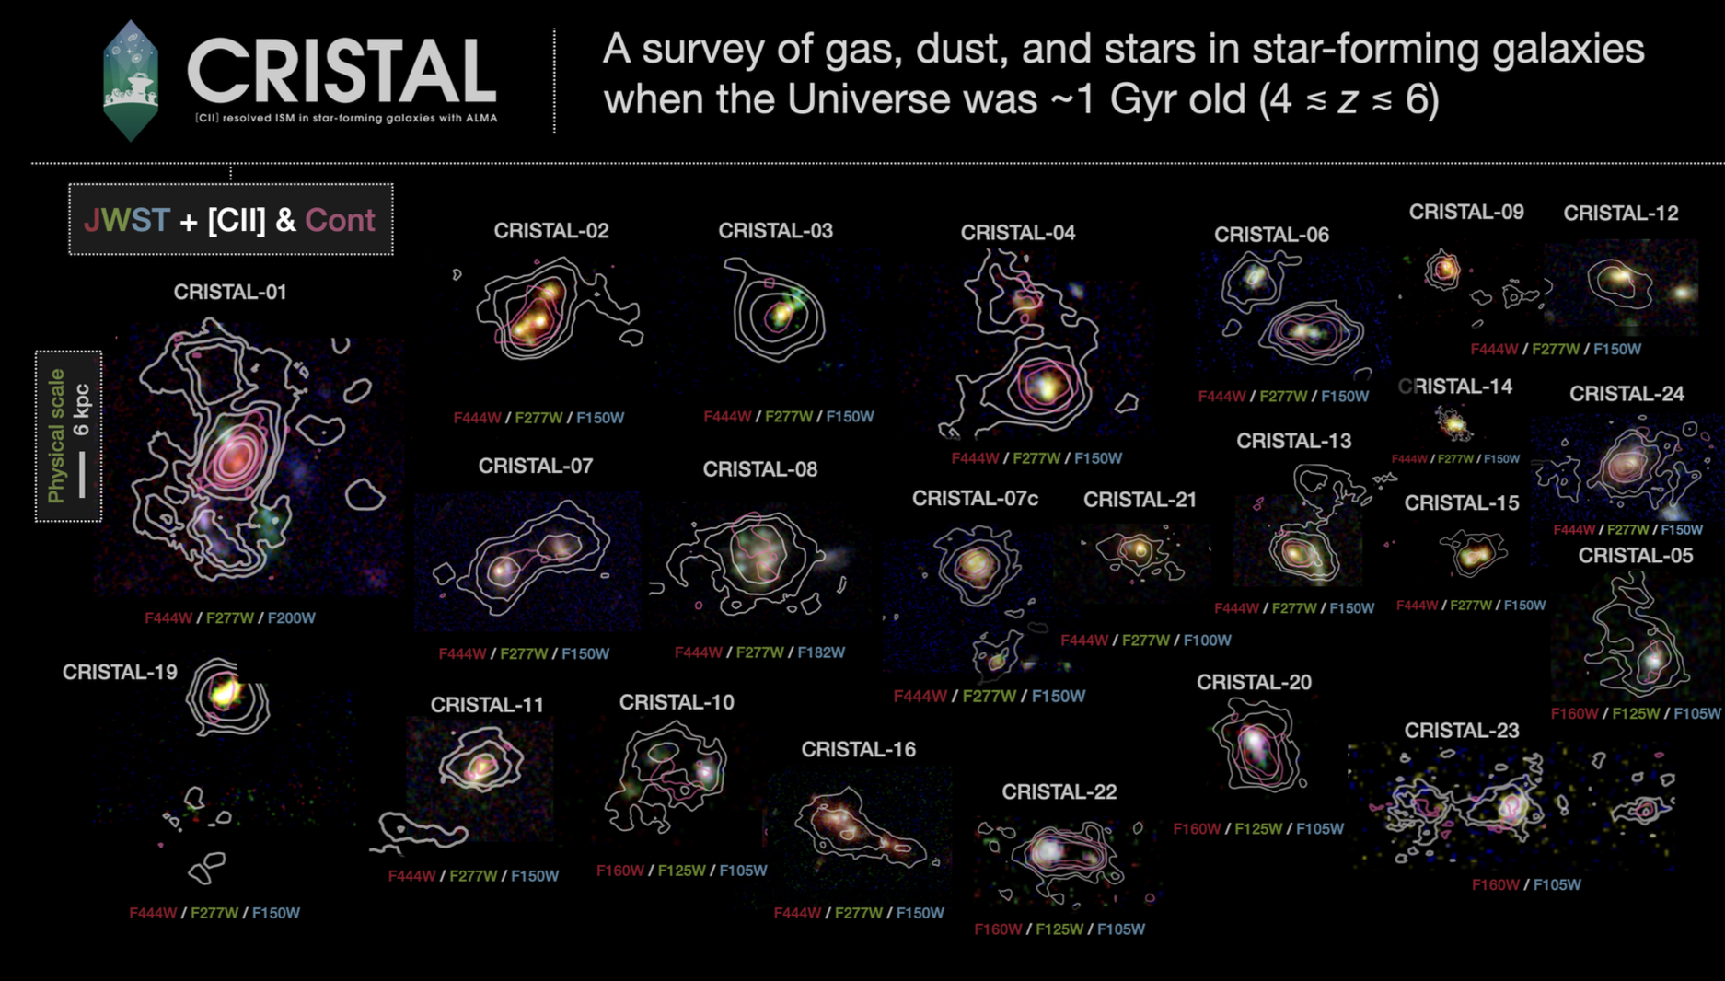
Herrera-Camus et al. 2025b

Slide 14
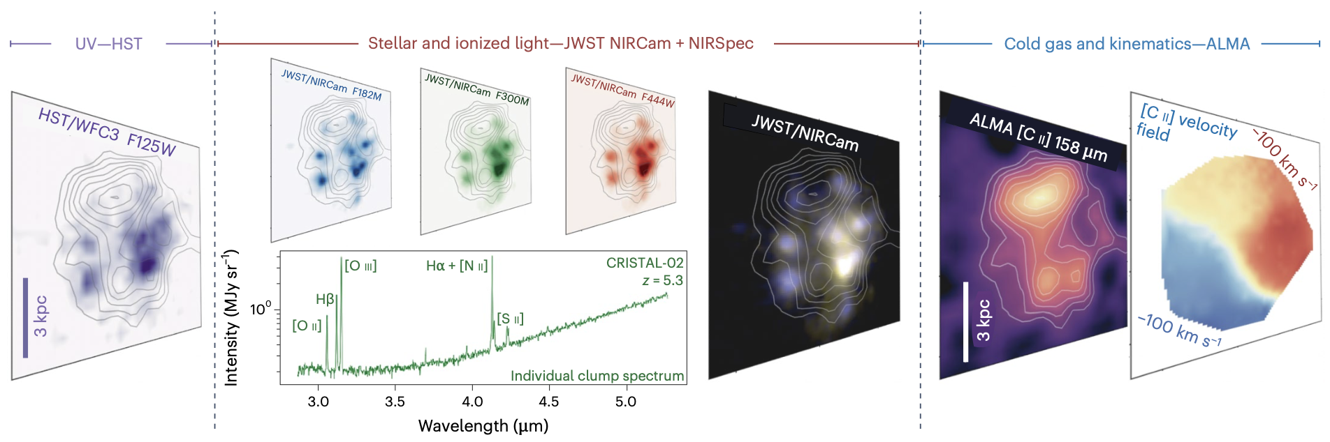
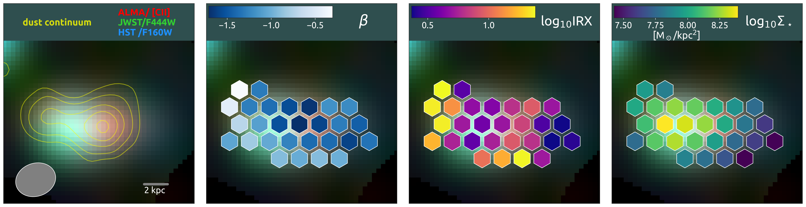

ALMA+JWST: Resolved (≲kpc) ISM properties of early galaxies
Herrera-Camus+25a
Nat. Astro. Review
Li, da Cunha+24
UV slope
IRX = LFIR/LUV
Stellar mass
Public Database:
~1,000 independent regions: metallicities, dust continuum, SED model,
[CII] and optical lines, etc
+
Daizhong Liu
Purple Mountain Observatory
Baeza-Garay, RHC,+ (in prep)

Slide 15

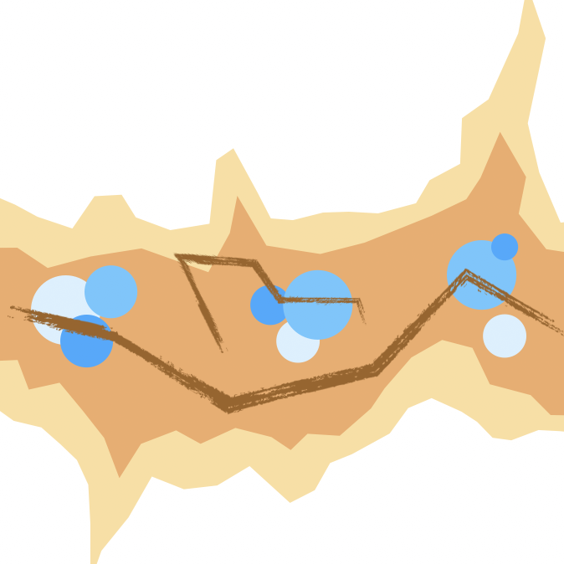
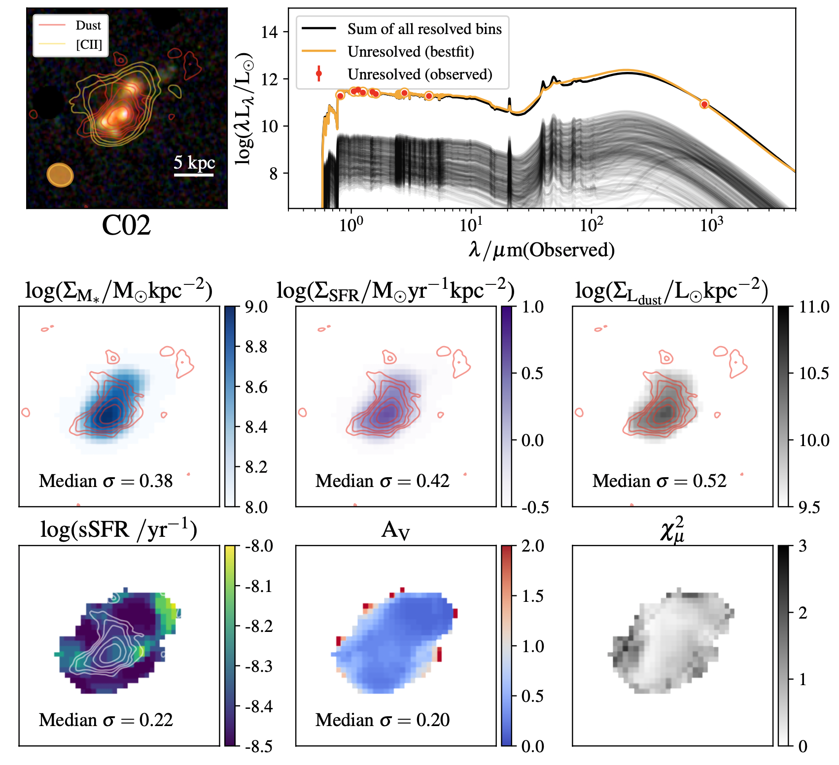

SED modelling
ALMA dust continuum 160 µm
Spatially resolved SED modeling using MAGPHYS
Li, da Cunha, CRISTAL collaboration et al. 2025
*MsC Astrophysics (HKU)

Slide 16
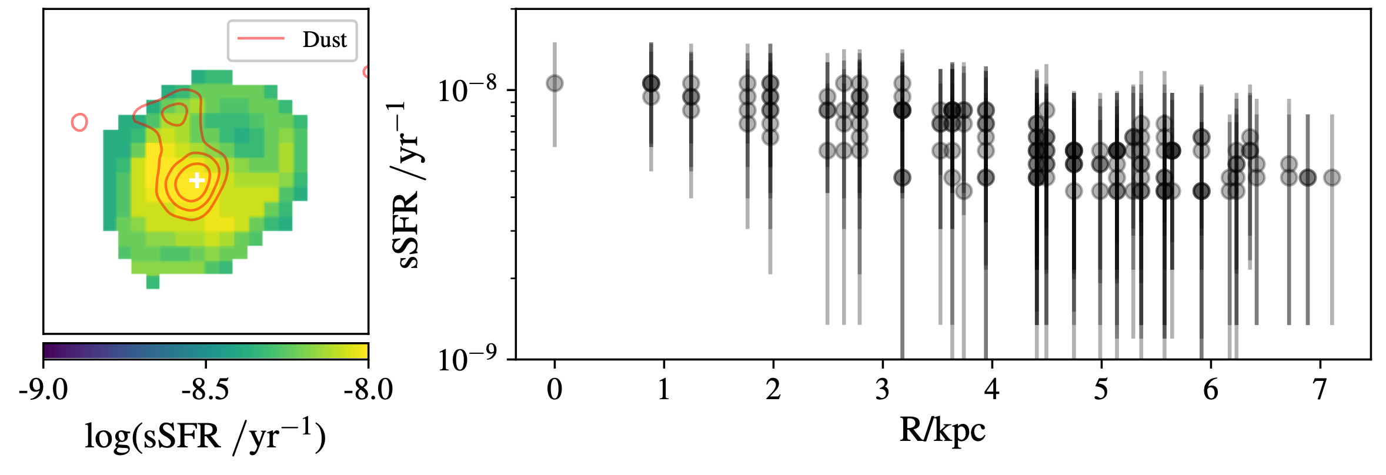

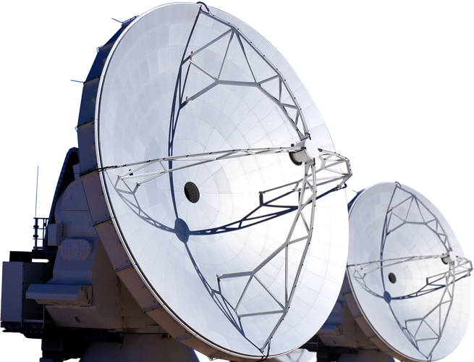
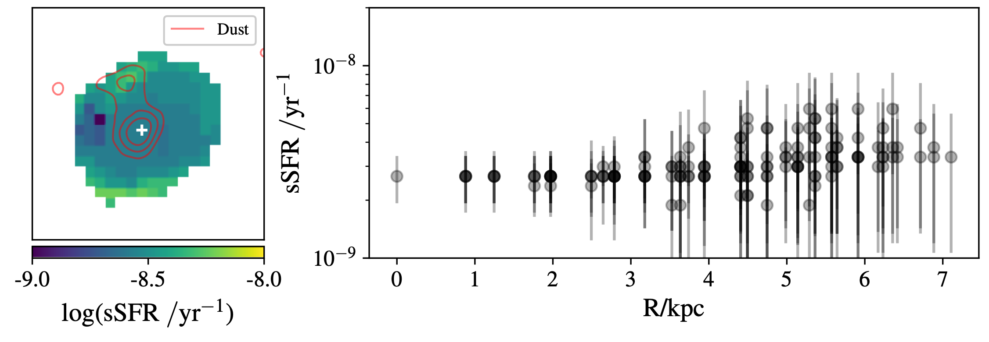
SED modelling
Dust continuum
✅
Dust continuum
Inclusion of dust (ALMA): break the age-dust degeneracy
Li et al. 2025
Li et al. 2025

Slide 17
The Dynamic, Multi-Phase Nature of Typical Early Galaxies
What is the fraction of regular rotating disk and interacting systems? What is the fraction of DM within these systems? How turbulent is the gas?
Kinematics
How much gas and dust there is in these early galaxy systems?
ISM

Slide 18
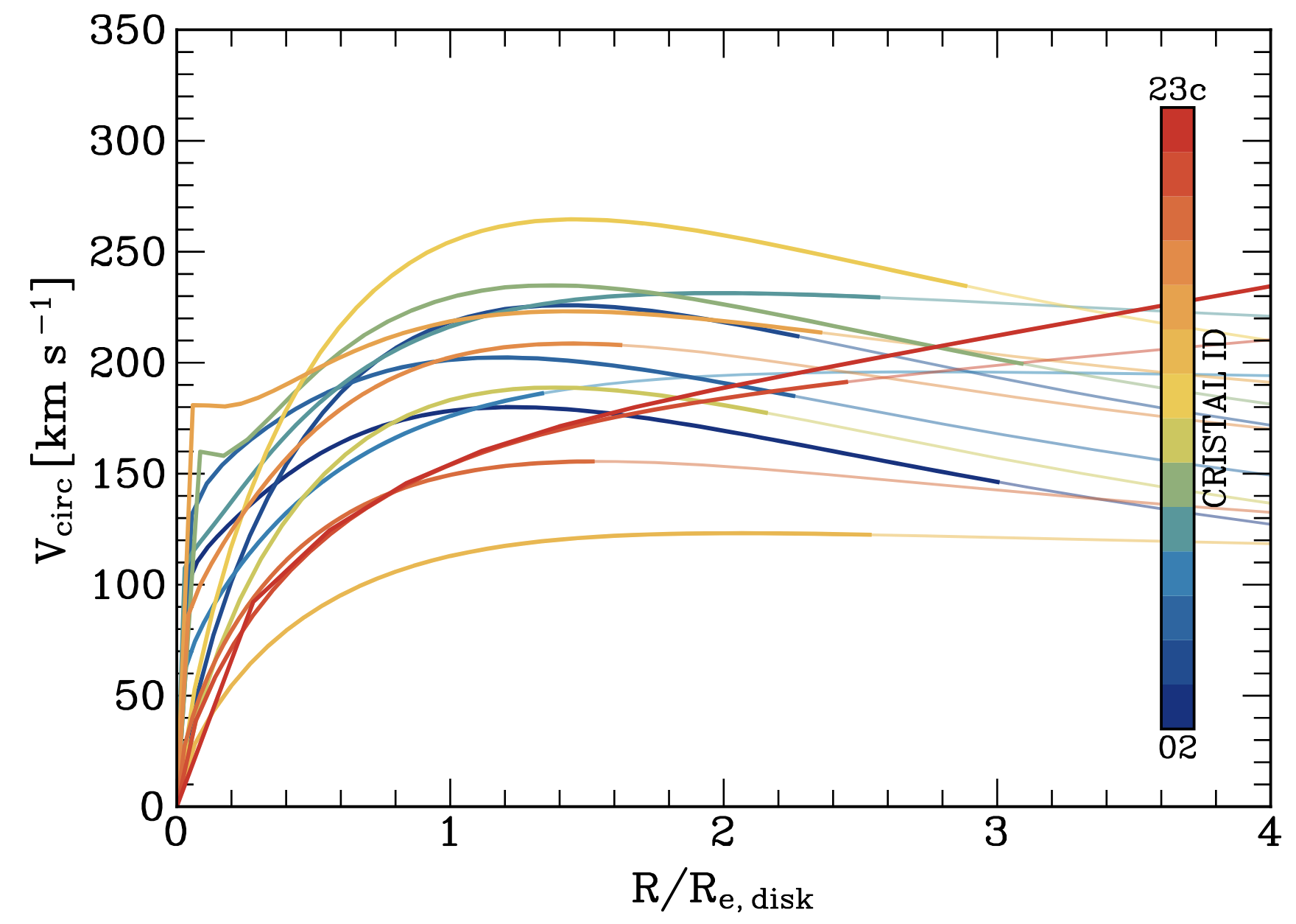

Kinematics + Dark Matter
[CII] Rotation curves
Rotating
disks
Disks in
multiple
systems
Non disks
Low dark matter fractions
<fDM(Re)> ≈ 20% [5,60]%
*extra slide
Consisten with early JWST results
(Ferreira et al. 2023, Kartaltepe et al. 2023)
Lee, Förster Schreiber, RHC et al. 2025
*MsC Astrophysics (HKU)

Slide 19
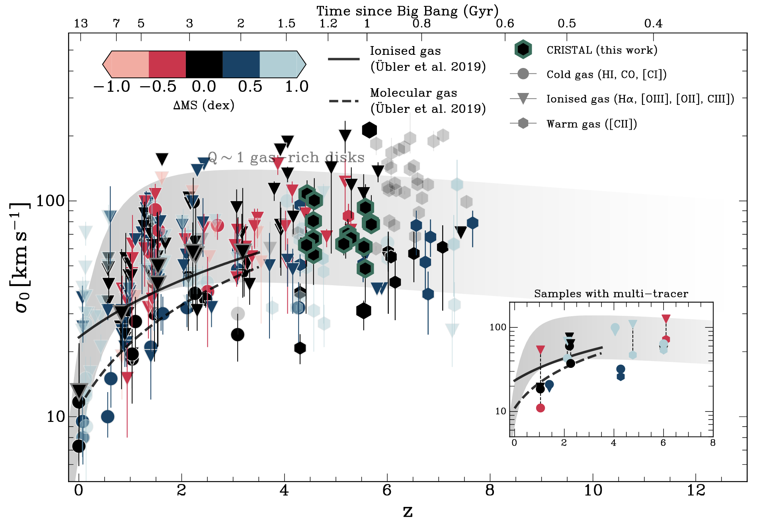
Kinematics
High-z galaxies are more turbulent than nearby disks
✦ SF feedback not enough. Radial transport: main driver
ISM Turbulence
Lee, Förster Schreiber, RHC
et al. 2025

Slide 20
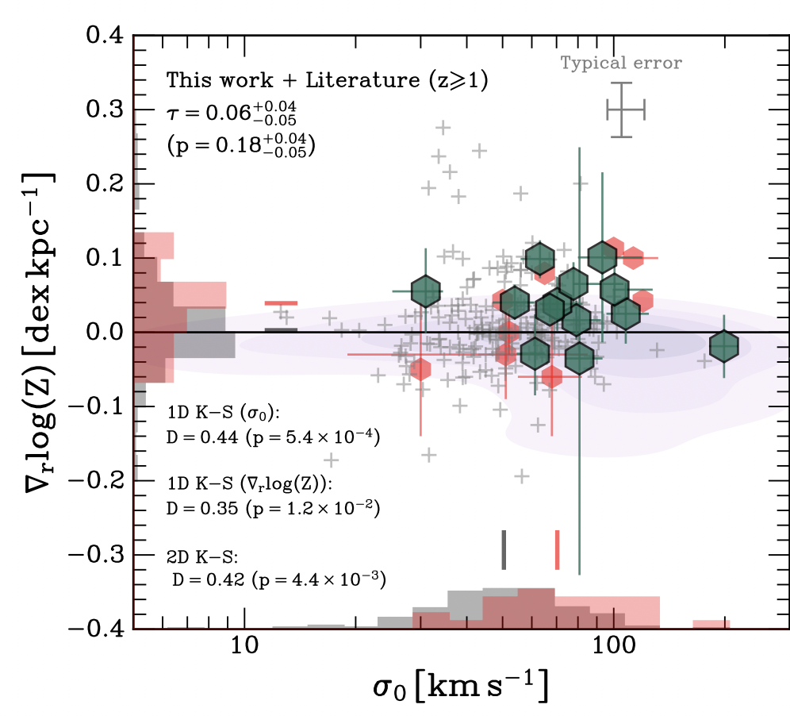
Kinematics +
ISM
Metallicity gradient (▽log(Z)) vs turbulence (σ0)
Positive
Flat/positive▽log(Z):
(1) accretion of metal-poor gas to the inner kpc
Flat
(2) galactic outflow that remove gas from the center and redistribute it (*extra slides)
Negative
(e.g. massive nearby galaxies)
Lee, Förster Schreiber, RHC
et al. submitted

Slide 21
The Dynamic, Multi-Phase Nature of Typical Early Galaxies
What is the fraction of regular rotating disk and interacting systems? What is the fraction of DM within these systems? How turbulent is the gas?
Kinematics
How much gas and dust there is in these early galaxy systems?
ISM

Slide 22
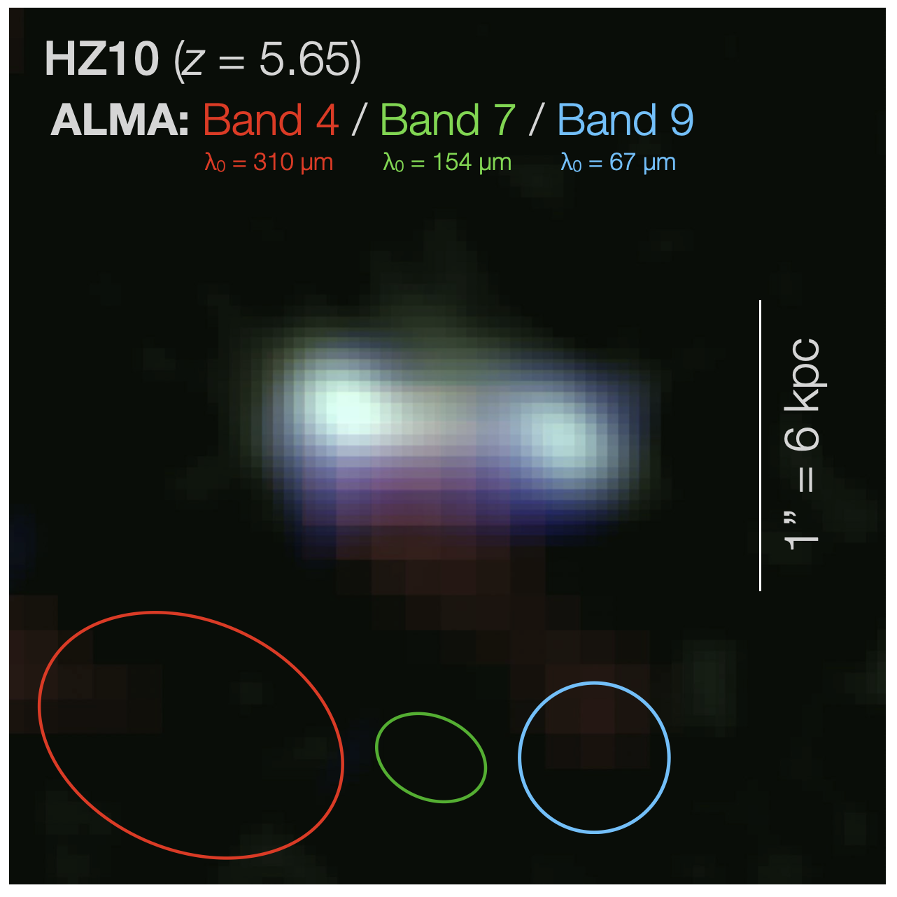
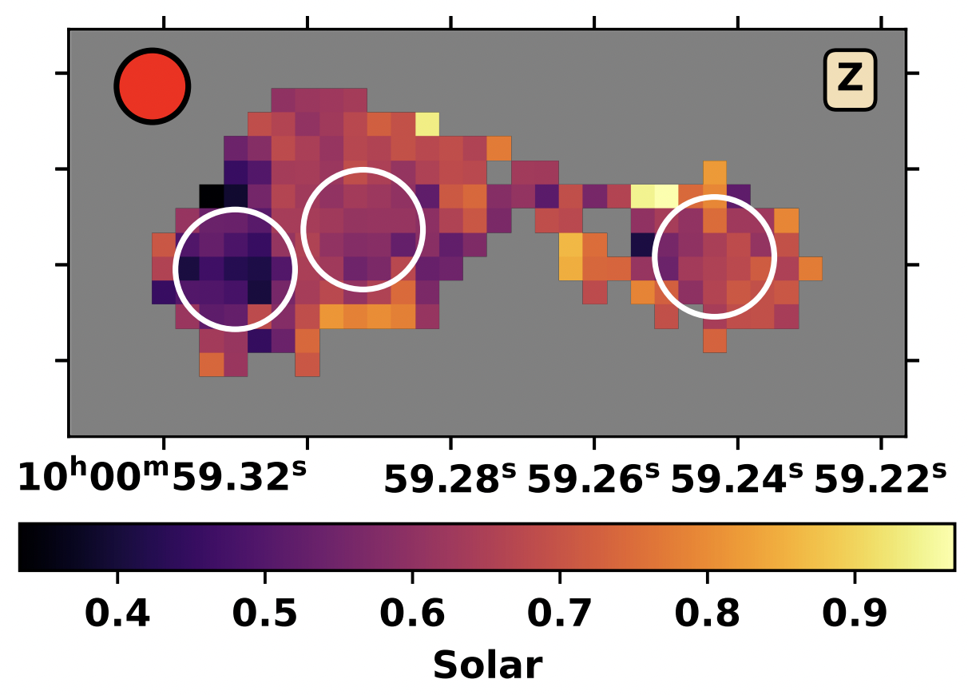
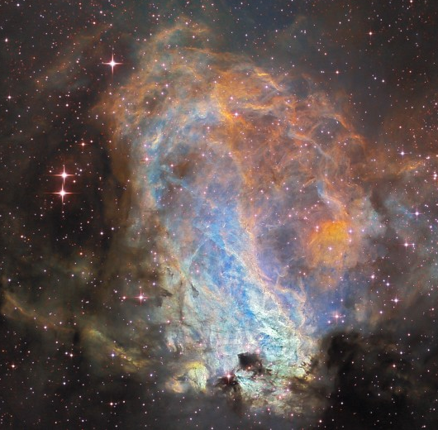
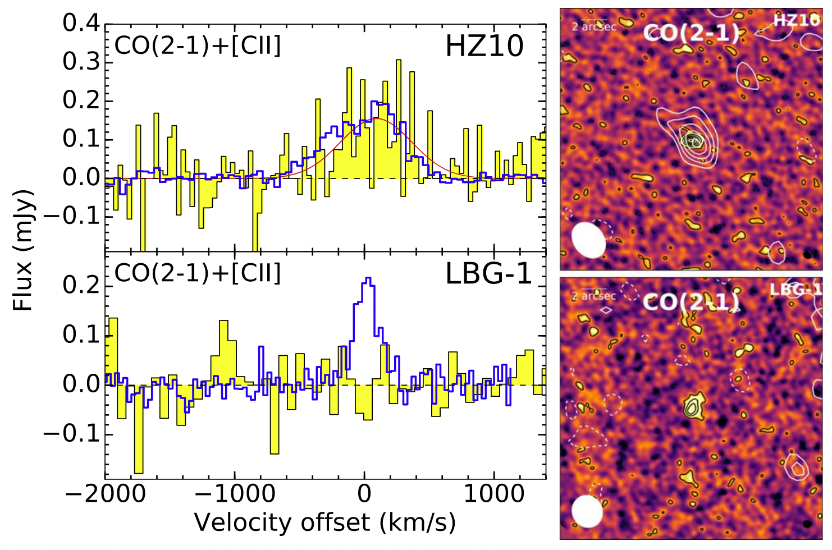
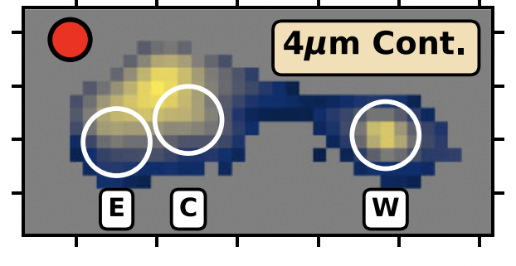
Interstellar Medium
The beautiful case of HZ10 (z=5.65)
Dust: Multi-band ALMA cont.
Metallicity: NIRSpec
+Band10 (2025)
Jones et al. 2025
Dust
Metals
Stars
Gas
Molecular gas: JVLA/CO(2-1)
Stellar continuum
Flux (mJy)
Pavesi et al. 2019

Slide 23
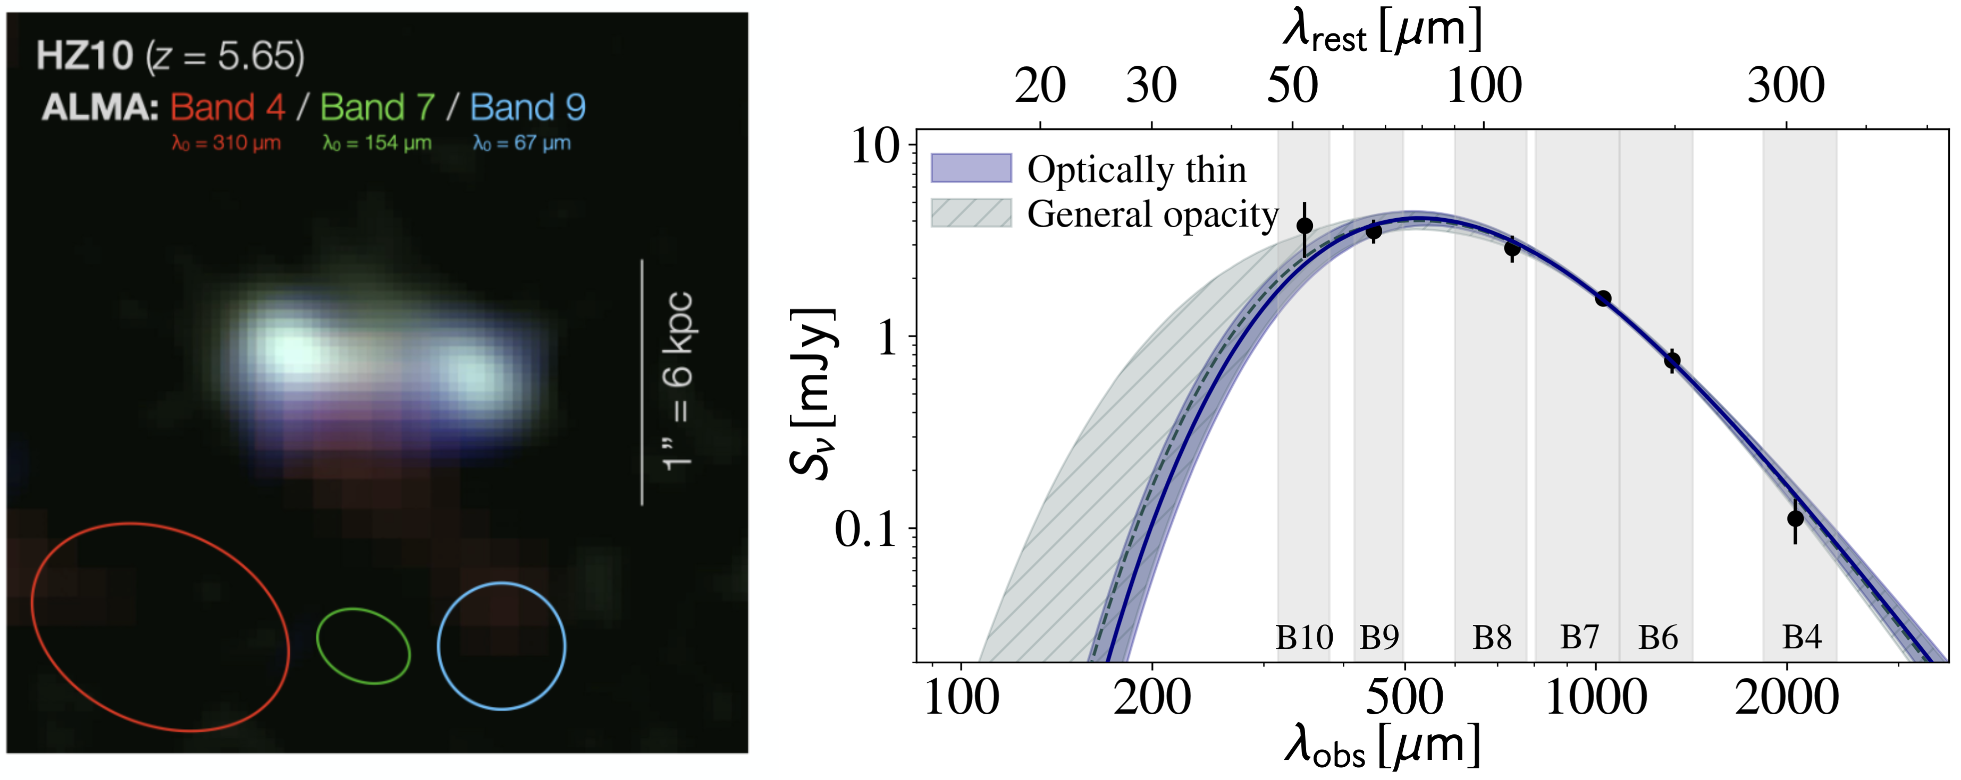


Interstellar Medium
M★ ≈ 10.3
z = 5.65
ISM & stars
Full dust SED from ~50 µm (Band 10) to ~300 µm (Band 4)
Tdust = 33±3 K (thin), Mdust = 10^{8.0±0.1} M⦿
Algera, RHC, et al. arXiv:251202320A
Villanueva, RHC, et al. 2025

Slide 24
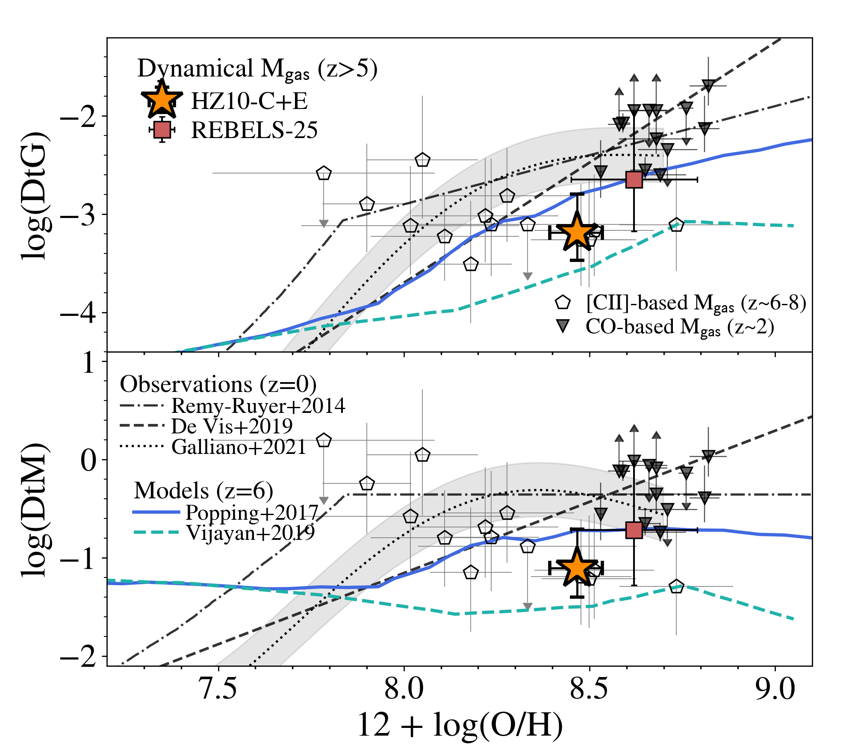
Interstellar Medium
Dust-to-gas ratio
DtG = Mdust/Mgas
(Mgas=Mdyn-M★)
HZ10 falls below the local scaling relation between dust-to-gas ratio and metallicity
Nearby galaxies
Dust-to-metal ratio
DtM = DtG/Z
Suggest a delayed build-up of dust, potentially due to inefficient ISM dust growth.
Nearby galaxies
Algera, RHC, et al. arXiv:251202320A

Slide 25
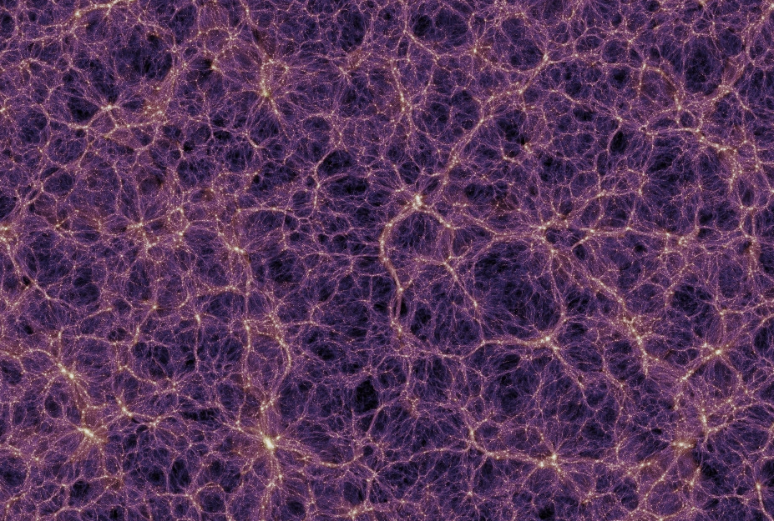

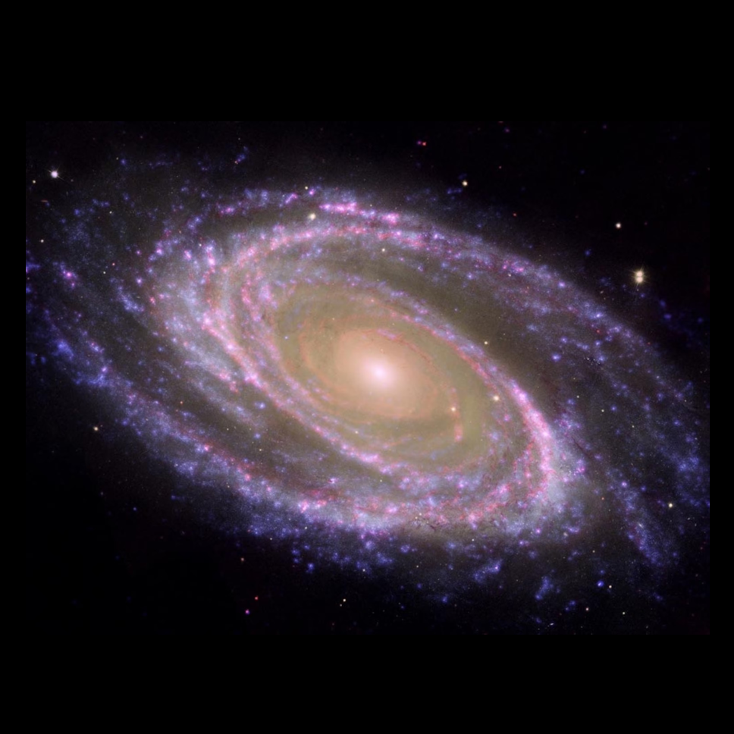

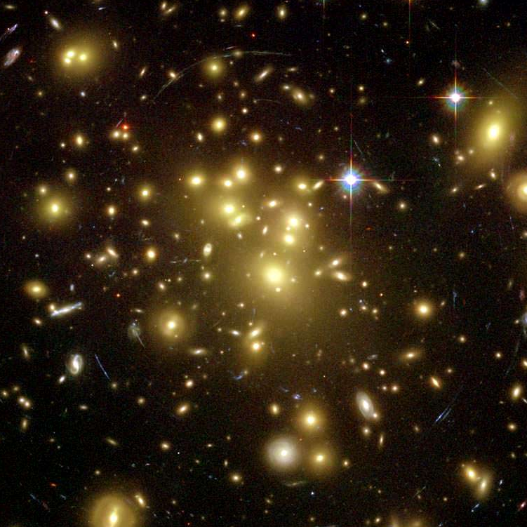

China-Chile Bilateral Conference for Astronomy
Nature
Rodrigo
Herrera-Camus
Manuel
Aravena
Internal
processes
Prof. Cheng Cheng
FAST/HI in
Clusters of galaxies
Lucia
Guaita
(19/20 - CAS-ANID)
Edo
Ibar
Nurture
Millennium Nucleus for Galaxies
AI tools
environment
Yara
Jaffé
4MOST/CHANCES
Guille
Cabrera
Rory
Smith

Slide 26
Extra slides

Slide 27
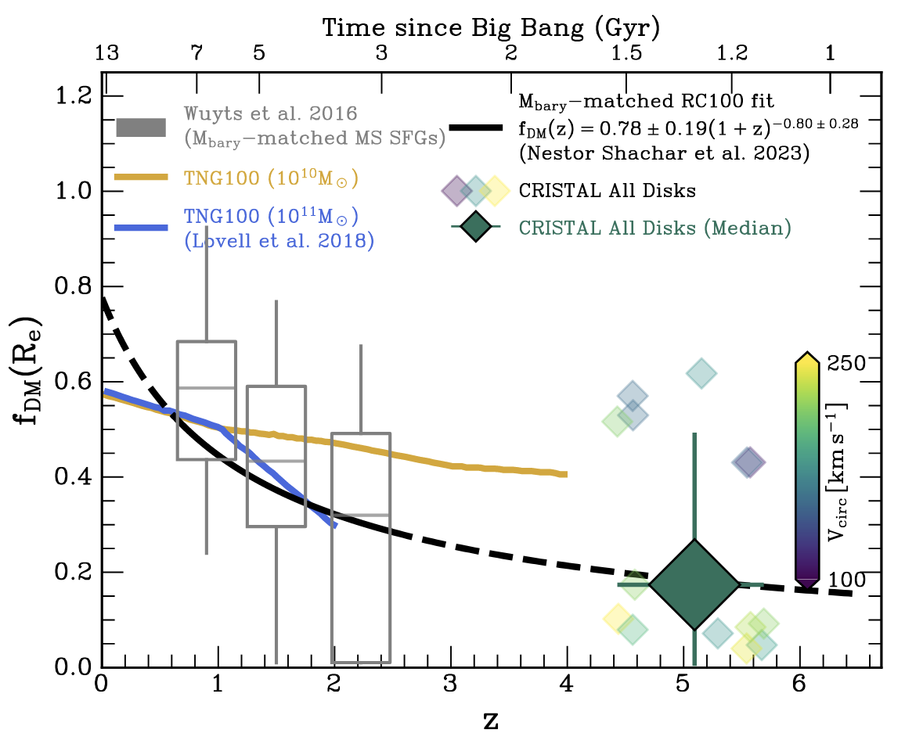
Kinematics: Observations
Typical, star-forming galaxies (4 ≲ z ≲ 6)
Dark matter fraction
Low dark matter fractions
<fDM(Re)> ≈ 20% [5,60]%
Broad agreement with the extrapolated trend based on studies of lower redshifts
Lee et al. 2025a

Slide 28
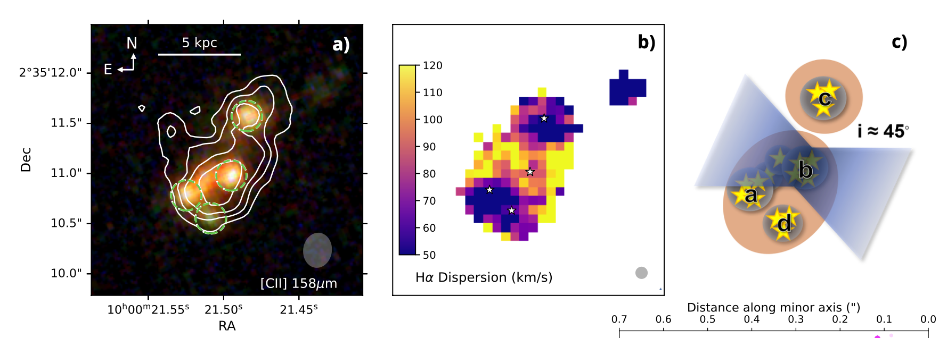

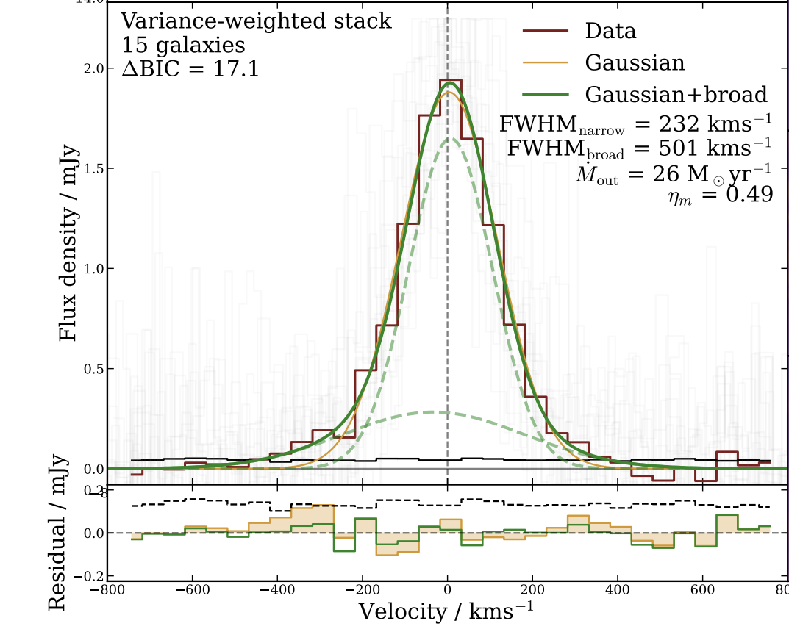
Davies, Fisher, Herrera-Camus et al. submitted
Multi-phase
(cold+warm)
outflow
Outflows
[CII] stacking:
Outflow of cold gas
vout~300 km/s and ηcold≈0.5±0.2
Birkin, Spilker, Herrera-Camus et al. 2025

Slide 29
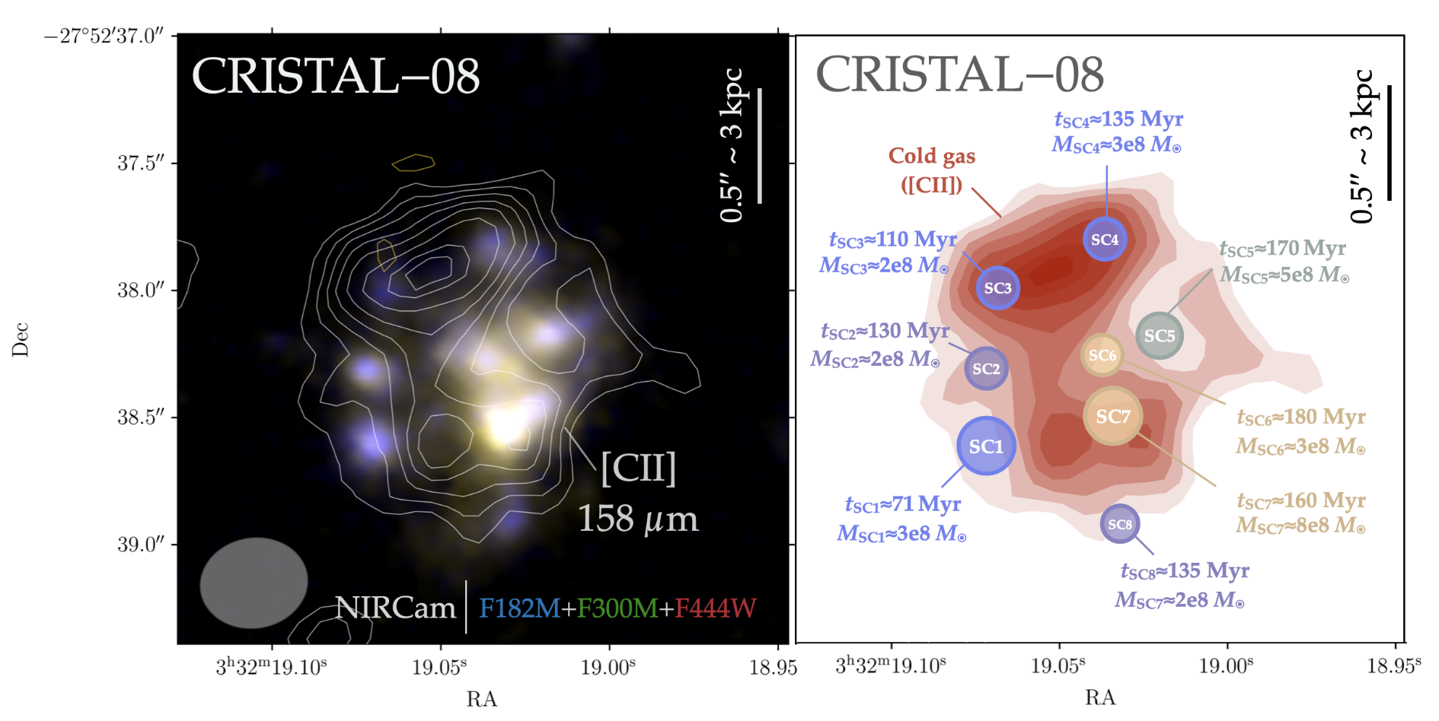
Outflows
z = 4.4
Herrera-Camus et al. In prep.

Slide 30
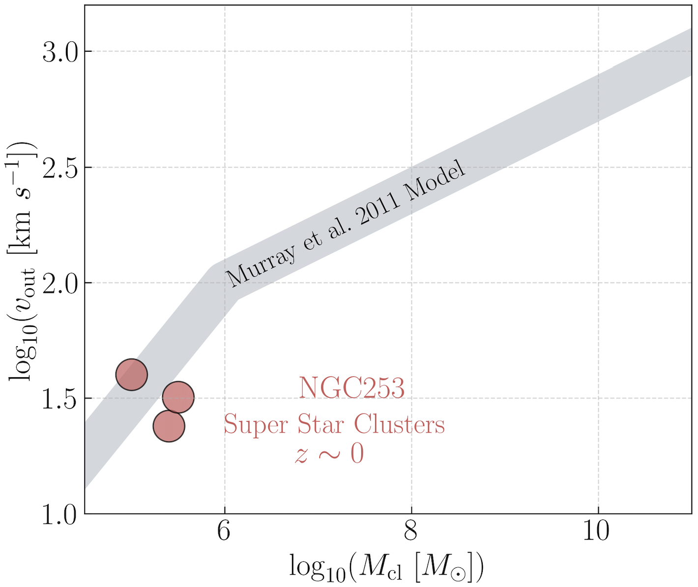
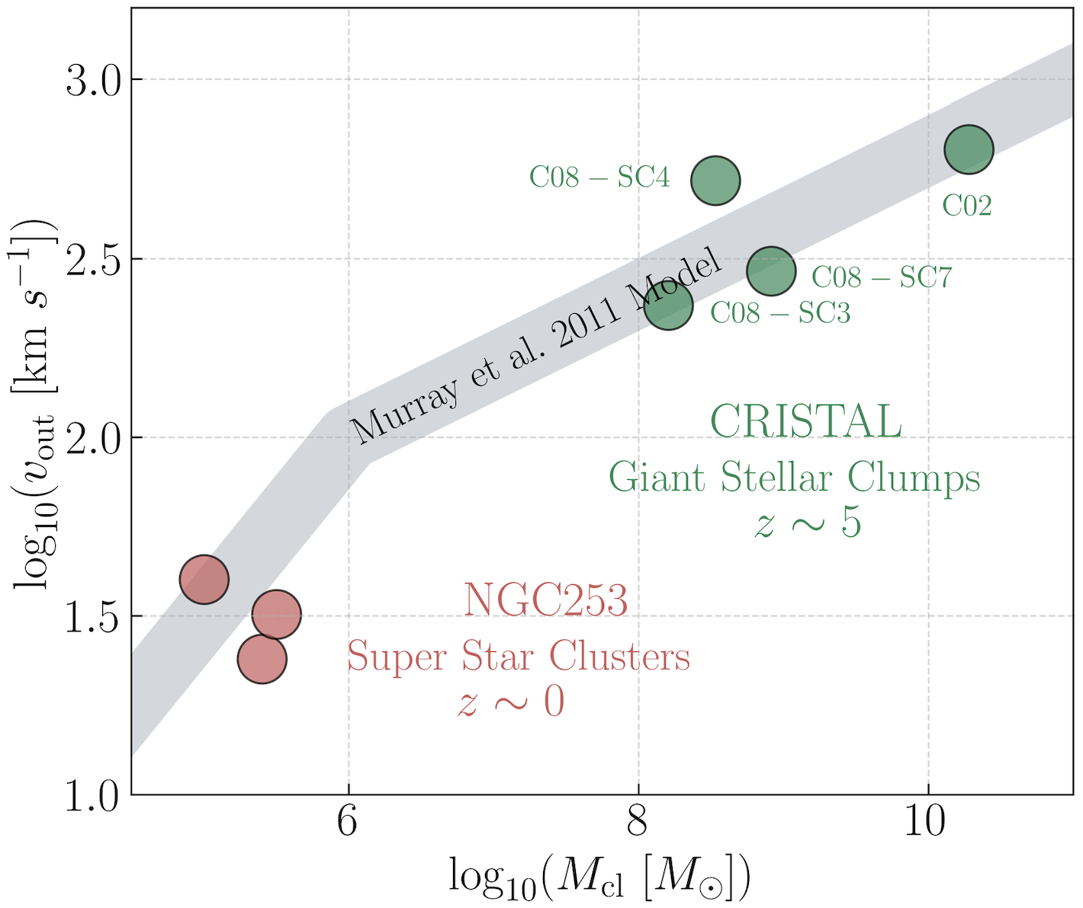
Outflows
Cold gas outflows
Radiative pressure
(Levy et al. 2022)
texpulsion ≲ tdepletion ~ tage
What is the fate of these clumps?
~30-60 Myr
~100-500 Myr
Herrera-Camus et al. In prep.

Slide 31
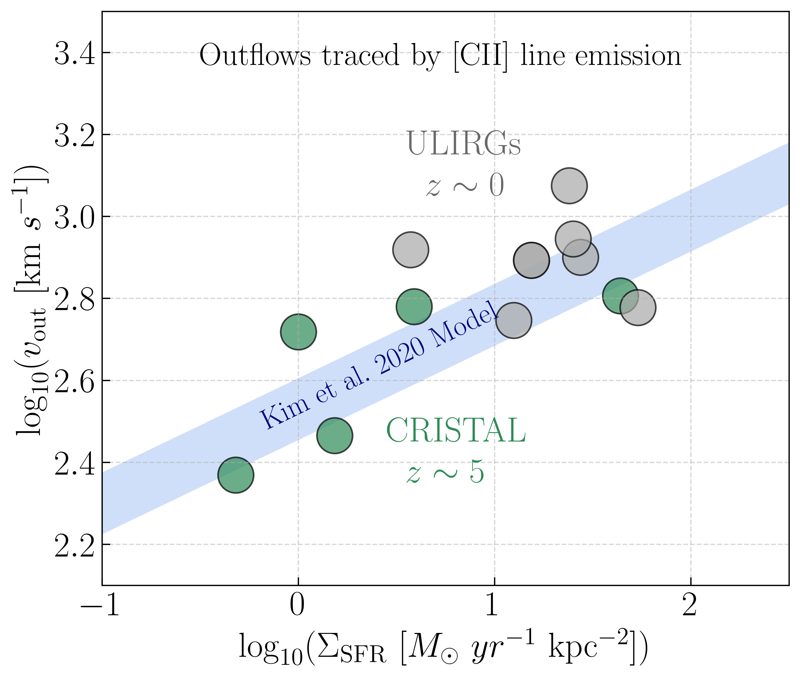


Outflows
Cold gas outflows
Stacking of CO(1-0) spectra from CARMA-EDGE nearby main-sequence galaxies
J. Martínez (PhD, UdeC)

