Slide 1
Pulsar Science at the Xinjiang Astronomical Observatory: Progress and Prospects
Wenming Yan (XAO)
Hong Kong
2026/01/06

Slide 2
Outline
Introduction to the XAO Pulsar Group
Group Members and Expertise
Key Research Areas
Major Research Highlights
Future Prospects with the QTT Telescope
Summary

Slide 3
Outline
Introduction to the XAO Pulsar Group
Group Members and Expertise
Key Research Areas
Major Research Highlights
Future Prospects with the QTT Telescope
Summary

Slide 4
XAO Pulsar Group
The Xinjiang Astronomical Observatory is the first institution in China to carry out research on pulsar observations.
Relying on the Nanshan 26-meter radio telescope, we have accumulated 24 years of observational data so far, with the effective archived data reaching 50,000 hours.
We regularly monitor about 300 pulsars (including more than 10 millisecond pulsars).
We have also successively carried out observations on radio rotating transients, magnetars, spider pulsars and other projects using FAST, Parkes, GMRT, Arecibo, Effelsberg ......

Slide 5
Outline
Introduction to the XAO Pulsar Group
Group Members and Expertise
Key Research Areas
Major Research Highlights
Future Prospects with the QTT Telescope
Summary

Slide 6








Group members — Observational Studies
Na Wang (Nina)
Group leader
Pulsar astronomy
Radio astronomy
Jianping Yuan
Pulsar timing
Wenming Yan
Pulsar searching
Pulsar emission physics
Zhigang Wen
Pulsar emission physics
Jumei Yao
Interstellar scintillation
Feifei Kou
Pulsar emission physics
Shuangqiang Wang
Pulsar emission physics
Pulsar Timing Array
Shengnan Sun
Pulsar emission physics
De Zhao
Pulsar Timing
Pulsar Timing Array

Slide 7

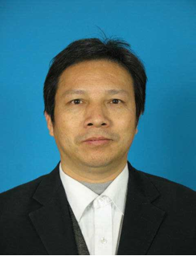


Group members — Theoretical Sciences
Xia Zhou
Director of the XAO
Neutron star physics
Zhifu Gao
Pulsar magnetic field
Rai Yuen
Pulsar emission physics
Abdusattar Kurban
Outburst phenomena associated with compact stars

Slide 8

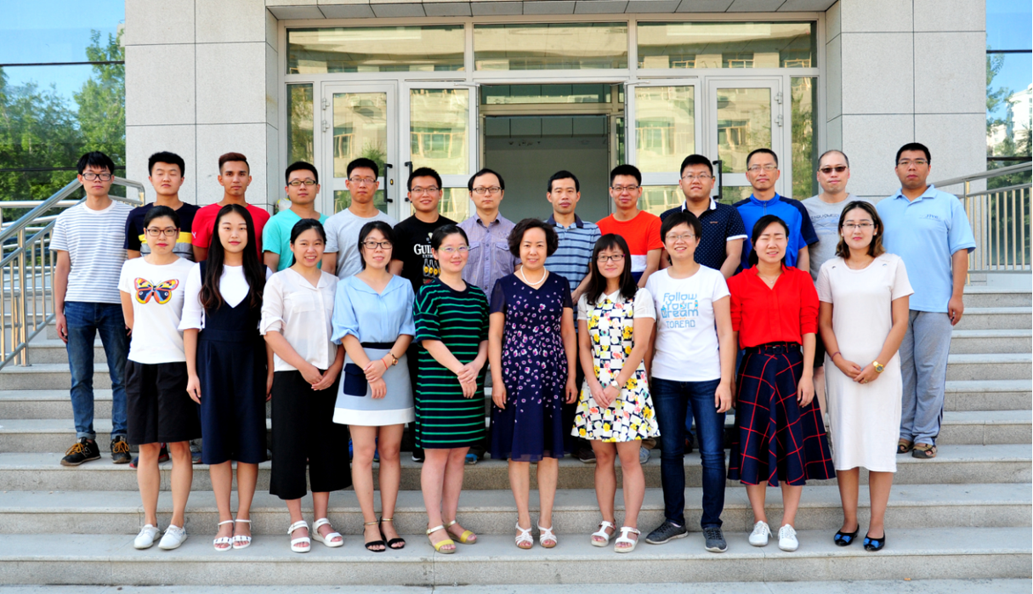
Group members
Weixin Zhou
Research administrator
AND 20+ Students

Slide 9
Outline
Introduction to the XAO Pulsar Group
Group Members and Expertise
Key Research Areas
Major Research Highlights
Future Prospects with the QTT Telescope
Summary

Slide 10
Research areas
Pulsar searching
Pulsar timing and its applications
Pulsar emission physics
Interstellar scintillation
Origin of Fast Radio Bursts
Theoretical study of neutron stars

Slide 11
Outline
Introduction to the XAO Pulsar Group
Group Members and Expertise
Key Research Areas
Major Research Highlights
Future Prospects with the QTT Telescope
Summary

Slide 12
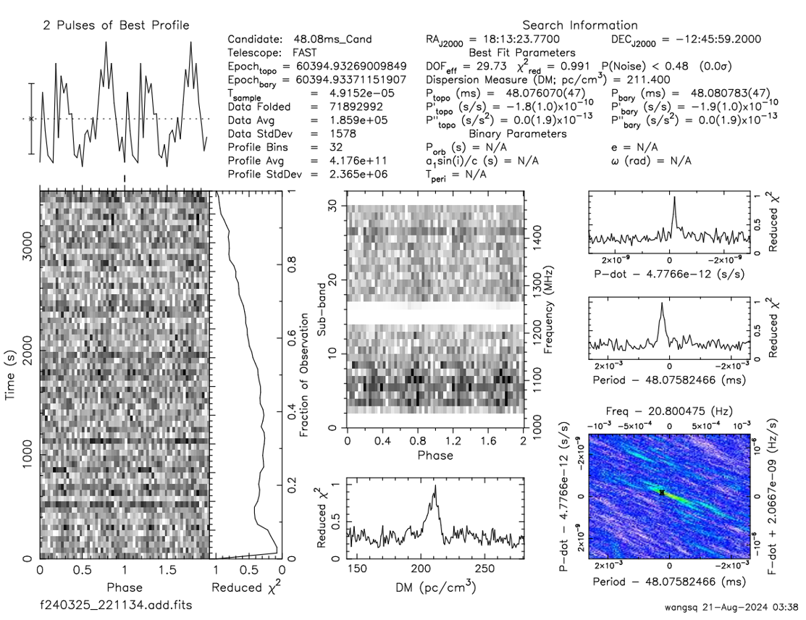
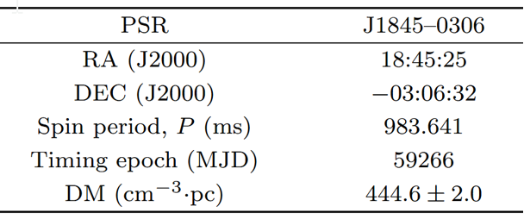
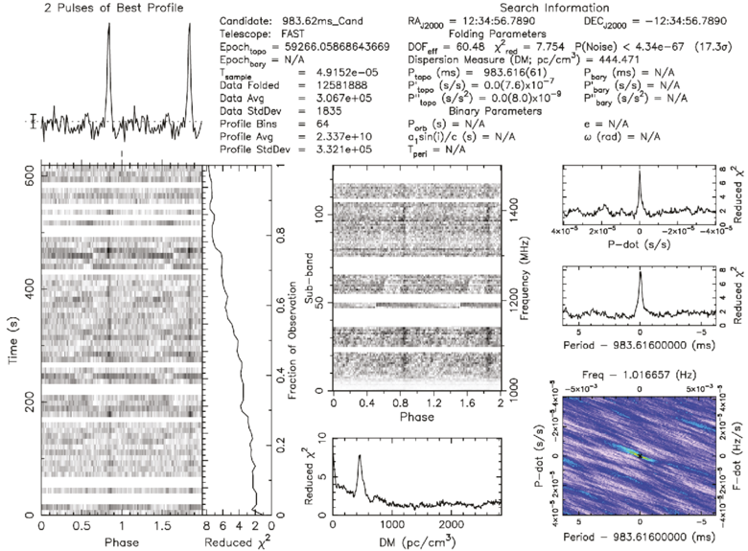
Research Highlights (1): Pulsar searching
Using FAST, a pulsar that might be associated with the supernova remnant G29.6+0.1 was discovered.
Radio pulse signals with a period of 48.08 milliseconds were detected in the gamma-ray pulsar PSR J1813-1246.
Wang et al. 2025, ApJ
Zhang et al. 2024, CPL

Slide 13
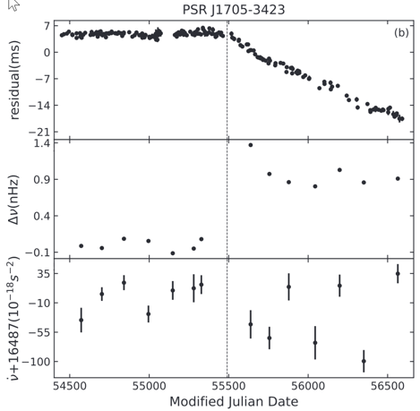
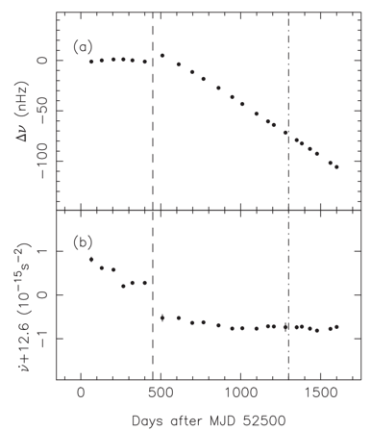
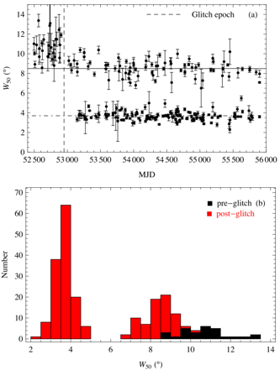
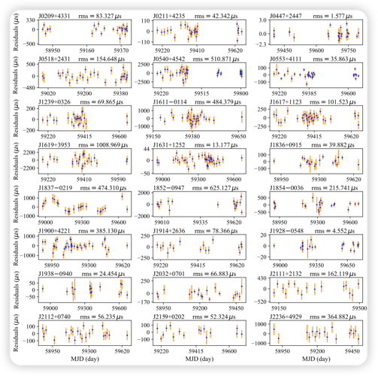
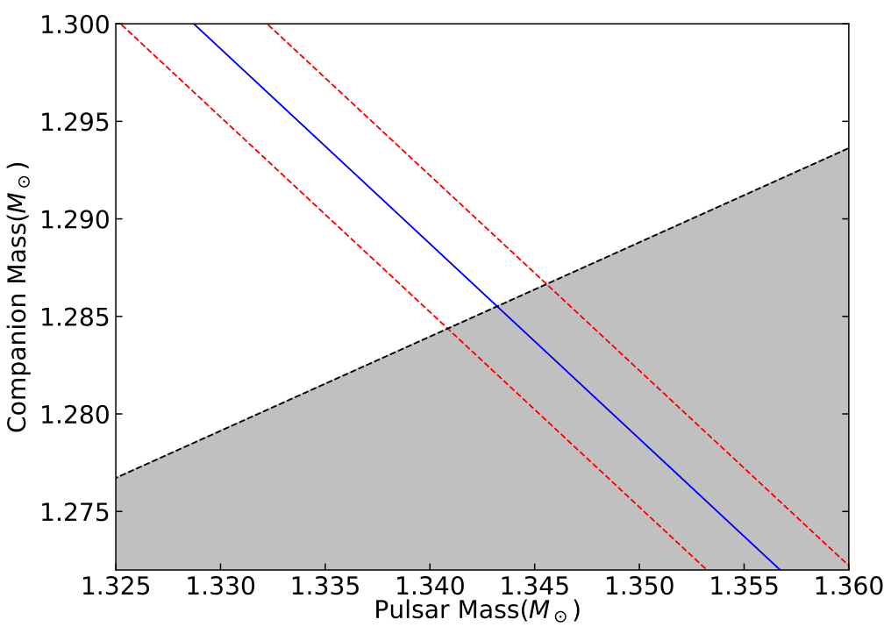
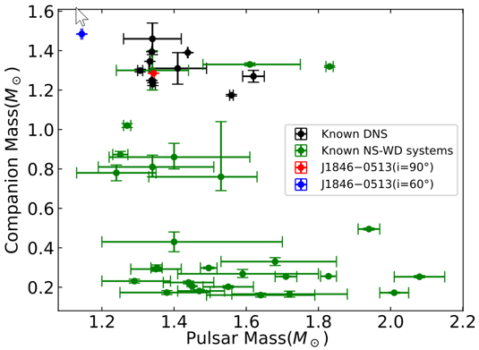
Research Highlights (2): Pulsar Timing
Spin instability: 79 glitch events were detected using the Nanshan telescope (11 papers were published), accounting for 12% of all published glitches
Follow-up timing of FAST discoverered pulsars: phase-connected timg solutions for 65 pulsars have been obtained
Correlation between rotation and radiation: emission modes of PSR B2035+36 changed along with the glitch, and the pulse profile narrowed after the glitch
Double Neutron System: two DNS candidates were discovered
Kou et al. 2018
MNRAS
Zhou et al. 2022, RAA
Wu et al. 2023, MNRAS
Zhao et al. 2024, ApJL

Slide 14
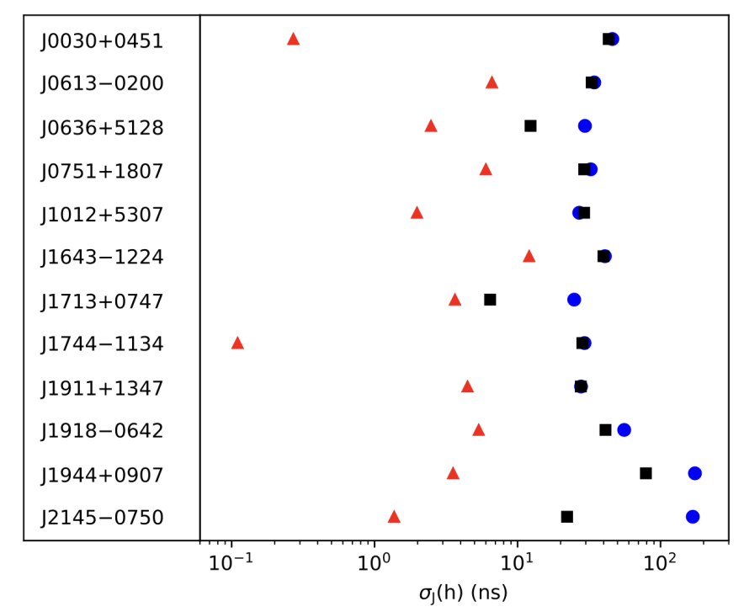
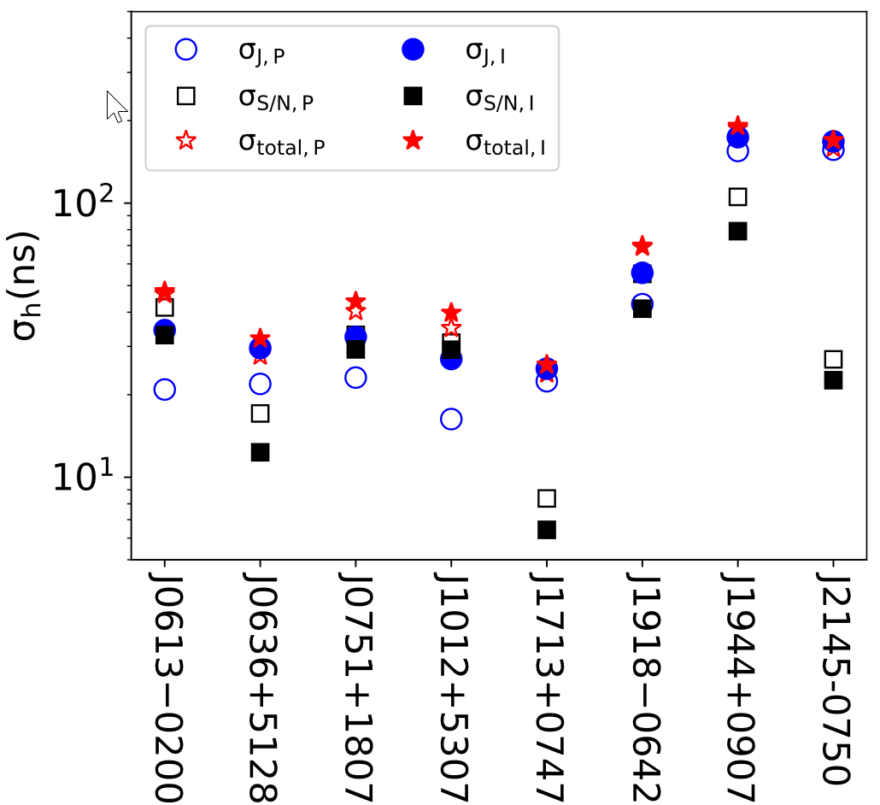
Research Highlights (3)：Jitter noise
Jitter noise is the dominant short-timescale noise in FAST millisecond pulsar observations
Jitter Noise level can be reduced using polarization timing
Wang et al. 2024, ApJ

Slide 15
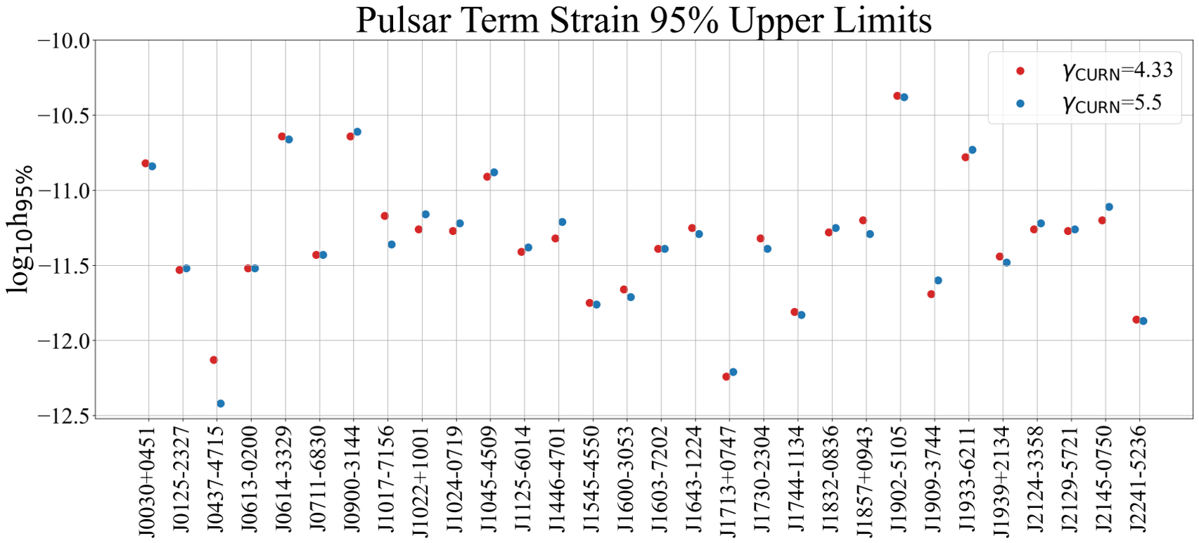
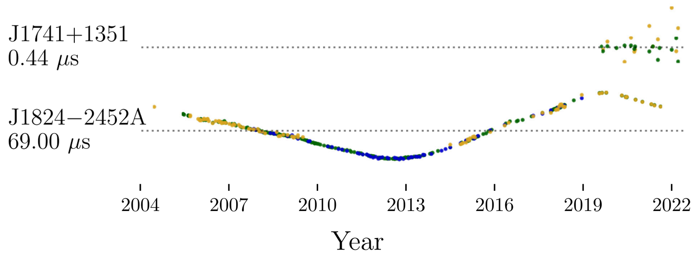
Research Highlights (4): Searching for Gravitational-Wave Bursts from Cosmic String Cusps
Based on PPTA-DR3, the search is carried out using the Bayesian method
PPTA-DR3 contains 32 pulsars with a total time span of 18 years.
Upper limit range of the amplitude of the pulsar-term GWCSs is concentrated between 10⁻¹² and 10⁻¹¹.
Xia et al. 2025

Slide 16
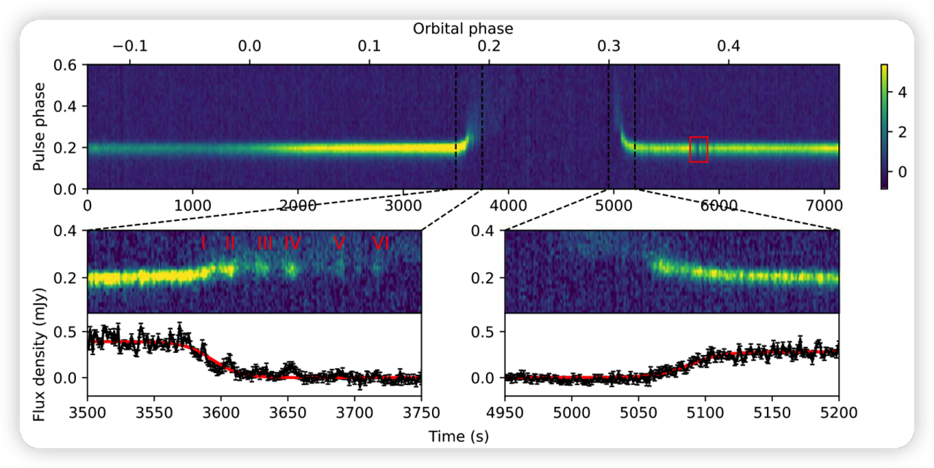
Research Highlights (5): Black widow pulsar
Black widows are millisecond pulsars ablating their companions. The material blown from the companion blocks the radio emission, resulting in radio eclipses.
PSR J1720-0533 is a FAST-discovered BW pulsar.
There are quasi-periodic pulse emission variations with a modulation period of ∼22 s during the ingress of the eclipse, which could be caused by plasma lensing.
Wang et al. 2021, ApJL

Slide 17
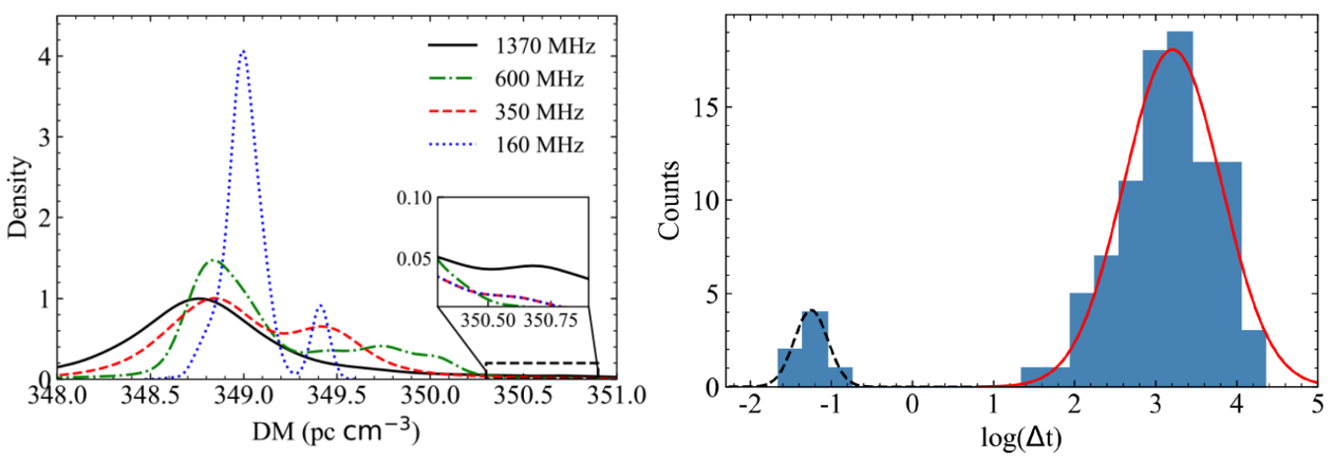
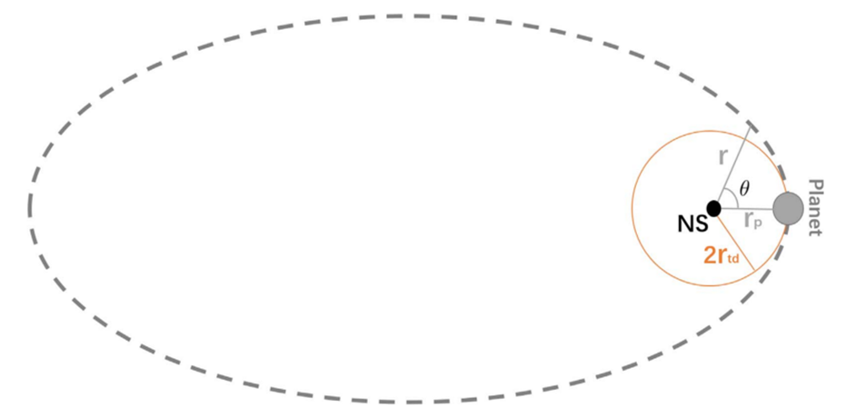
Research Highlights (6): FRB
We carried out statistical properties of the repeating of FRB 180916.J0158+65.
DMs at different frequencies show a bimodal distribution, and the waiting time also presents a bimodal distribution.
A model of the interaction between a magetised neutron star and its planet in an eccentric orbit was proposed to explain the origin of periodic repeating FRBs.
Wang et al. 2023, MNRAS
Kurban et al. 2022, ApJ

Slide 18
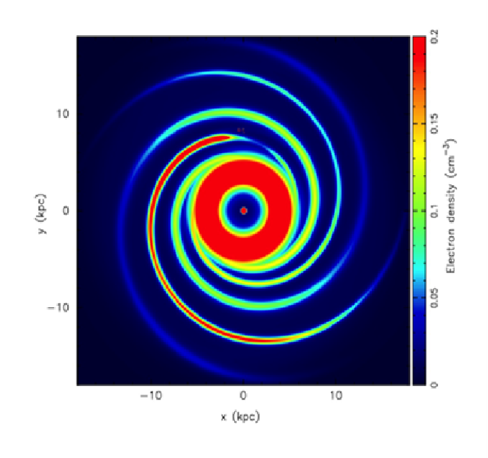


Research Highlights (7): Electron-density model
Based on new observational data and new structural parameters of the Milky Way, a new model YMW16 for the distribution of free electrons in the Galaxy, the Magellanic Clouds, and the intergalactic medium (IGM) was constructed.
This model not only improves the distance accuracy of the galactic pulsar model, but also outperforms the NE2001 model by nearly 40% within a 95% confidence interval.
Yao et al. 2017, ApJ
Notes:
The Galactic model is based on independently determined distances for 189 pulsars.

Slide 19
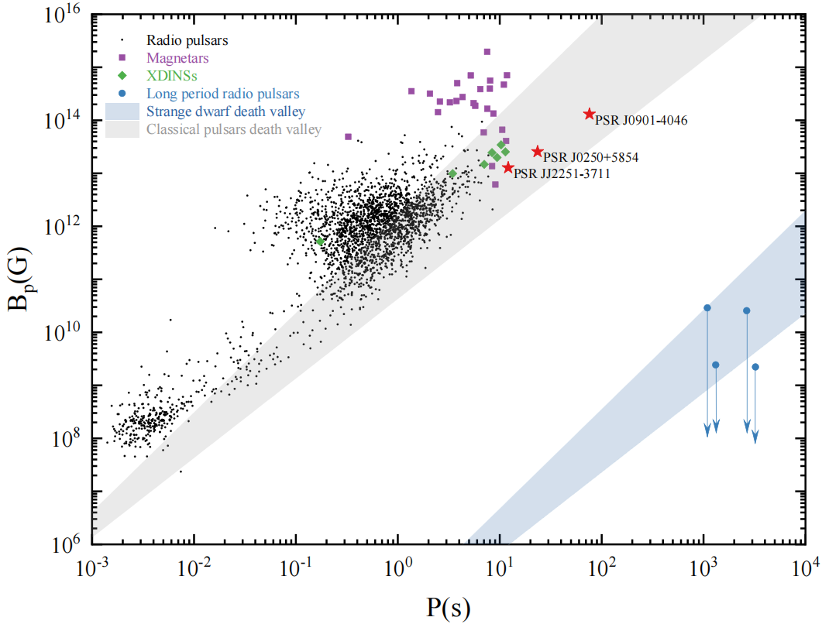
Research Highlights (8): Ultralong Period Radio Transients
ULPTs with periods of thousands of seconds challenge the standard pulsar model, which is based on rapidly rotating neutron stars.
We propose that these isolated sources are strange dwarf (SD) pulsars—compact objects with a strange quark matter core surrounded by a normal matter crust.
SD pulsars, with their much larger radii than traditional neutron stars and relatively weaker surface magnetic fields, can naturally explain the extremely long periods and coherent radio emission of ULPTs.
Zhou et al. 2025, ApJ

Slide 20
Outline
Introduction to the XAO Pulsar Group
Group Members and Expertise
Key Research Areas
Major Research Highlights
Future Prospects with the QTT Telescope
Summary

Slide 21
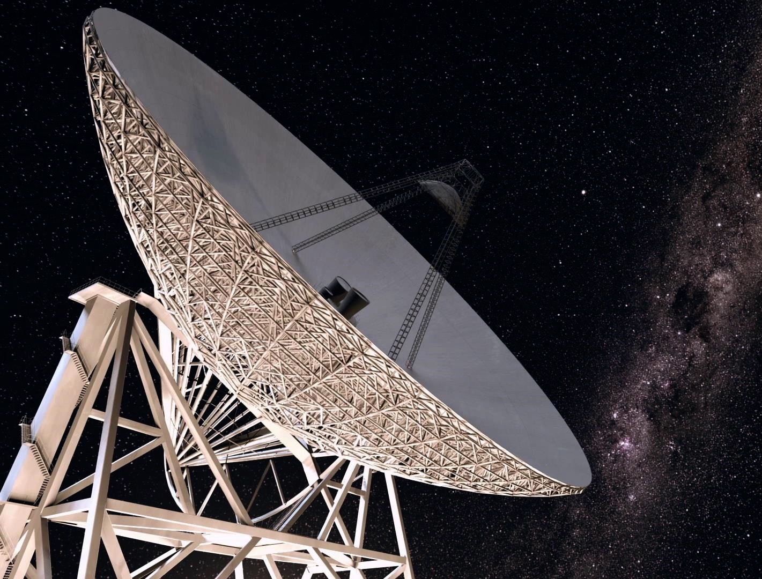
Future Prospects with the QTT Telescope
Complementary to FAST: Unlike the fixed-dish FAST , QTT's steerability allows for targeted, high-sensitivity follow-up observations across a wider frequency range, forming a powerful duo.
Major Scientific Goals in Pulsar Research
Detection of Nanohertz Gravitational Waves: QTT will conduct long-term, high-precision timing of millisecond pulsars to directly detect low-frequency gravitational waves from supermassive black hole binaries, testing fundamental theories of gravity
Expanding and Characterizing the Pulsar Population: QTT will conduct large-scale, systematic pulsar surveys to discover a large number of new pulsars, especially rare types . This will advance studies of stellar evolution and compact object physics.

Slide 22
Outline
Introduction to the XAO Pulsar Group
Group Members and Expertise
Key Research Areas
Major Research Highlights
Future Prospects with the QTT Telescope
Summary

Slide 23
Summary
The Xinjiang Astronomical Observatory is the first institution in China to carry out research on pulsar observations.
The pulsar group is a young yet highly experienced research team.
We conduct not only observational studies of pulsar-like objects but also related theoretical research.
We have achieved a wealth of results across multiple aspects of pulsar research.

Slide 24

Thanks！

