Slide 1
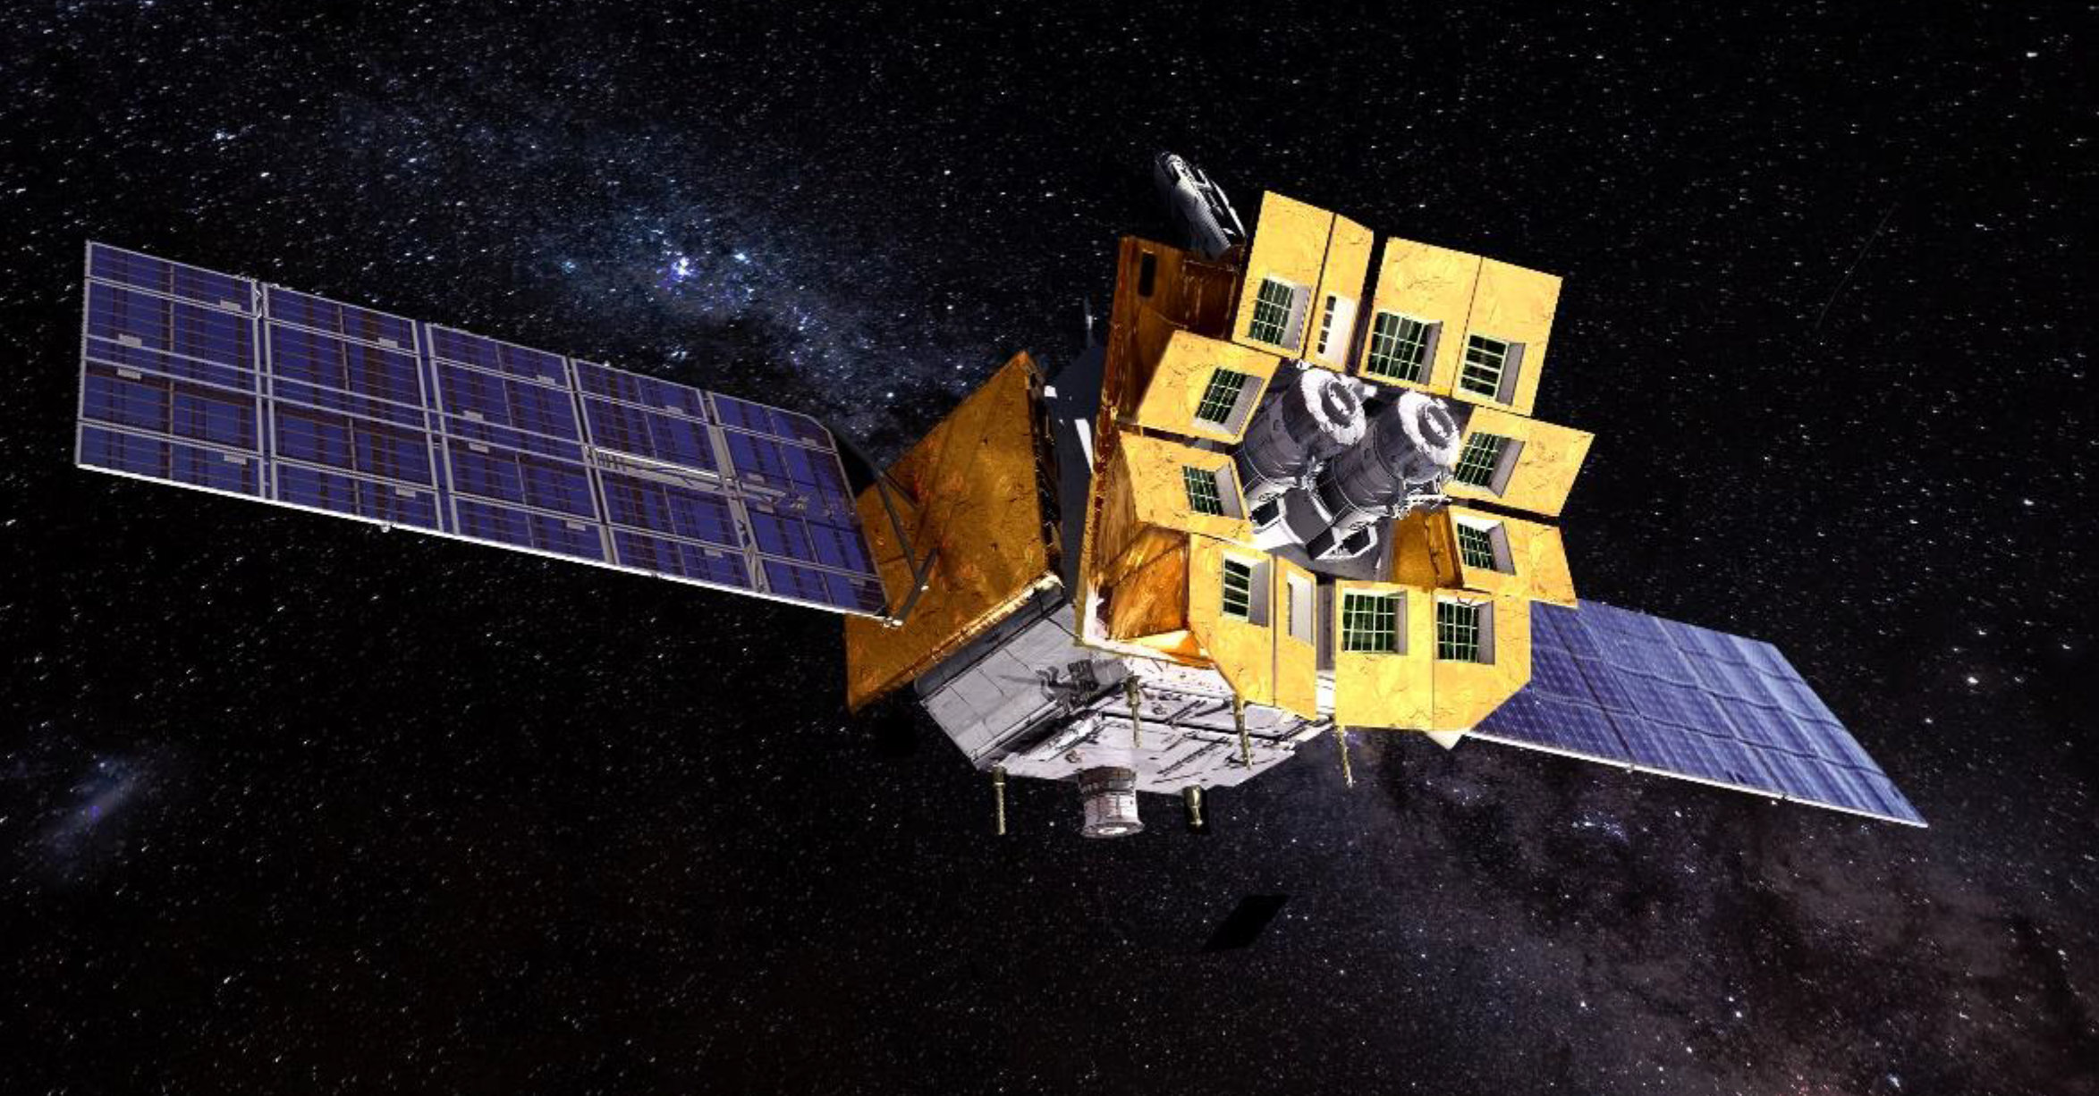





Observations of Einstein Probe Transients with Facilities in Chile
Wenxiong Li（李文雄）
NAOC
2026-01-09
7th China-Chile Bilateral Conference
Hong Kong

Slide 2
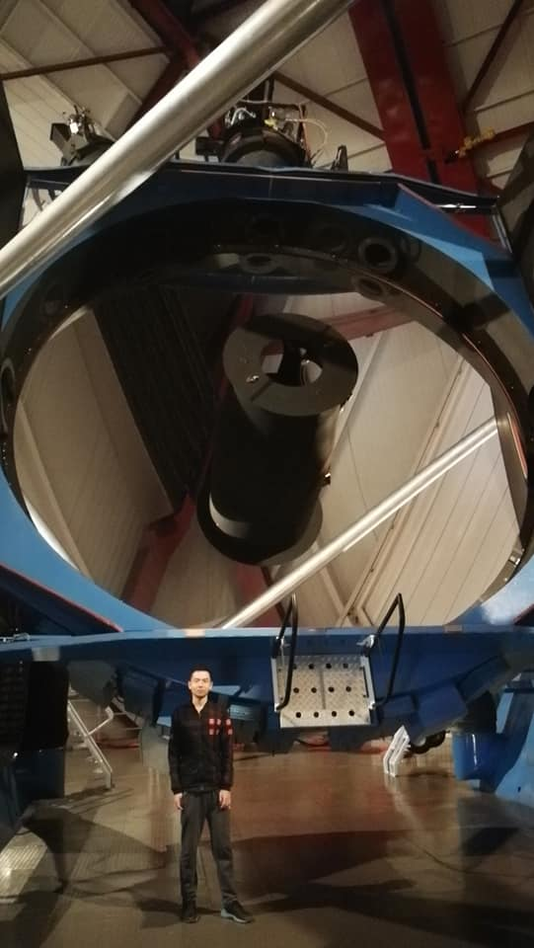

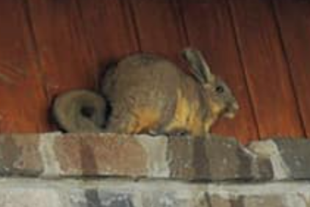
2018 Magellen telescope
Nidia Morrell
viscacha
兔鼠 rabbit+rat

Slide 3
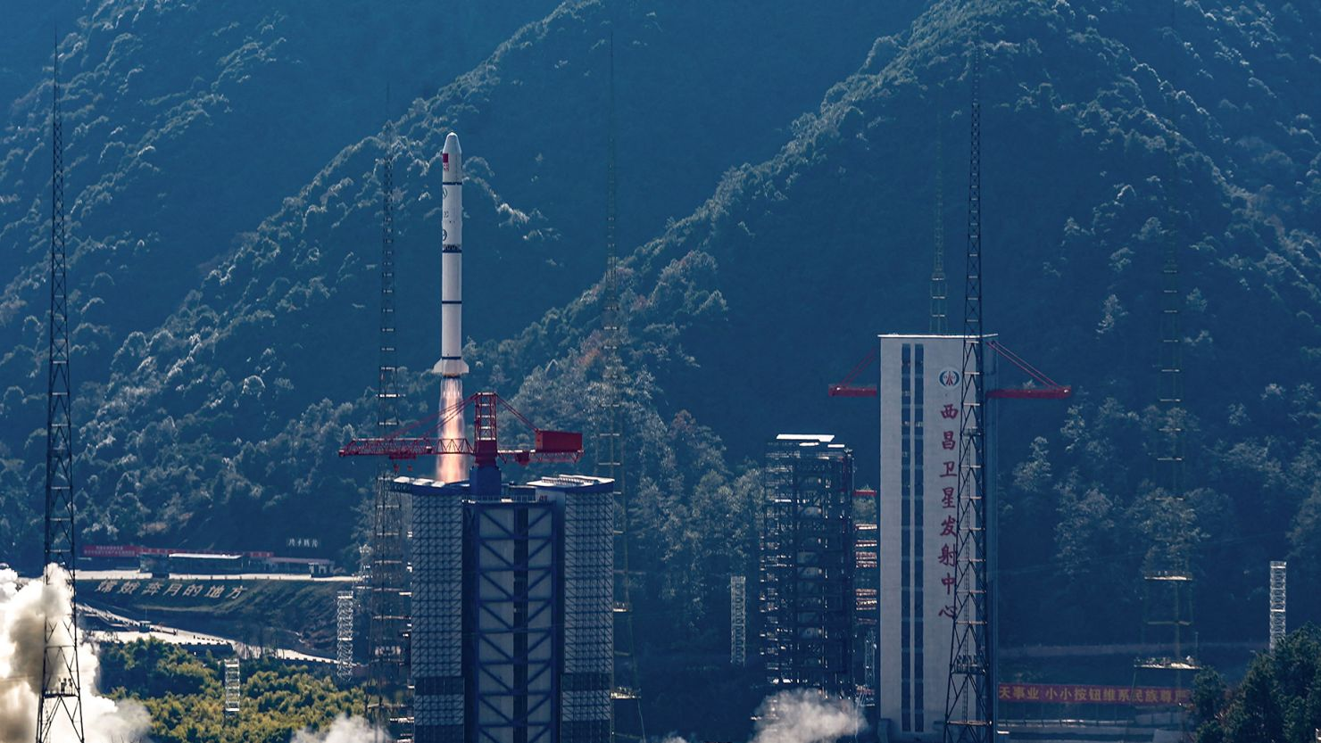
Launched on 2024 Jan. 9th
🎂 🎂

Slide 4
Outline
Introduction to EP
Observations of EP transients with facilities in Chile
EP-optical systemetic cross-match experiment

Slide 5
Introduction to EP
A soft X-ray mission to discover high-energy transients
Instruments | Energy Range | Field of View | Localization | Sensitivity
Wide Field X-ray Telescope (WXT) | 0.5 - 4 keV | 3600 deg² | 3’ | 1.2E-10 erg/cm²/s in 10 mins
Follow-up X-ray Telescope (FXT) | 0.5 - 10 keV | 60’diameter | 10” | 2.4E-13 erg/cm²/s in 15 mins

Slide 6
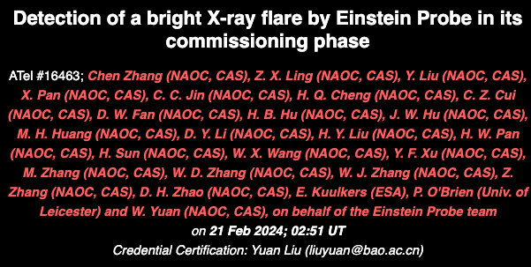
Introduction to EP
First ATel

Slide 7
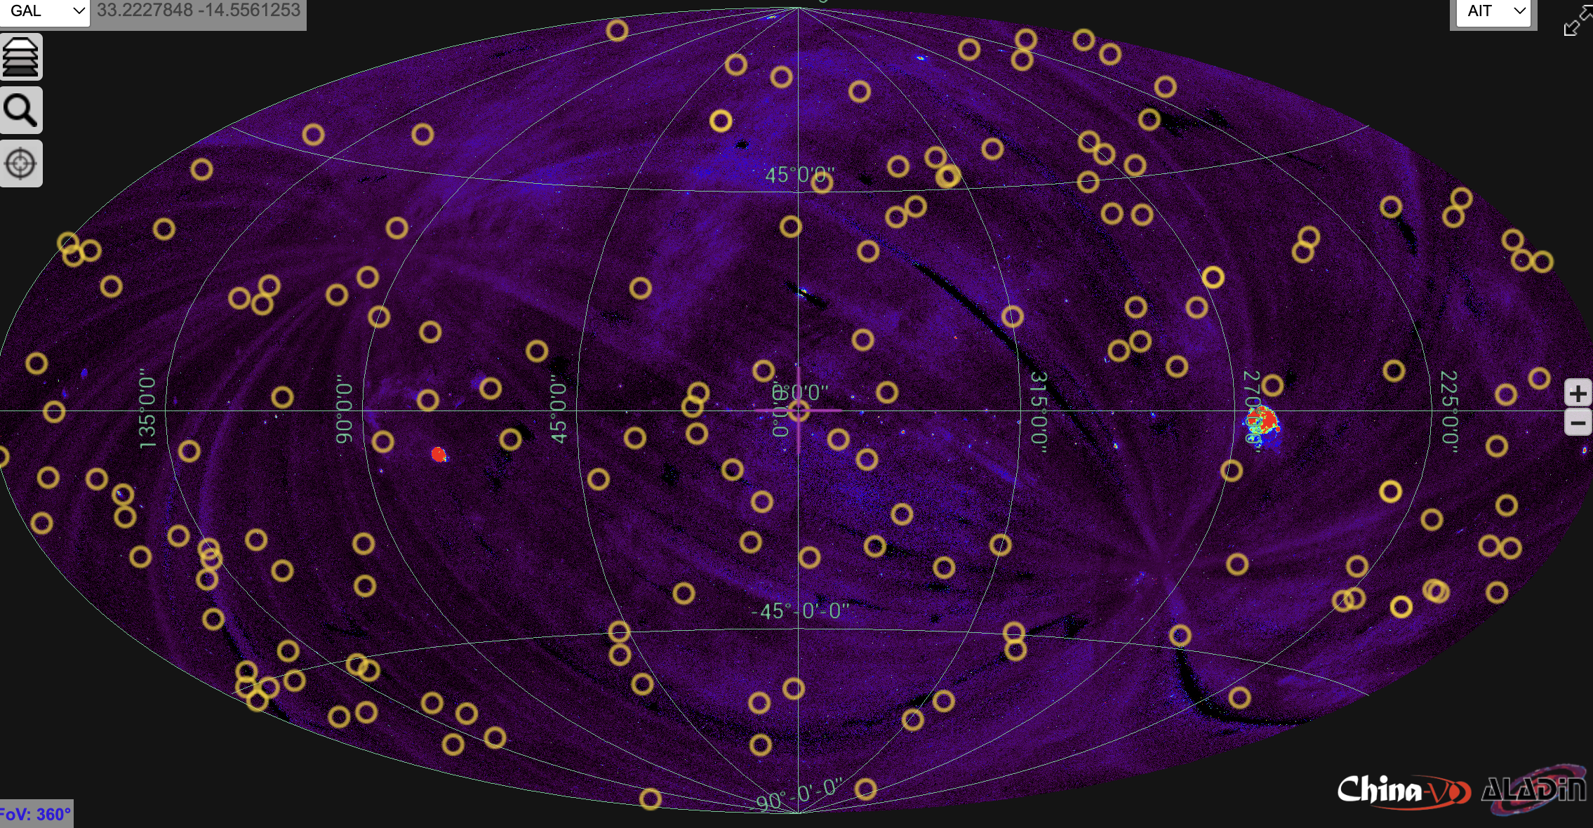

Slide 8
Science Topical Panels
300 science members: ~75% China, ~25% Europe
STP1: TDEs and AGNs
STP2: Fast extragalactic transients (GRBs and supernovae; etc.)
STP3: Multi-messenger (GW and neutrino)
STP4: Compact stellar objects (stellar mass BHs, NS, WDs; ultra-luminous X-ray sources)
STP5: Observatory Science
STP6: Follow-up observation activities

Slide 9
Observations of EP transients with facilities in Chile

Slide 10
Optical ground-based observations (GCN)
~1500 GCN related to EP
(18 by LWX✌)
> 70 telescopes
> 20 countries
Not included:
Atel reports
Observations without measurement
Results from papers

Slide 11

EP ground optical followup word cloud

Slide 12
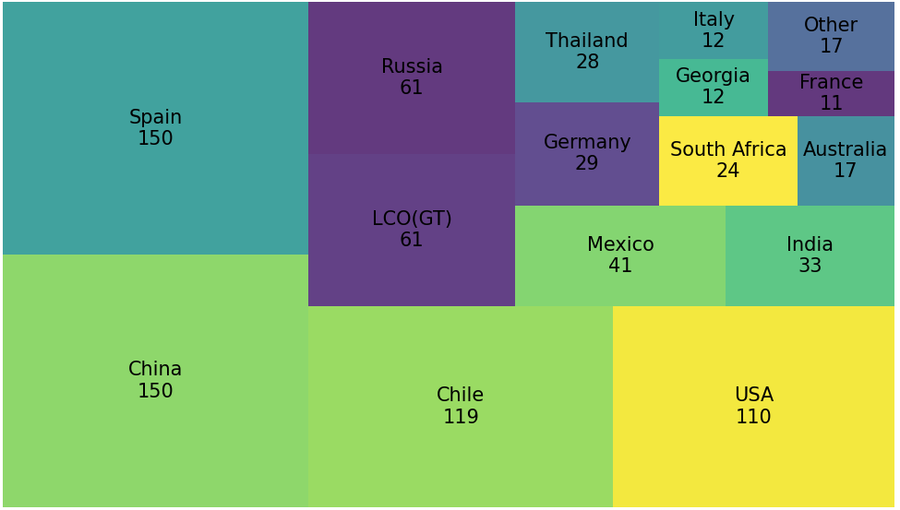
Optical ground-based observations (GCN)

Slide 13
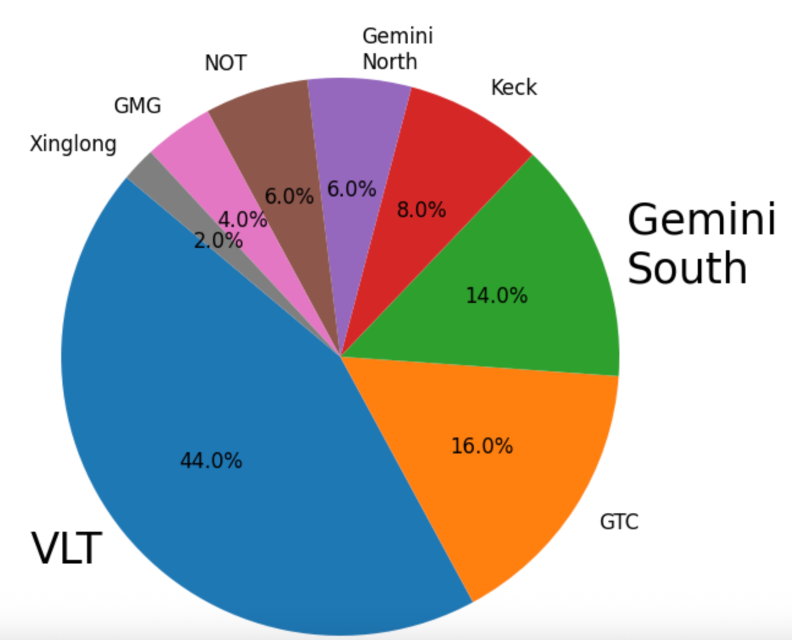
EP transient redshift (GCN)
52 GCNs in total
VLT + Gemini S ~ 60%!
~ China x 10

Slide 14
EP-optical systemetic cross-match
Runduo Liang, Wenxiong Li, Yunfei Xu, Liangduan Liu, Ken Smith, Stephen Smartt, Arne Rau, Franz Bauer, Ezequiel Treister, Jia-Sheng Huang, Sheng Yang, Lingzhi Wang, Hui Sun, Weimin Yuan etc.

Slide 15

EP-optical systemetic cross-match
X-ray Sample
Optical Sample
Known Source
Transient
EP-WXT
TNS
WFST
Stellar Flare
Cross-match
EP-FXT
ZTF
LSST
Filter
Alerce
Lasair
Runduo Liang
梁润铎
Thanks to Francisco, Alerce team
Follow up
Candidates

Slide 16
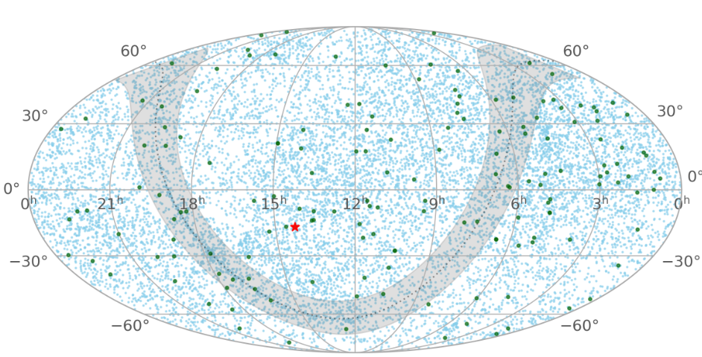
EP-optical systemetic cross-match
2024 Jan - 2025 June
X-ray: 95 High S/N
5140 low S/N
Optical: ZTF, TNS
Liang, LWX+, submitted

Slide 17
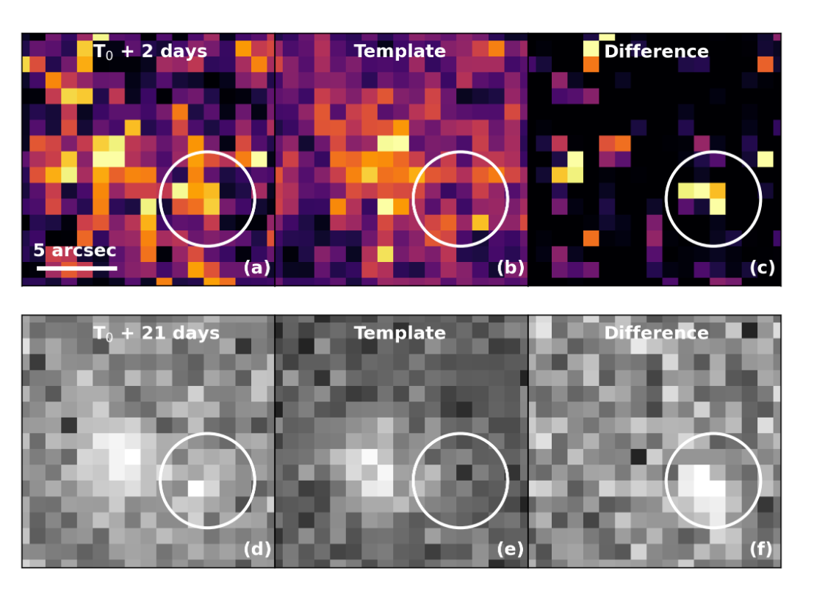
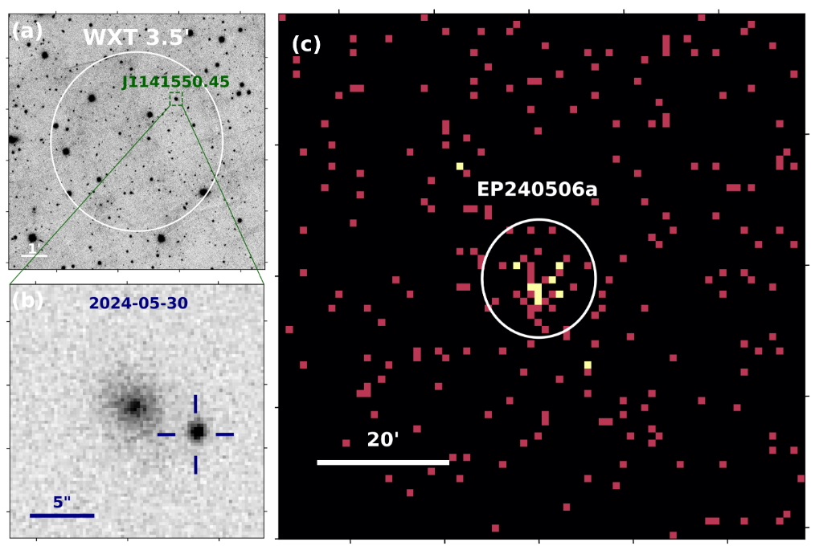
EP240506a: a missed EP-optical association
EP240506a on 2024-05-06
t ~ 50 seconds
After
Before
Swift/UVOT
Liang, LWX+, submitted

Slide 18
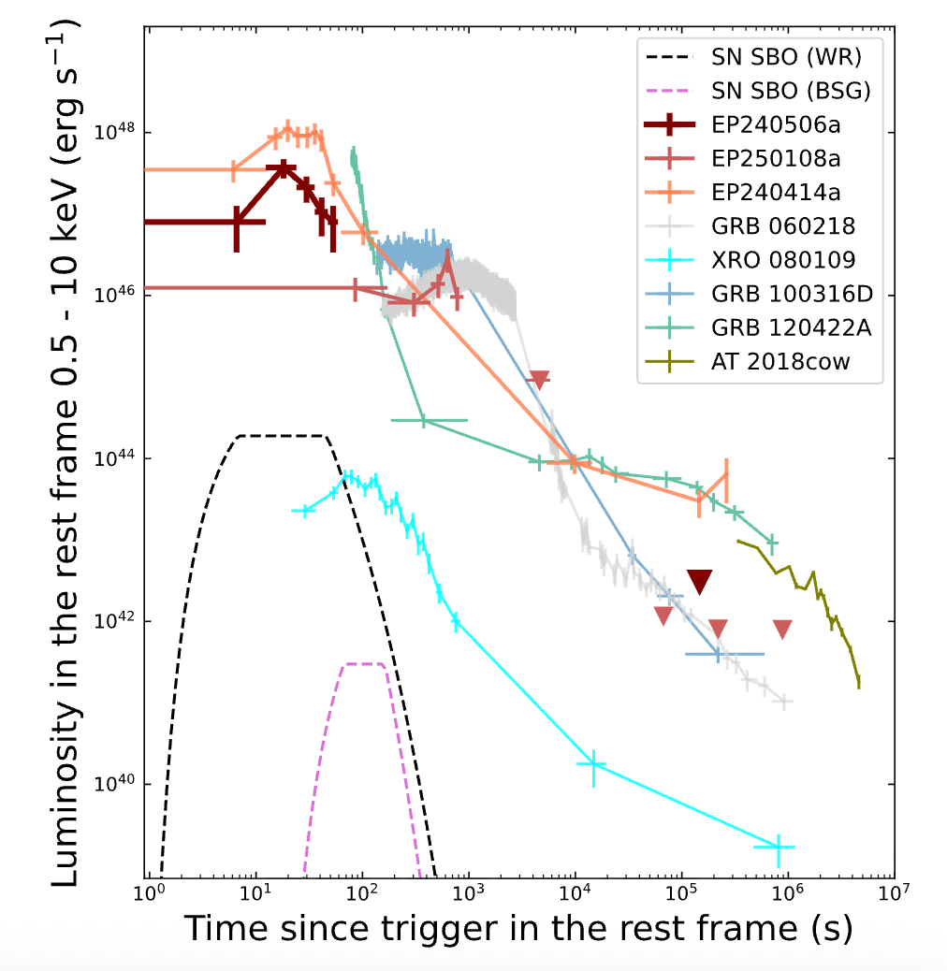
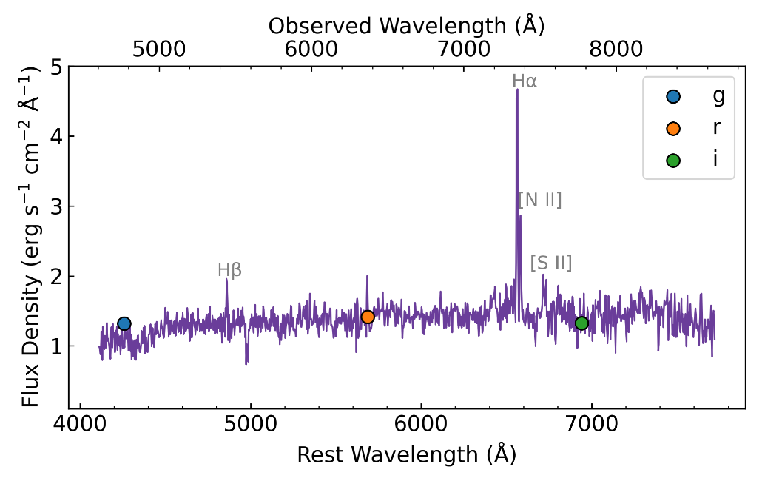
EP-optical systemetic cross-match
Host galaxy at z = 0.12
VLT/FOR2

Slide 19
EP-optical real-time cross-match
EP transient rate ~1 / 2-3 days, low S/N rate >10 / day
Monitor EP transients and low S/N sources using 1-2 m telescopes for several weeks
Detect possible optical emission and place physical constraints
司天原型机（兴隆）
武汉大学望远镜（冷湖）
清华南山望远镜（新疆南山）
山大威海1m望远镜（冷湖）
河北师大望远镜（冷湖）

Slide 20
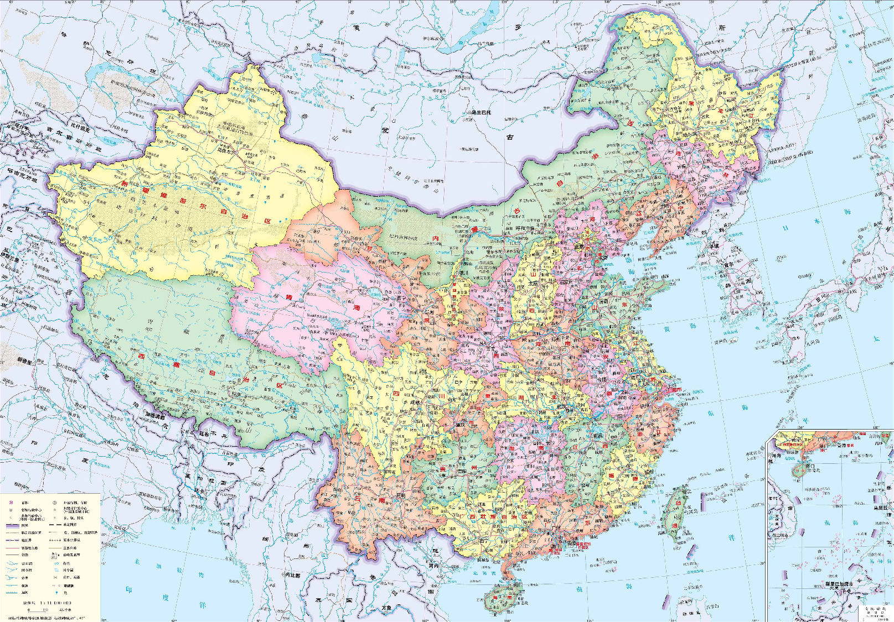

Slide 21
Summary
Thanks to Chilean community!
EP240506a is an EP-discovered supernova that was not identified during the initial observations.
Collaborations are welcome to carry out systematic follow-up of EP transients on week-to-month timescales.

