Slide 1
Chemical Abundances and Globular Clusters of MW Dwarf Galaxies
Baitian Tang （汤柏添）
Collaborators: Jose Fernandez-Trincado, Chengyuan Li,
Doug Geisler, Zhiqiang Yan, Long Wang, et al.
2026/01 HKU

Slide 2
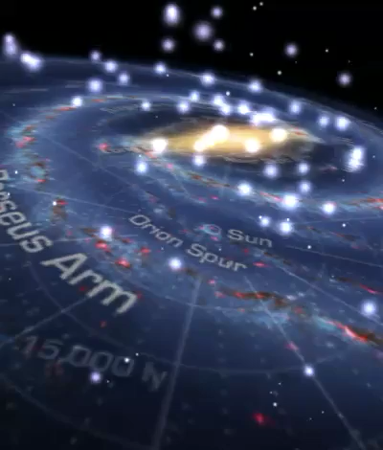
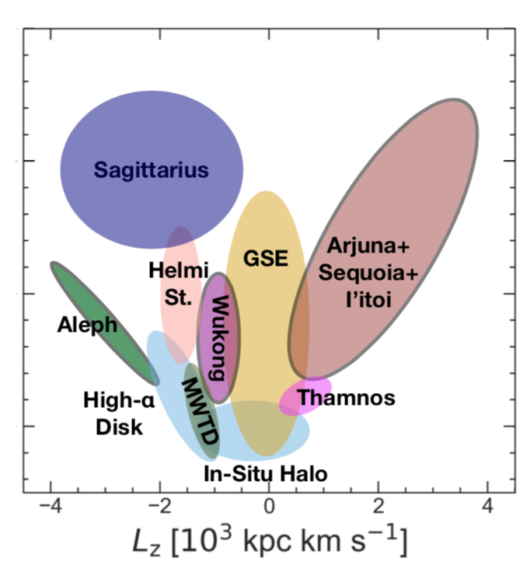
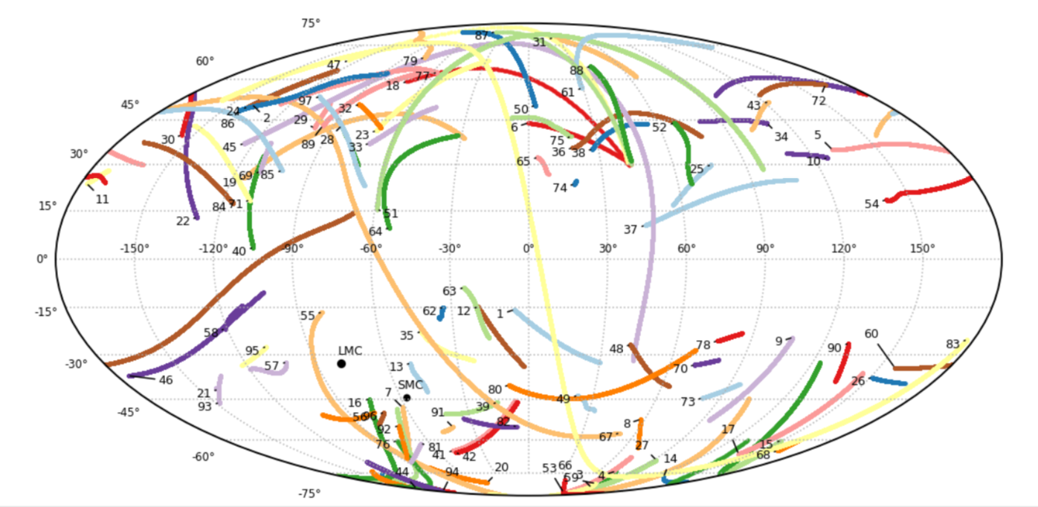
MW Building blocks
E
Dissolving
Dissolved
Existing

Slide 3
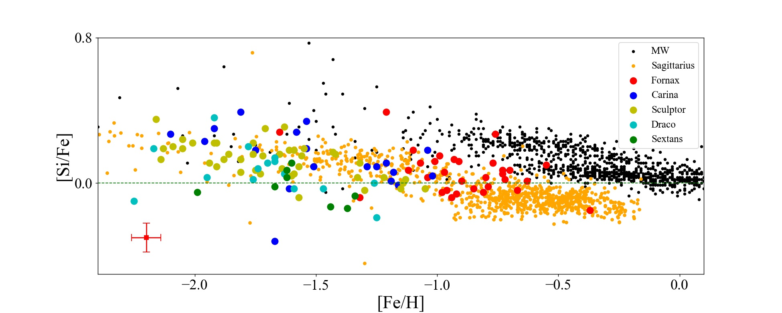
Alpha elements in classical dwarf galaxies
O, Mg, Si, Ca, and Ti abundances
Sgr shows flattening at high Z, second burst of SF? (Hasselquist)

Slide 4
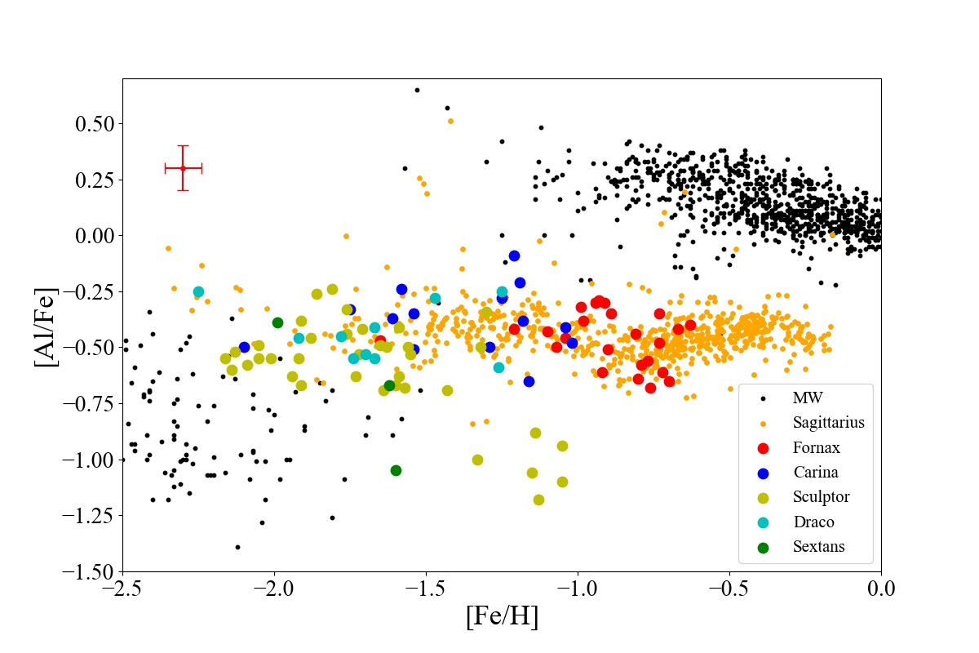
[Al/Fe]
Sgr shows a chevron shape; similar for Fnx but less certain.
Scl shows a weak decreasing trend
Car, Dra, Sex around -0.5, flat trend? Similar to some MW stars.
Tang, Zhang, Yan et al. (2023) A&A
Xu, Tang, et al., submitted

Slide 5
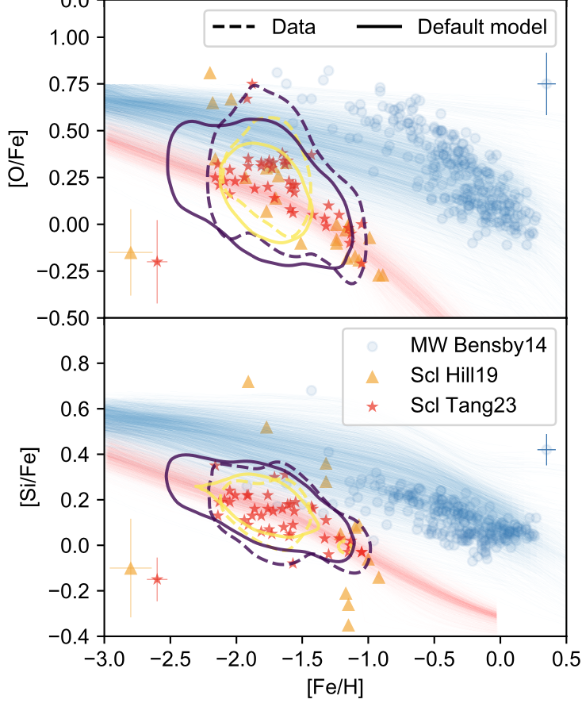
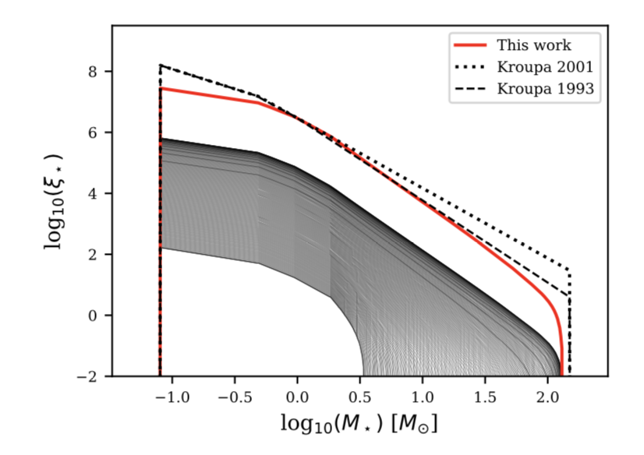
Scl IMF
We found deficiency in both high mass and low mass stars.
Varying IMF in a metal-poor/low star-forming efficiency environment?
Zhiqiang Yan+ in prep.

Slide 6
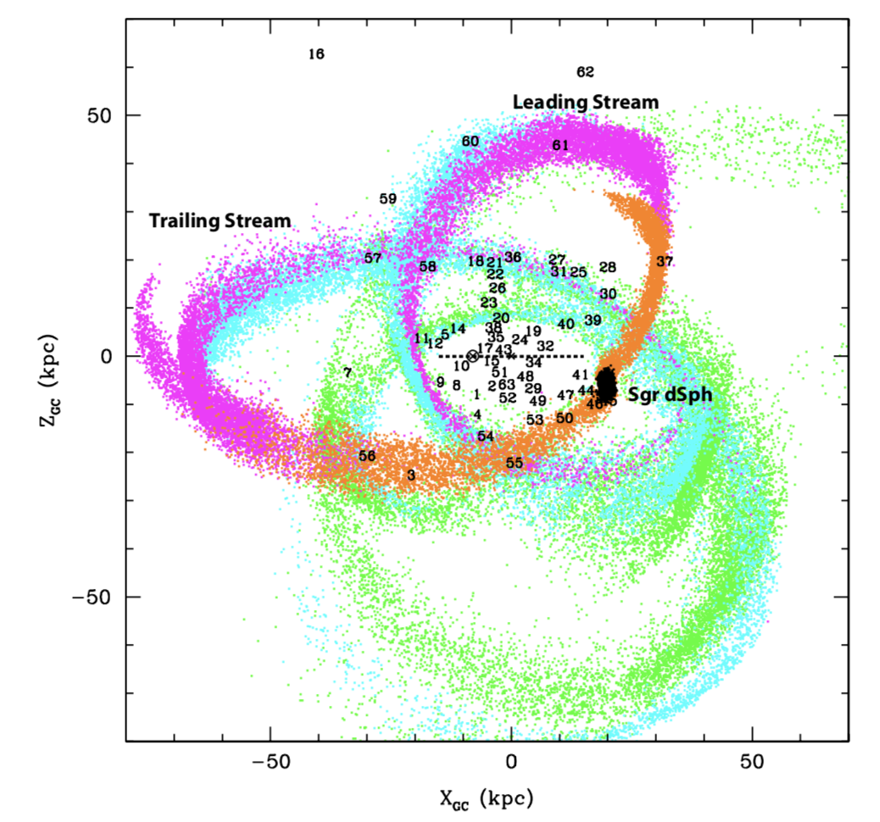
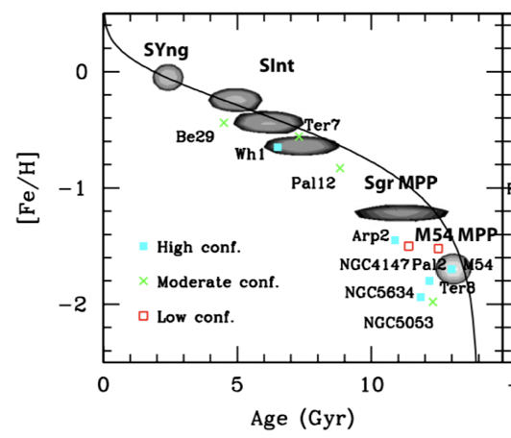
Star clusters in galaxy formation
Fossil record of galaxy formation
Law & Majewski 2010

Slide 7
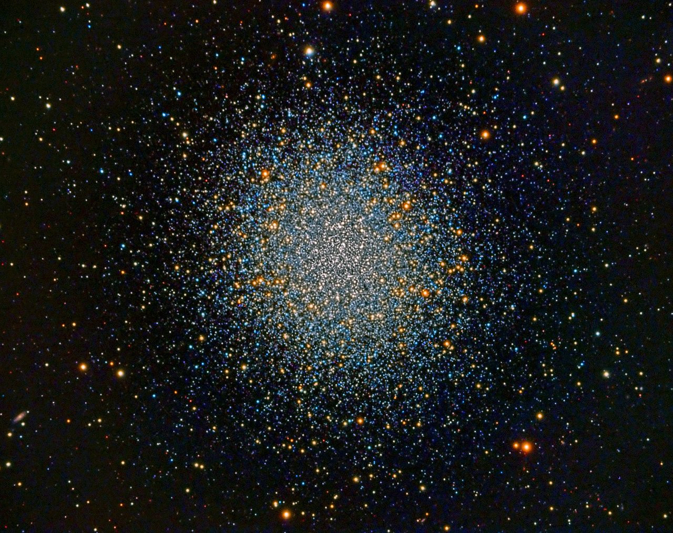
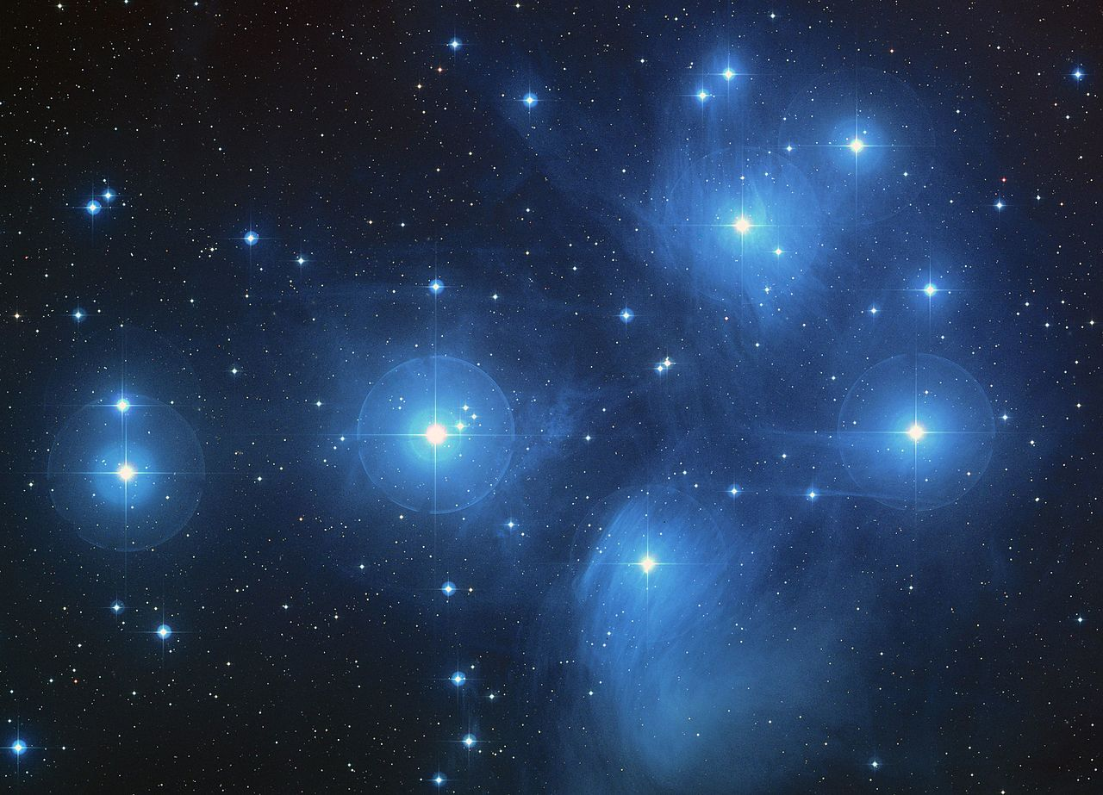
Two categories of SCs
Spread in C, N, O, Na, Mg, Al, etc.
Similar chemistry

Slide 8
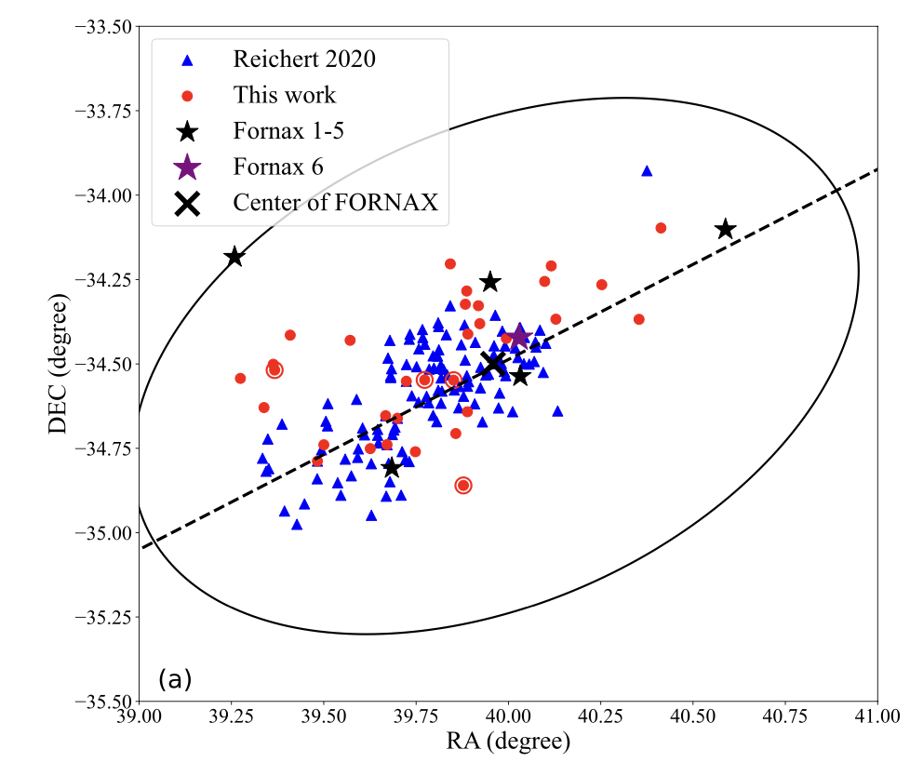
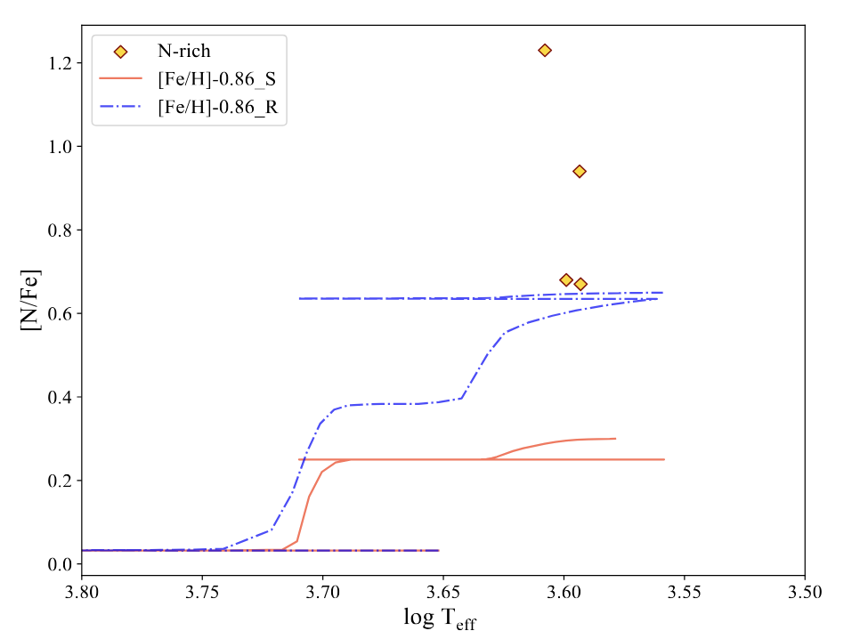
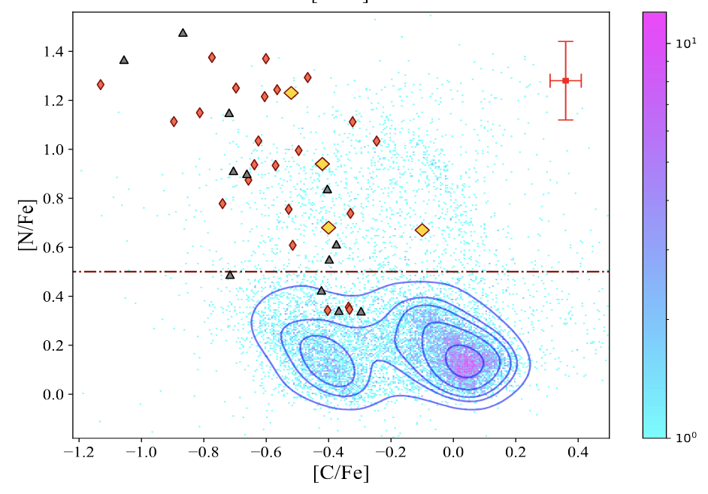

Fornax dSph
4/32 N-rich field stars [N/Fe] > 0.65, [C/Fe] < 0.15, and [Ce/Fe] < 0.5

Slide 9
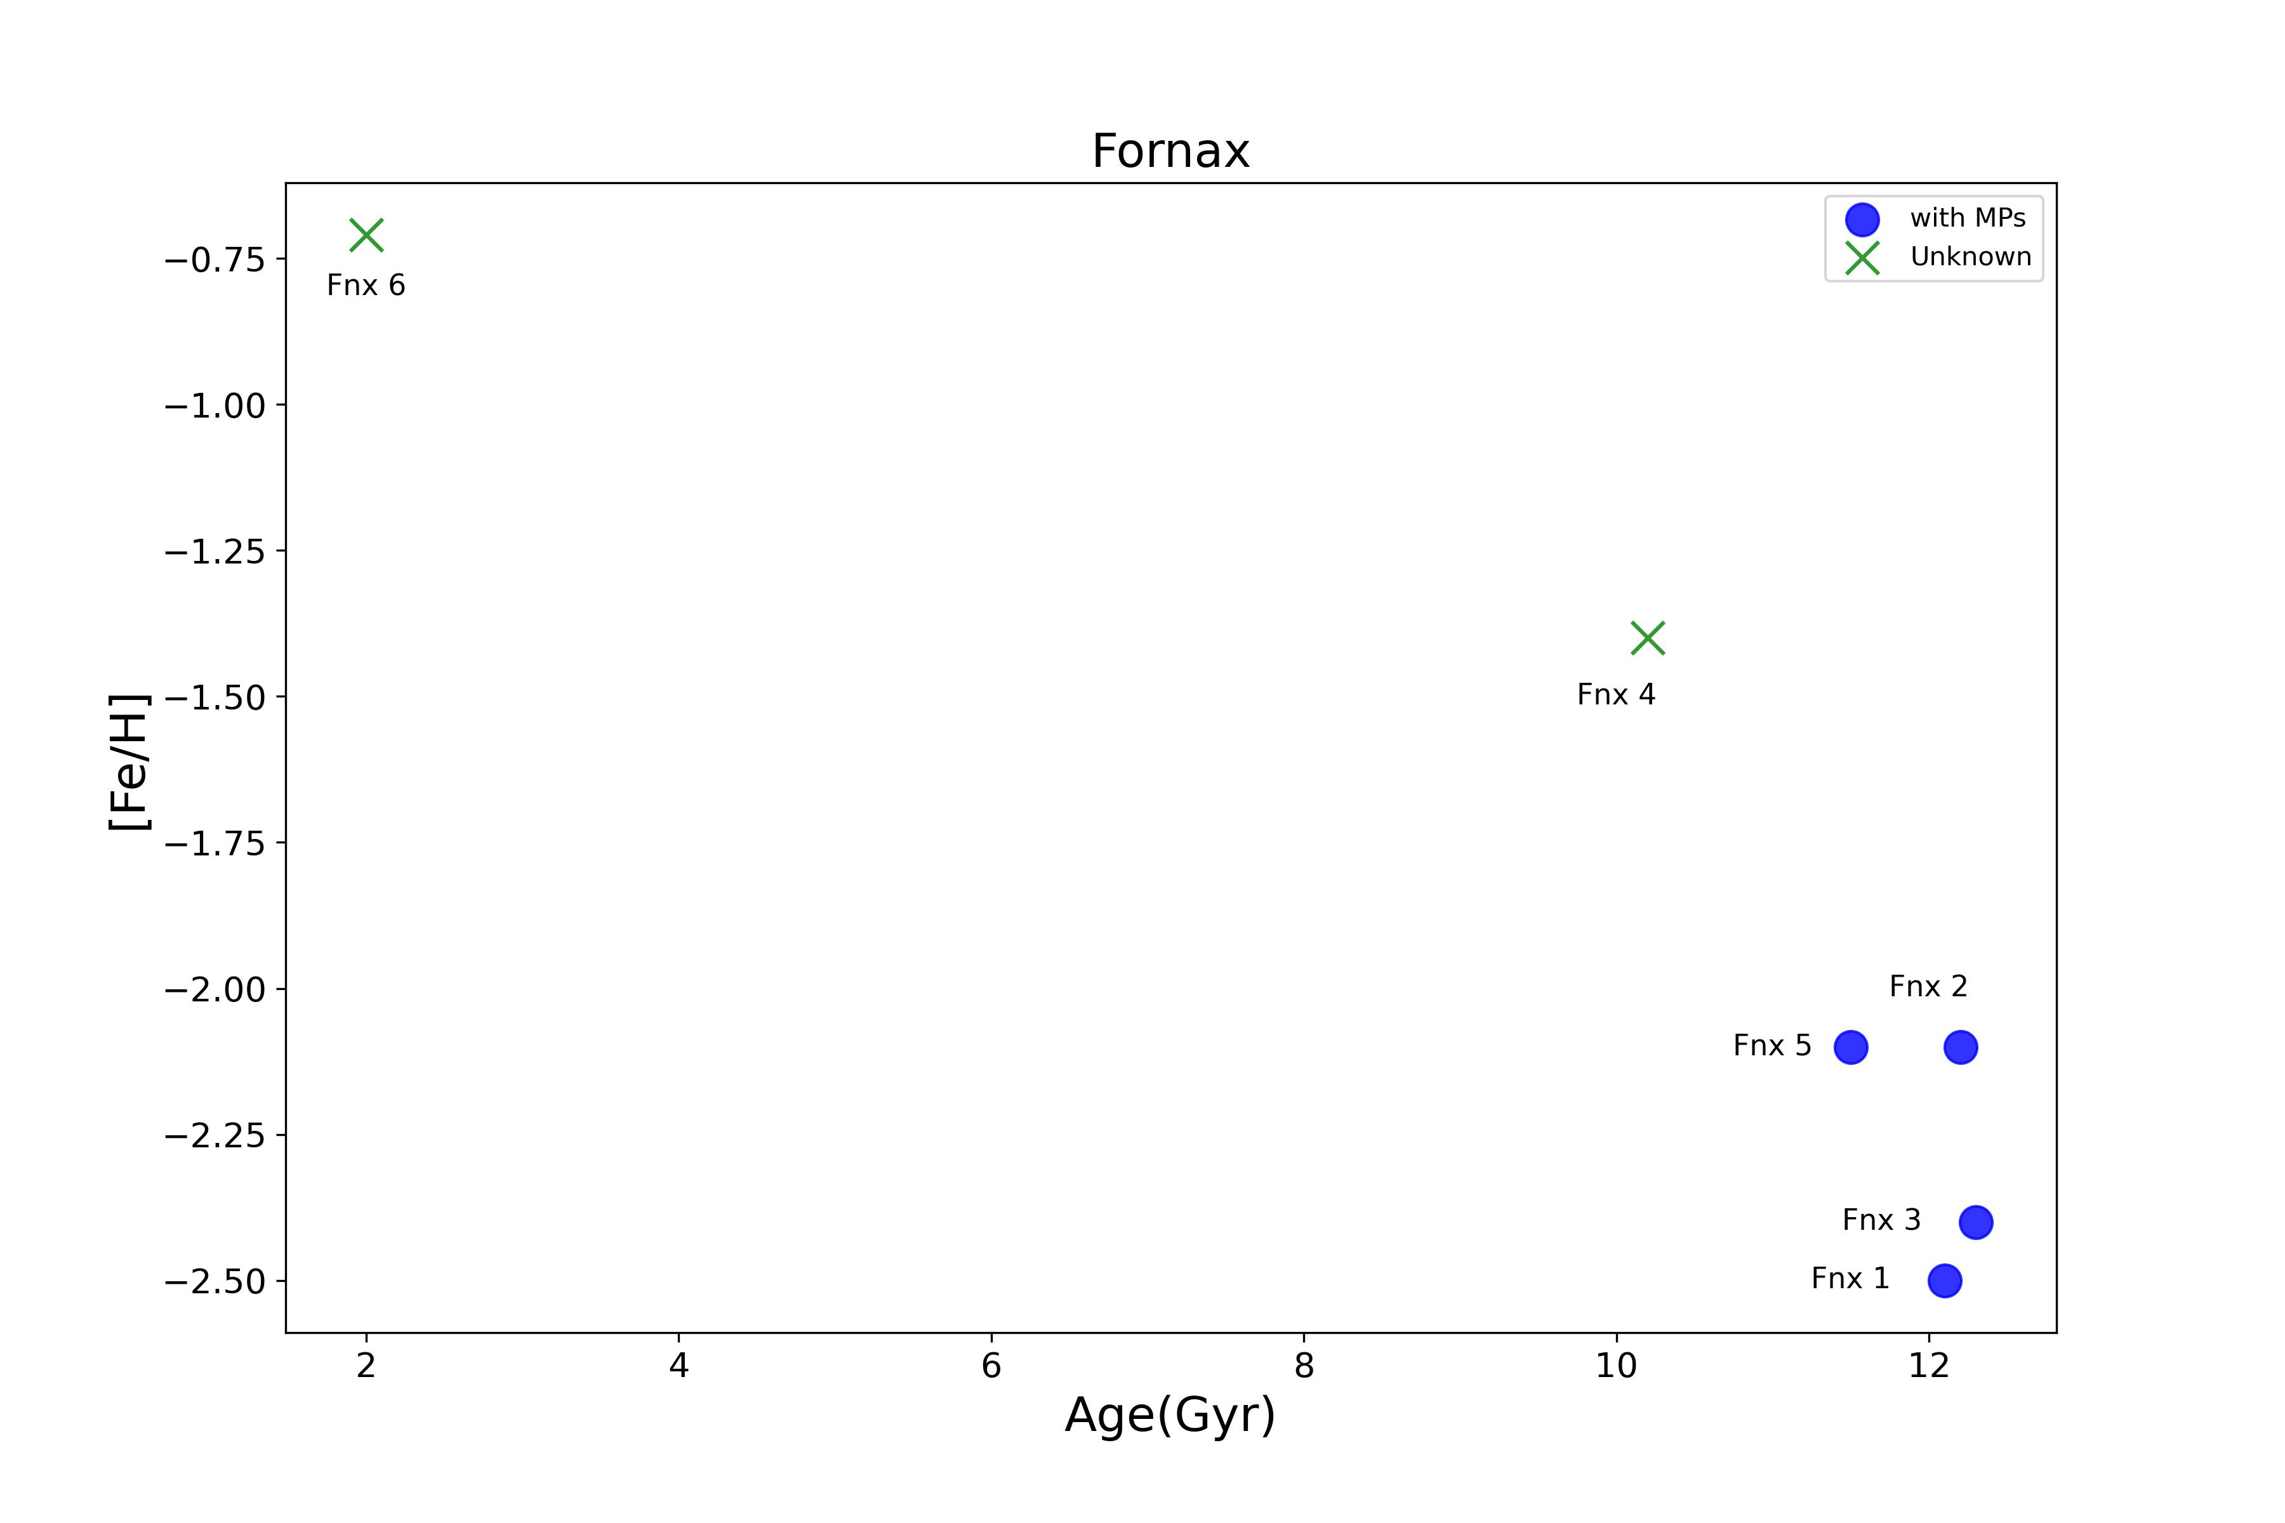
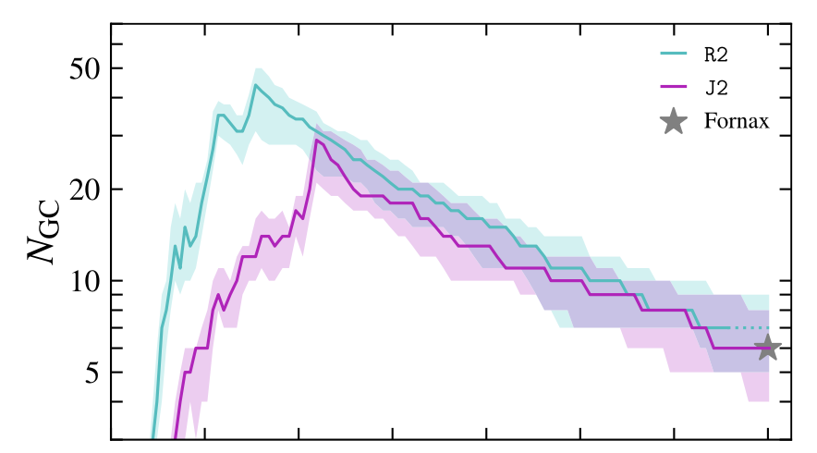
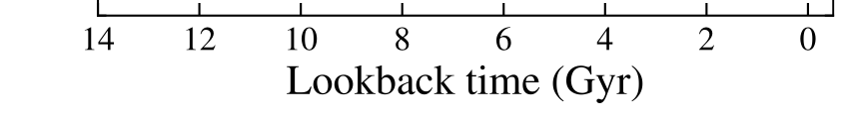
Fornax dSph
-1.0<[Fe/H]<-0.8
Disrupted GCs?
Simulations predict plenty.
Chen & Gnedin 2023
Notes:
Yingtian Chen

Slide 10
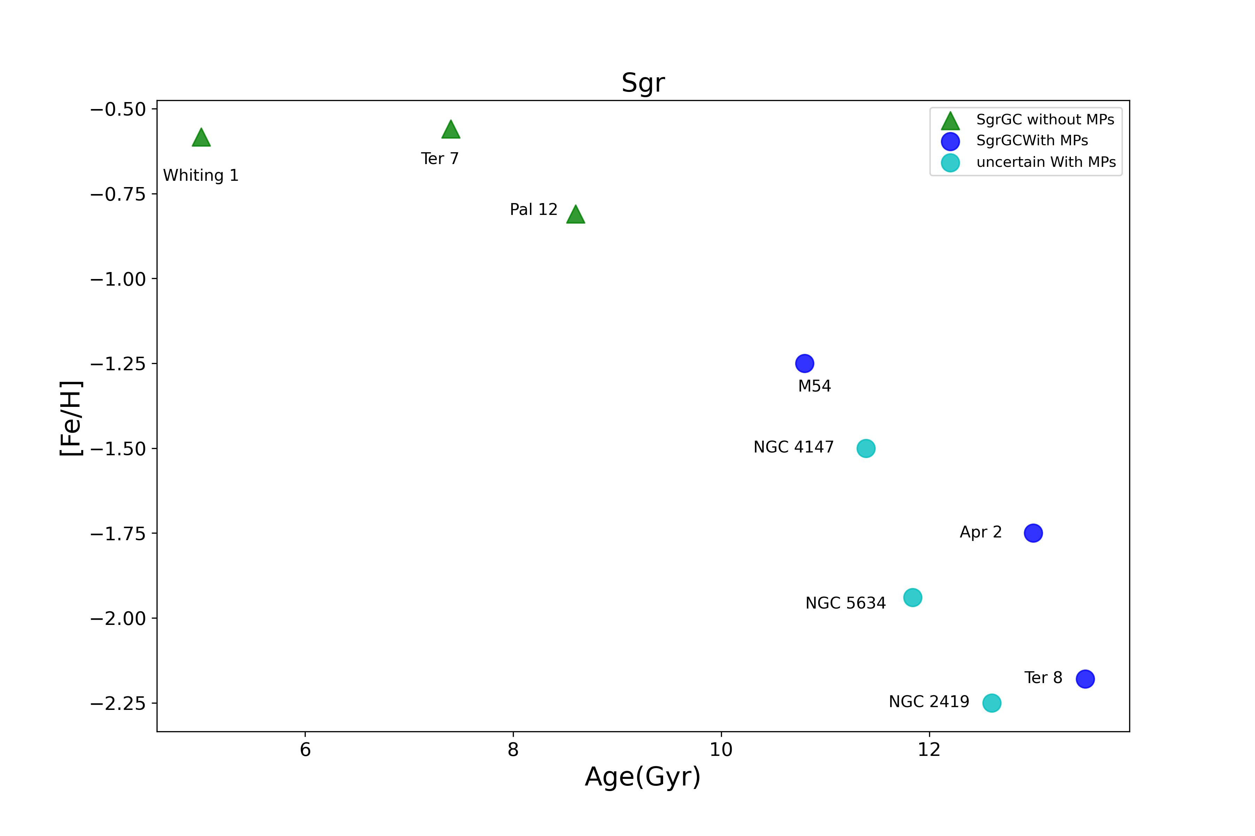
SCs of Sgr
Galactic environment affects the metallicity and cluster compactness, and thus the existence of MPs.

Slide 11
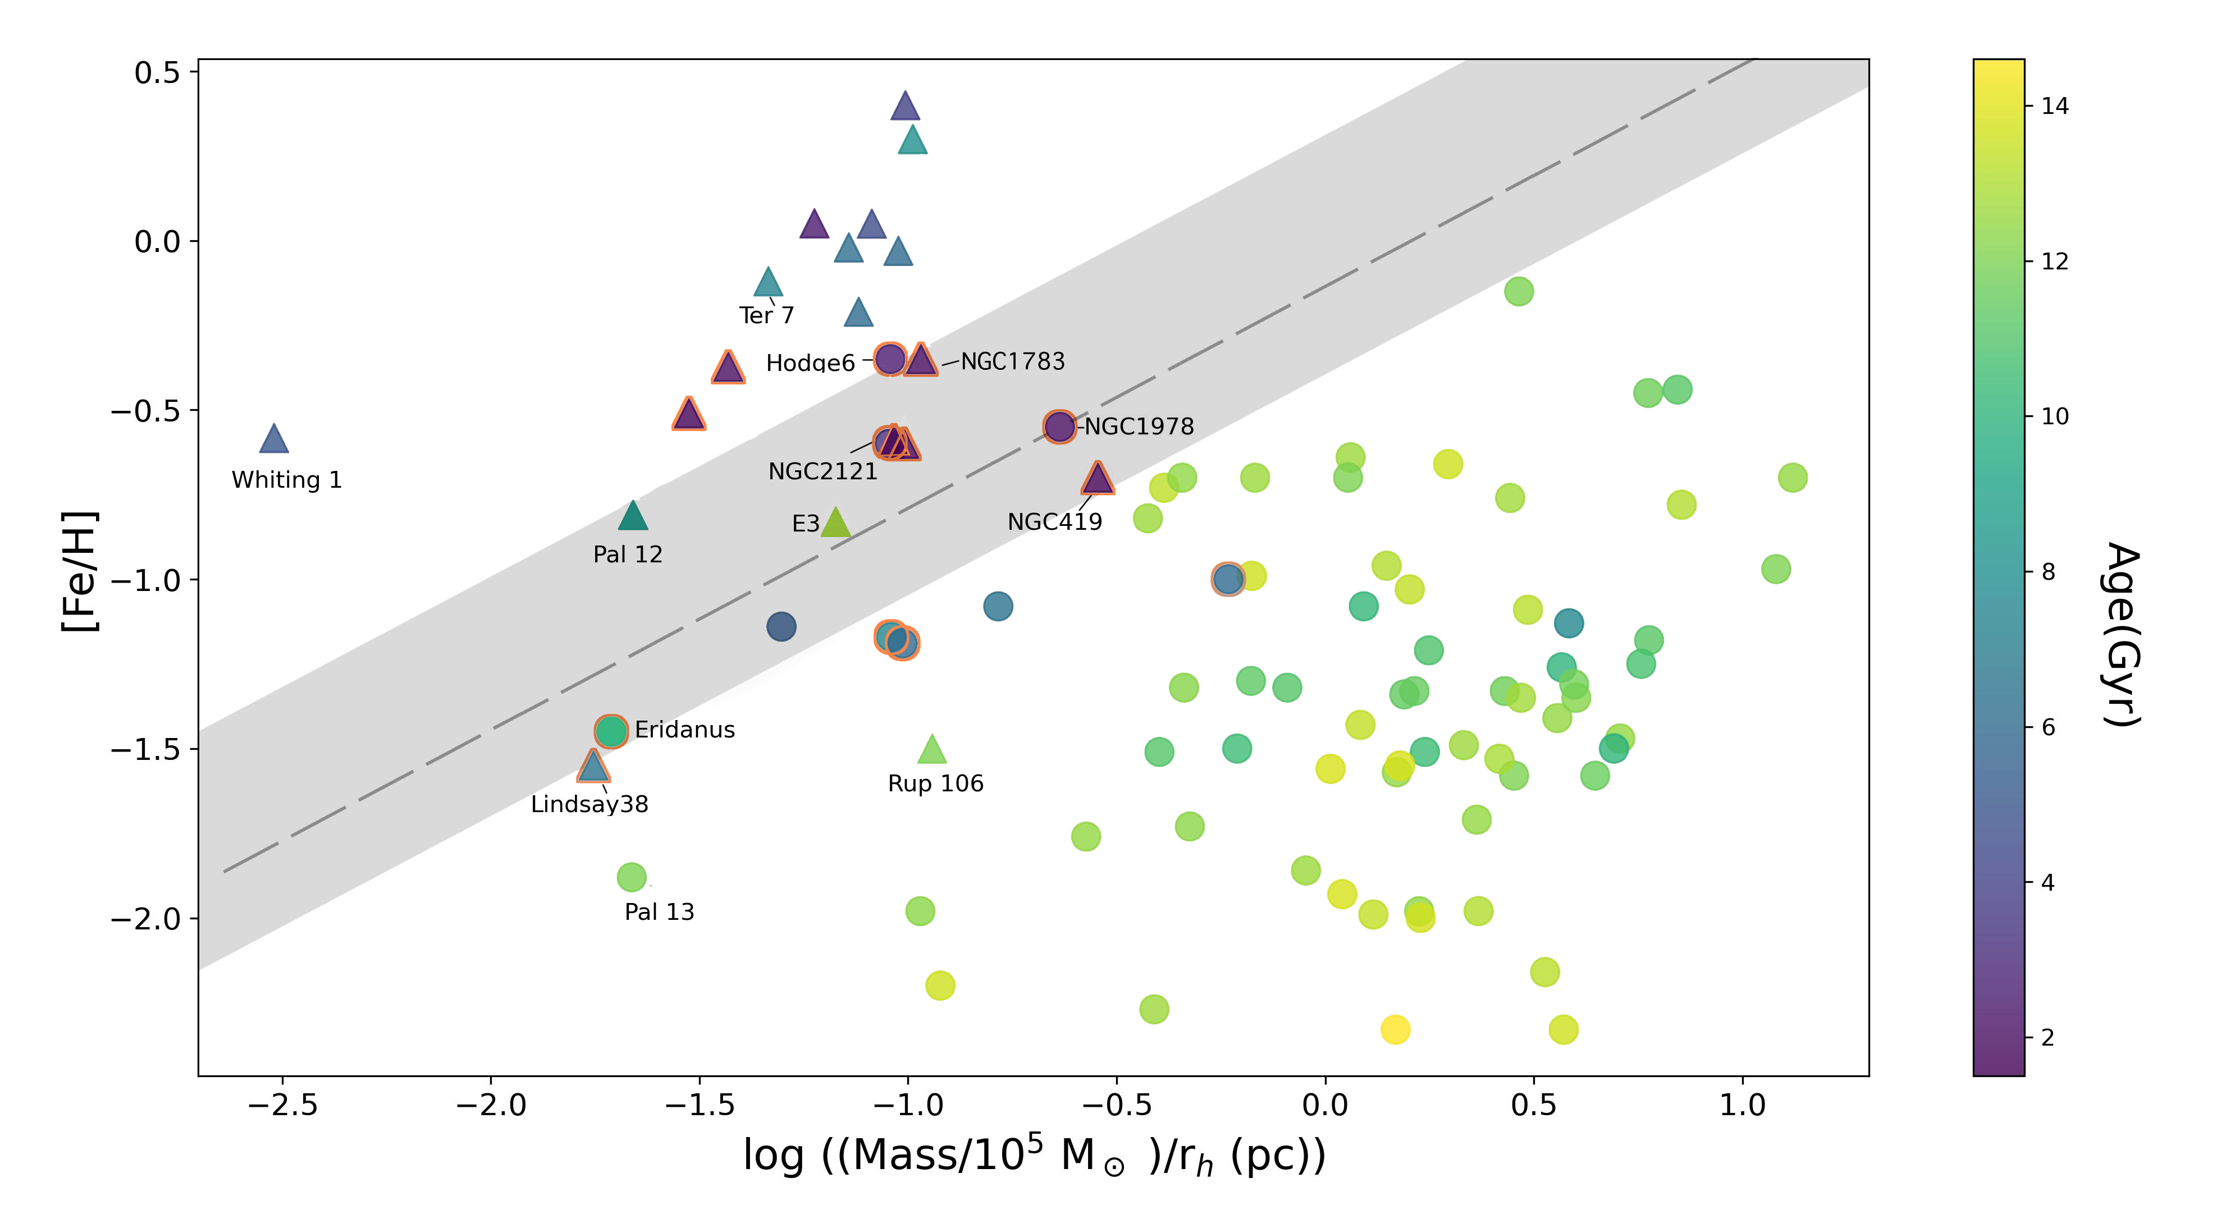
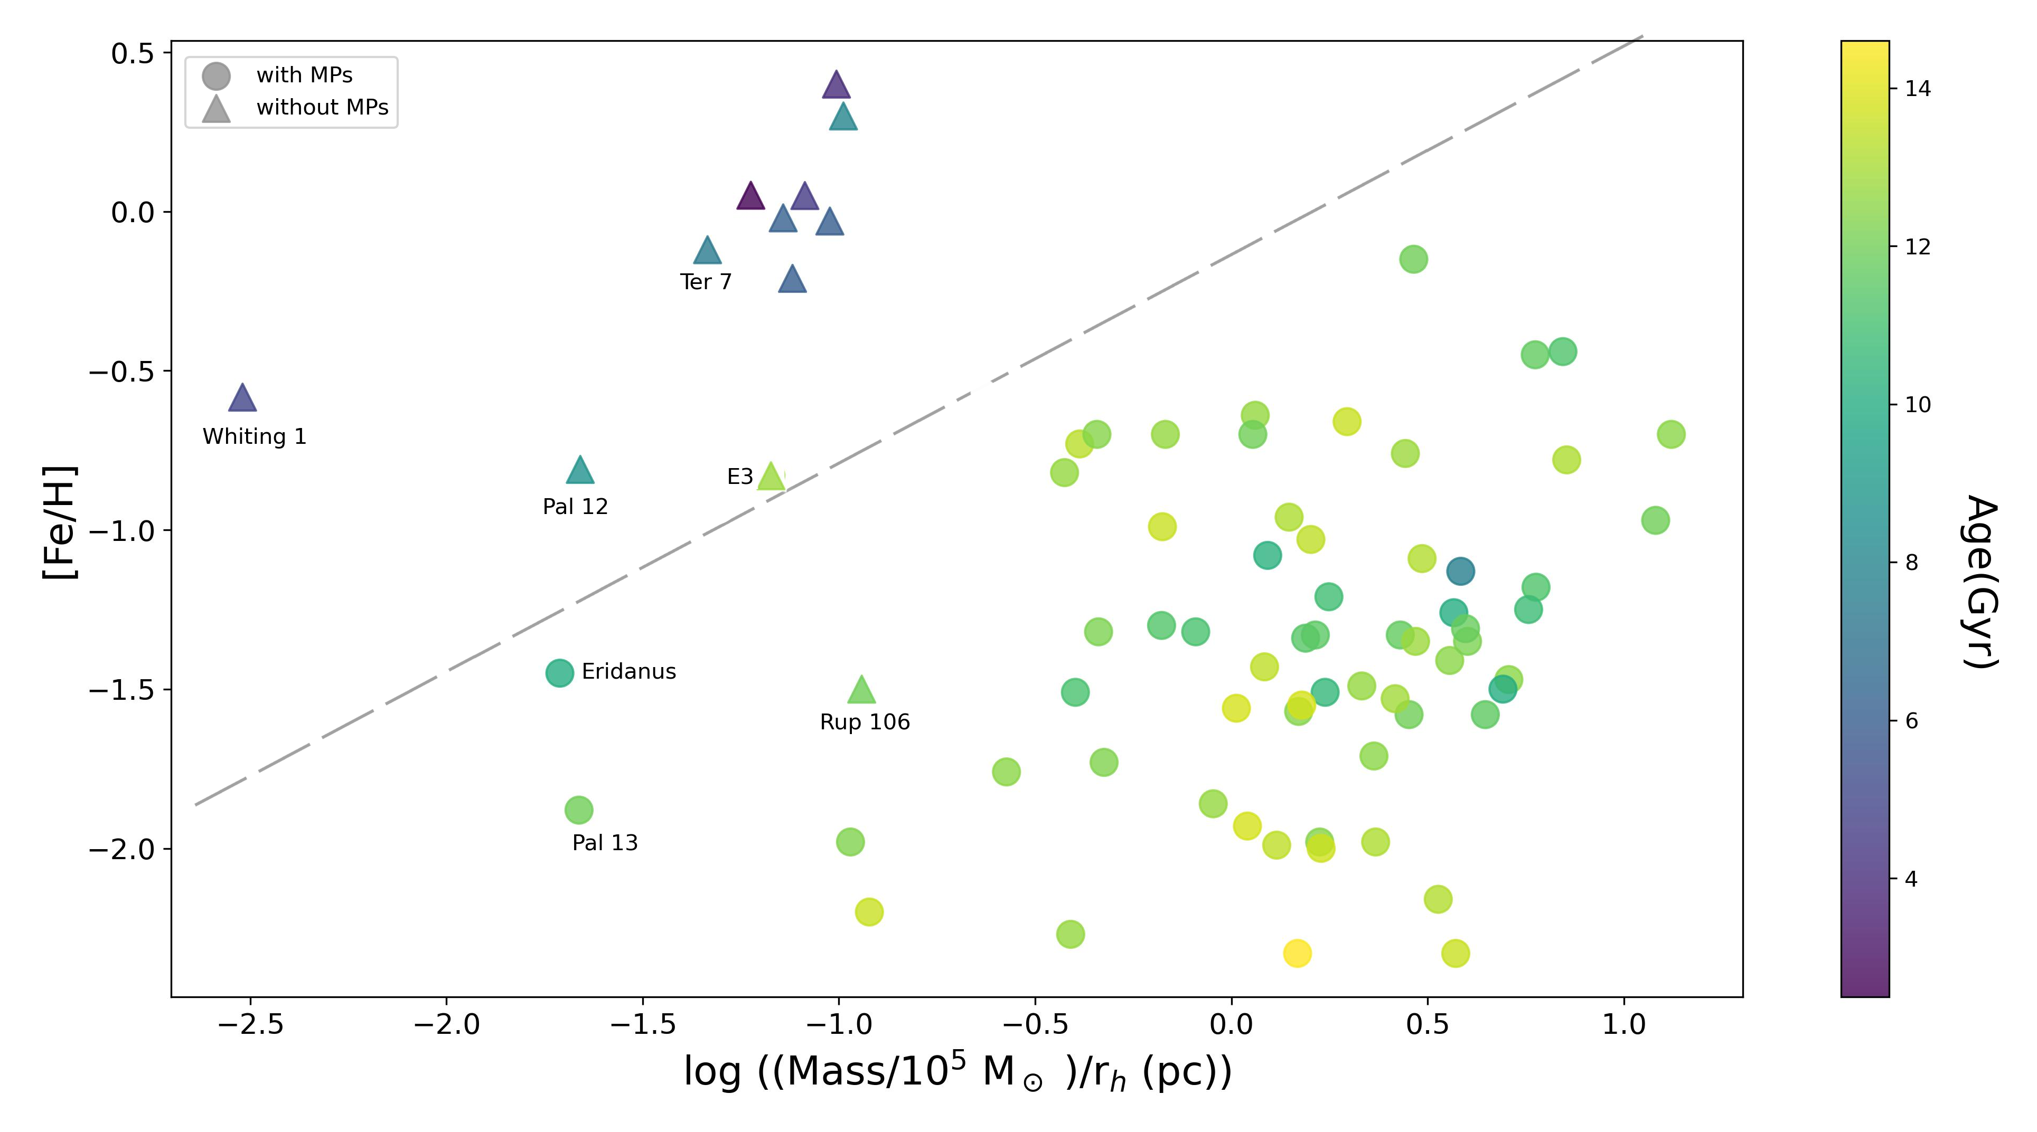

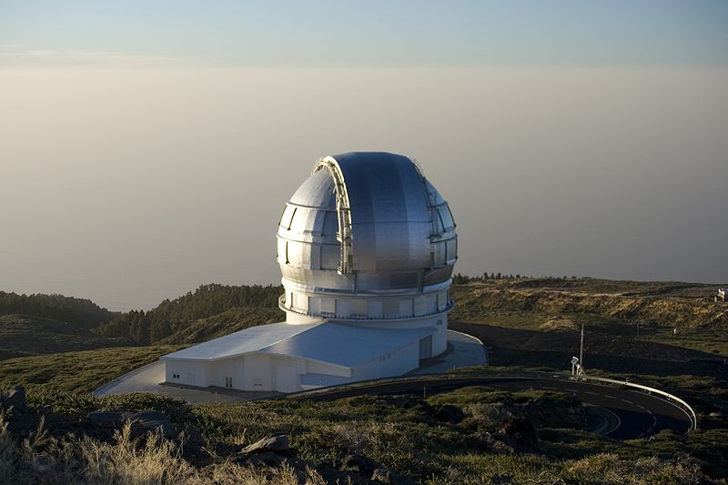
Driving factors behind MPs
The existence of MPs is related to metallicity and the compactness of star clusters.
Huang, Tang, et al. (2024) SCPMA
M2FS@Magellan
N6553, Tang+17
Wang, Tang et al. (2023) Eridanus
Tang, Wang et al. (2021) Pal 13
Li+20, Li+21
N5053, Tang+18
Yue Wang
OSIRIS@GTC
Notes:
Antonio & Gabriel
it’s probably not possible to determine the initial half-mass radius for the open clusters and many GCs as well. The reason is that the clusters are now tidally
filling and so essentially over a large range of starting radii the clusters would end up with the radii we see today since two-body relaxation will expand them until they
fill their tidal radii.

Slide 12
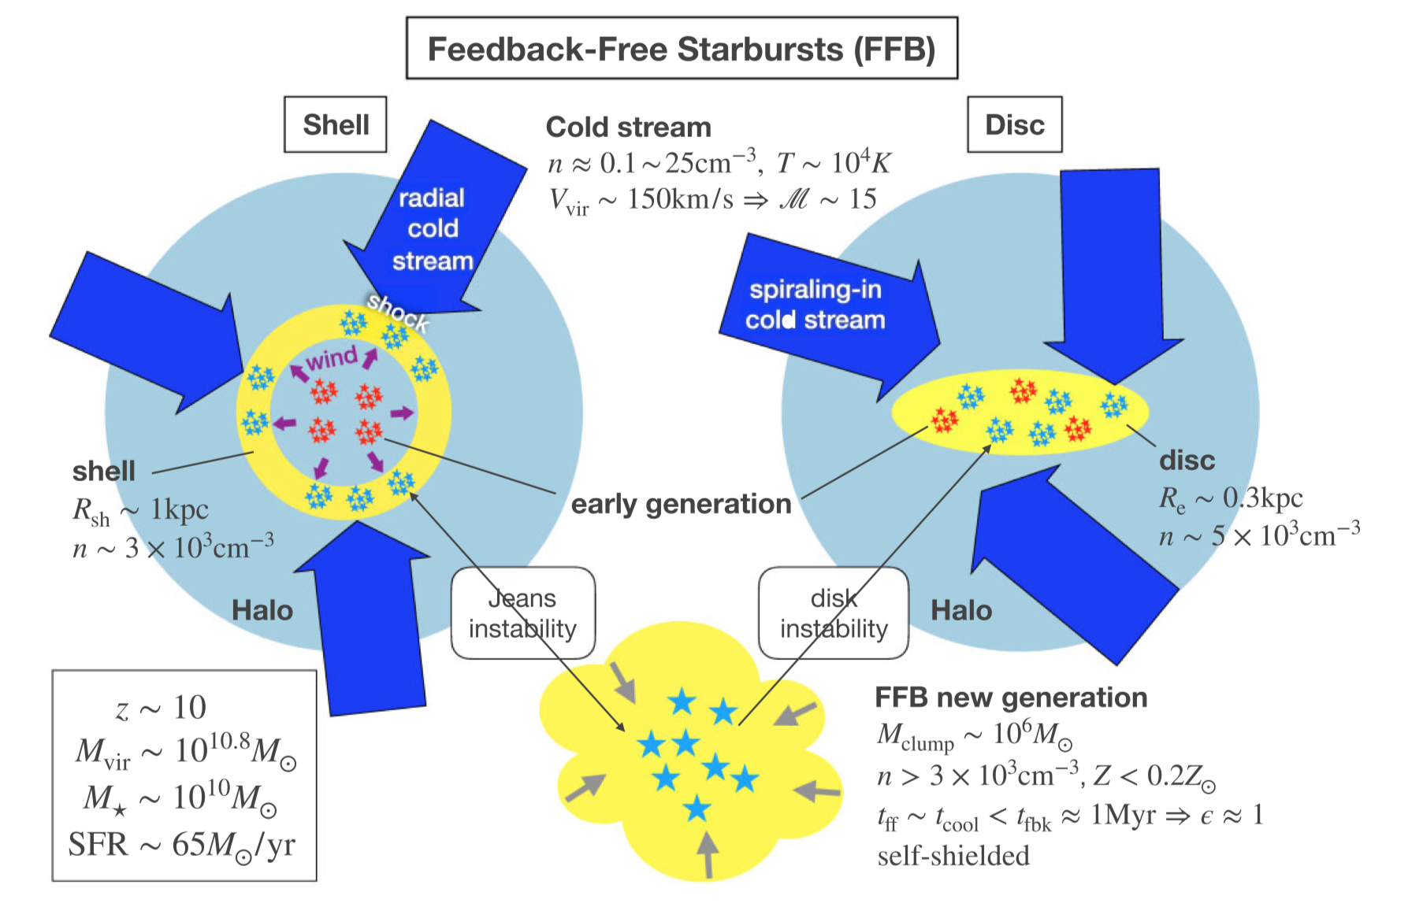
Extreme star formation
“We show that the high densities and low metallicities at this epoch guarantee a high star formation efficiency in the most massive dark-matter haloes. ” (Dekel+23)

Slide 13
Galactic globular clusters (GCs)
Galactic GCs were formed in different galaxies
Identifying their origins helps to constrain galaxy formation history
Traditionally classified using dynamics, but facing uncertainties due to Galactic potential evolution
Blue: MP; red: GE; green: Sag
orange: H99; brown: Sequoia pink: low-energy; cyan: high-energy
Massari +19

Slide 14
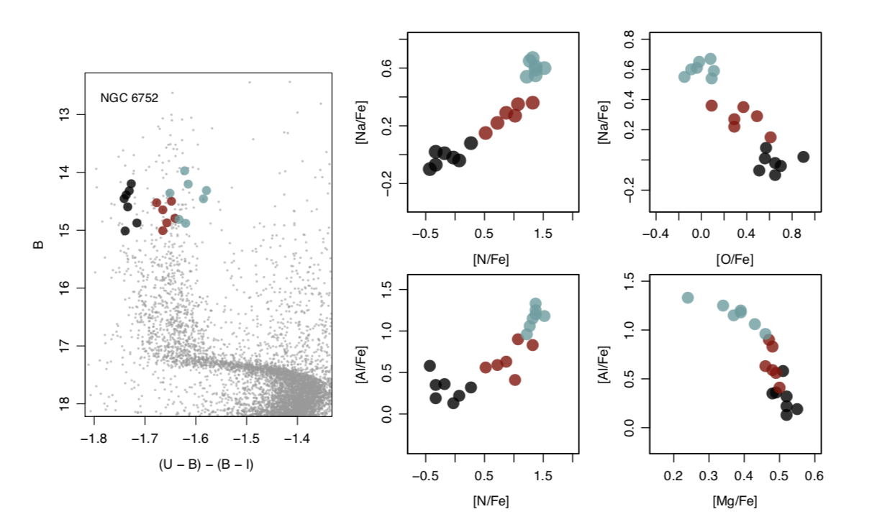
How about chemistry
Multiple populations!
Spread in C, N, O, Na, Mg, Al, etc.
Bastian & Lardo (2018)

Slide 15
How to separate the enrichment by galaxy and by GCs?
Lowest 1/3 population

Slide 16

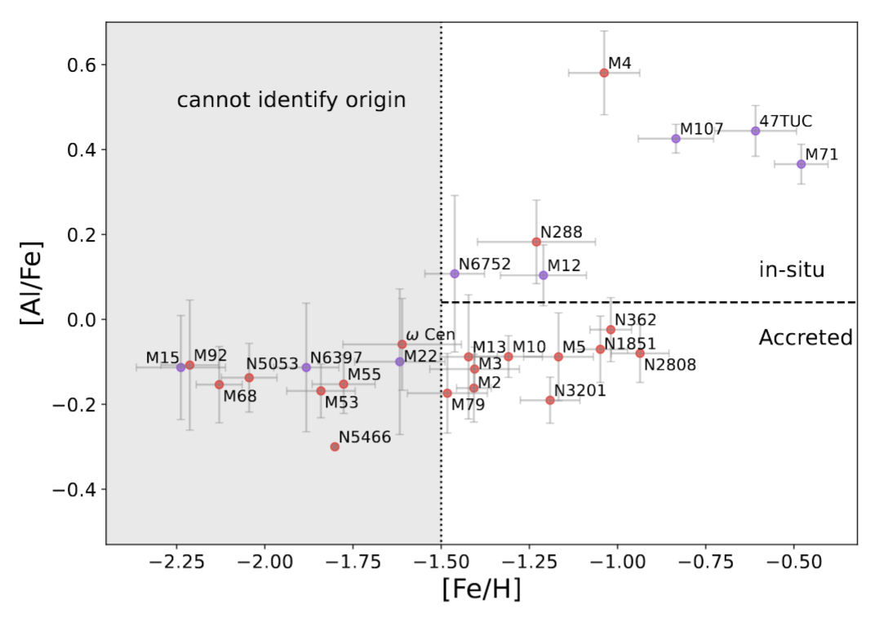
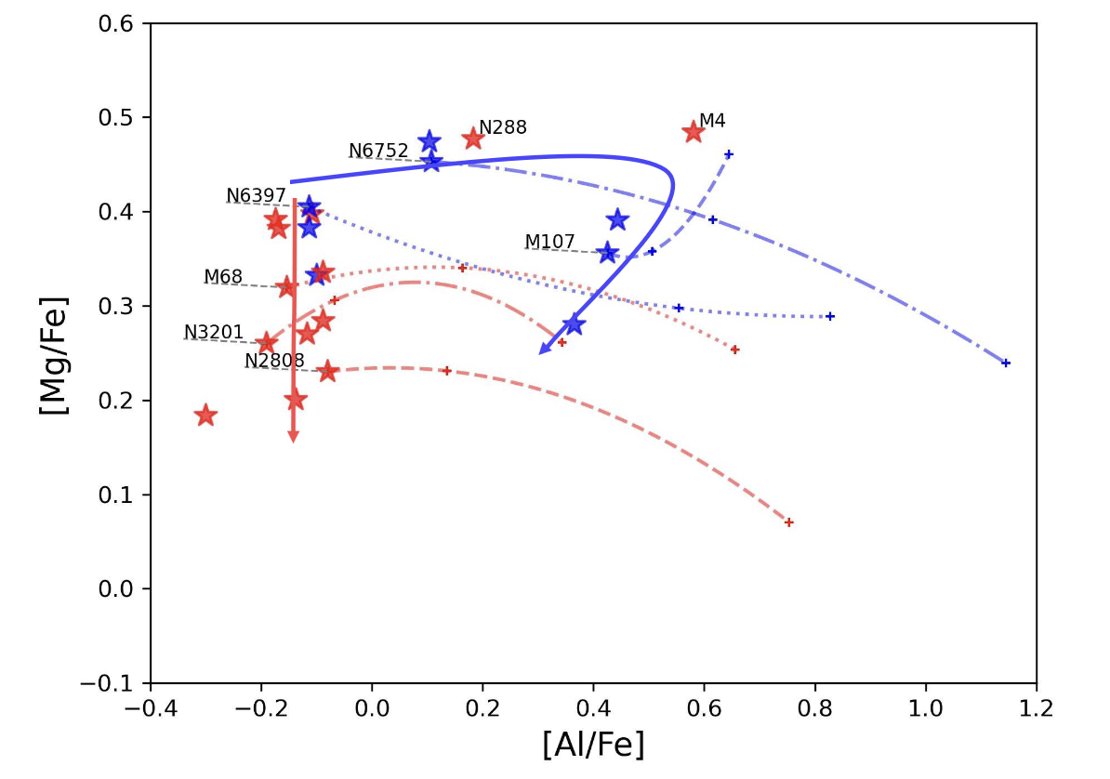
Chemically driven classification
Lin, Tang et al., 2025, ApJL

Slide 17
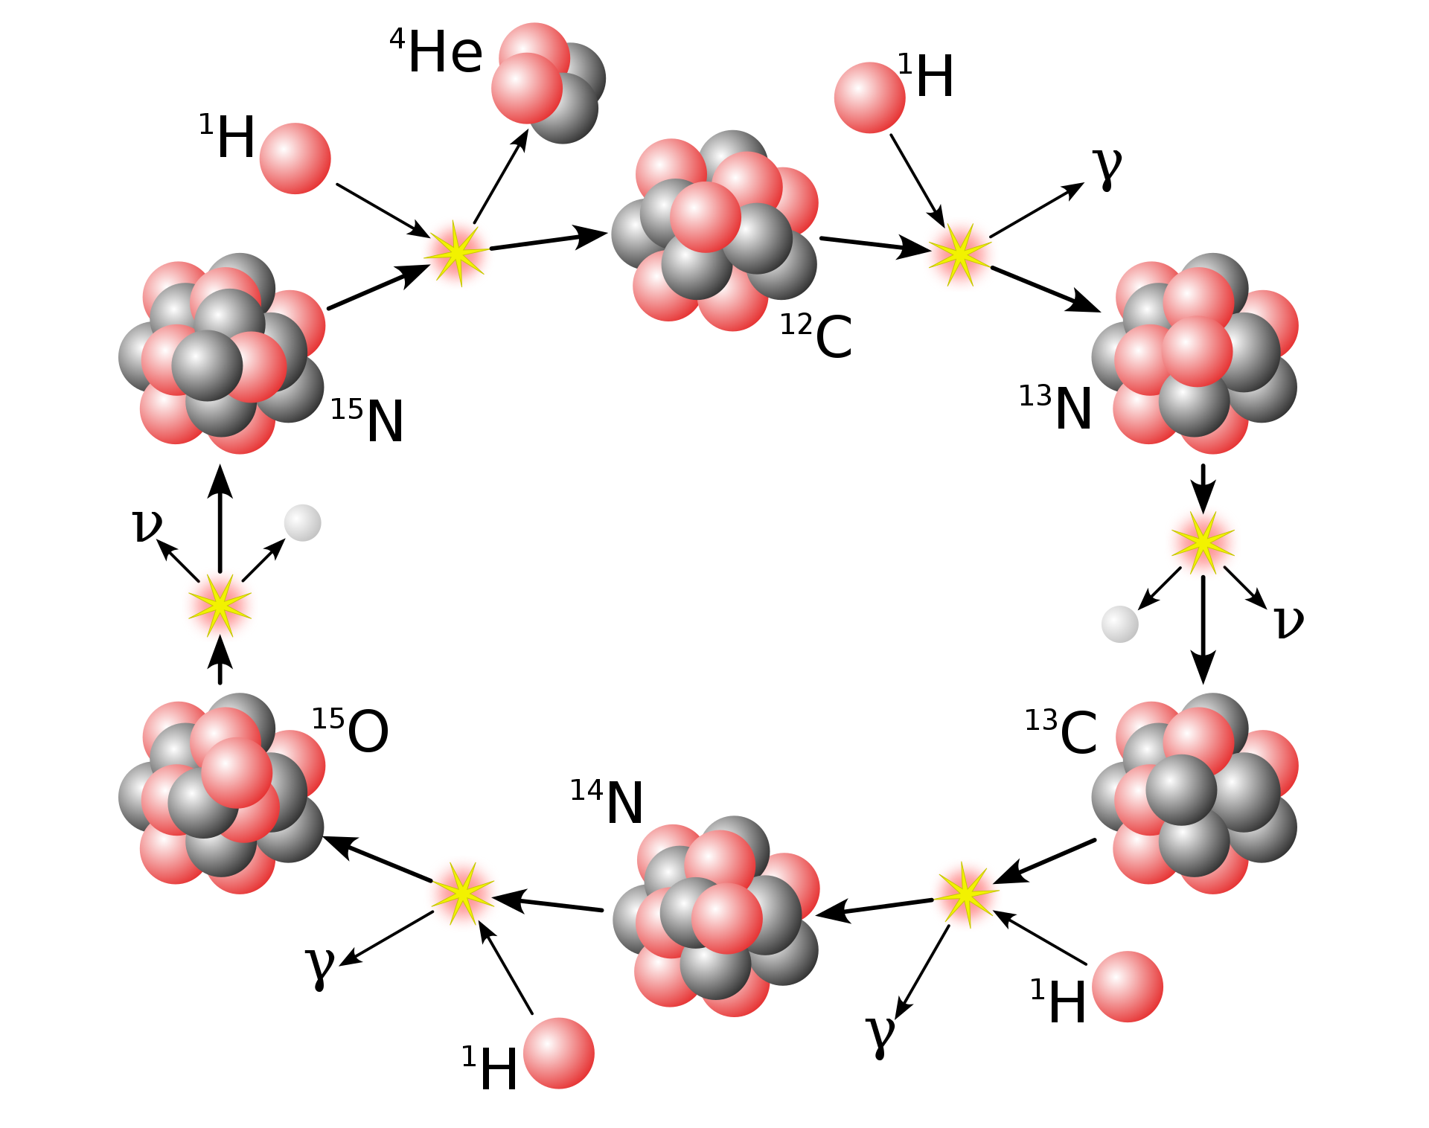
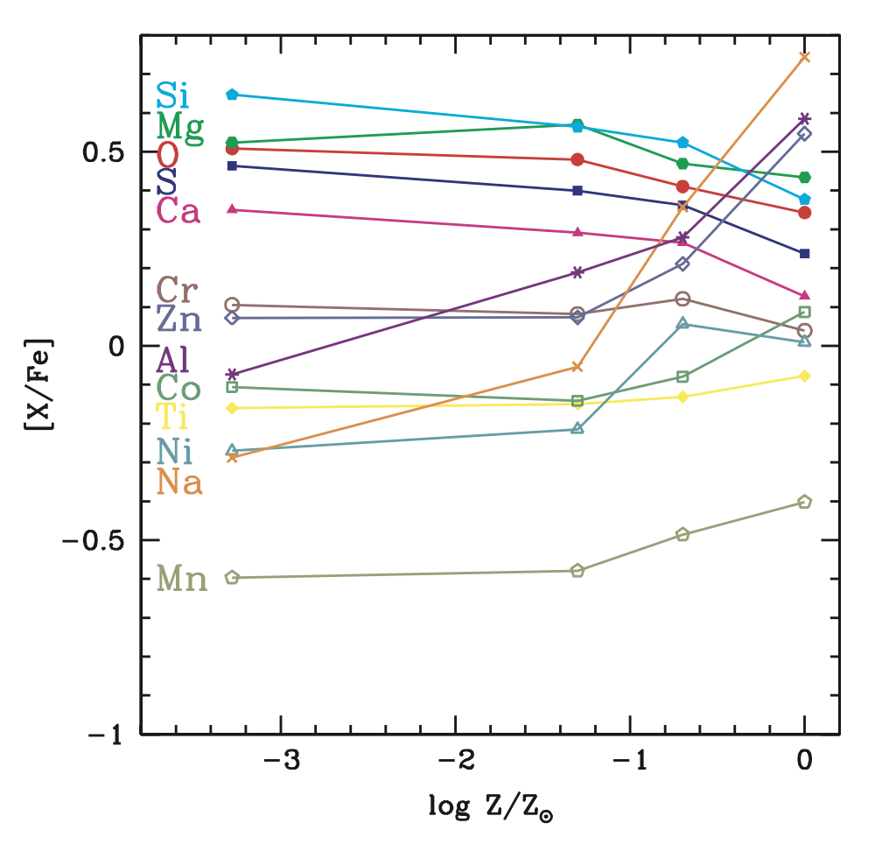



Nucleosynthesis
What about Al?
Primary nucleus ${}_{}^{12}C({}_{}^{12}C,p){}_{}^{23}{Na(α,p){}_{}^{26}{Mg}(p,γ){}_{}^{27}{Al}}$
Secondary nucleus ${}_{}^{14}N\left(α,γ\right){}_{}^{18}F\left(e^{+}υ\right){}_{}^{18}O\left(α,γ\right){}_{}^{22}{Ne}$ ${}_{}^{22}{Ne}$ produces surplus of neutrons
$${}_{}^{22}{Ne}\left(p,γ\right){}_{}^{23}{Na}$$
$${}_{}^{23}{Na}(α,p){}_{}^{26}{Mg}(p,γ){}_{}^{27}{Al}$$
Kobayashi+06

Slide 18
Nucleosynthesis
SNe Ia produces a lot of Fe peak elements, which affects dwarf galaxies and MW at different Z.
Dwarf galaxies
SNe Ia starts
MW
SNe Ia starts

Slide 19
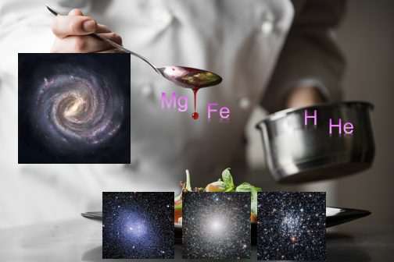
Gastronomi: Scrutinizing Galaxy-star cluster coevolution with Chemodynamics
Chemical abundances of MW satellites alpha elements, [Al/Fe] IMF from GCE models
Galaxy-Star cluster coevolution
Chemically driven GC classification a whole new scheme

Slide 20
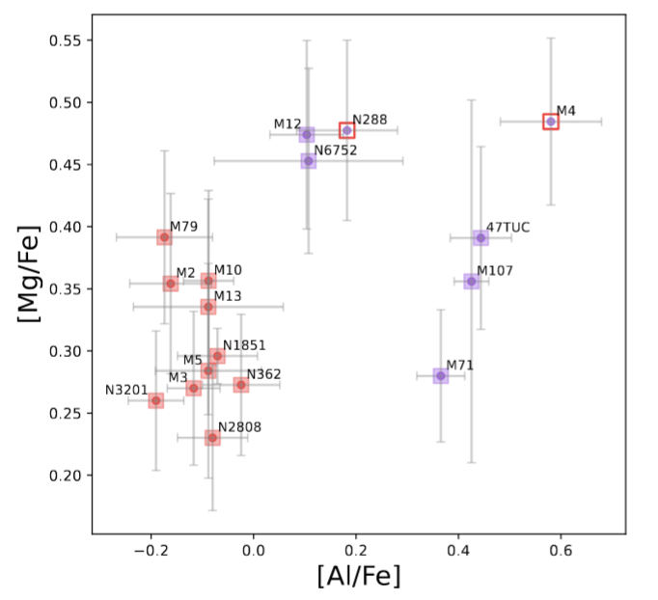
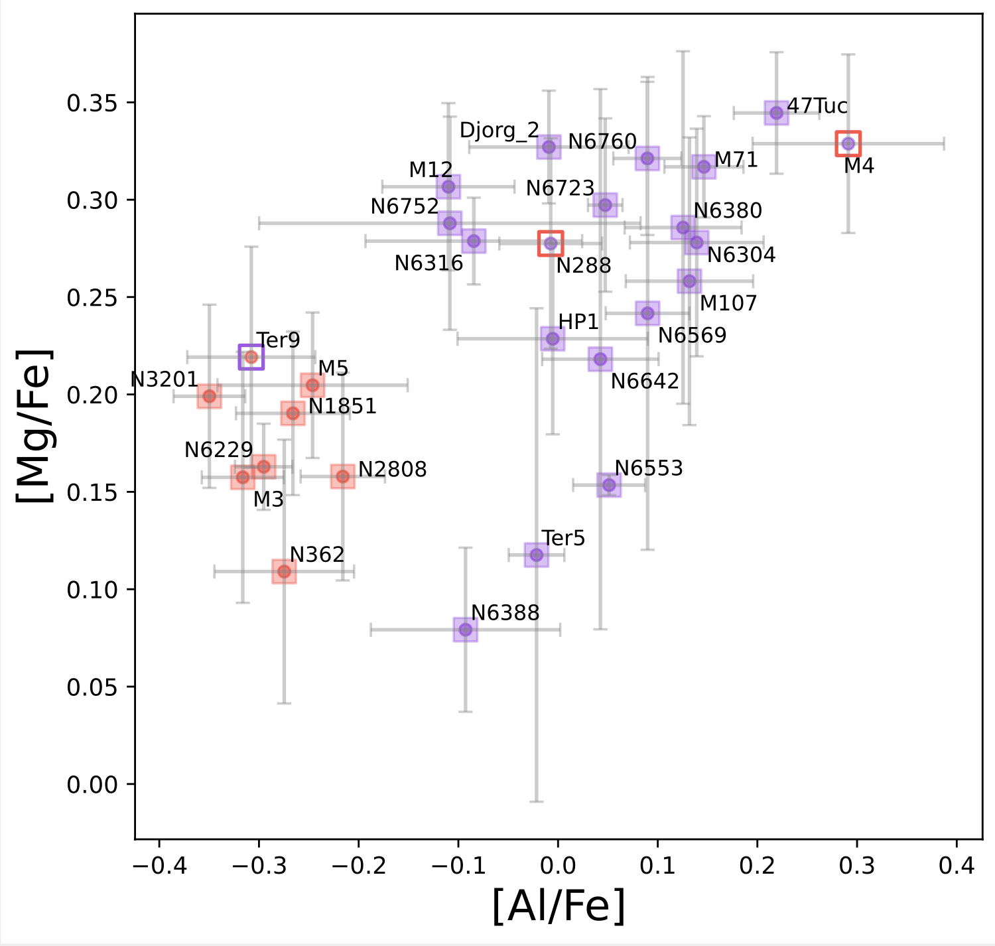
Chemically driven classification
Extended Sample

Slide 21
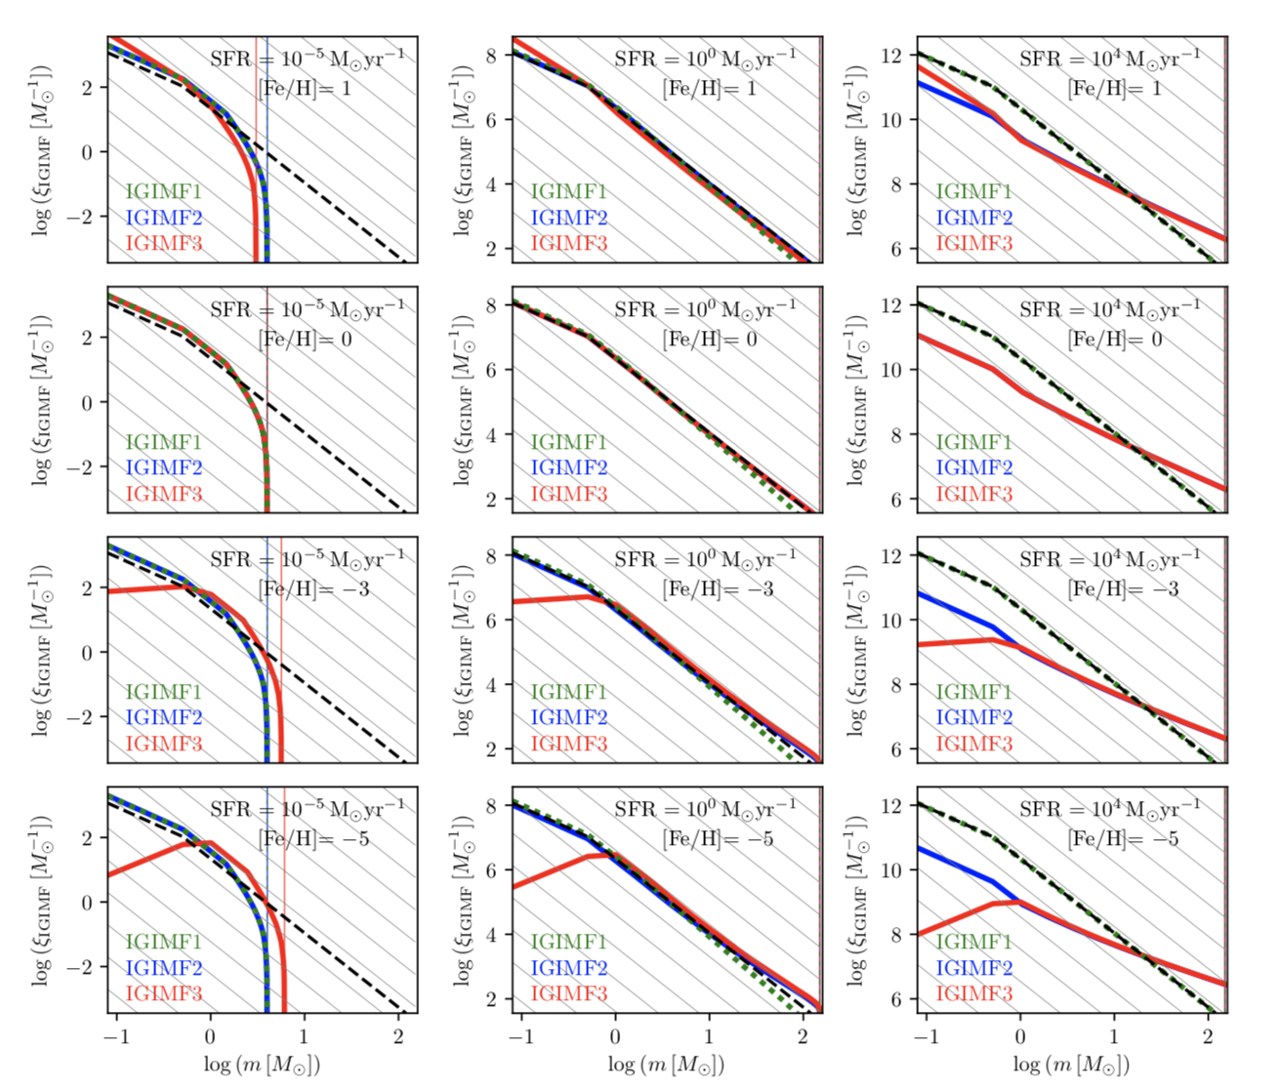
IMF, [Fe/H] and SFR
Jerabkova et al. (2018)

Slide 22
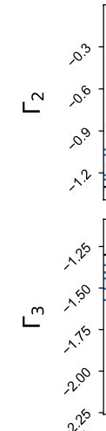
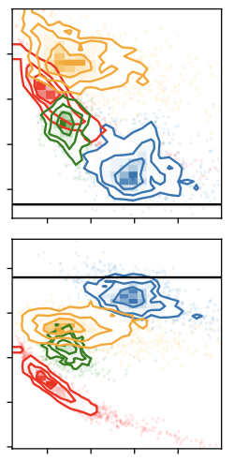
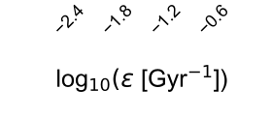
Low star formation efficiency
No GCs, nor N-rich field stars in Scl → Lack dense star formation → Low SF efficiency
The gas content in Scl may be perturbed and diffused by the energy feedback of the star formation activity or external interactions.
The metal-poor gas lacks coalescents, which also inhibits the process of cooling and efficient star formation
Slope of IMF low mass stars
MW
Slope of IMF high mass stars
Scl
star formation efficiency
Zhiqiang Yan+ in prep.

