Slide 1



CHINA-CHILE BILATERAL CONFERENCE 2026
Probing the nature and evolution of JWST’s little red dots
Linhua Jiang (江林华)
School of Physics & Kavli Institute for Astronomy and Astrophysics, Peking University
2026 Jan 4-9 ⋅ Hong Kong

Slide 2

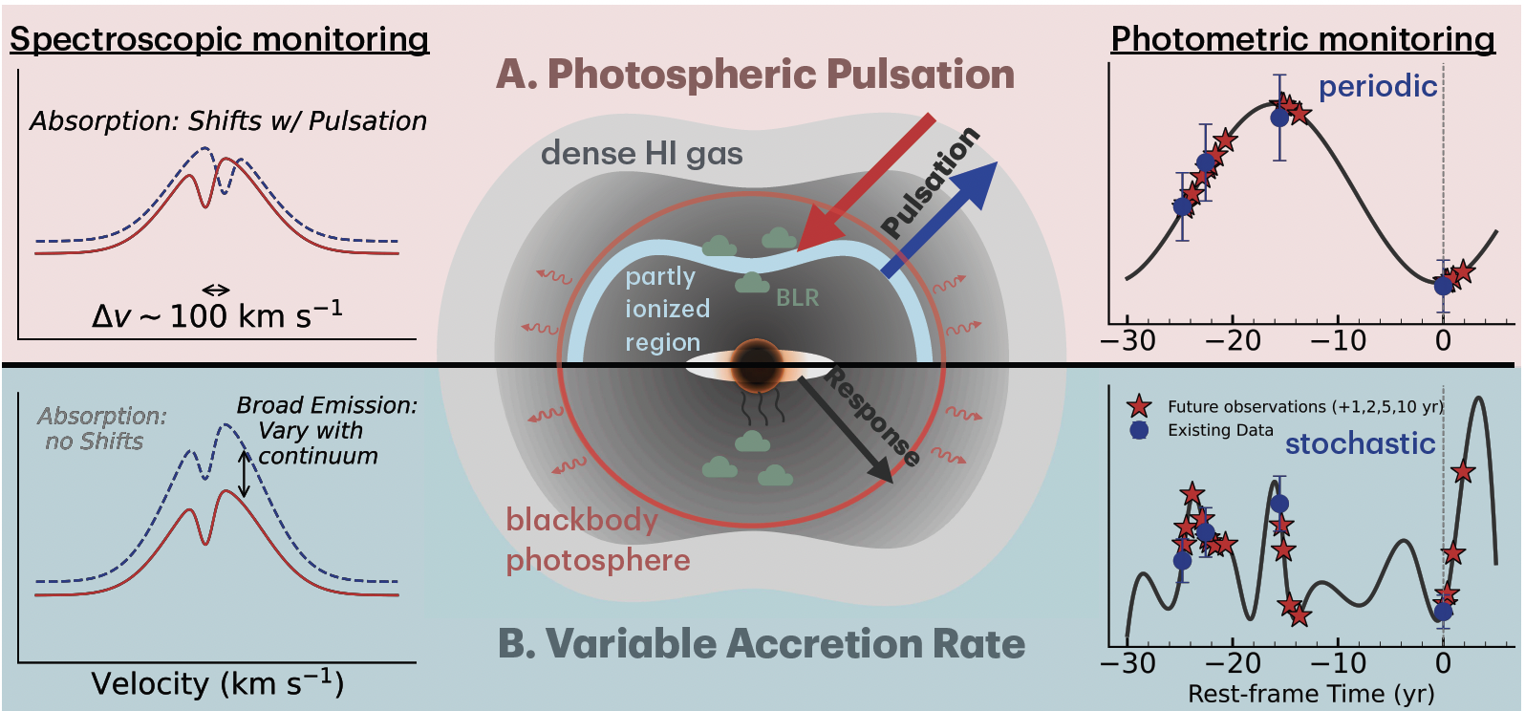
Contents
Introduction
Optical variability of little red dots (LRDs)
Narrow line LRDs
Two LRDs transitioning into quasars
LRD/AGN contribution to cosmic reionization
Summary
One LRD paper
in arXiv every day
Conceptional models of LRD dense gas envelopes
(Zhang, …, LJ, et al. 2026)
Notes:
一块块不完备的拼图。

Slide 3
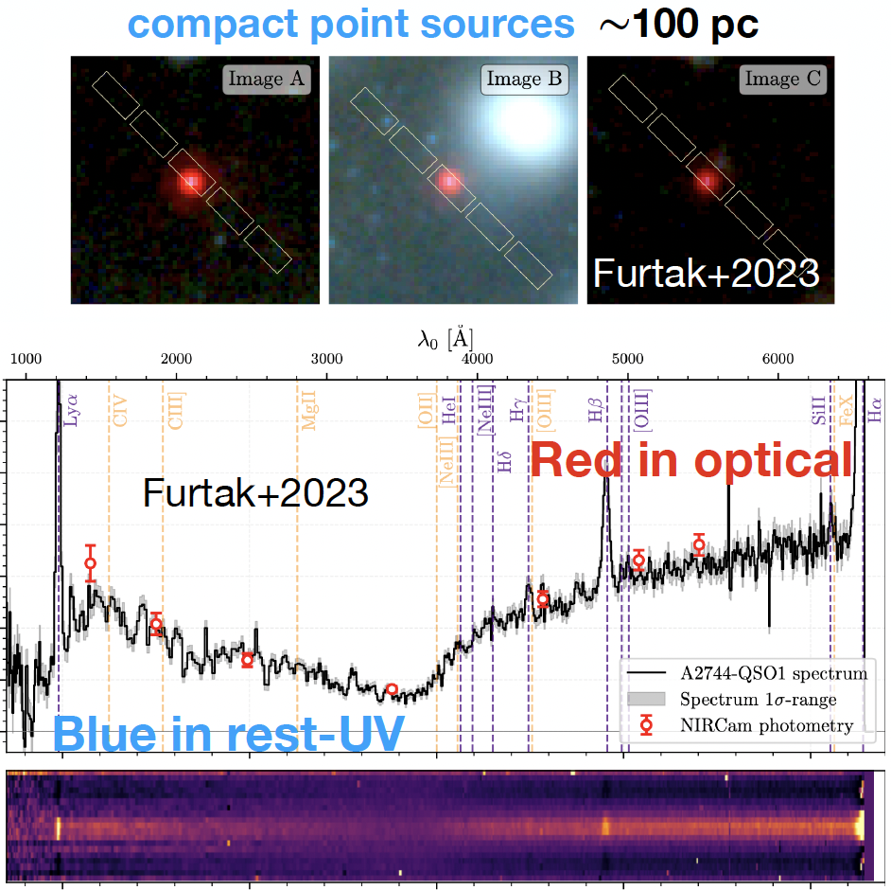
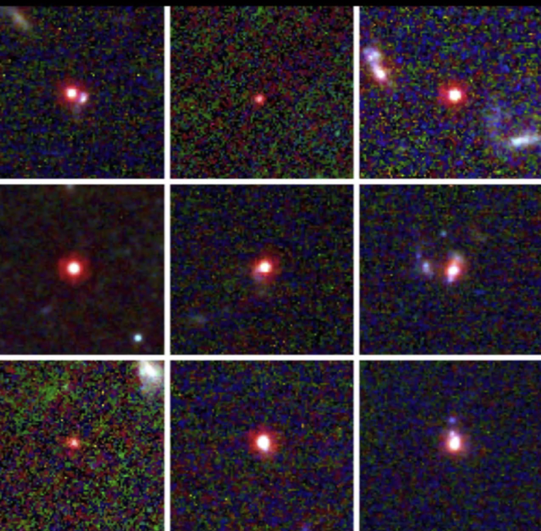
Introduction: little red dots (LRDs)
General properties of LRDs
“Little” + “red” + “V” shape
Compact in JWST NIRcam LW bands
(Refs: Furtak+2023; Labbé+2023; Matthee+2023; …)

Slide 4
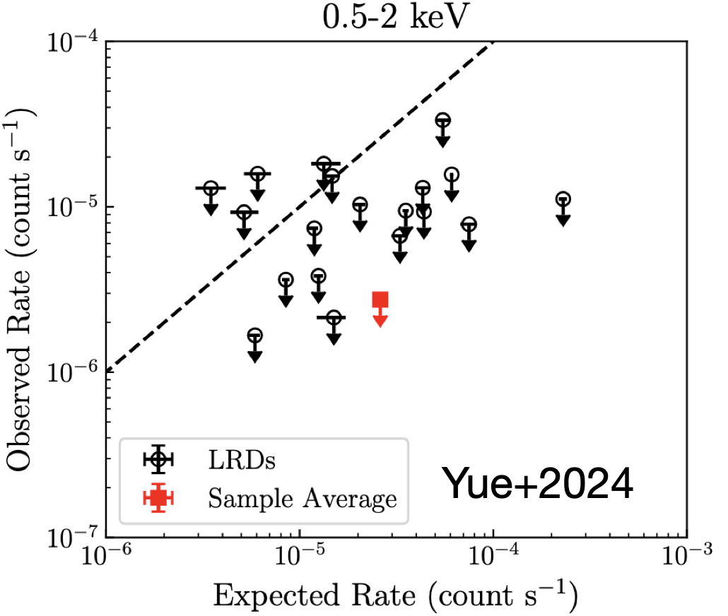
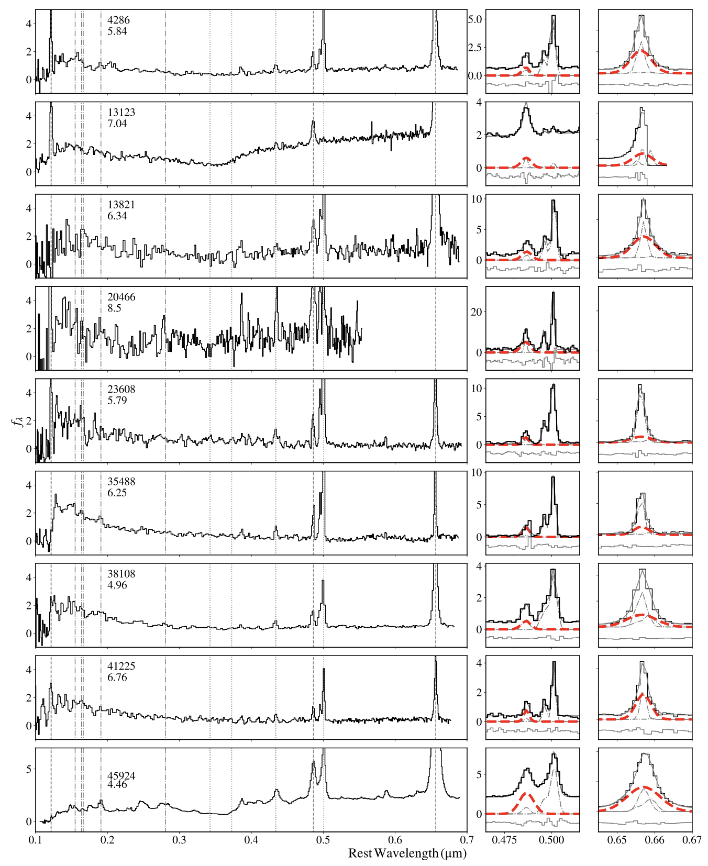
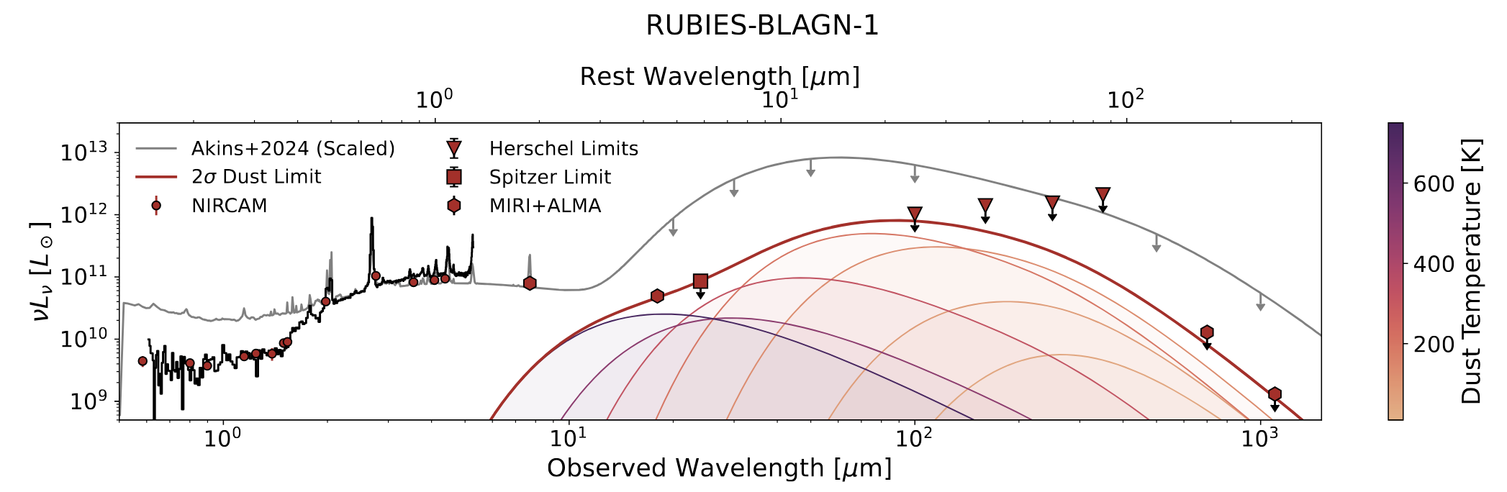
Introduction: LRDs
General properties of LRDs
“Little” + “red” + “V” shape + broad Balmer lines?
AGN?
X-ray weak
Weak dust emission
(Refs: Greene+2024; Yue+2024; Setton+2025; …)

Slide 5
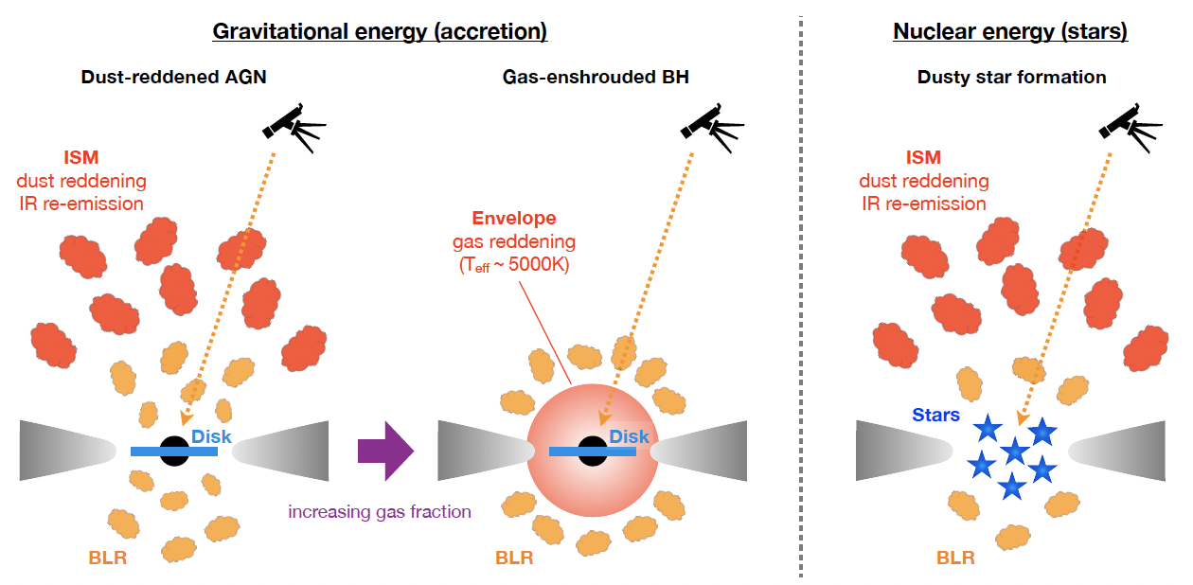
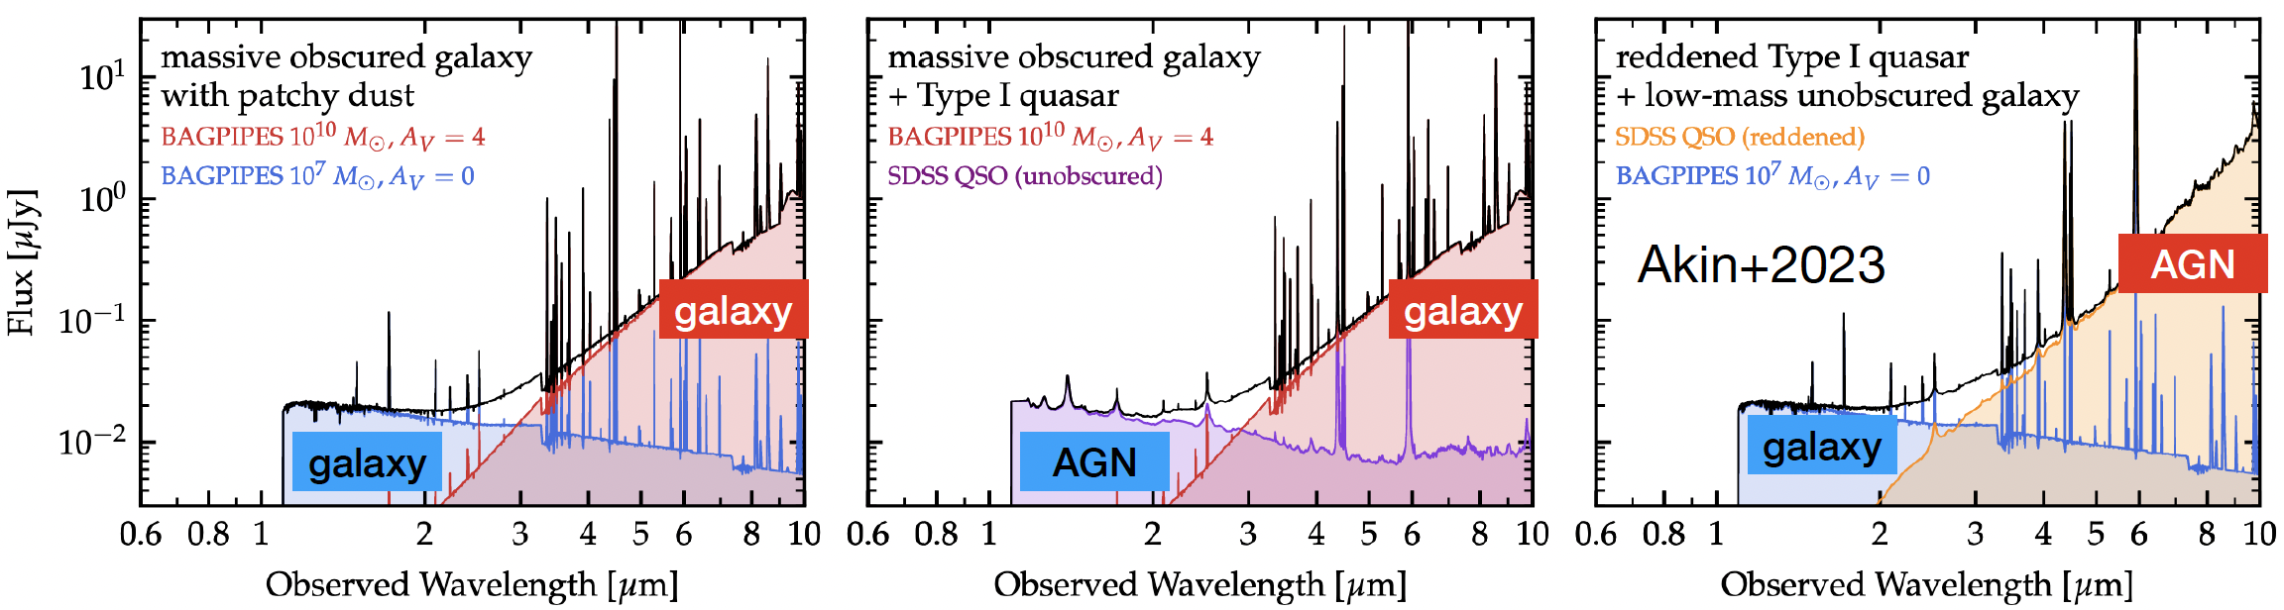
What are LRDs
A new type of galaxies? AGNs?
Combination of AGN and galaxies?
Super-Eddington accretion + dense gas envelop?
……
(Refs: Akin+2023; Inayoshi & Ho 2025; …)

Slide 6
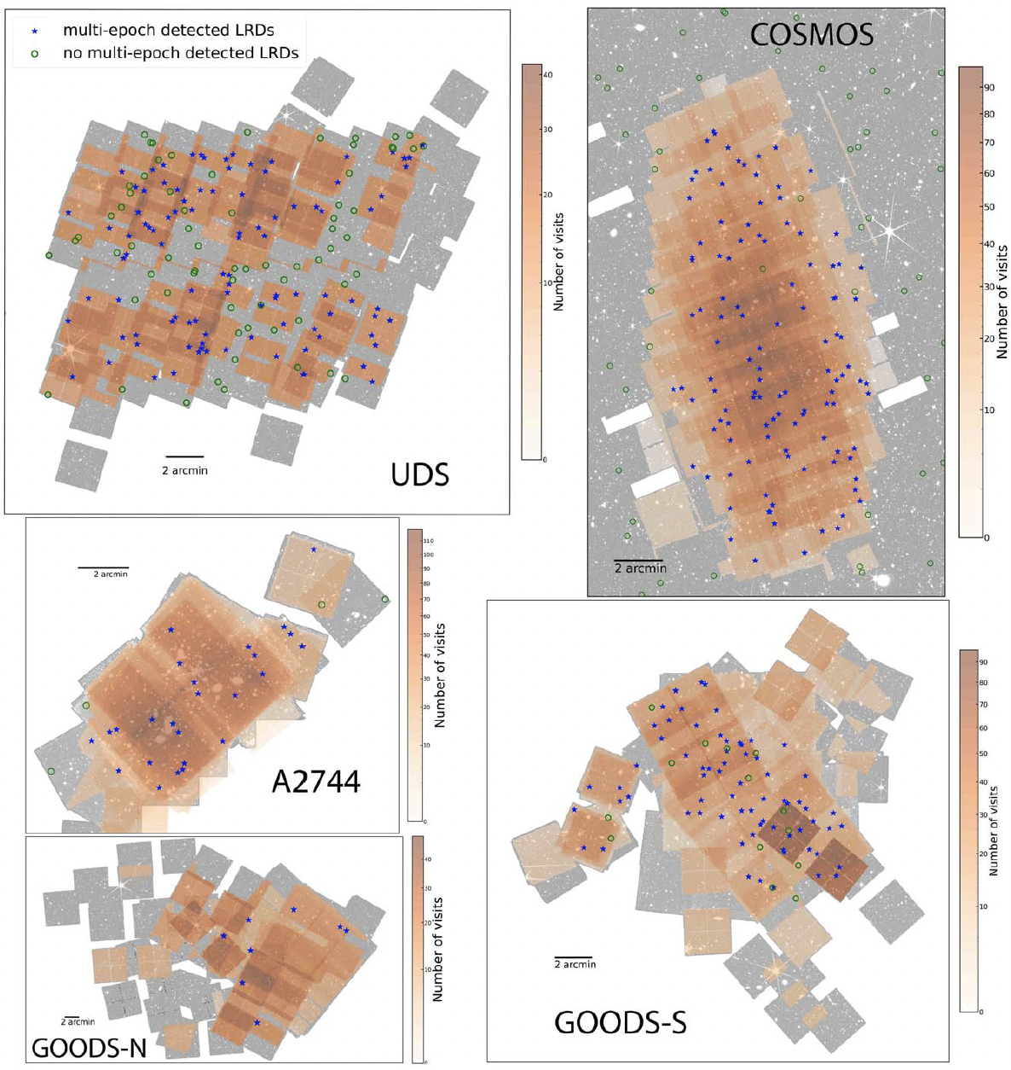
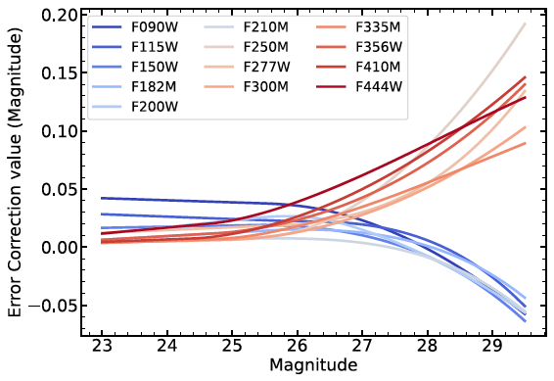
Optical variability of LRDs
Five fields: GOODS, COSMOS, UDS, A2744
>314 LRDs with multi-epoch JWST observations
Systematic offsets of photometric zero-points identified
(Zhang, LJ, et al. 2025, ApJ, 985,119)

Slide 7

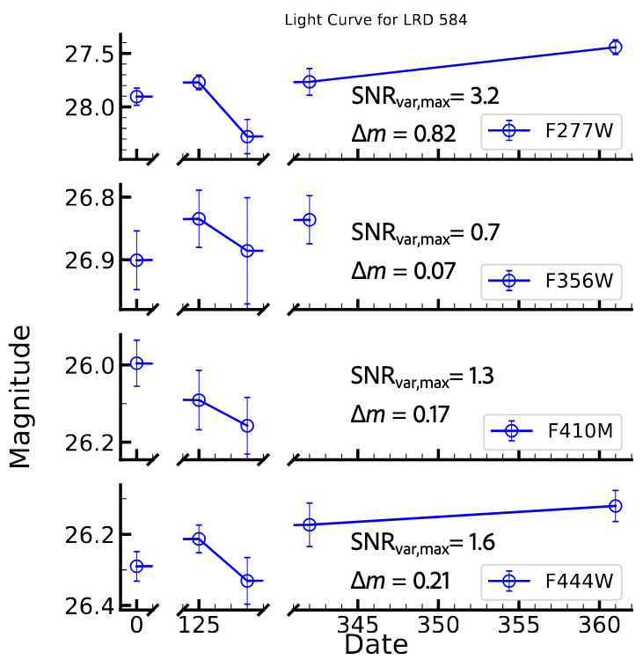
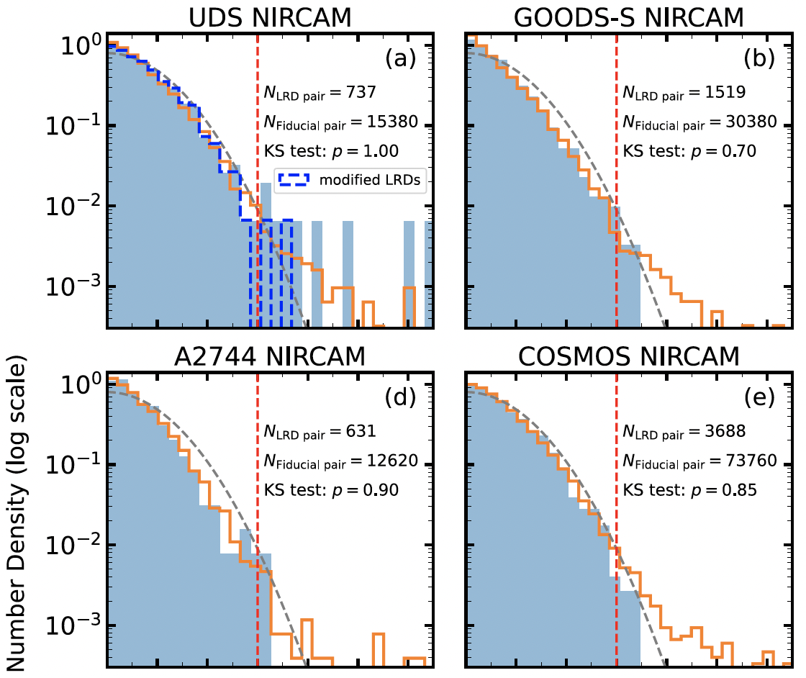
LRDs on average do not show strong variability
Only a tiny fraction of them show strong variability
comparison between LRDs and non-LRDs
(Zhang, LJ, et al. 2025, ApJ, 985,119)

Slide 8
Implications
Super-Eddington accretion of SMBHs in AGNs/LRDs?
LRDs are dominated by galaxies, not AGNs?
LRD dense gas envelopes block central AGNs? (model dependent)
Future JWST observations

Slide 9
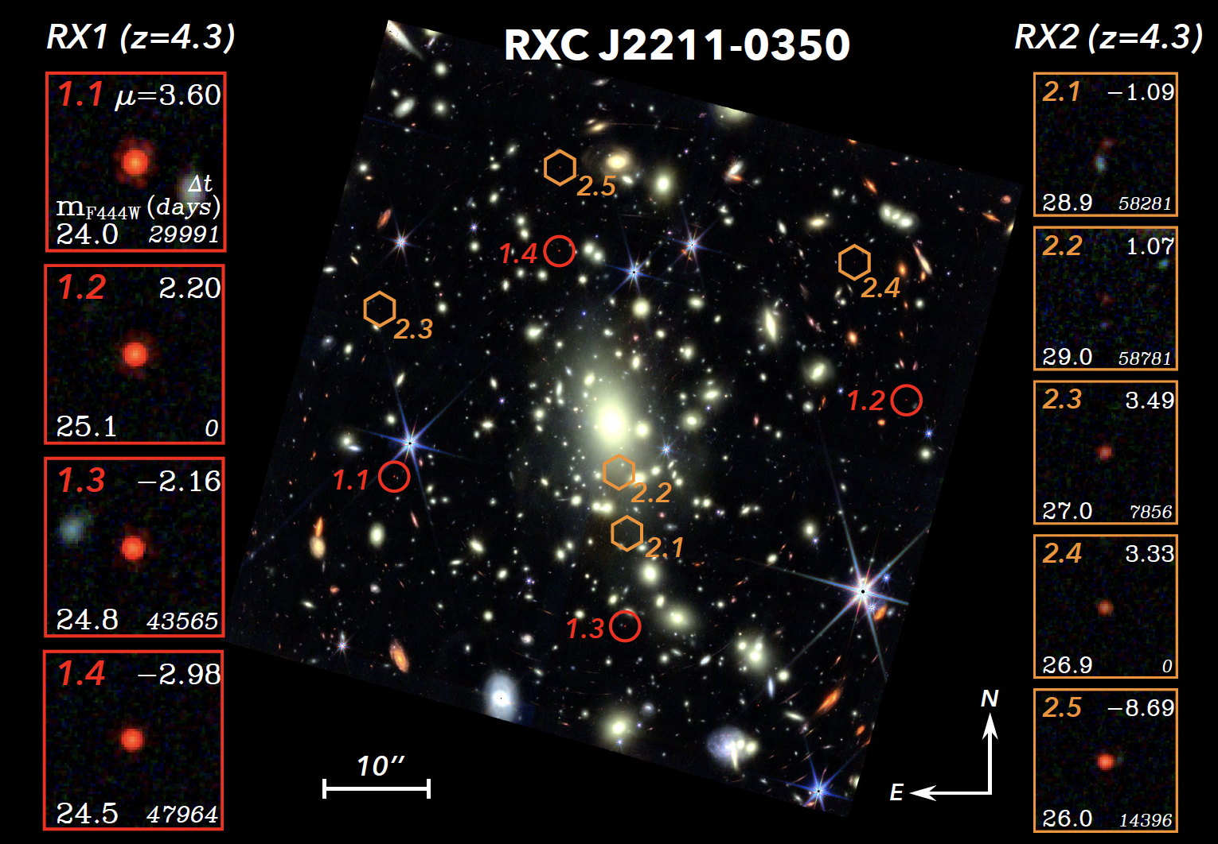
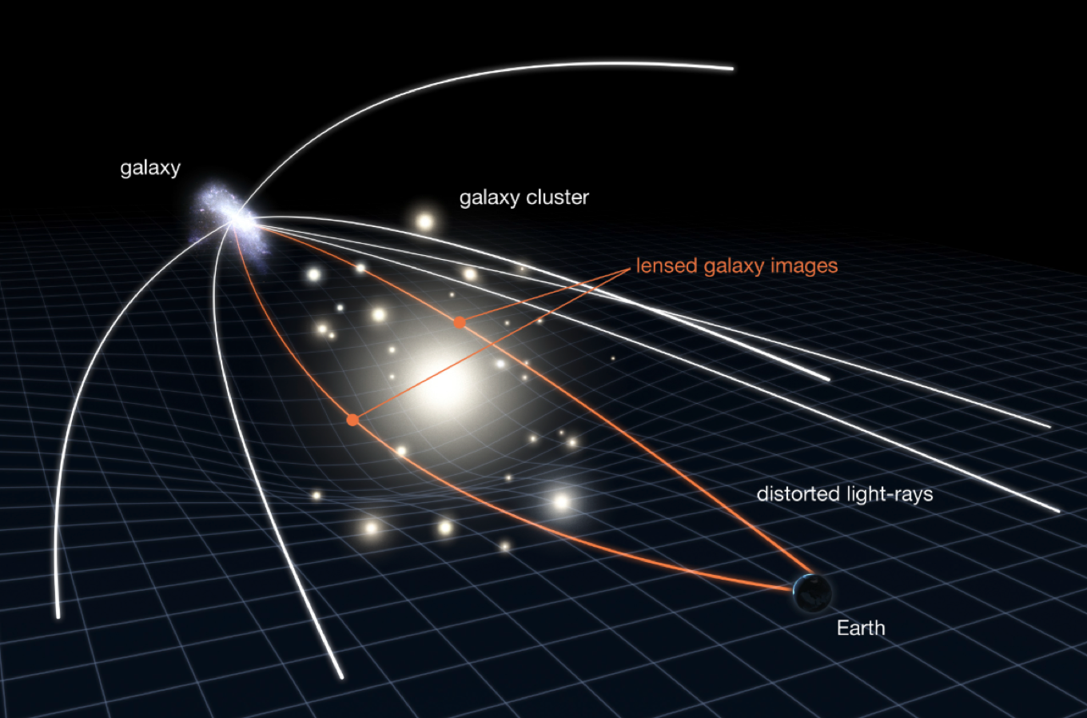
LRD with a variability detection over a century
Two LRDs at z~4.3 behand a cluster
Well derived lensing model with ~150 multiple images
Time delays > 100 yrs (rest-frame ~ 20 yrs)
(Zhang, ..., LJ, et al. 2026, submitted, arXiv:2512.05180)

Slide 10
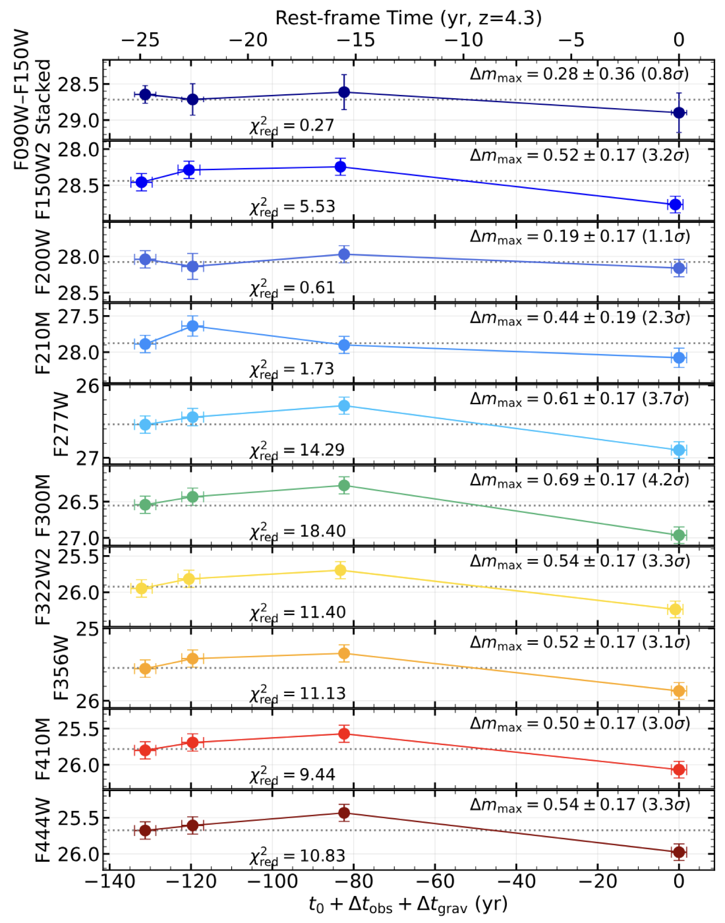
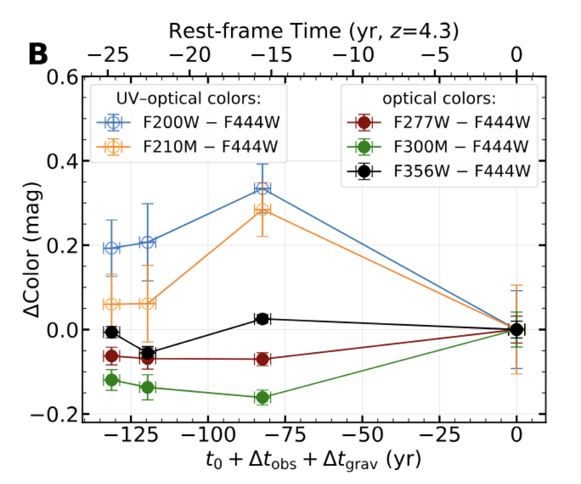
One LRD shows strong variabilities in broad-band photometry and colors

Slide 11
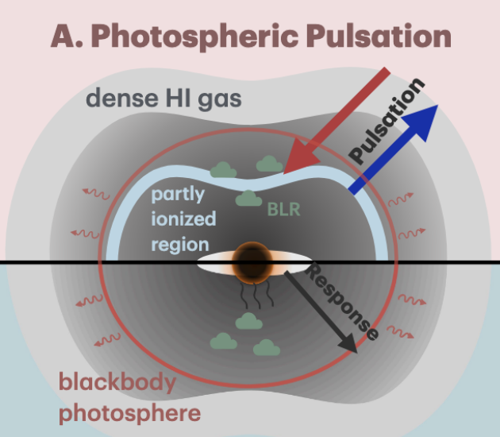
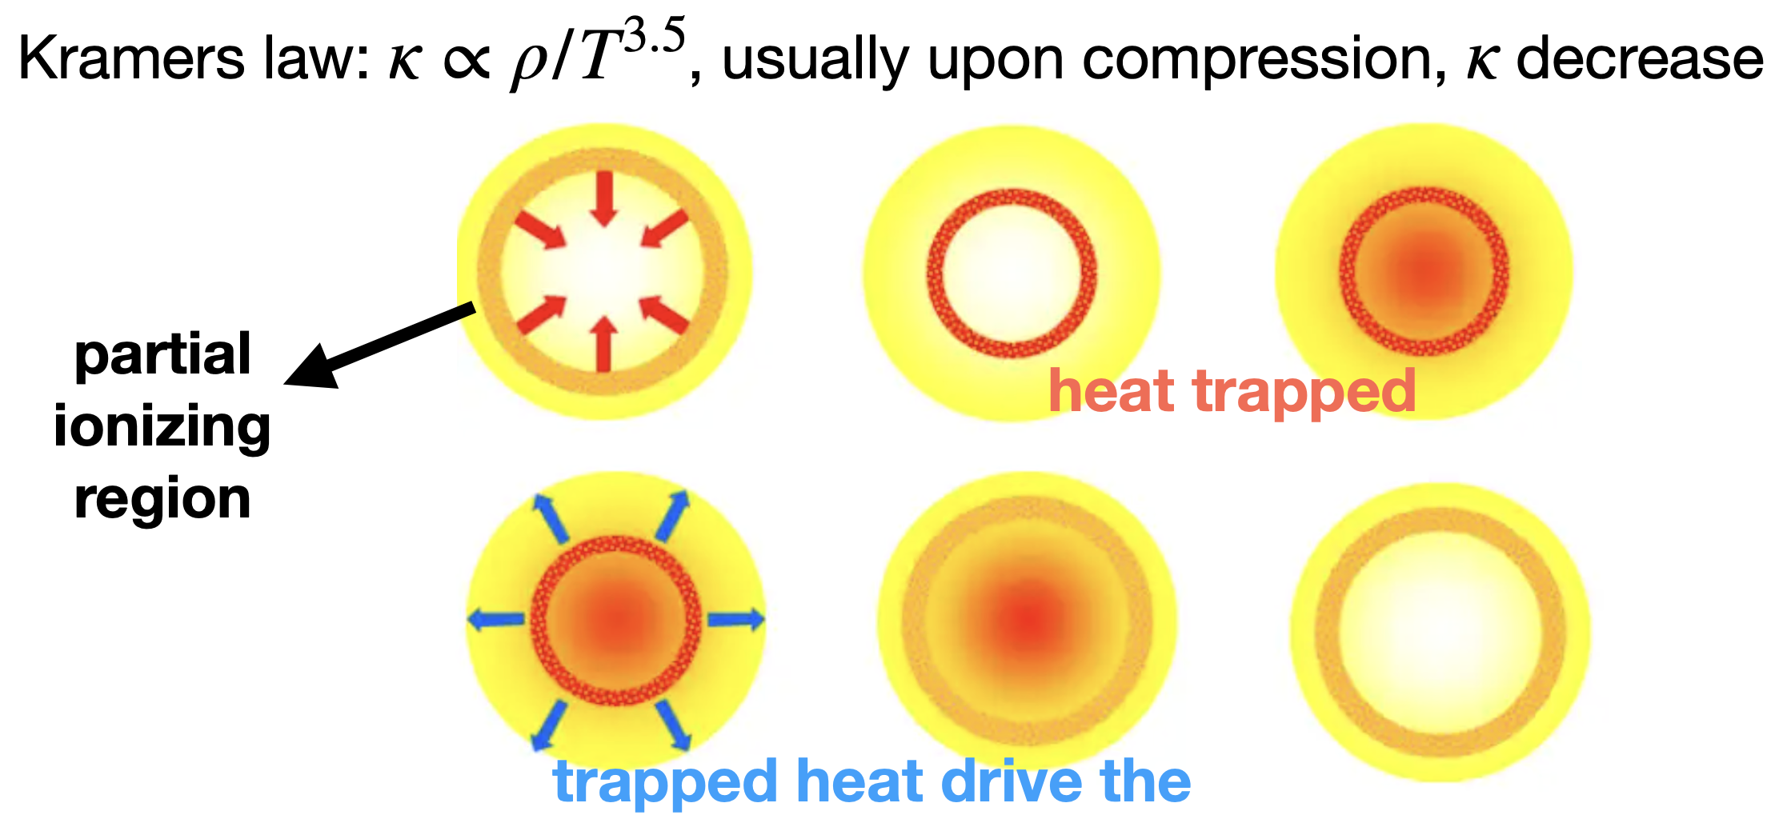
The variabilities can be explained by pulsation of a dense gas envelop/blackbody photosphere around a super-Eddington SMBH
𝜅-mechanism driven pulsation

Slide 12
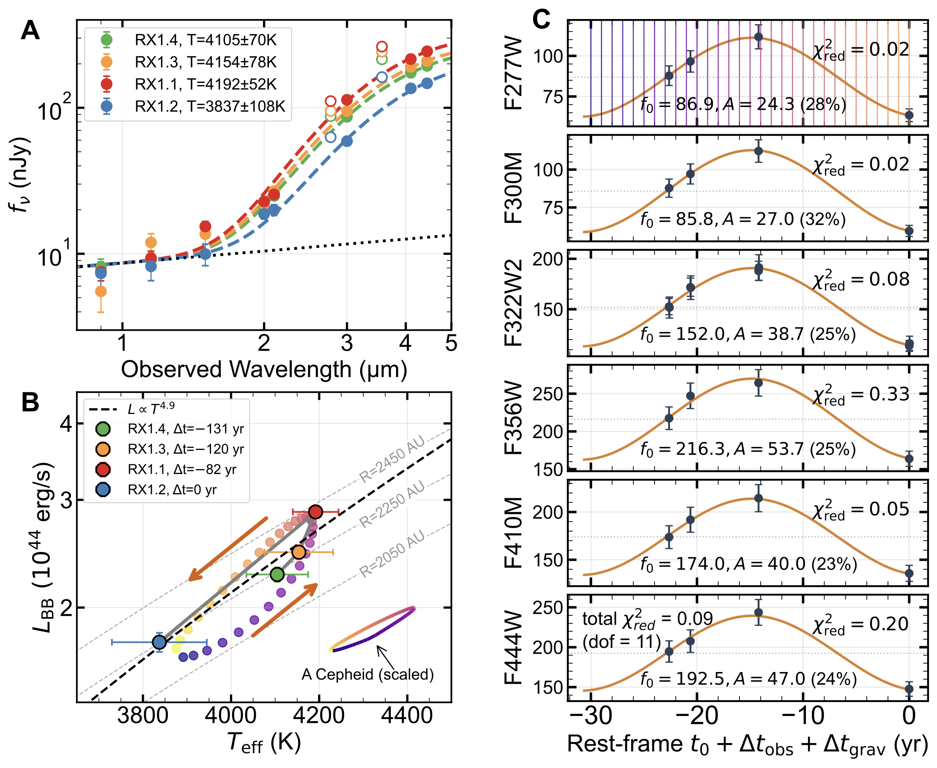
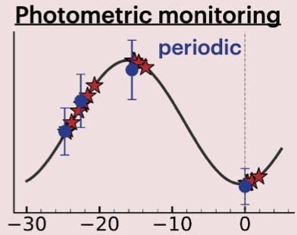
BB T ~ 4000 K
Size ~ 2000 AU
Pulsation ~ 10%
T ~ 32 yrs
(Zhang, ..., LJ, et al. 2026, submitted, arXiv:2512.05180)

Slide 13
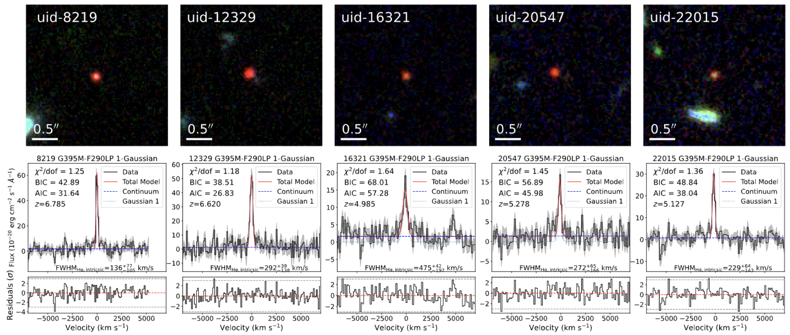
Narrow-line LRDs (LRDs must have broad lines?)
A sample of LRDs with narrow H𝛼 emission lines
Share other common LRD properties
Line width ~ 250 km/s
BIC₂ – BIC₁ > 1
BIC = 𝜒² + k ln n
5 narrow-line LRDs out of 32 LRDs that have medium-resolution spectra coverage of H𝛼

Slide 14
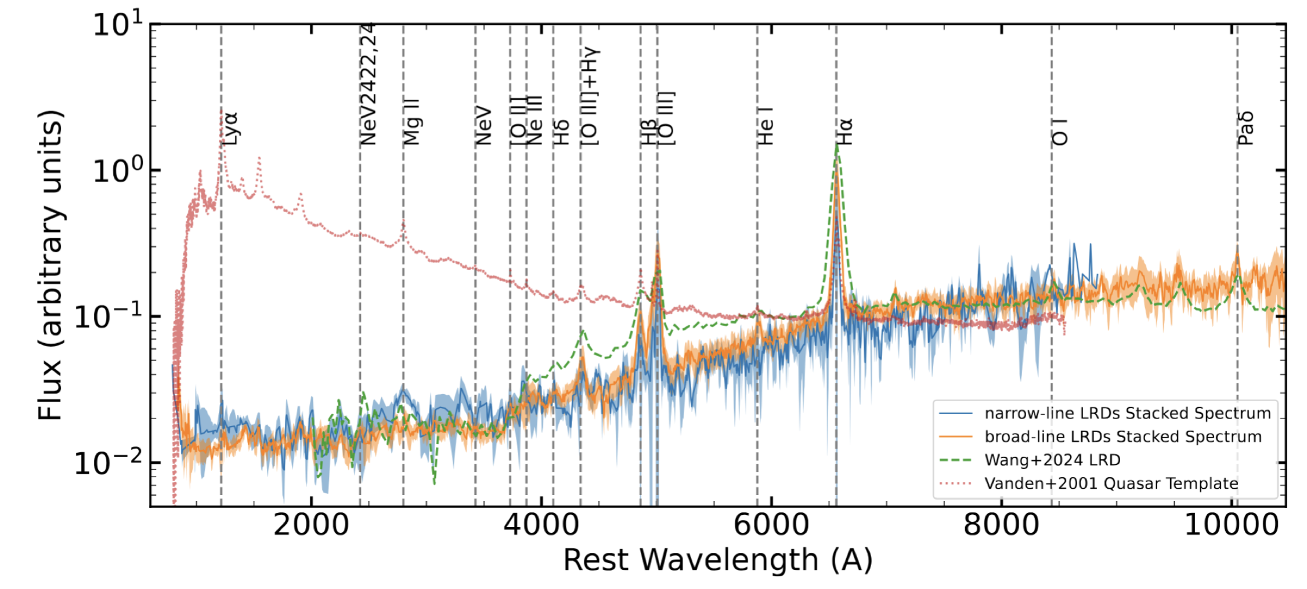
Comparison with broad-line LRDs and AGNs
AGN
NL LRDs
BL LRDs
Composite spectra of broad-line (BL), narrow-line (NL), and normal AGNs

Slide 15
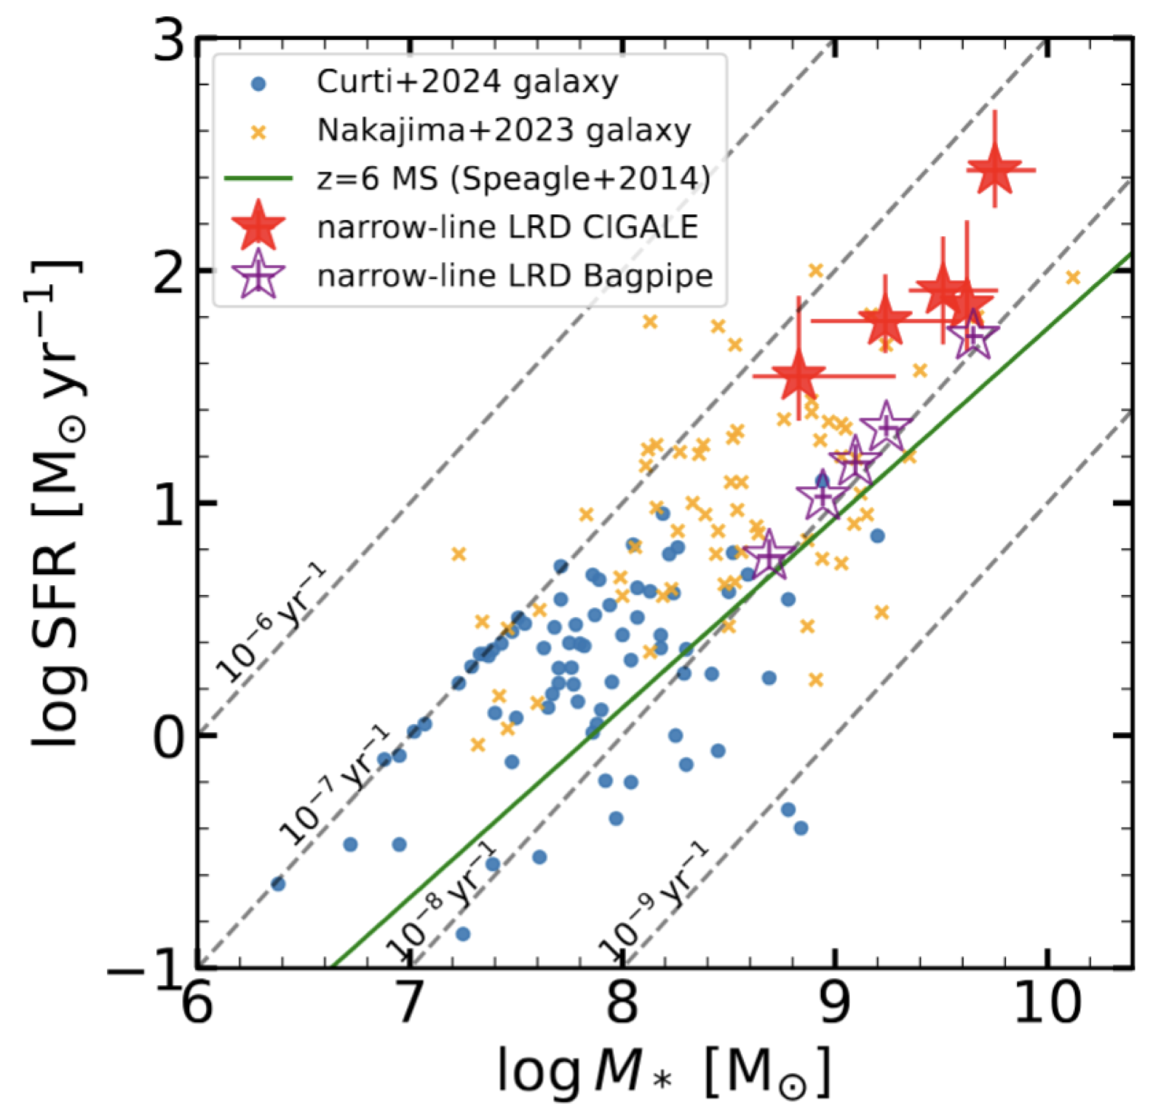
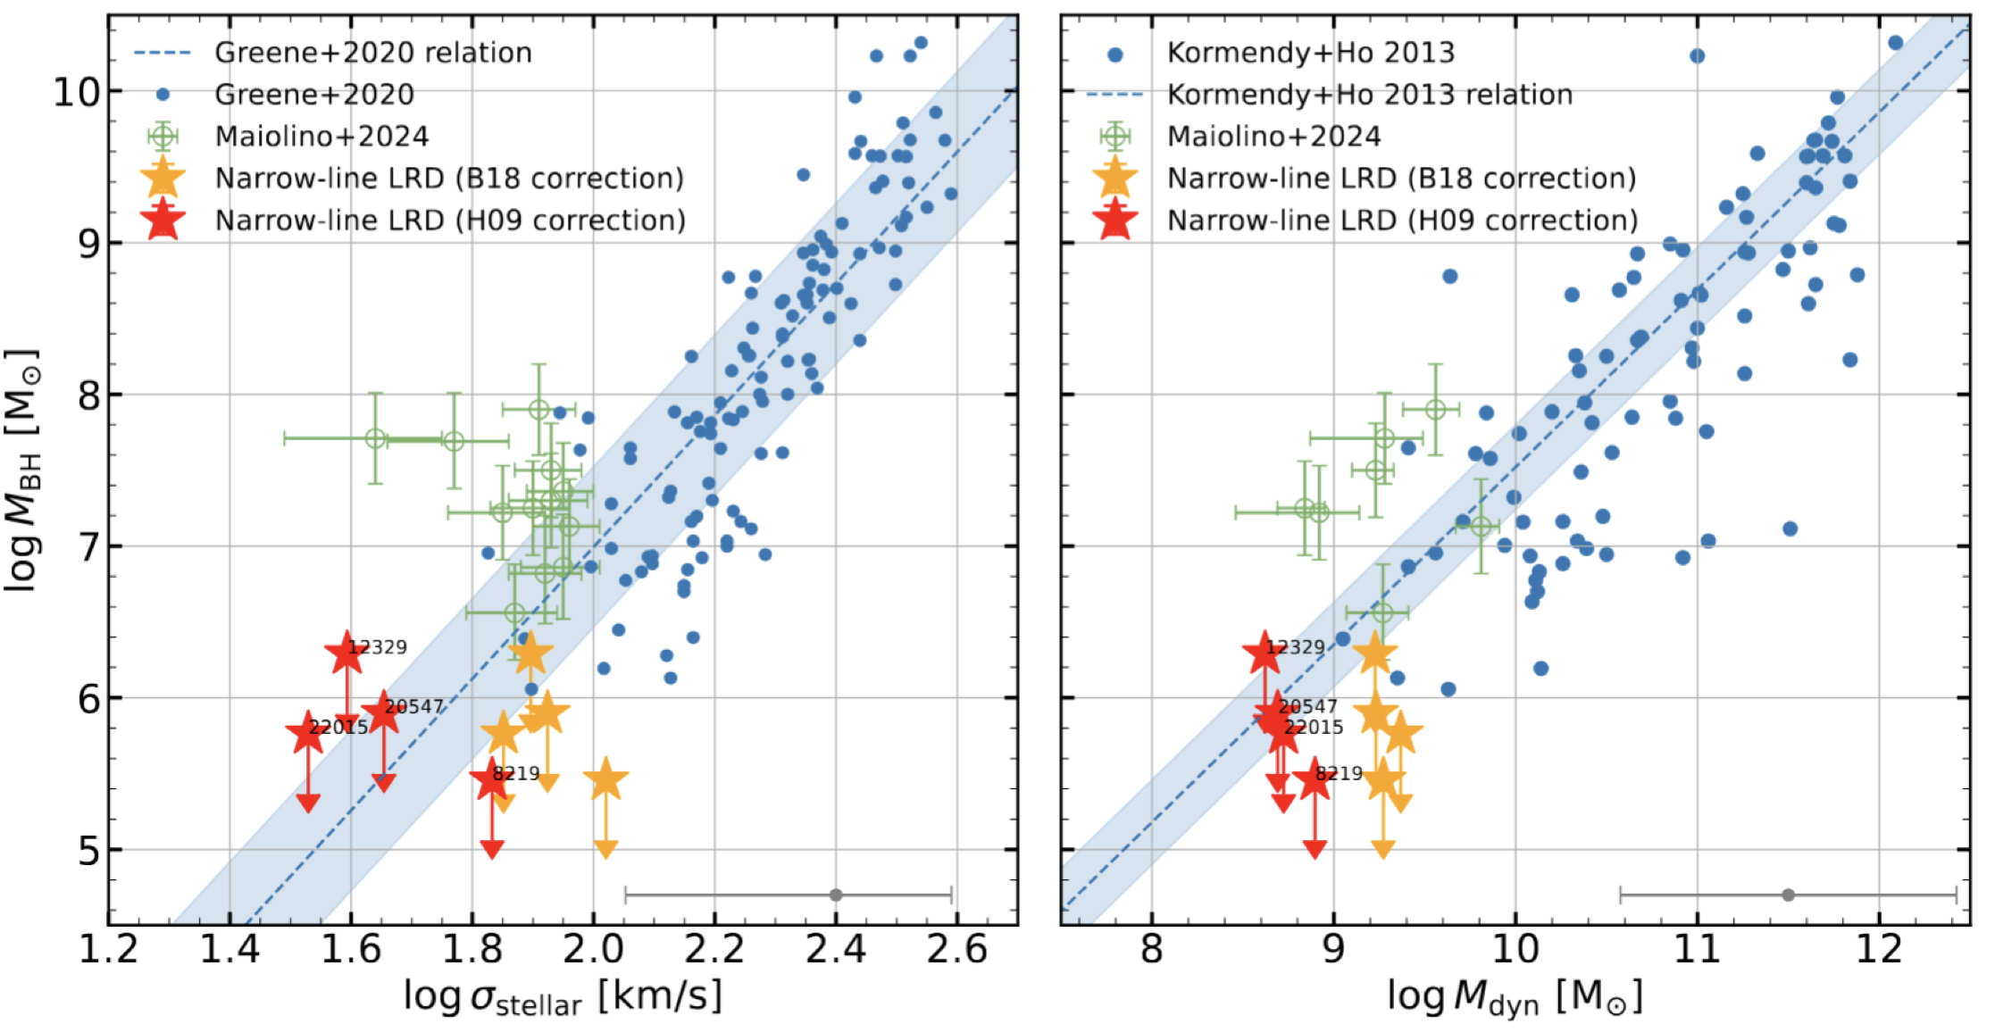
What are these narrow-line LRDs
If NL LRDs are purely star-forming galaxies?
High stellar masses (≥10^{9.5} M⊙) with high SFRs (≥20 M⊙ yr⁻¹)
If NL LRDs are AGNs with low black hole masses?
Slightly above the main sequence
To be answered: why no broad lines
Type 2 like counterparts of BL LRDs?
An early stage of BL LRDs?
...
Roughly consistent with the local relations in the M_{𝜎}−M_{BH} and M_{dyn}−M_{BH} plane?
(Zhang, LJ, et al. 2026, ApJ, submitted)

Slide 16
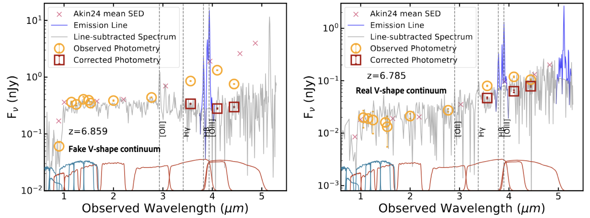
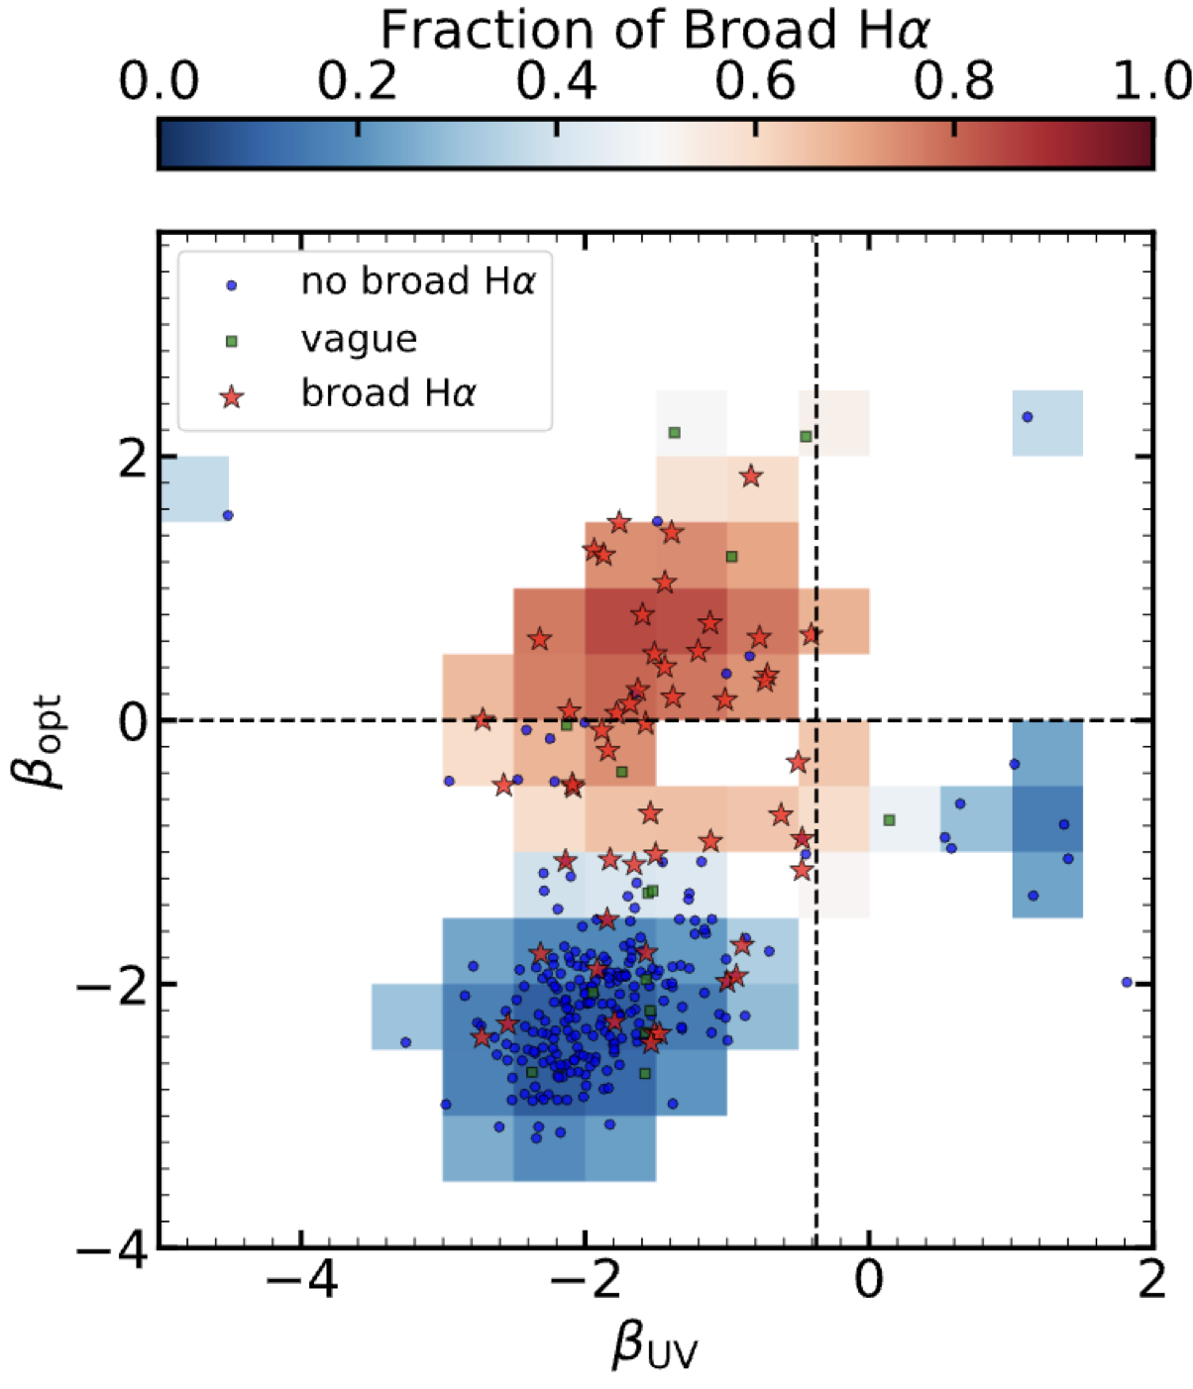
Some byproducts
Some previous LRDs are not real LRDs: their V-shape produced by line emission
Nearly half of the BL AGNs (24/55) exhibit V-shape continuum

Slide 17
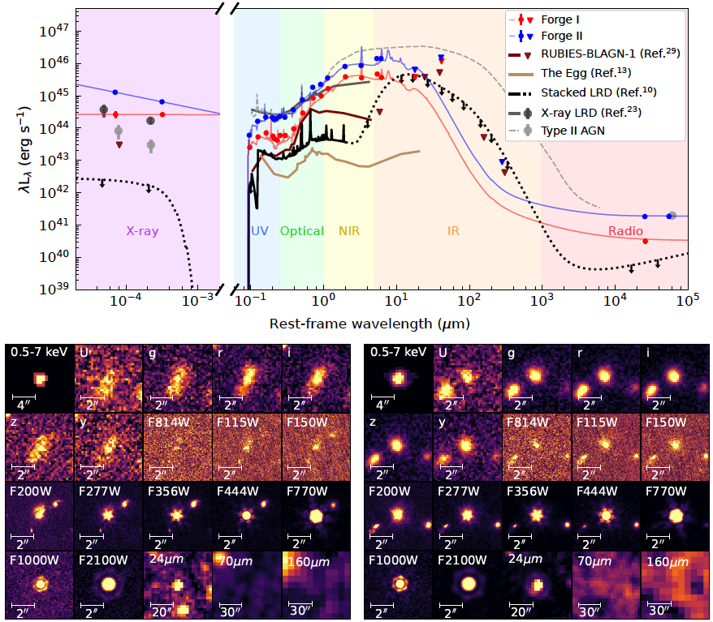
Two LRDs transitioning into quasars
Discovery of two unique LRDs: Forge I and Forge II at z ~ 3
“red” + “V-shape”: blue UV slope & red optical slope
“little”: point-like sources in F356W and longer bands
(Fu, ..., LJ, et al. 2026, submitted to Nature Astro., arXiv:2512.02096)
Notes:
but likely diffuse in the UV

Slide 18
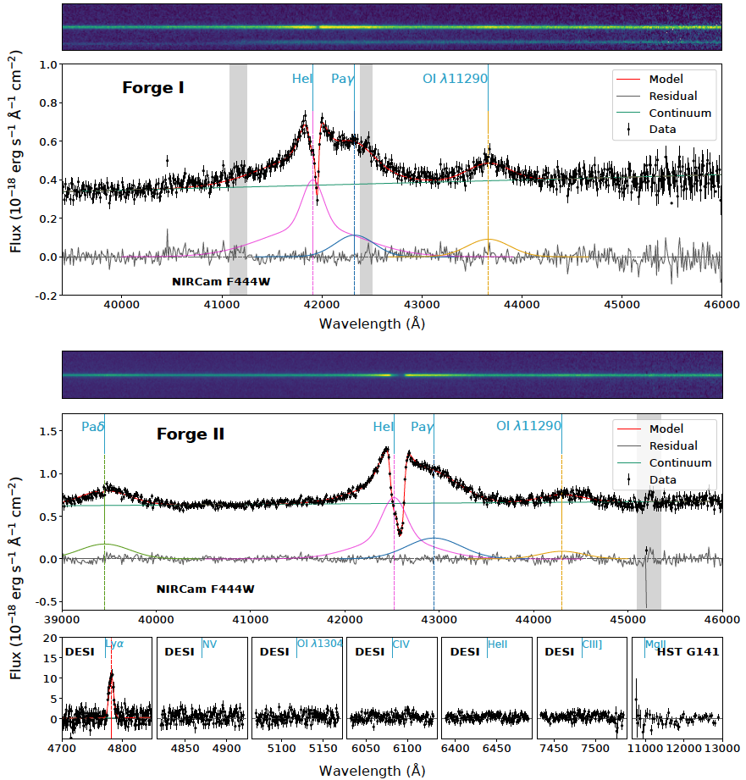
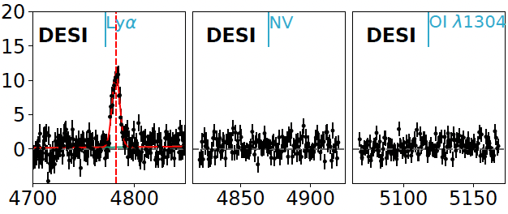
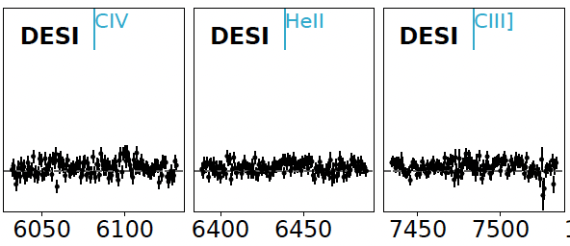
Forge I and Forge II
“Little” + “V-shape”
Broad emission lines
Broad He I emission + absorption
No UV metal emission lines!

Slide 19
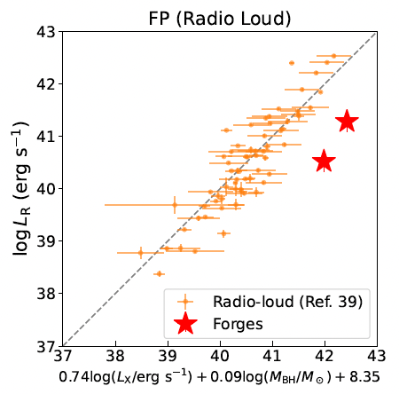
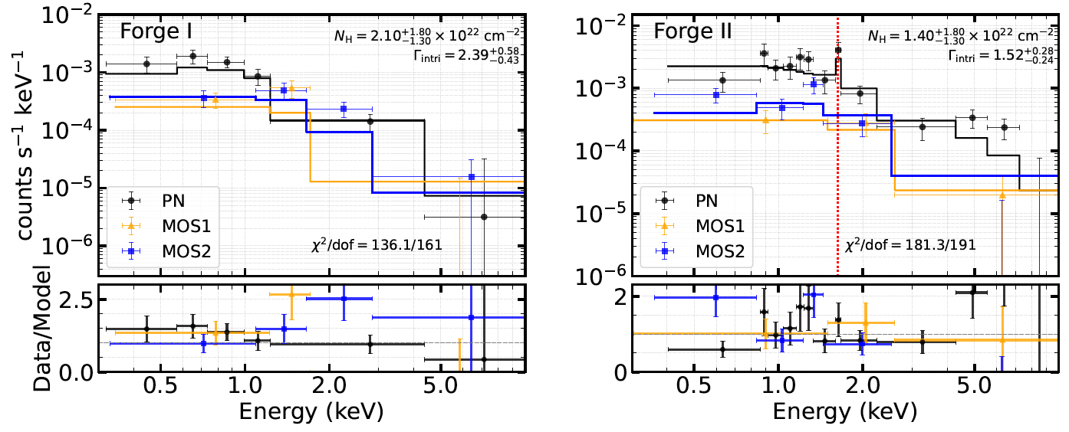
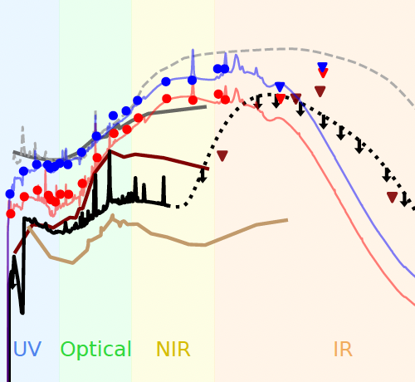
Forge I and Forge II
“Little” + “V-shape” + broad emission lines
No UV metal emission lines
Strong radio radiation
Strong IR radiation
Strong X-ray radiation

Slide 20
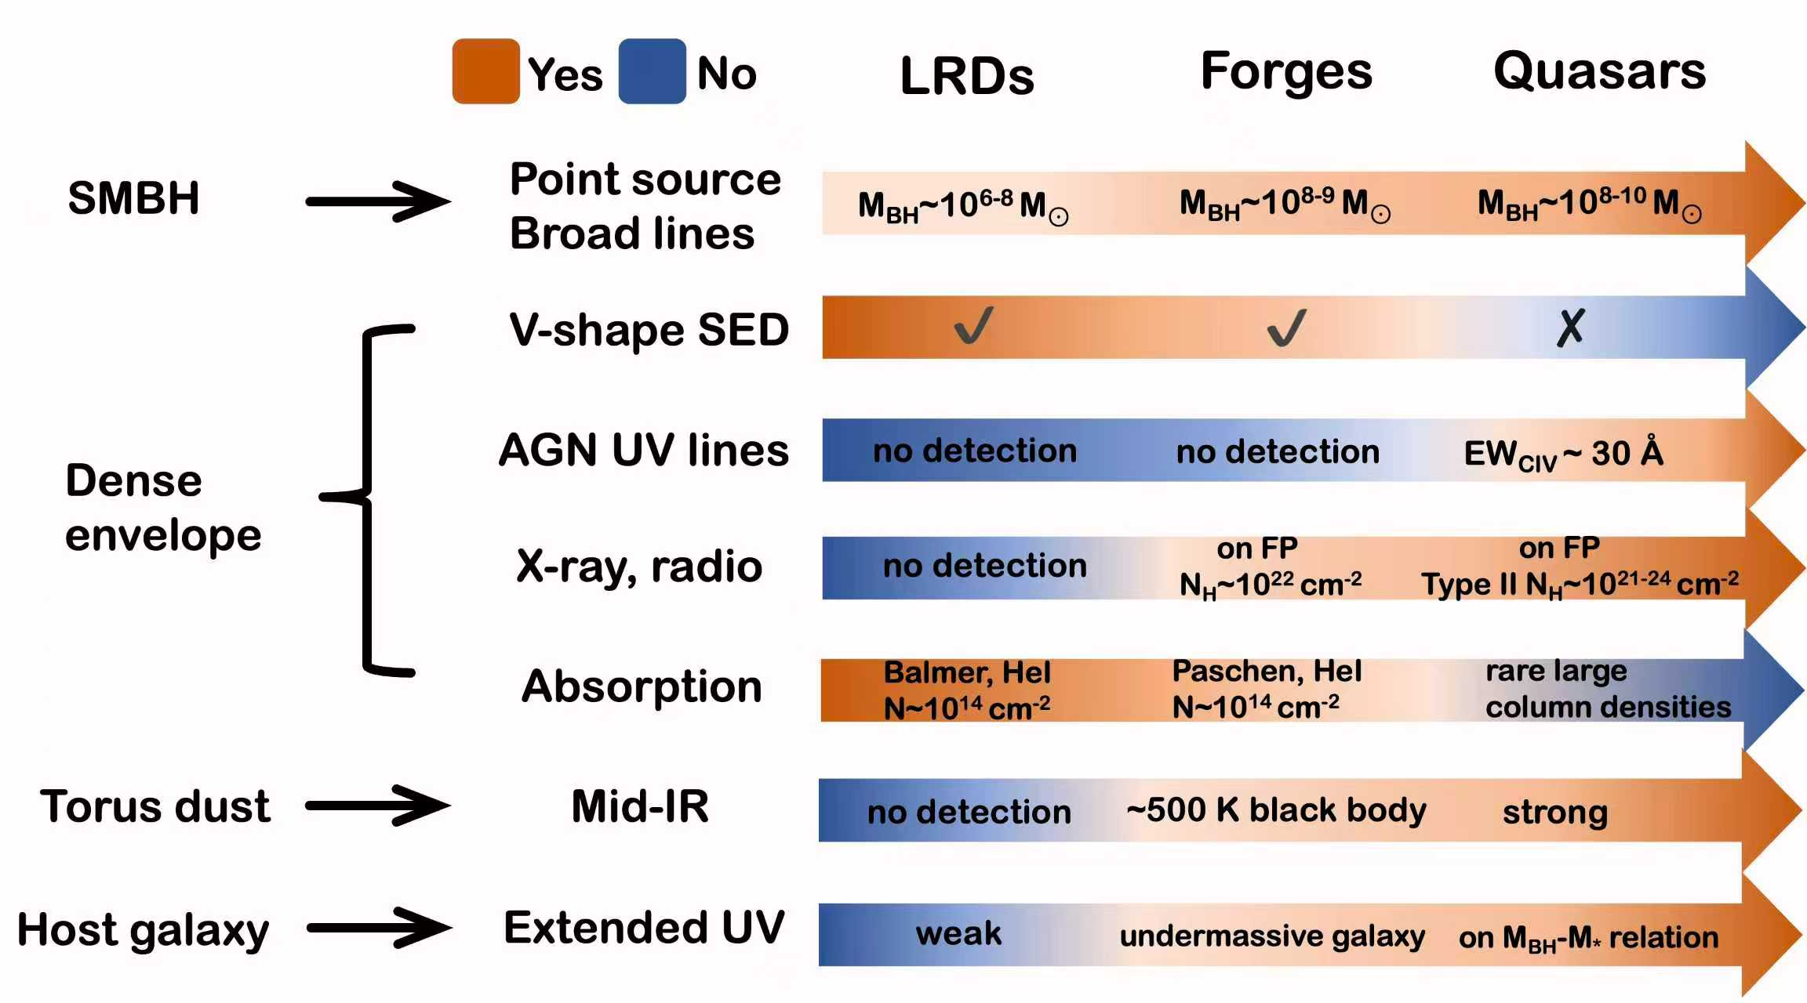

Slide 21
Forge I and Forge II in the context of LRD evolution
General model: super-Eddington accreting SMBHs enshrouded in dense gas
Dense gas envelope is dispersing, and the LRD phase is terminating
X-ray photons escape, while most UV photons remain trapped
Radio jets are weakly confined, and are leaking out of the systems
A dust torus starts to form and dominate the mid-IR SED
At least some LRDs will evolve into AGNs or quasars.
(Fu, ..., LJ, et al. 2026, submitted to Nature Astro.)

Slide 22
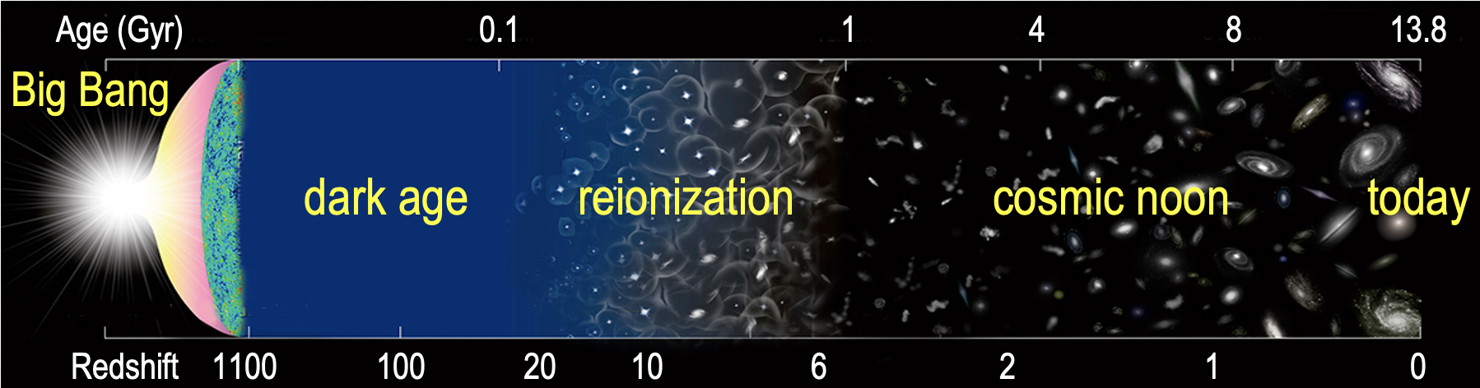
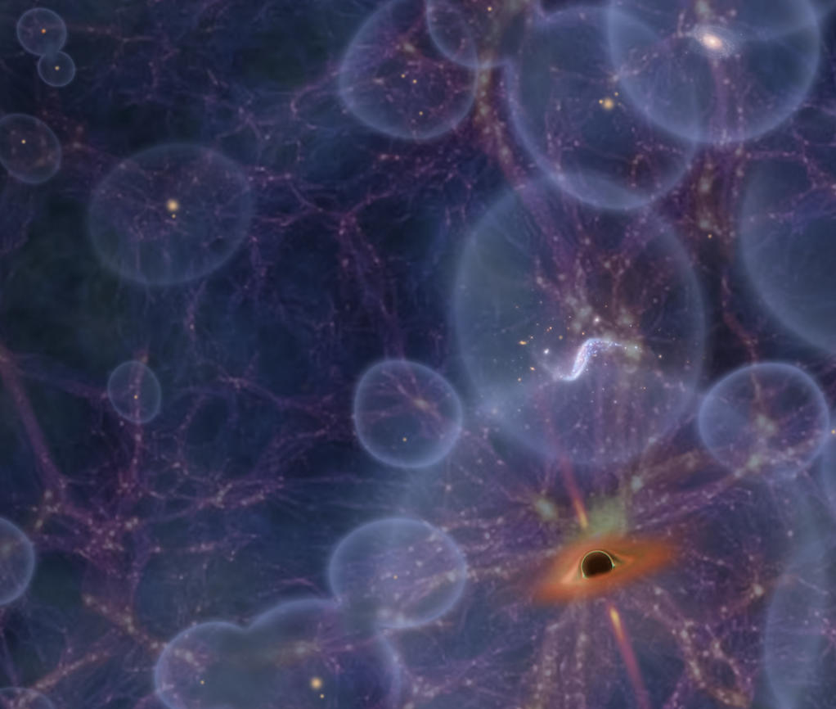
LRD/AGN contribution to cosmic reionization
A big and fundamental question: what objects provided Lyman continuum photons (𝝀 < 912 Å) responsible for reionization: galaxies (stars) or AGNs (SMBHs)?
ionizing bubbles
ionizing sources

Slide 23
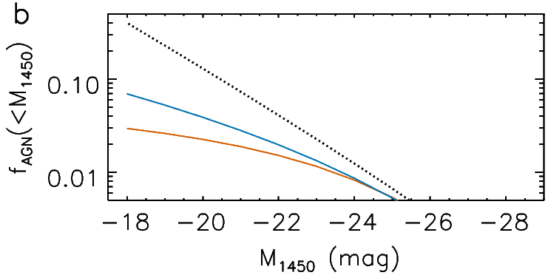
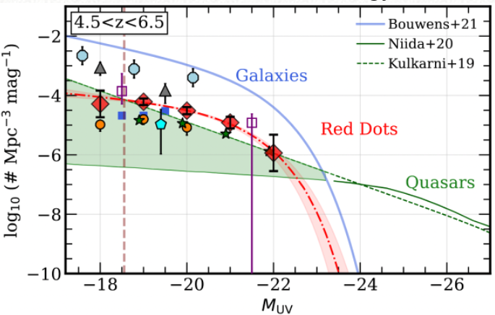
Pre-JWST results
Quasar/AGN luminosity function (LF)
→ Quasar/AGN contribution < 7%
If all LRDs are AGNs
AGN spatial density largely increases?
AGNs can be the dominant energy sources for reionization?
Quasar contribution
< 7% (95% CL)
(LJ, et al. 2022, Nature Astro., 6, 850)
Revisiting AGN contribution with JWST
A straightforward approach without knowing the nature of LRDs
James Dunlop: The paper, in my view, carefully and thoroughly settles a long-standing issue that AGNs (quasars) do not contribute significantly to cosmic hydrogen reionization.

Slide 24
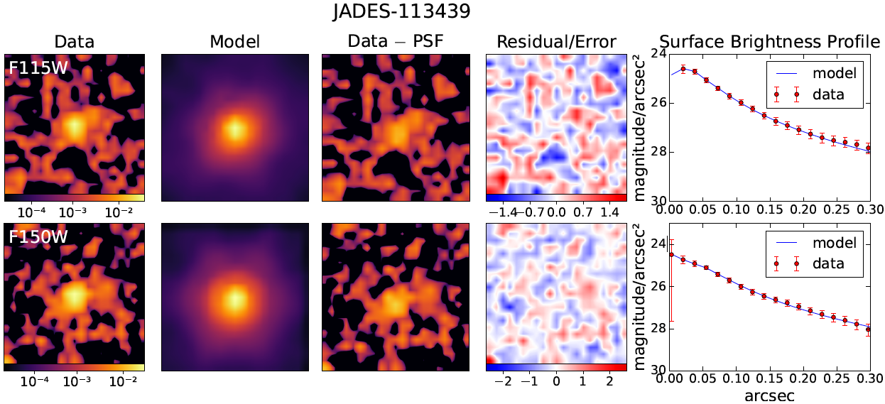
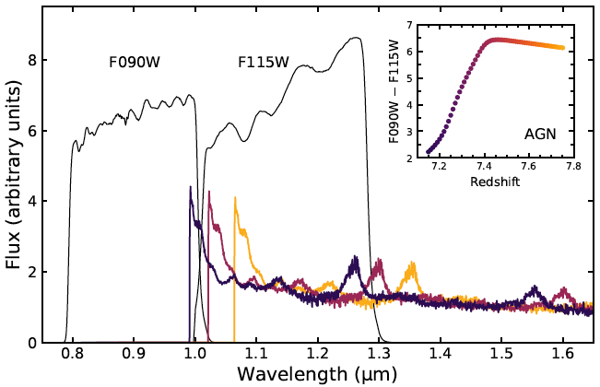
Step 1: build a sample of objects (galaxies and AGNs) at 7.15 < z < 7.75
Step 2: image decomposition
Images: F115W and F150W; our own images
GalfitM: PSF + Sersic
Assumption: PSF component = AGN
Absolute upper bound for the AGN density

Slide 25
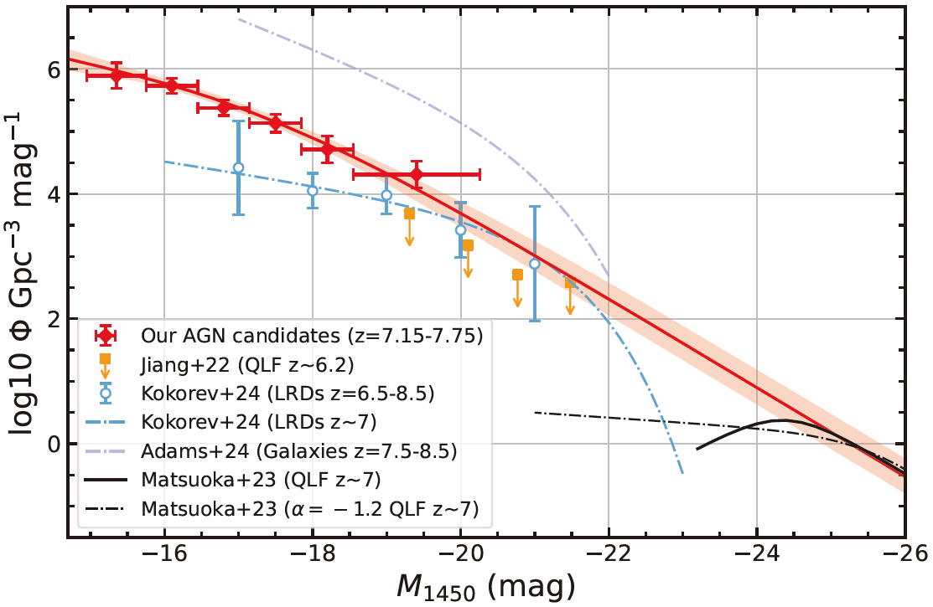
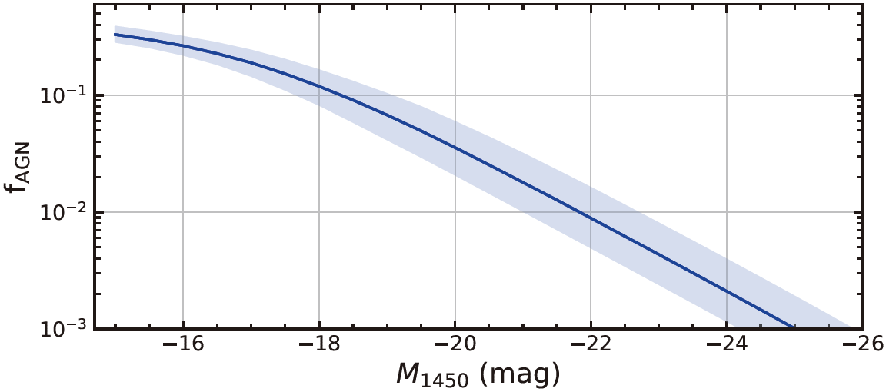
Step 3: AGN UV LF → AGN contribution to reionization
Our binned LF
Our model fit
f_{AGN}: photons from AGNs / total photons required for reionization
Our result: f_{AGN} ~ 32%
Quasars
(D. Jiang, LJ, et al. 2025, Nature Astro., 10.1038/s41550-025-02676-7)
Conclusively rule out AGNs as the dominant source of cosmic reionization

Slide 26
Why is LRDs’ contribution very low?
AGN
NL LRDs
BL LRDs
LRDs are generally very faint in the far-UV

Slide 27
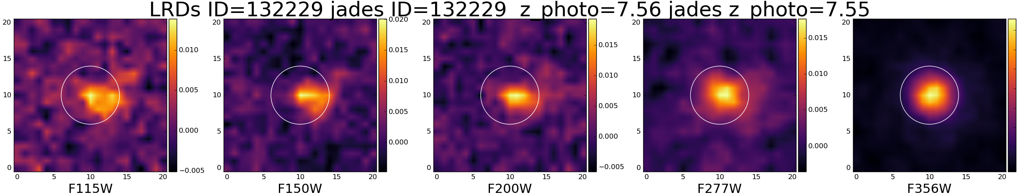
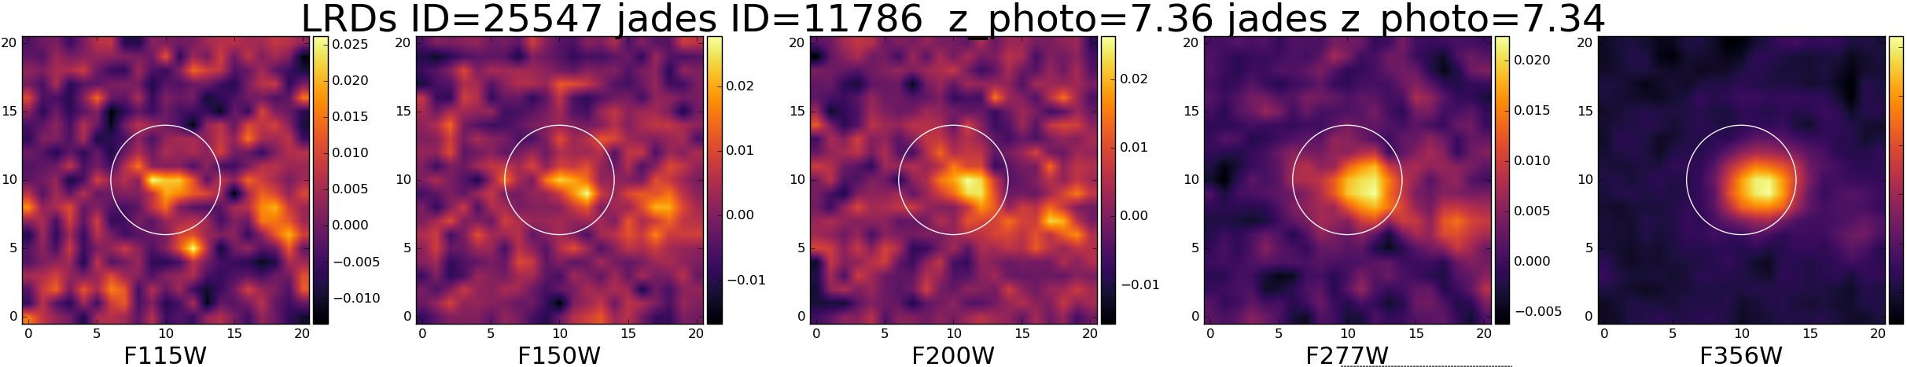
Many LRDs are not dominated by AGNs in the far-UV

Slide 28
Summary
LRDs on average do not show strong optical variability.
We built a sample of narrow-line LRDs.
Two unique LRDs are evolving into normal quasars.
A LRD with a variability detection over a century.
LRDs/AGNs are not the dominant source of reionization.
Pieces of jigsaw puzzle

