Slide 1




Strong spectral features from asymptotic giant branch stars in distant quiescent galaxies
7th China-Chile Bilateral Conference for Astronomy
Speaker: Shiying LU (陆诗莹)
Anqing Normal University
Main Contributors: Emanuele Daddi, Claudia Maraston, Mark Dickinson, Pablo Arrabal Haro, Raphael Gobat, Alvio Renzini, Mauro Giavalisco
ShiyingLu@smail.nju.edu.cn
2026-01-06
Notes:
Good morning, everyone. I’m ShiyingLU, a teacher from Anqing Normal University. I thank the committee for giving me the opportunity to present a research finding from last year.

Slide 2

1. Motivation & Background
2. Sample & Results
3. Analysis & Conclusion
Notes:
Here is my online. It includes fours sections. Lets start from the first one: Motivation and Background.

Slide 3
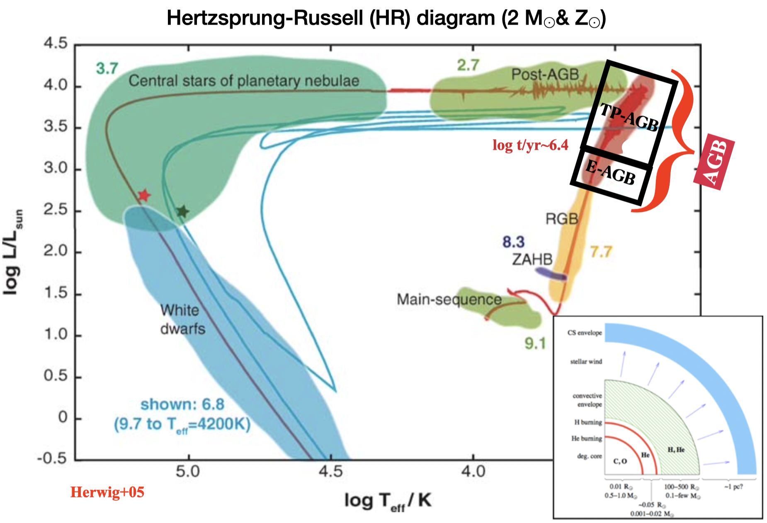
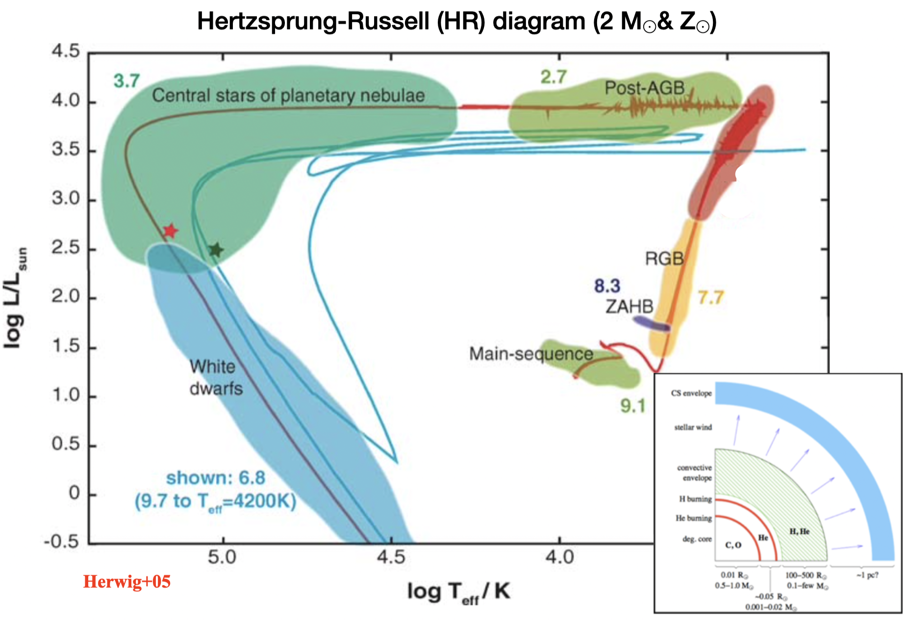

What is the TP-AGB star?
Asymptotic-Giant-Branch (AGB) phase:
Early AGB (E-AGB)
Thermally Pulsing AGB (TP-AGB)
TP-AGB
low- and intermediate-mass stars (~0.8-10M⊙);
double-shell burning: H + He;
complex interplay: envelope convection, mixing, and mass loss (a few Myr);
reach the highest luminosity;
significantly affect NIR spectra and color.
Q: It would be challenging to model their energetic contribution to stellar population spectra.
Notes:
Before we start talking about TP-AGB studies, we should know what the TP-AGB star is. The left figure shows the H-R diagram for 2 solar masses at solar metallicity. The asymptotic giant branch (AGB) phase is marked. It includes two phases: early AGB and thermally pulsing AGB. We mainly focus on the TP-AGB phase. It is a prominent phase of helium and hydrogen double-shell burning in low-mass and intermediate-mass stars. There is a complex interplay in this phase, including envelope convection, mixing, and mass loss. In this phase, stars can reach the highest luminosity and significantly affect the near-infrared spectra and color. So, it would be challenging to model their energetic contribution to stellar population spectra.

Slide 4
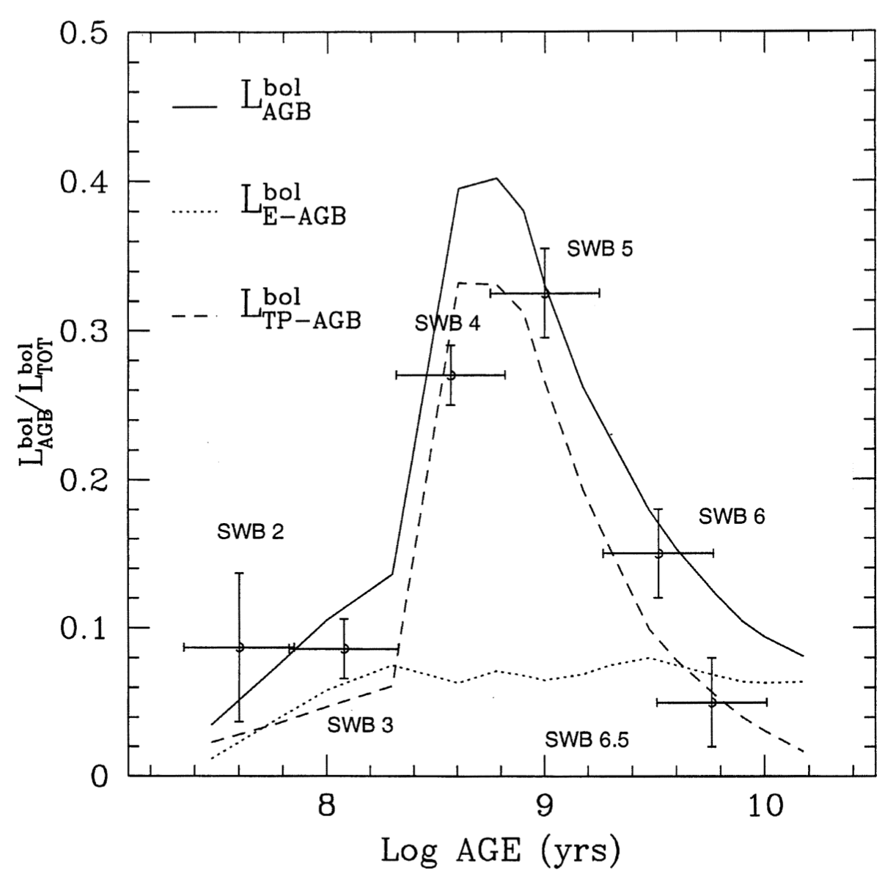
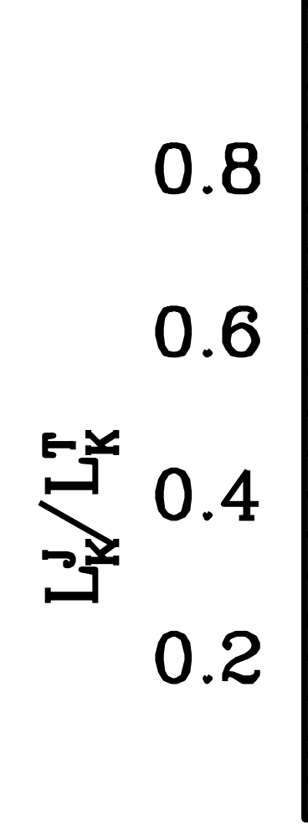
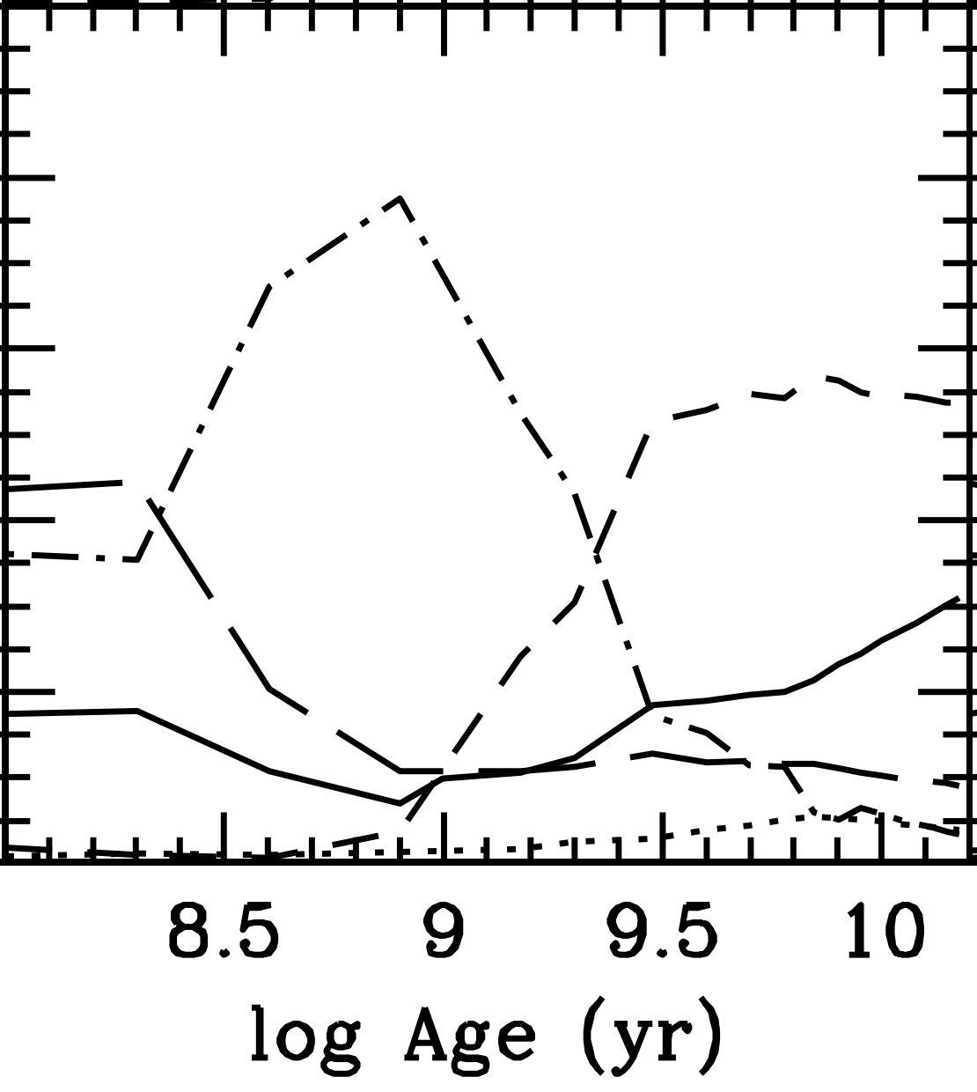

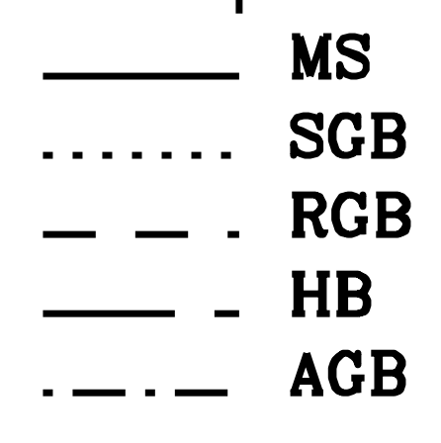

Why do we need to study TP-AGB stars?
0.2
2Gyr
K-band
→
TP-AGB
→
E-AGB
Maraston+05
Maraston+1998
TP-AGB stars contribute up to ~40% of the bolometric light of stellar population in the age range 0.2 Gyr<t<2Gyr (the fraction up to 80% in NIR).
Notes:
So why do we need to study TP-AGB stars. Lets look at these two figures, both show the age as a function of the AGB light contribution.
The left indicates TP-AGB stars could contribute up to ~40% of the bolometric light of stellar populations in the age range of 0.2 to 2Gyr. When in the K band, the fraction would be up to 80%. The fraction of TP-AGB contribution is huge in NIR so we should not ignore it.

Slide 5

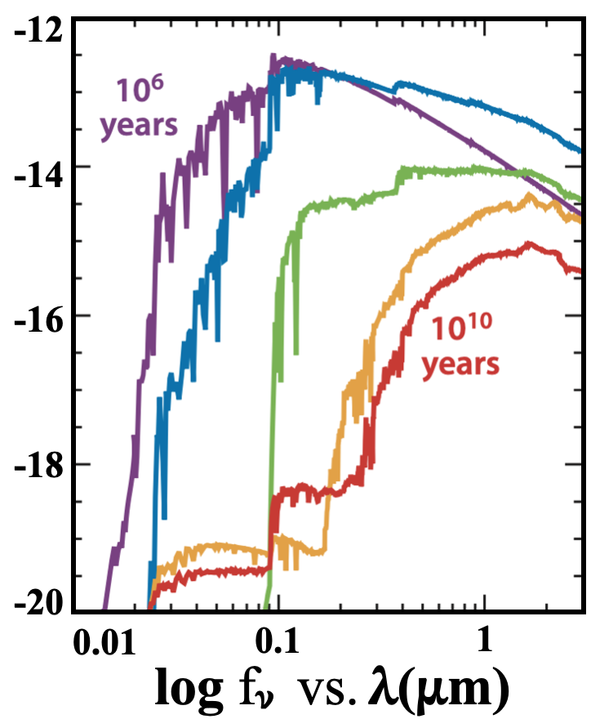
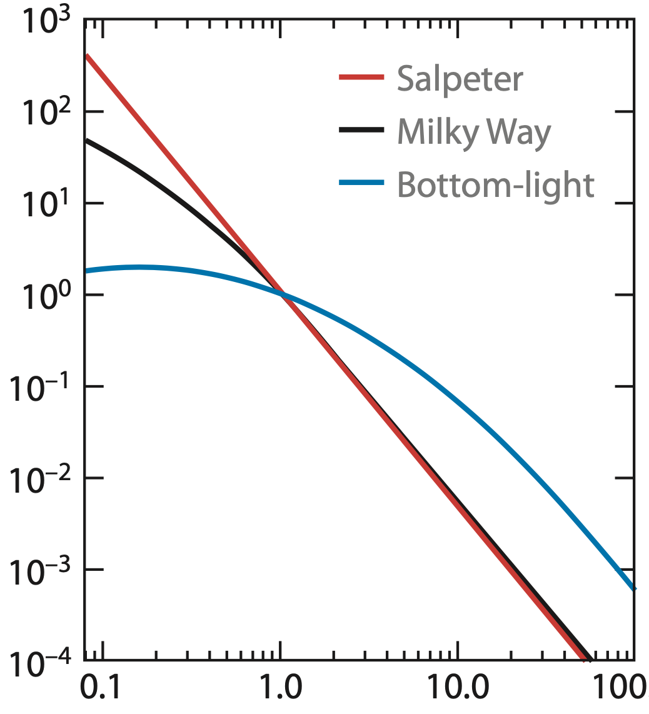
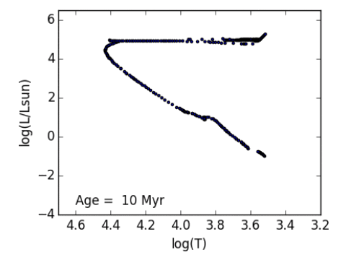
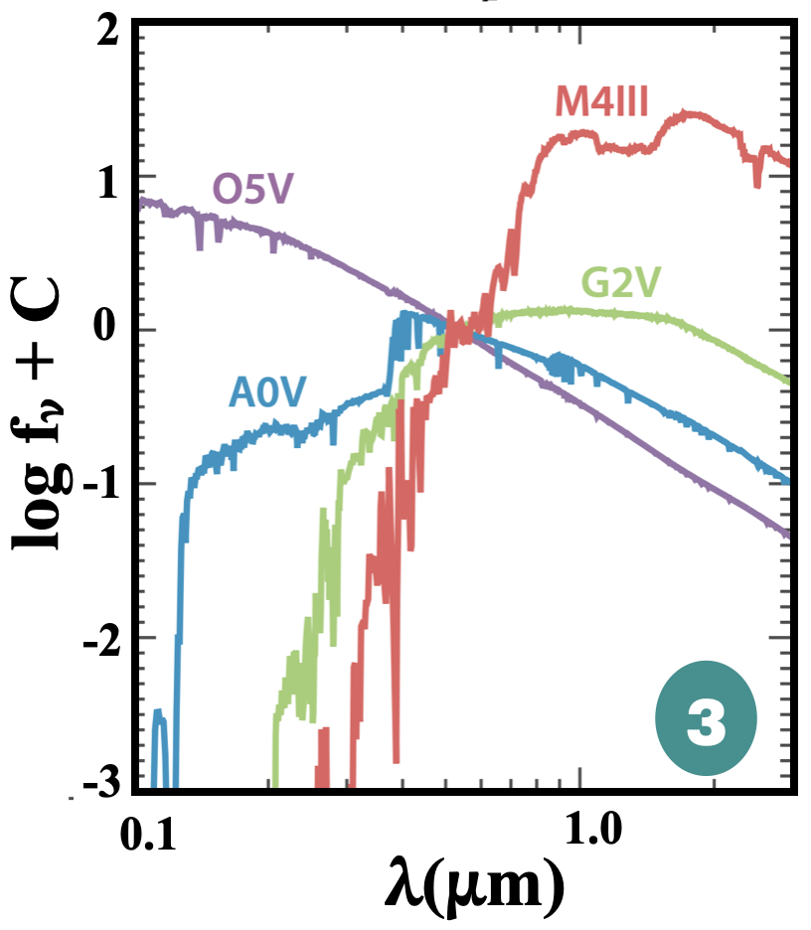
What problems exist in the current SSP model?
Simple stellar population
Initial mass function
Theorem/Isochrone
Stellar spectra
10³
6
10²
4
10¹
10⁰
2
dN/dM
log(L/L⊙)
10⁻¹
0
10⁻²
-2
10⁻³
1
2
3
10⁻⁴
-4
0.1
1.0
10
100
4.6
4.4
4.2
4.0
3.8
3.6
3.4
M(M⊙)
log (T)
Conroy+13
The estimation of galaxy physical properties depends on the stellar population synthesis model (e.g., SFH, age, and M*);
A simple stellar population (SSP) requires THREE basic ingredients.
THREE
Most stellar phases are modeled without doubt, but TP-AGB stars are an exception.
Notes:
As we know, people usually adopt the stellar population synthesis model to fit the galaxy spectrum or SED to estimate the galaxy's physical properties, such as stellar mass, age, and SFH. But are there any problems with the basic tools? We know that an SSP requires three basic ingredients: an IMF, the theorem of stellar evolution, and the library of stellar spectra.
Most stellar phases can be modeled without doubt, but TP-AGB stars are an exception. They evolve very quickly and are affected by poorly understood physics, so ingredients 2 and 3 cannot be accurately obtained.

Slide 6
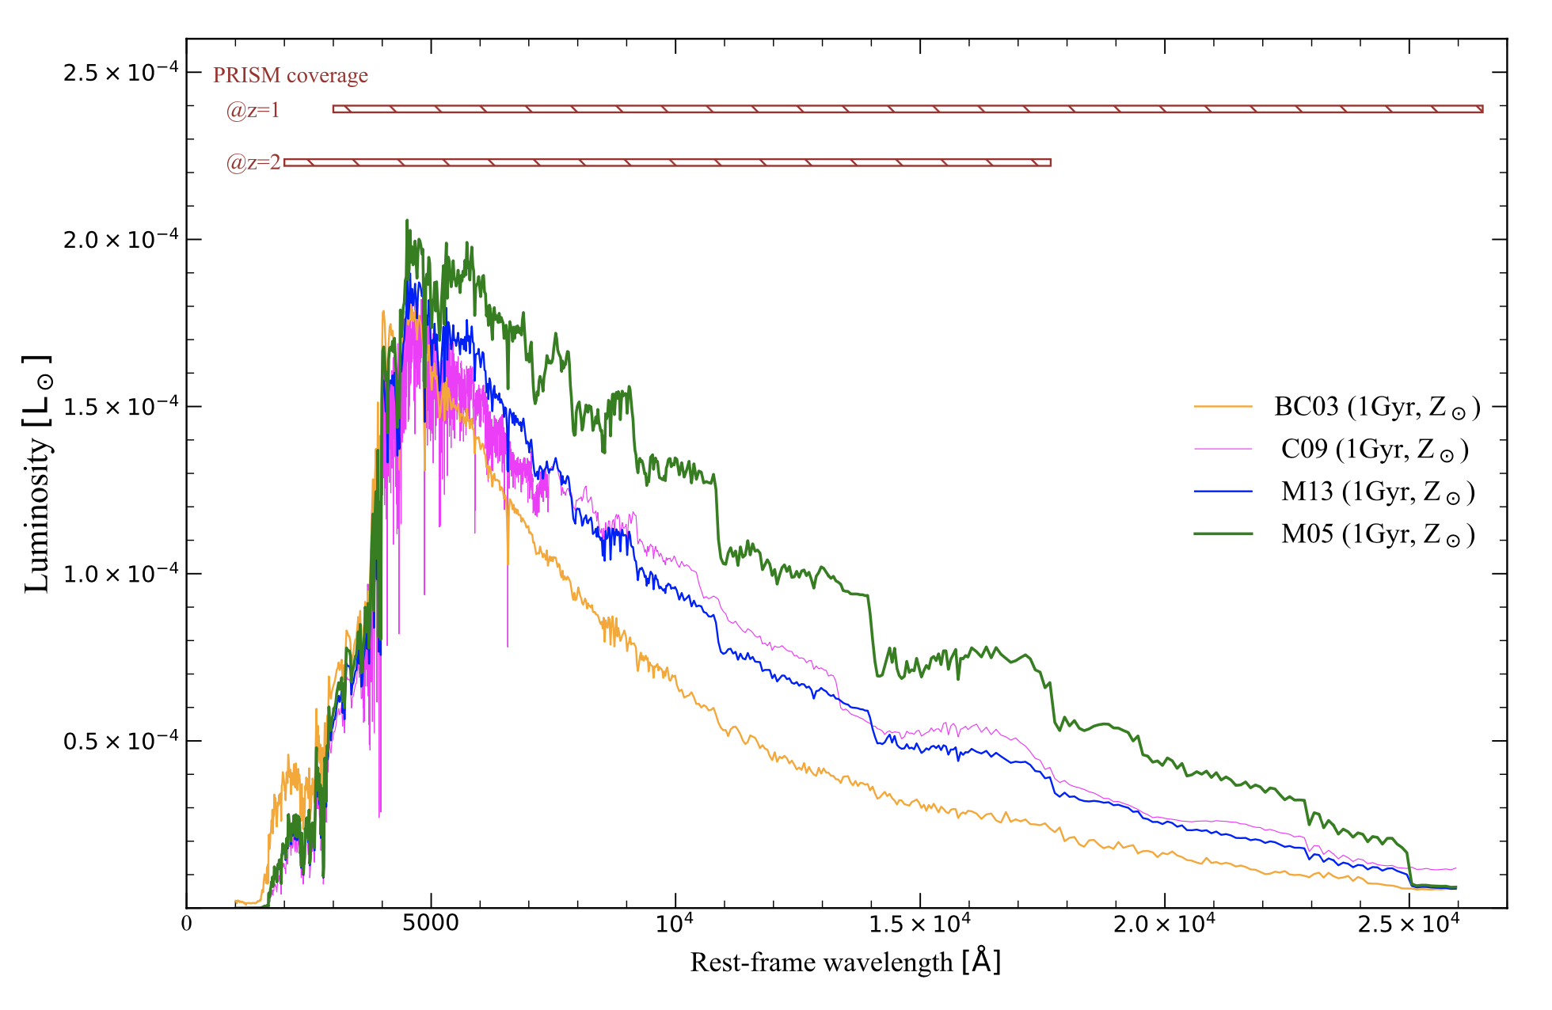
How do the current models treat the TP-AGB contribution?
Model/Ingredients |  | Theorem/ isochrone | Stellar spectra | TP-AGB contribution
BC03 | Bruzual & Charlot+03 | isochrone | excluding TP-AGB | poor
C09 | Conroy+09 | isochrone | including TP-AGB | light
M13 | Revision of M05 (Noël+2013) | fuel consumption |  | mild
M05 | Maraston+05 |  |  | heavy
Luminosity [L⊙]
Based on different TP-AGB contributed models, galaxy ages and masses could change significantly.
5000
20000
Rest-frame wavelength[Å]
Notes:
But how do different models treat the TP-AGB contribution? Here, we list four main different models: Bruzual & Charlot 2003, Conroy 2009, and the Maraston model (M05). M13 is the revision of M05. They adopted different theorems and stellar spectra, which resulted in the TP-AGB contribution in the model varying from poor to heavy. The left figure shows the SSP distribution at 1Gyr and solar metallicity in these four models. We can clearly see that there is a big difference between BC03, shown in orange, and M05, shown in green, especially in the rest-frame wavelength range between 5000 angstroms to 2 microns. This suggests that based on different TP-AGB contributed models, galaxy ages and mass could change significantly.

Slide 7
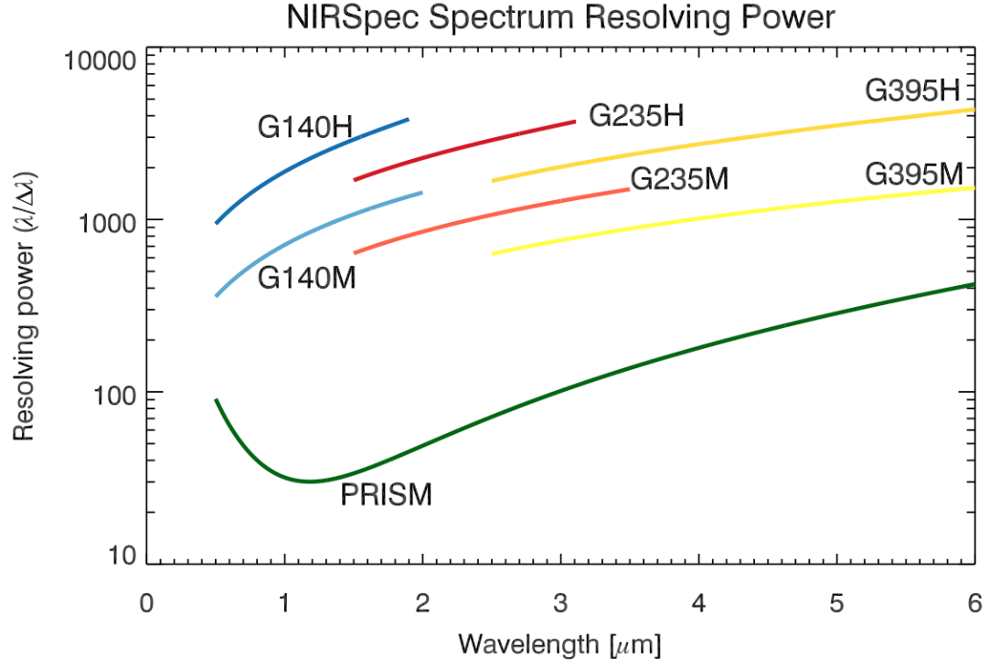
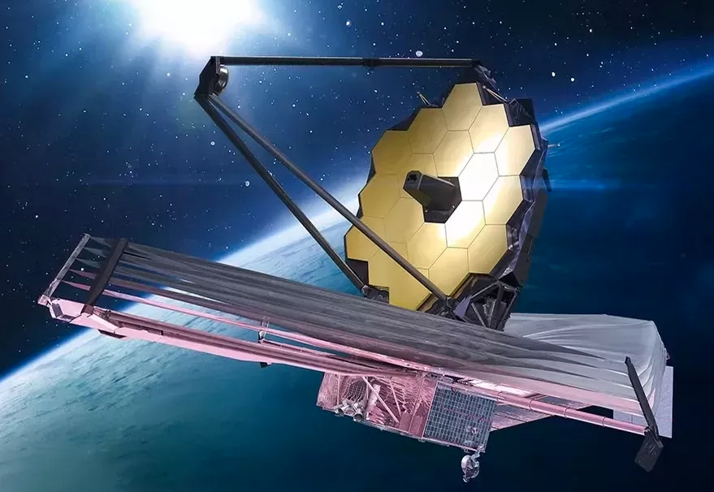
Previous studies contributing to the TP-AGB model
Gal Type | dataset | redshift | Refs | results
post-SB | SDSS+H+K spec | ~0.2 | Zibetti+13 | BC03; featureless
 | photometry | 0.7-2.0 | Kriek+10 | BC03
 | HST phot+spec | 0.2-0.7 | Liu+23 | M05/M13
Seyfert (most spirals) | spec | <41Mpc | Riffel+15 | M05; strong TP-AGB
Passive (ideal) | photometry | zspec; 1.4-2.7 | Maraston+06 | M05
 |  | zspec; 1.3-2.7 | Capozzi+16 | M13
James Webb
No consistent results were obtained.
Quiescent high-redshift galaxies are ideal laboratories because ~1Gyr galaxies produce the peak contribution of TP-AGB stars to the NIR. However, no spectra are available.
Chance !
JWST/NIRSpec can directly provide the NIR spectrum.
NIRSpec/PRISM can cover the wavelength range of 0.5-5.3𝛍 m, which contains many TP-AGB features.
Notes:
Many previous studies have attempted to constrain the contribution of the TP-AGB phase by fitting the spectra and SED of different kinds of galaxies over a wide redshift range, but their results conflict with each other. Some support the BC03 model, but some are not. And these two studies, Maraston 2006 and Cappozzi 2016, have approved that passive quiescent galaxies at high redshift are the ideal laboratories to constrain the TP-AGB contribution because their mass-weighted ages of ~1Gyr produce the peak contribution of TP-AGB stars to the NIR.
For example, this figure shows the SED of the quiescent galaxy from Capozzi+16 at the redshift 1.4. They adopted three different models to fit this galaxy SED, including M05, M13, and BC03. The best-fit stellar mass and age in each model are listed in the upper left. They found that the Maraston model, M05, tends to give younger age and lower Mass. They only can use the photometry without spectra available.
But now, we have JWST observations. The JWST NIRSpec can provide the NIR spectrum directly, and the PRISM can cover wavelengths from 0.5 to 5 um continuously, which contains many TP-AGB features.

Slide 8

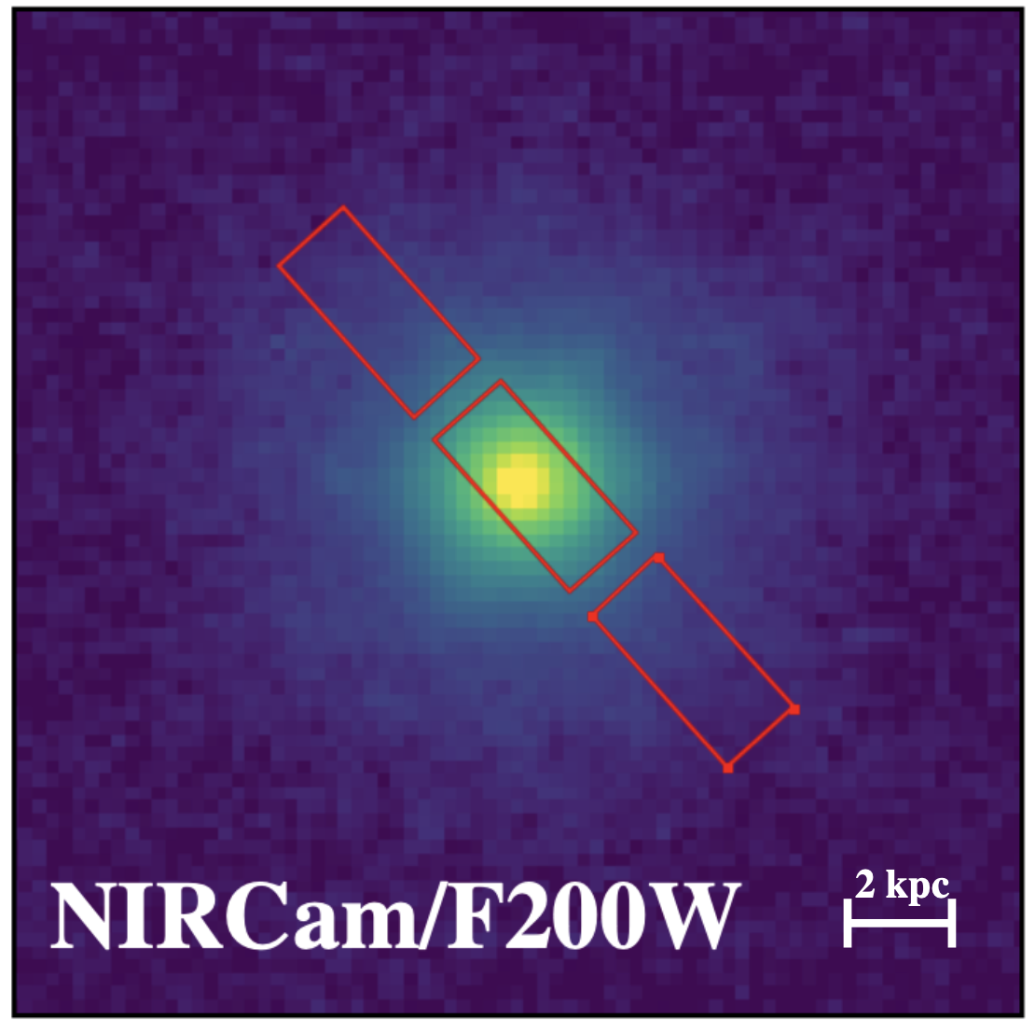
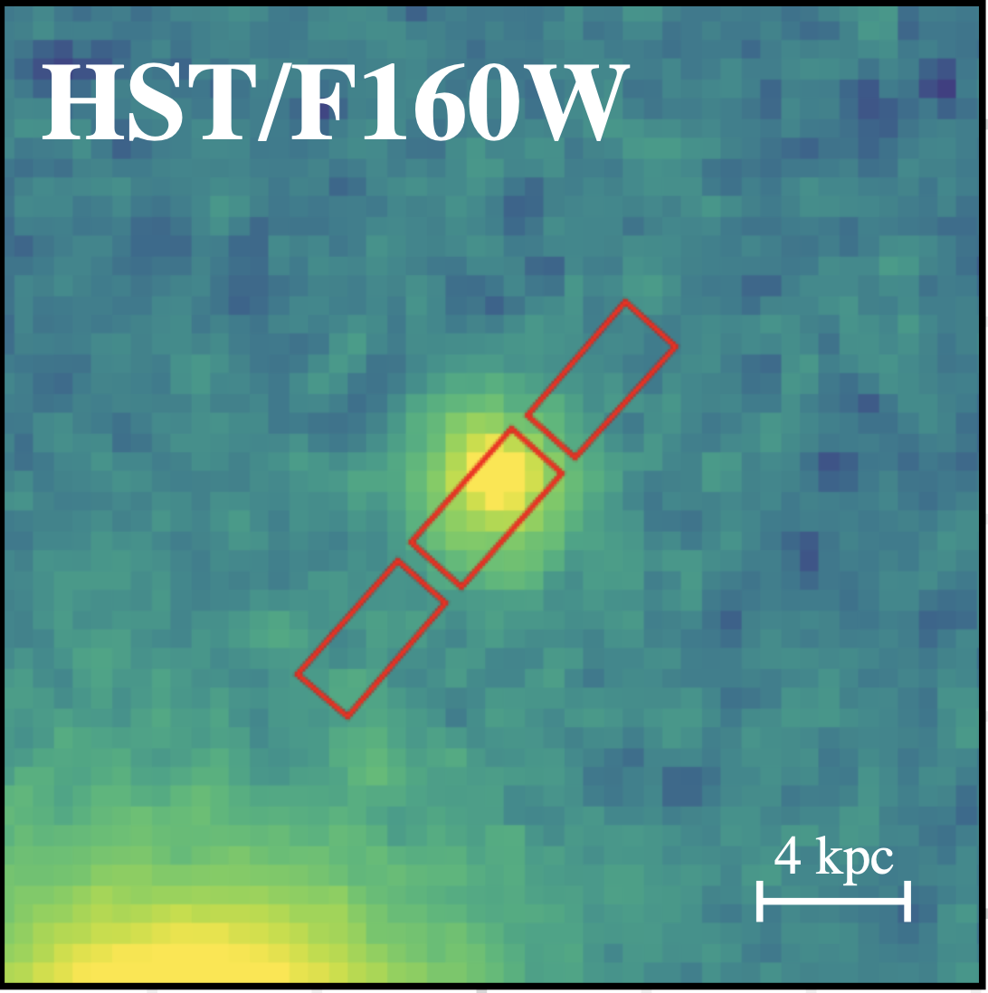
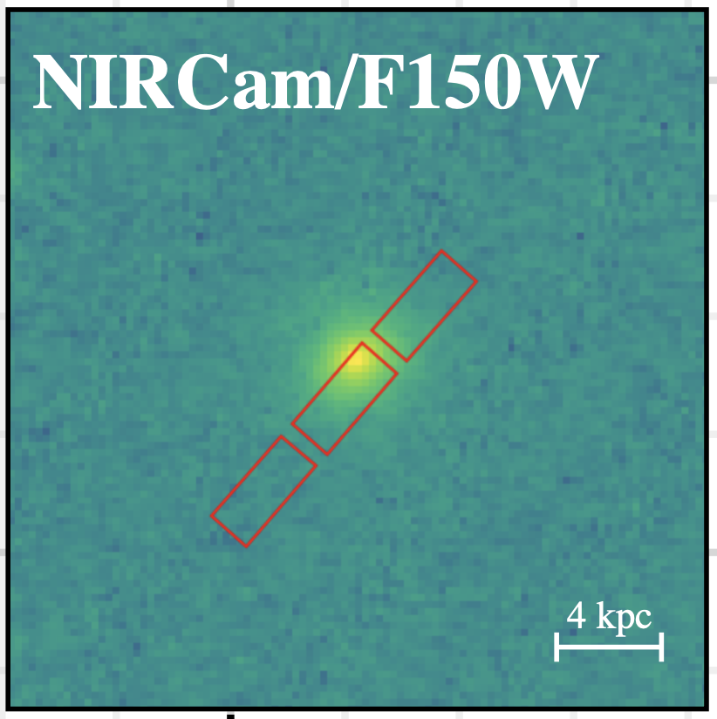
Sample Selection
CANDELS/EGS field
z_phot>1.0
UVJ + t/𝛕 >1
N=1084
CEERS/EGS
JWST/NIRSpec Obs
N=1491
QGs with NIRspec Obs
N=31
=
SFH~exp(t/𝛕 ), where 𝛕 is e-folding quenching timescale
D36123
SNR~200
Mag(3.6um) =21.4
8595
SNR~15
Mag(3.6um) =24.0
9025
SNR~7 (bin)
Mag(3.6um) =23.0
Three candidates: clear D4000 break, no emission lines, 1<z<2, relatively high SNR; compact size (re≲0.1 arcsec)
Notes:
So, we want to select quiescent galaxies at high redshift with spectral observations. We adopted the UVJ diagram plus the criterion of t/tau >1 to select quiescent galaxies at photo_z >1 in the CANDELS/EGS field. Then we cross them with the JWST/NIRSpec observations from CEERS in the same field.
About 31 quiescent galaxies are selected. Then, we visually inspected the spectrum of each galaxy. Eventually, we retained three galaxies, D36123, 8595, and 9025, with clear D4000 break, no emission lines, and relatively high SNR. And I will focus on the first one, which has the highest SNR, about 200.

Slide 9
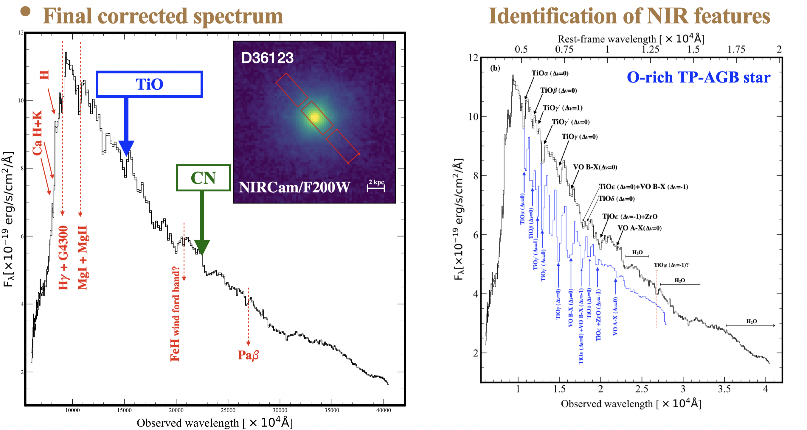
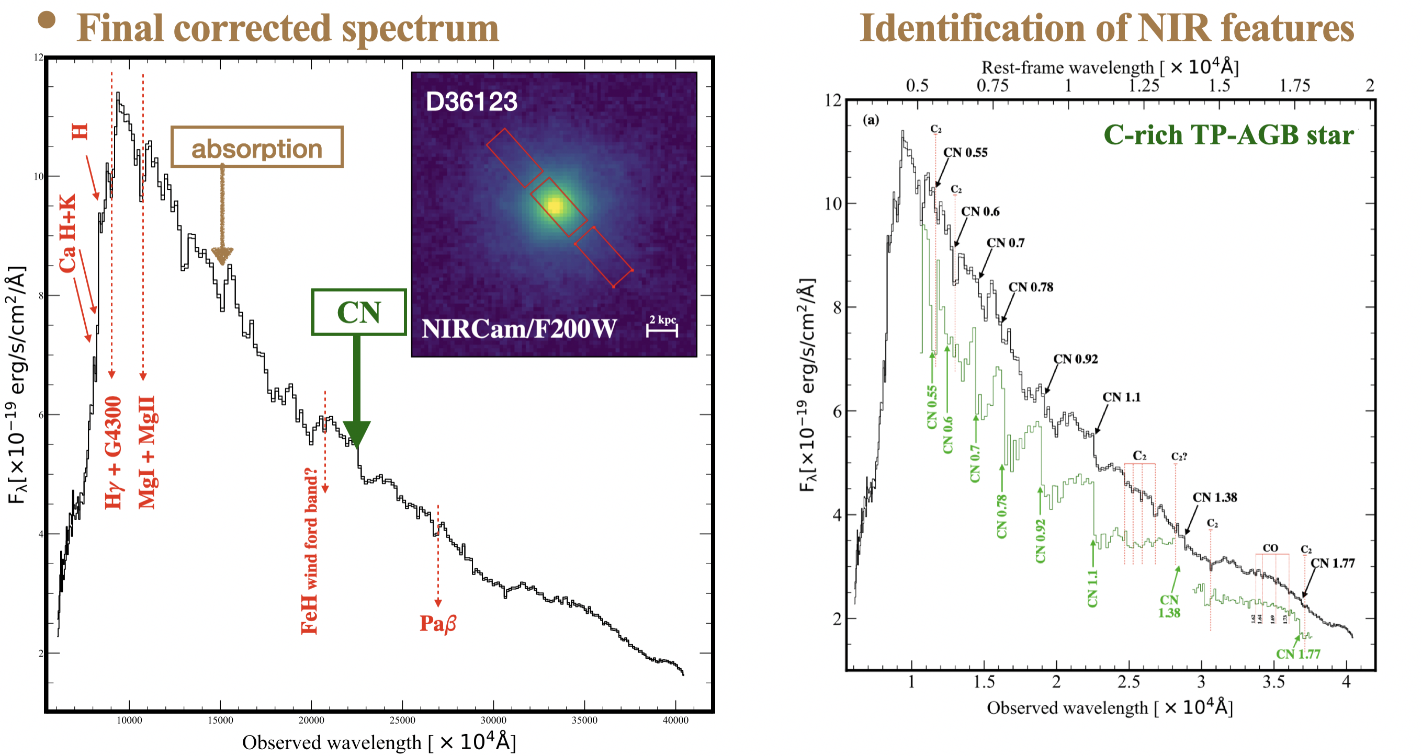
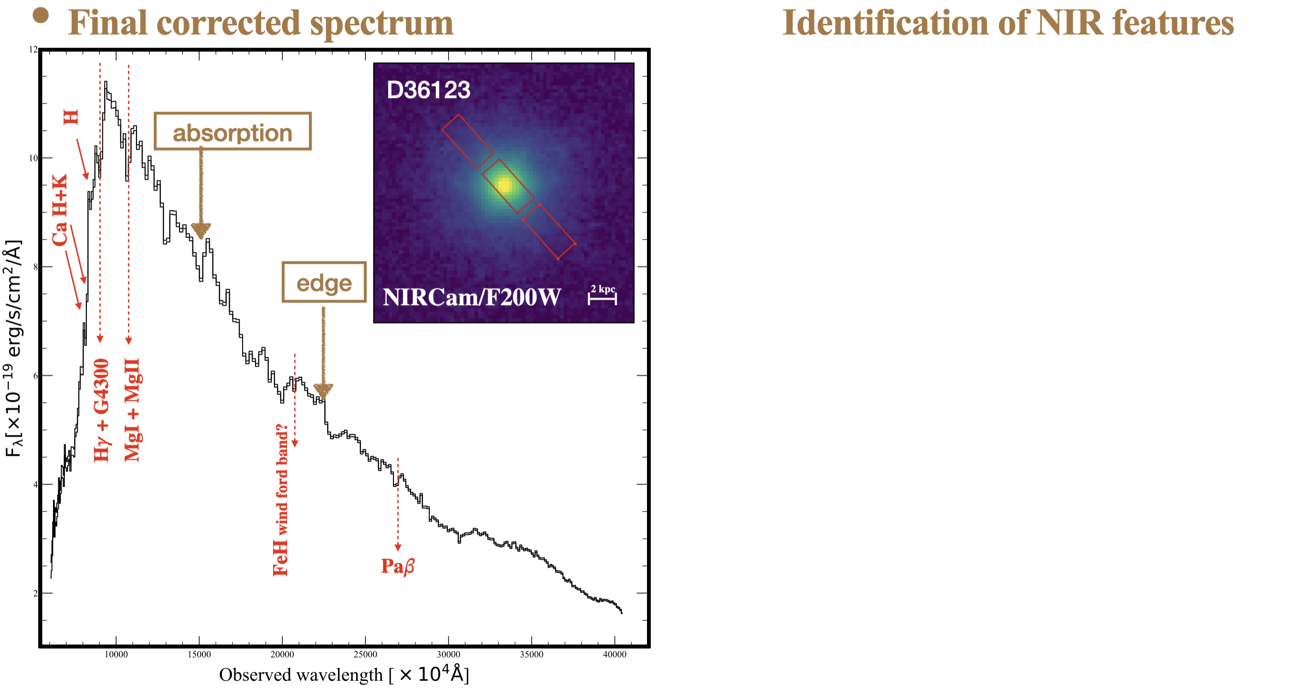
Results: D36123 with the highest SNR
Notes:
After a series of data calibrations, we obtained the final corrected spectrum of the entire galaxy, as shown on the left. Except for common absorption features, as marked in red arrows, there is a large number of features that are detected in the NIR, such as the broad absorption and the edge.
To identify these NIR features, we compare the observed spectrum with the spectrum of C-rich TP-AGB stars. We find the edges are mainly contributed by CN. While the absorptions are mainly from TiO features when compared with the spectrum of O-rich TP-AGB stars.

Slide 10
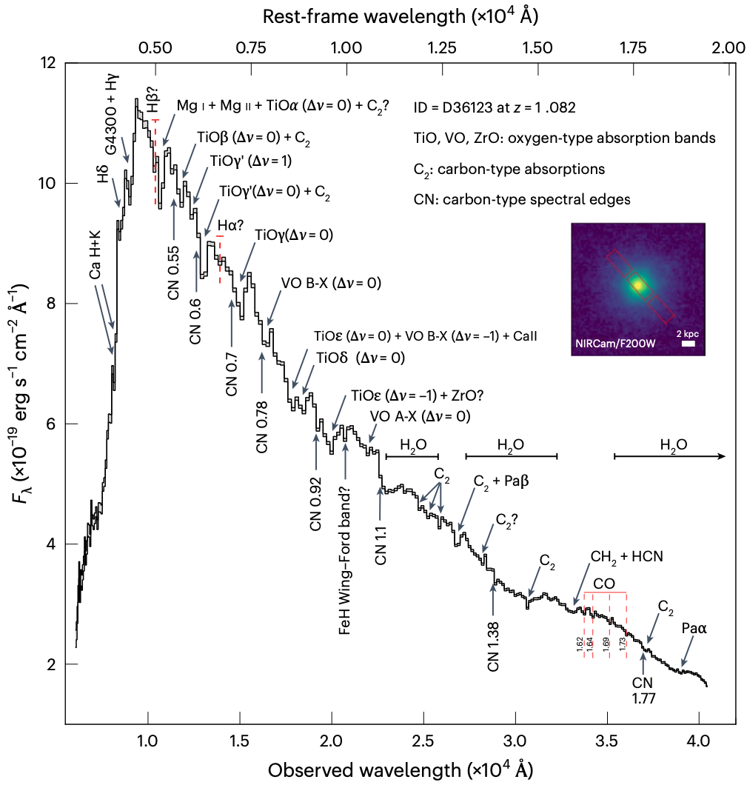


D36123 Results: Spectral signs for TP-AGB star contribution
These observed spectral features are related to diverse stellar types in the AGB (E-AGB +TP-AGB):
CN 1.1𝜇m:
particularly enhanced in rich N-type C stars;
produced by the third dredge-up and therefore demonstrate the presence of a contribution by TP-AGB stars;
Multiple TiO(氧化钛) absorptions concomitant with CN and C2 features (First):
C—> metal-poor vs. O—> metal-rich;
indicating a broad distribution of stellar metallicities.
ZrO(Zirconia, 氧化锆) and VO(Vanadium oxide, 氧化钒):
V and Zr are only produced by s-process nucleosynthesis;
ONLY detected in the coolest TP-AGB stars.
Notes:
If we labeled all of them onto the same spectrum, the result shows like the figure in the left panel. These observed spectral features are related to diverse stellar types in the AGB phase. I would like to highlight three points.
Firstly, there is a strong CN feature at the rest-frame 1.1 um. This feature particularly can be enhanced in rich N-type C stars, and produced by the third dredge-up, so the existence of this feature demonstrates the presence of a contribution by TP-AGB stars. Secondly, it is the first time to observe multiple Titanium dioxide（TiO） absorptions concomitant with CN and C2 features in the same spectrum.
Thirdly, we detect the Zirconia (ZrO) and Vanadium Oxide (VO). Since Vanadium (V) and Zirconium (Zr) are only produced by s-process nucleosynthesis, those VO and ZrO are expected to be detectable only in the coolest TP-AGB stars.
%As we know, the metal-poor stars evolve preferentially into carbon-rich TP-AGB stars, and the metal-rich ones into oxygen-rich (M Type) TP-AGB stars, so the observations from both indicate the broad distribution of stellar metallicities.

Slide 11
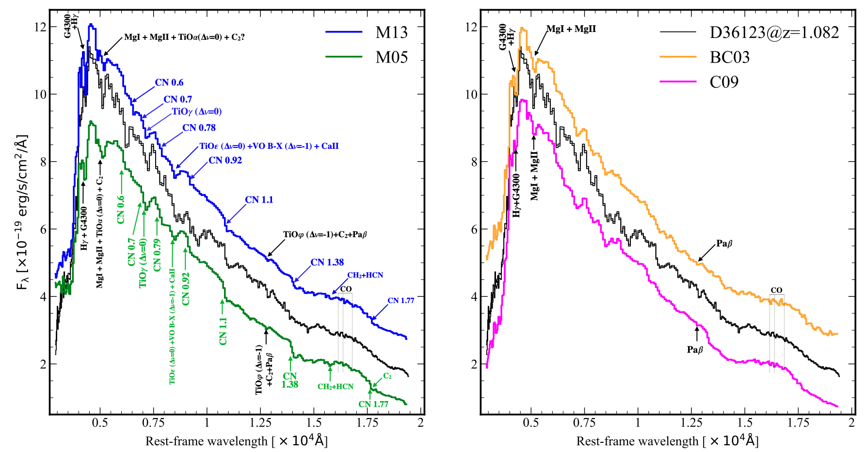
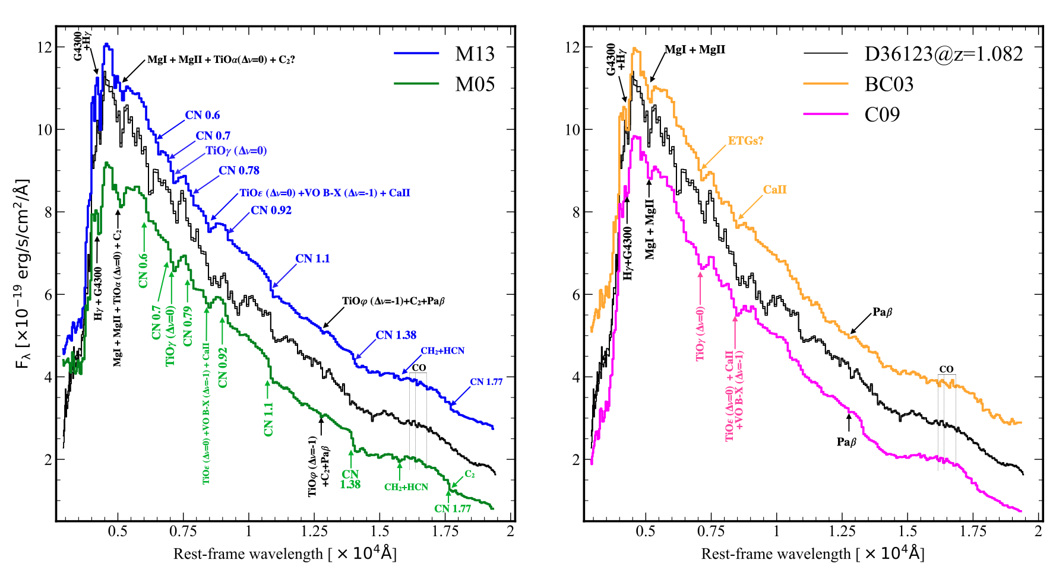
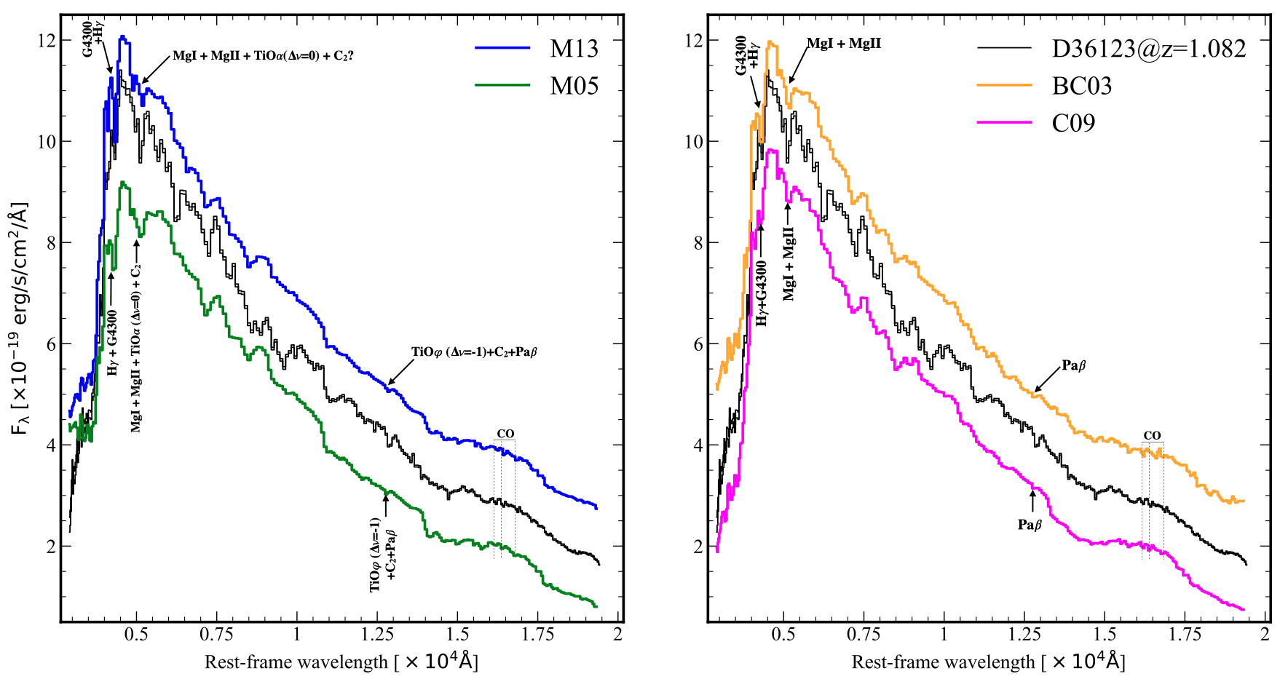
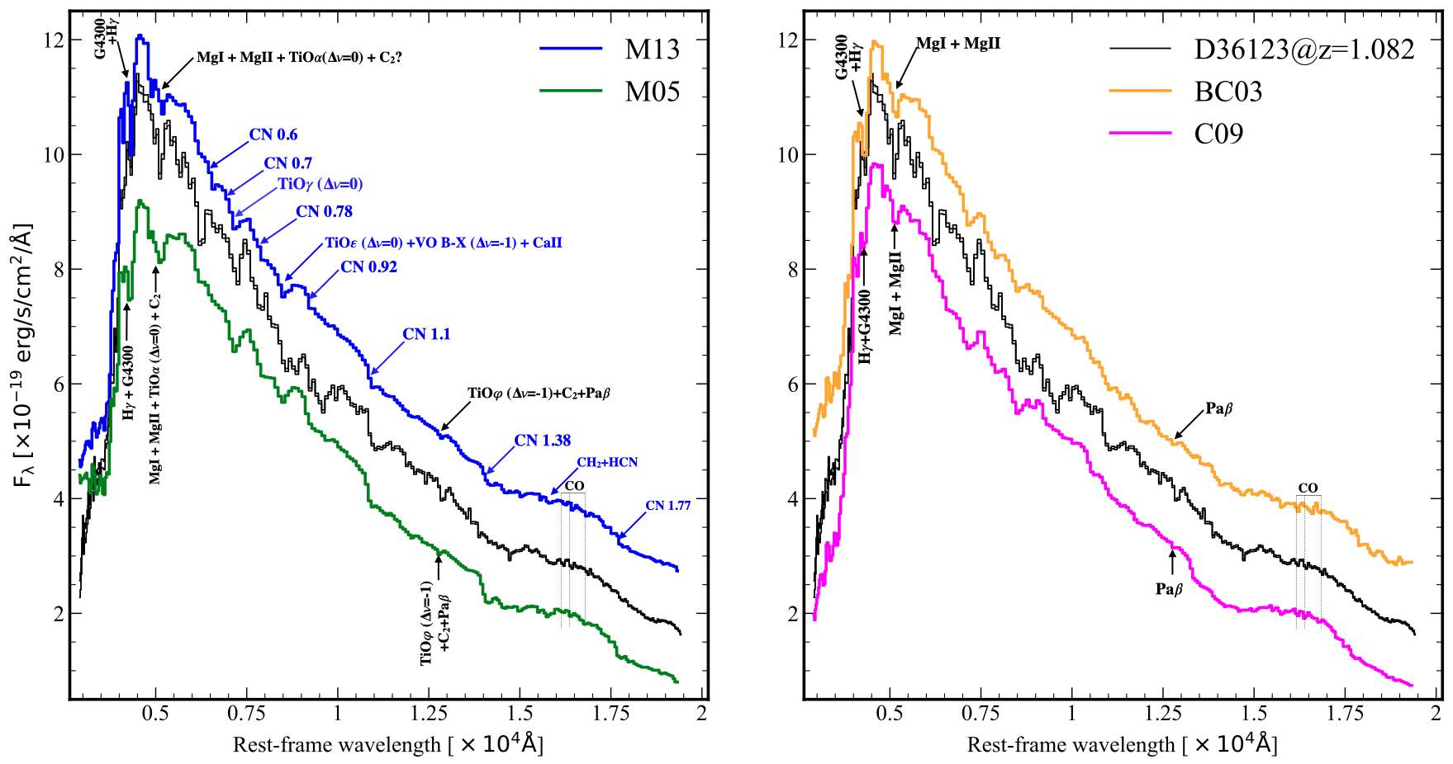
D36123 Results: Best-fit results from different models
Setups in models:
delay-𝜏 model
(SFH~t/𝜏² e^{-t/𝜏})
metallicity free
dust free
appropriate resolution
model | reduced chi-sq
BC03 | 59.6
C09 | 52.9
M13 | 39.0
M05 | 102.6
M13 provides the best overall fit, and identifies the majority of TP-AGB features
indicating that the current model is lacking some stellar ingredients that are present in the galaxy and are needed.
M05 shows the worst overall fit due to the clear discrepancy at 𝜆rest<5000Å but still can match many features.
Notes:
We adopted different template models to fit this observed spectrum. We find that the M13 model, shown in blue, can provide the best overall fit and identify the majority of TP-AGB features. While the M05 model shows the worst fit due to the clear discrepancy at a rest-frame wavelength < 5000 angstroms, but still can match many features, compared to the BC03 and C09 models.
Even for the best-fit M13 model, the reduced chi-square is still large, which probably indicates that the current model is lacking some stellar ingredients that are present in this galaxy and are needed.

Slide 12
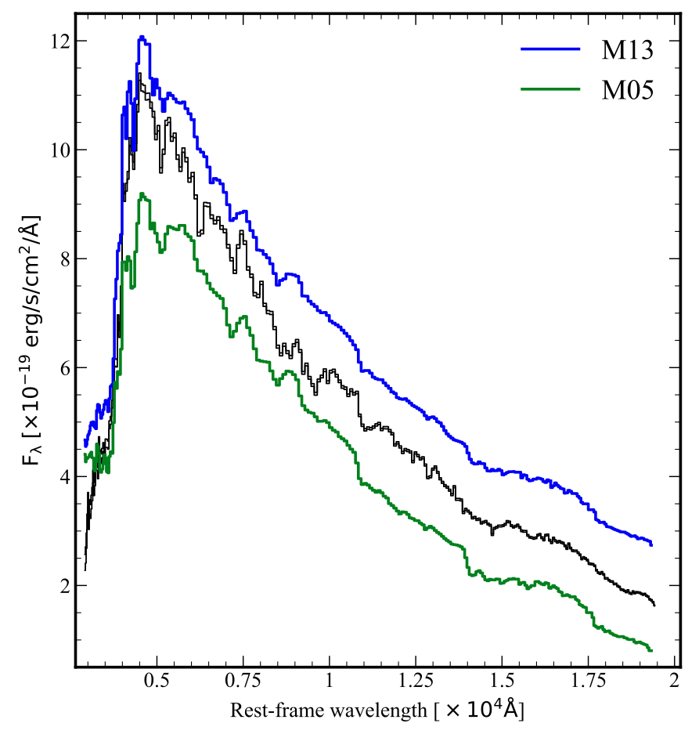
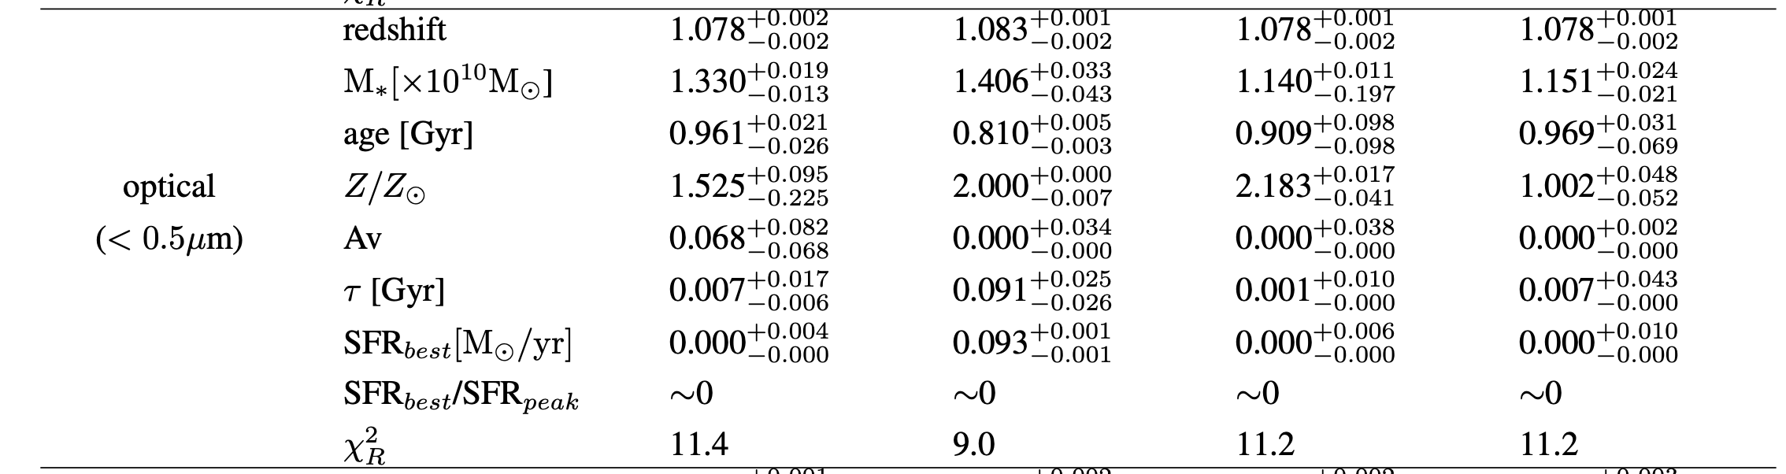
Analysis: Where do these NIR features come from TP-AGB, RSG, or RGB?
age ~1Gyr
SFR~0
TP-AGB:
𝛌 rest <5000Å fit, mass-weighted age~1Gyr in four models, which is indeed the age when TP-AGB features are expected to nearly peak.
RSG(red-supergiant)?
RSG(<10Myr): safely exclude
Notes:
Based on the above results, we want to explore where these near-infrared features come from, from TP-AGB, RGB, or RSG. We did some tests. We separate our spectrum into two parts, the optical part where the rest-frame wavelength is less than 5000 angstroms, and the remaining near-infrared part. When we only fit the optical part, all models converge to a mass-weighted age of about 1 Gyr, which is indeed the age when TP-AGB features are expected to nearly peak. We can also safely exclude the contribution from red supergiants because they have ages around 10Myr.

Slide 13
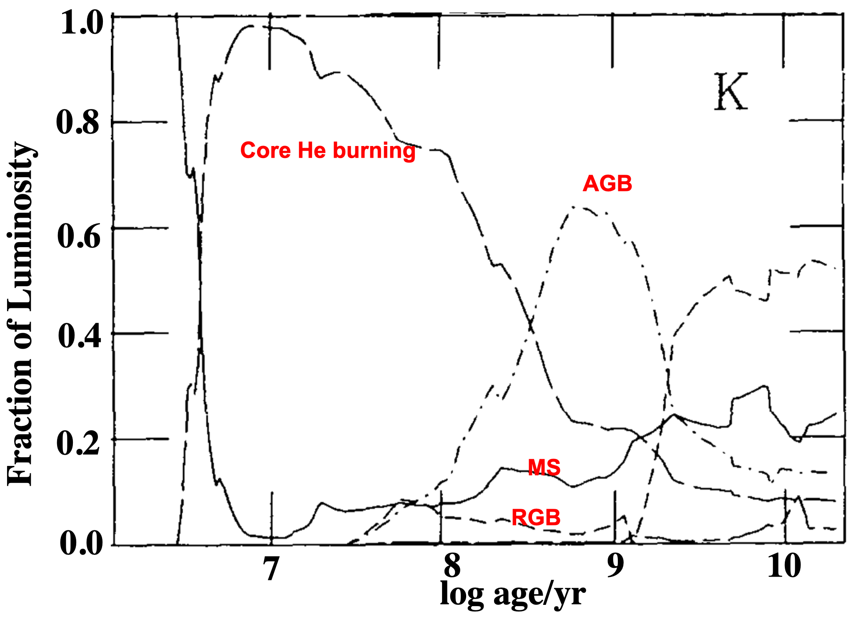

Analysis: Where do these NIR features come from TP-AGB, RSG, or RGB?
TP-AGB:
𝛌 rest <5000Å fit, mass-weighted age~1Gyr in four models, which is indeed the age when TP-AGB features are expected to nearly peak.
Bruzual+Charlot+1993
RSG(red-supergiant)?
RSG(<10Myr): safely exclude
RGB (red-giant-branch):
~20-30% in K band (M05 model)
~10-20% in K band (BC03-type model)
NOT Dominated
Therefore, NIR features are dominated by TP-AGB stars
Notes:
How about RGB? As shown in the right figure, the full RGB contribution to the total light in the K band around 1 Gyr is about 20-30% in M05 models, and 10-20% for the BC03-type model, so RGB stars can not dominate the spectrum. Instead, these NIR features are dominated by TP-AGB stars.

Slide 14
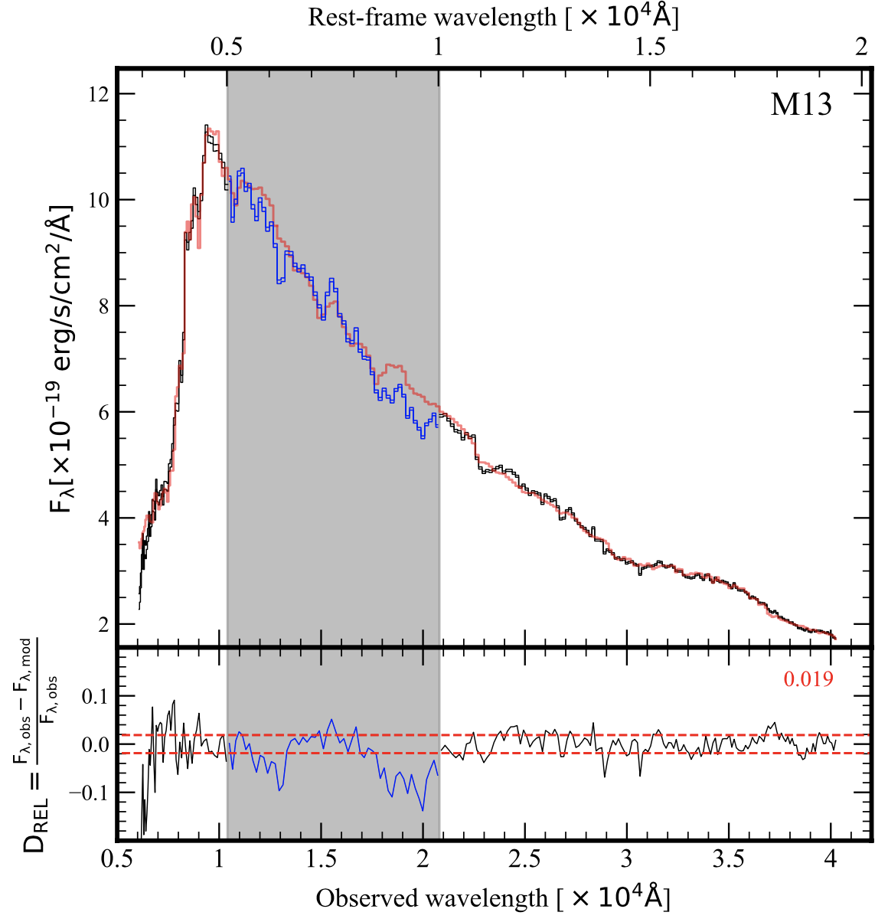


Analysis: What is the reason for the high reduced Chi-squared value?
Reduced Chi-square for D36123
rest-frame range | BC03 TP-AGB-poor | C09 TP-AGB-light | M13 TP-AGB-mild | M05 TP-AGB-heavy
full | 59.6 | 52.9 | 39.0 | 102.6 (due to <0.5um)
optical <0.5um | 11.4 | 9.0 | 11.2 | 11.2
NIR >0.5um | 60.7 | 58.5 | 40.7 | 66.6
full excluding 0.5-1um | 32.2 | 23.1 | 16.3 | 83.7
D36123:M13
0.019
The fit in the NIR spectrum leads to high reduced chi-squares;
Model ingredients could be responsible for this discrepancy;
This stimulates new generations of improved models.
0.040
☛
optical
others >0.04-0.08
NIR
Notes:
Why is the reduced chi-squared value very high? If we only fit the optical part, the reduced chi-squares are around 10, but if we only fit the NIR part, the reduced chi-square will become larger around 50-60, this suggests that it is the fit in the NIR spectrum that leads to the high reduced chi-squares. When we mask the region between 0.5-1 um and then fit the remaining spectrum. This masked region contains many TP-AGB strong features. We find that the M13 model can balance the remaining fit better than others, and it can predict the features in the masked region better than others as well. This also suggests that the ingredients in models (even for M13) could be responsible for the discrepancy between the observed spectrum and the best-fit model. This stimulates us to improve our current models.

Slide 15
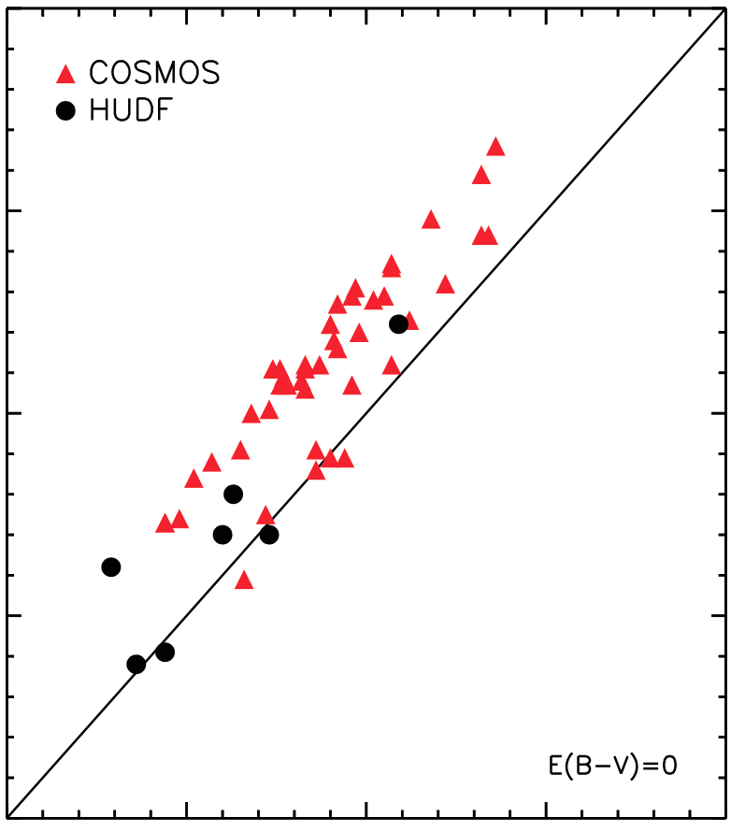
Analysis: Impacts of the chosen model on derived properties: M* and age
TP-AGB-poor
TP-AGB-mild
 | Obj\mod | BC03 | C09 | M13 | M05
 | D36123 | 1.493 | 1.489 | 1.167 | 1.552
 | 8595 | 0.791 | 0.736 | 0.545 | 0.676
 | 9025 | 0.834 | 0.914 | 0.796 | 0.482
TP-AGB-poor (BC03) vs. TP-AGB-mild (M13)
younger mass-weighted age (100Myr ~1Gyr)
lower stellar mass (30%)
Stellar Mass
M* [×10¹⁰M⨀]
 | Obj\mod | BC03 | C09 | M13 | M05
 | D36123 | 1.661 | 0.751 | 0.621 | 2.224
 | 8595 | 1.913 | 0.798 | 0.732 | 1.908
 | 9025 | 1.905 | 2.059 | 1.606 | 0.202
~0.3dex
10.5
log M*/M⊙ (BC03)
Mass-weighted
age [Gyr]
10
11
11.5
12
Capozzi+16, QGs, 1.3<zspec<2.7
10
10.5
11
11.5
12
log M*/M⊙ (M13)
Notes:
If we adopt these different models, what are the impacts of the chosen model on the derived physical properties of galaxies, especially for stellar mass and age? The best-fit stellar masses and ages in different models for three targets are listed in the top and bottom tables, separately. BC03 model is the common model used in the high-redshift studies. If we compare the results from BC03 to those from M13, we find that the M13 model tends to give younger mass-weighted age (younger than 100Myr-1Gyr) and lower stellar mass (~30%), which are consistent with previous studies.

Slide 16

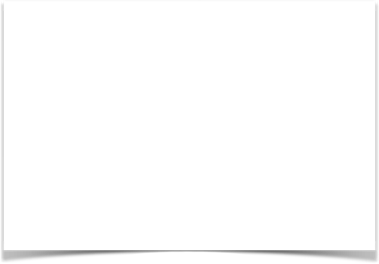
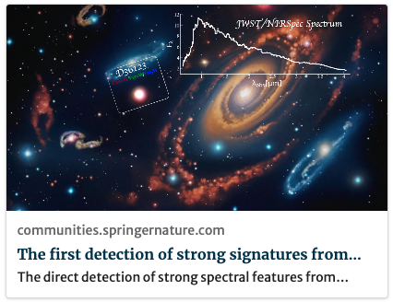
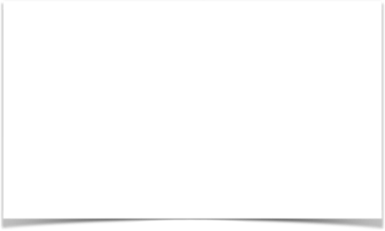
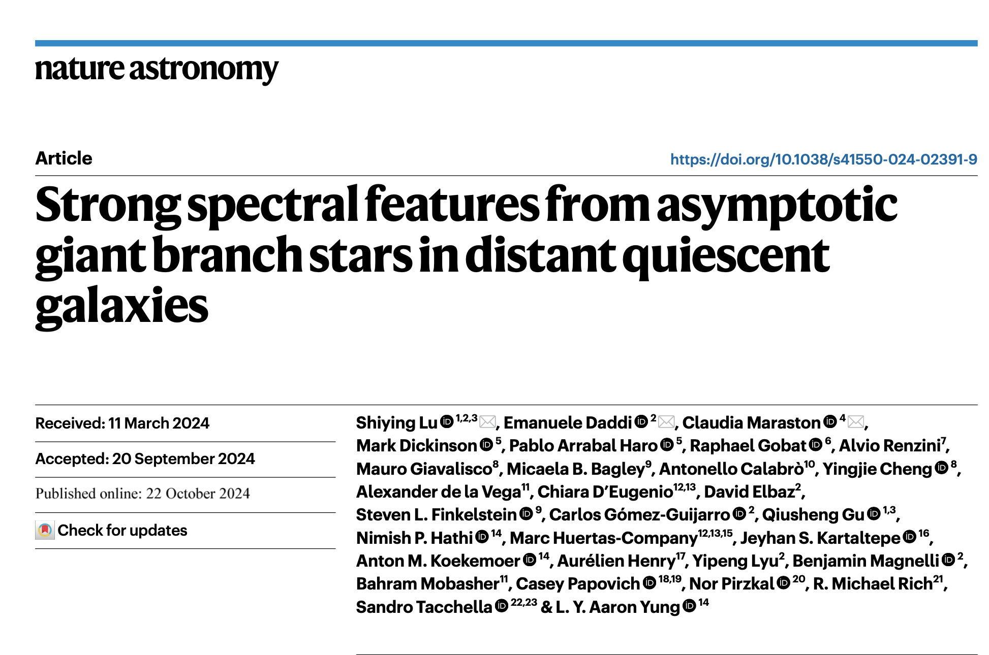
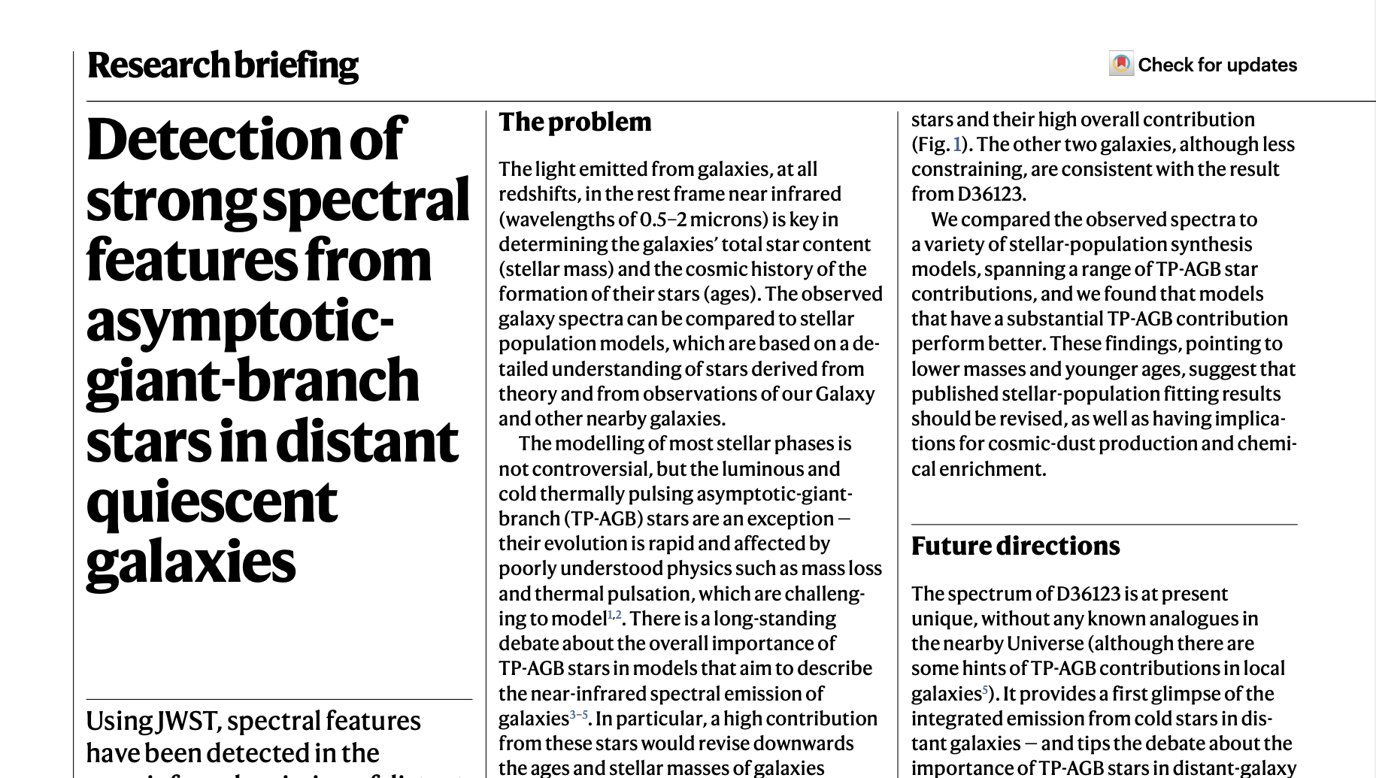

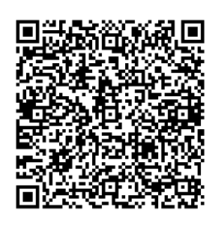

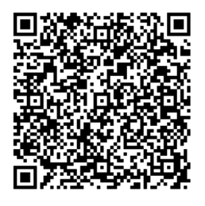
Conclusion
The TP-AGB is the primary model ingredient driving the fitting of our spectra.
M13 and M05 models are in better agreement with the NIR features;
M13 gives the best fit among the four models;
Based on the current small sample:
M13 models tend to give lower stellar mass (<30%) and younger mass-weighted age (100Myr-1Gyr);
But, for individual galaxies, fitting results rely on the unknown details of the SFH.
The next-generation model is needed due to no small reduced Chi-square obtained in M13 of D36123.
Research Briefing
Nature Astronomy
blog post: Behind the paper
news resport
Notes:
Finally, based on these NIRspec spectra of quiescent galaxies, we confirm that TP-AGB stars are the primary model ingredient driving the fitting of our spectra, and the M13 model can give the best fit among the four main models. The M13 model trends to give lower stellar mass and younger mass-weighted age. However, the caveat is that our sample is not large enough, and the individual galaxy study may be biased by the unknown details of the past star formation history. The next-generation model is needed due to no small reduced chi-square obtained in M13 of D36123. The related work has been published in Nature Astronomy.

Slide 17
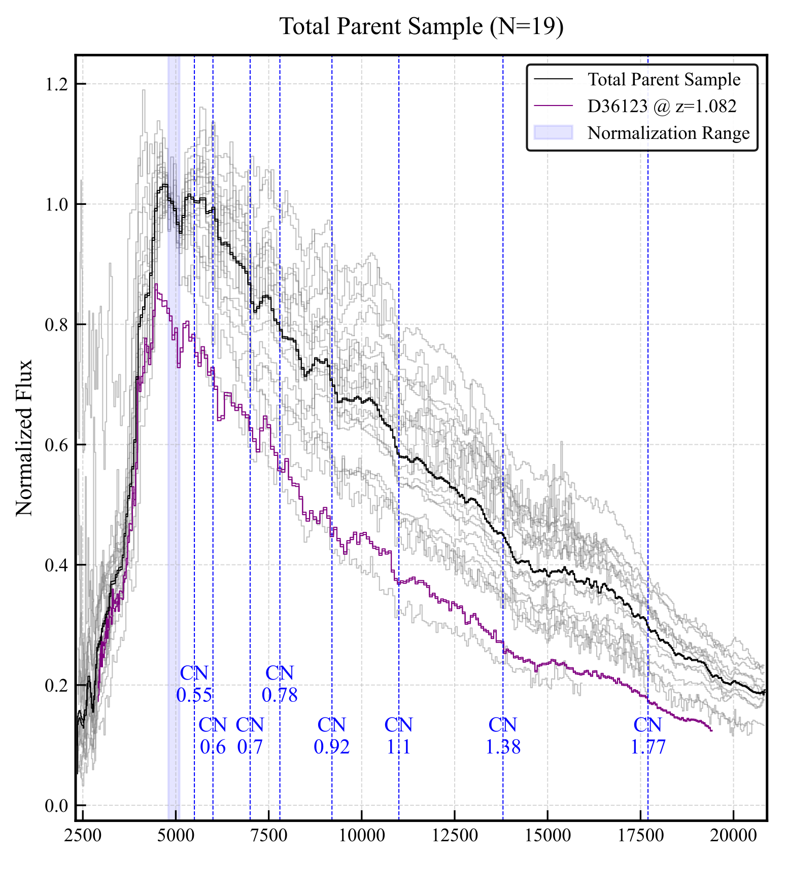
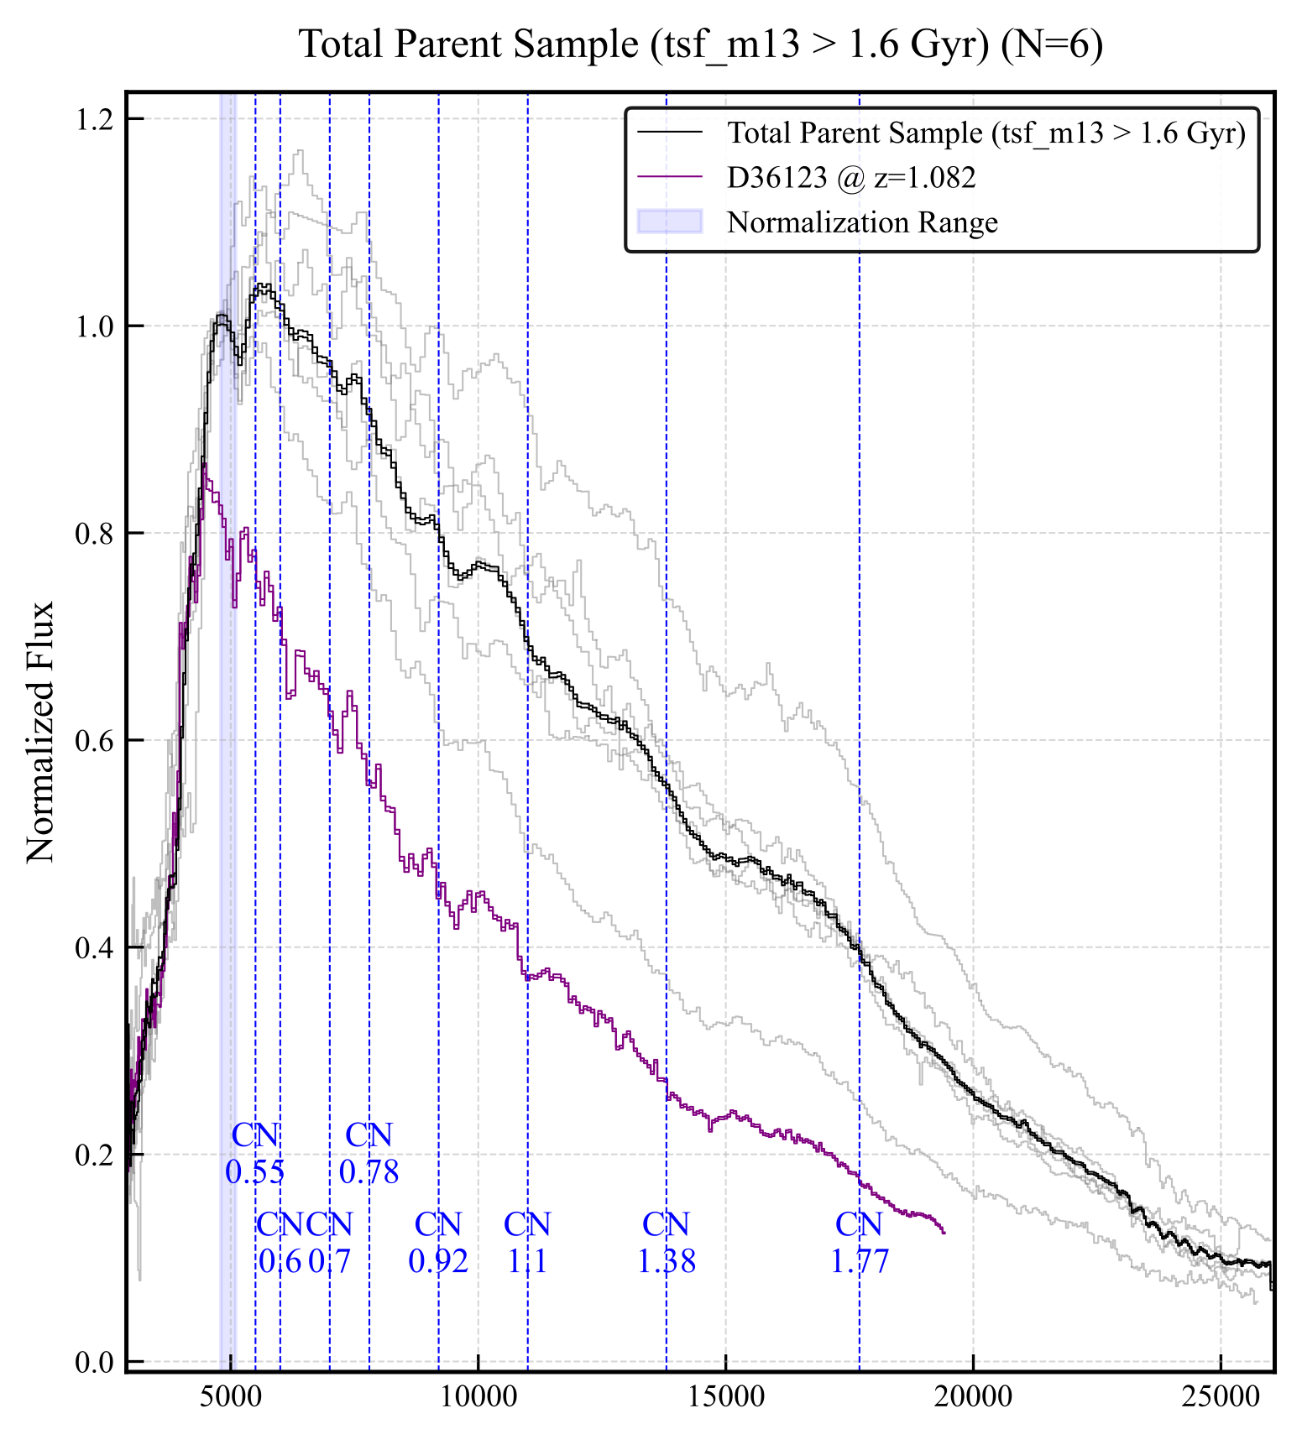
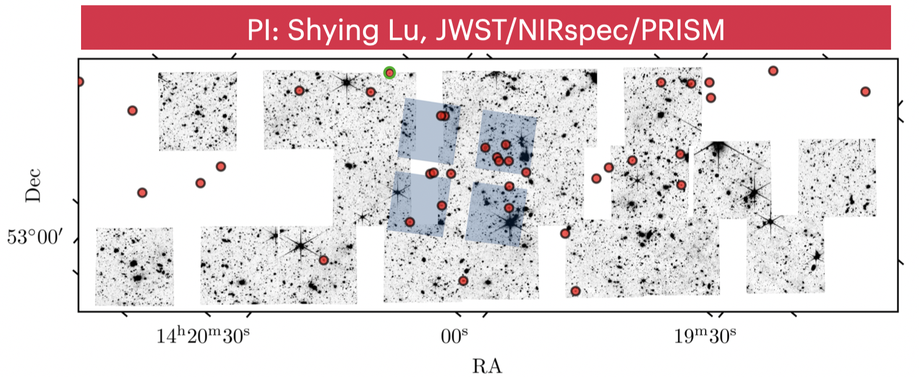
0.4 < age<1.6 Gyr, N=19
Preliminary results: 25 QGs GO-5019 and CEERS
age>1.6 Gyr, N=6
Preliminary
smoother
Notes:
To conduct further research, we obtained observations at JWST/Cycle 3, a point of NIRSpec observation. By combining CEERS observation data, we constructed spectra for approximately 20 QGs. Preliminary results show that QGs with the age dominated by TP-AGB stars exhibit spectral features that are stronger than those older QGs.

Slide 18
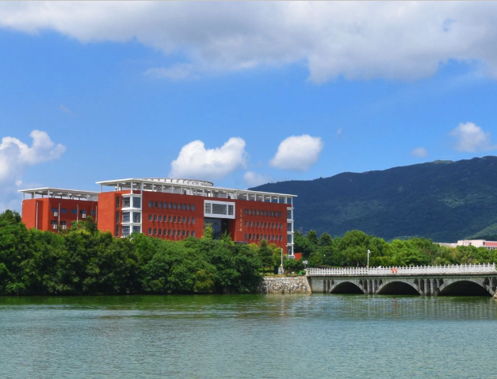
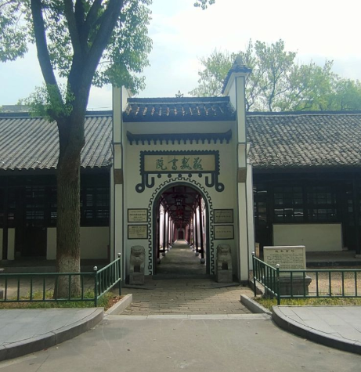
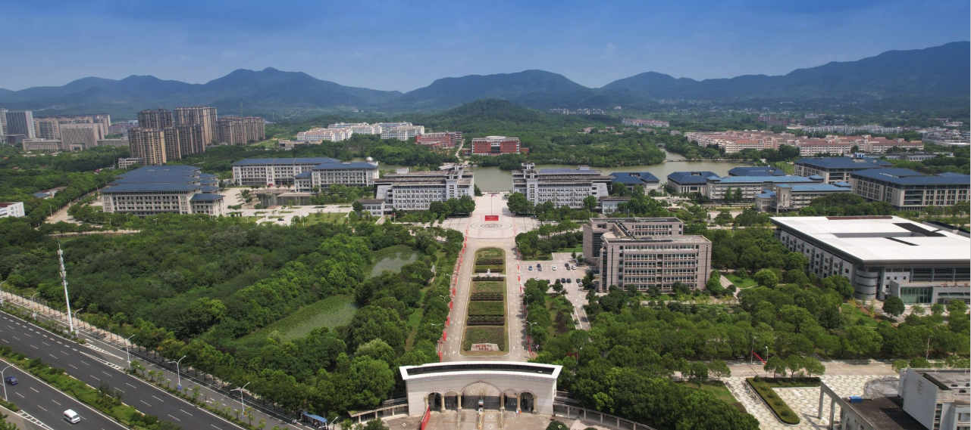
7th China-Chile Bilateral Conference for Astronomy
Thanks

Slide 19
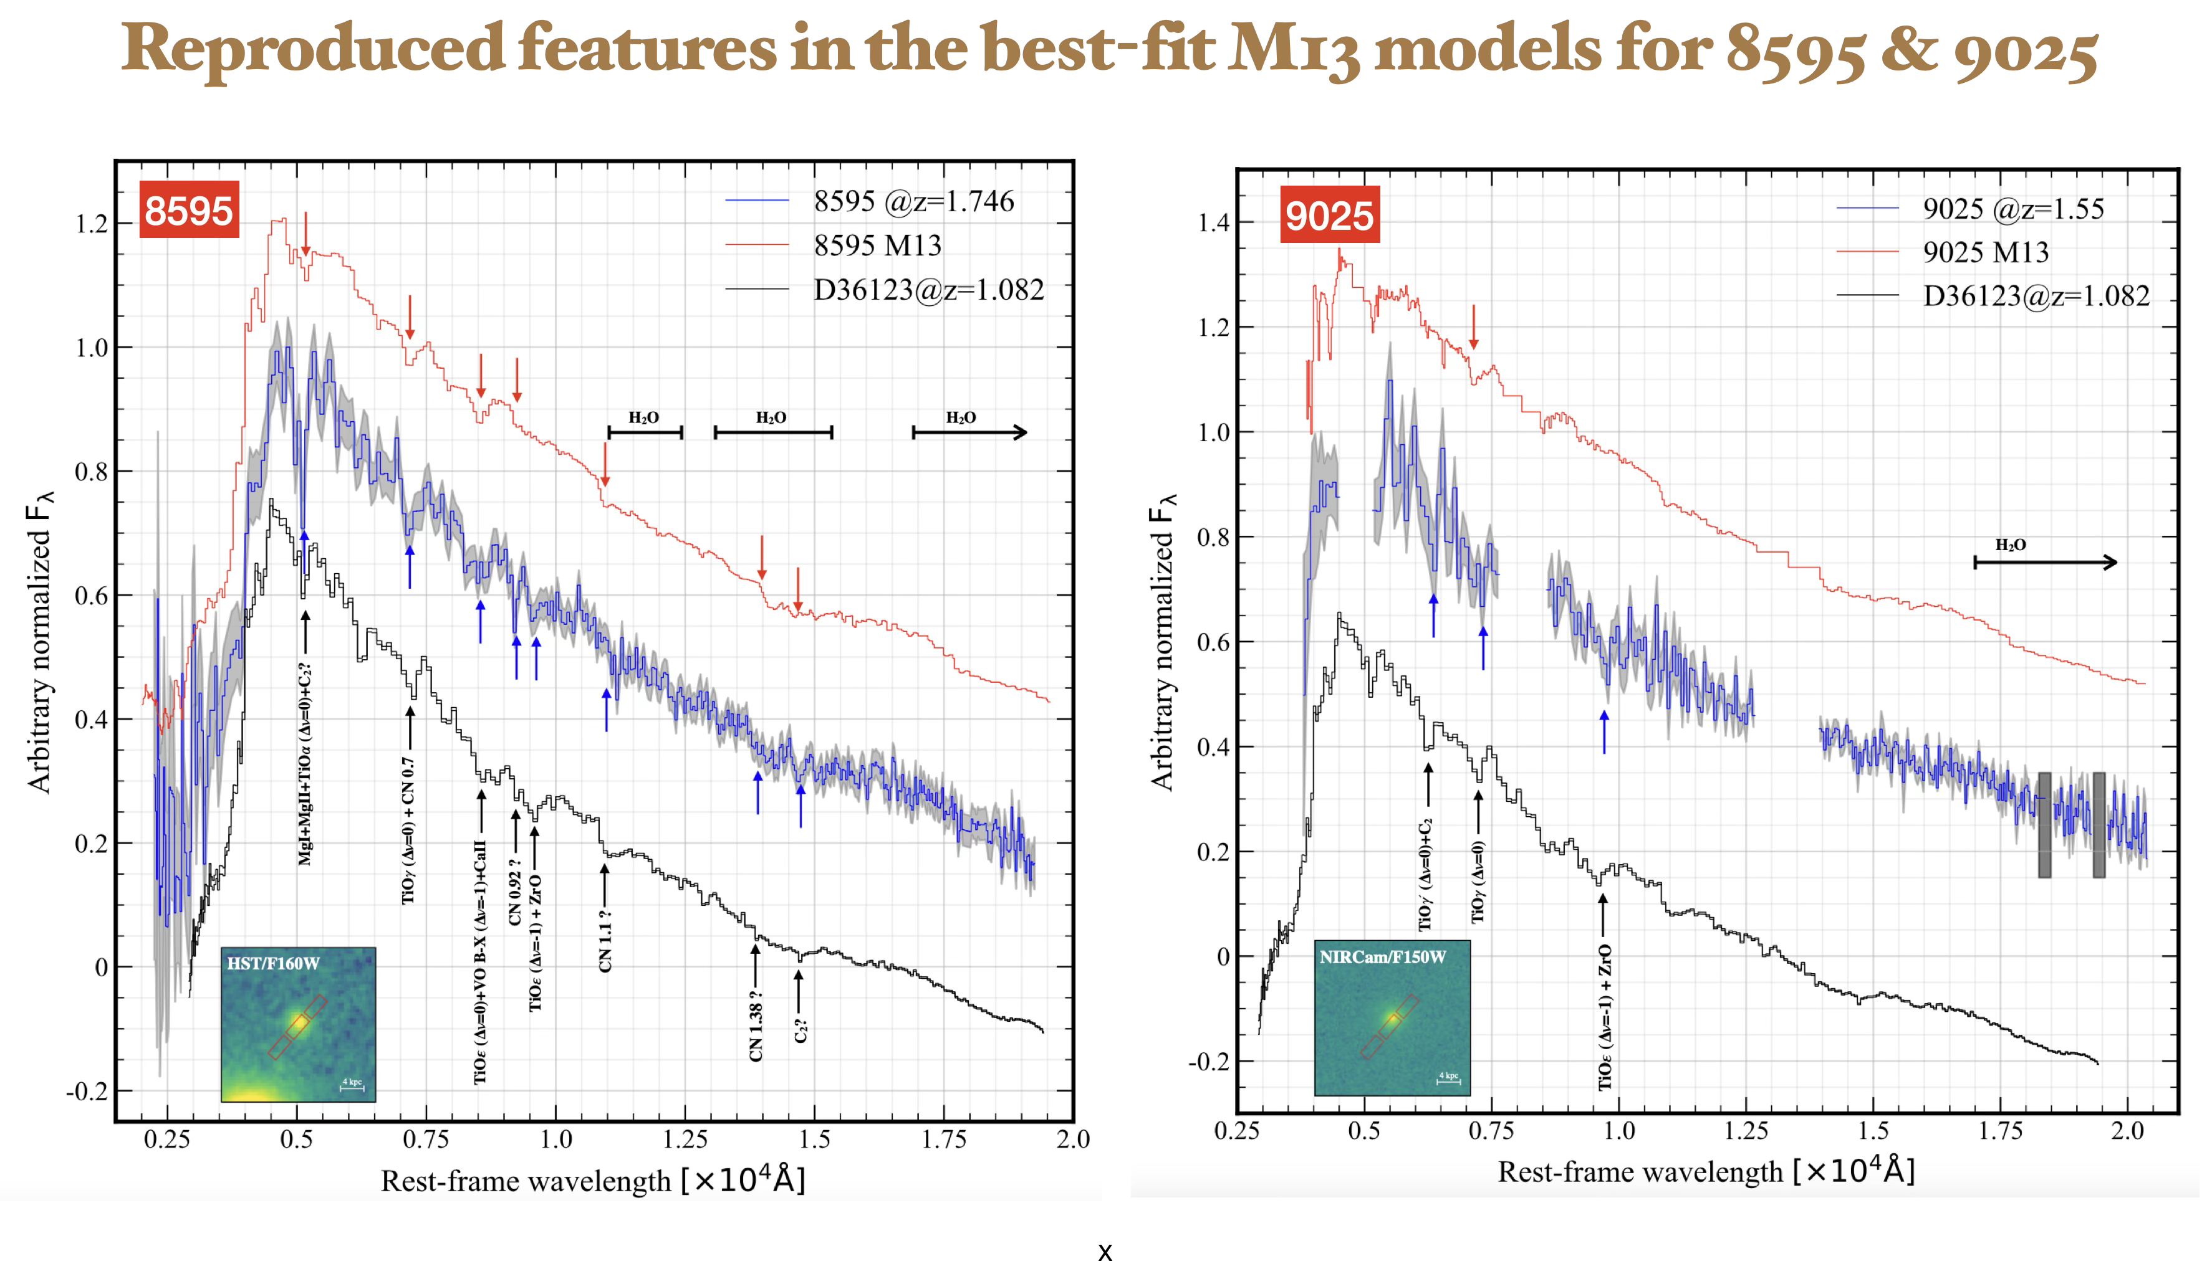
Appendix

Slide 20
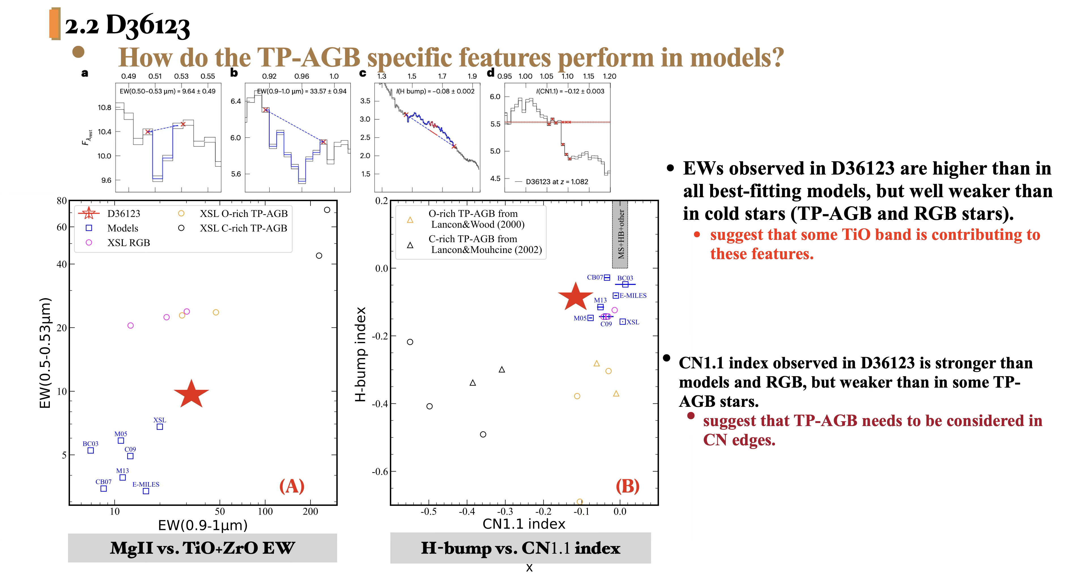
Appendix

Slide 21
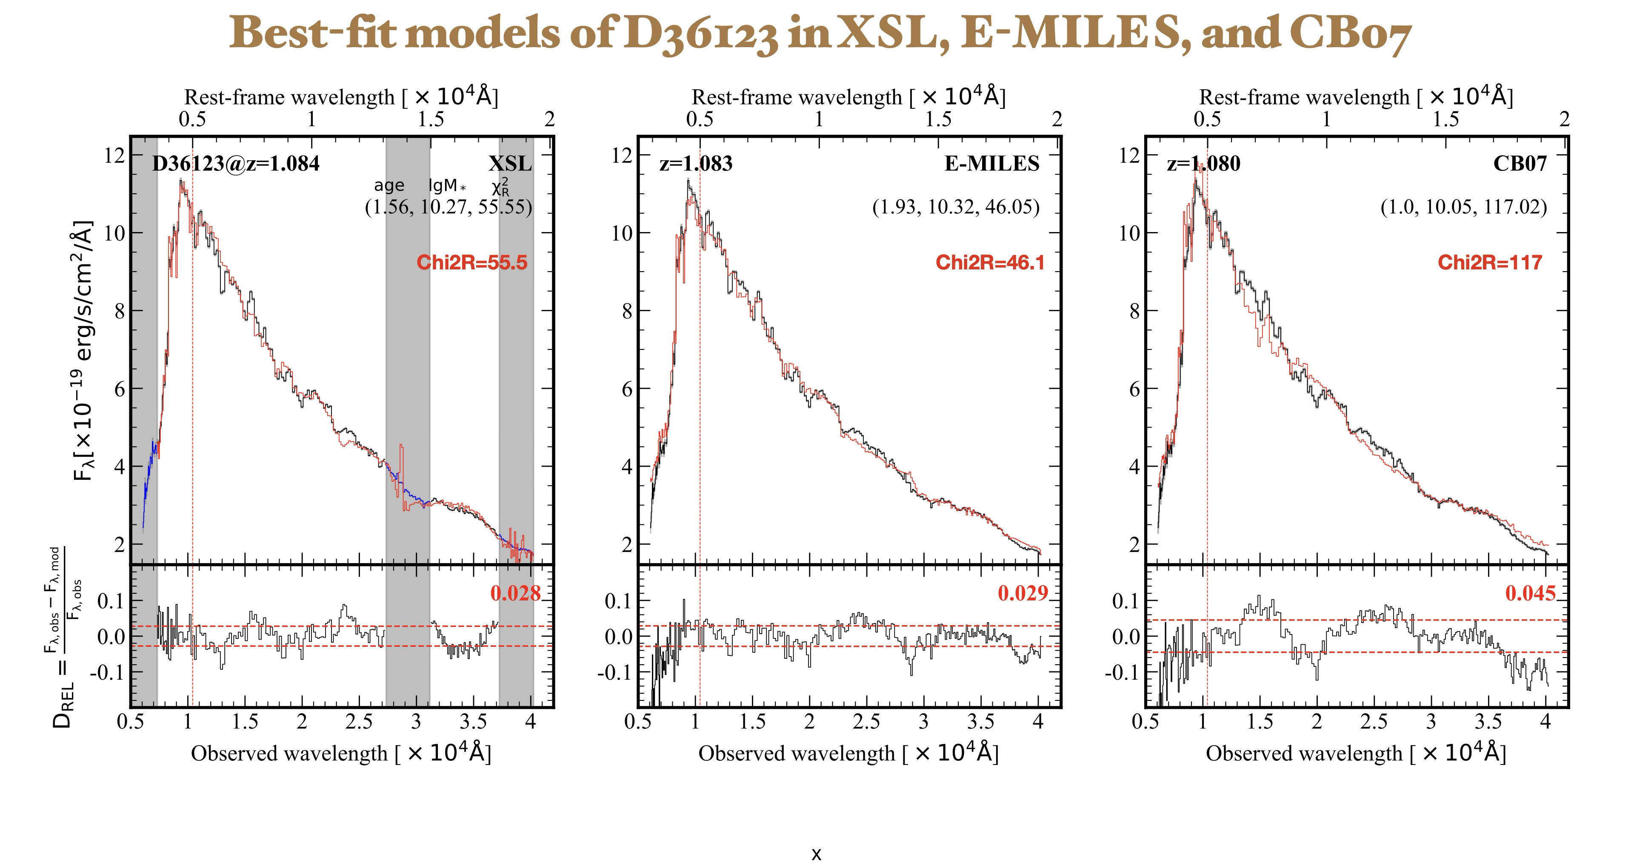
Appendix

Slide 22
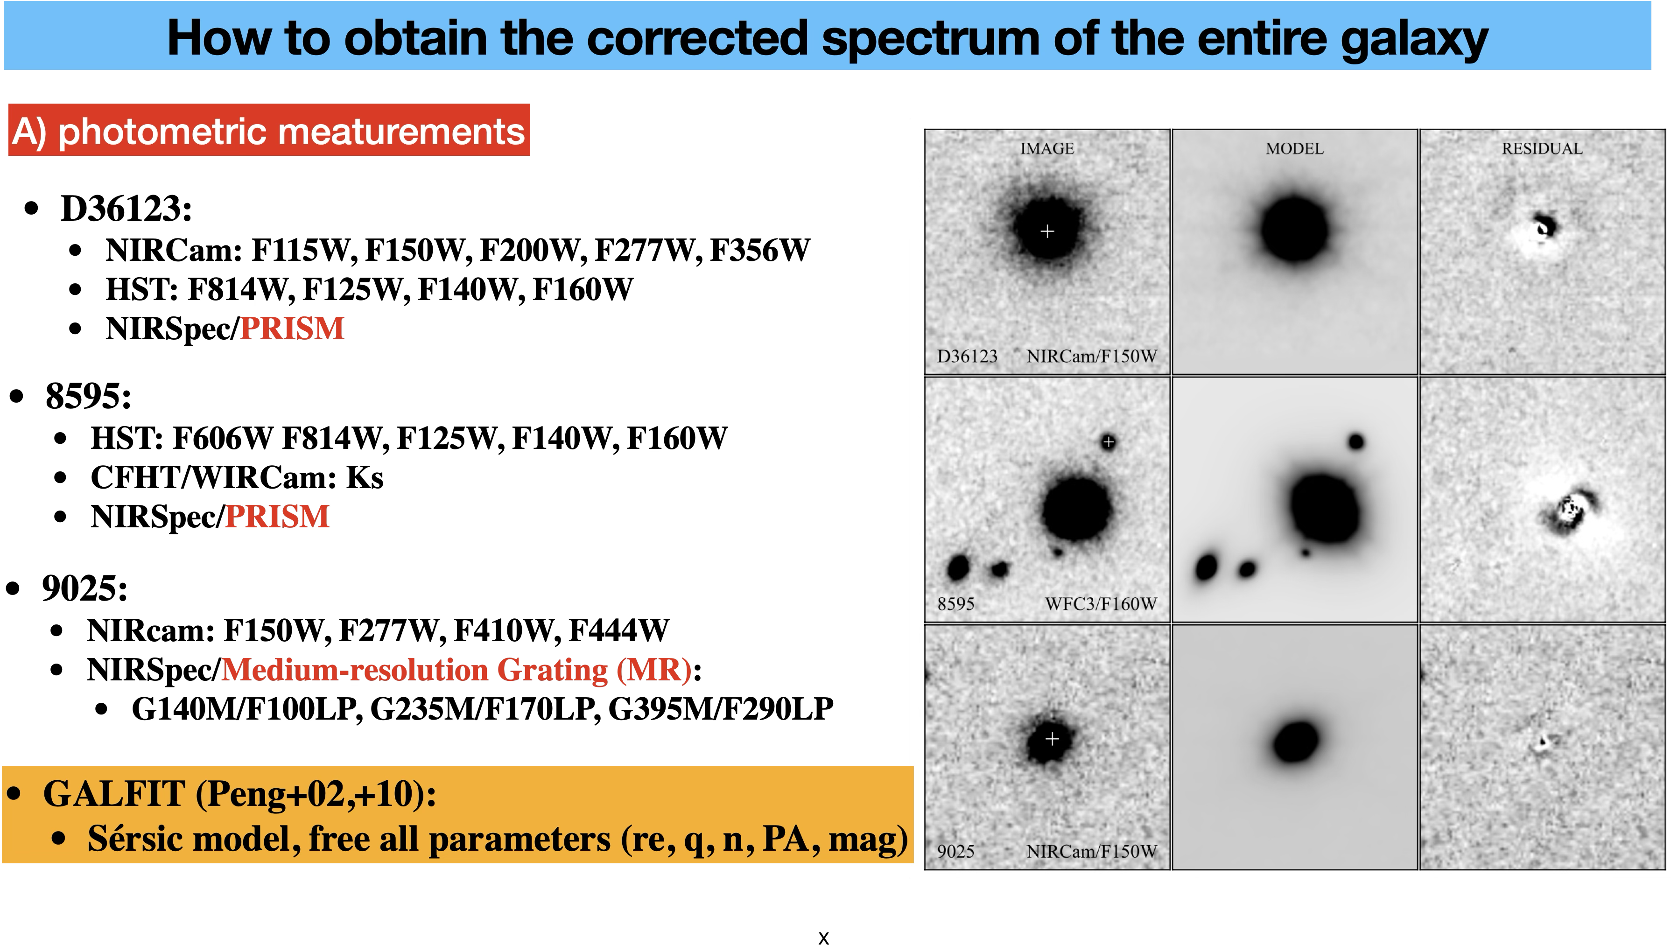
Appendix

Slide 23
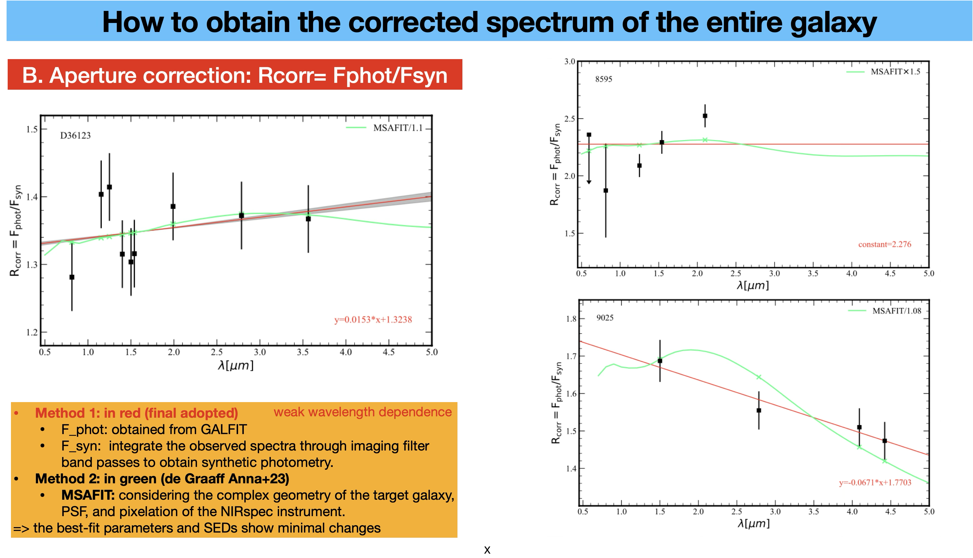
Appendix

Slide 24
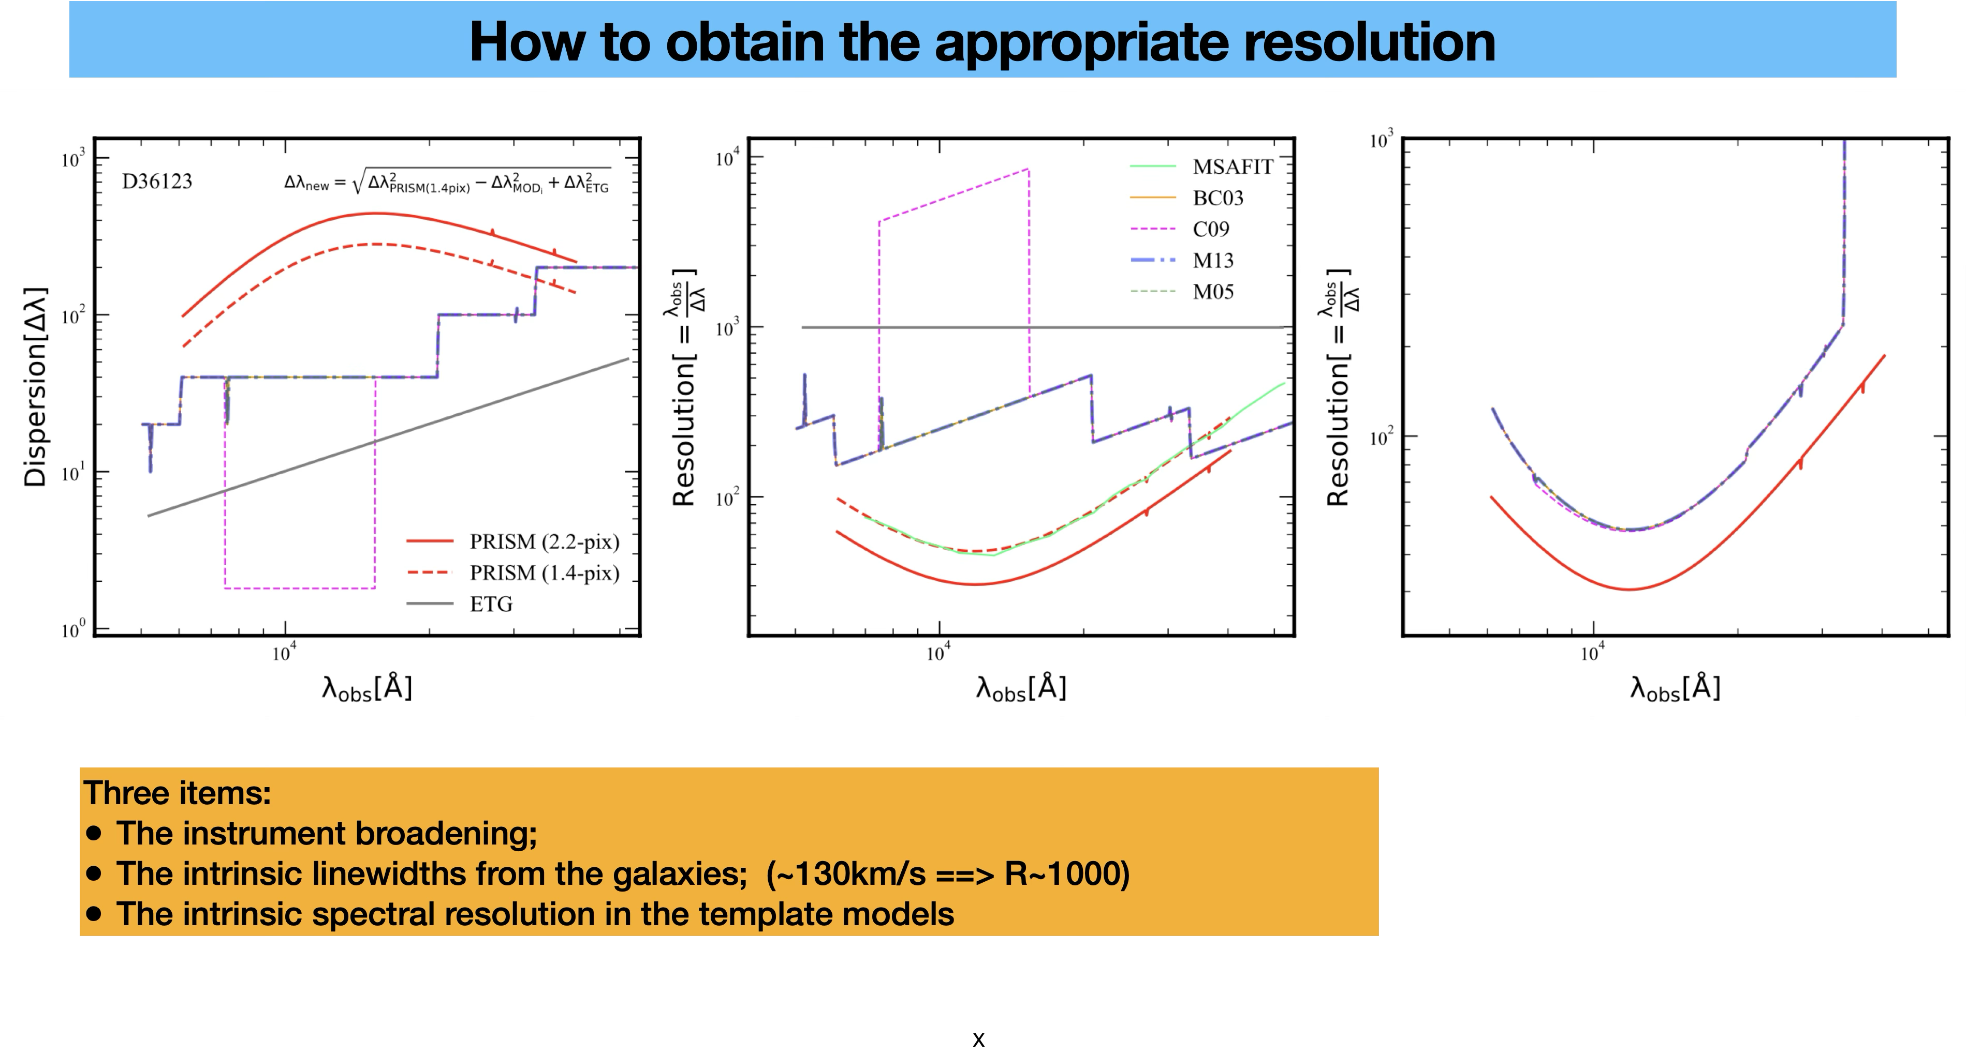
Appendix

Slide 25
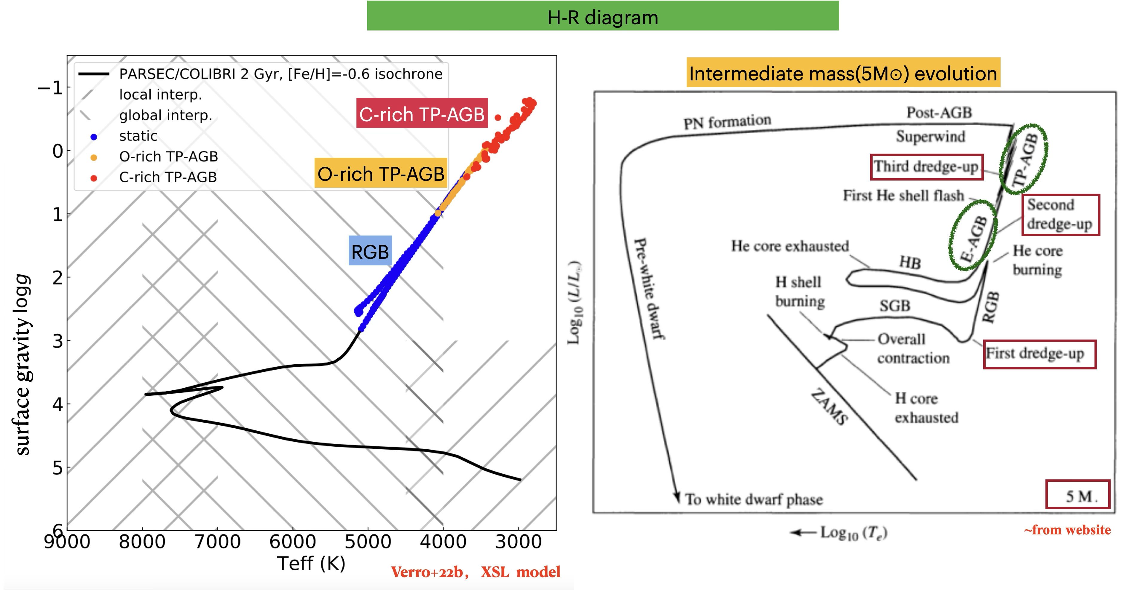
Appendix

