Slide 1
Extreme X-ray weakness and variability in super-Eddington accreting AGNs
Bin Luo
Nanjing University
01/2026, HKU

Slide 2
Outline
AGN X-rays and weak-line quasars
Extreme (factors >10) X-ray weakness and variability: a learning experience

Slide 3
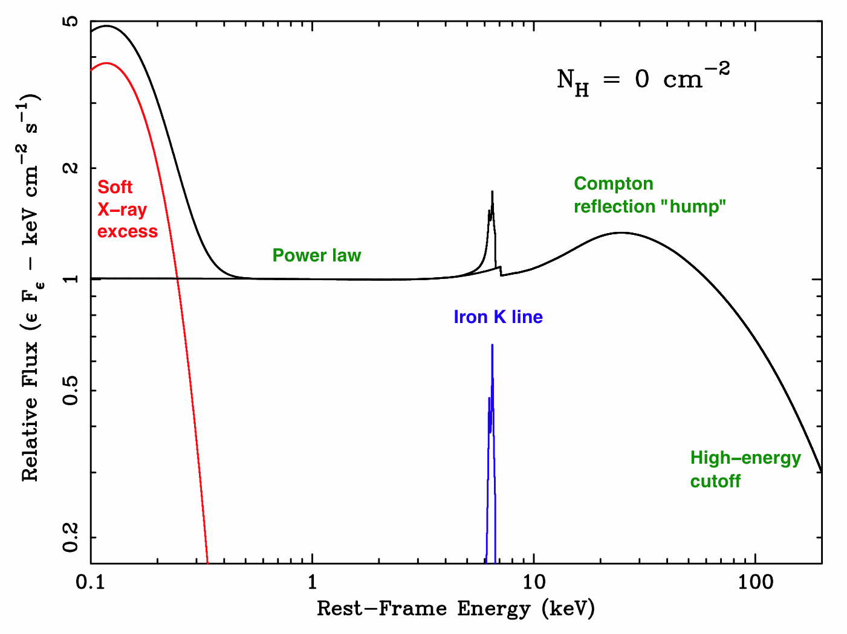
AGN X-ray spectrum and SED (Type 1, radio-quiet)
X-ray spectrum: mostly a power law; Γ~2
May be modified by obscuration
Broad-band SED
a_{ox}

Slide 4
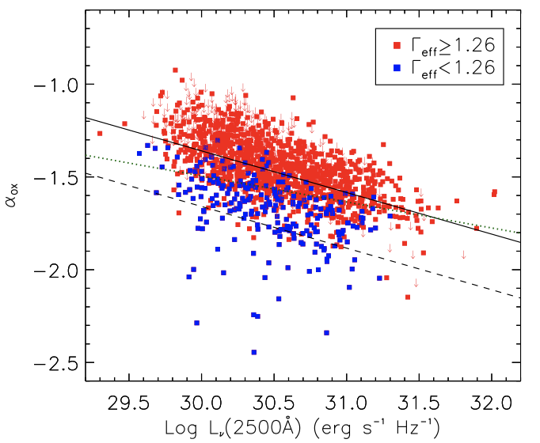
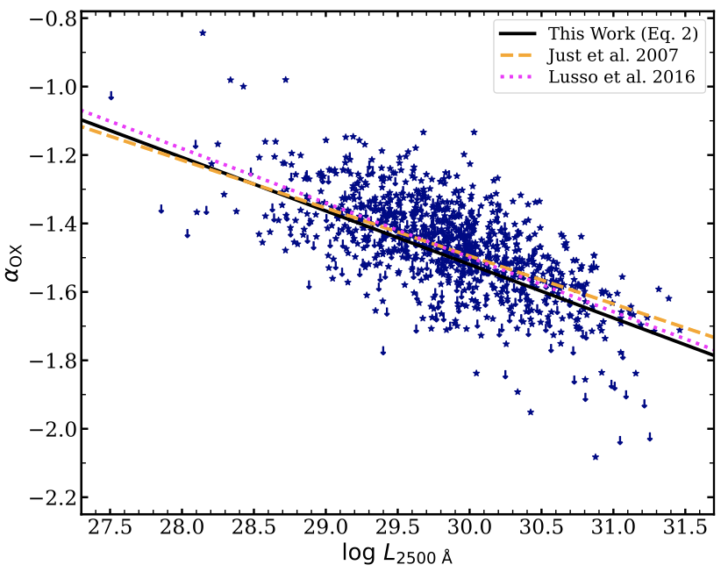
The a_{ox} – L₂₅₀₀ relation: a measure of X-ray strength
SDSS quasars
f_{weak}=6
AGNs in X-ray surveys
Pu, B.L. et al. (2020)
Huang, B.L. et al. (2025)
Stochastic variability increases the scatter, but not significant.
Removal of potentially X-ray absorbed objects important.

Slide 5
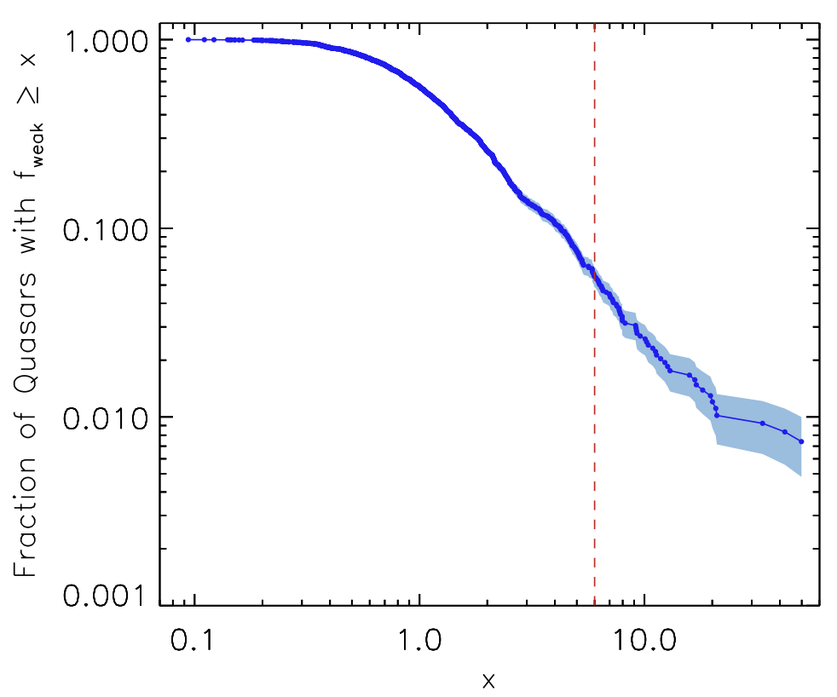
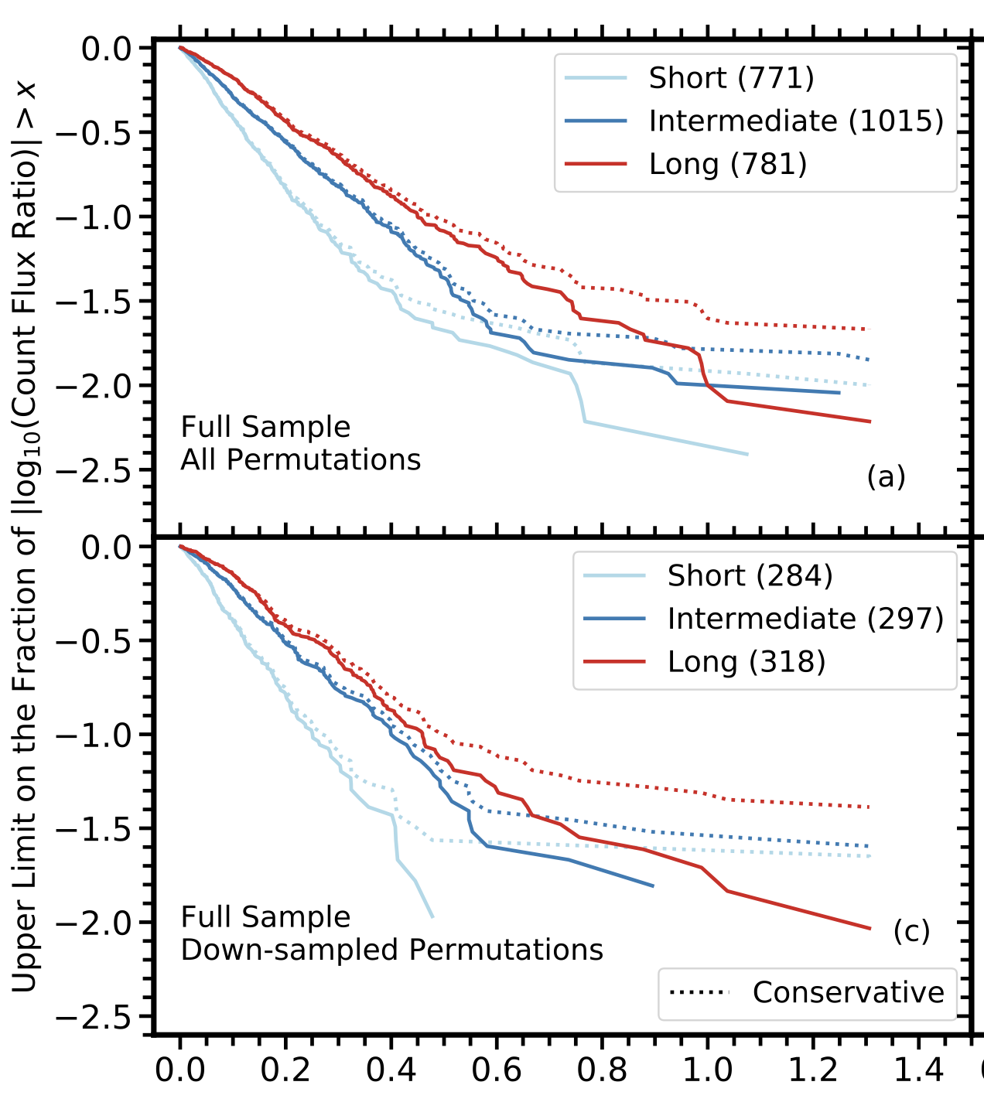
Typical quasars are not X-ray weak nor extremely variable
Timlin, Brandt, B.L. et al. (2020)
Pu, B.L. et al. (2020)
X-ray weak by factors >10: 2.7%
X-ray var by factors >10: <2.4%

Slide 6
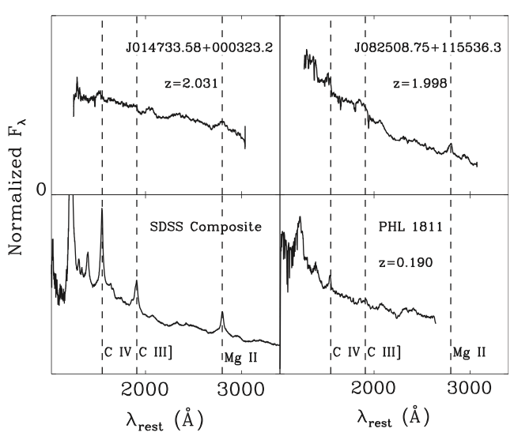
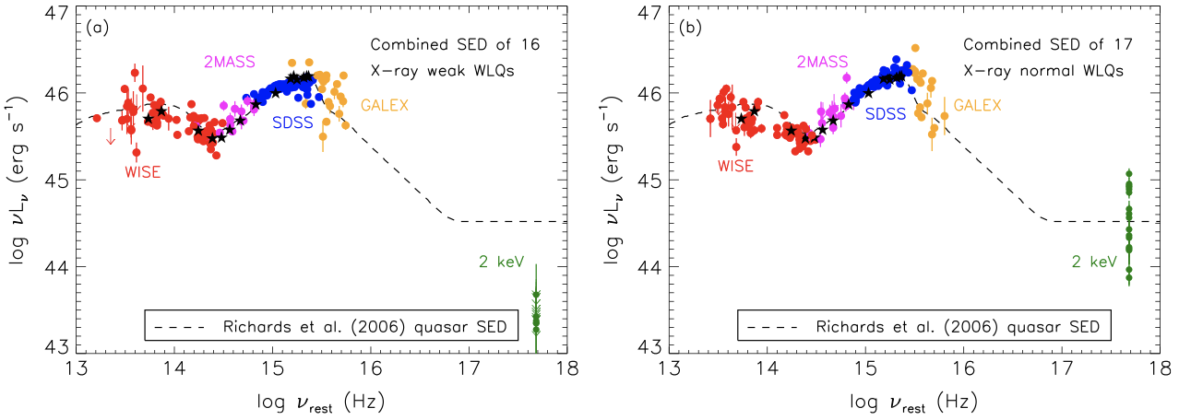
WLQs: ~ 50%-94% extremely X-ray weak
B.L. et al. (2015)
Weak UV broad emission lines (C IV, Lya).
f_{weak} >~ 20.
Small Γ values for the X-ray weak ones, and large Γ values for the X-ray normal ones.
Do not vary extremely given the limited data then.

Slide 7
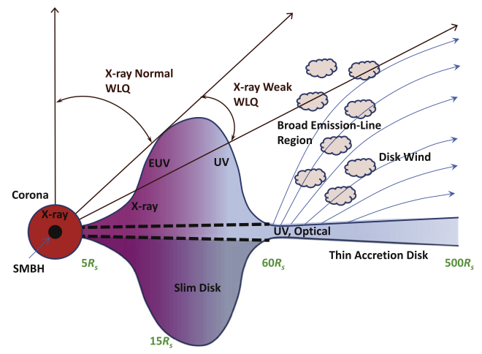
A simple obscuration model for WLQs
Super-Eddington
Thick disk: shileding the CIV BLR and sometimes the X-ray corona
Powerful disk wind
X-rays: either normal or heavily obscured
B.L. et al. (2015)

Slide 8
New findinds: extreme X-ray variability

Slide 9
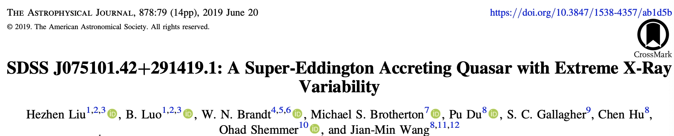
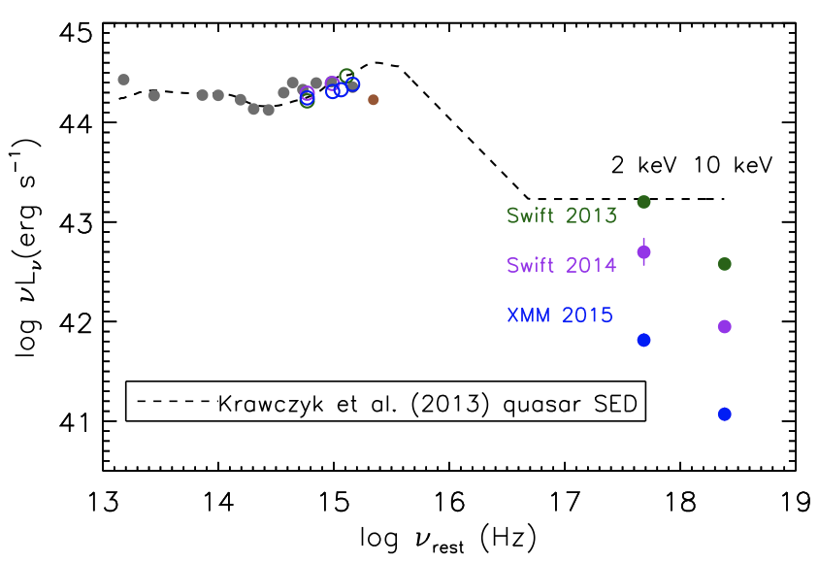
Beginning: J0751, extreme X-ray weakness + variability
A local S-E quasar
X-ray normal + X-ray weak
Varied by a factor ~ 22
No corresponding optical/UV variability
Similar nature to WLQ, but with variable absorption?

Slide 10
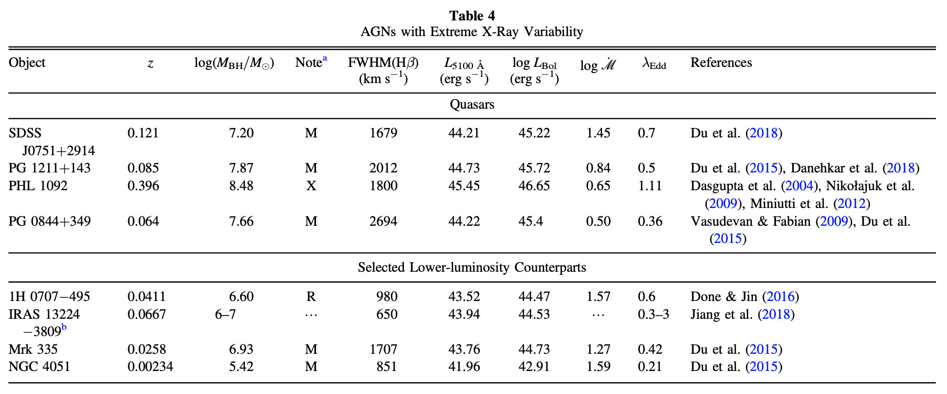
Extreme X-ray variability not new, e.g., NLS1s
Liu, B.L. et al. (2019)
But not examined in terms of their X-ray emission strengths. Sometimes terms as “flares”.

Slide 11
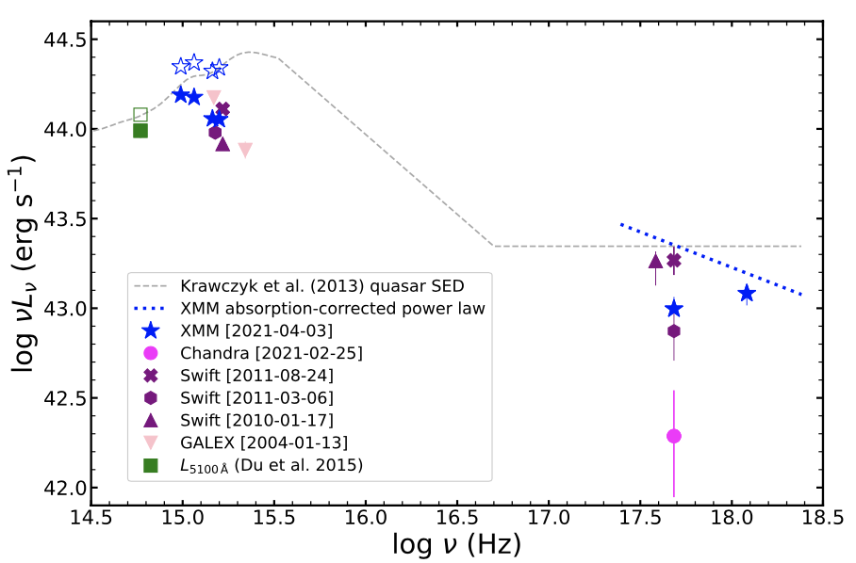
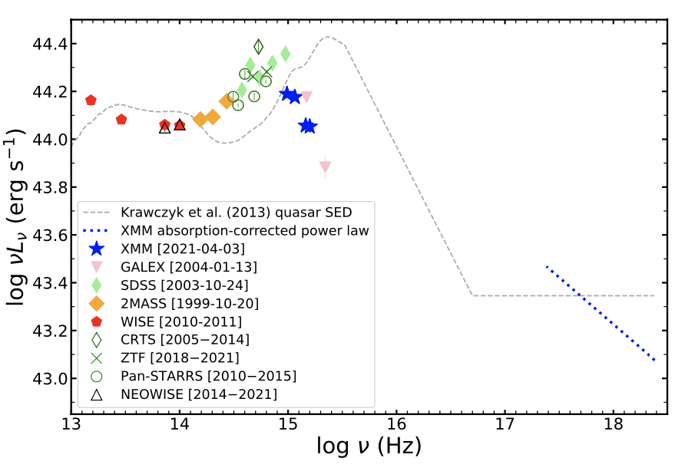
We searched for more: J0814
Huang, B.L. et al. (2023)
Steep X-ray spectra (no signs of obscuration) in the low states
Host-dominated optical + UV extinction

Slide 12
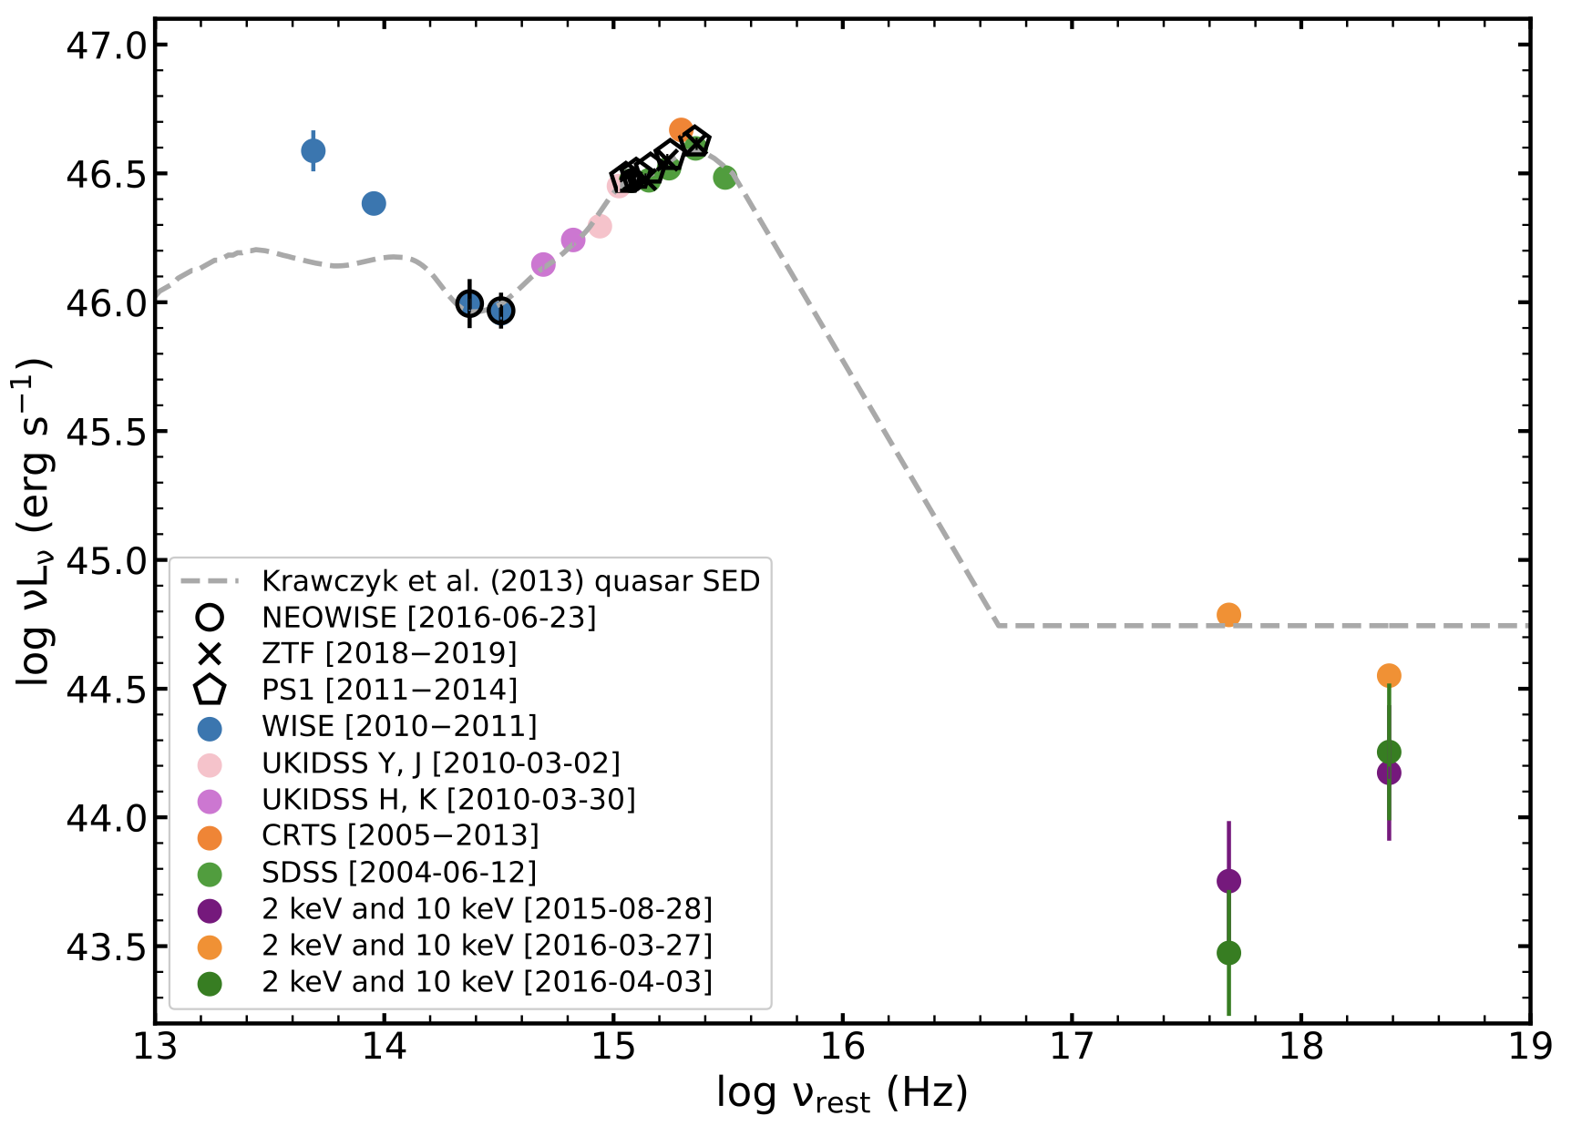
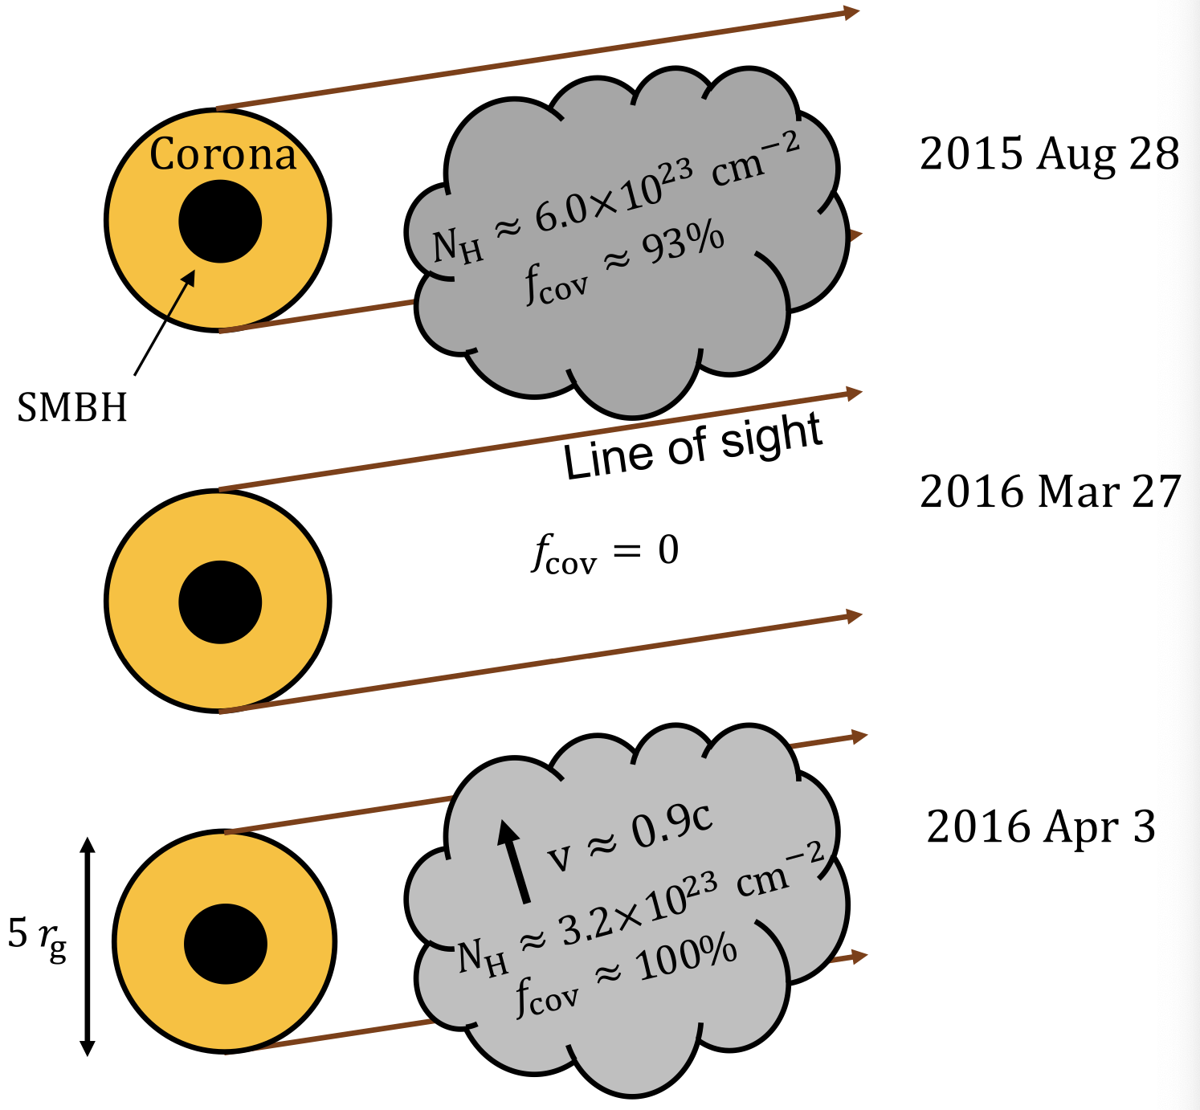
J1350, z=2.6, logM_{BH}=9.8
Liu, B.L. et al. (2022)
Rapid variability: by a factor of 7.6 within 2 days. v=0.9c.
Also a WLQ.

Slide 13
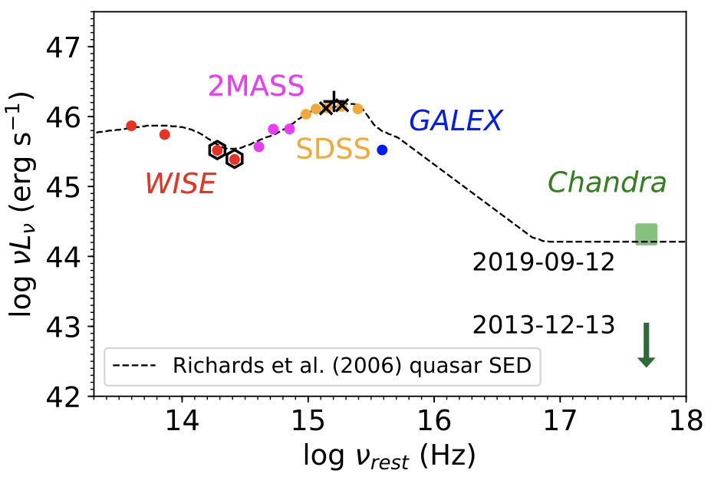

An extremely X-ray variable WLQ
SDSS J1539 (z=1.9)
Ni, Brandt, B.L. et al. (2020)
2020-6-17

Slide 14
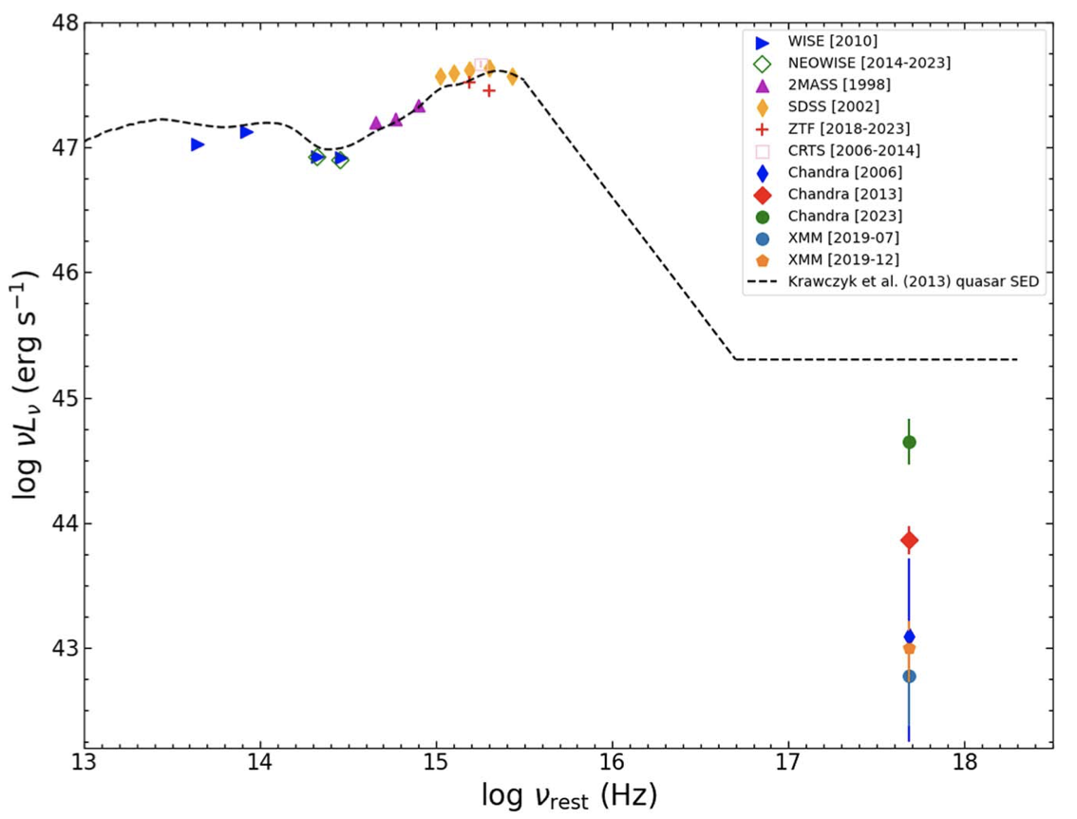
Another extremely X-ray variable WLQ
SDSS J1521 (z=2.24)
Wang, Brandt, B.L. et al. (2024)

Slide 15
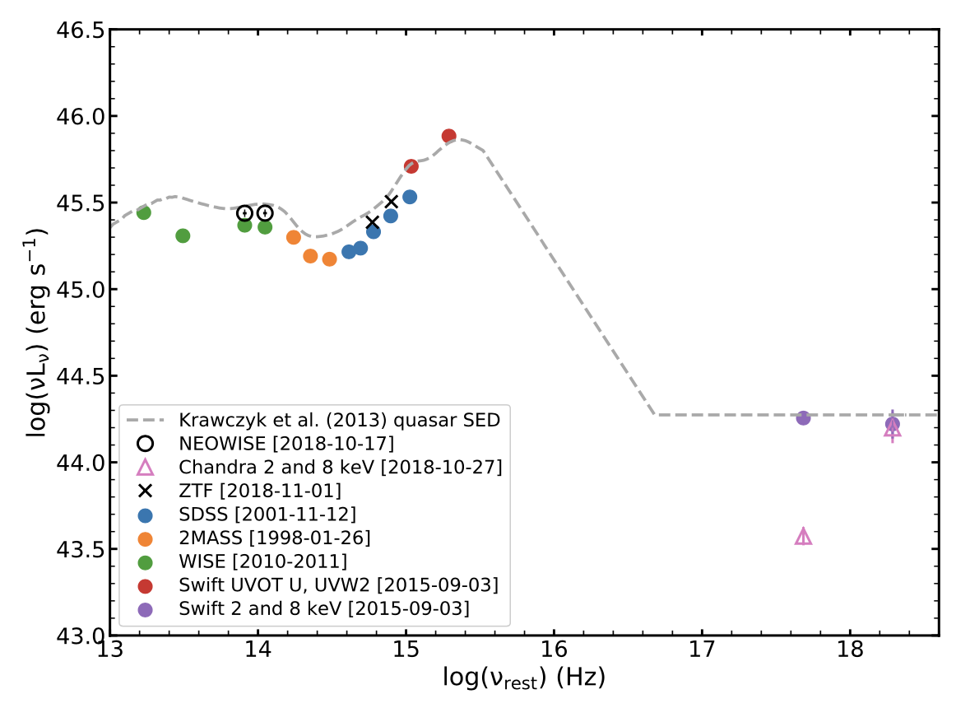
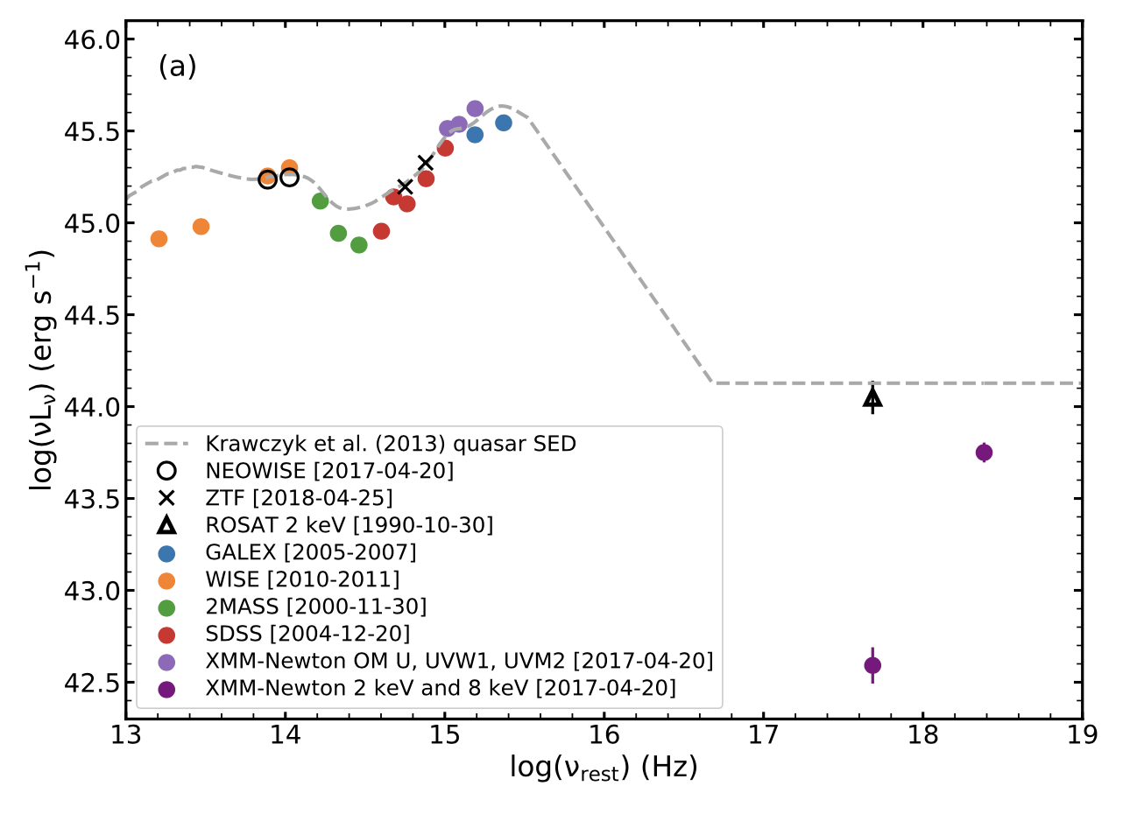
Some more
SDSS J0743
PG 0923

Slide 16
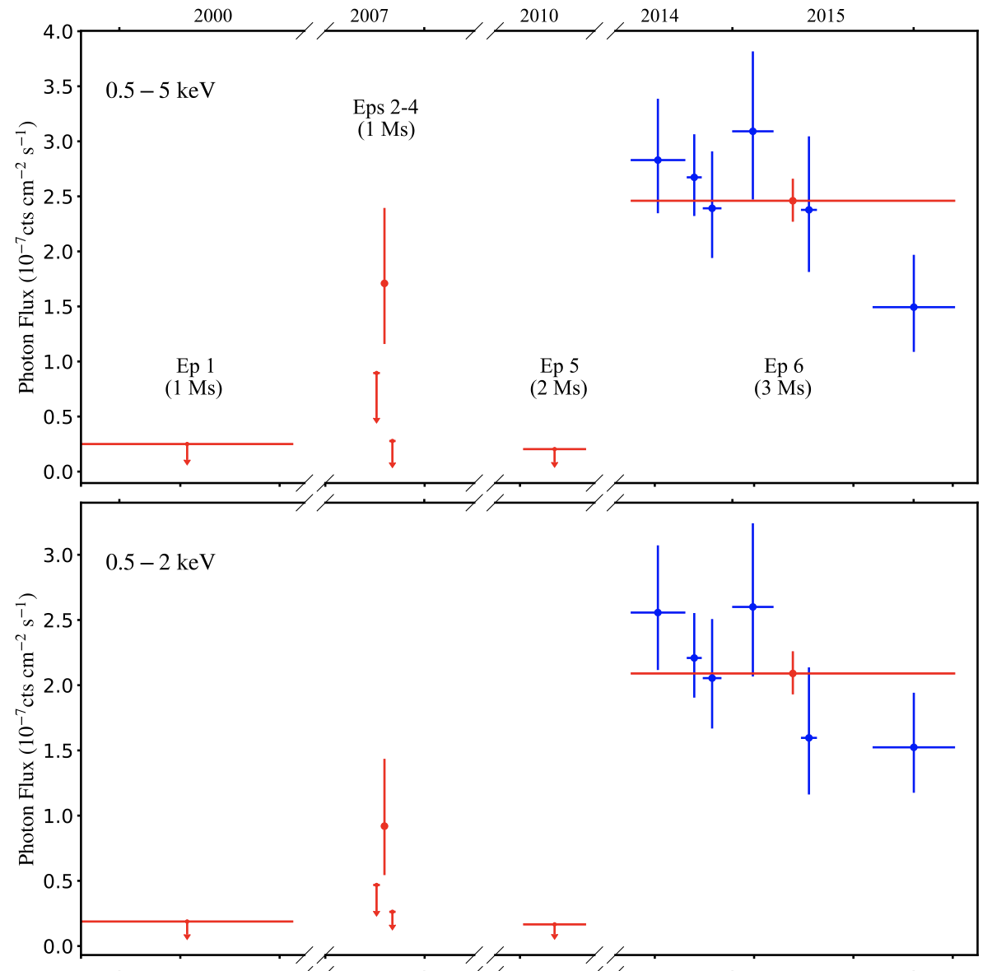
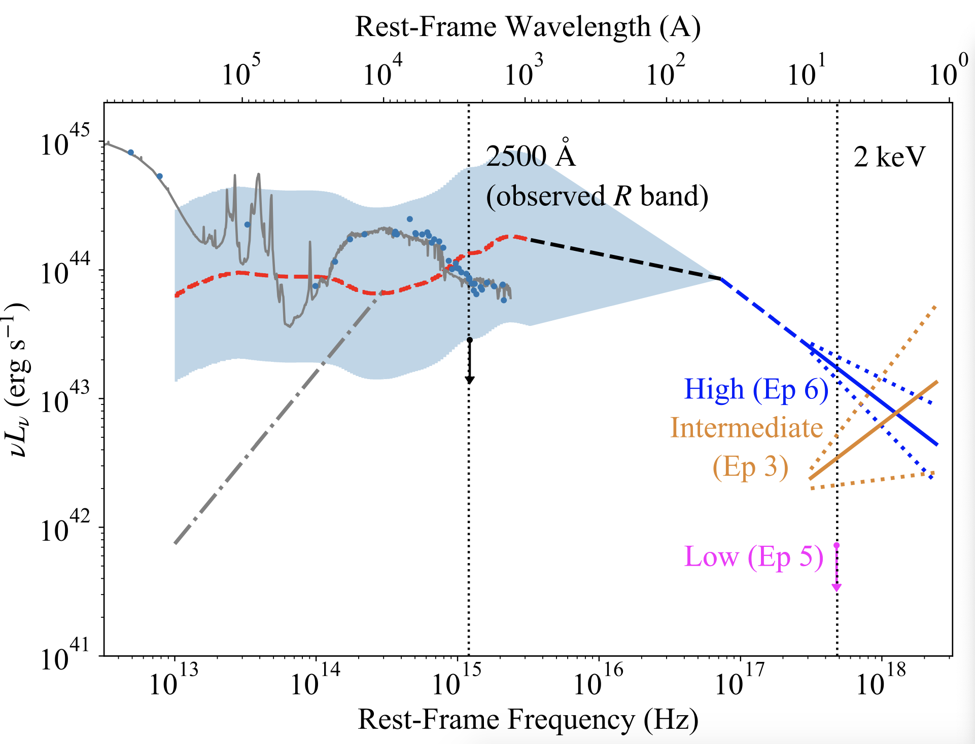
XID 403 in the 7 Ms CDF-S
Yu, B.L. et al. (2023)
A NLS1 (logM_{BH}~6.7) analog at z=1.6

Slide 17
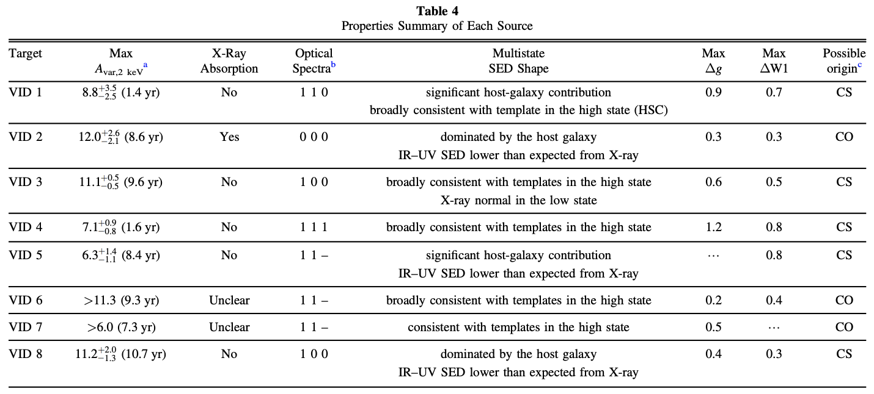
Extremely X-ray variable AGNs in XMM-LSS
Zhang, B.L. et al. (2025)
8 candidates in the 5.3 deg² X-ray + multiwavelength survey.
5 changing-state and 3 changing-obscuration.

Slide 18
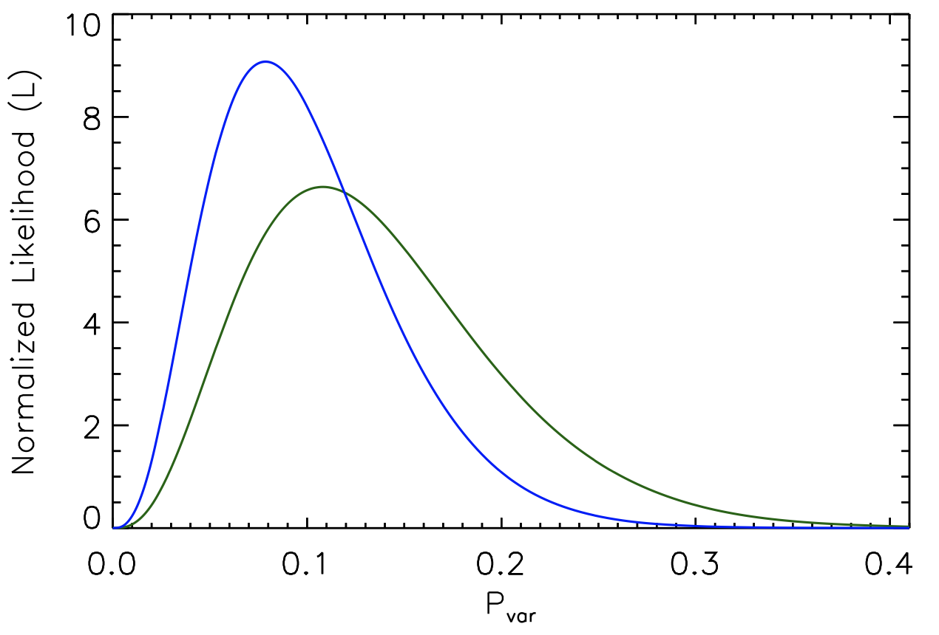
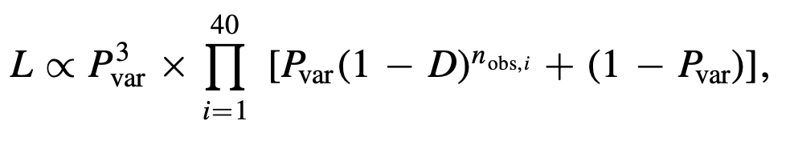
Variable frequency estimate
Liu, B.L. et al. (2019)
15%-24% adopting a 30%-60% duty cycle
Thus much more frequent among Super-Eddington AGNs

Slide 19
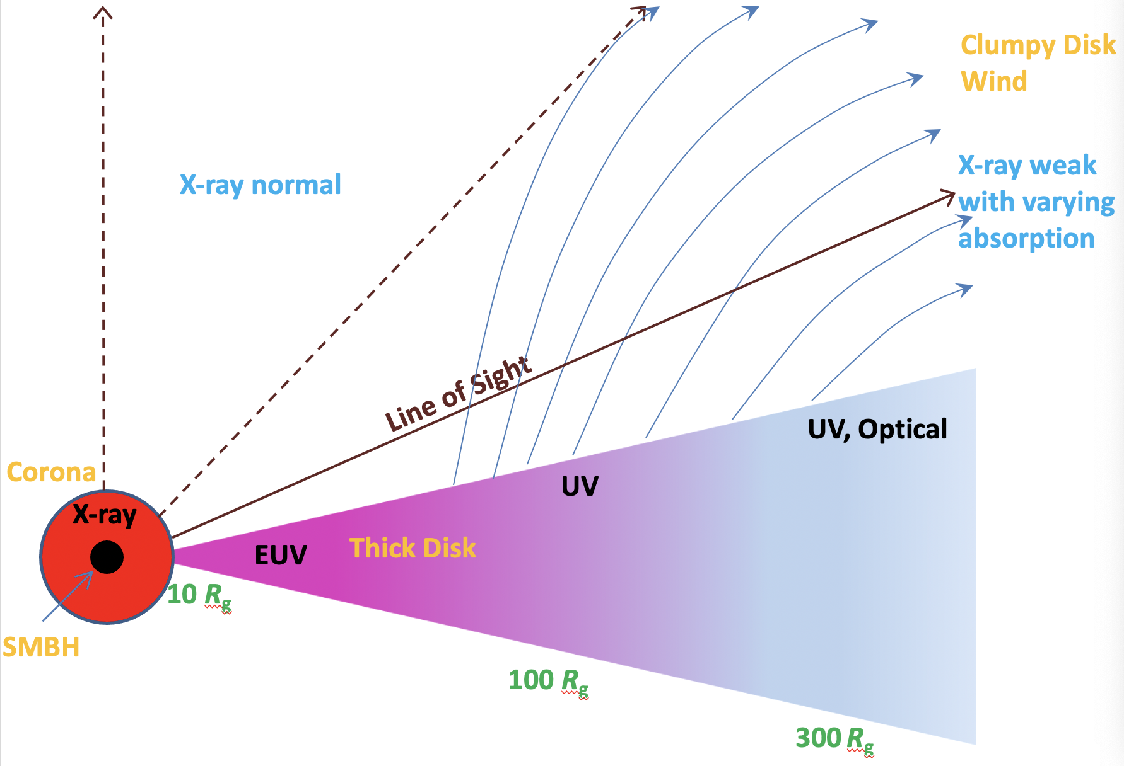
A universal obscuration scenario
Absorber: small-scale clumpy dust-free disk wind
Partial covering possible, steep spectra in the soft X-rays
Powerful (e.g., Compton-thick) due to super-Eddington accretion; large soilid angle
Covering factor & column density variable

Slide 20
Take home messages
The value of extreme/strange objects
Good to examine the X-ray emission strengths for variable objects
AGN winds at play; might connect to JWST little red dots

Slide 21
Backup slides

Slide 22
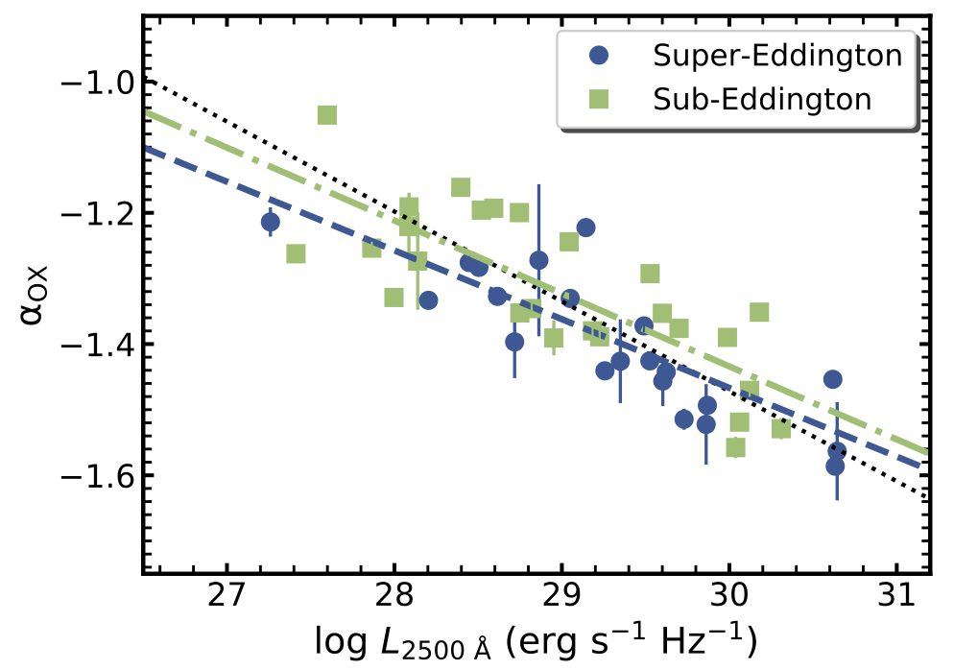
But the same disk-corona connection
Liu, B.L. et al. (2021)
21 Super- and 26 sub-Eddington AGNs with RM SMBH masses.
Consistent a_{ox} – L₂₅₀₀ relations, if only high-state data are used.
a_{ox} may depend on M_{BH} and L/L_{Edd} intrinsically.

Slide 23
Our Key Findings:
Typical AGNs are not X-ray weak.
Super-Eddington AGNs could be (~ 20-50%) extremely (f_{weak}>10) X-ray weak.
They may vary between X-ray weak and X-ray normal states.
No corresponding optical/IR variability.
A few could vary super rapidly (~ light speed).
May show no absorption signatures in the
weak states.
X-ray absorption!

Slide 24
An Eddingtong-ratio vs. obscuration sequence
Typical AGNs SEAMBHs WLQs
Eddington ratios
Disk thickness (affects the C IV BLR or even the corona)
Disk-wind strength (density, velocity)
X-ray weakness
Frequency of being X-ray weak
Covering factor & column densinty variability (decreases)

