Slide 1



VariableTNG: Baryon feedback on Galaxy Formation
Hong Guo
Shanghai Astronomical Observatory
Collaborators：Yikai Liu，Volker Springel，Kexin Liu, Luis C. Ho

Slide 2
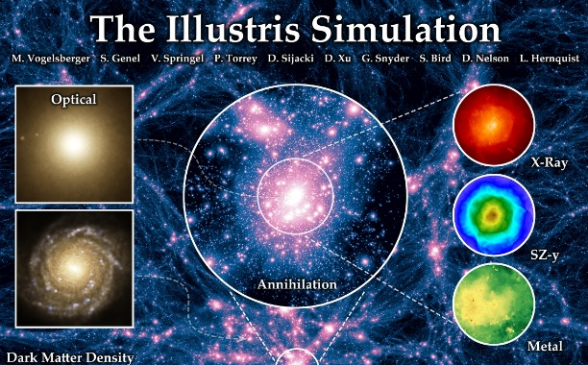
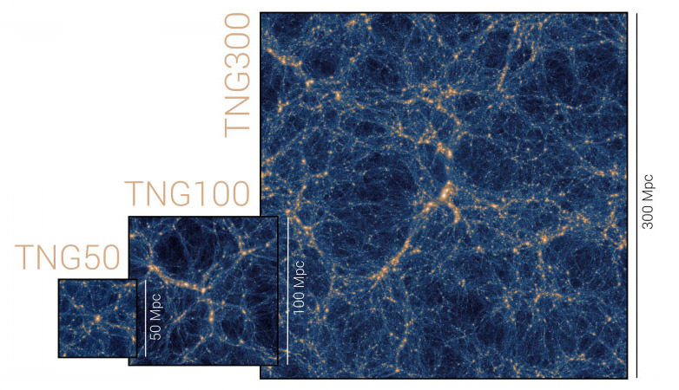
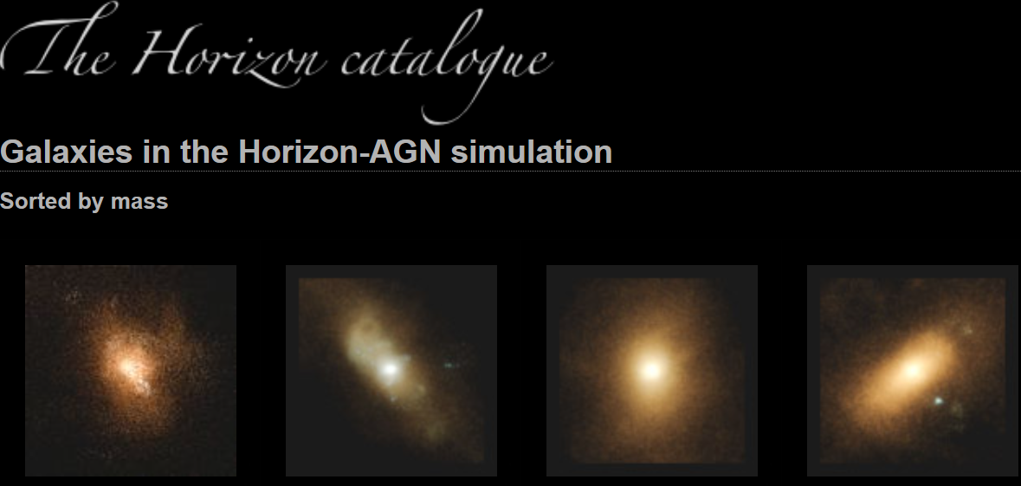


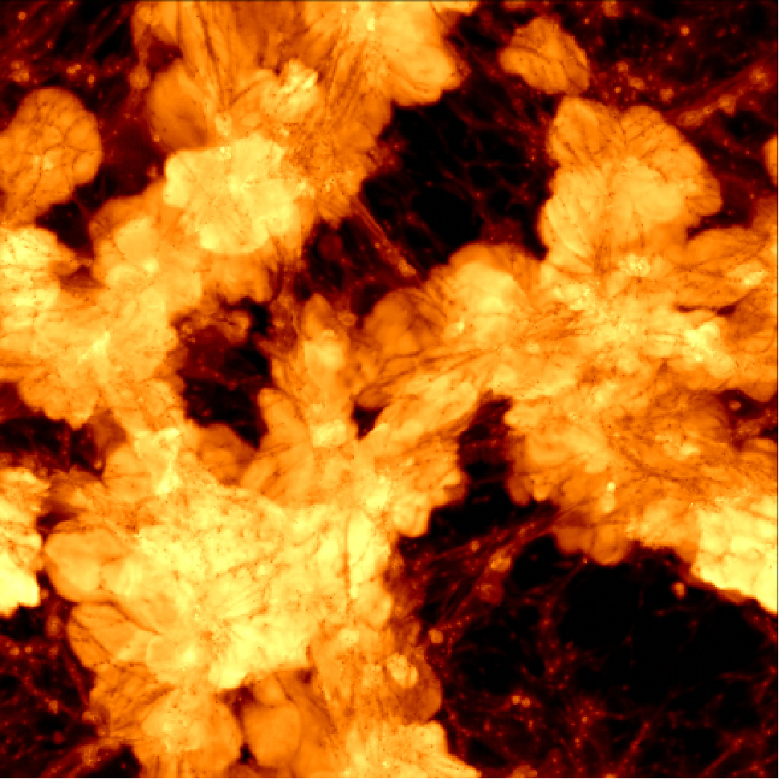
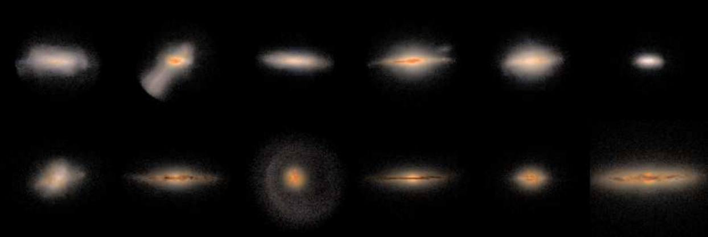

Cosmological Hydrodynamical Simulations
IllustrisTNG
Horizon-AGN
SIMBA
NIHAO

Slide 3
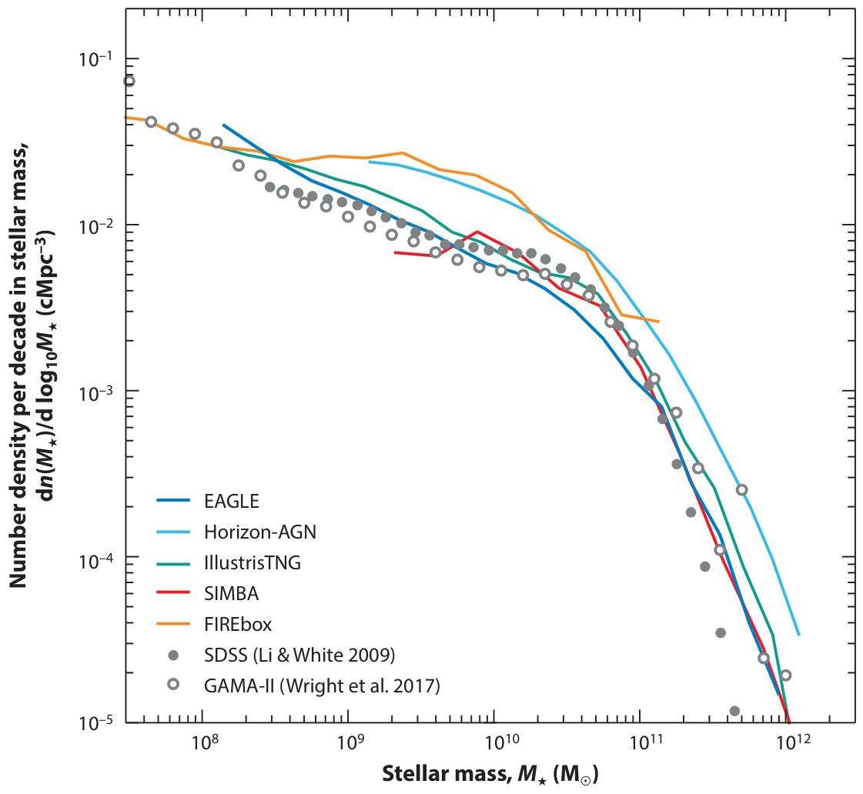
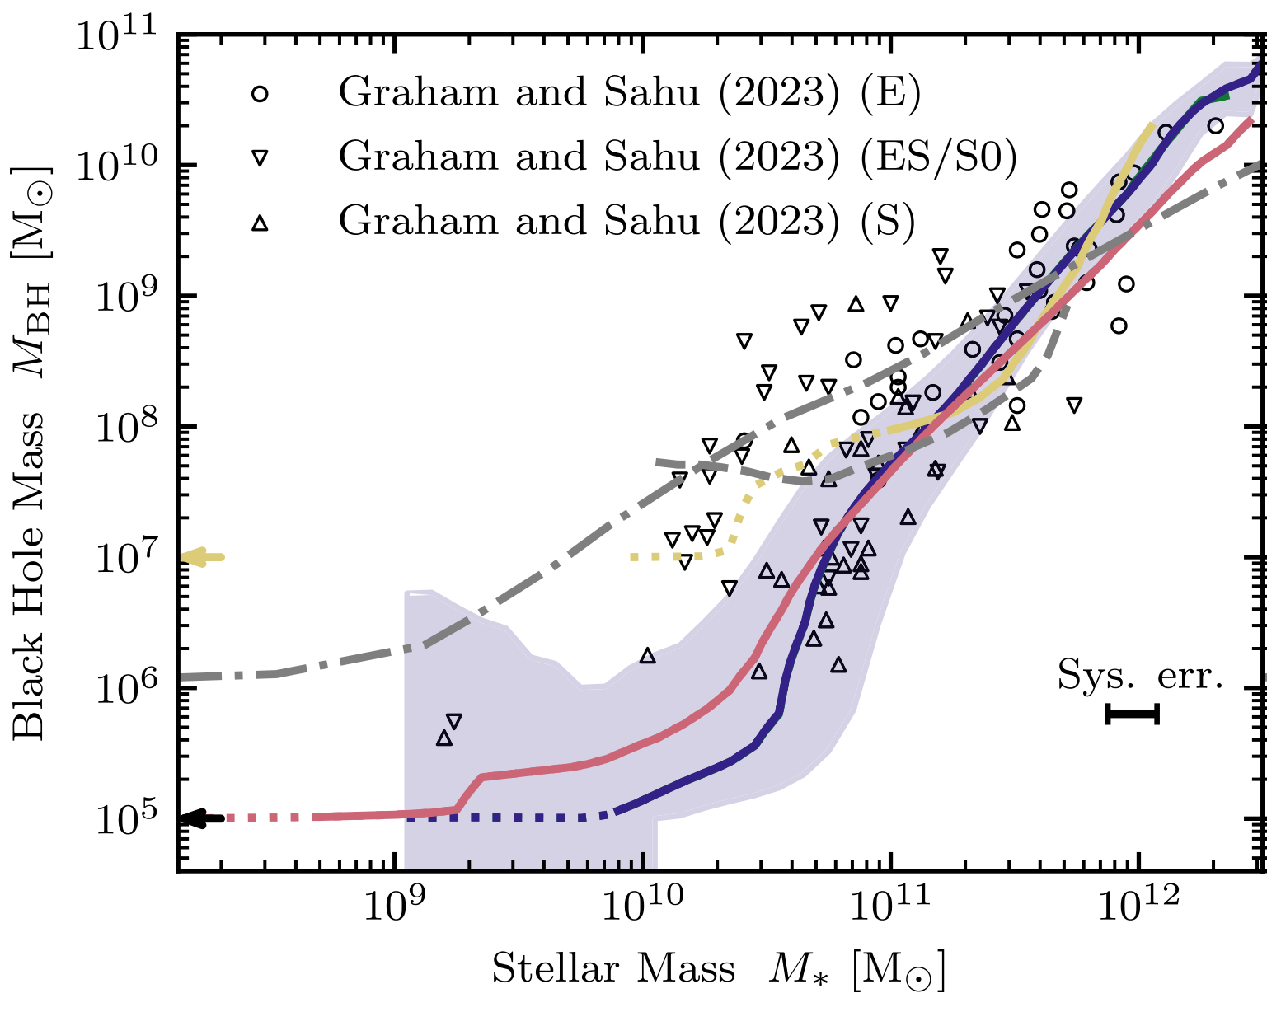
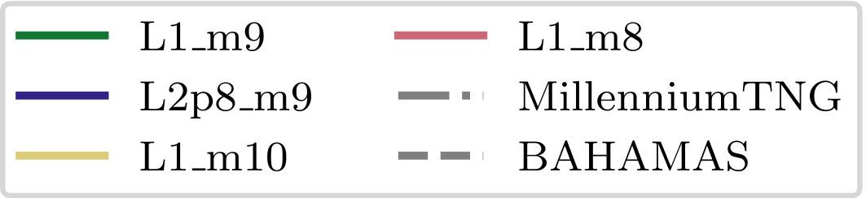
Hydrodynamical Simulations Match Observations
Galaxy Stellar Mass Function
恒星质量函数
Crain & van de Voort, 2023, ARA&A
Schaye et al. 2023

Slide 4
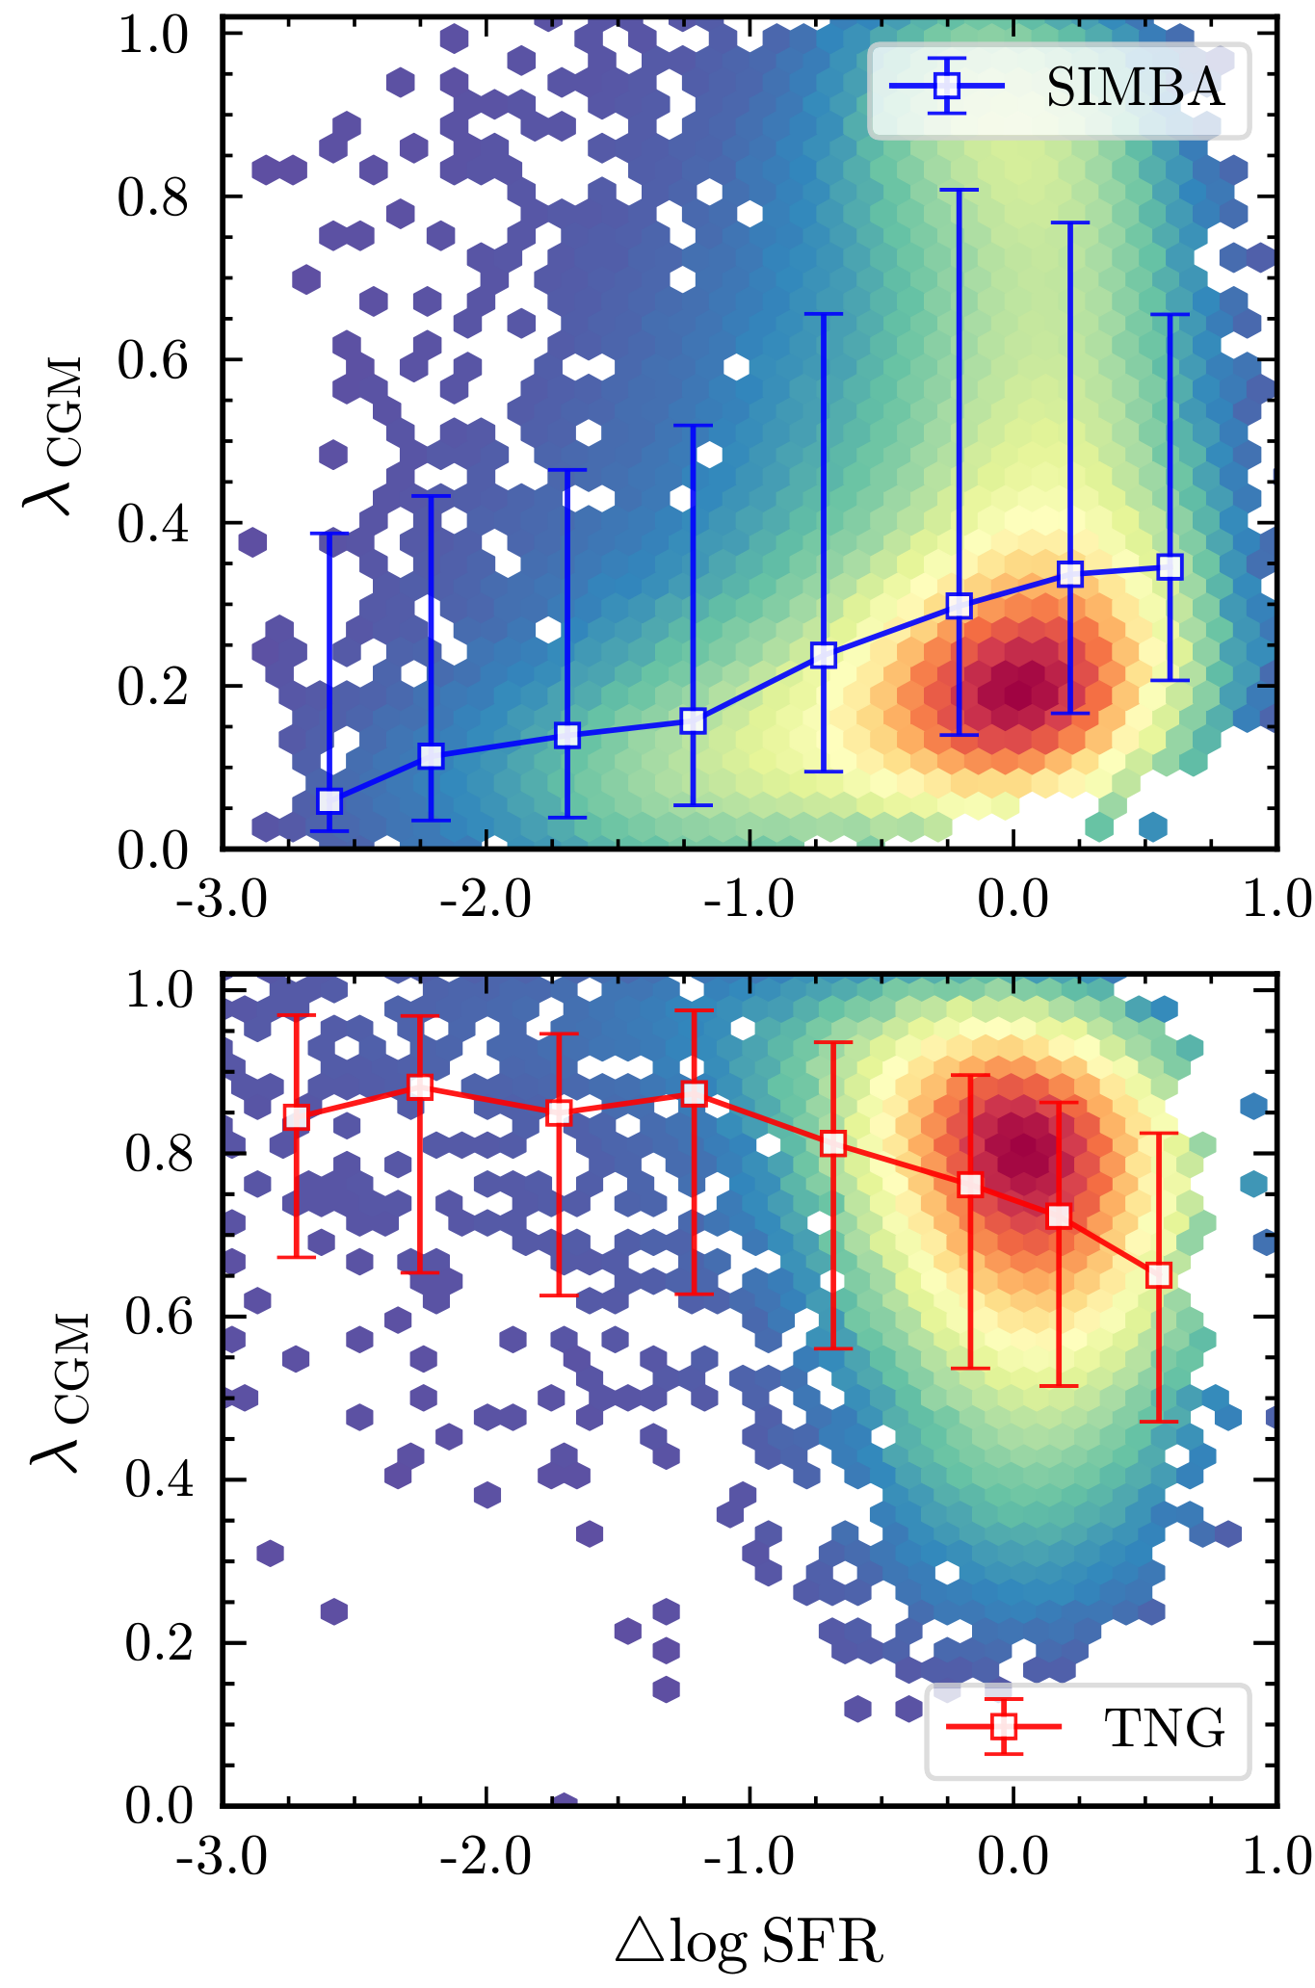
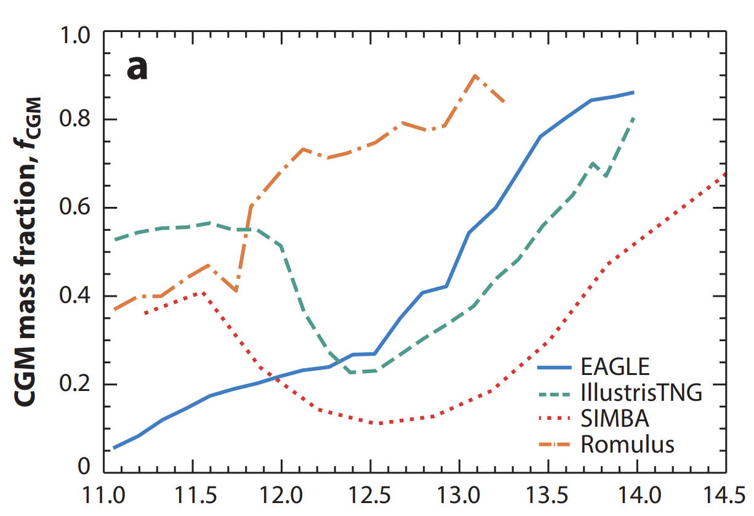

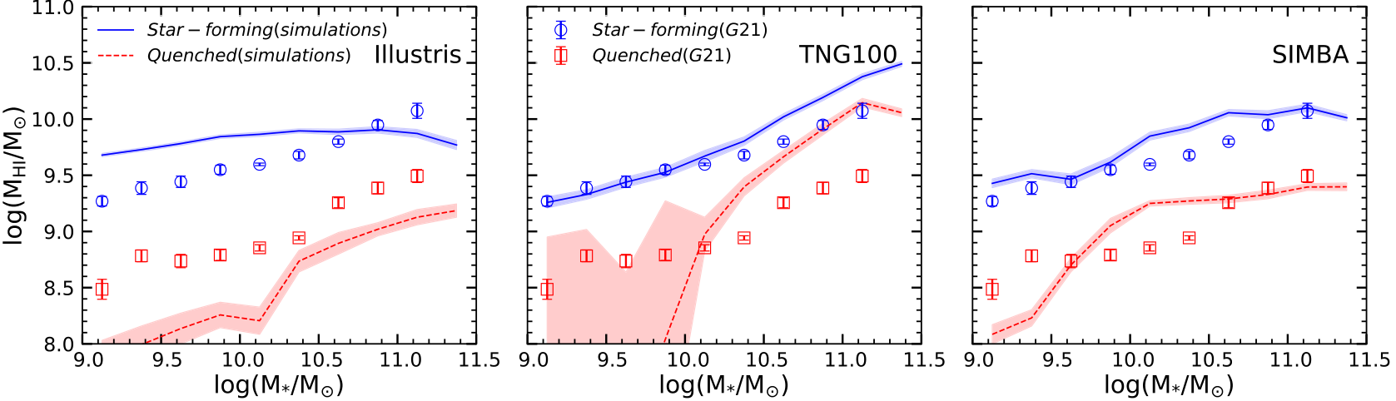

Discrepancies among Simulations
Liu, Guo*, et al. 2025
Crain & van de Voort, 2023, ARA&A
Ma, Liu, Guo*, et al. 2022

Slide 5
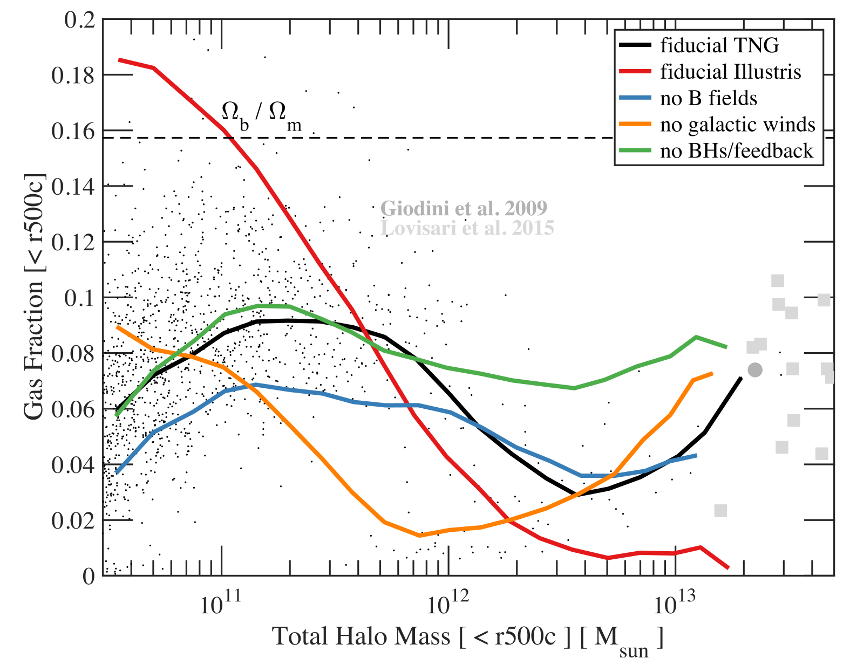
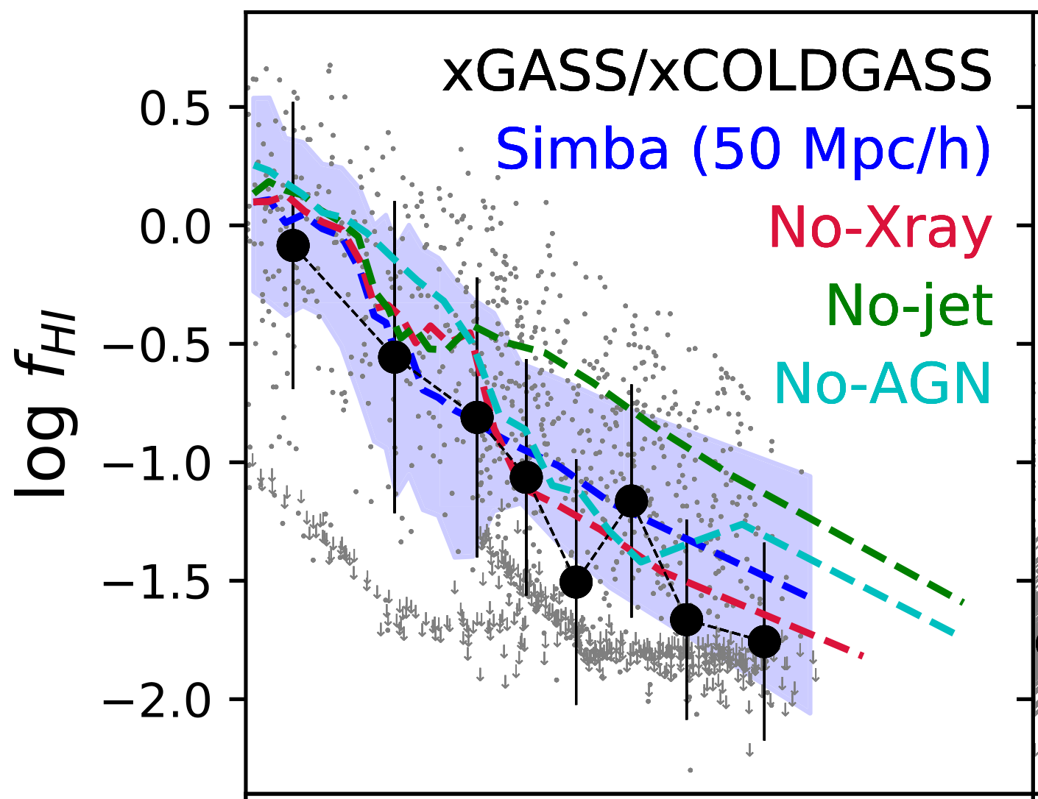
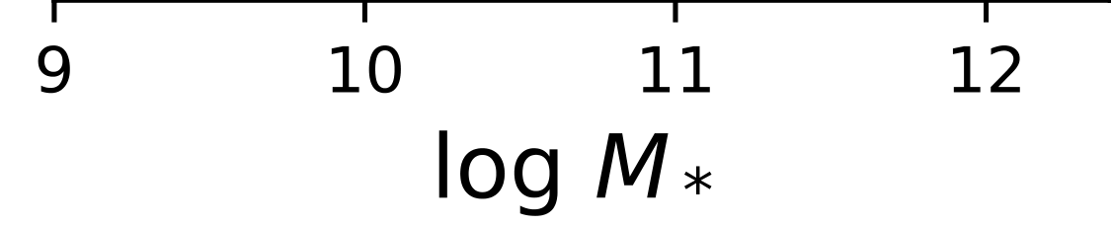
Variations within the models
Pillepich et al. 2018
Dave et al. 2020

Slide 6
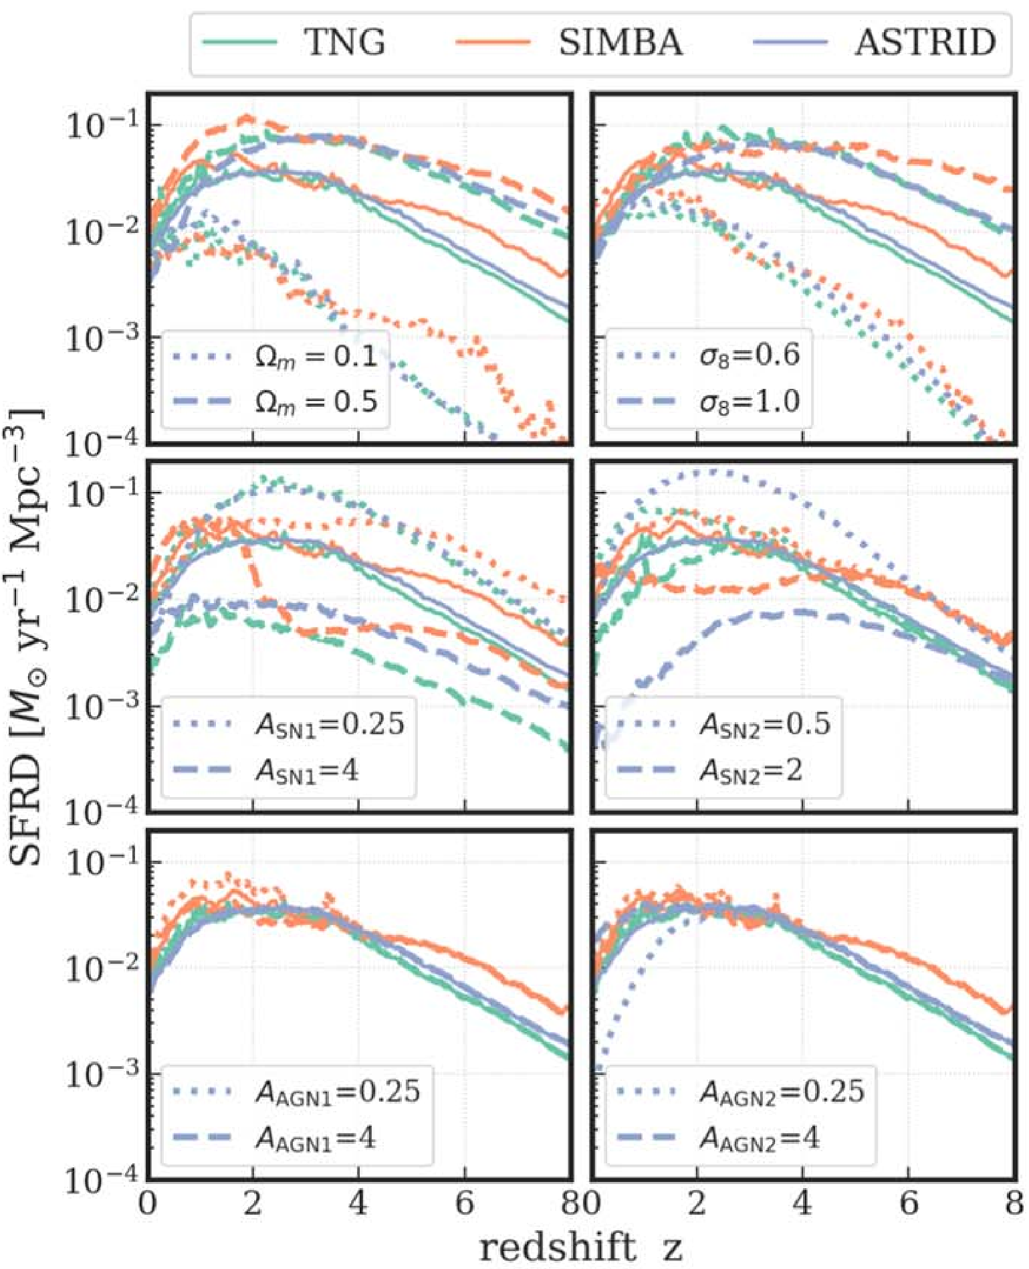
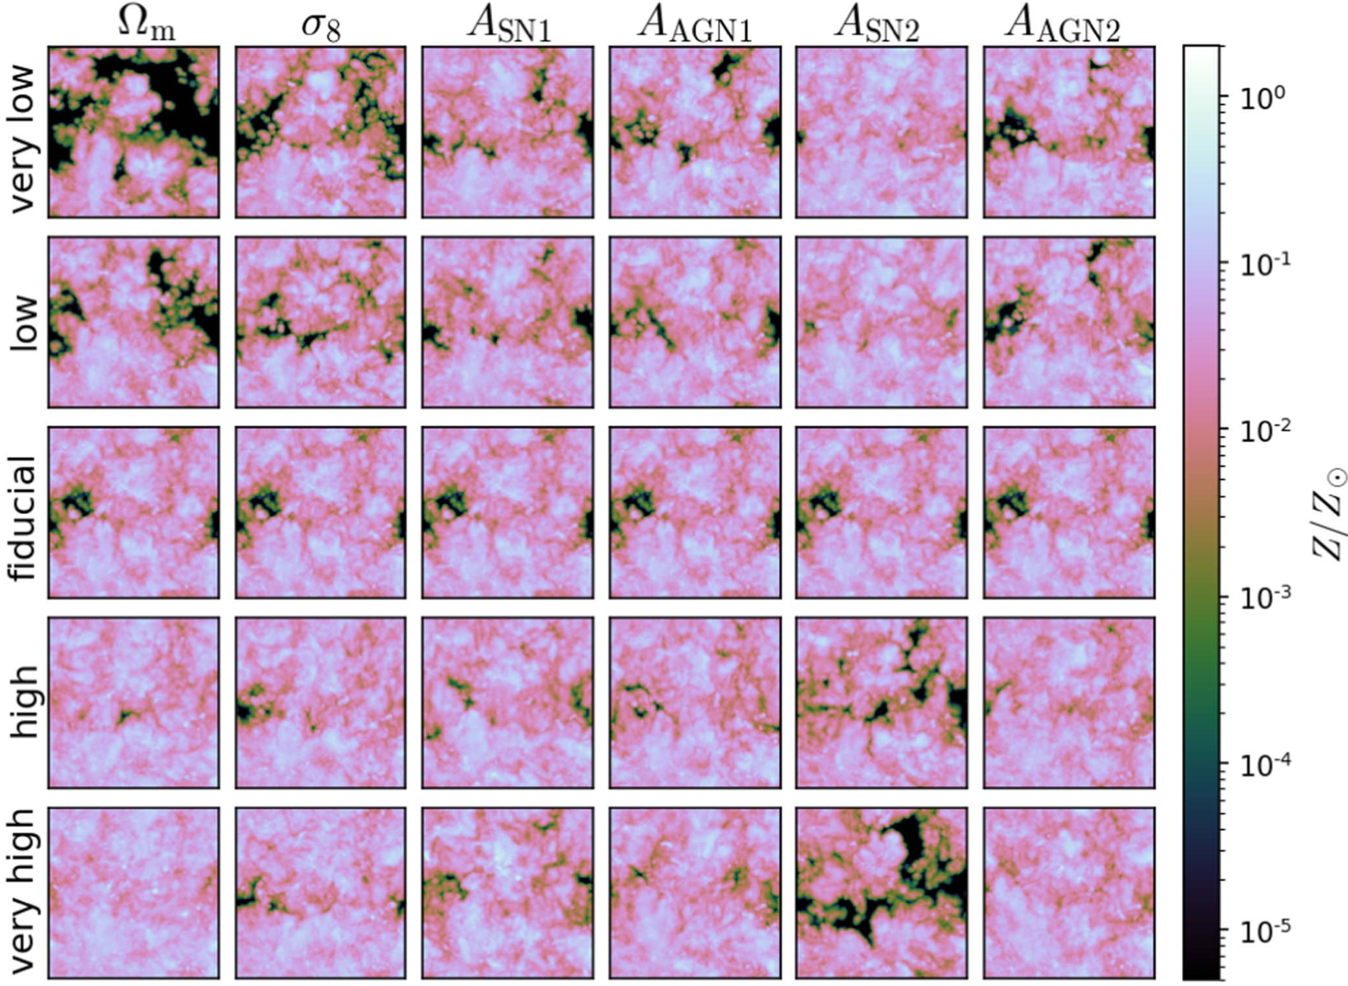
Cosmology and Astrophysics with MachinE Learning (CAMELS) project
Villaescusa-Navarro et al. (2021)
Box size：25Mpc/h，resolution: ~10⁸M
Ni et al. (2023)

Slide 7
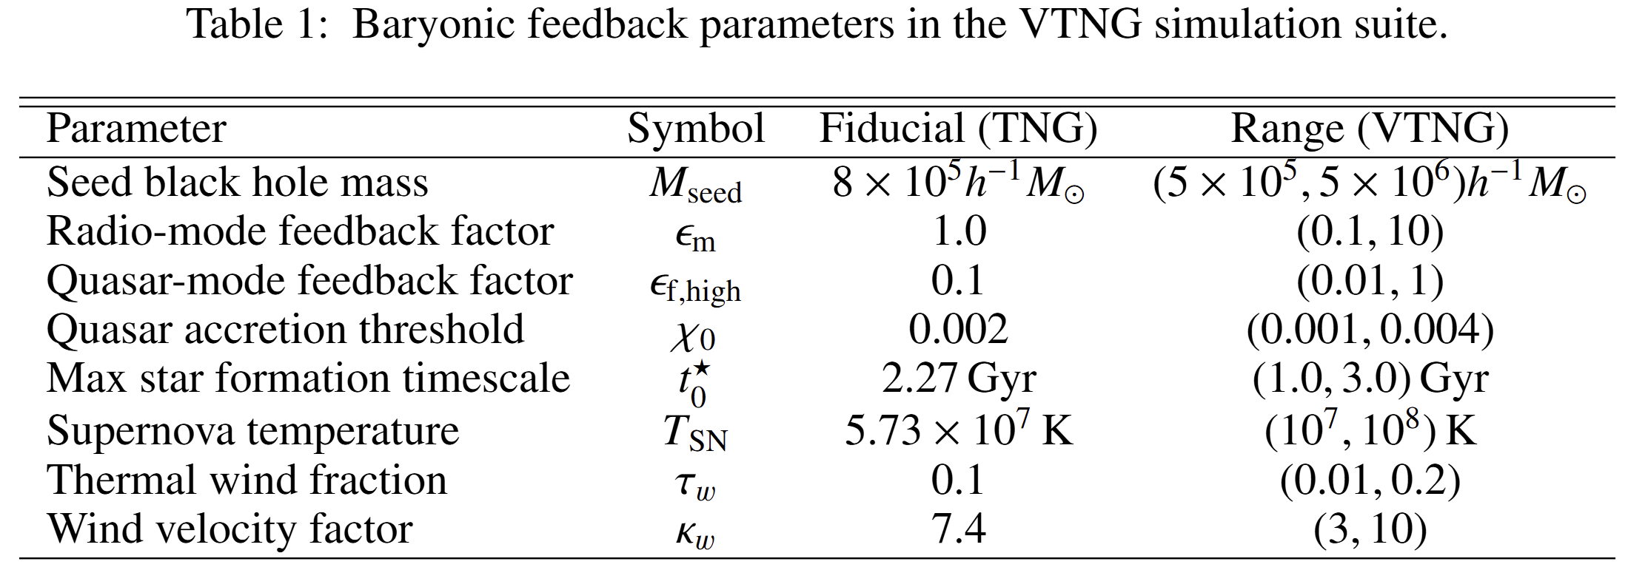
The VariableTNG (VTNG) Project
Based on TNG model
Box size: 50Mpc/h, mass resolution: 2.4*10⁶M
100 runs: the same initial condition, the same cosmological param.
Black Hole Growth
&
AGN Feedback
Star formation
&
Supernova Feedback

Slide 8
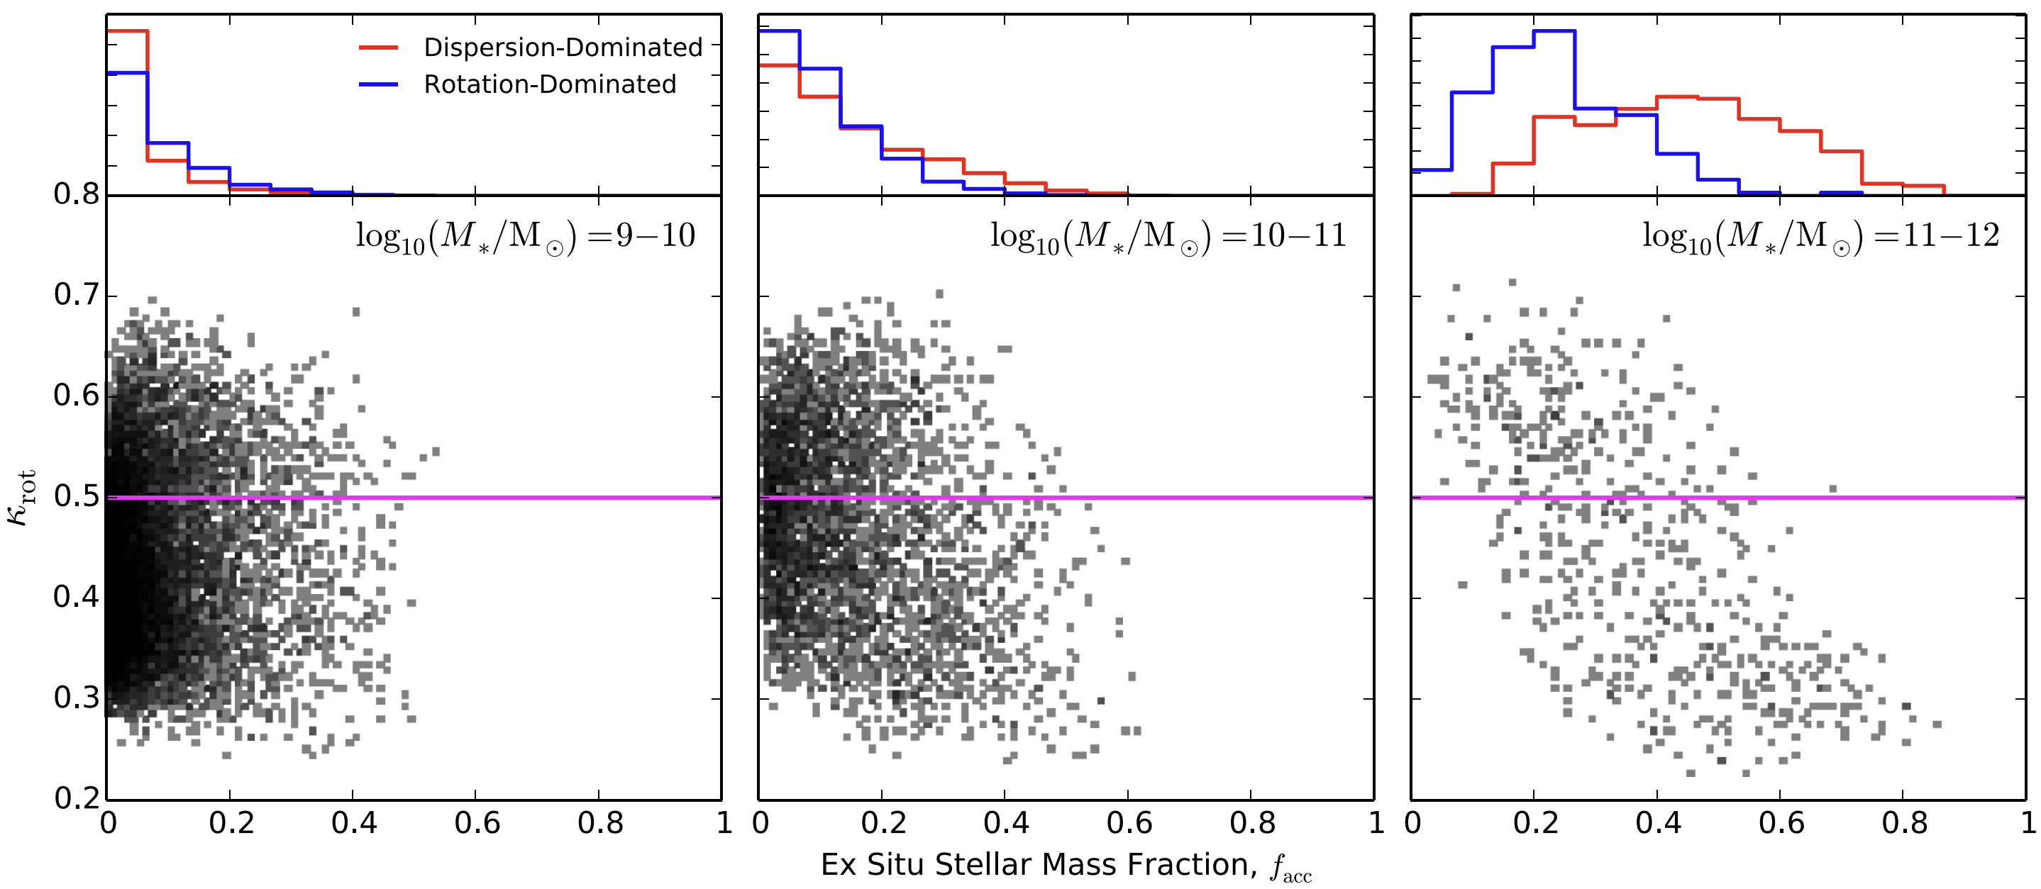
How does Baryon Feedback Affect Galaxy Morphology?
Merger history determines the morphology of massive galaxies
Ex-situ stellar mass fraction as the indicator of mergers
discs
spheroids
Rodriguez-Gomez et al. (2017), using illustris simulation

Slide 9
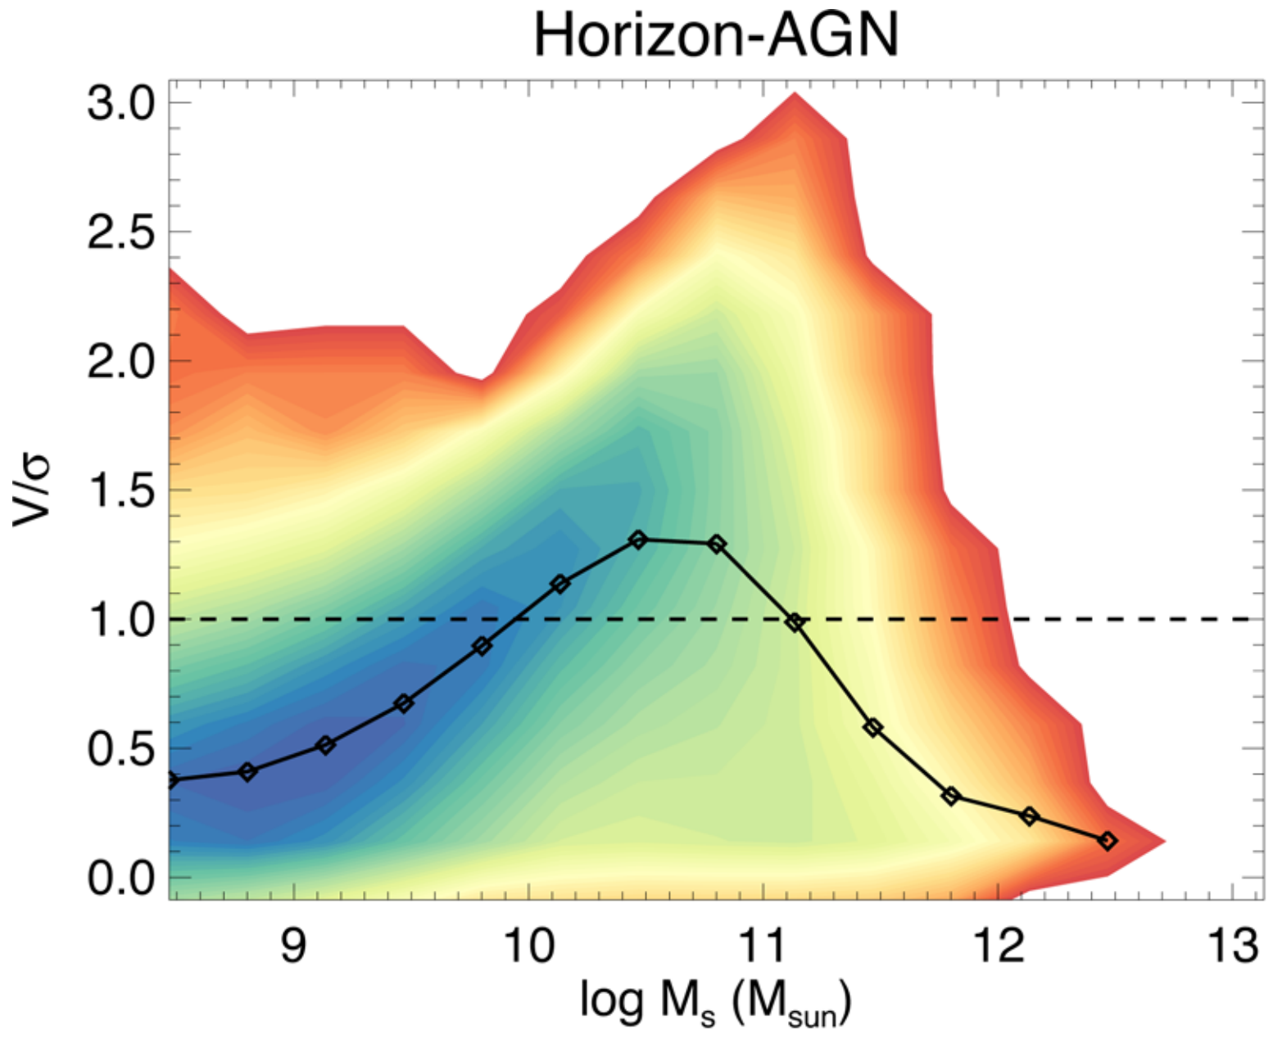
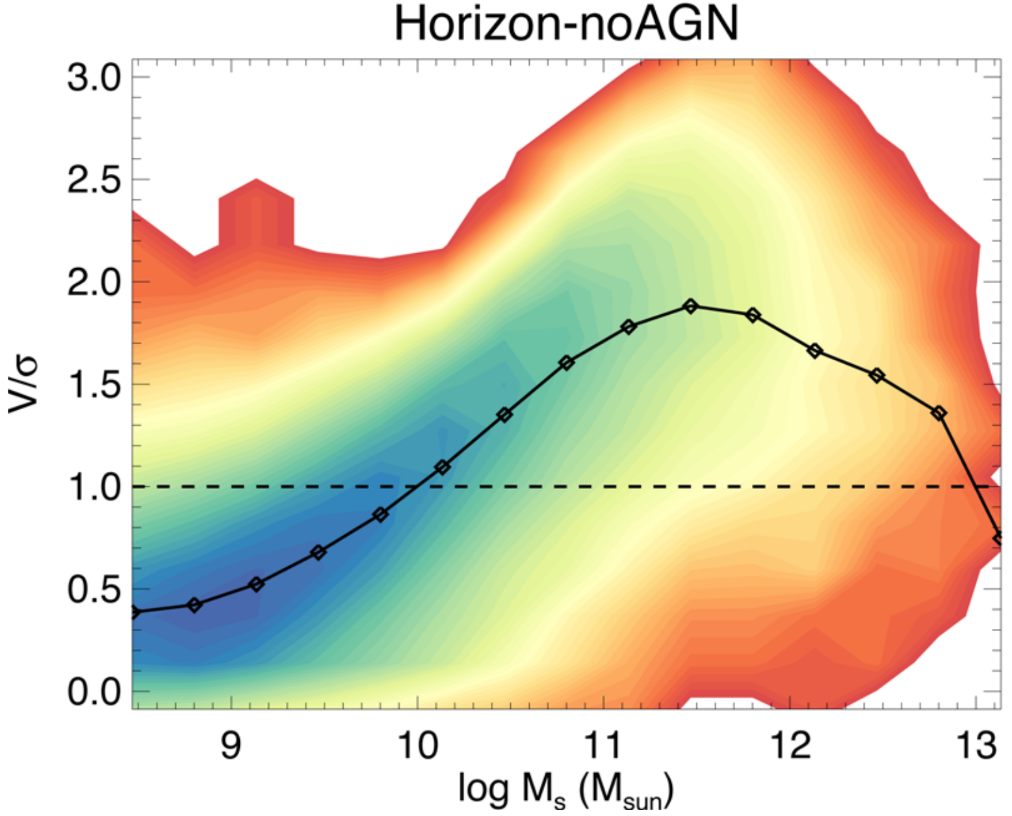
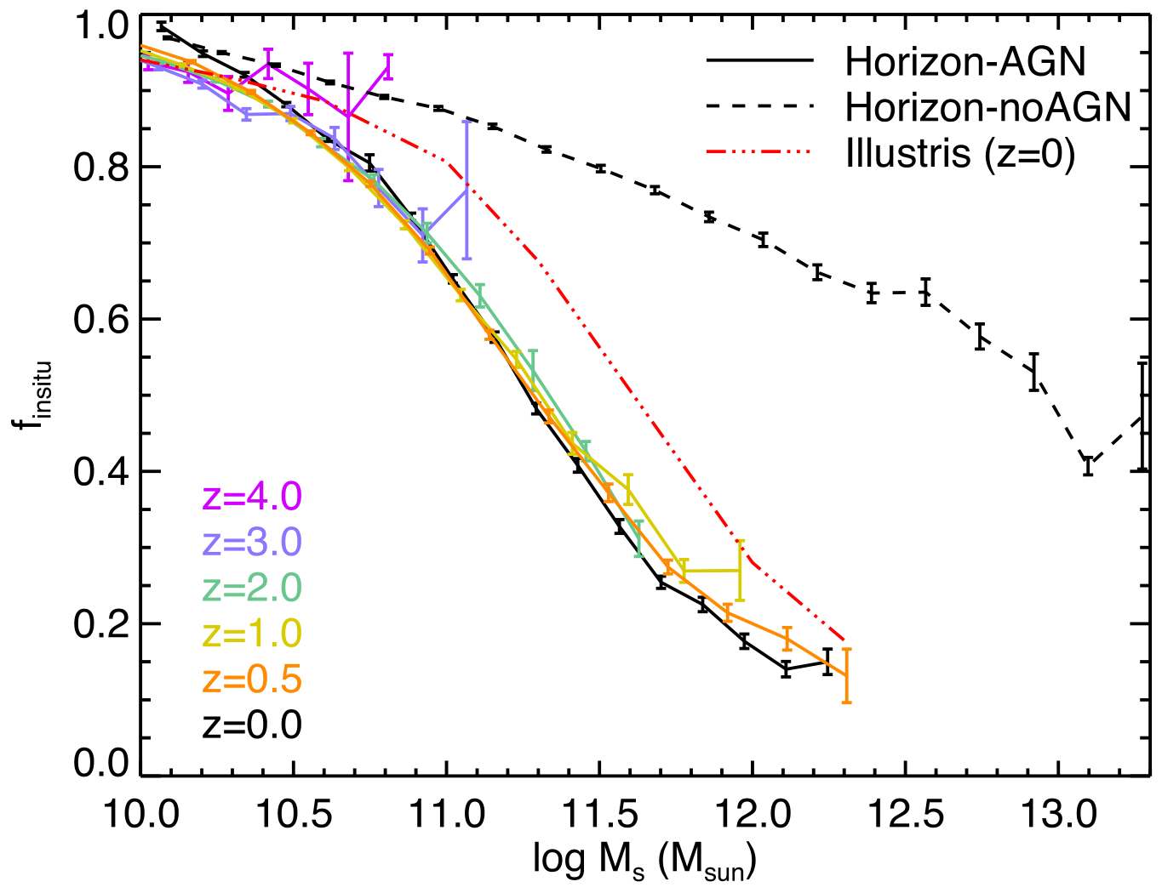
AGN Feedback Matters For Massive Galaxies
Without AGN feedback, most massive galaxies would become spirals
In-situ stellar mass fraction is significantly enhanced without AGN feedback
In-situ stars are more rotation-dominated
Dubois et al. (2016)

Slide 10
Key Question
What are the dominant mechanisms shaping galaxies’ morphology?

Slide 11
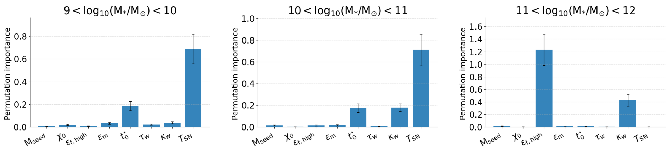
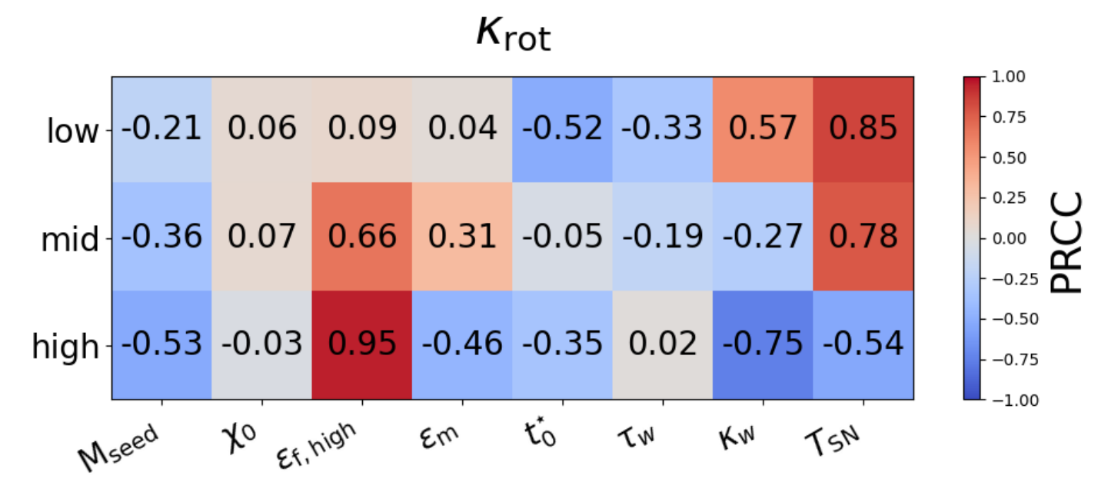
Which parameters matter for the galaxy morphology?
c/a
Supernova temperature
Quasar-mode feedback factor
K_{co}
Low-mass galaxies:
More supernova injection to the ISM, More discs
Massive galaxies:
higher quasar-mode feedback, More discs

Slide 12
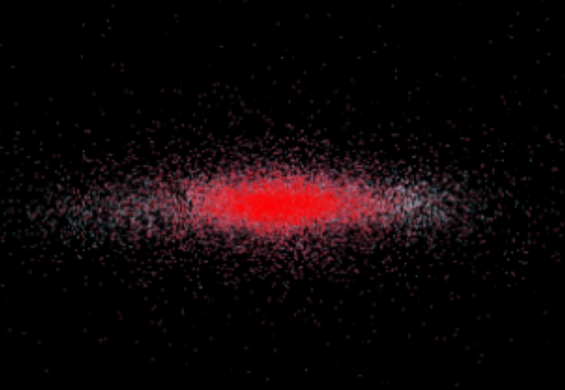
Impact of Supernova Temperature
SN feedback reduces the gas density, and prevents the star formation
Continued gas accretion until it reaches the much higher star formation threshold density
Intense star formation leads to a spiral galaxy with a thick disc

Slide 13
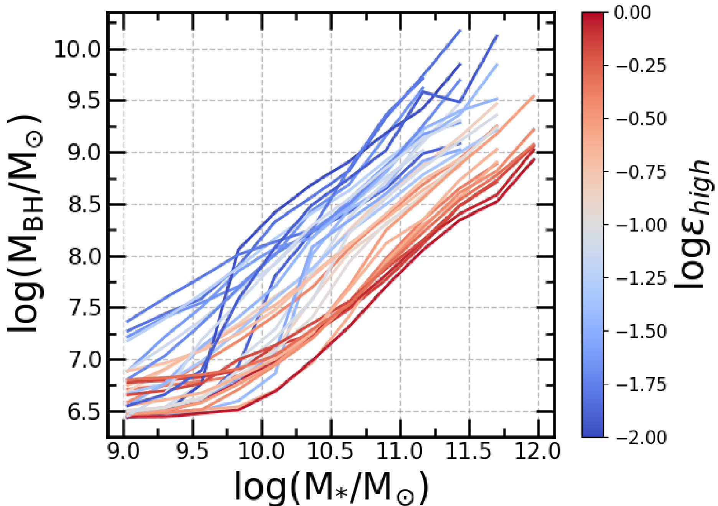
Impact of Quasar-mode Feedback Factor
Quasar-mode feedback factor suppresses the growth of black hole
Harder to enter the radio-mode (kinetic feedback)

Slide 14
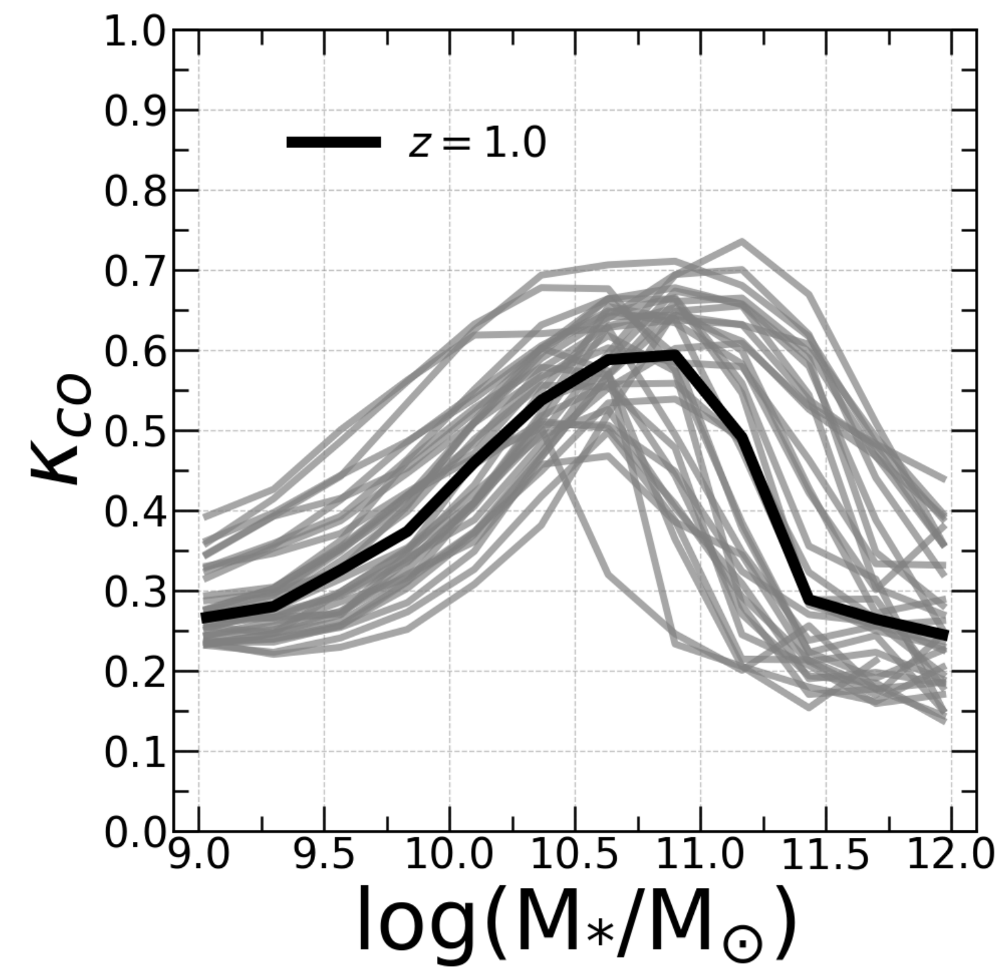
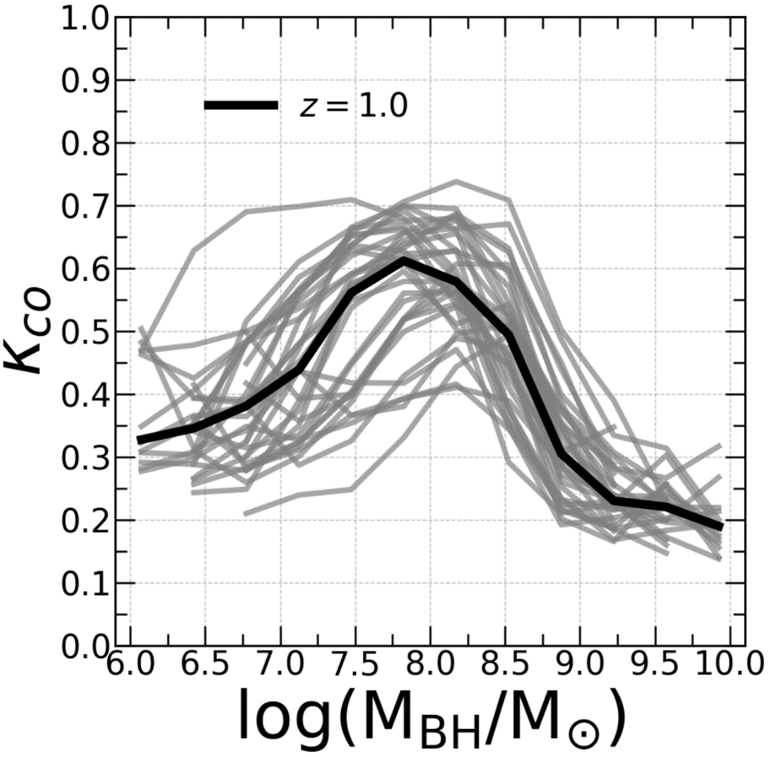
Is the morphology change due to total BH energy release?

Slide 15
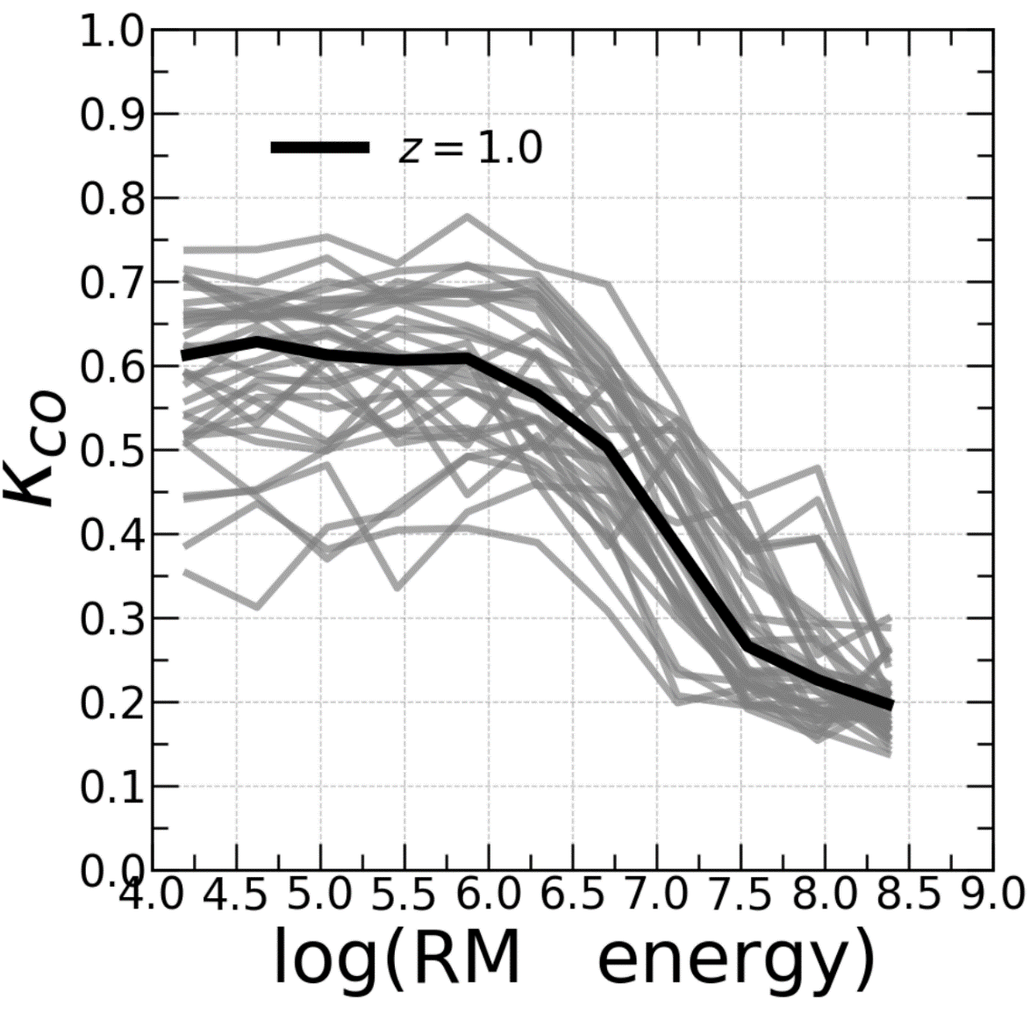
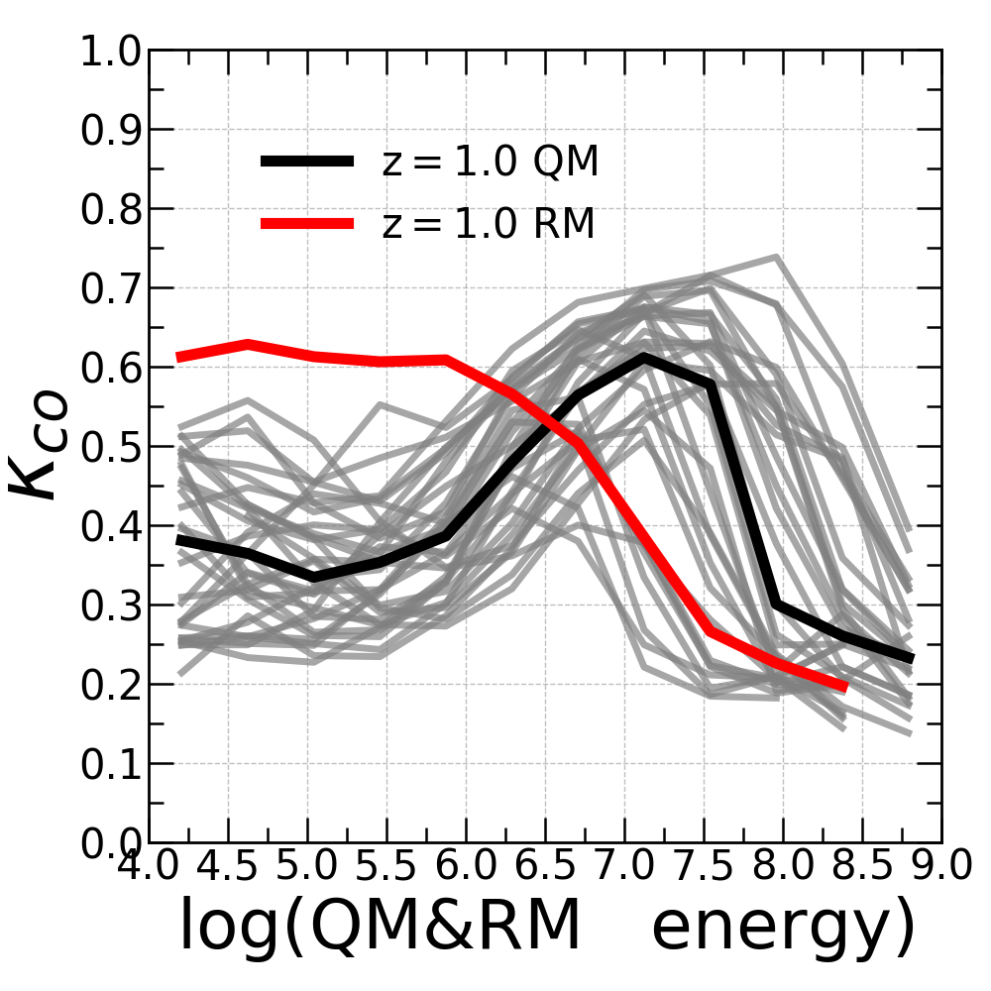
Total Feedback Energy Injection of Different Modes

Slide 16
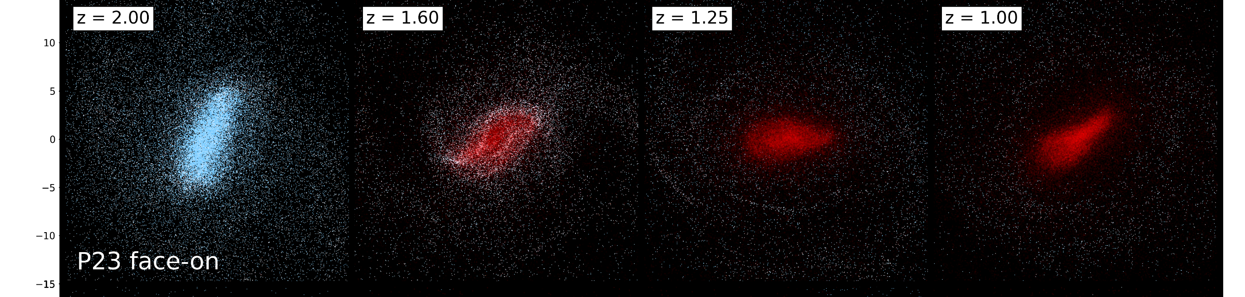
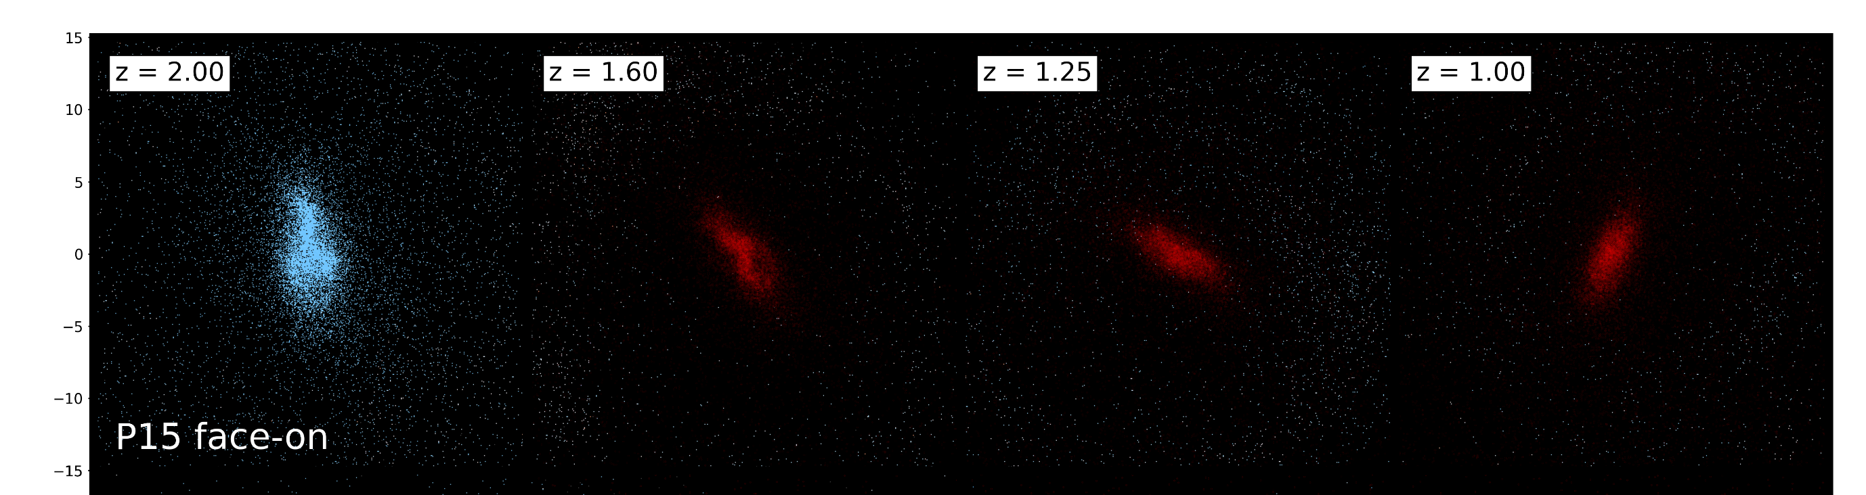
High quasar-mode feedback factor
Low quasar-mode feedback factor

Slide 17
Impact of AGN Feedback
AGN Feedback
In-situ Star formation
In-situ Star formation
Ex-situ Stars
Ex-situ Stars
morphology
morphology

Slide 18
Summary
The in-situ star formation fraction is key to the galaxy morphology
But the mechanisms are different for low and high mass galaxies
Morphologies of low-mass galaxies are driven by the supernova temperature while those of high-mass galaxies are dominated by the kinetic AGN feedback

