Slide 1

Storage ring studies of carbon cluster thermal electronic radiation
Klavs Hansen
Center for Joint Quantum Studies and Department of Physics, Tianjin University

Slide 2
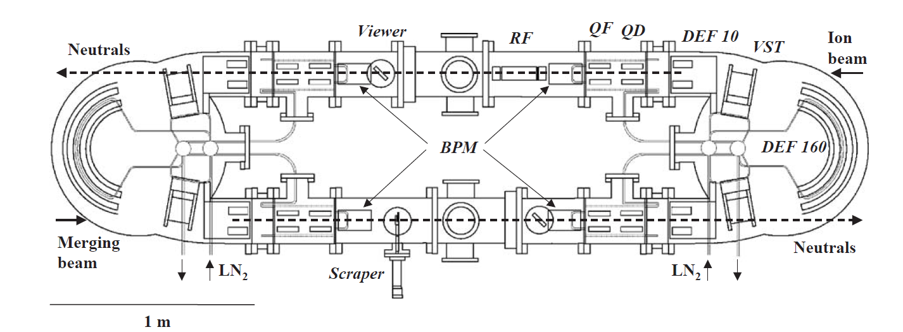
Electrostatic storage ring @ Tokyo Metropolitan University
Circulating hot ions, decay rates measured
Decays are statistical

Slide 3
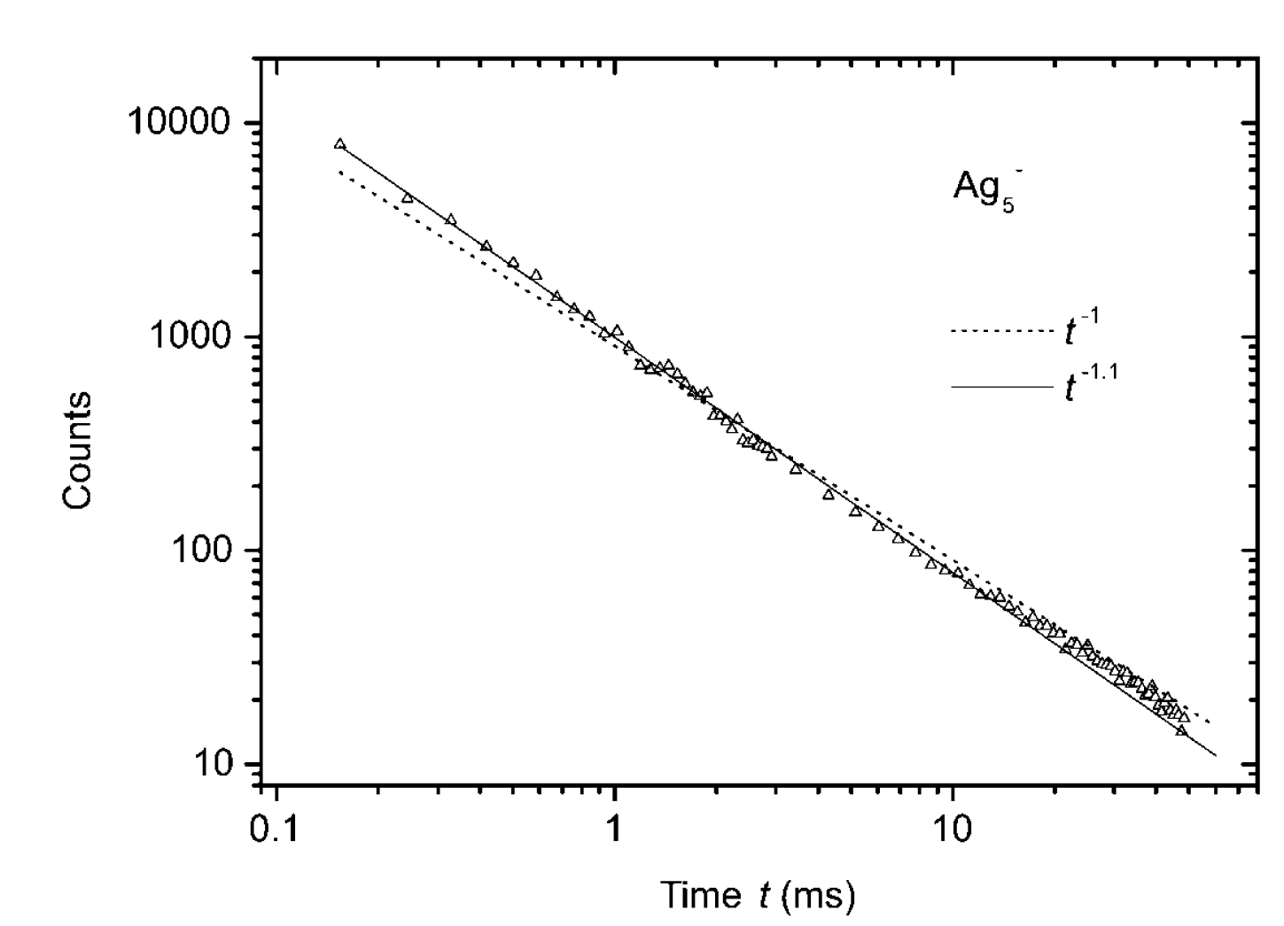
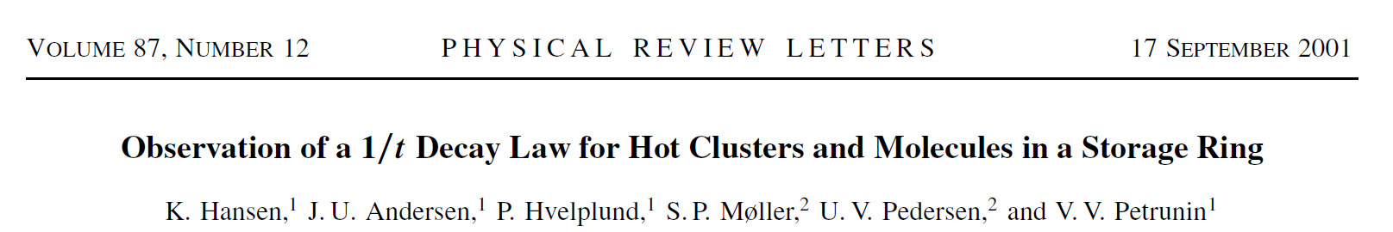
Decay rates follow a power law (for short times)

Slide 4
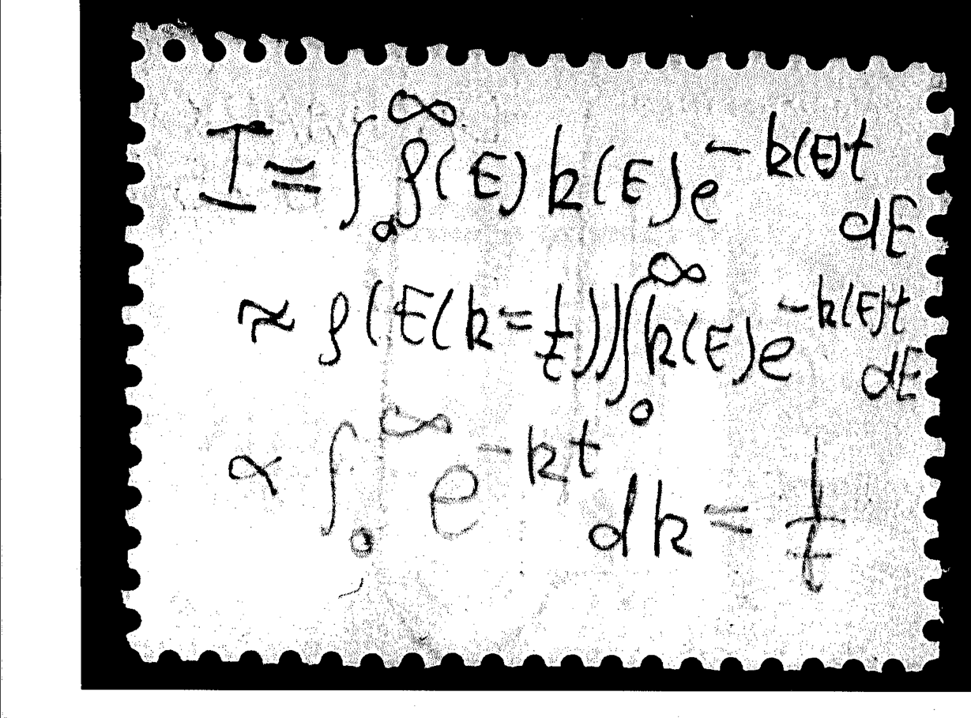
Assume broad energy distribution and
calculate the thermal decay rate
You don’t need the back of an envelope

Slide 5
Use deviation from power law
to determine photon emission
Competing channels:
C60⁻ C60 + e⁻
C60⁻ C60⁻ + hν
power law + radiation e^{-krt}/t kr = photon emission constant

Slide 6
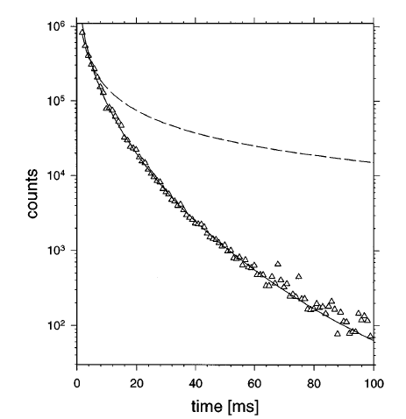
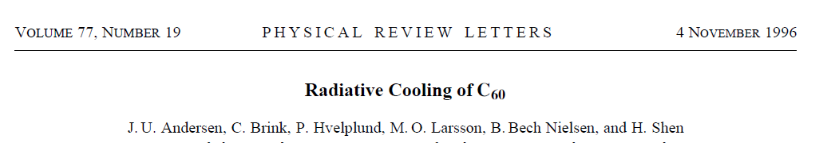
Effect of radiative cooling on thermionic emission of C₆₀⁻
Competition
C60⁻
C60 + e⁻
or
C60⁻
C60⁻ + hν
Power law decay

Slide 7
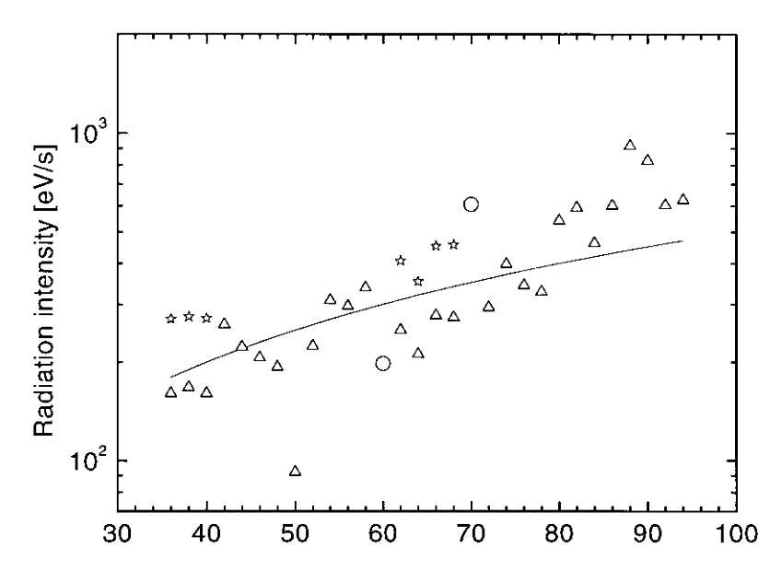
Emitted power from fullerene anions for kr
Emission from thermally
populated electronic
excited states
N

Slide 8
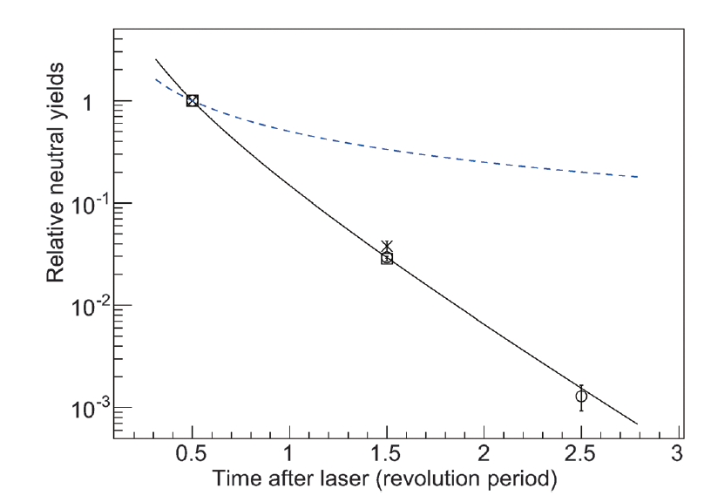
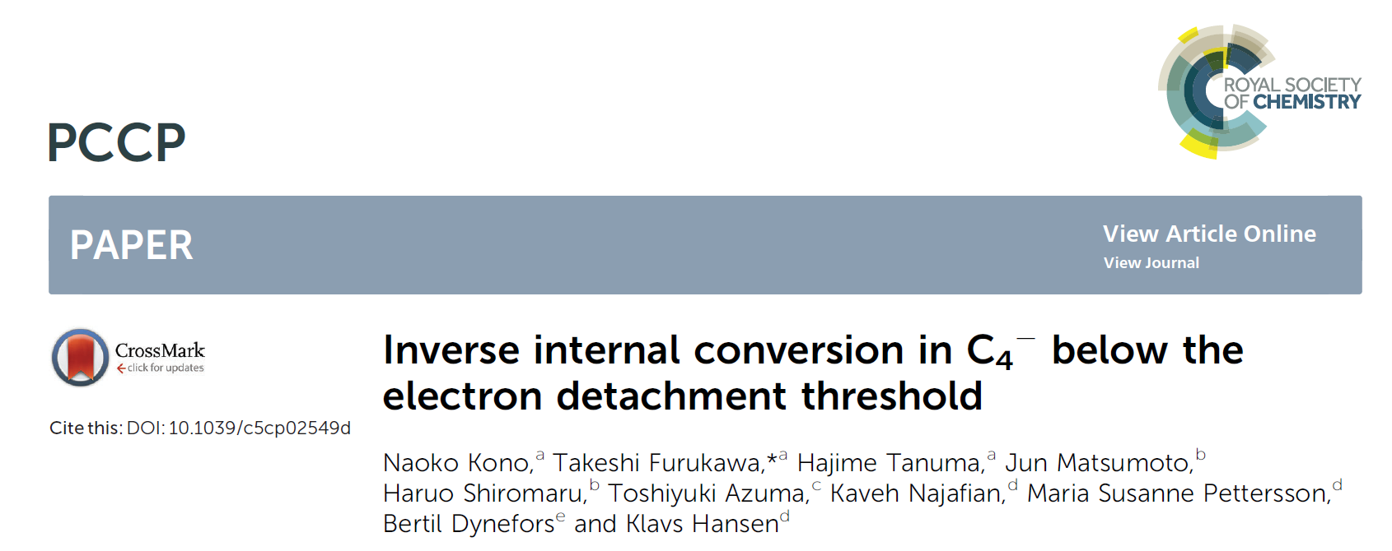
C₄⁻
electron emission
rates
Time constant of
~10 μs:
electronic cooling
Thermionic
emission after
laser excitation
1/t
e^{-krt}/t
time unit 31.6 μs

Slide 9
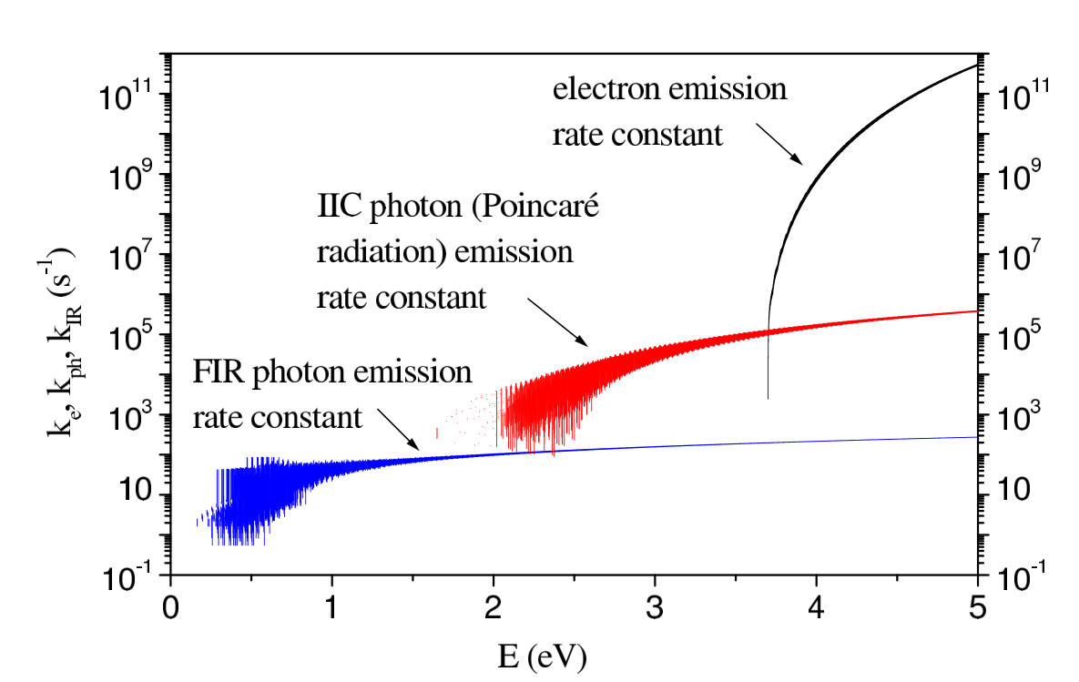
Energy dissipation rates of C4⁻
electronic radiation
(recurrent fluorescence)

Slide 10
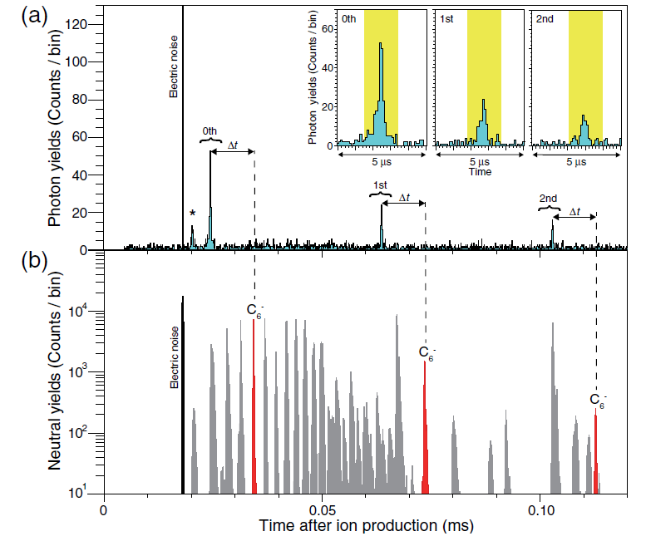
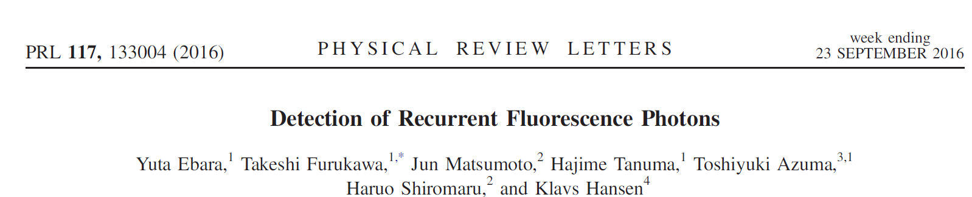
Observation of
emitted photons
from C6⁻
@ 2.0 eV

Slide 11
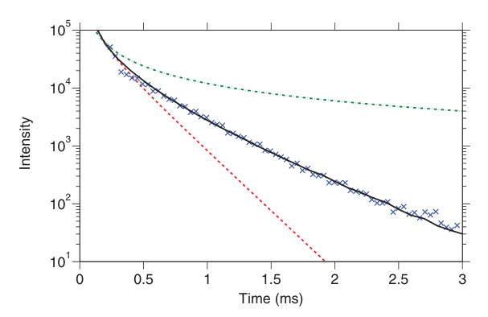
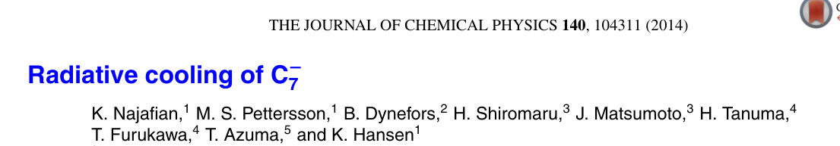
Spontaneous decay rate of hot C7⁻
Vibrational
cooling for N=7
Small anionic
carbon clusters
Odd N: IR emission
Even N: NIR, VIS
power law
power law +
IR radiation
exponential
decay

Slide 12
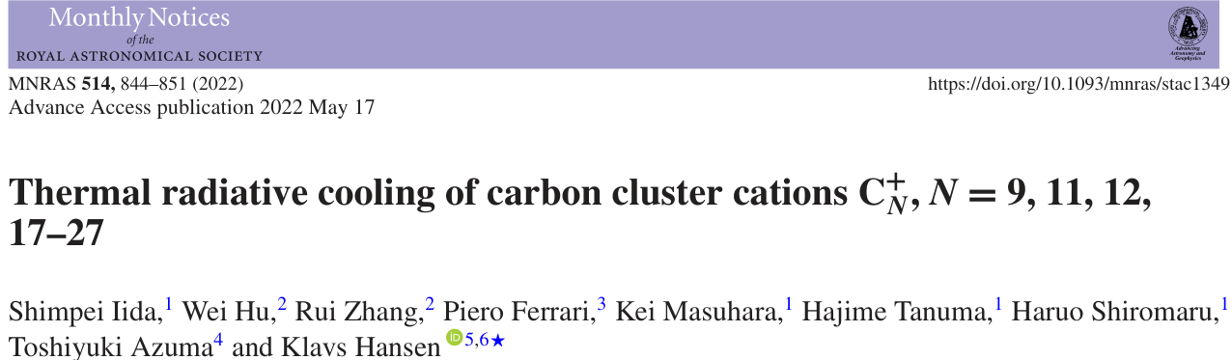
Not everything is anions

Slide 13
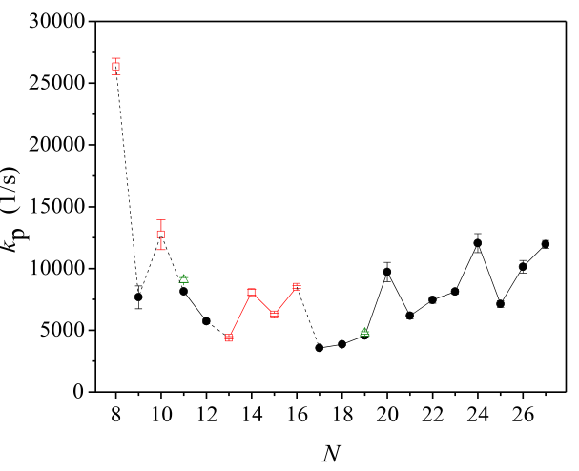
Carbon cluster cations
As elsewhere, the cooling
rates refer to the excitation
energy where
radiation rate
=
unimolecular decay rate

Slide 14
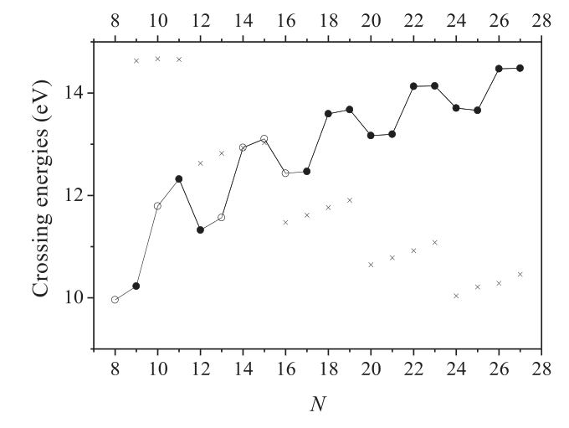
CN⁺ stabilization limits
fragmentation
sector
One photon in,
multiple photons out
quantum efficiency > 1
& broad spectrum
photon in
photons out
radiation
sector

Slide 15
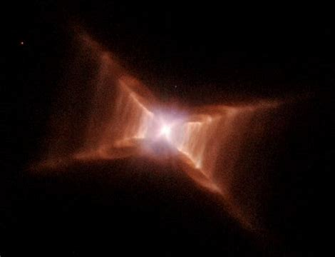
Is this giving us the color of the
red rectangle/extended red emission?

Slide 16
http://www.klavshansen.cn/
Thanks for your attention

Slide 17
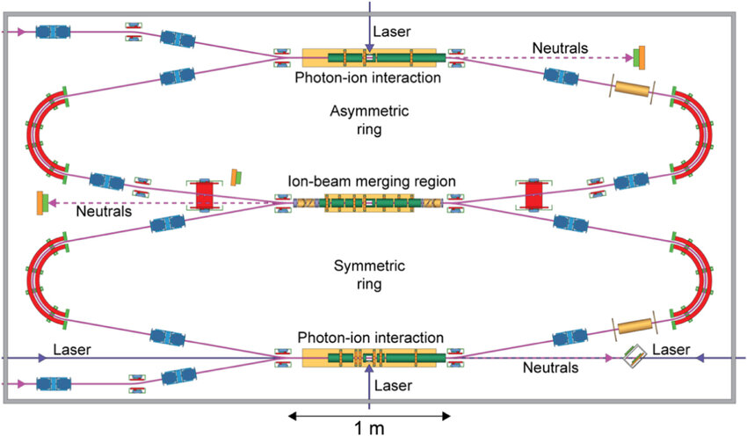
DESIREE, Stockholm
cryogenic (= hour long storage)
anion and cation recombination at low energy

Slide 18
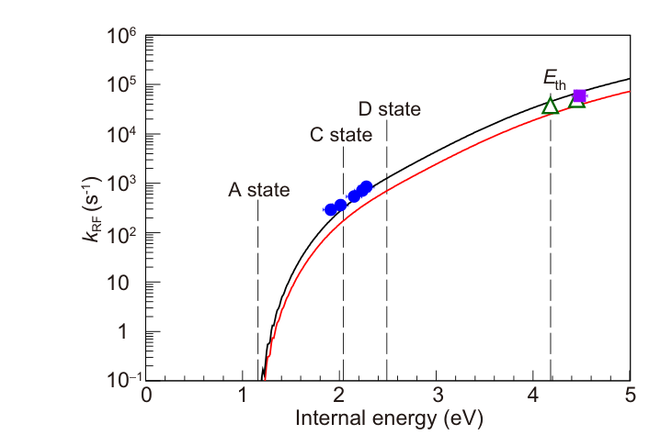
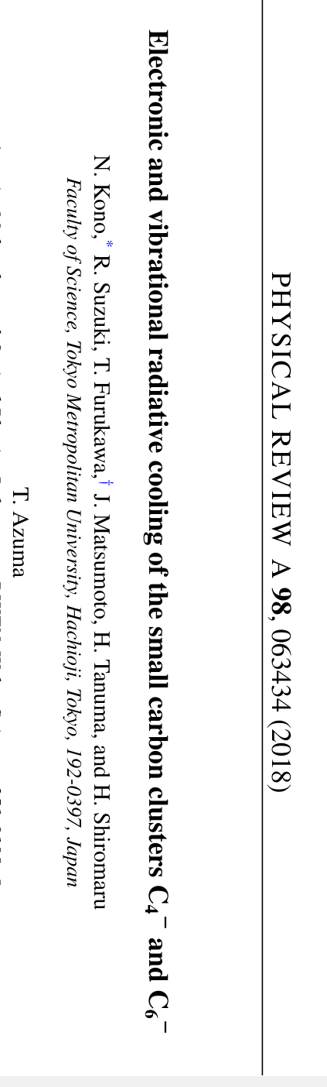
C6⁻ electronic radiation, theory+experiment
Photo emission rate constant

Slide 19
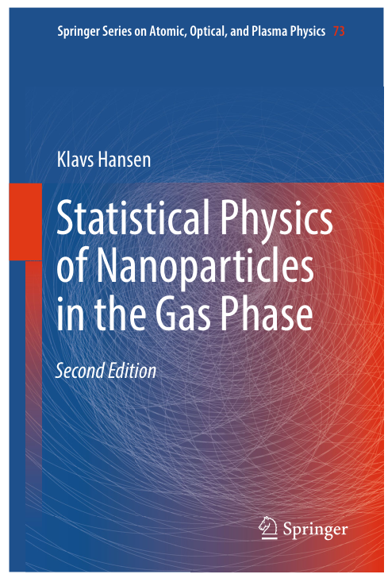

Slide 20
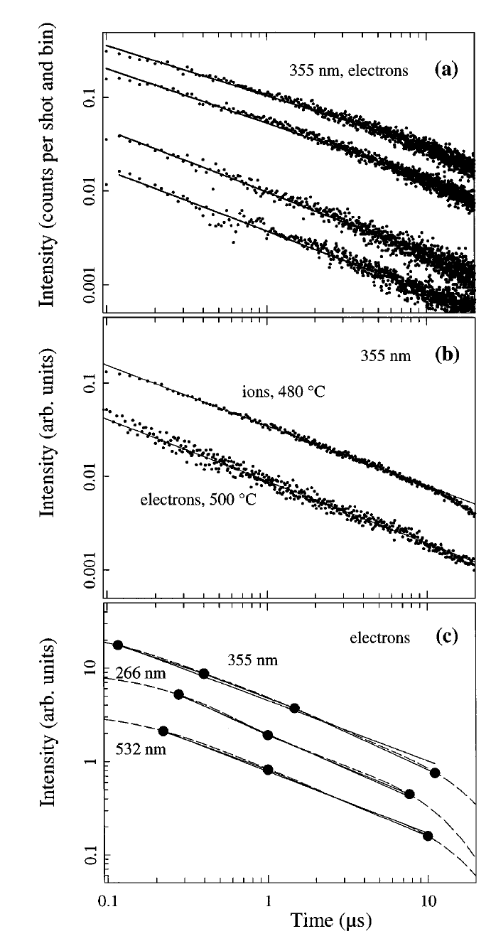
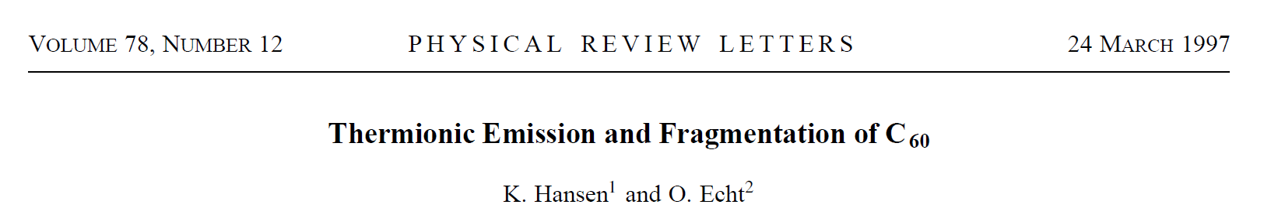
C₆₀ thermionic
emission

Slide 21
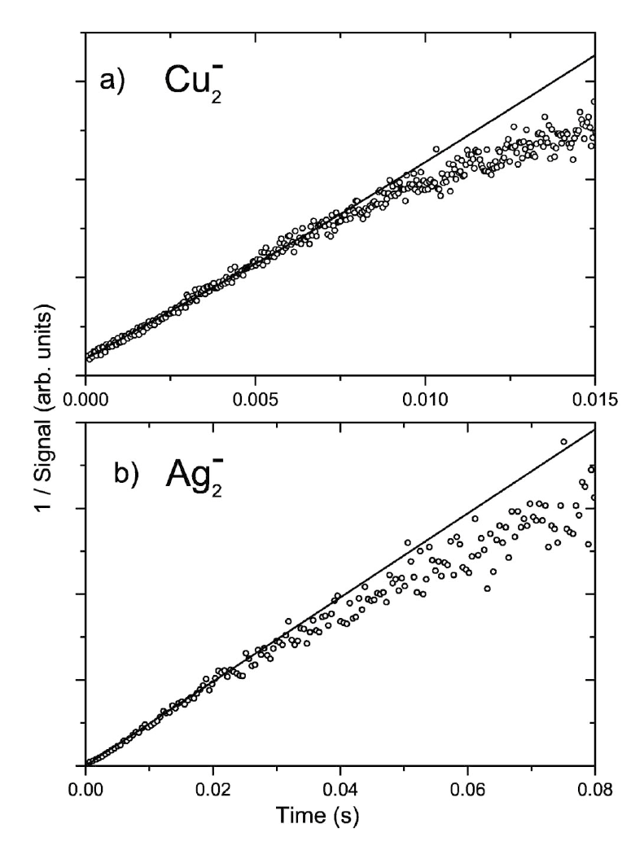
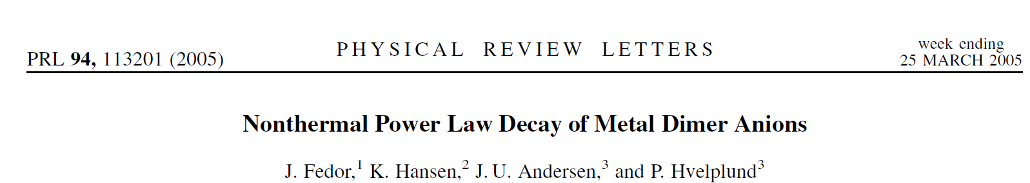
OBS 1/signal

Slide 22
Erice workshop in 2028, July 2-8
Directors Vitaly Kresin (USC) Juraj Fedor (Prague),
Joost Bakker (Nijmegen)
KH (where?)

