Slide 1


Einstein Probe Discovery of a New Type X-ray Transient and its Mysterious Link to Supernovae
Hui Sun 孙惠
H.Sun, W.X.Li, L.D.Liu on behalf of a large collaboration
National Astronomical Observatories, CAS
Einstein Probe Science Center

Slide 2
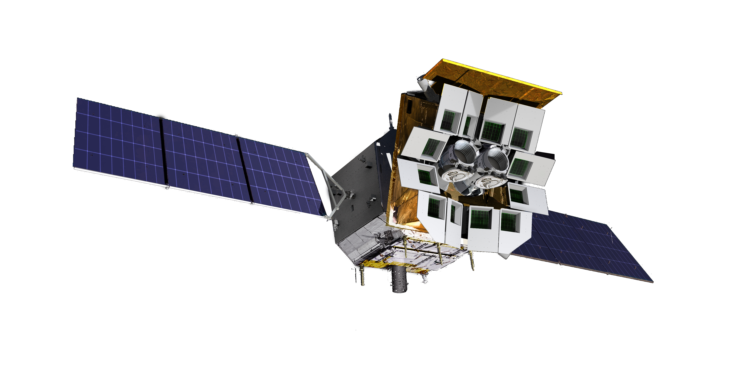



Einstein Probe (EP) “天关”卫星
Goals space X-ray observatory for time-domain astronomy
Discover soft X-ray transients & monitor source variability at unprecedented sensitivity
Characterise transients/variables by quick X-ray follow-up onboard
Disseminate transient alerts to astro. community in time, quick response ToO
Wide-field X-ray Telescope WXT
FoV >3600 sq. deg；Band: 0.5-4 keV
PI: Weimin Yuan
Follow-up X-ray Telescope FXT
Effe. area: 300 cm² @1keV (x 2 units)
Band: 0.3-10 keV
On-board data processing
Quick slew & autonomous follow-up
Launch: Jan 9 2024, Happy 2nd Birthday!
Since 2024/07- nominal mission (lifetime: 3 yr, goal 5 yr)
Notes:
Einstein Probe is an international mission led by the Chinese Academy of Sciences (CAS) in collaboration with the European Space Agency (ESA), the Max-Planck-Institute for extraterrestrial Physics (MPE), Germany, and the Centre National d'Études Spatiales (CNES), France.

Slide 3
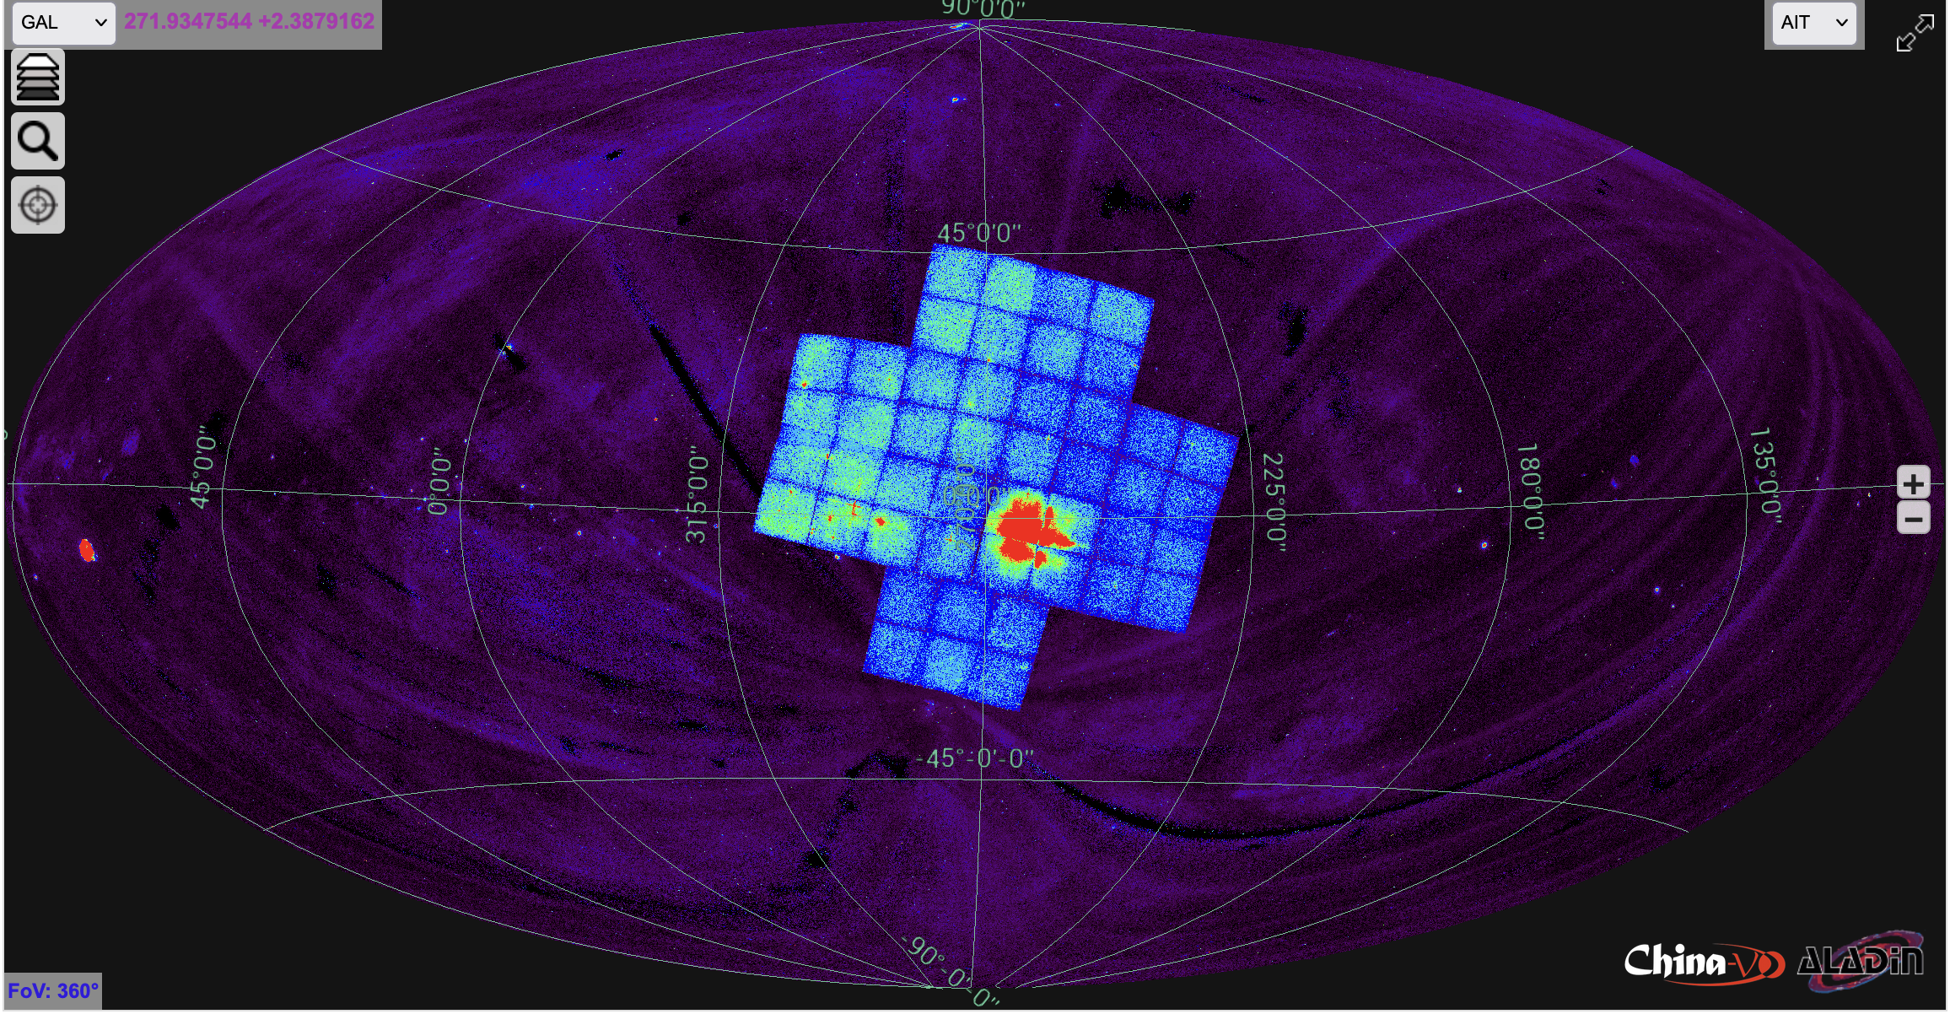
EP-WXT Single Observation Imaging（exp. 20 ks）

Slide 4
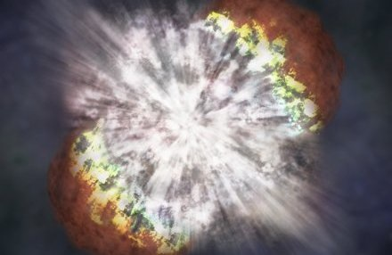

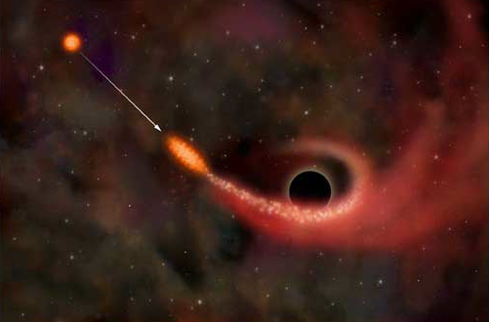
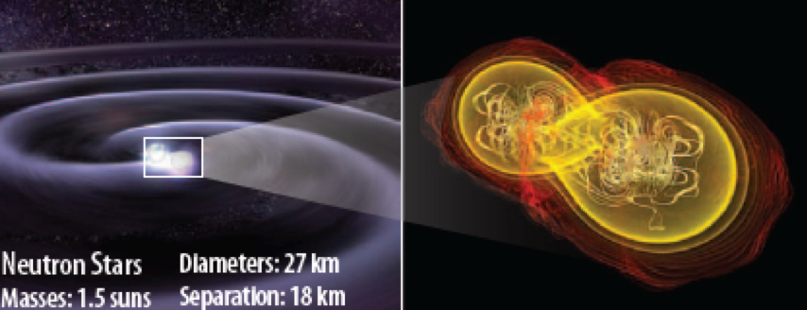
EP key science objectives
Systematic survey of soft X-ray transients and variability of X-ray sources with unprecedented combination of sensitivity and cadence
Discover otherwise quiescent black holes at almost all astrophysical mass scales and other compact objects by capturing their transient X-ray flares
Detect and localise the electromagnetic-wave sources of gravitational-wave events by synergy with gravitational-wave detectors

Slide 5
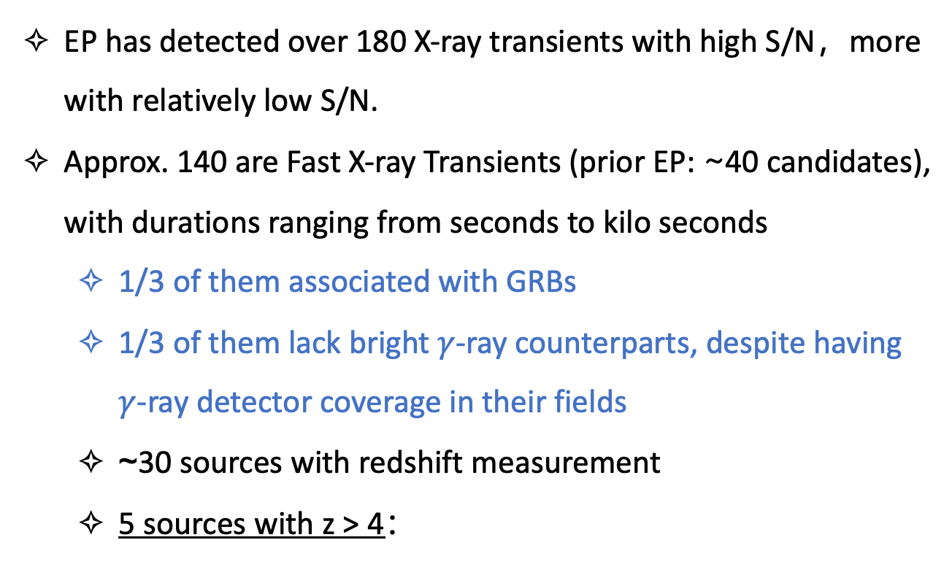
Fast X-ray transients detected with EP-WXT
EP has detected over 180 X-ray transients with high S/N，more with relatively low S/N.
Approx. 140 are Fast X-ray Transients (prior EP: ~40 candidates), with durations ranging from seconds to kilo seconds
1/3 of them associated with GRBs
1/3 of them lack bright $γ$-ray counterparts, despite having $γ$-ray detector coverage in their fields
~30 sources with redshift measurement
5 sources with z > 4：
(Wu et al. in preparation)
EP240315a (4.859) EP241025a (4.200) EP241217a (4.590) EP250215a (4.610)
EP250321a (4.368)
Notes:
EP的探测目标非常广泛，一个探测到150例不同时标的暂现源，这里列举了暂现源及快速暂现源随时间的增加，以及其中一部探测。

Slide 6
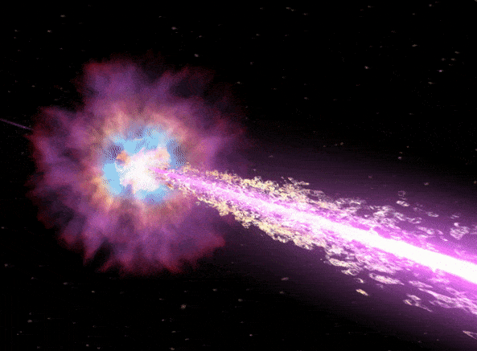
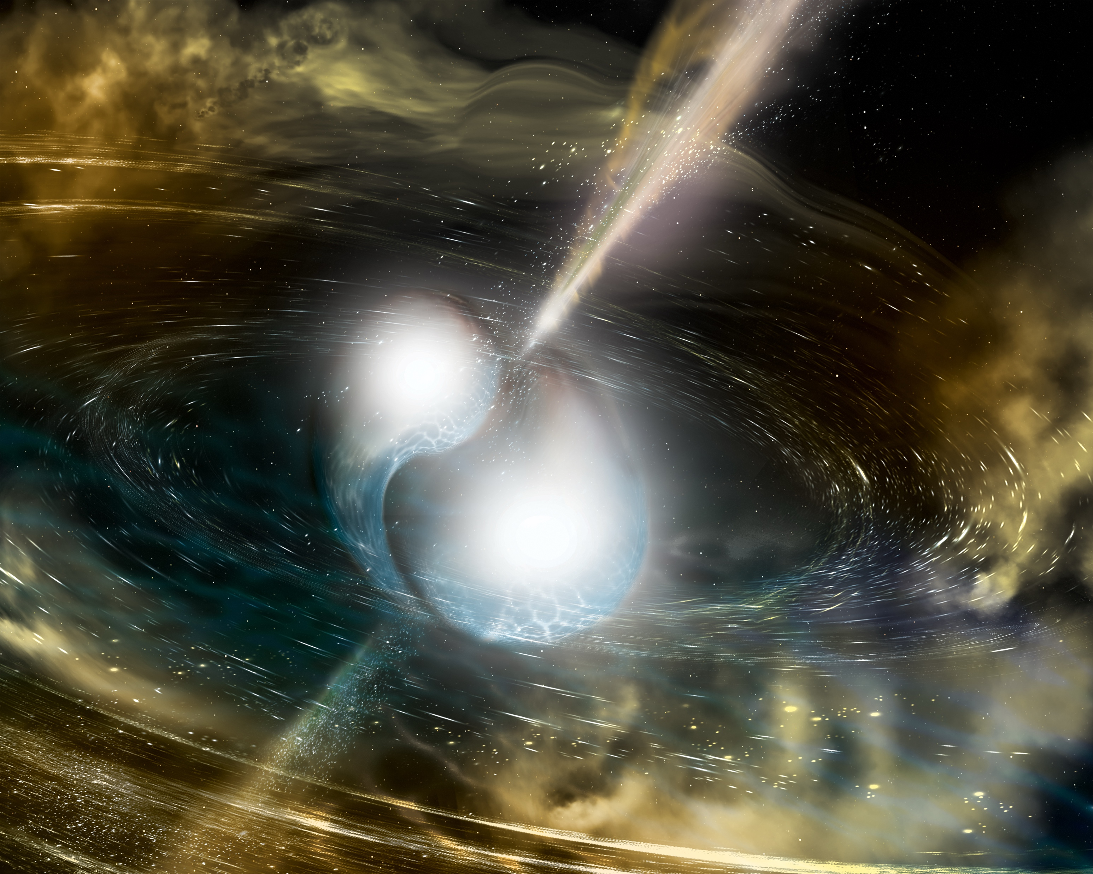
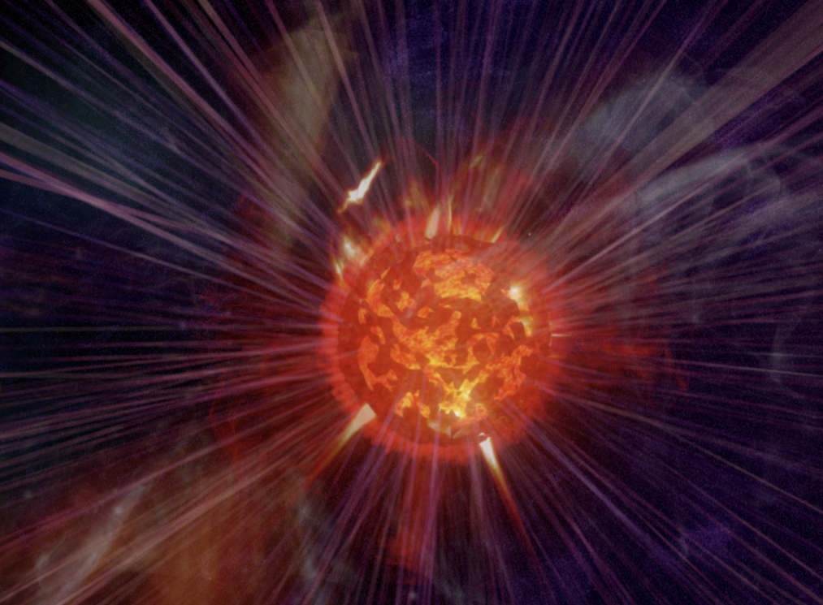
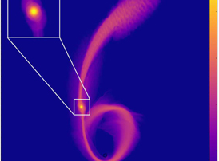
Possible physical origins for Fast X-ray transients
Gamma-ray burst
EP240219a (Yin+2024)
EP240315a (Liu+2025)
EP240617a (Wang+2025)
EP250801a (Jiang+2025)
…
Magnetar emission from
compact binary merger
GRB 230307A (LEIA, Sun+2025)
CDF-S XT2 (Xue+2019)
CDF-S XT1 (Bauer+2017)
…
SN Shock break-out
No conclusive detection
by EP yet
XRO 080109, Soderberg+2008
GRB 060218? Campana+2006
TDEs by WD-IMBH
system
EP250702a? (Li+2025)
Preliminary results
Also see Klein & Chevalier 1978; Waxman & Katz 2017; Dai et al. 2006; Zhang 2013; Sun et al. 2019; Zhang 2018; MacLeod et al. 2014; Maguire et al. 2020; Chen et al. 2023…

Slide 7
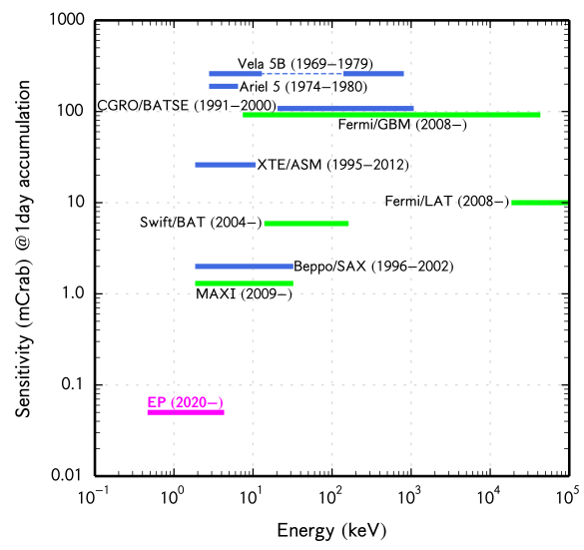
EP WXT Sensitivity
More than 1 order of magnitude more sensitive
“The new capability typically leads to major breakthroughs and holds promise for discovering new types of X-ray transients”
One-day exposure
EP(2024-)
energy band
Notes:
The simulated EP sensitivity and energy band, and comparison with current and previous
wide-field instruments. The sensitivity is for one-day exposure time, in units of milli-Crab.
It is clear that EP is more than 1 order of magnitude more sensitive than the rest of the instruments.
For the first time, all sky survey monitoring was carried out with soft X-rays (<2keV)

Slide 8
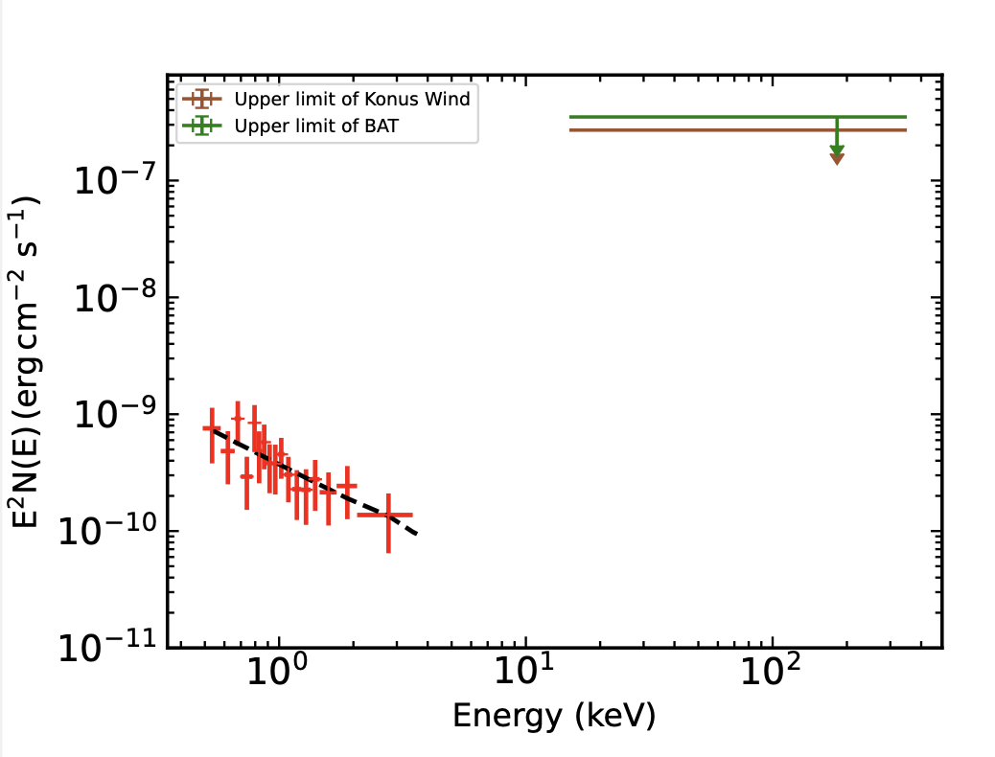

EP240414a: detection by the Wide-field X-ray Telescope
T₀ = 09:49:10 on 14 April 2024
Fast X-ray transient (T₉₀ = 155 s in 0.5–4 keV)
Soft spectrum: photon index 3.1
No gamma-ray signals detected: only upper limits given by Konus Wind and Swift/BAT (Fermi/GBM in SAA)
WXT light curve
Upper limits
Photon index $Γ={3.1}_{−0.7}^{±0.8}$
Sun, Li, Liu et al. 2025
Nature Astronomy
Notes:
EP0414a可能就是这样一例事件，给我们理解快速暂现源带来了一些新的启示

Slide 9
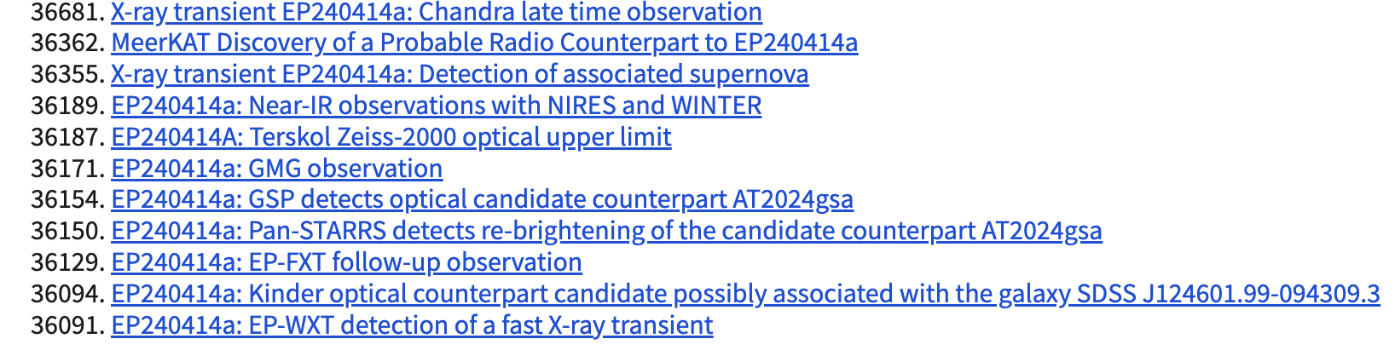
Follow-up Reports in GCN Circulars
FXT observation confirmed the optical detection 2hrs later
Kinder optical counterpart candidate
Notes:
An optical counterpart candidate was identified next to a galaxy.

Slide 10
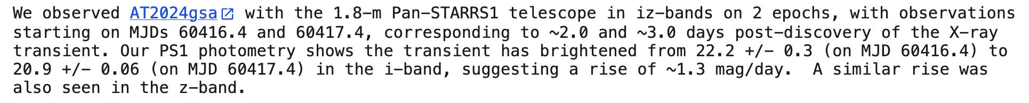
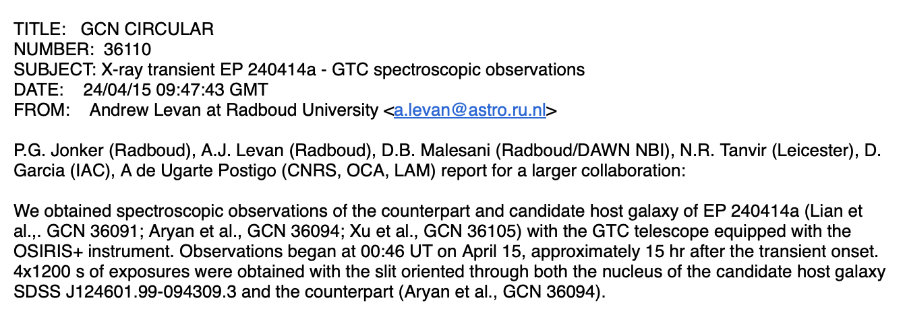
Follow-up Reports in GCN Circulars
FXT observation confirmed the optical detection 2hrs later
Kinder optical counterpart candidate
z = 0.4 for the potential host galaxy
L_{X,peak}~1.3e48 erg/s
Notes:
An optical counterpart candidate was identified next to a galaxy.

Slide 11
Optical: Indication of a Type Ic Broad-lined SN
Long-term light curve

Slide 12
Optical: Indication of a Type Ic Broad-lined SN
Long-term light curve
~1 day
Obtained using NIRES on the Keck II telescope
Later rebrightening due to the spectroscopically-
confirmed type Ic-BL supernova
A bright optical bump at T₀+4 days
CORE-COLLAPSE OF A WOLF-RAYET STAR

Slide 13
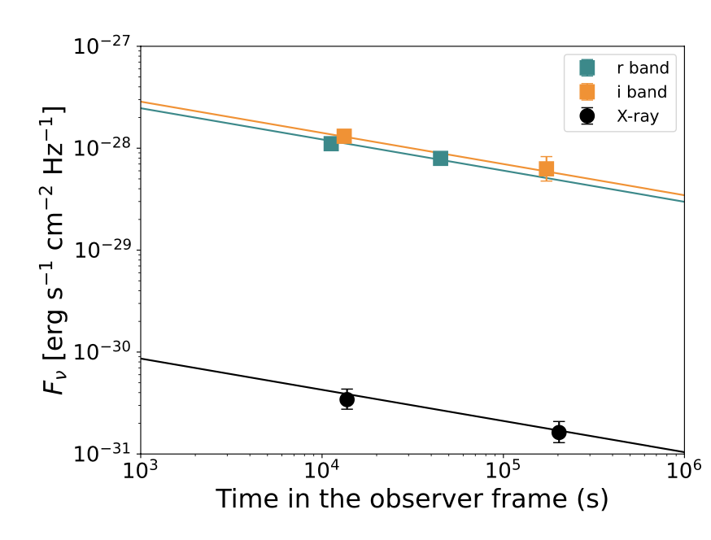
Optical: Indication of a Type Ic Broad-lined SN
Long-term light curve
Afterglow from a weak successful jet
(Lorentz factor ~13)
Shock breakout and cooling emission from the expanding hot material at large radii ~10¹⁴ cm
Implying an extended shell
Notes:
At T₀ + 4 days, an optical bump observed peaking at M_{z} ∼ −21.5 mag
At T₀ + 15 days, another optical bump appears, fainter but broader than the second one, with a peak luminosity of M_{I} ≈−19.5 mag, confirmed to a Type Ic-BL SN (z = 0.401)

Slide 14
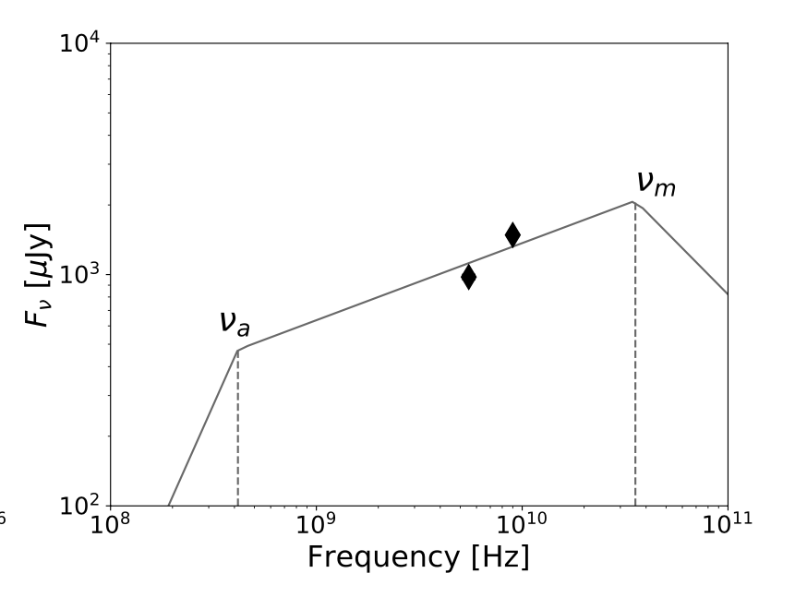
Radio: originate from weak-relativistic jet
T₀ + 19 days
Detected at ∼ T₀ + 19 days (ATCA , PI: An Tao)
Rising spectrum between 5.5 and 9 GHz
Comparable to that of luminous GRBs

Slide 15
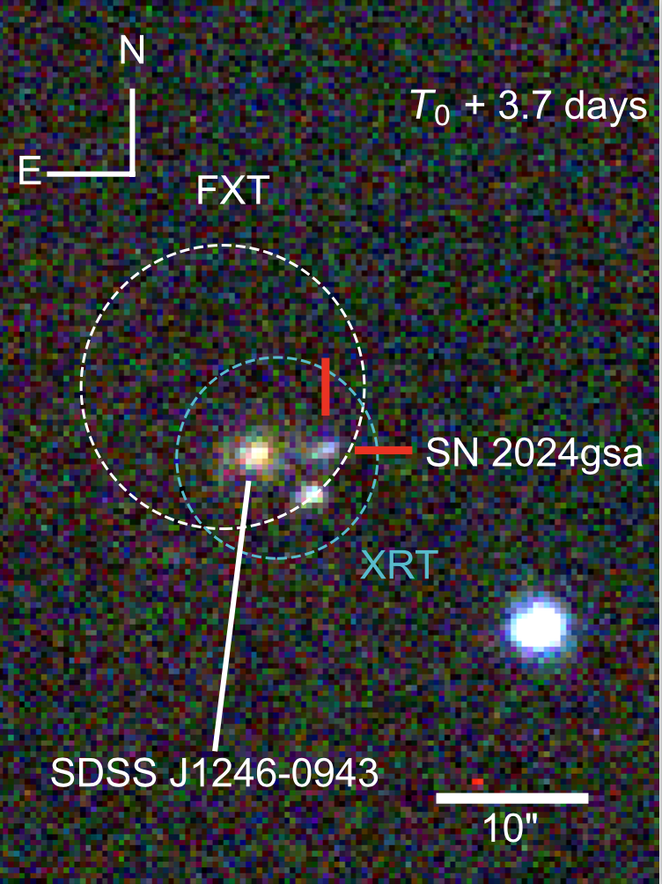
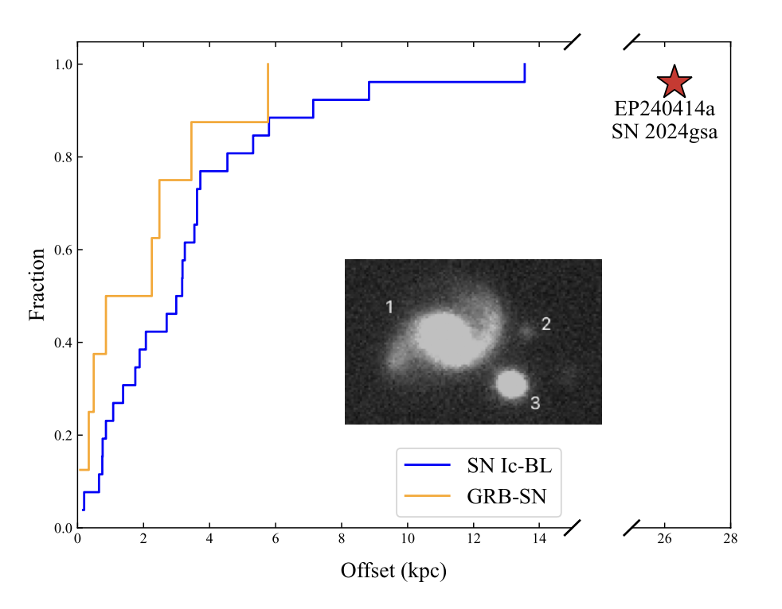
Host galaxy: large offset
SN 2024gsa
Projected offset ~ 26.3 kpc
Significantly larger than the typical offset for SNe Ic-BL

Slide 16
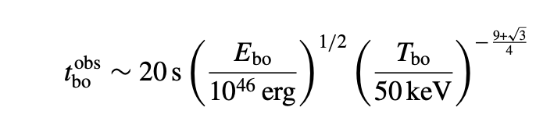
EP240414a: new type of fast X-ray transient
Much brighter than theoretical prediction from SN shock breakout
Much softer spectrum (E_peak < 1.3 keV), a unique outlier in the “Amati relation”
Failed to satisfy the relativistic shock breakout relation
Large offset from its host galaxy
Soft fast X-ray transient from a weak relativistic jet in an extended shell associated with core-collapse explosion
Relativistic breakout relation
Nakar & Sari 2012
× inconsistent
The relativistic shock breakouts can explain very well the energy, temperature, and timescales of the prompt emission of all observed ll-GRBs
shock breakout prediction

Slide 17
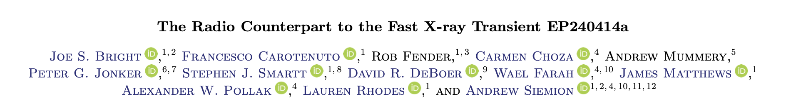
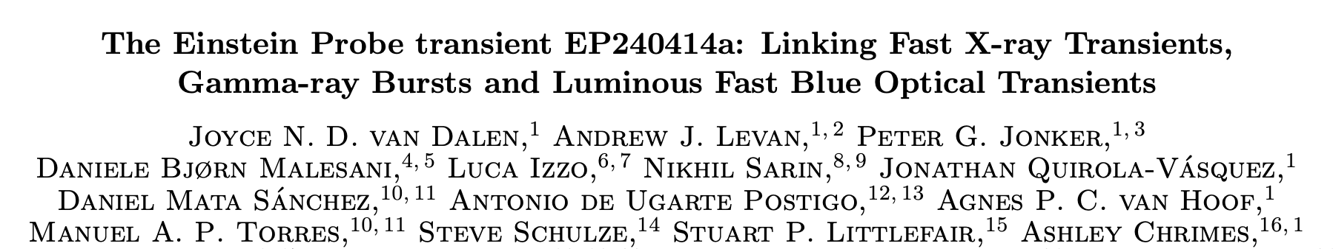
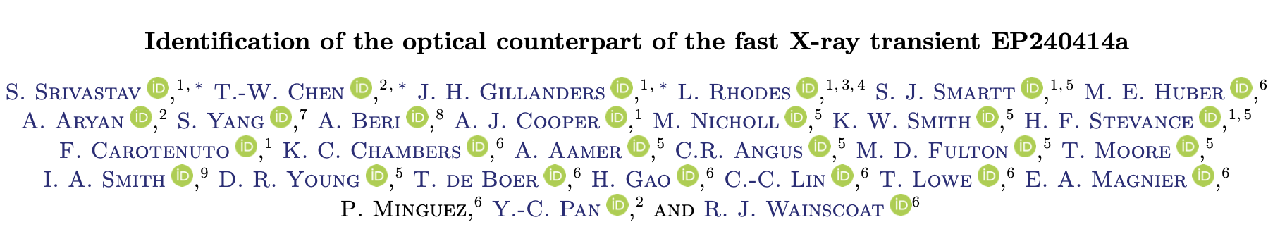
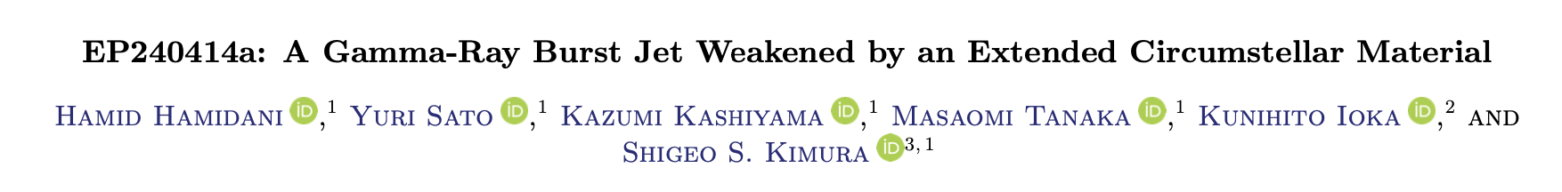
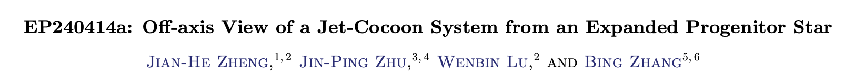
Beyond this work…

Slide 18
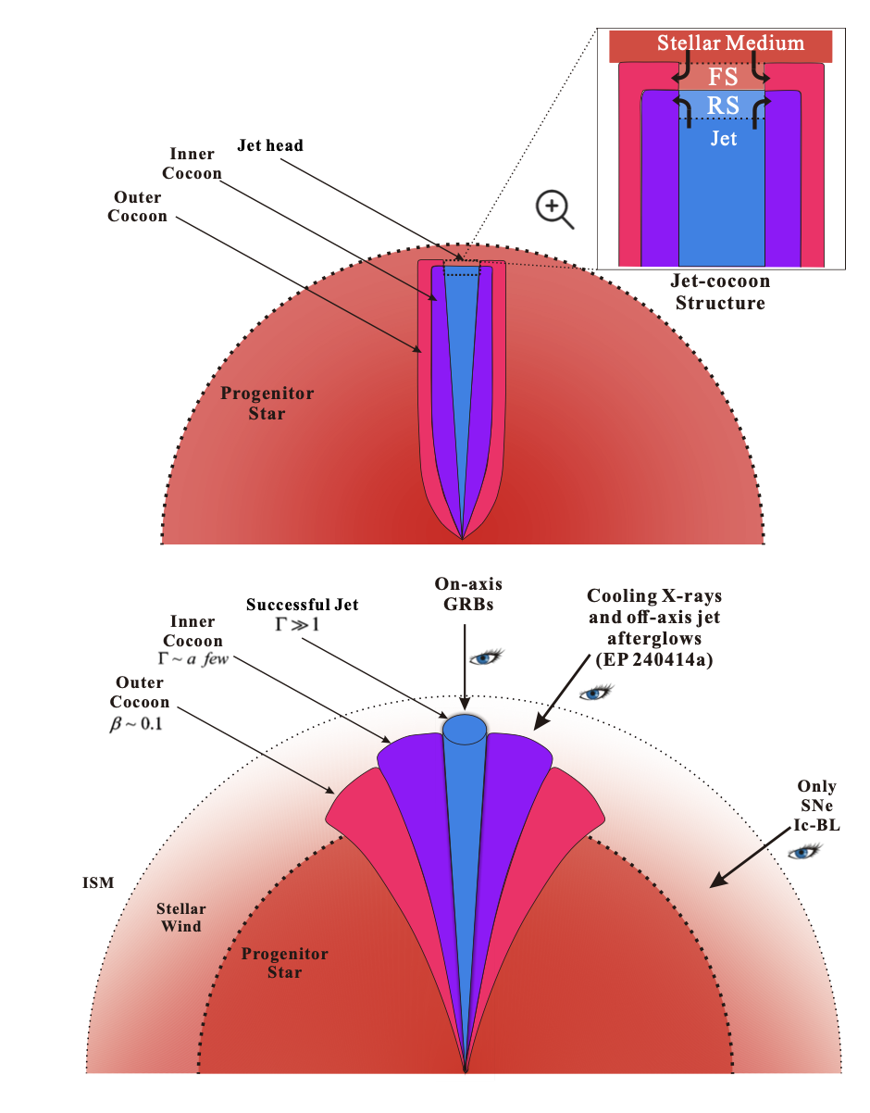
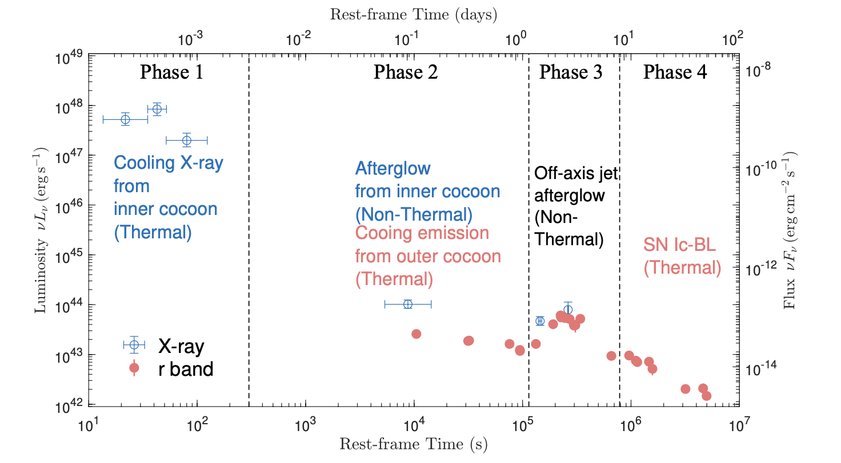
Theoretical modeling also see …
Zheng et al. 2025

Slide 19
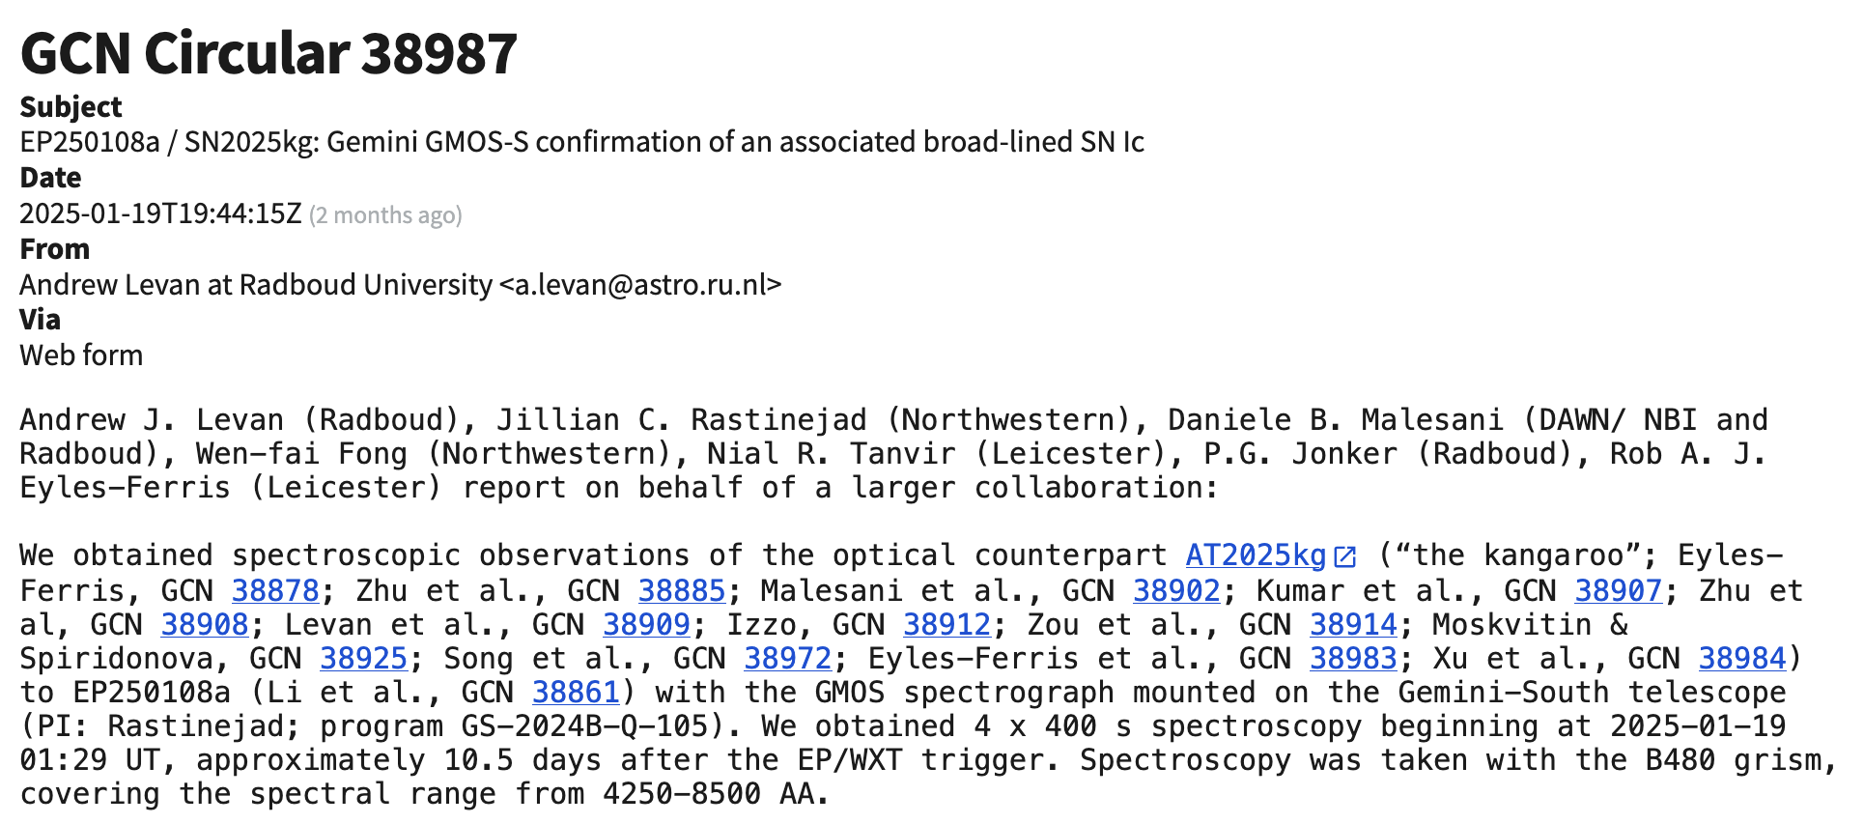
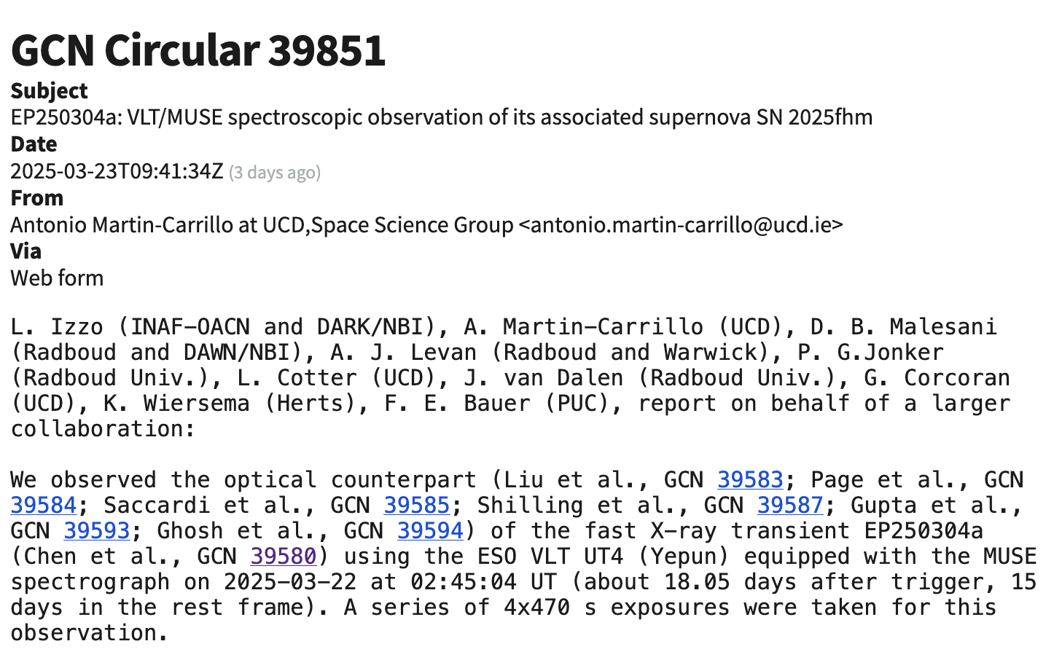
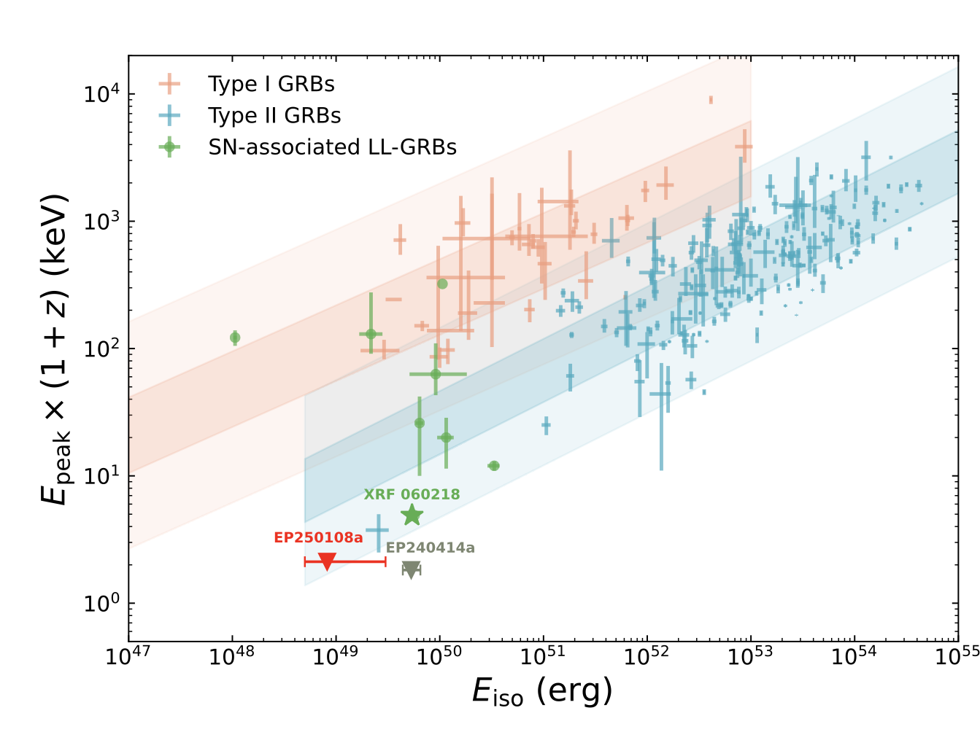
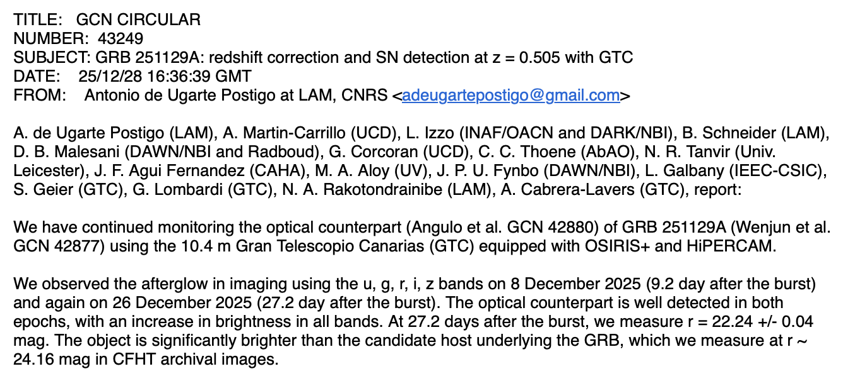
More EP transients in association with SNe
EP240414a (0.4)，EP250108a (0.176)，EP250304a (0.200), EP240506a (0.12), EP250827b (0.1194), EP251129a (0.505), EP240821a (1.67, spectroscopically identified by JWST)
Sun+2025, Li+2025, Izzo+2025, Liang+2025, Srinivasaragavan+2025, de Ugarte Postigo+2025, van Hoof+2025
EP250304a/SN 2025fhm @z=0.200
EP250108a/SN 2025kg
@z=0.176
WXT
WXT
GRB 251229A/EP251229a @z=0.505
Li et al. under review
arXiv: 2504.17034
Notes:
the most distant spectroscopically identified gamma ray-burst (GRB)-SN to date

Slide 20
Summary
EP has detected more than 100 fast X-ray transients, revealing potentially diverse origins.
EP240414a/SN 2024gsa, as one of the well studied event, was found to originate from the core-collapse explosion of an extragalactic massive star.
The soft spectrum, bright peak X-ray luminosity and multiband follow-up data revealed the existence of a weak relativistic jet interacting with an extended shell.
We are expecting more soft X-ray transients like EP240414a or new types of events in EP data.
Timely follow-up observations are critical to diagnose the physical origins.
“The journey has just begun. The greatest discoveries may still be ahead.”
EP website: ep.bao.ac.cn
Thank you for your attention!
Contact me: hsun@nao.cas.cn

