Slide 1
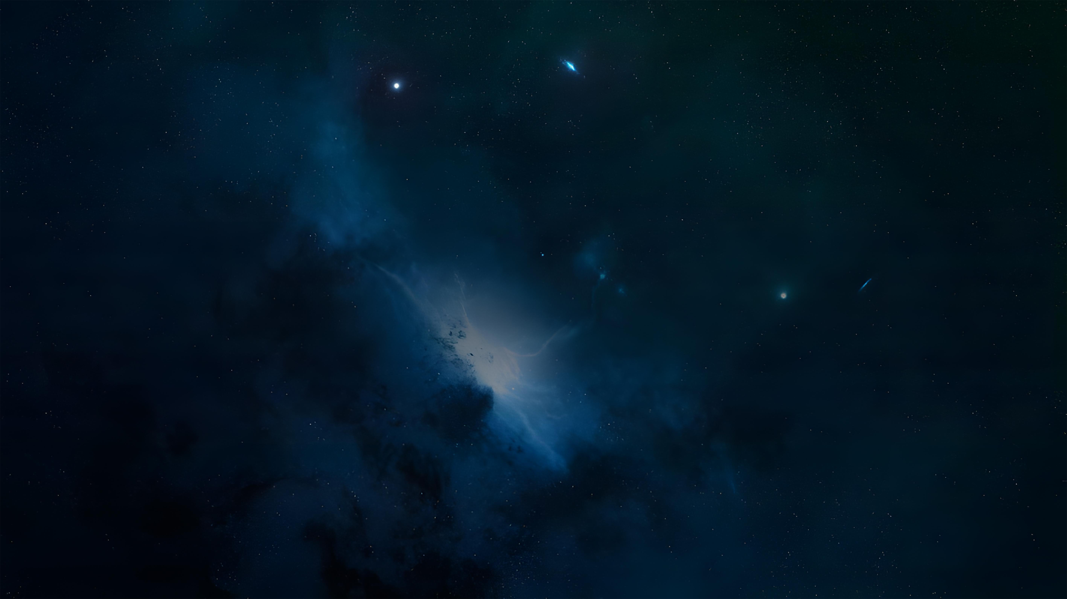

LOTUS: L2 Orbital Telescope for
Ultraviolet Spectroscopy
Unlocking the FUV/NUV (90–350 nm) with CSST Heritage & Advanced CMOS Technology
Suijian Xue
National Astronomical Observatories, CAS
Collaborations: HK & Inland Universities & CAS institutes
7th China-Chile Bilateral Conference for Astronomy, 2026 Jan. 6-9, HKU

Slide 2
Outline
Concept & Science
The Foundation – Heritage & Technology
The Solution – Telescope & Instrument
Science Aspirations
Mission Profile & Conclusion
7th China-Chile Bilateral Conference for Astronomy, 2026 Jan. 6-9, HKU

Slide 3
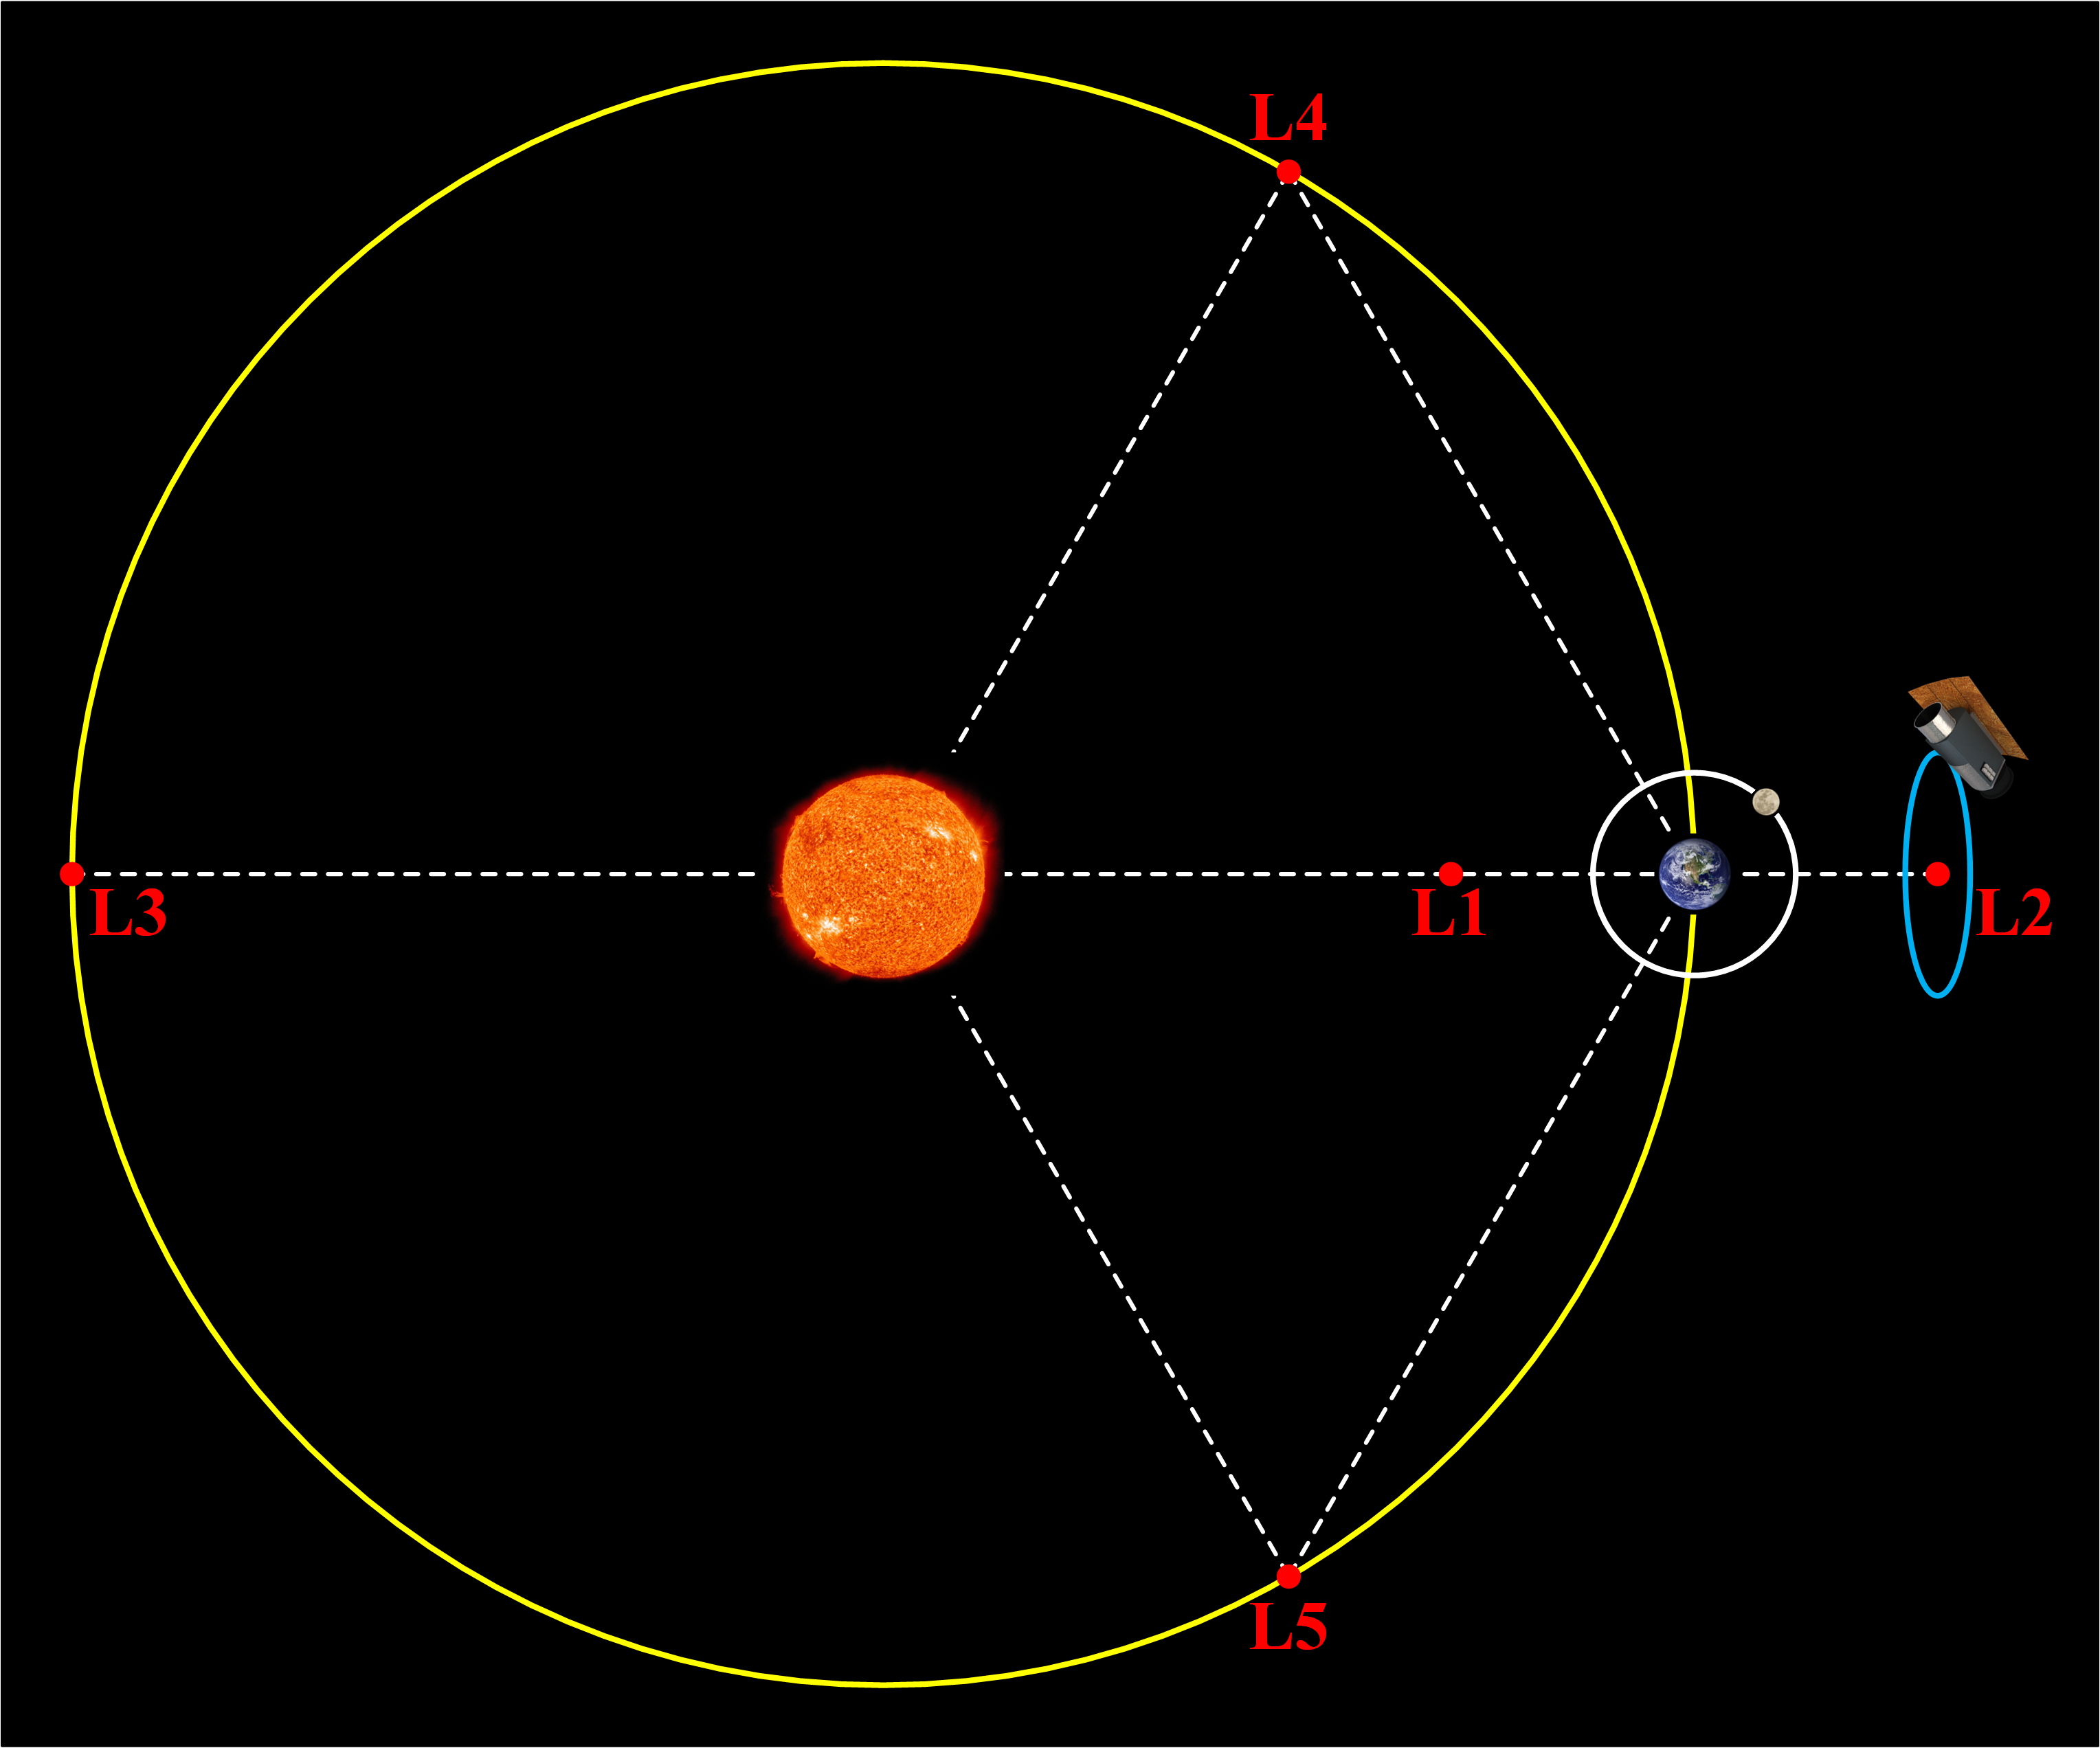
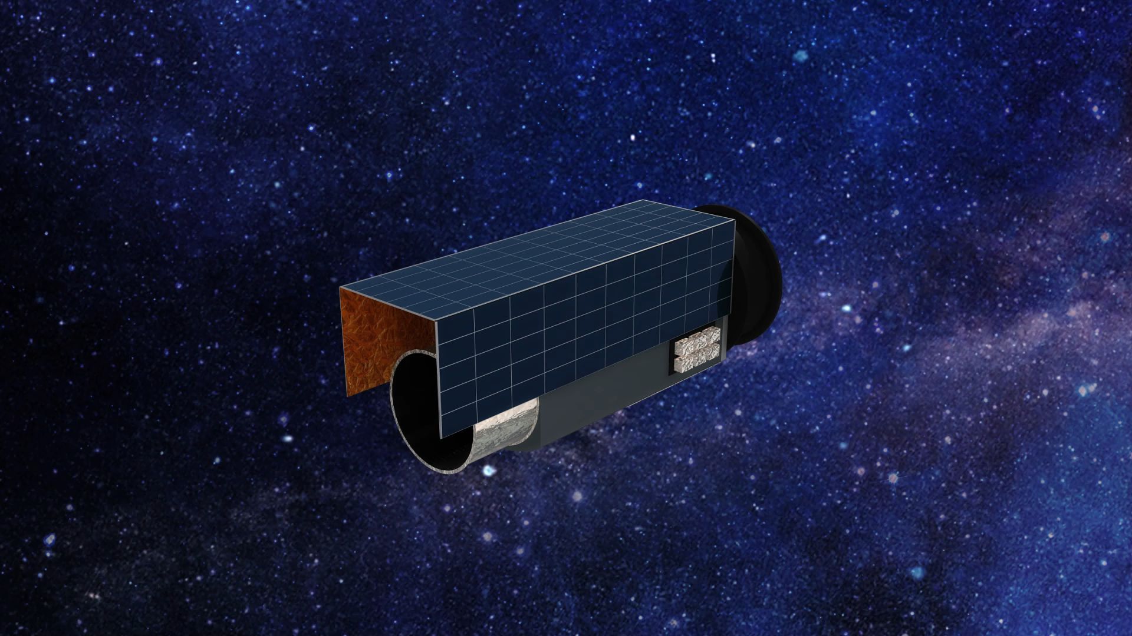
Mission Concept and Driving Sciences
Mission Scope
2-meter SiC Aperture
Sun-earth L2
90-350 nm Range
Multi-mode Obitial Spectrograph + Imager
Long-term operation observatory
Precision pointing
LOTUS
Key Sciences
1. Mapping the "Hidden Half" of Galaxies (The
CGM in Emission)
2. AGN Feedback & Supermassive Black Hole
Winds
3. The "Death" of Exoplanet Atmospheres
4. Gravitational Wave "Early Warning" (Time-
Domain Astronomy)
5. The Origin of Life's Building Blocks
(Protoplanetary Disks)
Why it is cost-Effective?

Slide 4
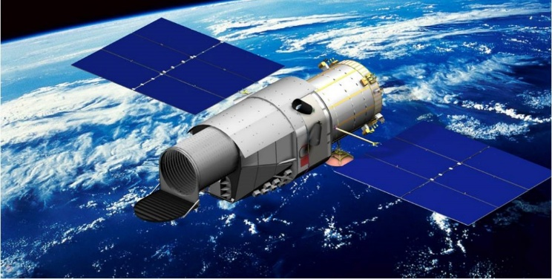
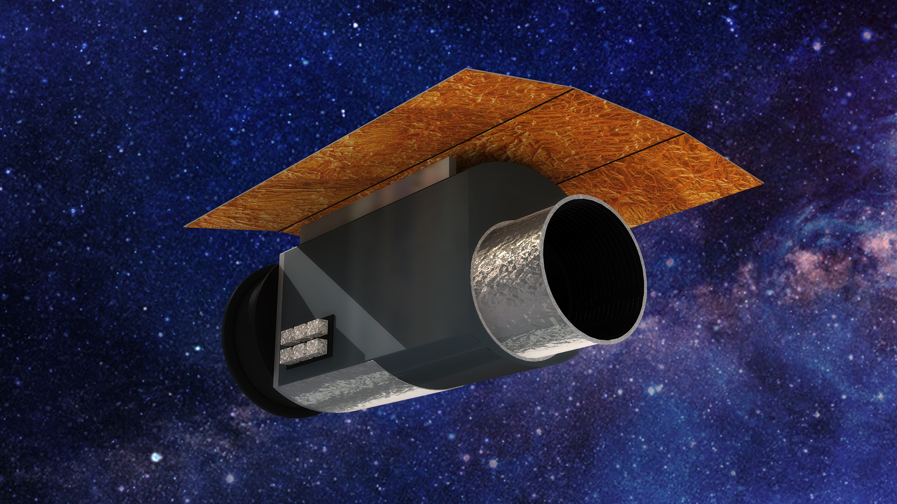
The Foundation
– Heritage & Technology
CSST Key Technology Heritage
Critical Breakthroughs Needed !
2m SiC Mirror: Manufacturing & Testing capabilities.
Structural Stability: Large-scale, high-stiffness support trusses.
Mirror Support: 2m-class mount & support mechanisms.
I n-Orbit Operations: Maintenance & servicing protocols.
Precision Pointing: Ultra-stable Image Stabilization Control (≤0.01"≤0.01").
Thermal Control: Large opto-mechanical system management.
Stray Light: High-performance baffling & suppression.
Vibration: Micro-vibration isolation & suppression.
AIT: Large Space Optical Payload Assembly, Integration & Test
Active Optics: In-orbit wavefront sensing & correction.
Advanced FUV Coatings
High-Reflectivity Designs for 90–350 nm (Al+LiF / SiC).
Next-Gen Detectors
High-Sensitivity, Low-Noise Back-Illuminated sCMOS.
Super-Smooth Optics:
Polishing & Testing (< 1nm RMS roughness).
需突破

Slide 5
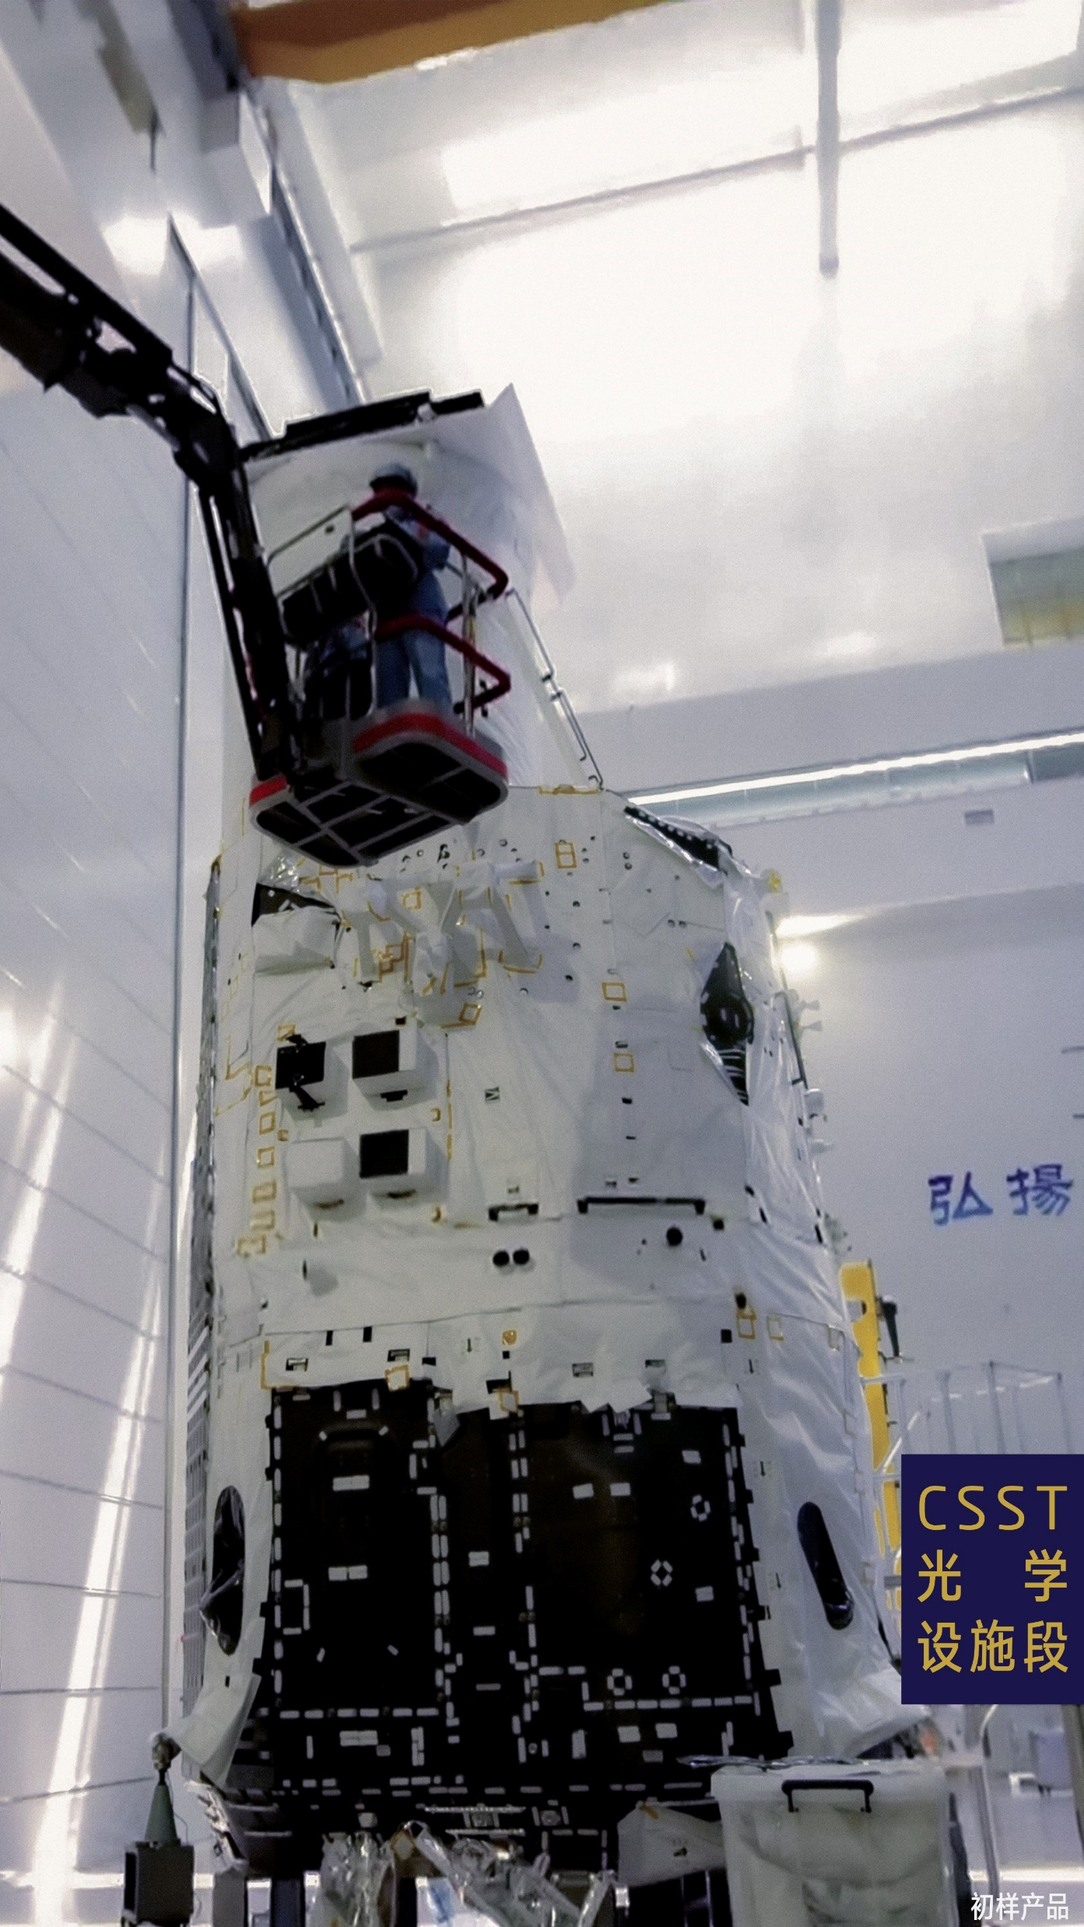
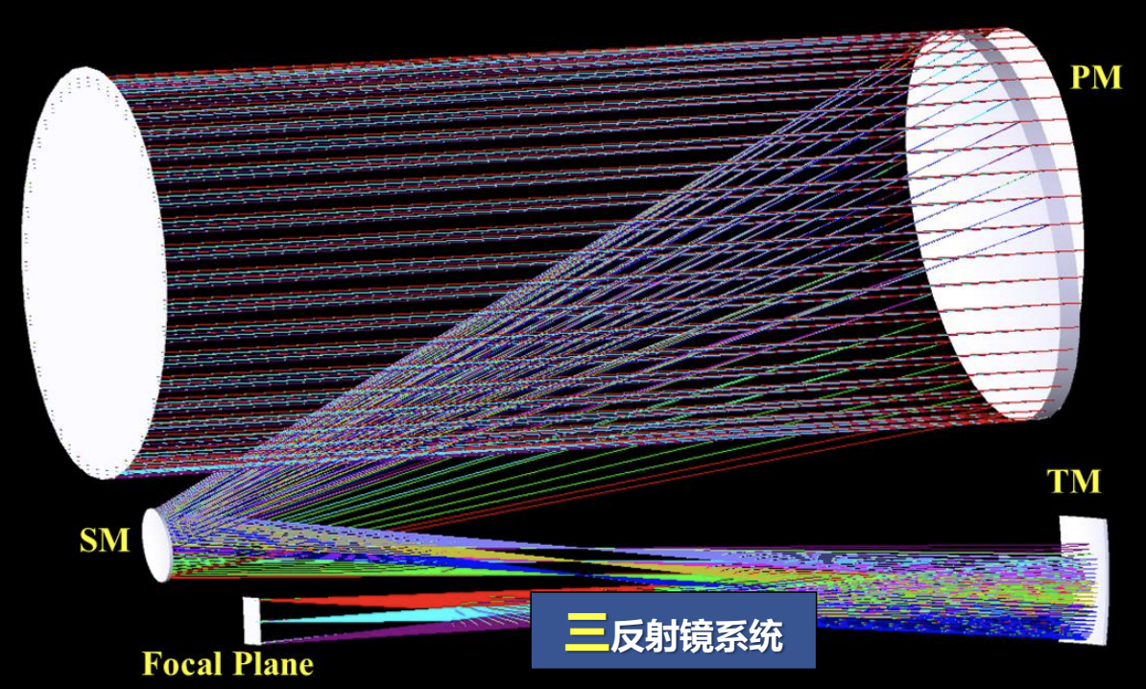
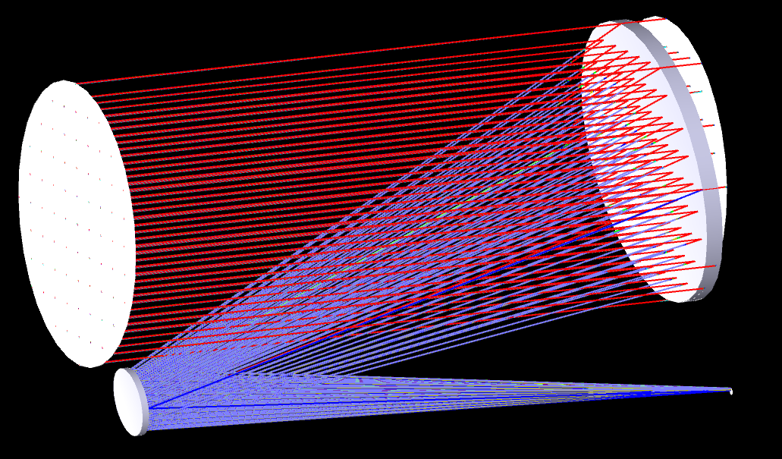
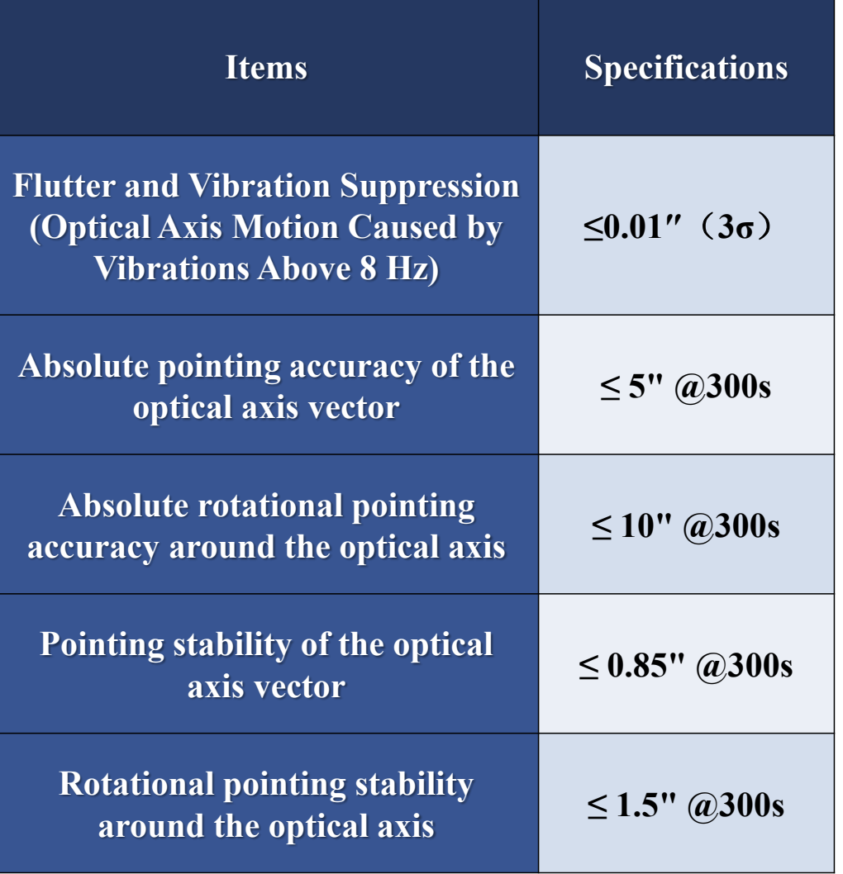
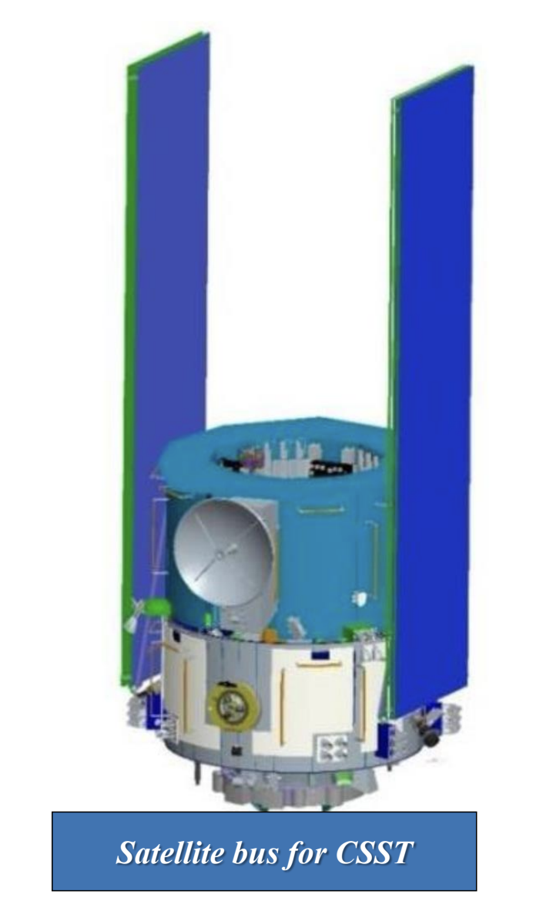
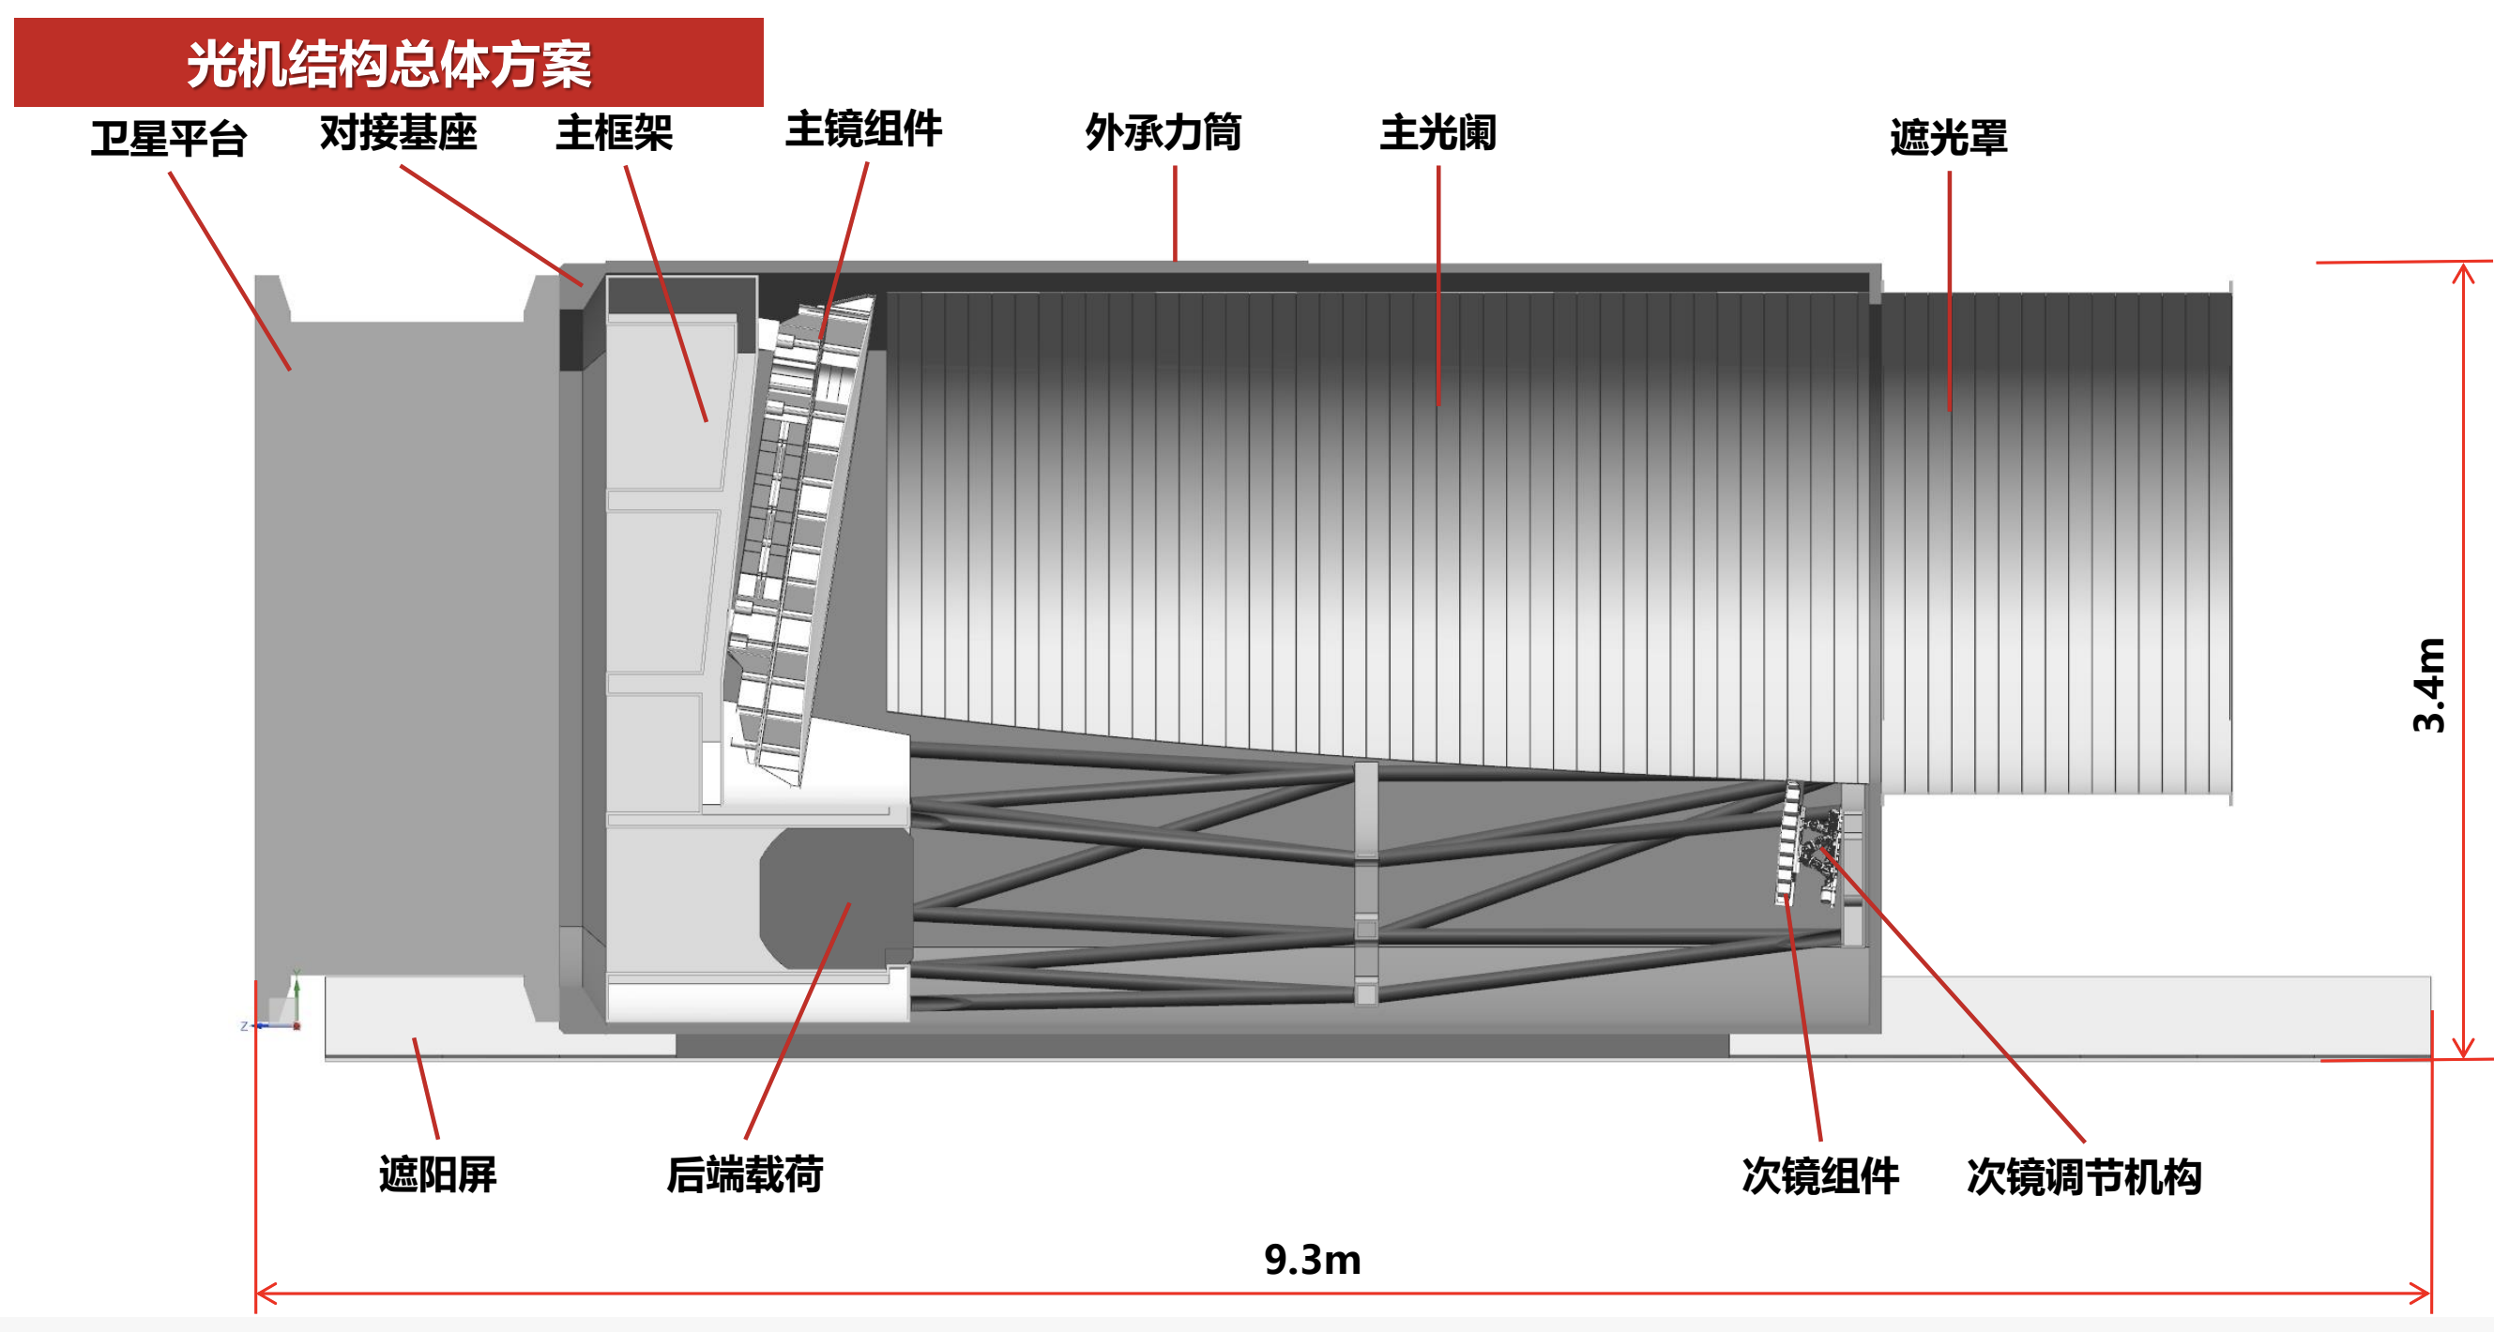
LOTUS’ Telescope & integrated flight confirguration
LOTUS: Off-axis 2 mirors
CSST：Off-axis 3 mirrors
LOTUS Instrument
“立卧合一”真空罐大门
“立卧合一”真空罐罐体

Slide 6
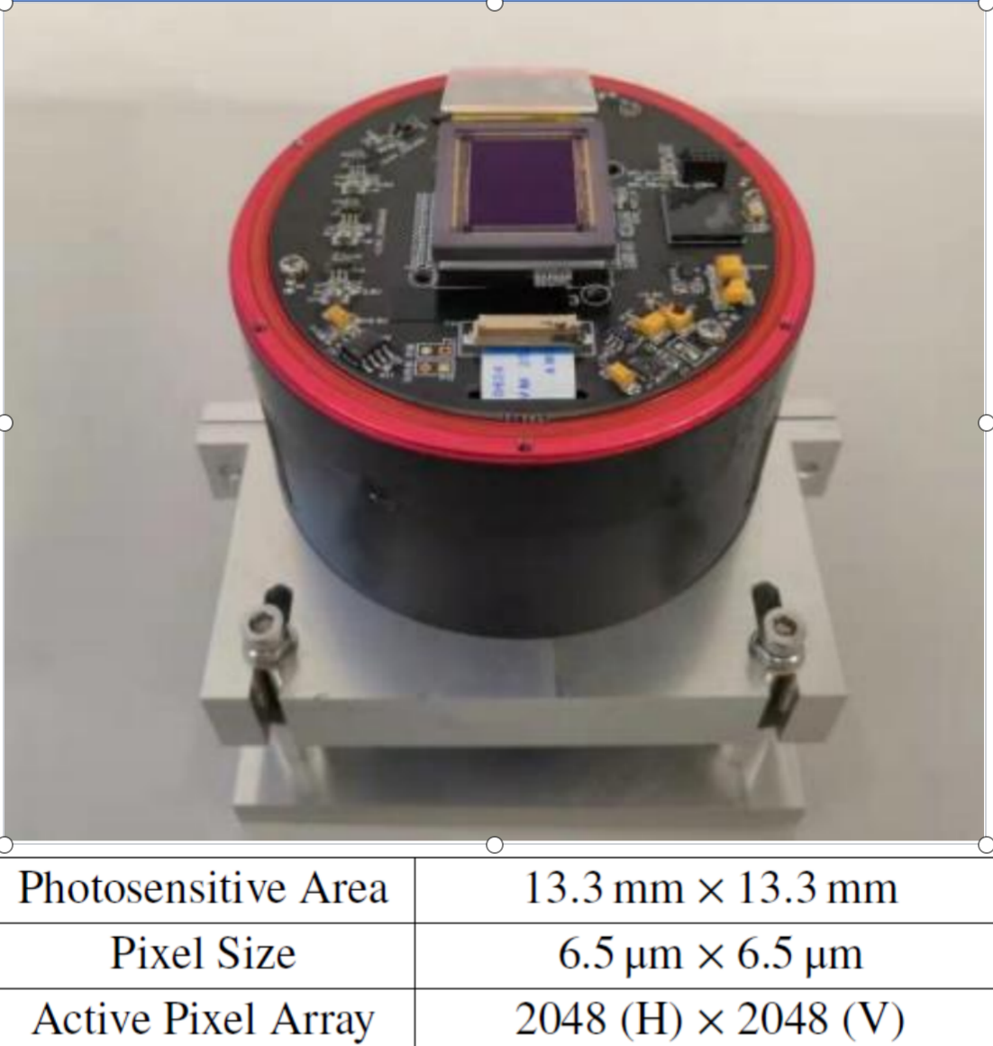
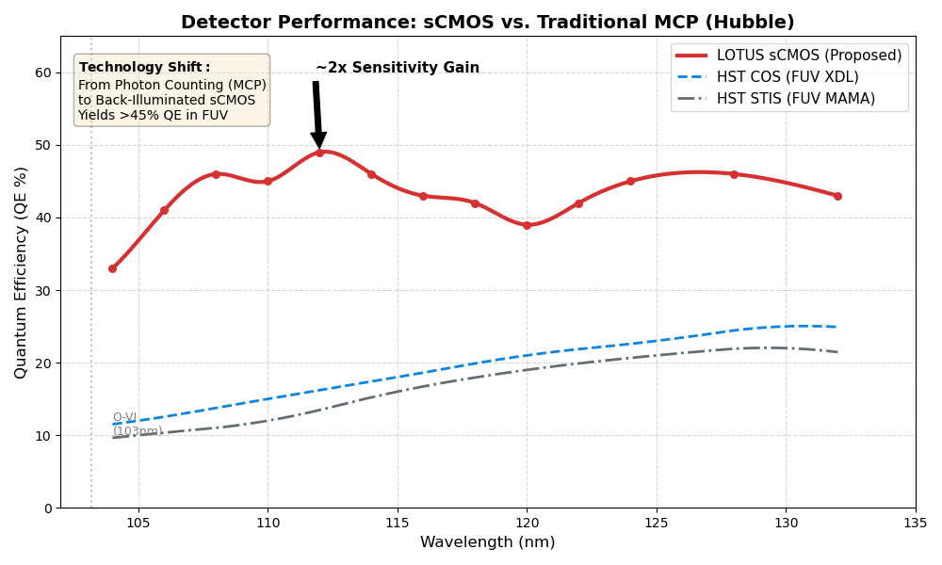
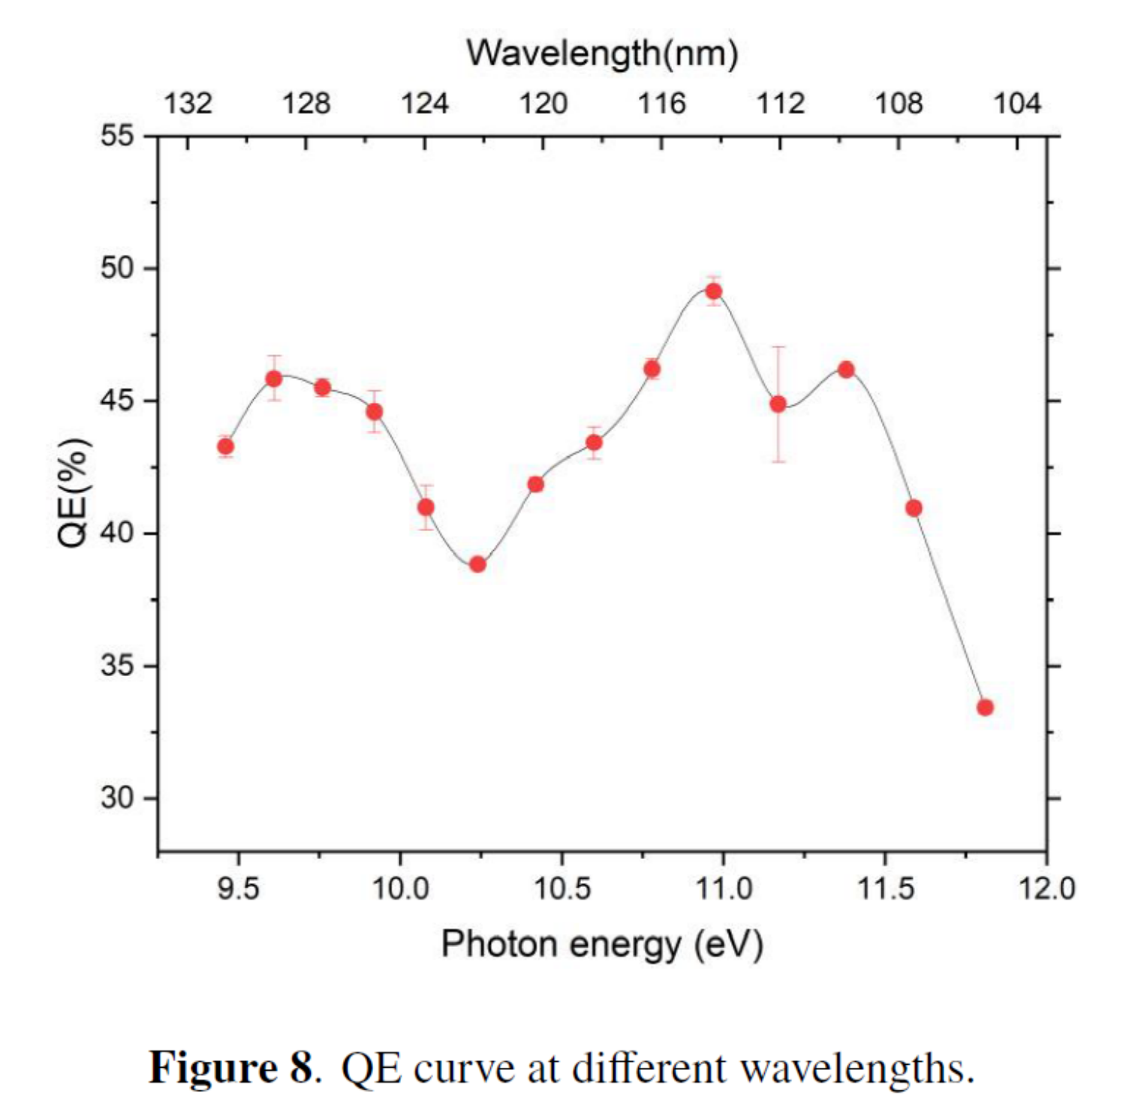
UV detectors: sCMOS vs MCP
Tetsuo Harada et al 2020 Appl. Phys. Express
LOTUS (sCMOS) ~50% QE, which effectively doubles the efficiency of HST's detectors.
HST uses Micro-Channel Plates (MCPs), their QE peaks at 20–25% and drops significantly below 115 nm
“立卧合一”真空罐大门
“立卧合一”真空罐罐体
Liu W., Ji Li et al 2022 JINST

Slide 7
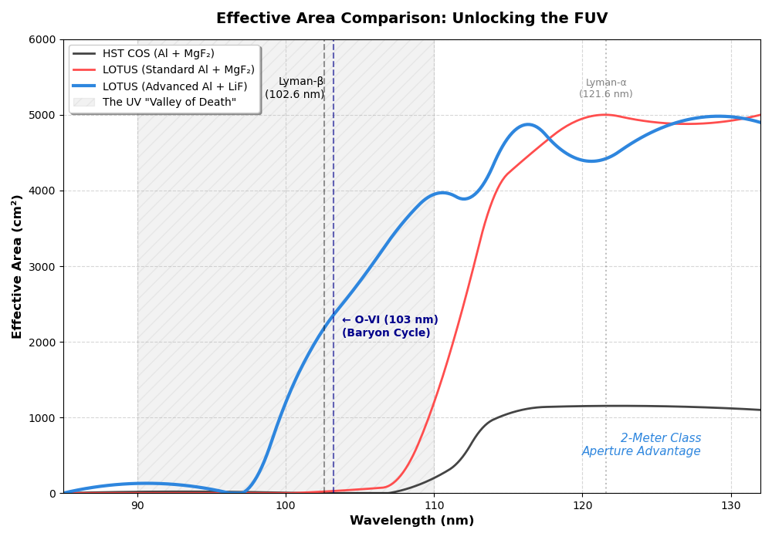
Dedicated FUV Sensitivity Performance
LOTUS:
Advnanced coating & Pulsor CMOS dector
Hubble is aging!

Slide 8
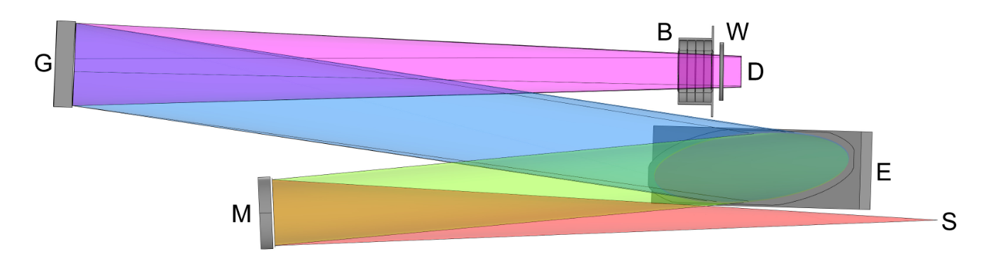
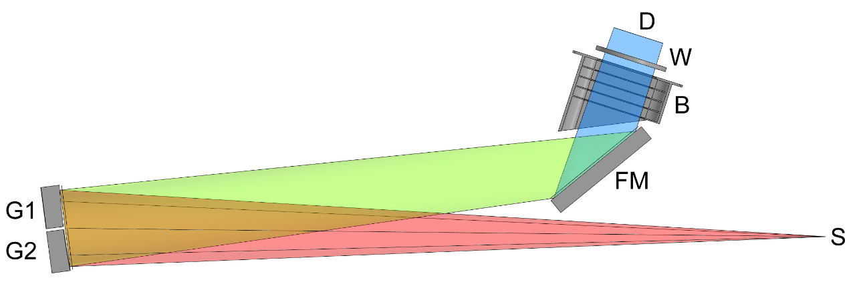
The Payload – Instrument Module
Design requirements:
Single Instrument, Multi-Mode
Mechanism: A high-precision Flip-Mirror switches between Survey (Imaging) and Physics (Spectroscopy)
"One slit, four answers" with Slit Wheel and Grating Turret
“Swiss Army Knife” plan
Sub-System | Wavelength | Slit | Resolution (R) | Detector | Key Science
Imager | 90–350 nm |  | N/A (Imaging) | sCMOS 4k x 2k | Galaxy morphology, Star formation regions
Spec Mode 1 | 90–350 nm | 2.0” | ~1,500 G1 | sCMOS 4k x 4k | Redshift surveys, Faint quasars
Spec Mode 2 | 90–180 nm | 0.5” | ~5,000 G2 | (Shared) | Stellar winds, O-VI absorption
Spec Mode 3 | 180–350 nm | 0.5” | ~5,000 G3 | (Shared) | Mg-II outflows, AGN monitoring
Spec Mode 4 | 90–350 nm | 01” | ~40,000 G4 | (Shared) | ISM chemical abundances, local bubble gas
“立卧合一”真空罐罐体
“立卧合一”真空罐大门

Slide 9
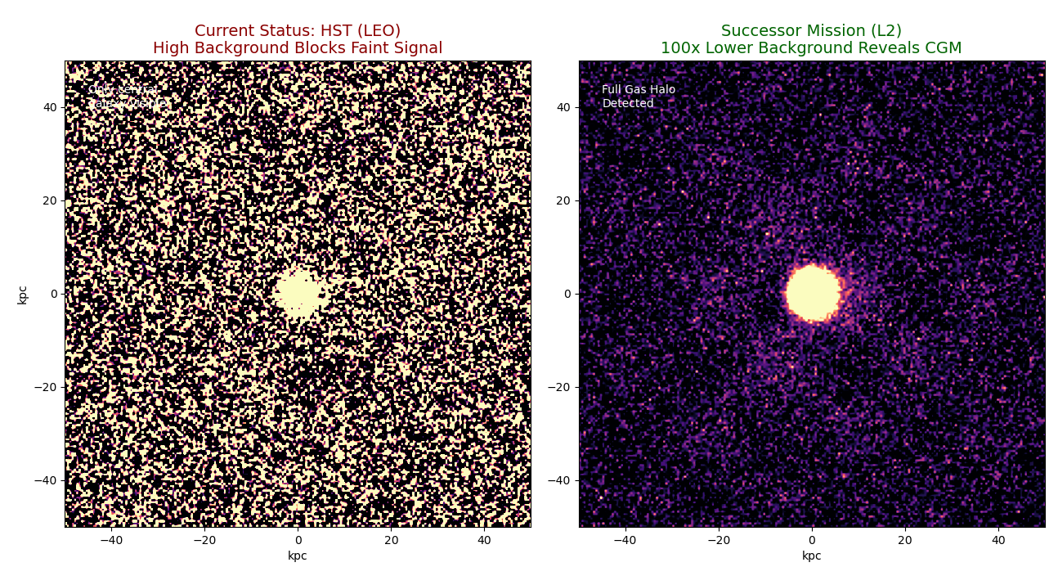
'Geocoronal Fog' effect
LEO: glowing H in Earth's upper atmosphere generates noise that buries the faint emission of the Cosmic Web.
L2: sky background drops by two orders of magnitude, allowing the LOTUS to explore the filamentary structure of the Circumgalactic Medium in mere hours rather than weeks.
For faint UV observations (specifically around Lα, moving a 2m telescope from LEO to L2 is roughly equivalent to building a 20m telescope in LEO！
“立卧合一”真空罐大门

Slide 10
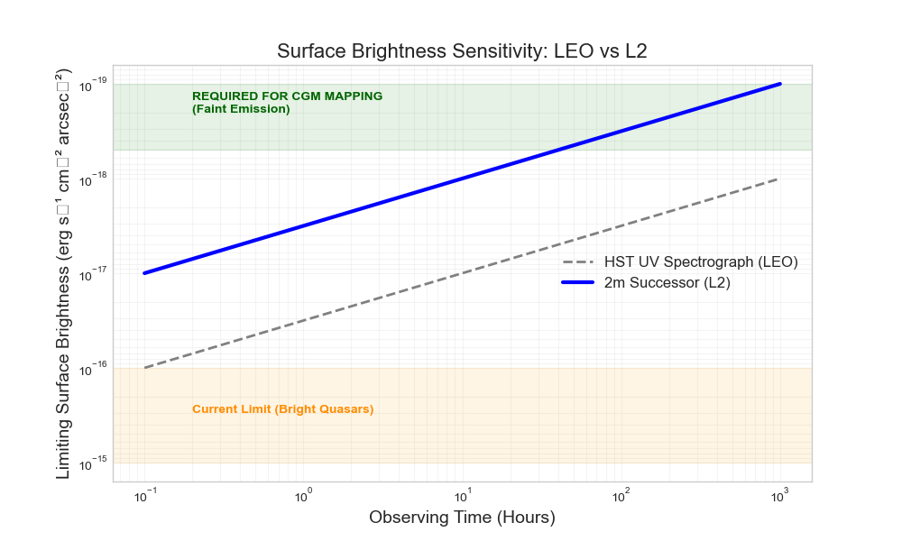
Science aspiration for CGM: Transforming UV astronomy
LUTUS enters the discovery space in under 10 hours of exposure!
HST hits a 'noise floor', ~ 10³ hours needed to map the faint structure
“立卧合一”真空罐大门

Slide 11
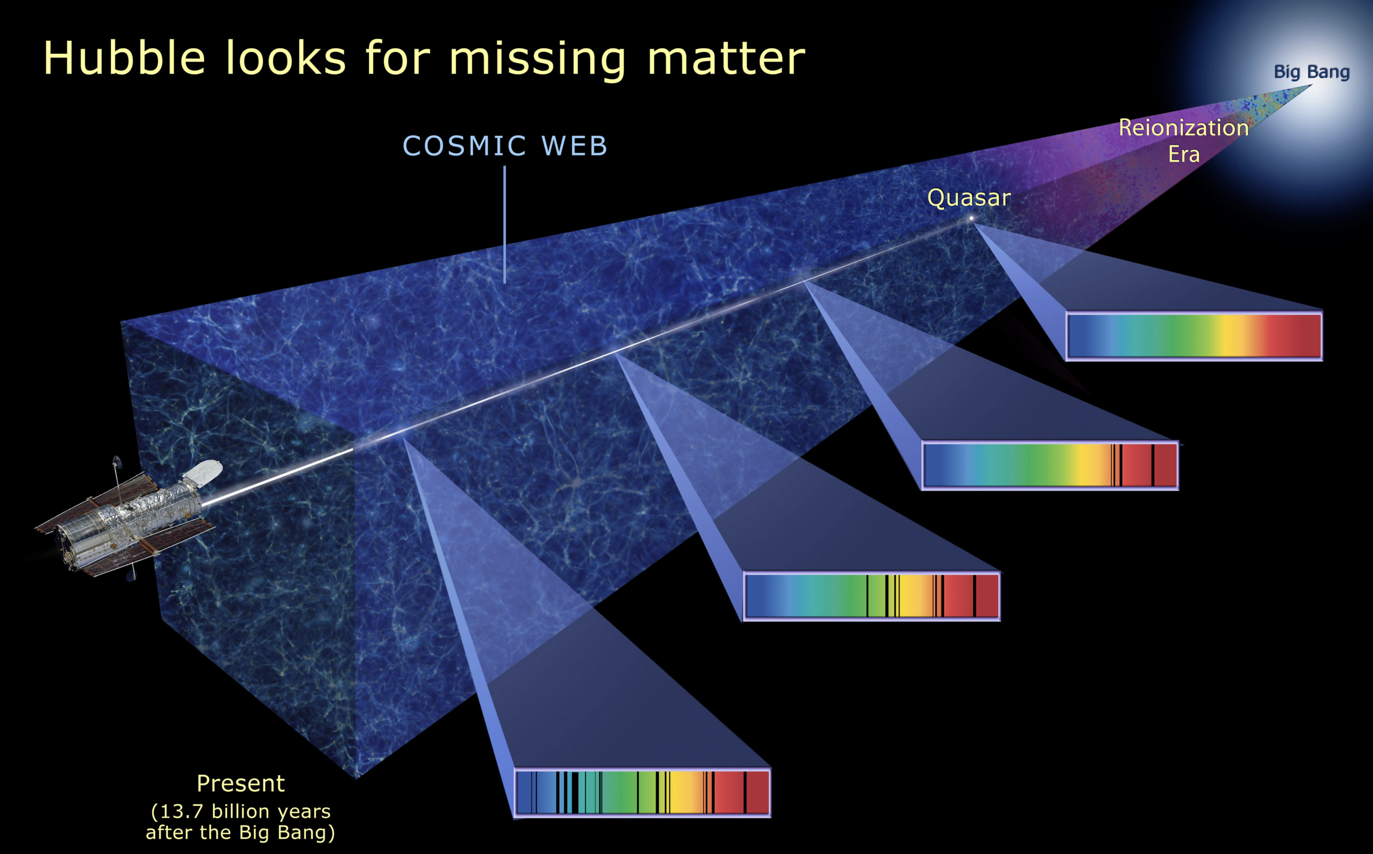
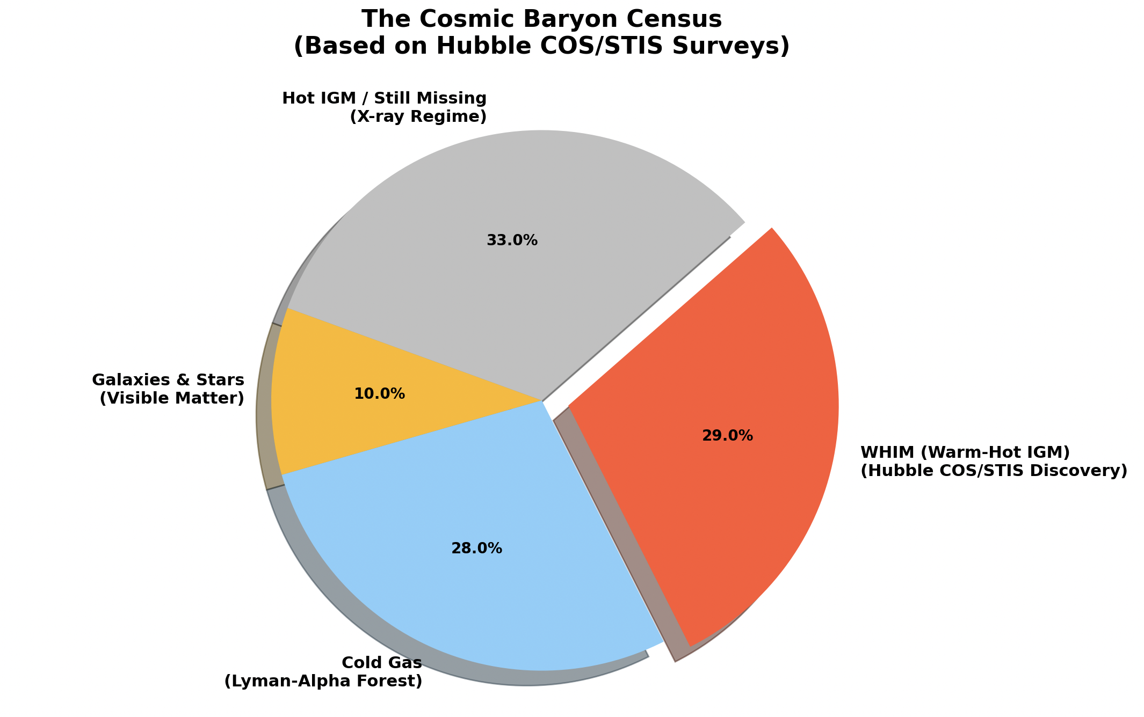
Unlocking Cosmic Web in Hydrogen Emission
CGM is the "Hidden Half" of galaxies
Tracing the Flow: how it behaves?
Is it falling in to fuel new star formation? (Accretion)
Is it being blown out by supernovae? (Feedback)?
See the glowing Web with kinematics
Hubble has made countless discoveries, its single greatest achievement in UV spectroscopy is the mapping of the "Cosmic Web" and the Intergalactic Medium (IGM)
“立卧合一”真空罐大门

Slide 12
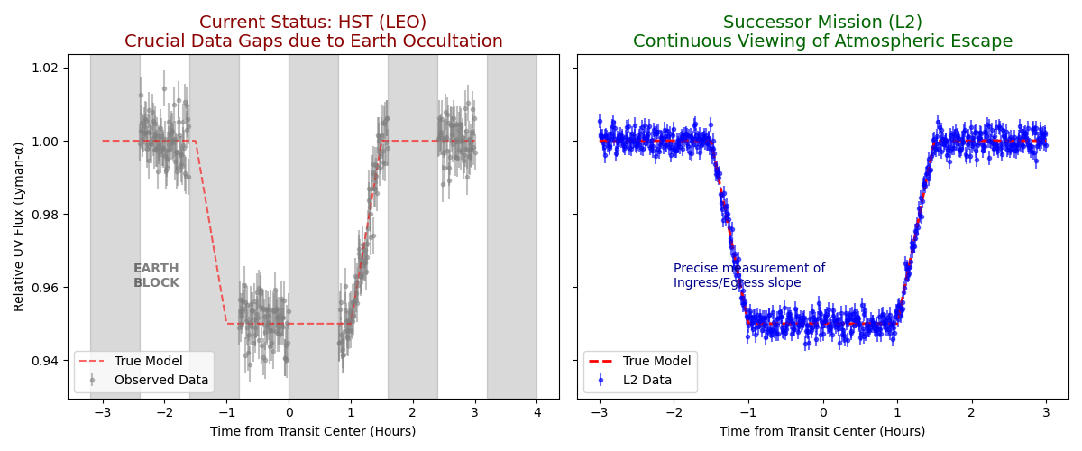
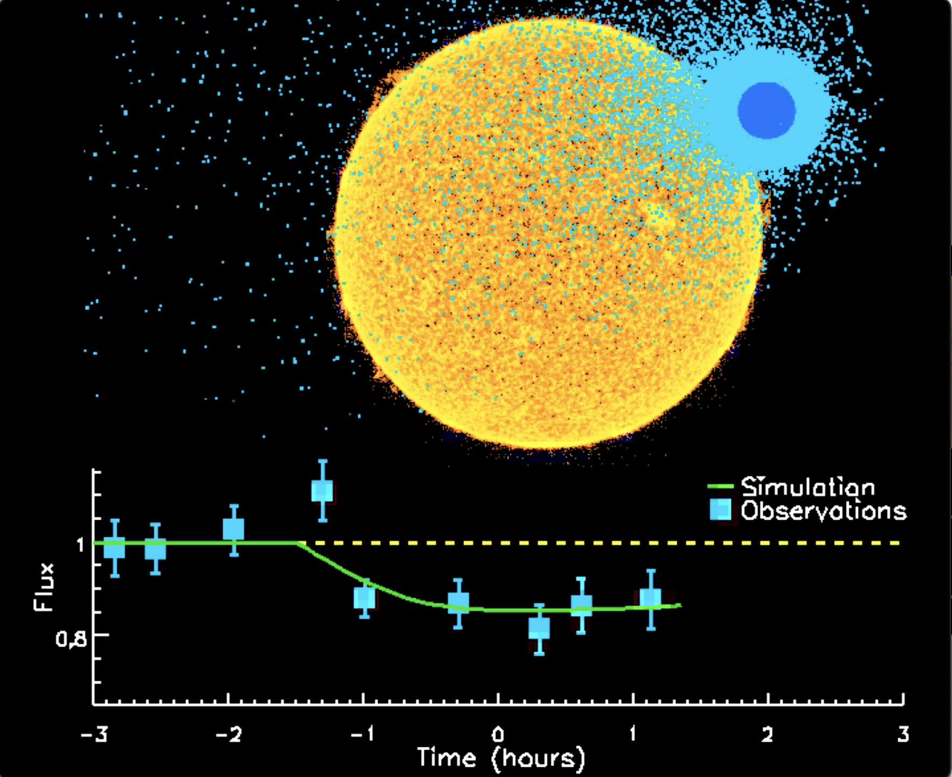
Science Aspiration for Atmospheric Escape
Atmospheric escape creates a massive, comet-like tail around the planet, stretching the transit duration. In LEO , Earth occultations chop the data into pieces, often forcing us to miss the critical ingress or egress where the atmosphere is most visible. LOTUS provides a continuous baseline, allowing us to precisely measure the shape of the gas tail, infering the mass-loss rate

Slide 13
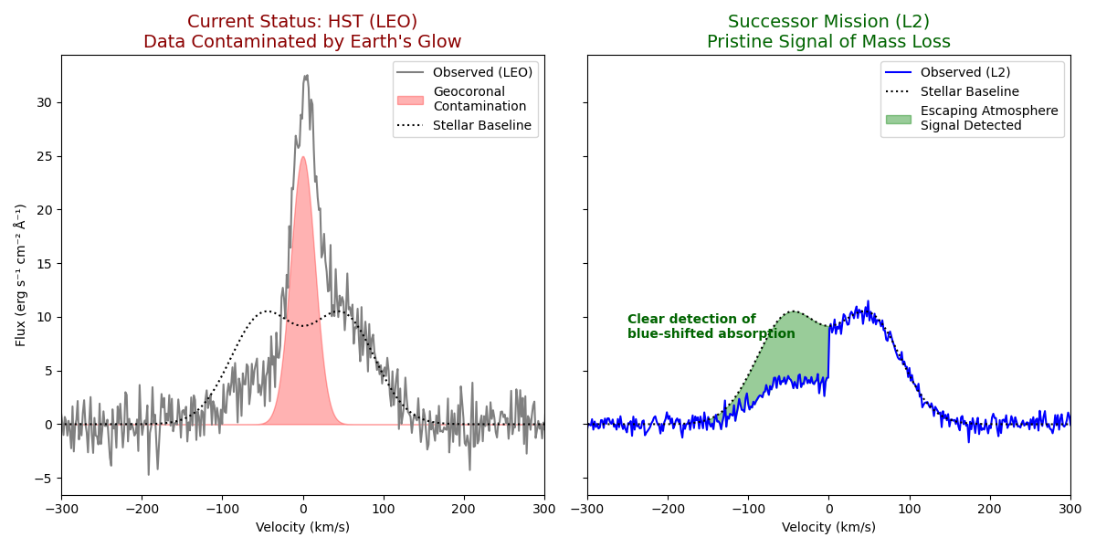
Science Aspiration for Exoplanet Atmospheres
To measure the mass-loss rate, we must observe the Lα line. In LEO, the 'Geocorona' contaminates the center of the line, burying the signal. At L2, the sky is dark. We can clearly resolve the 'blue-shifted' absorption, which tells us exactly how fast the atmosphere is escaping toward space

Slide 14
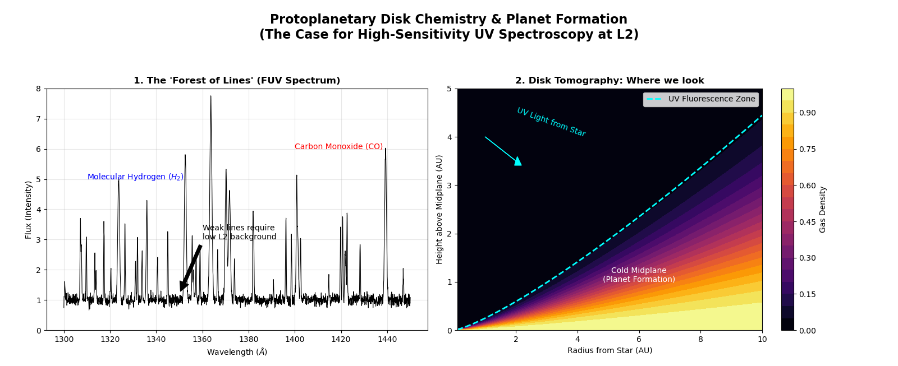
Science Aspiration for The Origin of Life's Building Blocks
How much water and organic material is available in "baby planets?

Slide 15
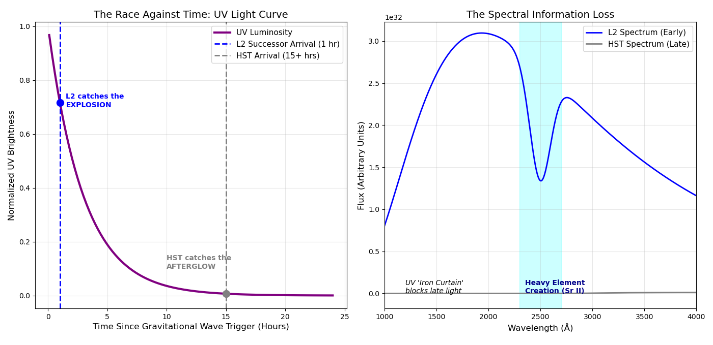
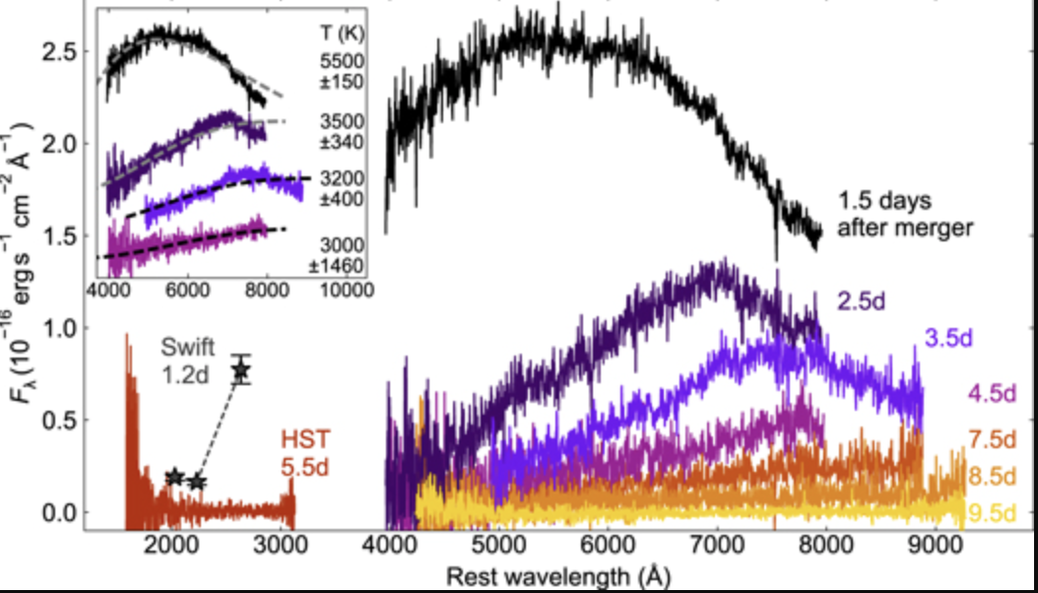
Science Aspiration for Gravitational Wave "Early Warning"
The UV data from HST (S/N < 1, essentially an upper limit)
Chornock et al. (2017)
Kilonova ejecta move at relativistic speeds (0.2c), smearing all spectral features into broad waves. High resolution is wasted here. A Successor Mission needs a 'Rapid Response' Low-Resolution Mode (R∼100) to capture the broad UV absorption of newly synthesized heavy elements before they cool and vanish

Slide 16
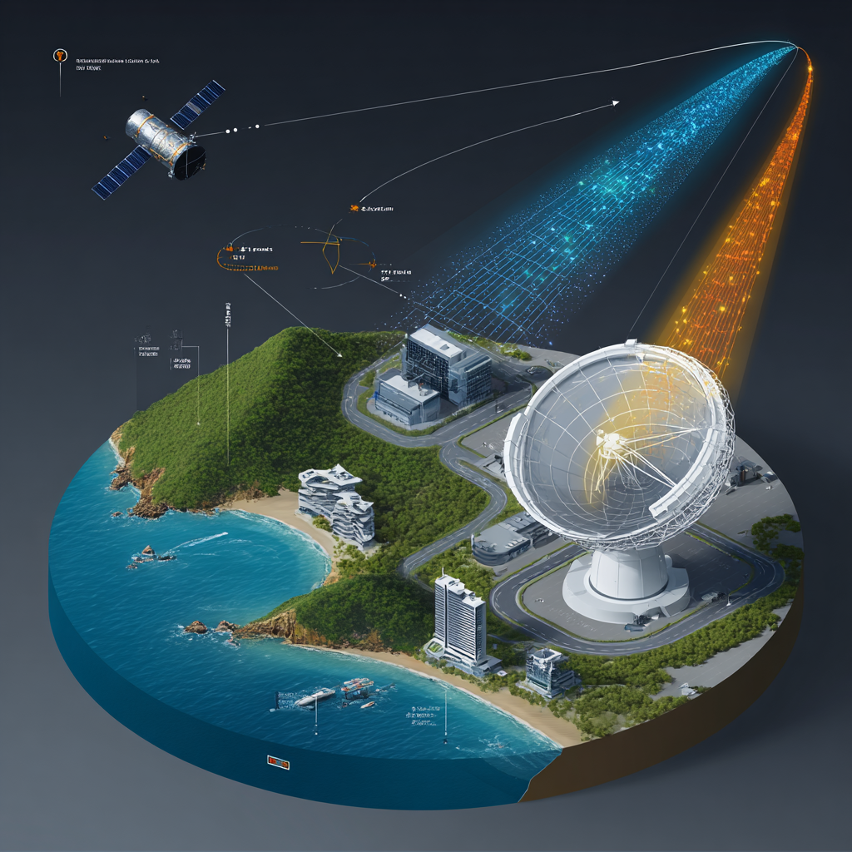
Integrated Ground Segment & Data Flow
Science Operation Center in Hong Kong
Construct a dedicated deep-space antenna housed in a protective Radome to handle the high-speed science data downlink
Meanwhile, the mission Command and Control will be handled via the existing Mainland deep space network
“立卧合一”真空罐罐体
This architecture allows the Hong Kong center to focus entirely on data processing, archiving, and serving the global science community—functioning effectively as the 'Hubble Institute' of the East."
“立卧合一”真空罐大门

Slide 17
Conclusion
While HST is legendary, it suffers Low Earth Orbit (LEO) fundamental limitations for UV spectroscopy:
It is blocked by Earth for roughly half of every 90-minute orbit.
It struggles with high "geocoronal" background (a glow of hydrogen atoms in Earth's upper atmosphere) that drowns out faint UV signals.
A 2m UV telescope at L2, LOTUS would sit in the dark, cold vacuum far from Earth's glow, offering continuous viewing and a stable thermal environment. This efficiency gain (~2-3x better than LEO) effectively makes a 2m telescope at L2 as powerful as a 4m telescope in LEO, or roughly equivalent to building a 20m telescope in LEO for faint FUV observations.
The accomplishment of CSST, leaves behind a wealth of engineering resources for a new mission, LOTUS, and offers a promising pathway toward realizing a dedicated and cost-effective space UV observatory in a less 10 year timeline!
LOTUS initiative wlecomes more international communities to join the efforts to promote the powerful new capabilities for exploring the far-ultraviolet universe！
“立卧合一”真空罐罐体
“立卧合一”真空罐大门

