Slide 1
Quasar Surveys in China and Quasar Candidate Selections in Southern Sky
7th China - Chile Bilateral Astronomy Conference (CCBC2026), HKU, 2026/01/05-09
Xue-Bing Wu (DoA & KIAA, Peking University)
Collaborators: Yuming Fu (Leiden), Yuxuan Pang (UCAS), Rui Zhu (PKU), Bing Lyu (PKU), Su Yao (NAOC), Junjie Jin (NAOC), Yanli Ai (SZTU), Feige Wang (Michigan), Jinyi Yang (Michigan), Weimin Yi (YNAO), Qian Yang (CfA), Wenwen Zuo (SHAO), Ran Wang (PKU), Yanxia Zhang (NAOC), Zhiying Huo (NAOC), Linhua Jiang (PKU), Xiaohui Fan (Arizona), …

Slide 2
Content
LAMOST quasar survey
Bright high-z quasar survey
A survey of quasars behind the Galactic Plane
CatSouth: QSO candidates in southern sky
CSST quasar survey

Slide 3
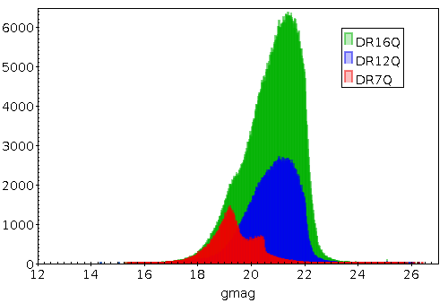
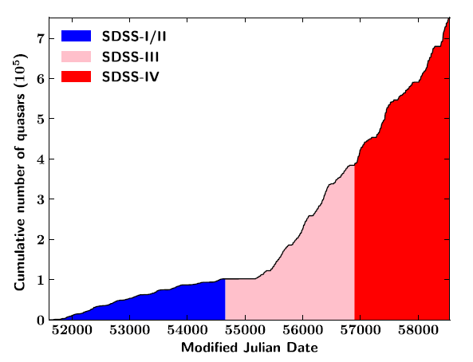
Quasar surveys before DESI
Representative surveys | Numbers
The Bright Quasar Survey (BQS; Schmidt & Green, 1983) | 114
The Large Bright Quasar Survey (LBQS; Hewett, Foltz, & Chaffee, 1995) | 1,000
The 2dF Quasar Redshift Survey (2QZ; Croom et al. 2004) | 23,338
The 7th data release of the SDSS Quasar Catalog (DR7Q; Schneider et al. 2010) | 105,783
SDSS DR12Q (Pâris et al. 2017) | 297,301
SDSS DR14Q (Pâris et al. 2018) | 526,356
SDSS DR16Q (Lyke et al. 2020) (contains candidates that are not visually inspected) | 750,414
LAMOST Quasar Survey (Jin, Wu et al. 2023) | 31,866
(Lyke et al. 2020)

Slide 4
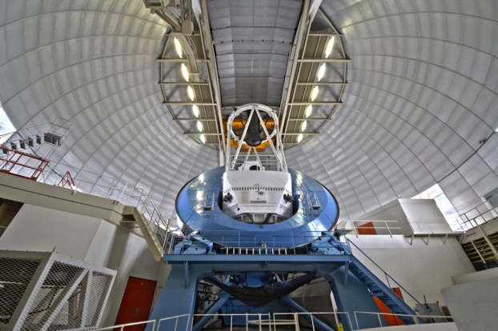
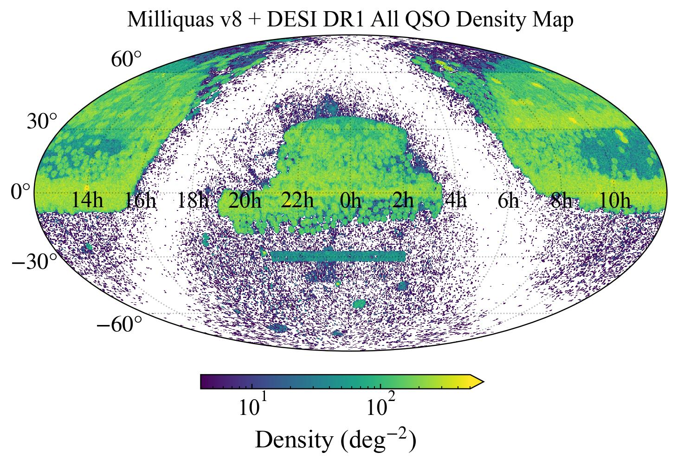
New record of quasar number with DESI
Milliquas v8 + DESI DR1 include more than 2 million spectroscopically identified QSOs
Still inhomogeneous over the sky
DESI, SDSS mainly cover the northern sky and avoid the low Galactic latitude regions
DESI quasar sample is incomplete at bright end
Lack quasars behind the Galactic Plane
Lack quasars in southern sky
Equatorial coordinates

Slide 5
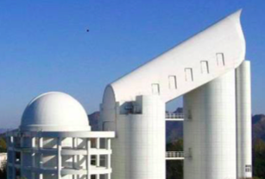
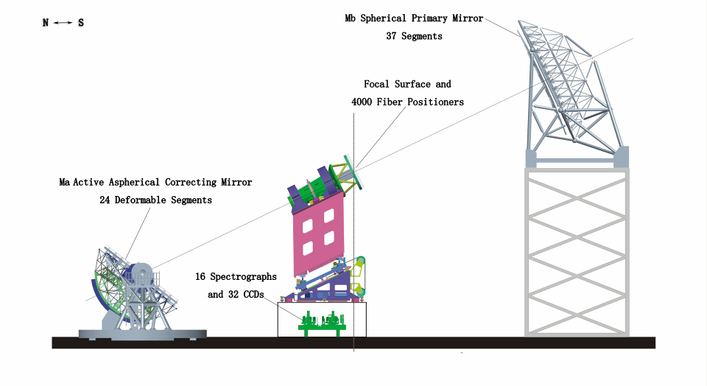
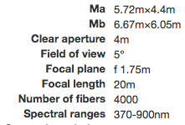
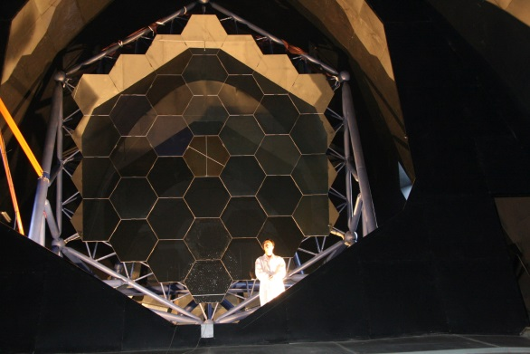
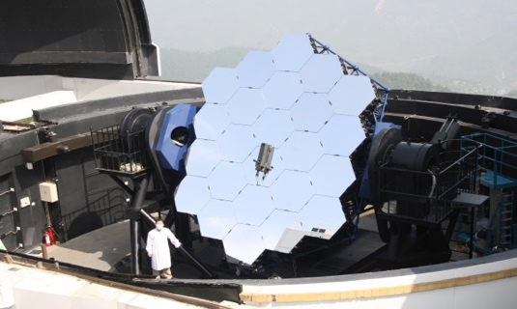
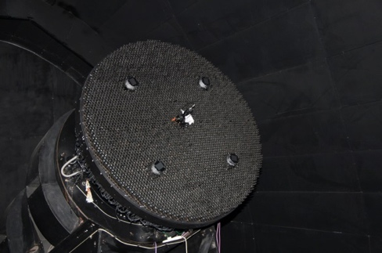
LAMOST (Guo Shoujing Telescope, 2008)
1. LAMOST Quasar Survey
http://www.lamost.org
Mb
6.1m
FP
1.7m
Ma
4.9m

Slide 6
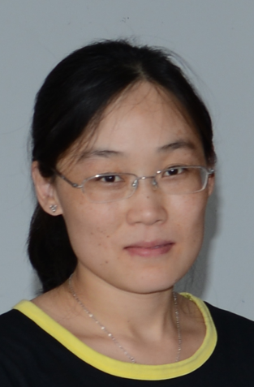



LAMOST Quasar Survey
艾艳丽
Ai, Yanli
（SZTU）
LQS has identified 67521 quasars (40293 independently discovered, 29513 new)
  DR1: Ai, Wu, Yang, et al., 2016, AJ, 151, 24 (Paper I)
    3921 quasars identified, 1180 new
  DR2-DR3: Dong, Wu, Ai, et al., 2018, AJ, 155, 189 (Paper II)
    19935 identified, 12126 independent, 8100 new
  DR4-DR5: Yao, Wu, Ai, et al., 2019, ApJS, 240, 6 (Paper III)
    19253 identified, 11458 independent, 8162 new
  DR6-DR9: Jin, Wu, Fu, et al., 2023, ApJS, 265, 25 (Paper IV)
    13066 identified, 7102 independent, 6685 new
  DR10-DR12: Lyu, Wu, Jin, et al., 2025, ApJS, in press (Paper V)
    11346 identified, 8427 independent, 5386 new
董晓怡
Dong, Xiaoyi
姚苏
Yao, Su
(NAOC)
金骏杰
Jin, Junjie
(NAOC)
吕兵
Lyu, Bing
(PKU)

Slide 7
Quasar target selections
Point-sources in SDSS images （exclude galaxies）and 16< i_{mag}<20
Optical-infrared color-color selections（exclude stars）
  SDSS/UKIDSS: Y-K > 0.46(g-z) + 0.82 or J-K > 0.45(i-Y-0.366) (Wu & Jia 2010)
  SDSS/WISE: w1-w2>0.57 or z-w1>0.66(g-z)+2.01 (Wu et al. 2012)
Data-mining selections
  Support vector machine (SVM) classifiers (Peng et al. 2012)
  Extreme deconvolution method (XDQSO, Bovy et al. 2011)
  Kernel density estimator (KDE, Richards et al. 2009)
Supplemented via multi-wavelength (optical-X-ray/radio) data matching Objects with SDSS photometry in the X-ray sources of XMM-Newton, Chandra, ROSAT and radio sources in FIRST (Becker et al. 1995) and NVSS

Slide 8
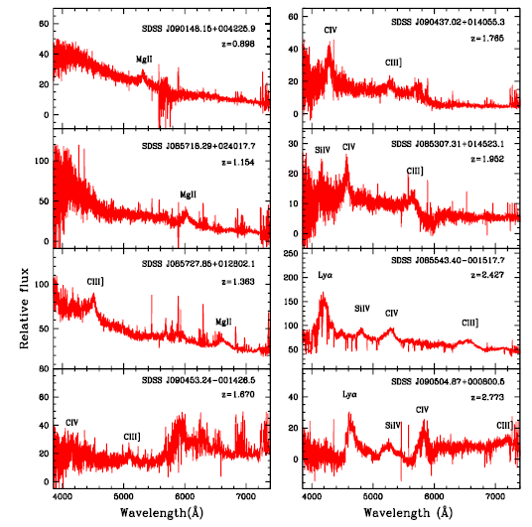
Eight new quasars discovered by LAMOST in one shot during the 2009 commissioning (Wu et al. 2010)

Slide 9
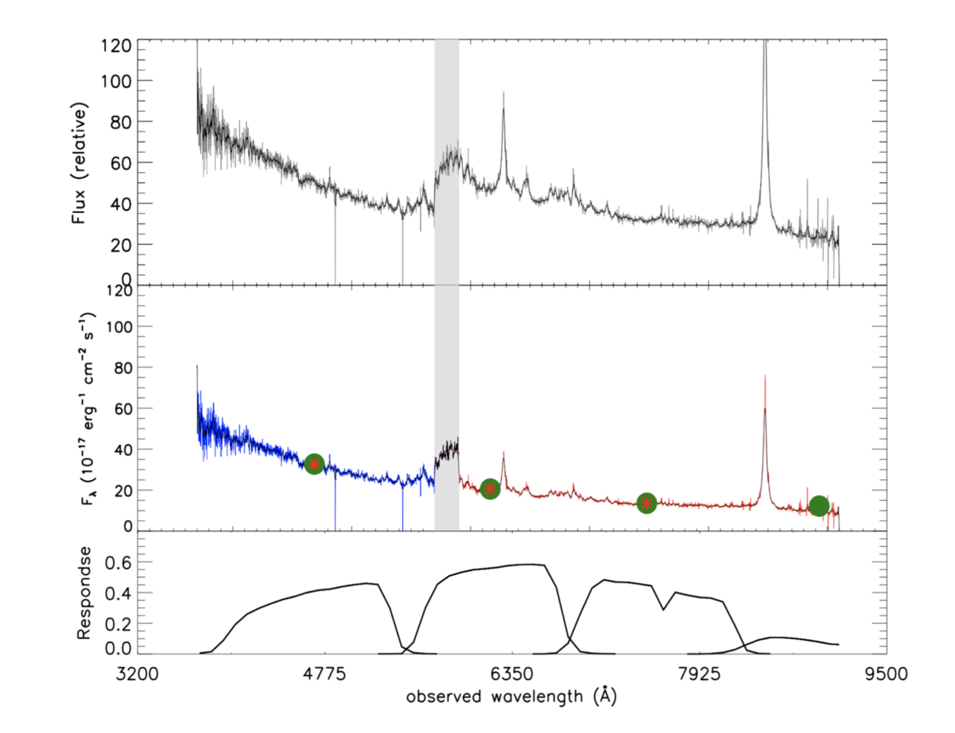
Absolute flux calibration (LAMOST blue + red spectra)
Connection defect
Original spectrum only with the relative flux calibration.
The spectrum after the absolute flux-calibration.
Shape of continuum conforms to the power-law
filter curves for the SDSS in g, r, i, z-band.
(DR6-9, with SDSS)
(DR10-12, with ZTF)

Slide 10
Emission line measurements

Slide 11
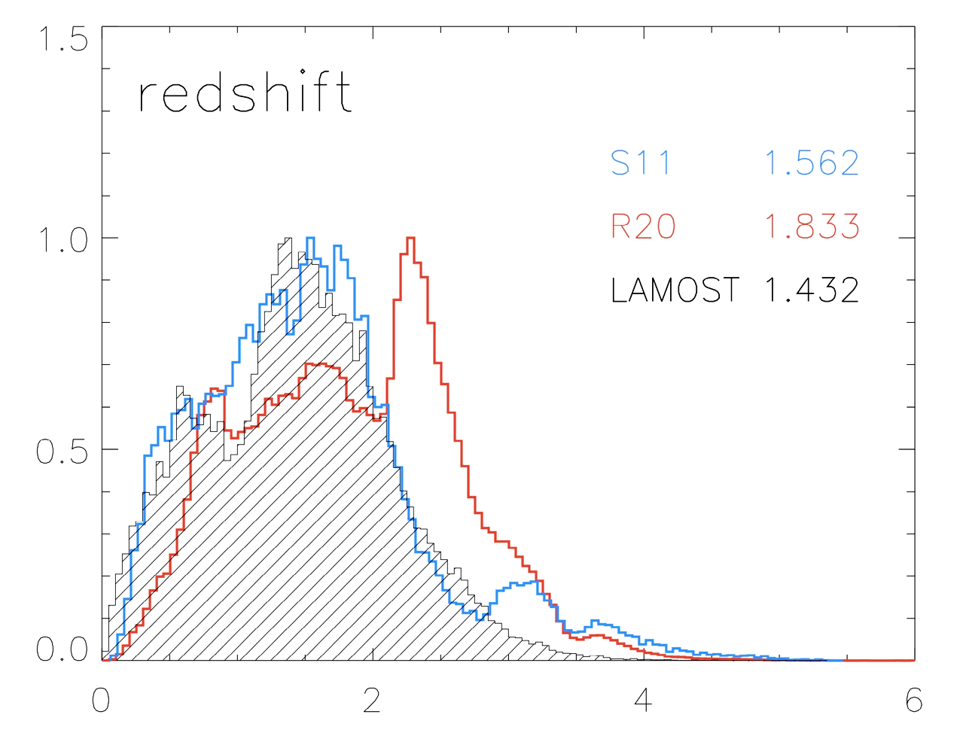
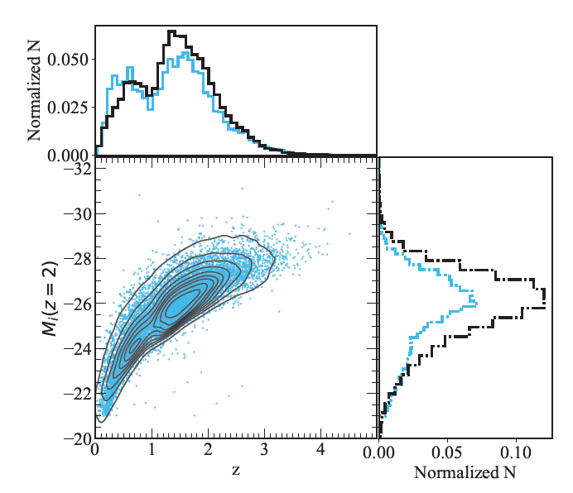
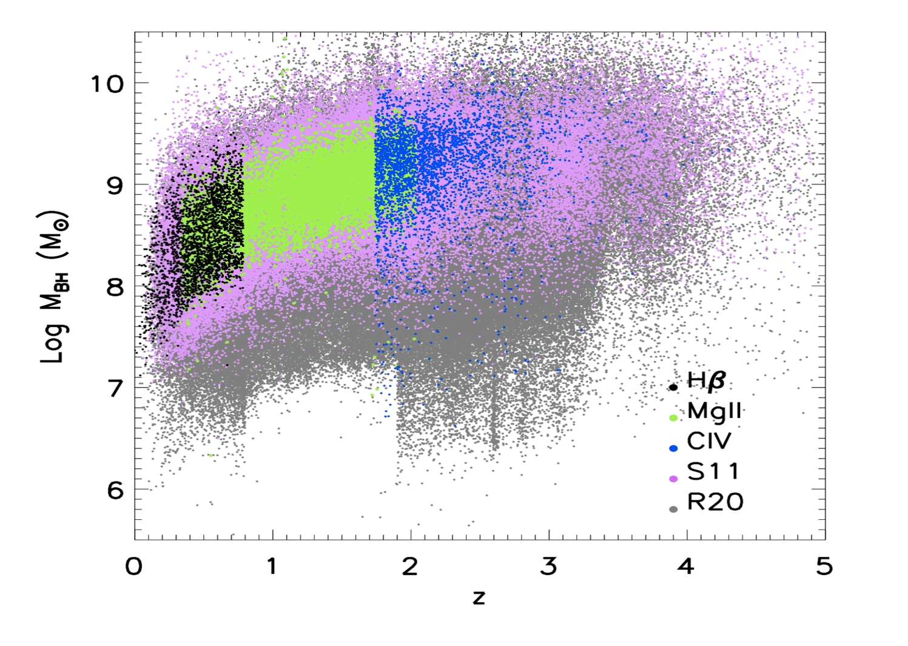
Redshifts and BH masses of LAMOST QSOs
DR 6-9
DR 10-12
Jin, Wu, et al. (2023,ApJS)
Lyu, Wu, et al. (2025,ApJS)

Slide 12
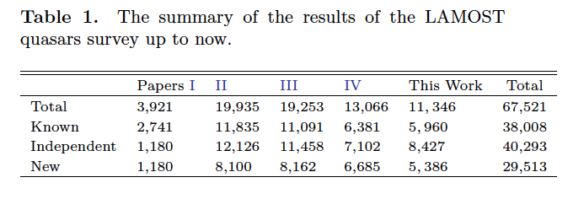
Sky distributions in Equatorial coordinates
DR1-5 data: https://explore.china-vo.org/article/20190107155838
DR6-9 data: https://nadc.china-vo.org/data/article/20230111164332
Lyu, Wu, et al. (2025,ApJS, in press)
Quasars in DR 10-12
Quasars in DR 1-12

Slide 13
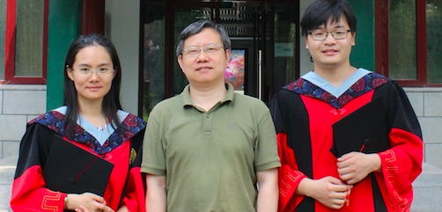
2. Bright High-z Quasar Survey
About 300 at z>5 ; 100 at z>5.7; 1 at z>7 （before 2016）
An obvious dip at z~5.5 !

Slide 14
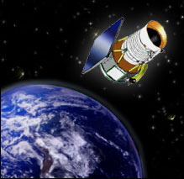
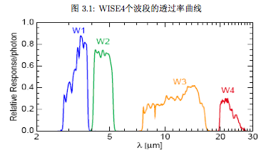

Select high-z quasar candidates with SDSS-WISE
Because WISE detection rate of z>4.5 quasars is 70%, using WISE can help find z~5 quasars if the revised selection criteria adopted
QSO
Star
Star
QSO
WISE 40cm
Mid-IR
(Wang F., Wu, X.-B., et al. 2016, ApJ)
Feige Wang (UMich)
Hubble Fellow 2019

Slide 15
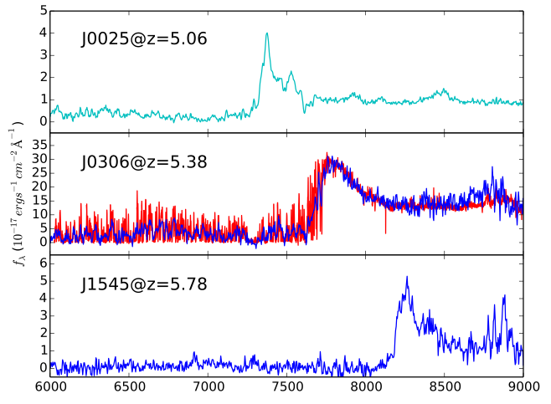
SDSS-WISE High-z Quasar Candidates
-->76 new luminous quasars
MMT(6.5m)
Magellan(6.5m)
Known quasars
Lijiang 2.4m
(Wang F., et al. 2016, ApJ)

Slide 16
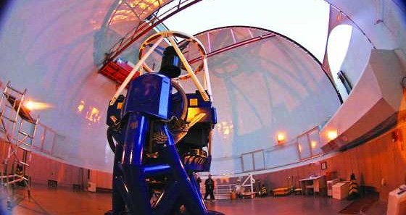
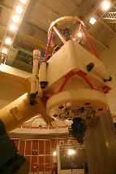
Bright High-z Quasar Survey
Discovered 100+ z~5 quasars
All z>5 quasars
z>5 quasars with z_{AB}<20.5
New quasars discovered by us before 2017
J0100+2802
The most luminous quasar at z>6
(Wu+2015, Nature)

Slide 17
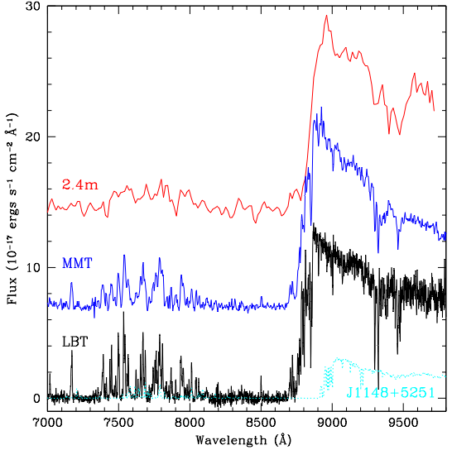
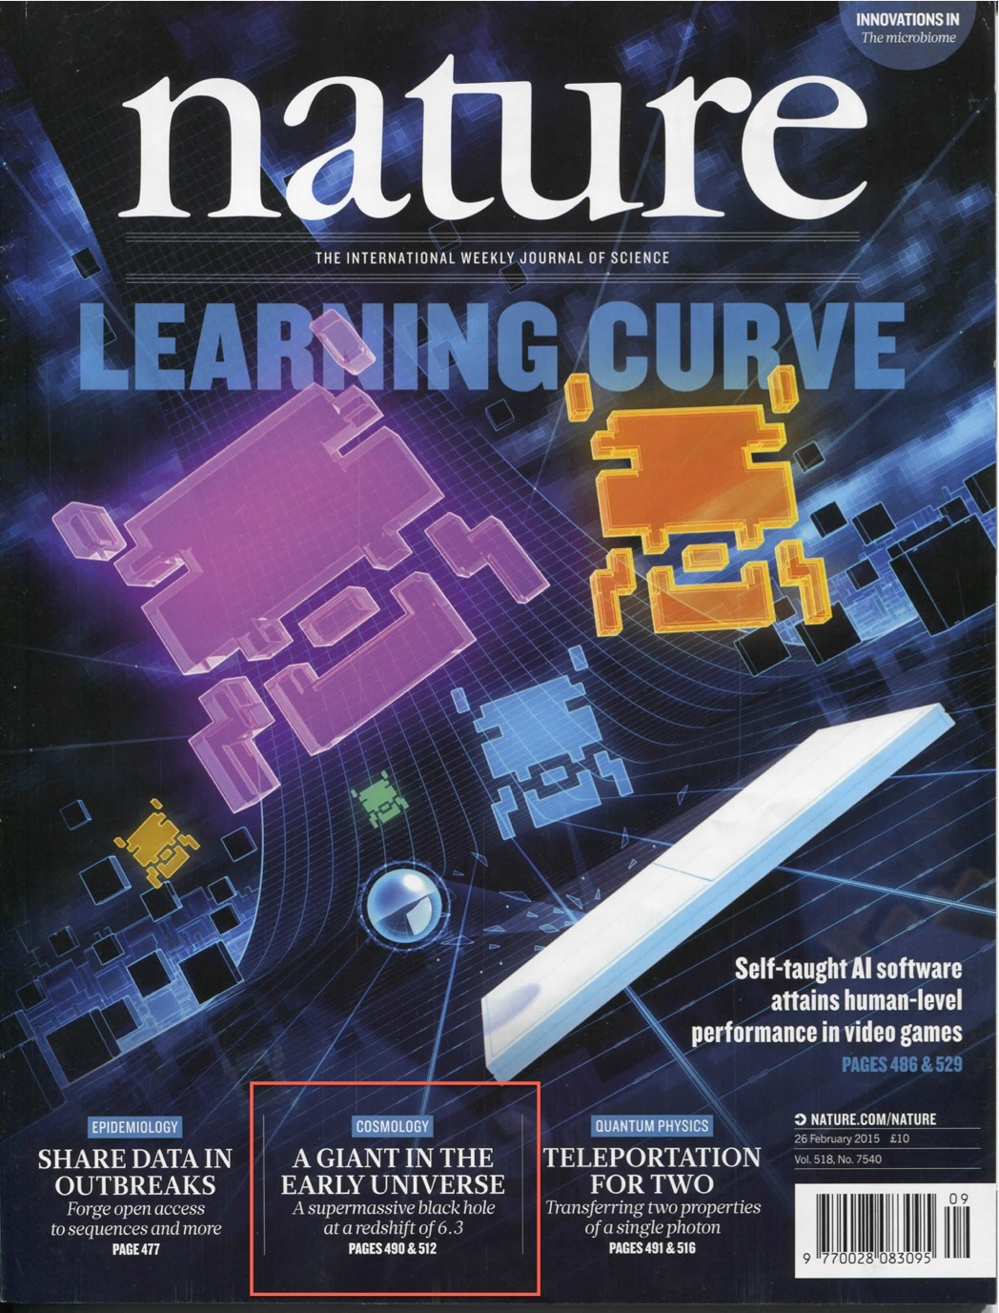
The most luminous quasar at z>6
J0100＋2802 （first spectrum on Dec. 29, 2013 with 2.4m LJT）
z=6.30
(6.5米)
(2*8.4米)
Wu, Wang, Fan, et al. (2015, Nature, 518, 512 ;
>700 citations!)

Slide 18
Near-IR Spectroscopy (Jan.-Oct., 2014)
LBT(2*8.4m; Jan.)
Gemini
(8.1m; Aug.)
Magellan in Chile
(6.5m; Oct.; R~6000,
S/N>30)
MgII FWHM ~ 5130 km/s
L₃₀₀₀~3.15E47 erg/s
BH mass ~ 12 billion solar masses !
Confirmed by JWST (10h) & VLT(11h) observations （Eilers+ 2023)
J
H
K
Wu, Wang, Fan, et al. (2015)

Slide 19
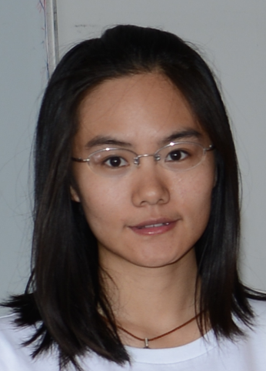
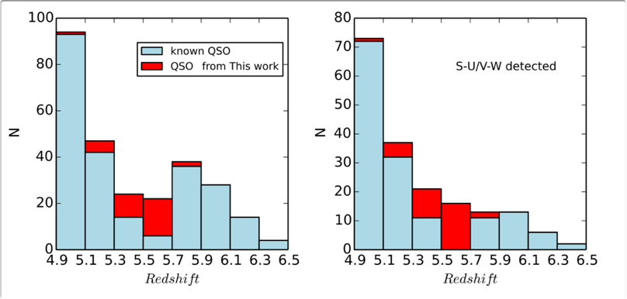
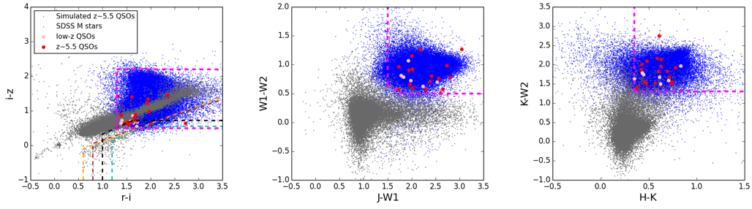
A new z~5.5 quasar survey based on SDSS-ULAS/VHS/UHS-WISE
In a ~ 5000 square degree field, z < 20.5 mag; SDSS; UKIRT InfraRed Deep Sky Surveys - Large Area Survey(ULAS); VISTA Hemisphere Survey(VHS); WISE
Extended sample
  in UKIRT Hemisphere Survey (UHS, J-band) area; SDSS - UHS ~ 8000 deg^2; + Pan-STARRS1 (PS1) data
We have discovered 26 new z~5.5 quasars; 15 more z~5.5 quasars from Pan-Starrs1（Yang J., et al. 2017; 2018）
Jinyi Yang
AP in UMich
Since 2024
Yang J. et al. (2017, AJ)

Slide 20
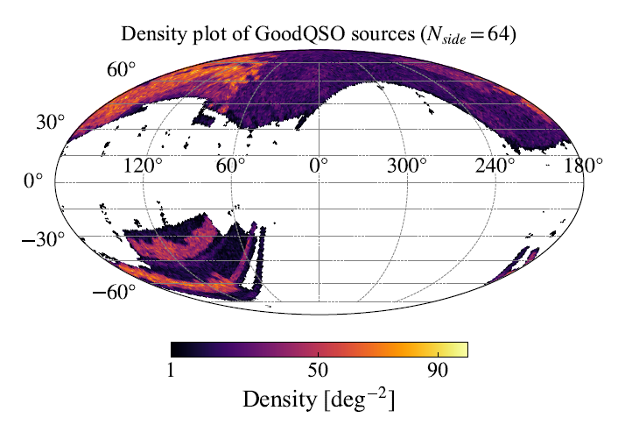
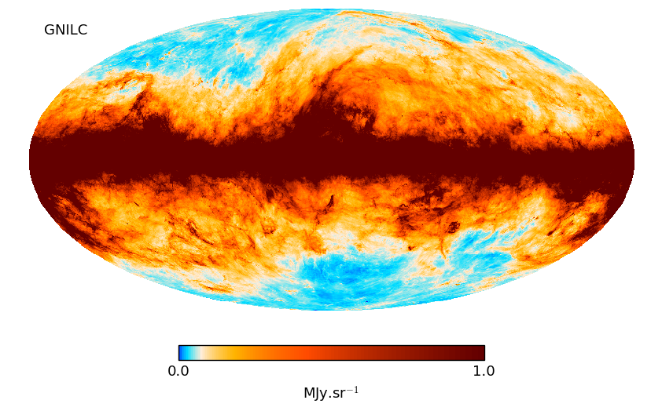
3. A survey of quasars behind the Galactic plane
SDSS DR14Q (Pâris et al. 2018)
Full-sky map of the Galactic thermal dust emission: Planck 2013
Very few quasars behind the Galactic plane!

Slide 21
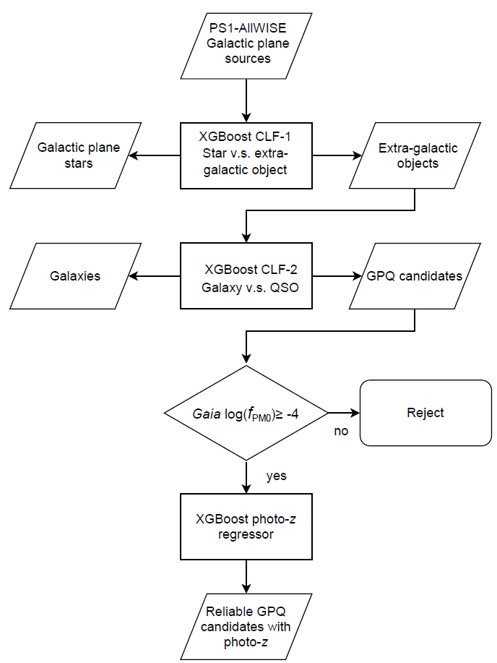

Two-step classification using PS1 & ALLWISE data
67,723,473
Feature selection:
g-r,r-i,i-z,z-y,g-W1,r-W1,i-W1,z-W1,y-W1,W1-W2,W2-W3,i-i_kron,z-z_kron
Classification 1: star vs. extragalactic (quasar + galaxy)
Classification 2: galaxy vs. quasar
Algorithm: XGBoost (Chen & Guestrin 2016). Hyper-parameter tuning tool: Optuna (Akiba et al. 2019).
Exclude stars
3,549,685
Exclude galaxies
165,294
Yuming Fu
Postdoc at
Leiden Univ.
Proper motion
160,946
Fu, Wu, et al. 2021

Slide 22
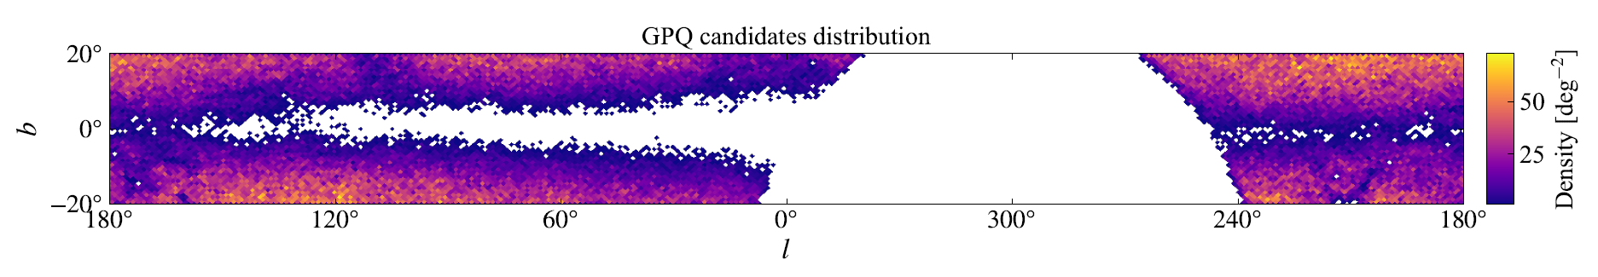
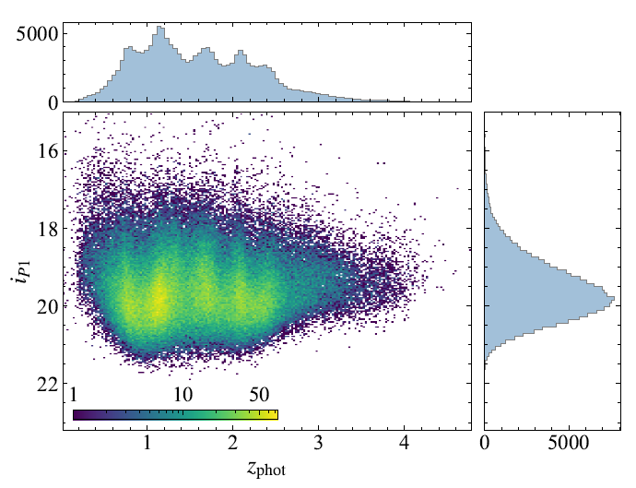
Properties of the final GPQ catalog
(known stars / duplicates excluded)
Source number | 160,946
Photo-z range | [0.016, 4.777]
Expected redshift range | (0, 5)
Sky coverage | |b|<20°, δ>-30°
Targets added in LAMOST Quasar Survey!
Fu, Wu et al. 2021, ApJS

Slide 23
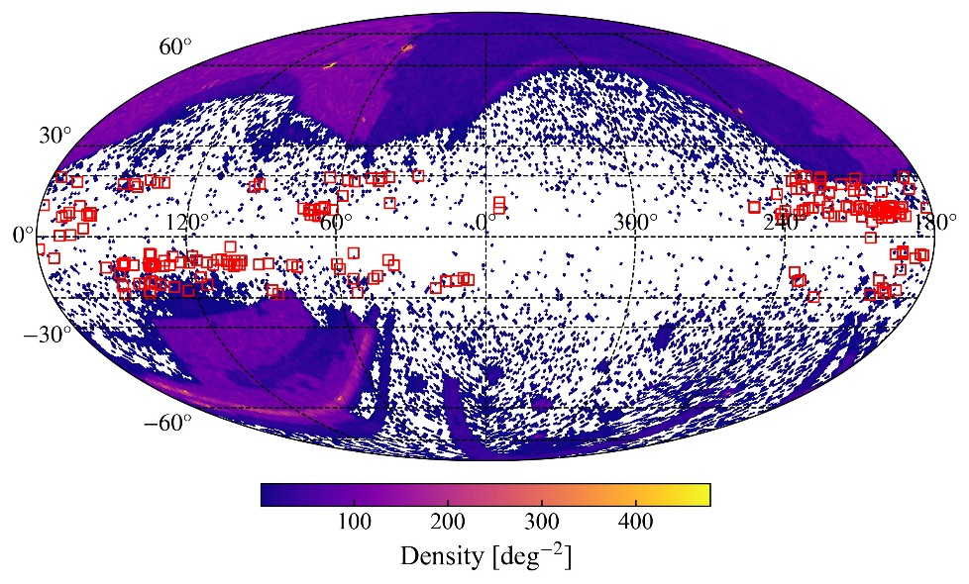
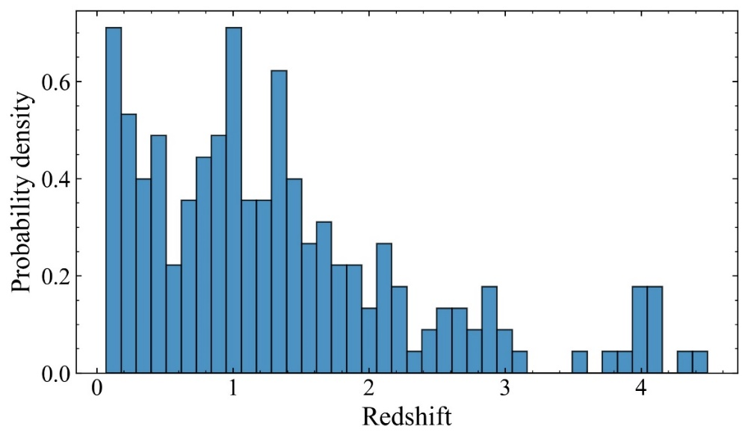
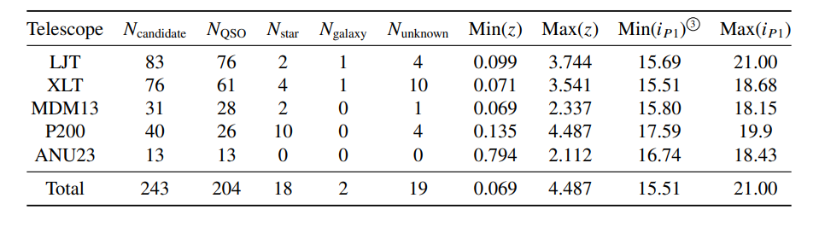
Spectral identification results
204 GPQs identified, 192 of which are new discoveries.
Success rate 84%. (204/243)
Fu, Wu et al. 2022, ApJS

Slide 24
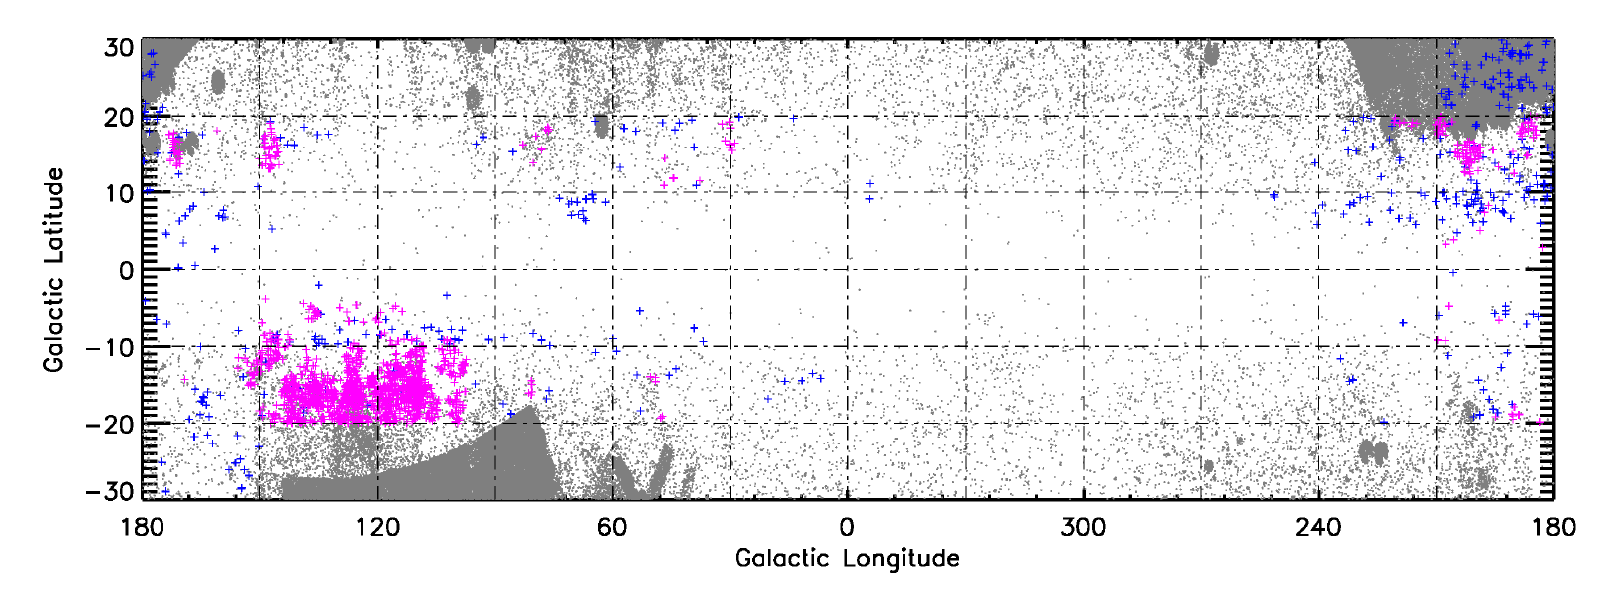
Spectroscopic Identifications of ~ 1300 New Quasars at |b| < 20º from LAMOST DR10
Huo, Fu et al. (2025, ApJS)
Magenta crosses: LAMOST newly identified GPQs
Blue crosses: Known GPQs from Im et al. (2007), Huo et al. (2017) and Fu et al. (2022)
Grey dots: QSOs/AGNs or candidates from the Milliquas (Flesch 2023).

Slide 25
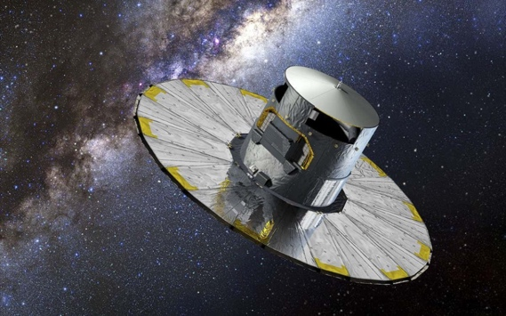
4. CatSouth: QSO candidates in southern sky
Quasars should have near zero proper motions
Gaia DR3 QSO candidates (6.6 million) have high proper motion -> high stellar contamination
Gaia DR3 QSO Candidates
SDSS DR16Q Confirmed QSOs

Slide 26
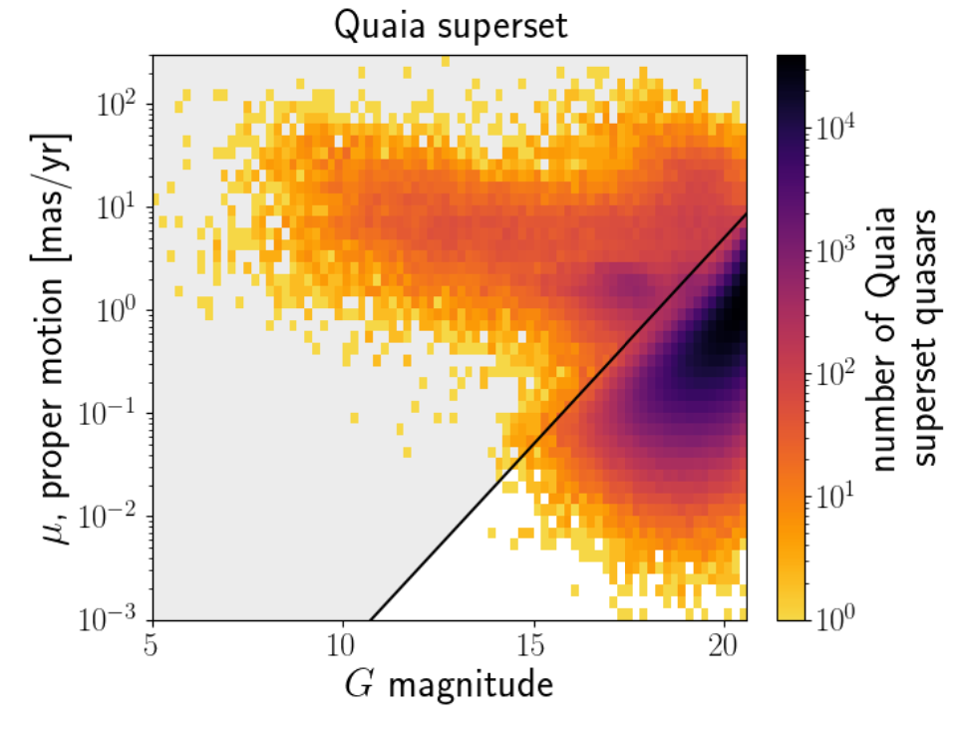
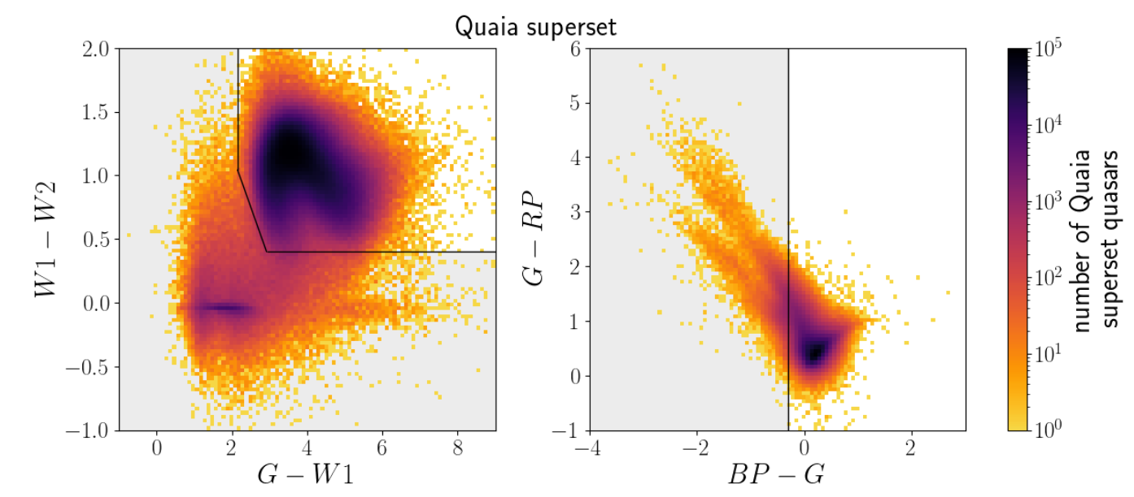
Quaia (Gaia–UnWISE) quasar catalog based on color–magnitude and proper-motion cuts
Purer than the original Gaia DR3 quasar candidate catalog; Lower completeness.
Color cuts
Mag-proper motion cut
Storey-Fisher et al. 2024

Slide 27
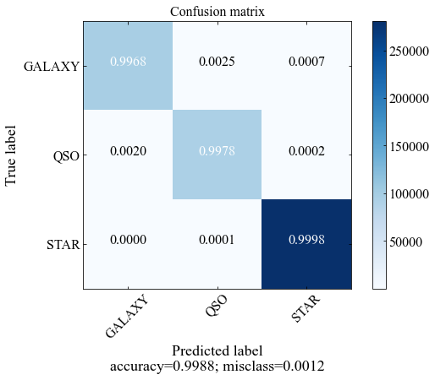
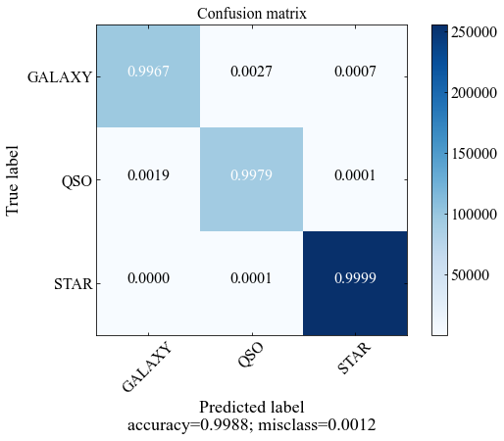
XGBoost classification model
Data（Opt+IR）: Gaia DR3, Pan-STARRS DR1, & CatWISE2020
Feature: g-r, r-i, i-z, z-y, g-W1, r-W1, i-W1, z-W1, y-W1, W1-W2, G_{BP}-G_{RP} , G_{BP}-G, G-G_{RP} , corrected BP/RP excess factor (morphology)
Classifier CLF_LVAC sample: LAMOST VAC stars、SDSS QSOs & galaxies
Classifier CLF_GDR3 sample: Gaia DR3 Stars、SDSS QSOs & galaxies
For test, both classifiers have accuracy >0.9988
Take mean as the final result，pQSO_mean>0.95 -> QSO candidates
CLF_LVAC
CLF_GDR3

Slide 28
The CatNorth quasar candidate catalog at Dec>–30°
Re-classified the Gaia DR3 quasar candidates based on Gaia, Pan-STARRS, and CatWISE2020 data; ensemble machine learning method applied.
3π sky coverage.
1.5 million sources in total; Higher completeness than Quaia, while maintaining similar purity (~90%).
Higher overall redshift accuracy than Gaia and Quaia.
Fu, Wu, et al. 2024, ApJS, 271, 54

Slide 29
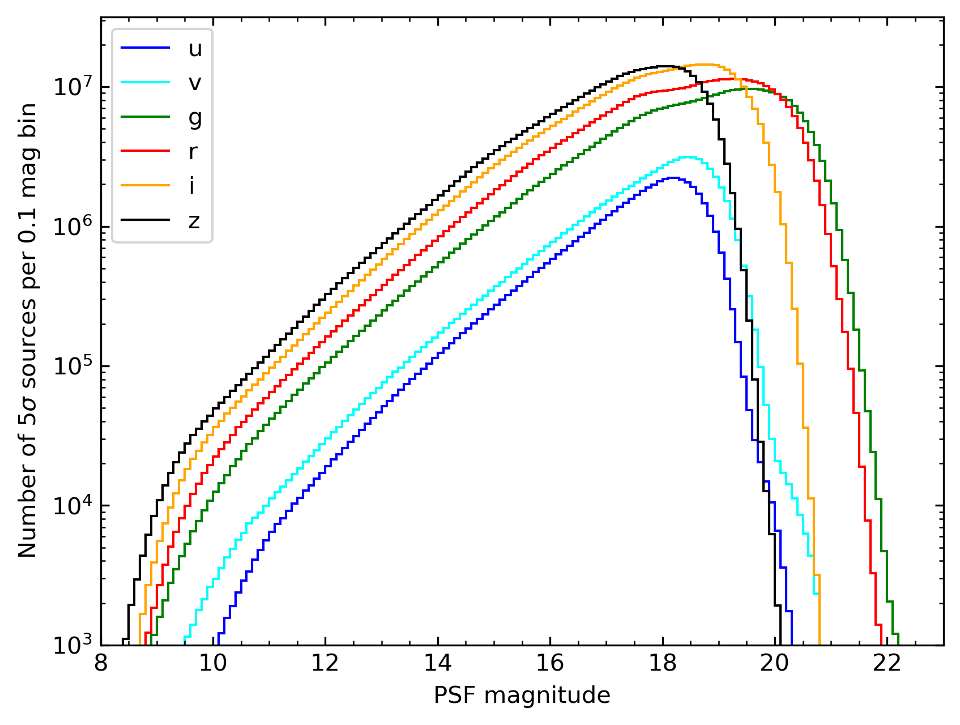
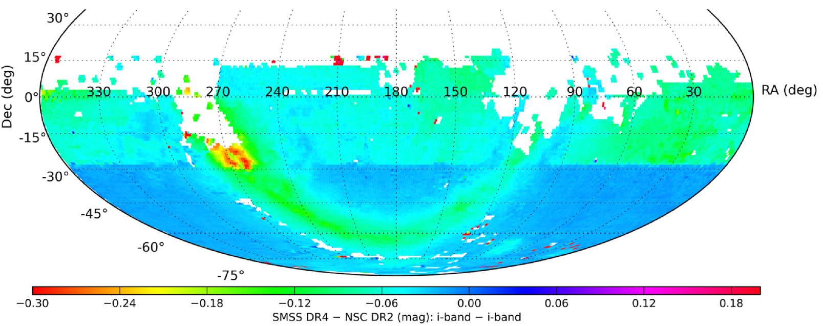
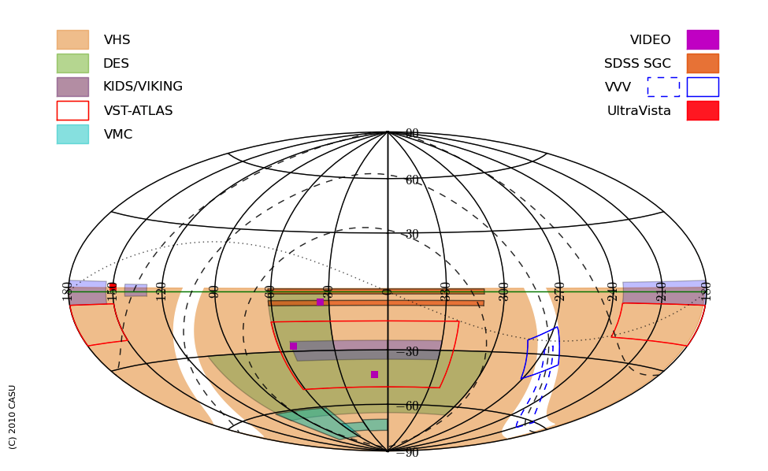
Photometric catalogs for CatSouth
Magnitude distribution of SMSS DR4
Optimal sky coverage achieved through the integration of multiple sky surveys:
Gaia DR3, CatWISE2020 + AllWISE
Ground-based optical:
  SkyMapper Southern Sky Survey (SMSS) DR4; mainly covers δ<0°, with partial coverage to δ<16°; griz bands are used.
  The NSC (NOIRLab Source Catalog) DR2 is used to impute missing griz data.
Ground-based NIR:
  VISTA surveys (VHS, VIKING, VMC, VVV); J and Ks bands
  2MASS is used to impute missing VISTA data through empirical conversion.
Onken et al. 2024, PASA, 41, e061
SMSS DR4 vs. NSC DR2 i-band magnitude
VISTA survey sky coverages (version 2010; VISTA wiki)

Slide 30
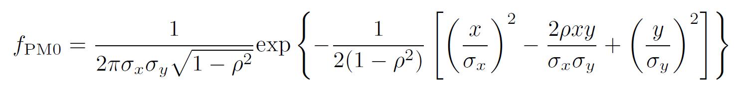
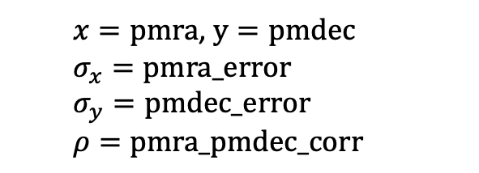
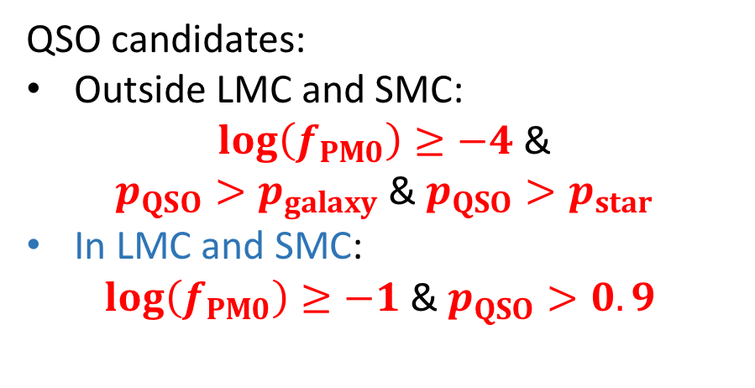
Additional cut based on Gaia proper-motion
Stellar locus
revealed
Probability density of zero proper motion ($f_{PM0}$):
  $x=pmra$, $y=pmdec$
  $$σ_{x}=pmra_error$$
  $$σ_{y}=pmdec_error$$
  $$ρ=pmra_pmdec_corr$$
QSO candidates:
Outside LMC and SMC:
$\log\left(f_{PM0}\right)≥−4$ &
$p_{QSO}>p_{galaxy}$ & $p_{QSO}>p_{star}$
In LMC and SMC:
$\log\left(f_{PM0}\right)≥−1$& $p_{QSO}>0.9$
Fu, Wu et al. 2024, 2025

Slide 31
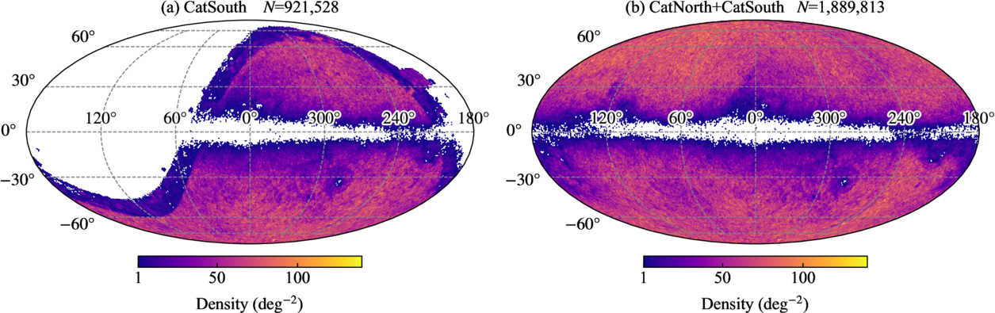
The CatSouth/CatGlobe quasar candidate catalogs
Left: CatSouth at δ≲16° (N=0.92 million).
Right: The all-sky CatGlobe catalog by combining CatNorth and CatSouth (N=1.89 million)
Fu, Wu et al. 2025, ApJS

Slide 32
Proper motion distributions of the original Gaia QSO candidate catalog and CatGlobe
Gaia DR3 QSO candidates
Purified QSO candidates (CatGlobe)
Fu, Wu et al. 2025

Slide 33
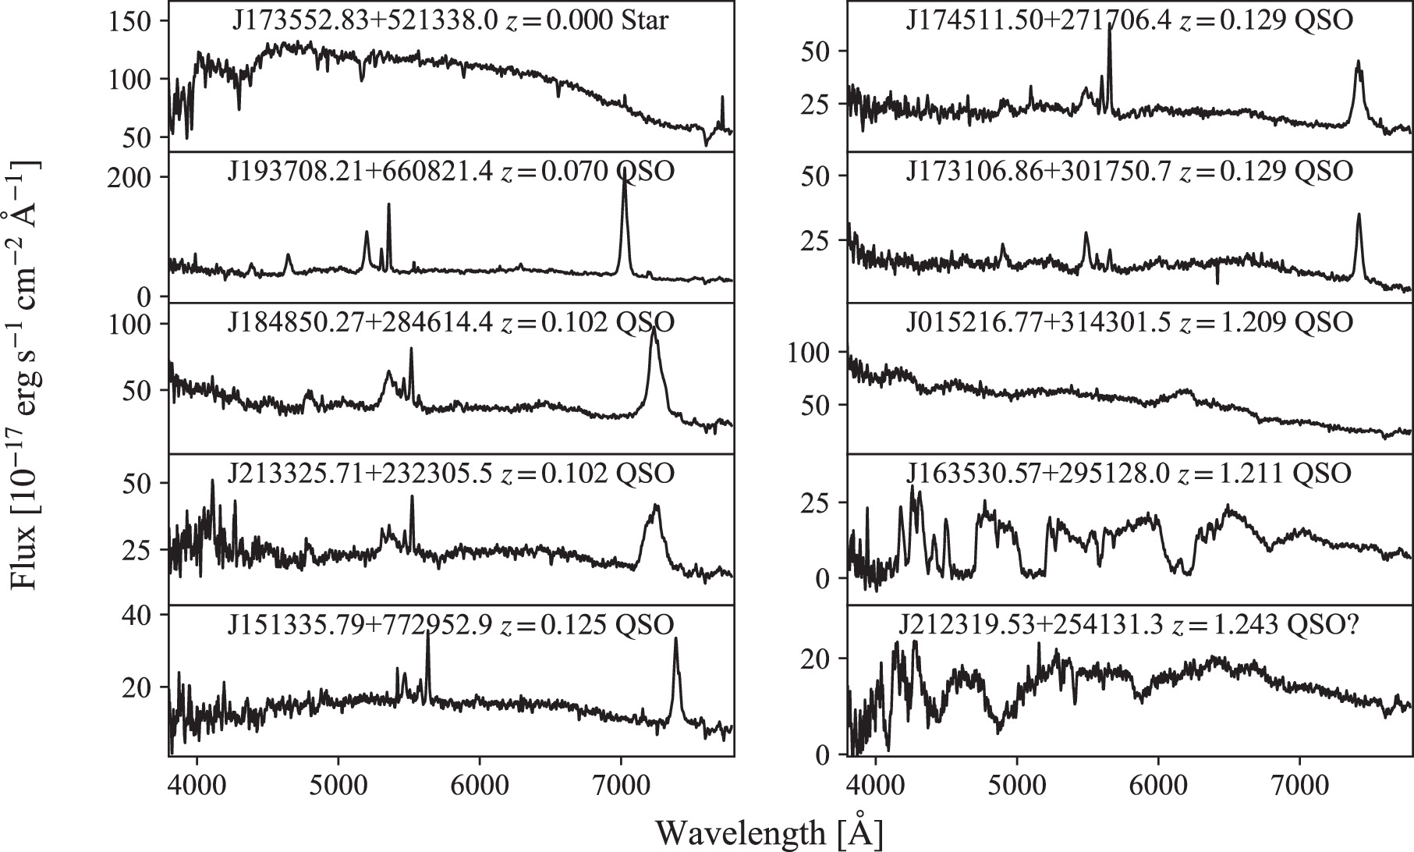
QSO candidate observations
India HCT 2m random observations (2023-08-16):
  G<20.5
  In CatNorth but not in Quaia
  New candidates
Similar accuracy with Quaia，
Much higher completeness!
Broad absorption QSO

Slide 34



5. CSST Quasar Survey
CSST：Chinese Space Station Survey Telescope（2027）
Imaging filters
Photometric & Slitless Spectroscopic Surveys：
  Wide field survey: 17,500 deg² (~26m/22m(spec))
  Deep field survey: 400 deg²(~27m/23m(spec))
  Ultra-deep field survey (TBD): 9 deg²
CSST quasar survey will produce more than ten million QSO candidates and more than a million QSOs identified by slitless spectra
T(%)
Wavelength (nm)
Spec. filters

Slide 35
CSST quasar number estimate
1.7 million quasars in m_{R} = 18~22mag, z = 0~5
  Spectra extraction rate
>99% due to deep image data
Quasar with spectra
Contamination rate: ~10%
10-20% in galaxy cluster fields
~5% in deep field (check by 3D-HST data)
Quasar with good spectra
  Successful classified
>99% from CNN confusion matrix
Quasar sample from CSST: ~1.5 million
  Previous known quasars
SDSS, DESI EDR, CatNorth…
New Quasar sample: ~1 million (+deep field)
Pang, Wu et al. 2025, ApJ, 980, 223

Slide 36


CSST high-z quasars (a few thousands z>6 quasars)

Slide 37
Summary
We have carried out several quasar surveys in China, including LAMOST quasar survey, bright high-z quasar survey and a survey for quasars behind the Galactic plane.
LAMOST Quasar Survey has identified 67521 quasars (40293 independently discovered, 29513 new) . In bright high-z quasar survey, we discovered hundreds of quasars at z>5, which fills the gap at z~5.5. The discovery of the most luminous quasar with 12 billion solar mass SMBH at z>6 challenges the BH growth theory in the early Universe.
Behind the Galactic plane, we discovered 1500 new background quasars. LAMOST survey will discover more.
With XGBoost-based ensemble classifier, we reclassify Gaia DR3 quasar candidates and present 1.89million quasar candidates, including 0.92 million in southern sky
CSST quasar survey is in planning, aiming at produce 10million+ quasar candidates and 1million+ quasars identified from slitless spectroscopy

