Slide 1
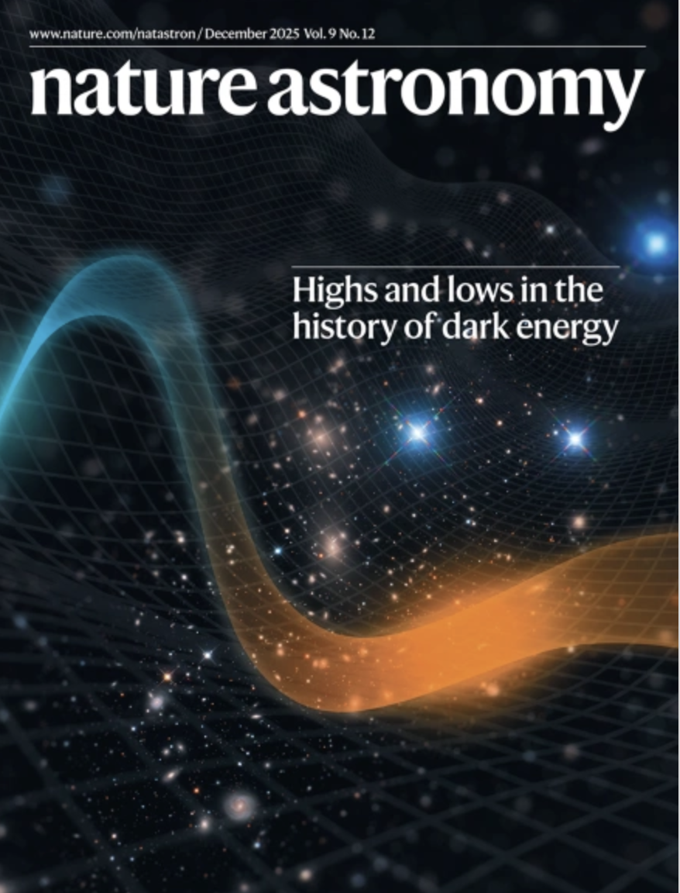
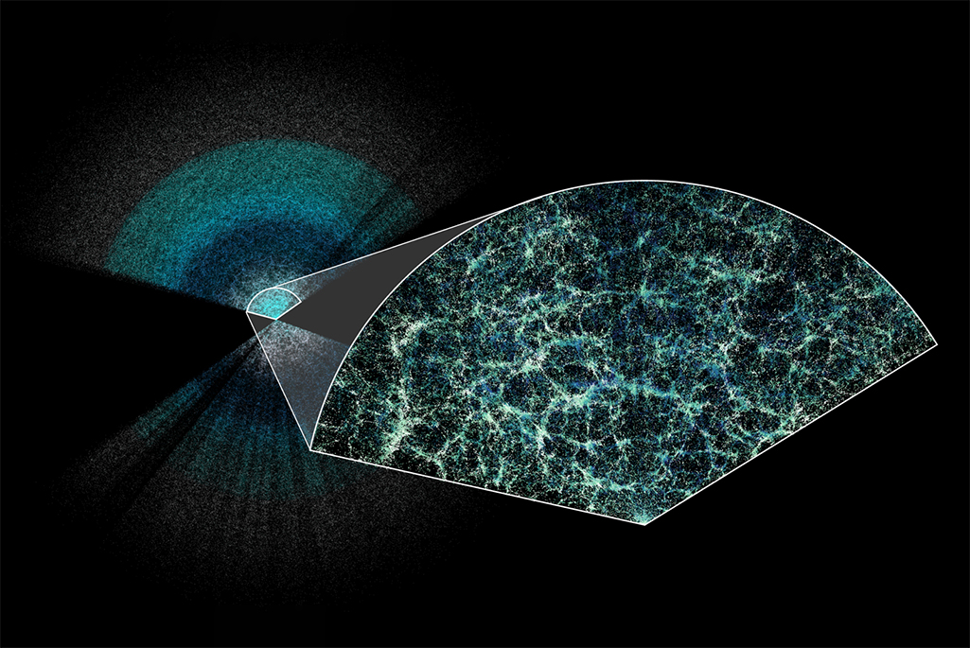
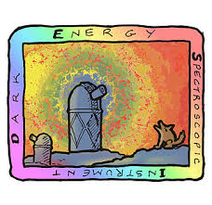
Cosmological implications of massive galaxy surveys
Gong-Bo Zhao
National Astronomical Observatories, CAS
January 9, 2026

Slide 2
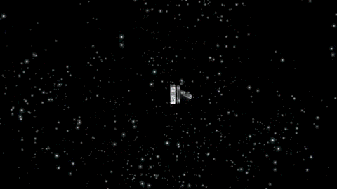
Multiple cosmological probes
CMB

Slide 3

Multiple cosmological probes
CMB
1978, 2006

Slide 4
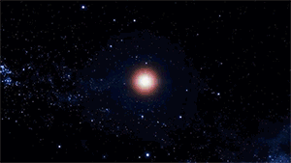
Multiple cosmological probes
CMB
1978, 2006
SNe

Slide 5
Multiple cosmological probes
CMB
1978, 2006
SNe
2011

Slide 6
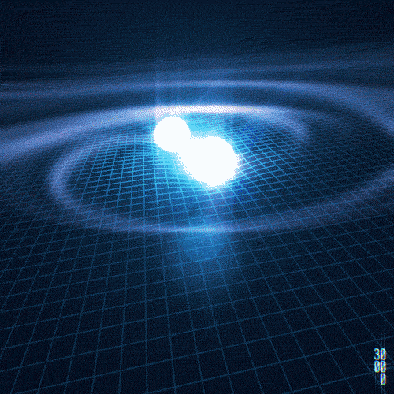
Multiple cosmological probes
CMB
Gravitational waves
1978, 2006
SNe
2011

Slide 7
Multiple cosmological probes
CMB
Gravitational waves
1978, 2006
2017
SNe
2011

Slide 8
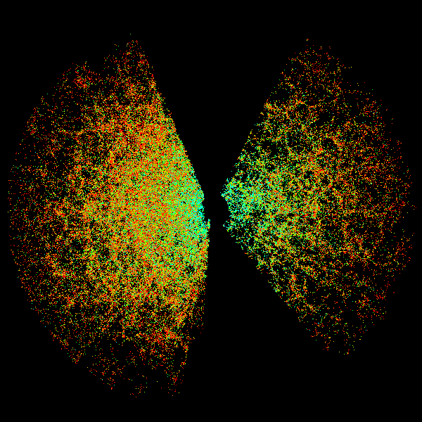
Multiple cosmological probes
CMB
Gravitational waves
1978, 2006
2017
SNe
LSS
2011

Slide 9

Multiple cosmological probes
CMB
Gravitational waves
1978, 2006
2017
SNe
LSS
2011
2014

Slide 10
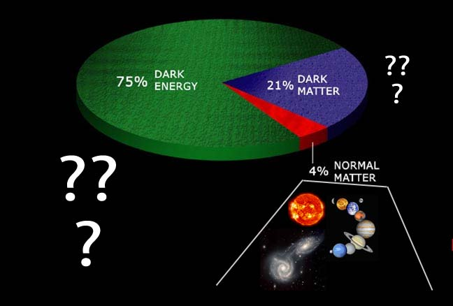
100 x

Slide 11
CMB (1978)
Gravitational waves (2017)
CMB (2006)
Theoretical cosmology (2019)
Cosmic Acceleration (2011)
Black holes (2020)
100 x

Slide 12
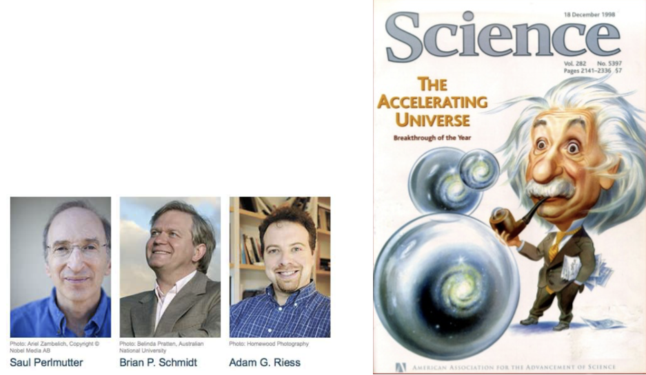
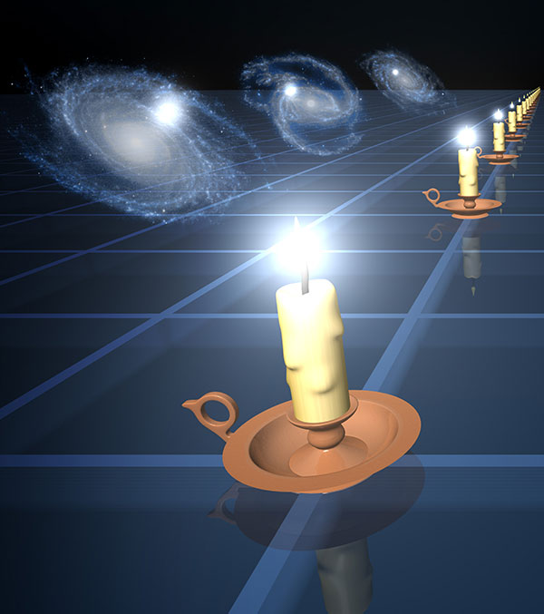
The accelerating
Universe!
2011

Slide 13

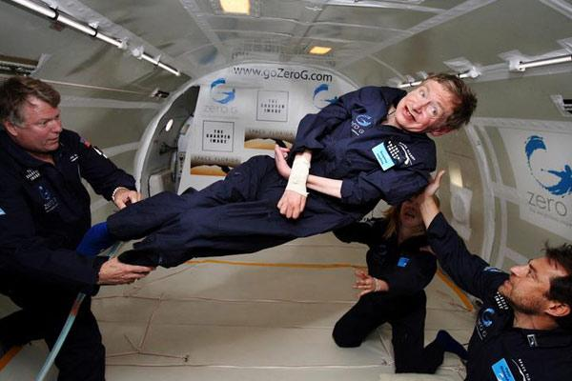

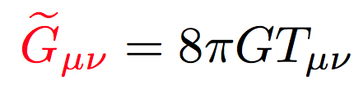
The expansion of the Universe can accelerate if
In GR, to add new ‘repulsive matter’, which contributes 70% total energy
To modify General Relativity
NASA/Jim Campbell/Aero-News Network
Dark Energy
Modified Gravity

Slide 14
The expansion of the Universe can accelerate if
In GR, to add new ‘repulsive matter’, which contributes 70% total energy
To modify General Relativity
NASA/Jim Campbell/Aero-News Network
Dark Energy
Modified Gravity
Galaxy surveys can break the dark degeneracy!

Slide 15
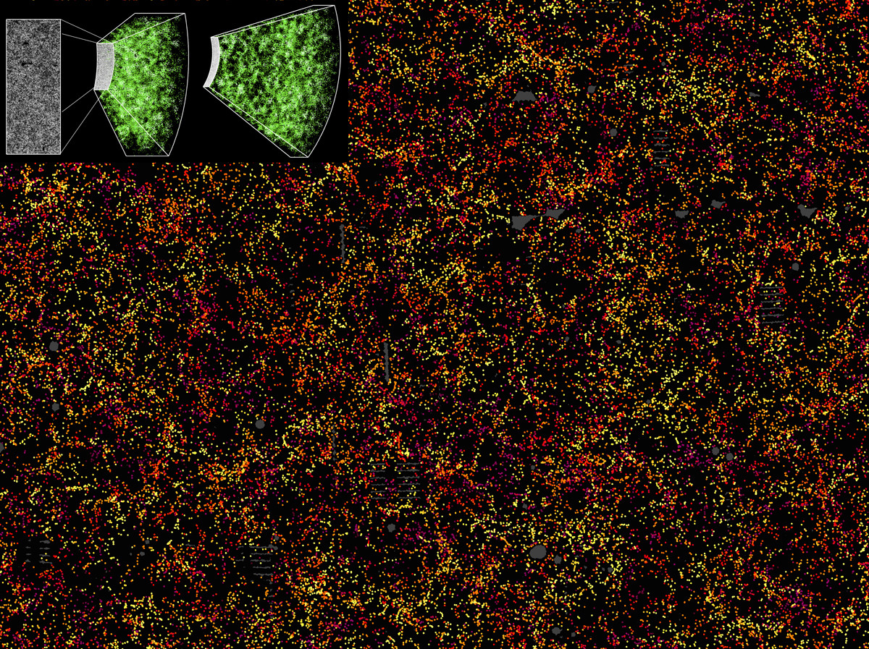
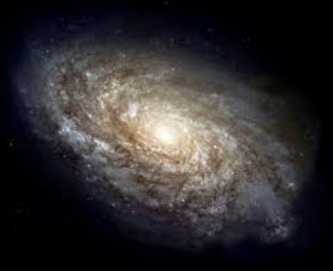

Massive redshift surveys as
a key cosmological probe
BOSS

Slide 16
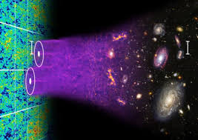

Large z-surveys：a key probe of the Universe
Large-scale clustering
Dark Energy

Slide 17
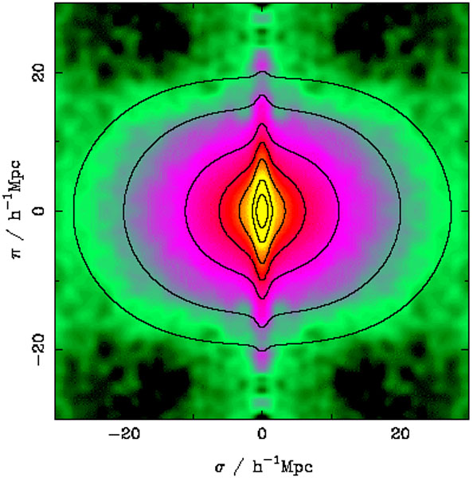

Large z-surveys：a key probe of the Universe
Large-scale clustering
Mid-scale clustering
Dark Energy
Modified Gravity

Slide 18
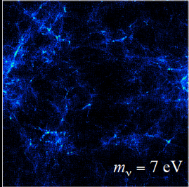
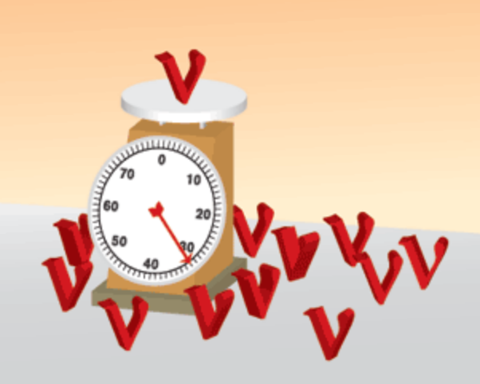
Large z-surveys：a key probe of the Universe
Large-scale clustering
Mid-scale clustering
Small-scale clustering
Dark Energy
Modified Gravity
Neutrino masses

Slide 19
Large z-surveys：a key probe of the Universe
Large-scale clustering
Mid-scale clustering
Small-scale clustering
Shaw’s prize (2014)
Nobel Prize (2011)
Nobel Prize (2015)
Dark Energy
Modified Gravity
Neutrino masses

Slide 20
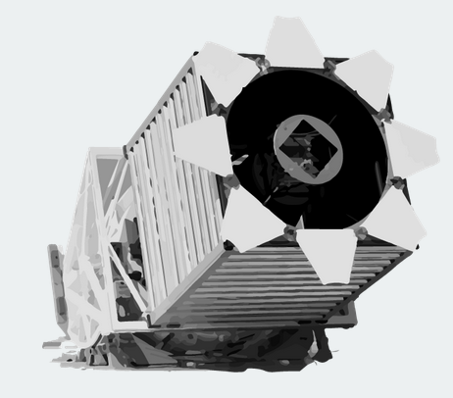

New Mexico
2.5m
2009
2014
2020
2021
2022
SDSS-III
Baryon Oscillation Spectroscopic Survey (BOSS) (z<0.6)
1.6M LRGs
The largest in last decade

Slide 21
2009
2014
2020
2021
2022
SDSS-IV
extended BOSS (eBOSS)
1M LRGs, ELGs and QSOs
(0.6<z<3.5)
The largest in the past 5 years

Slide 22


DESI & PFS
>30M LRGs, ELGs and QSOs
(0<z<3.5)
Largest ongoing surveys
2024
2025
2026
2027
2028
PFS, 10m
DESI, 4m

Slide 23
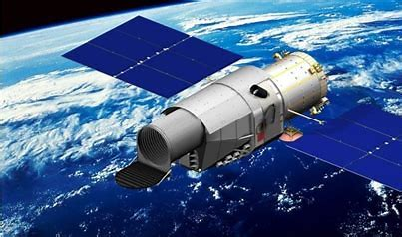

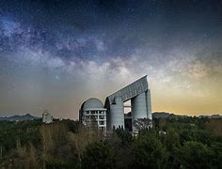
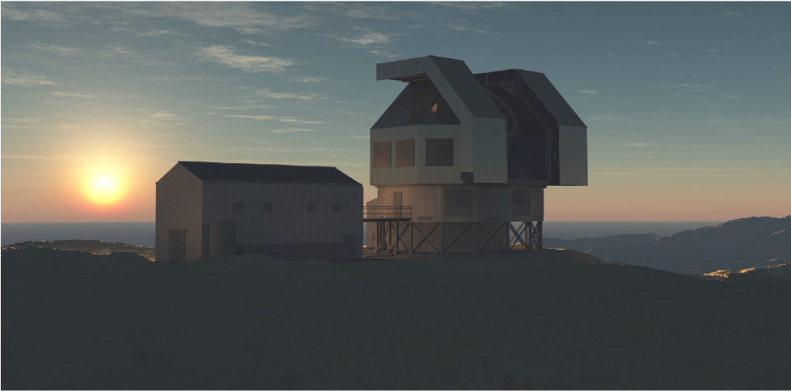
CSST, 2m in space
MUST, 6.5m
ESST, 10+m

Slide 24
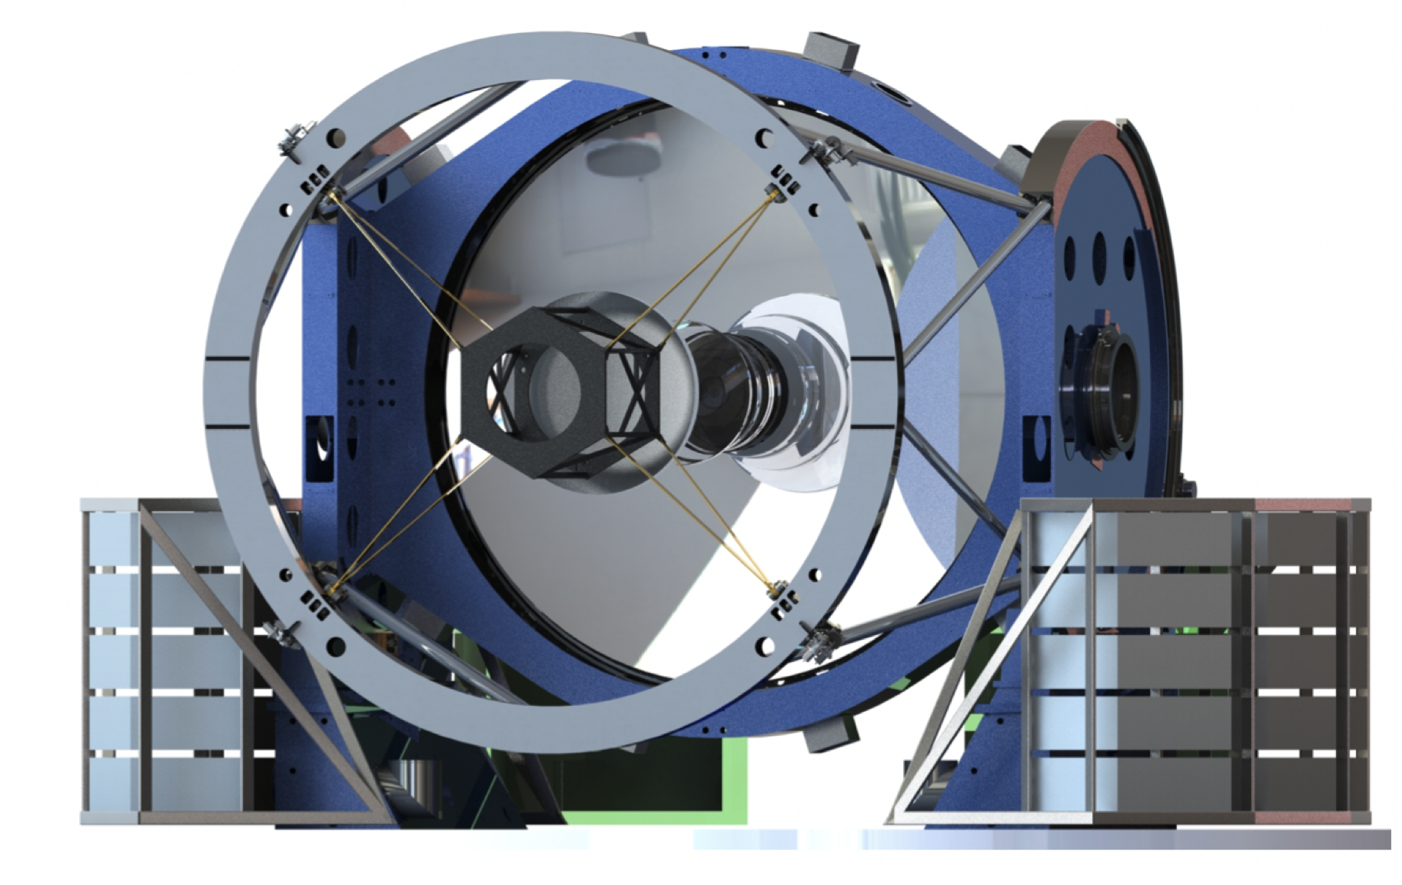
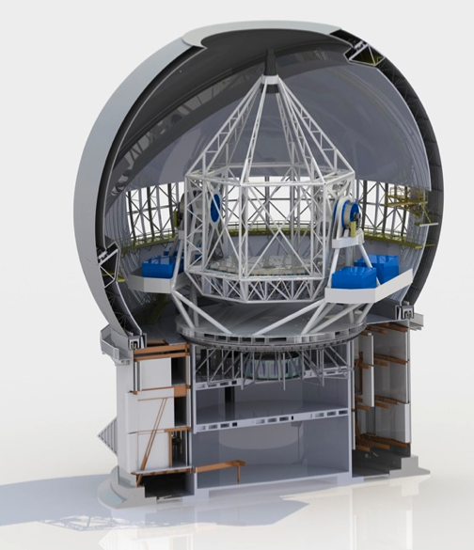
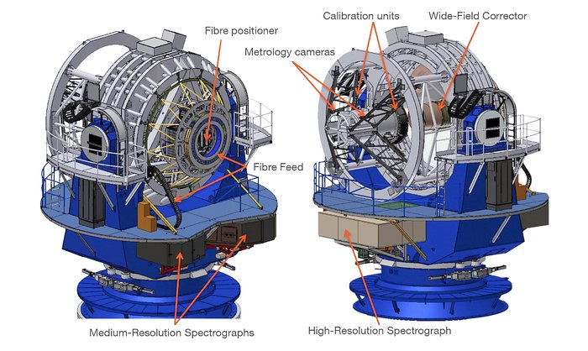
CSST, 2m in space
MUST, 6.5m
ESST, 10+m
4MOST, 4m
MegaMapper, 6.5m
WST, 10+m

Slide 25
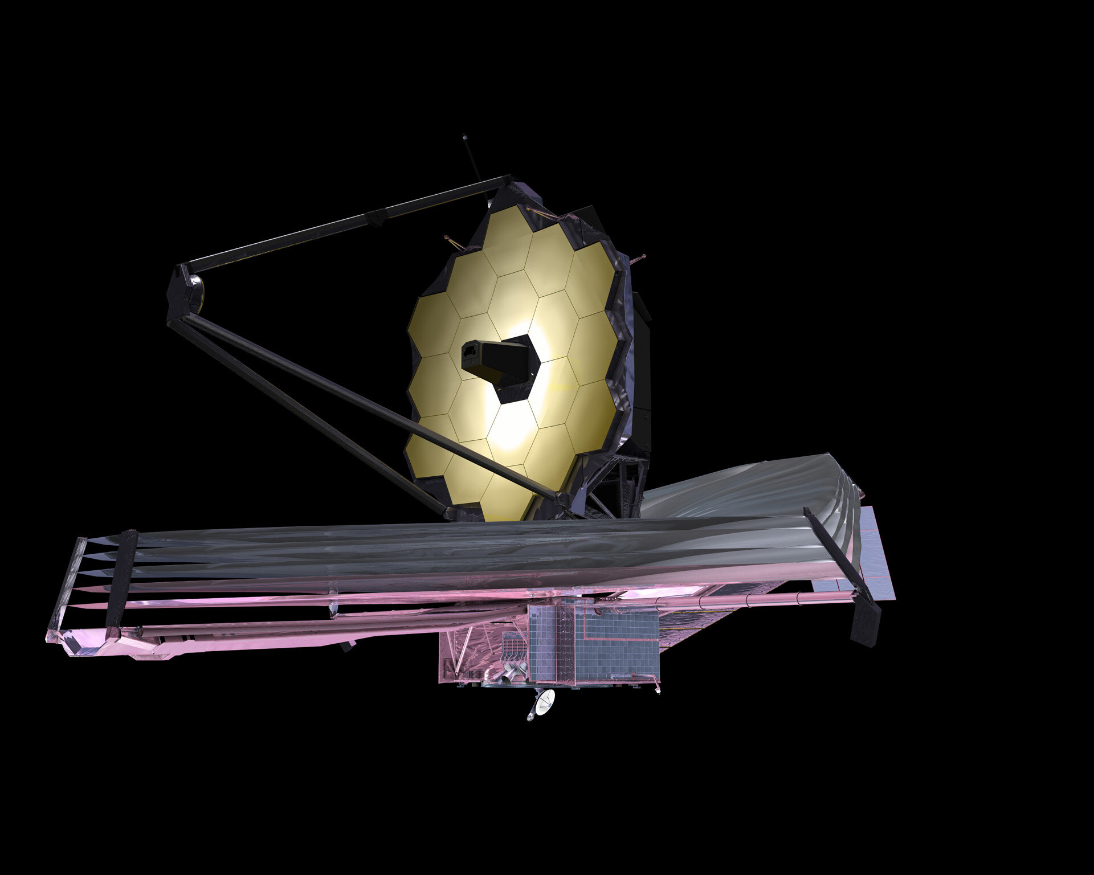
CSST, 2m in space
MUST, 6.5m
ESST, 10+m
280 m in space!!
arXiv: 2010.06064
4MOST, 4m
MegaMapper, 6.5m
WST, 10+m

Slide 26
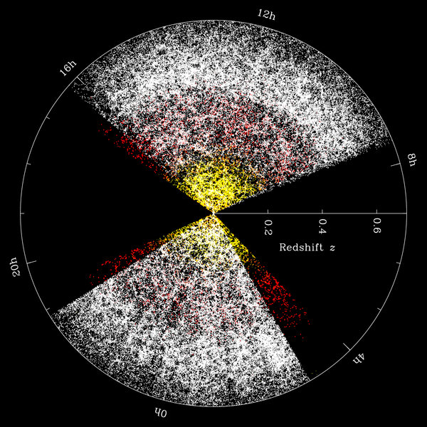
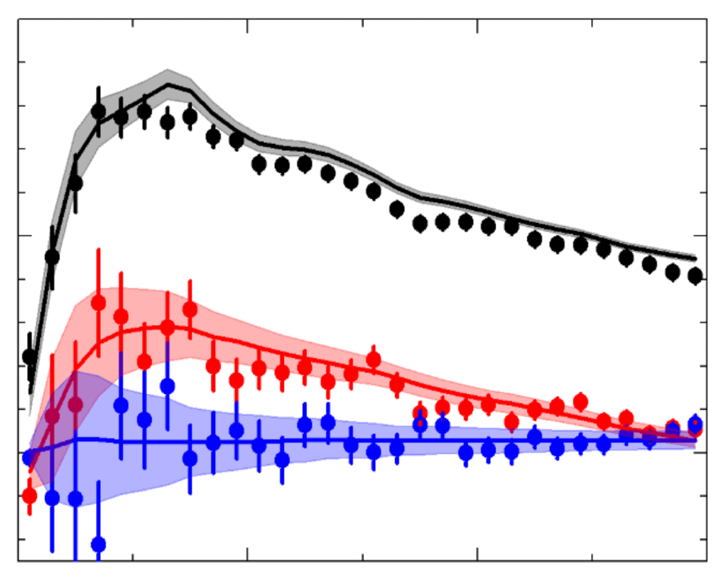
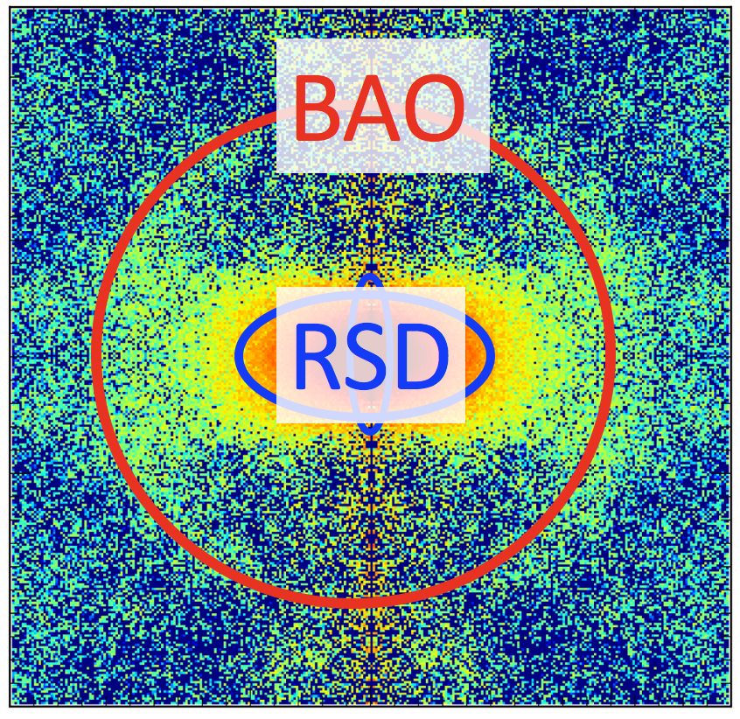
Cosmic acceleration
LSS survey
Model
Sim.
Stat.
Dark Energy
Modified Gravity
ξ(s), P(k)
Neutrino masses
BAO, RSD

Slide 27
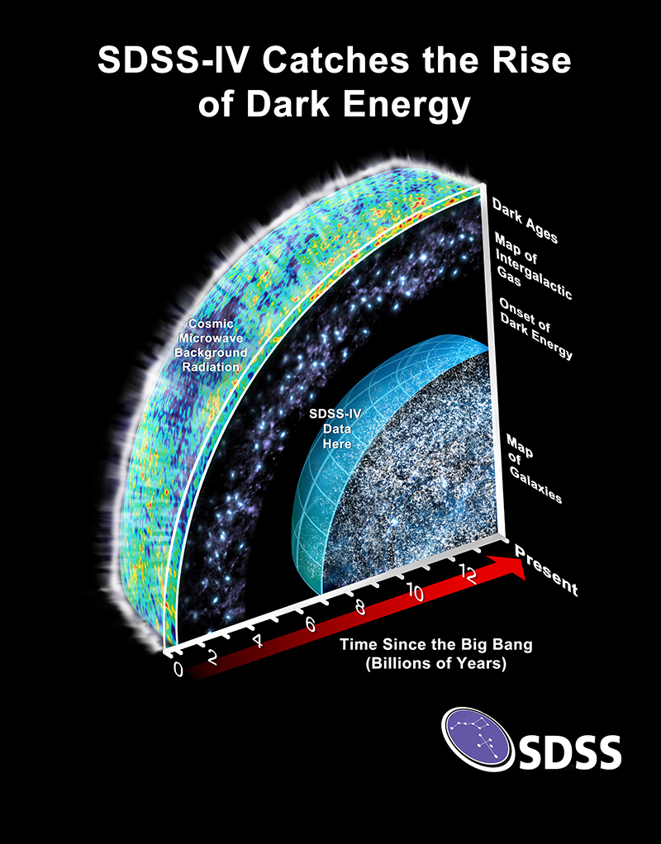
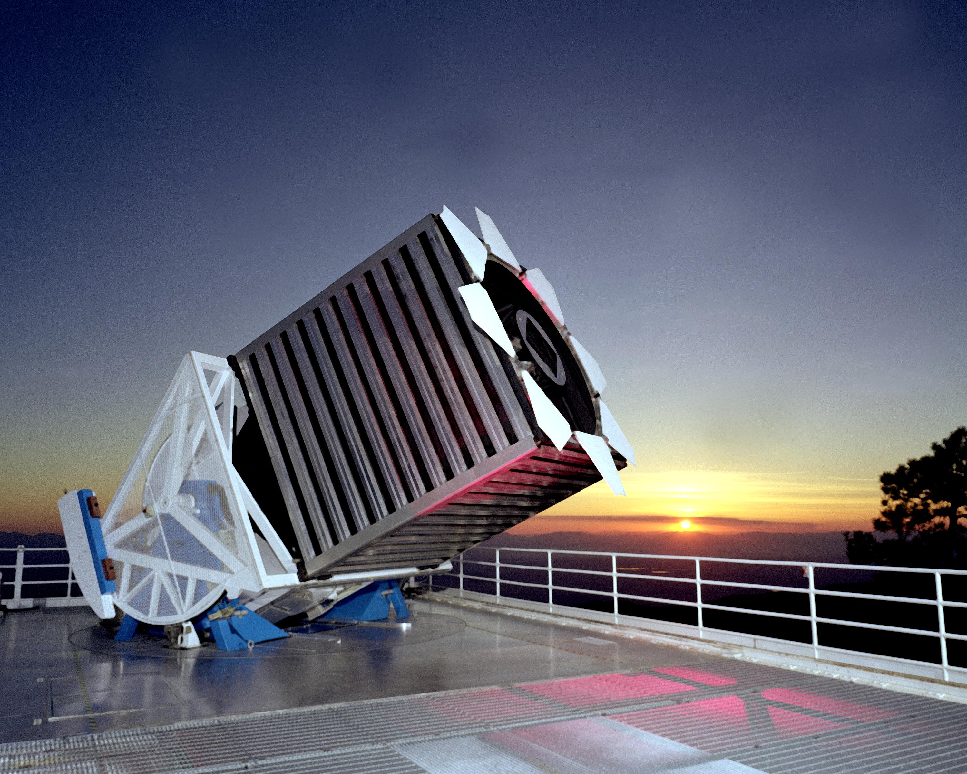
eBOSS (2014-2020)
2.5 m SDSS telescope @ New Mexico

Slide 28

eBOSS result released on July 20, 2020 in 20+ papers
sdss.org

Slide 29
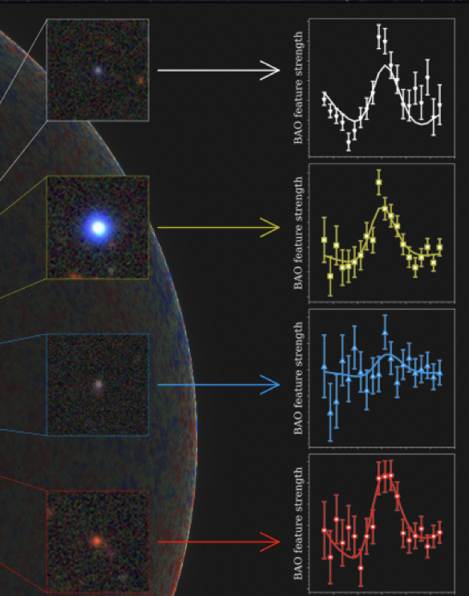
eBOSS tracers
Lyman-a forest
Clustering quasars
Emission Line Galaxies (ELGs)
Luminous Red Galaxies (LRGs)

Slide 30
ELG (k-space): De Mattia et al, 2007.09008
ELG (s-space): Tamone et al, 2007.09009
LRG (k-space): Gil-Marin et al, 2007.08994
LRG (s-space): Bautista et al, 2007.08993
ELG x LRG (k-space): G-B. Zhao et al, 2007.09011
ELG x LRG (s-space): Y. Wang et al, 2007.09010

Slide 31
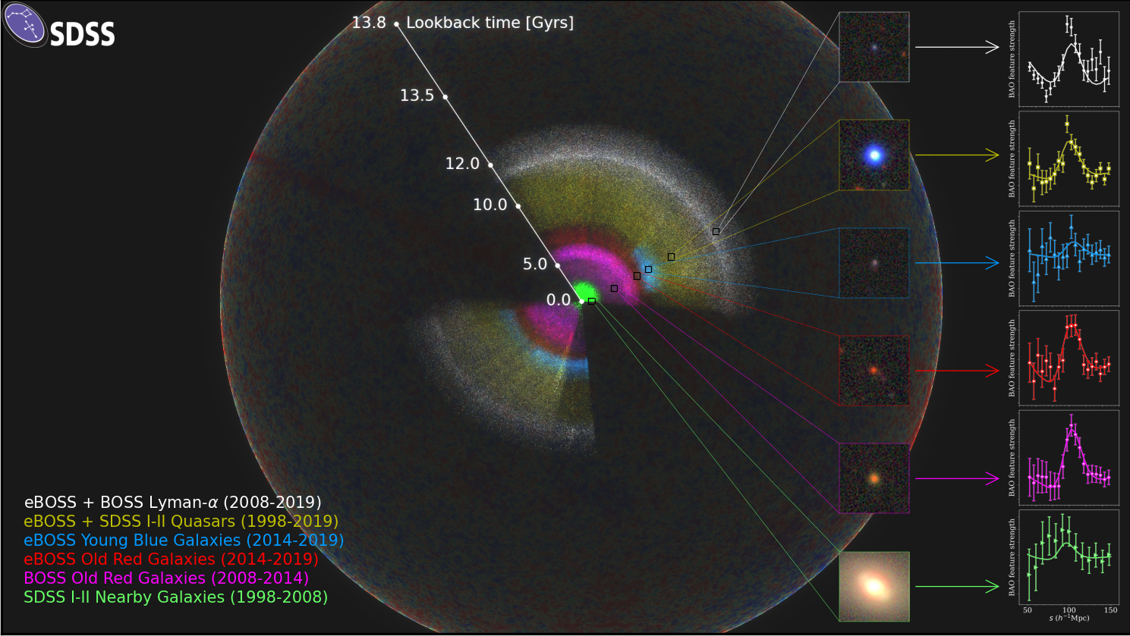

Slide 32
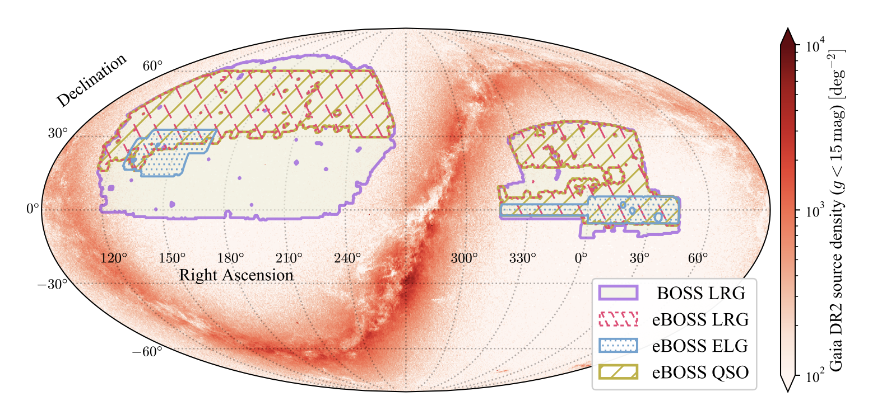
eBOSS footprint
C. Zhao+, 2020

Slide 33
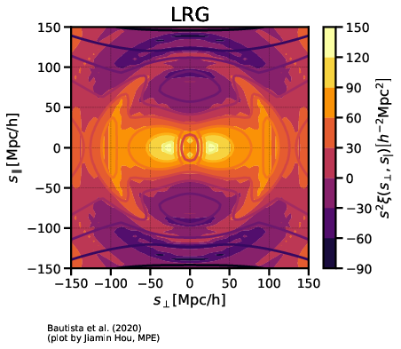
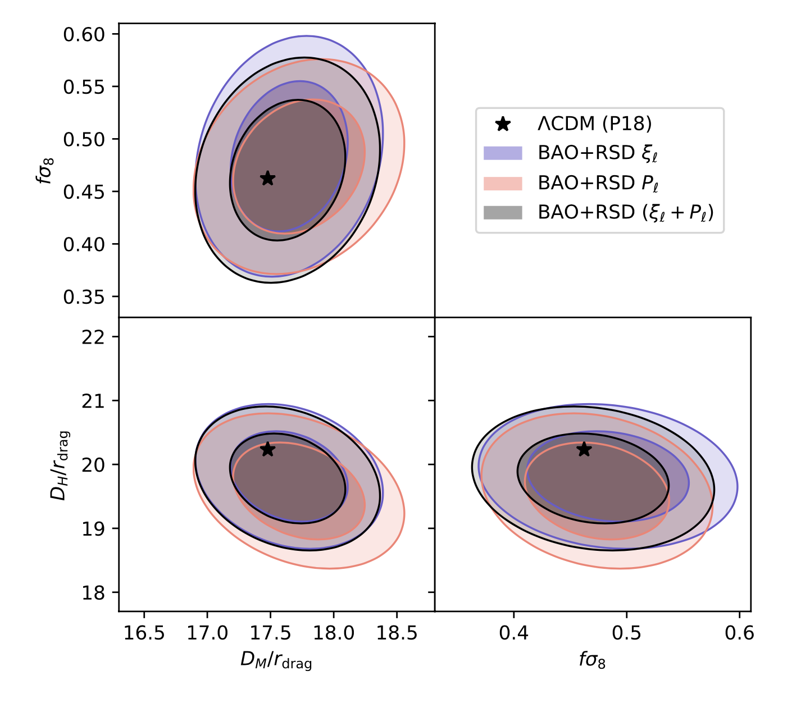
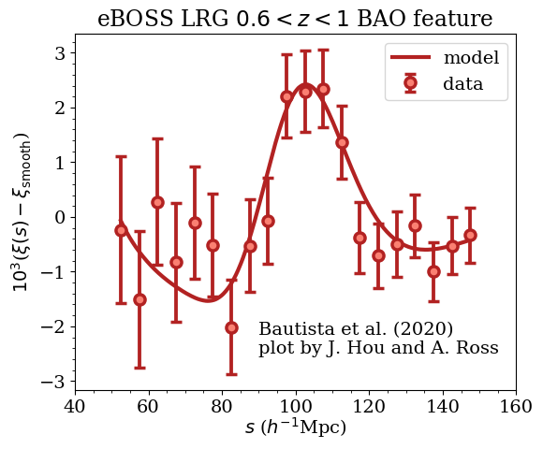
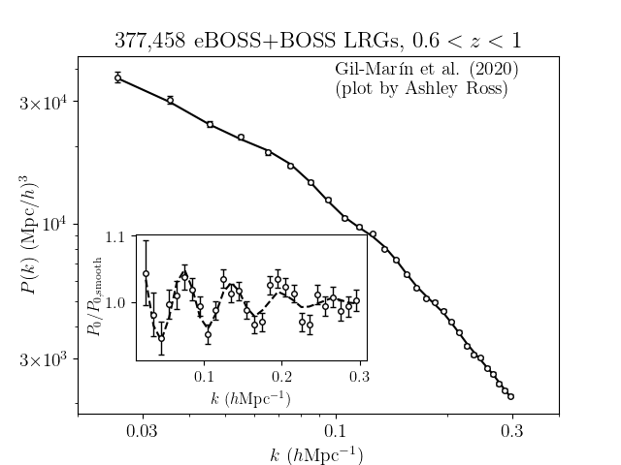
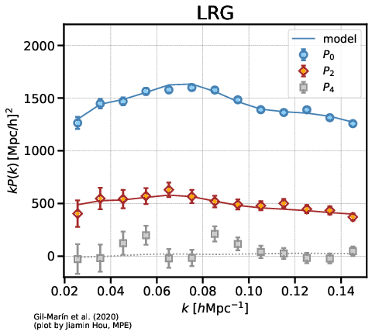
Luminous Red Galaxies (LRGs)
0.6 < z < 1.0, z_{eff} = 0.77
~9500 deg²
~400 K spectra
Bautista+, 2020; Gil-Marin+, 2020

Slide 34
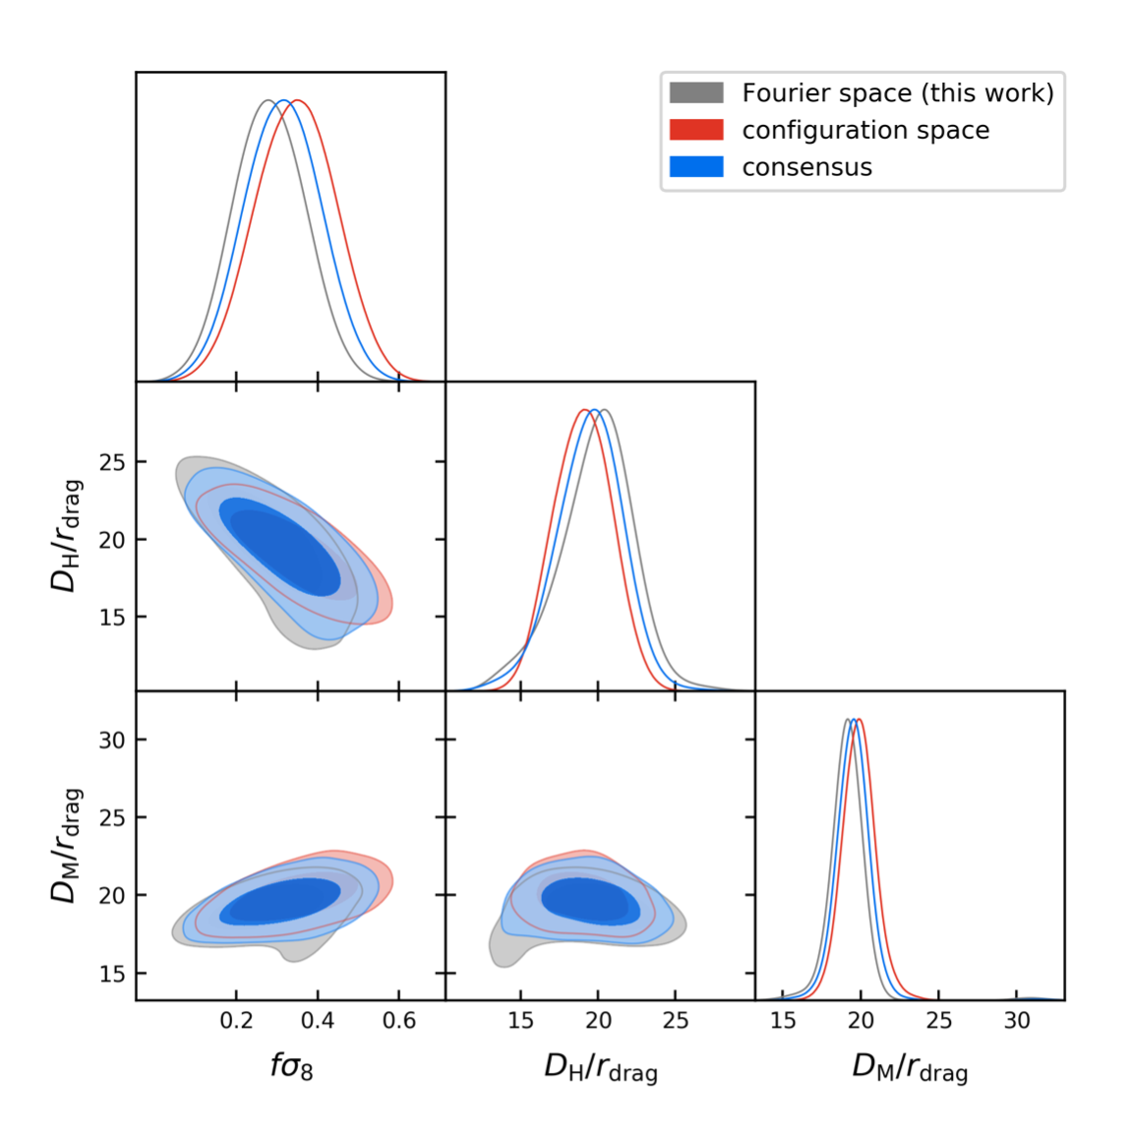
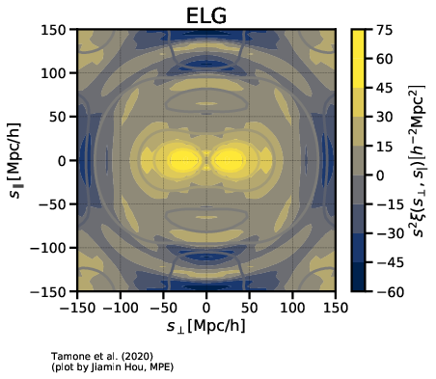
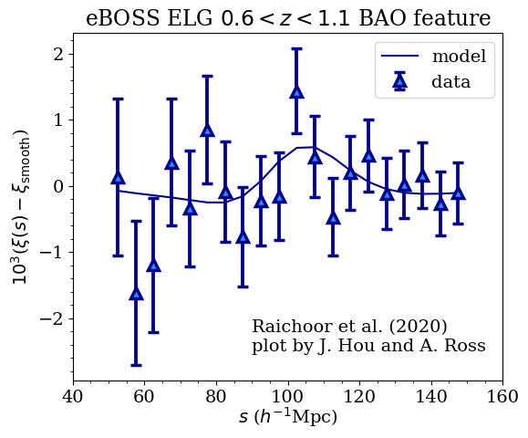
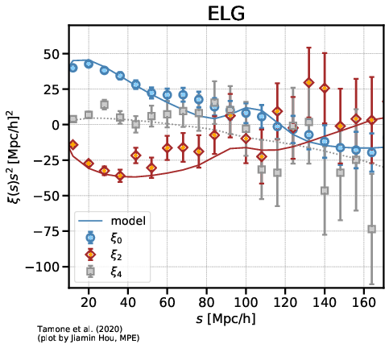
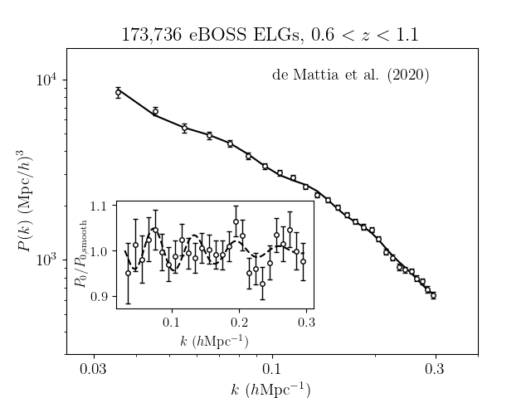
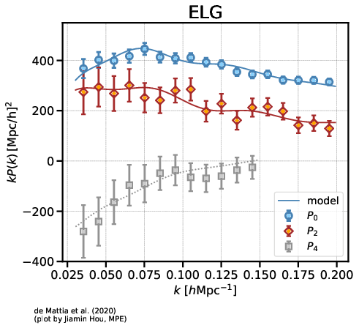
Emission line Galaxies (ELGs)
0.6 < z < 1.1, z_{eff} = 0.845
~730 deg²
~170 K spectra
de Mattia+, 2020; Tamone+, 2020

Slide 35
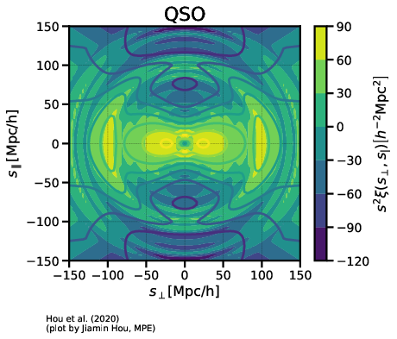
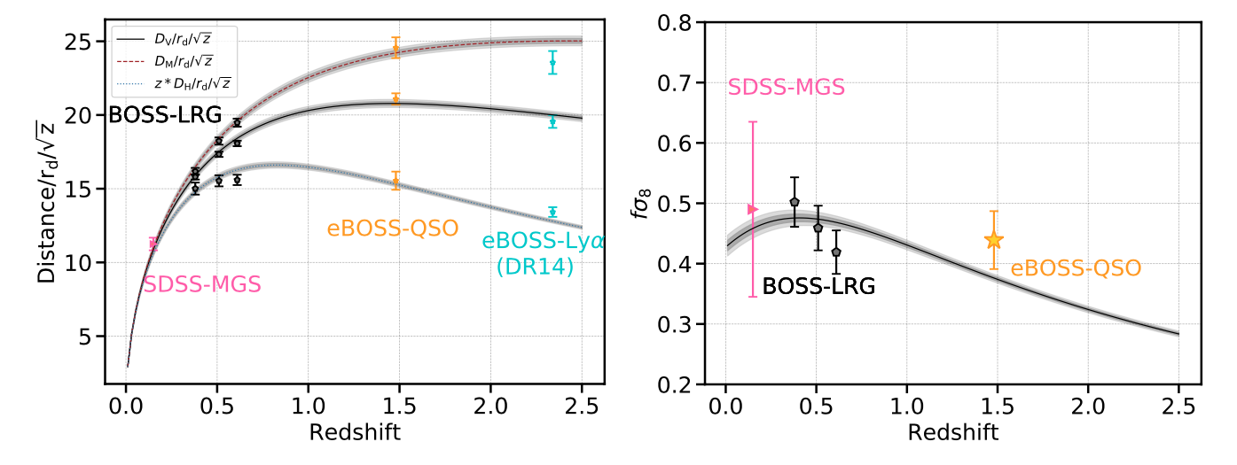
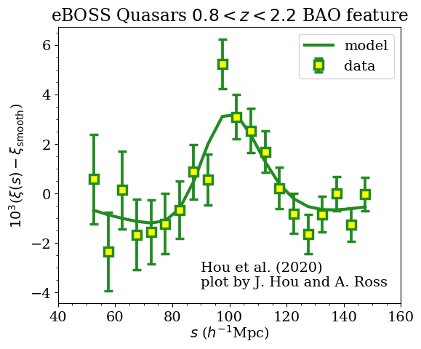
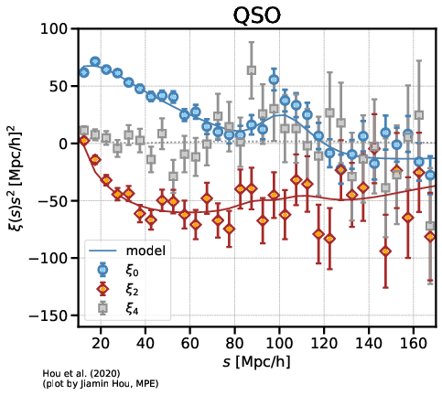
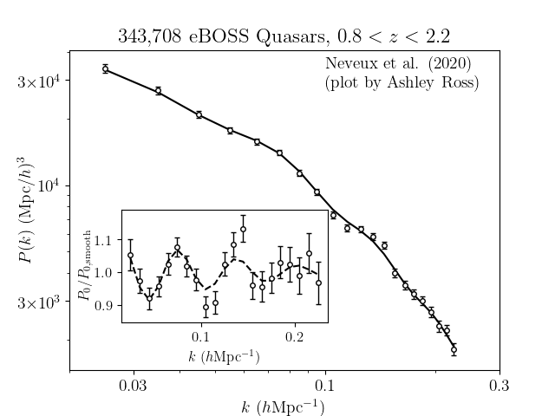

Clustering quasars (QSOs)
0.8 < z < 2.2, z_{eff} = 1.48
~4700 deg²
~340 K spectra
Hou+, 2020; Neveux+, 2020

Slide 36

Angular overlap
GBZ+, 2020

Slide 37

Radial overlap

Slide 38


Slide 39

GBZ+, 2020

Slide 40

GBZ+, 2020

Slide 41

GBZ+, 2020

Slide 42


Slide 43

A first detection of BAO from galaxy-ellipticity correlations
d’Assignies D. et al. 2021

Slide 44


Xu, Jing, GBZ et al, Nature Astronomy (2023)

Slide 45

A detection of BAO from radio-optical galaxy cross-power

Slide 46



A detection of BAO from radio-optical galaxy cross-power
J. Zheng, P. Tiwari, GBZ, et al (LoTSS collaboration), 2504.20722, A&A (2025)

Slide 47

A study of dynamical dark gravity using DESI
DESI paper: 2503.14738

Slide 48
Two ways to study dynamics of dark energy
Indirect: get features of w(z) directly from distance measurements
✓: cheap; no data combination needed
✗: no w(z) derived

Slide 49
Two ways to study dynamics of dark energy
Indirect: get features of w(z) directly from distance measurements
✓: cheap; no data combination needed
✗: no w(z) derived
Direct: reconstruct w(z) from observations
✓: show w(z) with details
✗: expensive; usually requires datasets to be combined

Slide 50


Probing dynamical DE from distance measurements
(Gu et al, 2404.06303; Wang et al, 2404.06310)
(Zhu et al, 2015)

Slide 51




Slide 52


Slide 53




Gu, Wang, Wang, GBZ, et al [DESI collaboration], 2504.06118, Nature Astronomy (2025)

Slide 54




Reconstructing the evolution history of dark energy
Crittenden, Pogosian, GBZ (CPZ, JCAP 2009)
Crittenden, GBZ, Pogosian, Samushia, Zhang (JCAP 2012)

Slide 55

Theory-motivated correlated prior on w(z) (Raveri et al, 1703.05297)

Slide 56

Raveri et al, 1703.05297

Slide 57



Slide 58

Gu, Wang, Wang, GBZ, et al [DESI collaboration], 2504.06118, Nature Astronomy (2025)

Slide 59

Goldstein, Celoria & Schmidt, arXiv: 2507.16970

Slide 60

Bayesian Evidence

Slide 61

Development of spectroscopic survey
Large-scale spectroscopic surveys are critical on studying dark matter, dark energy, large scale structure of the Universe, galaxy formation and evolution etc.
A new round of technical revolution has been initiated by proposing WST and ESST.
Spectroscopic
Photometric
Notes:
This requires the telescope get larger aperture and field of view, in order to capture more spectroscopic information more than photometric survey.

Slide 62

Ground-based survey telescopes will go into the era of 10m class
The number of fibers increases up to tens of thousands
Number of fibers
Aperture
Notes:
颜色区分多目标光谱巡天（孔雀蓝）和多目标积分视场光谱巡天（橘红色），点圈代表在建或计划中的望远镜

Slide 63






Hundreds of fibers
Thousands of fibers
Tens of thousands
1997
2000
2012
2021
2025
2030+
2dfGRS
SDSS
LAMOST
DESI
PFS
ESST, WST
…
3.9m 2.5m 4m 4m 8m 12m

Slide 64






ESST science cases
Dark matter
Dark energy
The Milky Way
Galaxies
Exoplanets
Black holes
Stars

Slide 65

Revealing the nature of dark energy
2012: 2.5 σ (Zhao et al, PRL)
2017: 3.5 σ (Zhao et al, Nature Astronomy; SDSS-BOSS survey)
2025: 4.3σ (Zhao’s group et al, Nature Astronomy; DESI survey)
>5 σ (ESST forecast)
Equation of state (P/ρ)

Slide 66

Extremely-large Spectroscopic Survey Telescope (ESST)
Aperture：12 meters
Magnitude limit：V=23 (LR)
FOV：2°
Fiber：30000~50000
Instruments： MOS-LMR
MOS-HR
PIFS
New concept instruments
Site: Chile (Paranal or Pachon)

Slide 67

ESST Optical design
Nasmyth focus, equips the MOS-LMR, and MOS-HR
A second mirror for multi-focus
Compact optics with high throughput
Simultaneously observation with wide field MOS and central field IFS
Innovative S-ADC made by lens-prism segments can be used on large optical telescope
M2
Spherical mirror
M4
M3
Relay optics for Coude focus
M1
Schmidt corrector
Coude focus, for mounting IFS

Slide 68

WST
Aperture: 12 meters
FOV: 2.5~5 square degrees (MOS)
Fiber capacity: 20000 (MOS)

Slide 69
Comparison between ESST and WST
Telescope | ESST | WST
Aperture | 12 m | 12 m
FOV | 2° (Nasmyth) 13’ (Coude) | 2° (Nasmyth) 13’ (Coude)
Focal ratio | F/4 (Nasmyth) F/37.2 (Coude) | F/3 (Nasmyth) F/35 (Coude)
Band | 0.36-1.8 μm（Nasmyth、Coude） | 0.37-1.0 μm（Nasmyth、Coude）
Number of fibers | 30000~50000 | ~20000
Focal plane | 1.69 m | 1.27 m
Simultaneously observation with IFS | Yes | Yes
Image quality (EE80) | Nasmyth ≤0.40 arcsec | Nasmyth ≤0.8 arcsec
ESST: Compact optics, Wide band, Large focal plane, More fibers, better image quality

Slide 70

Next generation fiber positioning system
Dual rotation fiber optic positioning system will be thinner for larger fiber scale, higher-positioning accuracy, and lower thermal effect.
Comparison with two generations of fiber positioners
Theory of dual rotation
Central rotation：0°~360°
Off-axial rotation：0°~180°
On-axial translation：focusing

Slide 71

Concept of instruments for ESST
Key technologies
Clustering technology based on 100+ spectrographs
IFS Implement in spectroscopic survey
Large scale spectroscopic survey
Multi-object Low-Medium Resolution
Multi-object High Resolution
Panoramic Integral Field Spectrograph
New concept based on integrated optics

Slide 72


ESST — Multi-object Low-Medium Resolution spectrographs
Takes great challenges of MOS with 30000 fibers：
Gets larger aperture, wider aperture, faster focal ratio, and broadband
Spectrograph scale production and maintenance
ESST MOS-LMR：
  Adds a fiber relay station
  Build an instrument matrix to manage 60+ spectrographs
    Fiber capacity：500 fibers/spec.
    Resolution：R = 3000~4000 @ φ1”fiber
    Wavelength coverage：370-900nm at one shot
  1st phase：a group of 40 spec. to build the basic
  Capability of multi-object observation
Ref. DESI fiber transmission unit
Ref：DESI spectrograph array

Slide 73


ESST — Multi-object High Resolution spectrographs
Most of MOS-HR (R~20000) is mounted on 4-8m telescopes
Has taken full use of the existing capabilities in manufacture
Higher resolution, narrower band（MSE requirement：R~40000，bandwidth λ/30）
ESST MOS-HR：
  Fiber capacity：~3000 fibers (~100 fibers / spec.)
  Resolution：R=10000~20000
  Bandwidth：λ/20 ~λ/30 (any part in band of 370 – 900nm）
New concept of MOS-HR

Slide 74


ESST — Integral Field Spectrographs
Two instrument designs:
Multi-object IFS（Tens of IFUs，large field of view，Reference: HETDEX-VIRUS）
Panoramic IFS（a few amins，high duty rate，Reference：VLT-MUSE）
ESST IFS concepts:
Location: Coudé focus
FOV：2’×2’，Seeing limit，sky aperture of FU：1”x1”；
GLAO condition，sky aperture of IFU：≤0.5”x0.5”
Resolution：R=1000~3000 @ 500-900nm （370-900nm）
HET-VIRUS Multi-object IFS group
VLT-MUSE 1’x1’Panoramic IFS

Slide 75


Support from the Chinese astronomical community
ESST
consortium
Strategic Guidance Committee
(8 Academicians)
Scientific committee
(30 representative astronomers)
Science Working Groups
(40 young scientists)

Slide 76




CAS South America Center
for Astronomy (CASSACA)
Ventarrones
ALMA
ACT
CBI/QUIET
Aste
TAO
CCAT
Llano de Chajnantor
(Atacama)
Armazones E-ELT (EU)
Paranal VLT (EU)
Las Campanas, GMT (US)
La Silla (EU)
Tololo
SOAR
Gemini (US) LSST
Pachón

Slide 77
Summary and next steps
DESI BAO data show interesting signs of new physics, awaiting confirmation of Y5 and later observations (MUST, ESST, etc);
As statistical errors get reduced, more work is needed to mitigate the systematics;
New statistics (MFs, wavelets, etc) and new ideas (tests of parity, etc) are needed to probe new physics from future galaxy surveys.

Slide 78




RAA(Research in Astronomy and Astrophysics)
2024 SCI IF: 2.8 Q2
CiteScore 3.7
A monthly astronomy journal, published by NAOC and Chinese Astronomical Society
(2001 - ), and distributed by IOPP internationally
Sections: Research Papers, Invited Reviews, Letters, Data Papers, Scientific Reminiscences
Editorial Board:
Editors-in-Chief: Zhanwen Han, Liang Gao
Steer Committee: Luis Ho, Wing-Huen Ip, Yipeng Jing, Jingxiu Wang, Robert Williams
and other 26 Scientific Editors
Available in IOPP & RAA websites:
http://iopscience.iop.org/journal/1674-4527,
http://www.raa-journal.org

Slide 79

RAA(Research in Astronomy and Astrophysics)
2024 SCI IF: 2.8 Q2
CiteScore 3.7
A monthly astronomy journal, published by NAOC and Chinese Astronomical Society
(2001 - ), and distributed by IOPP internationally
Sections: Research Papers, Invited Reviews, Letters, Data Papers, Scientific Reminiscences
Editorial Board:
Editors-in-Chief: Zhanwen Han, Liang Gao
Steer Committee: Luis Ho, Wing-Huen Ip, Yipeng Jing, Jingxiu Wang, Robert Williams
and other 26 Scientific Editors
Available in IOPP & RAA websites:
http://iopscience.iop.org/journal/1674-4527,
http://www.raa-journal.org

