Slide 1



Effects of the environment and mass accretion of dark matter halos on galaxy morphology
Andrés López-Echeverri
Juan Carlos Muñoz-Cuartas
Pregrado Astronomía - IF - Universidad de Antioquia - Grupo de Física y Astrofísica Computacional

Slide 2
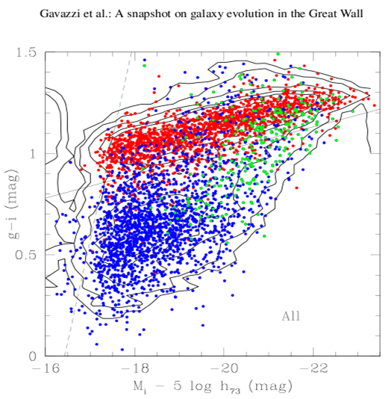
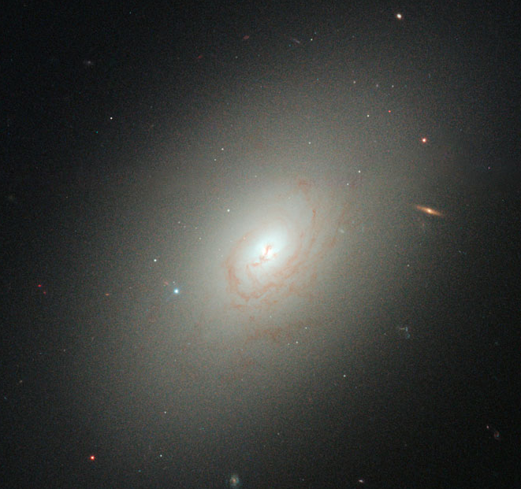
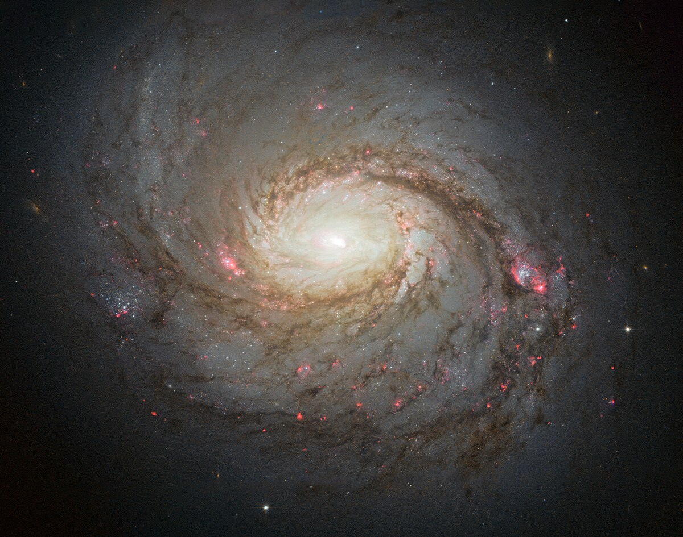
Galactic Bimodality
Elliptical Galaxies
Two main type of galaxies: red and blue ones.
Blue ones are active, young, with disk morphology.
Red ones are passive, whit elliptical morphology.
Spiral Galaxies
This suggests differences in evolution history and environment

Slide 3
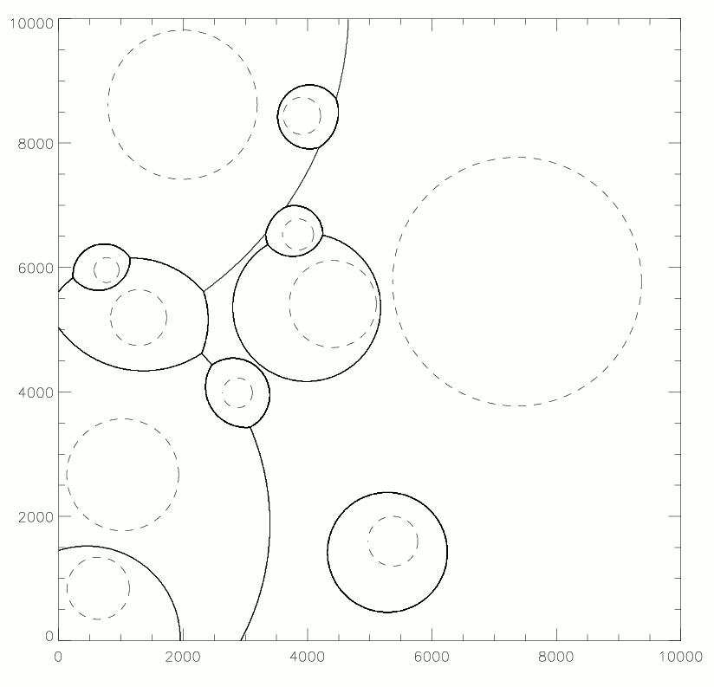
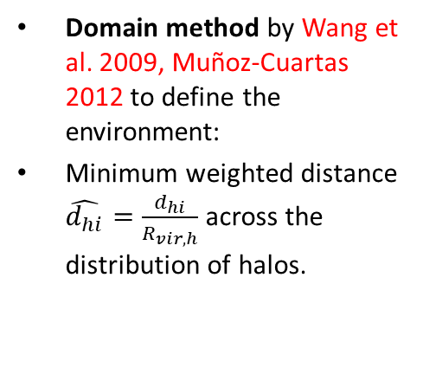
The domain as a measure of the environment of dark matter halos
Graph representing the domain of halos (Wang 2009)
Domain Contours
Domain method by Wang et al. 2009, Muñoz-Cuartas 2012 to define the environment:
Minimum weighted distance $\hat{d_{hi}}=\frac{d_{hi}}{R_{vir,h}}$ across the distribution of halos.

Slide 4
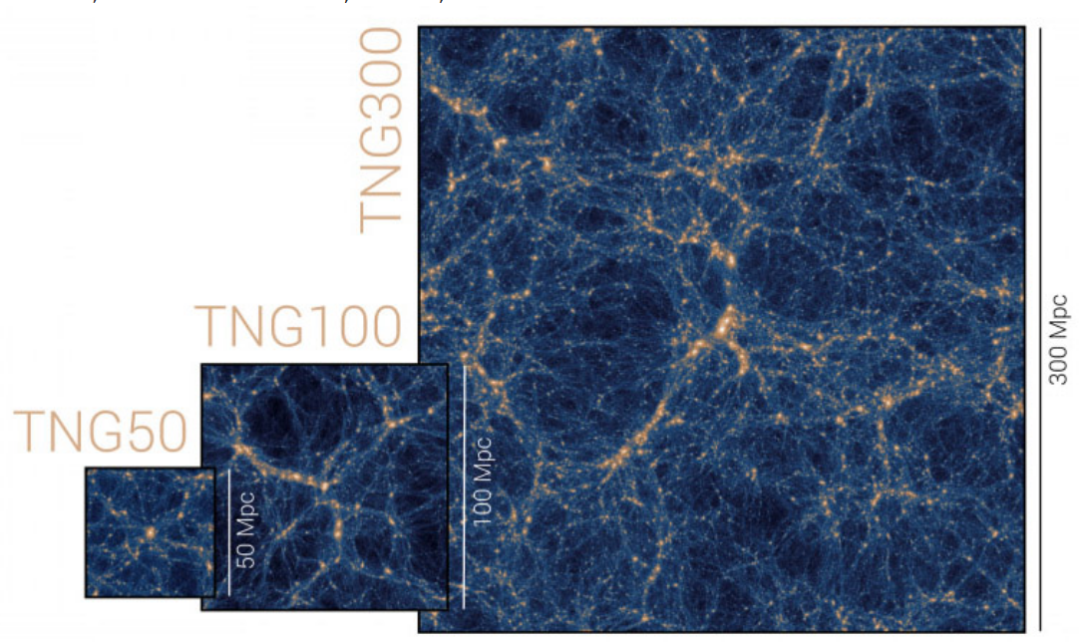
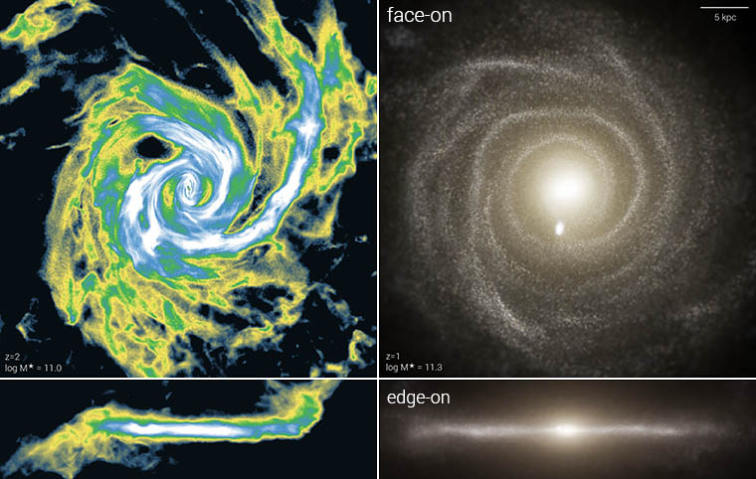

The IllustrisTNG Project
Different boxes in IllustrisTNG
The IllustrisTNG project is a suite of state-of-the-art cosmological galaxy formation simulations.
We use the catalogues and merger trees from IllustrisTNG50.
We use three simulations:
TNG50-1: the complete simulation. ${2160}^{3}$ particles.
TNG50-2: ${1080}^{3}$ particles.
TNG50-3: ${540}^{3}$ particles.
Galaxies in IllustrisTNG50

Slide 5

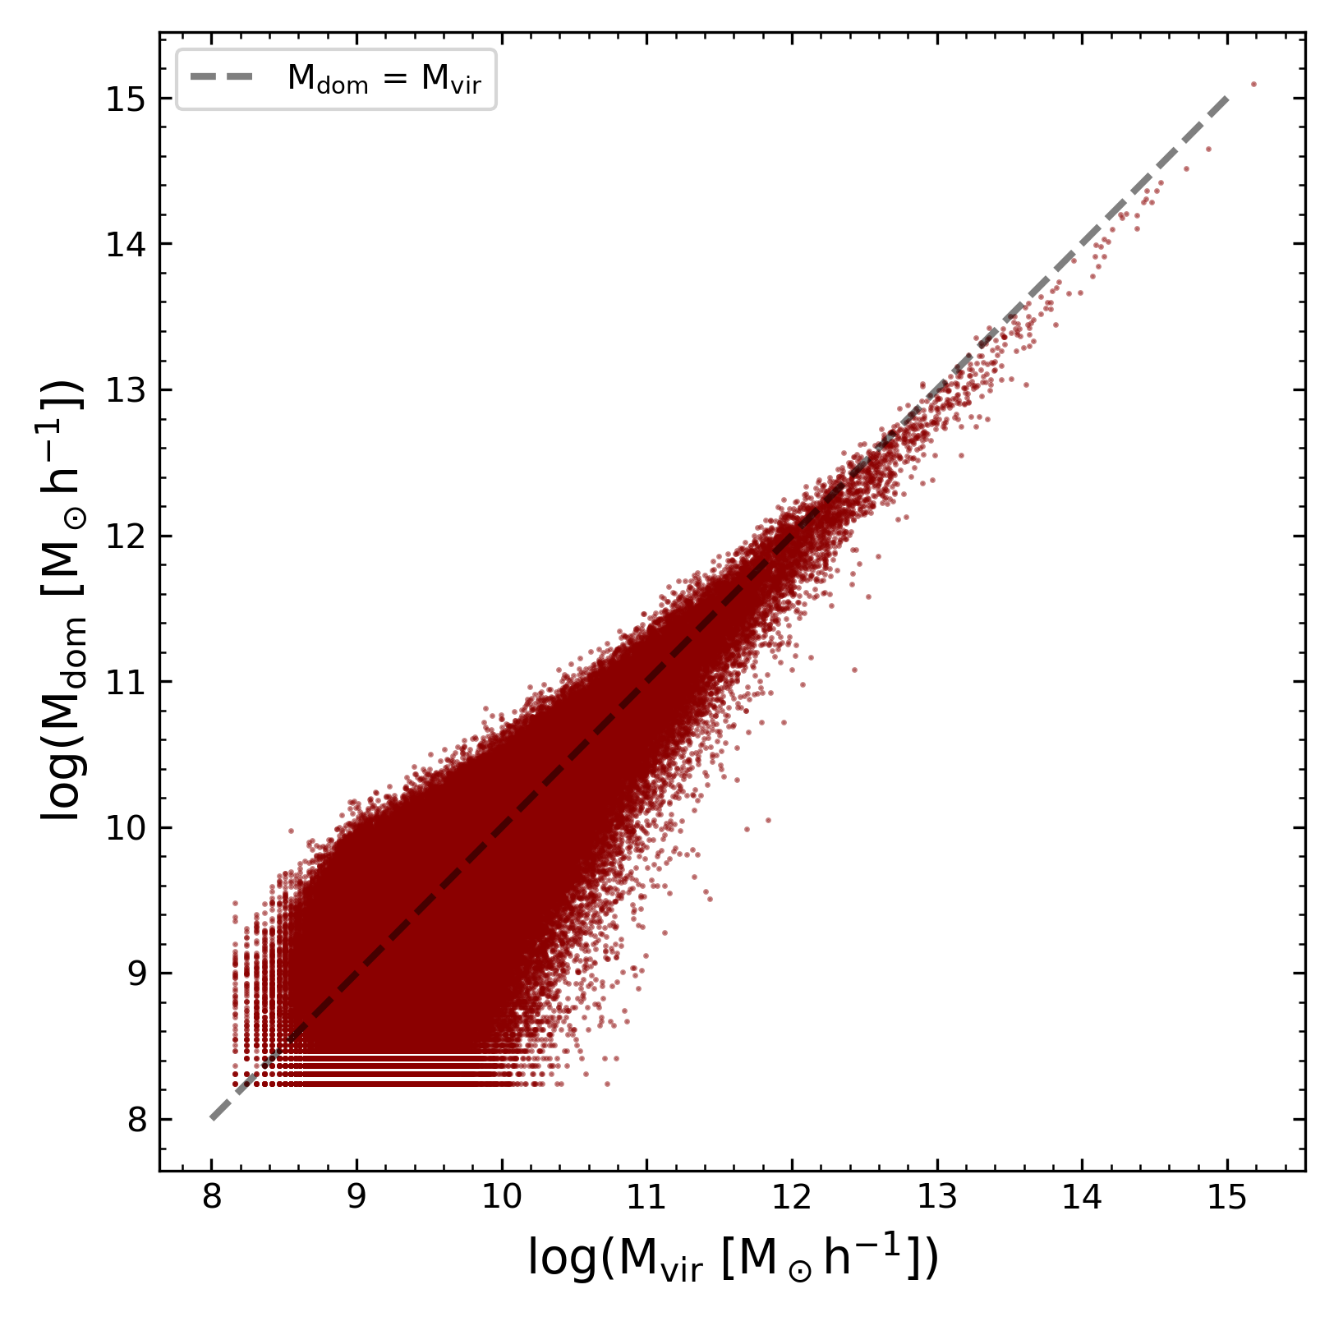
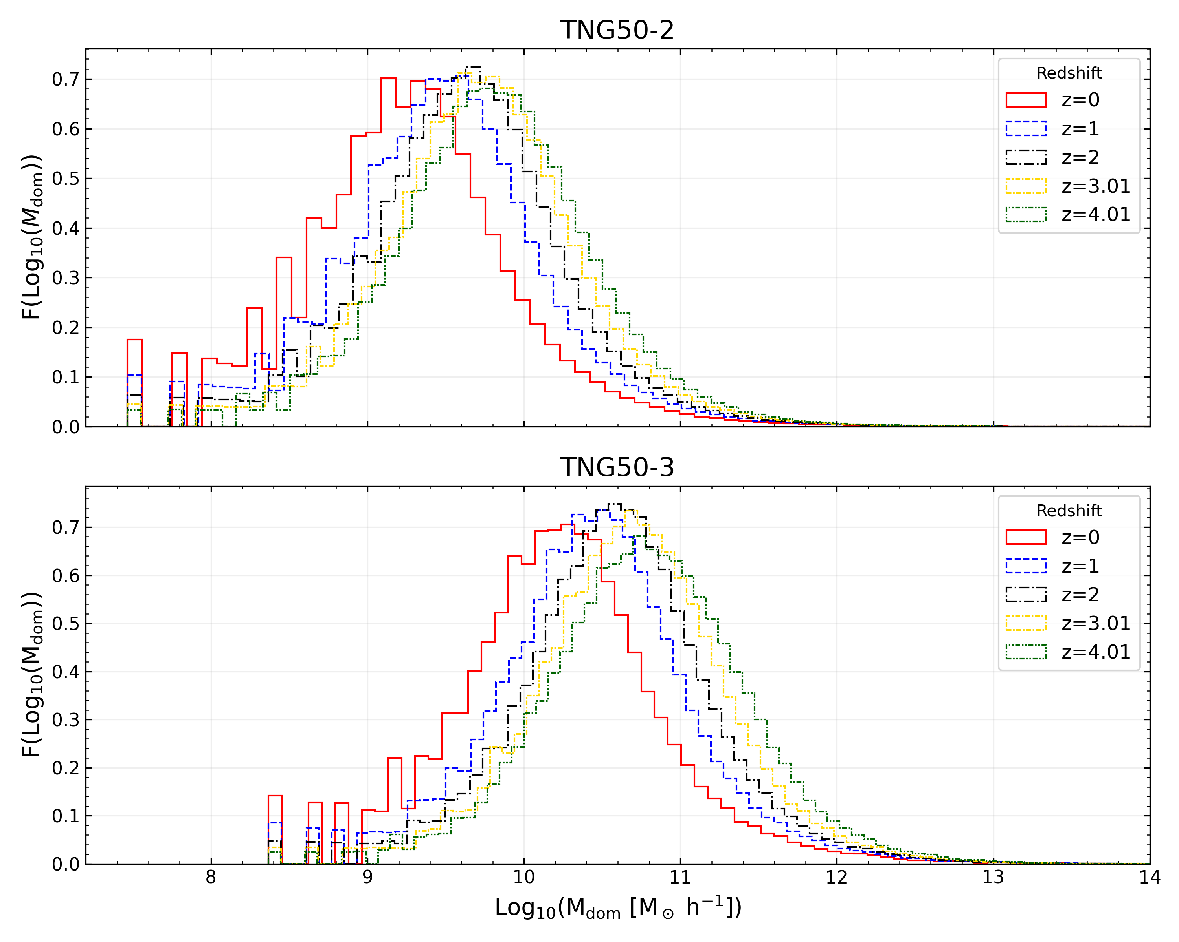
Results: Domain Properties
Lower variability ->
Relationship between domain mass and virial mass
<- Higher variability
Mass function at different Redshifts
Temporal Evolution

Slide 6
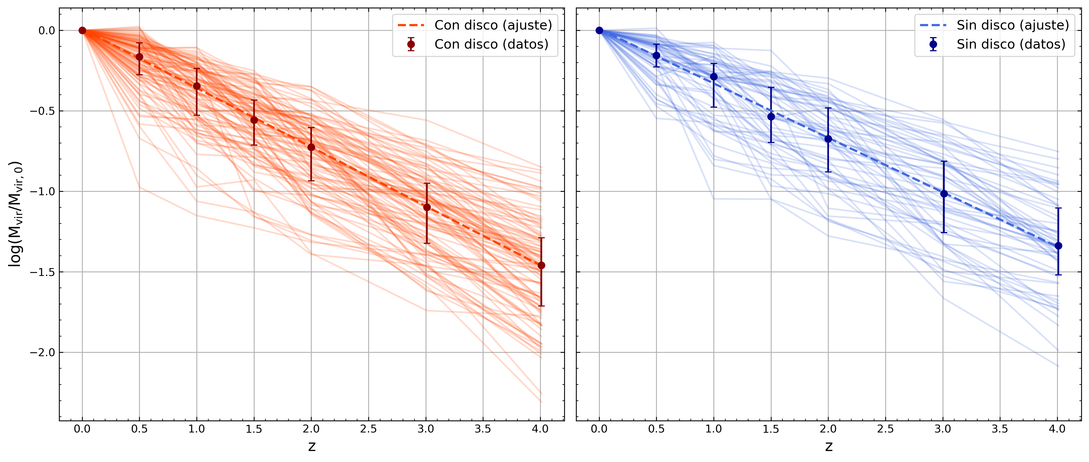
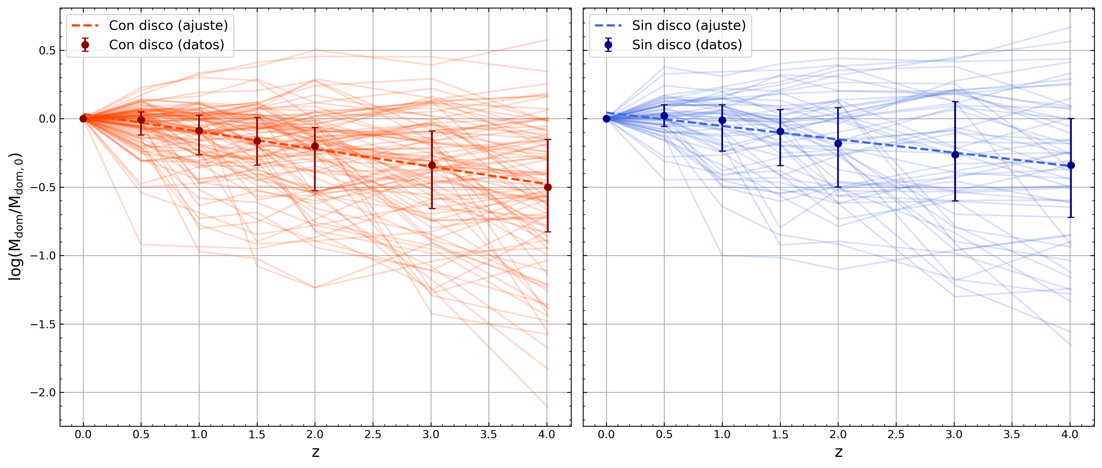




Results: Mass accretion and domain evolution for halos with disk and without disk We found clear differences in the virial accretion histories but not in the domain evolution histories for halos with and without disks
Disk
No Disk
Virial mass accretion history
$$\log\left(\frac{M_{vir}}{M_{vir,0}}\right) = −0.367z + 0.008$$
$$\log\left(\frac{M_{vir}}{M_{vir,0}}\right) = −0.338z + 0.008$$
p-value = 0.0087
Shallower evolution
p = 0.0048
Steeper evolution
Disk
No disk
Domain mass evolution history
$$\log\left(\frac{M_{dom}}{M_{dom,0}}\right) = −0.128z + 0.034$$
$$\log\left(\frac{M_{dom}}{M_{dom,0}}\right) = −0.097z + 0.044$$
p-value = 0.1625

Slide 7
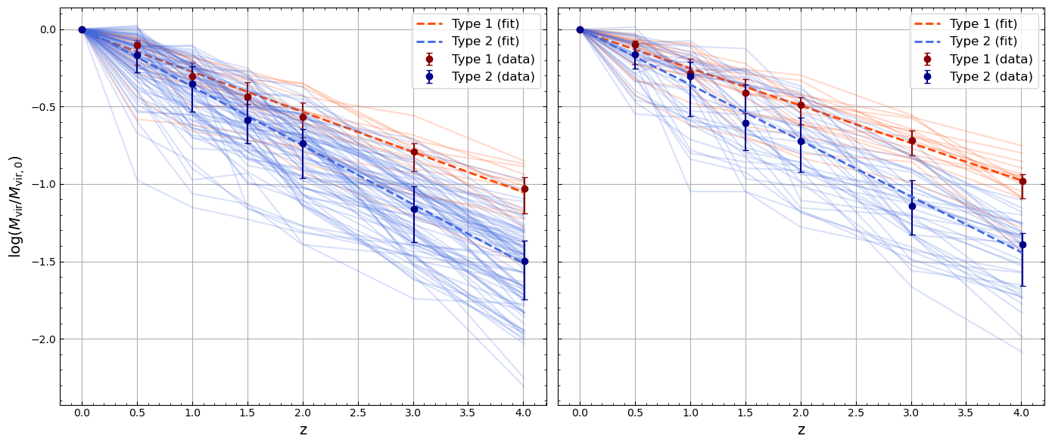






Results: Mass accretion by type of domain evolution We found significant differences in the virial mass accretion between halos with increasing and decreasing domain. Halos with increasing domain accrete virial mass more efficiently.
Halos with disk
Halos without disk
Type 1: $\log\left(\frac{M_{vir}}{M_{vir,0}}\right) = −0.259z − 0.017$
Type 1: $\log\left(\frac{M_{vir}}{M_{vir,0}}\right) = −0.242z − 0.011$
Type 2: $\log\left(\frac{M_{vir}}{M_{vir,0}}\right) = −0.380z + 0.009$
Type 2: $\log\left(\frac{M_{vir}}{M_{vir,0}}\right) = −0.361z+ 0.001$
p-value:$1.95×10^{−8}$
p-value: $8.17×10^{−9}$

Slide 8
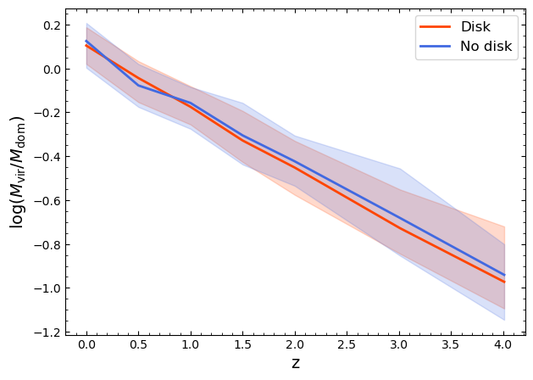
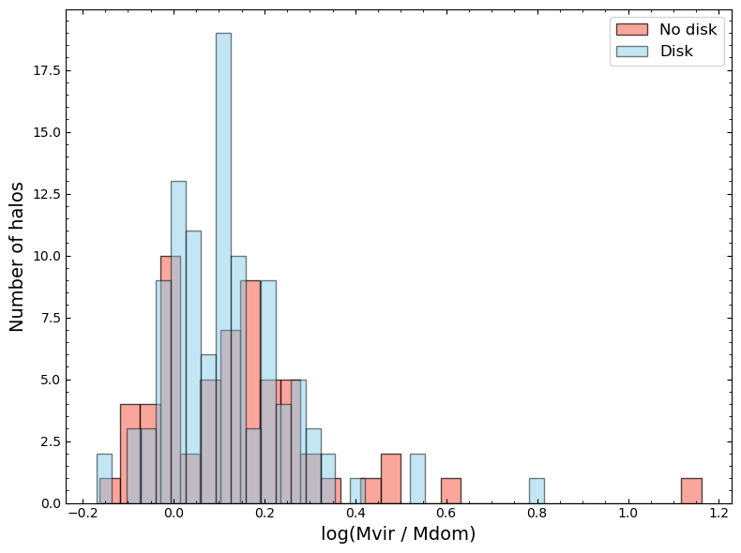
Results: Quotient between Mdom and Mvir No significant differences between halos with disk galaxies and halos without disk galaxies in Mvir/Mdom (p-value < 0.05)
p-value: 0.2181
Mvir / Mdom accretion history in halos with and without disk
Mvir / Mdom distribution in halos with and without disk

Slide 9
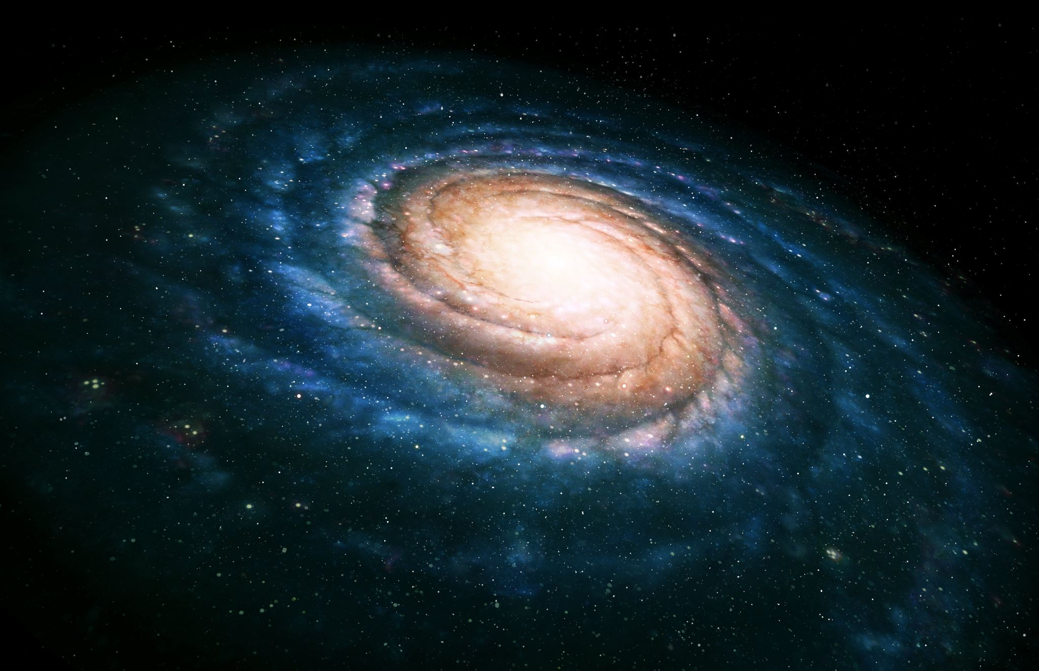
Conclusions
Galactic morphology is closely related to the mass accretion history of its halo.
How the halo environment growths in time is related with how efficiently the halo accretes mass.
The domain method allows the environment to be characterized in a physical and non-arbitrary manner.
The distributions of the ratio 𝑀vir/𝑀dom show no differences between galaxies with and without disks.

Slide 10
References
[1] Muñoz-Cuartas, J.C., Properties of the cosmic mass distribution: Halos, environments and galaxies, PhD Thesis, Potsdam Universitaet, 2012
[2] F. A. Cardona Jaramillo, "About galactic disk formation and the relation between satellite orbital parameters and the morphology of the host galaxy," M.Sc. thesis, Institute of Physics, Faculty of Exact and Natural Sciences, University of Antioquia, Medellín, Colombia, Jan. 2021. Advisor: J. C. Muñoz-Cuartas.
[3] D. Nelson, V. Springel, A. Pillepich, V. Rodriguez-Gomez, P. Torrey, S. Genel, M. Vogelsberger, R. Pakmor, F. Marinacci, R. Weinberger, L. Kelley, M. Lovell, B. Diemer, and L. Hernquist, “The IllustrisTNG Simulations: Public Data Release,” arXiv, vol. arXiv:1812.05609, 2021.
[4] D. Nelson, A. Pillepich, V. Springel, R. Pakmor, R. Weinberger, S. Genel, P. Torrey, M. Vogelsberger, F. Marinacci, and L. Hernquist, “First results from the TNG50 simulation: galactic outflows driven by supernovae and black hole feedback,” Monthly Notices of the Royal Astronomical Society, vol. 490, no. 3, pp. 3234–3261, Aug. 2019, doi: 10.1093/mnras/stz2306.
[5] A. Pillepich, D. Nelson, V. Springel, R. Pakmor, P. Torrey, R. Weinberger, M. Vogelsberger, F. Marinacci, S. Genel, A. van der Wel, and L. Hernquist, “First results from the TNG50 simulation: the evolution of stellar and gaseous discs across cosmic time,” Monthly Notices of the Royal Astronomical Society, vol. 490, no. 3, pp. 3196–3233, Sep. 2019, doi: 10.1093/mnras/stz2338.
[6] R. Weinberger, V. Springel, L. Hernquist, A. Pillepich, F. Marinacci, R. Pakmor, D. Nelson, S. Genel, M. Vogelsberger, J. Naiman, and P. Torrey, “Simulating galaxy formation with black hole driven thermal and kinetic feedback,” Monthly Notices of the Royal Astronomical Society, vol. 465, no. 3, pp. 3291–3308, Nov. 2016, doi: 10.1093/mnras/stw2944.
[7] P. Wang, X. Kang, N. I. Libeskind, Q. Guo, S. Gottlöber, and W. Wang, “A robust determination of halo environment in the cosmic field,” *New Astronomy*, vol. 80, p. 101405, 2020, doi: [10.1016/j.newast.2020.101405](https://doi.org/10.1016/j.newast.2020.101405).

Slide 11
Thanks for your attention

Slide 12
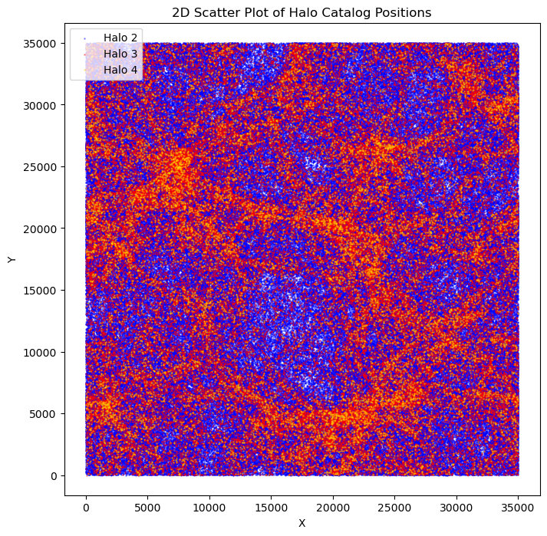

Slide 13
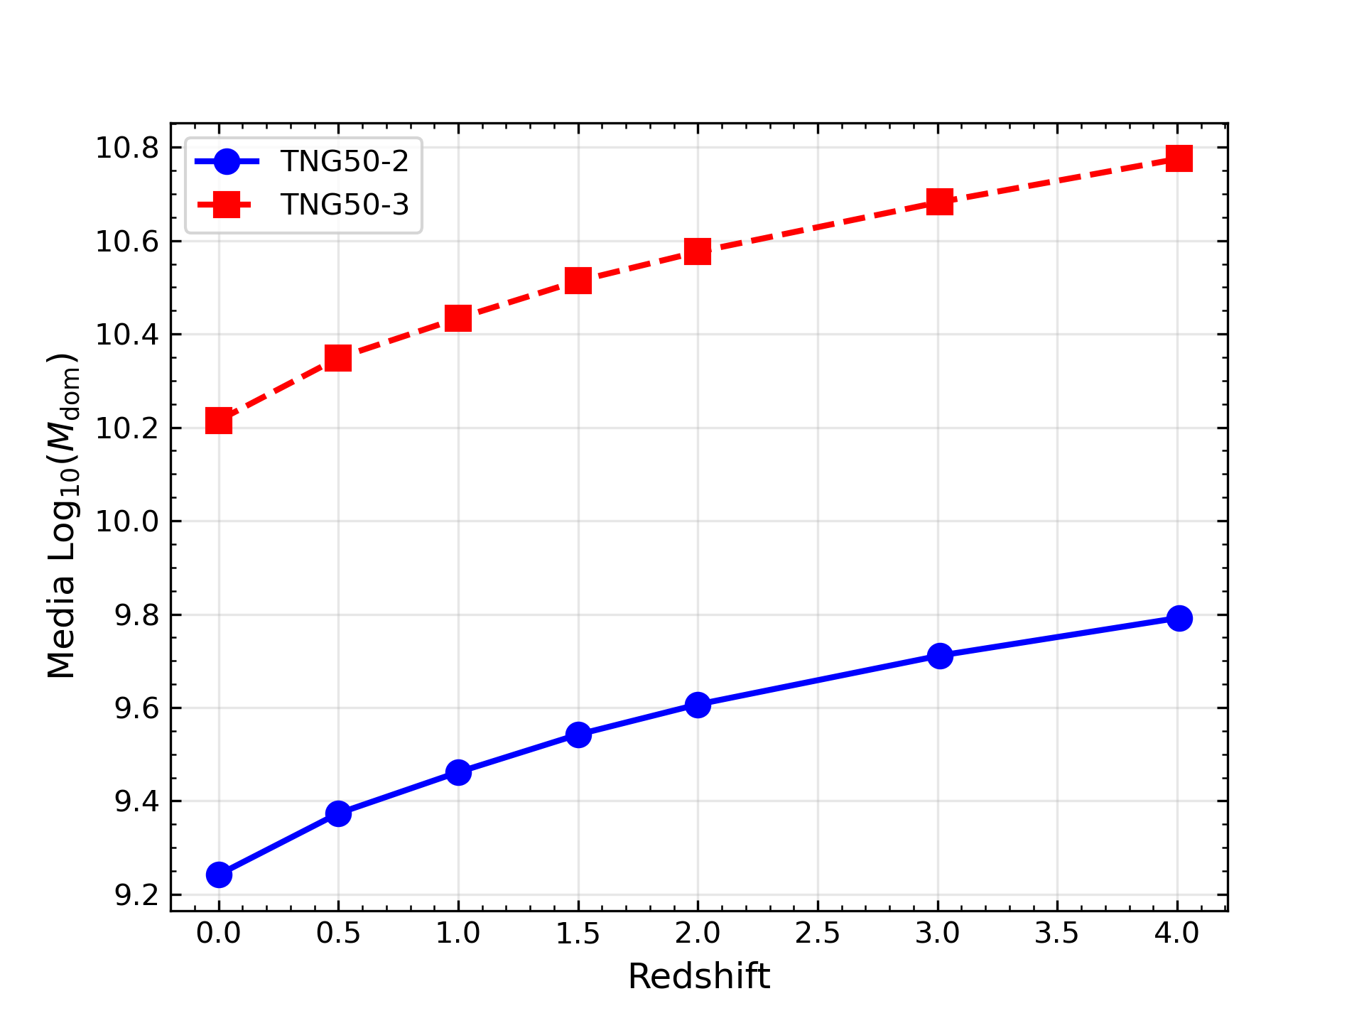

Slide 14
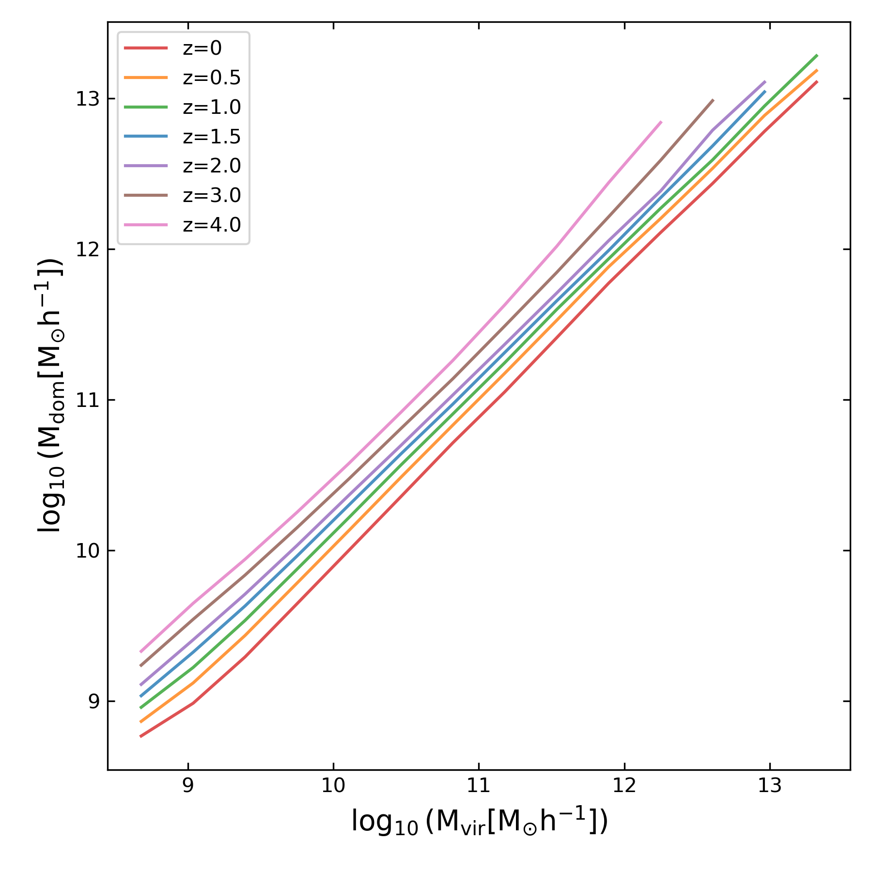

Slide 15
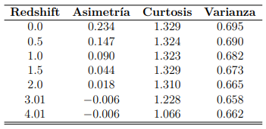

Slide 16
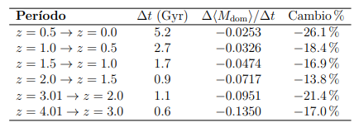

Slide 17
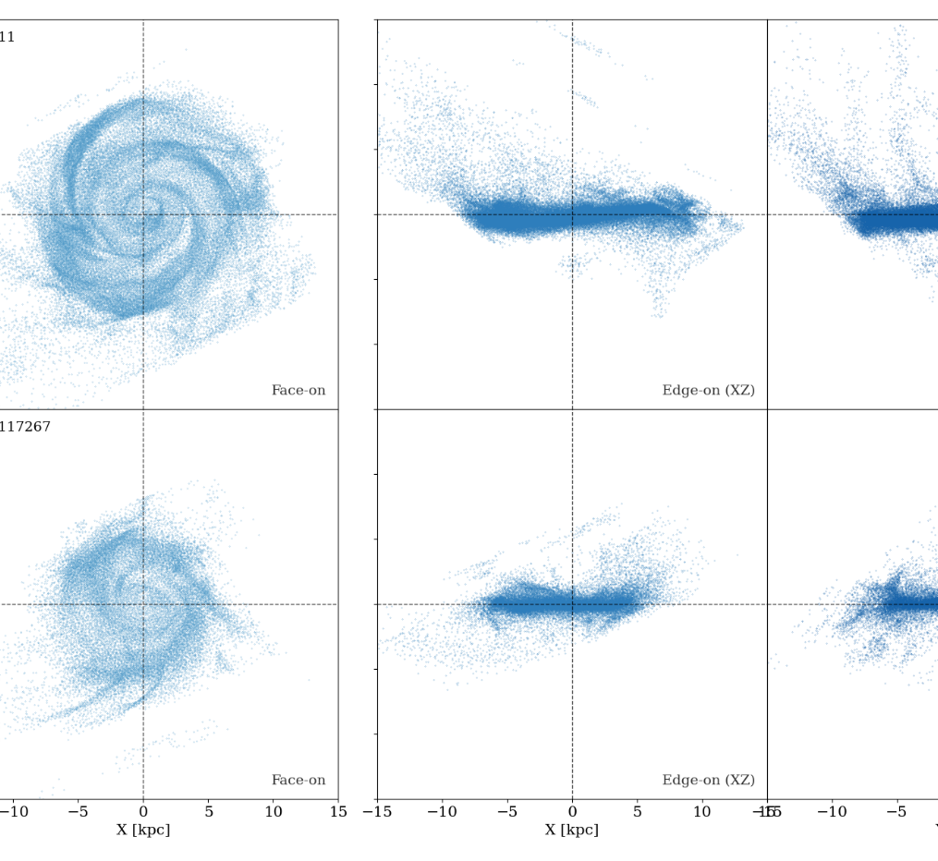
Matching between runs: Strategy for solving a technical problem
Identification of disks with gas particles (Certuche & Muñoz-Cuartas 2025)
Matching halos between runs
TNG50-1: High resolution but high computational cost.
TNG50-3: Low resolution but low computational cost.

Slide 18
Morphology, evolution and galactic environment
The morphology is associated with merger history.
These histories depend on the cosmological environment in which the halo grows (Cardona & Muñoz-Cuartas 2021).
Objective: To study how the environment and the evolution of mass influence the final morphology of galaxies.

