Slide 1
Screens affecting the memory
By Karolina Kuśmierz & Magda Dróżdż

Slide 2
Main idea & why this topic?
The new phone policy & its impact
Help with studying
Interests a lot of young people
Our curiosity
Hypothesis
Screens are disturbing the memory. They make us forget what we just learned because of overstimulation that we get from it

Slide 3
What do we want to show?
How human memory is fragile.
Being mindful in how we study.
The influence of screens on everything.

Slide 4
Process of the experiment
  -Group 1 is watching one of the 4 videos (chosen by us)
  -Group 2 is staying on the corridor, (possibly) in silence or talking about the picture
1. Explaining the students what we will be doing and why we are doing it;
2. Showing them the picture for 2 minutes and telling they must remember as many details as possible
3. Splitting them into 2 groups
4. Group 2 is coming back to the class
5. The whole class gets a test in their L1 (L2 if its L2/geo/eco class) about the picture.

Slide 5
Expanding the experiment
Funny video
[Psychodelic "fever dream" video]
Not evoking emotions
Cute video
Scary video
Short
long

Slide 6
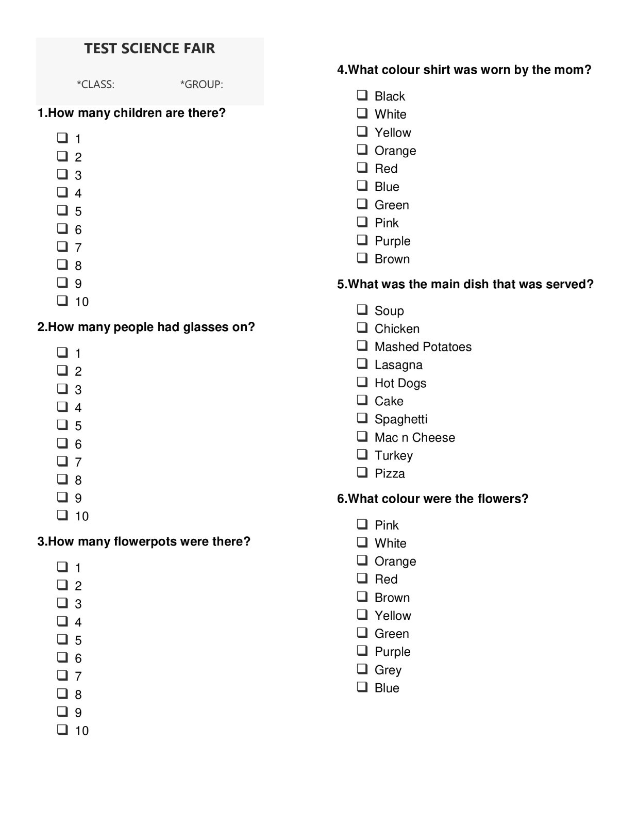
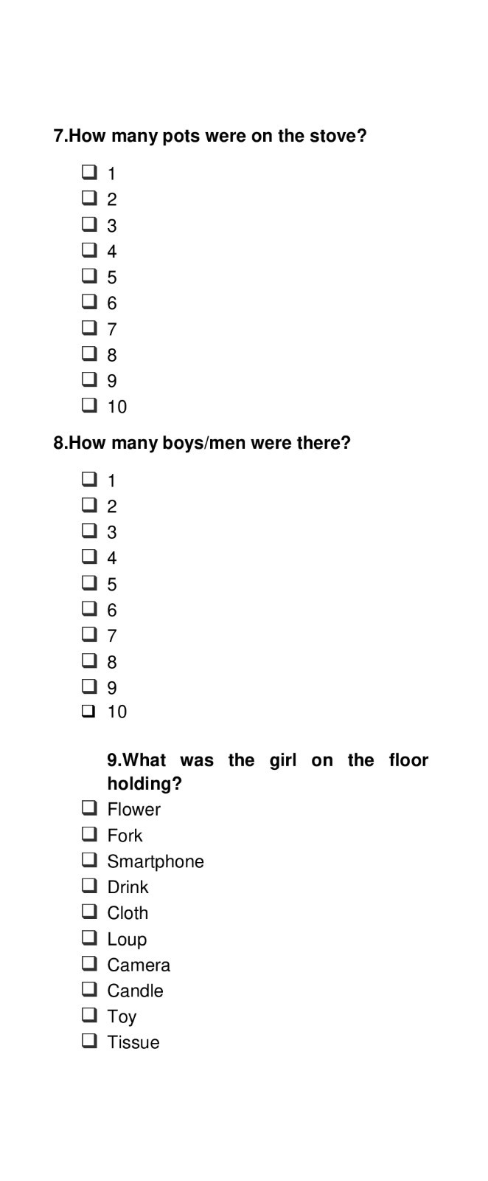
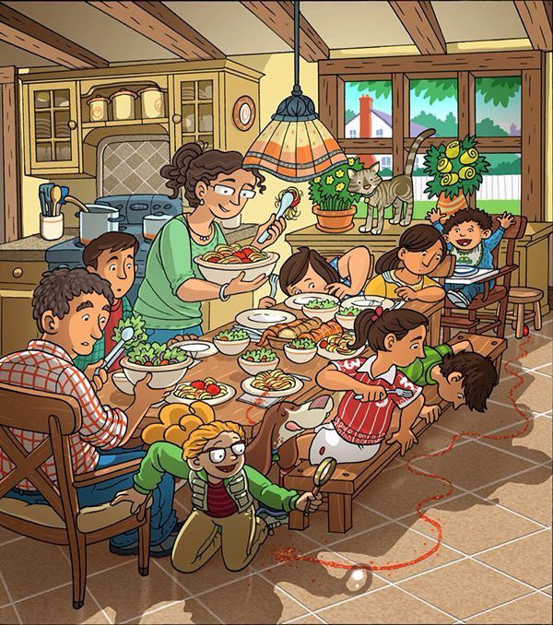
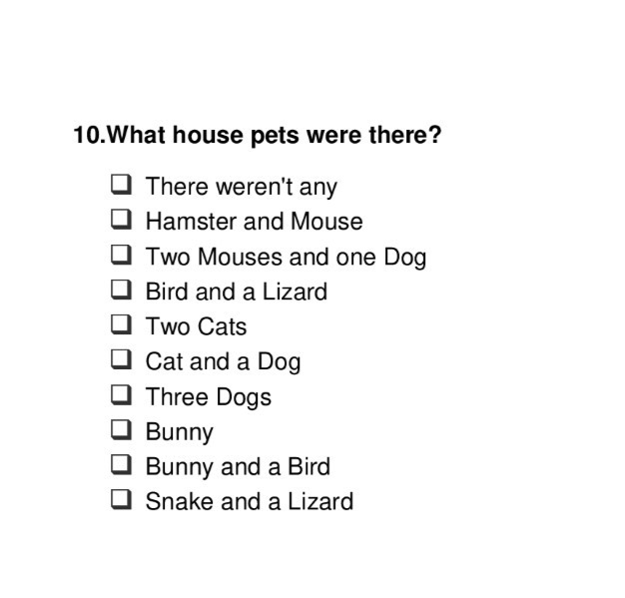
Important figures / pictures

Slide 7
Data
Number of tested students in total: 505
Number of tested classes: 32
The test was translated from english into other languages by chat gpt (*then checked by a native speaker)
The videos used were:
Shot from "The Ring" (scary video)
Combination of cute cats videos (cute video)
"Fever Dream - Psychedelic 2D Animation" From Youtube, (short and long [made with a loop] video)

Slide 8
Results: in terms of the video watched
[Unit is a percantage of right answers]
 | Short Video | Long Video | Cute Video | Scary Video
Group1 | 60.0% | 53.2% | 56.1% | 53.9%
Group2 | 61.2% | 52.2% | 59.0% | 62.0%

Slide 9
Results: in terms of the population of the sample
[unit is a number of people]
Class | short | video | long | video | cute | video | scary | video
 | g1 | g2 | g1 | g2 | g1 | g2 | g1 | g2
s1 | 7 | 8 |  |  | 6 | 5
s2 |  |  |  |  | 7 | 6
s3 | 9 | 7 | 18 | 16 | 8 | 7 | 22 | 23
s4 | 15 | 16 | 5 | 4 | 19 | 18 | 8 | 6
s5 | 31 | 29 |  |  |  |  | 23 | 18
s6 | 15 | 11 | 13 | 11 | 6 | 7 | 16 | 13
s7 |  |  | 26 | 24 | 11 | 11
Total | 77 | 71 | 62 | 55 | 57 | 54 | 69 | 60

Slide 10
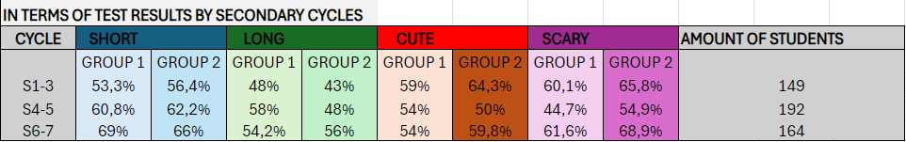
Results:
Grades are divided into 3 cycles
Cycle | Group 1 | Group 2 | Group 1 | Group 2 | Group 1 | Group 2 | Group 1 | Group 2
 | short | video | long | video | cute | video | scary | video
s1-3 | 53.3% | 56.4% | 48.0% | 43.0% | 59.0% | 64.3% | 60.1% | 65.8%
s4-5 | 60.8% | 62.2% | 58.0% | 48.0% | 54.0% | 50.0% | 44.7% | 54.9%
s6-7 | 69.0% | 66.0% | 54.2% | 56.0% | 54.0% | 59.8% | 61.6% | 68.9%

Slide 11
Explanation of the results (length)
The difference between subgroups (1&2) are very small.
However, difference between percange of right answers in short video and long are significant.
It shows how time of screen exposure has impact on the memory
Shorter screen exposure better memory
[*consider margin of error?]

Slide 12
Explanation of the results (emotions)
Expectations: cuter video would have better results than the scary one.
Bigger difference in subgroups (1&2) than length videos. [8.1% difference with g1 being worse in scary video]
Scary video
Cute video
Stress creating false memories; high cortisol levels affecting long term memory
Our records having slight difference in % [2.9%, worse for g1] in sources founded fun videos perform negatively (OECD, 2024)

Slide 13
Disturbance of the experiment
Talking
Not focusing on the picture we were showing
Talking in the corridor
Using a phone
Cheating on the test
Writing wrong group number by a student
Ensurance of more controlled environment and willing/determined participants/volunteers

Slide 14

Recommendations
This chart represents our addiction to screens.
[120 students asked, sample from ages between 13-18]
One video scrolling for hours

Slide 15
Biography
Henry, M. (n.d.). [The impact of acute psychosocial stress on false memory]. University of Cape Town. Retrieved March 7, 2025, from https://humanities.uct.ac.za/sites/default/files/content_migration/humanities_uct_ac_za/1233/files/Michelle.Henry_.pdf
Newcomer, J. W., Selke, G., Melson, A. K., Hershey, T., Craft, S., Richards, K., & Alderson, A. L. (1999). “Decreased memory performance in healthy humans induced by stress-level cortisol treatment.” (“Decreased Memory Performance in Healthy Humans Induced by Stress-Level ...”) Archives of General Psychiatry, 56(6), 527-533. Retrieved March 7, 2025, from
https://doi.org/10.1001/archpsyc.56.6.527
OECD. (2024). Students, digital devices and success: A policy review (OECD Report). OECD Publishing. Retrieved March 7, 2025, from
https://www.oecd.org/content/dam/oecd/en/publications/reports/2024/05/students-digital-devices-and-success_621829ff/9e4c0624-en.pdf
Twenge, J. M., & Campbell, W. K. (2018). Associations between screen time and lower psychological well-being among children and adolescents: Evidence from a population-based study. Preventive Medicine Reports, 12, 271–283.
Retrieved March 9, 2025, from
https://pmc.ncbi.nlm.nih.gov/articles/PMC6214874/

