Slide 1



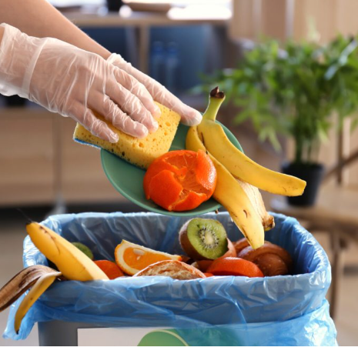
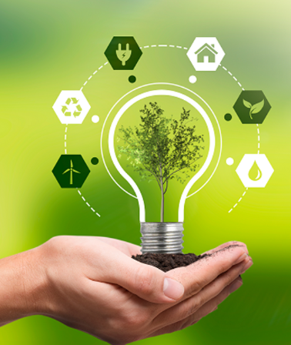



Waste to Watt
Transforming waste into an eco-friendly energy source
By Riya Kalkar S5ENB and Yijin Wang S5ENA
European School RheinMain

Slide 2


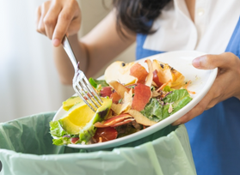
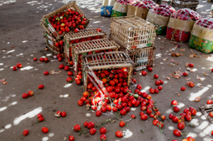
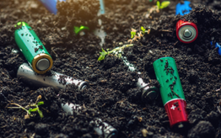




Introduction & Aim of the project
Today our world faces two significant challenges:
Food loss
Battery pollution
Approximately 13% of food is wasted during transportation, and an additional 1.6 billion tonnes are discarded in grocery stores.
common electrolytes like LiPF₆ are harmful to both humans and the environment, during production and when disposed improperly.
Solution
by developing a food-based electrolyte battery using salts from the wasted/spoiled fruits and vegetable, food loss will be reduced and the usage of non-ecofriendly batteries will be minimized.

Slide 3



Overview of the project
Objectives
  To create a food-based electrolyte battery to address/solve two global challenges: food loss and battery pollution
  To create battery carrying an average of 1.5 - 2 V. (Enough to power small appliances)
  To test out different spoiled/wasted fruits or vegetables for obtaining electrolyte with best voltage
  To design a battery using the concept of galvanic cell

Slide 4

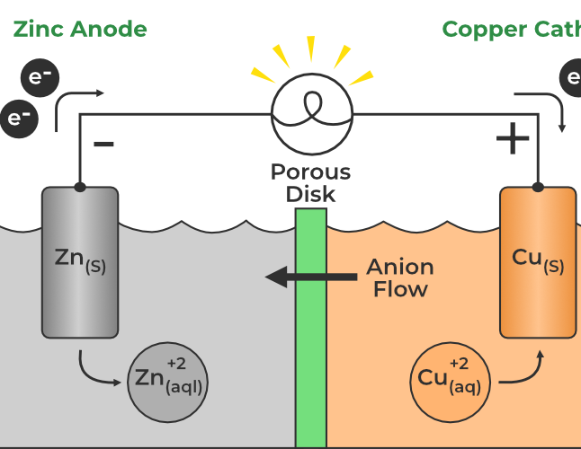
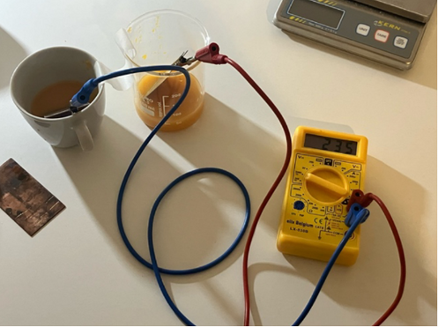
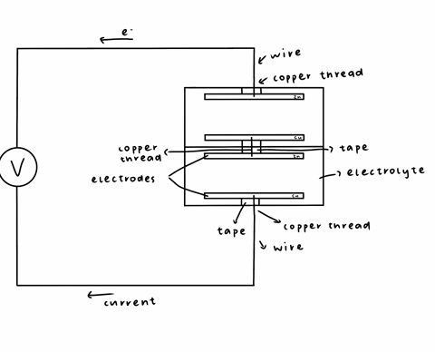
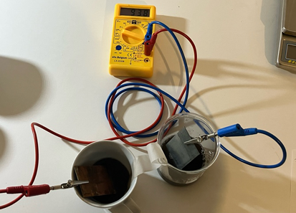



Methods & Development
Stage 1: set up galvanic cells and record results
Stage 2: design and build the battery
Chemistry background:
Knowledge of electricity and galvanic cells from the S5 class syllabus
Electrodes: zinc,copper,aluminium
Used 5 old mandarins, 12 sprouted potatoes
Set up two interconnected galvanic cells inside the battery. (use previous data for size, no. of galvanic cell, desired voltage)
PHASE 1
PHASE 2
PHASE 3

Slide 5
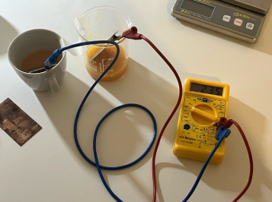
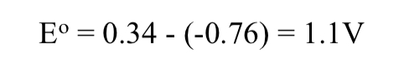
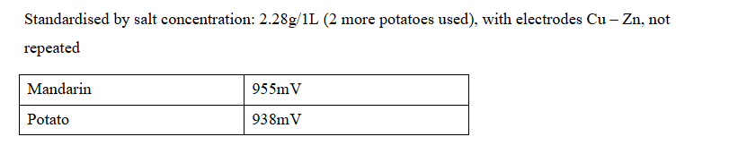
Our Results – stage 1
Galvanic Cell:
  Electrode pair Cu-Zn produces the most voltage
  Mandarins produce a higher voltage compared to potatoes.
  1 galvanic cell was incapable of producing more than 1V of voltage

Slide 6

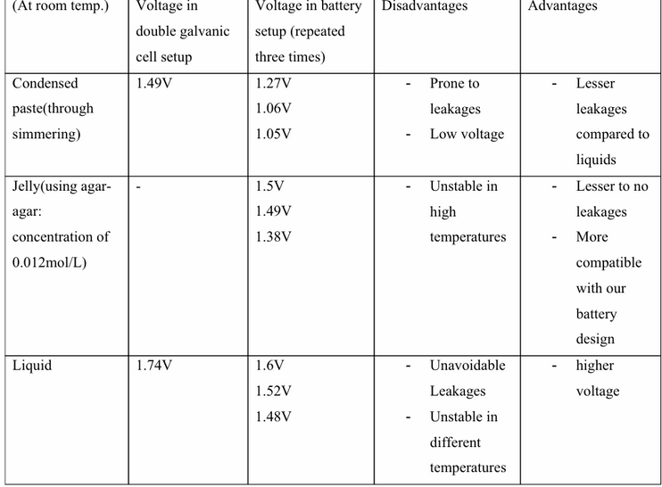
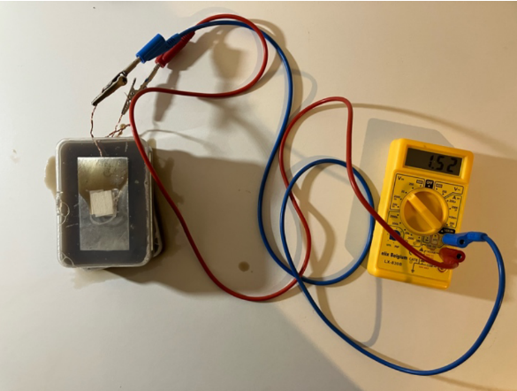
Our Results – stage 2
  Finalised design of the battery consists of two connected galvanic cells
  highest voltage produced was 1.52 V.

Slide 7
Observations
Improvements
  The zinc-copper electrode pair produced more voltage than the expected aluminum-copper pair
  The condensed paste electrolyte produced lower voltage than expected
  Voltage decreased when transitioning from the double galvanic cell setup to the battery setup
  Air Gaps in Plastic Boxes
  Copper Thread Conductivity Issues
  Use thicker copper threads
  Experiment with the placement of the copper threads
  Further compress the battery
  Measure the current produced by the experiments
  Decrease the amount of air bubbles in the battery boxes

Slide 8

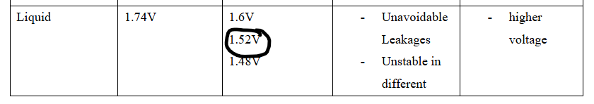

Conclusion
Battery with the highest voltage has an average voltage of 1.52 V.

Slide 9
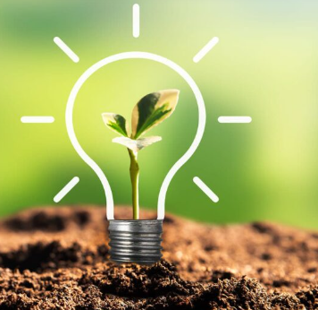

Acknowledgments & Sources
Thanks to Dr. Anne Samland, for guiding us throughout
  STEM Generation. Potato power! https://stemgeneration.org/potato-power/ Accessed 22/10/2024
  Working scientifically with vegetable and fruit batteries. https://discovery.ucl.ac.uk/id/eprint/10141611/1/PS%20171%20Markwick%20and%20White%20Electricity.pdf Accessed 22/10/2024
  Uni Siegen. Half cells and Galvanic cells https://www.chemie-biologie.uni-siegen.de/ac/hjd/lehre/ws0910/vortraege_advanced/utsch_half_cells_and_galvanic_cellsws0910_corr.pdf Accessed 07/01/2025
  Green Electrolytes for Aqueous Ion Batteries: Towards High-Energy and Low-Temperature Applications. https://chemistry-europe.onlinelibrary.wiley.com/doi/abs/10.1002/batt.202400579 Accessed 07/01/2025 Accessed 26/11/2024

Slide 10

Let us take a step further towards making our world greener
Thank you for listening!

