Slide 1

SELF-SUSTAINED
MOISTURE-INVOLVED ELECTRICITY GENERATION
Arnav GUPTA, Oberon JOHNSON, Matvey NIKONOROV

Slide 2
“It is estimated that water absorbs and releases up to 60 PW (10¹⁵ W) of energy per year, three orders of magnitude more than the annual global energy consumption. Moisture energy generators aim to harness this energy through various methods.”

Slide 3
PURPOSE
Our aim was to explore Moisture Energy Generators, as a renewable energy technology that can generate electricity from water vapour in the air using ordinary household materials

Slide 4
PROBLEM
ENERGY INEQUALITY & ACCESS
Nearly a billion people still lack access to electricity in rural regions
LIMITATIONS OF RENEWABLES
Solar panels need sunlight. Wind turbines need wind.
CLIMATE CHANGE
Rising temperatures and emissions are disrupting weather and ecosystems.

Slide 5
01
02
TABLE OF CONTENTS
03
04
05
HOW MEGS WORK
MATERIALS AND KEY COMPONENTS
DESIGNS AND ITERATIONS
RESULTS
DISCUSSION AND CONCLUSION

Slide 6
01
HOW MEGS WORK

Slide 7
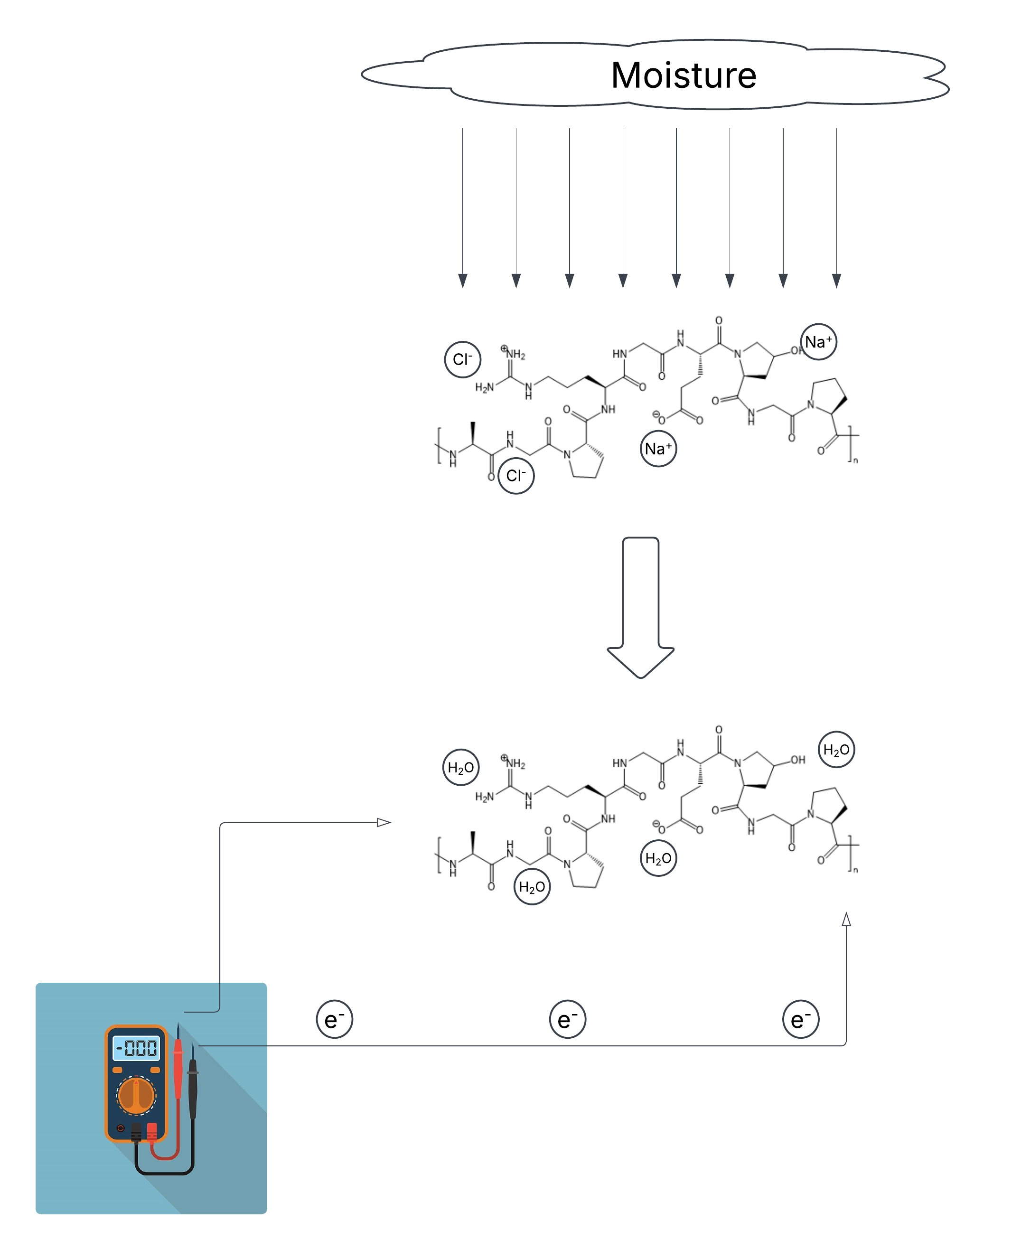
How MEGs work

Slide 8
02
MATERAILS & KEY COMPONENTS

Slide 9
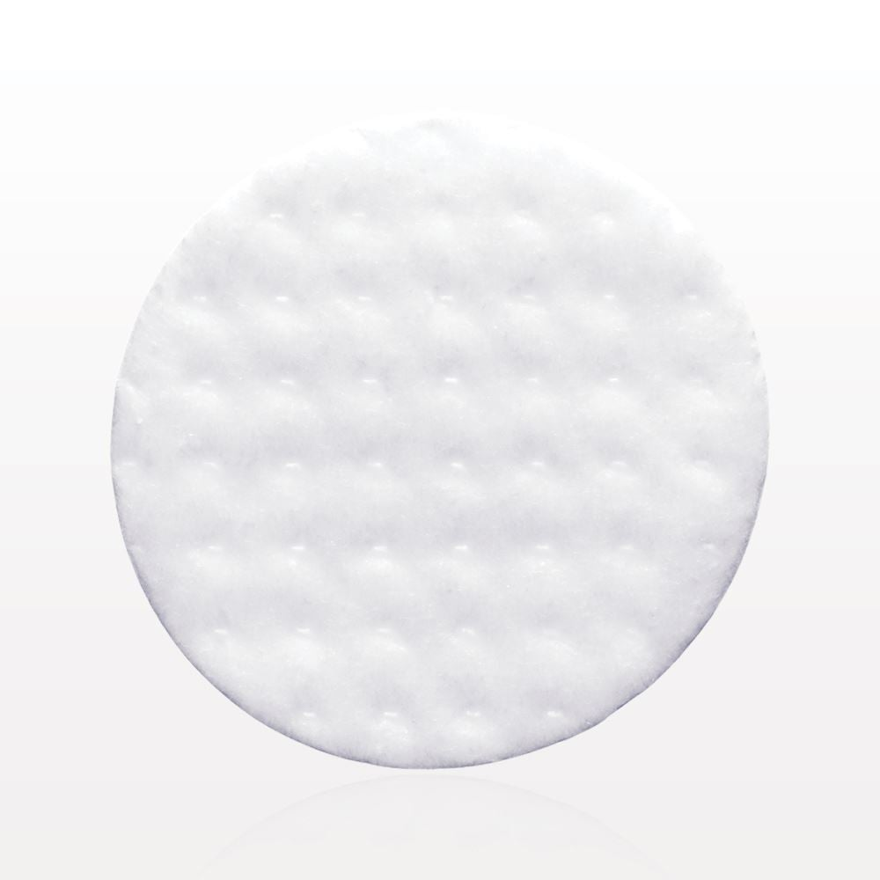
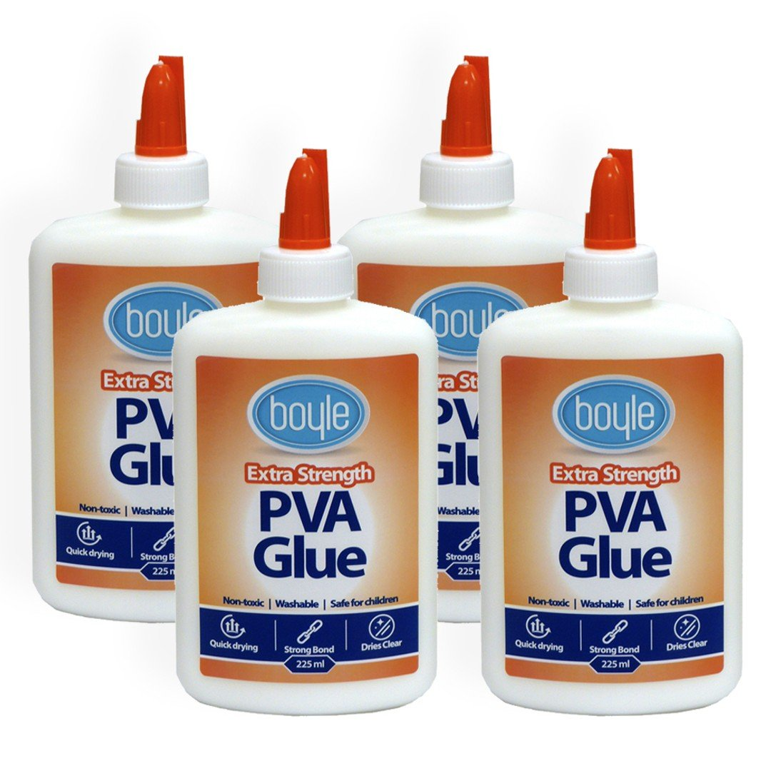
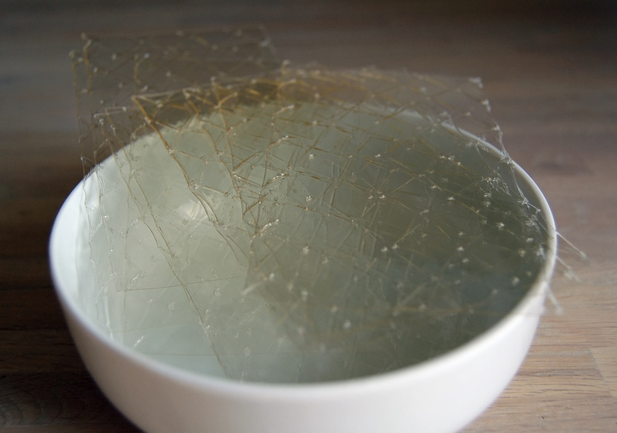
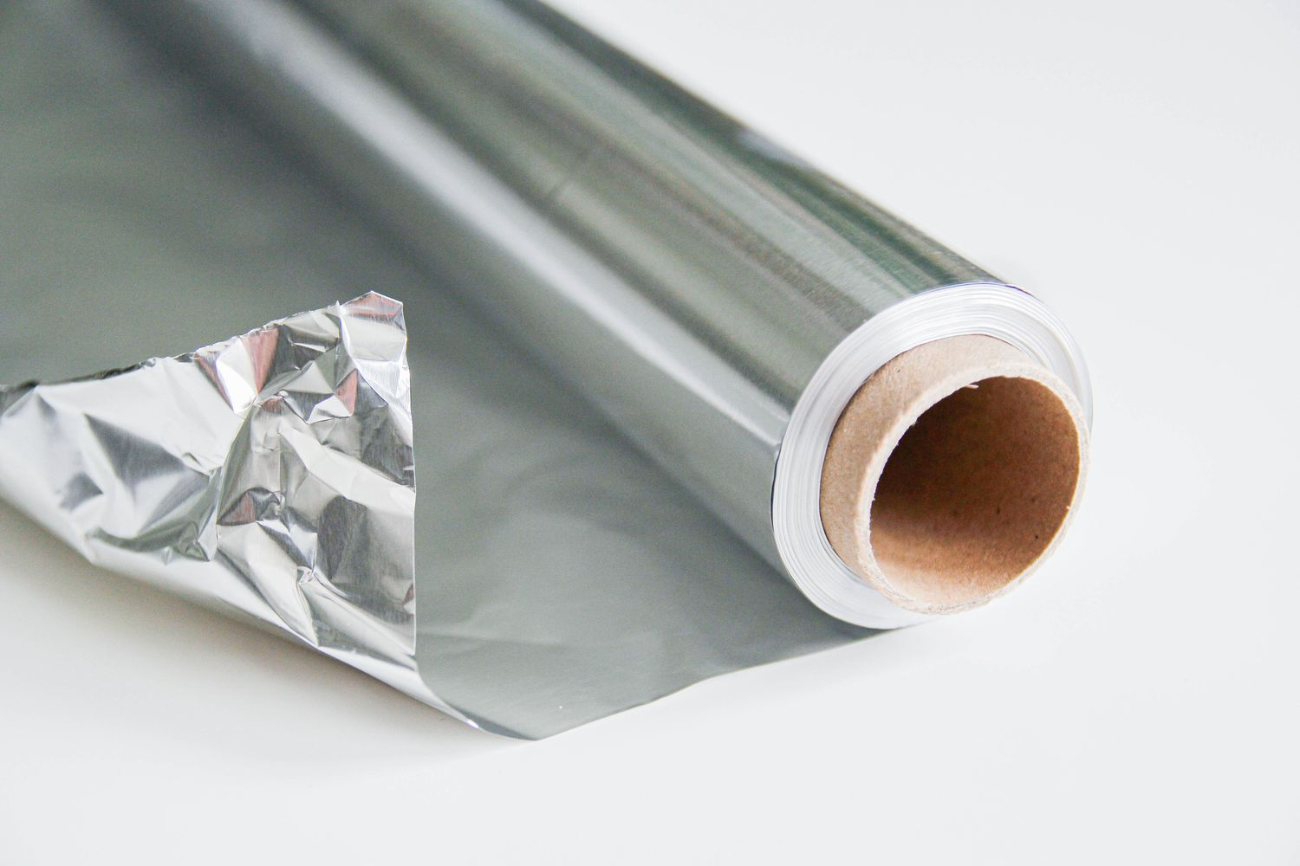
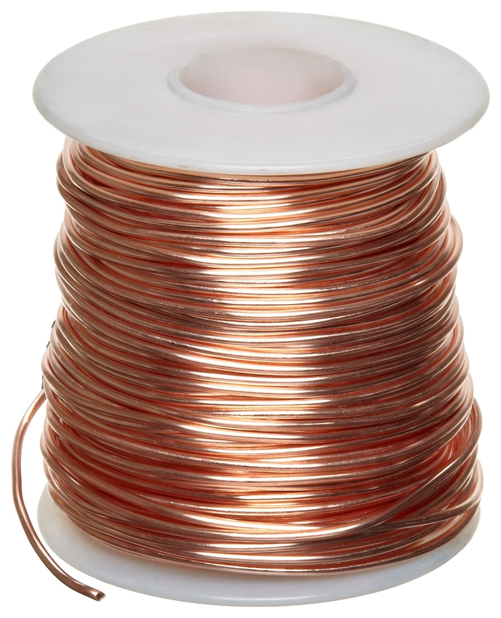
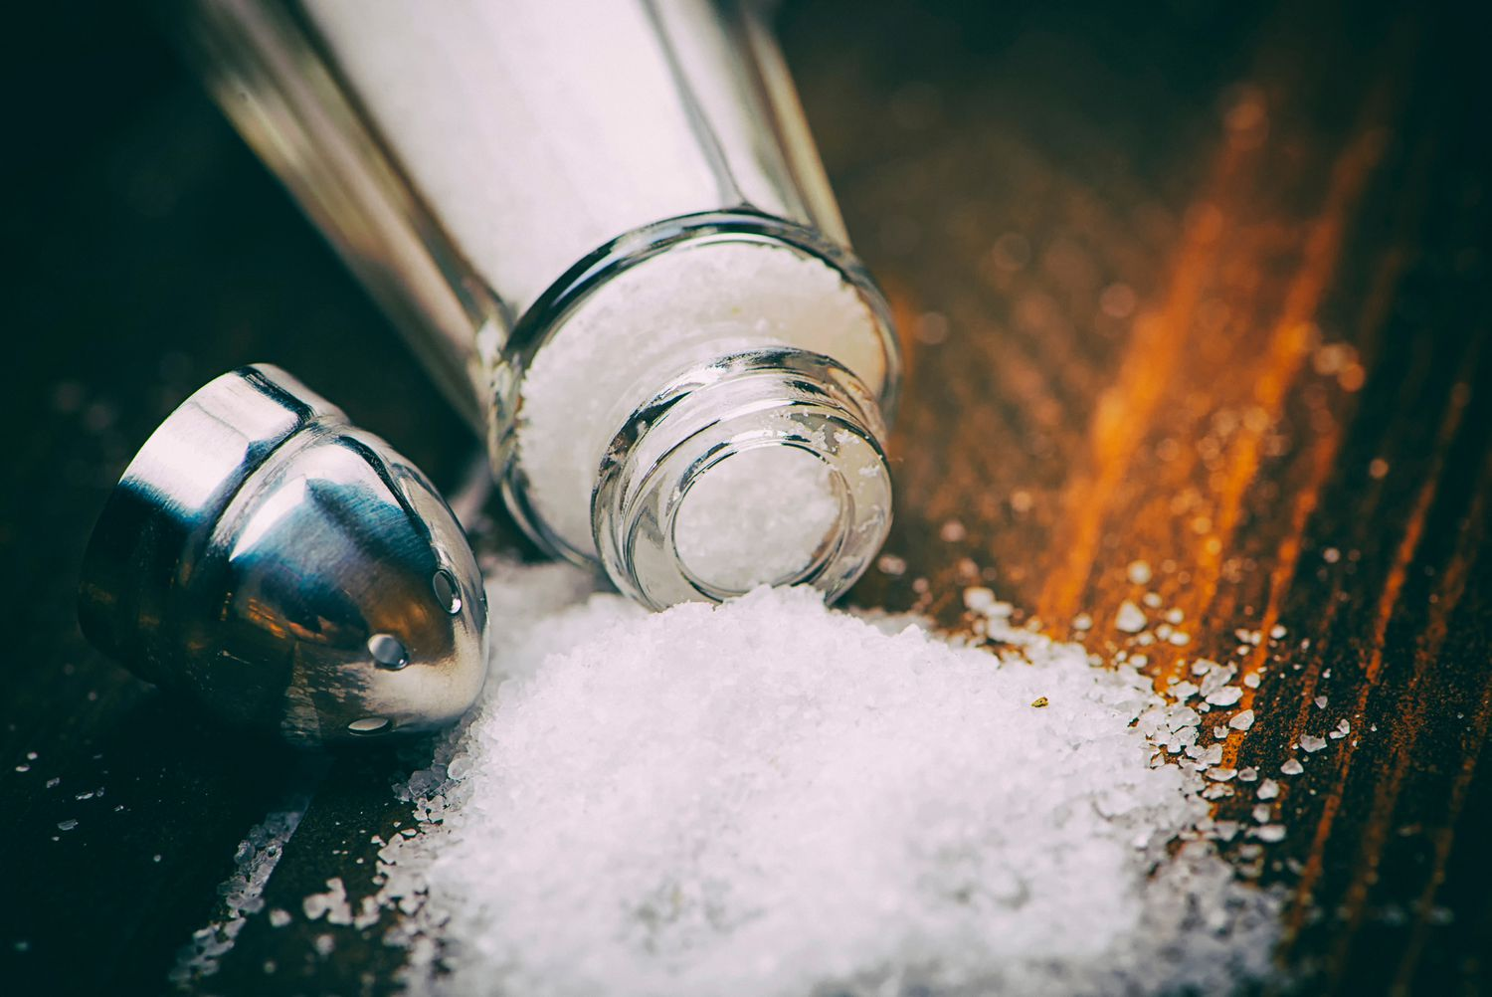
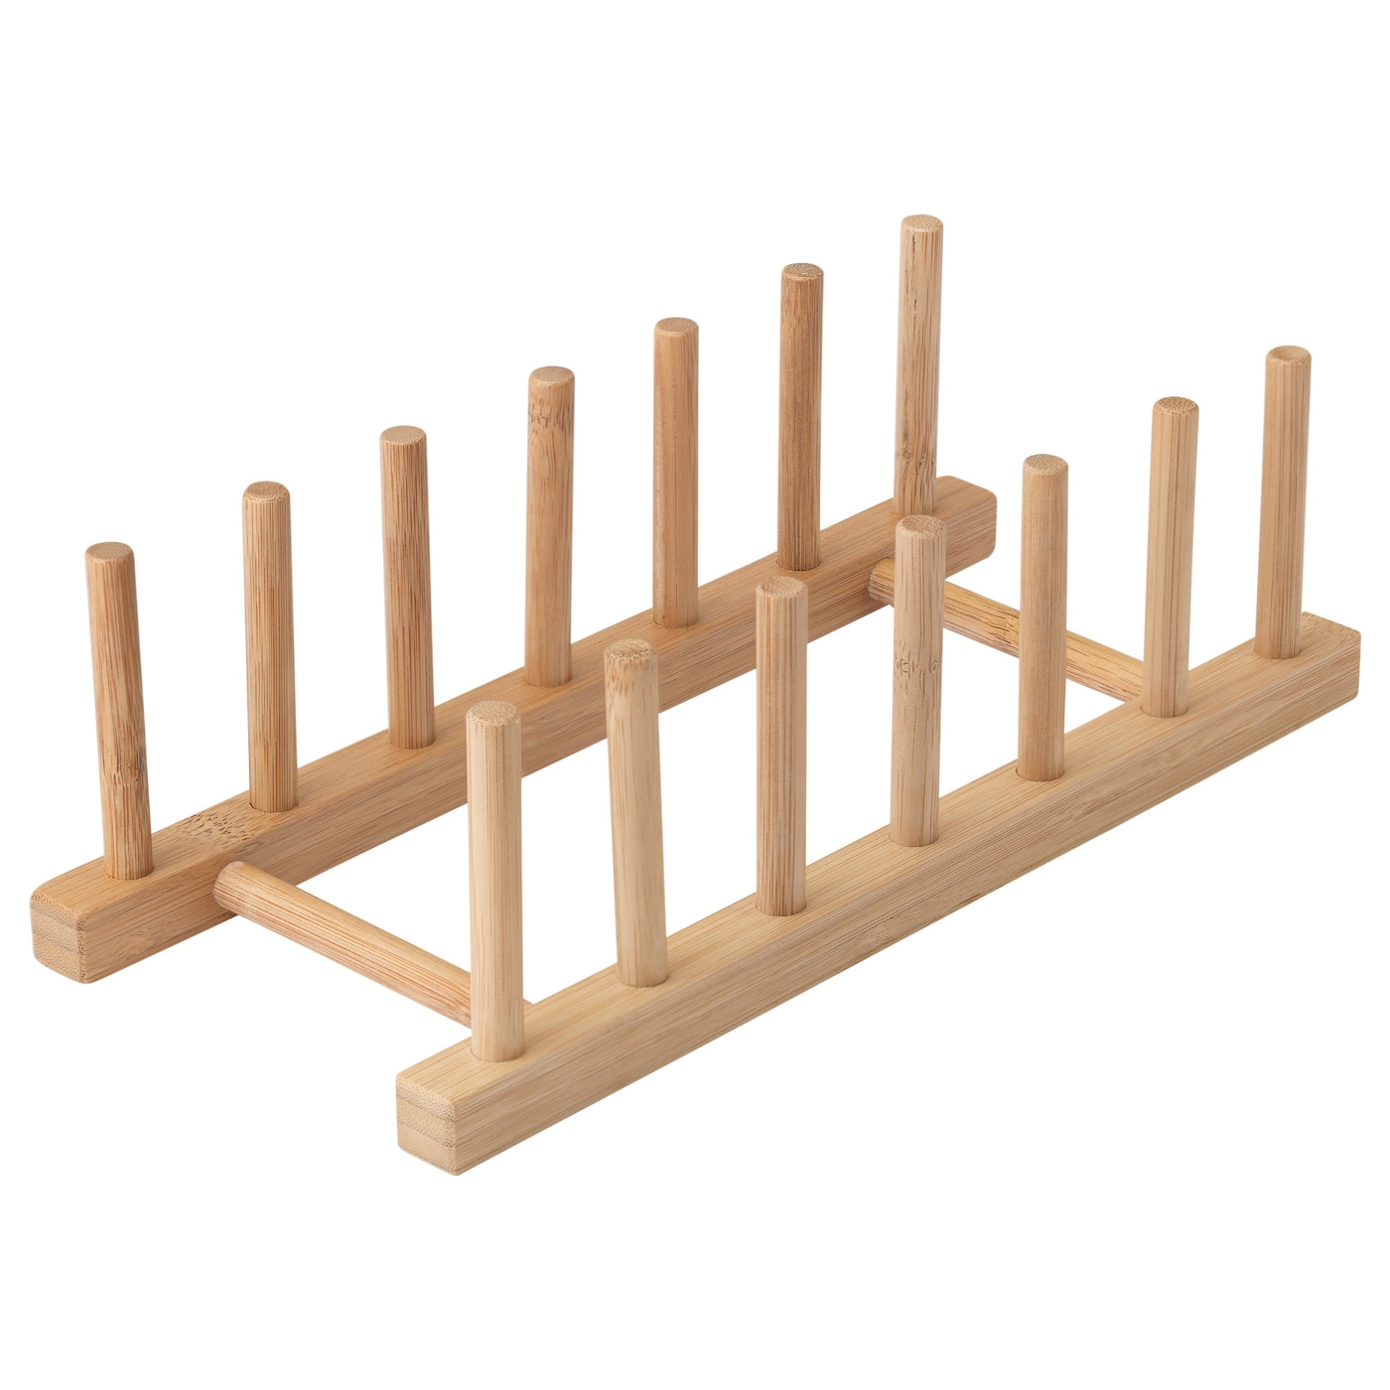
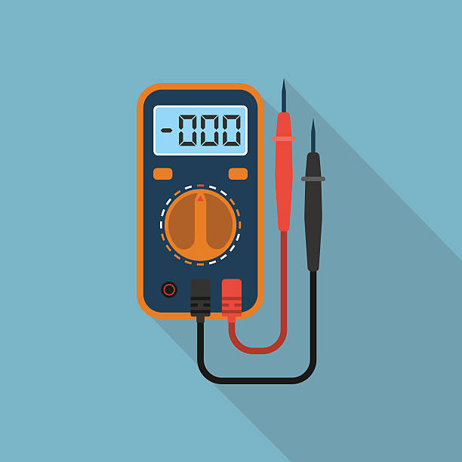
MATERIALS

Slide 10
03
DESIGN &
ITERATIONS

Slide 11
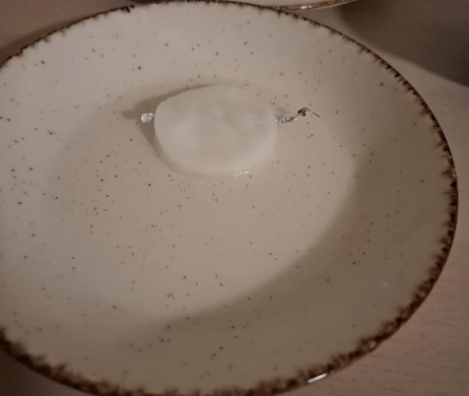
DESIGN #1
COTTON PAD
ALUMINIUM
NaCL Solution

Slide 12
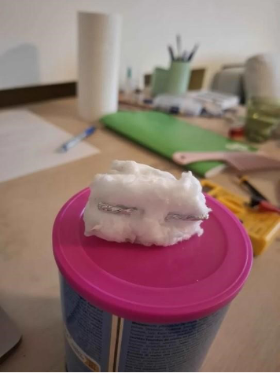
DESIGN #2
COTTON PAD
ALUMINIUM
NaCl Solution

Slide 13
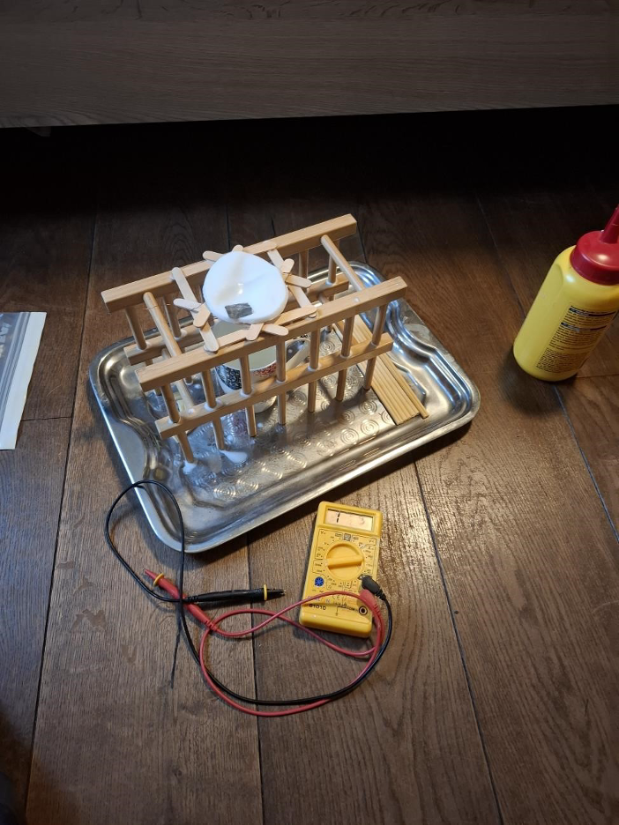
DESIGN #3
COTTON PAD
WOODEN STRUCTURE
PVA GLUE
NaCl Solution
ALUMINIUM
MULTIMETER

Slide 14
04
RESULTS

Slide 15
RESULTS
 | Voltage | Current | Area
Design 1 | 0.5V | 2 microamps | 18 cm2
Design 2 | 0.3V | 1 microamp | 10 square cm
Design 3 | 0.7V | 8 microamps | 30 square cm

Slide 16
05
DISCUSSION & CONCLUSION

Slide 17
DISCUSSION
POWER OUTPUT
MATERAILS
Current: max 80 µA
Voltage: max 0.7 V
Household Materials
SCABILITY
HUMIDITY
Design Issues
Atmospheric Moisture Levels

Slide 18
PROS & CONS
CONS | PROS
Low Power Output | Continuous Operation
Limited Research & Development | Renewable and Eco-Friendly Energy Source
Environmental Dependence | Low-Cost Materials

Slide 19
CONCLUSION
FEASIBILITY
PERFORMANCE
POTENTIAL
Simple MEG principle, using easily attainable household materials
Promising voltage output however low current, revealed need for material and design improvements.
Serve as complementary energy sources in humid, low-light environments.

Slide 20
QUESTIONS?

Slide 21
REFERENCES
Su Yang, Lei Zhang, Jianfeng Mao, Jianmiao Guo, Yang Chai, Jianhua Hao, Wei Chen &
Xiaoming Tao: "Green moisture-electric generator based on supramolecular nanofiber
networks": https://www.nature.com/articles/s41467-024-47652-3 Accessed 12-Sep-2024
Peng Duan, Chenxing Wang, Yinpeng Huang, Chunqiao Fu, Xulei Lu, Yong Zhang, Yuming
Yao, Lei Chen, Qi-Chang He, Linmao Qian & Tingting Yang: "Moisture-based green energy
harvesting over 600 hours via supramolecular nanofiber networks":
https://www.nature.com/articles/s41467-024-55516-z Accessed 09-Feb-2025
"A Long Life Moisture‐Enabled Electric Generator Based on Ionic Hydrogels":
https://onlinelibrary.wiley.com/doi/full/10.1002/advs.202305530 Accessed 28-Aug-2024
"Humidity-Tolerant Moisture-Driven Energy Generator with MXene Nanofluidic Channels":
https://pubs.acs.org/doi/10.1021/acsnano.2c10747 Accessed 09-Feb-2025

