Slide 1
CAN YEAST ADAPT?
A STUDY OF HOW YEAST ADAPTS TO ANTIFUNGAL MEDICATION
Emily Bach (S7ENA) & Allegra Gross (S7ENB)
European School RheinMain

Slide 2
Aim Of This Project
To understand if baker’s yeast can build resistance to the antifungal medication Terbinafine.
To see if resistance could be seen using optical density measurements.
If there is resistance – does it occur within all samples?

Slide 3
The Problem With Resistance
Antifungal resistance is an increasing global health problem.
It occurs when antifungal medications can no longer stop the growth of fungal infections.
Resistance means the fungus can fight the effect of the antifungal medication.
This leads to limited treatment options.
Some causes of antifungal resistance are: improper use of antifungal medication, natural resistance, and spontaneous resistance.

Slide 4
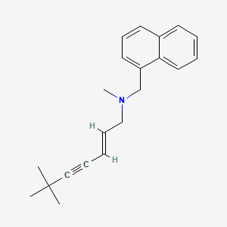
Antifungal Medication: Terbinafine
Used to treat:
  ringworm
  athlete's foot
  fungal nail infection
Works by inhibiting the synthesis of an essential component of the fungal cell membrane called ergosterol.
Comes in the form of cream, nail polish, pills, spray, and gel.
The pill version was used for this experiment.
https://pubchem.ncbi.nlm.nih.gov/compound/Terbinafine

Slide 5
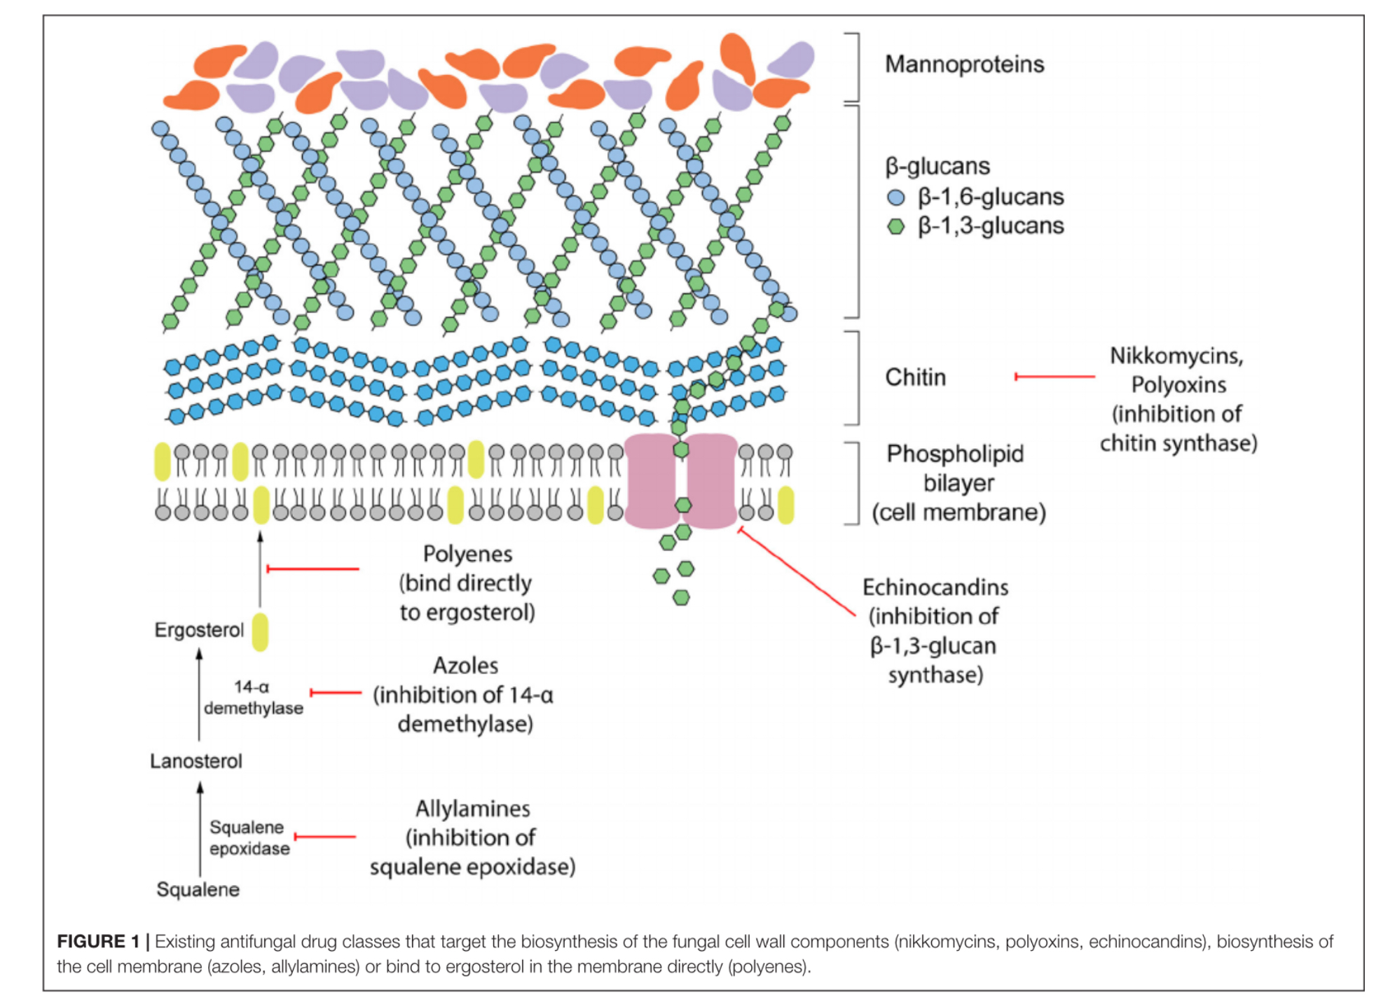
Antifungal Medication: Terbinafine
https://pubmed.ncbi.nlm.nih.gov/33511160/
“Targeting Unconventional Pathways in Pursuit of Novel Antifungals”

Slide 6
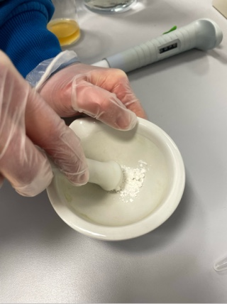
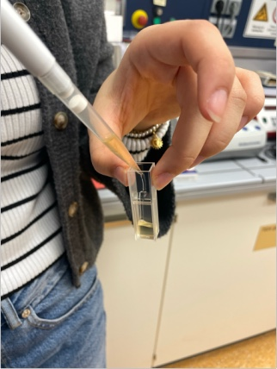
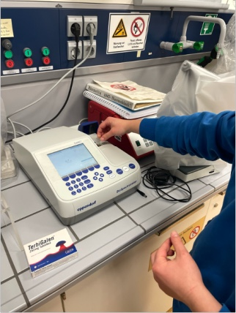
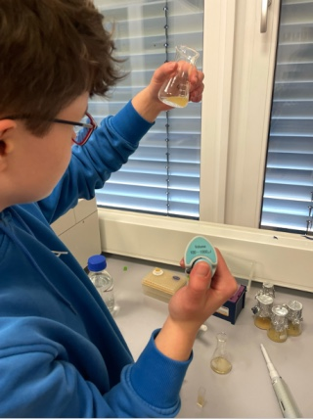
Experimental Procedure

Slide 7
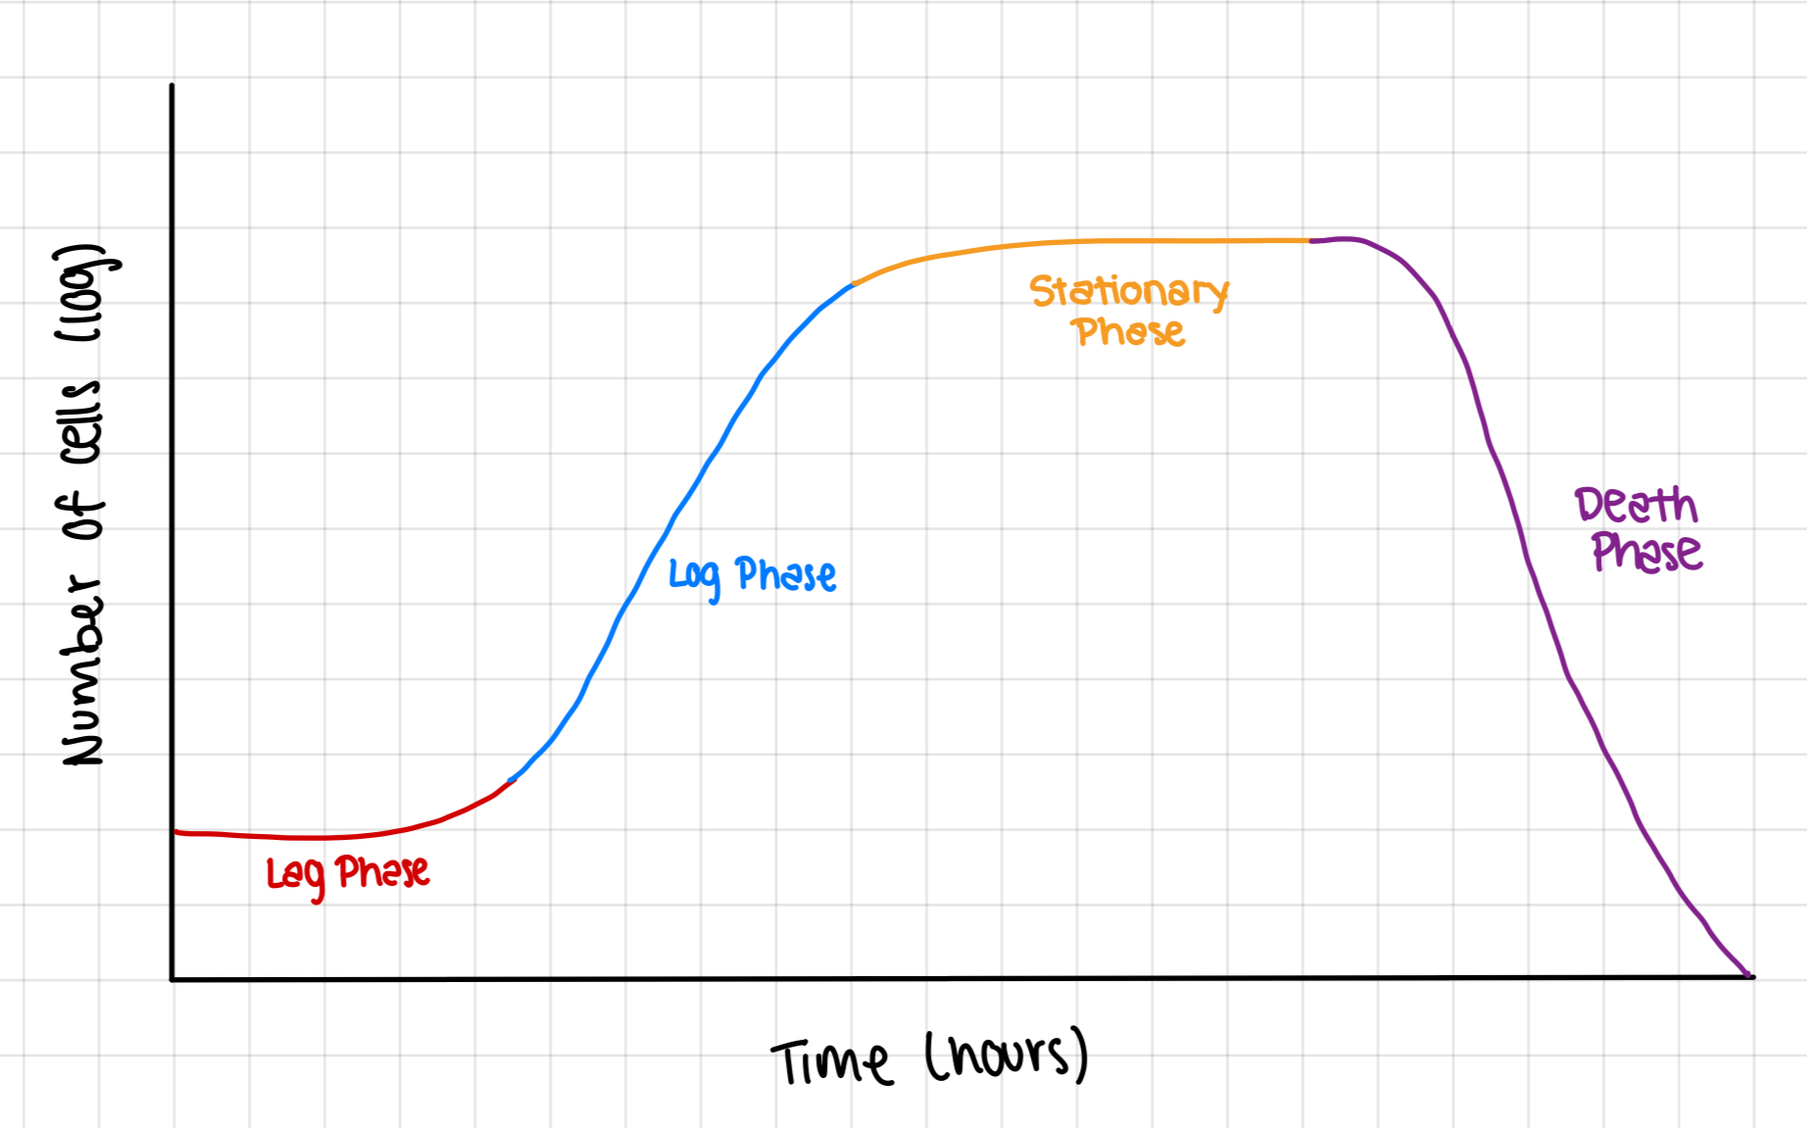
Yeast Growth Curve

Slide 8
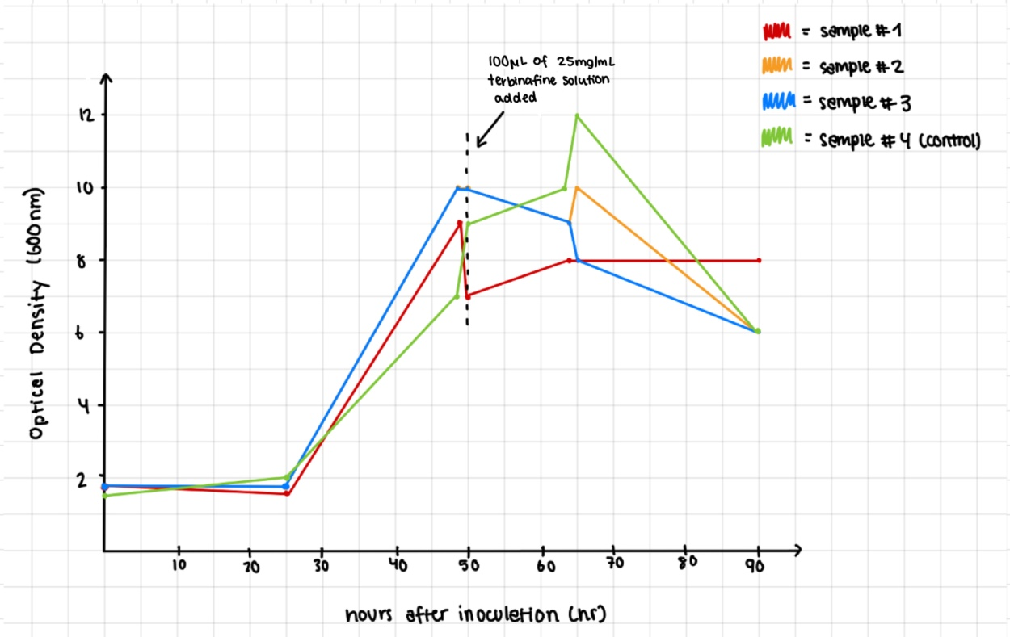
Growth Curve #1

Slide 9
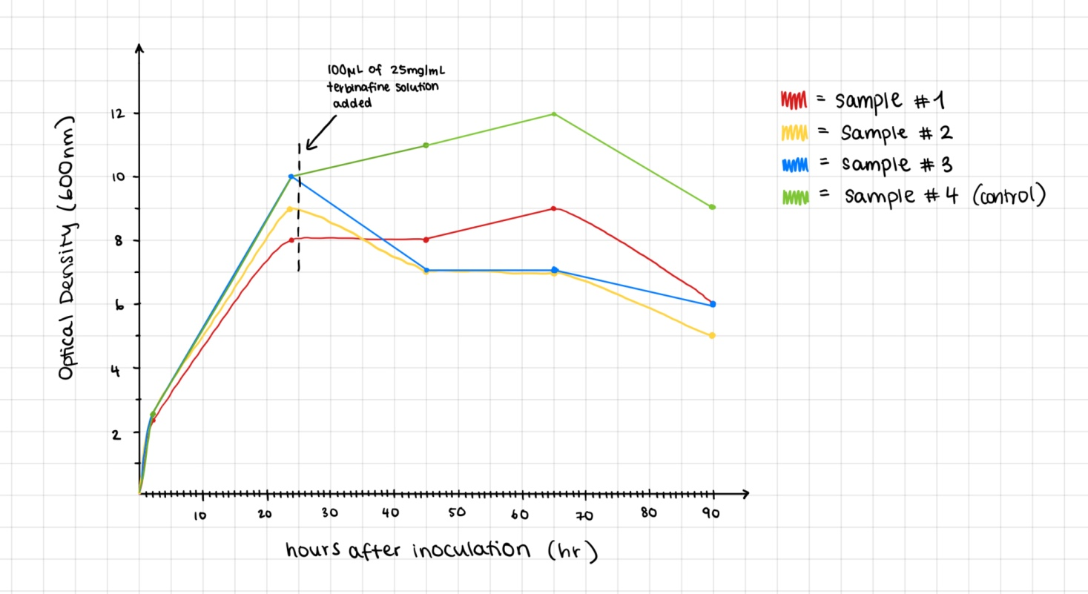
Growth Curve #2

Slide 10
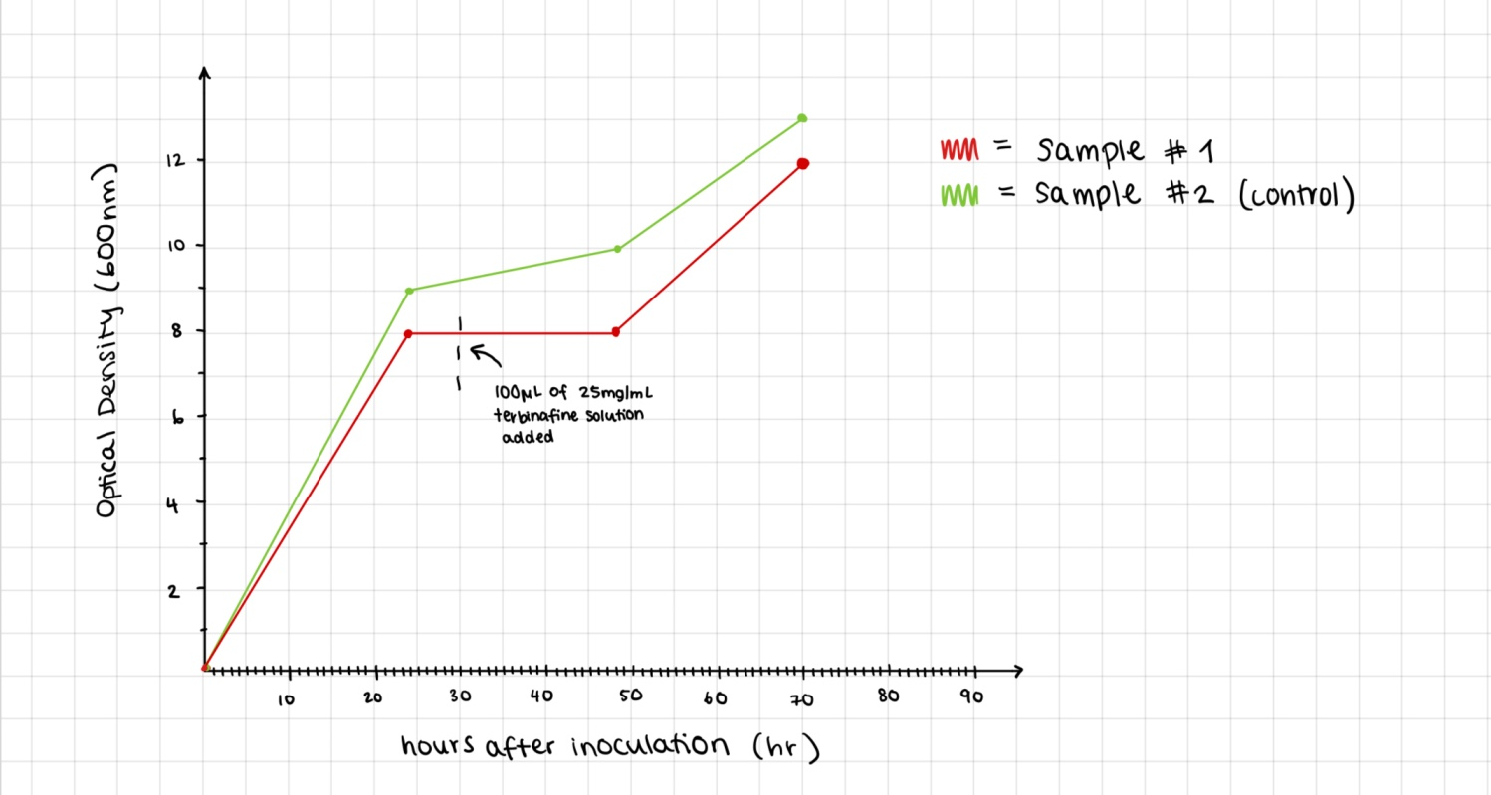
Growth Curve #3

Slide 11
Conclusion
Some of our results suggest that the yeast did build resistance to the antifungal medication.
Further testing would have to be done to determine if yeast really builds resistance.

Slide 12
How could this experiment be expanded?
More growth curves
Test various concentrations of antifungal medication
Test different antifungal medications
Observation of samples under the microscope
Count cells for more precise observation of growth

Slide 13
Acknowledgments
Thank you to Dr. Samland who supported us through the whole process of our project. From helping us with the correct setup of the experiments to answering any questions we had.
We would also like to thank the other lab teachers at ESRM for always opening the lab to allow us to work on our project any time we needed to.

Slide 14
References
professional, Cleveland Clinic medical. “Antifungal Resistance: What It Is, Causes, Treatment & Prevention.” Cleveland Clinic, 19 Mar. 2025, my.clevelandclinic.org/health/articles/21557-antifungal-resistance.
“YPD Media.” Sharebiology, 16 July 2023, sharebiology.com/ypd-media/#:~:text=YPD%20media%20(yeast%20extract%20peptone,yeast%20extract%20aids%20faster%20growth.
National Center for Biotechnology Information. "PubChem Compound Summary for CID 1549008, Terbinafine" PubChem, https://pubchem.ncbi.nlm.nih.gov/compound/Terbinafine. Accessed 31 March, 2025.
Nguyen S, Truong JQ, Bruning JB. Targeting Unconventional Pathways in Pursuit of Novel Antifungals. Front Mol Biosci. 2021 Jan 12;7:621366. doi: 10.3389/fmolb.2020.621366. PMID: 33511160; PMCID: PMC7835888.

Slide 15
Thank You For Your Attention!

