Slide 1
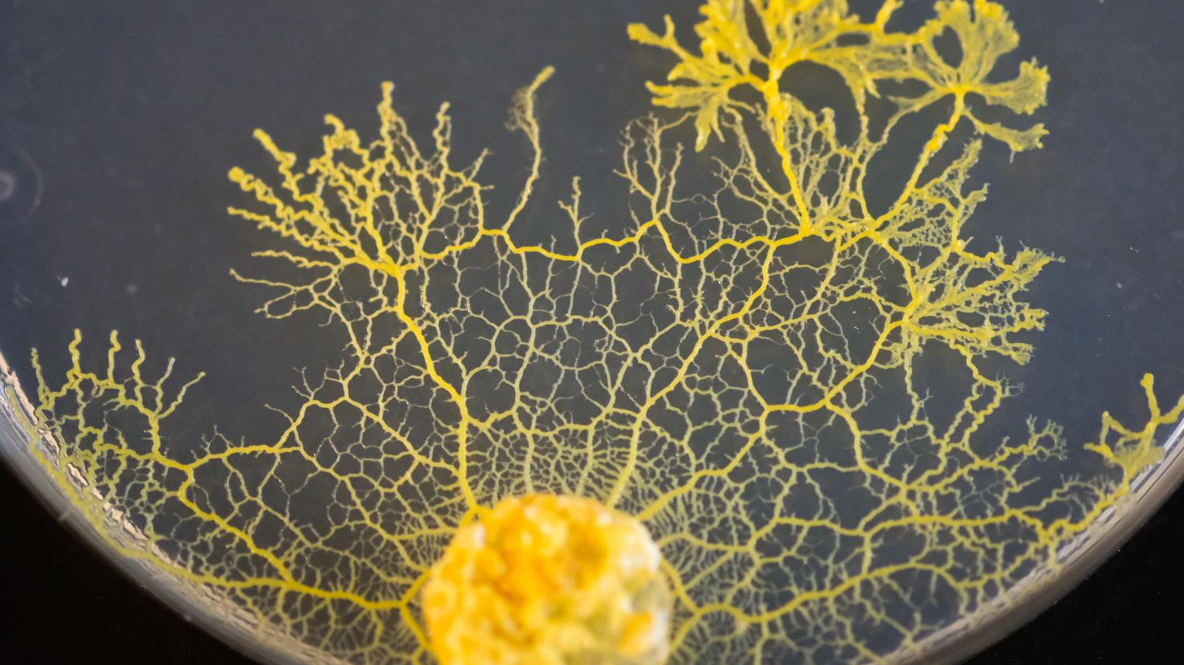
Using the Blob as a Navigation System
By Ana Marija Kukovec (S6ENB), Mariana Waicman Gonçalves (S6ENC) and Nicolò Broom (S6ENC)
ESLUX2 Mamer

Slide 2
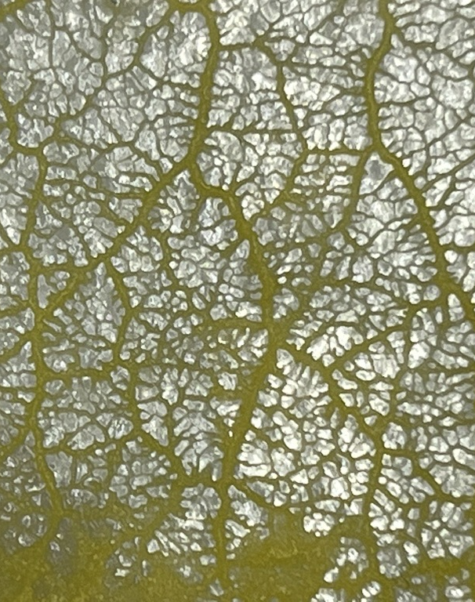
Contents
Aim of our project
Our model
What is the Blob?
Optimal conditions for the Blob to grow
The Blob shows us the fastest path
Conclusion
Our project on a global scale
Sources

Slide 3
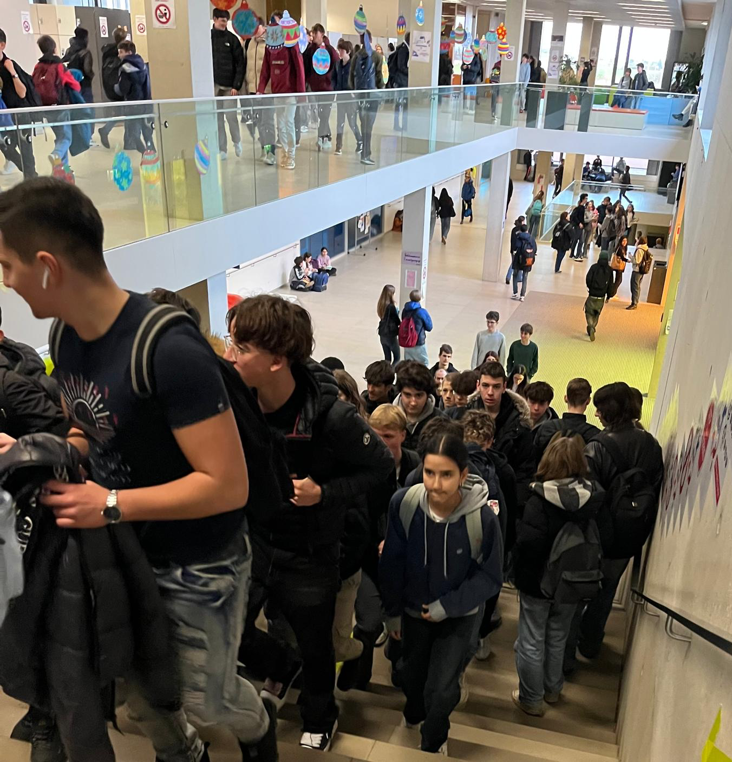
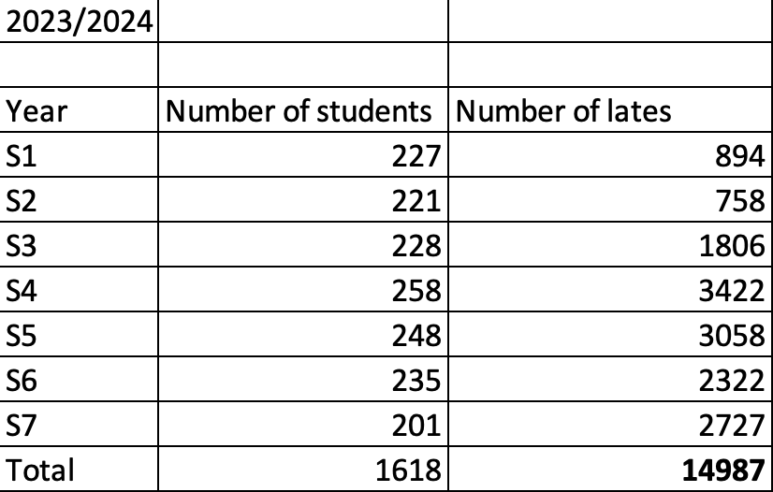
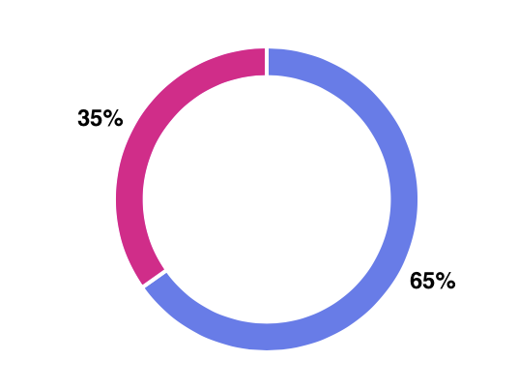
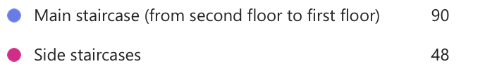
Aim of our project
Many students are late to class due to overuse of the main staircase.
Prove using the Blob that the side staircases are the fastest path.

Slide 4
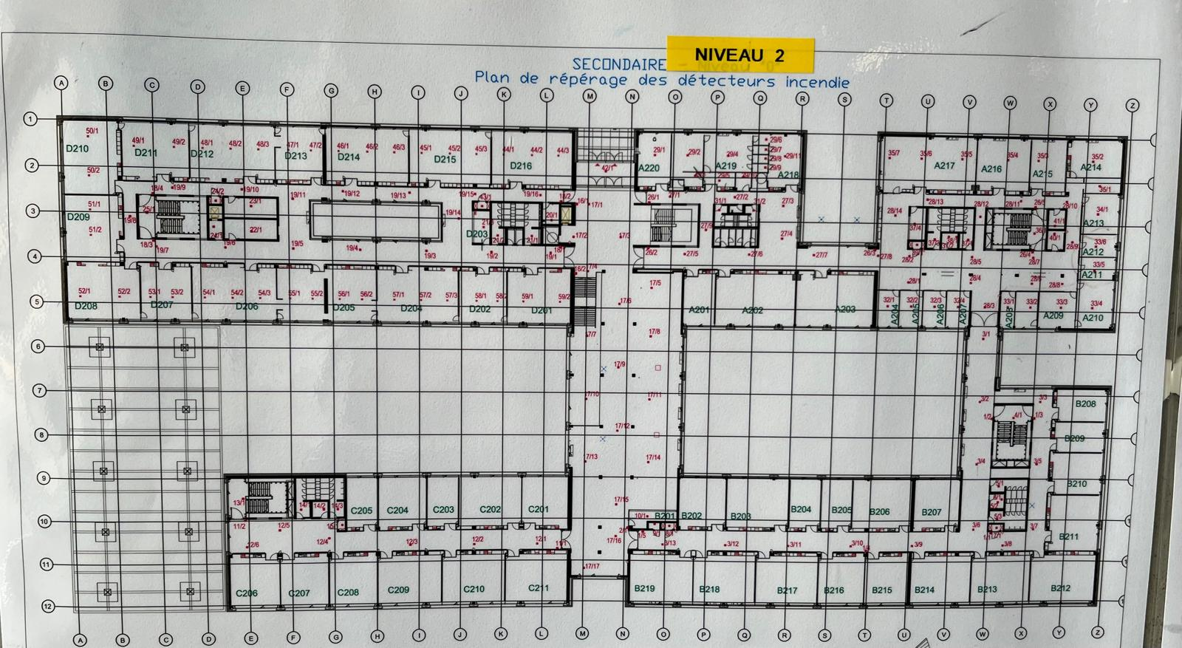
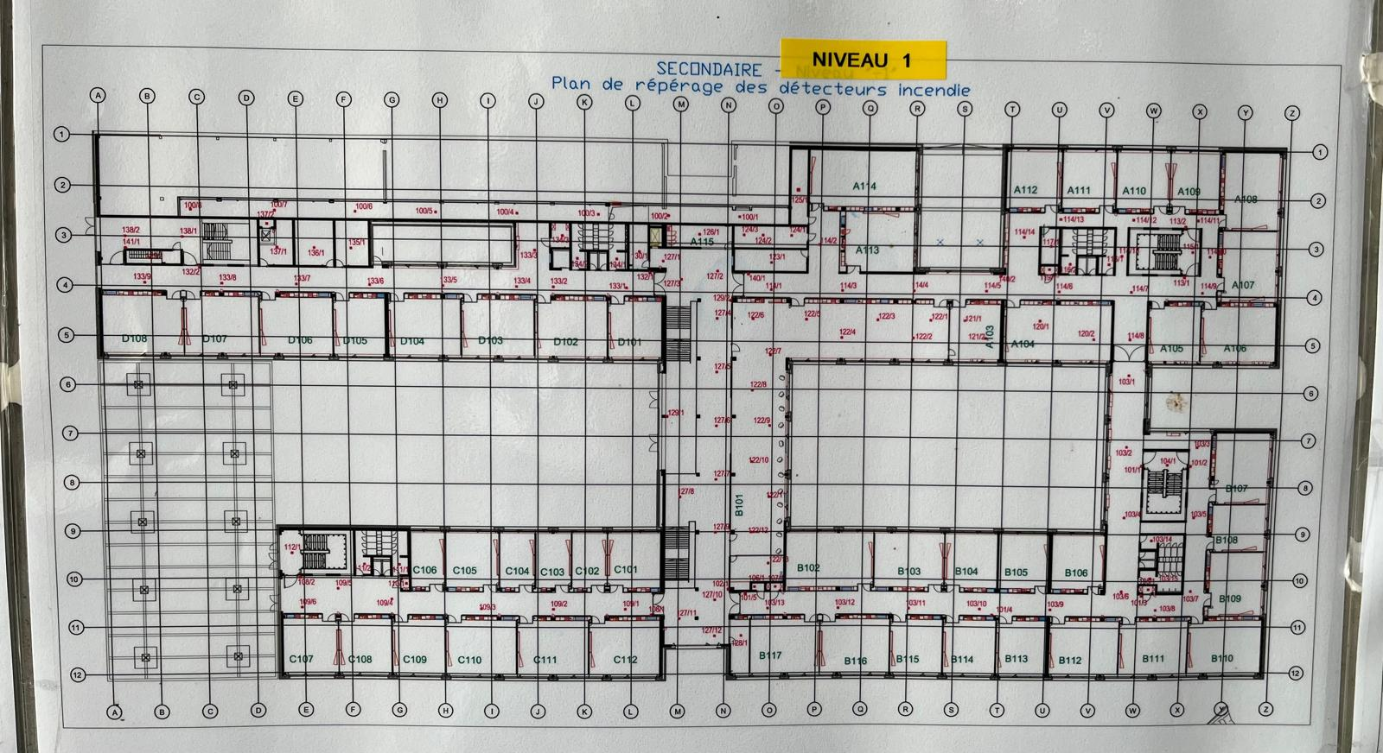
Blueprints of secondary building
Second floor
First floor
D corridor
A corridor
D corridor
A corridor
C corridor
C corridor
B corridor
B corridor

Slide 5
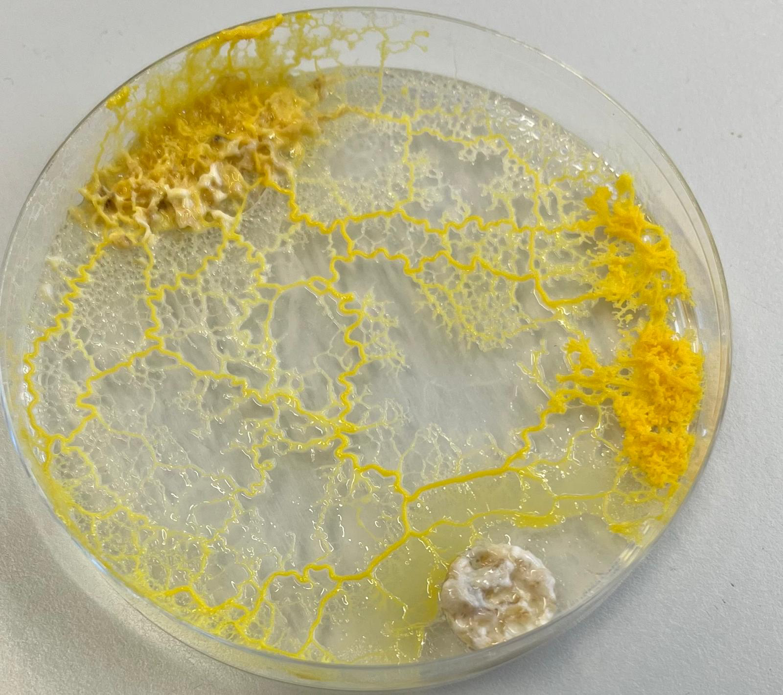
Latin name: physarum polycephalum
Classification: Slime mold
What is the Blob?
A multi-cerebral eukaryotic organism
3 types of Blob: Ava, Charly and Badamia
Food source: bacteria, fungi, algae and organic material
Food emits chemo-attractants that Blob senses and approaches in the fastest way
More objective perception of space compared to humans

Slide 6
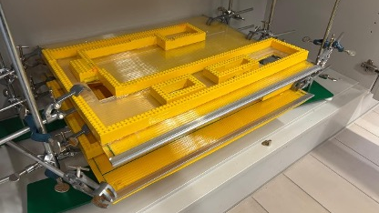
Our model

Slide 7
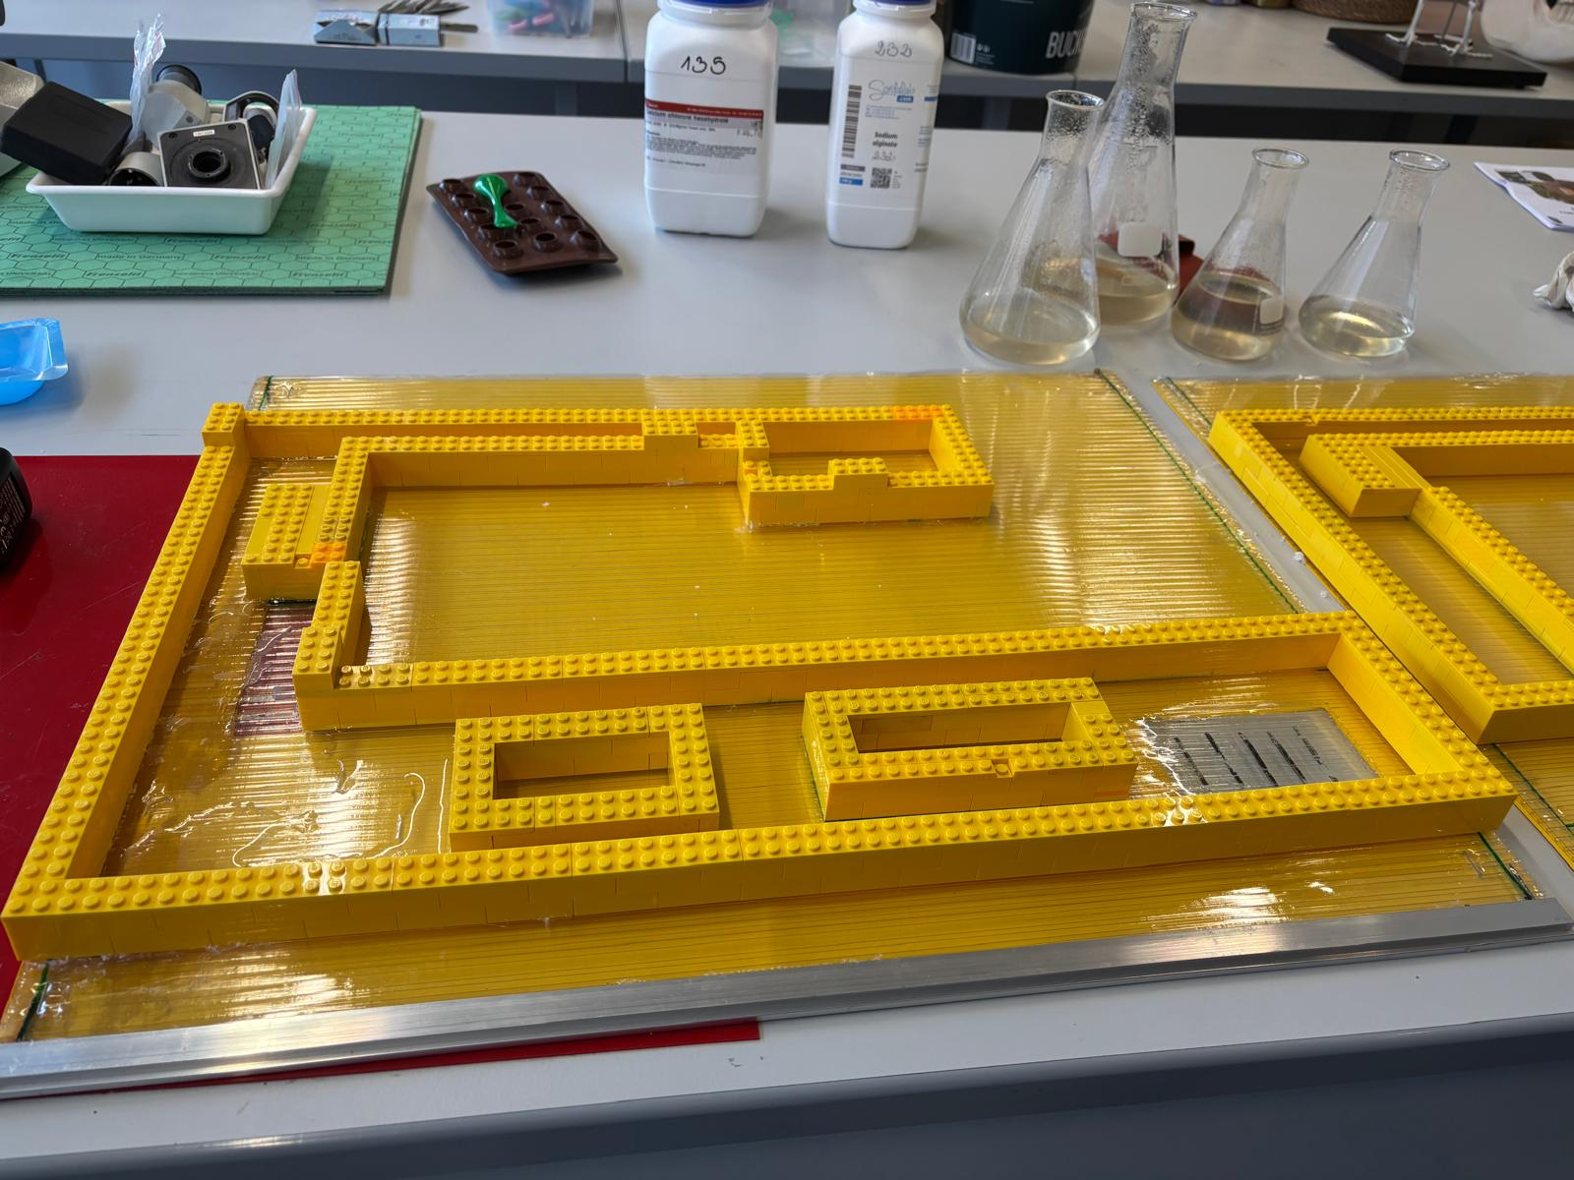
Second floor model
Side staircase 2
C corridor
Side staircase 1
Main staircase
D corridor

Slide 8
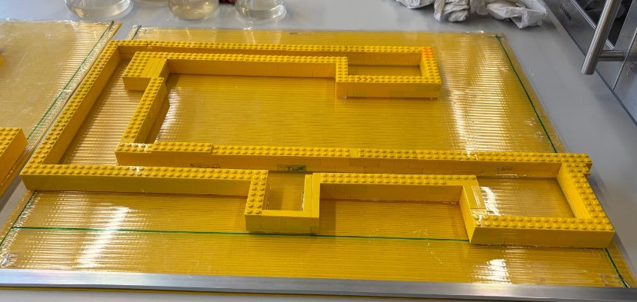
First floor model
Side staircase 2
C corridor
Main staircase
Side staircase 1
D corridor

Slide 9
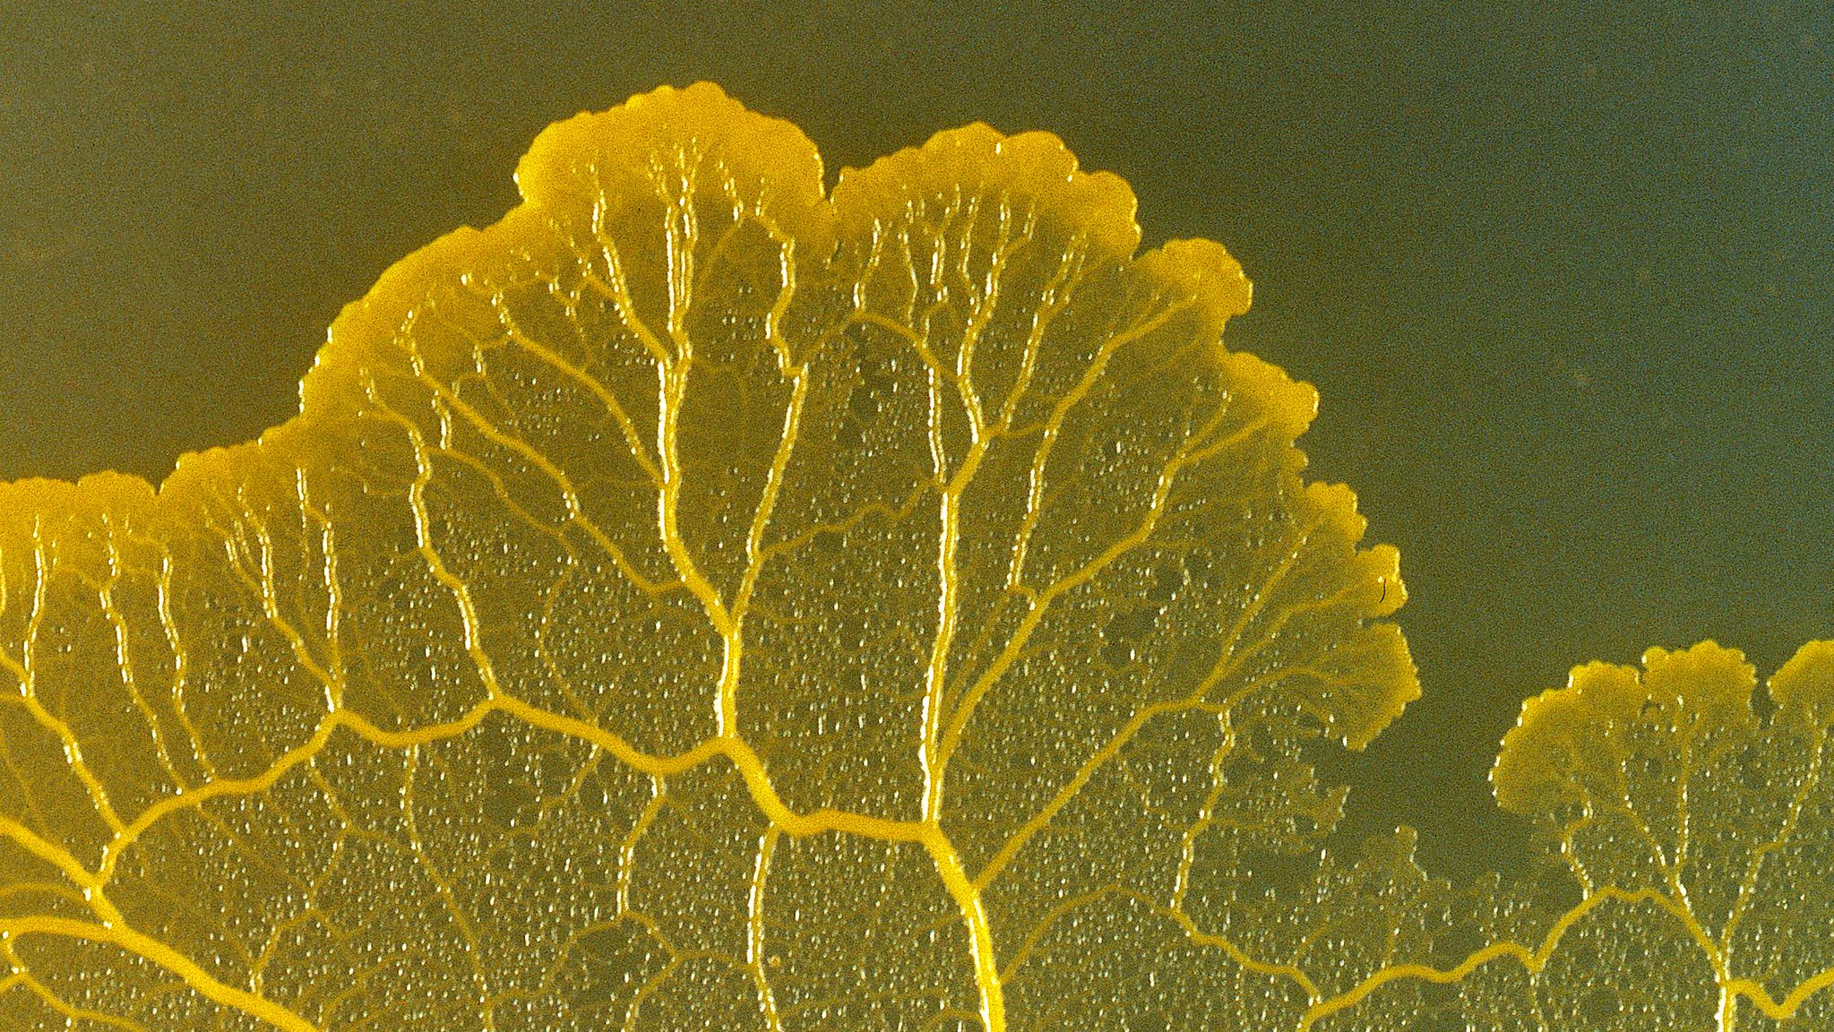
Optimal conditions for the Blob to grow

Slide 10






Agar thickness
Colour of Lego and Paper
Temperature
Light sensitivity
Respiration

Slide 11
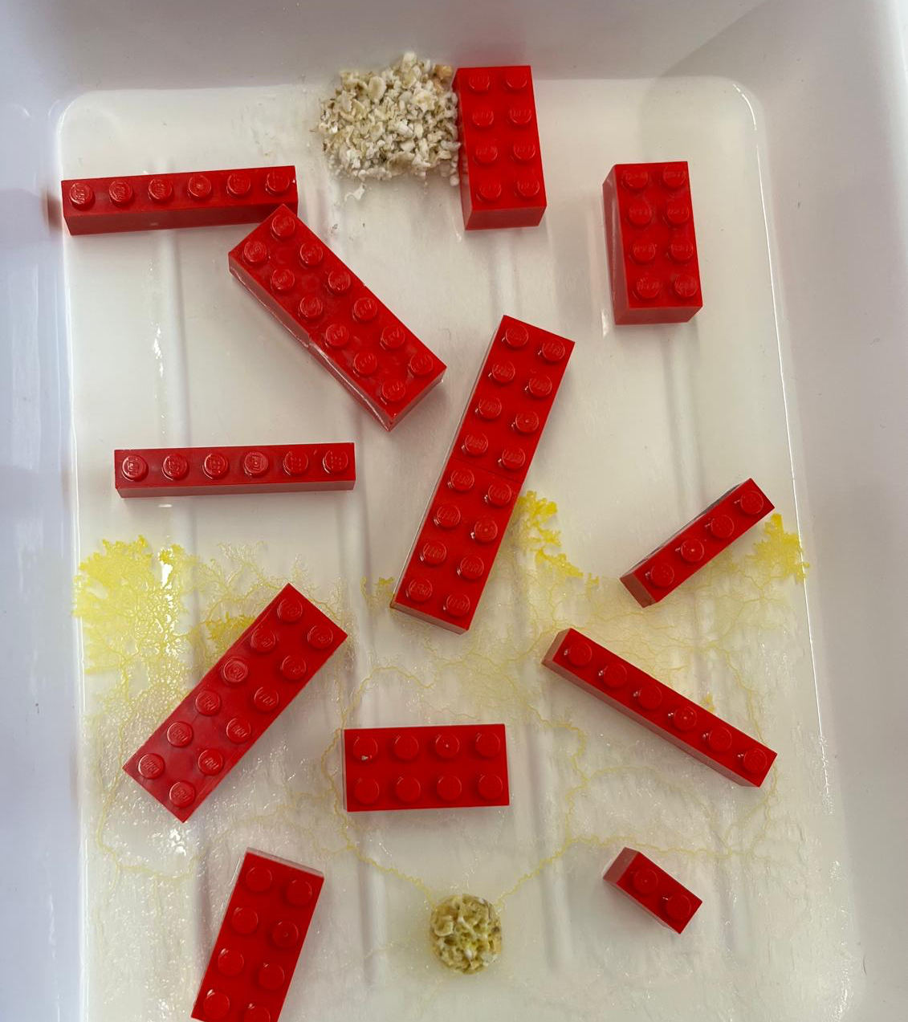
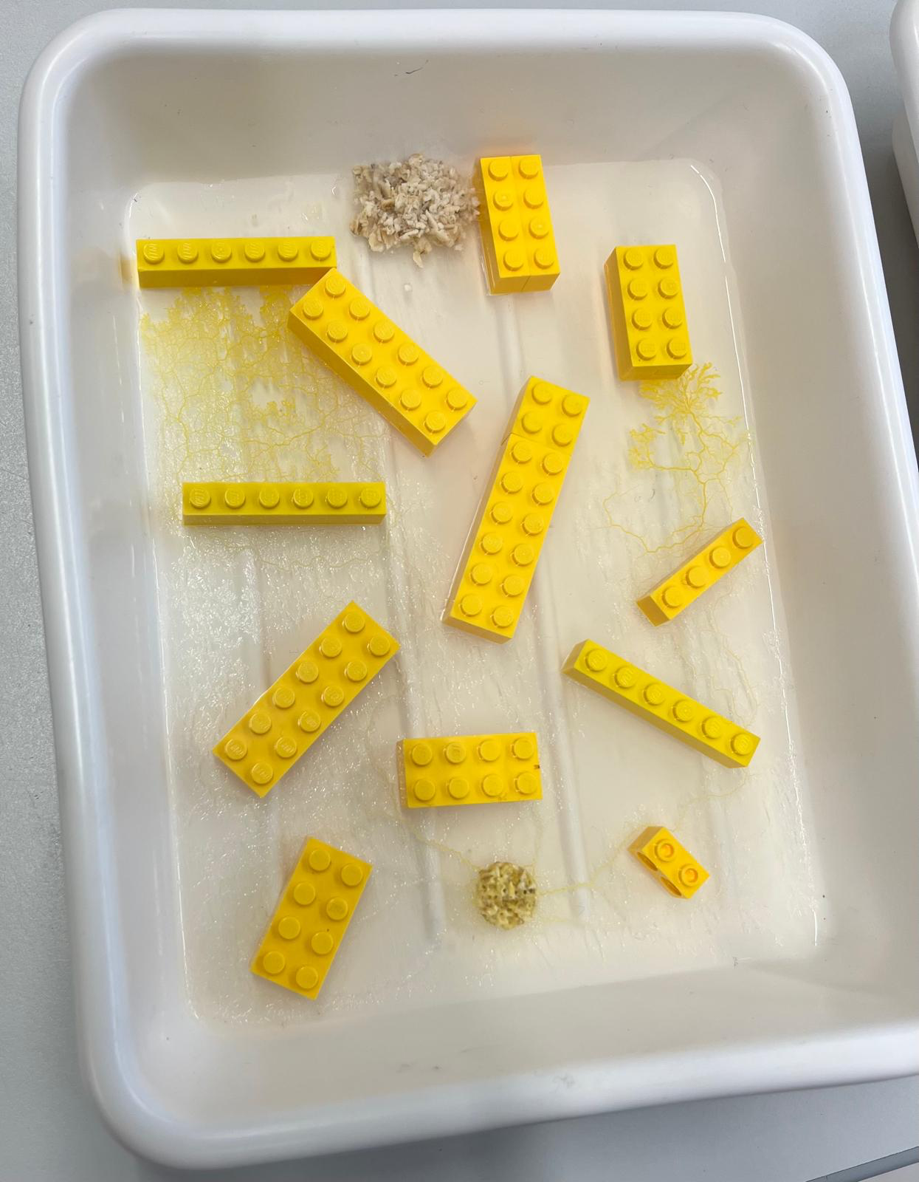
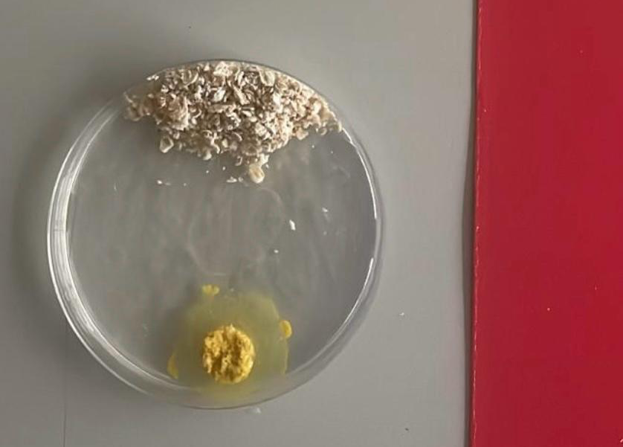
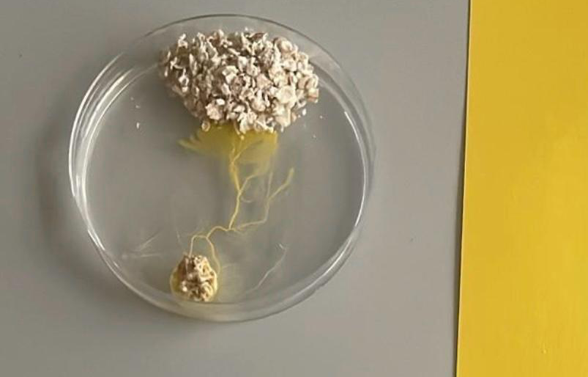
Experiment 1: Testing Blob's sensitivity to colour
Aim: To find the optimal colour for the growth of the Blob.
Conclusion: The Blob grows faster if it is in yellow environment.
Reasons:
Photoreceptors sense different wavelengths of light
Yellow light - wavelength of 570-590nm
Red light - wavelength of 650-700nm

Slide 12


Agar thickness
Colour of Lego and Paper
Temperature
Light sensitivity
Respiration

Slide 13
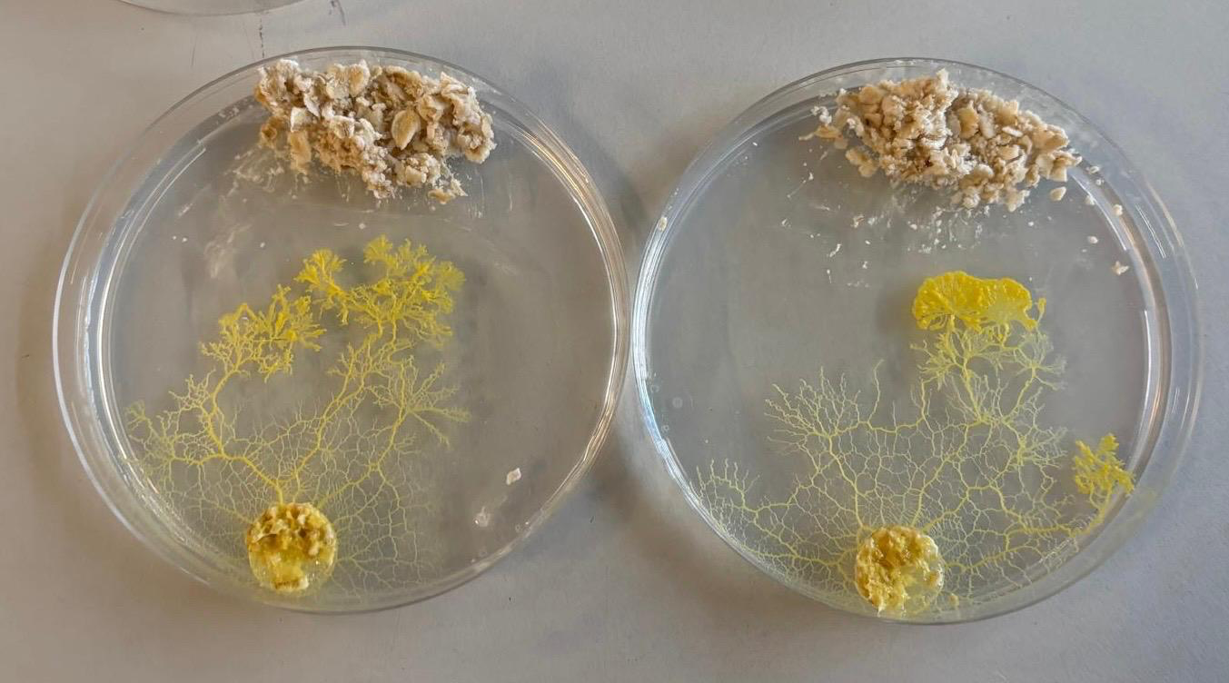
Experiment 2: Testing light sensitivity
Aim: does intensity of light that the Blob is exposed to affects its growth.
Conclusion: the Blob in dim environment grew faster – prefers less exposure to light.
Reason:
Natural habitat on shady forest floor
Blob in dim environment
Blob in the light

Slide 14

Agar thickness
Colour of Lego and Paper
Temperature
Light sensitivity
Respiration

Slide 15
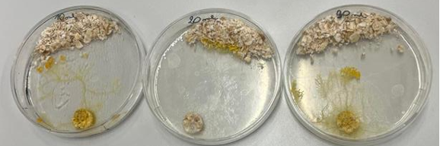
Experiment 3: Agar Thickness
Aim: testing whether the Blob prefers a certain agar thickness.
Conclusion: grows most efficiently at 20 ml thickness of agar.
10ml 20ml 30ml

Slide 16

Agar thickness
Colour of Lego and Paper
Temperature
Light sensitivity
Respiration

Slide 17
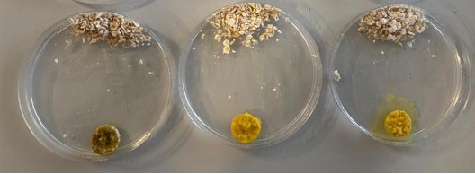
Experiment 4: Testing effects of temperature
Aim: finding the optimal temperature for the Blob to grow.
Conclusion: the Blob prefers a room temperature environment.
Reasons:
Enzymes are sensitive to temperature
Hight temperature: denaturation
Low temperature: slow functioning
37°C 7°C 21°C

Slide 18

Agar thickness
Colour of Lego and Paper
Temperature
Light sensitivity
Respiration

Slide 19
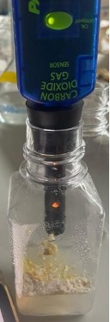
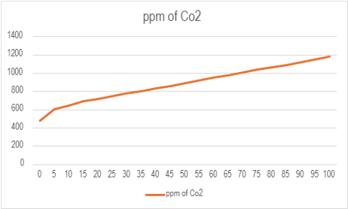
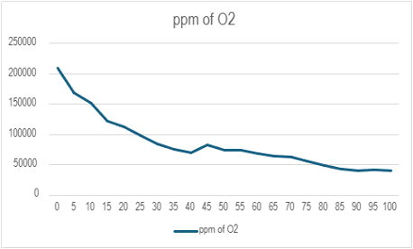
Experiment 5: Respiration (O₂ and CO₂)
Aim: testing if the Blob undergoes cellular respiration and needs oxygen to grow.
Conclusion: the Blob undergoes cellular respiration and requires oxygen from the air to grow.

Slide 20
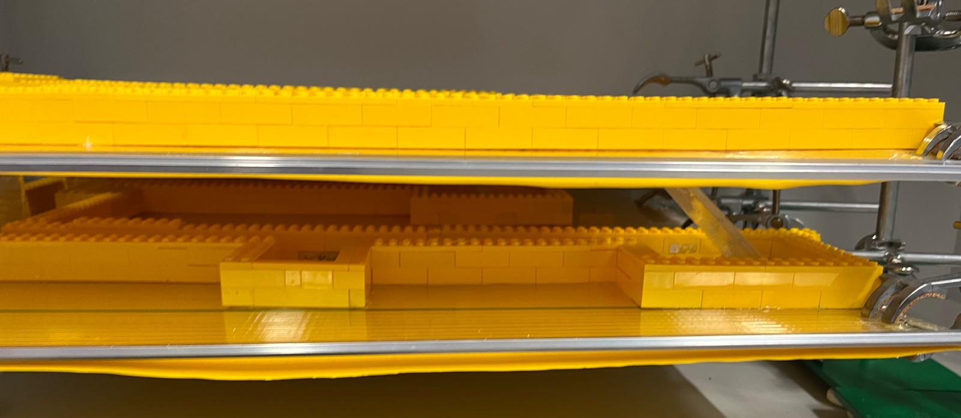
Experiment 6: Testing if the Blob can ascend a ramp

Slide 21
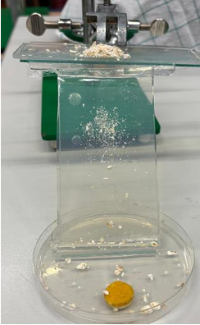
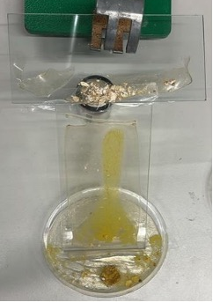
Experiment 6: Testing if the Blob can ascend a ramp
Aim: to see whether the Blob can go up a ramp used for our scaled model.
Conclusion: the Blob can climb up a 45-degree ramp.
Reasons:
Extracellular matrix
Chemo-attractants
Day 1
Day 4

Slide 22
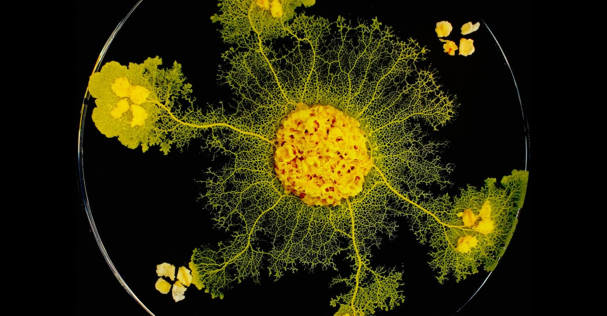
The Blob finds the fastest path through the model

Slide 23
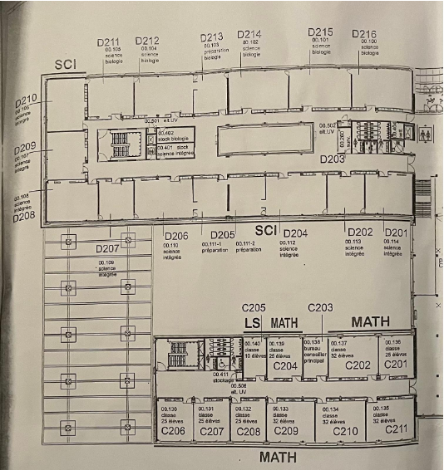
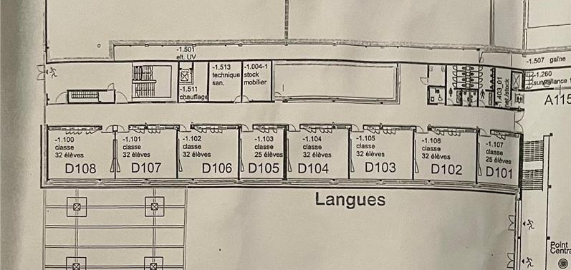
Possible paths Blob can take
Red: main staircase
Yellow: side staircase
Using side staircase: 52.45m
Using main staircase: 83m

Slide 24
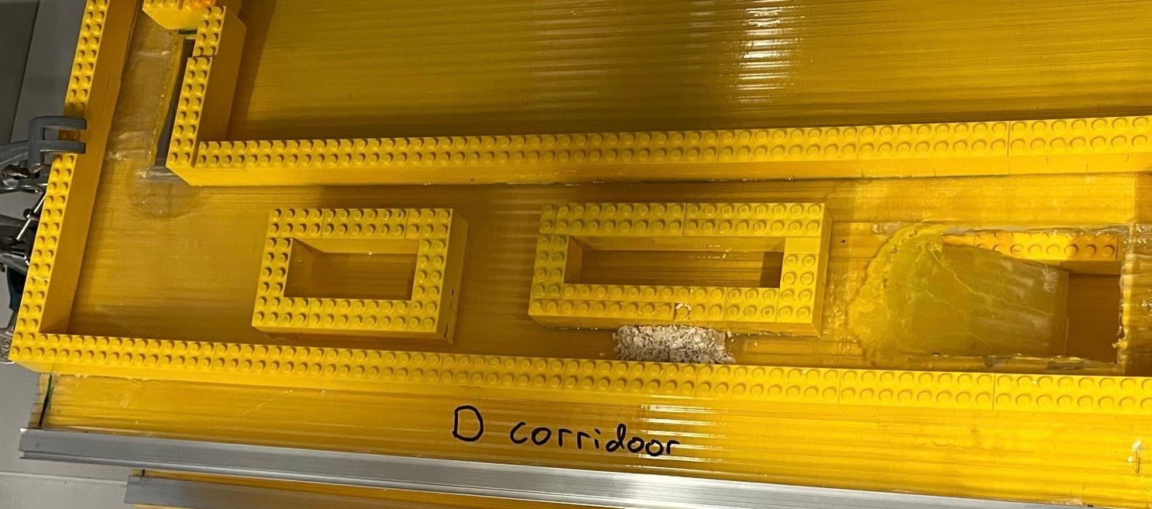
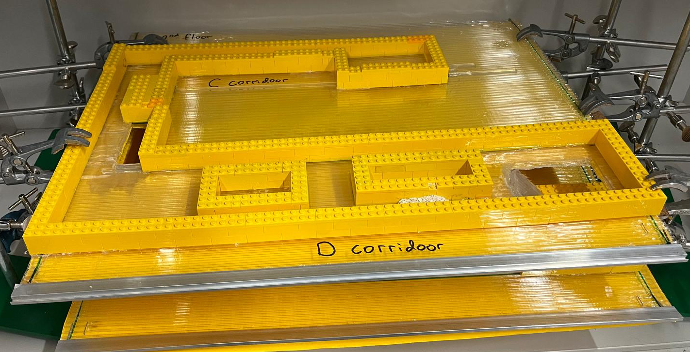
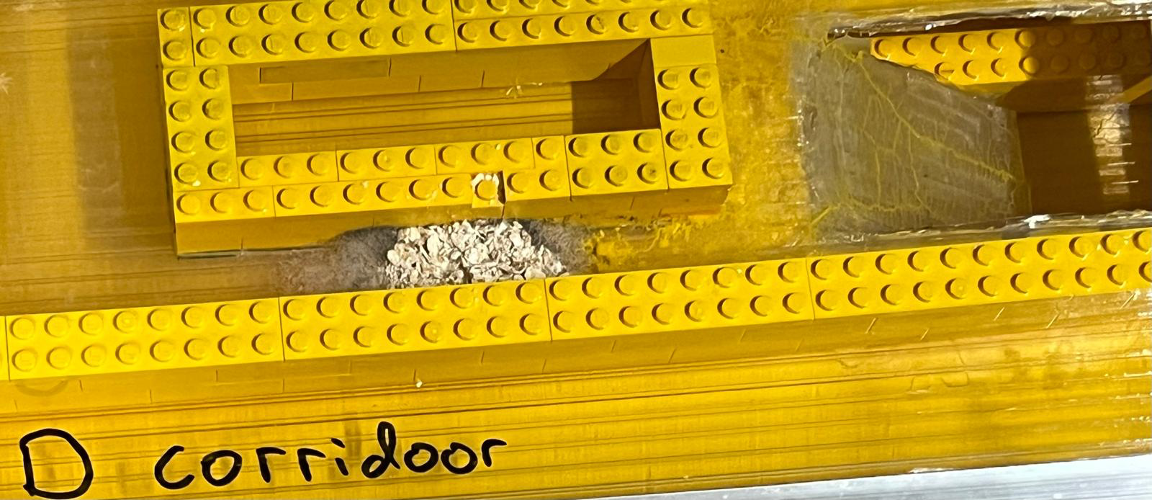
Path 1: D corridor
Side staircase
Blob on the first floor: language corridor
Side staircase
Main staircase
Oats on the second floor: science corridor
Side staircase

Slide 25
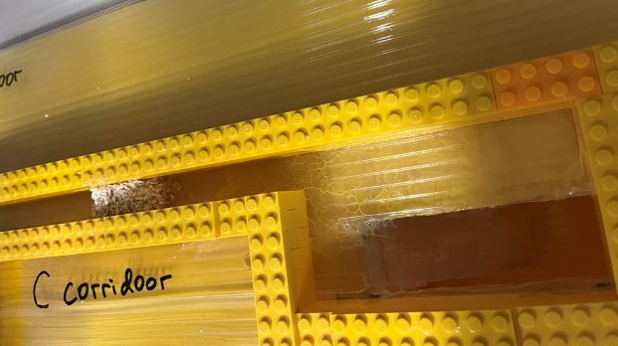
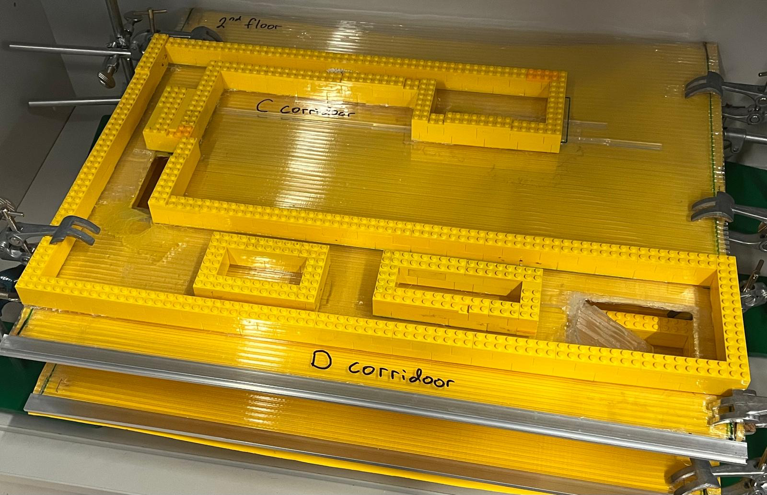
Blob on the first floor: language corridor
Path 2: C corridor
Main staircase
Side staircase
Side staircase
Oats on the second floor: maths corridor
Using side staircase: 40.75m
Using main staircase:80.31m

Slide 26
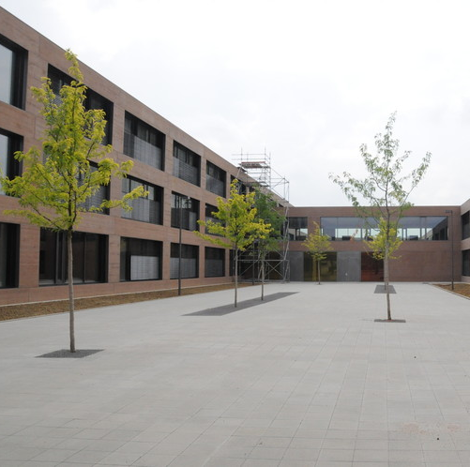
Conclusion
Blob used the side staircases, proving that it is the shorter path.
Students are late because they are not using the fastest path.
Pupils should use them more to reduce congestion and reduce lateness.

Slide 27
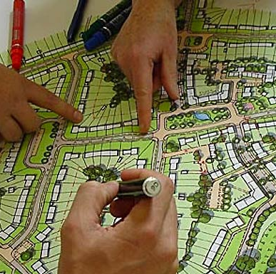
Our project on a global scale
Blob can be used to efficiently navigate around our school.
Urban planning: bus routes, metro lines, street planning.

Slide 28
Sources
The Slime Blob That Won the Internet Is Weirder Than You Think | WIRED
Slime mold solves maze in one pass, assisted by gradient of chemo-attractants - PubMed
fralinlifesci.vt.edu/content/fralinlifesci_vt_edu/en/education-and-outreach/biotech-in-a-box/biotech-caging-the-blob/_jcr_content/content/download/file.res/Caging the Blob Manual.pdf
A Slime Mold Called Le Blob | Joyful Microbe
Le Labo du Blob - Acheter un kit blob : expériences inédites offertes
Découvrez l'histoire du blob, cet organisme unicellulaire qui ressemble à une omelette
The Blob: Slime Molds | Herbarium | USU

Slide 29
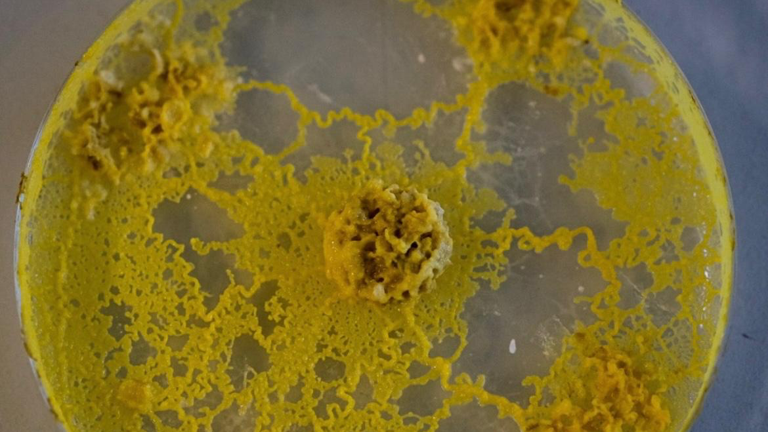
THANK YOU FOR YOUR ATTENTION!

