Slide 1
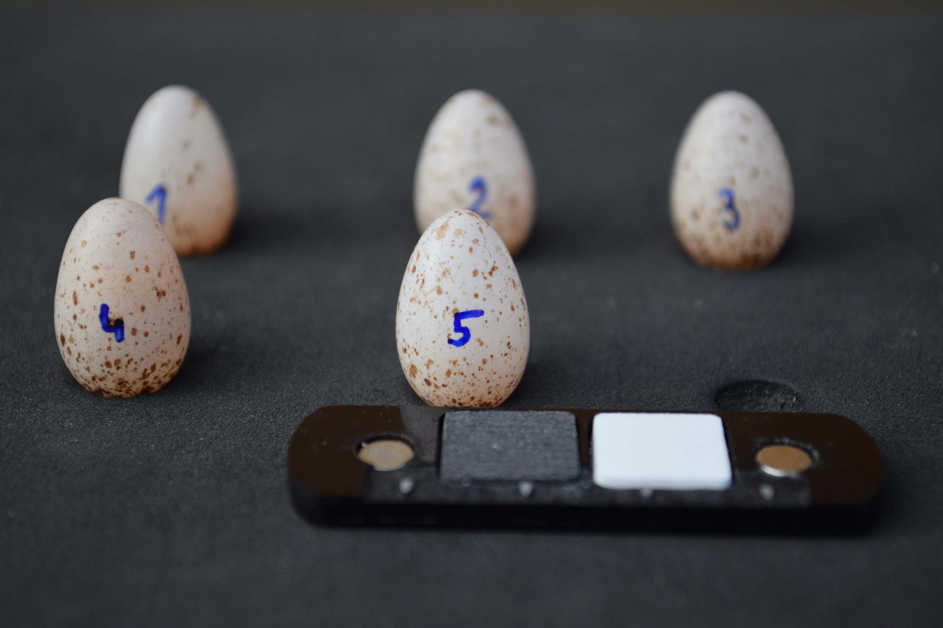
Barn Swallow (Hirundo Rustica) Eggs as an Indicator of Female Quality
Photo: Michal Šulc
Klára Levrincová S6EN International European School Warsaw

Slide 2
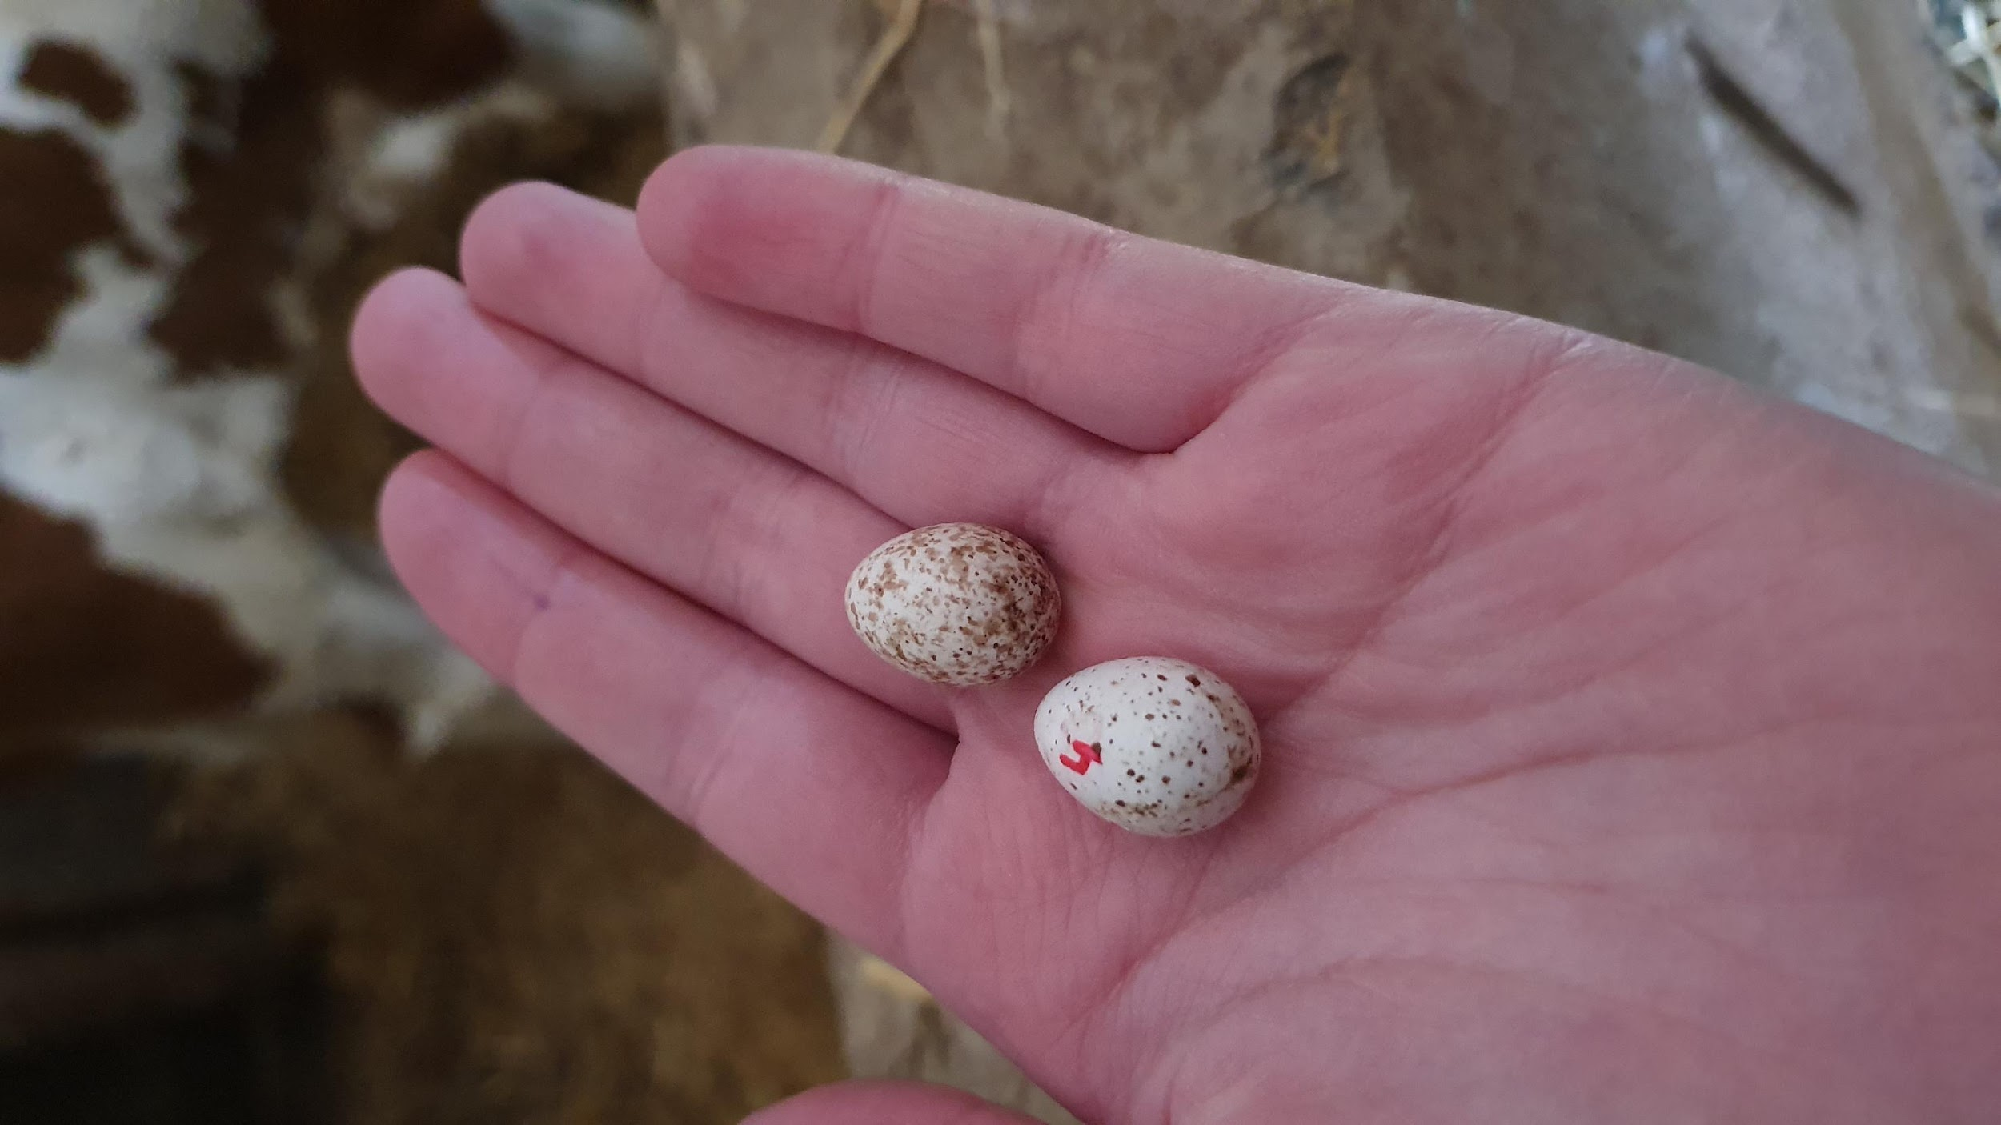
Pigmentation is crucial
Protection (predators, nest parasites, UV radiation)
Structural role
Protoporphyrin - brown-red spots
→ causes oxidative stress

Slide 3
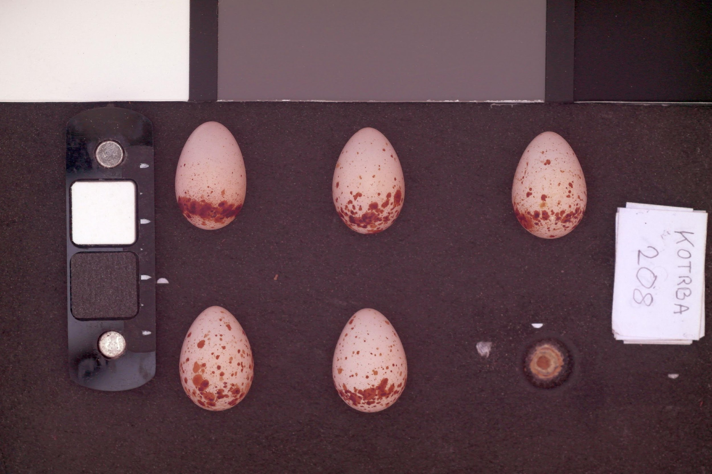
Nejen „fleky“
Photo: Michal Šulc
protoporfyrin
Fig.1. Protoporphyrin pattern exemple on eggs

Slide 4
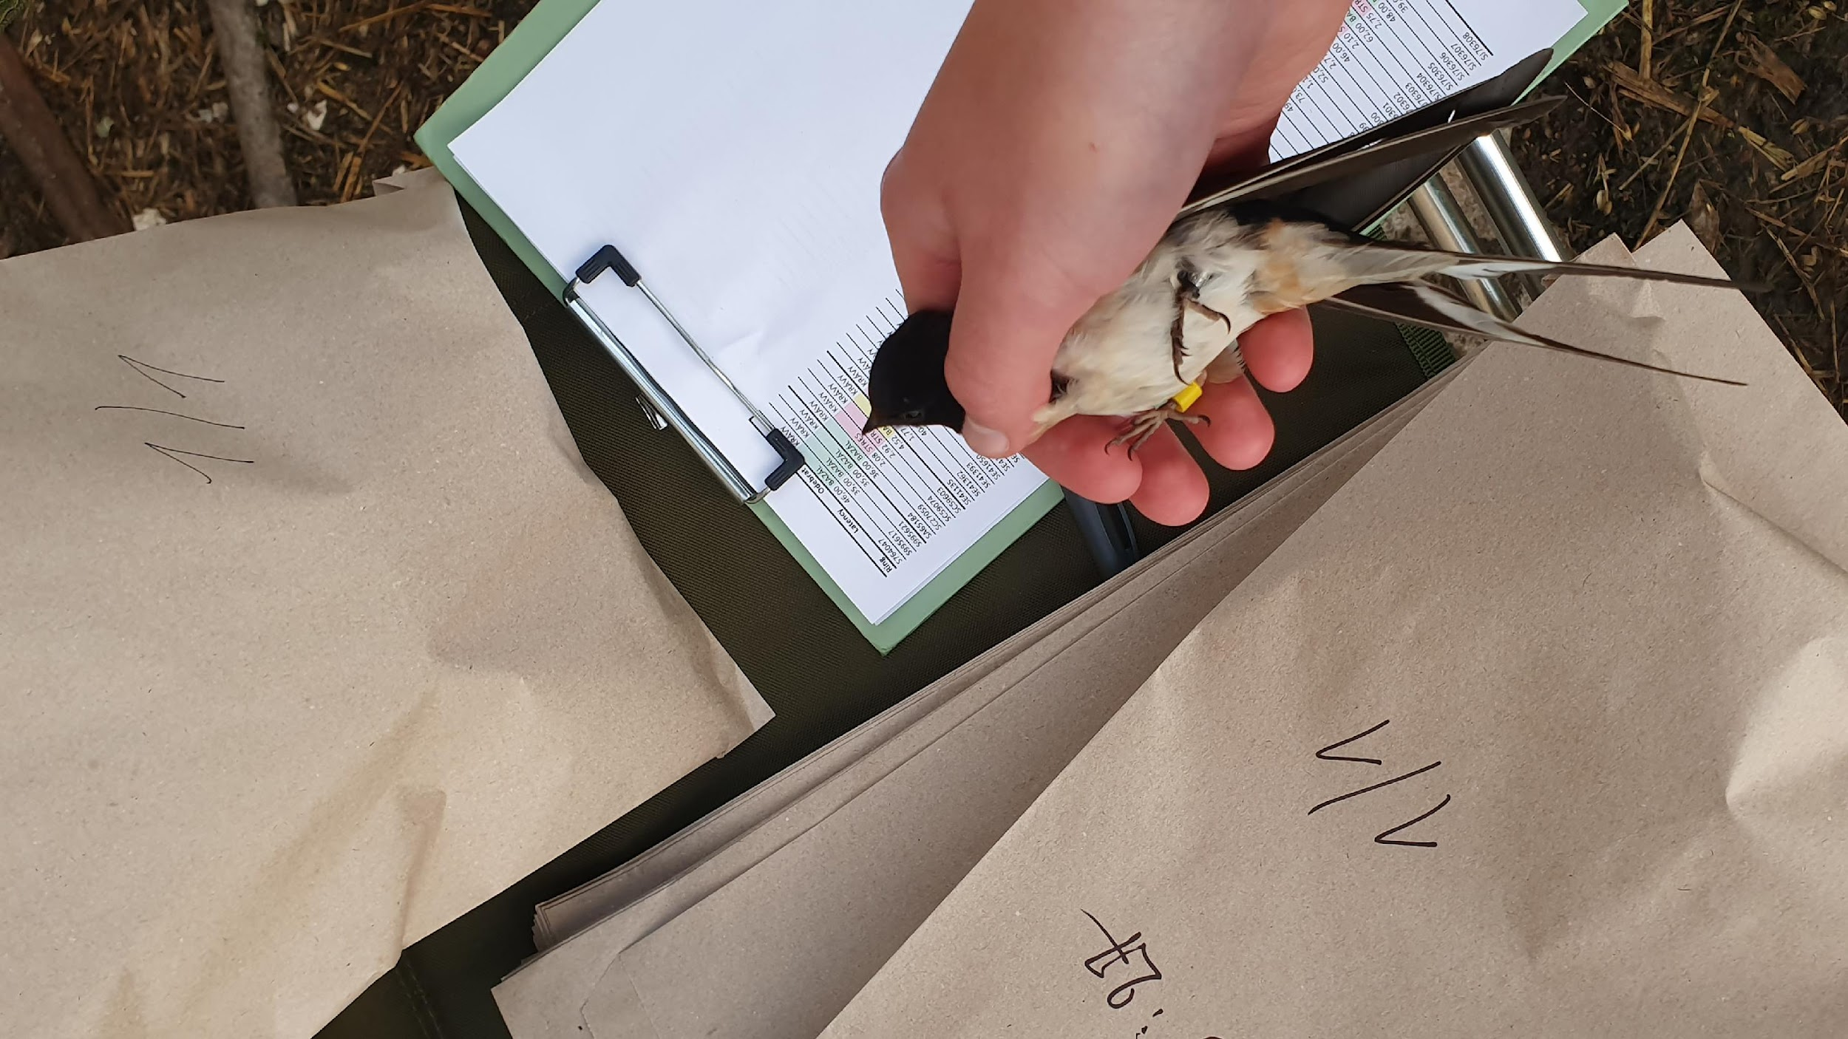
Can egg spotting be used to assess barn swallow female quality?

Slide 5
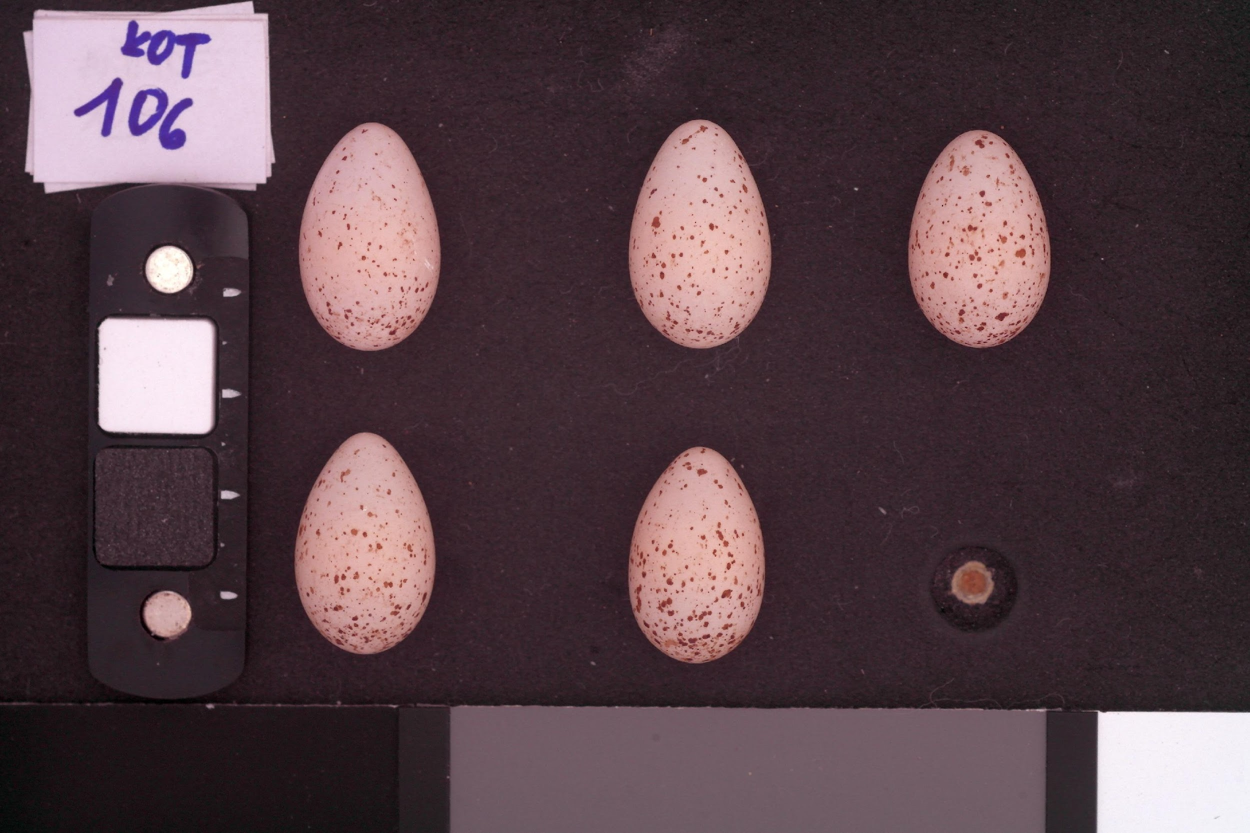
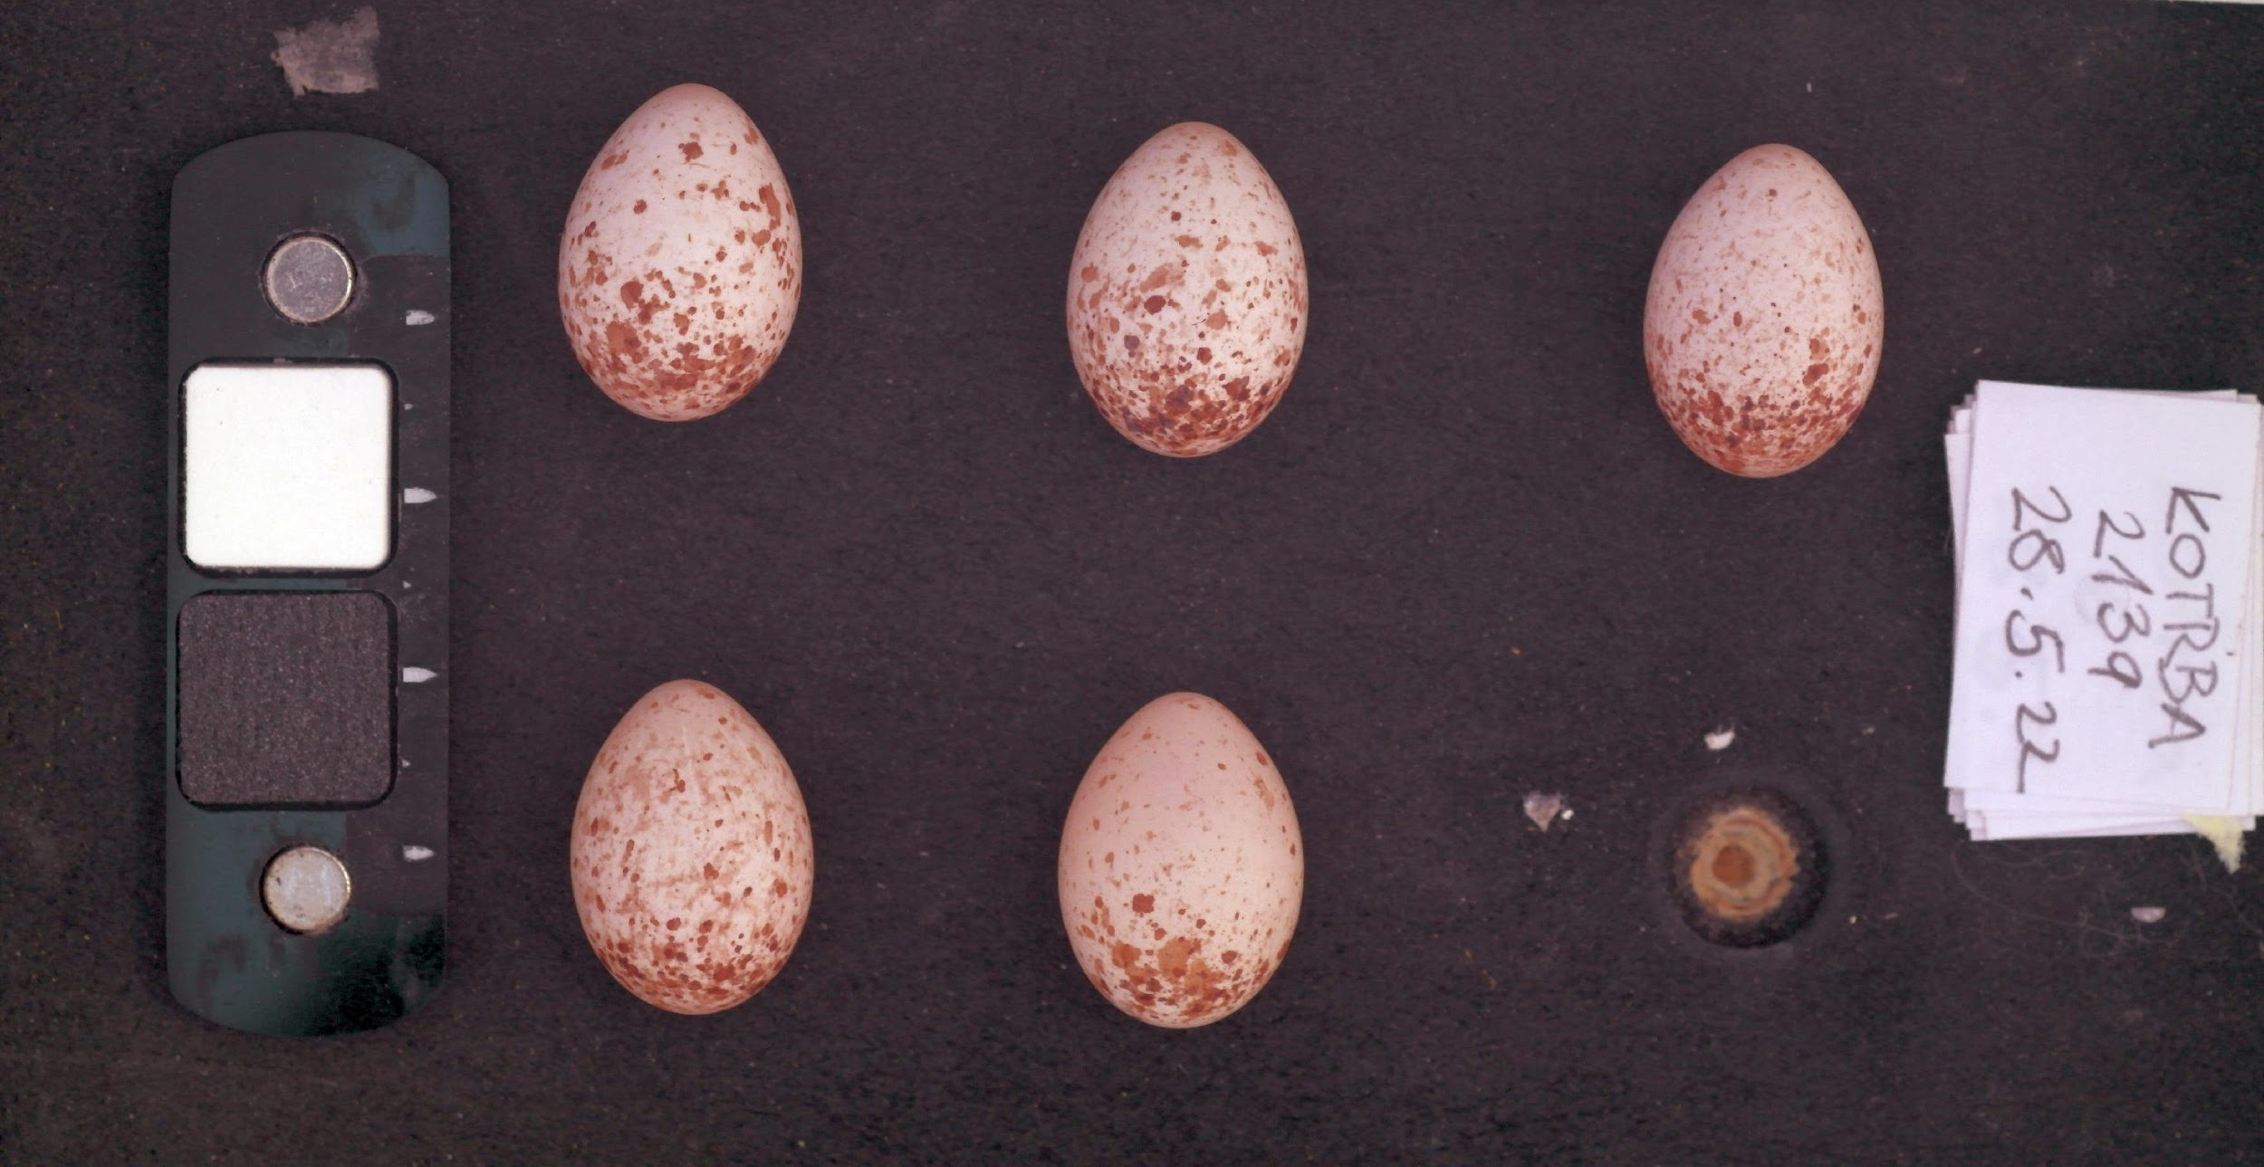
Hypotheses:
High-quality females (expected to have lower oxidative stress):
Less spotted eggs
Lighter spots
Lower within-clutch variation
Fig. 2. Comparison of barn swallow clutches: (left) lighter, less spotted; (right) darker, more heavily spotted. Both clutches prepared for analysis.

Slide 6
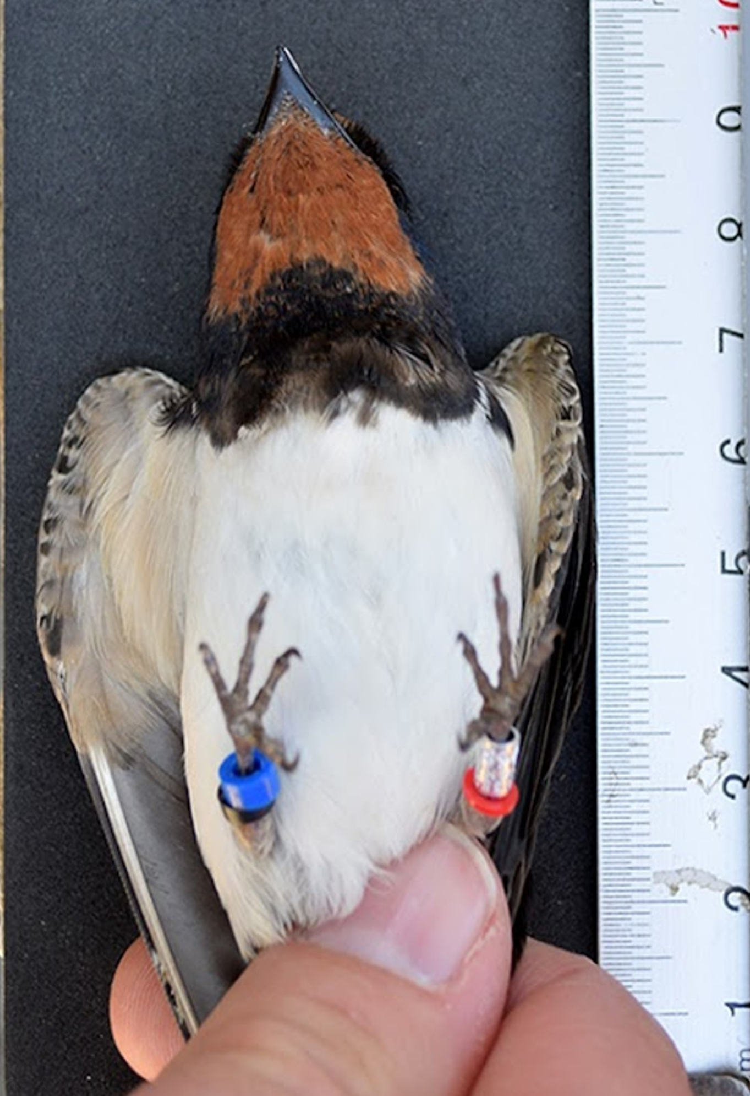
Methodology
Fig. 3. Measuring a ringed barn swallow to assess body size (tarsus)
Females: 290
Successful: 225
Data Collection on Females
Physiological traits: body mass, tarsus length, age
Stress indicators: corticosterone, glucose, hematocrit
Nesting data: number of eggs and fledglings
Egg Trait Analysis from Photos
  MICA Toolbox in ImageJ (red channel): spot coverage and spot brightness
Correlation analysis
Comparing results: linking female condition, egg traits, and reproductive success
Photo: Michal Šulc

Slide 7
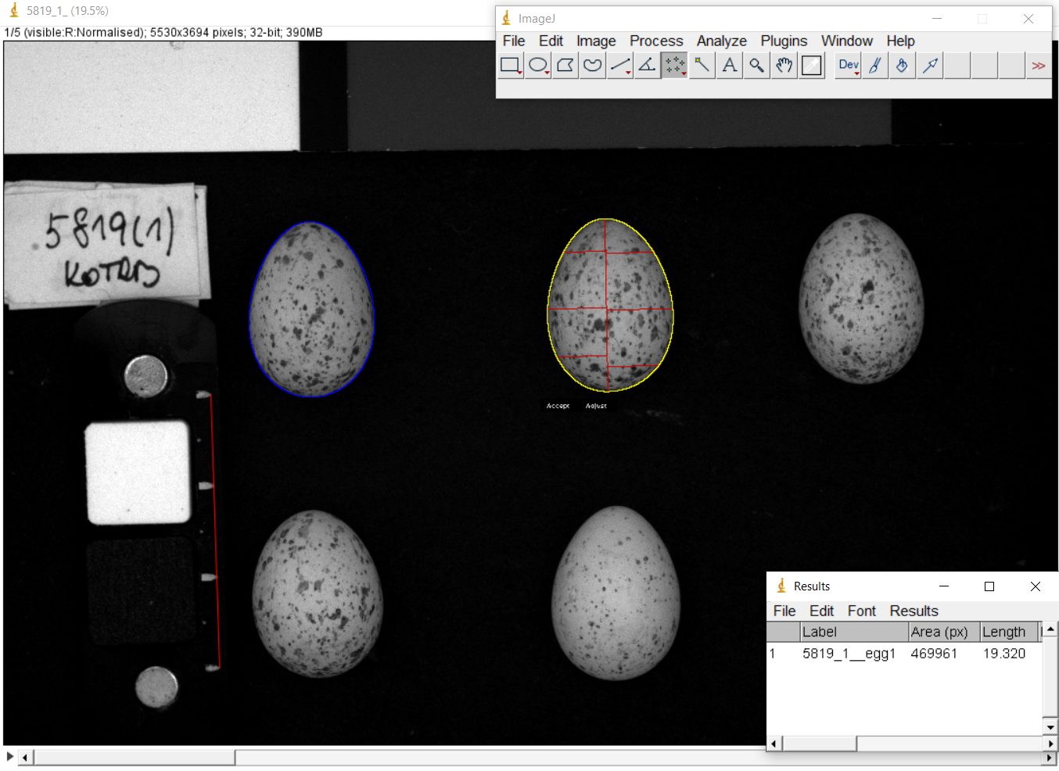
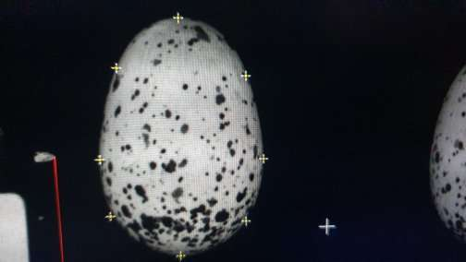
ImageJ
Fig. 4. Using ImageJ software to select egg perimeter and area for quantifying spot patterns.

Slide 8
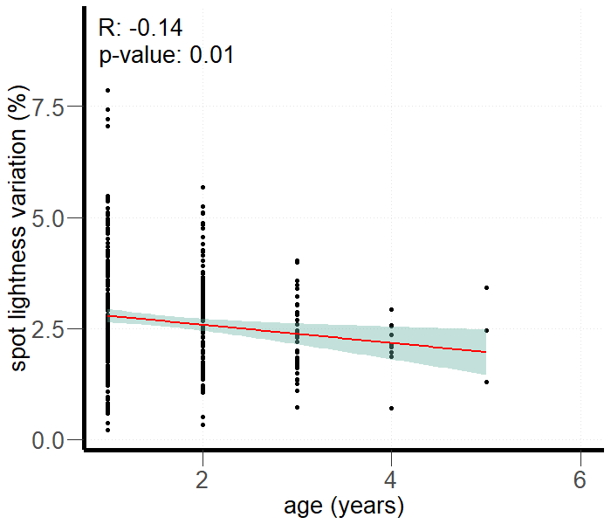
Age-related spot lightness variation within a clutch
Results

Slide 9
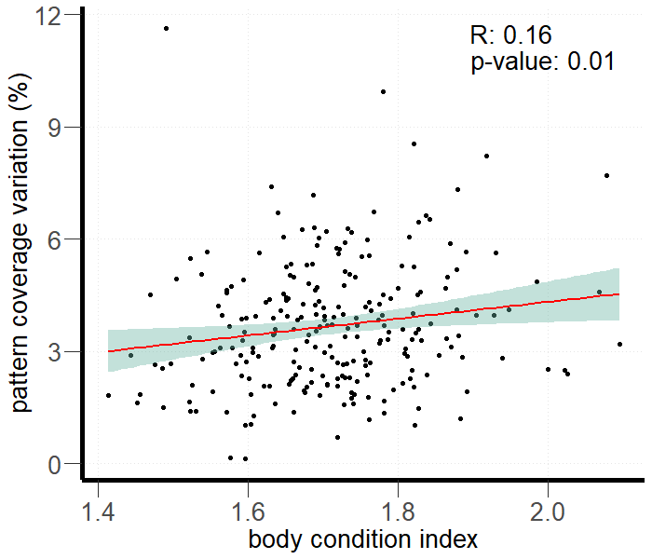
Pattern coverage variation related to body condition
Body condition = body mass/tarsus length

Slide 10
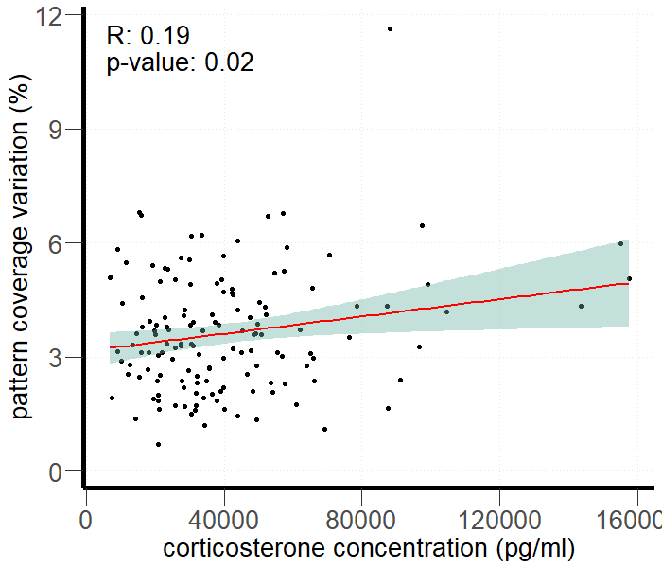
Pattern coverage variation related to corticosterone conc.

Slide 11
Conclusion of results
No correlation between rate of pattern coverage, rate of spot lightness, and female quality
Older females → less variation in spot brightness
Higher corticosterone levels → more variation in spot coverage
Higher corticosterone levels → more variation in spot coverage

Slide 12
Possible Explanations
Pigmentation probably genetically determined
Possible environmental impact on protoporphyrin
Better pigment regulation with age
Stress disrupts pigment consistency

Slide 13



Future?
Effect of parasites/disease on eggshell pigmentation?
Genetic basis of pigmentation?
Include background color in assessment?

Slide 14
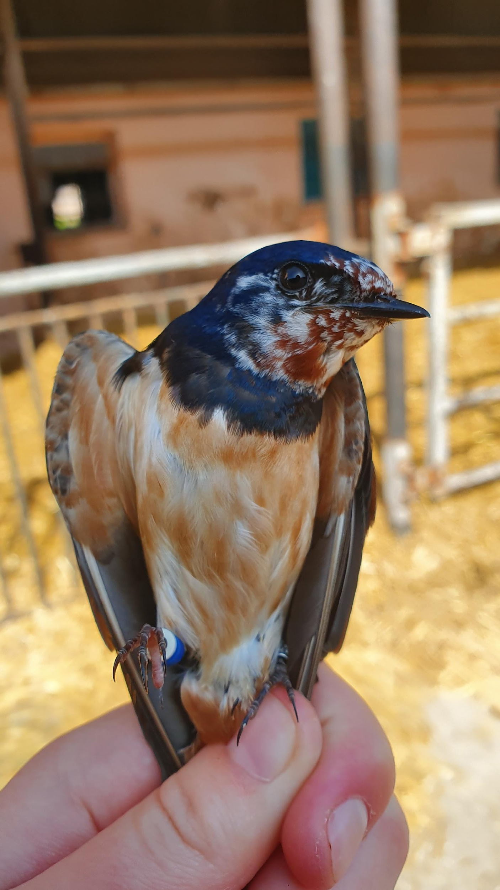
References
Hau, M., Casagrande, S., Ouyang, J. Q., and Baugh, A. T. 2010. Corticosterone, Testosterone and Life-History Strategies of Birds. Proceedings of the Royal Society B: Biological Sciences, 277(1697), 3203–3212.
Hodges, K. E., Mortimer, N. T., Vrailas-Mortimer, A. D., Sakaluk, S. K., and Thompson, C. F. 2020. Connecting the Dots: Avian Eggshell Pigmentation, Female Condition and Paternal Provisioning Effort. Biological Journal of the Linnean Society, 130(1), 114–127.
Kilner, R. M. 2006. The Evolution of Egg Colour and Patterning in Birds. Biological Reviews of the Cambridge Philosophical Society, 81(3).
Labocha, M., and Hayes, J. 2012. Morphometric Indices of Body Condition in Birds: A Review. Journal of Ornithology, 153, 1–22.
Magrath, R. D. 1992. The Effect of Egg Mass on the Growth and Survival of Blackbirds: A Field Experiment. Journal of Zoology, 227(4), 639–654.
Martínez, A., López-Rull, I., and Fargallo, J. A. 2023. To Prevent Oxidative Stress, What about Protoporphyrin IX, Biliverdin, and Bilirubin? Antioxidants, 12(9), 1662.
Moreno, J., and Osorno, J. L. 2003. Avian Egg Colour and Sexual Selection: Does Eggshell Pigmentation Reflect Female Condition and Genetic Quality? Ecology Letters, 6, 803–806.
Protoporphyrin and Eggshell Strength: Preliminary Findings from a Passerine Bird. 2024. ResearchGate, October 22.
Samiullah, S., Roberts, J. R., and Chousalkar, K. 2015. Eggshell Color in Brown-Egg Laying Hens—A Review. Poultry Science, 94(10), 2566–2575.
Thanks belongs to: ​
Mgr. Michal Šulc, Ph.D.​
Academy of Sciences of the Czech Republic​
And others​
for valuable advice, help with data collection, and the opportunity to participate in fieldwork and contribute to terrain data collection

