Slide 2

Biodegradable Hydrogels:
"A Solution for Watering and Growing Plants"
Mario Neshevski, Kaloyan Kuzmanov
S2 BG European School Brussels IV Laeken

Slide 3
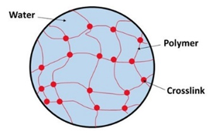
Content
What's a biodegradable hydrogel?
Our expectations of the project
Materials
Method
Discussion
Improvements and error analysis
Future directions
Conclusion 💧🌿🌎
References

Slide 4
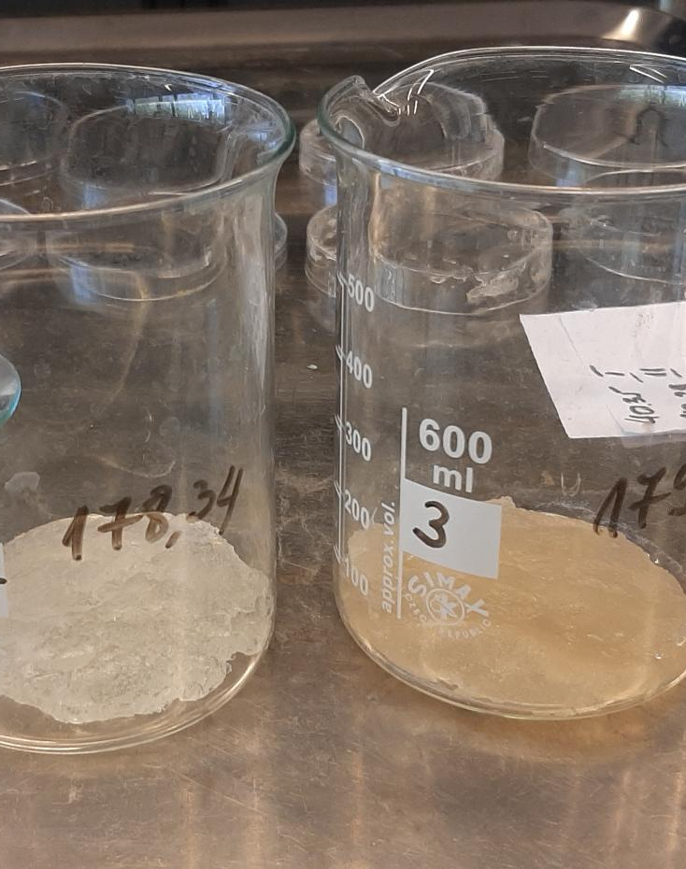
What is a biodegradable hydrogel?
Aim of the project
  To identify an effective solution for watering plants over extended periods
  To choose the hydrogel with the best absorption capacity
Description
  Network of natural biodegradable polymers
  Has the ability to absorb and release water solutions
Use
  Contains water
  Medicine- wound dressing
  Agriculture

Slide 5
Our expectations of the project
The hydrogel should absorb water and give it
Saving water
Water flowers during long periods

Slide 6
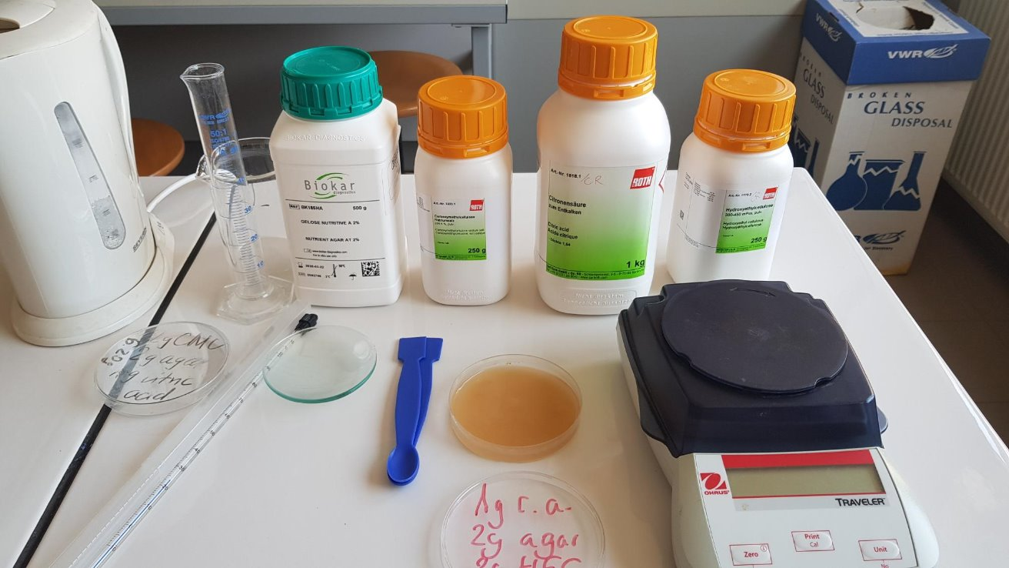
Materials
Natural polymers:
  HEC- Hydroxyethyl cellulose
  CMC- Carboxymethyl cellulose
  Agar
  Citric acid
Chemical glassware
Two plants -in our project Kalanchoe and African violets

Slide 7
Method
Types of hydrogels | Agar (g.) | HEC (g.) | CMC (g.) | Citric Acid (g.)
Hydrogel 1. | 2 | 2 | - | 1
Hydrogel 2. | - | 2 | 2 | 1
Hydrogel 3. | 2 | - | 2 | 1
Hydrogel 4. | - | 4 | - | 1
Hydrogel 5. | 4 | - | - | 1
Hydrogel 6. | - | - | 4 | 1
We explored different combinations of the biopolymers to determine the hydrogel with the best absorption capacity
Measurement of the mass of the ingredients lead as to find the best hydrogel

Slide 8
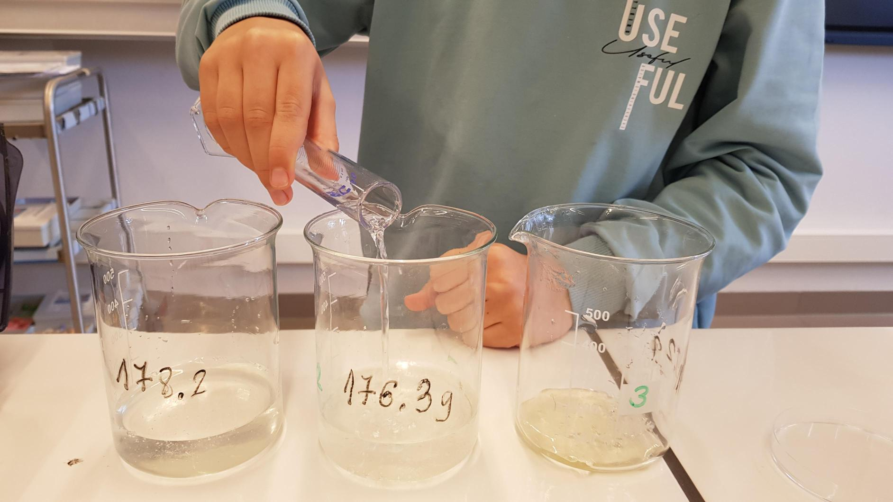
Making mixture by adding 50ml. hot water (60°C) to the container with the polymers
Stirring until all the components of the mixture are uniformly mixed
After 24 hours the hydrogel is ready converted into homogenous mixture
Testing absorption capacity:
  For 1 hour
  For a longer period
  In the soil with the plants

Slide 9
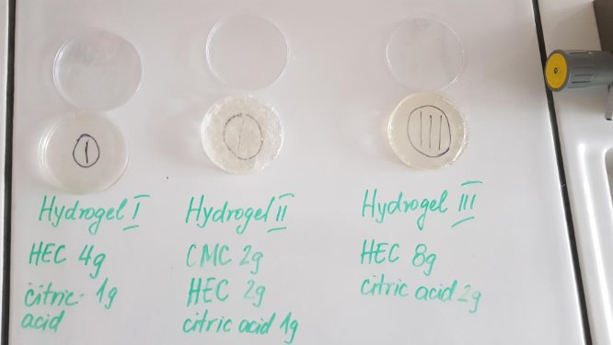
Discussion
Exclusion of agar as a component
1st test of absorption
Choosing the best hydrogel for testing in the soil- Hydrogel II
Types of hydrogels | Hydrogel absorption (%)
Hydrogel I | 9%
Hydrogel II | 70%
Hydrogel III | 17%

Slide 10
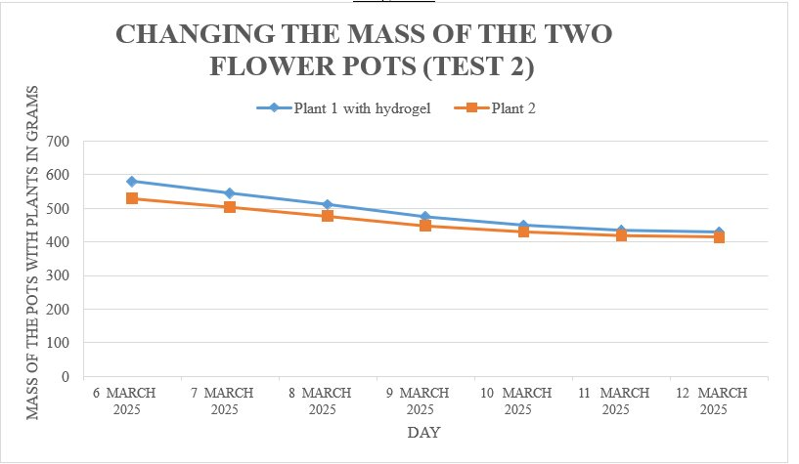
Types of hydrogel mixtures | Hydrogel absorption (%)
Hydrogel 2 (2g CMC 2g HEC) | For 6 days 181%
Hydrogel 2.1 (4g HEC 2g CMC | For 3 days 62%
Hydrogel 2.2 (6g HEC 2g CMC) | For 9 days 305%
Different ratios of HEC and CMC
Monitoring of hydrogels in the soil
Second test in soil – almost successful

Slide 11
Types of hydrogel mixtures | Hydrogel absorption (%)
Hydrogel 2 (2g CMC 2g HEC) | For 6 days 181%
Hydrogel 2.1 (4g HEC 2g CMC | For 3 days 62%
Hydrogel 2.2 (6g HEC 2g CMC) | For 9 days 305%

Slide 12

Improvements and error analysis
More experiments with different ratios of the components
Equal period of time to measure the absorption capacity of the hydrogels

Slide 13
Future directions
Experimenting with different soil type
Experimenting with other types of plant
Basic
Acidic
Green plant
Tree
Flower plant
Developing in two ways

Slide 14
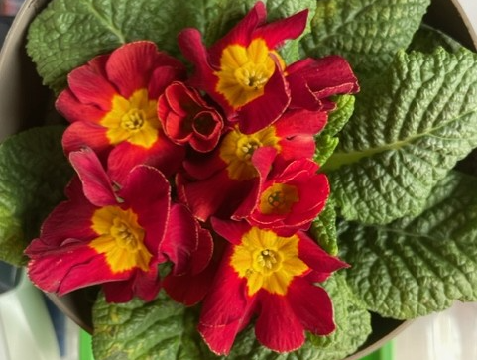
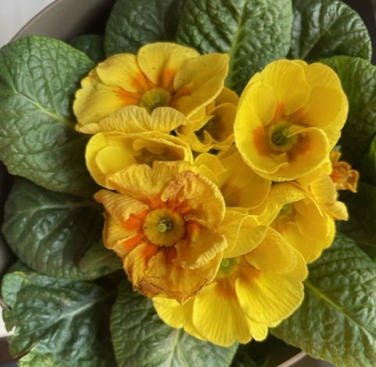
Conclusion 💧🌿🌎
By experimenting with different hydrogel ratios, we successfully formulated hydrogel with the best absorption capacity
This project proves that biodegradable hydrogels:
can effectively help plants retain and access water over extended periods
Perform best with the right hydrogel-to-water ratio
Support growth of African violets (Saintpaulia) and Kalanchoe
Are a simple, eco-friendly way to keep soil moist in school gardens

Slide 15
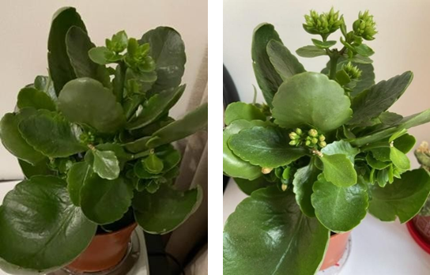
Development of a Kalanchoe with hydrogel and with minimal watering

Slide 16
References
kemox. (2023, June 2). How is Hydroxyethyl Cellulose Made? Unveiling the Process and the Kemox
Advantage. Kemox. https://www.kemoxcellulose.com/how-is-hydroxyethyl-cellulose-made/
Carboxymethyl cellulose (cmc, cellulose gum), sodium carboxymethyl cellulose (cmc). (2022, February 6). Center for Science in the Public Interest. https://www.cspinet.org/article/carboxymethylcellulose-cmc-cellulose-gum-sodium-carboxymethyl-cellulose-cmc
Slutz, S. (2023, October 12). Can Biodegradable Hydrogels Help Conserve Water in Farming? | Science Project. Science Buddies. https://www.sciencebuddies.org/science-fair-

Slide 17
projects/project_ideas/AgTech_p013/agricultural-technology/water-conservation-hydrogels
Miller, C. (2023, January 31). Hold On to That Water! Making Biodegradable Hydrogels - Activity. TeachEngineering.org. https://www.teachengineering.org/activities/view/uoh-2667-biodegradablehydrogels-water-conservation
MyBib Contributors. (2019, May 26). APA Citation Generator – FREE & Fast – (6th Edition, 2019).
MyBib. https://www.mybib.com/tools/apa-citation-generator
English - Polish translator | Glosbe Translate. (n.d.). Translate.glosbe.com. https://translate.glosbe.com/
DeepL. (2024). DeepL Translator. Deepl.com. https://www.deepl.com/en/translator

Slide 18
Thank you for your attention!
Mario Neshevski and Kaloyan Kuzmanov
Teacher: Nevena Kalpakova

