Slide 1
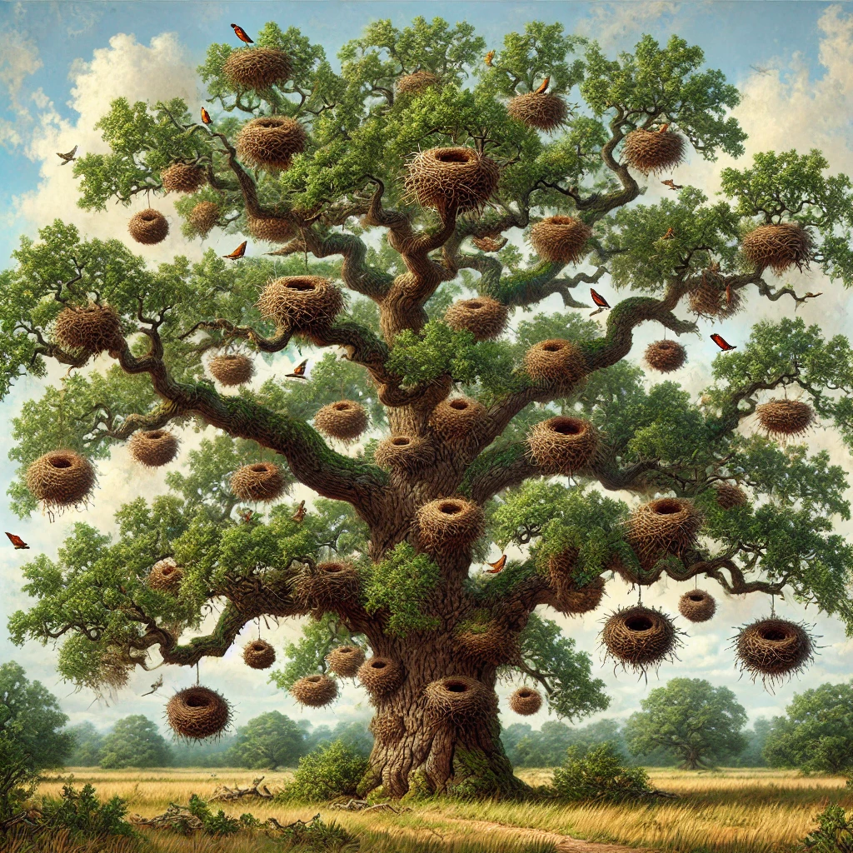
Reasons Behind Changes in Bird Migration Routes: An analysis of potential causes.
By Jesús Álvarez Ruiz, Secondary 4 English Section, International European School of Warsaw

Slide 2
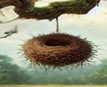
Introduction
Bird migration
White stork 1822 in Germany.
Changes in migration
Research is crucial, why?

Slide 3

In Europe, some human activities being carried out may harm the approximately 400 species of migratory birds present in our continent.
These are the causes.
The results

Slide 4
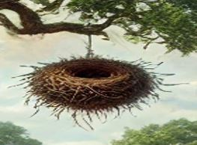
Climatic factors
Big deviations
Climate change
Increase of temperatures
Droughts and floods
Small deviations
Storms and hurricanes
Strong winds

Slide 5
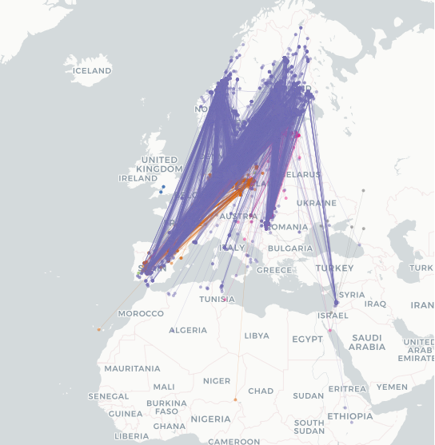

Slide 6
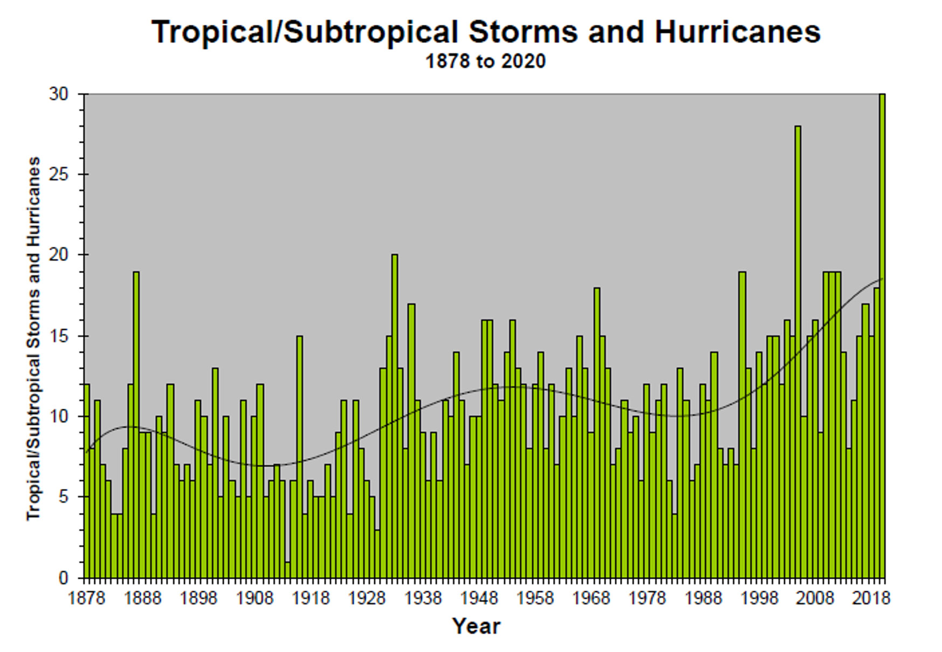

Slide 7

Nutritional factors
Food availability
Food scarcity
Invasive species
Preparation for migration

Slide 8
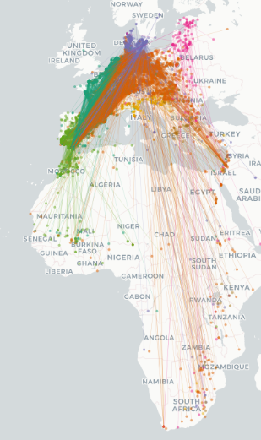
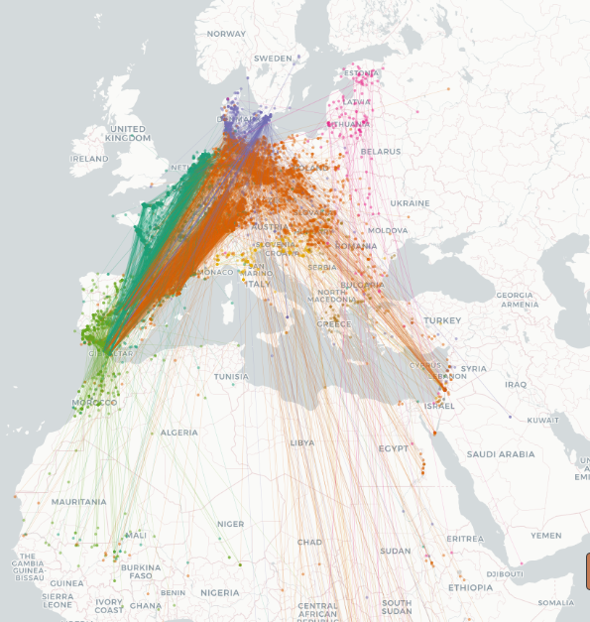
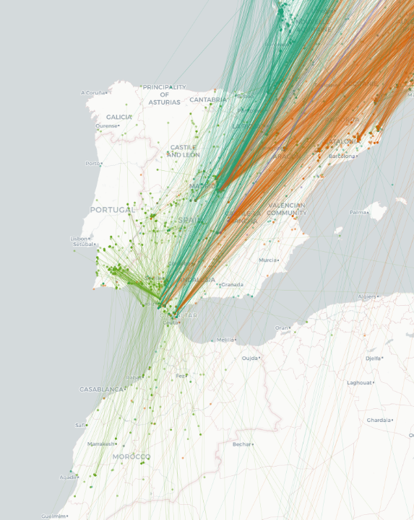

Slide 9
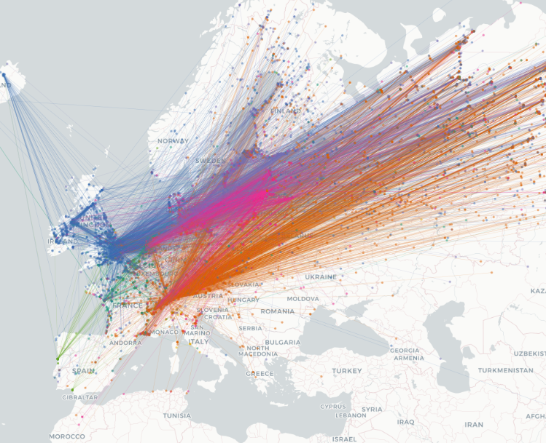

Slide 10

Human-caused factors
Deforestation, pollution, landfills, buildings, ….

Slide 11

Habitat destruction
Deforestation
Beach loss
Rural expansion
Glasses

Slide 12
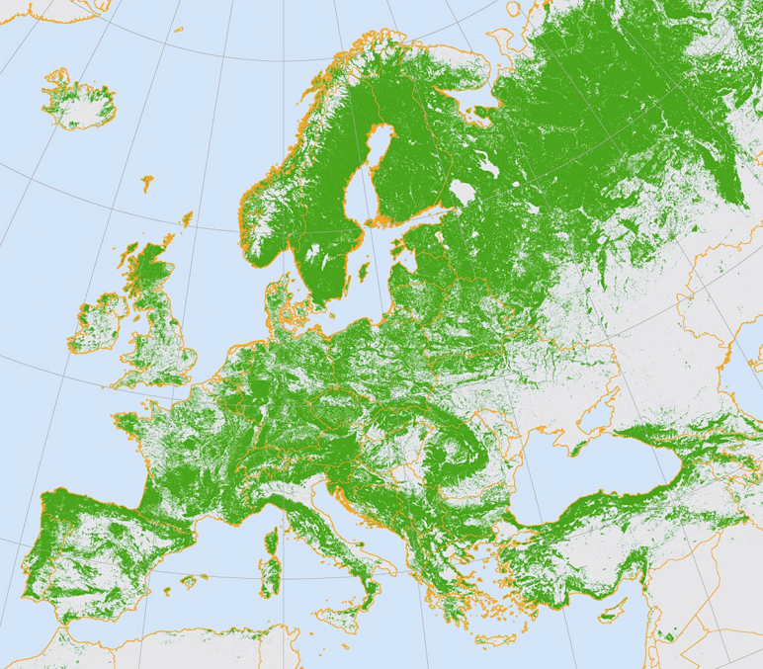

Slide 13
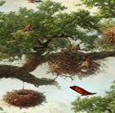
Pollution and landfills
Plastic pollution
  Food
  Plastic in the ocean
  Nest materials
Light pollution
  Disorientation
  Timing disruption
Air and sea pollution
  Hydrocarbons
  Toxic emissions

Slide 14
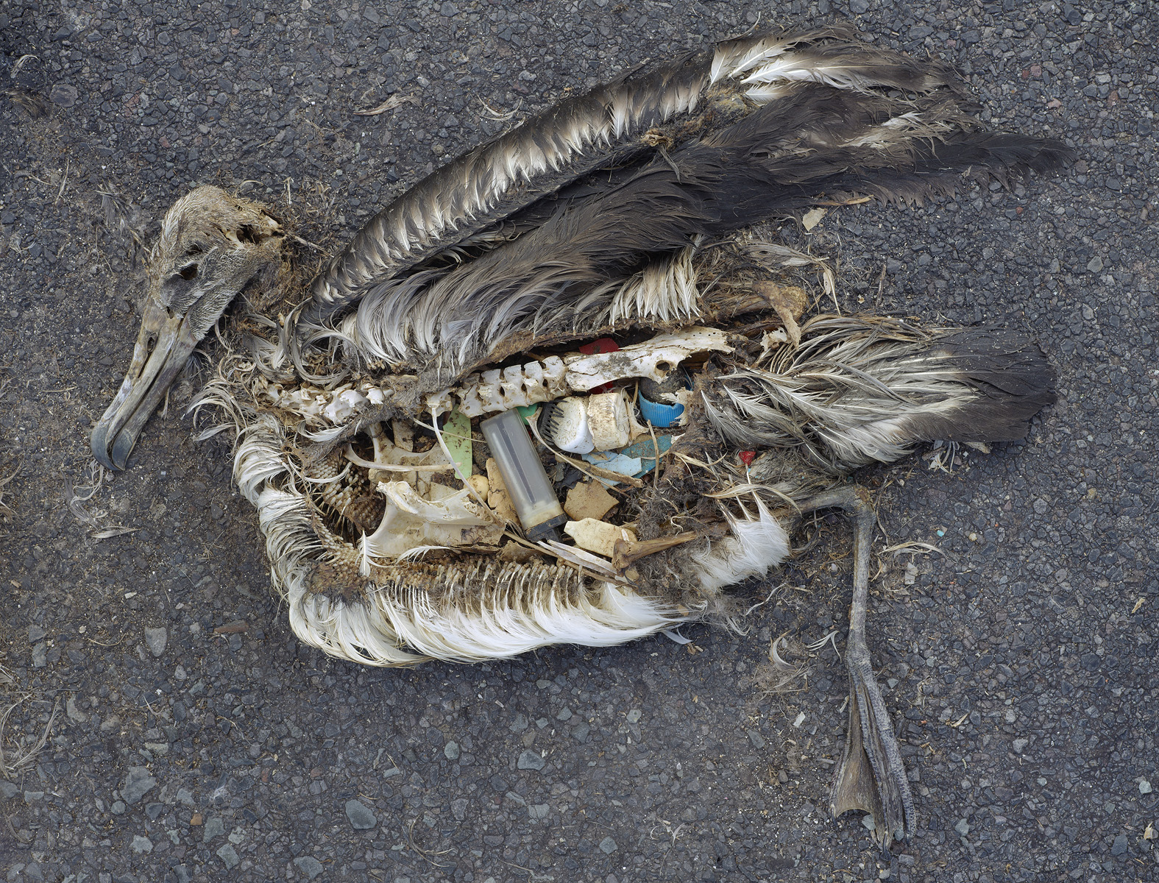

Slide 15
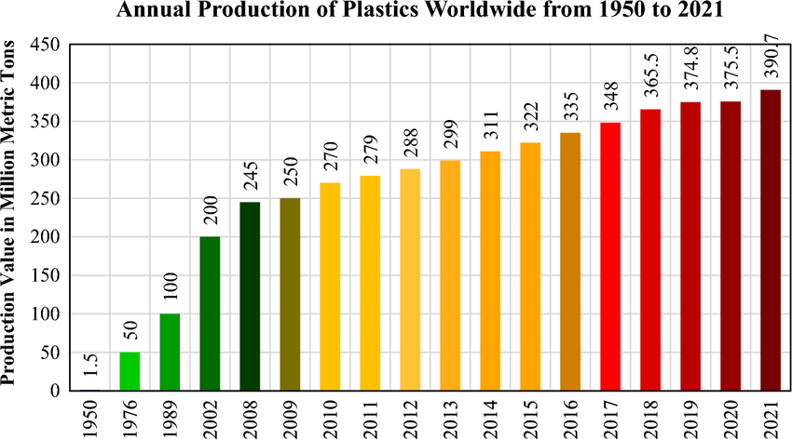

Slide 16
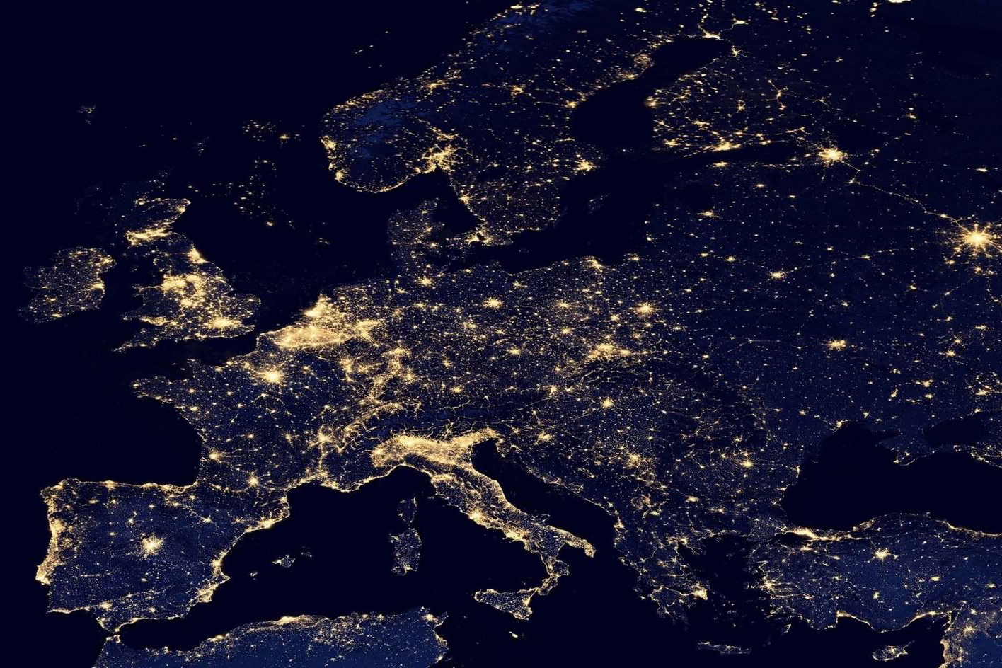
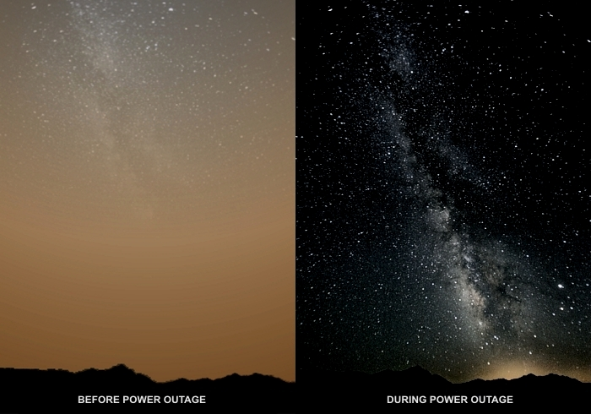

Slide 17

Poisons and pesticides
Ingestion
Lethargic behavior

Slide 18
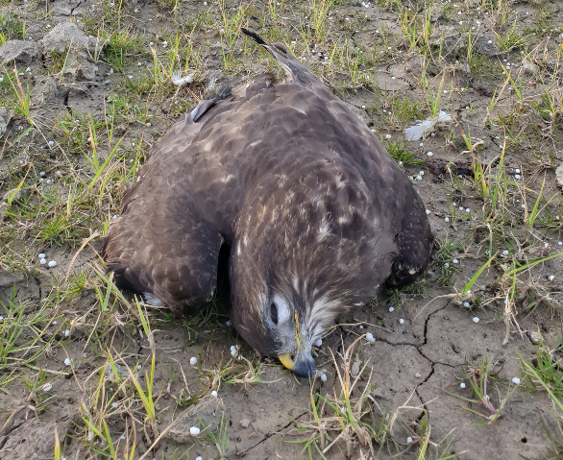

Slide 19

Discussion and conclusion
The migratory patterns of birds have changed over the last few decades due to three main groups of factors: Food-related, Climate-related, and Human-caused factors.

Slide 20
Any questions?

Slide 21
Sources and Acknowledgements

Slide 22
I would like to thank my parents for their help. Thanks to them, I would not have had the time and space I needed to carry out this study. Their support has been essential, as, like anyone, I have had my ups and downs.
I also want to thank my biology teacher, who gave me the opportunity and introduced me to this competition, knowing my love for biology.
A thousand thanks to my former teachers, Don Ignacio Quevedo Ferrer and José Nieto, for without their help, I would not have been able to understand or include even half of the things I have incorporated. Thanks to them, who are in contact with SEO/Birdlife, which I also thank them, I have been able to observe nest cameras and find more material.
Thanks to my friend, who is trained in ornithology and has provided me with books that have been of great help.
And finally, many thanks to my classmates and schoolmates, who have helped me continue with this work.

Slide 23
Bird Migration Atlas, migrationatlas.org, accessed 03/03/2025
Migra, migraciondeaves.org, accessed 03/03/2025
Sergi Alcalde, National Geographic España, Nadie imagino que un ave podría volar tan lejos sin detenerse, https://www.nationalgeographic.com.es/mundo-animal/ave-que-volo-mas-lejos_22178, accessed 03/03/2025
Sarah Romero, National Geographic España, Una ola de calor en el Pacifico mata a 4 millones de aves marinas: un desastre ambiental sin precedentes, https://www.nationalgeographic.com.es/medio-ambiente/ola-calor-pacifico-mata-a-4-millones-aves-marinas-desastre-ambiental-sin-precedentes_23895, accessed 03/03/2025
American Avocet, https://explorer.audubon.org/explore/species/1564/american-avocet/migration?sidebar=collapse&selectedHex=&zoom=2&x=1694065.6087975225&y=-398603.67265824054&range=0.7587%2C0.7787, accessed 03/03/2025
Marine Flyways-Seabird Tracking Database, https://www.seabirdtracking.org/, accessed 03/03/2025
Freydis Vigfusdottir, Tandfonline, https://www.tandfonline.com/doi/full/10.1080/00063657.2013.811214#d1e414. accessed 03/03/2025
Jochen Schreiber & W. Daniel Kissling, 2005, Factors affecting the breeding success of Arctic Terns (Sterna paradisaea) in a colony at Kaldbaksbotnur, Faroe Islands, p.3-7
DataZone by BirdLife, Artic tern, https://datazone.birdlife.org/species/factsheet/arctic-tern-sterna-paradisaea, accessed 03/03/2025
Migra, Cigueña Blanca, https://migraciondeaves.org/en/especie/white-stork/, accessed 03/03/2025
Seo BirdLife, Vencejo comun, https://seo.org/ave/vencejo-comun/, accessed 03/03/2025
Joaquin Elcacho, La Vanguardia, Récord mundial de vuelo sin escalas: este pájaro supero los 12.000 Km en 11 dias, https://www.lavanguardia.com/natural/20201014/484072710781/pajaro-ave-aguja-colipinta-bate-record-mundial-vuelo-sin-escalas-alaska-nueva-zelanda.html, published 2020
Abel G. M., National Geographic España, Así surgieron las primeras aves a partir de los dinosaurios con plumas, https://www.nationalgeographic.com.es/ciencia/asi-surgieron-primeras-aves-a-partir-dinosaurios-plumas_17250, accessed 06/03/2025
DW, Piedras perdidas revelarían larga migración de dinosaurios, https://www.dw.com/es/piedras-perdidas-revelar%C3%ADan-migraci%C3%B3n-de-dinosaurios-de-m%C3%A1s-de-1600-kil%C3%B3metros/a-57206843#:~:text=Recientes%20descubrimientos%20demuestran%20que%20los,cambios%20de%20clima%20y%20temperatura, accessed 06/03/2025, published 2021
Wikipedia, Migración de las aves, https://es.wikipedia.org/wiki/Migraci%C3%B3n_de_las_aves#Visi%C3%B3n_hist%C3%B3rica, accessed 06/03/2025
Audubon, What This Gruesome Stork Taught us about migration, https://www.audubon.org/news/what-gruesome-stork-taught-us-about-bird-migration, accessed 06/03/2025
Data zone by BirdLife, Common crane, https://datazone.birdlife.org/species/factsheet/common-crane-grus-grus, accessed 07/03/2025
Data zone by BirdLife, Common swift, https://datazone.birdlife.org/species/factsheet/common-swift-apus-apus, accessed 07/03/2025
Data zone by BirdLife, White stork, https://datazone.birdlife.org/species/factsheet/white-stork-ciconia-ciconia, accessed 07/03/2025
Sánchez Juárez C. J. & García Delster V., 2016, De aves migratorias a lombrices de tierra, Elementos Buap, p.2
Víctor R. Cueto & Javier Lopez de Casenave, 2006, Nuevas miradas sobre las aves migratorias americanas: técnicas, patrones, procesos y mecanismos, El Hornero
José Luis Rangel Salazar et al., 2013, Amenazas a la avifauna, ResearchGate, p. 3-5
Wikipedia, Fauna de Europa, https://es.wikipedia.org/wiki/Fauna_de_Europa#:~:text=La%20lista%20de%20aves%20europeas,de%20ellas%20reproductoras%20en%20Europa). , accessed 08/03/2025Seo BirdLife, Grulla común, https://seo.org/ave/grulla-comun/#:~:text=La%20Lista%20Roja%20Europea%20de,com%C3%BAn%20actualmente%20se%20encuentra%20extinta., accessed 08/03/2025

Slide 24
Trading Economics, Polonia-Temperatura, https://es.tradingeconomics.com/poland/temperature#:~:text=Celsius%20en%201940.-,La%20temperatura%20en%20Polonia%20promedi%C3%B3%208.02%20grados%20Celsius%20desde%201901,5.71%20grados%20Celsius%20en%201940.&text=Polonia%20%2D%20Temperatura-,La%20temperatura%20en%20Polonia%20aument%C3%B3%20a%2010.24%20grados%20Celsius%20en,9.74%20grados%20Celsius%20en%202022., accessed 08/03/2025
United Nations Climate Change, El cambio climático altera las principales corrientes de aire y provoca una meteorología extrema, 2013, https://unfccc.int/es/news/el-cambio-climatico-altera-las-principales-corrientes-de-aire-y-provoca-una-meteorologia-extrema, accessed 08/032025
Sergi Alcalde, National Geographic España, El regadío está secando Doñana. Así afectan las explotaciones ilegales a la preservación del humedal más grande de Europa, https://www.nationalgeographic.com.es/medio-ambiente/regadio-seca-donana_17870, accessed 09/03/2025
Diario de Sevilla, Doñana, expulsada de la prestigiosa lista verde de la Unión Internacional para la Conservación de la Naturaleza, https://www.diariodesevilla.es/andalucia/Donana-expulsada-Union-Internacional-Conservacion-Naturaleza_0_1858314334.html, accessed 09/03/2025
Kieran Mulvaney, National Geographic, Estados Unidos se enfrenta a un histórico 2024 repleto de huracanes, https://www.nationalgeographic.es/medio-ambiente/2024/03/temporada-huracanes-historica-2024-estados-unidos, accessed 09/03/2025
Seo BirdLife, Porrón moñudo, https://seo.org/ave/porron-monudo/, accessed 09/03/2025
Wikipedia, Aythya fuligula, https://es.wikipedia.org/wiki/Aythya_fuligula, accessed 09/03/2025
Carmen Nicolas, Que Animal, RTVE, La bióloga Ana Bermejo nos desvela por qué las cigüeñas ya no migran, https://www.rtve.es/television/20201123/biologa-ana-bermejo-desvela-porque-as-ciguenas-ya-no-migran/2057930.shtml#:~:text=S%C3%AD%2C%20cierto.,de%20residuos%20urbanos%20y%20arrozales., accessed 09/03/2025
Euro News, Ola de calor en México: El Niño mata a cientos de aves, 2023, https://es.euronews.com/green/2023/06/16/ola-de-calor-en-mexico-el-nino-mata-a-cientos-de-aves, accessed 09/03/2025
Dicyt, La presencia de carpas reduce las poblaciones de aves en lagunas de gran valor ecológico, https://dicyt.com/noticias/la-presencia-de-carpas-reduce-las-poblaciones-de-aves-en-lagunas-de-gran-valor-ecologico, accessed 09/03/2025
DW, La peligrosa vida de las aves migratorias, https://www.dw.com/es/la-peligrosa-vida-de-las-aves-migratorias/a-61746966, accessed 09/03/2025
Ecoticias, La pérdida de los hábitats naturales amenaza a las aves migratorias a nivel mundial, https://www.ecoticias.com/naturaleza/48282_la-perdida-de-los-habitats-naturales-amenaza-a-las-aves-migratorias-a-nivel-mundial, accessed 09/03/2025
Stephanie Valle Cubero, The Toucan Rescue Ranch, Comprendiendo las maravillas y los desafíos de la migración de las aves, 2024, https://toucanrescueranch.org/es/2024/06/understanding-the-marvels-and-challenges-of-bird-migration/, accessed 10/03/2025
Navodi Kuruppu, 3Bee, Deforestación en Europa: Plan de acción de la UE, https://blog.3bee.com/es/deforestacion-en-europa-perspectivas-del-plan-de-accion-de-la-ue/#next-3, accessed 10/03/2025
Seo BirdLife, Aves y cristales, https://seo.org/cristales-trampa-mortal-aves/, accessed 10/03/2025
Global Paris, La contaminación y las aves migratorias: cómo les afecta, https://globalparis.es/la-contaminacion-y-las-aves-migratorias-como-les-afecta/, accessed 10/03/2025
Cristina Crespo Garay, National Geographic, Las cigüeñas abandonan su migración a África y se establecen en España, https://www.nationalgeographic.es/animales/2020/02/las-ciguenas-abandonan-su-migracion-a-africa-y-se-establecen-en-espana, accessed 10/03/2025
ITOPF ,EFECTOS DE LA CONTAMINACIÓN POR HIDROCARBUROS EN EL MEDIO MARINO, https://www.itopf.org/fileadmin/language_variants/Final_TIP_13_2011_SP.pdf, p.5
Josep del Hoyo, 2020, All the Birds of the World, Lynx Editions, p.135,187,242,264,271
Heather Angel et al., 1992, Enciclopeida del Reino Animal, Susaeta Editions p.152,153, 164, 174, 179, 182
Paul Sterry el al., ?, Aves de España y Europa, Susaeta Editions, p.22, 41, 80, 123, 138, 146
Paul R. Ehrlich et al., 1994, Guia del Observador de Aves: Una Guia sobre la Historia Natural de las Aves de Europa, Omega, p.43, 63, 95, 117, 145, 217, 219, 339, 377, 405
Larss Svensson, 1999, Collins Bird Guide, Collins, p.33, 85, 87, 183, 139-171, 201, 137
Mike Unwin, 2022, La Vuelta al Mundo en 80 Aves, Blume, p.45, 56, 78, 86, 110

Slide 25
Larss Svensson, 1999, Collins Bird Guide, Collins, p.33, 85, 87, 183, 139-171, 201, 137
Mike Unwin, 2022, La Vuelta al Mundo en 80 Aves, Blume, p.45, 56, 78, 86, 110
Jacek Betleja, Wyborcza, Niezwykła historia mewy delawarskiej. Biały kruk wśród mew w końcu trafia na listę, accessed 13/03/2025
Yudhijit Bhattacharjee, National Geographic España, La Espectacular Migracion de las Aves, https://www.nationalgeographic.com.es/naturaleza/espectacular-migracion-aves_16882, accessed 13/03/2025
Cristina Crespo Garay, National Geographic, 12 fotografías del impacto de la marea negra en Perú, https://www.nationalgeographic.es/photography/2022/01/12-fotografias-del-impacto-de-la-marea-negra-en-peru, accessed 13/03/2025
Irec (Instituto de Investigación en Recursos Cinegéticos), ¿Cómo afecta a las cigüeñas alimentarse en los vertederos?, 2021, https://www.irec.es/publicaciones-destacadas/efectos-ciguena-blanca-alimentacion-vertederos-residuos-urbanos/, accessed 13/03/2025
Jacek Betleja, Wyborcza, Niezwykła historia mewy delawarskiej. Biały kruk wśród mew w końcu trafia na listę, accessed 13/03/2025
Yudhijit Bhattacharjee, National Geographic España, La Espectacular Migracion de las Aves, https://www.nationalgeographic.com.es/naturaleza/espectacular-migracion-aves_16882, accessed 13/03/2025
Cristina Crespo Garay, National Geographic, 12 fotografías del impacto de la marea negra en Perú, https://www.nationalgeographic.es/photography/2022/01/12-fotografias-del-impacto-de-la-marea-negra-en-peru, accessed 13/03/2025
Irec (Instituto de Investigación en Recursos Cinegéticos), ¿Cómo afecta a las cigüeñas alimentarse en los vertederos?, 2021, https://www.irec.es/publicaciones-destacadas/efectos-ciguena-blanca-alimentacion-vertederos-residuos-urbanos/, accessed 13/03/2025
Seo BirdLife, Grulla común, https://seo.org/ave/grulla-comun/#:~:text=La%20Lista%20Roja%20Europea%20de,com%C3%BAn%20actualmente%20se%20encuentra%20extinta., accessed 08/03/2025

