Slide 1
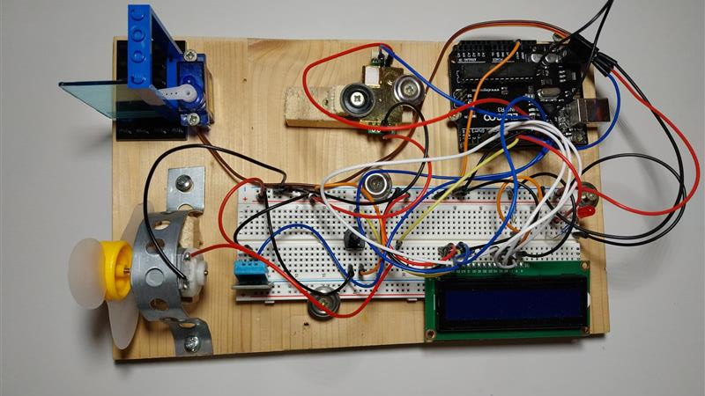
Optimal sleeping conditions
By Diego de Santos and Nico Fernandez

Slide 2

Motivation and Goal
Motivation:
  Problem --> not max productivity
  Idea to solve this
Goal:
  Achieve optimal condition
  CO₂, temperature, and humidity
Notes:
Goal:
Achieve optimal sleeping conditions by regulating CO₂, temperature, and humidity.
Enhance rest quality without increasing sleep duration.
Boost productivity for workers, companies, children, and anyone.
Save time by improving sleep efficiency.
Motivation:
Poor sleeping conditions are often underestimated but significantly impact daily productivity and health.
Many people are unaware of how environmental factors like CO₂ levels, temperature, and humidity affect sleep quality.
By addressing these factors, we aim to provide an accessible solution to improve sleep and overall well-being.

Slide 3

Sleep quality
Sleep Quality:
  Poor sleep leads to health deterioration
  Optimal Conditions:
    CO₂: 1200 ppm (parts per million).
    Temperature: 16°C - 22°C.
    Humidity: 40-60%.
Notes:
Sleep Quality:
Poor sleep leads to cognitive decline, decreased work performance, and increased risk of chronic diseases (e.g., diabetes, cardiovascular diseases, depression).
Adults need 7-9 hours of sleep per night, but the quality of sleep is just as important as its duration.
Environmental factors like CO₂ levels, temperature, and humidity significantly influence sleep quality (Thermal environment and sleep quality: A review, 2017).
Optimal Conditions:
CO₂ Levels: Should be below 1200 ppm (parts per million).
Temperature: Ideal range is between 16°C and 22°C.
Humidity: Should be maintained at a comfortable level, typically between 40-60%.

Slide 4
Notes:
Arduino UNO R3: Microcontroller for processing data and controlling the system.
USB Cable / 9V1A Adapter: Provides power to the Arduino.
830 Tie-Points Breadboard: Used for circuit assembly.
Jumper Wires: For connecting components.
DHT11 Temperature and Humidity Module: Measures temperature and humidity.
MH-Z19 CO₂ Sensor: Measures CO₂ concentration.
Potentiometer 10K: Adjusts values within the circuit.
Resistor 10K: Used in the circuit.
LCD 1602 Module: Displays real-time data for user monitoring.
Servo Motor SG90: Simulates window opening and closing.
Fan Blade and 3-6V Motor: Lowers temperature.
Red LED: Simulates heating (replaces radiator).

Slide 5
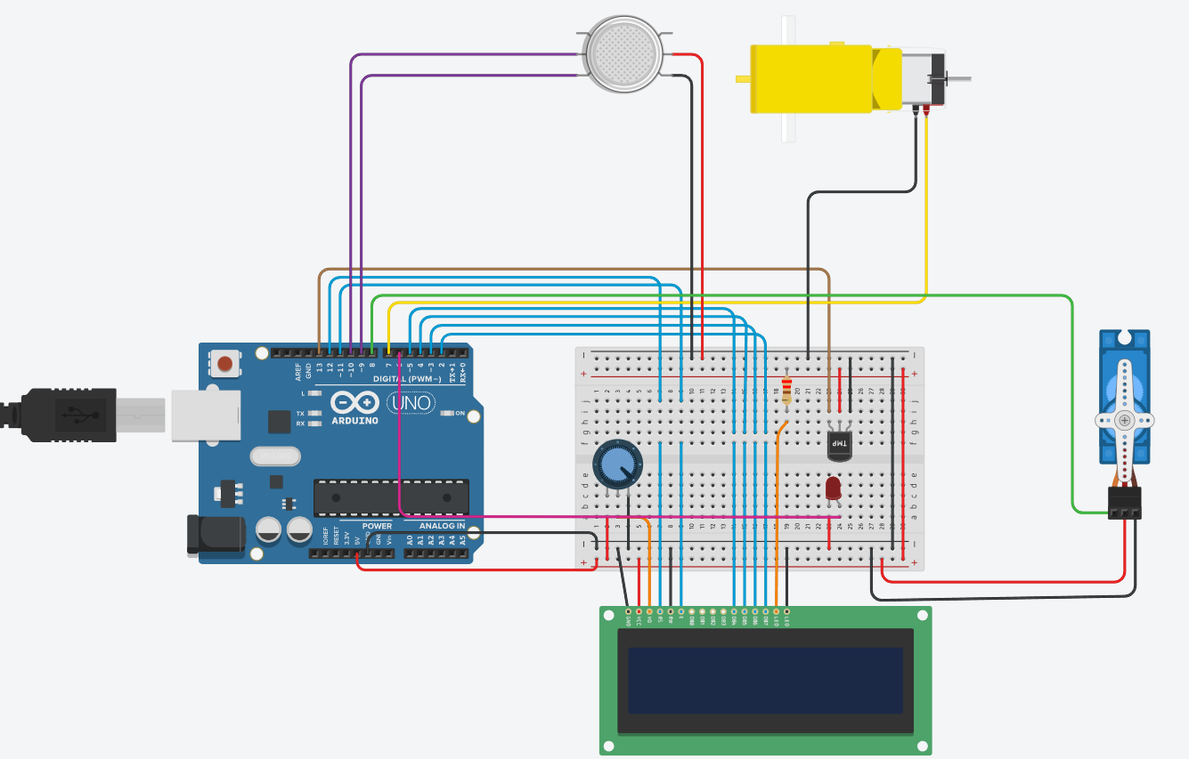
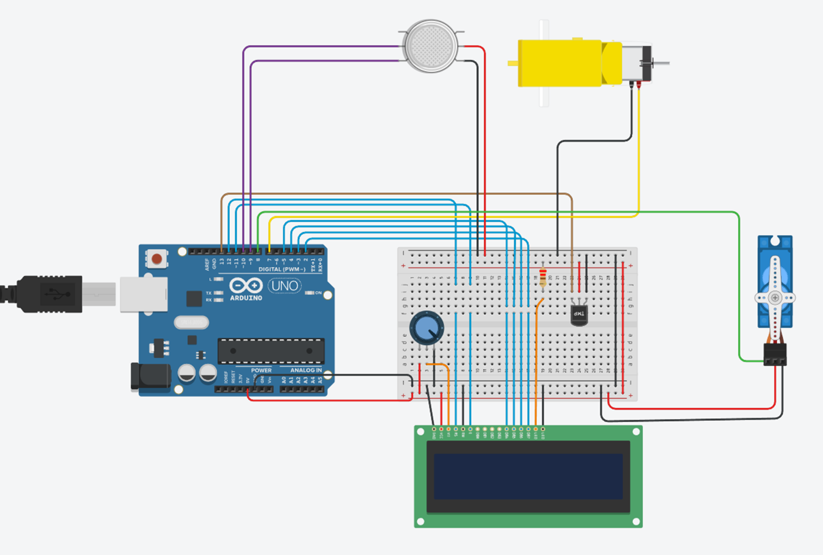
Fan Blade and 3-6V Motor
mh-z19 CO₂ sensor
DHT11 Temperature and humidity module
Breadboard
Servo Motor SG90
Arduino UNO R3
Red LED
Potentiometer
LCD 1602 module

Slide 6
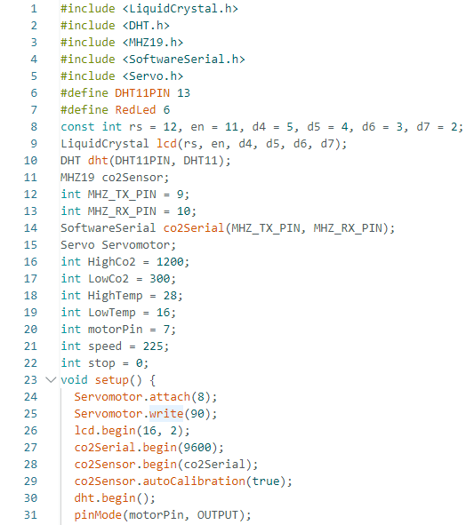
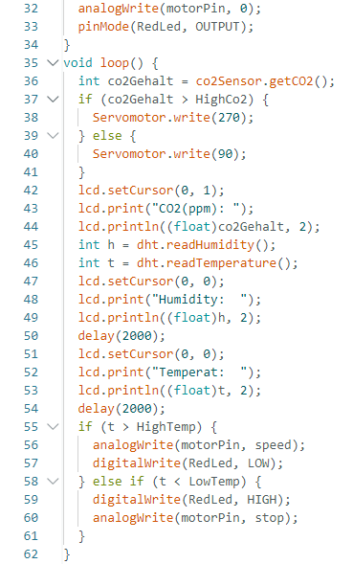
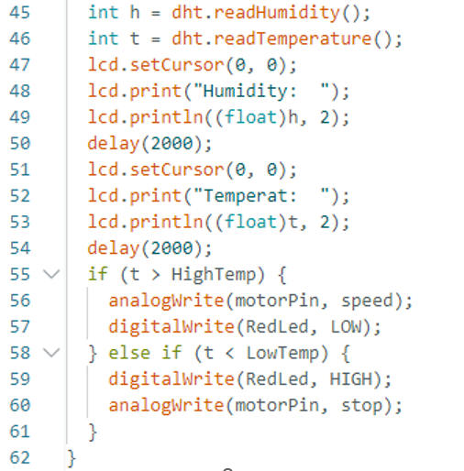
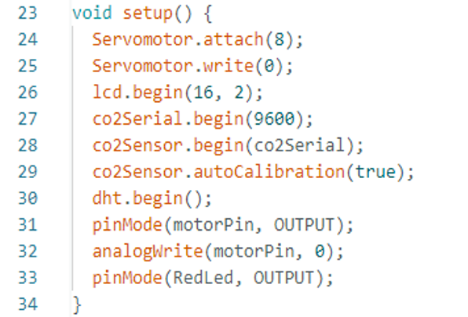
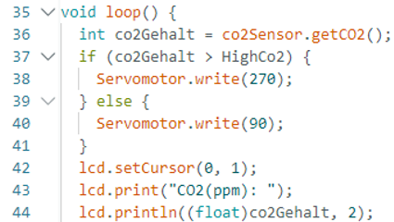
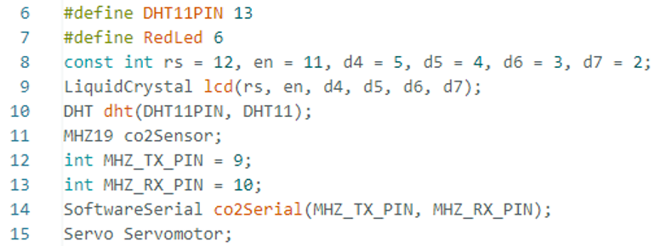
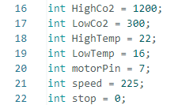
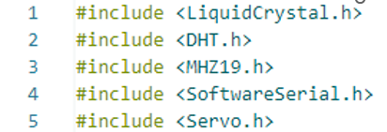
Temperature and Humidity Measurement
Component Initialization and Definitions
CO₂ measurement and display
Sets threshold values
Initial Setup
Libraries
Notes:
Libraries and Definitions (Lines 1-8)
The code uses several libraries to manage different sensors and devices:
LiquidCrystal.h: Controls the LCD display.
DHT.h: Manages the DHT11 temperature and humidity sensor.
MHZ19.h: Handles the MH-Z19 CO₂ sensor.
SoftwareSerial.h: Enables serial communication with the CO₂ sensor.
Servo.h: Controls a servo motor that simulates opening a window.
Component Initialization (Lines 9-19)
Defines pins for the LCD display, DHT11 sensor, red led and CO₂ sensor.
Creates a Servo Servomotor object to control window opening.
Sets threshold values for:
HighCo2 = 1200 ppm (upper CO₂ limit).
LowCo2 = 300 ppm (lower CO₂ limit).
HighTemp = 22°C (maximum temperature threshold).
LowTemp = 16°C (minimum temperature threshold).
Configures control variables for motor and ventilation:
motorPin = 7: Controls the fan.
speed = 225: Fan motor speed.
stop = 0: Stops the fan.
Initial Setup (setup) - Lines 21-34
Initializes the servo motor and keeps it closed (Servomotor.write(0);).
Activates the LCD screen (lcd.begin(16,2);).
Configures communication with the MH-Z19 CO₂ sensor.
Enables auto-calibration for the CO₂ sensor (autoCalibration(true);).
Starts the DHT sensor to read temperature and humidity.
Configures output pins for the fan and red LED.
Main Loop (loop) - Lines 36-63
Runs continuously to monitor and adjust environmental conditions.
Step 1: CO₂ Measurement (Lines 37-41)
co2Gehalt = co2Sensor.get CO₂ (); → Retrieves the CO₂ concentration.
If it exceeds 1200 ppm, the servo motor activates (Servomotor.write(90);), simulating an open window.
If it is below the threshold, the window closes (Servomotor.write(0);).
Step 2: Display CO₂ on LCD (Lines 42-44)
Shows the CO₂ concentration in ppm on the LCD display.
Step 3: Humidity and Temperature Measurement (Lines 45-51)
h = dht.readHumidity(); → Reads humidity.
t = dht.readTemperature(); → Reads temperature.
Displays the values on the LCD screen with a 2-second delay between readings.
Step 4: Temperature Control (Lines 52-63)
If the temperature is above 22°C, the fan turns on (analogWrite(motorPin, speed);), and the red LED turns off (digitalWrite(RedLed, LOW);).
If the temperature is below 16°C, the red LED turns on (digitalWrite(RedLed, HIGH);), and the fan turns off (analogWrite(motorPin, stop);).

Slide 7
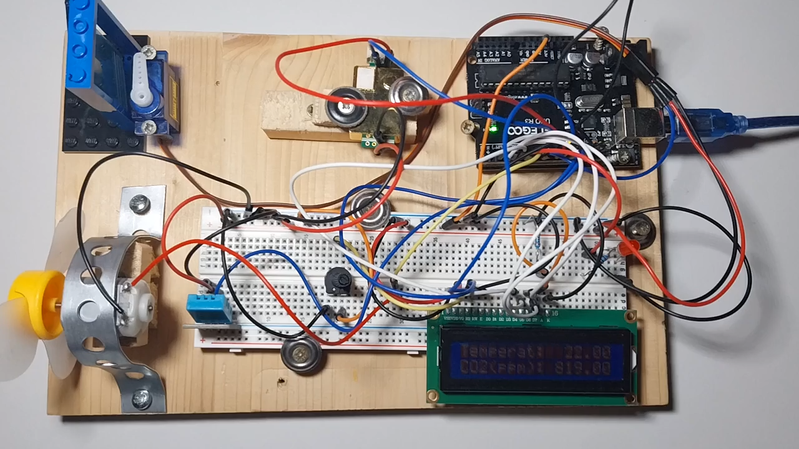

Slide 8
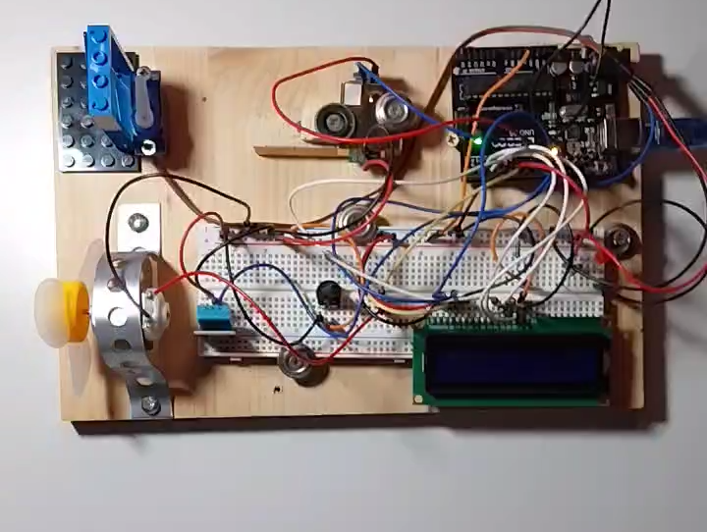

Slide 9
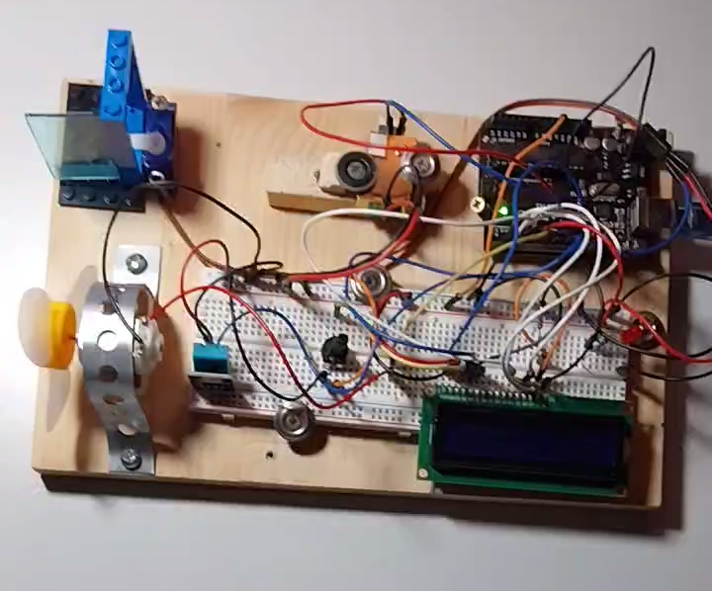

Slide 10
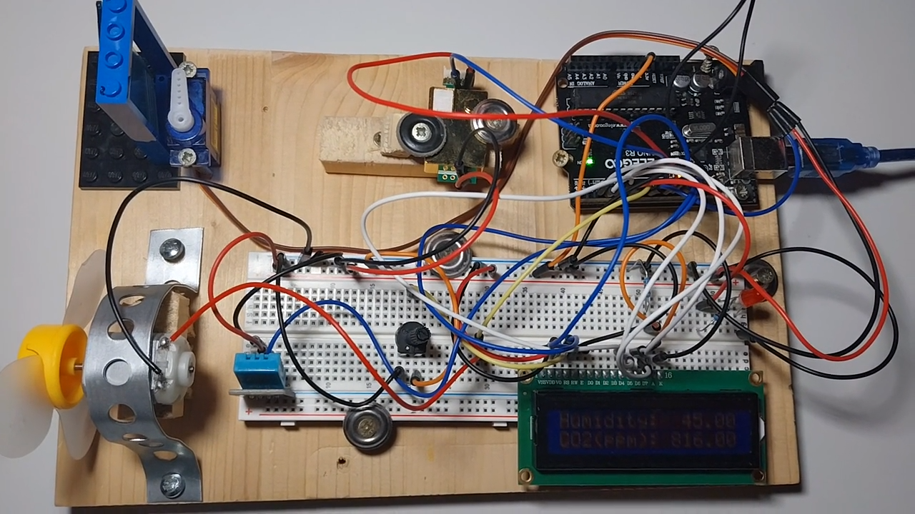

Slide 11
The building process
Challenges:
Balancing schoolwork and project
Code was the most challenging part
We made many mistakes but learned from each error.
Learning Experience:
New Arduino components.
Online Arduino community
Construction simpler than coding.
Outcome:
The project is easy to transport and build
Affordable (total cost: 20-25 euros).
No prior knowledge of Arduino or programming
Notes:
The building process
Challenges:
Balancing schoolwork and project development was difficult, especially due to lack of sleep.
Writing the Arduino code was the most challenging part, as we had no prior programming experience.
We made many mistakes but learned from each error.
Learning Experience:
We discovered and learned to use new Arduino components.
Online resources, tutorials, and the Arduino community were invaluable in helping us understand how to use each module.
The construction of the project was simpler than the coding part.
Outcome:
We developed a functional project that detects environmental data and activates the corresponding mechanisms.
The project is easy to transport, build, and affordable (total cost: 20-25 euros).
No prior knowledge of Arduino or programming is required to assemble it.

Slide 12

Advantages over other similar products
Affordability
  20-25 euros
Real-time Monitoring
  live data
https://sl.bing.net/fEMS588oPYW
Notes:
Affordability: The total cost of components is only 20-25 euros, making it an accessible solution for improving sleep conditions.
Real-time Monitoring: The LCD screen displays live data, allowing users to monitor conditions at any time.

Slide 13

Advantages over other similar products
Automated Adjustments
  Automatic reaction
Portability:
  easy to transport
  different environments.
https://sl.bing.net/dCOmpDB4ptA
Notes:
Automated Adjustments: The system continuously adapts to maintain optimal conditions without user intervention.
Portability: The project is easy to transport and can be used in different environments.

Slide 14

Conclusion
Future Developments:
  Expand and adapt to new systems
  Connect to smart devices
Final Thoughts:
  Not just solve practical problem
  Valuable learning
  Inspires other people
https://www.bing.com/images/search?view=detailV2&ccid=cj7Npuxl&id=42414FFDCF1D6395768D13691010438E79F12FAC&thid=OIP.cj7NpuxldUYvzDeYID1ChAHaE8&mediaurl=https%3a%2f%2fsocialmediastatistik.de%2fsomestat%2fwp-content%2fuploads%2f2017%2f07%2fsmartwatch-828786_960_720.jpg&cdnurl=https%3a%2f%2fth.bing.com%2fth%2fid%2fR.723ecda6ec6575462fcc3798203d4284%3frik%3drC%252fxeY5DEBBpEw%26pid%3dImgRaw%26r%3d0&exph=640&expw=960&q=smart+devices&simid=607999247951794812&FORM=IRPRST&ck=83C1549D16077B81B10ED413F6E4D4ED&selectedIndex=13&itb=0&qft=+filterui%3alicense-L2_L3_L4_L5_L6_L7
Notes:
Impact:
Poor sleeping conditions are a major cause of productivity issues.
By maintaining an ideal environment, individuals can achieve deeper and more restorative sleep, leading to improved productivity and overall well-being.
Future Developments:
Expand the system’s adaptability to different room sizes.
Integrate smart home technology for a more seamless user experience.
Implement solutions in workplaces, schools, and homes to revolutionize sleep hygiene.
Final Thoughts:
This project not only solves a practical problem but also provides a valuable learning experience in electronics, programming, and problem-solving.
We hope this project inspires others to explore how technology can improve everyday life.

Slide 15
References
Scientific papers on the importance of sleep quality:
  https://pubmed.ncbi.nlm.nih.gov/19338508/
  https://pubmed.ncbi.nlm.nih.gov/29073412/
  https://www.sciencedirect.com/science/article/abs/pii/S0378778817317681
Arduino website:
  https://www.arduino.cc/
Tinkercad (used for online prototyping):
  https://www.tinkercad.com/dashboard

