Slide 1

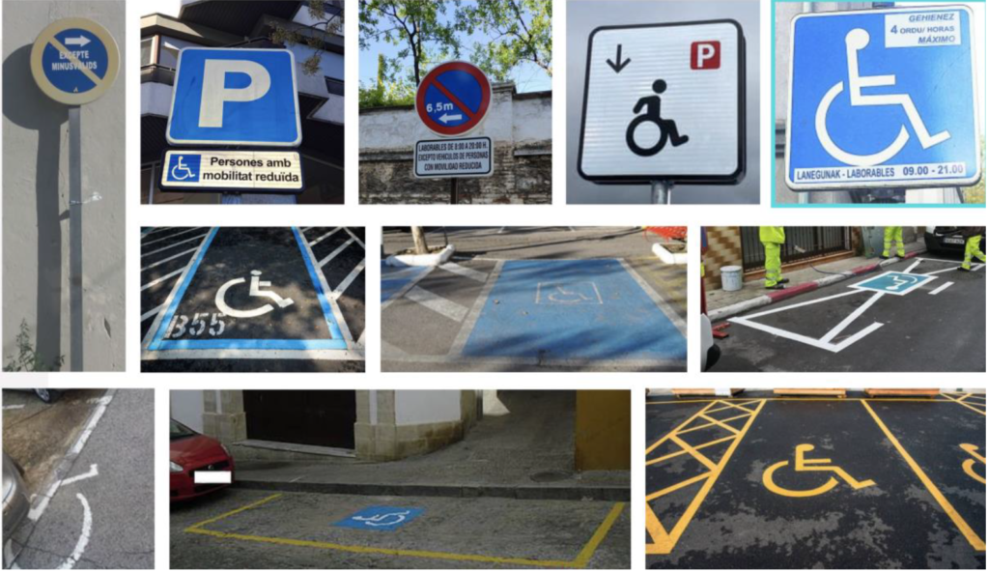

Mauro Pais Álvarez S1 ES ALICANTE
Put Yourself in My Place, Not in My Space

Slide 2
Mauro Pais Álvarez S1 ES ALICANTE
Put Yourself in My Place, Not in My Space
INDEX
1.Identifying Reduced Mobility Spaces
2. Understanding Arduino Technology
3. Development Process with Arduino
4. The Working Prototype
5. Physical Representation with LEGO
6. Proposals for Improvement
7. Making a Difference Together

Slide 3
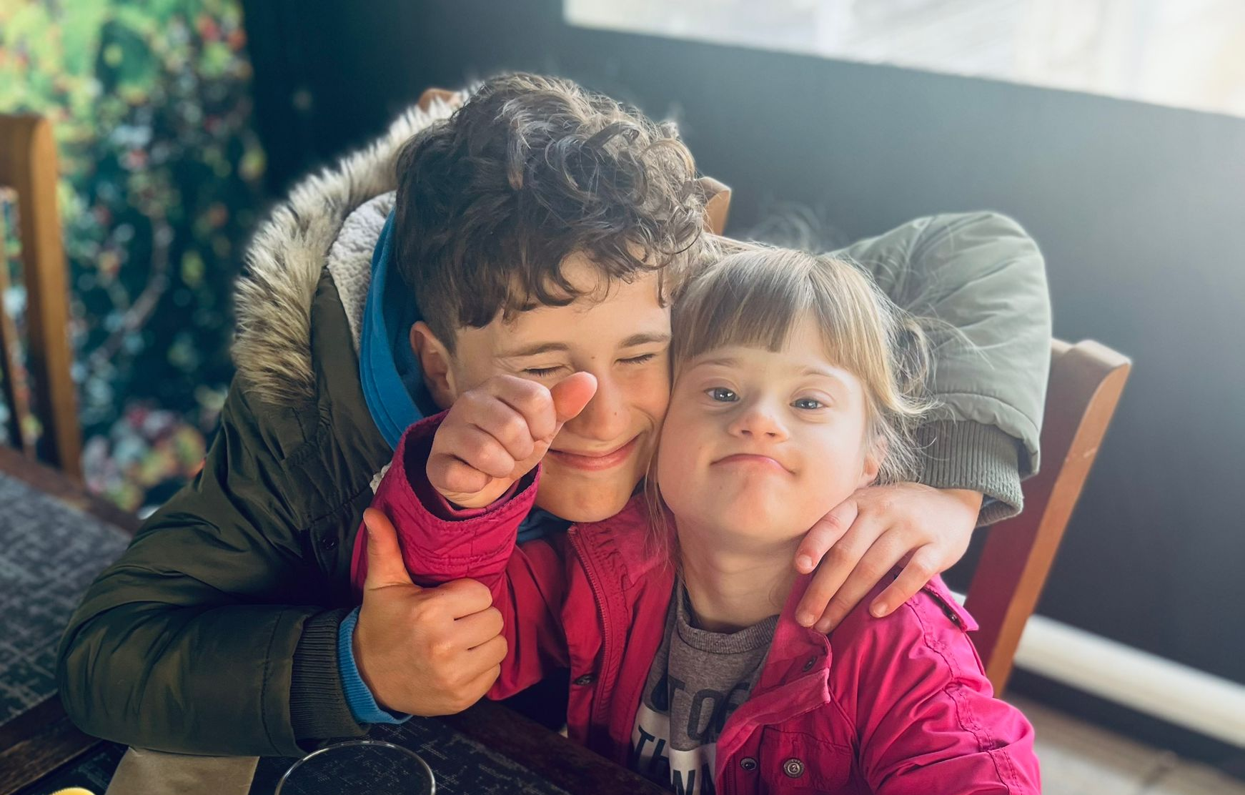
Mauro Pais Álvarez S1 ES ALICANTE
Put Yourself in My Place, Not in My Space
INTRODUCTION
-People with mobility problems.
-Problems for the people
who need the spaces.
- Experiences many times
with my sister who needs these places.
- Deterrent system, with an Arduino.

Slide 4
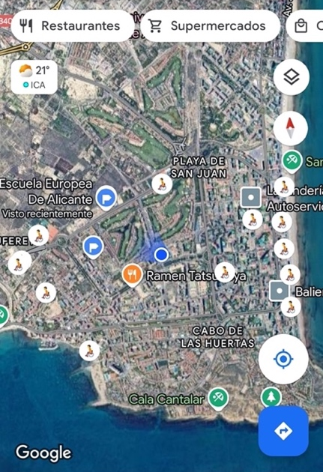
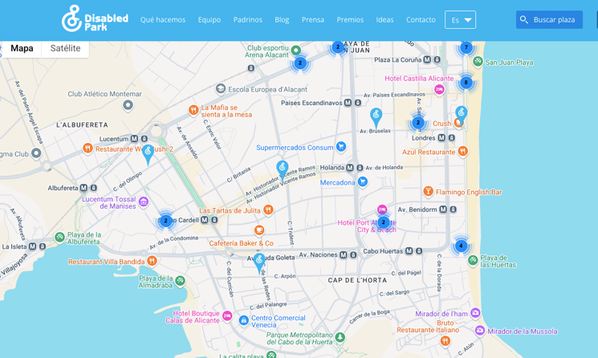
Mauro Pais Álvarez S1 ES ALICANTE
1. Identifying Reduced Mobility
Spaces
1
Google Maps Survey
Reduced mobility spaces in Alicante, around the European School of Alicante.
2
DisabledPark Application
Application that facilitates geolocation of parking spaces for people with disabilities.
3
Distribution Analysis
Many residential streets have very large distances without any reduced mobility spaces.

Slide 5
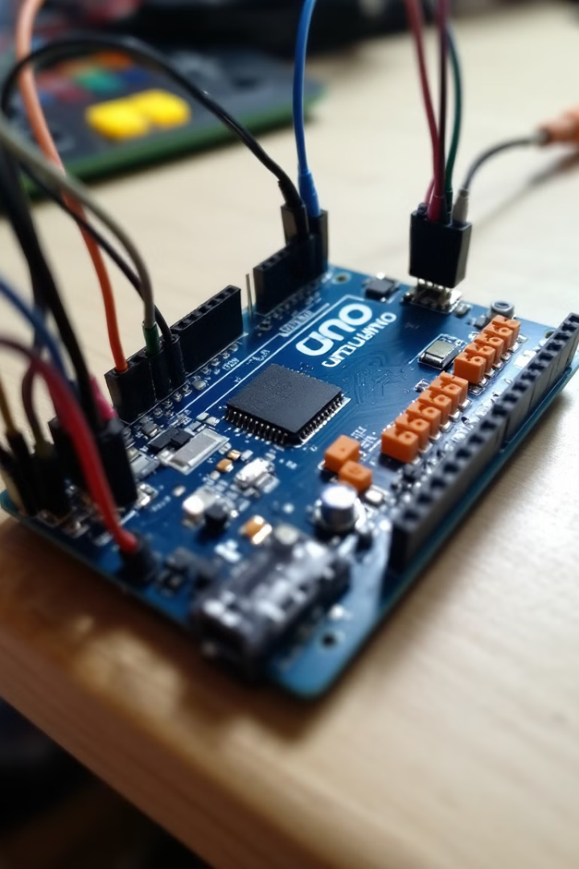
Mauro Pais Álvarez S1 ES ALICANTE
2. Understanding Arduino Technology
Arduino UNO Board
Programming Code
The "brain" of the project - a printed circuit board with a microcontroller that has pins to connect wires, sensors, motors, or lights.
Written on the computer using the Arduino IDE program, giving instructions to the board for controlling the connected components.
Electronic Components
Some parts including LEDs (lights), buttons, sensors, and motors that connect to the board to perform different functions in the system.

Slide 6
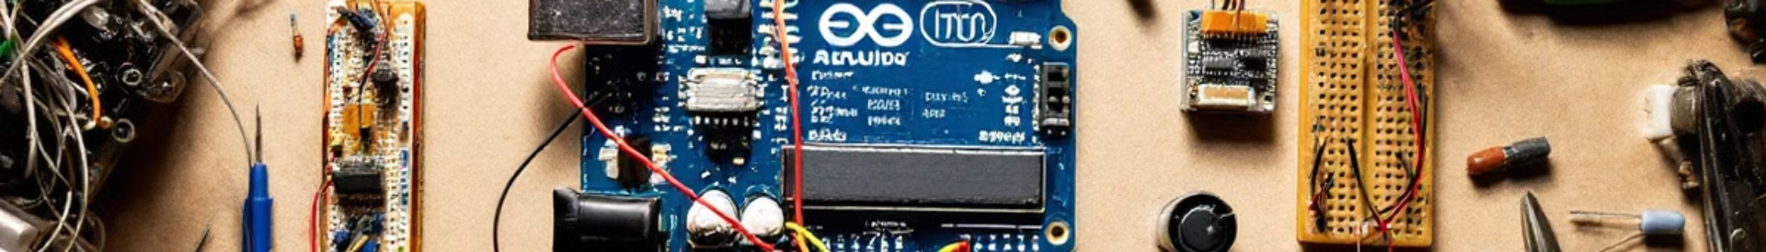




3. Development Process with Arduino
Basic LED Connection
First step was connecting a red LED with a 220Ω resistor and two wires to the Arduino board, learning how to control simple light output.
Motion Sensor Integration
Added a motion sensor to detect obstacles (cars), with green light indicating available space and red light showing occupied space.
RFID Card Recognition
Incorporated an MFRC RC 522 NFC RFID module to recognize reduced mobility cards with attached RFID stickers, enabling the system to verify authorized vehicles.
Complete System Assembly
Combined all components into a functioning prototype that could detect cars
and verify whether they had proper authorization to use the space.
Mauro Pais Álvarez S1 ES ALICANTE

Slide 7
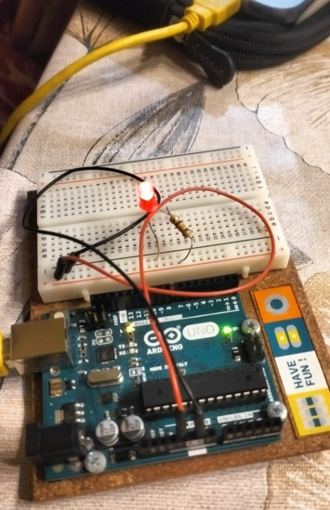
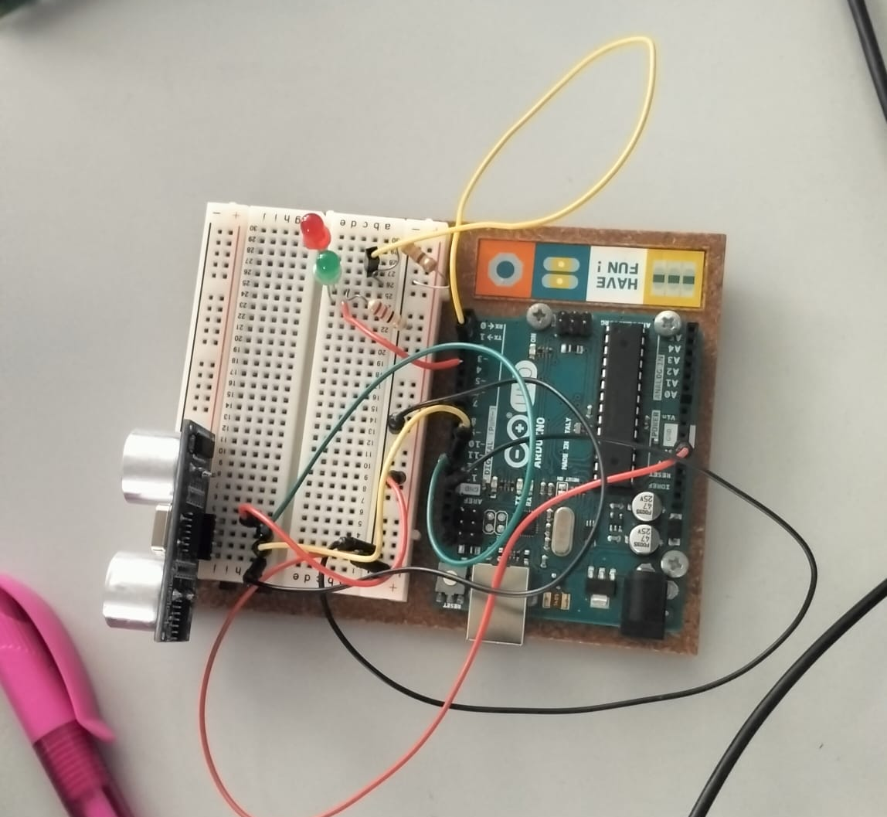
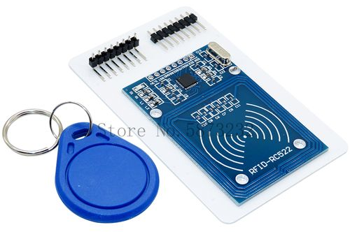
Mauro Pais Álvarez S1 ES ALICANTE
Step 1. Turn on a red LED.
Step 2. Detect an object and switch the lights from green (no obstacle) to red (with obstacle).
Step 3. Identified the reduced mobility card with a sticker and a RFID Module, MFRC 522.

Slide 8



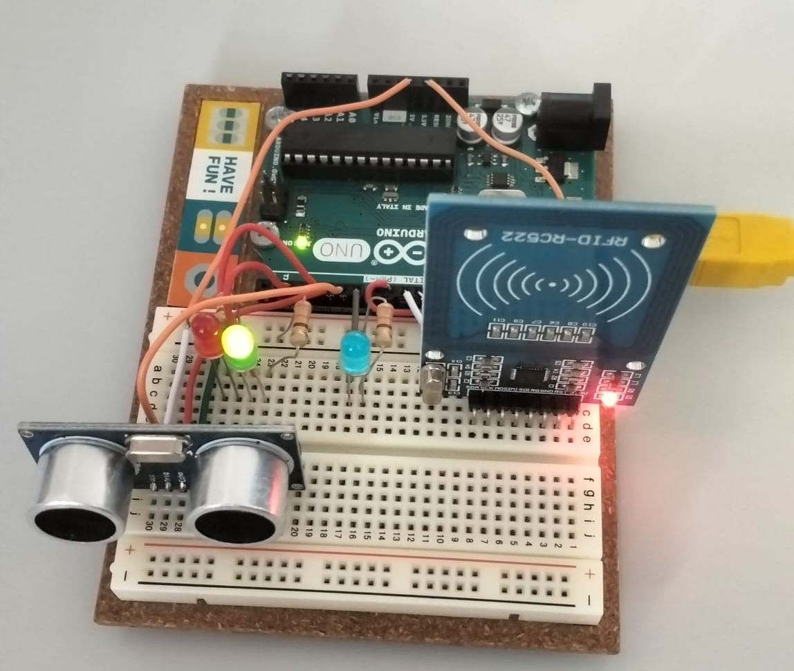
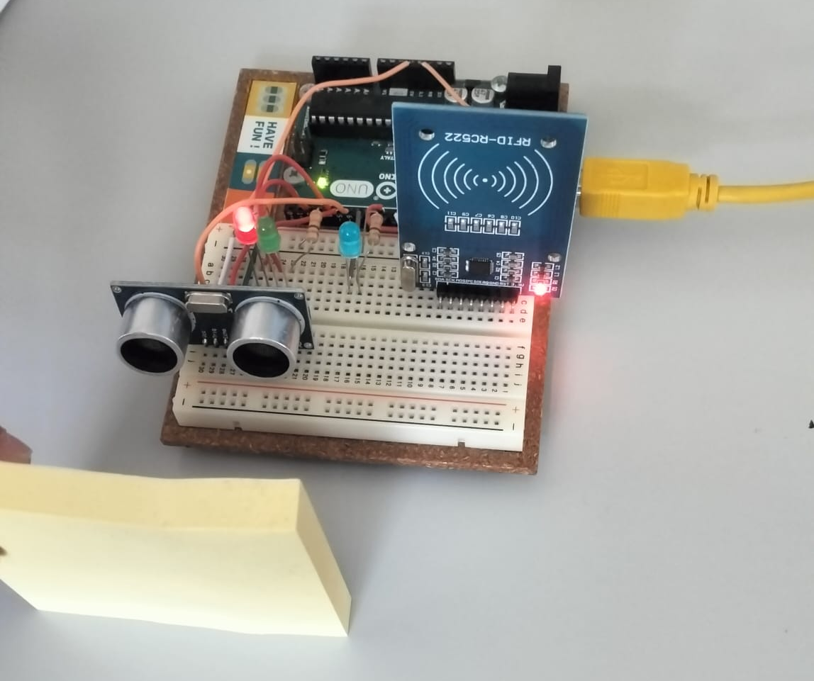
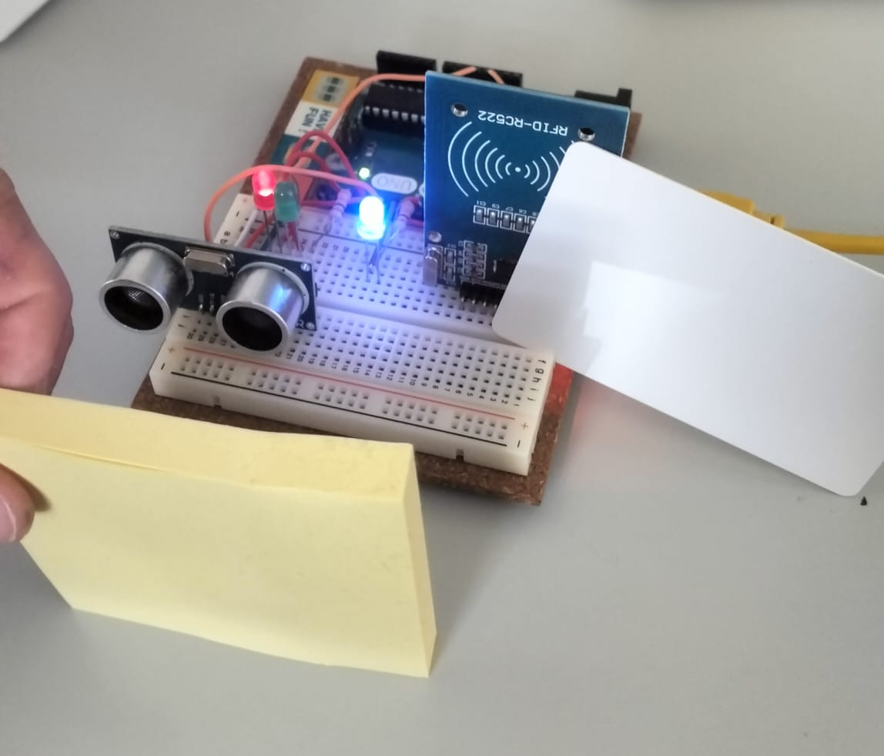
Mauro Pais Álvarez S1 ES ALICANTE
4. The Working Prototype
Green Light
Red Light
Blue Light

Slide 9
Mauro Pais Álvarez S1 ES ALICANTE
4. The Working Prototype: the code
#include <SPI.h>
#include <MFRC522.h>
#define trigPin 6
#define echoPin 5
#define rojo 4
#define verde 2
#define azul 7
#define RST_PIN 9 //Pin 9 para el reset del RC522
#define SS_PIN 10 //Pin 10 para el SS (SDA) del RC522
MFRC522 mfrc522(SS_PIN, RST_PIN); //Creamos el objeto para el RC522
void setup() {
Serial.begin(9600);
pinMode(trigPin, OUTPUT);
pinMode(echoPin, INPUT);
pinMode(rojo, OUTPUT);
pinMode(verde, OUTPUT);
pinMode(azul, OUTPUT);
Serial.begin(9600); //Iniciamos la comunicación serial
SPI.begin(); //Iniciamos el Bus SPI
mfrc522.PCD_Init(); // Iniciamos el MFRC522
Serial.println("MAURO");

Slide 10
Mauro Pais Álvarez S1 ES ALICANTE
4. The Working Prototype: the code
// Rutina de inicio: alterna ambos LED durante 2 segundos
unsigned long inicio = millis();
while(millis() - inicio < 2000) {
digitalWrite(rojo, HIGH);
digitalWrite(verde, LOW);
digitalWrite(azul, LOW);
delay(250);
digitalWrite(rojo, LOW);
digitalWrite(verde, HIGH);
digitalWrite(azul, HIGH);
delay(250);
}
// Apaga ambos LED para iniciar en estado neutro
digitalWrite(rojo, LOW);
digitalWrite(verde, LOW);
digitalWrite(azul, LOW);
}
void loop() {
// Generamos el pulso de trigger de forma correcta
digitalWrite(trigPin, LOW); // Aseguramos que esté en bajo
delayMicroseconds(2);
digitalWrite(trigPin, HIGH); // Pulso de 10 µs
delayMicroseconds(10);
digitalWrite(trigPin, LOW);

Slide 11
Mauro Pais Álvarez S1 ES ALICANTE
4. The Working Prototype: the code
// Leemos el pulso de eco y calculamos la distancia
long duracion = pulseIn(echoPin, HIGH);
long distancia = duracion / 2 / 29.1; // Conversión a centímetros
Serial.print("Distancia: ");
Serial.print(distancia);
Serial.println(" cm");
// Configuramos el LED según la distancia
int Limite = 100; // Umbral en cm
if (distancia < Limite) {
digitalWrite(rojo, HIGH);
digitalWrite(verde, LOW);
if ( mfrc522.PICC_IsNewCardPresent()) {
digitalWrite(azul, HIGH);
Serial.println("TARJETA DETECTADA");
}
} else {
digitalWrite(rojo, LOW);
digitalWrite(verde, HIGH);
digitalWrite(azul, LOW);
Serial.println("APAGAR TARJETA");
}
delay(500); // Pausa para estabilizar las mediciones y no saturar el monitor serial
}

Slide 12
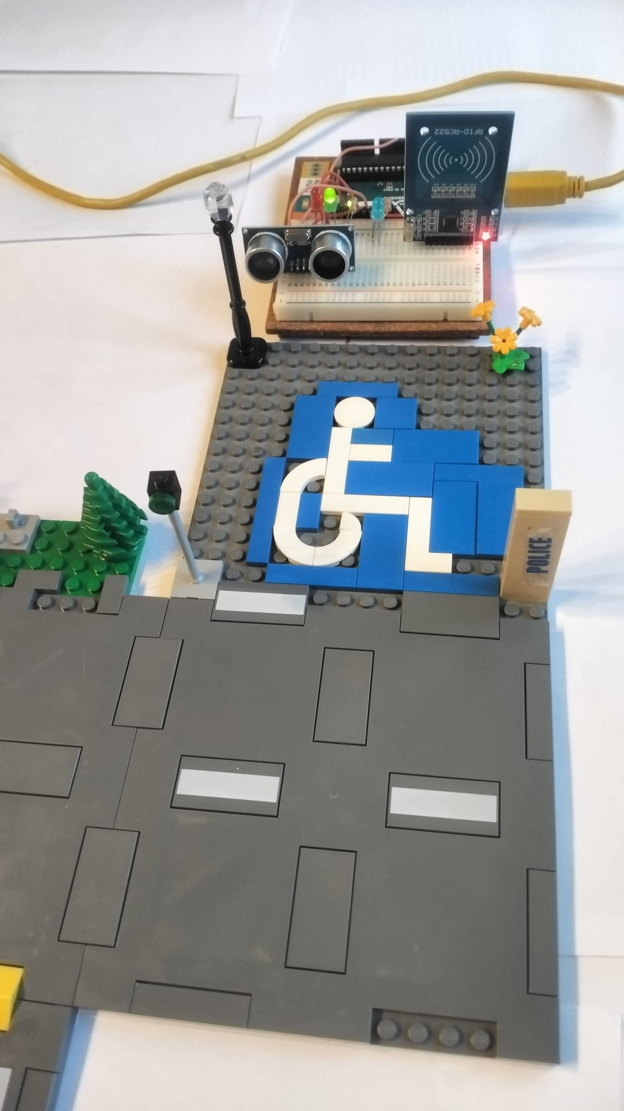
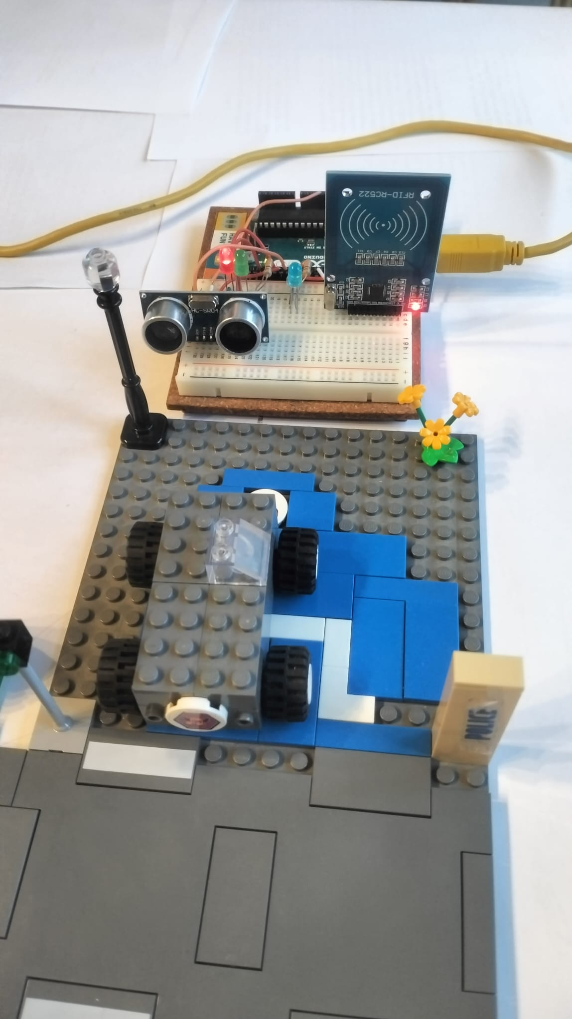
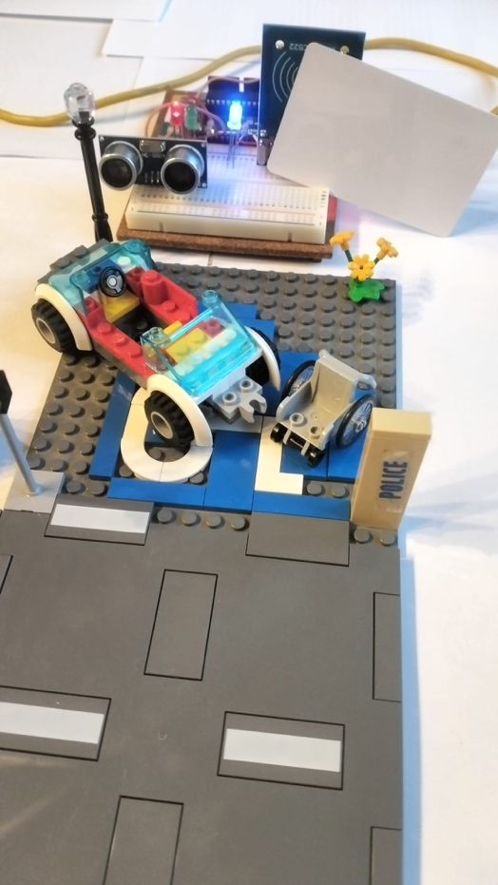
Mauro Pais Álvarez S1ES ALICANTE
5. Physical Representation with LEGO
Available Space
Unauthorized Parking
Authorized Vehicle

Slide 13
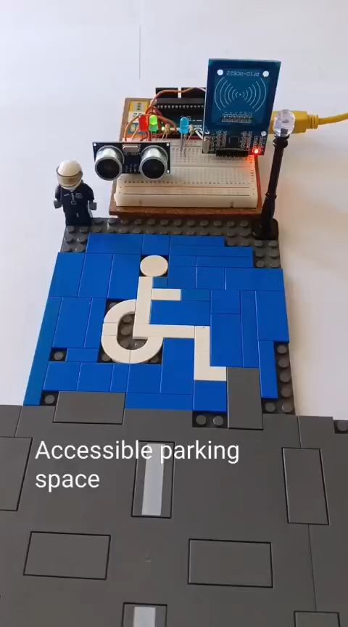
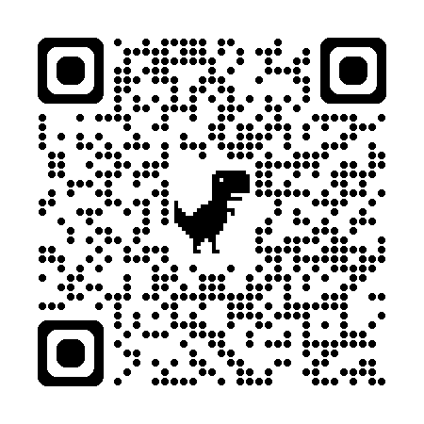
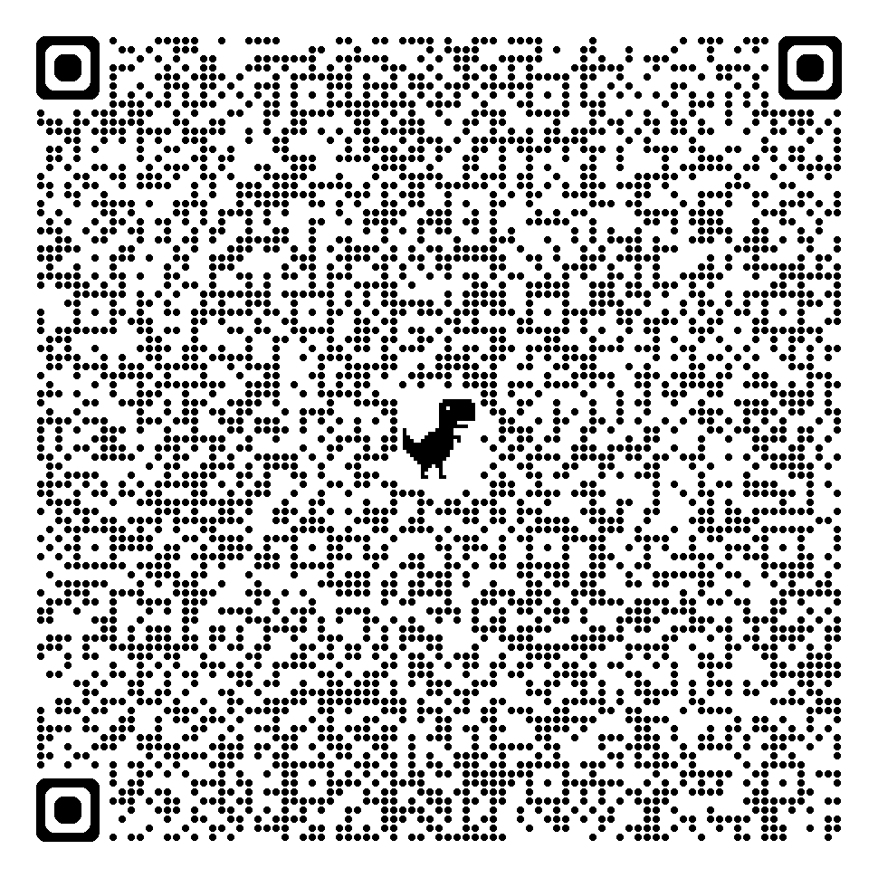
Mauro Pais Álvarez S1ES ALICANTE
Video physical
representation
with LEGO
Link Microsoft Stream
Link youtube

Slide 14



Mauro Pais Álvarez S1 ES ALICANTE
6.Proposals for Improvement
Solar Power Implementation
Add solar panels to make the system more sustainable.
2
EU-Wide Card Integration
RFID stickers on all reduced mobility cards issued in the European Union.
1
Police Communication System
Develop internet connectivity to alert local police.
3

Slide 15




Mauro Pais Álvarez S1 ES ALICANTE
7. Making a Difference Together
1
Empathy
Understanding the daily challenges faced by people with reduced mobility.
2
Awareness
Recognizing the impact of the incorrect use of mobility reduced spaces.
Action
3
Implementing technological solutions to address the problem.
4
Community
Working together to create more accessible environments.

Slide 16
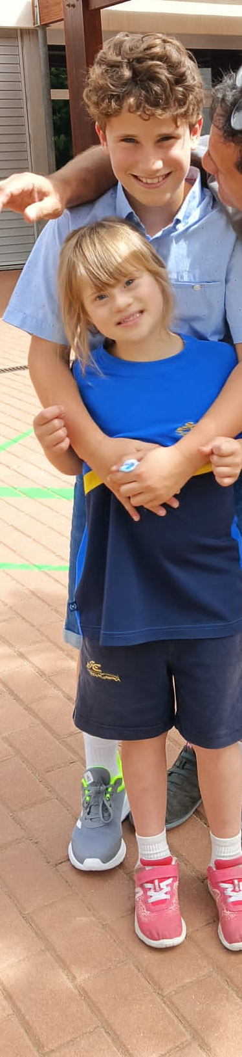
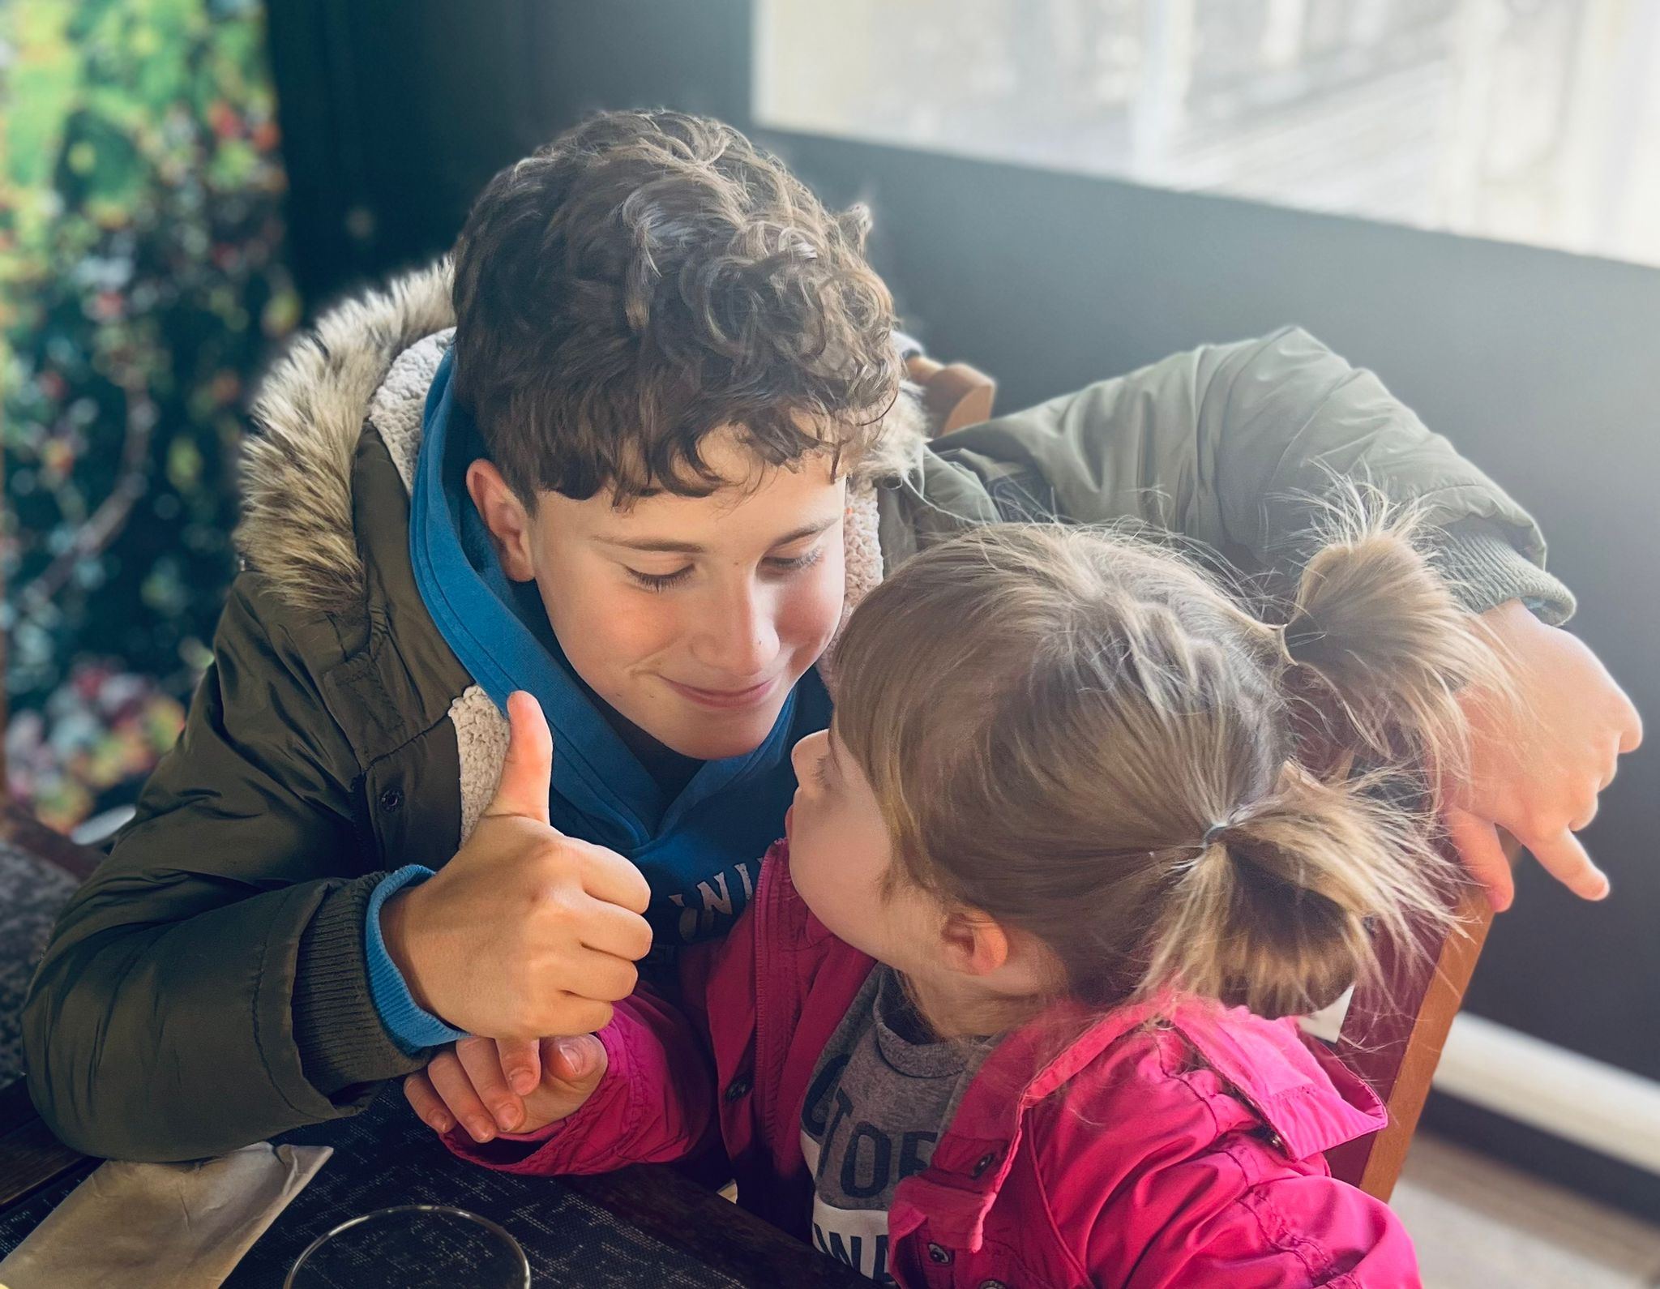
Mauro Pais Álvarez S1 ES ALICANTE
7. Making a Difference Together

Slide 17
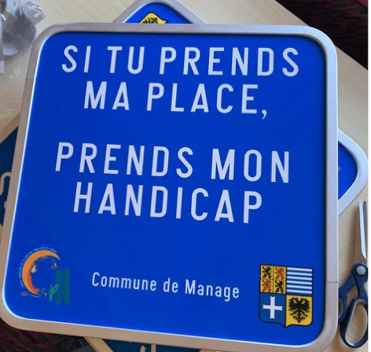
Mauro Pais Álvarez S1 ES ALICANTE
7. Making a Difference Together
As many signs for reduced mobility spaces in Belgium and France indicate: "If you take my place, take my disability."
Let's make life easier for those who need it most.
Thank you for being part of this solution!
Thank you for your attention

