Slide 1



Enhancing Bulletproof Vests with Non-Newtonian Fluid
A Solution for Urban Security Challenges
Marcelli Stefano, Pambianco Cristian, Pastori Lorenzo
Tutor Dr. Fatima Longo
ESF S3ITA

Slide 2
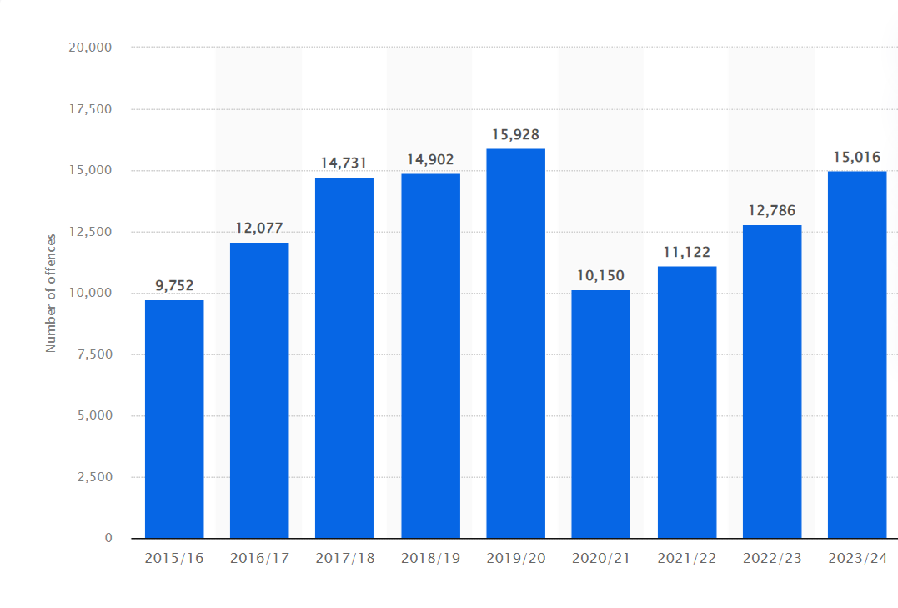
Introduction
There is an increasing need for protective equipment for big cities citizens in response to increased risk of physical assault in cities and crowded areas:
  71% of gun victims are homicides and the majority are civilians
  The torso is the most attacked location
Number of police recorded knife or sharp instrument offences in London from 2015/16 to 2023/24

Slide 3


Project's objectives
The project creates a personal defence vest using shear-thickening fluids (STFs) for urban protection.
It's designed to be lighter, cheaper, and life-saving, offering peace of mind in uncertain times.

Slide 4
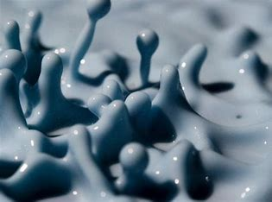
Materials
225 g cornflour
230 ml water
A large plastic mixing bowl
Spoon (optional)
Small food bag

Slide 5

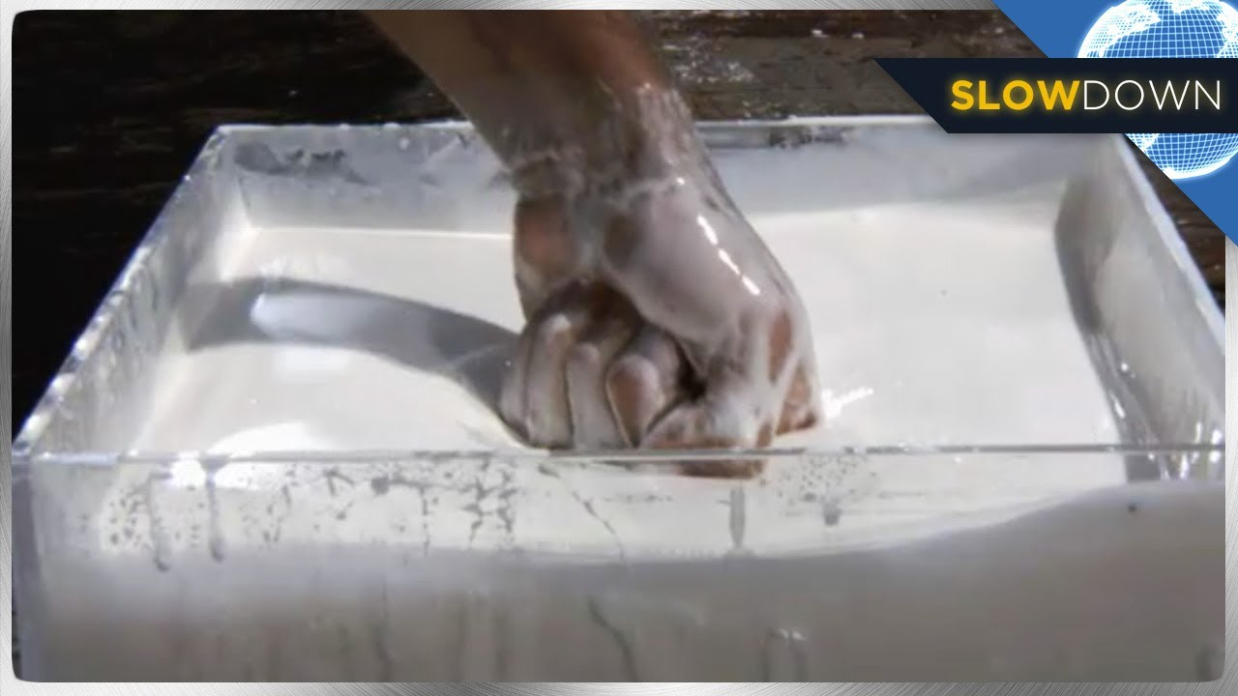
NON-NEWTONIAN FLUID (STF)
Properties
Increased mobility.
Major resistance to impact
Procedure
Put water and cornstarch in a bowl.
Stir together thoroughly using either your hands or a spoon.
Keep mixing until the mixture is smooth and around the consistency of honey.
More spreading of energy

Slide 6
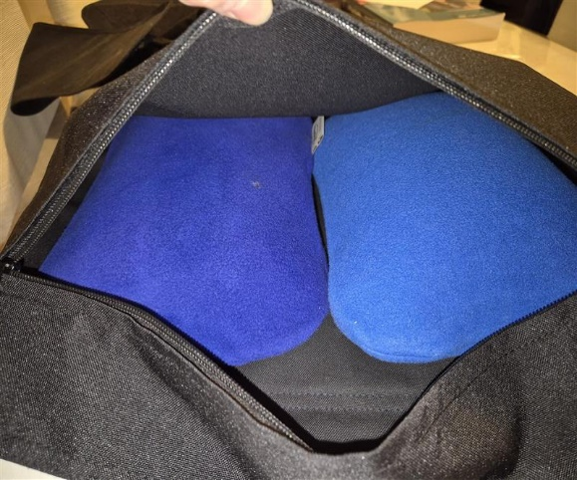
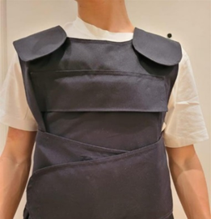
Procedure to Assemble the vest
Place the produced SFT in soft small containers
Insert the SFT containers in the vest like seen in the image
Notes:
STFs become more viscous when subjected to shear stress, meaning they thicken and resist flow.
Due to their thickening behavior, STFs are often used in applications requiring impact protection, such as body armor.
The thickening effect is reversible; once the stress is removed, the fluid returns to its original state.

Slide 7
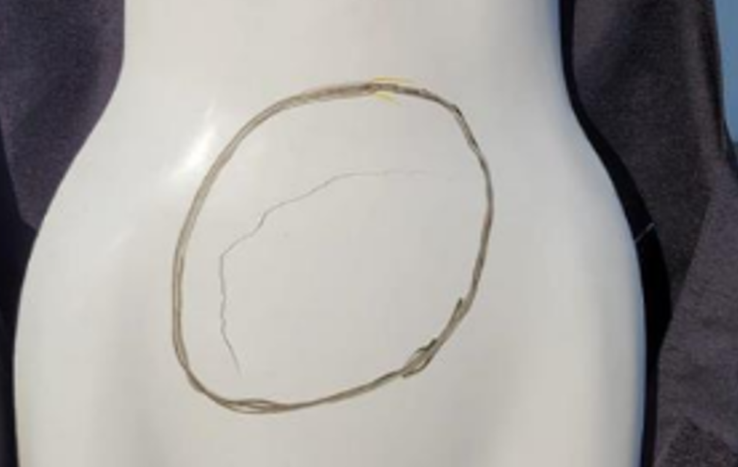
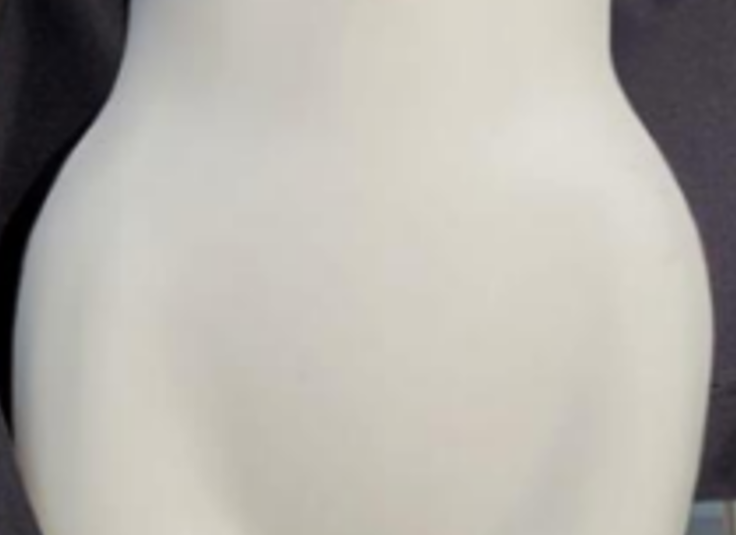
Results
Without the shear-thickening fluid (STF), the steel plate failed to effectively absorb the bat's impact, resulting in significant damage to the mannequin.
The addition of STF improved protection by distributing the impact force more effectively, reducing the extent of damage.
These tests, supported by simulation data, demonstrate that STF enhances protective performance of a vest through energy dissipation, stress reduction, and improvement of the toughness of armor materials.
Notes:
First, we struck the mannequin with the steel plate. Without the presence of the shear-thickening fluid (STF), the mannequin's surface was severely harmed, as seen in Figure 5. Without the presence of the STF, the hard impact provided direct contact with the steel plate to the mannequin's chest and created visible localized damage. Without the presence of the energy-dispersion function and the cushioning provided by the STF, the steel plate could not provide the mannequin with proper protection.
Then we struck the mannequin with the bat. For the STF-free scenario, the mannequin showed observable damage to the outer layer, Figure 5. For the STF-free excessive impact loading, the steel plate impacted the mannequin's chest directly and produced observable localized damage. Without the role played by the STF in energy dispersion and the role played by the buffer, the steel plate failed to successfully protect the mannequin.
Then we conducted the stabbing test with and without the STF. There was an excellent improvement in the level of protection offered using the STF in both scenarios. Under the stabbing force, wearing the STF, the steel plate operated smoother and more steadily. It recoiled more effectively and transferred only minor damage to the mannequin, as evidenced by Figure 5. The STF operated like an "airbag," redistributing the impact force and allowing the kinetic energy to be dispersed throughout the body surface. It substantially lowered the risk of serious injury and only produced minor markings on the mannequin.
These tests are corroborated by simulation results and provide the efficacy of the STF in augmenting vest protective performance. By dissipating impact energy and minimizing localized stress, the STF at the same time increases armour toughness and increases wearer protection. This dual function provided by the STF as an impact dispersing medium and a blunt trauma cushioning layer—renders it a promising supplement to traditional armour materials.

Slide 8
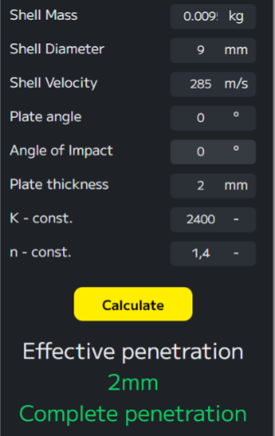
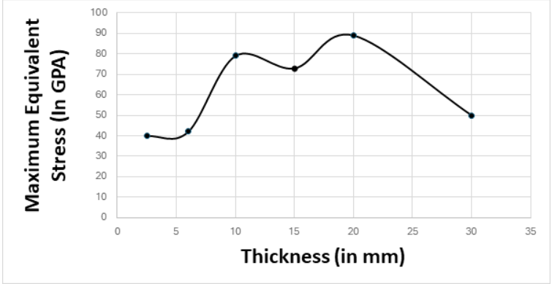
Simulation of 9 mm soft core bullet impact on a steel plate at 0° without STF

Slide 9
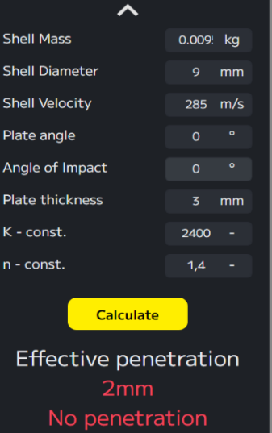
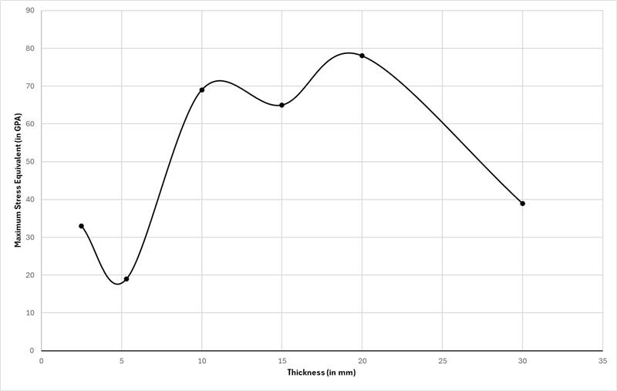
Simulation of 9 mm soft core bullet impact on a steel plate at 0° with STF

Slide 10

Main challenges
The STF showed signs of deterioration in its composition after 2-4 weeks, further investigation is required.
Challenges included keeping STF mixing consistent, with simulations without variation in the real world; further testing is needed.
Additional work needed to improve the design and to study the use of more advanced materials in the vest assembling.
Notes:
This bulletproof vest can further individual protection with its improved design and innovative materials.
It offers better protection for individuals in risky scenarios, providing convenience and reliability.
Thanks to modern technology, this vest can set a new standard for personal protection gear.
The vest is made to save lives and grant individuals peace of mind in unexpected circumstances.
Its improved design can lead to better, more reliable protection for everyone.

Slide 11
Achievements
The experiments demonstrated the effectiveness of the Shear-thickening fluids vest.
STF showed to be able to restrict damage intensity by efficient dispersion of kinetic energy on violent impact.
STF deployed in bulletproof vests can contribute to urban security.
Compared to Kevlar, STF vest would be cheaper, lighter, more comfortable and less bulky.
Notes:
This bulletproof vest can further individual protection with its improved design and innovative materials.
It offers better protection for individuals in risky scenarios, providing convenience and reliability.
Thanks to modern technology, this vest can set a new standard for personal protection gear.
The vest is made to save lives and grant individuals peace of mind in unexpected circumstances.
Its improved design can lead to better, more reliable protection for everyone.

Slide 12

References
https://www.stem.org.uk/system/files/elibrary-resources/2016/05/Make%20a%20non-Newtonian%20fluid.pdf
Accessed 06/09/2024
Manish Kumar Bhuarya, Mayank Singh Rajput, Arpan Gupta, Finite Element Simulation of Impact on Metal Plate, Procedia Engineering, Volume 173, 2017, Pages 259-263
https://www.sciencedirect.com/science/article/pii/S1877705816344009
Accessed 06/03/2025
https://www.statista.com/statistics/864736/knife-crime-in-london/
Accessed 06/03/2025
​
Notes:
Non da leggere

Slide 13
Acknowledgments​
Dr. F. Longo for mentoring us.​
Dr. G. Olivan for coordinating the ESSS at the European School of Frankfurt (ESF).​
Ms. A. Werani & Ms. K. Chatzivassiliadou, Deputy Director and Assistant Deputy Director of ESF respectively, for judging and organizing the preselection of the projects and allowing us to participate in the ESSS2025.​
Mr. S. Altemüller for correcting our work.
M. Corradin, C. Molitor, C. Rago, A. Stevanato, A. ​ for graphic design.
​
Notes:
Non da leggere

