Slide 1

Reaction between
Coca-Cola® and Mentos®
Luna Bosir Scek Mohamed & Joanna Sweeting
S1 EN European School Karlsruhe

Slide 2

Abstract
Inspired by several videos on YouTube, we became curious about the reaction that occurs when Mentos® are dropped into Coca-Cola®. Coca-Cola® contains carbon dioxide (CO₂), a gas dissolved in the liquid under pressure within the bottle.

Slide 3
Introduction
This experiment aimed to explore and better understand the reaction dynamics between Mentos® and the carbonated beverage.

Slide 4
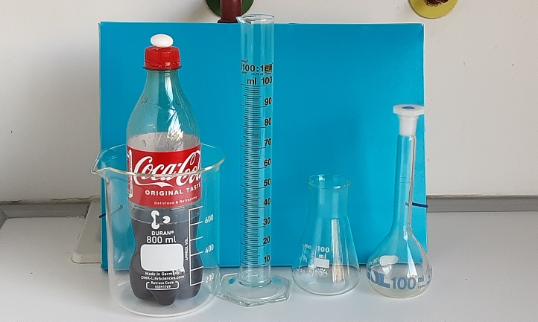
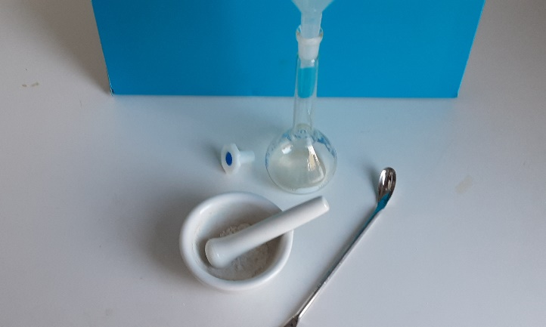
Materials
Coca-Cola® original taste 2 x 0.5L
Mentos® Chewy Dragées, natural mint flavors,
average mass 2.76 g, diameter 18.2 mm
1 sugar cube,
Beakers, 800 mL, 100 mL
Measuring cylinders, 100 mL
Conical flasks, 100 mL
Volumetric flask, 100 mL
Mortar and pestle
Plastic dropping pipettes
Spatula
Scalpel
Sand paper
Calliper
Optical microscope
Calculator
Camera from the mobile phone

Slide 5
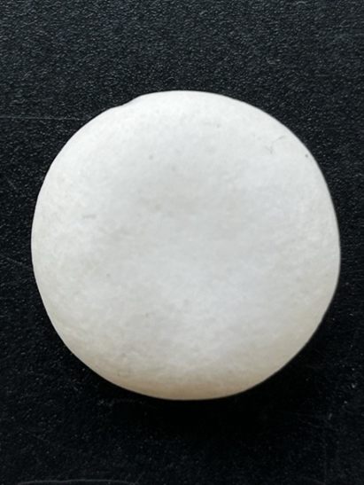
Experiment 1
First, we examined the surface of the Mentos using an optical microscope. However, the details were limited, so we switched to the camera on a mobile phone and zoomed in extensively. This revealed several bumps and scratches on the surface of the Mentos, which resembled the cratered landscape of the moon.

Slide 6
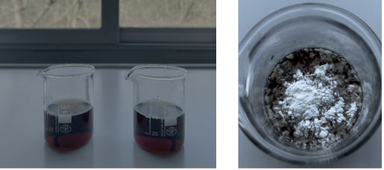
Experiment 2
To begin the experiment, we used two Mentos, one of which was crushed using a mortar and pestle. We then filled two 100 mL beakers with 100 mL of Coca-Cola each. When the Mentos were added to the beakers, the full-sized Mentos caused rapid fizzing, while the crushed Mentos showed no visible reaction and merely floated on the surface.

Slide 7
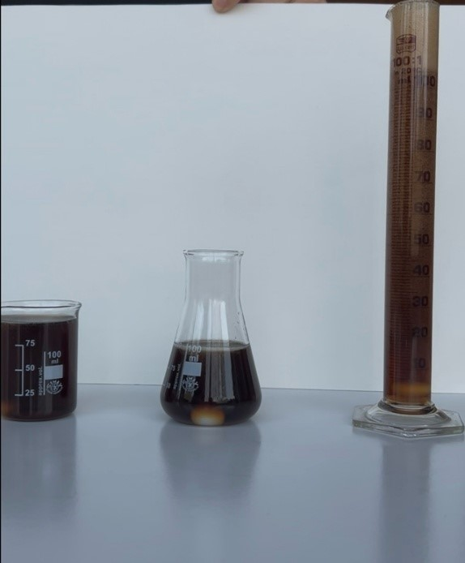
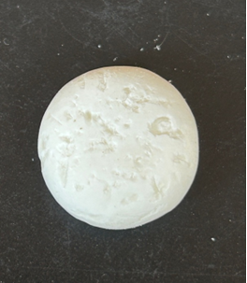
Experiment 3
This time, we used a 100 mL measuring cylinder, a 100 mL conical flask, and a 100 mL beaker. Each container was filled with an equal amount of Coca-Cola (100 mL), and a full-sized Mentos was added simultaneously to each. The Coca-Cola in the measuring cylinder reacted most vigorously, producing foam that rapidly built up and overflowed. The beaker showed the second-strongest reaction, with significant fizzing but no foam buildup. The conical flask produced only a slight fizzing reaction, which was notably weaker compared to the other two.

Slide 8
Experiment 4
Since the crushed Mentos in Experiment 3 did not produce a reaction, we investigated whether increasing the surface roughness of a Mentos would generate more foam when added to Coca-Cola. The roughness of the Mentos surface was increased by poking the Mentos with a scalpel. The Coca-Cola was poured into a 100 mL measuring cylinder, and the poked Mentos was dropped in.
Compared to Experiment 3, a significantly greater and more rapid generation of foam was observed.

Slide 9
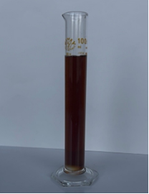
Experiment 5
In this experiment the surface of the Mentos was rubbed with sandpaper to obtain a smoother surface. Then Mentos was then dropped in a new 100 mL measuring cylinder, filled with 100 mL of Coca-Cola. No foam generation was observed.

Slide 10
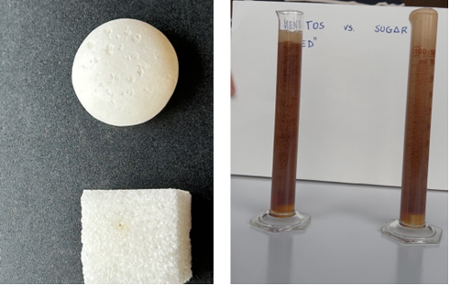
Experiment 6
Two 100 mL measuring cylinders were filled with 100 mL of Coca-Cola each. A Mentos was poked with a scalpel to increase its surface roughness. The poked Mentos and a sugar cube (mass = 2.97 g) were dropped simultaneously each in a separate measuring cylinder. It wasobserved that the sugar cube produced foam more rapidly than the Mentos, although both resulted in a similar overall amount of foam.

Slide 11
Conclusion
The gas and foam production in this reaction are not caused by the chemicals in the Mentos but by the texture of the object's surface. This was demonstrated by using a sugar cube instead of the Mentos and observing a similar or even greater gas and foam production.
Smooth surfaces fail to trigger a reaction, while rough surfaces initiate it. The rougher the surface, the more vigorous the reaction. The interaction between Coca-Cola and Mentos is a physical process known as nucleation, in which carbon dioxide gas escapes from the liquid due to the presence of surface irregularities.

Slide 12

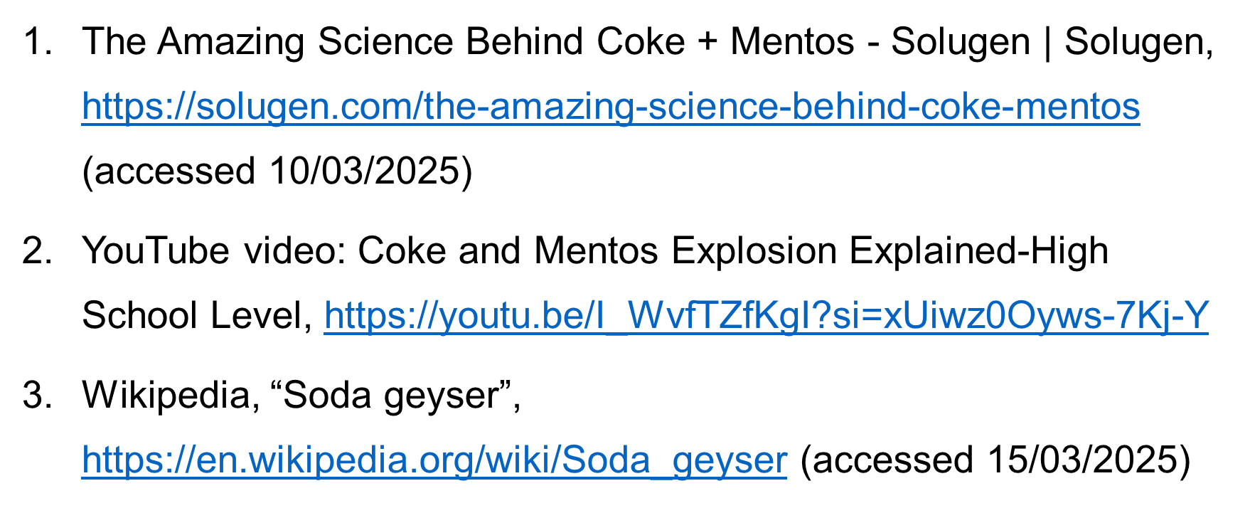
References

Slide 13

The end

