Slide 1
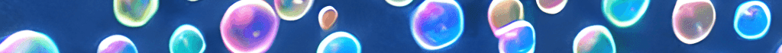
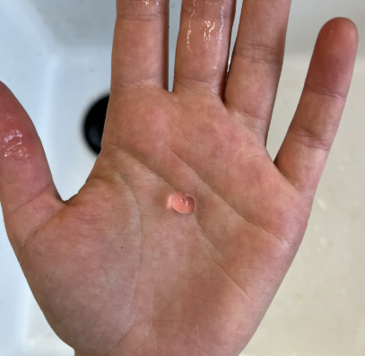
Liquid
Soap
Spherification
European Schools’ Science Symposium 2025 | European School Brussels I (ESBI) of Uccle, Belgium
BOUCHEZ Maeve MAM-S7FRA
TUTOR PICCOLOMINI Angela

Slide 2
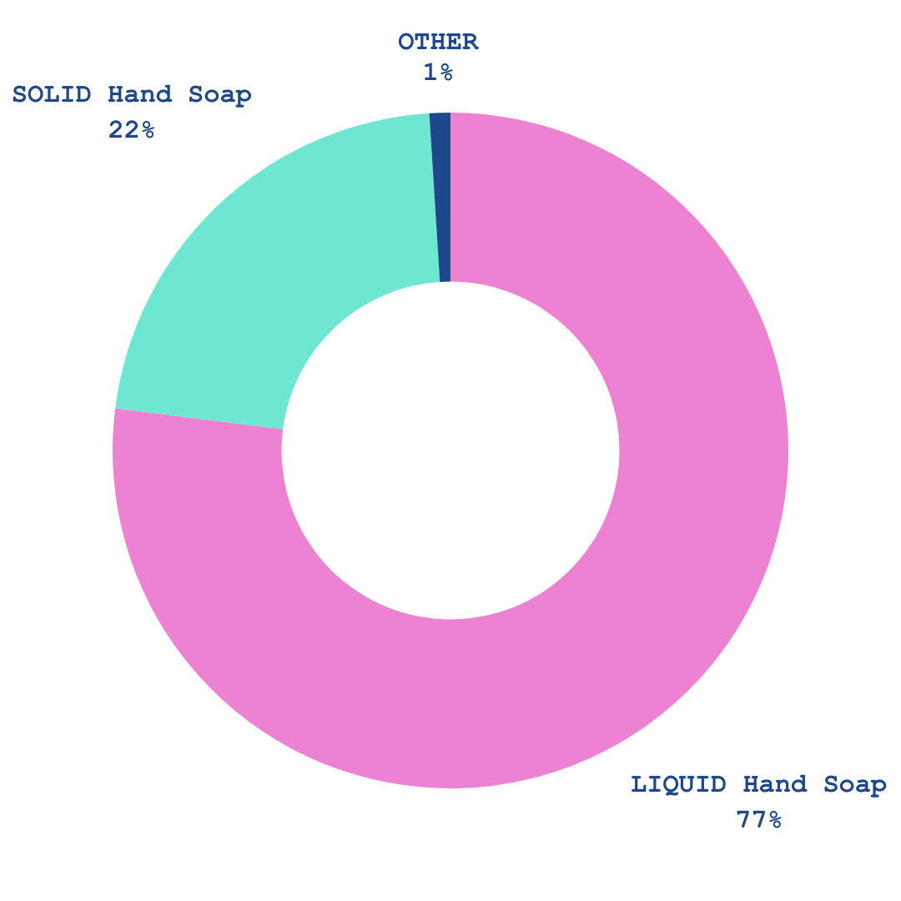
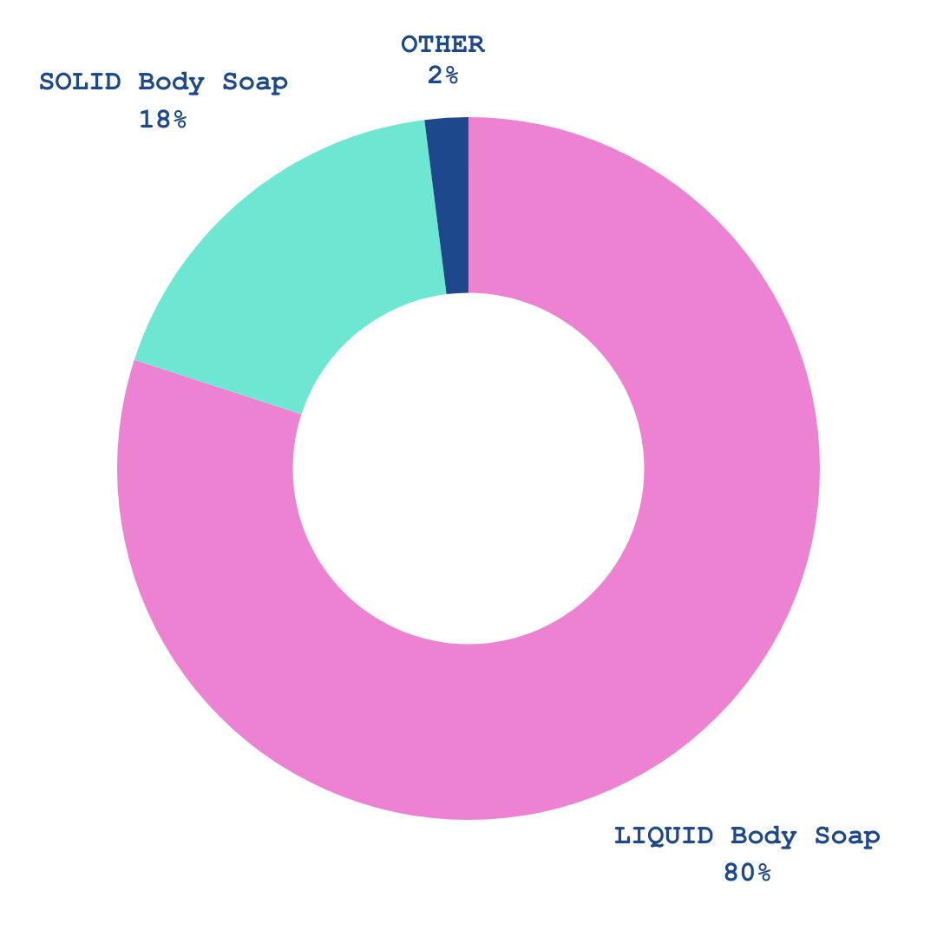
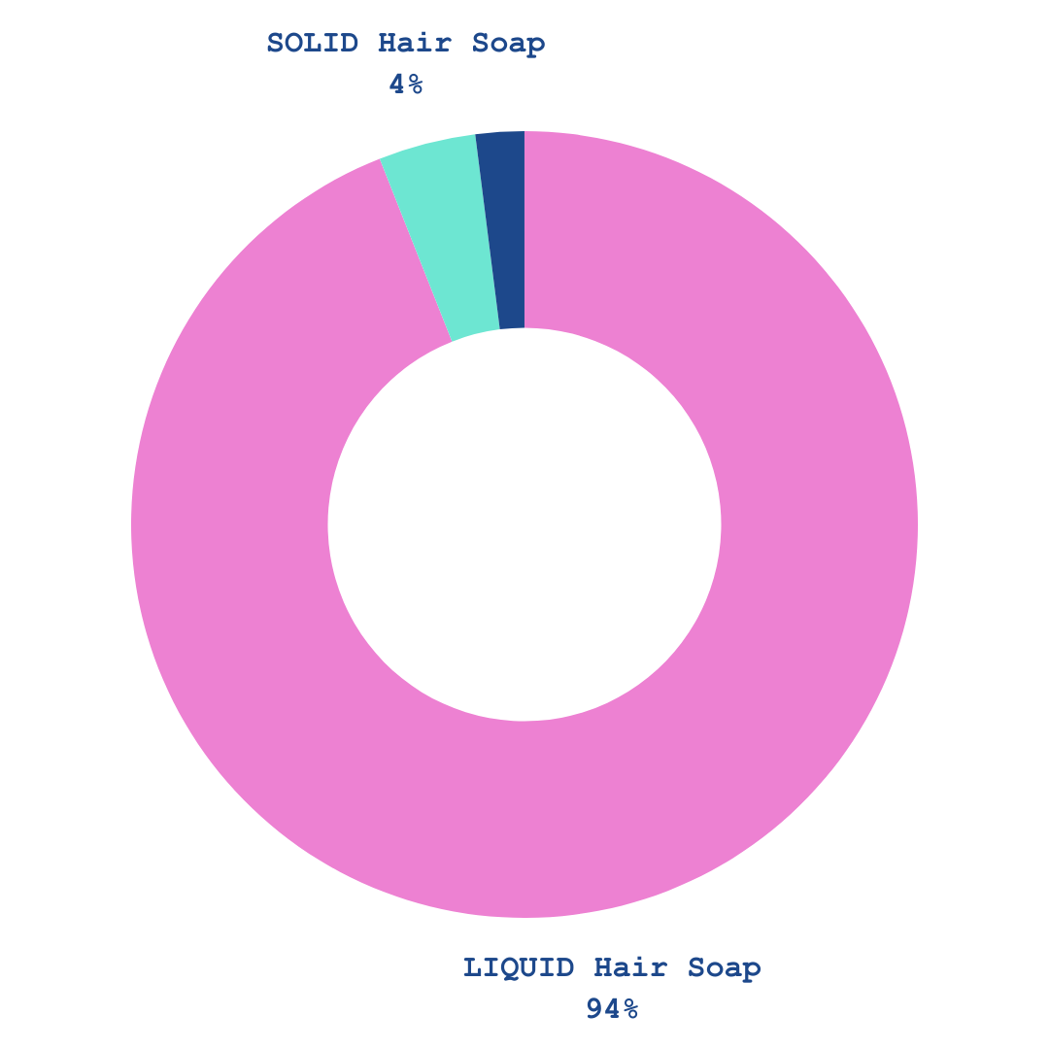
Soapy Survey:
Liquid soap tends to be favoured over solid soap.
FIGURE 1
LIQUID/SOLID/OTHER Hand Soap Users
FIGURE 2
LIQUID/SOLID/OTHER Body Soap Users
FIGURE 3
LIQUID/SOLID/OTHER Hair Soap Users

Slide 3
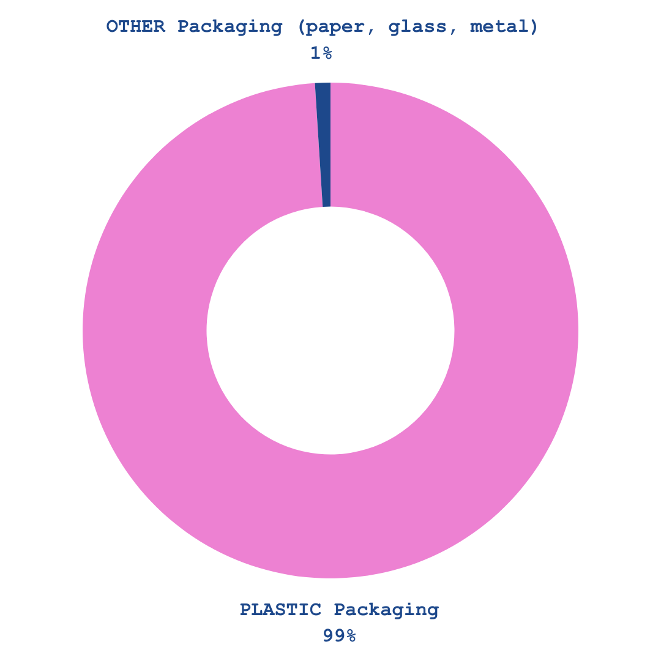
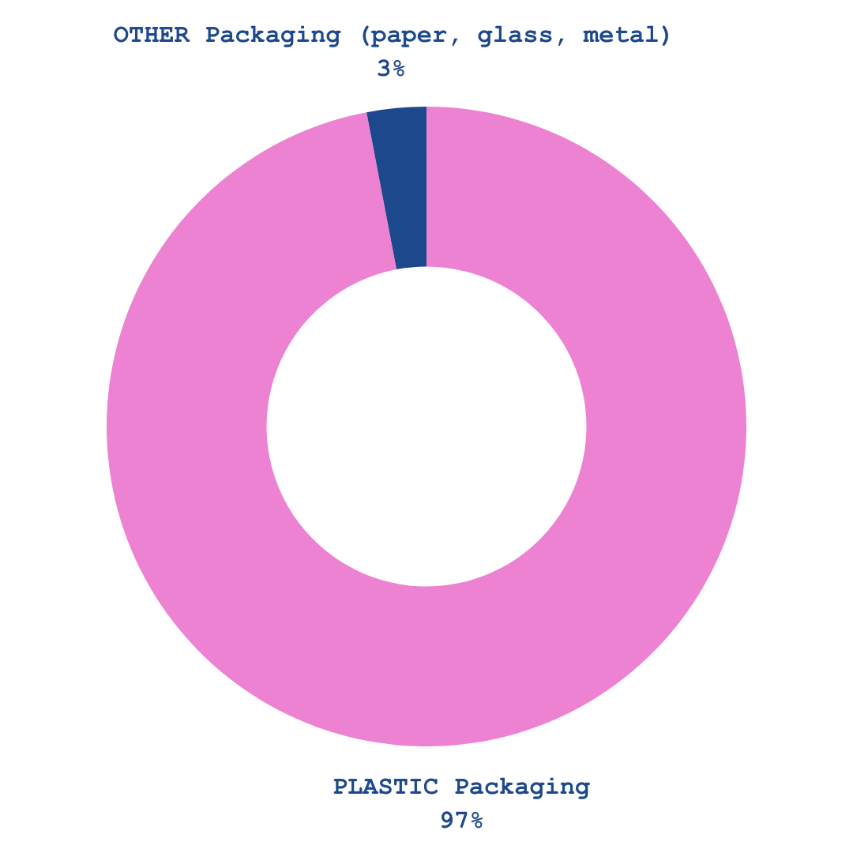
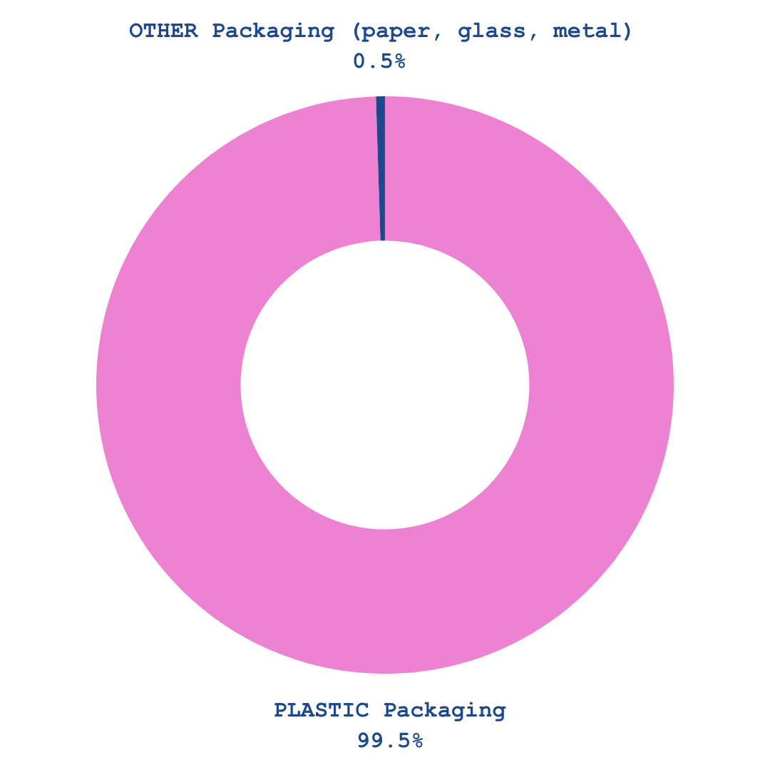
Soapy Survey:
Liquid soap tends to be packaged in plastic.
FIGURE 4
LIQUID Hand Soap Packaging
FIGURE 5
LIQUID Body Soap Packaging
FIGURE 6
LIQUID Hair Soap Packaging

Slide 4


The problem
How do we reduce the cosmetic industry’s plastic pollution and related carbon emissions?

Slide 5
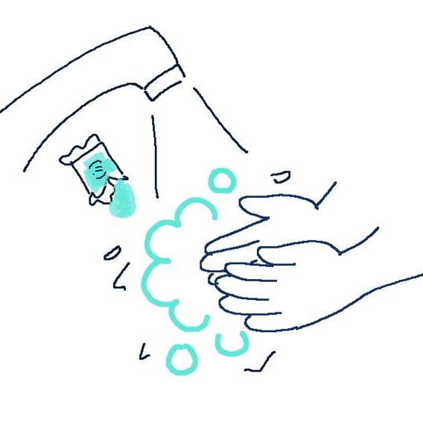
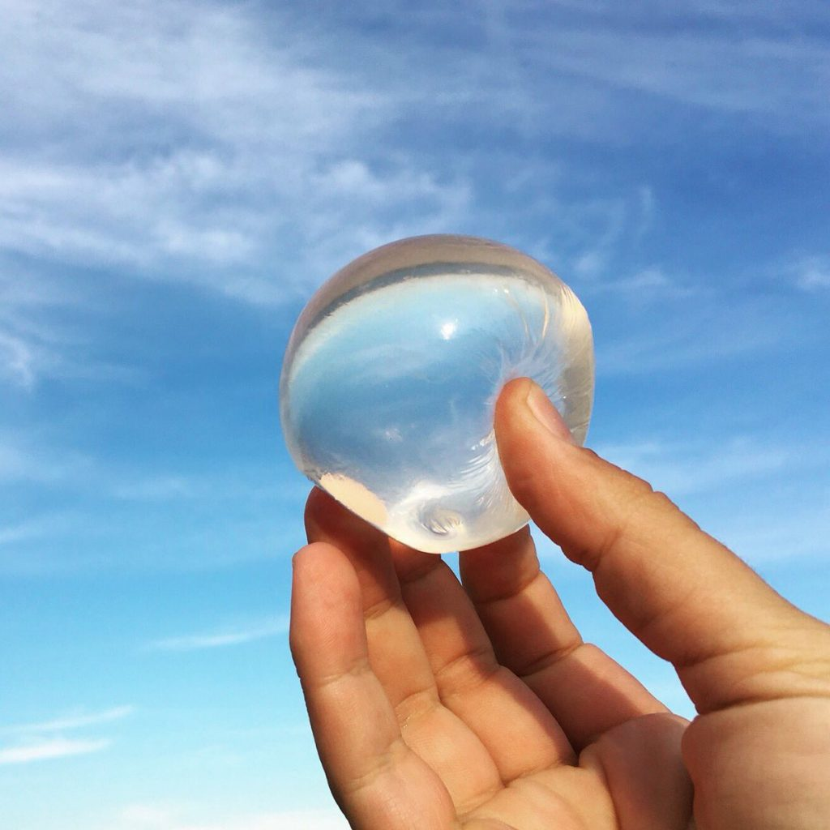
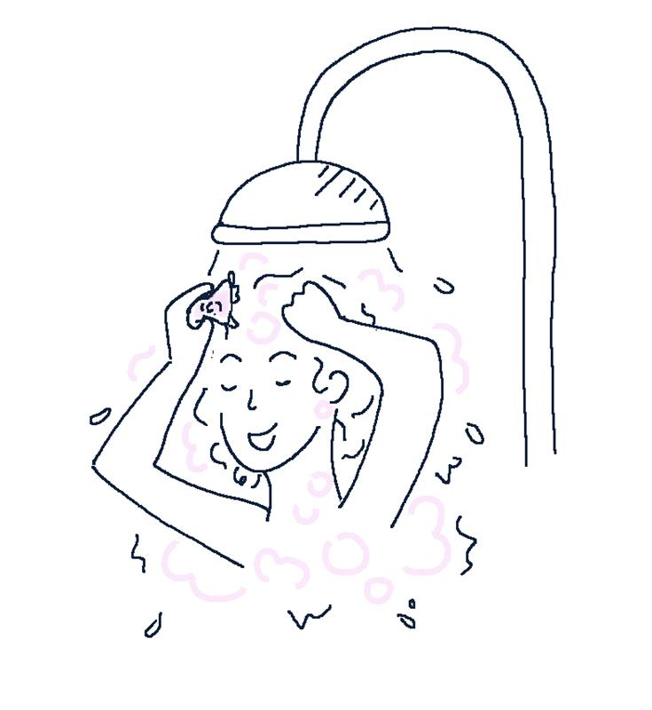
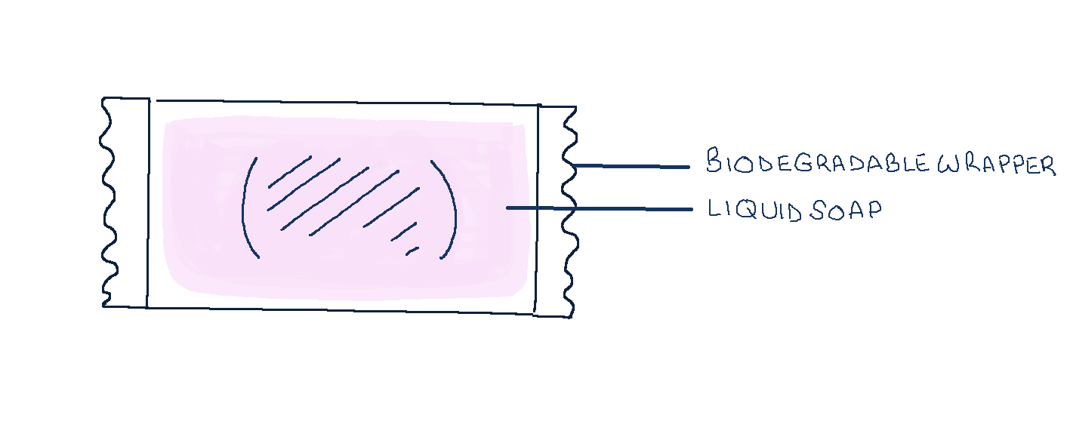
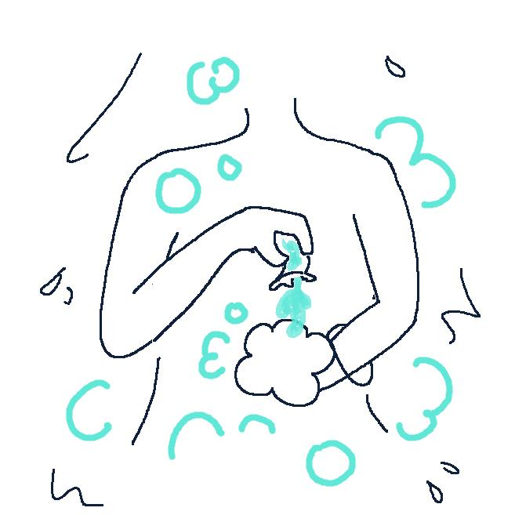
The idea
FIGURE 8
Hand Soap
CC BY-NC-ND
FIGURE 9
Hair Soap
FIGURE 10
Body Soap
FIGURE 7
Alternative liquid soap packaging model

Slide 6
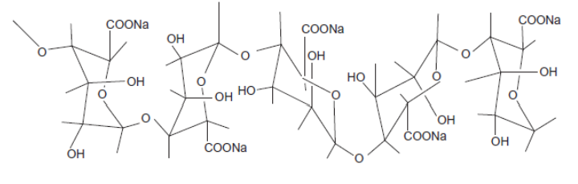
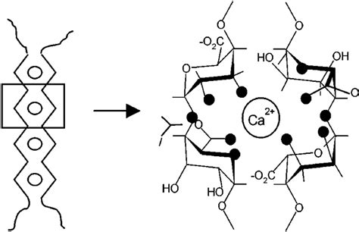
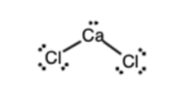
Materials and Methods
Spherification
FIGURE 11
Sodium Alginate
(NaC₆H₇O₆)_{n}
FIGURE 12
Calcium Chloride
(CaCl₂)
FIGURE 13
Calcium Alginate (C₁₂H₁₄CaO₁₂)_{n}

Slide 7
The question
Can spherification be used to create an eco-friendlier alternative to liquid soap plastic packaging?

Slide 8
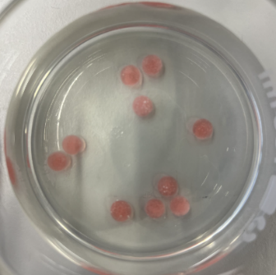
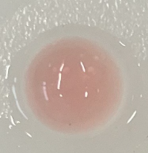
Soap can be spherified
using (frozen) reverse
spherification.
FIGURE 14
FIGURE 15
Calcium-chloride-enriched frozen liquid soap in sodium alginate bath
Spherified liquid soap

Slide 9
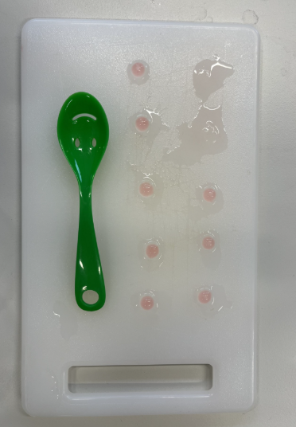
Small-scale balls of liquid
soap spherify from 3
minutes onwards.
1
min
2
min
3
min
4
min
5
min
FIGURE 16
6
min
7
min
8
min
9
min
10
min
Degree of spherification over time

Slide 10
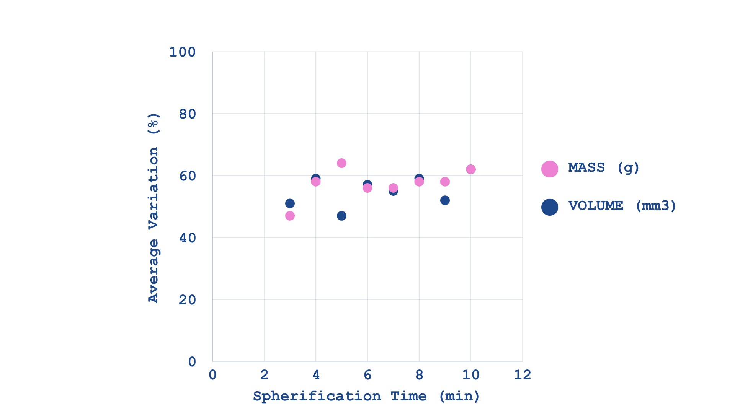
The membrane that forms around the
liquid soap during spherification
stabilises over time.
FIGURE 17
Average Mass and Volume Variation over time

Slide 11
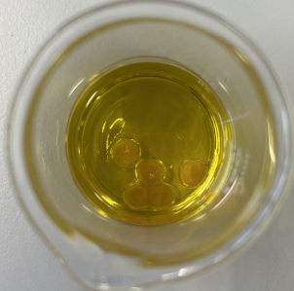
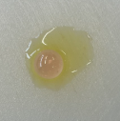
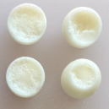
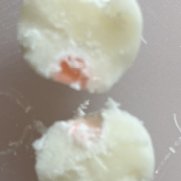
Spherified soap can
be preserved
in oils.
FIGURE 18
Spherified liquid soap in olive oil
FIGURE 19
Spherified liquid soap in olive oil (close-up)
FIGURE 20
Spherified liquid soap in coconut oil
FIGURE 21
Spherified liquid soap in coconut oil (close-up)

Slide 12
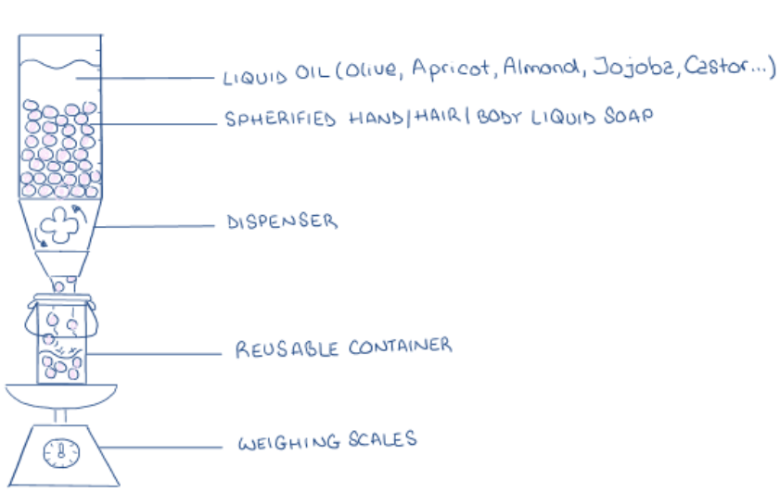
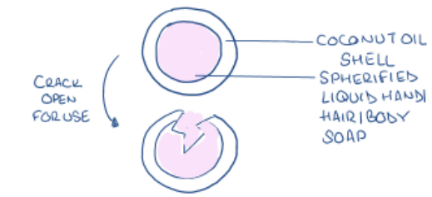
Spherified Liquid
Soap Packaging
Models
FIGURE 22
FIGURE 23
Packaging in liquid oils
Packaging in solid oils

Slide 13
My solution
So, how do we reduce the cosmetic industry’s plastic pollution and related carbon emissions?
Use of (frozen) reverse spherification and solid/liquid oils to produce plastic-free liquid soap packaging

