Slide 1
Verónica Jara Gómez S5ESB
ESSS 2025
EEB3
Agatha’s Game
Can mystery save the mind?

Slide 2
Index
  Introduction
  Objectives
  Materials and Methods
  Conclusions
  Acknowledgments and References

Slide 3


01
Introduction

Slide 4


Alzheimer’s Disease Dementia
Late Detection of The Disease
People at risk of Alzheimer’s face
Lack of Accessibility
Mental Health Issues

Slide 5

02
Objectives Of This Project

Slide 6


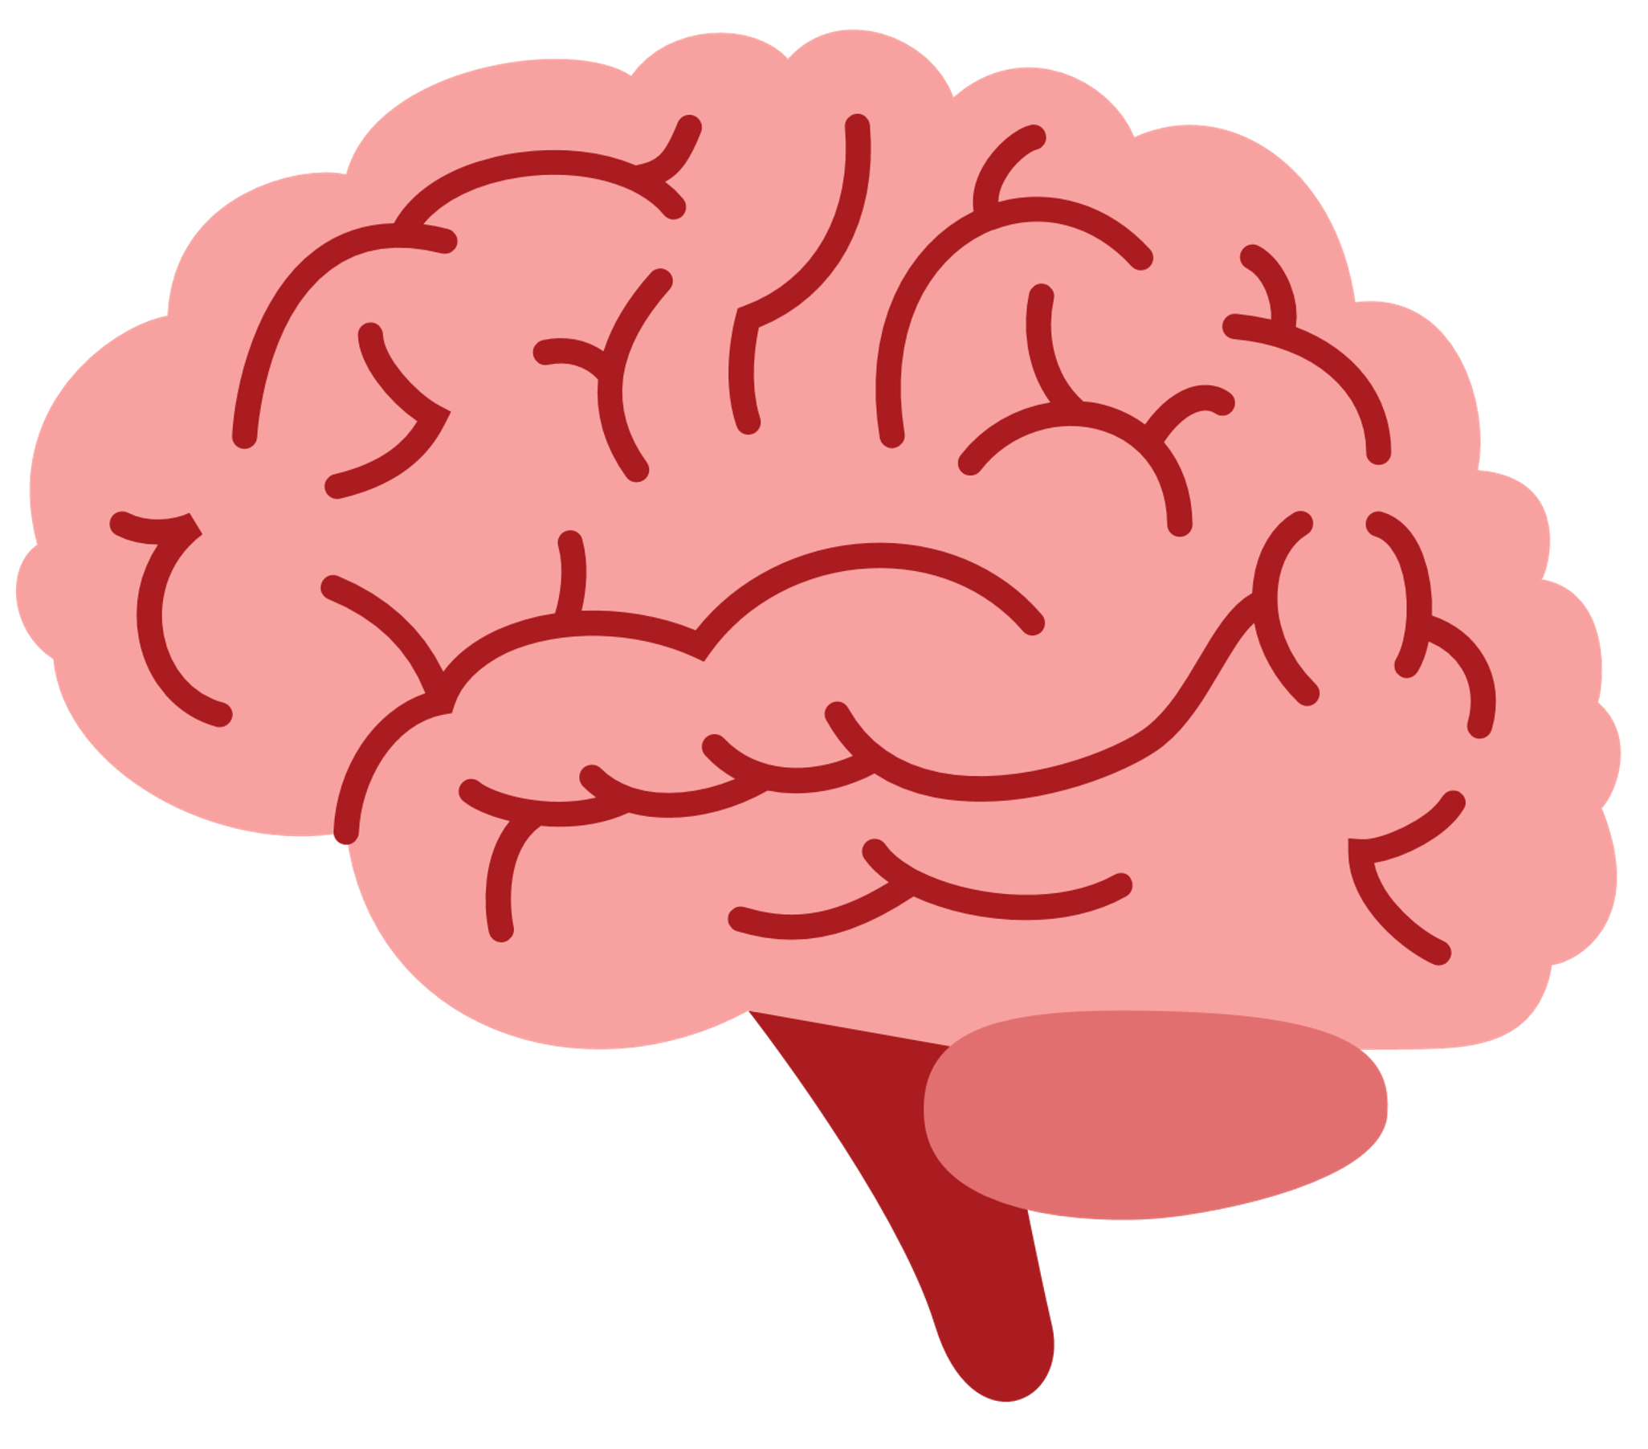
The Main Objectives Of Agatha’s Game
Palliation Of Cognitive Decline
Cognitive Training
Reinforcement of positive thinking

Slide 7





03
Materials And Methods

Slide 8

Game Development Materials
Game Development: Godot
Prototype Development: Scratch
Development Tools
Version control: GitHub
Storage: Godolitics
Data Analysis: Python

Slide 9
Methodology
  Implementation Of Cognitive Tests
  Use of Cognitive Behavioural Therapy
  Personalized Narrative
  Dynamic Difficulty Adjustment
  Reward System

Slide 10
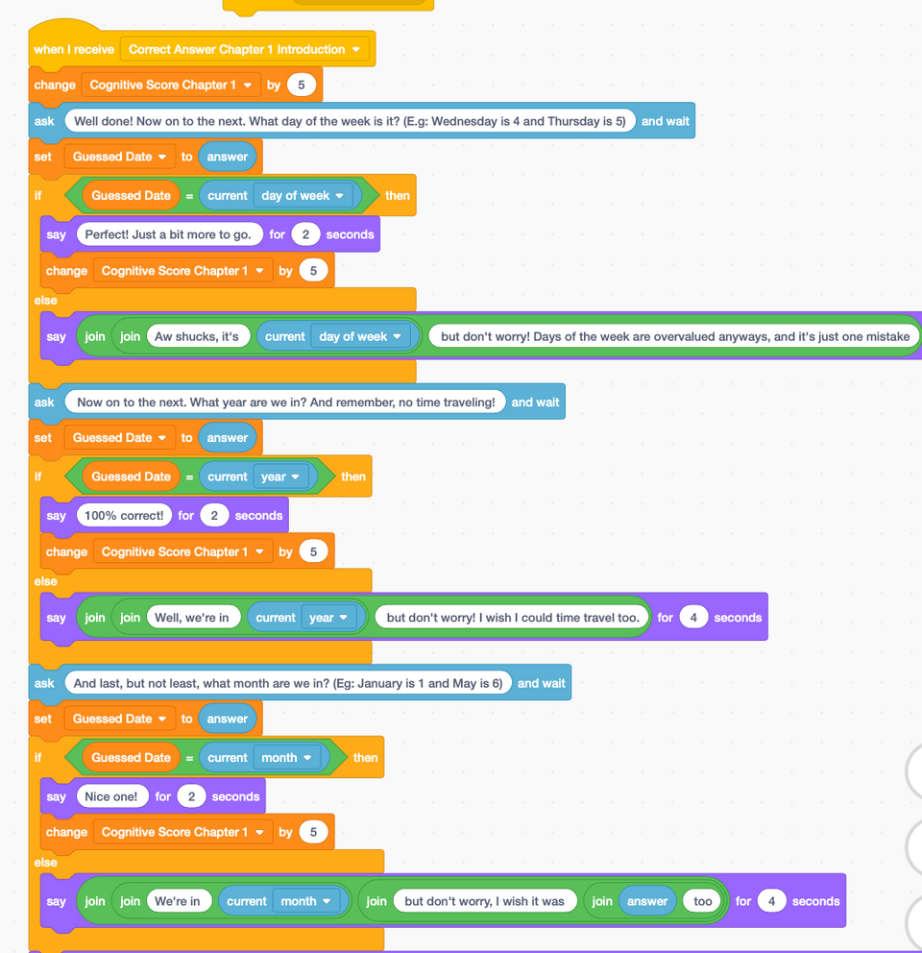
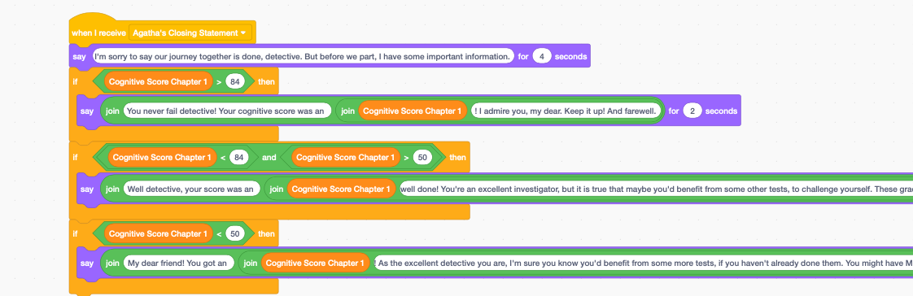
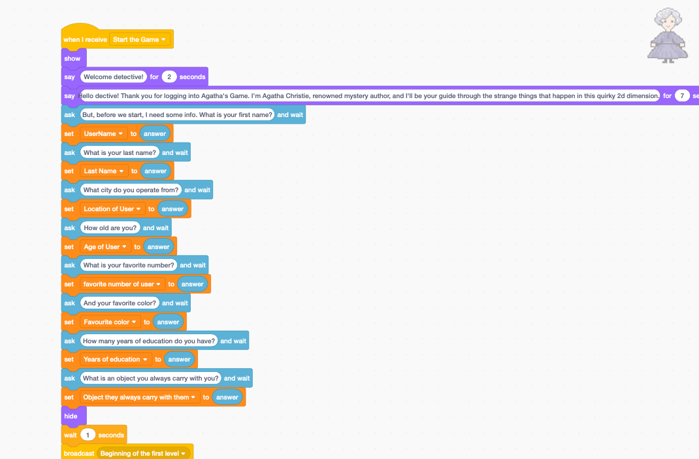
Software Development

Slide 11
Testing and Iteration
Phase 1: Initial Review
Participants | 5 test subjects of ages ranging from 50 to 85
Data Gathering | Comparison of Agatha’s Game’s cognitive score with that of the MoCa test, inquiry about user satisfaction.
Objective | 1) Test the game’s user interface and friendliness 2) Test Efficiency 3) Provide feedback on short-term improvements

Slide 12
Testing and Iteration
Phase 2: Efficiency
Participants | 20 people: control group 10 people: patients of early-stage Alzheimer’s Disease Dementia. 10 people: patients of mid-stage Alzheimer’s Disease Dementia.
Data Gathering | Players will play Agatha’s Game every day + Fill out a mood journal
Objective | To gauge the game’s effectiveness in palliating and improving cognition, and bettering mental health.

Slide 13


05
Conclusion

Slide 14
Agatha's Game has the potential to be a vital tool for diagnosis of Alzheimer’s, breaking barriers in accessibility and innovation

Slide 15
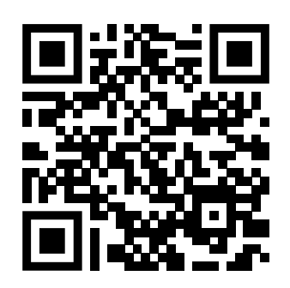
Try it yourself!

