Slide 1

The nutritional quality of food offered in European schools’ cafeterias
Georgina Iris Dimopoulou Vantsiouri
Vittoria Valentina Passanisi
EEB3 S1 ENA

Slide 2
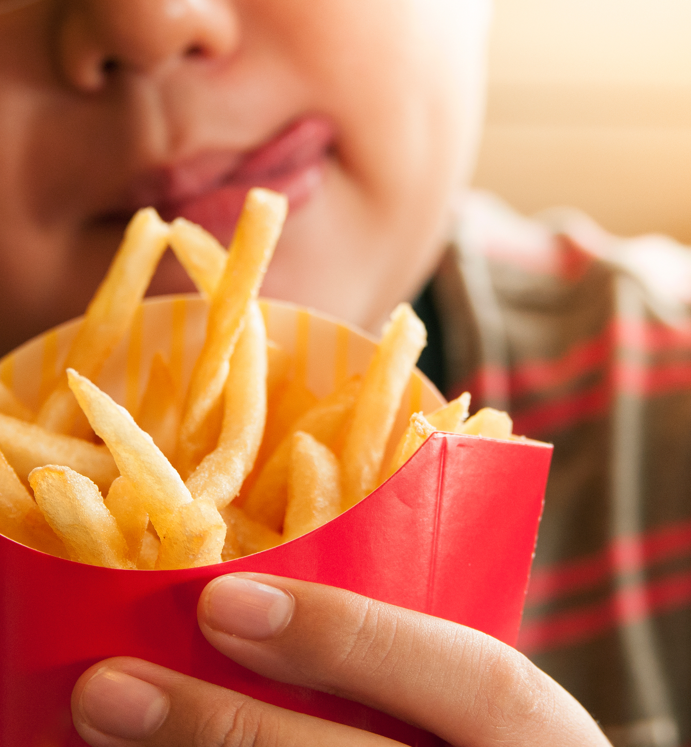
Introduction
Children obesity rates have quadrupled worldwide since 1990s. There were over 390 million overweight children and adolescents in 2022.
School cafeterias should contribute to making the healthy choice the easy choice for students.
Is food sold in European School cafeterias healthy?
Do students buy healthy food?
Notes:
The more unhealthy foods and drinks are being sold in school cafeterias, the more children are tempted to buy them
This is a problem because it fuels childhood obesity
According to the World Health Organisation ...Point 1
Point 2
To address these issues we assessed whether the the food offered at our cafeteria is healthy

Slide 3

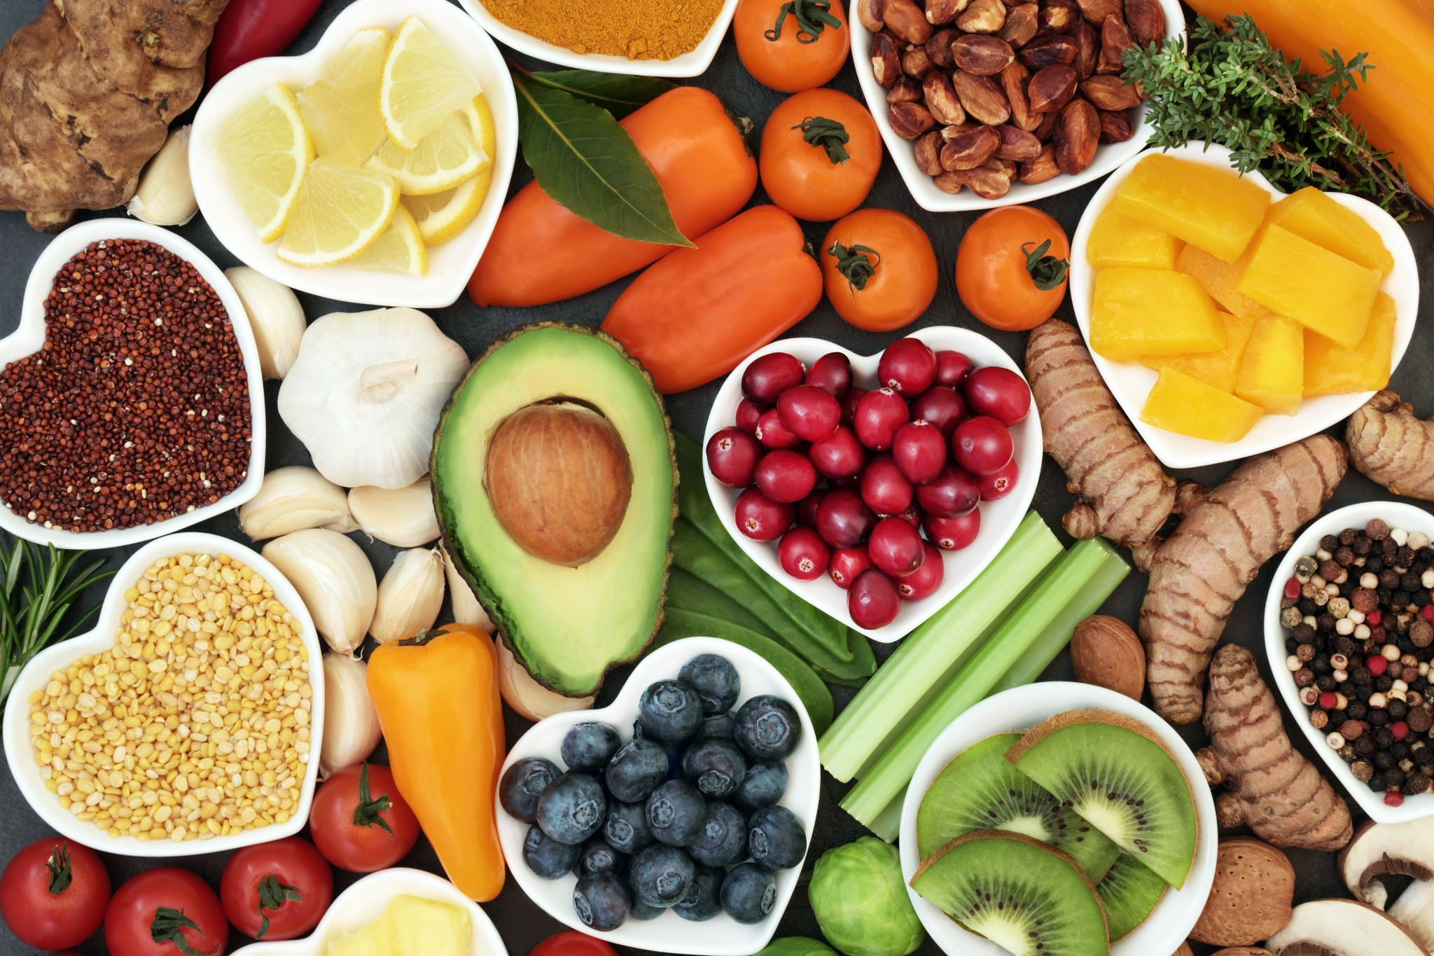
What is healthy food?
There are six essential nutrients:
protein
carbohydrates/ sugars macronutrients
fats
Our food choices determine the combination of nutrients we eat.
We need to consume all nutrients, but always in the right quantities. Some nutrients can be harmful if you consume them in excessive amounts!
vitamins
essential minerals, such as salt
water
micronutrients
Notes:
To answer our question, we need to define first what amounts to healthy food.
Food is made from nutrients.
Point 1...
Apple title last
For example, saturated fat, found in meat and dairy foods, contributes to clogged arteries and cardiovascular disease.

Slide 4
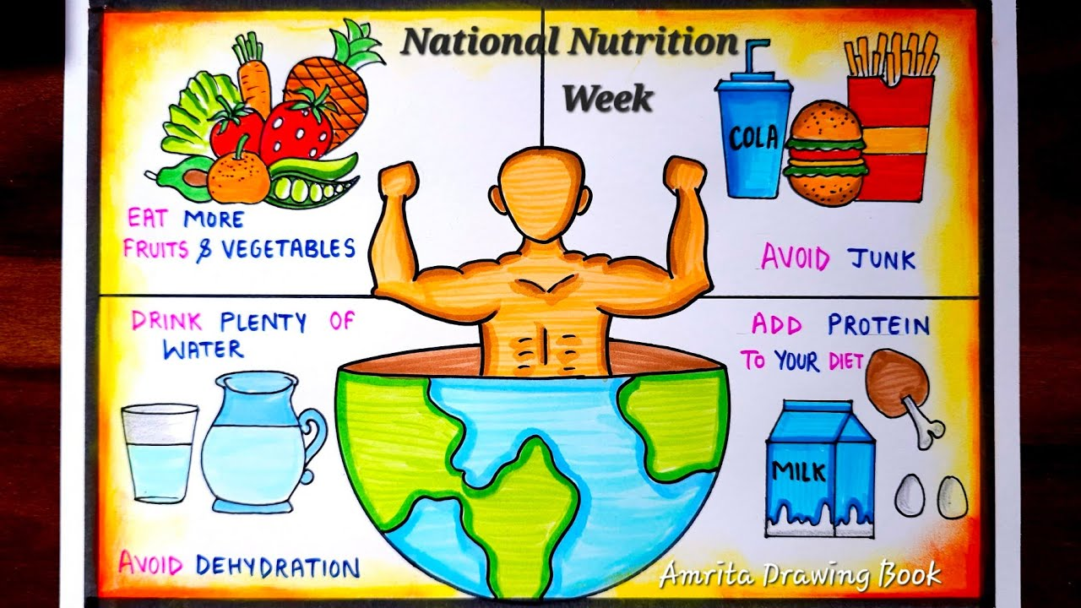
Combinations of nutrients in healthy food
Nutrition claims that can be made on foods according to EU law (Regulation 1924/2006)
LOW ENERGY:
Less than 40 kcal /100 g for solids or more than 20 kcal/100 ml for liquids.
LOW FAT:
Less than 3 g of fat per 100 g for solids or 1,5 g of fat per 100 ml for liquids .
LOW SUGARS:
Less than 5 g of sugars per 100 g for solids or 2,5 g of sugars per 100 ml for liquids.
LOW SODIUM/SALT:
Less than 0,12 g of sodium, or the equivalent value for salt, per 100 g or per 100 ml
HIGH FIBRE:
More than 6 g of fibre per 100 g or at least 3 g of fibre per 100 kcal
HIGH PROTEIN:
More than 20 % of the energy value of the food is provided by protein.
Notes:
To determine which combinations of nutrients amount to healthy food we relied on EU law.
Regulation 1924/2006 tells us when it can be claimed that food contains a combination of nutrients that is good for human health.
On the slide you can see the claims that can be made lawfully according to the Regulation and their conditions of use
[1] Regulation (EC) No 1924/2006 of the European Parliament and of the Council of 20 December 2006 on nutrition and health claims made on foods, OJ L 404, 30.12.2006, p. 9.

Slide 5
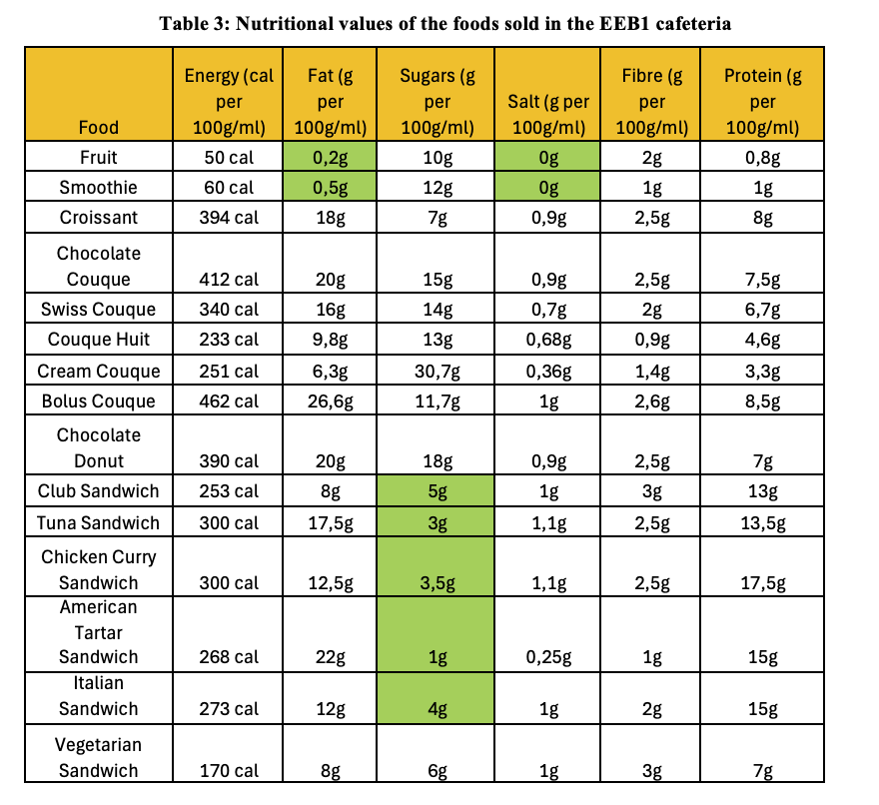
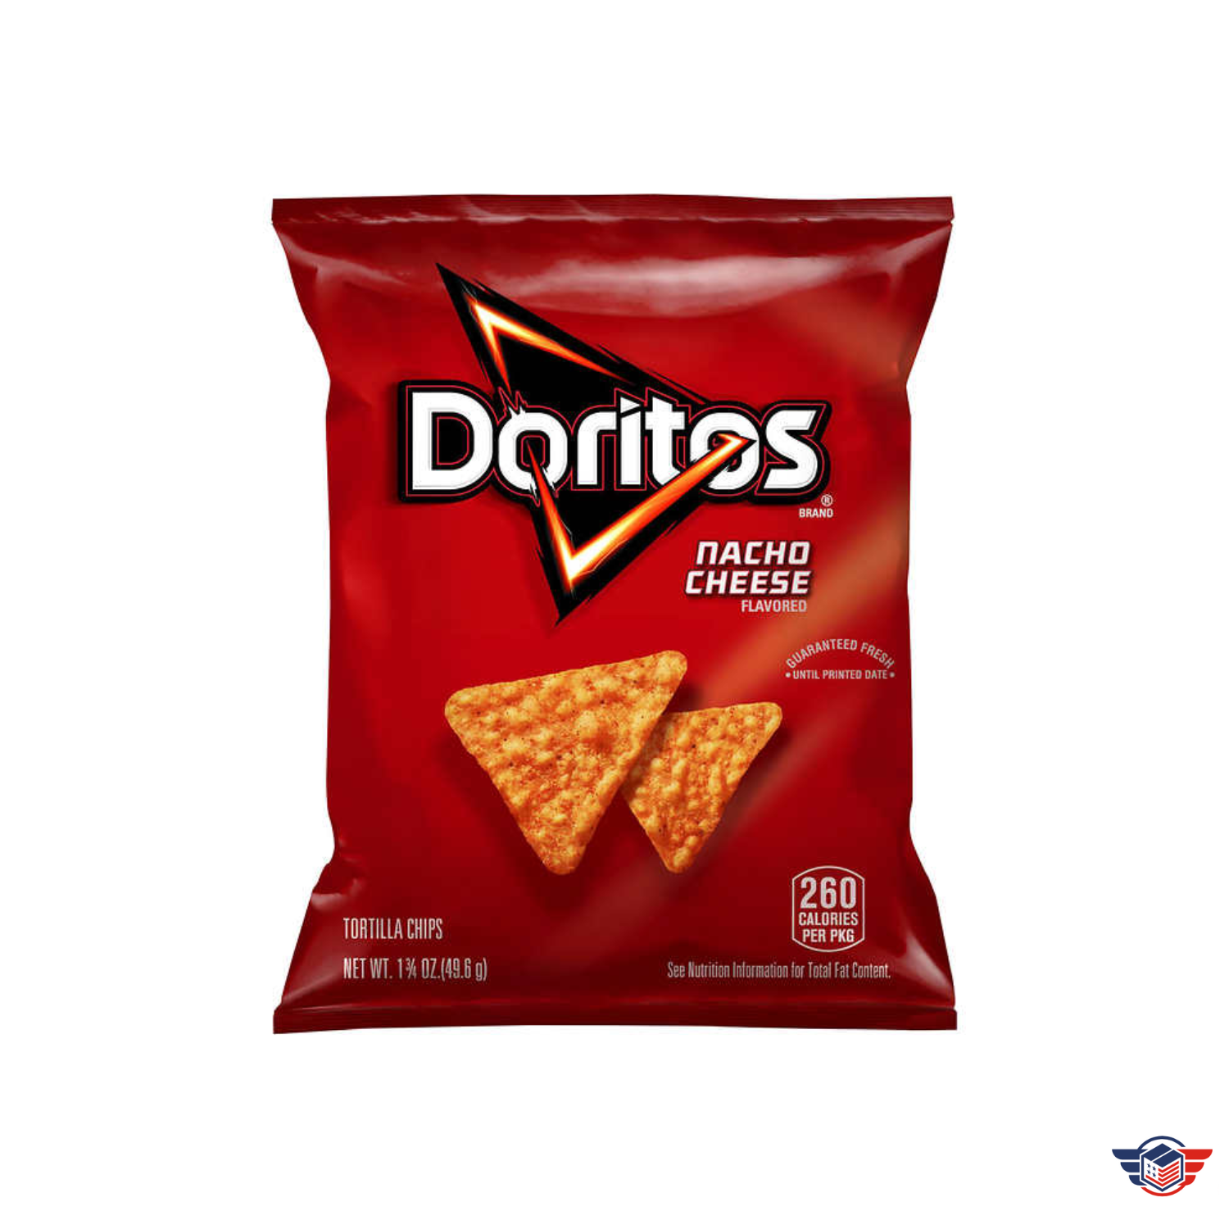
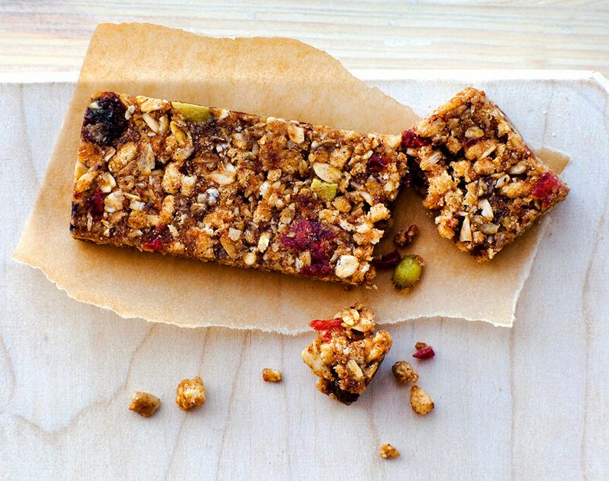
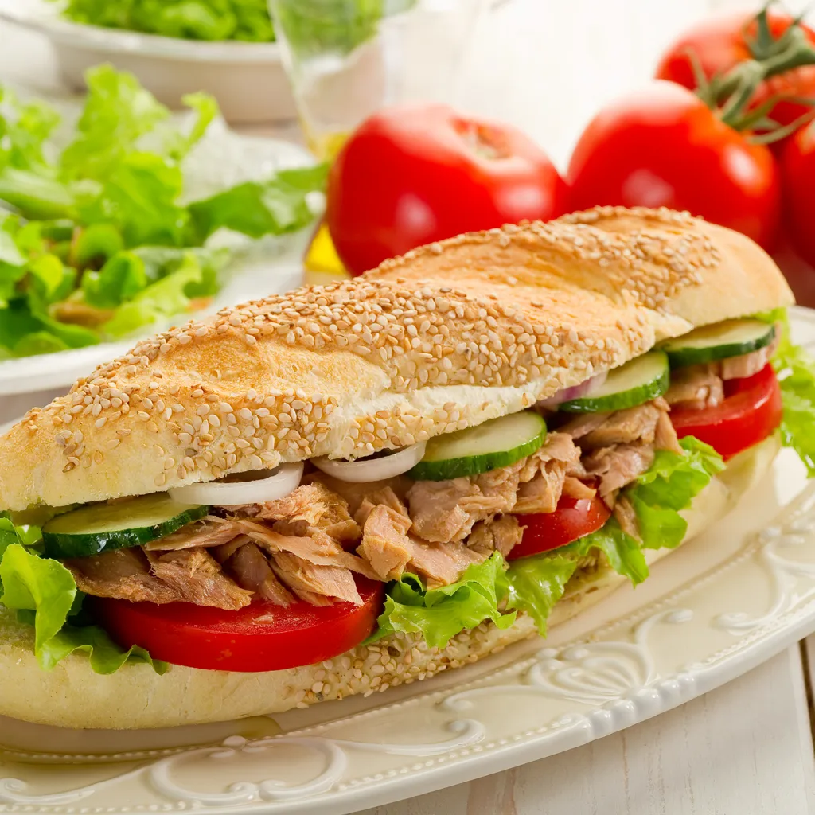
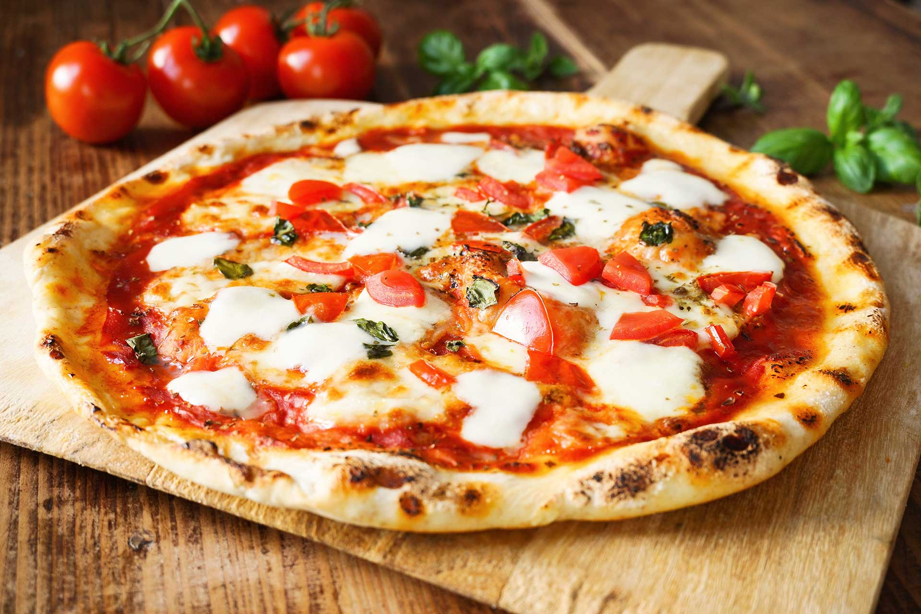

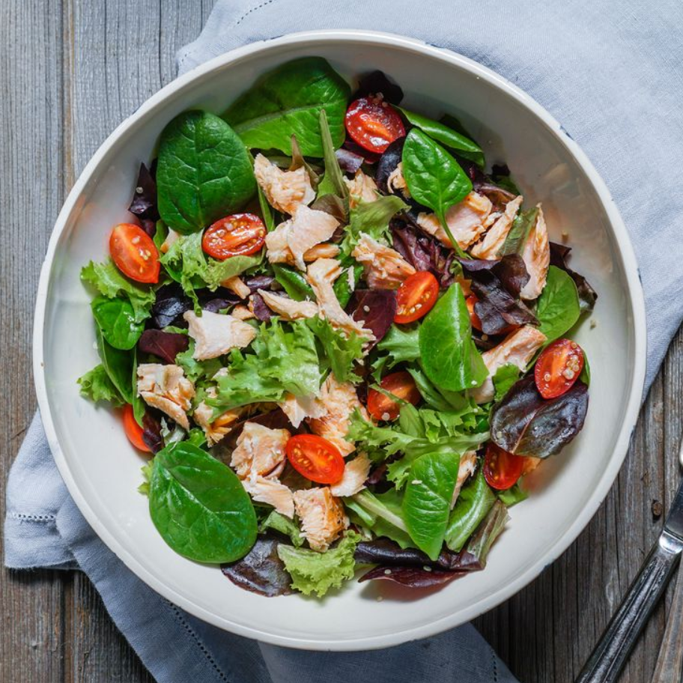
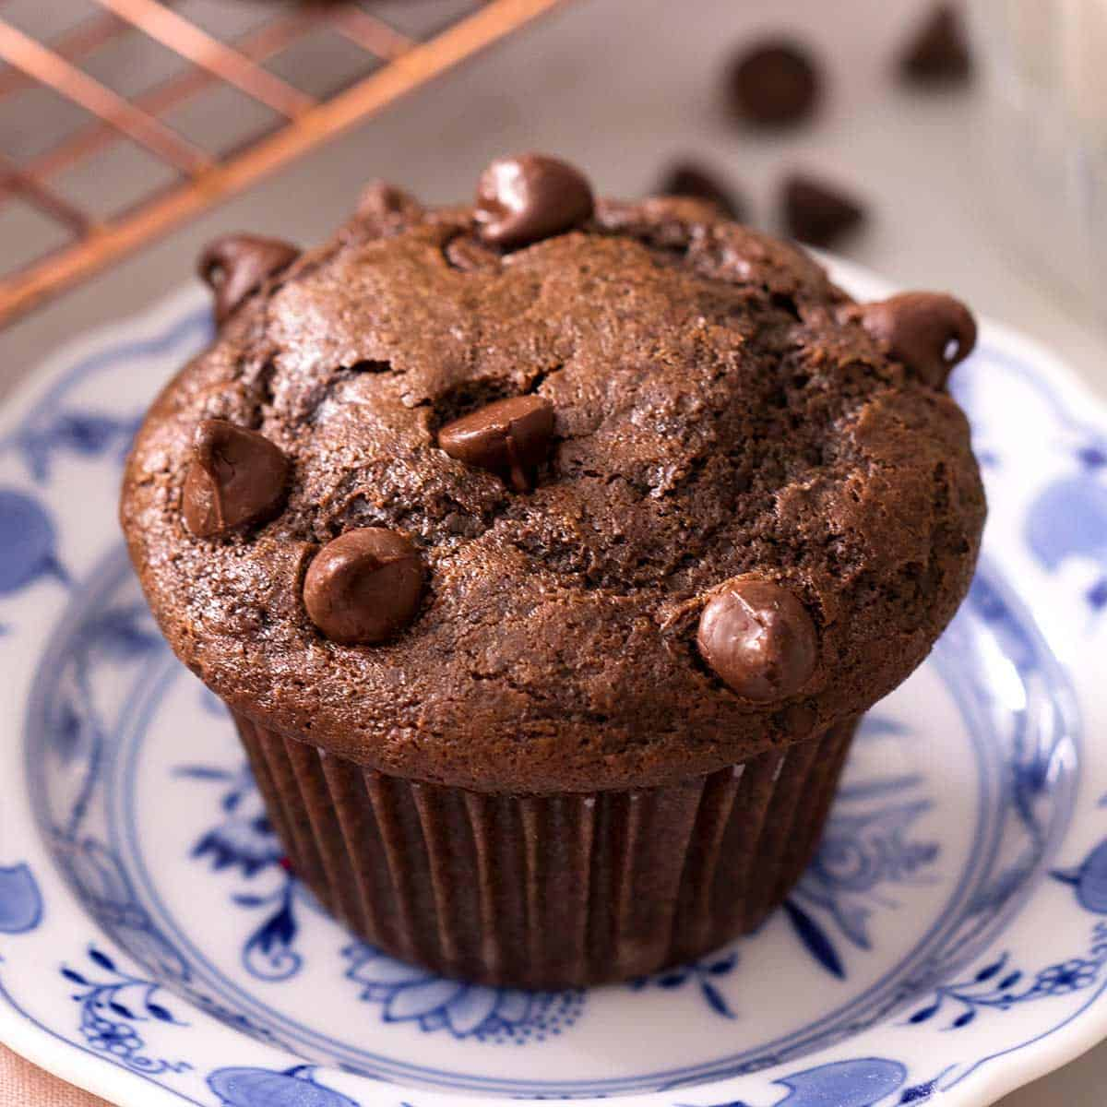


Methodology: Is cafeteria food healthy?
1. We collected the menus from the school cafeterias of Brussels European Schools: EEB1, EEB2, EEB3 and EEB4.
2. We created excel tables of the foods that the cafeterias offer and their content in nutrients.
3. We identified the foods that could lawfully claim in the EU that they are low in energy, low in fat, low in sugars, low in salt, high fibre or high in protein.
Healthy
Not
Healthy
4. We built a case study on students’ nutritional preferences, based on a questionnaire distributed to students in S1 EN.
5. We drew conclusions and prepared comparative graphs on the nutritional quality of the foods offered to students and on students’ nutritional preferences.

Slide 6
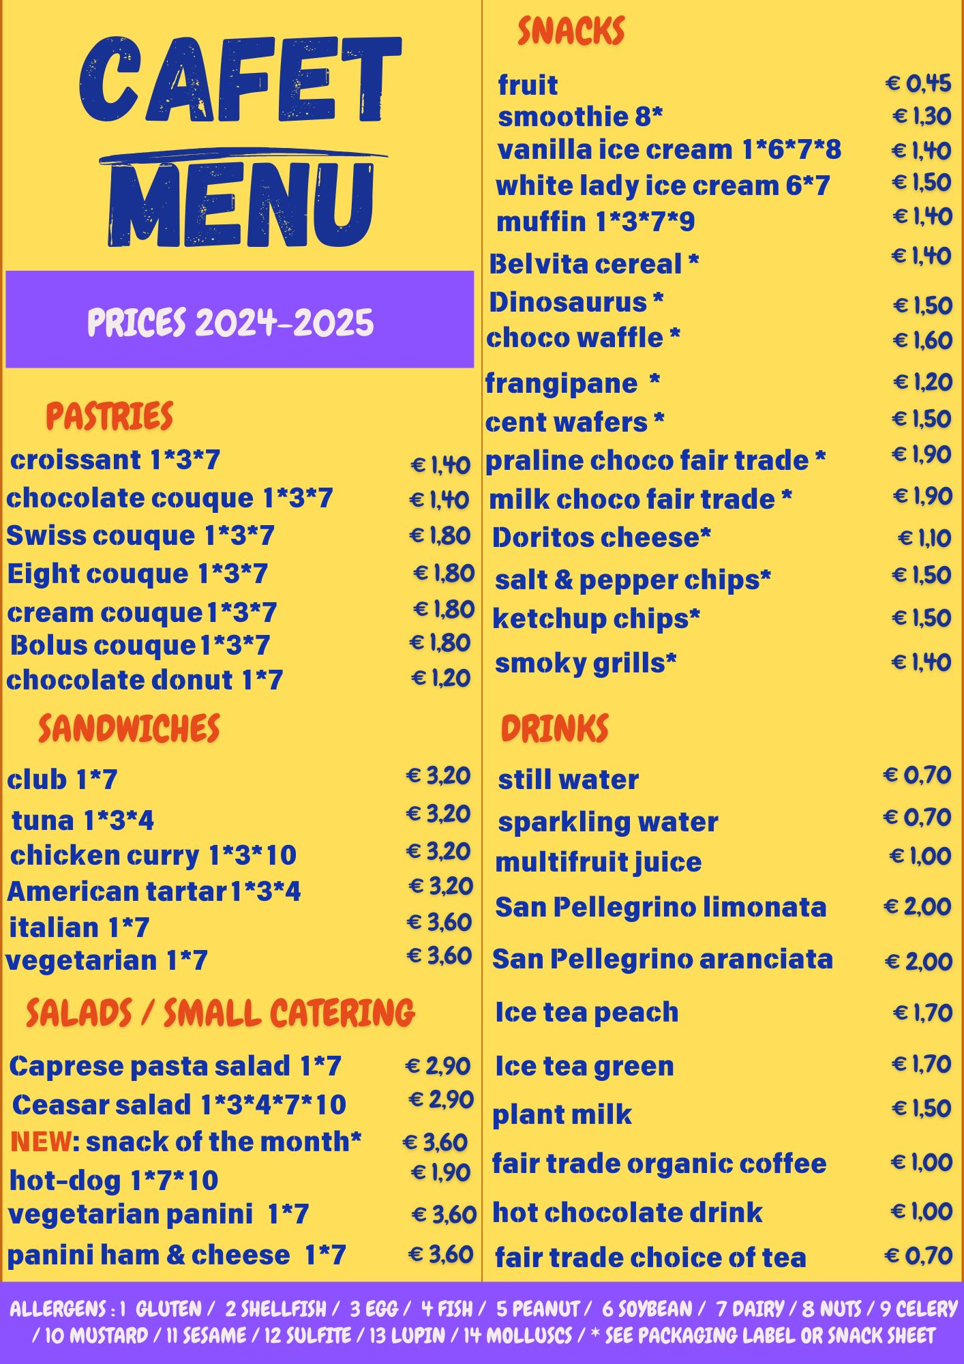
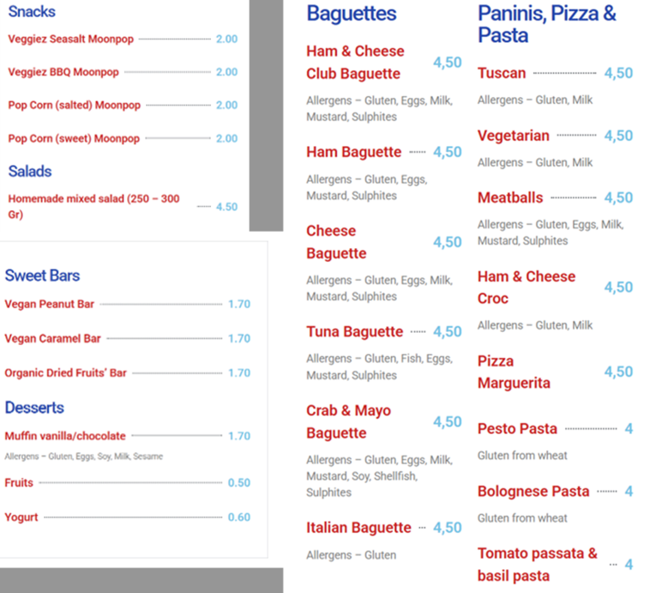
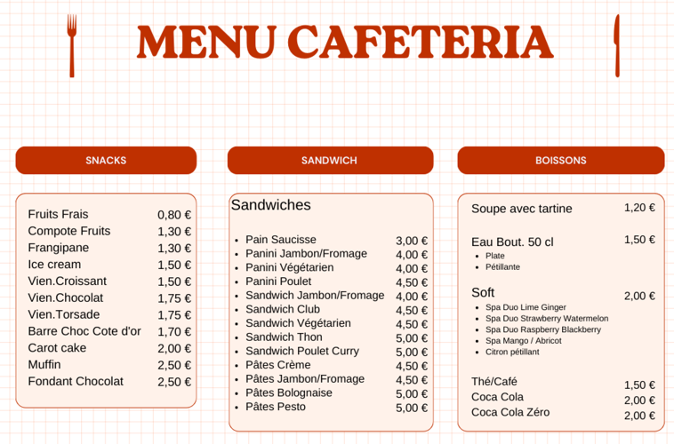
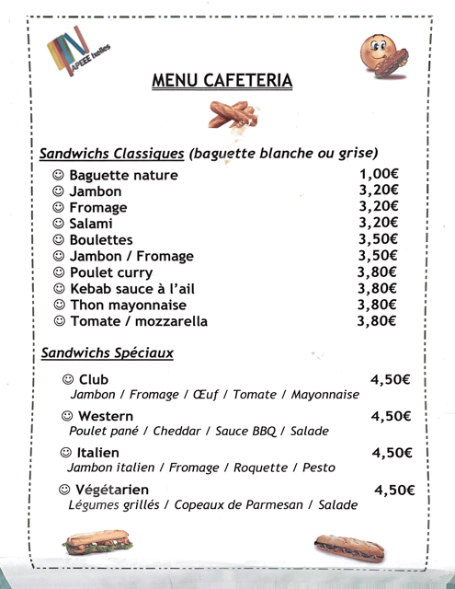
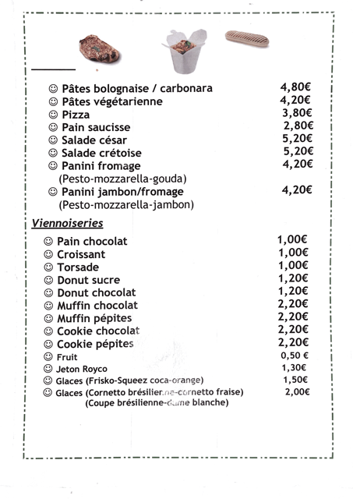
EEB1 and EEB2 Cafeterias’ menus
EEB1
EEB2
EEB4
EEB3

Slide 7
EEB3 and EEB4 Cafeterias’ menus
EEB3
EEB4

Slide 8


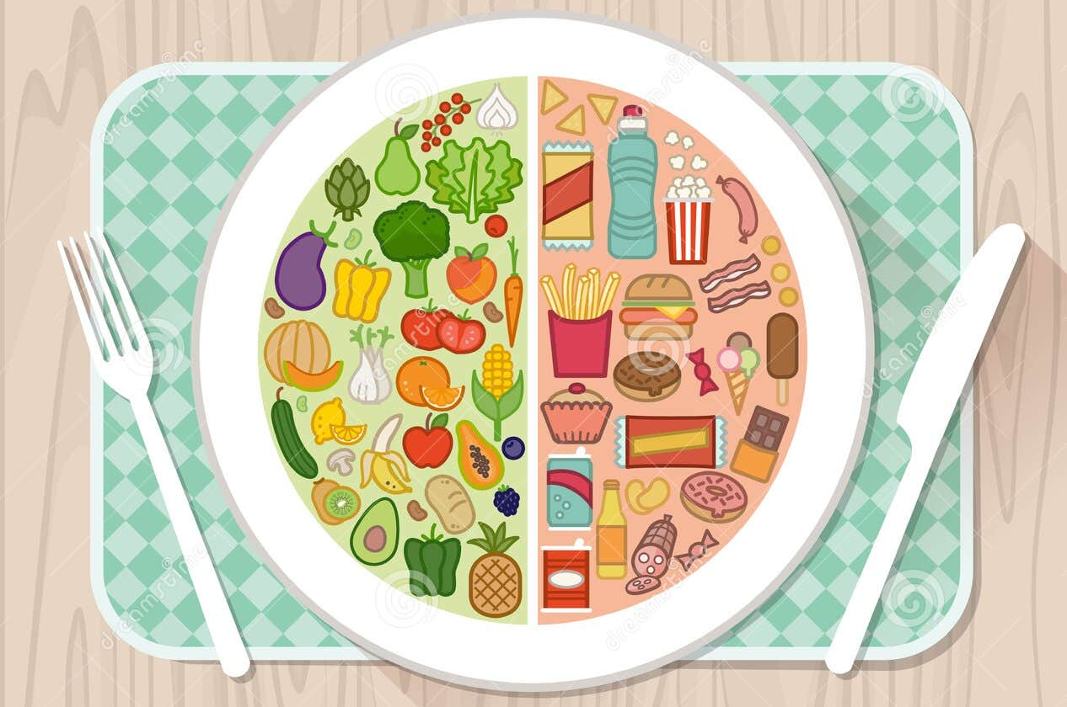
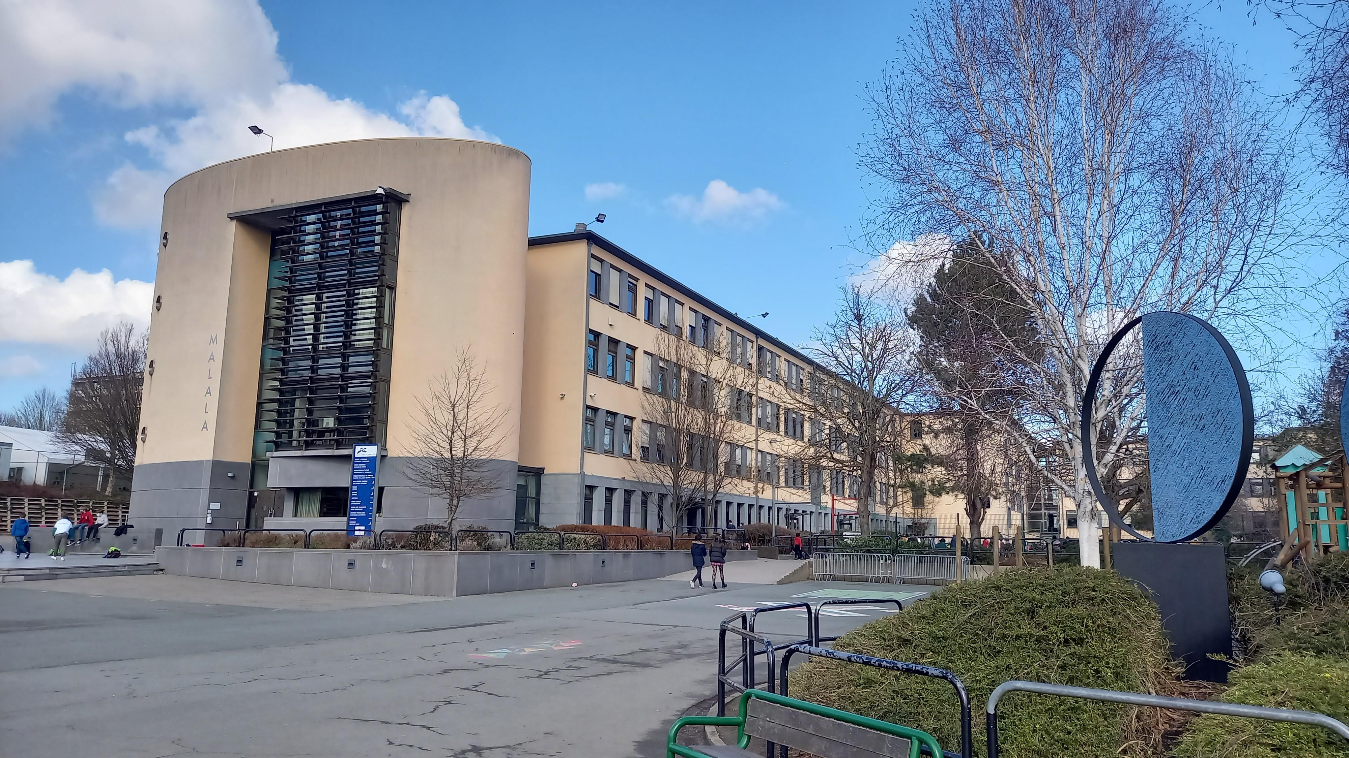
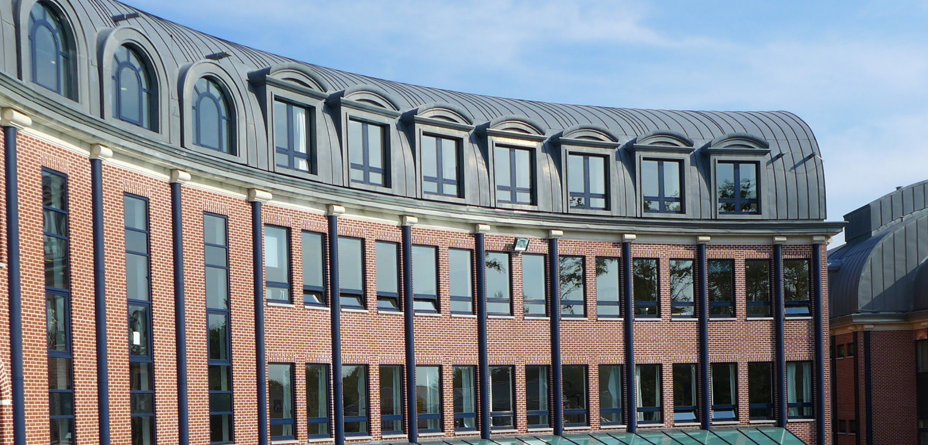
Results
Comparative Analysis

Slide 9
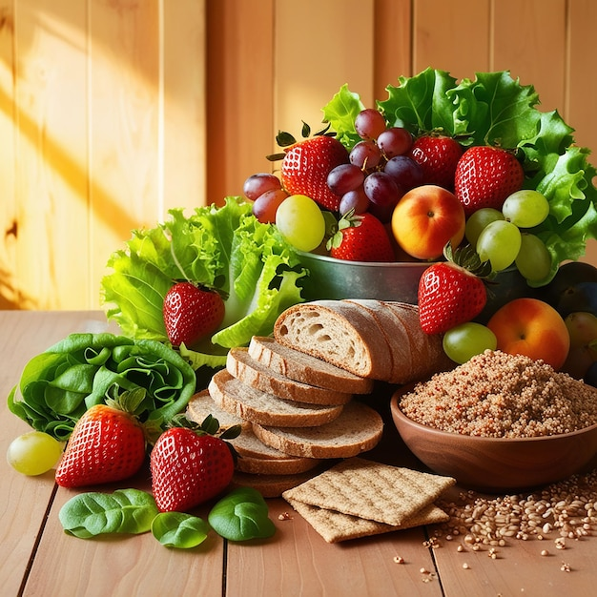
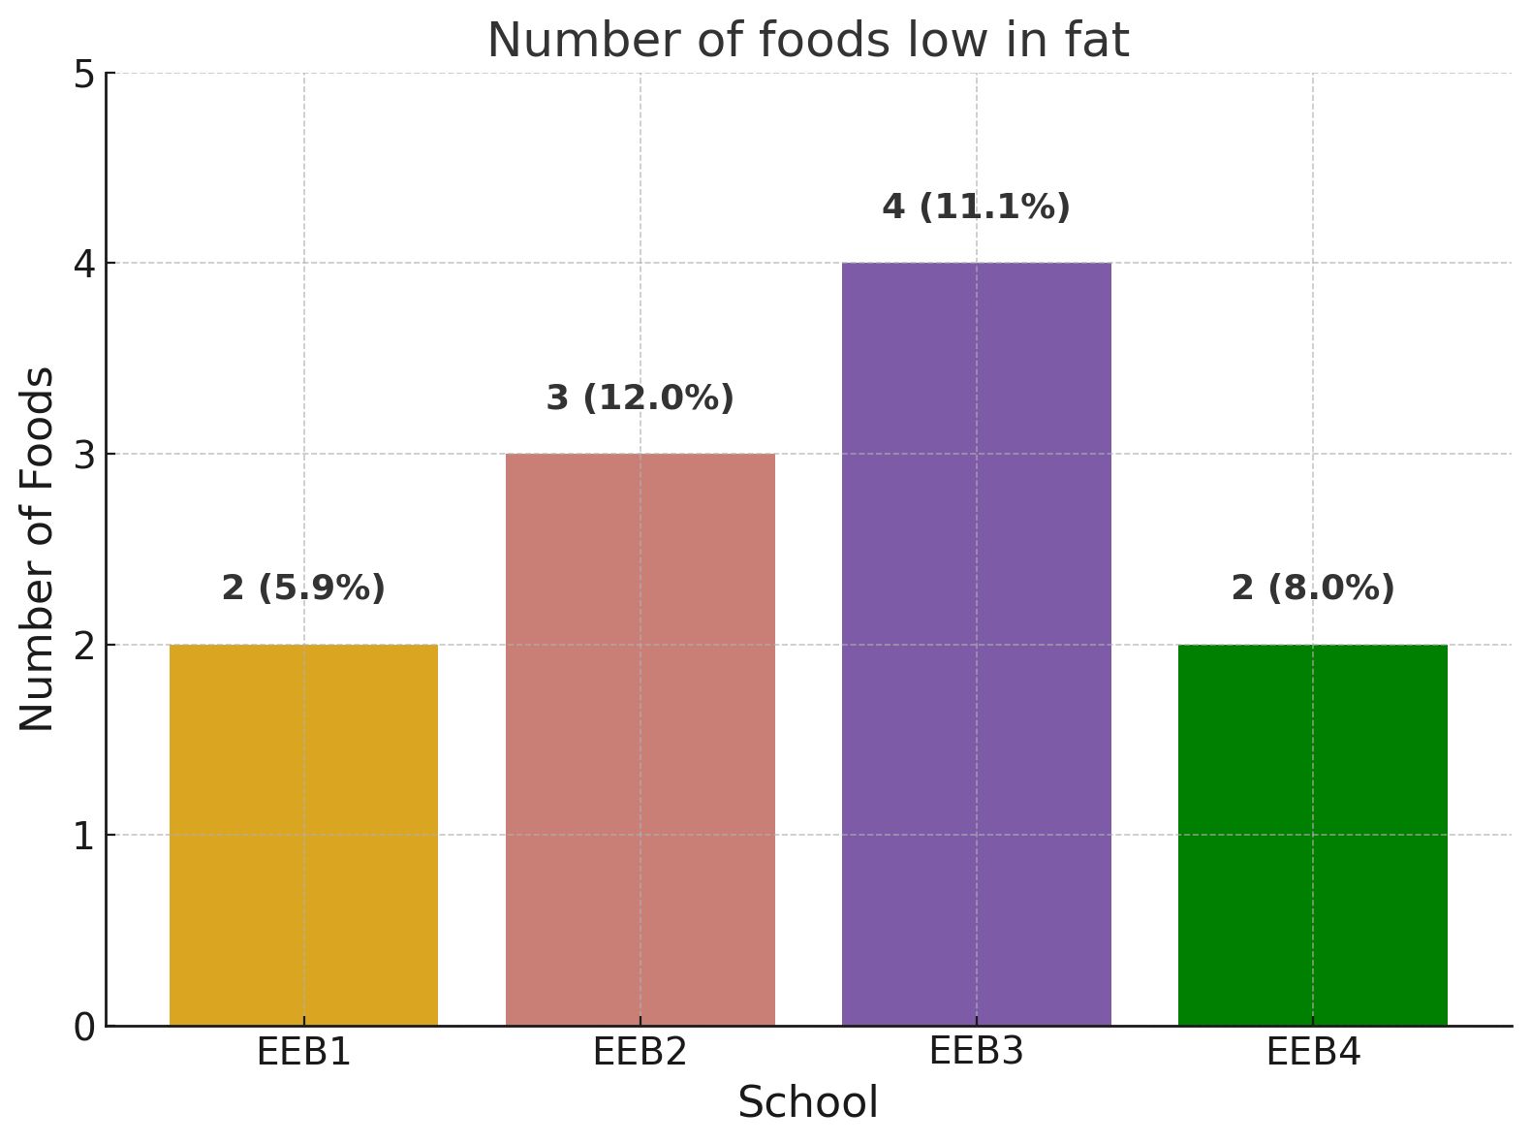
Foods low in fat
e.g: fruits, yoghurt, smoothie, salad, baguette
Maximum 11% (EEB3) to 12% (EEB2) of the foods
offered by the BXL European schools are low in fat
EEB1 and EEB4 offer only 2 snacks low in fat (6 to 8% of their menus)

Slide 10
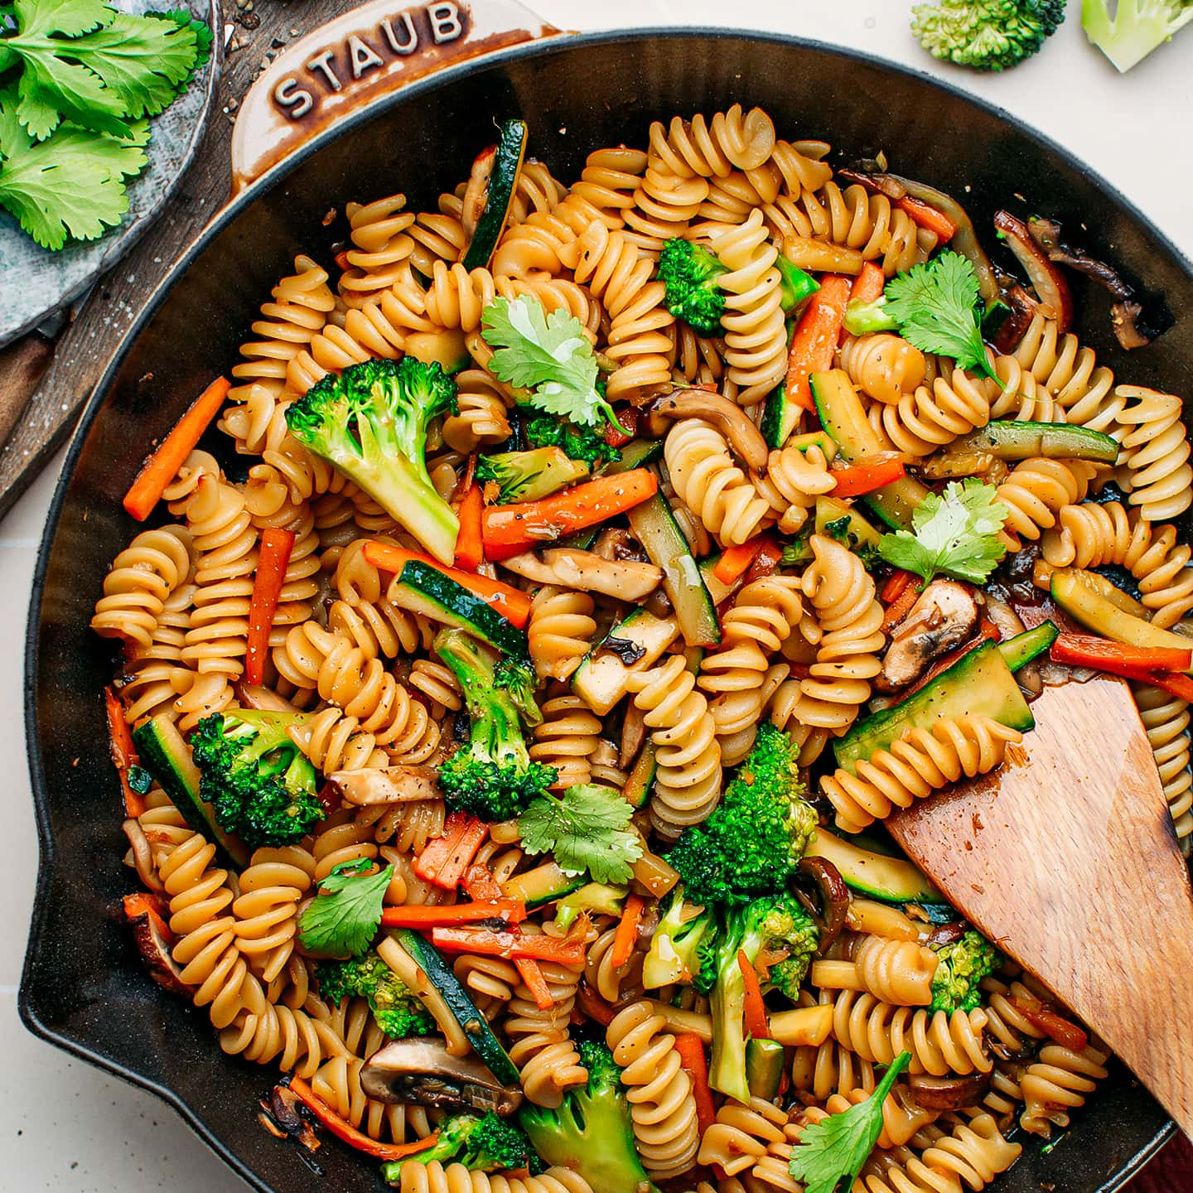
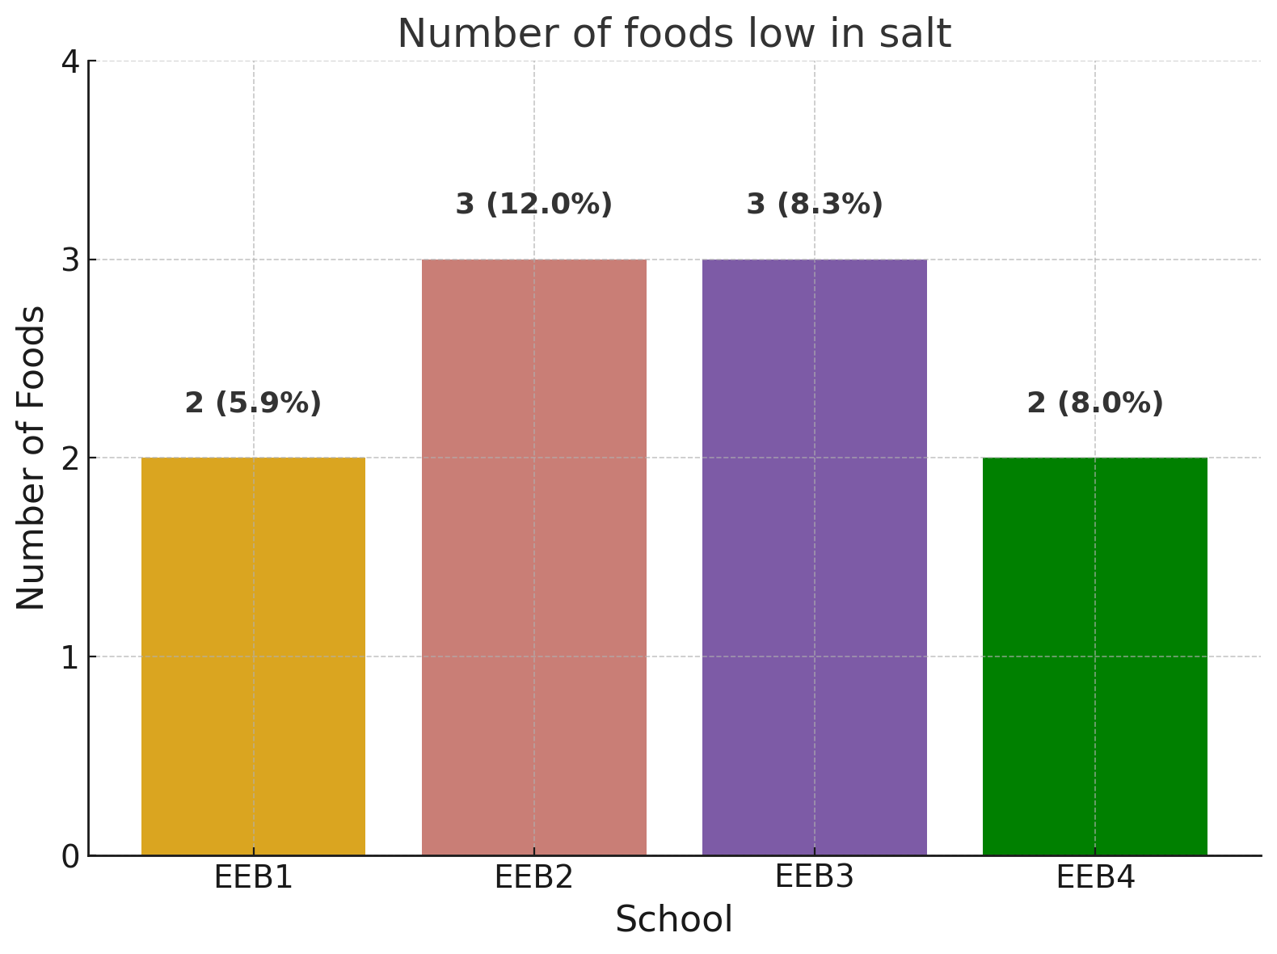
Foods low in salt
e.g: fruits, yoghurt, salad, vegetarian pasta
A maximum of 12% (3 snacks) of the foods offered in a school are low in salt (EEB2); 3 snacks as well for EEB3 (8.3%).
Only 2 snacks (<= 8%) for EBB1 and EBB4.

Slide 11
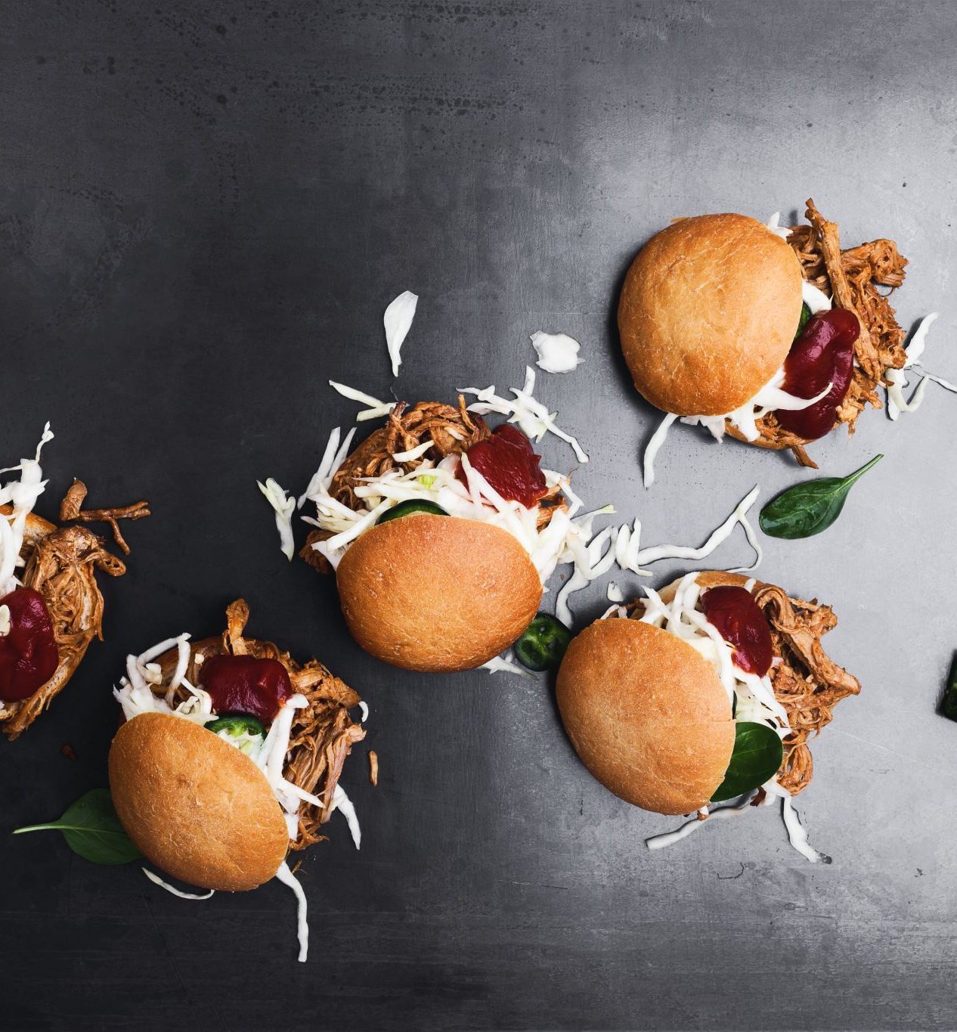
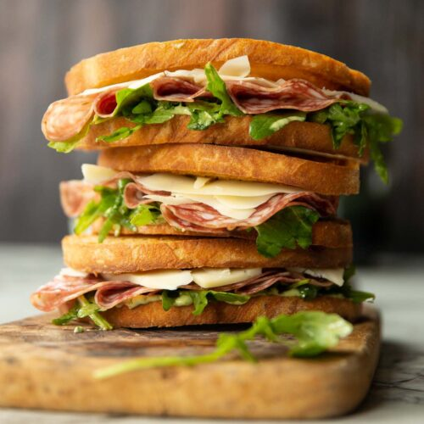
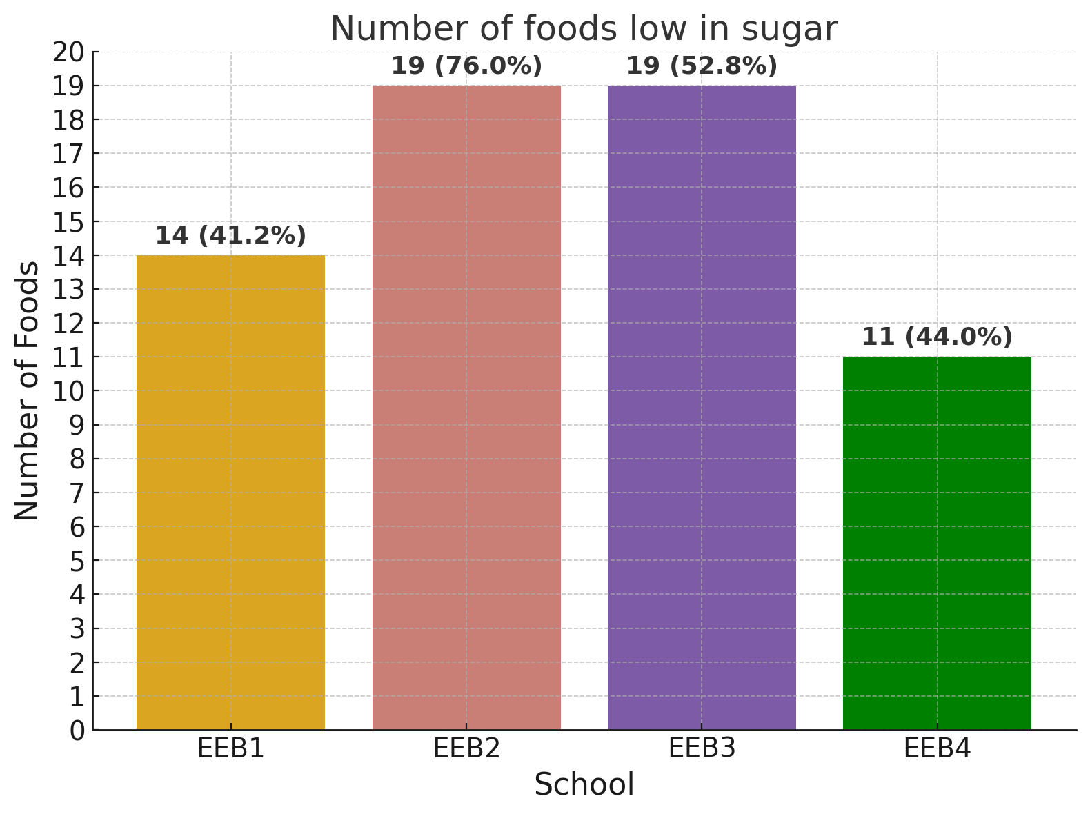
Foods low in sugar
e.g: fruits, yoghurt, salad, most sandwiches, pastas, pizza, sausage roll, hot dog, Doritos.
All schools offer a high number of foods low in sugar (19 for EEB2 (76%) and for EBB3 (52.8%)), but:
at least half of the foods offered remain very high in sugar: EBB3 - almost 50% and over 50% for EEB1 and EEB4
among the foods low in sugar, many are anyway unhealthy for other reasons

Slide 12
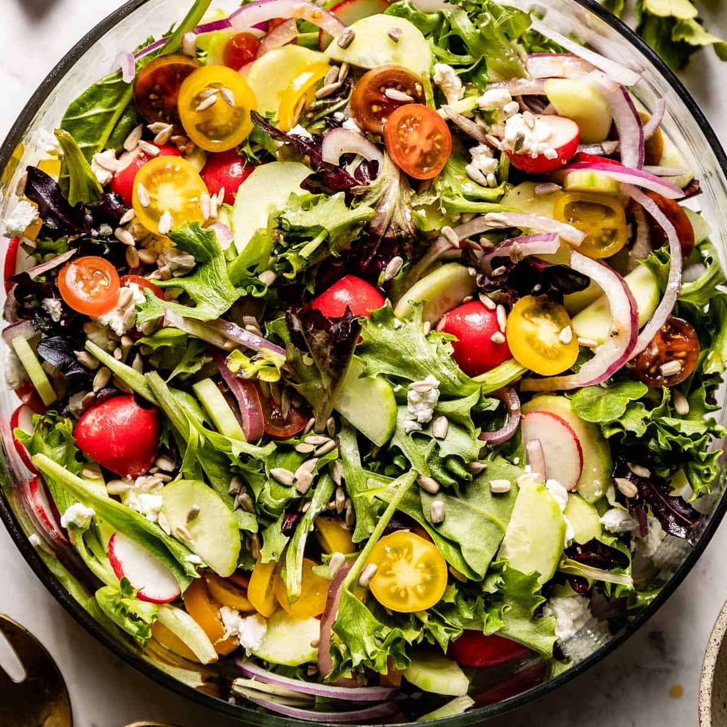
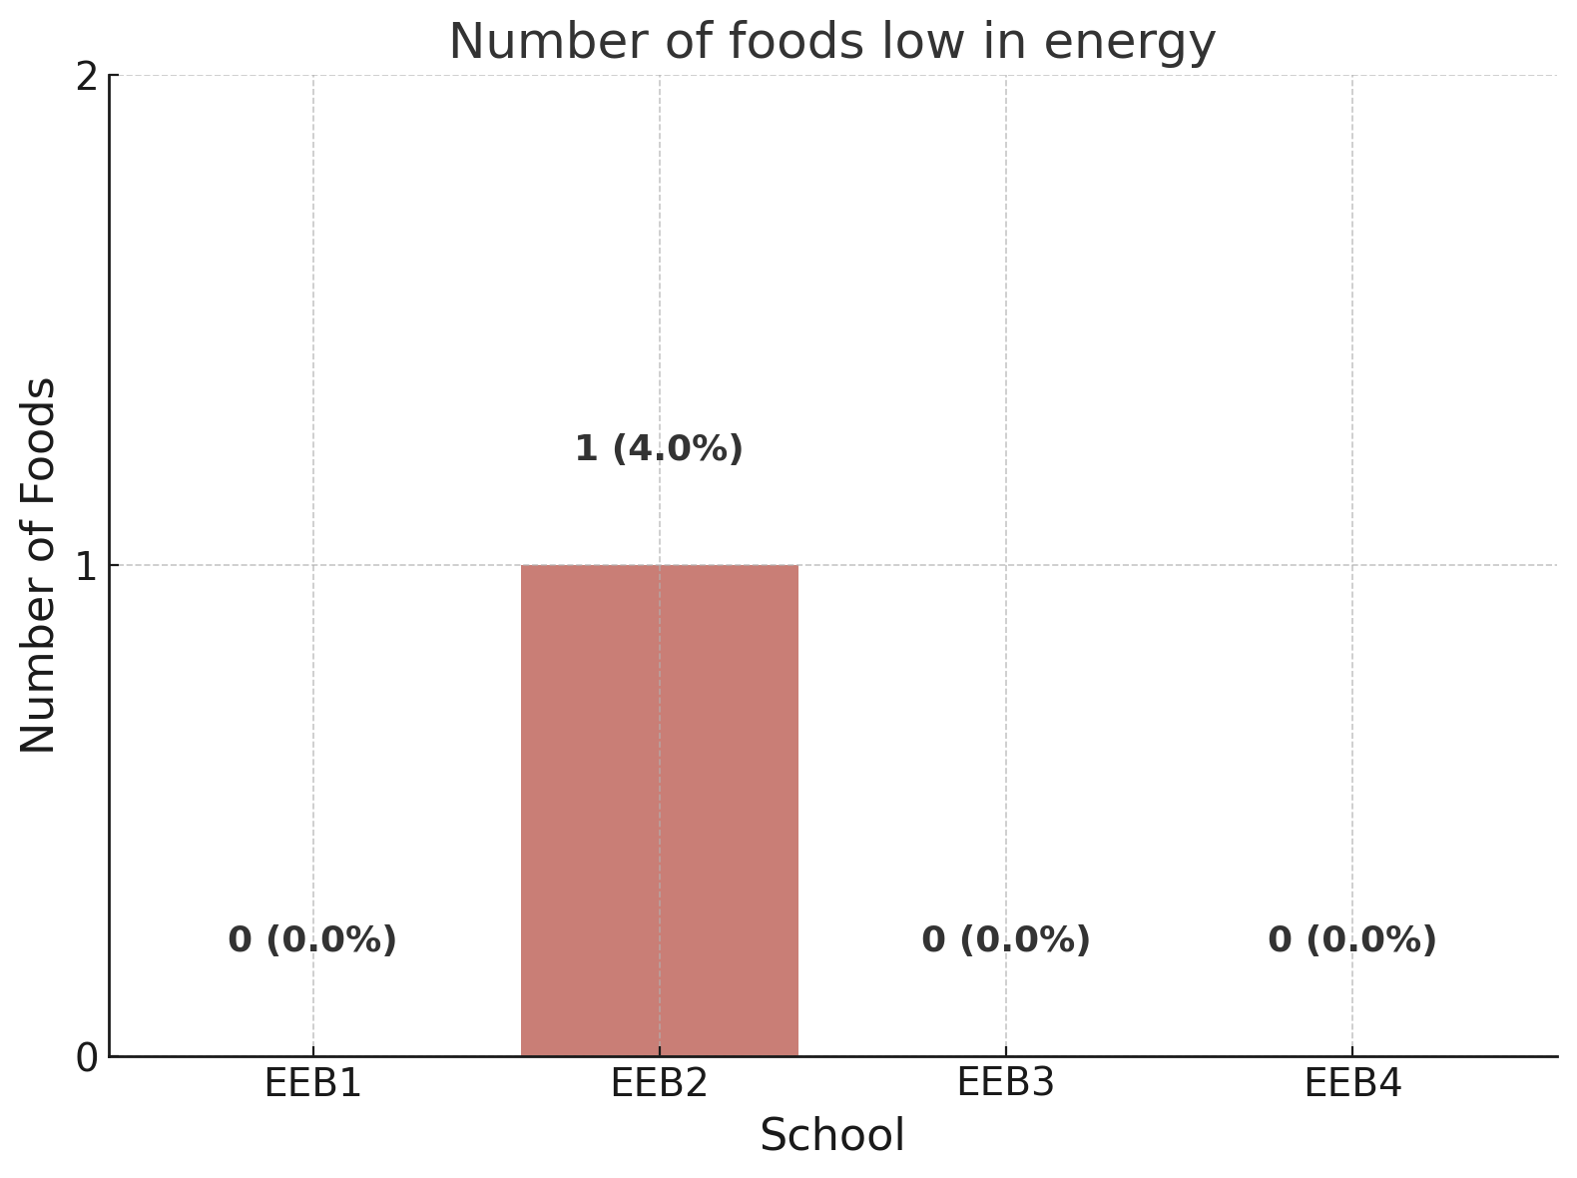
Foods low in energy
=> home made mixed salad
There is only one low energy snack
(EEB2; 40 Kcal / 100g)

Slide 13
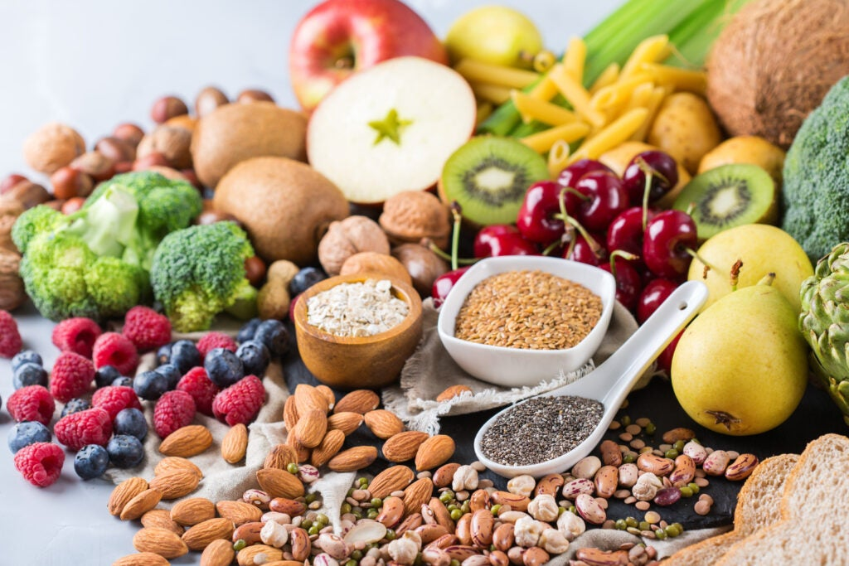
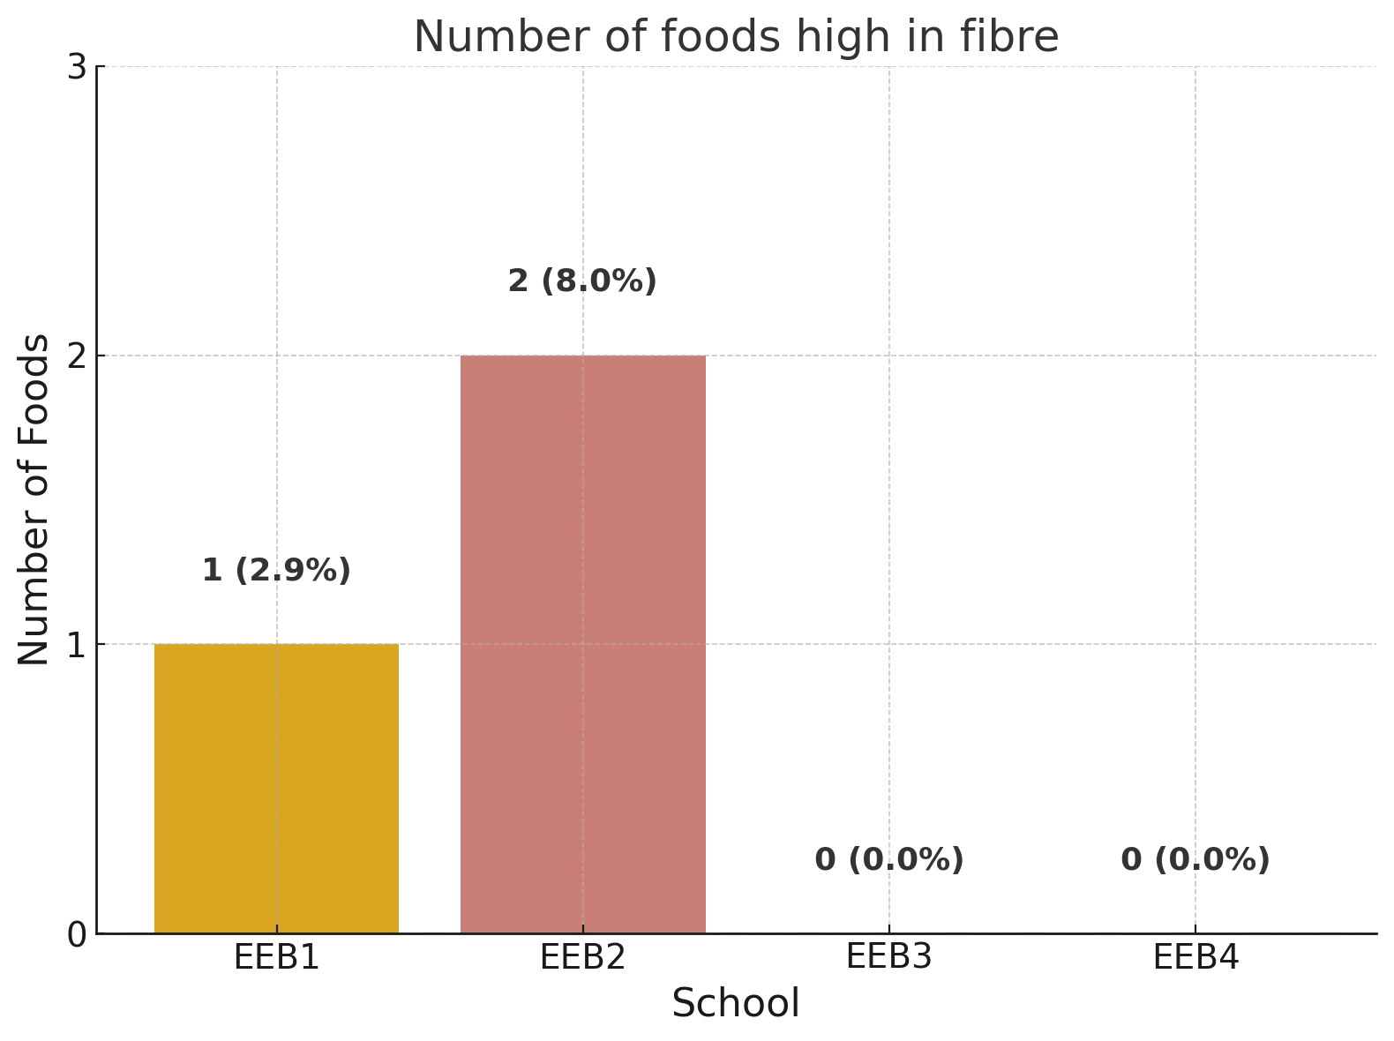
Foods high in fibre
0r high in protein
high in fibre e.g: Belvita cereal, vegan peanut bar, dried fruits’ bar
Only two schools offer some snacks high in fibre (EEB1: 1 snack and EEB2: 2 snacks)
None of the schools offers foods high in protein!

Slide 14
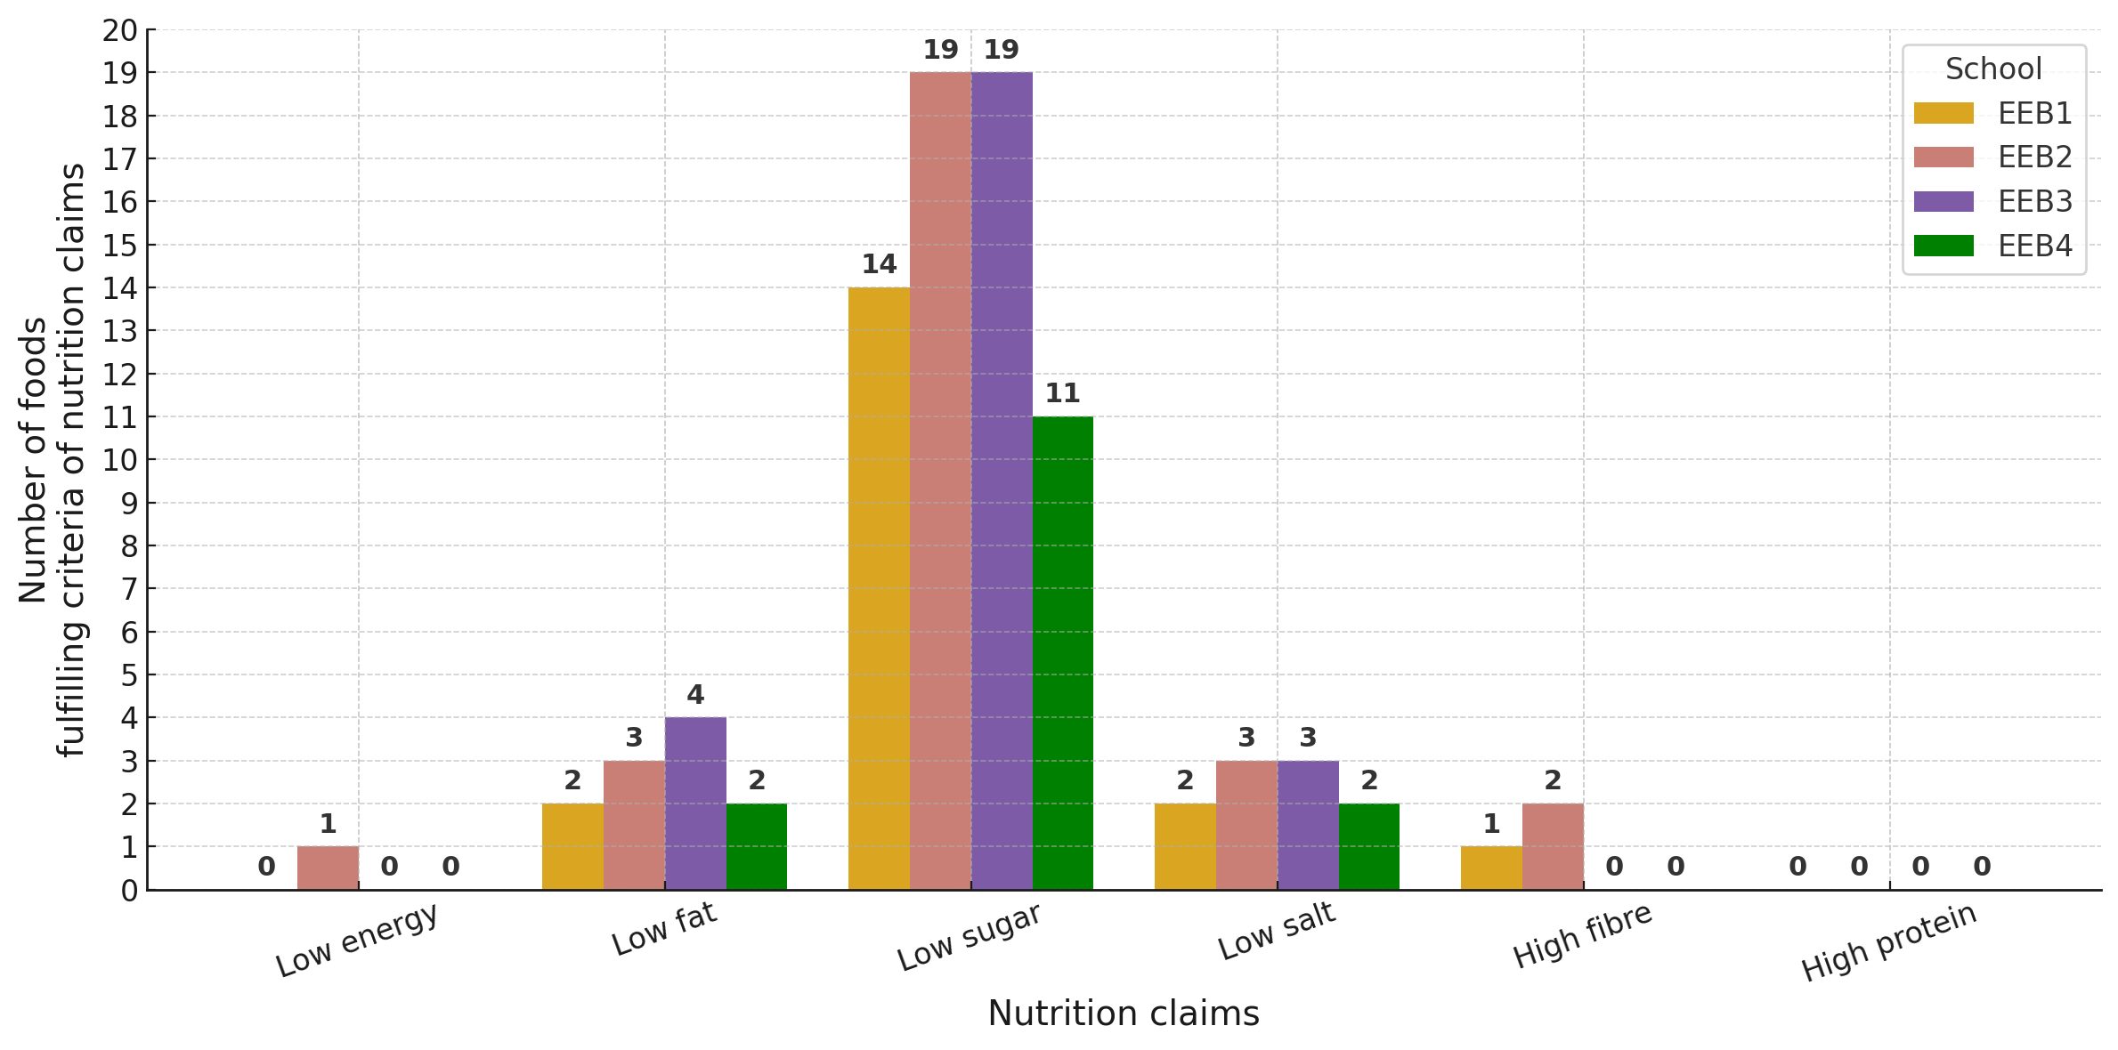
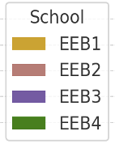
Comparison I:
Number of healthy foods per category
The best balance is achieved by EEB2 with the most of healthy foods meeting the criteria of almost all nutrition claims.
EEB3 is second, but it does not offer any high fibre or high protein snacks.

Slide 15
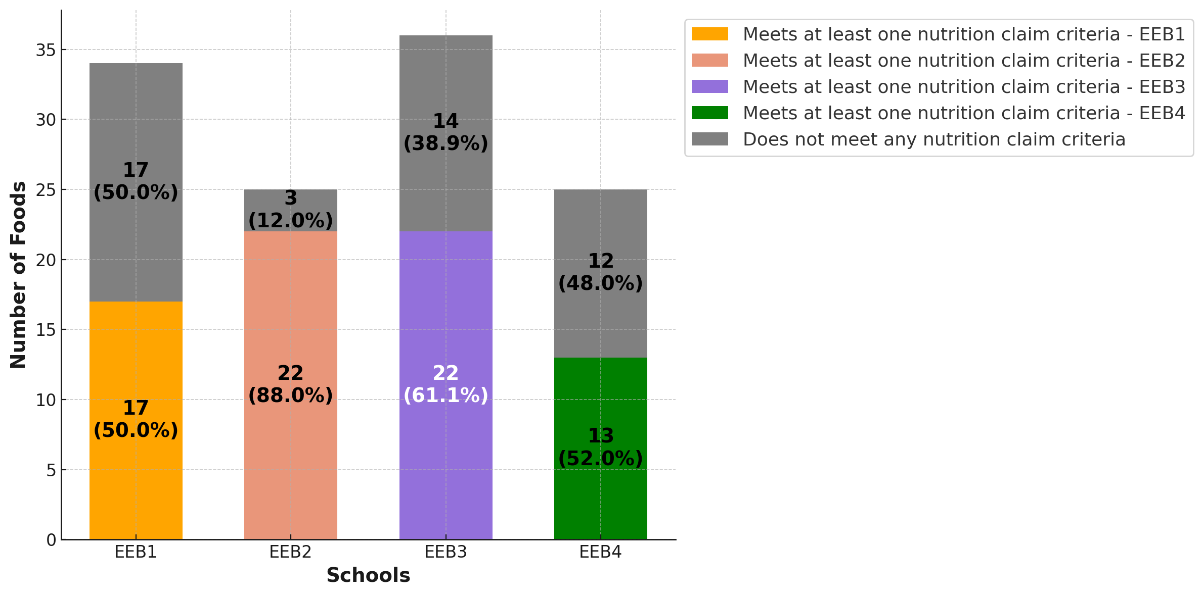
Comparison II:
Number of healthy/unhealthy foods per school
EEB2 and EEB3 offer the highest number of healthy foods (22)
Still 39% of foods in EEB3 is unhealthy, while in EEB2 – only 12%.
EEB2 offers the best choice of healthy foods!

Slide 16
Case study results:
Does the healthy profile of foods matter?
The healthy profile of foods does not appear to be relevant for the students’ choices!

Slide 17
Case study results:
What are popular foods?
The most popular foods are the less healthy ones!

Slide 18
Case study results:
How do student choose food?
Students claim to know which foods are healthy and to care about it.
Yet, whether food is healthy is not the only factor that influences student choices.

Slide 19

Conclusions
The majority of the European schools’ cafeterias do not offer enough foods with good nutritional characteristics.
Low fat and low salt choices are minimal.
More efforts are needed to make the healthy choice the easy choice.
There are no high protein snacks. Only two schools offer 1 or 2 snacks rich in fibre. Solely one school has a low calories dish.
There are a lot of low sugar choices, however the rest have a lot of sugar.
The best choice of healthy foods is offered by the school EEB2.
More efforts are needed to make the healthy choice the easy choice.
.
Notes:
The lack of plenty and various healthy foods on offer makes it harder for students to make the right choice, the easy choice. Given that many students eat in the cafeteria, more efforts should be made to offer more healthy choices to students.
We used the food offered at the EEB3 cafeteria as an example, but we hope that our work can have an impact on the food choice in all European Schools.

Slide 20
Recommendations I
Offer whole wheat versions of baguettes, paninis, pasta and pizza.
Substitute ultra processed ingredients with whole foods and fresh ingredients.
Substitute processed meats with fresh lean cuts, steamed, boiled or grilled.
Substitute the full fat dairy products with low fat versions.
Offer a wide variety of seasonal fruits and vegetables.
Broaden the variety of healthy snacks: unflavoured yoghurt, unsalted nuts, roasted chickpeas, kale chips, celery logs, energy rolls, granola bars.

Slide 21
Recommendations II
Introduce a simple, easy to understand marking system to help students identify healthy food choices
Educational campaign
High nutritional quality foods
Medium nutritional quality foods
Low nutritional quality foods

Slide 22
References
European Commission: Directorate-General for Research and Innovation and Group of Chief Scientific Advisors, Towards sustainable food consumption – Promoting healthy, affordable and sustainable food consumption choices, Publications Office of the European Union, 2023, https://data.europa.eu/doi/10.2777/29369.
Regulation (EC) No 1924/2006 of the European Parliament and of the Council of 20 December 2006 on nutrition and health claims made on foods, OJ L 404, 30.12.2006, p. 9.
World Heath Organization, Key Facts on Obesity and Overweight, available at: https://www.who.int/news-room/fact-sheets/detail/obesity-and-overweight
World Health Organization, Key Fact on Healthy Diet, available at: https://www.who.int/news-room/fact-sheets/detail/healthy-diet
Database of nutrients in foods: https://www.eatthismuch.com/food/browse, www.myfitnesspal.com

Slide 23
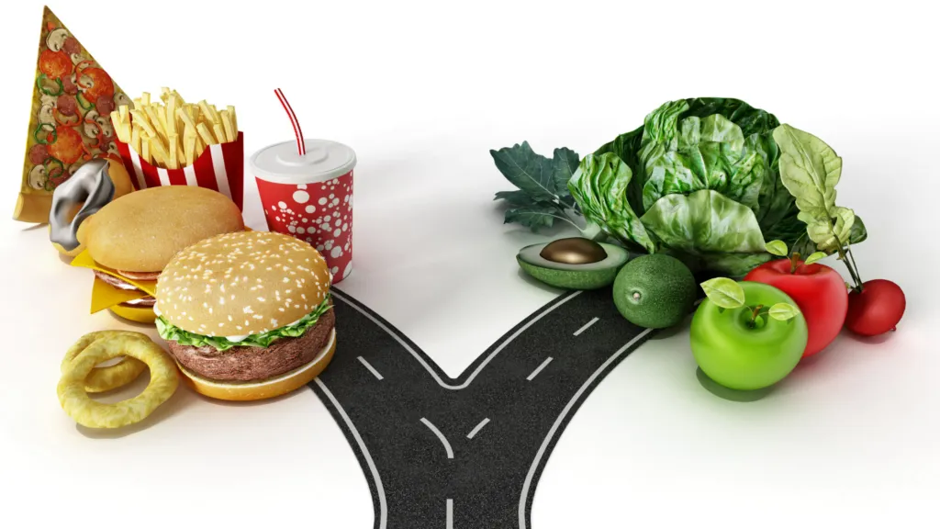
Thank you for listening
and making the right choice ->

