Slide 1
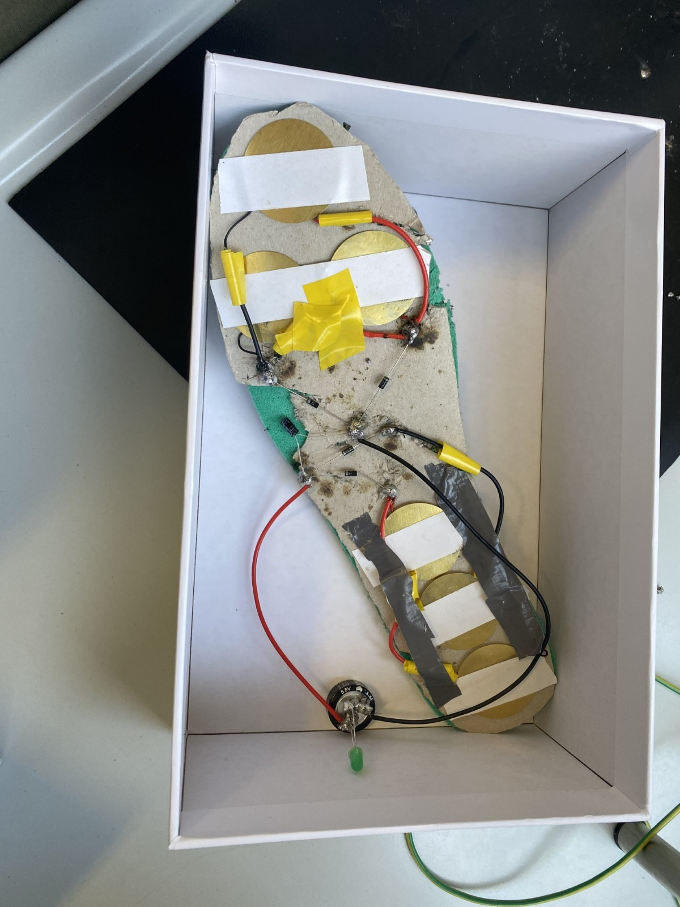

Walking Electricity
European School of Varese
By: Foivos Syrris Tsompanopoulos (S2ENA) and Miron Myroshnychenko (S2ENA)

Slide 2
Our Goal
Our objective was to design a shoe that generates and stores electricity with each step

Slide 3

Introduction
We built a shoe that can produce and store electricity using a system of piezoelectric discs embedded under the shoe's insole. After building the prototype we conducted multiple tests to answer four research questions.
1)What is the average electricity generated when walking?
2)What is the time and number of steps required to fully charge a 1.5F supercapacitor?
3)What is the time and number of steps needed to fully charge a standard 1.5V rechargeable battery?
4)What is the time and number of steps needed to fully charge an average smartphone?
The questions

Slide 4
Reseach questions
1)What is the average electricity generated when walking?
2)What is the time and number of steps required to fully charge a 1.5F supercapacitor?
3)What is the time and number of steps needed to fully charge a standard 1.5V rechargeable battery?
4)What is the time and number of steps needed to fully charge an average smartphone?
Materials (what we used)
1 sports shoe
1 hard cardboard cutout identical in measurements to the shoe's insole
Double-sided tape
6 35mm ceramic piezoelectric discs
1 soldering kit (containing wires)
4 1N007 diodes (to change the AC current into DC)
1 16V 33uF capacitor
Electrical tape
1 5.5V 1.5F supercapacitor
1 LED
Electrician scissors
1 Precise multimeter
2 x alligator clips for the multimeter

Slide 5
Materials (what we used)
1x sports shoe
1x hard cardboard cutout identical in measurements to the shoe's insole
Double-sided tape
6x 35mm ceramic piezoelectric discs
1x soldering kit (containing wires)
4x 1N007 diodes (to change the AC current into DC)
1x 16V 33uF capacitor
Electrical tape
1x 5.5V 1.5F supercapacitor
1x LED
Electrician scissors
1x Precise multimeter
2x alligator clips for the multimeter
The Building Process

Slide 6
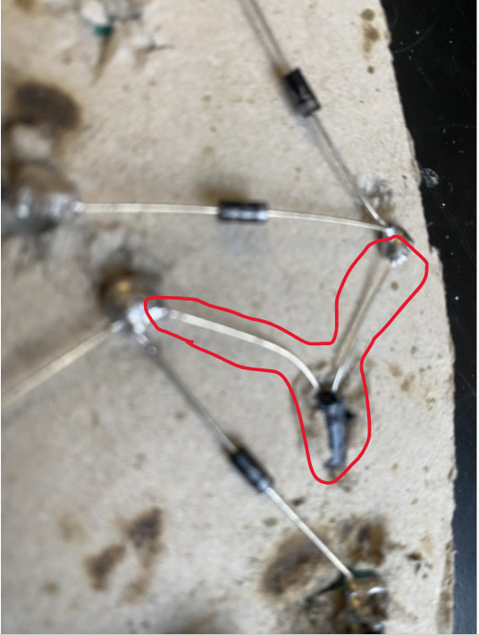
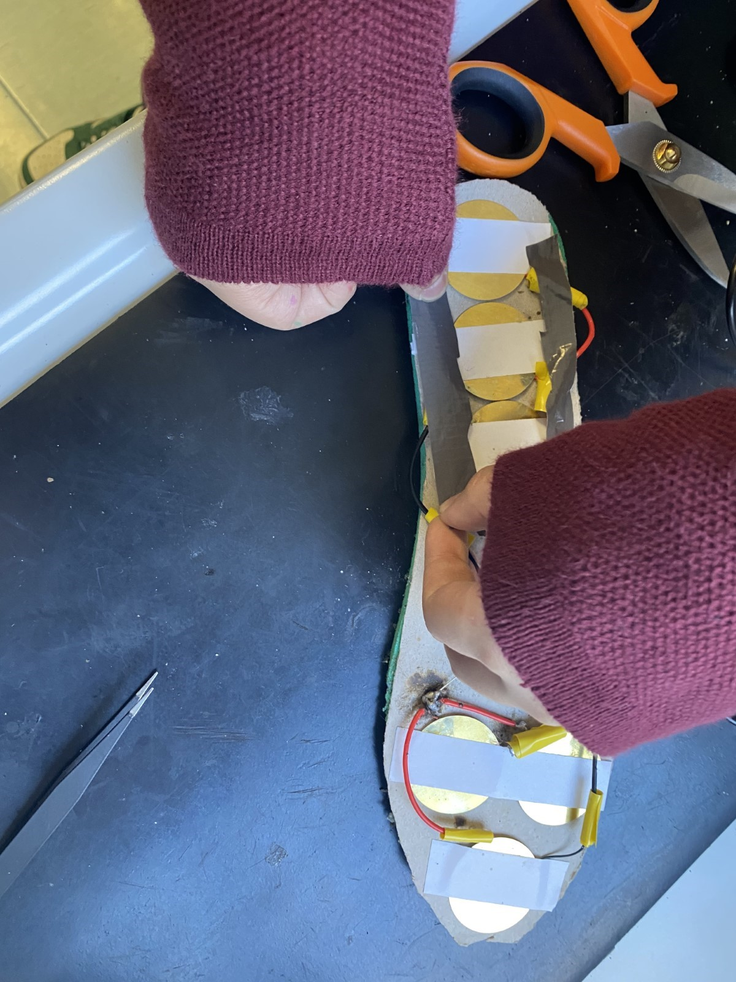
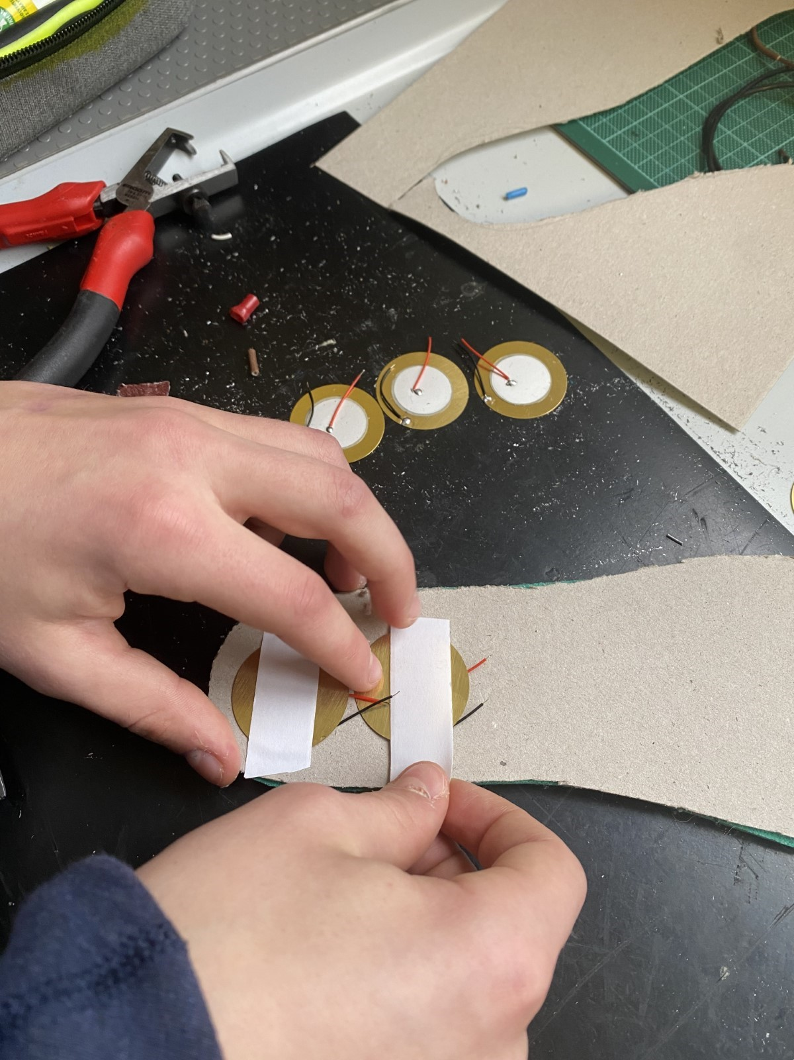
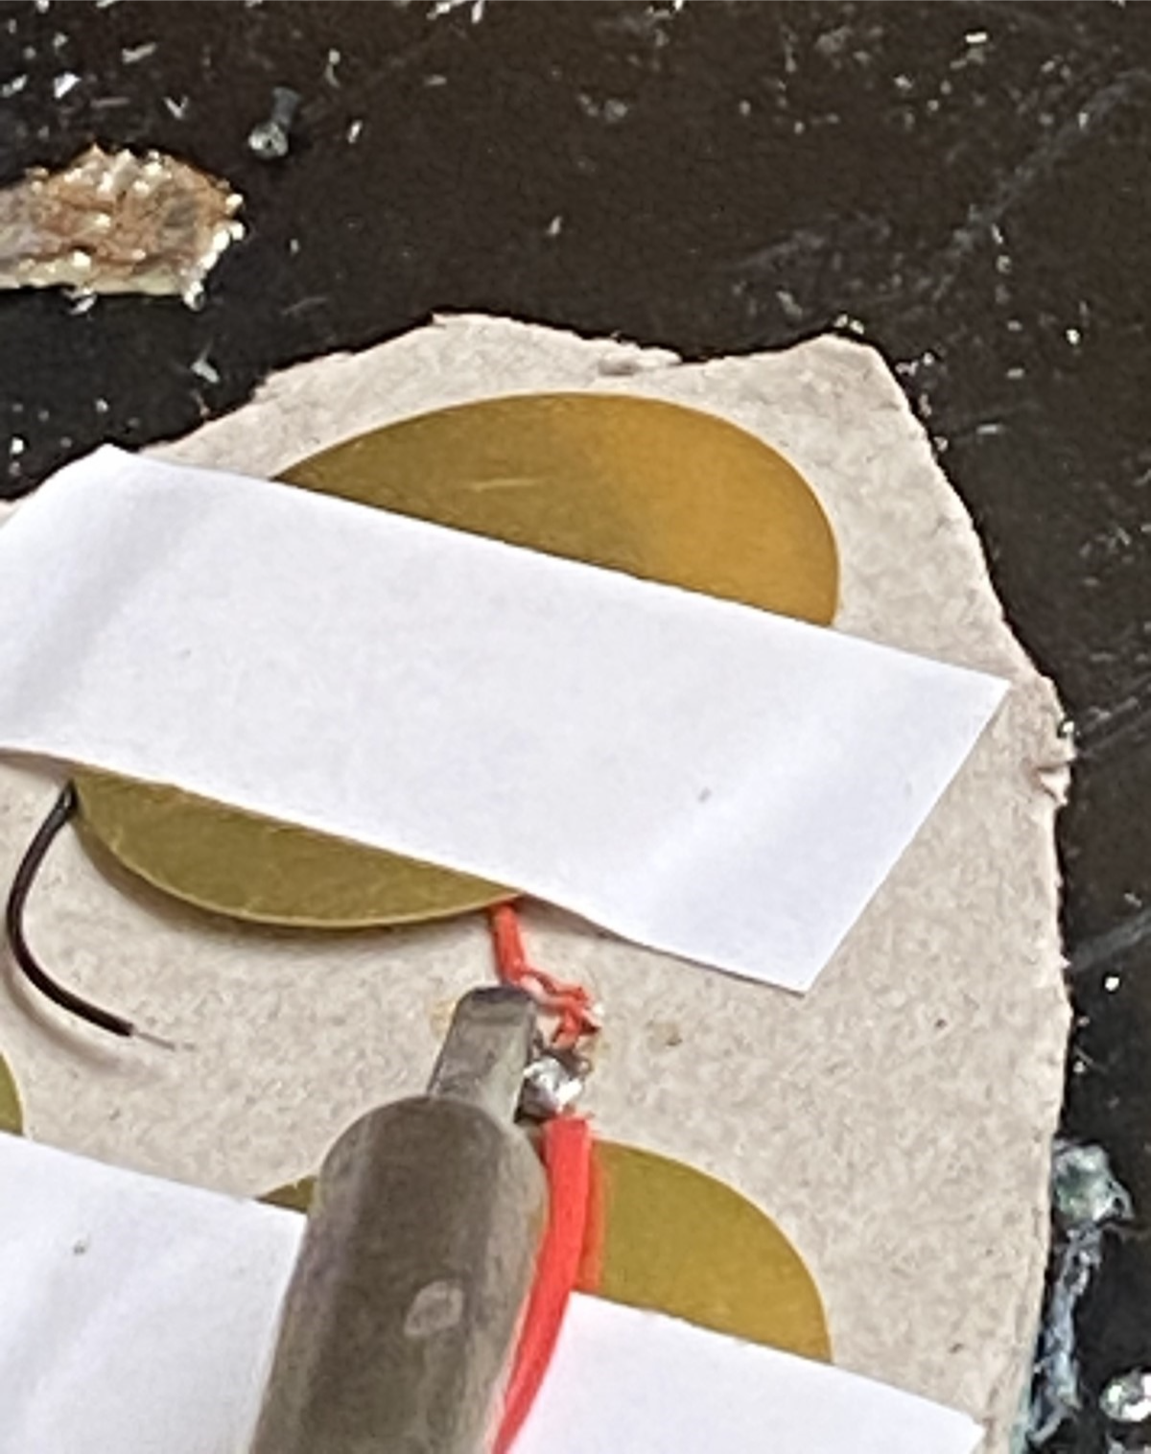
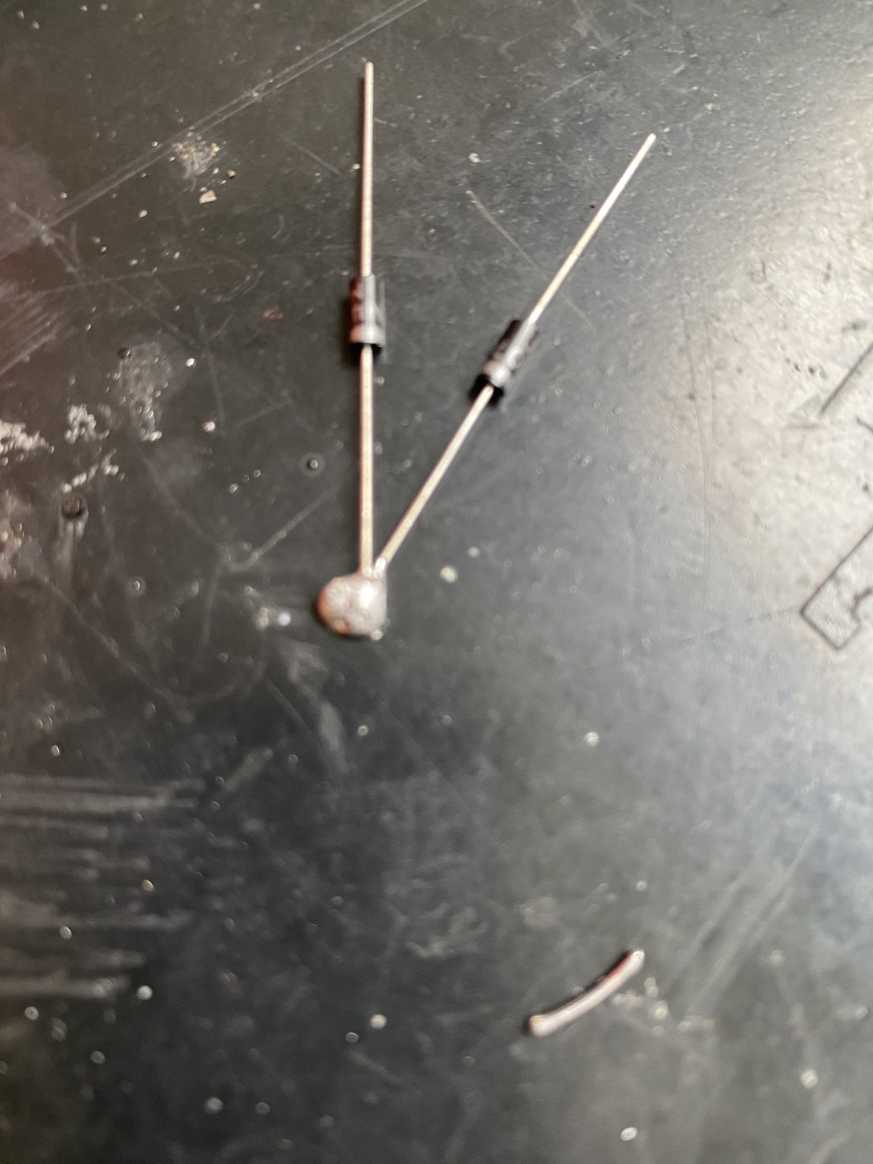
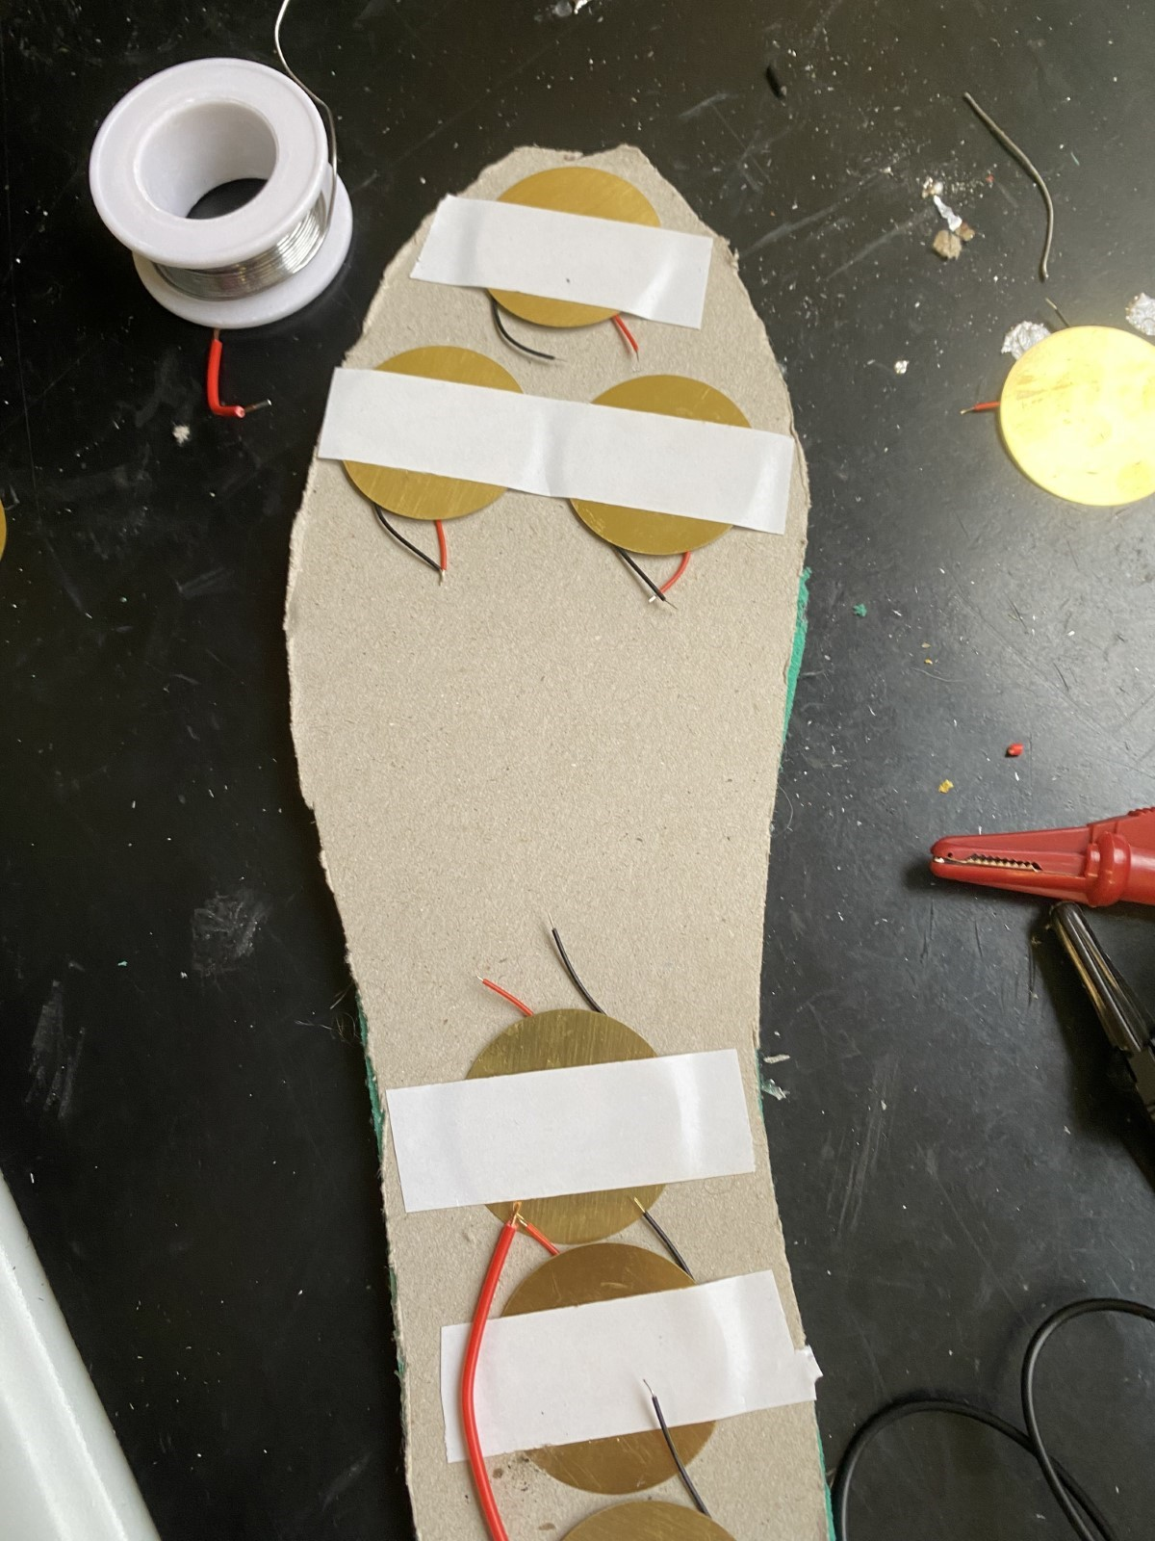
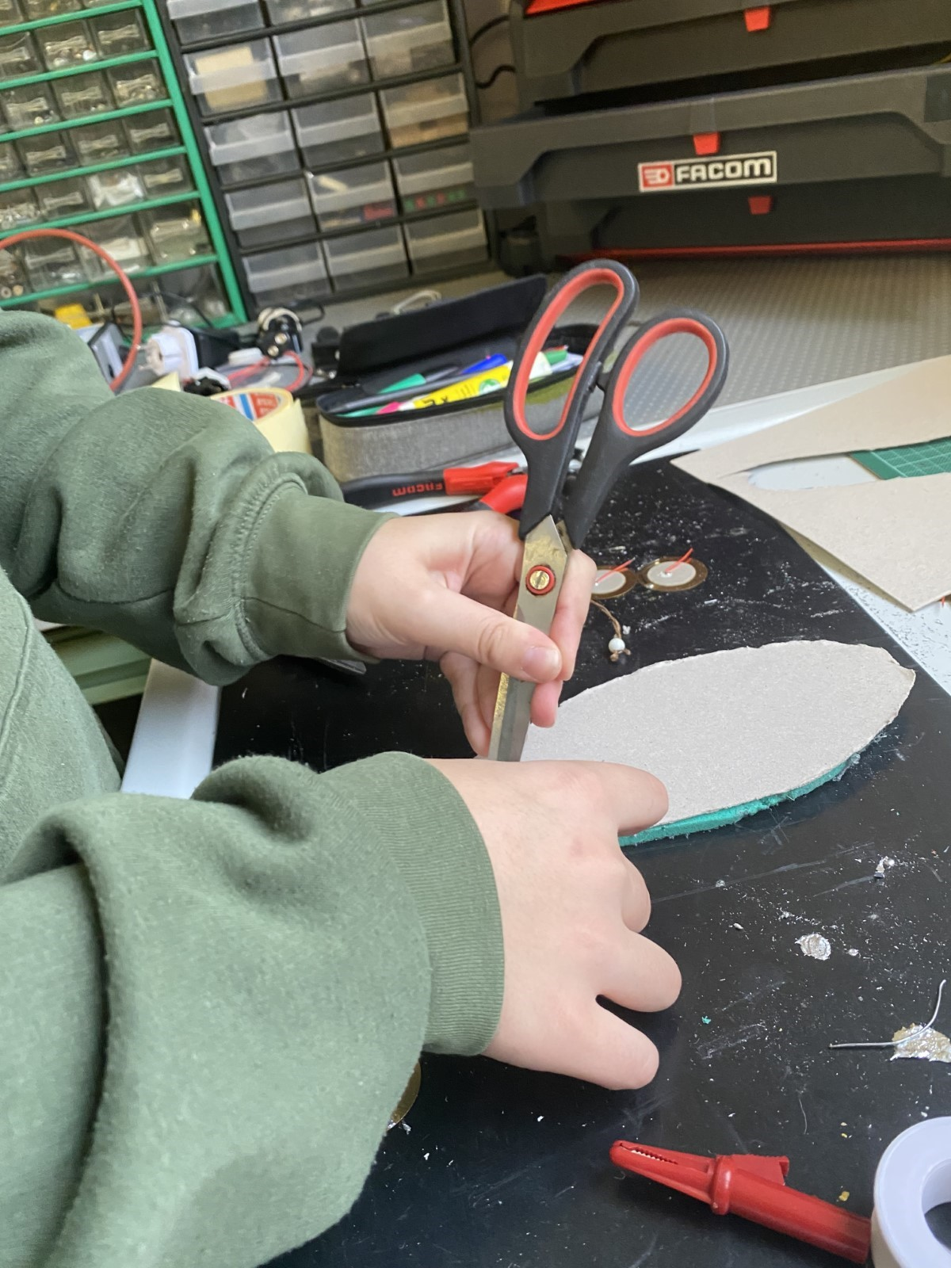
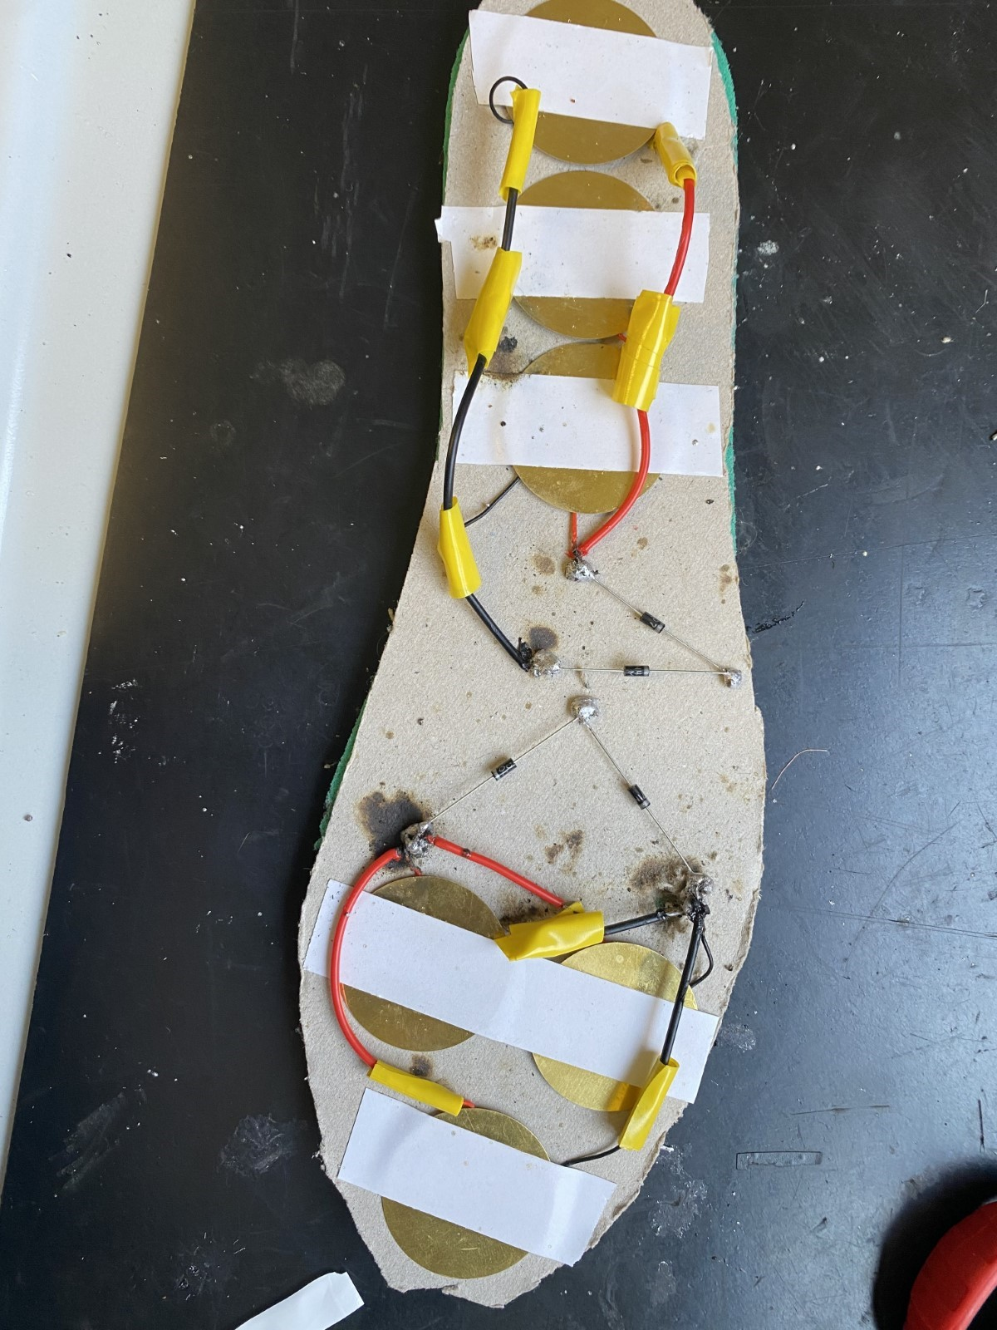
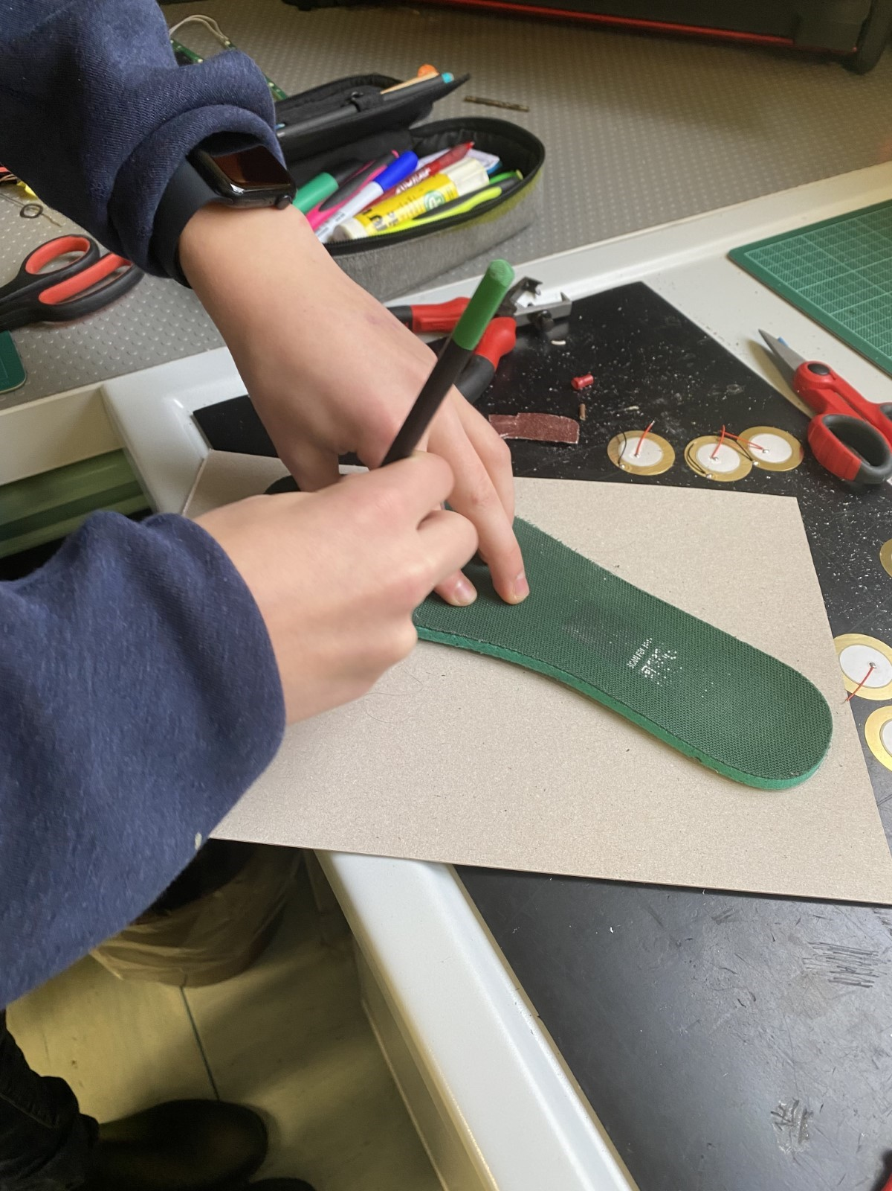
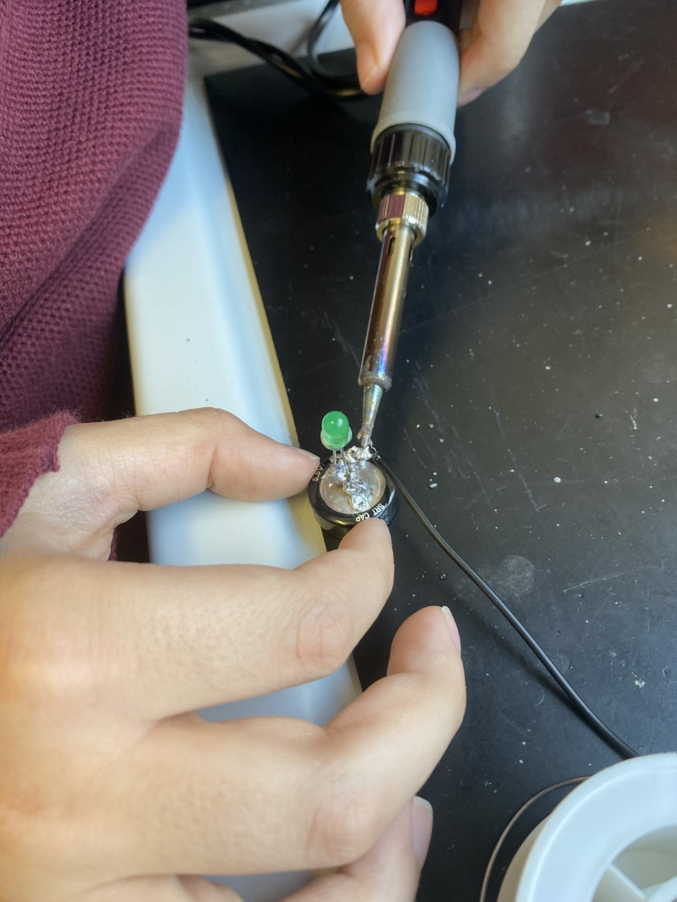
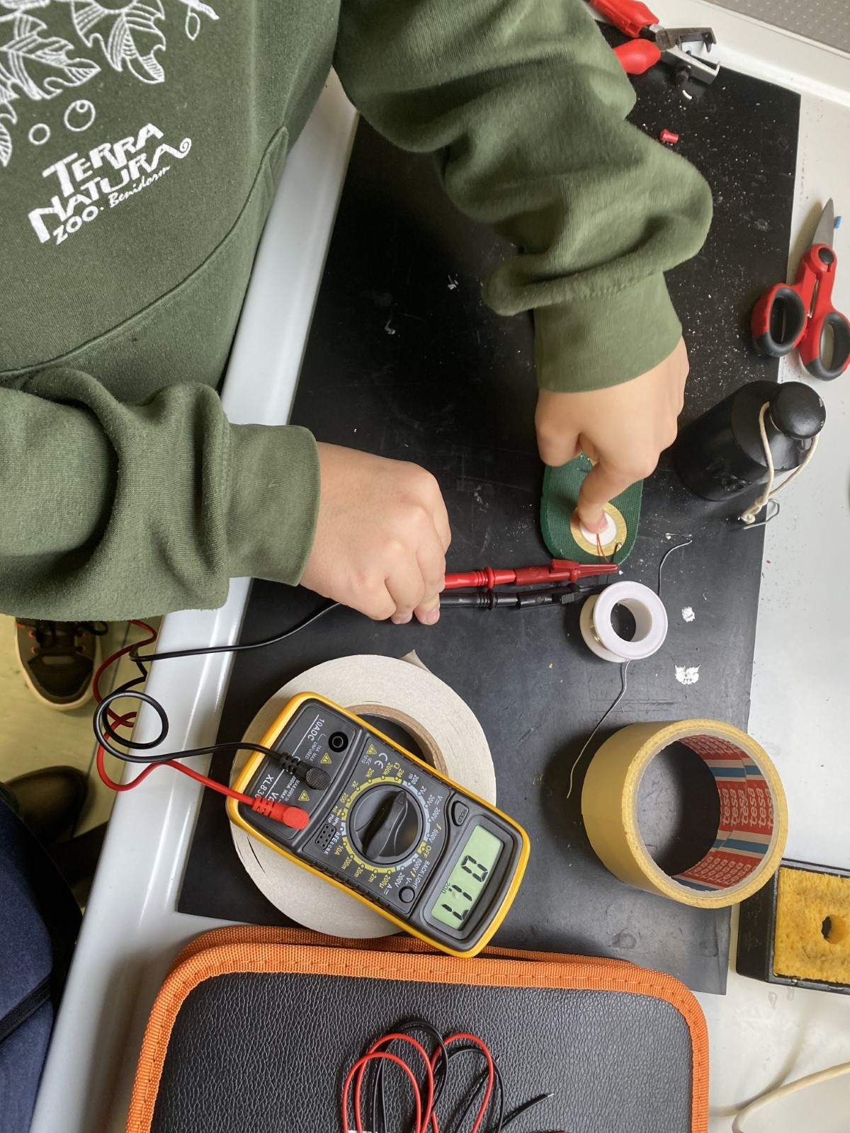
The Building Process
We tested the piezo discs and cut the cardboard.
6) We soldered on the 1.5F supercapacitor and one LED.
3) We soldered all the negative outputs together and all the positive outputs together from each side.
5) We soldered the 16V 33uF capacitor, secured the wires with tape, and made holes to expose the piezo discs to pressure.
2) We taped the piezoelectric discs to the cardboard.
4) We soldered the diodes in pairs to the outputs, ensuring each pair had a positive and negative wire. One set outputs only positive, the other only negative. Most wires were insulated with electrical tape.

Slide 7
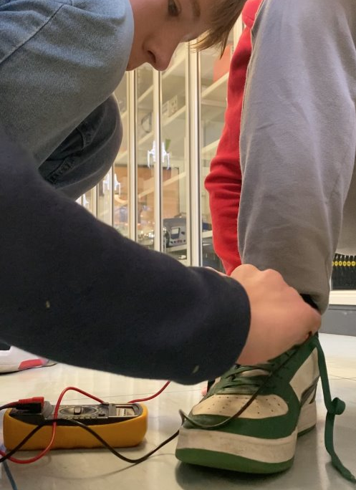
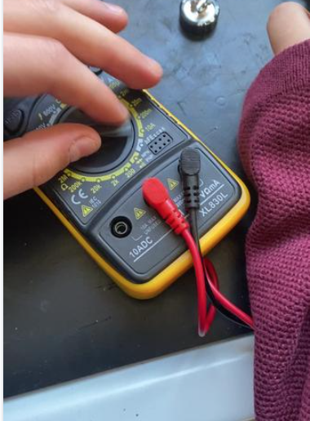

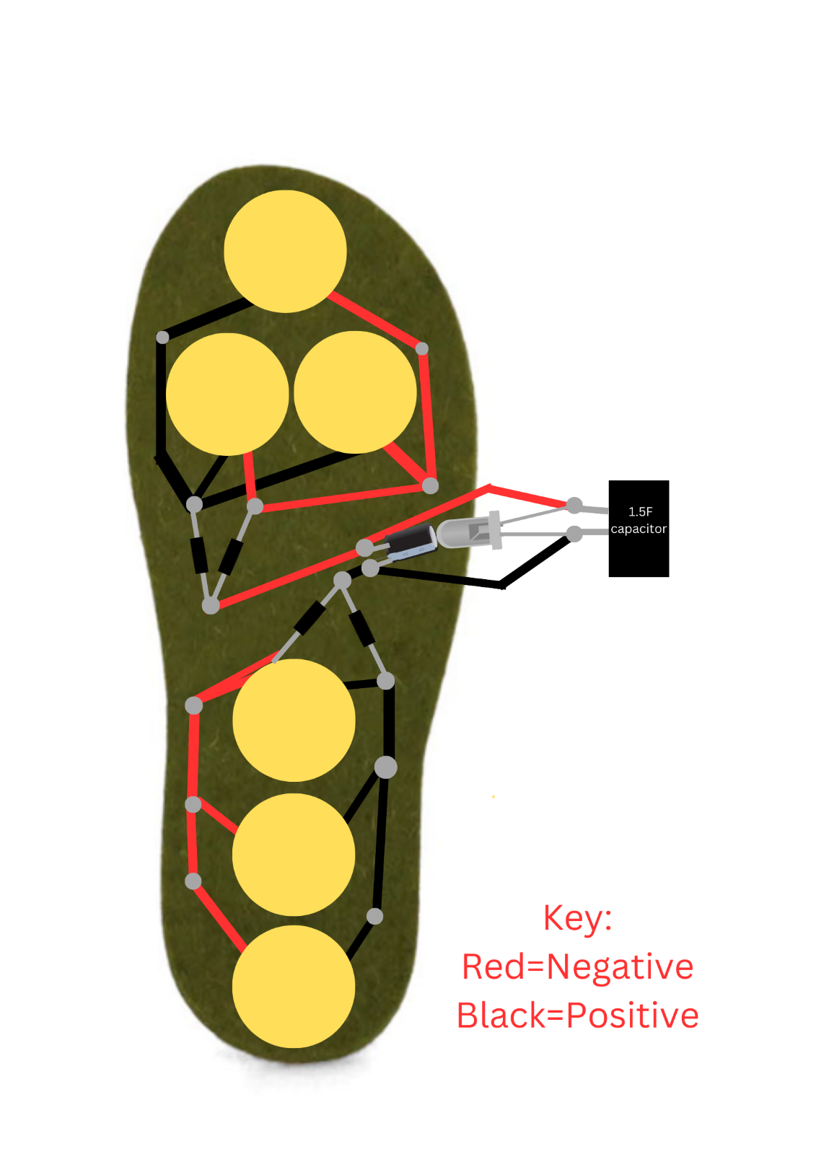
Extra Images
Our Prototype
As you can see here this is a diagram of our prototype.

Slide 8
Our Prototype
Here is a diagram of our prototype.

Slide 9
Our Results
Electricity Produced
Amperes produced (average when walking/stomping) | Volts produced (average when walking/stomping)
0.001A (1mA) | 0.16V
Time and number of steps to charge
 | The supercapacitor (about 1.15 mAh) | The average 1.5V AAA rechargeable battery (about 750 mAh) | The average smartphone (about 4,000 mAh)
Time | Approximately 2 hours and 17 minutes | Approximately 750 hours (31.21 days) | Approximately 4,000 hours (5.5 months)
Steps | Approximately 7,421 | Approximately 2,437,500 | Approximately 13,000,000

Slide 10
Improvements & future work
Explore different components to check their durability and efficiency.
Change the cardboard with a more resistant and flexible material and add more piezoelectric disks in different sizes to produce more electricity in the insole.
Try and run more different tests.

Slide 11



Acknowledgments and References
Acknowledgments
Antonio Marchese (School Physicist) -
Gave us instructions on how to use the soldering iron and other things.
Gave us some of the needed materials.
Let us work in the physics room.
Charlotte Dudal (our Science teacher) -
Let us work on the project during science lessons.
Gave us valuable suggestions.
Helped us send everything on time.
References:
Wikipedia. Piezoelectricity. https://en.wikipedia.org/wiki/Piezoelectricity. Accessed: 18/1/25
Wikipedia. Capacitor. https://en.wikipedia.org/wiki/Capacitor. Accessed: 10/3/25

Slide 12

Thank you for listening

