Slide 1
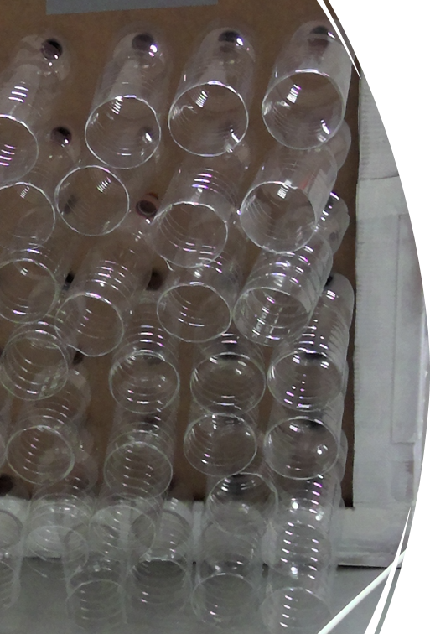
"Airbottle"
Air conditioning with bottles
By Maria del Mar Casanova Villanueva, Leire Gutierrez Lois y Anna Moschberger Jimenez

Slide 2
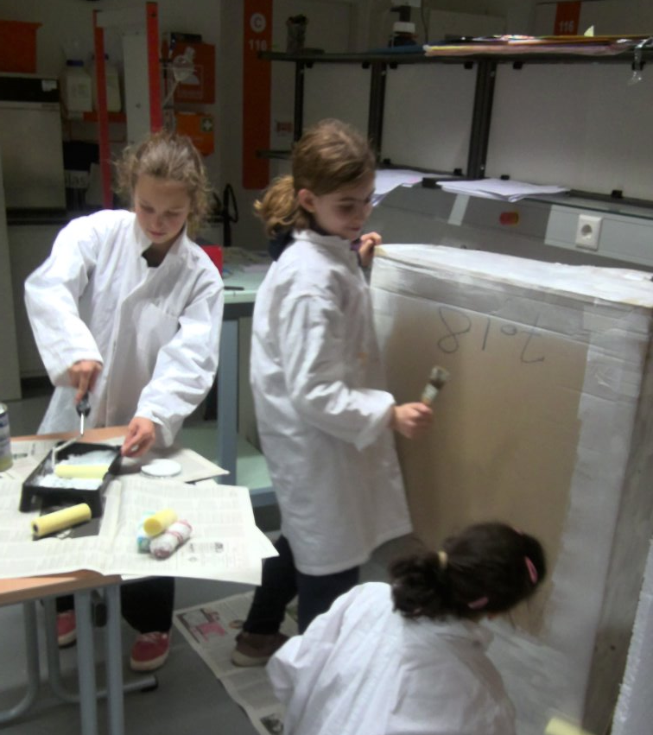
Index
Introduction
Hypothesis
Objective
Materials
Methods
Results
Discussion
Conclusion
Acknowledgements
References

Slide 3
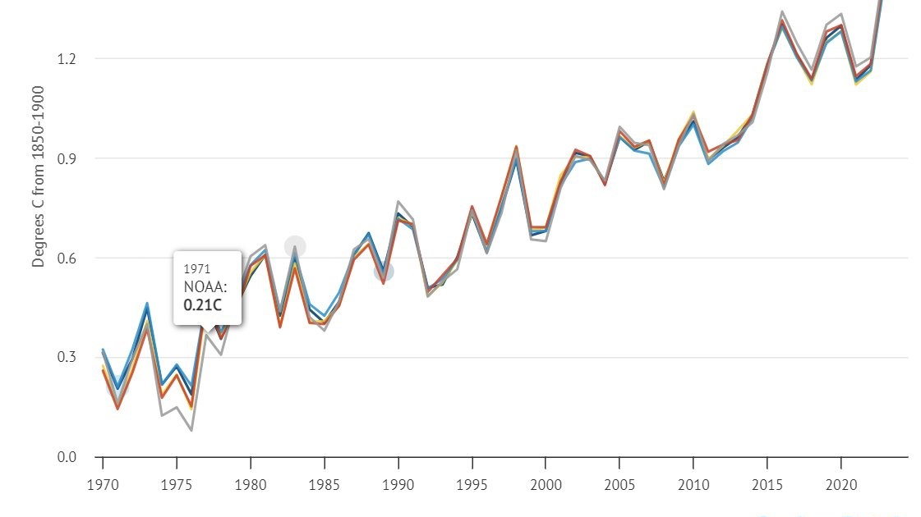
Introduction
Summers getting hotter
Increase in use of air-conditioning
2011–2020: warmest decade
Global warming impact

Slide 4
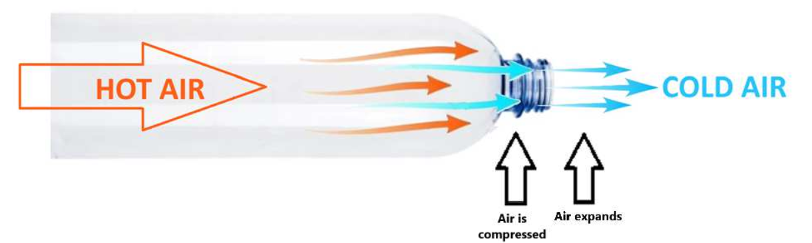
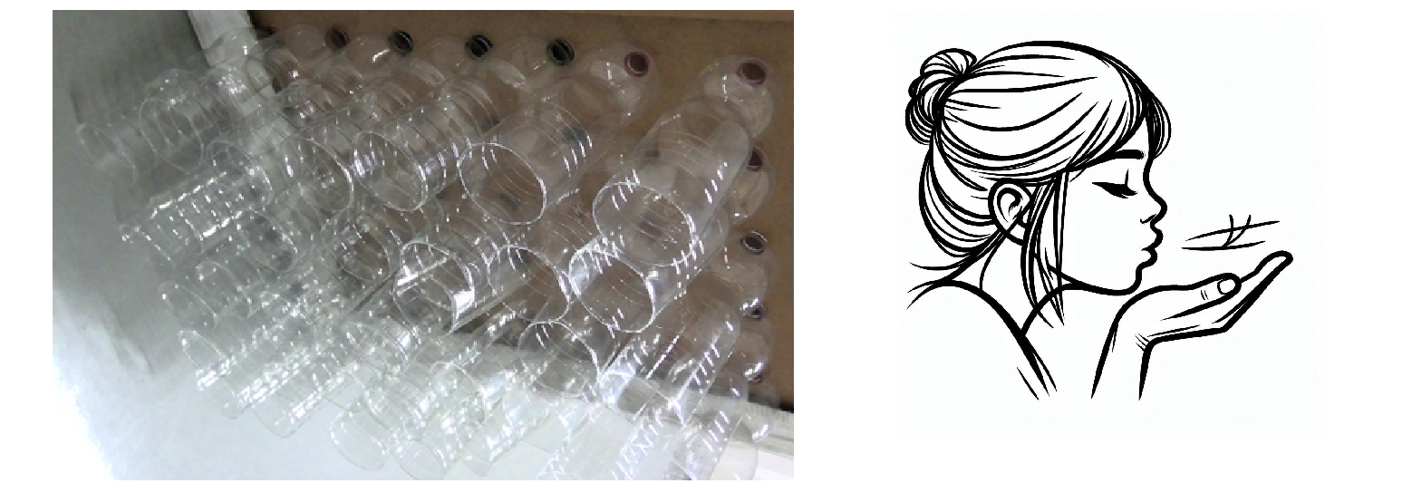
Introduction: our idea
Inspired by India’s Eco Cooler Project
Air flows through open plastic bottles
Cooling via Joule-Thomson effect

Slide 5
Hypothesis
When air passes through a bottle open at both ends, from the wider opening to the narrower opening, the air will cool down and the temperature on the other side will drop.
If we place a panel with a large number of bottles in a window, the air passing through the bottles will cool down, thus lowering the temperature inside the house.

Slide 6
Objective
Our goal is to create an air conditioner made from recycled materials that works without electricity to save energy and can be used by people who cannot afford a traditional air conditioner.

Slide 7
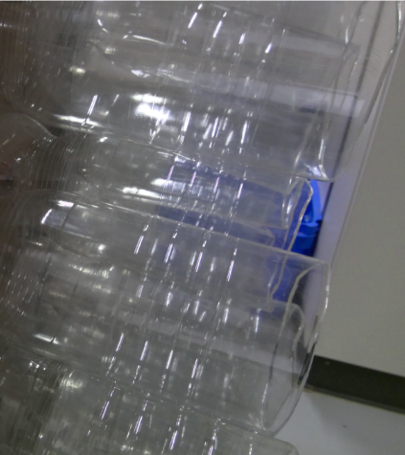
Materials
Panel (85 x 70 cm)
35 plastic bottles (1.5 L)
Bunsen burner, cutter, knife
Polystyrene panels
Cardboard box (120 x 80 x 75 cm)
Fan, thermometer, duct tape, etc.

Slide 8
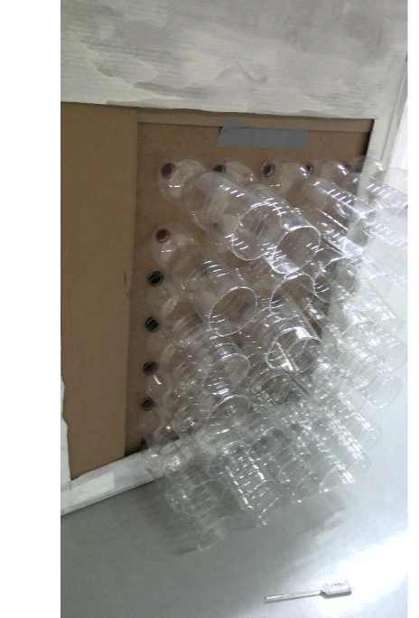
Methods: making the “Airbottle”
Drill 35 holes (7 x 5) in panel
Cut bottle bases, pierce caps
Insert bottles into panel

Slide 9
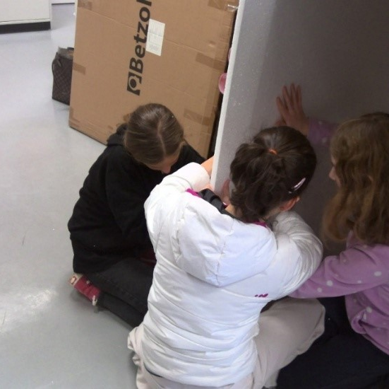
Methods: making the model house
Note:
Experiment done in winter (avg. 5°C) in Frankfurt.
Real window tests not possible — used a cardboard house + fan to simulate outside air.
Insulate box with polystyrene
Cut out “window”
Paint

Slide 10
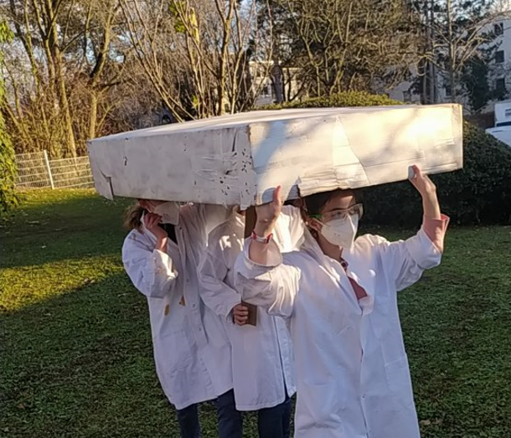
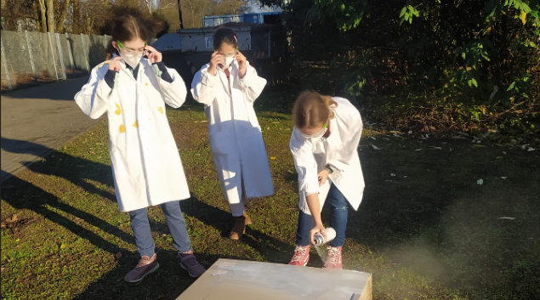
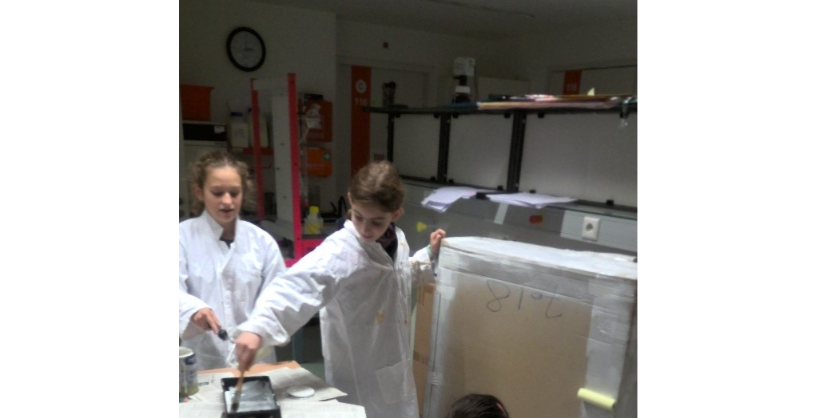
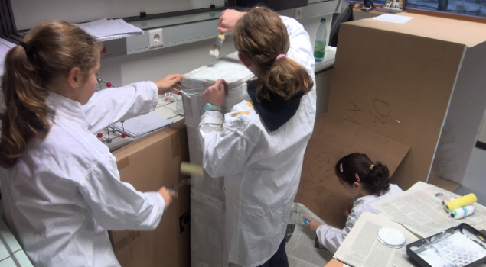

Slide 11
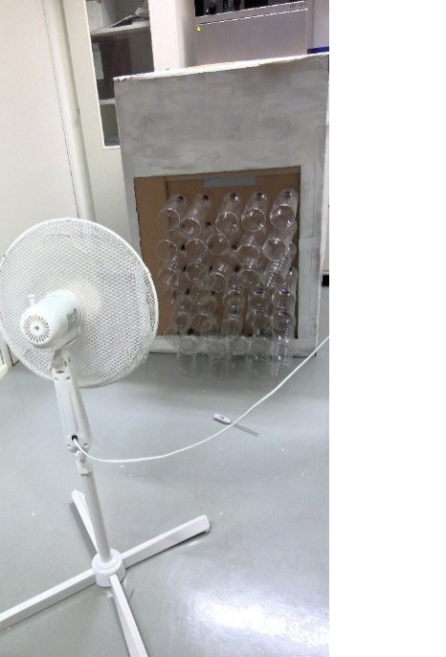
Methods: testing the air conditioner
1 thermometer inside, 1 outside
Fan simulates outdoor air
Record temp every 5 min (20–40 min)
Graph results in Excel

Slide 12
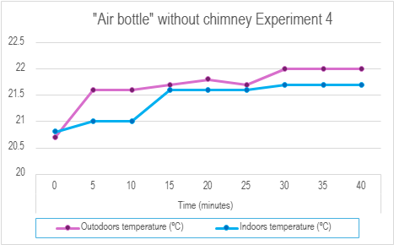
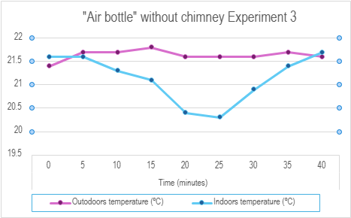
Results: without chimney

Slide 13
Discussion: without chimney
We added a ventilation chimney and repeated tests
Disappointing first results
We expected a clear decrease of the temperature
Slight temp rise (~0.5°C) at start, more outside than inside — likely due to body heat
Temp rise likely from trapped air and pressure buildup

Slide 14
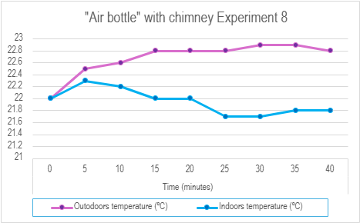
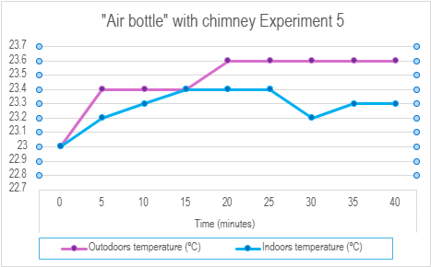
Results: with chimney

Slide 15
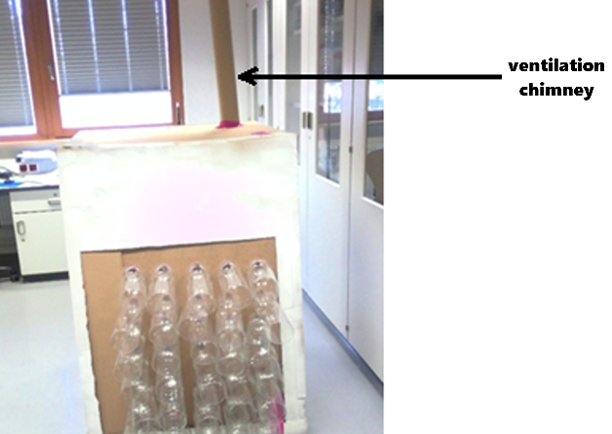
Discussion: with chimney
Initial temp rise (~0.5°C) still observed (likely body heat)
After 5–10 minutes, indoor temp stayed ~1°C lower than outdoor temp
Consistent results across all chimney tests

Slide 16
Conclusions
Hypothesis accepted — indoor temp dropped ~1°C
Expected greater cooling
Ventilation chimney is essential for airflow
“Airbottle reduced indoor temp by ~1°C”
Works with enough wind and proper ventilation
Results not perfect, but concept proven

Slide 17
Acknowledgements
We thank our school, European School of Frankfurt, for providing us with the necessary materials for our project and a laboratory to carry out the tests, as well as for giving us the opportunity to attend ESSS 2025.
We also thank the laboratory technicians for providing us with some of the materials used.
To the caretaker, José Claramunt, for making the holes in the table to insert the bottles.
Finally, we thank the teacher G. Oliván for encouraging us to participate in the ESSS and mentoring our project.

Slide 18
References
Carbon Brief web site Home - Carbon Brief » Clear on climate. Accessed March 2025.
Eco-cooler Eco Cooler: Zero Electricity Air Cooler. Accessed March 2025.
Joule-Thomson effect. Wikipedia Joule–Thomson effect - Wikipedia . Accessed March 2025.
Microsoft Corporation. (2024). Excel (Microsoft 365 Subscription). [Computer Software]. Microsoft Corporation. https://www.microsoft.com/en-us/microsoft-365/excel#:~:text=Microsoft%20Excel%20with%20a%20Microsoft,Excel%202007%2C%20and%20Excel%202003.
Microsoft Corporation. (2024). Word (Microsoft 365 Subscription). [Computer Software]. Microsoft Corporation. https://www.microsoft.com/en-us/microsoft-365/word
United Nations. What is climate change What is climate change? | United Nations. Accessed March 2025.

Slide 19

End
Thank you for listening
S1 ESA
European School Frankfurt am Main
Praunheimer Weg 126
D-60439 Frankfurt am Main

