Slide 1
Cleaning products: helpful or harmful?
Janka Hugelmann and Mathilda von Fürstenberg

Slide 2
What is our project about?
Cleaning agents and disinfectants are commonly used in everyday life to prevent the transmission of pathogens.
However, excessive use of disinfectants, especially in the food industry, can increase the incidence of cross-resistance.
We investigated the influence of household cleaning agents on the growth of symbiotic bacteria from saliva and skin samples.
We tested whether different cleaning agents inhibit bacterial growth and/or whether they can potentially promote the development of resistant bacterial strains.
¹ Wu-Chen RA, Feng J, Elhadidy M, Nambiar RB, Liao X, Yue M, Ding T. Long-term exposure to food-grade disinfectants causes cross-resistance to antibiotics in Salmonella enterica serovar Typhimurium strains with different antibiograms and sequence types. Antimicrob Resist Infect Control. 2023 Dec 13;12(1):145. doi: 10.1186/s13756-023-01333-w. PMID: 38093321; PMCID: PMC10717106.

Slide 3
Hypothesis
Aggressive cleaning agents inhibit bacterial growth in the short term.
Repeated use promotes resistant bacteria.

Slide 4
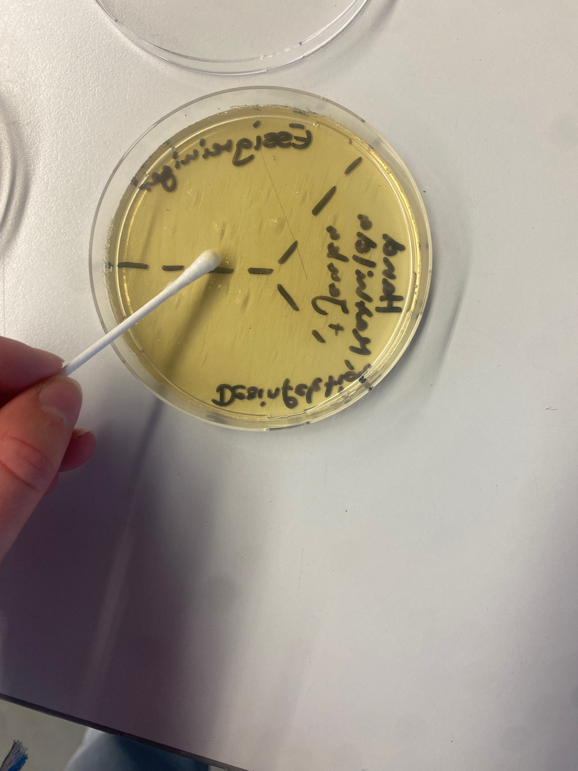
Implementation - Nutrient agar plates
Bacterial samples were taken from saliva and hands.
Incubated on nutrient agar plates at 37°C for 24 hours.
Various cleaning agents were added.
Incubated for another 24 hours.
Cleaning agents are applied:

Slide 5
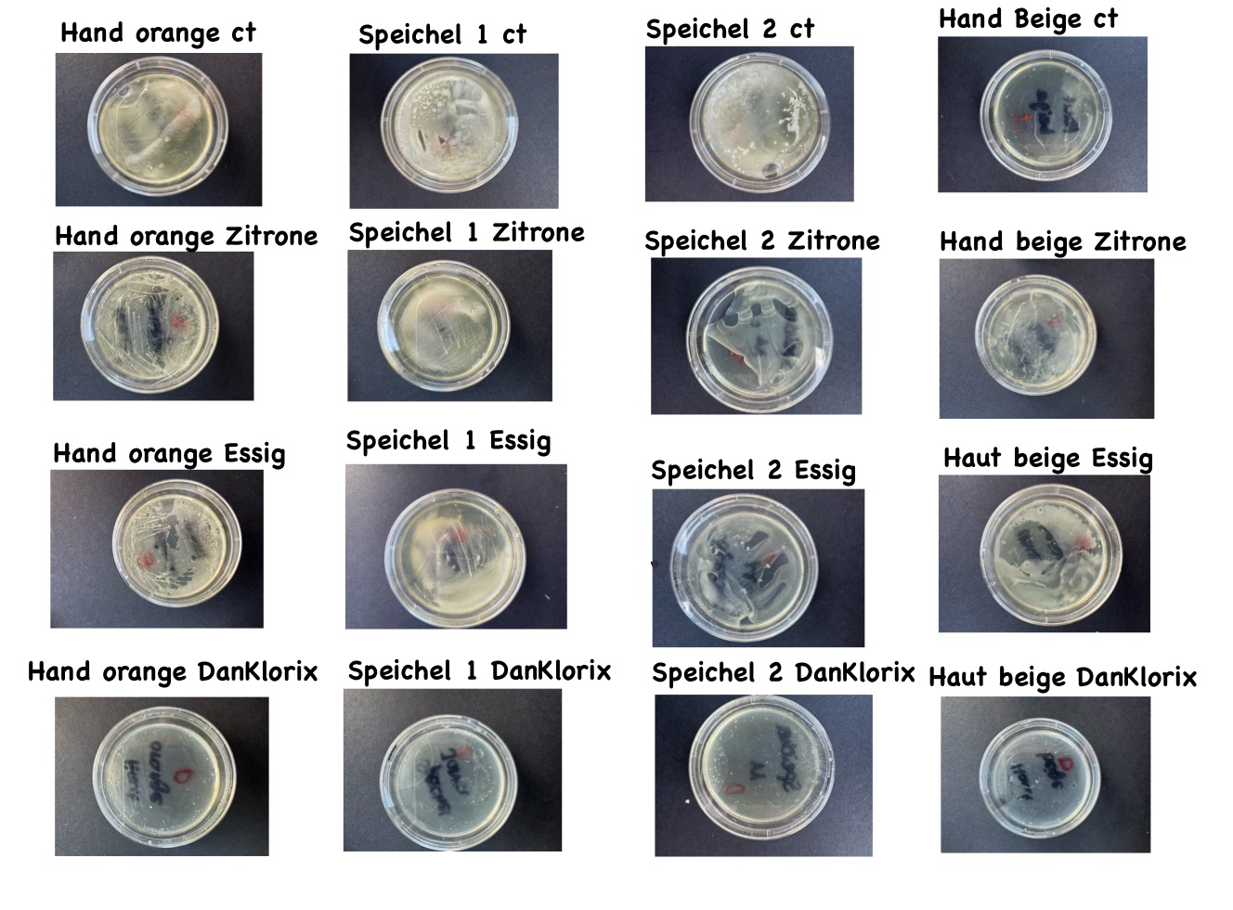
Evaluation of the nutrient agar plates

Slide 6
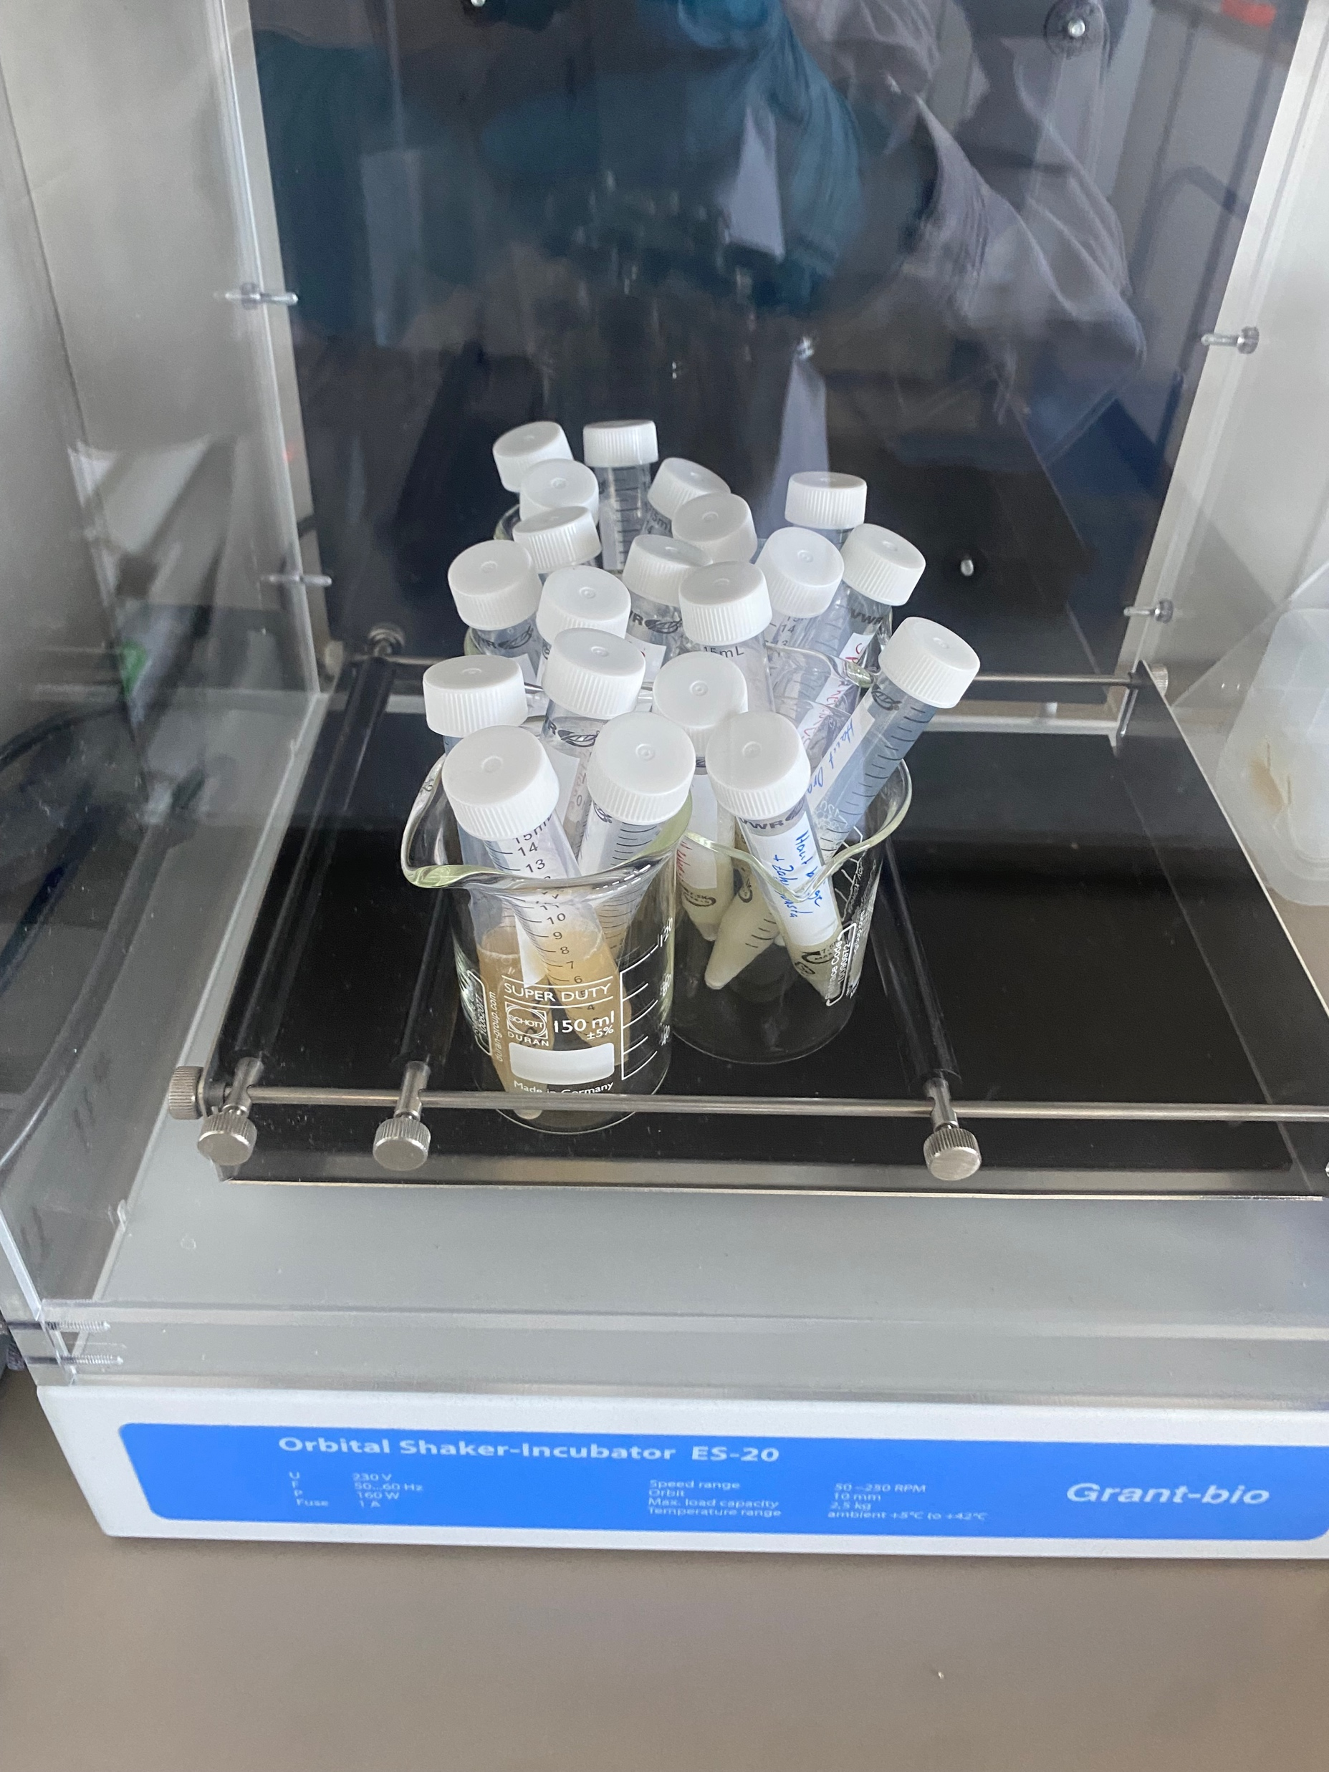
Implementation - Liquid cultures
Bacterial colonies are picked from agar plates and added to 100 ml of LB agar.
Cultures are incubated for 24 hours at 37°C with shaking.
Cultures are divided into 5 portions and the various cleaning agents are added.
Optical density is measured after 1 hour and after 24 hours.
Liquid cultures in the shaker:

Slide 7
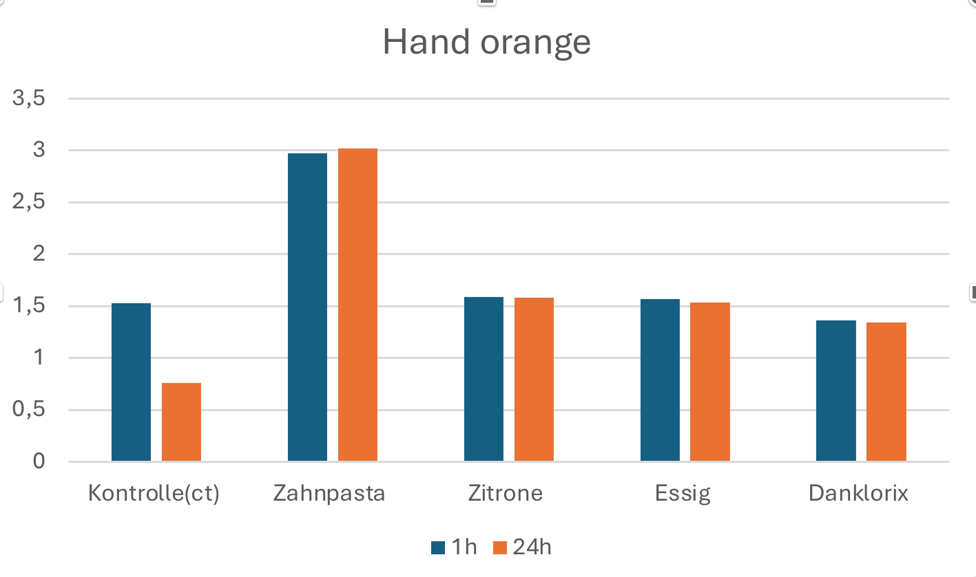
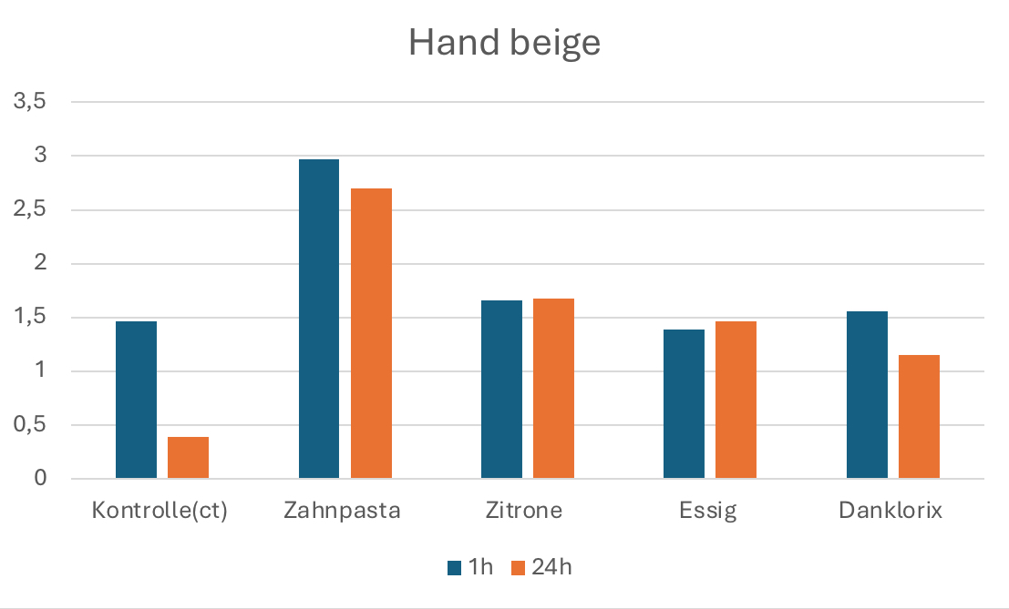
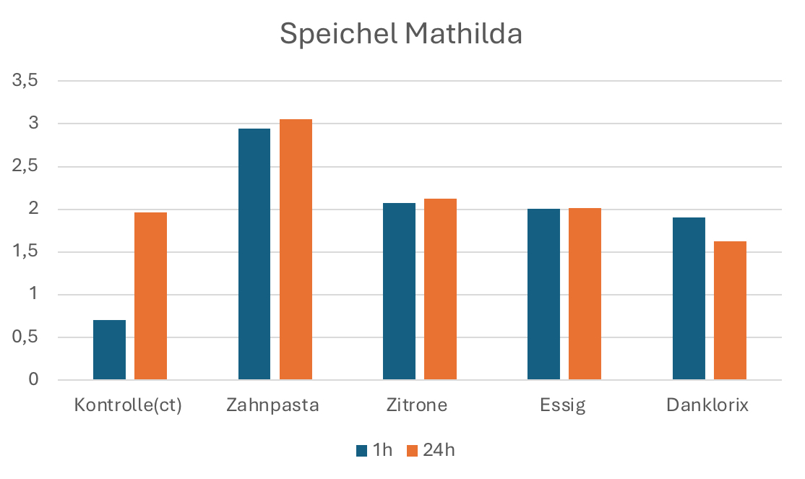
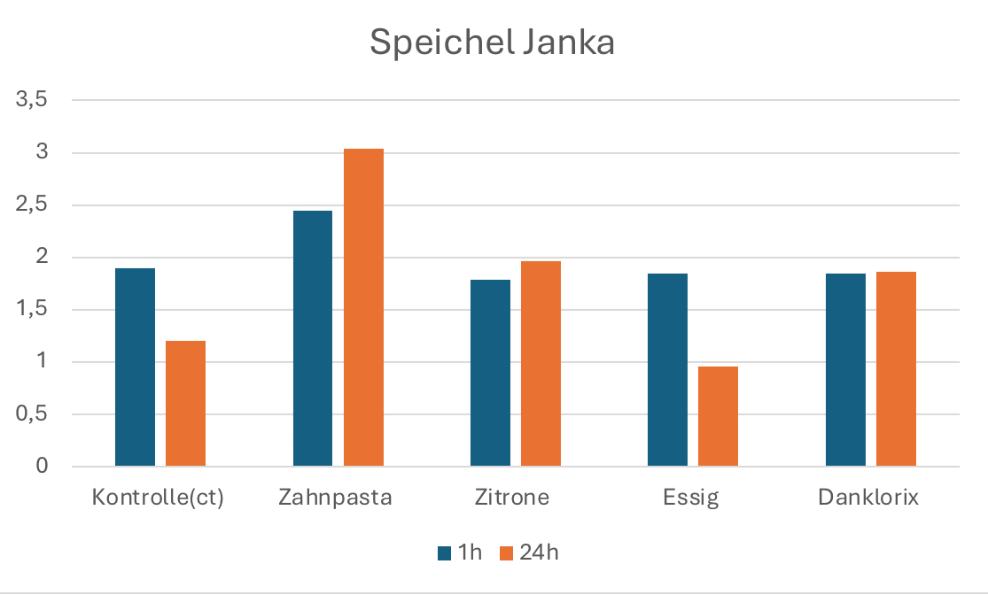
Evaluation of liquid cultures

Slide 8
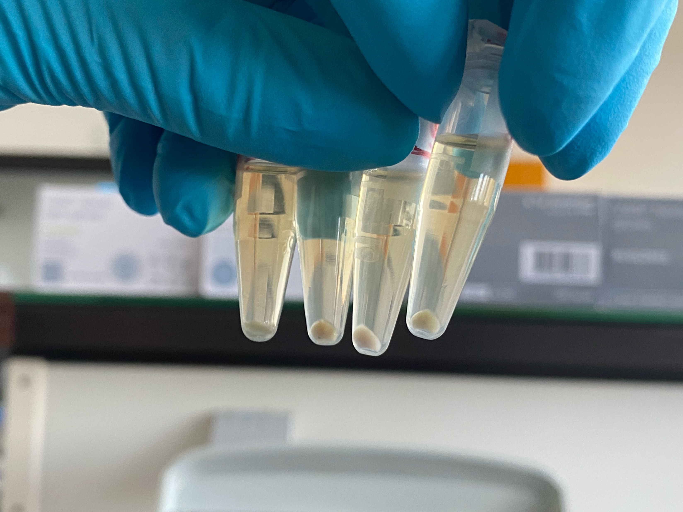
Implementation – API Galleries
Bacteria from liquid culture were centrifuged for 1 minute (13,000 rpm)
Dissolved in a sodium chloride solution
Bacterial suspensions were used in RapiD 20E apigalleries to identify bacterial species
Bacteria after centrifugation:

Slide 9
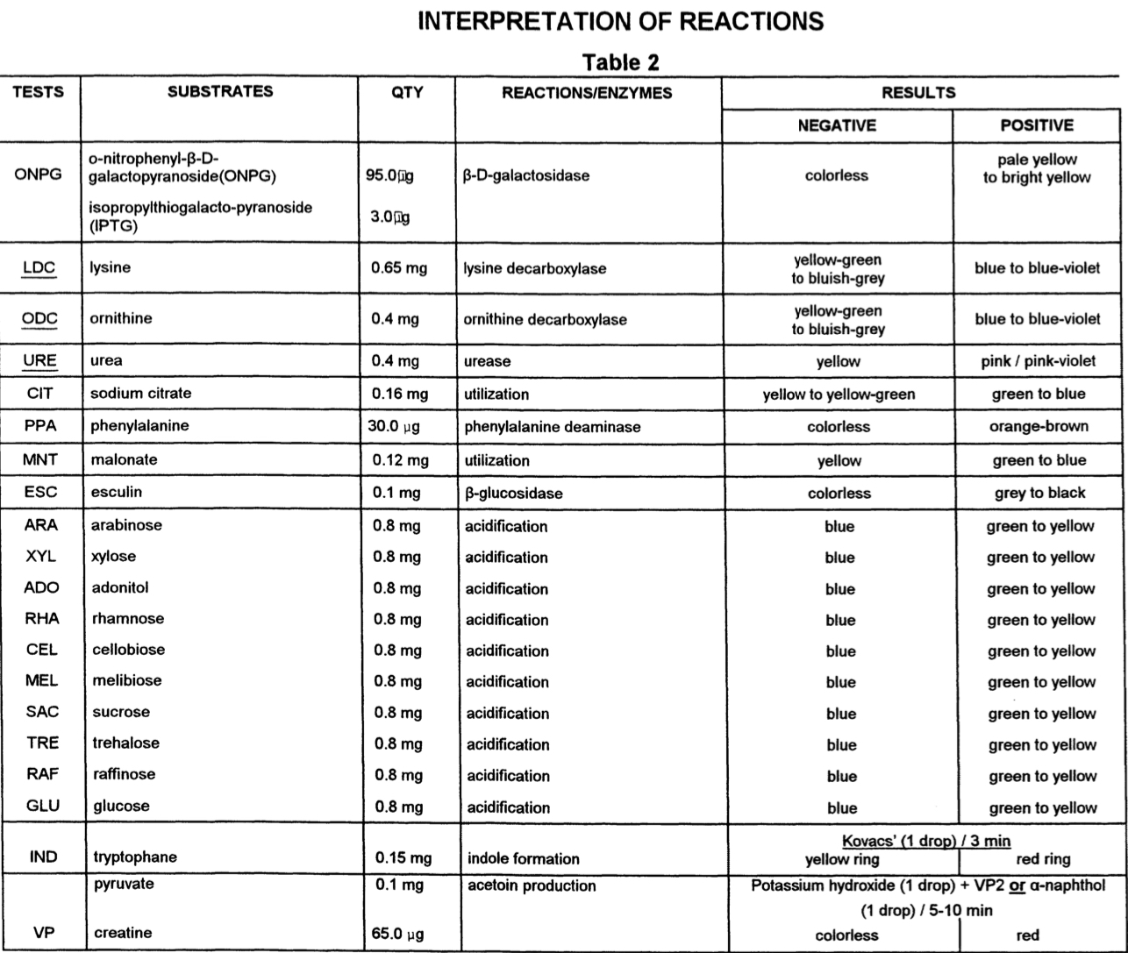
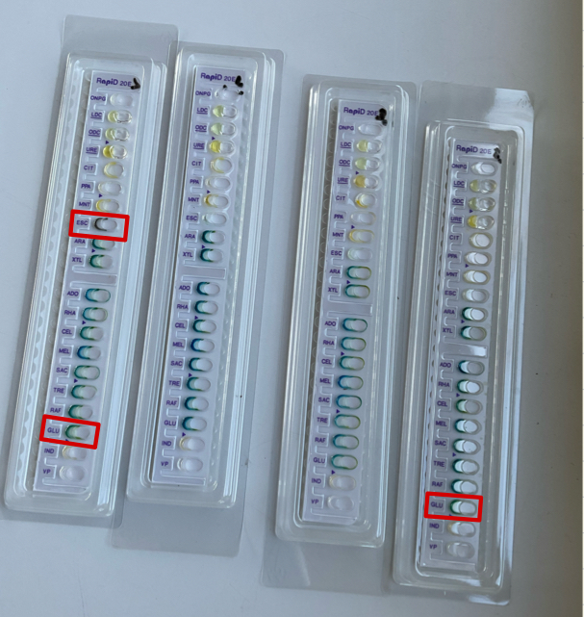
Bacterial identification results
1.
4.
3.
2.

Slide 10
Conclusion
Household cleaning products can inhibit bacterial growth in the short term.
However, long-term effects, particularly the development of resistance, require further experiments.
- Longer incubation times
- Testing from antibiotic-containing agar

Slide 11
Sources
¹ Wu RA, Feng J, Yue M, Liu D, Ding T. Overuse of food-grade disinfectants threatens a global spread of antimicrobial-resistant bacteria. Crit Rev Food Sci Nutr. 2024;64(19):6870-6879. doi: 10.1080/10408398.2023.2176814. Epub 2023 Feb 9. PMID: 36756870.
https://fire.biol.wwu.edu/cmoyer/zztemp_fire/biol346_W07/rapid20E.pdf
https://www.labor-duesseldorf.de/assets/Kompendium/1a670887fa/Mikrobiologie.pdf

