Slide 1
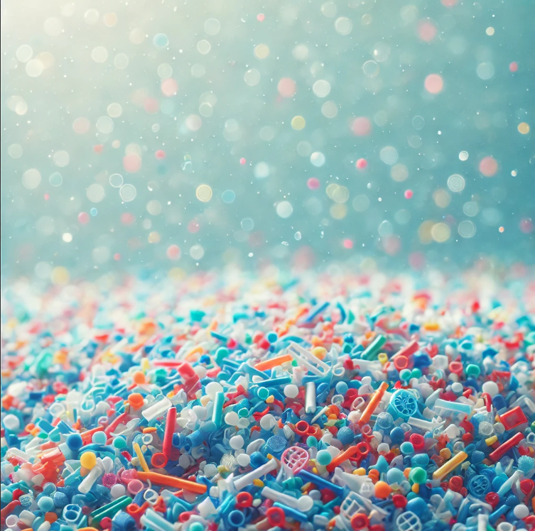
Microplastics in the Food Chains: The Effect of Microplastics on the Growth of Photosynthetic Organisms (Elodea canadensis)
Iliana Iakovidou, Eleni-Efrosini Patri, Dimitris Kremezis
Professor: Eleni Touliopoulou
European School of Brussels 3

Slide 2
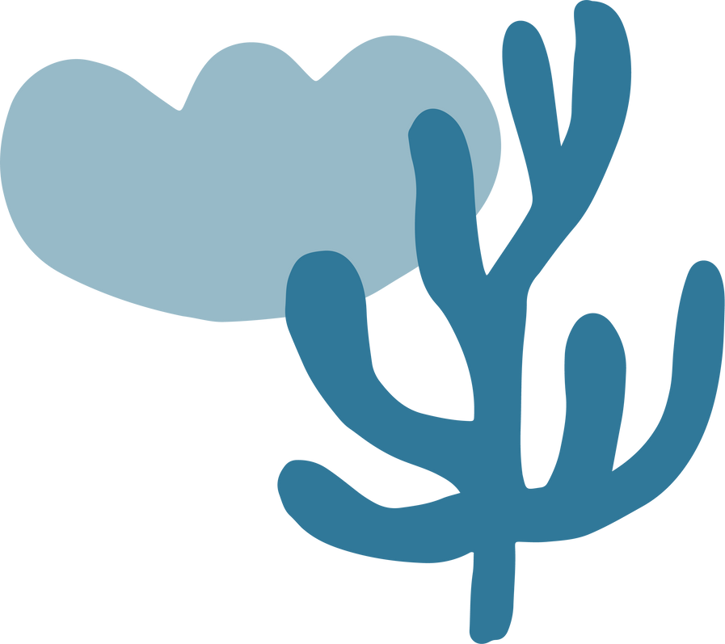
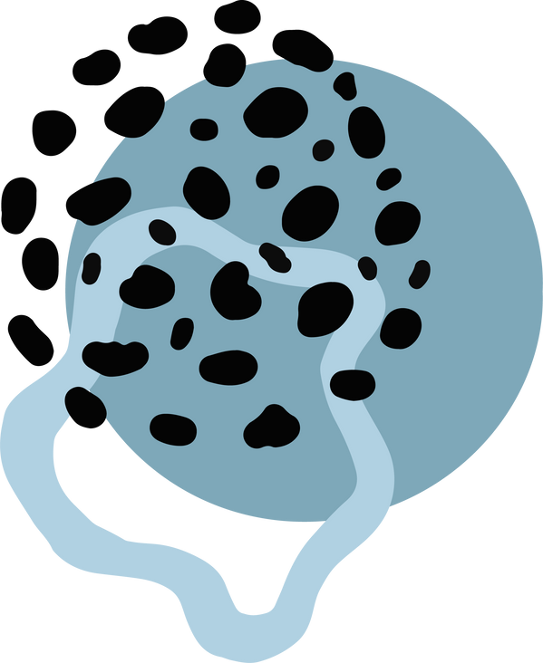


Content
Introduction
Materials and methods
Results
Conclusions and assumptions
Ecological implications
Summary

Slide 3
Introduction
What are microplastics ?
Plastic particles < 5mm in size
Result from breakdown of larger plastic items or intentional manufacturing
Previous Findings
Similar previous studies, showed that microplastics negatively affect plant growth, chlorophyll content, and photosynthetic efficiency
Photosynthesis Importance
Essential for the survival of aerobic organisms
Disruption can destabilize ecosystems and harm human society
Why Elodea canadensis ?
Tolerant of varied environmental conditions
Widely used in toxicological studies

Slide 4

Objective
Help advance research on the effects of microplastics
This study aims to explore how microplastics affect the growth of Elodea canadensis

Slide 5
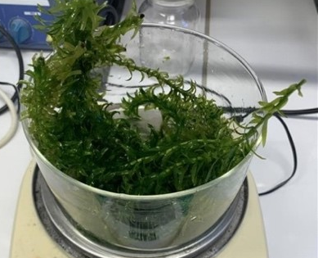
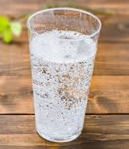
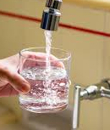
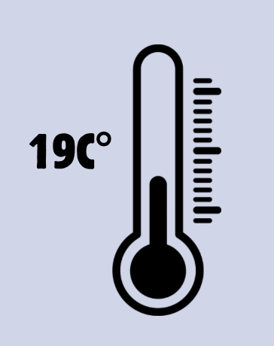
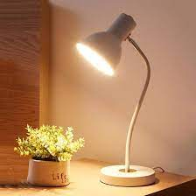
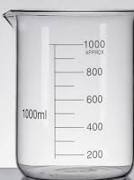
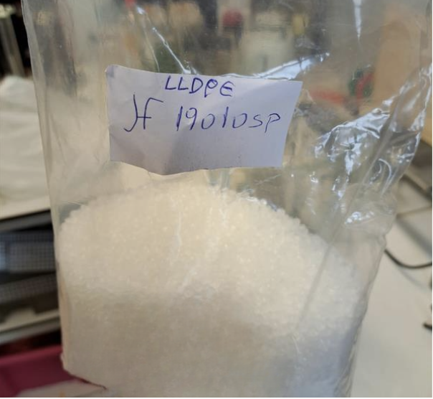
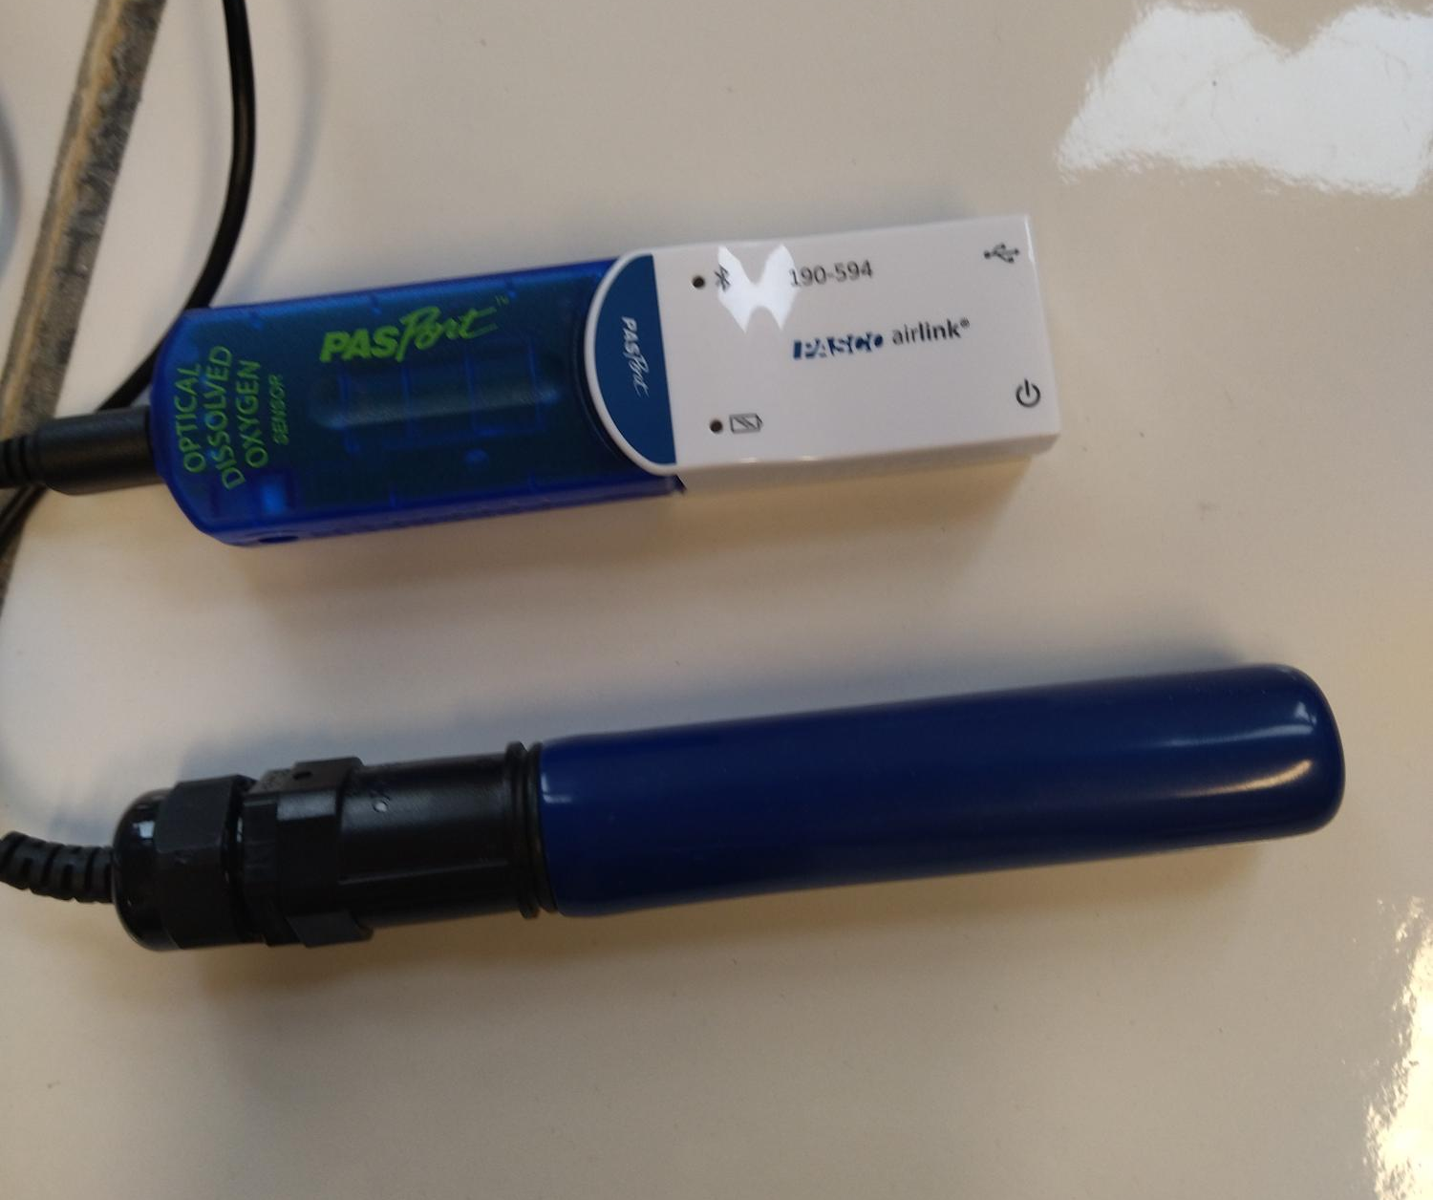
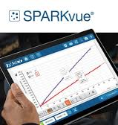
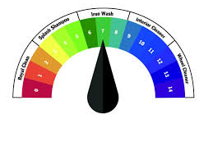
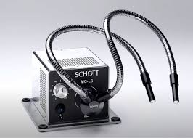
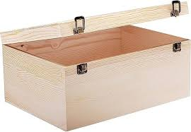
Materials
Materials | Conditions (for all the measurements)

Slide 6
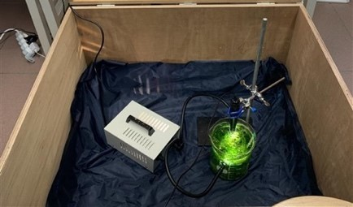

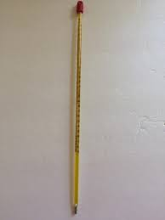
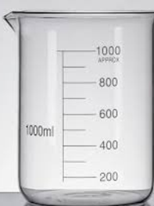
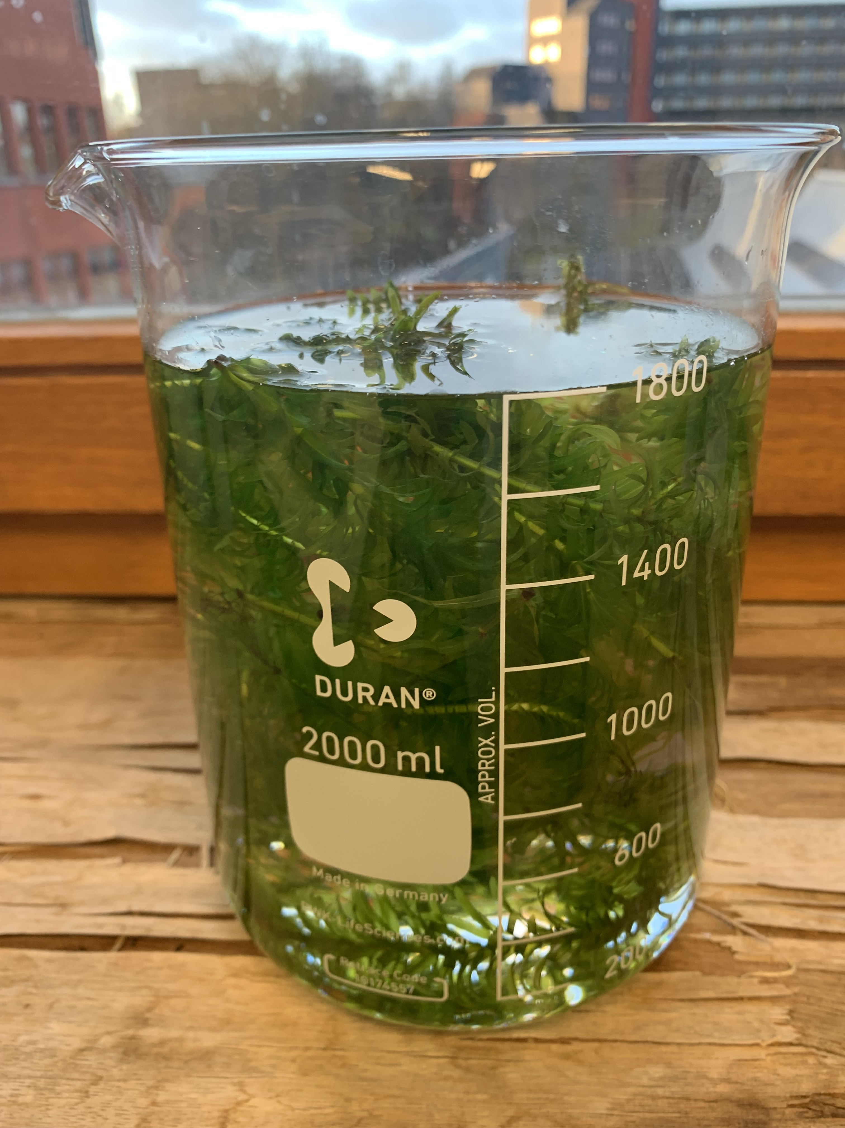
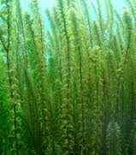
Methodology
Thermometer
computer
PASCO system

Slide 7
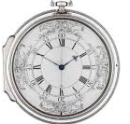
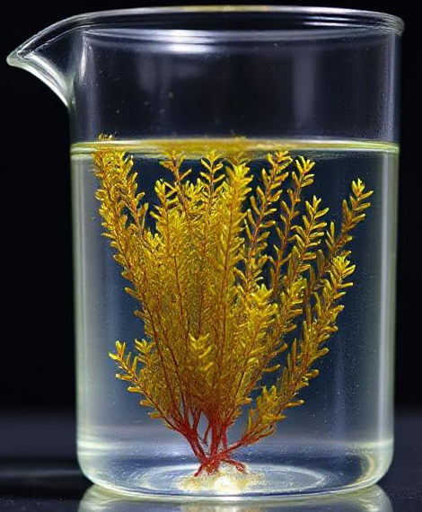
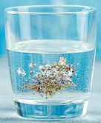
Methodology
Each of the following measurements lasted 3-5 hours
Controls | 8g/L concentration | 16g/L concentration
3 consecutive measurements over the period of 3 consecutive days | 1 measurement after a 48-hour exposure period to microplastics E. Canadensis renewed before exposure | 1 measurement after a 48-hour exposure period to microplastics E. Canadensis renewed before exposure

Slide 8
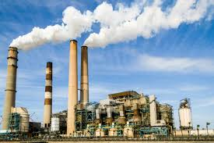



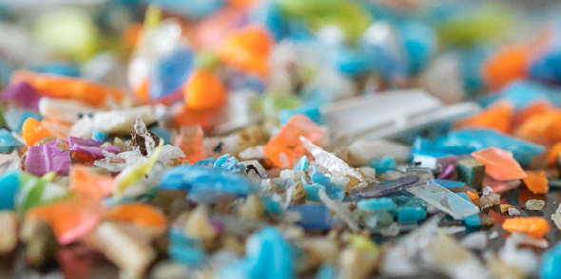
Methodology
The microplastics were of industrial origin, obtained from a plastic bag manufacturer.
This method was selected for its accessibility

Slide 9
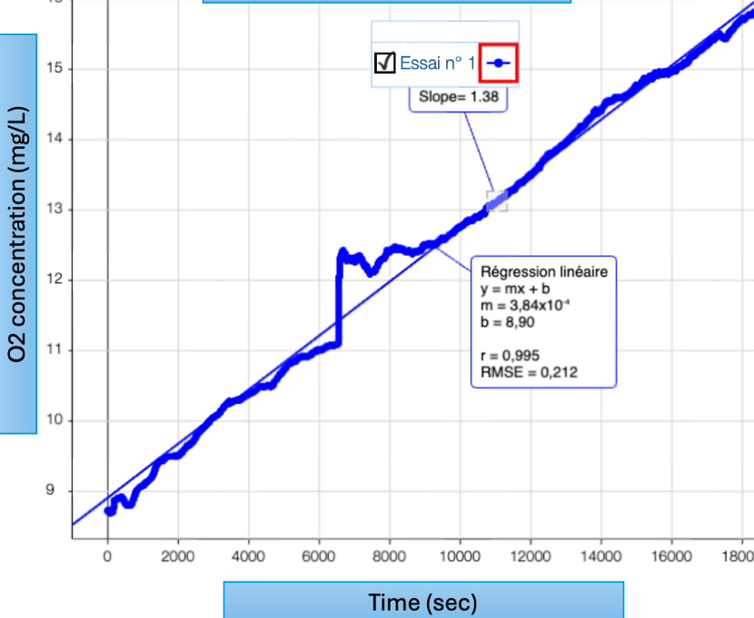
Results
Control group
Average rate of oxygen production from all controls is 2.03 mg/L*h. Linear oxygen increase across all control groups, three control experiments establish a reliable base for comparison.

Slide 10
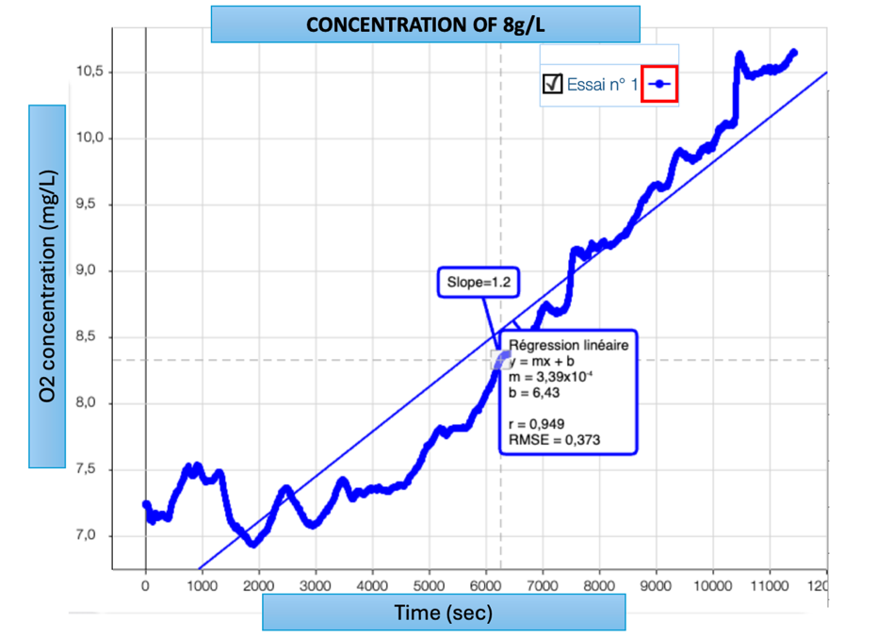
Results
Microplastic Exposure (8 g/L):
Oxygen increase rate: 1.2 mg/L*h
Slower oxygen increase, but low error.

Slide 11
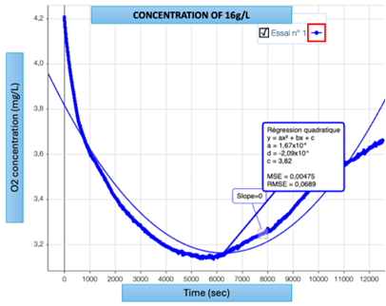
Results
Higher Microplastic Concentration (16 g/L):
  Oxygen concentration initially decreases before slightly increasing.
  Oxygen production drops to ≈ 0 mg/L*h, indicating severe disruption to photosynthesis.

Slide 12
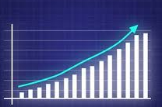
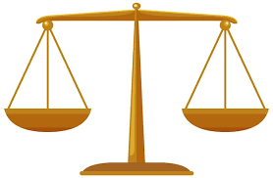
Discussion
Steady Oxygen Increase in the absence of microplastics
Cellular respiration
Photosynthesis
Possible causes for variation in measurements (ex. Control 3)

Slide 13
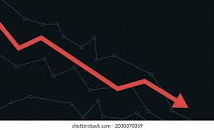
Discussion
Key Effects: Disruption of oxygen production, unbalanced photosynthesis & cellular respiration, trigger of physiological stress
Effects at 8 g/L
Effects at 16 g/L

Slide 14
Discussion
Possible causes for the drop in carbon dioxide uptake :
Reduced Light Availability Nutrient Limitations Toxic Effects & Oxidative Stress

Slide 15
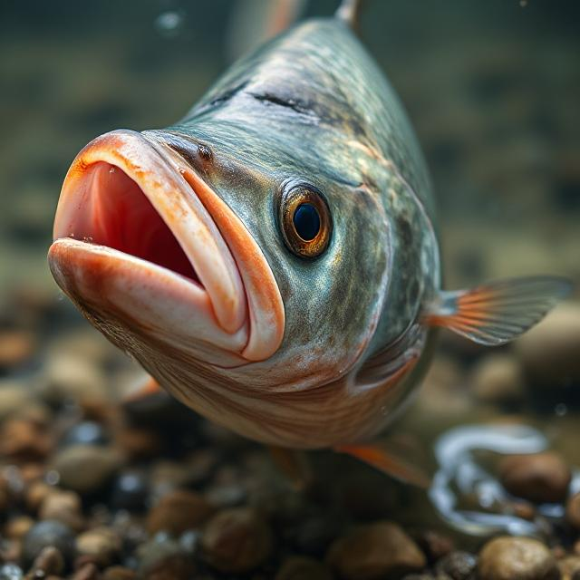
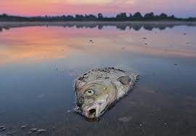
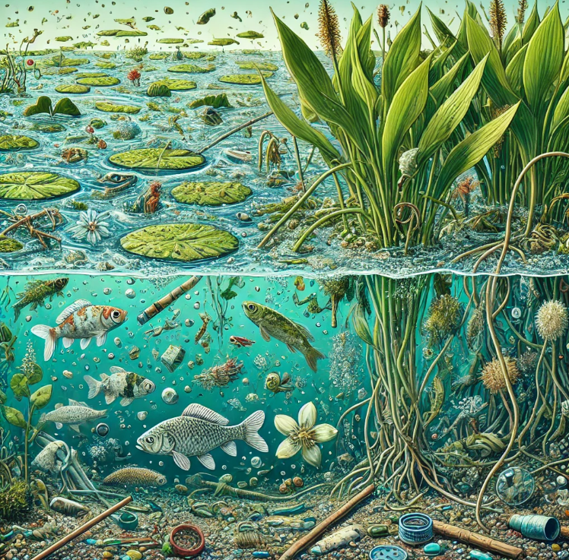
Ecological implications
Microplastics reduce oxygen levels, harming organisms that need dissolved oxygen
Photosynthetic organisms like Elodea canadensis are key to aquatic food chains; damage to them affects herbivores and organisms higher up in the food chain
Long-term microplastic exposure lowers photosynthesis, causing stress, slower growth, and ecosystem imbalances
Relevance to climate change due to decrease in oxygen production

Slide 16
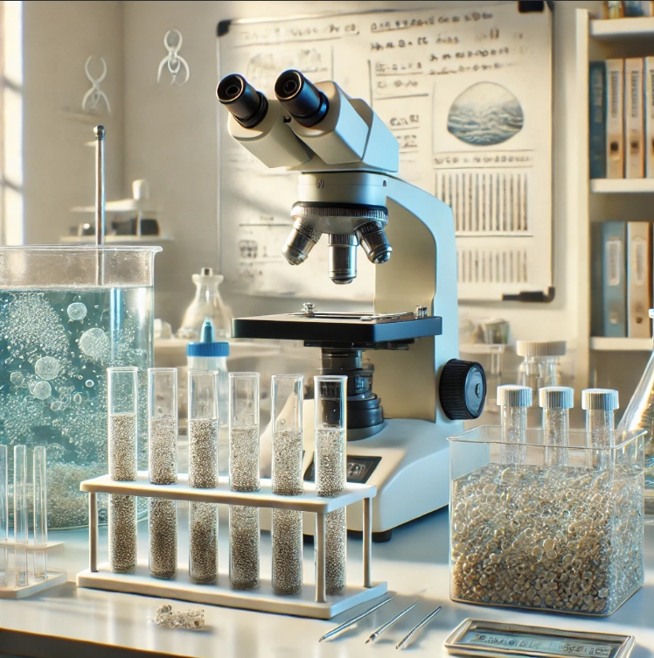
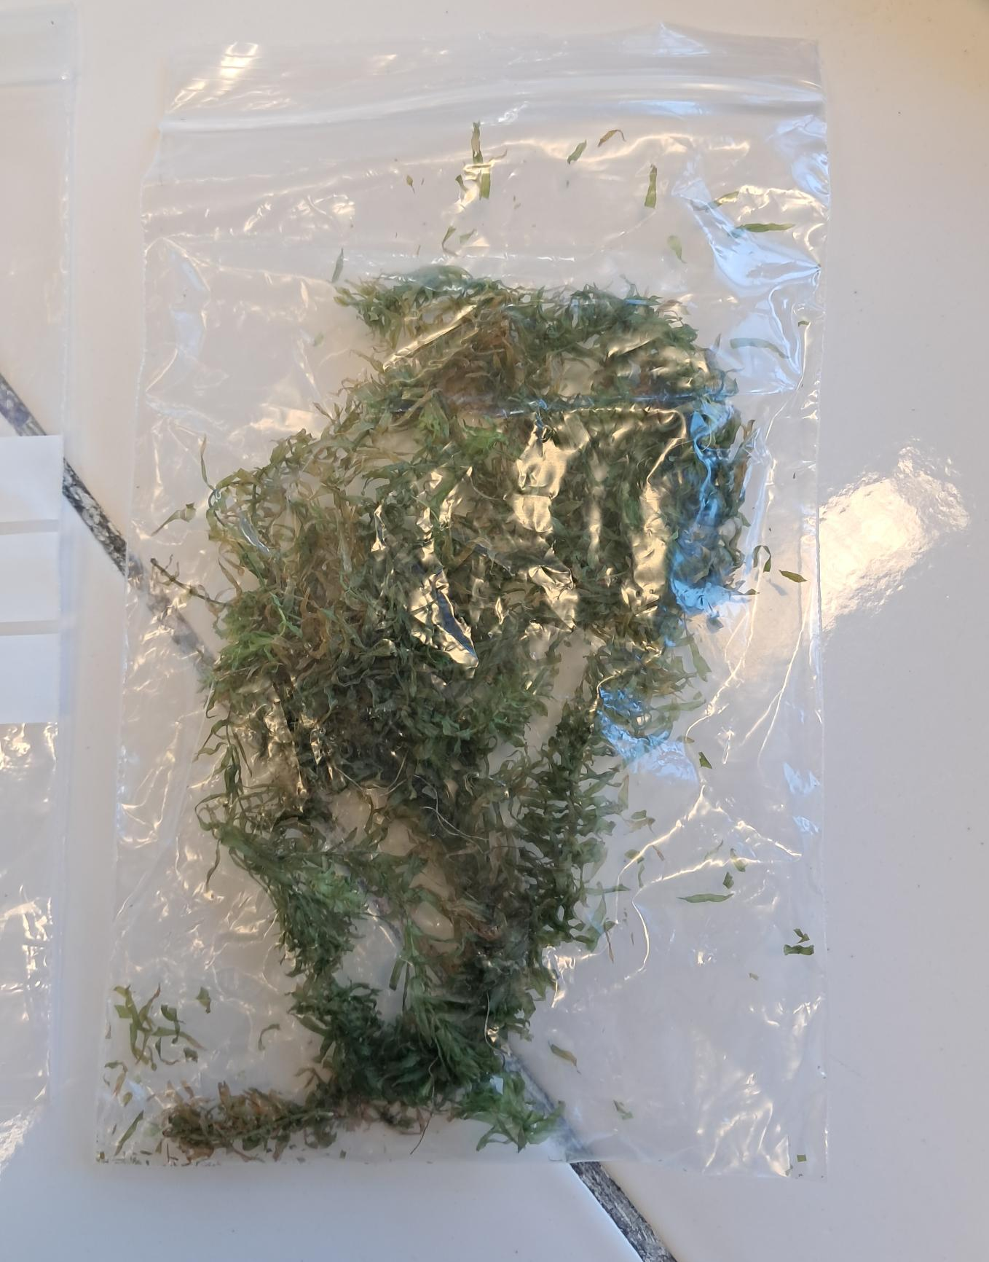
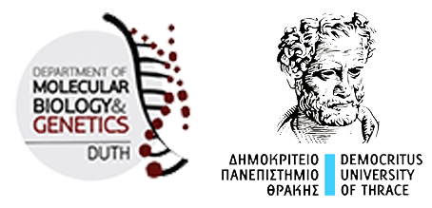
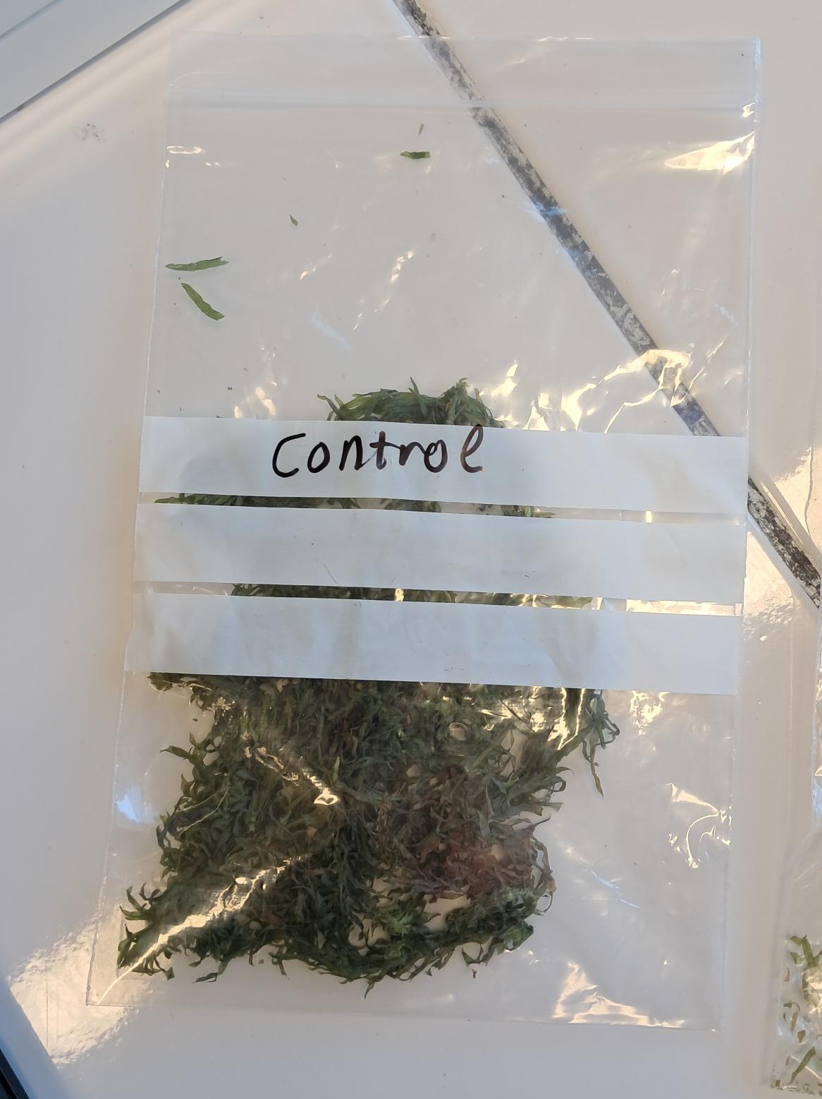

Future research
Protein-level analysis with Democritus University of Thrace
Focus on stress adaptation in photosynthetic organisms
Particularly relevant to habitat changes caused by climate change

Slide 17

Conclusion
Negative impact on photosynthetic organisms →confirmed
Higher microplastic concentrations = greater photosynthetic disruption
Need for strategies to reduce microplastic contamination in waters
E. Canadensis's ability to partially adapt to environmental changes → important tool in addressing the impacts of climate change

Slide 18
References
Valentina Constanta Tudor, Dorina Nicoleta Mocuta, Ruxandra Florina Teodorescu, Dragos Ion Smedescu. 2019. The Issue of Plastic and Microplastic Pollution in Soil. University of Agronomic Sciences and Veterinary Medicine of Bucharest. https://revmaterialeplastice.ro/pdf/3%20TUDOR%20V%20C%203%2019.pdf Accessed 12/03/2025.
National Library of Medicine, 2020 https://www.ncbi.nlm.nih.gov/mesh/?term=%22Microplastics%22 Accessed 12/03/2025.
Hanwen Chen, yinghuan Qin, Hao Huang and Weiyi Xu. 2020. A Regional Difference Analysis of Microplastic Pollution in Global Freshwater Bodies Based on a Regression Model. School of Resources and Environmental Engineering, Hefei University of Technology, Hefei 230009, China College of Civil Engineering, Sichuan Agricultural University, Chengdu 611830, China Wuhan Planning and Design Company, Wuhan 430014, China https://www.mdpi.com/2073-4441/12/7/1889 Accessed 12/03/20
Ludmiła Polechońska, Ula Rozman, Katarzyna Sokołowska, Gabriela Kalčíková. 2023. The bioadhesion and effects of microplastics and natural particles on growth, cell viability, physiology, and elemental content of an aquatic macrophyte Elodea canadensis. Department of Ecology, Biogeochemistry and Environmental Protection, University of Wrocław, ul. Kanonia 6/8, 50-328 Wrocław, Poland. Faculty of Chemistry and Chemical Technology, University of Ljubljana, 113 Večna pot, SI-1000 Ljubljana, Slovenia. Department of Plant Developmental Biology, University of Wrocław, ul. Kanonia 6/8, Wrocław 50-328, Poland. https://www.sciencedirect.com/science/article/pii/S004896972304648X#bb0185 Accessed 12/03/2025.
Yunxue Li, xianhua Liu, shrameeta Shinde, jiao Wang, pingping Zhang. 2021. Impacts of Micro- and Nanoplastics on Photosynthesis Activities of Photoautotrophs: A Mini-Review. School of Environmental Science and Engineering, Tianjin University, Tianjin, China. Department of Microbiology, Miami University, Oxford, OH, United States. College of Food Science and Engineering, Tianjin Agricultural University, Tianjin, China. https://pmc.ncbi.nlm.nih.gov/articles/PMC8660080/ Accessed 12/03/2025.
Mohammad Boshir ahmed, md. Saifur rahman, jahangir alom, Saif hasan, m.A.H. Johir, m. Ibrahim H. Mondal, da-young lee, jaeil park, john L. Zhou, myung-han yoon. 2021. Microplastic particles in the aquatic environment: A systematic review. School of Material Science and Engineering, Gwangju Institute of Science and Technology, Gwangju 61005, Republic of Korea. Department of Applied Chemistry and Chemical Engineering, University of Rajshahi, Rajshahi 6205, Bangladesh. Centre for Green Technology, School of Civil and Environmental Engineering, University of Technology Sydney, 15 Broadway, Sydney, NSW 2007, Australia.https://www.sciencedirect.com/science/article/abs/pii/S0048969721008603 Accessed 12/03/2025.
Jianhua Ge, Huang Li, Peng Liu, Zhiping Zhang, Zhuozhi Ouyang, Xuetao G. 2021. Review of the toxic effect of microplastics on terrestrial and aquatic plants School of Earth and Environment, Anhui University of Science & Technology, Huainan 232001, China. Key Laboratory of Plant Nutrition and the Agri-environment in Northwest China, Ministry of Agriculture. College of Natural Resources and Environment, Northwest A & F University, Yangling 712100, China.https://www.sciencedirect.com/science/article/abs/pii/S0048969721034045 Accessed 12/03/2025.
Ula Rozman, Tilen Turk, Tina Skalar, Marija Zupančič, Nataša Čelan Korošin, Marjan Marinšek, Jesus Olivero-Verbel, Gabriela Kalčíková. 2021. An extensive characterization of various environmentally relevant microplastics – Material properties, leaching and ecotoxicity testing. University of Ljubljana, Faculty of Chemistry and Chemical Technology, 113 Večna pot, SI-1000 Ljubljana, Slovenia. University of Cartagena, Environmental and Computational Chemistry Group, School of Pharmaceutical Sciences, Zaragocilla Campus, 130015 Cartagena, Colombia.https://www.sciencedirect.com/science/article/pii/S0048969721006446?via%3Dihub Accessed 12/03/2025.

Slide 19
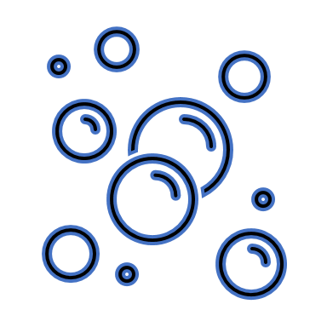

THANK YOU FOR YOUR ATTENTION !

