Slide 1
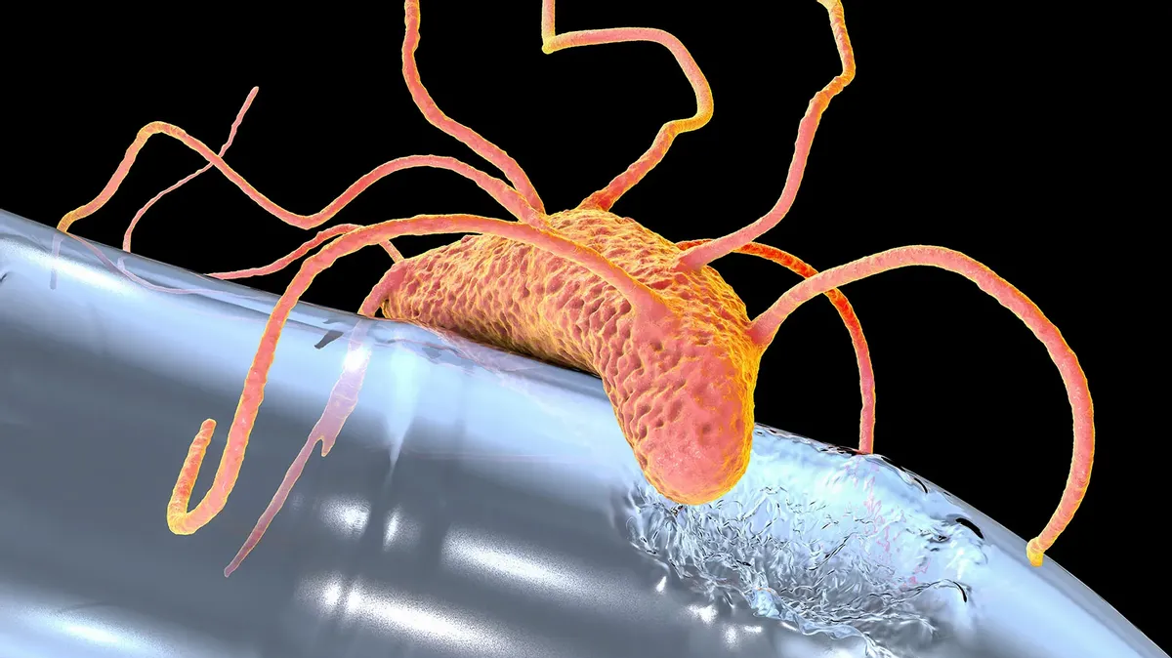
IDEONELLA SAKAIENSIS: Optimising Conditions for Plastic Degradation
Shradda Vijaya Kumara, S5ENA
Amelia Wood, S5ENA
(Image credit: Getty Images)

Slide 2
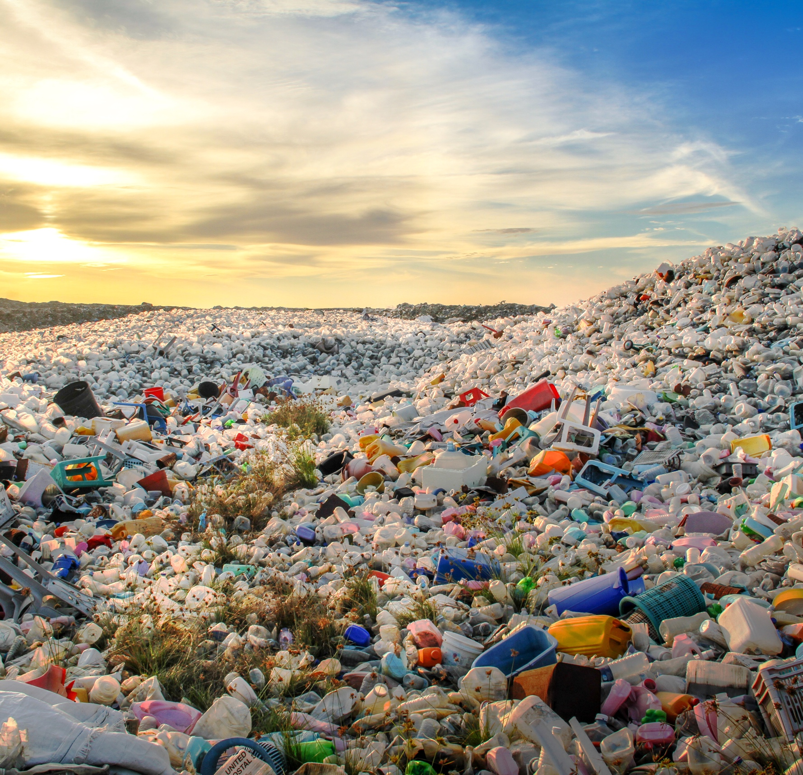
INTRODUCTION:
https://datatopics.worldbank.org/what-a-waste/img/v3_waste_disposal_site.jpg
Polyethylene terephthalate (PET) and Polystyrene (PS) are major contributors to plastic pollution
Effect on ecosystems
Need for sustainable solutions to accelerate degradation

Slide 3
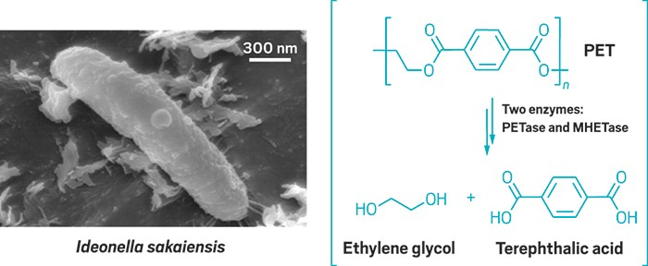
IDEONELLA SAKAIENSIS:
The bacterium, Ideonella sakaiensis, was discovered in 2016 - Kyoto Institute of Technology, Keio University
Produces PETase and MHETase enzymes to degrade PET
Potential applications in reducing plastic waste in landfills, water, industrial settings, etc.
https://cen.acs.org/articles/94/i49/Worlds-first-PET-munching-microbe.html

Slide 4

AIM:
Optimal conditions for PET degradation
Testing if Ideonella sakaiensis can also degrade PS
Implementing the bacteria in real-life settings: eco-friendly products, marine environments, landfills, etc.

Slide 5
MATERIAL:
Ideonella sakaiensis from Leibniz Institute (DSZM)
Medium 830
Agar plates
Incubator
PET and PS samples (1cm² each)

Slide 6

METHOD:
Working in sterile conditions
Growing the bacteria
Plating the bacteria
Allowing bacteria to grow on plates in the presence of plastic

Slide 7
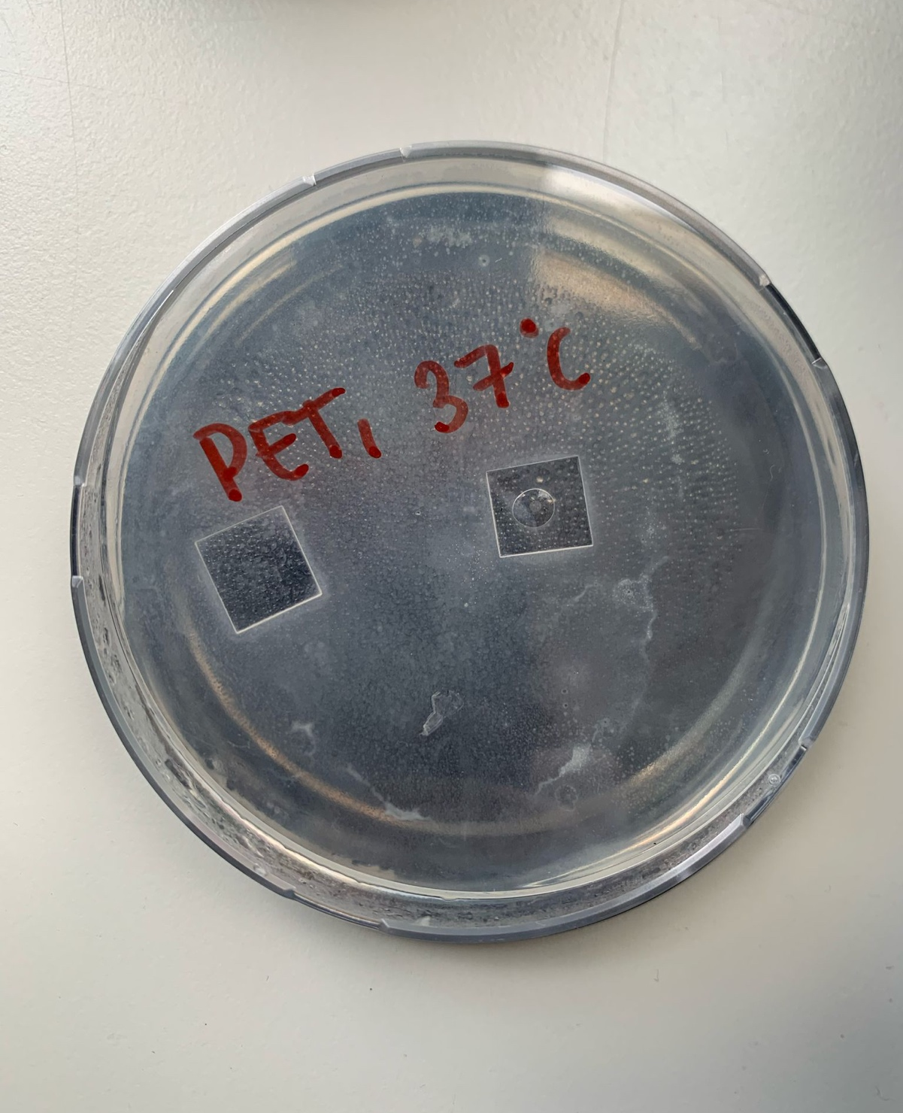
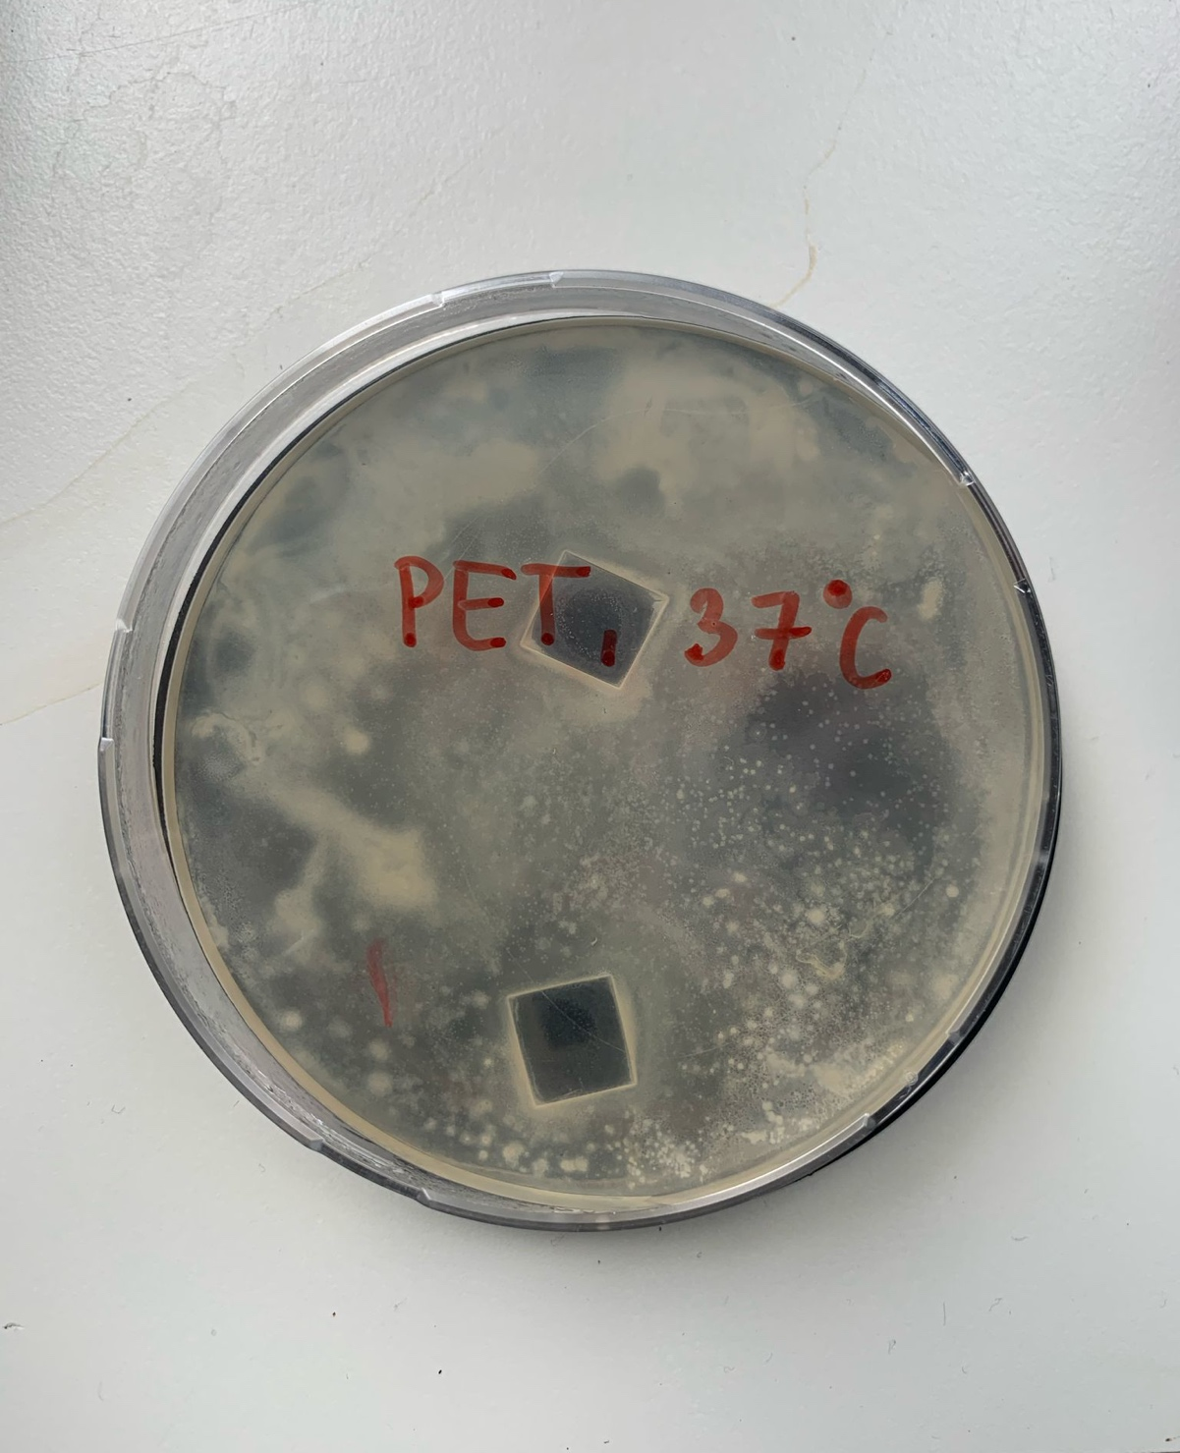
RESULTS: PET
2 weeks after plating
Bacterial growth surrounding plastic samples
No visible degradation of plastic
Difference in agar plates might be due to contamination

Slide 8
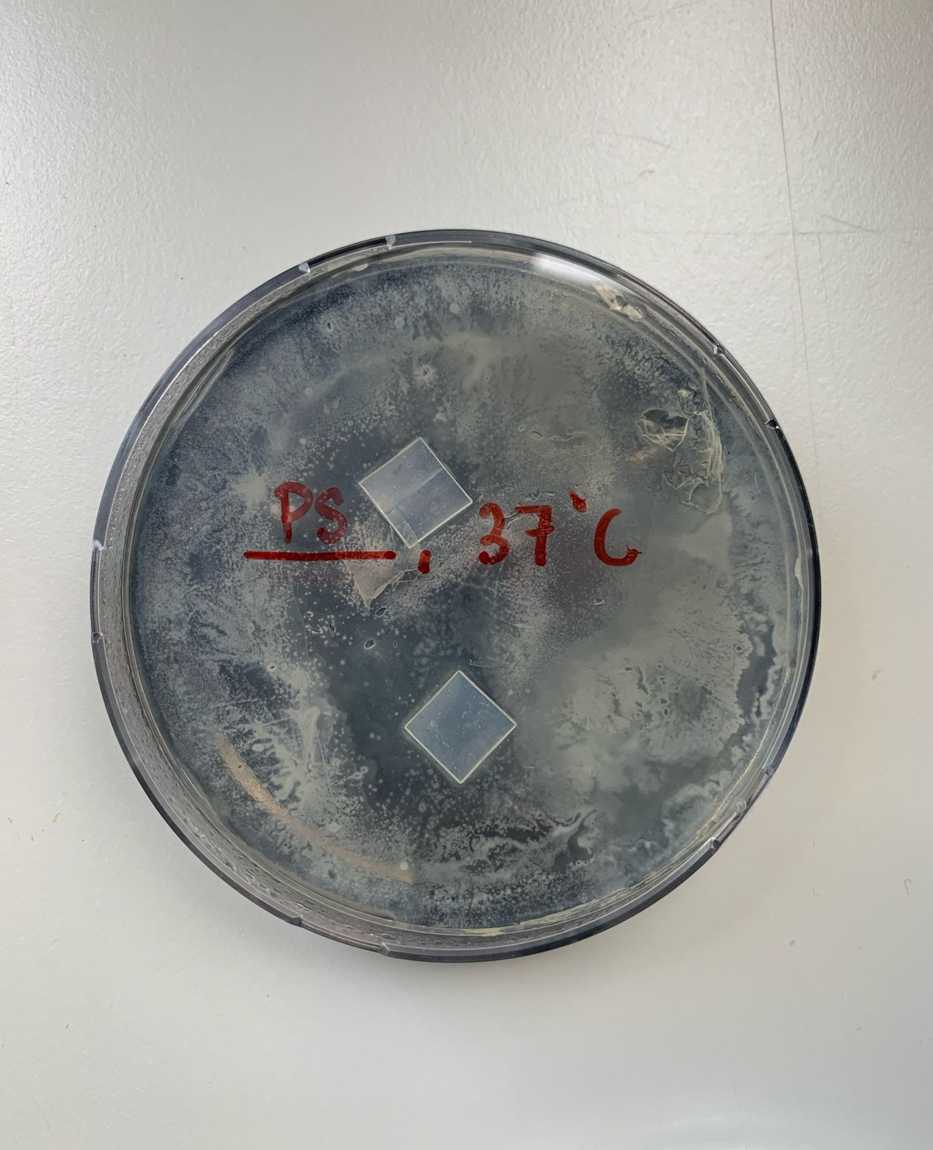
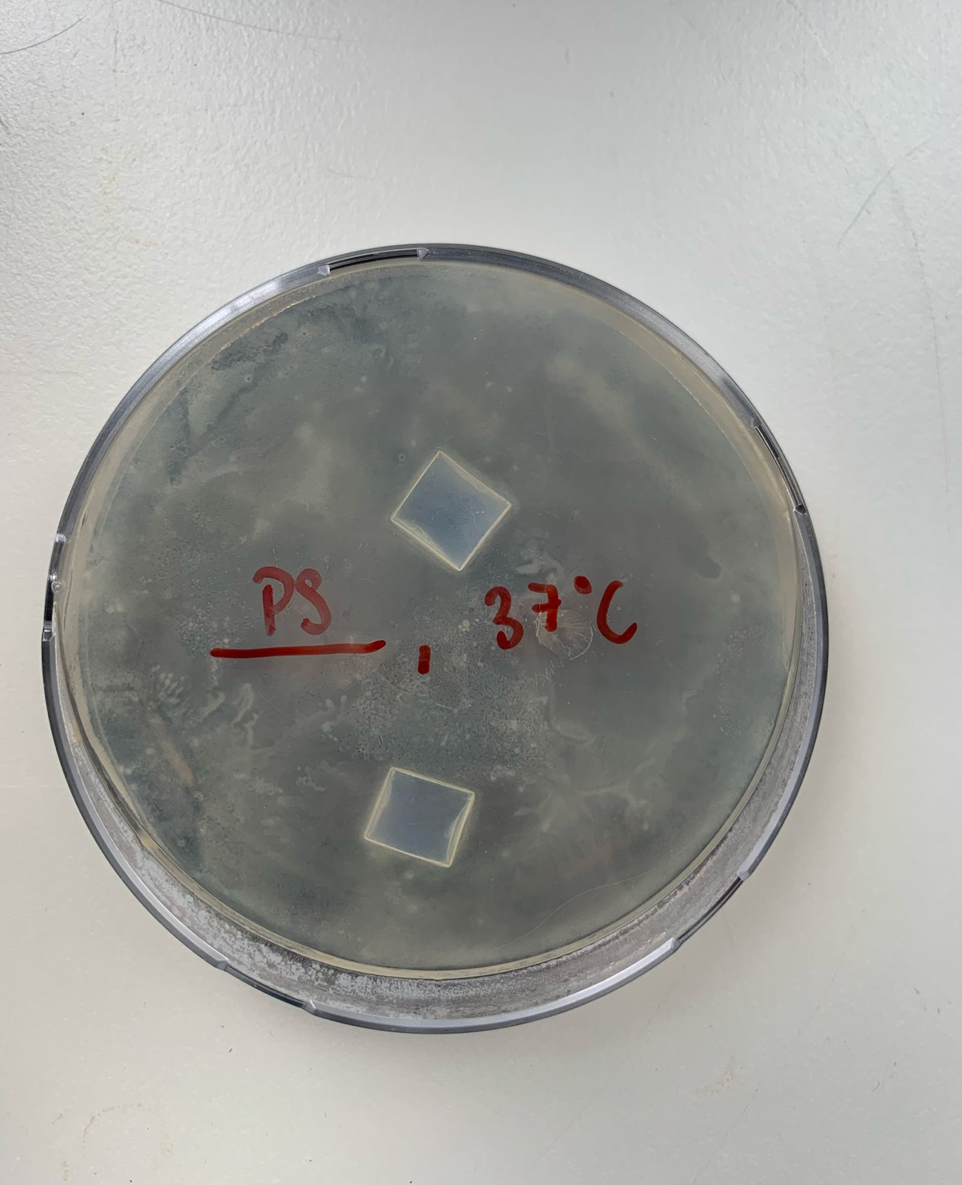
RESULTS: PS
2 weeks after plating
Bacterial growth surrounding plastic samples
No visible degradation of plastic
Plastic seems to be cloudy, but no visible degradation

Slide 9
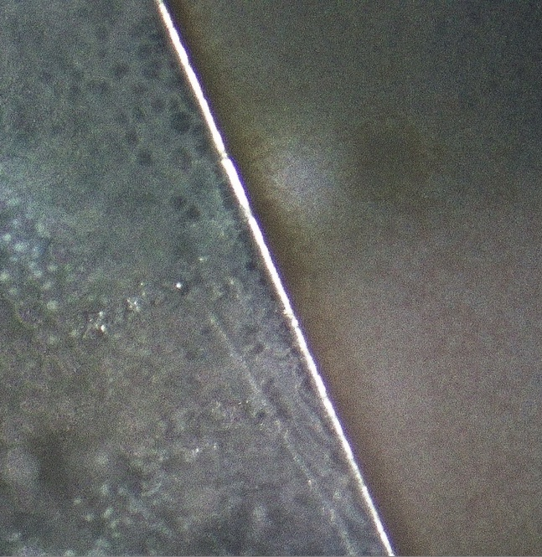
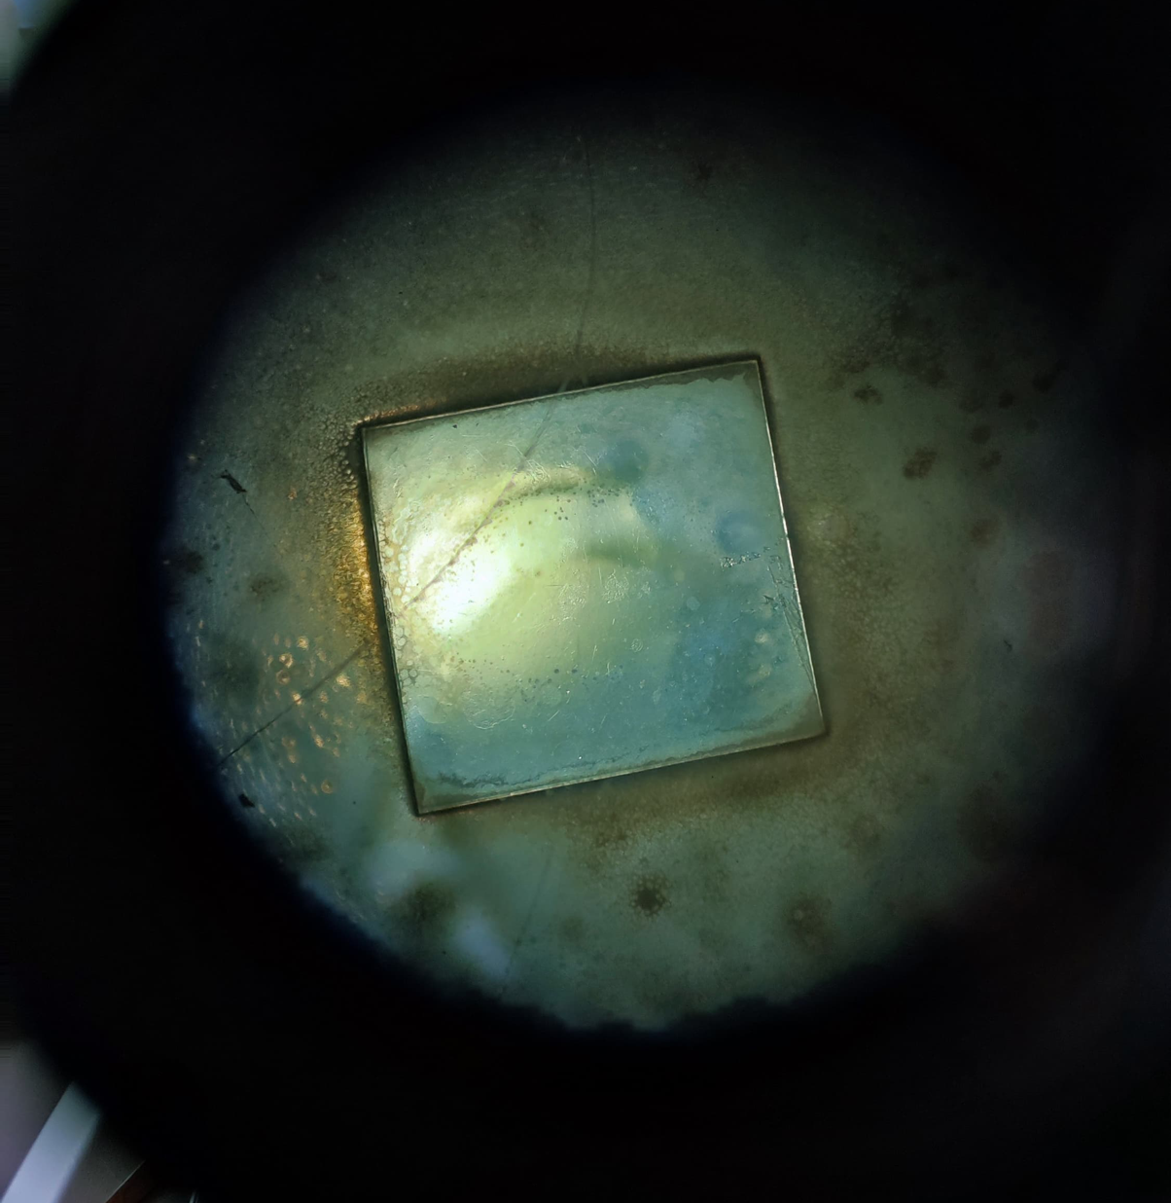
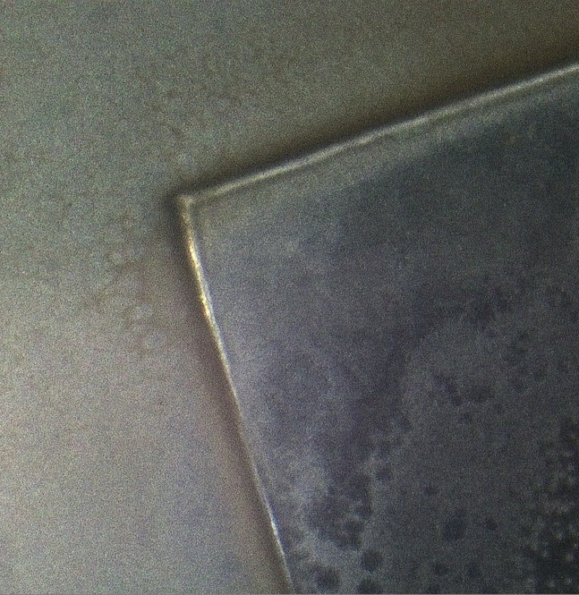
RESULTS 2: PET
3 weeks after plating
Some irregularities are visible
No major cracks or significant erosion

Slide 10
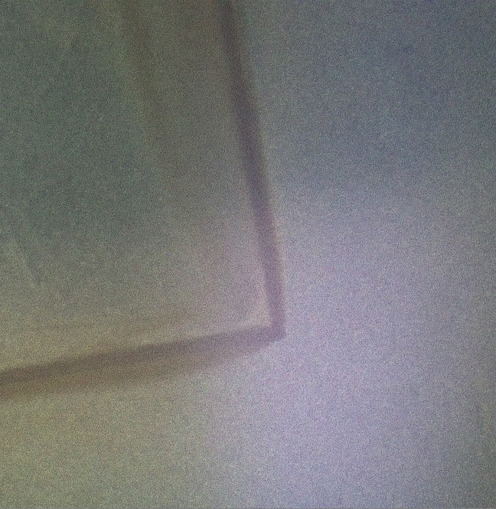
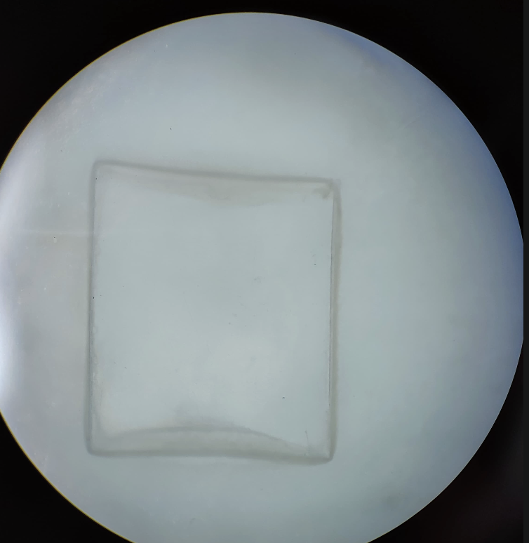
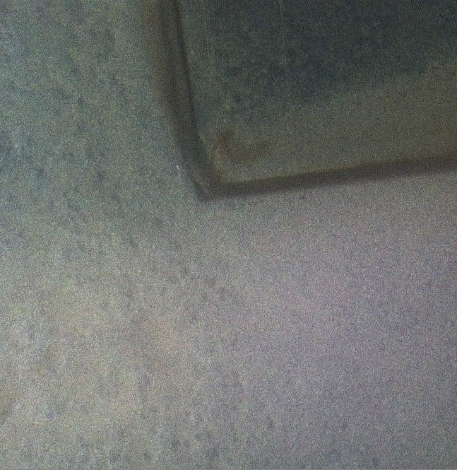
RESULTS 2: PS
3 weeks after plating
Minor differences in comparison to PET
Compared to the PET samples, smoother, cleaner, but duller edges

Slide 11

DISCUSSION:
Bacterial growth is evident
Process of plastic degradation is slow
More time needed to assess degradation
No visible changes in plastic samples at this stage
Conditions that lead to plastic degradation need to be worked on

Slide 12
ACKNOWLEDGEMENTS:
Mr. Beaufils Philippe, who made this possible.
The European School of Karlsruhe, for giving us this opportunity and letting us use their lab and equipment.
Our family and friends, for supporting us.
And you, for listening to our presentation.

Slide 13
REFERENCES:
https://www.salon.com/2022/05/01/the-race-to-design-a-bacteria-that-can-eat-plastic/
https://www.sciencedirect.com/topics/agricultural-and-biological-sciences/ideonella
https://www.theguardian.com/environment/2023/sep/28/plastic-eating-bacteria-enzyme-recycling-waste
https://microbenotes.com/ideonella-sakaiensis-plastic-eating-bacteria/
https://www.science.org/doi/10.1126/science.aad6359
https://www.mdpi.com/2073-4360/15/7/1779
https://www.livescience.com/plastic-eating-bacteria
https://en.wikipedia.org/wiki/Ideonella_sakaiensis
https://cen.acs.org/articles/94/i49/Worlds-first-PET-munching-microbe.html

