Slide 1
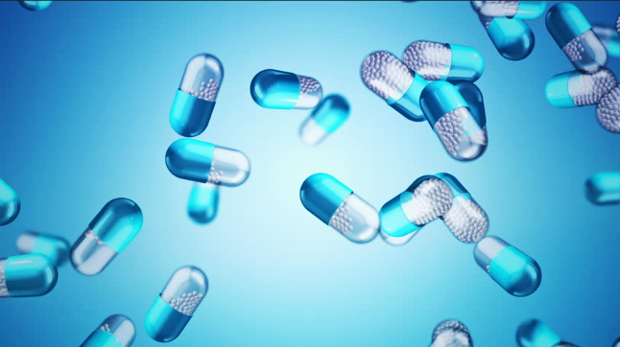
Do natural antibiotics cure?
By Javier Canals Estirado (S2 ES) and Rodrigo Martínez Barberá (S2 ES)
European School of Alicante

Slide 2
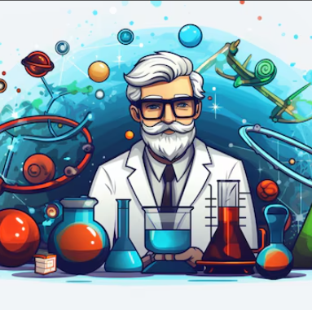
Index
Introduction
Hypothesis and objectives
Materials
Procedure
Results
Conclusions
Proposals for improvement
References
Acknowledgments

Slide 3
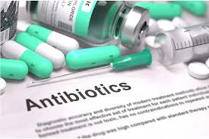
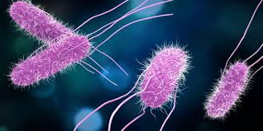
Introduction
Bacteria are necessary but can cause diseases.
Antibiotics kill or inhibit bacteria.
Develop new antibiotics.
Super resistant bacteria.

Slide 4
Hypothesis and
Objectives
Hypothesis: Extracts from plants and fungi can work as natural antibiotics.
The objective: to test some plants and fungi as bactericides.

Slide 5
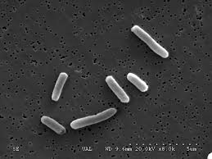
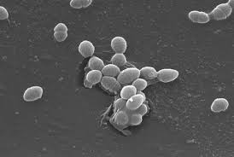
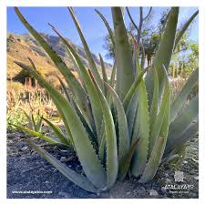
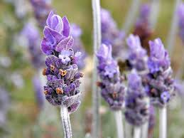
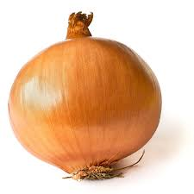
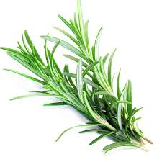
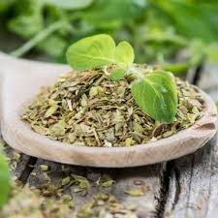
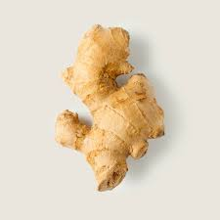
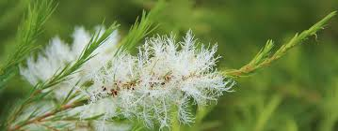
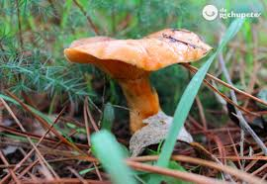
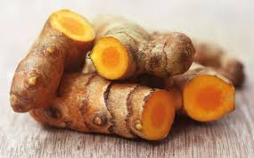
Materials
We use 2 species of bacteria:
“Gram positive” family ( Escherichia coli )
“Gram negative” family ( Enterococcus faecalis )
As possible antibiotic substances we will test:
Aloe vera, lavender, onion, rosemary, turmeric, oregano, ginger, tea tree, and a mushroom (rovellón)

Slide 6
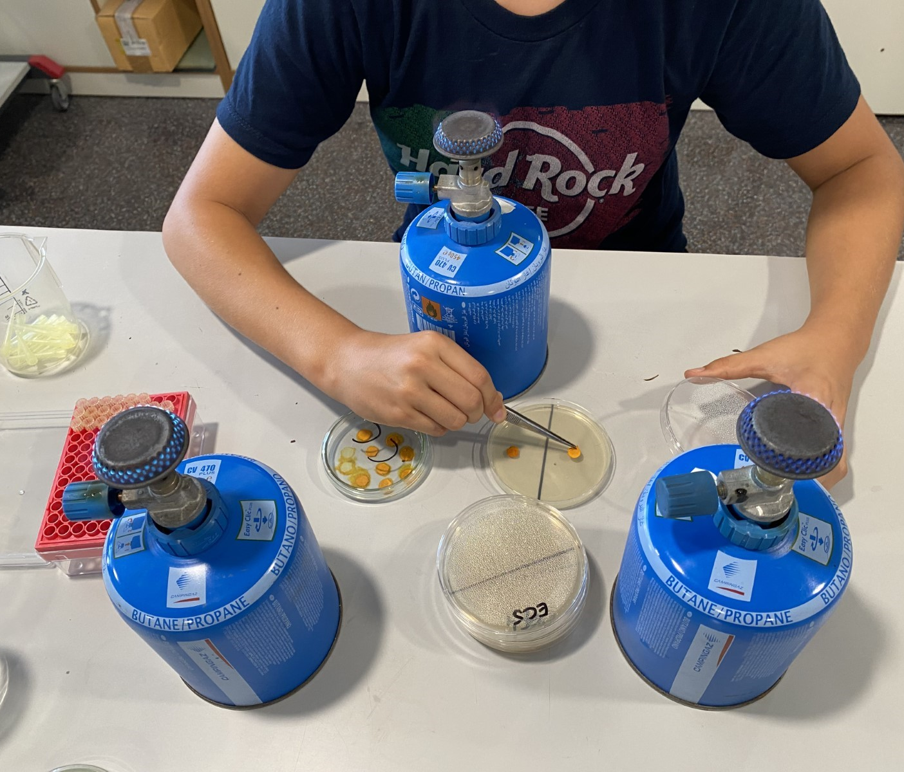
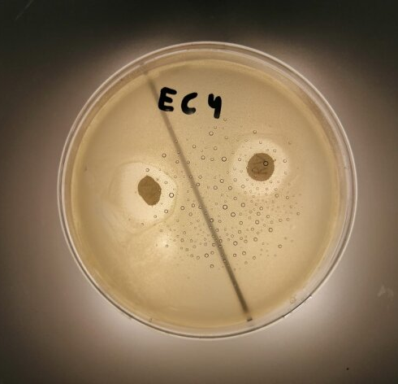
Procedures
Extraction of compounds from plants and fungi (extracts).
Record manufacturing.
Assembly of culture and seeding plates.
Data recording and calculation of antibiotic effect from the inhibition halo.
Petri dish
Escherichia bacteria coli
Discs impregnated with extracts
Bacterial growth inhibition halo

Slide 7
Experimental design
Negative control culture without bacteria.
Positive control of bacterial growth inhibition (inhibition halos) with 4 commercial antibiotics: tetracycline, penicillin, streptomycin and chloramphenicol.
Experimental cultures with discs impregnated with 9 different types of plant and fungal extracts.
Two Petri dishes are used for each condition (repetitions), with two discs on each plate, to provide enough data.

Slide 8
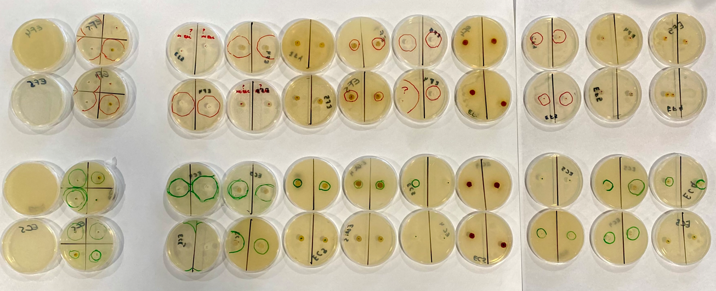
Results
Some plant extracts have shown bactericidal activity.
Positive Control (Antibiotics)
Negative Control
Turmeric
Chanterelle
Tea tree
Oregano
Ginger
Rosemary
Aloe Vera
Onion
Lavender
EF4
EF5
E. coli E. faecalis
EC4
EC5
The largest inhibition zones were found for tea tree extract and oregano, which were comparable to those observed with commercial antibiotics.

Slide 9
Results (inhibition halo's raw data, in cm)
 | EC4 D1 | EC4 D2 | EC5 D1 | EC5 D2 | Mean Escherichia coli |  |  | EF4 D1 | EF4 D2 | EF5 D1 | EF5 D2 | Mean Enterococcus faecalis
Aloe Vera | 0 | 0 | 0 | 1.4 | 0.35 |  |  | 2.5 | 0 | 3.1 | 2.8 | 2.1
Chanterelle | 2.1 | 2 | 2 | 2.6 | 2.175 |  |  | 0 | 0 | 0 | 0 | 0
Lavender | 0 | 0 | 1.5 | 1.6 | 0.775 |  |  | 0 | 0 | 0 | 0 | 0
Rosemary | 0 | 0 | 1.5 | 1.5 | 0.75 |  |  | 2.4 | 1.6 | 2.2 | 1.8 | 2
Onion | 0 | 0 | 1.5 | 1.6 | 0.775 |  |  | 1.9 | 2.2 | 2.2 | 23 | 2.15
Oregano | 3 | 2.5 | 3.5 | 3.5 | 3.125 |  |  | 0 | 0 | 4 | 4 | 2
Ginger | 0 | 0 | 1.5 | 1.6 | 0.775 |  |  | 0 | 0 | 0 | 0 | 0
Tea Tree | 6 | 6 | 4 | 3.5 | 4.875 |  |  | 0 | 0 | 4 | 3.7 | 2
Turmeric | 0 | 0 | 0 | 0 | 0 |  |  | 0 | 0 | 0 | 0 | 0
P10 | 1.5 | 0 |  |  | 0.75 |  |  | 0 | 0 |  |  | 0
C30 | 3 | 2.8 |  |  | 2.9 |  |  | 4.2 | 3.6 |  |  | 3.9
S300 | 4 | 2.7 |  |  | 3.35 |  |  | 3.6 | 4.4 |  |  | 4
TE30 | 1.7 | 2.1 |  |  | 1.9 |  |  | 3.5 | 3.8 |  |  | 3.65

Slide 10
Results (bar graph)

Slide 11

CONCLUSIONS
Extracts from some plants and fungi serve as natural antibiotics.
Bacterial species do not react the same way to the same antibiotics, whether natural or artificial.
Our E.coli species is an example of bacteria resistant to penicillin.
Tea tree and oregano are the extracts with the highest bactericidal activity.
We must take care of our planet and continue researching plants and fungi because they may contain undiscovered substances that could cure some current, or even future, diseases.
Not only would we have to produce artificial antibiotics, but we could also use plants and some mushrooms and fungi that would help avoid having to use artificial antibiotics that have more side effects than an antibiotic made from plants.

Slide 12

Proposals for improvement
On a technical level, it would be interesting and possibly fruitful to replicate the experiment, increasing the number of observations. This way, the results are more robust and credible.
On a scientific level, it would be attractive to increase the number of extracts tested. This would increase the chances of natural antibiotics establishing themselves alongside other antibiotics in the pharmaceutical market.
Finally, we propose similarly investigating whether extracts from seaweed exist, as these could contain antibodies against microorganisms from bygone eras and, therefore, offer protection.

Slide 13

References
National Geographic: the problem of resistance to antibiotics
https://education.nationalgeographic.org/resource/antibiotic-resistance-beefing/
Wikipedia: antibiotics and Louis Pasteur.
https://es.wikipedia.org/wiki/Antibi%C3%B3tico
https://es.wikipedia.org/wiki/Louis_Pasteur
Juan J. Picazo. “Métodos básicos para el estudio de la evaluación a antimicrobianos”, en Procedimientos en microbiología clínica. Recomendaciones de la Sociedad Española de Enfermedades infecciosas y Microbiología Clínica. https://www.seimc.org/contenidos/documentoscientificos/procedimientosmicrobiologia/seimc-procedimientomicrobiologia12.pdf

Slide 14

Acknowledgments
To Mr. Rafael Crespillo, biology teacher for the middle and upper cycle of the School of the Spanish section, for being our mentor from the beginning, for helping us choose the topic and telling us how real scientific research is done.
To Mr. Juan Mareque , our super laboratory technician for biology and chemistry, for always having the laboratory ready for us, listening to us, helping us, advising us so that we had the project ready for this big day... thank you, Juan!
To Mr. Mauricio Martínez F., for support and guide our work, and help us with the official documents and powerpoint presentation.
To Rodrigo's grandparents who live in Ayora (Valencia, Spain), for supplying us with some plants and the mushroom... thank you, grandparents!
To our parents, for supporting and encouraging us with the project... and especially to Alicia Estirado, Javier's mother, for facilitating the most important part of the project: gram- positive and gram- negative bacteria... thank you, parents!

