Slide 1

Study of Different Plants Under Different Lighting Conditions to Determine how They Thrive
Sathvika KRISHNA, Kenda MOHAMED, Freddie LEE
S2-EN

Slide 2
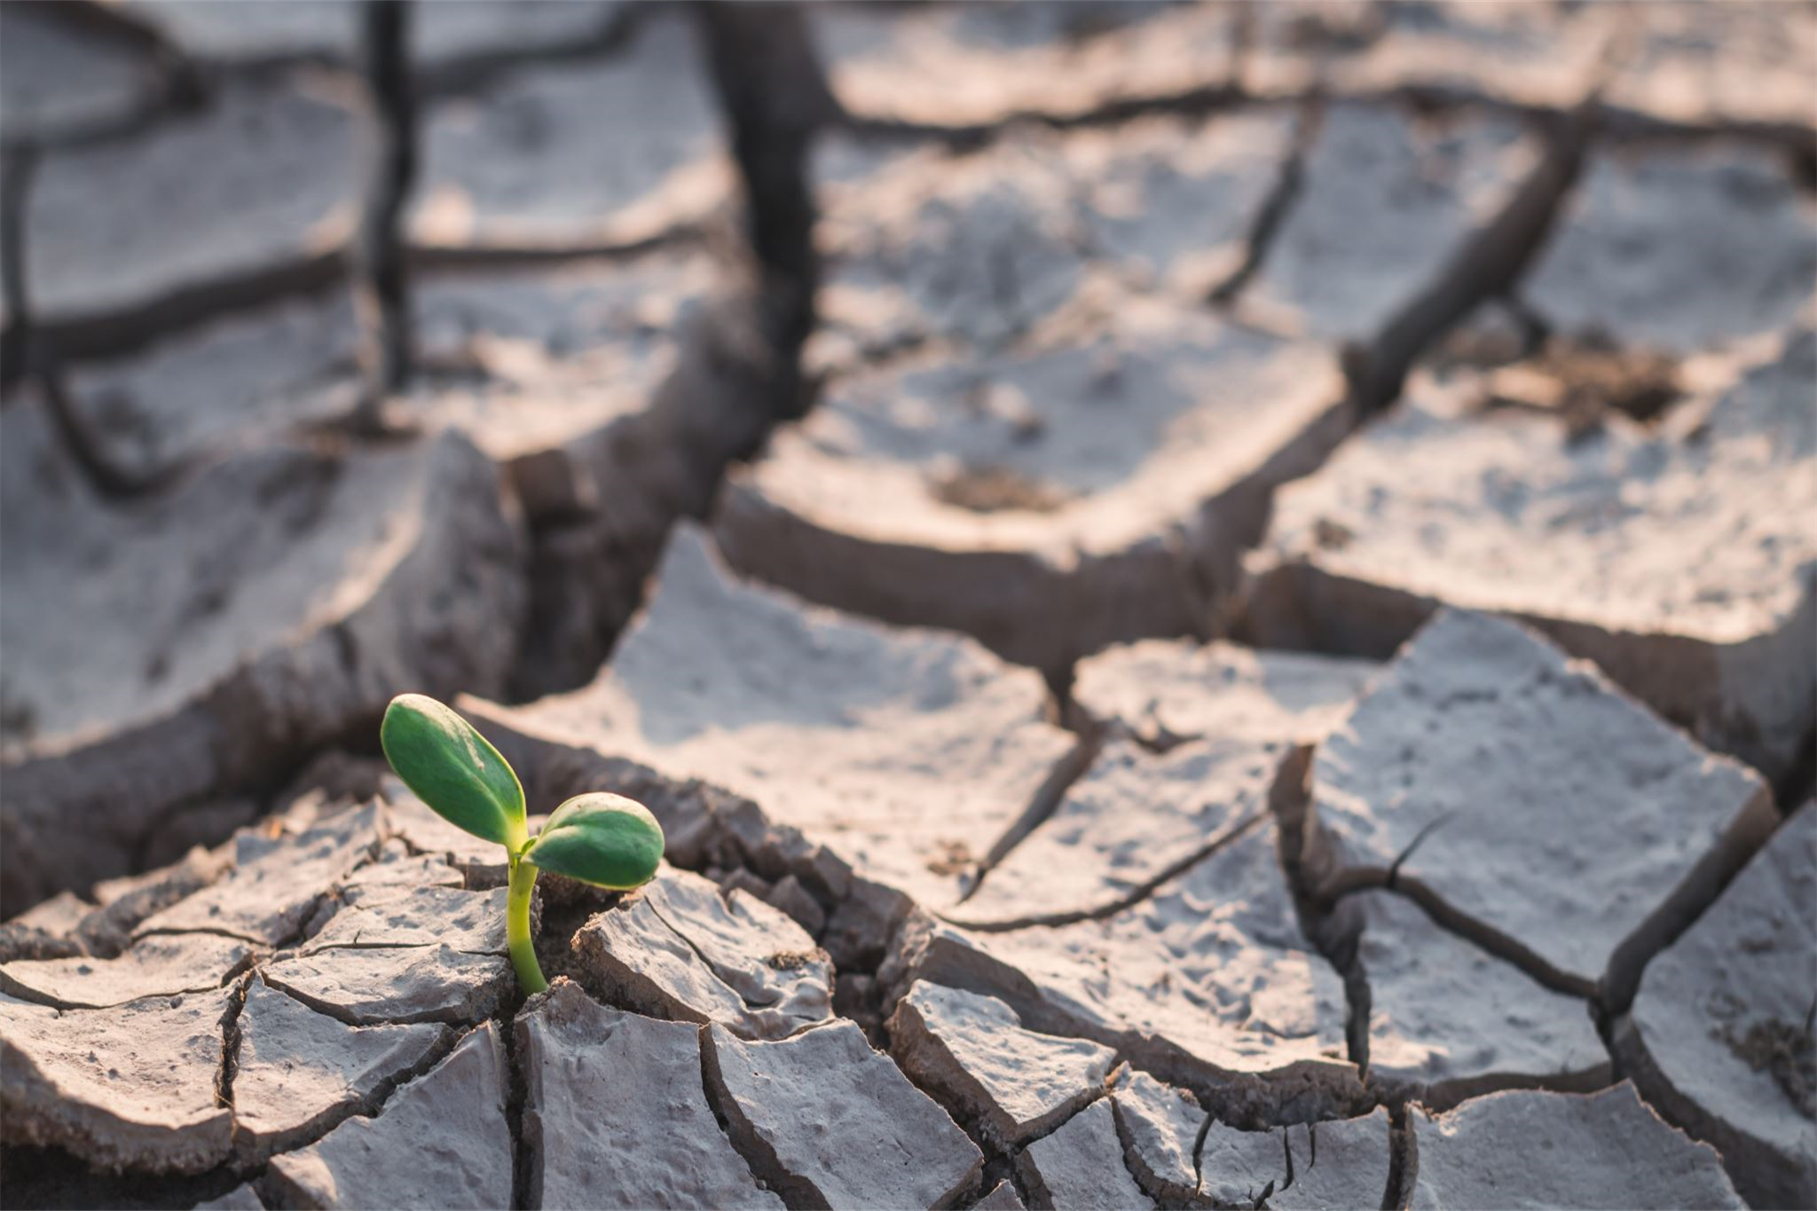
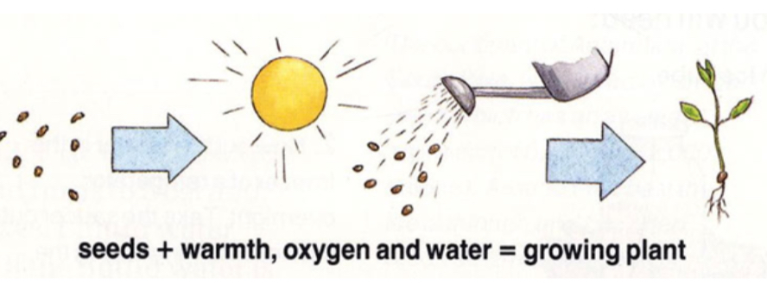

Introduction
​
Environmental factors for germination
5 different light sources

Slide 3
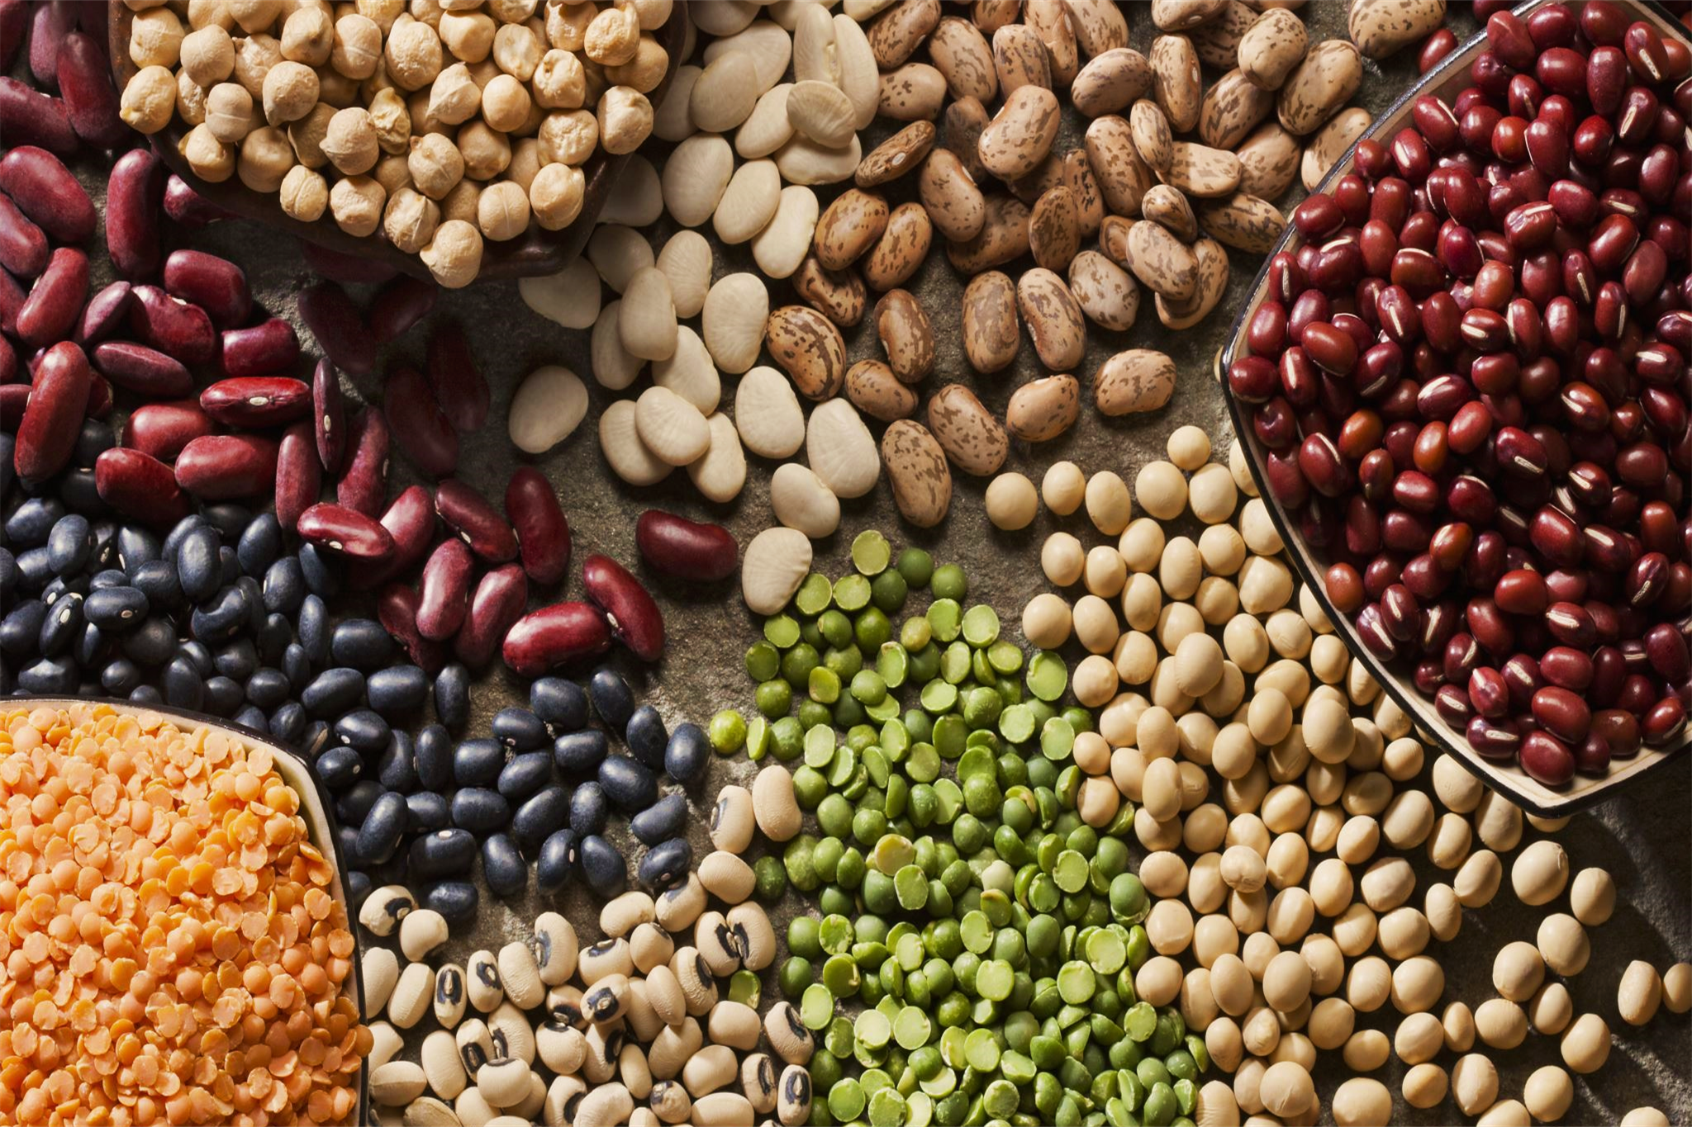
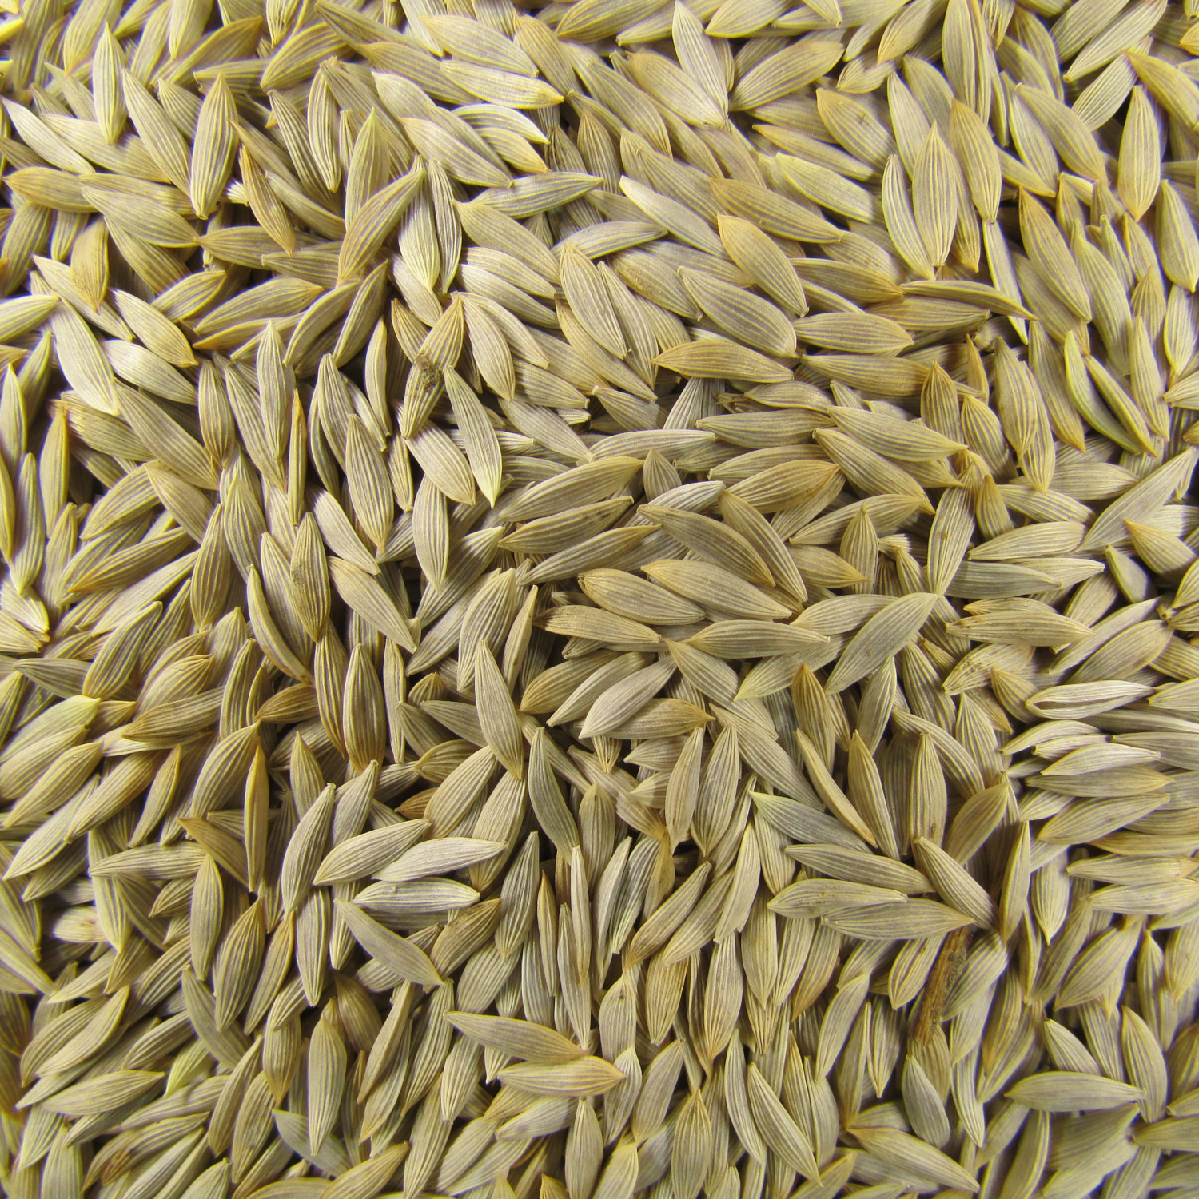
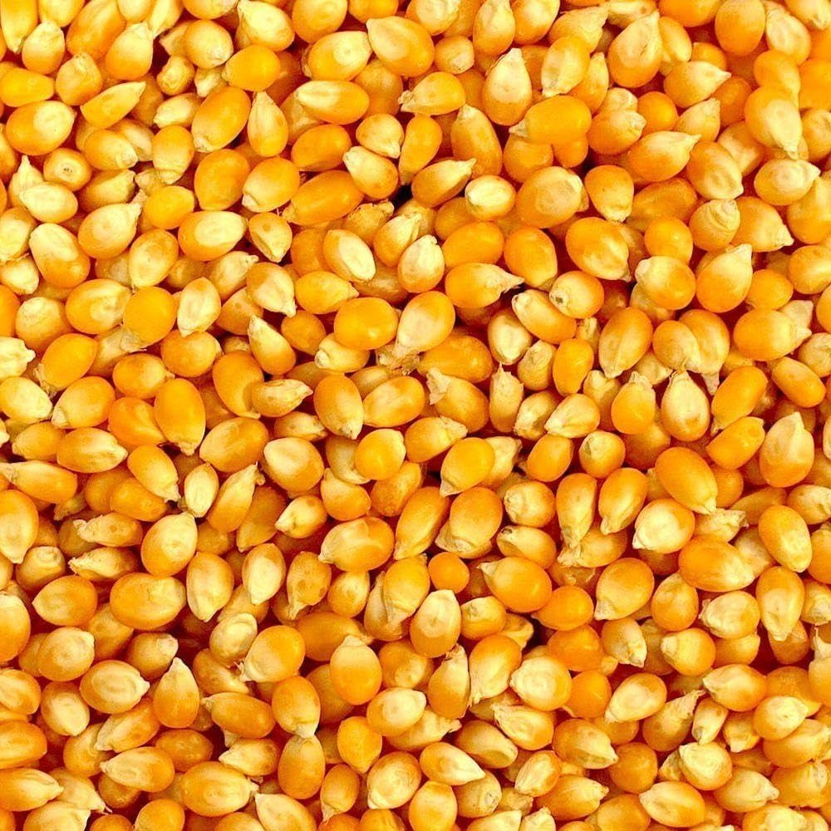
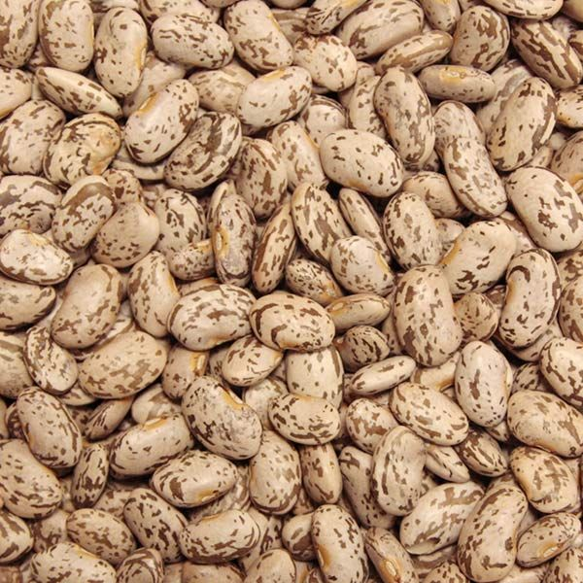
3 Different Seeds We Used
​
Lactuca sativa ​
Zea mays
Phaseolus vulgaris

Slide 4

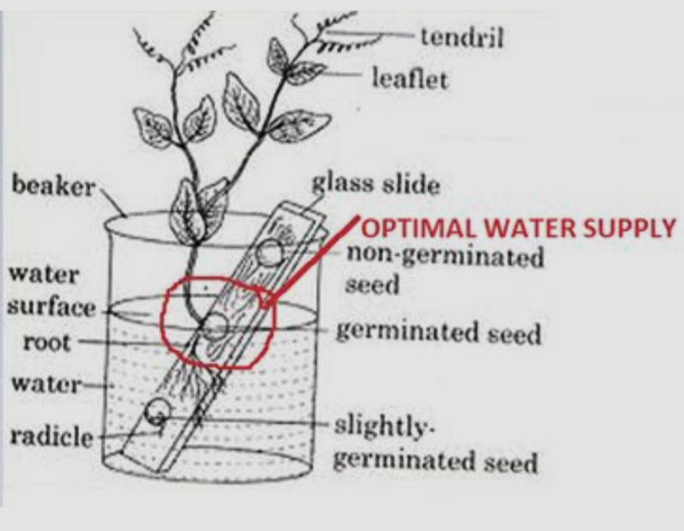
Water

Slide 5
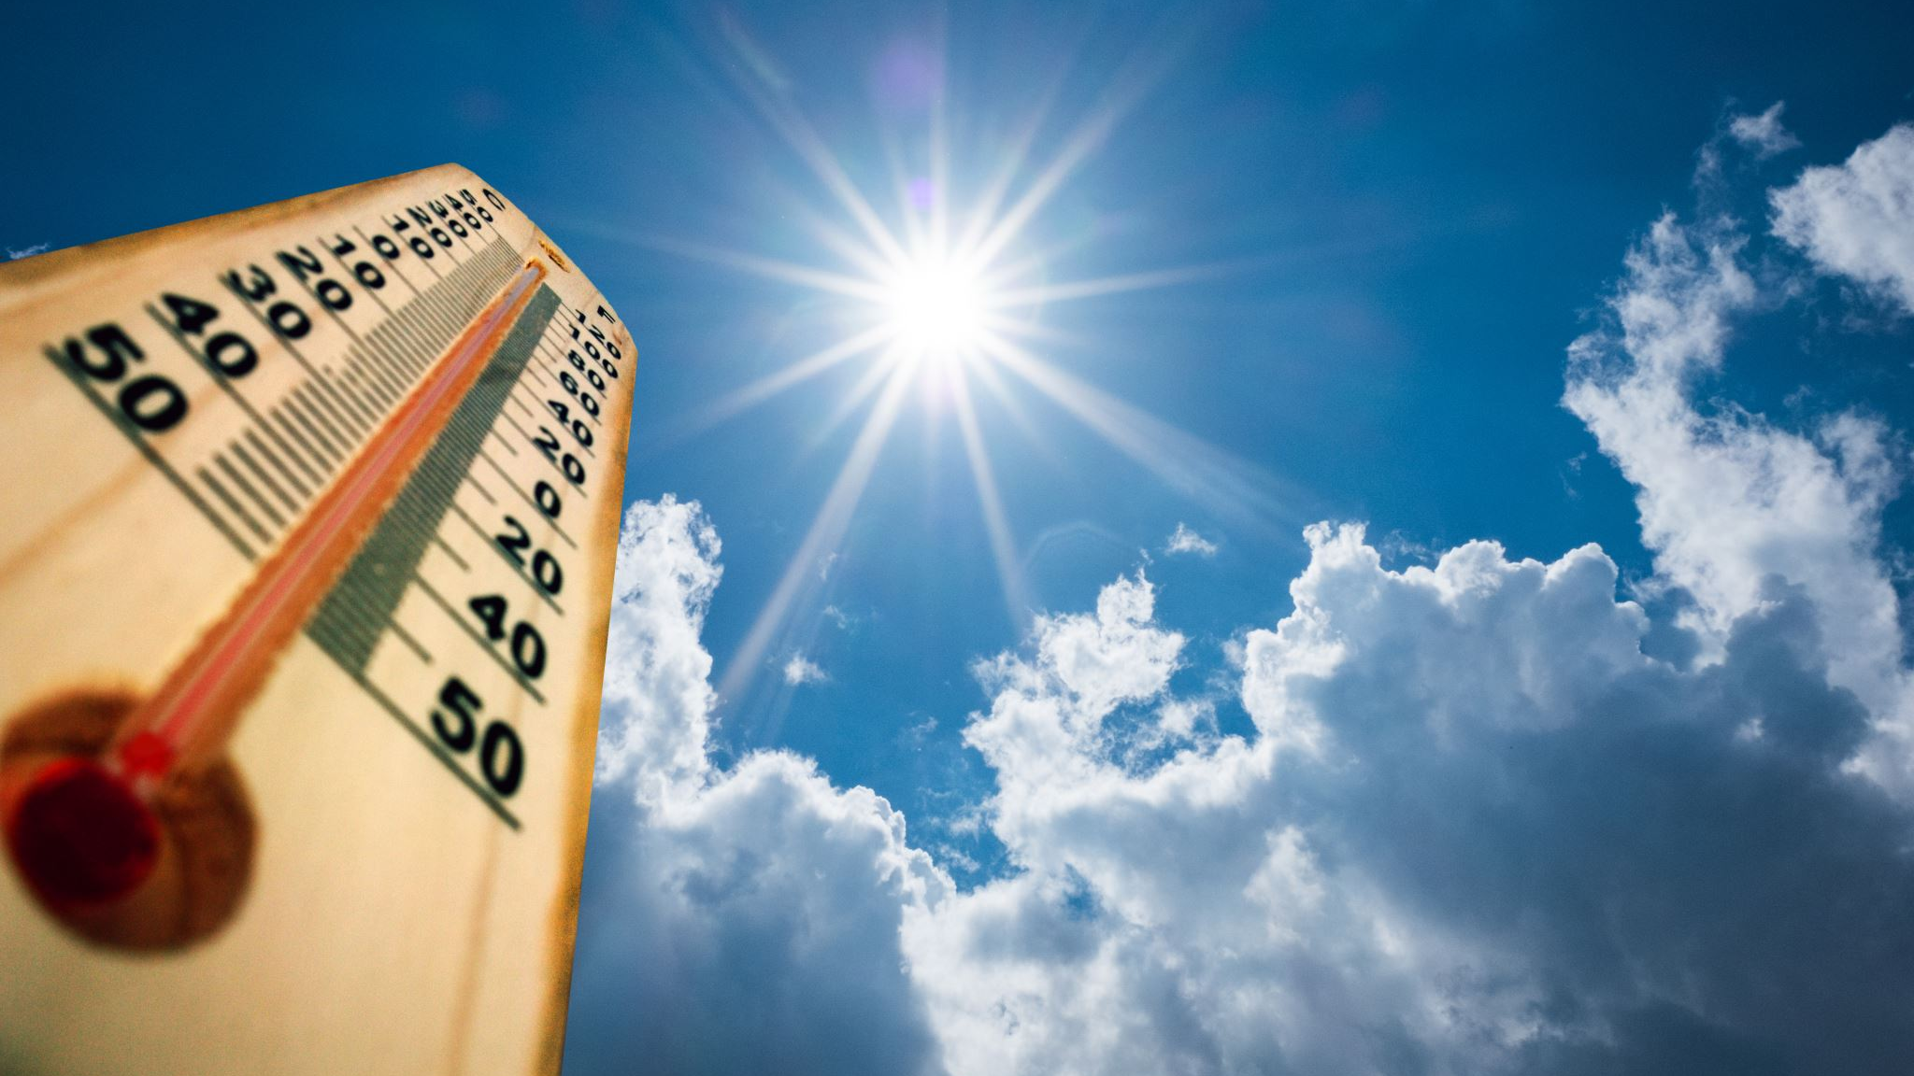
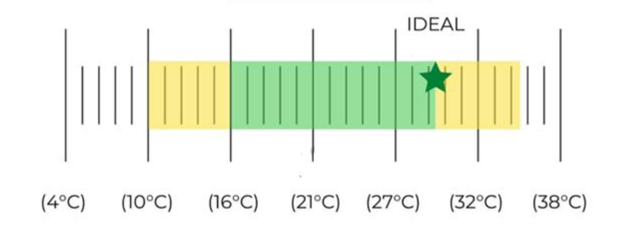
Temperature

Slide 6
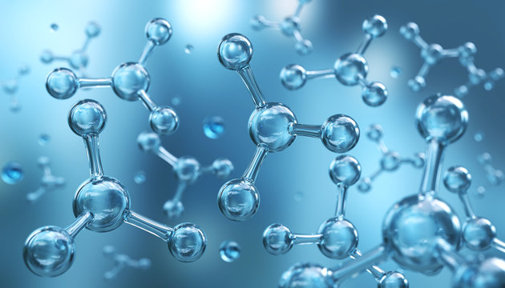
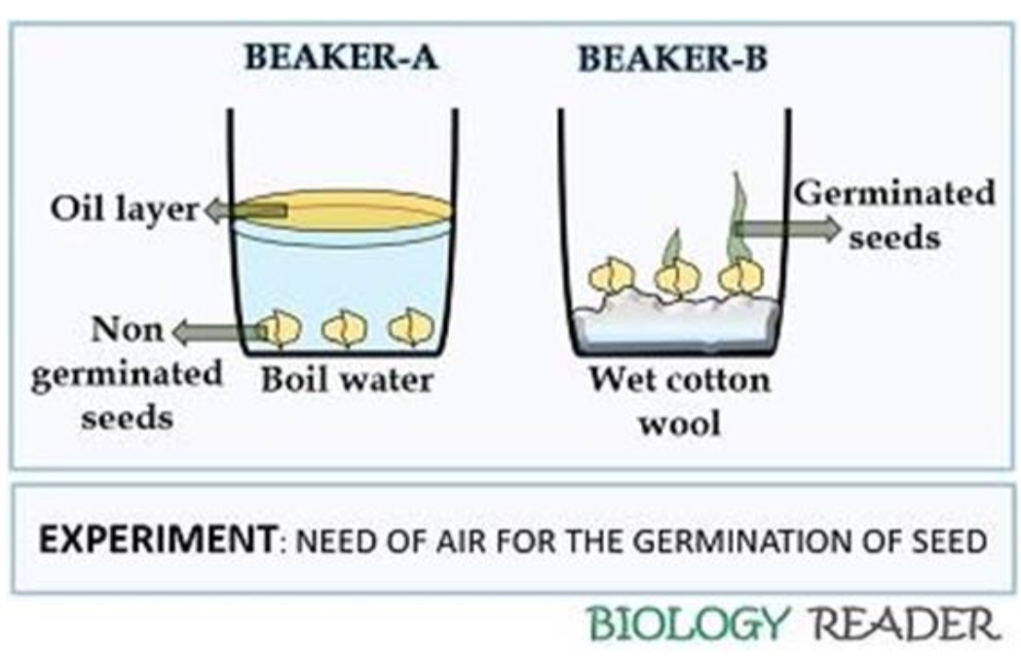
Oxygen

Slide 7
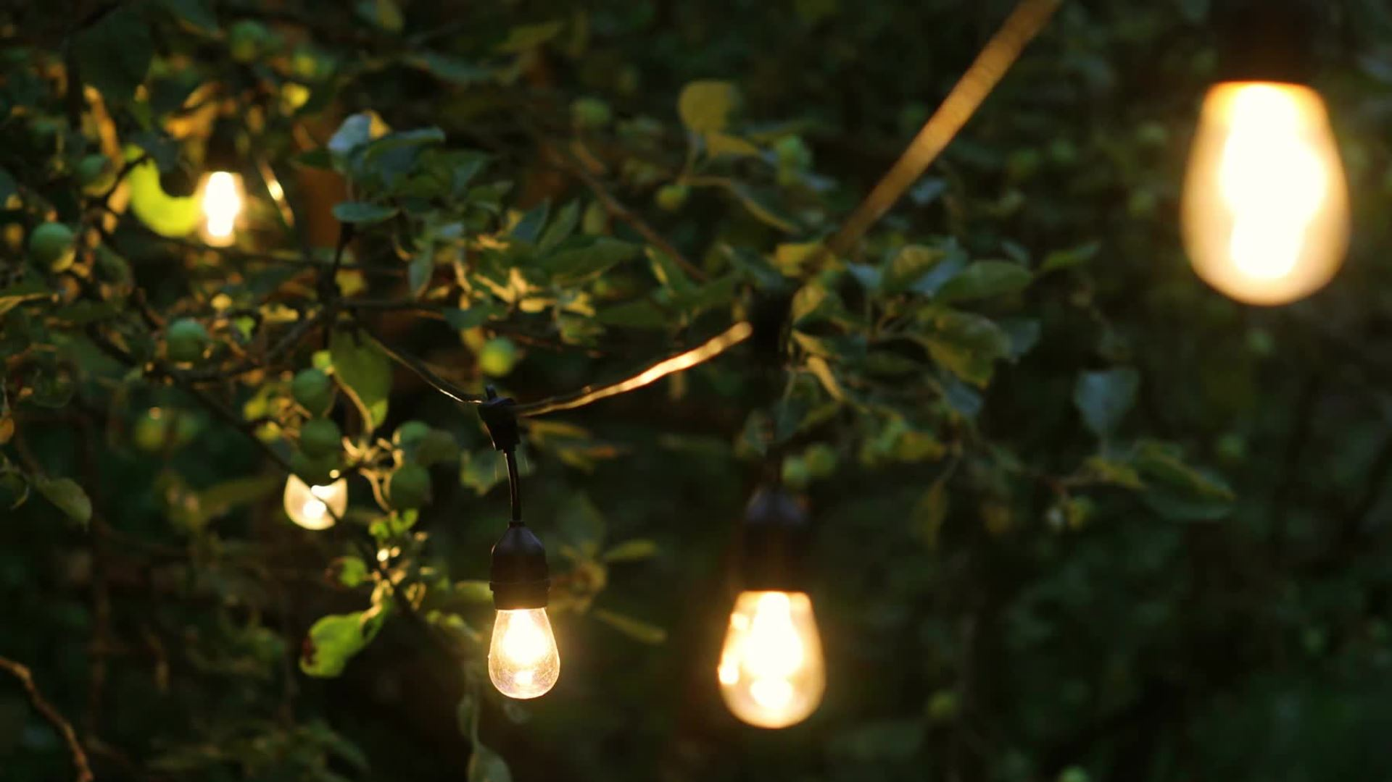
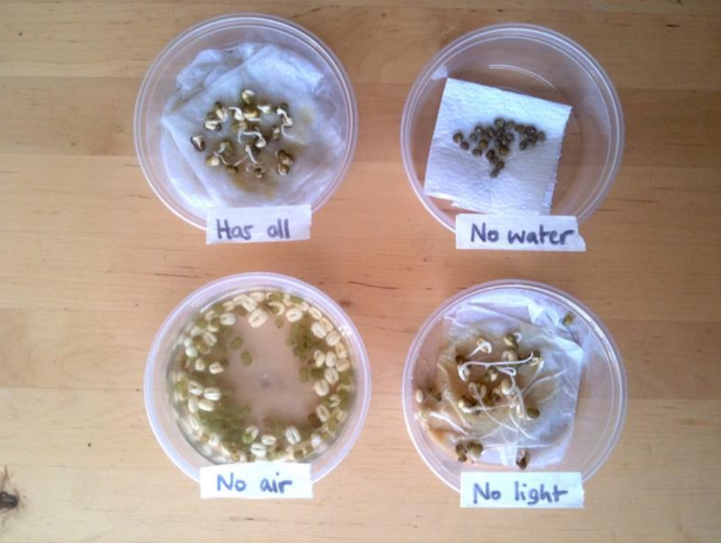
Light

Slide 8

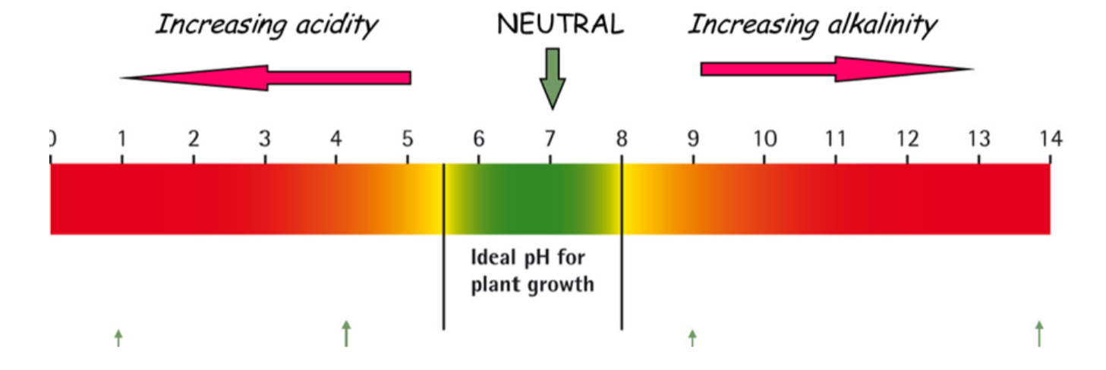
Soil pH

Slide 9

Materials
Seeds: 4. Containers
- Lactuca sativa - Shoeboxes with the light attached
- Zea mays - Plastic cups
- Phaseolus vulgaris 5. Watering equipment
2. Substrate - Spray bottle
- Paper 6. Environmental conditions
3. Lighting set up - Room temperature (22-25 Celsius)
- Red light (660 nm) 7. Measuring tool
- Blue light (450 nm) - Ruler
- Green light (530 nm)
- Yellow light (590 nm)
- Darkness

Slide 10

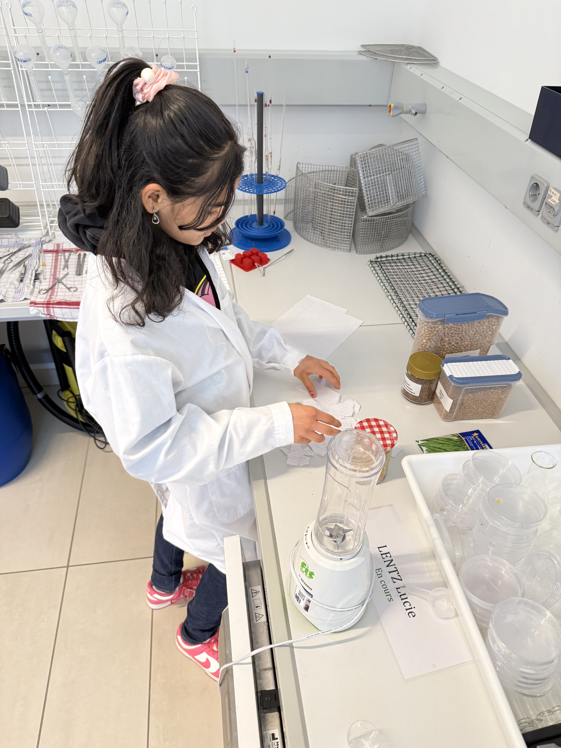
Methods
Preparation of the substrate
- Paper was moistened with water until damp.
2. Seed placement
- 10 seeds were placed evenly in each container.
3. Lighting conditions
- The LED lights were placed over the boxes.
4. Daily monitoring
- Moister level was checked
- The height was checked

Slide 11

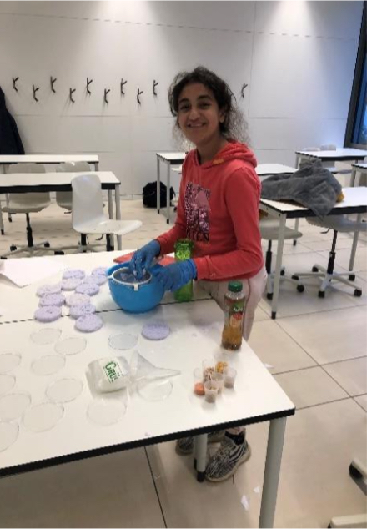
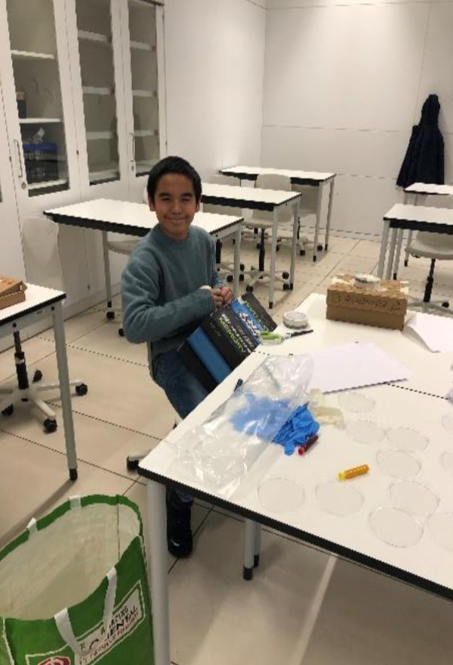
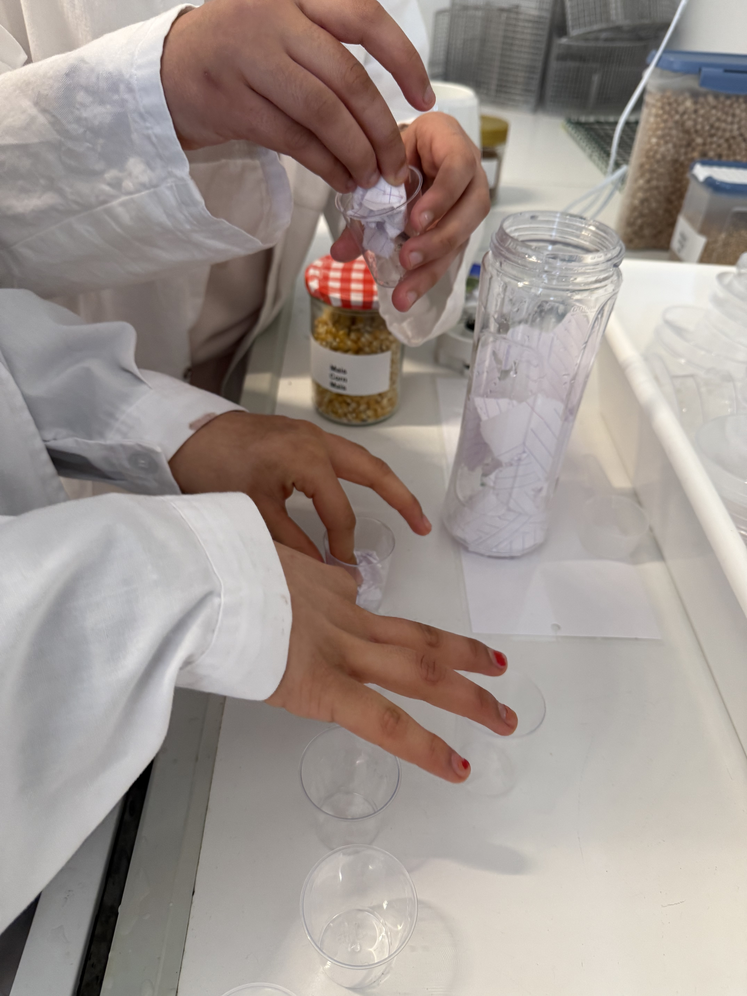
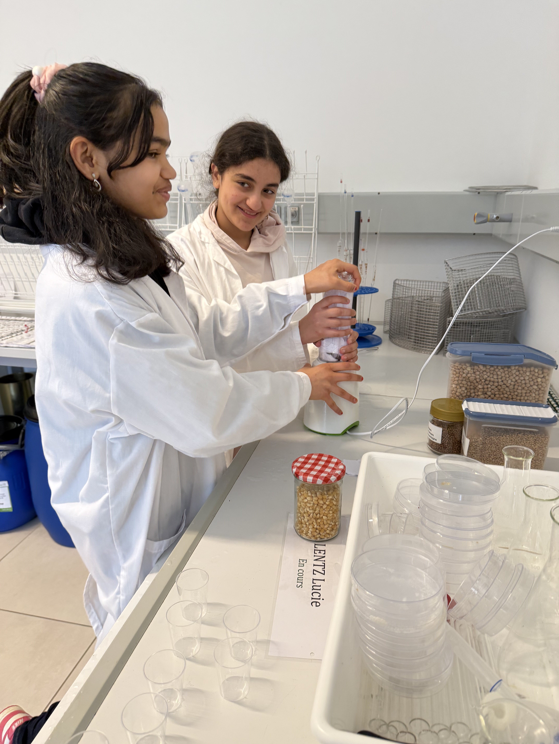
Calculation
The germination percentages were calculated after 10 days : number of germinated seeds x 100

Slide 12

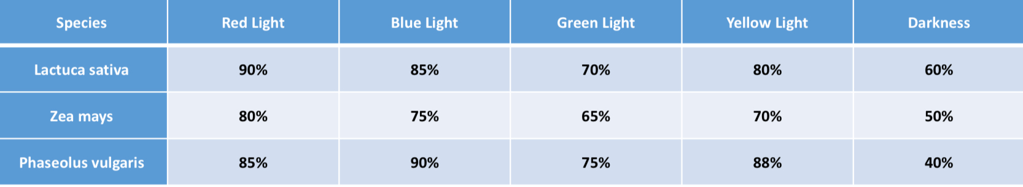
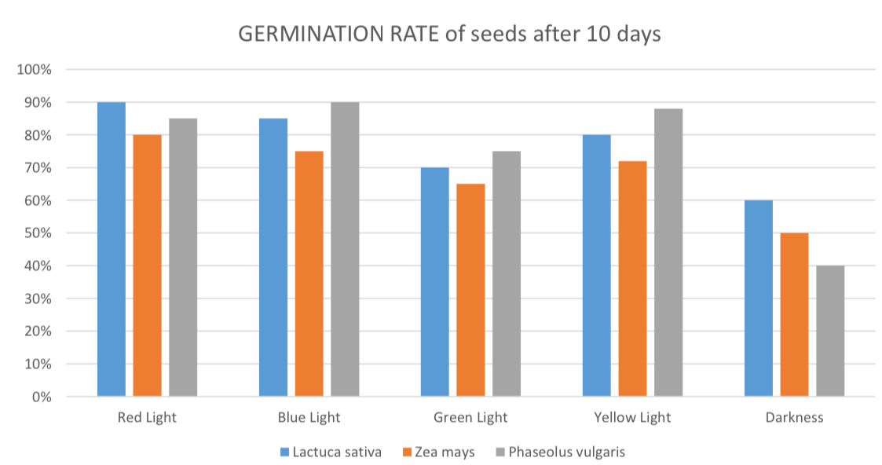
Germination ratio

Slide 13

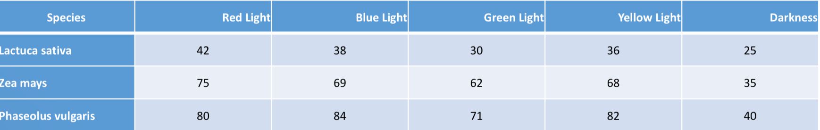
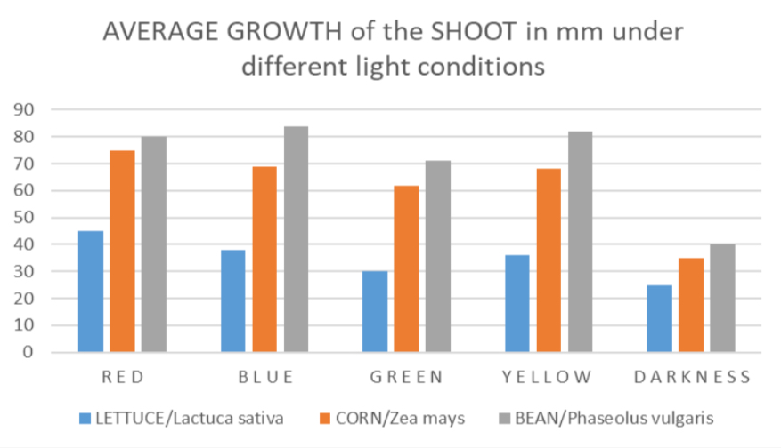
Average shoot length (mm)

Slide 14
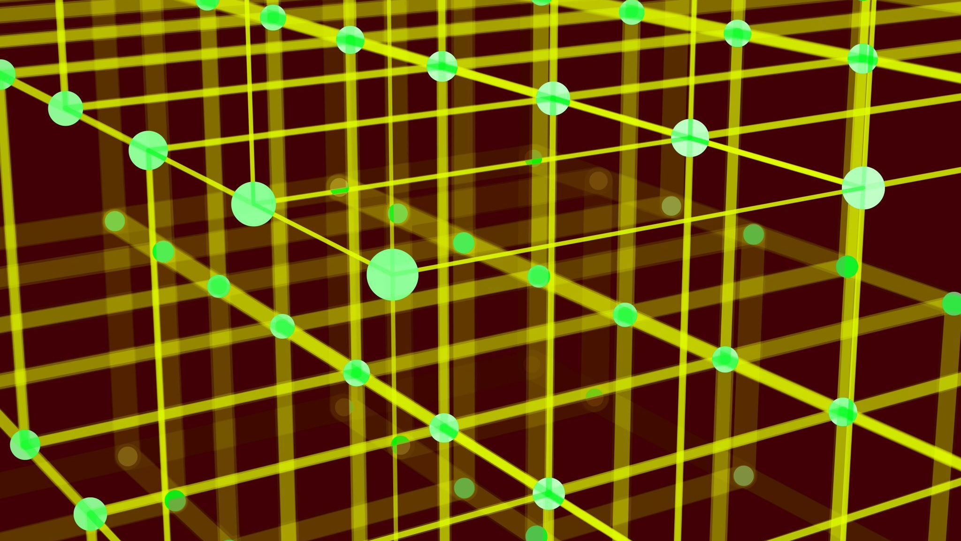
General observations
Lactuca sativa had the highest germination under red light, but average growth under other lighting conditions (except dark).
Zea mays germinated best under red light and grew well under blue light too. However, it demonstrated stunted growth under darkness.
Phaseolus vulgaris was less affected by the light colours in terms of germination. It had strong germination under red and blue light and stunted growth in darkness.

Slide 15

Discussion
Red light- Red light was beneficial for all plant species in our experiment.
Blue light- Blue light was very effective for plant germination, especially for beans.
Green light- Resulted in moderate growth.
Yellow light- Resulted in moderate growth.
Darkness- All species resulted in stunted growth.

Slide 16

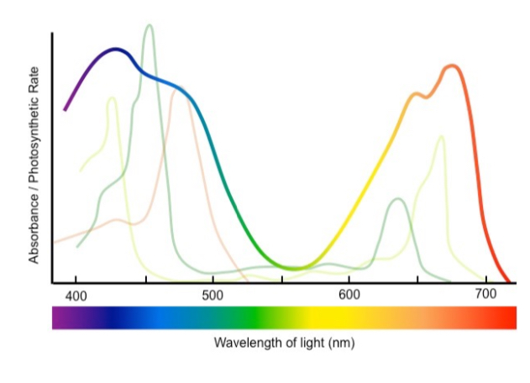
Conclusion
Different lighting conditions do have measurable impact on the early stages of plant growth on lettuce , beans and corn, which corresponds to the spectrum of light absorbed by the plants.
Action Spectrum | BioNinja

Slide 17

References
AgriTechTomorrow The Power of Red Light in Greenhouse Farming | AgriTechTomorrow Accessed
07.03.2025
- Eric Runkle: Eﬀects of Blue Lights on Plants- 2017.
- Chen, X., Xue, X., Guo, W., Wang, L., & Qiao, X. (2014). Growth and quality responses of 'Green Oak Leaf
leQuce to diﬀerent raOos of red light to blue light in a closed plant factory. InternaOonal Journal of
Agriculture & Biology, 16(4), 736-744.
- Raviv, M. & Lieth, J.H. (2008). Soilless Culture: Theory and PracOce. Elsevier.
- Raviv, M., Blom, T.J., & Giuﬀrida, F. (2019). Greenhouse and Nursery Management PracOces to Enhance
Sustainability. HortScience, 54(3), 611-618.
- Singh, D., Basu, C., Melear, N., & Roberts, R.J. (2015). Light emiung diodes in agriculture. Renewable and Sustainable Energy Reviews, 46, 31-42.
Spectrum of light picture + more mentioned on the report.

