Slide 1
Fine Tuning Photosynthesis
Focusing on Plant’s Favourite Colors
Abdullah Siam | S3ENA | European School RheinMain

Slide 2
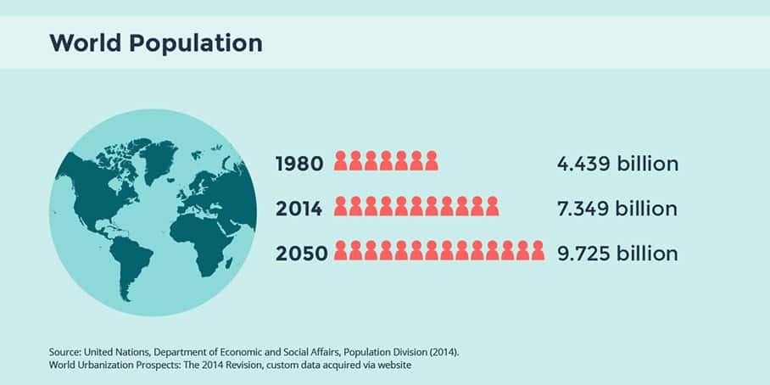
Background
The global population is projected to reach 9.7 billion by 2050.
60% increase in food production is needed.
More agricultural land is not possible but more efficient methods.
Methods to increasing food production:
  Aeroponics
  Hydroponics
  Gene Editing
  LEDs
https://www.google.com/url?sa=i&url=https%3A%2F%2Fwww.urbanet.info%2Fworld-urban-population%2F&psig=AOvVaw1w46yIy-p1Akr4vKswaIq1&ust=1742671264511000&source=images&cd=vfe&opi=89978449&ved=0CBcQjhxqFwoTCMjk4NDym4wDFQAAAAAdAAAAABAE

Slide 3
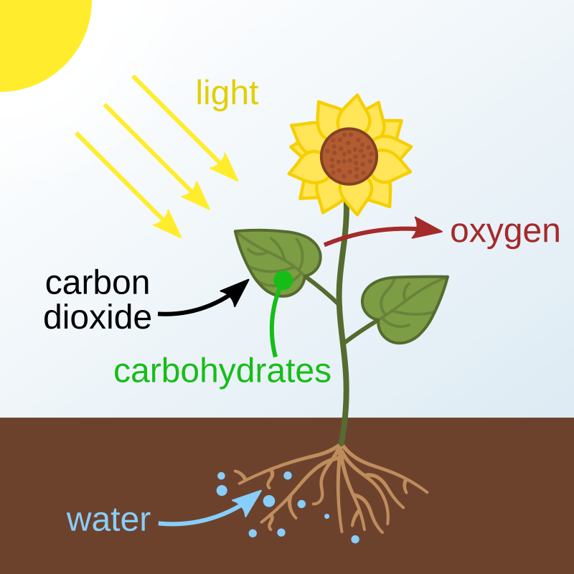
Photosynthesis
Photosynthesis:
  Green plants convert light energy into chemical energy..
  6H₂O + 6CO₂ C₆H₁₂O₆ + 6O₂
Factors:
  Light Intensity and Quality
  Temperature
  CO₂ Concentration
  Water Availability
Sunlight

Slide 4
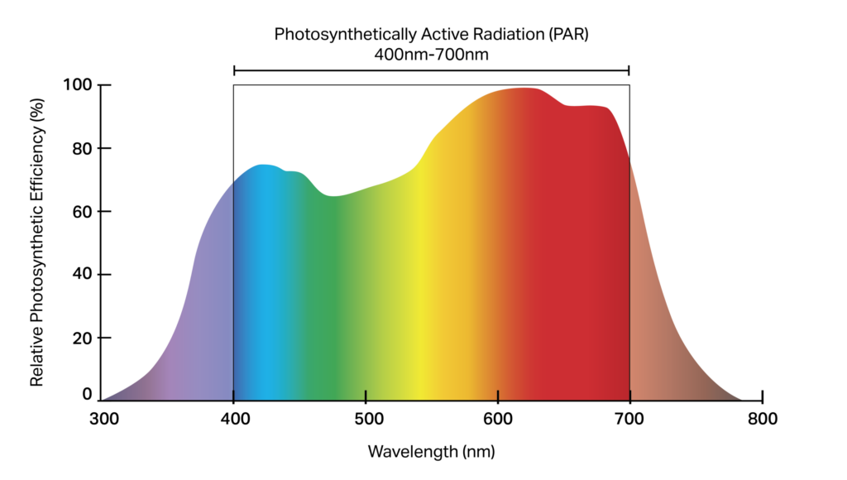
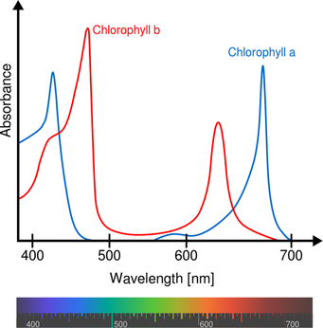
Photosynthetic Efficiency
Photosynthetic Efficiency:
  Ratio chemical energy in a plant to energy of light absorbed.
  Indicates how efficiently plant uses light energy for growth.
  Theoretical maximum – 26%.
  Average efficiency – 1 to 3%.
Photosynthetic Efficiency & Light Quality:
  Chlorophyll A and B best absorb blue (400 – 500 nm) and red (600 – 700 nm) wavelengths.
  Blue and red wavelengths also have the highest relative photosynthetic efficiency.
  LEDs are used to emit these wavelengths.
https://www.researchgate.net/figure/The-wavelength-range-of-the-photosynthetically-active-radiation-PAR-Nelson-and-Bugbee_fig5_364386462.
https://www.researchgate.net/figure/The-wavelength-range-of-the-photosynthetically-active-radiation-PAR-Nelson-and-Bugbee_fig5_364386462.

Slide 5
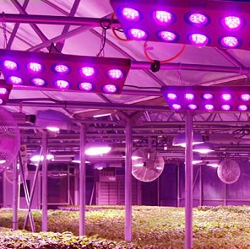
Use of LEDs
LEDs can be used to increase plant growth by emitting specific wavelengths.
Advantages of LEDs:
  Low power consumption.
  Customizable and scalable.
  Able to emit specific wavelengths precisely.
Disadvantages of LEDs:
  High initial cost.
  Large scale operations use a lot of electricity.
  Require mining of rare earth metals.
( https://www.ledinside.com/news/2014/7/world_largest_led_plant_grow_factory_built_in_japan )

Slide 6
Alternative to LEDs
A more environmentally option to LEDs was investigated- Optic gel filters.
1
Gelatine is natural and biodegradable.
2
No electricity consumption.
3
No electronic waste and mining.
More environmentally friendly.

Slide 7
Question
Does the use of optic gel increase the photosynthetic efficiency of:
  Primula vulgaris (common Primrose).
  Thymus vulgaris (Thyme).
Can the use of a blue or red focused spectrum in isolation yield desired attributes in plants?

Slide 8
Hypothesis – Photosynthetic Efficiency
Plants under filter will have an increased photosynthetic efficiency despite ~ 50% less sunlight:
  Photosynthetic efficiency is higher at lower sunlight intensities.
  Plants anyway only absorb 34% of sunlight.
  Photoinhibition is avoided.
  By focusing only on needed wavelengths, less energy will be wasted processing unneeded wavelengths.

Slide 9
Hypothesis – Morphological Effects
Plants under the blue filter:
  Better health and more even growth.
  More vegetative growth in Thymus vulgaris.
  More leaves for Primula vulgaris.
  Increased photosynthetic efficiency for Thymus vulgaris.
Plants under the red filter:
  More vibrant colors.
  More flowers in Primula vulgaris.
  Larger leaf and canopy area for both species.
  Increased photosynthetic efficiency for Primula vulgaris.

Slide 10
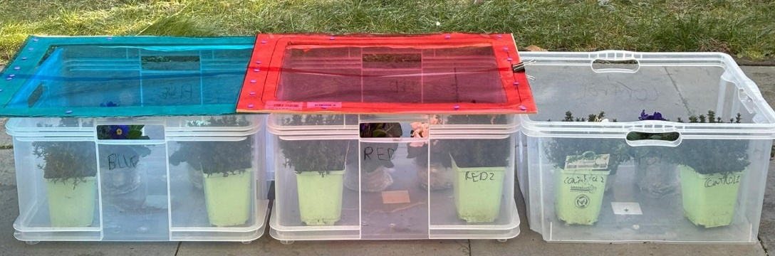
Methods
Six specimens each from Thymus vulgaris and Primula vulgaris in total.
3 groups – red, blue, and control.
Two specimens each from species.
Red Group:
  Under a filter, which mainly transmits red wavelengths (600 – 700 nm).
Blue Group:
  Under a filter, mainly transmitting blue wavelengths (400 – 500 nm)
Control Group:
  No filter – natural sunlight.

Slide 11
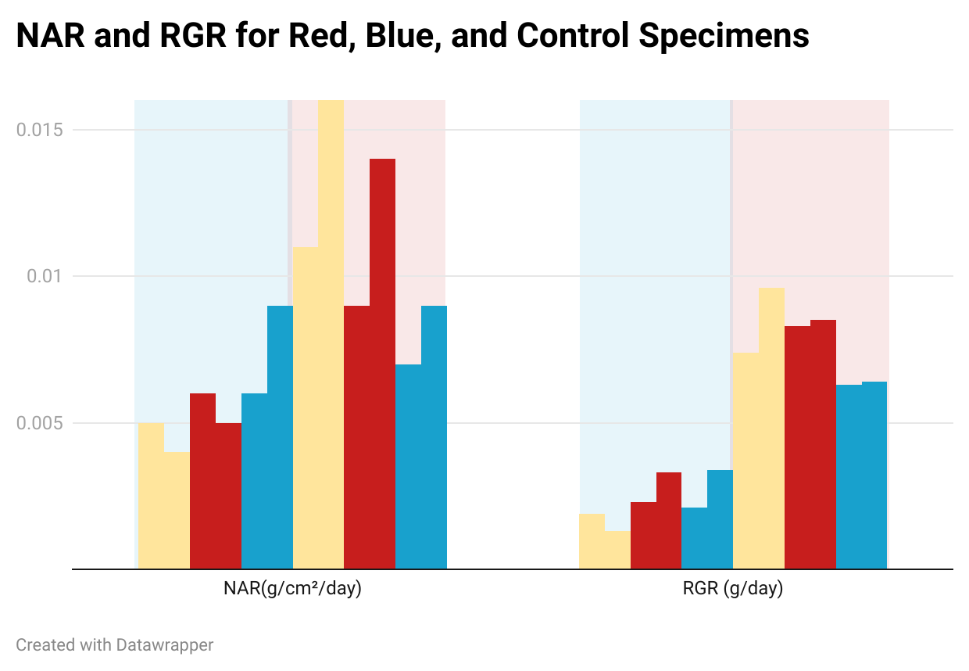
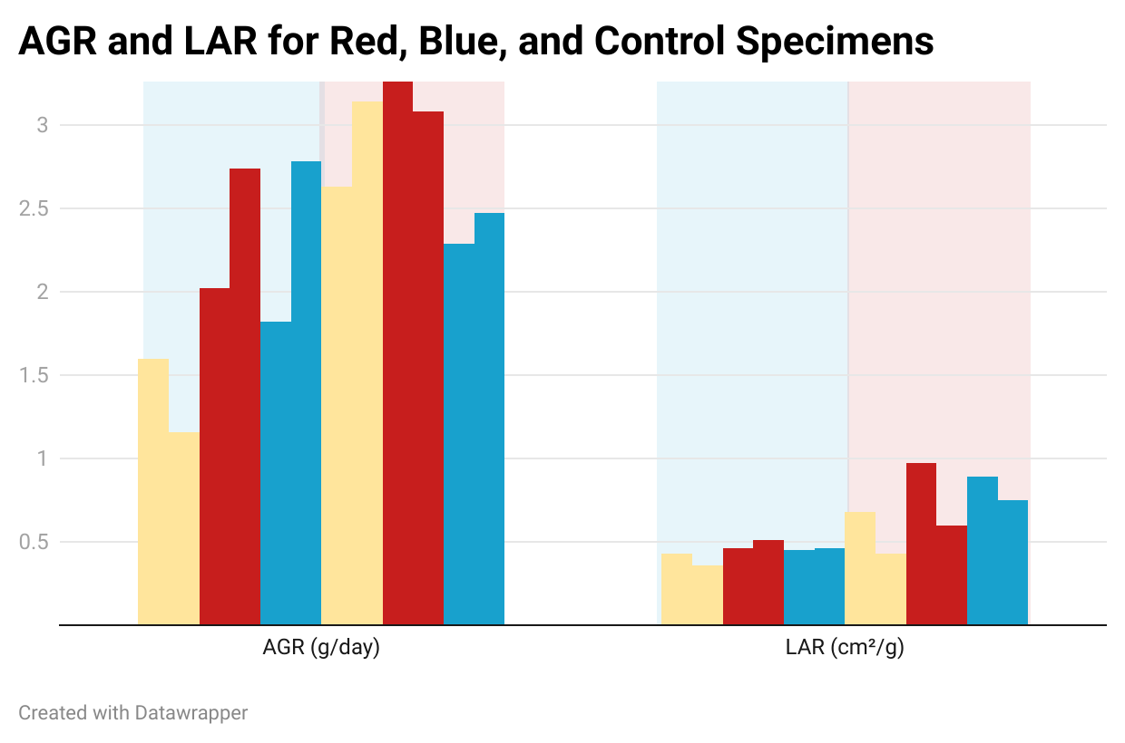
Results – Photosynthetic Efficiency
Same Species of Each Group | Average Photosynthetic Efficiency
Primula vulgaris | 0.99
Thymus vulgaris | 0.72
Primula vulgaris | 0.8
Thymus vulgaris | 0.69
Primula vulgaris | 0.87
Thymus vulgaris | 0.45

Slide 12
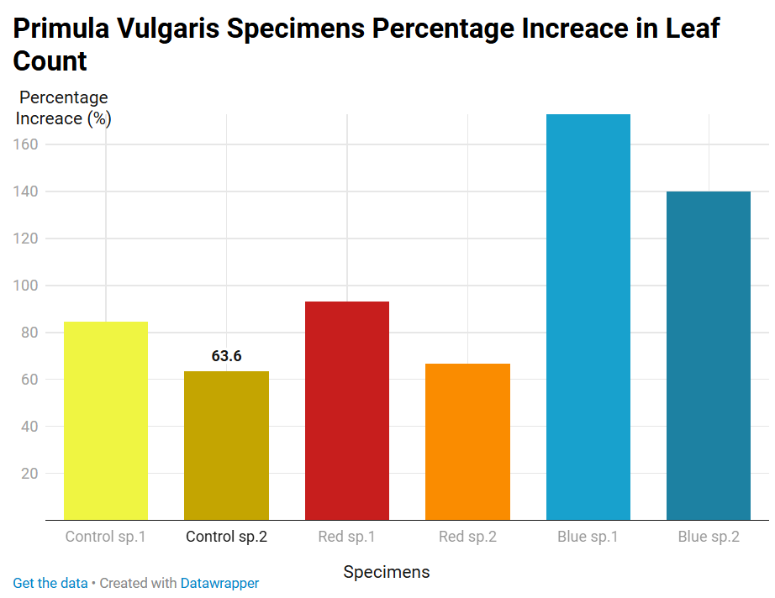
Results – Morphology (Primula vulgaris)
Red Group:
  Canopy area
  Leaf area
  Flower count.
Blue Group:
  Height
  Leaf count
  Color
  Health
Control Group:
  Mass

Slide 13
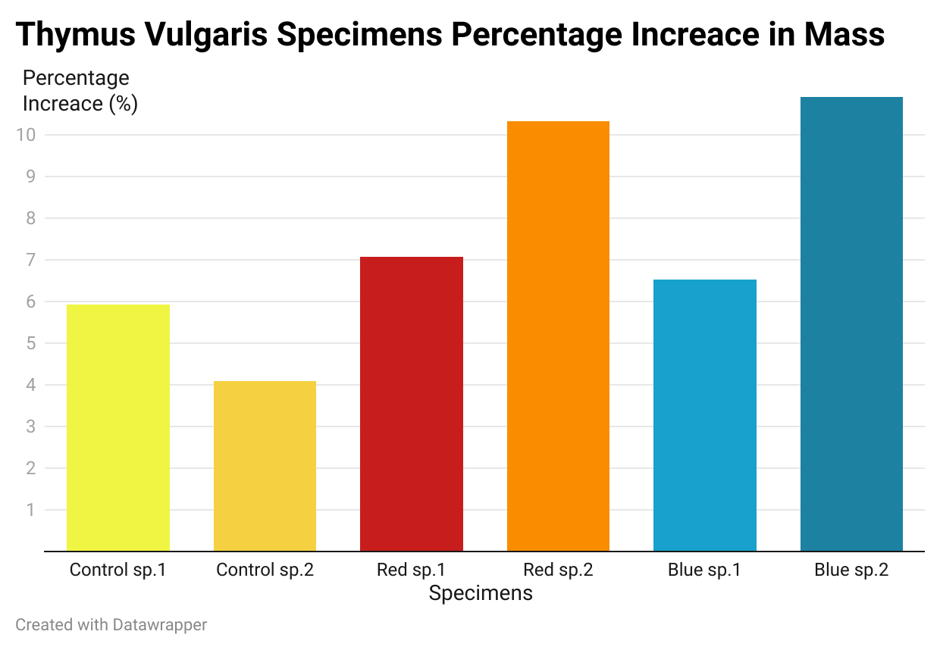
Results – Morphology
(Thmus vulgaris)
Red Group:
  Canopy Area
Blue Group:
  Height
  Mass
Control Group:
  In no metric the control group performed better.

Slide 14
Conclusion
A red focused spectrum increased photosynthetic efficiency the most for both species (~ 30% more).
Red Focused Spectra
A blue focused spectrum was better than natural sunlight for Thymus vulgaris.
Blue Focused Spectra
Red and blue focused spectra had different morphological consequences for plants, trading off better results in some aspects of growth for bad results in other aspects.
Morphological Consequences

Slide 15
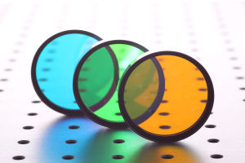
Next Steps
Experiment with interference filters:
  More environmentaly friendly.
  More precise.
Combine red and blue filters for higher photosynthetic efficiency.
https://www.google.com/url?sa=i&url=https%3A%2F%2Fwww.comaroptics.com%2Fproducts%2Ffilters%2Finterference-filters&psig=AOvVaw0pEO93ZszDXDbYCTspY_kj&ust=1742824978786000&source=images&cd=vfe&opi=89978449&ved=0CBcQjhxqFwoTCLi33ZmvoIwDFQAAAAAdAAAAABAJ

Slide 16
Acknowledgements
I would like to thank Dr. Anne Samland for help and guidance throughout my project.

Slide 17
References
EIT Food. https://www.eitfood.eu/blog/sustainably-feeding-the-world-in-2050-are-efficiency-and-equity-the-answer. Accessed 19/02/2025.
Internet Geography. https://www.internetgeography.net/topics/how-can-we-increase-the-amount-of-food-produced-globally/. Accessed 21/03/2025.
Tony Blair Institute for Global Change. https://institute.global/insights/tech-and-digitalisation/gene-editing-food-production-charting-way-forward. Accessed 21/03/2025.
Brittanica. https://www.britannica.com/science/photosynthesis/Basic-products-of-photosynthesis. Accessed 26/11/2024.
Max Plank Institute. https://www.mpsd.mpg.de/17628/2015-04-chlorophyll-rubio. Accessed 26/11/2024.
Research Gate. https://www.researchgate.net/figure/The-wavelength-range-of-the-photosynthetically-active-radiation-PAR-Nelson-and-Bugbee_fig5_364386462. Accessed 04/03/2025.
Banagel. https://banagelatin.com/gelatin_sustainability/#:~:text=Gelatin%20is%20a%20beneficial%20and,are%20produced%20by%20chemical%20synthesis.. Accessed 22/03/2025.
Vertiket. https://www.vertikit.co.uk/the-influence-of-different-light-wavelengths-on-plant-growth/. Accessed 22/03/2025.

Slide 18
References
Research Gate. https://www.researchgate.net/publication/344934119_Increasing_Growth_of_Lettuce_and_Mizuna_under_Sole-Source_LED_Lighting_Using_Longer_Photoperiods_with_the_Same_Daily_Light_Integral. Accessed 05/12/2024.
ScienceDirect. https://www.sciencedirect.com/topics/agricultural-and-biological-sciences/photoinhibition#:~:text=Photoinhibition%20of%20photosynthesis%20is%20defined,decreased%20overall%20capacity%20for%20photosynthesis. Accessed 06/01/2025.

Slide 19

Thank you for your attention.
Questions?

Slide 20
Extra Information

Slide 21
Morphological Effects
Red Light
Encourages flowering and fruit production.
Leaf expansion and stem elongation.
Blue Light
Equal leaf distribution and compact growth.
Better health and increased chlorophyll production.
Green Light
Penetrates through foliage better, reaching more plants.
Also leads to leaf expansion.
More stomatal opening.

Slide 22

Metrics
Photosynthetic Efficiency:
Average Growth Rate (AGR)
Relative Growth Rate (RGR)
Net Assimilation Rate (NAR)
Leaf Area Ratio (LAR)
Morphological Effects:
Height
Canopy and leaf area
Visual analysis of health and color.
Flower and leaf count

Slide 23
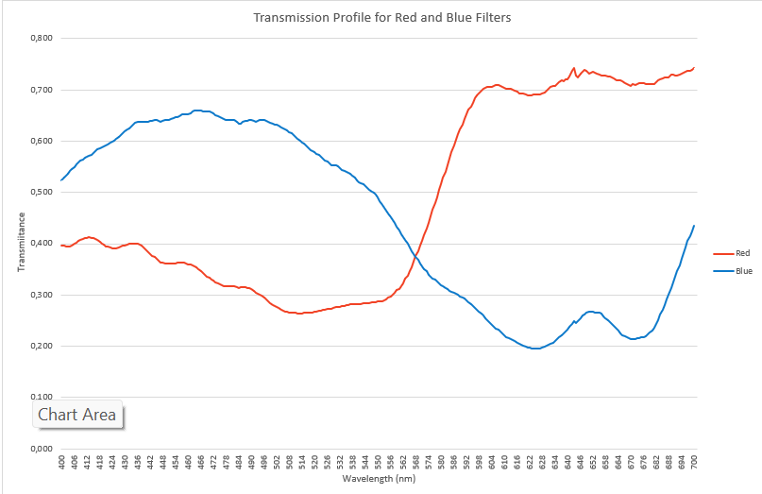
Choice of Filters
Red Filter:
  LEE 109 Salmon.
  Transmitted ~ 48.3% of sunlight.
  640 – 670 nm wavelengths were transmitted the most.
Blue Filter:
  LEE 117 Steel Blue.
  Transmitted ~ 44.4% of sunlight.
  440 – 470 nm wavelengths were transmitted the most.

