Slide 1
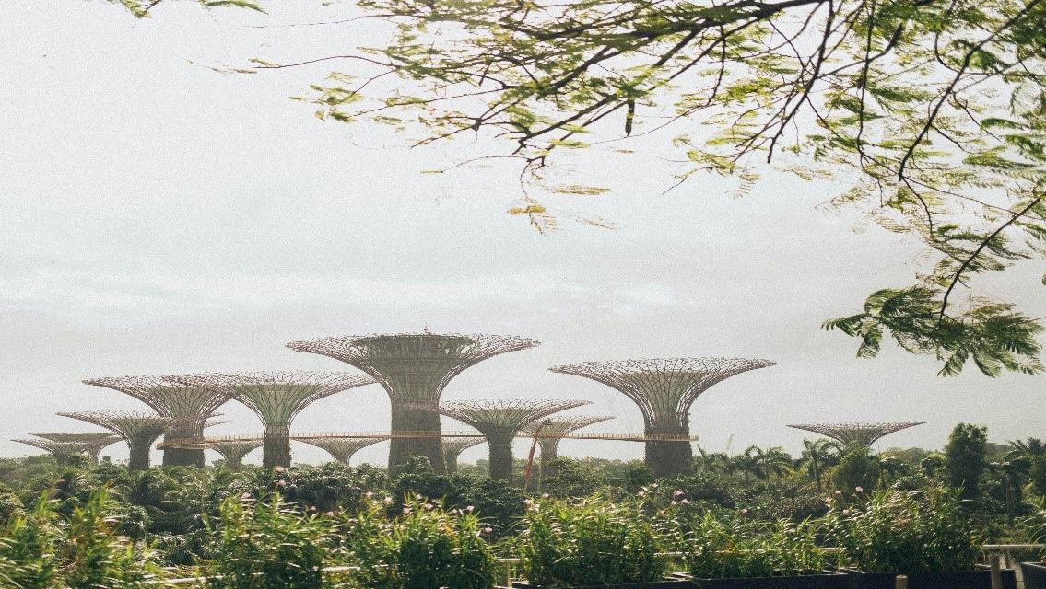
Sustainable Cities
How can Cities Become More Sustainable?

Slide 2
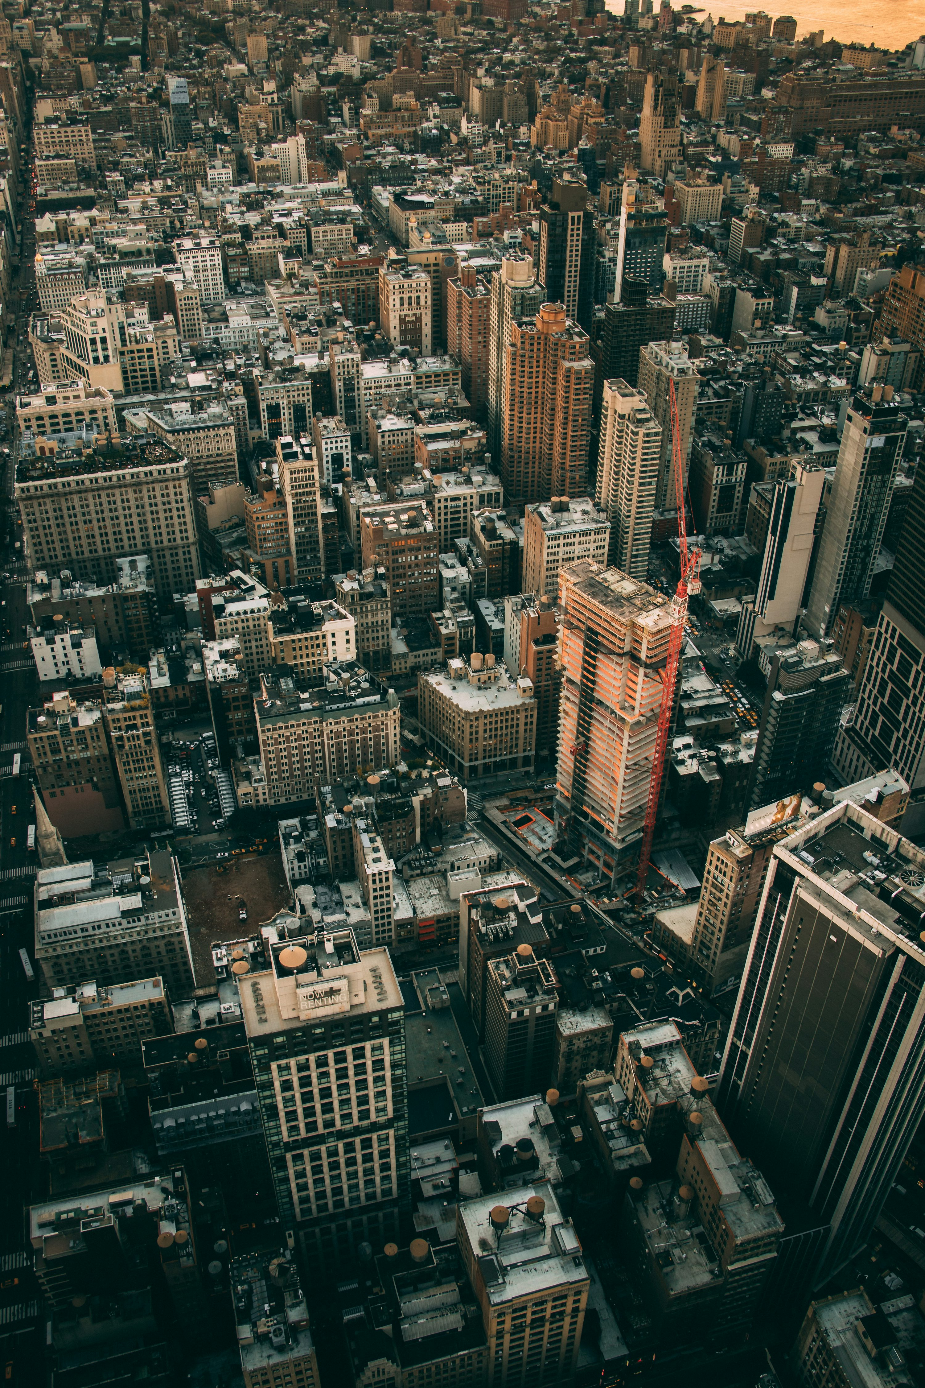
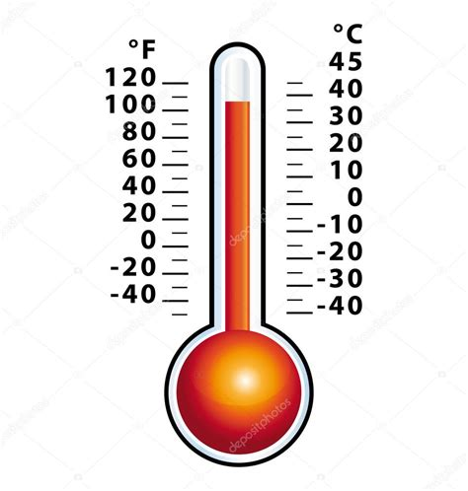
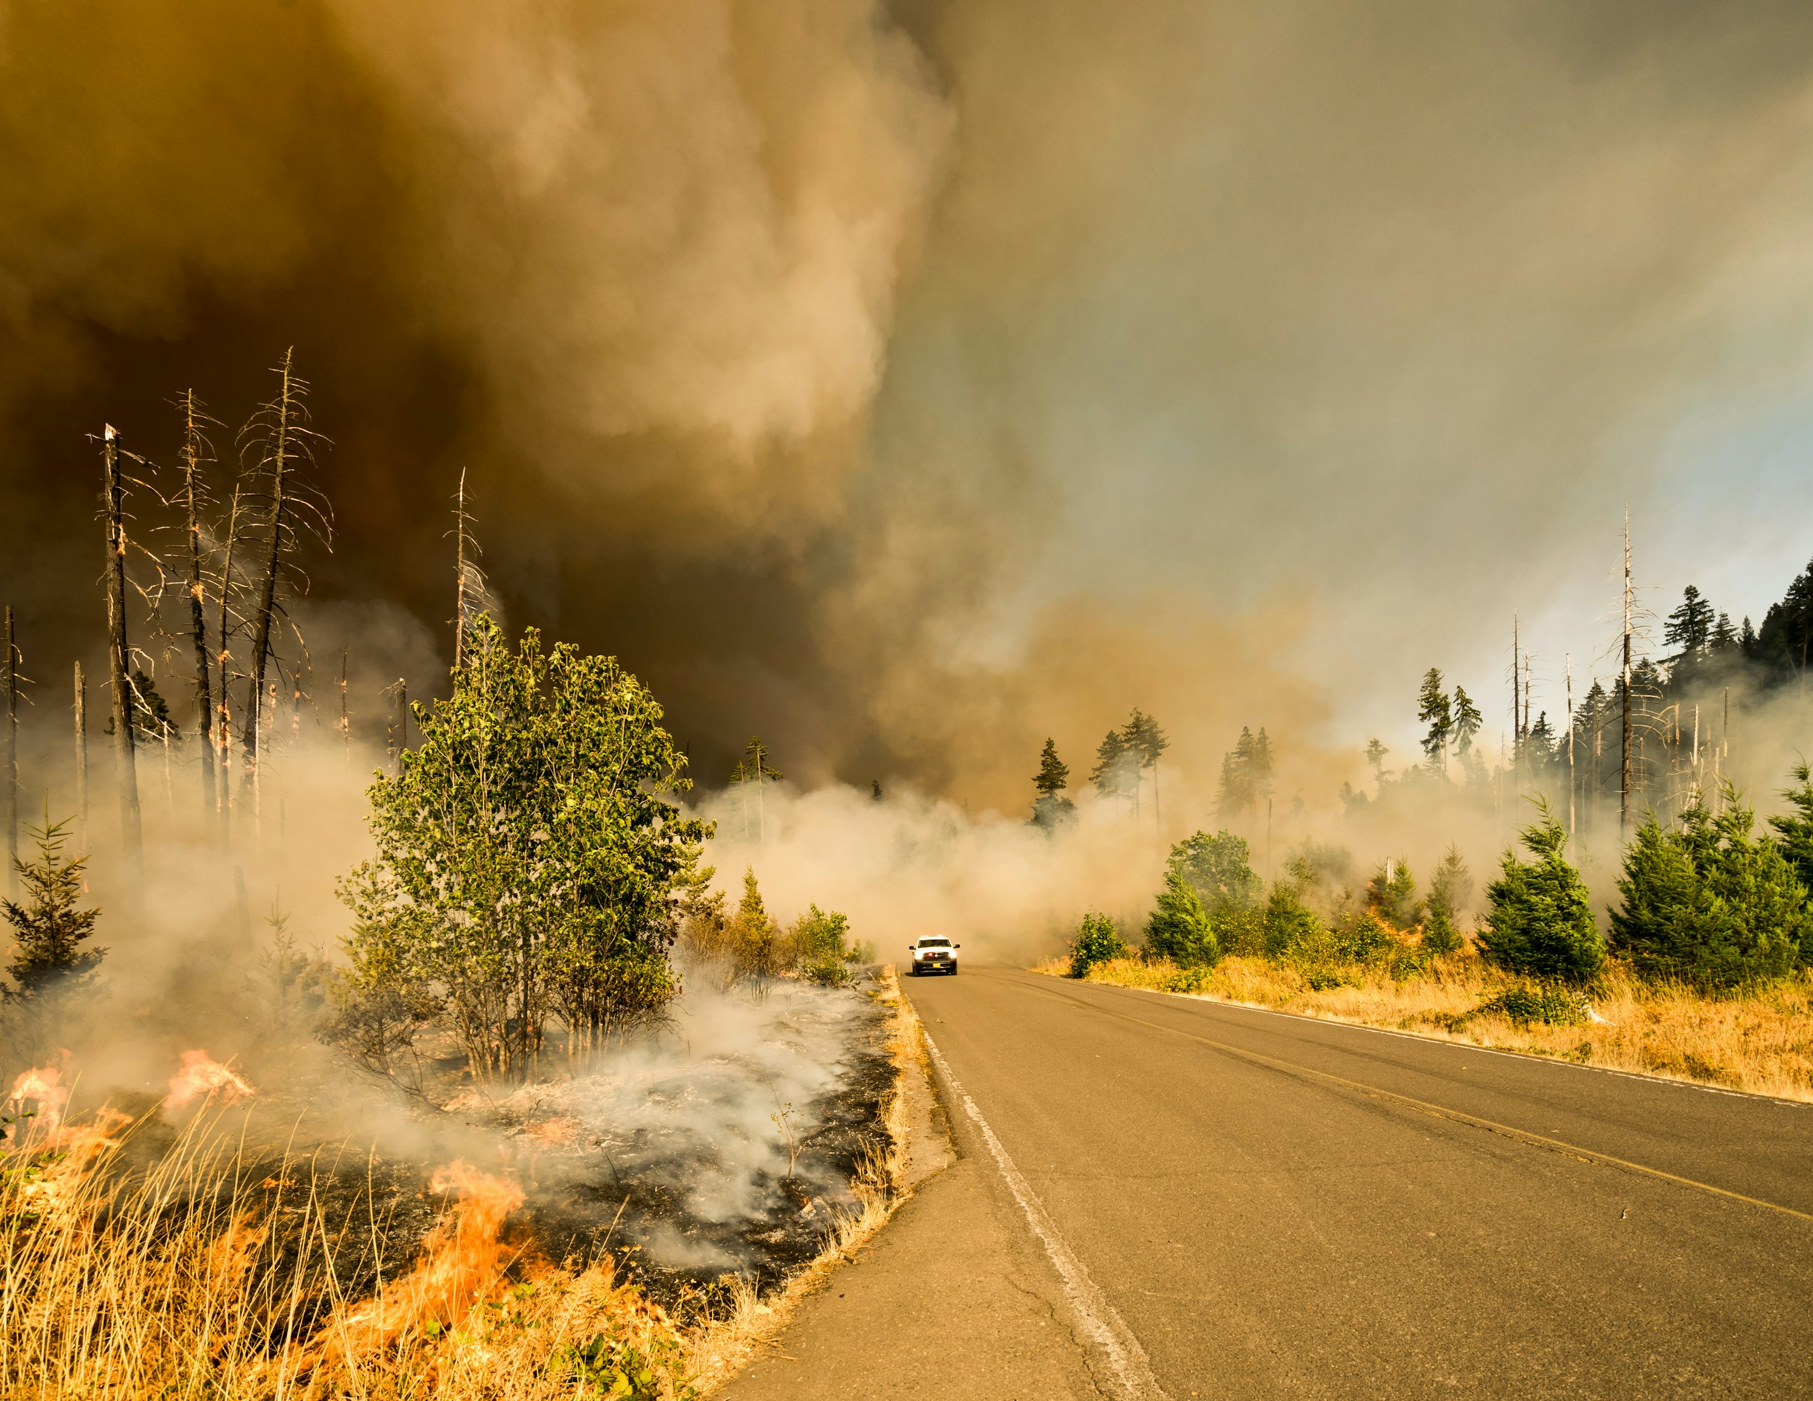
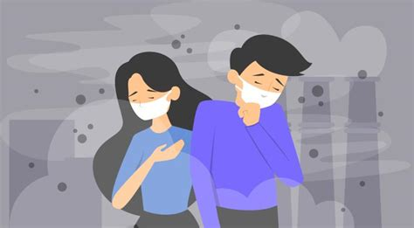
Why Sustainable Cities?

Slide 3

Aim of Project
Presenting a roadmap towards sustainable cities
Helping to improve sustainability in my city

Slide 4
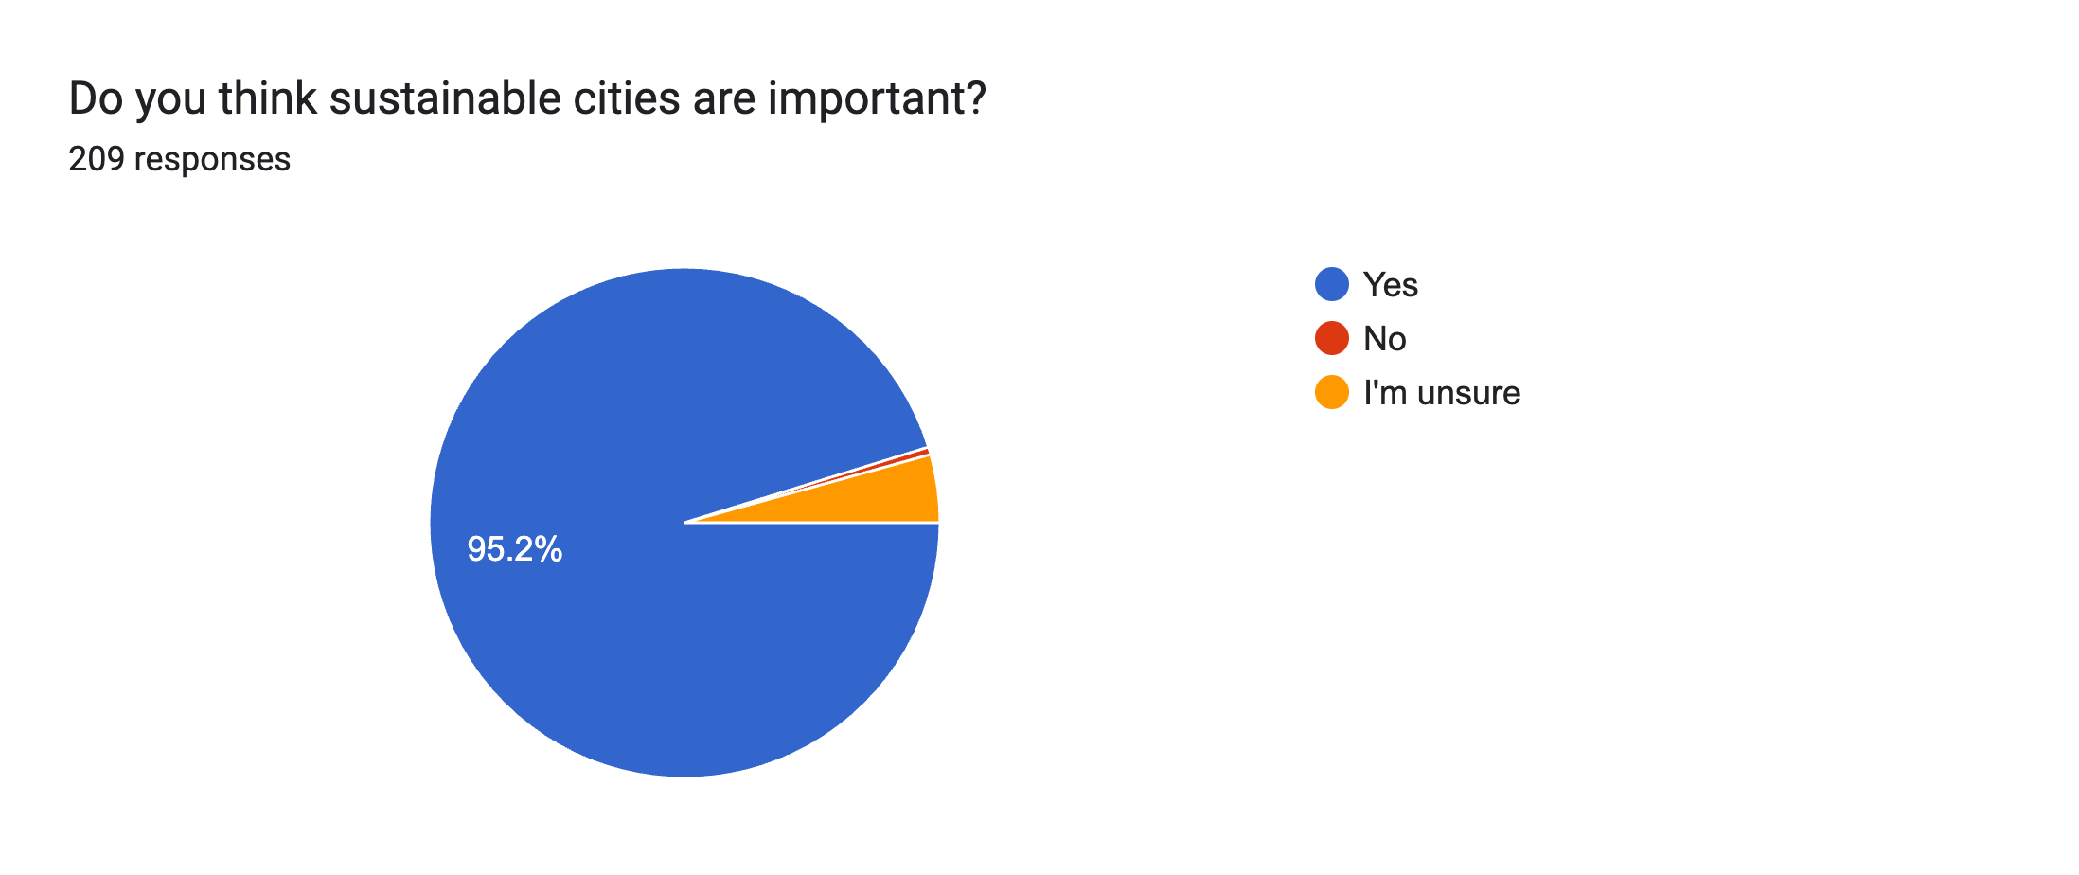
Survey

Slide 5
Survey

Slide 6
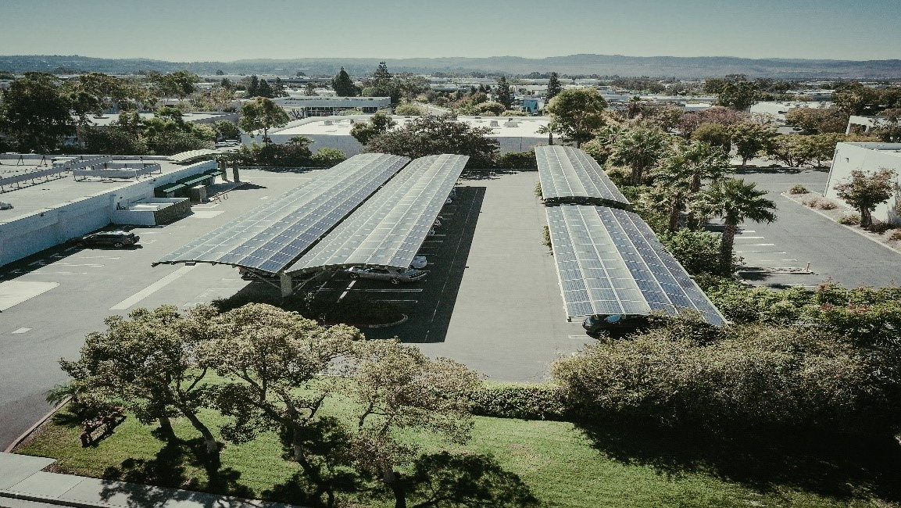
Survey Analysis
Sustainable cities are important for many
Concern for many: climate change, expensive living, little urban greenery, too much waste generation and little awareness and action
Most frequent solutions mentioned: financial support from government, more investments on sustainability, awards for living sustainably, improving public transport, incorporating urban greenery and educating the young generation in school

Slide 7
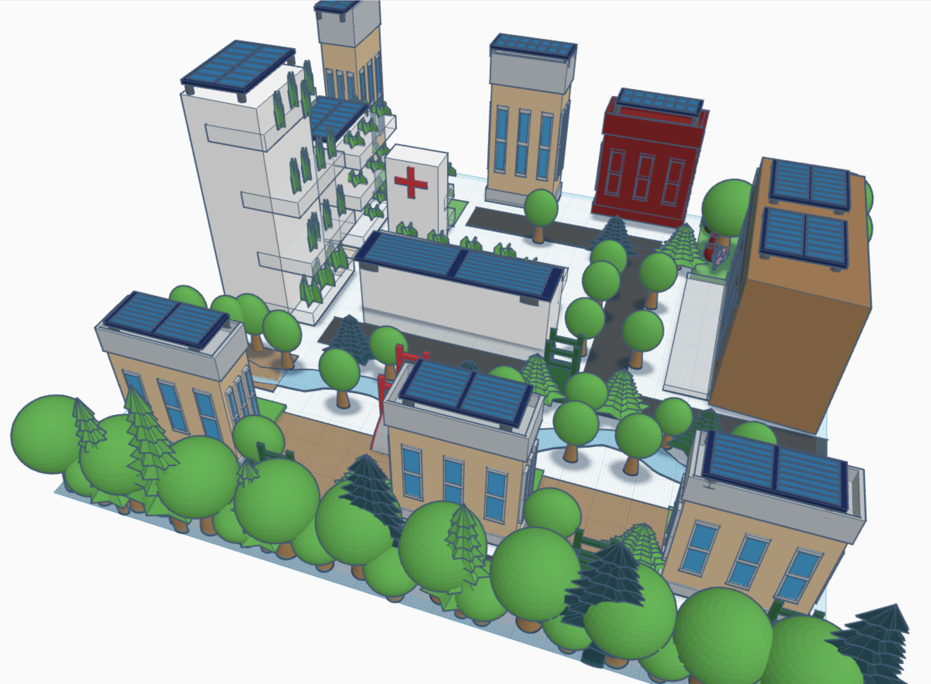
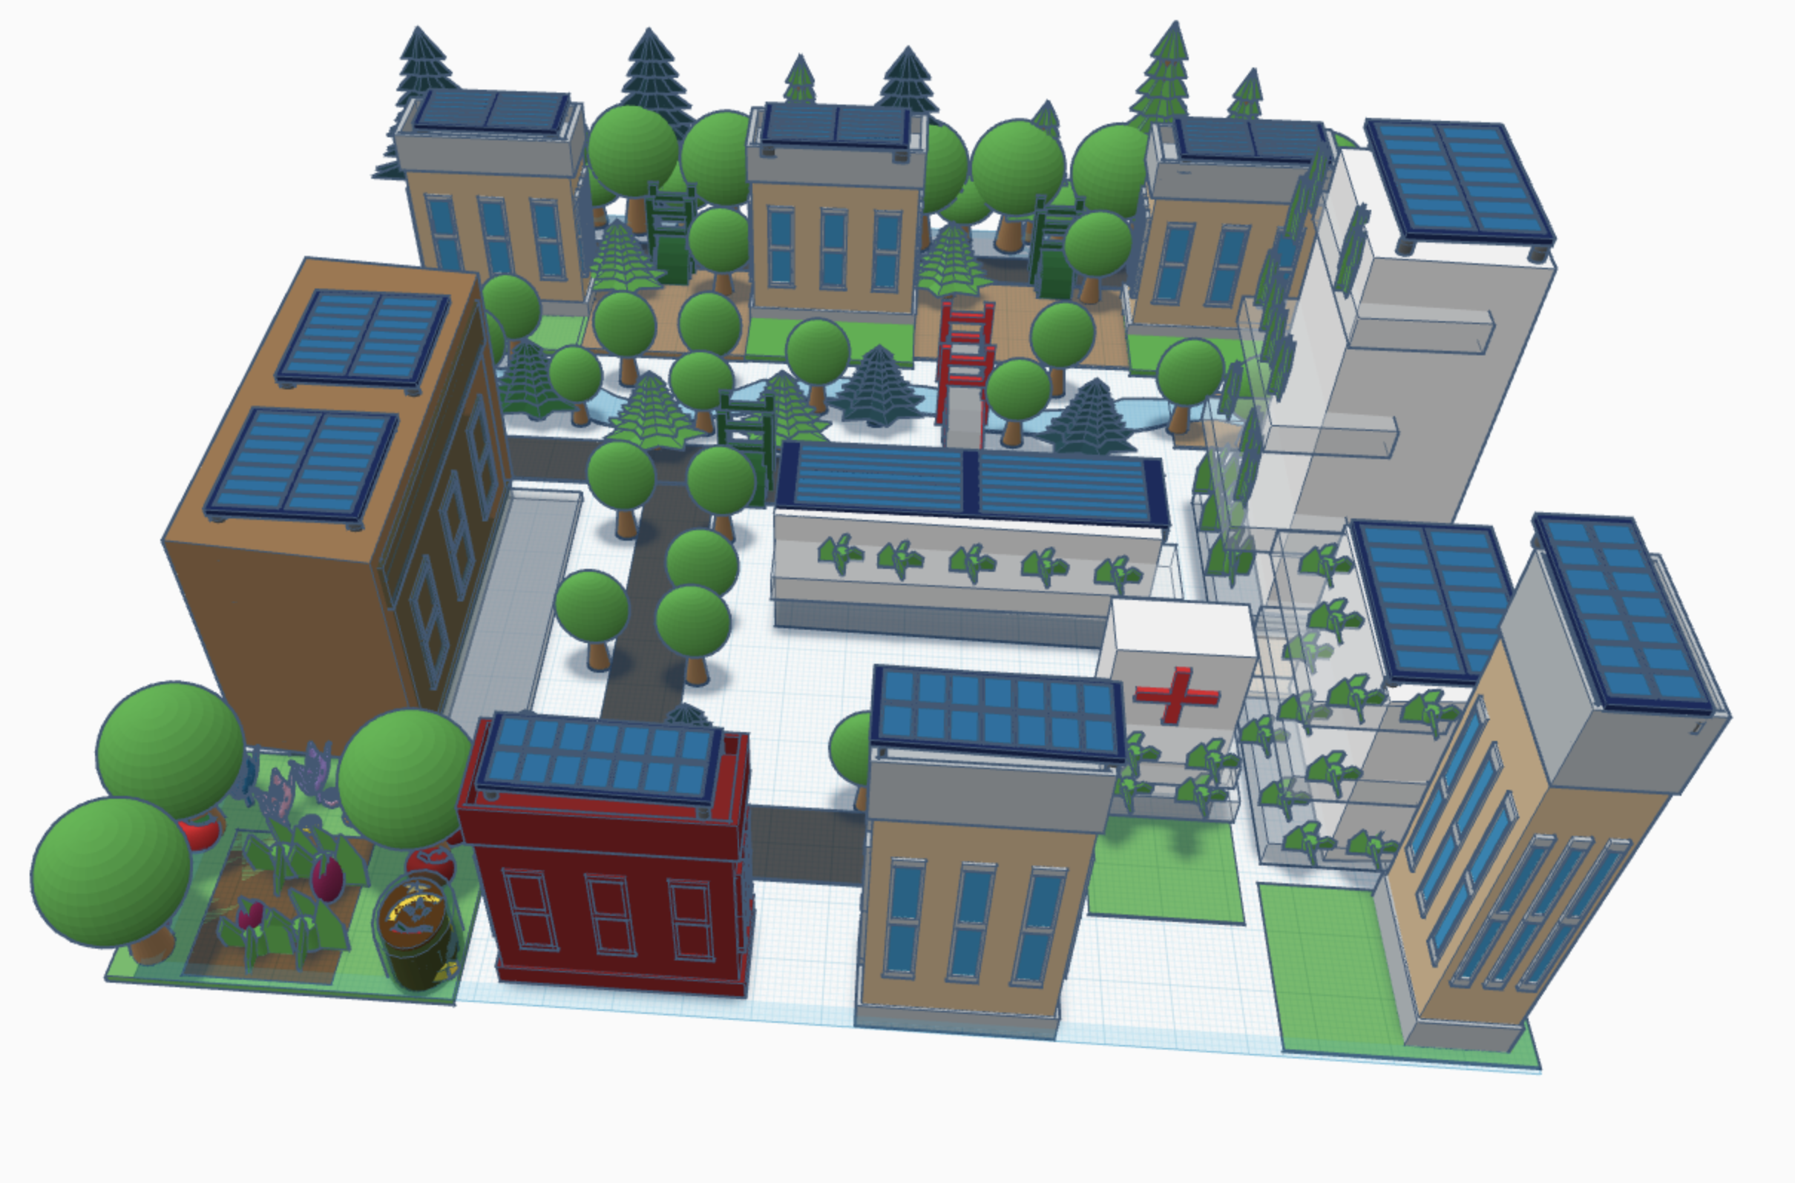
3D Model
180°
I included urban greenery, wildlife bridges, solar panels on buildings and no-car zones

Slide 8
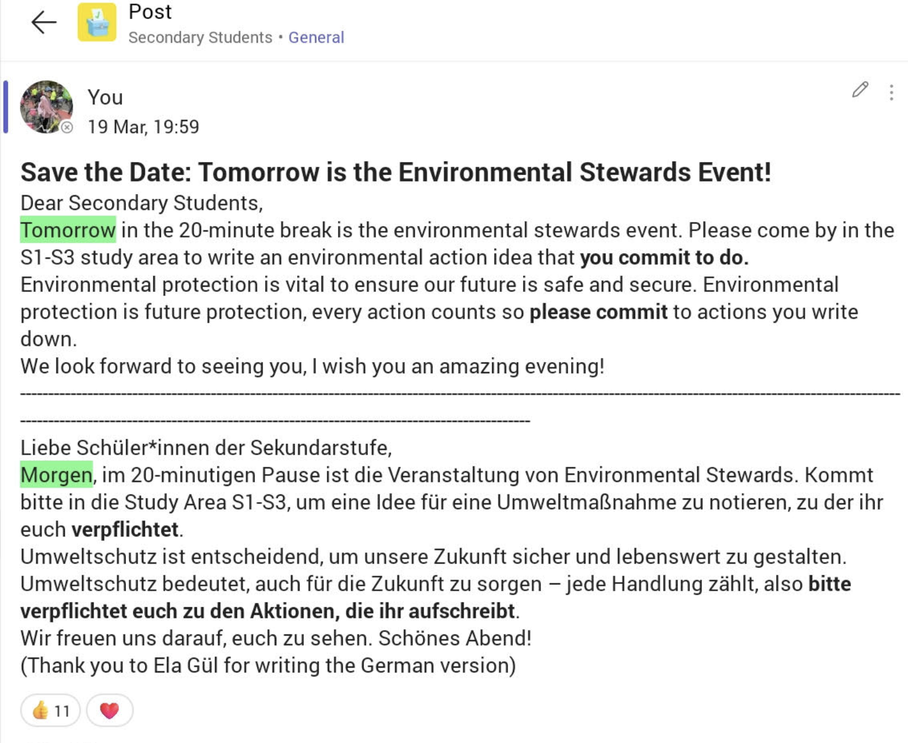
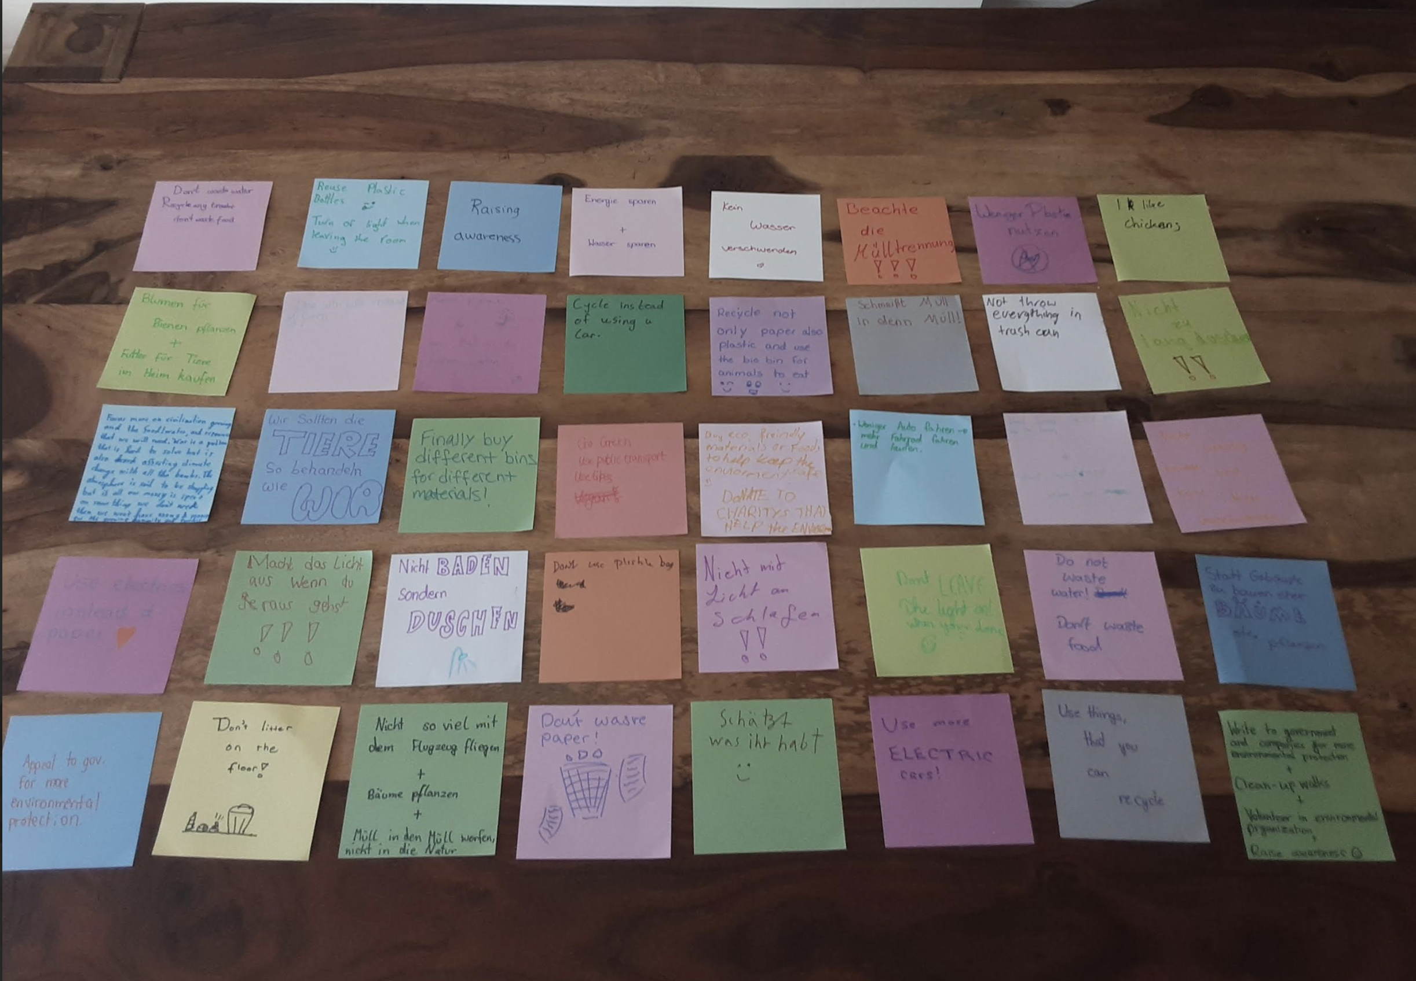
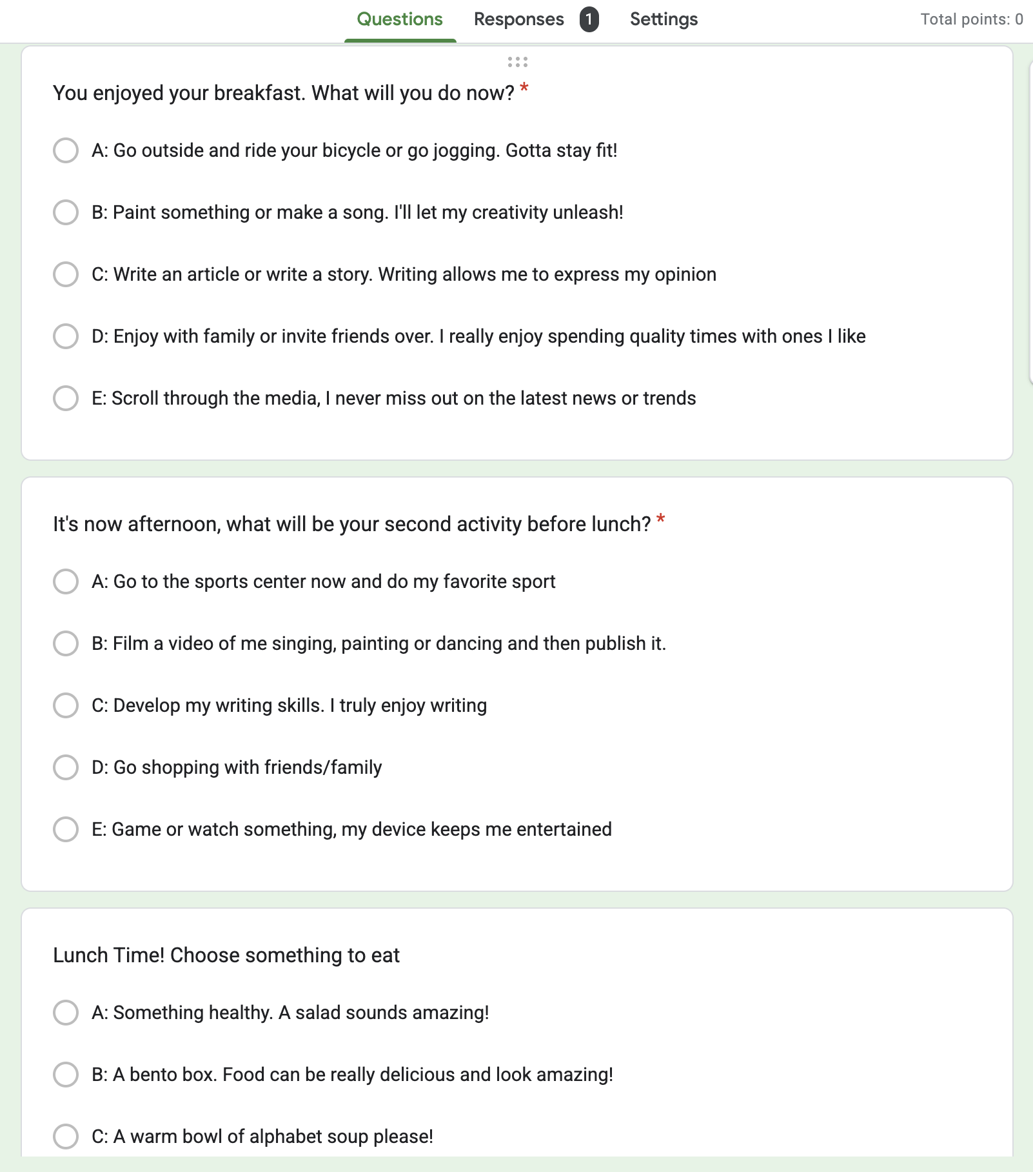
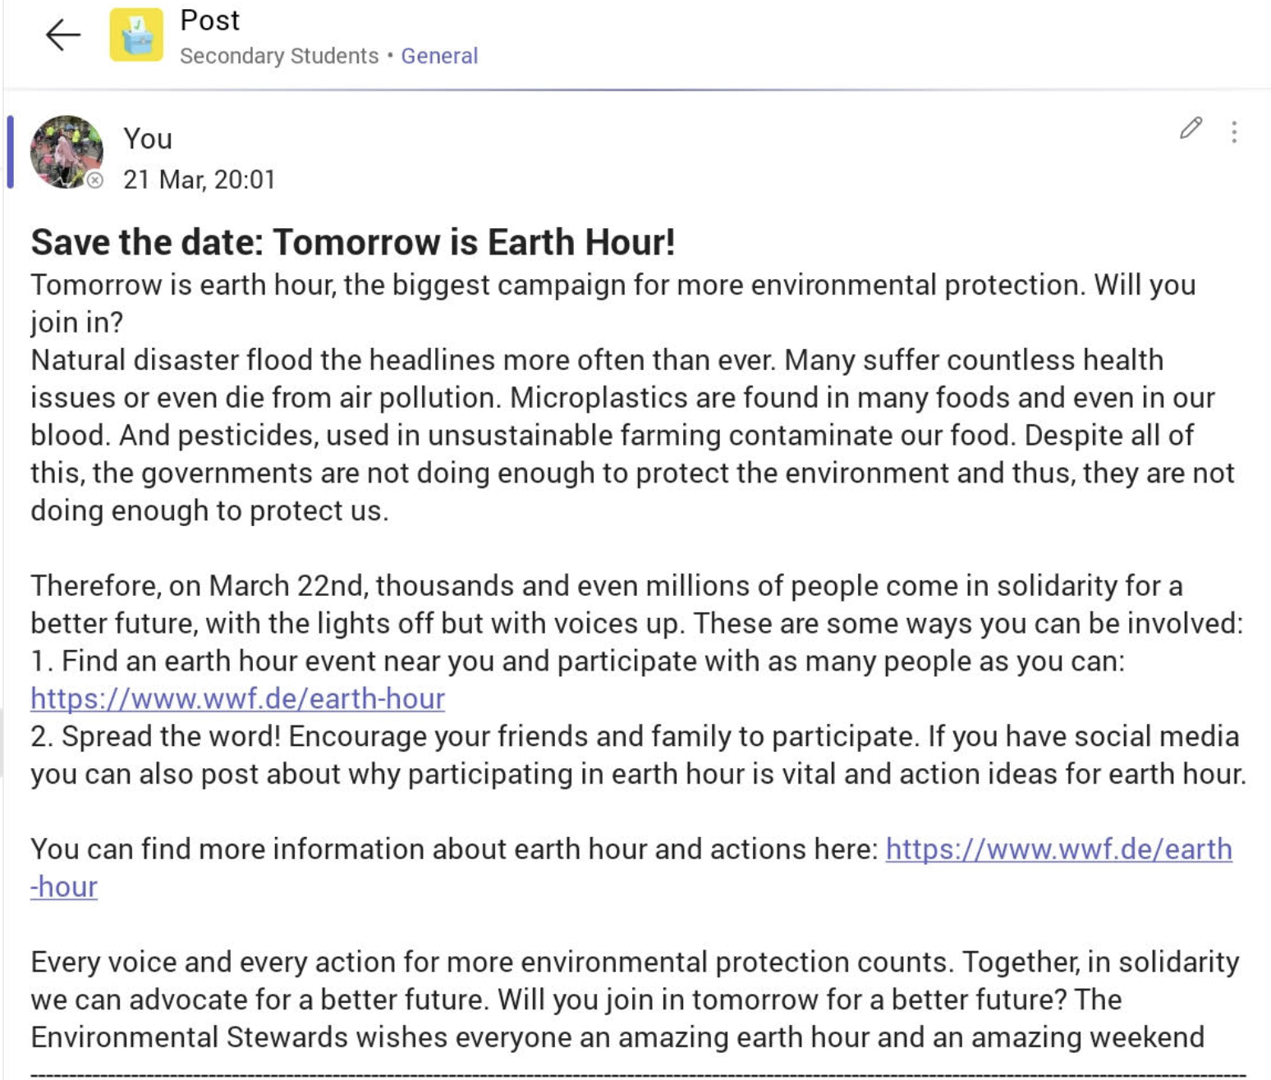
Environmental Group
Event Reminder
Environmental Action Ideas Students Commit to Do
Personality Quiz
Earth Hour Reminder

Slide 9
Conclusion
Ambitious Action
Will Power
Collective Action
Awarenes

Slide 10
Sources (Pictures)
https://unsplash.com/photos/aerial-view-photography-of-city-jP_21V34SeQ
https://tse1.explicit.bing.net/th?id=OIP.JumLFrJEaBGnFhazoDYi7wHaHy&pid=Api
https://tse2.mm.bing.net/th?id=OIP.OYHyNgKPhx6dwx8rqBh4-wHaEF&pid=Api
https://unsplash.com/photos/white-vehicle-near-tall-tree-at-cloudy-sky-during-daytime--iretlQZEU4
https://www.pexels.com/photo/gardens-by-the-bay-singapore-1907047/
https://www.pexels.com/photo/landscape-sky-buildings-industry-9799737/

Slide 11
Sources (Information)
https://www.un.org/en/desa/around-25-billion-more-people-will-be-living-cities-2050-projects-new-un-report

Slide 12
Acknowledgments
Thank you to Dr. Samland who is my mentor for this project. She helped me by giving ideas for the project.
Thank you to my parents who helped me by double-checking my work and who helped motivate me and gave me suggestions.
Thank you to everyone who filled out the survey, your responses are the only reason I could make an appeal to Frankfurt’s mayor.
Thank you to Mihika Parashar and Ruofan Yang who helped me with my ESSS outline.
Thank you to all the participants of Environmental Stewards Club I am truly grateful to have an amazing team to advocate for more environmental protection.

Slide 13
Thank you for Listening

